Slide 2
BLM Threshold Strategy
(vis-a-vis UFOs and Quenches)
B. Auchmann for the BLM Thresholds Working Group
with substantial contributions by T. Baer, R. Bruce, F. Cerutti, B. Dehning,
L. Esposito, E.B. Holzer, A. Lechner, O. Picha, S. Redaelli, M. Sapinski,
N. Shetty, E. Skordis, and others.

Slide 3
Overview
Reminder of post-LS1 UFO prognostics
BLM thresholds for the UFO scenario in the arcs
  Energy deposition
  BLM signal
  Quench level
Other post-LS1 BLM threshold strategies
  Cold magnets
  Warm magnets
  Collimators
For more on the topic, see presentations at the 2014 Workshop on Beam-Induced Quenches, September 15-16 at CERN,
http://indico.cern.ch/event/BIQ2014.

Slide 4
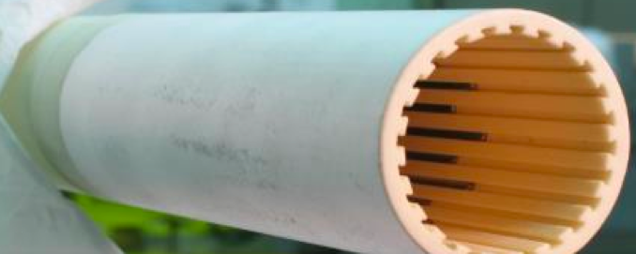
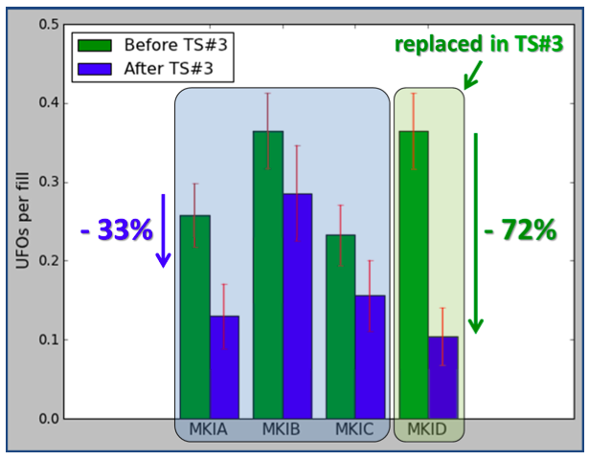
Reminder of UFOs in MKIs
Monday morning talk on LBDS and Kickers after LS1 by W. Bartmann.
Mitigation to reduce UFO activity in the MKIs:
improved cleaning procedures ➔ reduction of dust particles by factor 20-40;
installation of additional screen conductors to reduce
peak voltages by factor 7 ➔ further reduction of
particle-detachment from ceramic tubes.
Efficiency of the measures was proven with test
installation during the 3rd technical stop in 2012.
➔ MKI UFOs are not expected to be
the limiting Issue at 6.5 TeV.

Slide 5
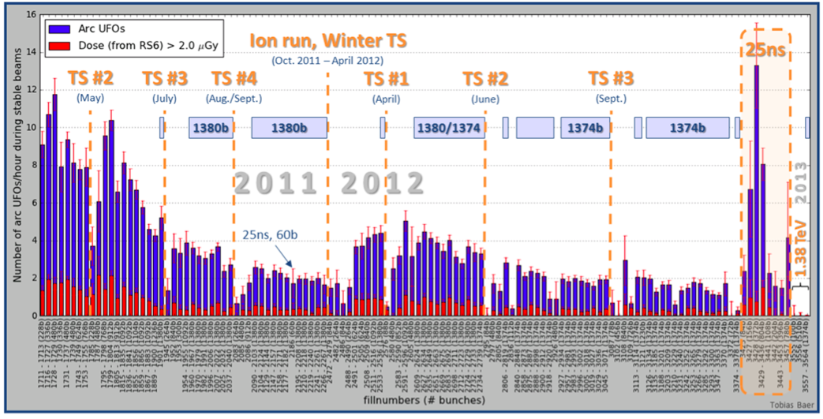
Reminder of UFO Problematic in the Arcs
As beam energy goes from 4 TeV to 6.5 TeV:
energy-deposition per proton-particle collision increases ~2.4x;
quench level decreases 2-3x;
average UFO duration decreases due to smaller beam sizes;
Other effects after LS1:
deconditioning due to warm-up and openings;
more BLM triggers due to monitor re-location;
possible quenches from UFO losses shorter than MPS reaction time;
increased UFO rate (at least initially) for 25 ns bunch spacing;
new confidence through SMACC that quenches at 6.5 TeV are not catastrophic, albeit undesirable.
NB: Values updated wrt. T. Baer, CERN-THESIS-2013-233

Slide 6
Reminder of UFO Problematic in the Arcs
As beam energy goes from 4 TeV to 6.5 TeV:
energy-deposition per proton-particle collision increases ~2.4x;
quench level decreases 2-3x;
average UFO duration decreases due to smaller beam sizes;
Other effects after LS1:
deconditioning due to warm-up and openings;
more BLM triggers due to monitor re-location;
possible quenches from UFO losses shorter than MPS reaction time;
increased UFO rate (at least initially) for 25 ns bunch spacing;
new confidence through SMACC that quenches at 6.5 TeV are not catastrophic, albeit undesirable.
In short, after LS1, in the arcs
UFO-induced quenches and/or BLM triggers in the arcs are expected;
no mitigation was possible to reduce UFO activity;
nonetheless the situation can be substantially improved through:
  the relocation of BLMs for 100% coverage of SC magnets,
  and a refinement of BLM thresholds to avoid unnecessary triggers and quenches.
NB: Values updated wrt. T. Baer, CERN-THESIS-2013-233

Slide 7
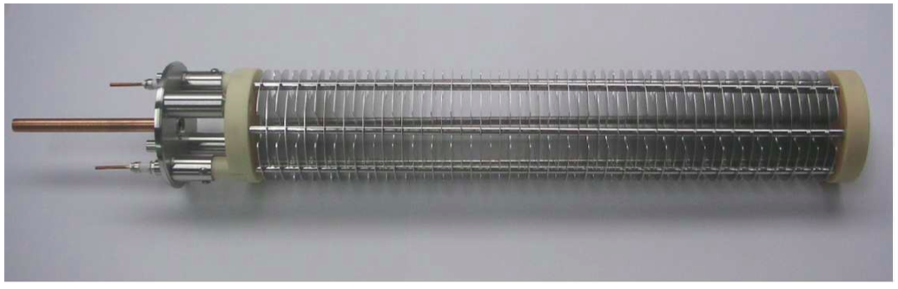
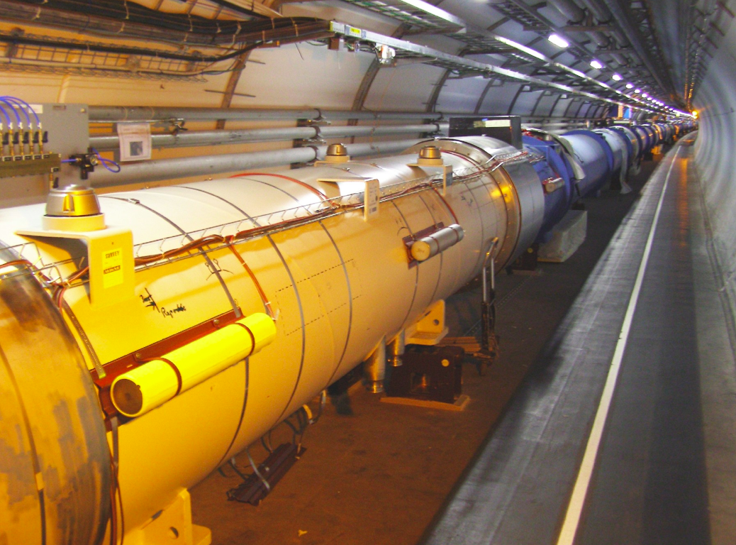
BLM Thresholds
Ionization chamber:
standard LHC monitor
~3600
N₂ gas filling at 1.1 bar
Length 50 cm
Current from the ionization chamber is
integrated over 12 different time intervals
(running sums) ranging from
40 µs to 84 s.
Thresholds are set for 12 running sums
and 32 energy levels.
➔ 1.5 million thresholds.

Slide 8
BLM Threshold Formula
The assumed signal at quench is composed of three input factors:
The MasterThreshold is a multiple of the BLMSignal@Quench.
The AppliedThreshold is set with the MonitorFactor (0…1].
The factor N shall ensure safety from damage while providing flexibility and room for corrections via the MonitorFactor.
2009 Startup for cold magnets: N = 3, MonitorFactor = 0.1.

Slide 9
BLM Threshold Formula
The assumed signal at quench is composed of three input factors:
BLMResponse and EnergyDeposit are
defined wrt. a beam loss scenario, e.g., UFO, accidental orbit bump, collision debris, etc;
simulated by FLUKA;
validated with operational data
and/or quench tests.
Different scenarios yield different
BLMResponse/EnergyDeposit ratios.
QuenchLevel is
predicted by electro-thermal models
that are validated by quench tests.
Fast orbit-bump scenario.

Slide 10
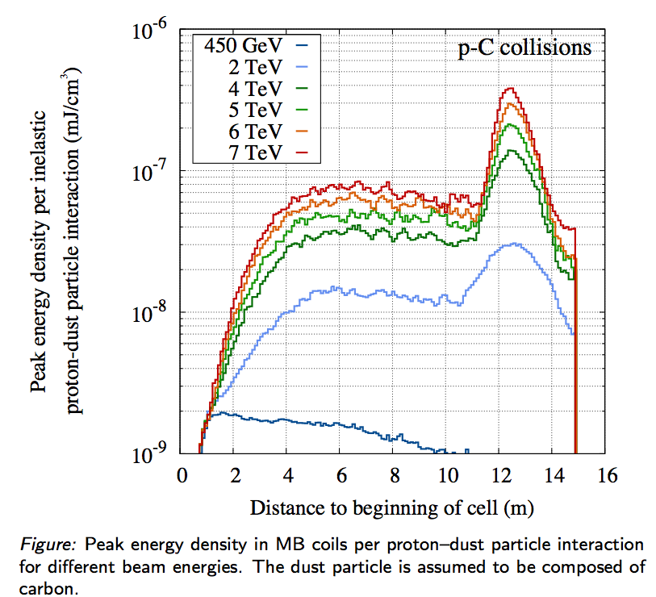
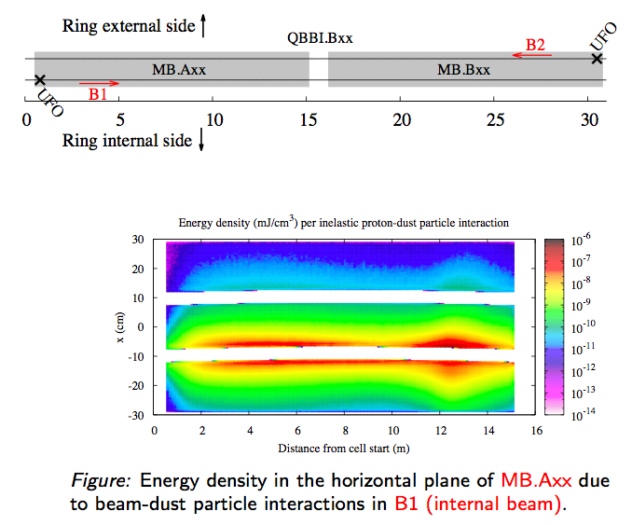
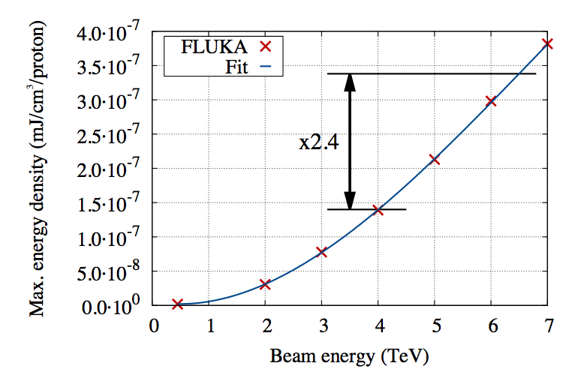
UFO loss scenario EnergyDeposit
EnergyDeposit for p-C collision at the beginning of an MB.
Maximum of the deposition is due to neutral particles and MB sagitta.

Slide 11
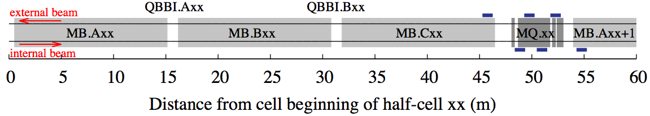
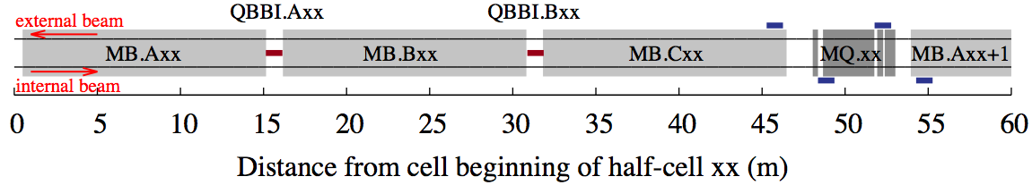
UFO loss scenario BLMResponse
BLMs moved from centre of MQ to position above MB-MB interconnects.
Vertical position about 3x less sensitive to UFO losses than horizontal, but covering both beams.
Pre-LS1:
Post-LS1:
Notes:
Animation of relocation?

Slide 12
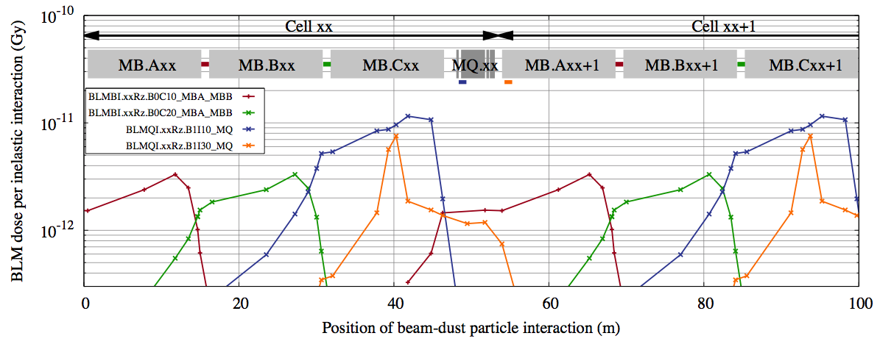
UFO loss scenario BLMResponse
FLUKA study of p-C collision; BLMResponse as a function U.F.O. location.
The installation of BLMs on MB-MB interconnects increases the sensitivity at the beginning of the cell by a factor 30 ➔ 100% coverage can be achieved.

Slide 13
Testing the QuenchLevel
Quench tests are controlled beam-loss events provoking quenches, designed to
represent a realistic beam-loss scenario;
provide validation of quench levels in relevant working points.
Over the past year the Quench Test Analysis Working Group has performed detailed analysis of seven events and quench tests.
Duration | Method | Energy | Temperature
single-turn | kick | 450 GeV | 1.9 K
single-turn | collimation | 0.45/6 TeV | 4.5 K
10 ms | wire scanner | 3.5 TeV | 4.5 K
10 ms | orbit bump | 4 TeV | 1.9 K
10 s | collimation | 4 TeV | 1.9 K
6 s | dyn. orbit bump | 3.5 TeV | 1.9 K
20 s | orbit bump | 4 TeV | 1.9 K

Slide 14
Quench Test Analysis
What is the energy deposition in the coil at the moment of quench?
Settings: bump
amplitude etc.
Particle tracking:
spatial distribution
P. shower: norm.
space distribution
FCBM: loss rate
BLM: normalized
time distribution
Input
Beam parameter
measurements:
ε, Q, etc.
QPS: moment
of quench
QPS: moment
of quench
Upper bound
or estimate
quench
Analysis
Particle
Tracking
Particle
Shower
Quench
Level
Electro-Thermal
Estimate (MQED)
no quench
Lower bound
Validation
BPM signals
Quench test
BLM normalized
time distribution
BLM signals
Subscale
experiments
Notes:
Knowing the energy-deposition in the coil at moment of quench.
Particle tracking only if not “fixed-target”.
Particle-shower upper bound for single-turn, otherwise estimate with uncertainty on moment of quench.
Note that quench level is “per loss scenario”!
That includes of course magnet type, op temp, time scale of losses, but also longitudinal and transverse loss distribution depending on time scale.
Electro-thermal model validation per subscale experiment:
for fast losses not yet done and not likely only with additional simulation to understand the experiment.
Steady-state losses are trivially equal to experiment, but is the model able to extrapolate to other situations?

Slide 15
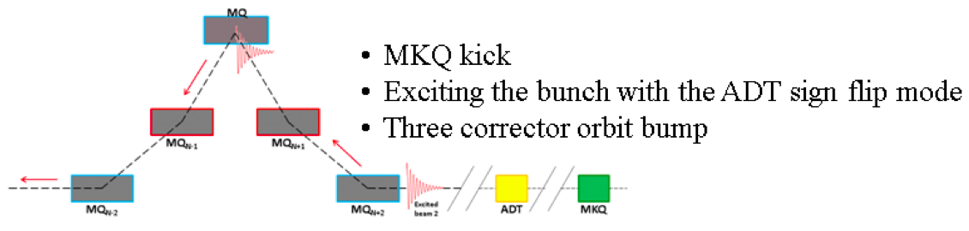
Testing the QuenchLevel
Fast orbit-bump quench test (15/02/2013)
Millisecond-losses induced by
combined orbit bump, MKI kick,
and coherent ADT excitation.
After ~10 ms a quench occurred 4x above QP3 quench-level estimate.
The model’s lower estimate may be due to µs substructure of loss pulse.

Slide 16
Applying AdHoc factor to QuenchLevel
Outcome of the orbit-bump quench test: Factor 4 higher quench level in the 10-millisecond time range and possibly below.
We propose to start after LS1 with an optimistic correction of electro-thermal model between 40 µs and 10 ms.
Minimum Quench Energy Density
2010 dynamic orbit
bump quench test.
x4
2013 fast orbit
bump quench test.
2008 strong-kick event
validated quench level.

Slide 17
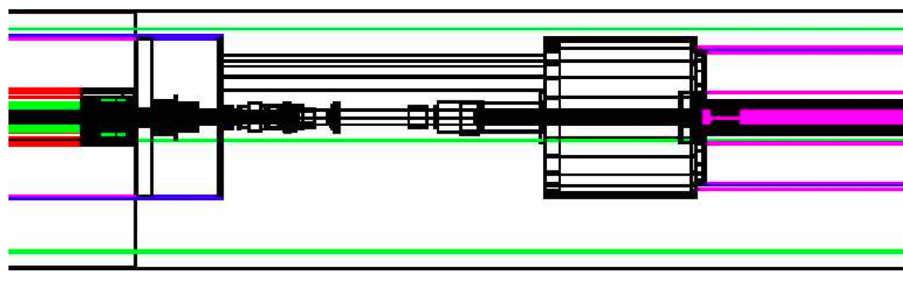
Arc thresholds
MB
MQ
The initial beam-loss scenario were on
losses in the MB-MQ interconnects.
It was adjusted several times based on
UFO observations and quench tests.
C. Kurfürst, CERN-THESIS-2010-070
6.5 TeV BLMSignal@Quench on MQ BLMs

Slide 18
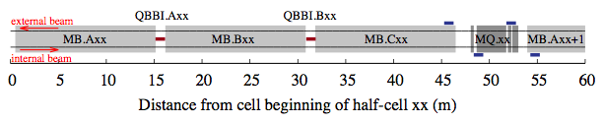
Arc thresholds
3
1
After LS1 we foresee
UFO scenario on MB-MB interconnects;
UFO and orbit-bump scenarios on MQs:
  Position 1 is sensitive for UFOs;
  Position 3 is sensitive for orbit bumps.
Beam-loss scenarios for MQ BLMs.
MQ BLMs | 40 µs – 80 ms | 80 ms – 80 s
450 GeV – 4 TeV | Orbit Bump | Orbit Bump
4 TeV – 6.5 TeV | UFO | Orbit Bump
BLMSignal@Quench*AdHoc on MQ BLMs
NB: the higher QuenchLevel is almost
completely outweighed by the lower
BLMResponse/EnergyDeposit ratio
of the UFO scenario wrt. the
interconnect-loss scenario.

Slide 19
N-Factor and MonitorFactor
The MasterThreshold is a multiple of the BLMSignal@Quench.
The AppliedThreshold is set with the MonitorFactor (0…1].
For flexible and efficient tuning of thresholds we propose
i.e., to set the AppliedThreshold to the predicted BLMSignal@Quench.
 | Beginning Run 1 |  | Beginning Run 2
 | N | MF | N | MF
Cold magnets | 3 | 0.1 | 10 | 0.1

Slide 20
Arc-UFO BLM Strategy
We use FLUKA models and
optimistic quench levels to
define thresholds.
Thresholds are set for 100%
coverage of the arcs.
Ratios of BLM-signals and
FLUKA model will allow
for localization of UFOs.
Absolute BLM signals will allow to estimate the energy
deposition in coils.
➔ We can obtain efficiently upper and lower bounds on
quench levels, and optimize the BLM thresholds.
For this purpose, N = 10 and Monitorfactor = 0.1 set
the AppliedThreshold to the predicted BLMSignal@Quench.
BLMResponse
QuenchLevel

Slide 21
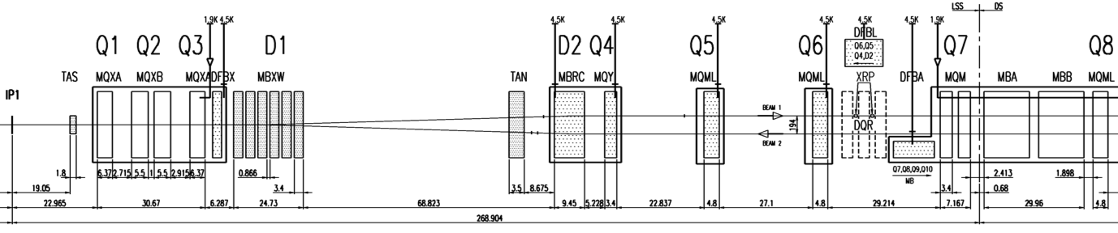
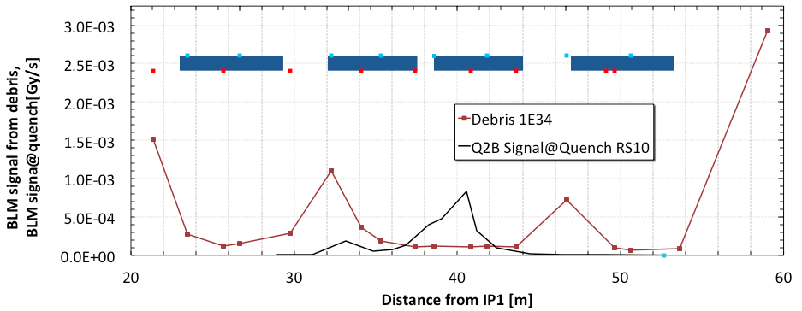
Thresholds on Other Cold Magnets
DS magnets will be set for UFO and orbit-bump scenarios, as in the arcs.
Thresholds on separation dipoles will be set using the UFO scenario.
IPQs and Triplets will be set for UFOs and orbit bumps, similar to MQs.
Triplet BLM thresholds have to ensure that physics debris (different loss scenario!) will not dump the beam. Thresholds will be kept safely above debris.
Physics Debris vs. BLMSignal@Quench for Orbit Bump in RS10

Slide 22
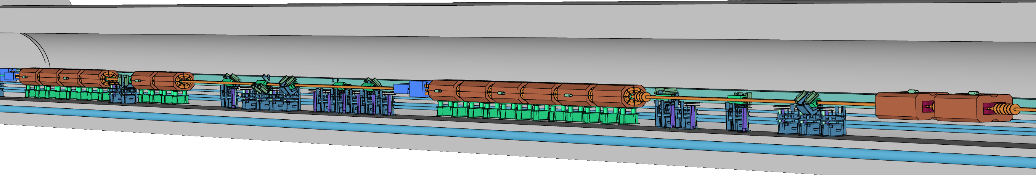
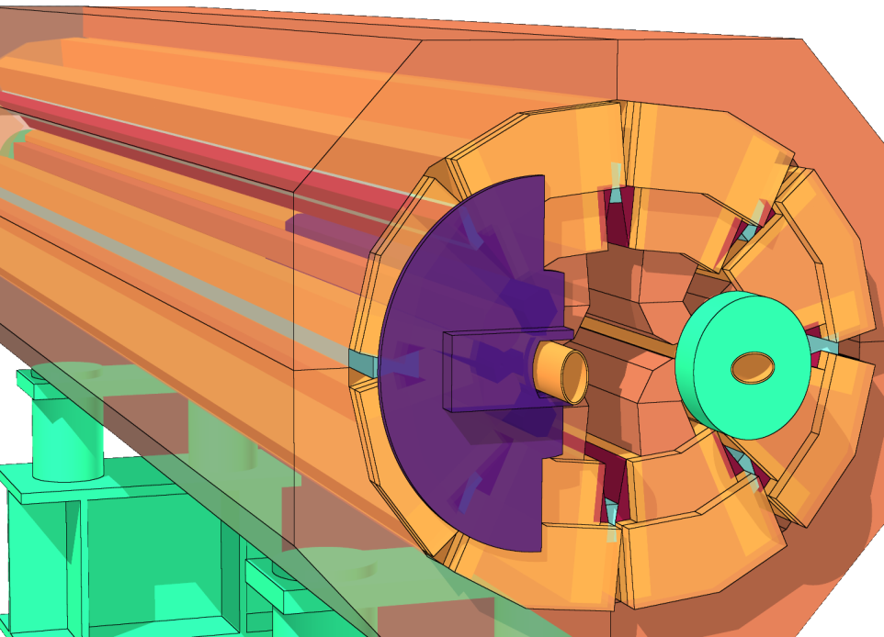
Thresholds on Warm Magnets
New shielding has been installed on MQWs in IR3 and IR7 during LS1.
BLM dose is used offline in conjunction RadMon counts to monitor the integrated dose.
A new FLUKA model will be used to set BLM thresholds protecting
the vacuum tube from damage,
the coil from over-heating.
Beam 2
MQWA.C4R7
MQWA.E4R7
MQWA.D5R7
MQWA.E5R7
MBW.A
MBW.B
Notes:
Ask Leftheris for meaning of green and violet shielding

Slide 23
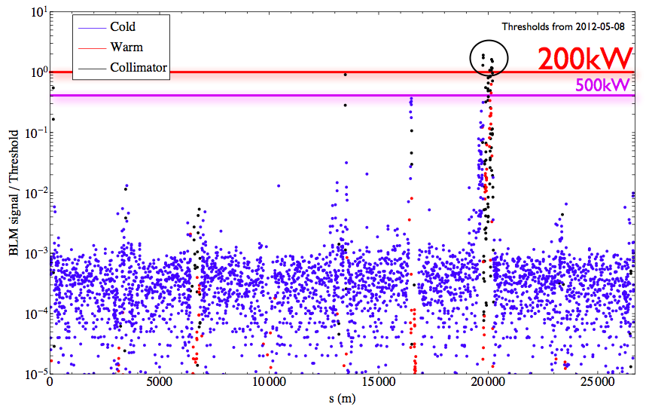
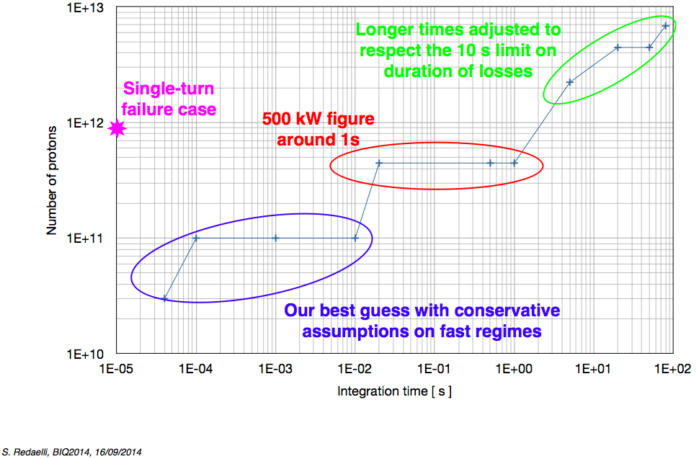
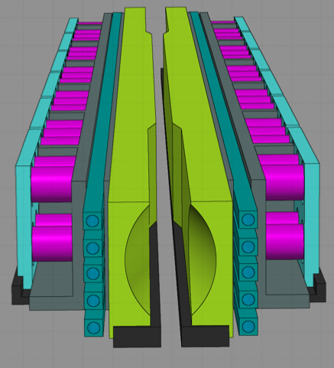
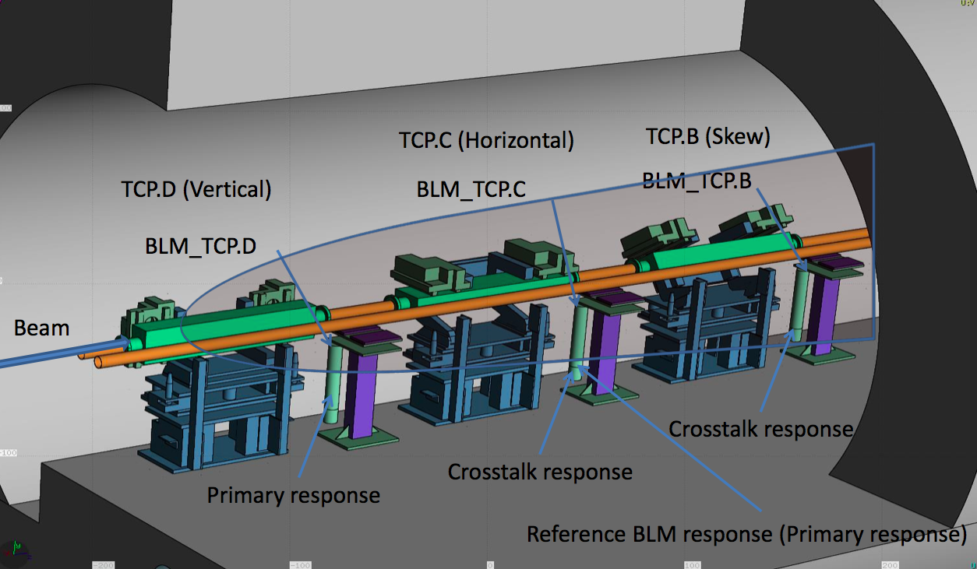
Thresholds on Collimators
Thresholds on collimators will be set based on
loss-maps that are scaled up to 500 kW
primary losses on the TCPs;
updated damage levels of collimators based
on material and geometry;
FLUKA models of energy-deposition in
collimators and BLM signals;
experience with cross-talk between monitors
on adjacent collimators.

Slide 24
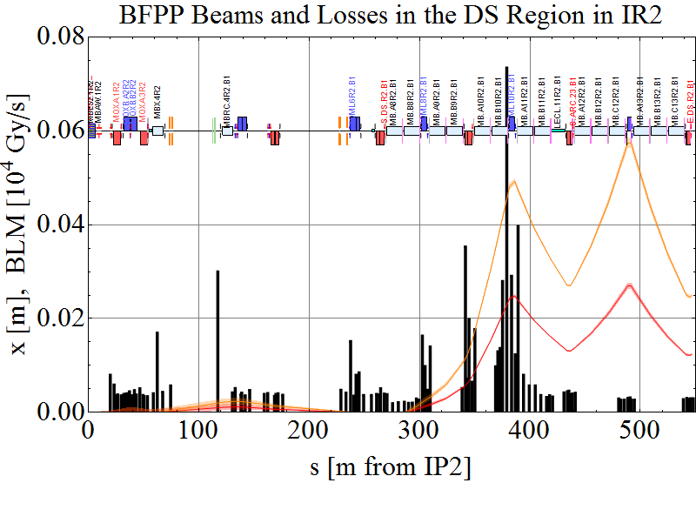
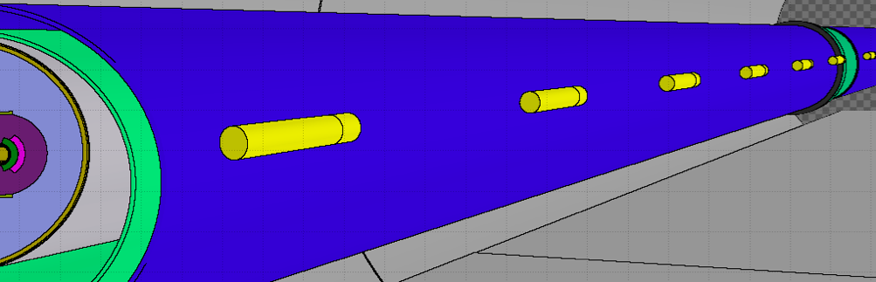
Thresholds for Ion Operation
Secondary ion beams from IPs and collimation led to very localized losses.
Additional BLMs on DS dipoles will be used to protect MBs from this scenario.
FLUKA model of DS dipole
2011 Pb-Pb
Courtesy J. Jowett

Slide 25
Conclusion
New BLM positions in the arcs and FLUKA models will allow to localize and quantify UFOs.
Quench tests provide grounds for optimistic assumptions on quench levels.
Efficient tuning of BLM thresholds is possible – some UFO-induced quenches are to be expected.
Strategies for cold magnets, warm magnets, and collimators were discussed in detail at BIQ workshop. They are based on improved models and updated loss scenarios.
Detailed verification of all updated thresholds against “proven” 4 TeV thresholds will be carried out.
Tools for the offline monitoring of BLM signals vs. thresholds as well as signals vs. noise around the ring exist and will be deployed during Run 2. The goal is a proactive detection of potential limitations for operation.
Future quench tests to validate quench levels further are desirable.
Notes:
Check tool strategy with Barbara and Matti.

