Slide 1
Expected impact of hardware changes on impedance and beam induced heating during run 2
G. Arduini, M. Barnes, O. Berrig, N. Biancacci, F. Caspers, H. Day, J. Esteban Mueller, A. Grudiev,
J. Kuczerowski, E. Métral, N. Minafra, N. Mounet, A. Nosych, A. Passarelli, G. Rumolo, J. Varela, B. Salvant, E. Shaposhnikova, C. Vollinger, M. Wendt, C. Zannini for the impedance team
With the invaluable help of
equipment groups, experiments, as well as collimation, MPP, operation teams and
HL-LHC WP2.4 collaborators.

Slide 2
Main messages
Significant impedance related issues during run 1:
→ Impressive effort by all involved equipment groups to assess and reduce impedance of their device (in particular TE-VSC, EN-STI, EN-MME, BE-BI, collimation team, BE-RF, ATLAS, ATLAS-AFP, ATLAS-ALFA, CMS, TOTEM, ALICE, LHCb)
Concerning beam induced RF Heating:
→ Many problems in run 1 linked to unexpected non-conformities.
→ Mitigations put in place but new non-conformities likely in run 2.
→ Need for efficient monitoring and alarms
→ Known limitations that led to increase bunch length from 1 ns to 1.25 ns were removed.
→ Many devices will need careful follow up (e.g. TDI, BSRT, Roman pots, MKI, BGV).
Concerning LHC impedance: changes are expected to be transparent, but keep an eye on:
→ the new TCTP and TCSP collimators with BPMs and ferrites
→ the Roman pots, new TCL4 and especially TCL6 if they approach the beam to low gaps

Slide 3
Agenda
Main messages
Context:
  Impedance and beam induced RF heating
Hardware changes potentially affecting impedance during LS1
Status of beam induced heating and instabilities
Conclusions

Slide 4
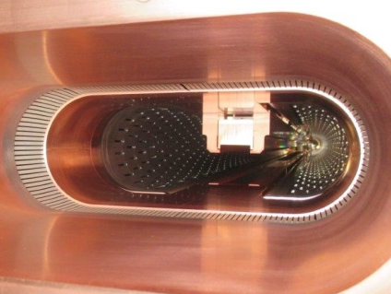
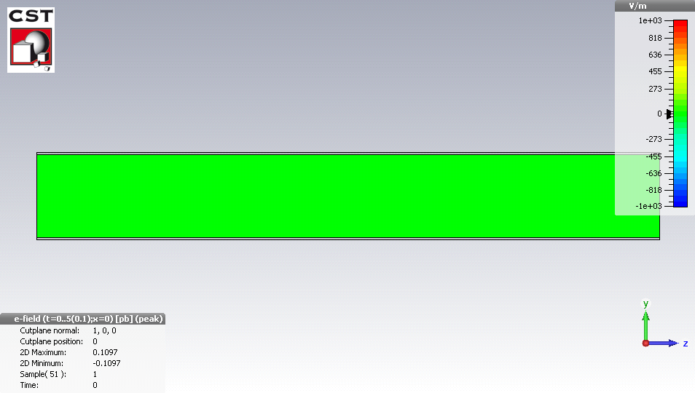
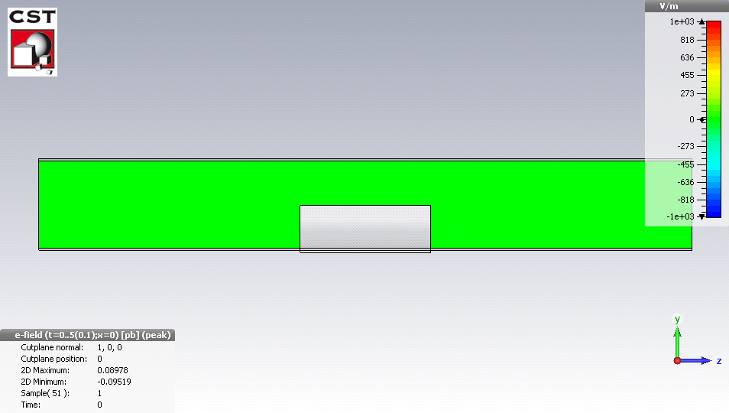
Context: impact of beam impedance on performance
When an ultrarelativistic beam of particles traverses a device which
  is not smooth
  or is not a perfect conductor,
  it will produce wakefields that will perturb the following particles
  → resistive or geometric wakefields (in time domain) and impedance (in frequency domain).
Example of perturbation caused by an obstacle in a beam pipe:
In a round beam pipe
In a round beam pipe with sharp obstacle
→ resonant RF mode

Slide 5
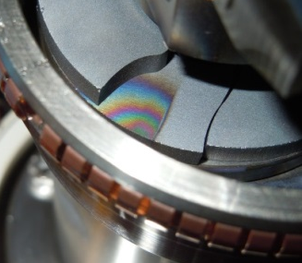
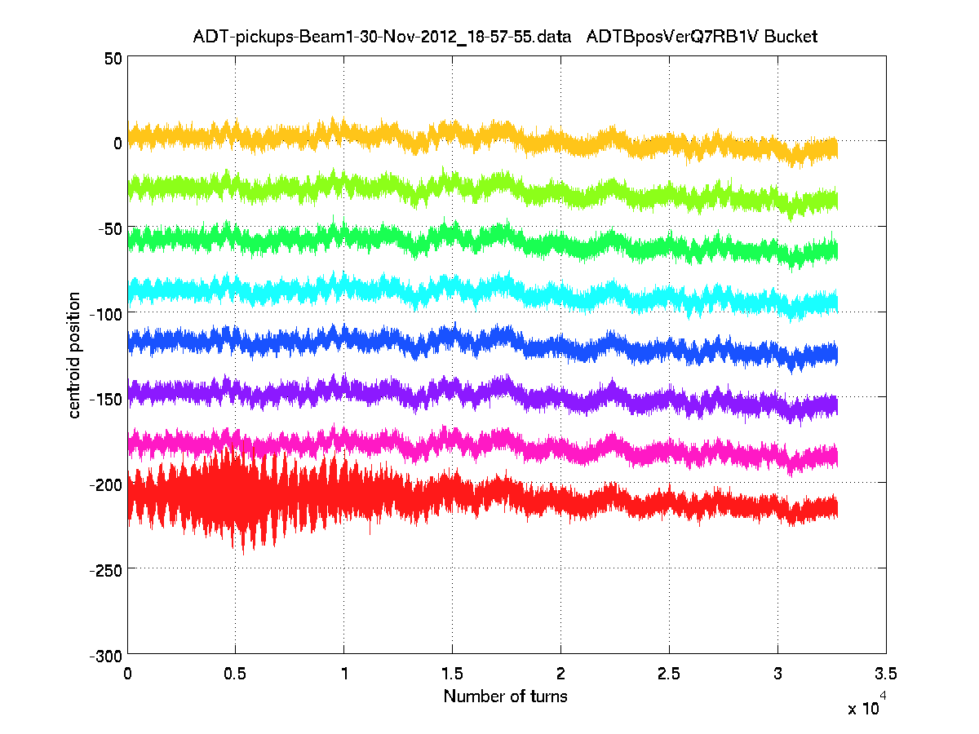
Context: impact of beam impedance on performance
These electromagnetic perturbations are usually decomposed into longitudinal and transverse impedance
  longitudinal impedance leads to energy lost from the particle and dissipated in the walls of the neighbouring devices
  → heating of beam surrounding
  → temperature interlocks or degradation of machine devices
  → during run 1, the LHC bunch length needed to be increased from 1 ns to 1.25 ns)
  Longitudinal/transverse impedance leads to perturbation of the synchrotron/betatron oscillations
  → can excite longitudinal/transverse instabilities
  →degrades beam quality (beam losses, emittance growth and dumps)
  → many transverse instabilities occurred in LHC during run 1.
Current policy enforced by impedance team (when receiving a request):
New equipment should by default remain in the shadow of the current LHC impedance
New longitudinal resonant modes should have a shunt impedance below 200 kOhm
Impact of new transverse resonant modes checked with beam synamics simulations
Expected heat loads communicated to equipment owner to take appropriate action

Slide 6
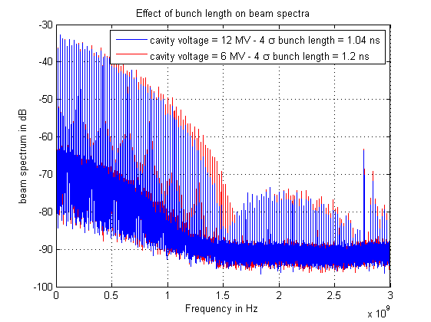
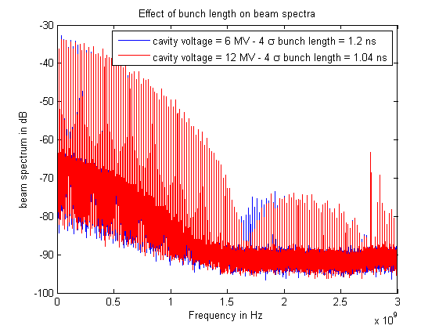
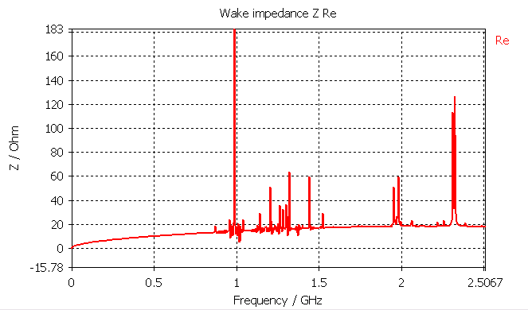
Context: what can be done if heating is too large?
Power loss for M equidistant bunches:
Reduce longitudinal impedance
Reduce intensity per bunch (as efficient with broadband and narrow band impedances)
Reduce number of bunches (less efficient with broadband impedances)
Optimize the power spectrum (change bunch length but also bunch shape, e.g. with flat bunches)
Extract the heat and/or improve the resistance to heat of the device
Impedance Re(Z_{long})
Narrow band at f_{res}
σ=1.25 ns
σ=1 ns
broadband
→ In case a problem is observed during a fill , the bunch length and/or bunch shape could be optimized, instead of dumping the beam.

Slide 7
Agenda
Main messages
Context:
Hardware changes potentially affecting impedance during LS1
Impact on beam induced heating
Impact on instabilities
Conclusions

Slide 8


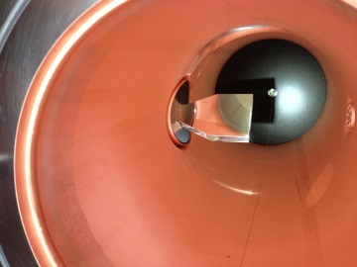
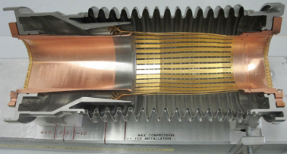
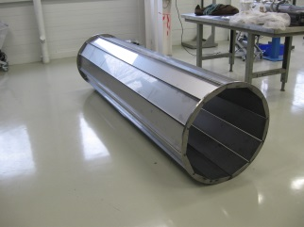
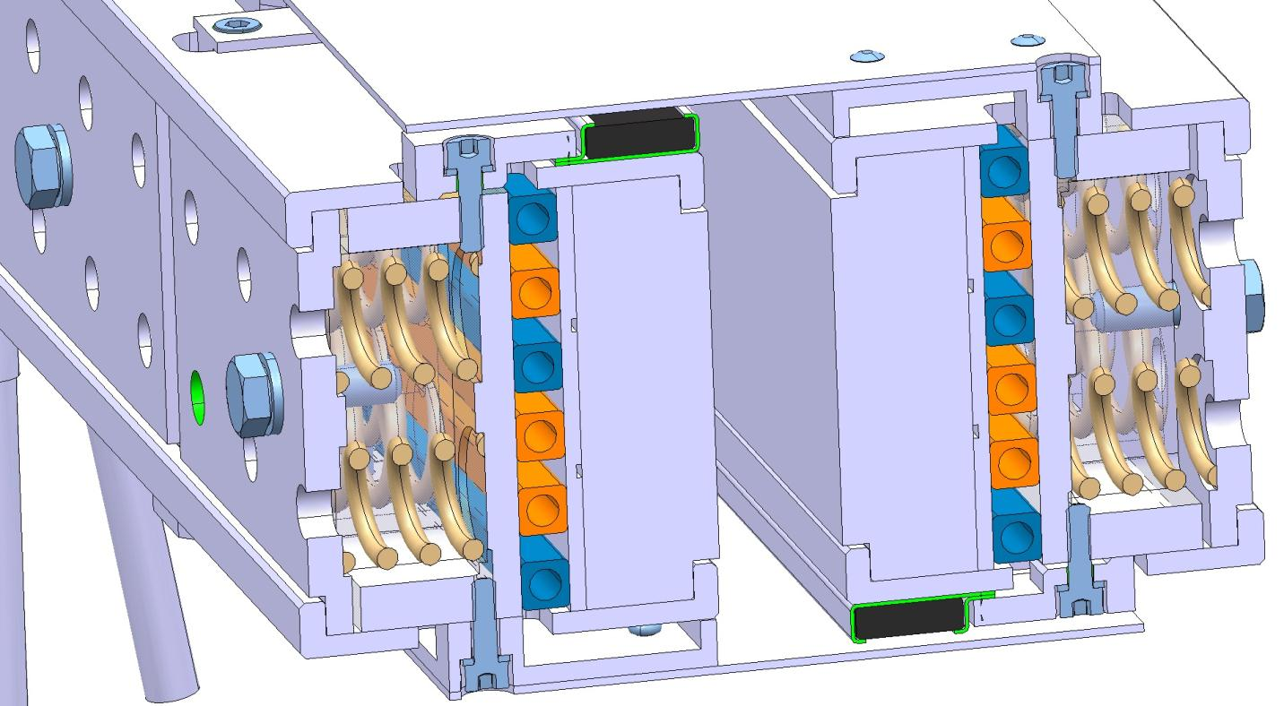
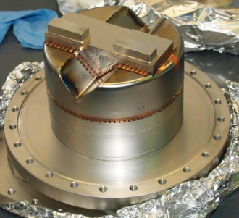
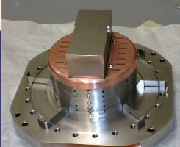
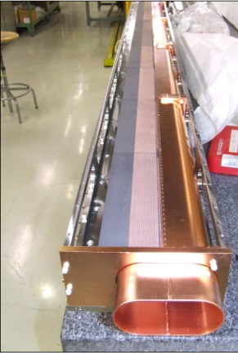
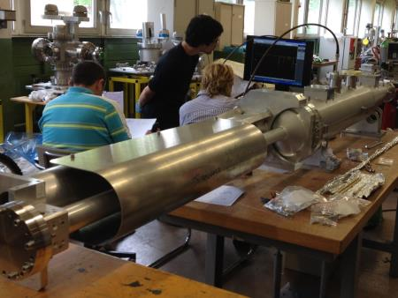
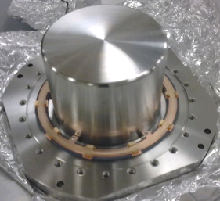
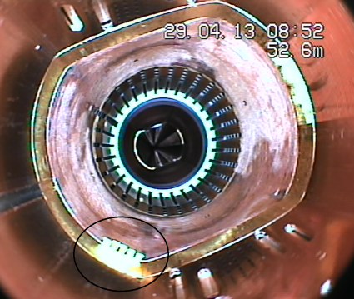
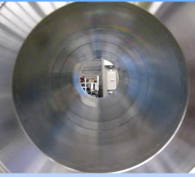
Hardware changes during LS1 that may impact impedance
Consolidation:
  TDI beam screen consolidation
  TCP replacement with spare
  BSRT mirror design change
  RF fingers consolidation, carroussel
Upgrade:
  Tertiary collimators with BPMs (TCTP and TCSP)
  ATLAS-ALFA
  “TOTEM consolidation” of existing Roman pots
  MKI screen conductor upgrade
  New experimental beam pipe in CMS and ATLAS
  Schottky
New equipment:
  New TCL4 and TCL6
  3rd TCDQ module
  BGV on B2
  New “TOTEM upgrade” pots
  New UA9 goniometer
Non conformities:
  Contacts in triplets
  RF fingers next to TCTH and TCTV in pt 5

Slide 9
Hardware changes during LS1 that may impact impedance
Consolidation:
  TDI beam screen consolidation
  TCP replacement
  BSRT
  RF fingers consolidation, carroussel
Upgrade:
  TCTP and TCSP
  ATLAS-ALFA
  “TOTEM consolidation” of existing Roman pots
  MKI
  New experimental beam pipe in CMS and ATLAS
New equipment:
  TCL4
  TCL6
  3rd TCDQ module
  BGV
  New “TOTEM upgrade” pots
  UA9 goniometer
Modifications in order to reduce beam induced heating

Slide 10
Hardware changes during LS1 that may impact impedance
Issue to follow up
Consolidation:
  TDI beam screen consolidation
  TCP replacement
  BSRT
  RF fingers consolidation, carroussel
Upgrade:
  TCTP and TCSP
  ATLAS-ALFA
  “TOTEM consolidation” of existing Roman pots
  MKI
  New experimental beam pipe in CMS and ATLAS
New equipment:
  TCL4
  TCL6
  3rd TCDQ module
  BGV
  New “TOTEM upgrade” pots
  UA9 goniometer
heating
heating
instabilities
heating
Heating/instabilities
instabilities
instabilities
heating
Heating/instabilities
Modifications in order to reduce beam induced heating

Slide 11
Agenda
Main messages
Context:
Hardware changes potentially affecting impedance during LS1
  Focus on TDI, BSRT, Roman pots, MKI, TCTP, TCSPs, TCLs
Status of beam induced heating and instabilities
Conclusions

Slide 12
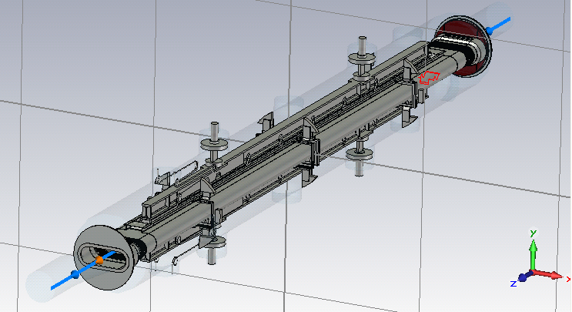
Impact on beam induced heating: TDI
Significant issues before LS1:
  Large outgassing with beam → issues for background of experiments
  Deformation of beam screen → issue for device integrity and machine protection
  Deformation of jaw → issue for device integrity and machine protection
Causes:
  No temperature monitoring, so difficult to understand what was going on
  Water cooling eventually inefficient
  Not easy to design as it is an internal dump (very long jaw, large volume, abrupt steps, dielectric material)
Actions taken during LS1:
  Stiffening of beam screen
  More pumping power
  Refurbishment of jaw mechanism
  Removed copper coating on the beam screen (to reduce shunt impedance of HOMs)
  Temperature probes added on the lower jaw (4) on the support (2), and on the beam screen (2).
  → despite very large effort by EN-STI and TE-VSC, similar heat load as before LS1 expected for run 2
  → heating issues may come back
  → however, the refurbished TDIs should cope better with this heat load
What can we do if problems come back?
  Spares with copper coating studied for installation in Christmas stop 2015/2016.
  Decrease intensity per bunch
  Additional diagnostics and impedance measurements before the installation should indicate the best mitigation mechanism (bunch length increase or bunch shape change)
  Spend as little time as possible with TDI jaw gap closed (e.g. open after each injection if this does not jeopardize reliability).
Consolidated TDI in tunnel
→ To be monitored very closely in run 2

Slide 13
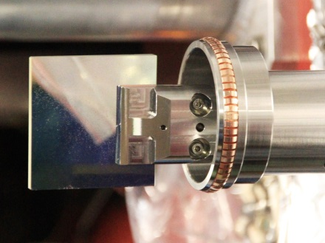


Impact on beam induced heating: BSRT
Significant issues before LS1:
  Deformation of mirror → problem for emittance measurement
  Damage on holder and ferrite → problem for machine protection
Causes:
  ferrite to damp the RF mode due to the mirror and mirror holder, but difficult to evacuate the heat from the ferrite in vacuum
Actions taken during LS1:
  → mirror and mirror holder geometry modified to attenuate the RF mode
  → RF mode expected to be small enough so that no ferrite is installed
  → Ongoing RF measurements and RF studies to validate the design
  → Simulations currently predict 50 to 200 W on the whole device
  (2 to 10 W on the mirror if the mode overlaps with the beam spectrum)
What can we do if problems come back?
  Increase bunch length, Decrease intensity per bunch
  Try to cool from outside the vacuum chamber since a large proportion of the heat should be dissipated in the copper coated vacuum pipe.
  Slightly move the mirror holder to try and avoid overlapping of RF mode with beam frequencies.
→ Changes should make things better but to be monitored very closely in run 2

Slide 14
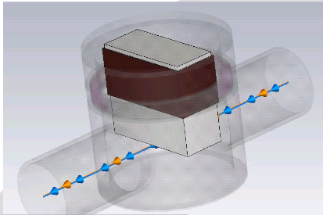
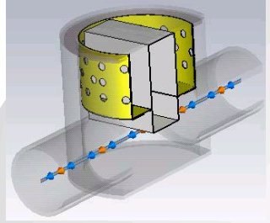
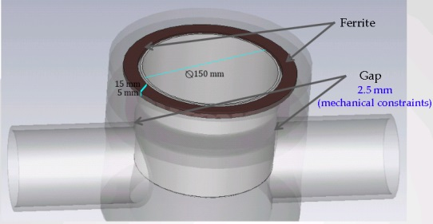
Impact on beam induced heating: roman pots
Significant issues before LS1:
  Temperature of ATLAS-ALFA detector close to damage limit
  Efficient cooling on TOTEM but related heating/outgassing may have generated Cryo regulation issues on neighboring Q6R5 (evidence of overheating of the ferrites were found during LS1).
Causes:
  Design was not optimized to reduce heating
  No cooling designed for ATLAS-ALFA
  TOTEM pots wish to approach the high intensity beams
Actions taken during LS1:
  → significant redesign of the Roman pots and relocation of ferrites where they can be cooled more easily
  → For ATLAS-ALFA, improvement of heat extraction and cooling capacity.
What can we do if problems come back?
  Increase bunch length, decrease intensity per bunch
  Increase cooling capacity
  Keep Roman pots far from the high intensity beam
→ Changes should make things better, to be monitored very closely in run 2
(in particular when approaching high intensity beam)

Slide 15
Impact on beam induced heating: MKI
Issues before LS1:
  Temperature of one kicker approached ferrite Curie temperature, which affected the kicker performance → need to wait before injection.
Causes:
  9 screen conductors had to be removed with respect to design before run 1 to avoid electrical breakdowns.
  Difficult to design cooling in vacuum together with the kicker high voltage.
  Non-conformity of one MKI kicker (old MKI8D): screen conductors were twisted and not screening efficiently.
Actions taken during LS1:
  → Implementation of results of pre-LS1 studies to redesign the screen conductors, to allow to install all 24 screen conductors (staggered without metallization at end)
  → systematic measurements of all MKIs before installation to detect non-conformities
What can we do if problems come back? (not expected)
  Check if problem is a non-conformity or a design problem
  Check if the temperature increase affects performance (softstart)
  Decrease intensity per bunch
  Increasing bunch length should help
M. Barnes et al
M. Barnes et al
Pre-LS1: 9 conductors removed
→ Problem expected to be solved, but to be monitored in run 2

Slide 16
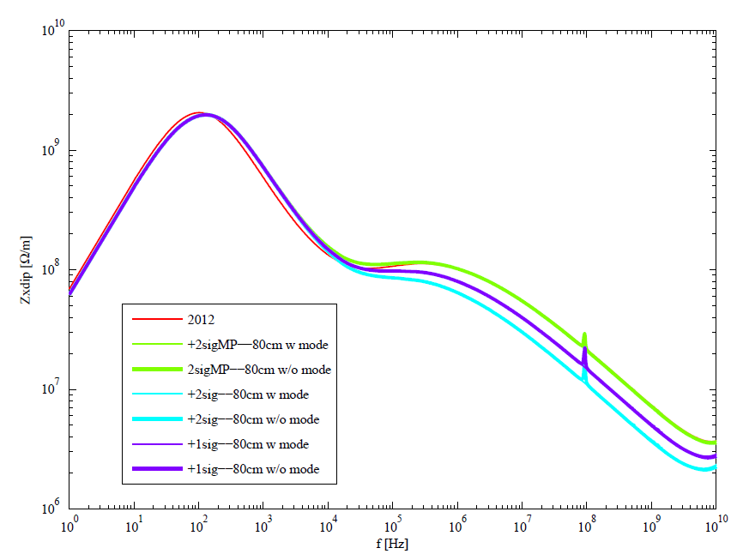
Impact on instabilities: new collimators with BPMs and ferrites
Potential issues:
  Transverse RF mode enhanced by the large beta function at the tertiary collimators
  ferrite heating
Causes:
  New design with BPMs made the design of lateral RF contacts difficult
  → following all the issues with RF contacts in 2011, recommendation by the impedance team in 2011 to leave the gap open and install ferrites (only for the 8 TCTPs and 1 TCSG in 6 per beam, provided the gap is not too small).
N. Biancacci et al
Consequence: TCTP transverse mode at ~100 MHz (~30% above the impedance baseline at that frequency)
→ Impact on beam dynamics?

Slide 17
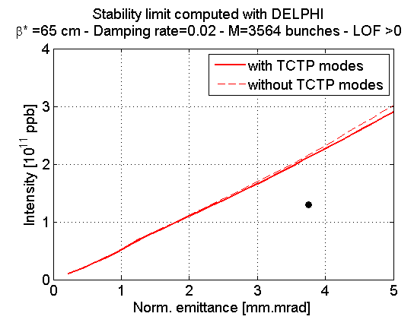
Impact on instabilities: new collimators with BPMs and ferrites
Expected consequences on beam dynamics:
  → DELPHI, HEADTAIL and NHTVS simulations performed by N. Mounet and A. Burov (TCTP meeting in April 2013) and rechecked by N. Biancacci et al (in 2014). → small impact on beam stability expected.
  Most of the beam induced heat load on the jaw and not the ferrites (~1 W expected on the ferrites after LS1)
Actions during LS1:
  Heavy simulation and measurement campaign to characterize fully the new collimator design (with the help of EN-MME, A. Mostacci (La Sapienza), M. Zobov and O. Frasciello, INFN Frascati and HL-LHC WP2 funding).
What can we do if there are still problems?
  Check if problem is a non-conformity or design problem
  to decide if useful to change with spare
  Decrease intensity per bunch
  For stability, increase jaw gap, or at constant gap
  decrease beta function at the TCTs.
  For heating, increasing bunch length
  and decreasing jaw gap (!) should help.
  Future designs of collimators with BPMs should
  use lateral RF contacts instead of/in addition to
  ferrites.
N. Biancacci et al
BEAM UNSTABLE
25 ns nominal beam
BEAM STABLE
→ Impact is expected to be small
→ Need to be monitored in run 2

Slide 18
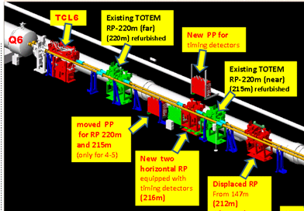
Impact on instabilities: new TCL4 and TCL6 + Roman pots
Causes:
  Very small gaps for Roman pots and TCL6 → high impedance
  TCL4 has a smaller impact (metallic collimator at reasonable gaps)
  Need to wait for the operational scenarios for these collimators and Roman pots (to be discussed at LMC: a tradeoff should be found between TOTEM protection and performance and requests by the impedance/energy deposition/collimation teams).
What can we do if there are problems?
  Retract the jaws and the Roman pots!
  Decrease bunch intensity
Impedance could limit the smallest operational gap
Need to be monitored in run 2

Slide 19
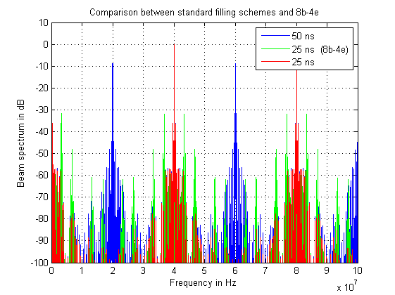
Other relevant information due to changes
3rd TCDQ module → simulated impact on impedance expected to be small
BGV → potential heating by RF mode at high frequency to be monitored
UA9 goniometer → no impact expected since well shielded from the beam.
Passive absorbers in IR3 → no impact expected.
New beam pipe in CMS and ATLAS → no issue expected.
TCP spare that was overheating will be inspected this week with EN-STI colleagues.
8b4e beam may lead to more heating due to the additional beam spectral lines that are not present with either regular 50 ns or 25 ns beams
New studies account for the impact
of 2 counter-rotating beams on beam
induced heating in the beam screen
(with weld)→ G. Iadarola, G. Rumolo and
C. Zannini. The impact is small so far
(for heating, 1 beam +1 beam ~ 2 beams).

Slide 20
Agenda
Main messages
Context:
Hardware changes potentially affecting impedance during LS1
Status of beam induced heating and instabilities
Conclusions

Slide 21
Status of pre-LS1 beam induced RF heating issues
Element | Problem | 2011 | 2012 | 2015 (expected)
Double-bellow VMTSA | Damage |  |  | All VMTSAs removed
Injection protection collimator TDI | Damage |  |  | Beam screen reinforced. Copper coating on the jaws abandoned
Injection kicker MKI | Delay (cold-down) |  |  | Beam screen upgraded
Primary collimator TCP B6L7.B1 | Few dumps |  |  | Non-conformity should be removed (suspected cooling system issue)
Tertiary collimators TCTVB | Few dumps |  |  | All TCTVBs have been removed.
Beam screen standalone Q6R5 | Regulation at the limit |  |  | Valves upgraded Neighboring TOTEM pot upgraded
ATLAS-ALFA roman pot | Risk of damage |  |  | New design being installed
Synchrotron light telescope BSRT | Damaged |  |  | New design being installed
All issues that led to increase bunch length from 1 ns to 1.25 ns in 2011 are expected to be solved:
  All MKIs were upgraded, all now have 24 screen conductors.
  Cryo margins on standalones were increased (L. Tavian, S. Claudet)
  TCTVB collimators were removed

Slide 22
Status of beam induced RF heating:
Predicted impact of consolidations and changing bunch length on heating (ongoing work)
Element | Before LS1 (1.7e11 p/b – 1374 bunches- 1.25 ns) | Consolidation of design during LS1 | After LS1 (1.2e11 p/b – 2748 bunches -1.25 ns) | After LS1 (1.2e11 p/b – 2748 bunches -1 ns)
TDI (resistive wall at 55 mm) | 36 W | Yes (but not on the jaw) | 36 W (~) | 48 W (+33%)
Arc beam screens | 186 mW/m | No | 215 mW/m (+15%) | 300 mW/m
Triplet beam screens (Q1/Q2-Q3) | 286/360 MW/m | No | 331/419 mW/m (+15%) | 460/590 mW/m
MKI | 70 W/m (*) 160 W/m (**) | Yes | To be computed | 36 to 55 W/m (-79% to -67% c.f. non-conforming)
MKD | 22 W | No | 22 W (~) | 30 W (+35%)
TCP collimator | 62 W | No | 60 W (~) | 92 W (+48%)
TCTP (at +/-5 mm) | - | - | 3 W | 5W
TOTEM** at 40 mm at 2 mm | 10 W 57 W | Yes for some | 5 W (-50%) 10 W (-80%) | 13 W (+30%) 27 W (-32%)
ATLAS-ALFA at 40 mm | 37 W | Yes | 7 W (-80%) | 20 W (-45%)
BSRT mirror (broadband/narrow band) | 30 W (/0 W) | Yes | 1 W (/1 to 4 W potential) | 4 W (/2 to 8 W potential)
BGV (potential modes) | - | - | 50 W (potential) | 1 kW (potential)
ALICE cone (mode at 750 MHz) CMS cone (mode at 530 MHz) LHCb (mode at 630 MHz) | 200 W (potential) 55 W “ 50 W “ | No | 400 W (potential) 110 W “ 100 W “ | 640 W (potential) 300 W “ 190 W “
Significant improvements expected after LS1 consolidation on many equipment
Should be checked with temperature and power spectrum monitoring
(*) for conform MKI with 15 screen conductors
(**) for non-conforming MKI
(***) resistive wall not included

Slide 23
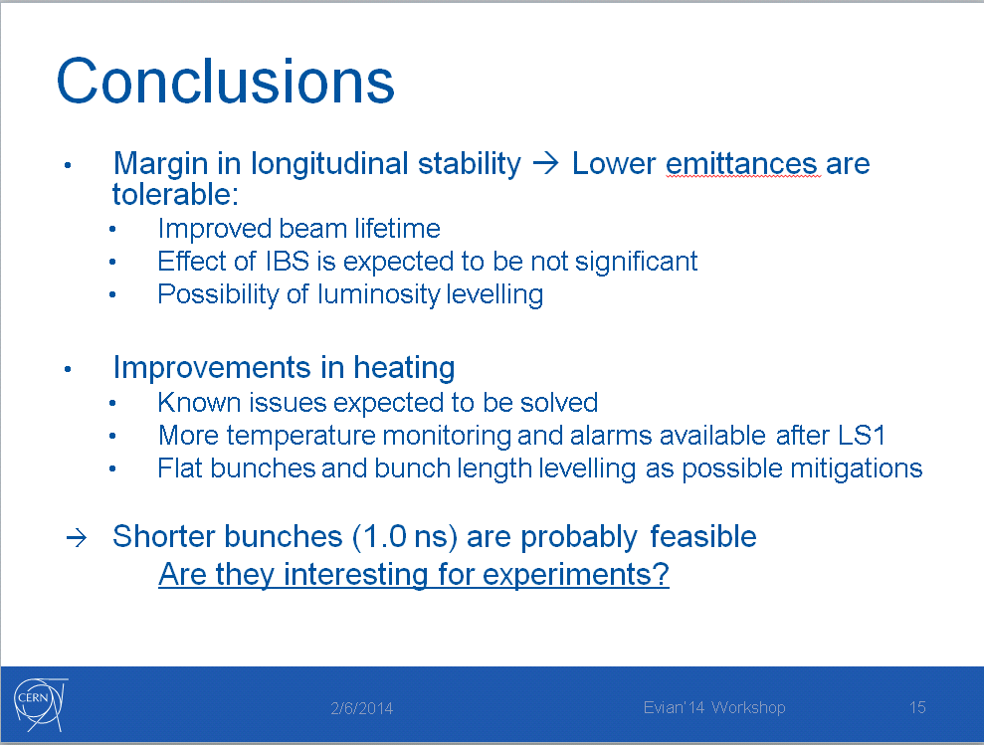
Status of longitudinal stability
Evian 2014 talk of J. E. Mueller et al

Slide 24
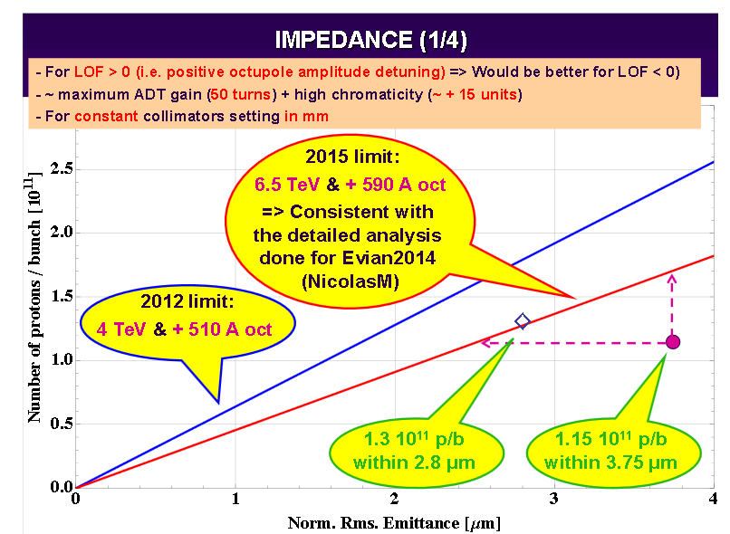
Status of transverse impedance related instabilities
E. Métral, LMC 188
→ Nominal 25 ns beam should be stable with both octupole polarities, high chromaticity
and maximum ADT gain.

Slide 25
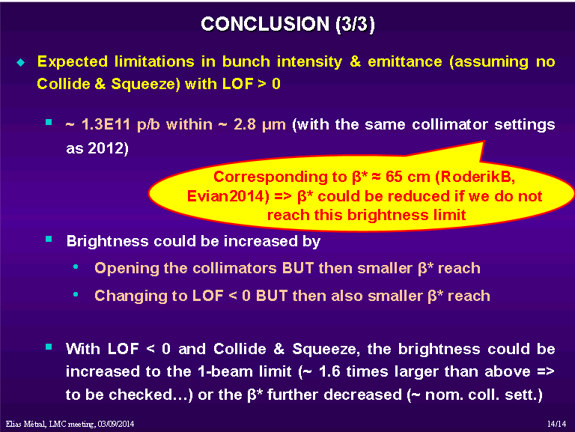
Status of transverse impedance related instabilities
E. Métral, LMC188

Slide 26
Agenda
Main messages
Context:
Hardware changes potentially affecting impedance during LS1
Status of beam induced heating and instabilities
Conclusions

Slide 27
Main messages
Significant impedance related issues during run 1
Impressive effort by all involved equipment groups to assess and reduce impedance
Beam induced RF heating: most issues should be solved, but careful follow up is needed
Global LHC impedance: changes are expected to be transparent, but careful follow up is needed
Longitudinal stability: no limitation expected so far, to be checked in dedicated MDs at 6.5 TeV.
Transverse stability: it is difficult to predict where the limit will be, but strategies could be put in place in case the stability limit is lower than expected.
→ Heating and stability diagnostics improvements will be crucial after LS1
to diagnose and mitigate potential issues.

Slide 28
Many thanks for your attention!

Slide 29
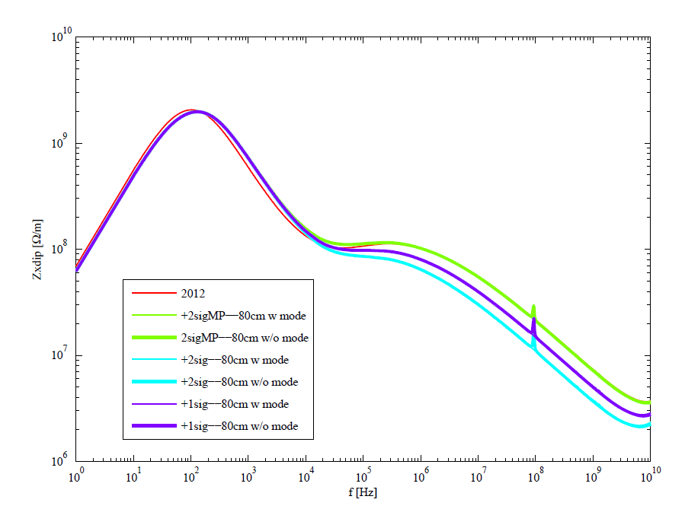
Zx dip

Slide 30
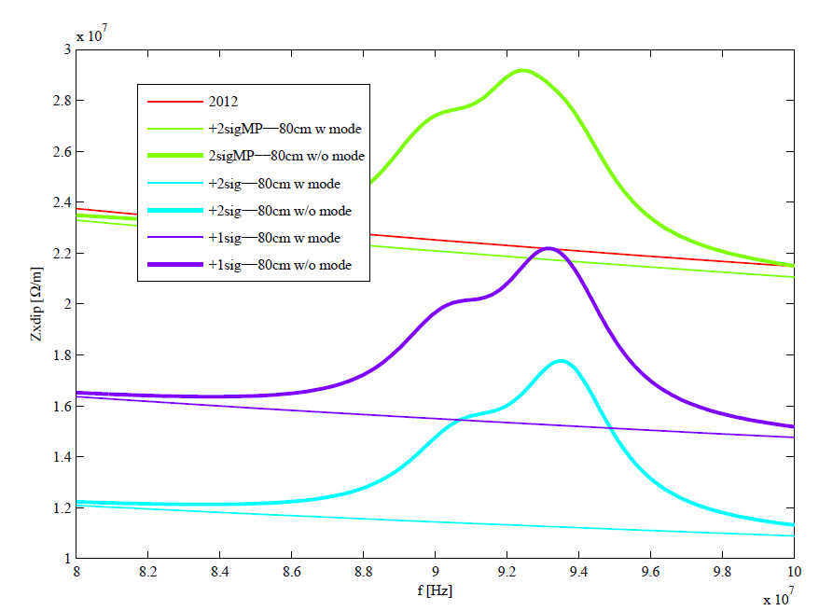
Zx dip (zoom)

Slide 31
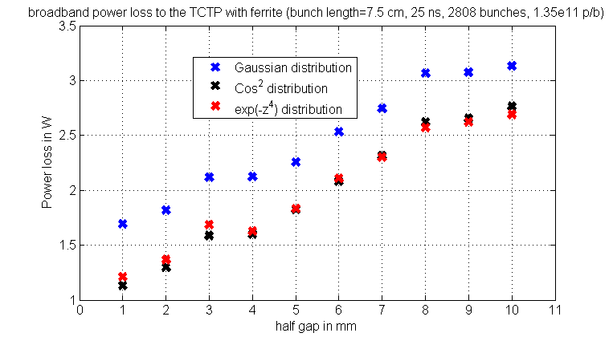
Power loss TCTP
(post-LS1, 25 ns, bunch length = 7.5 cm)
→ 50% to 100% of this heat load goes to the two lines of ferrite

Slide 32
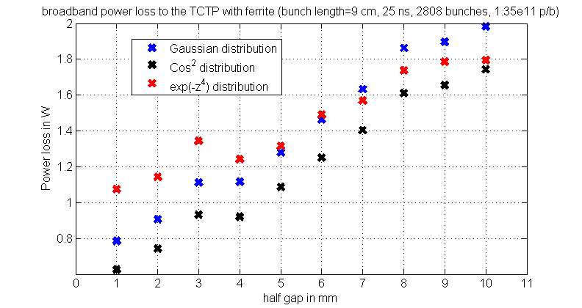
Power loss TCTP
(post-LS1, 25 ns, bunch length = 9 cm)
→ 50% to 100% of this heat load goes to the two lines of ferrite

Slide 33
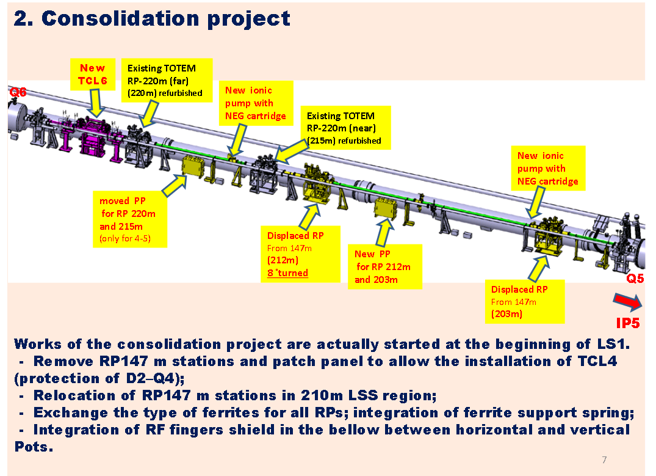
D.Druzhkin (NIKIET, Moscow, Russia)

Slide 34
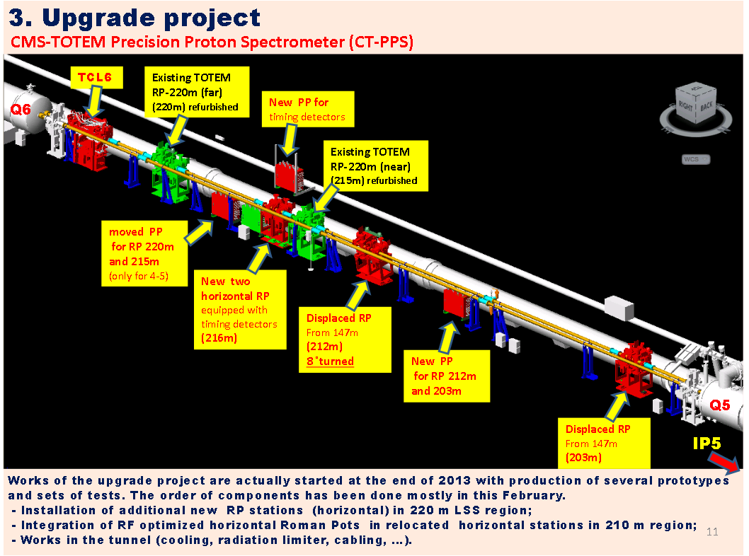
D.Druzhkin (NIKIET, Moscow, Russia)

Slide 35
Check parameters for high beta runs
Pressure during fills
TDI measurements
TCTP heat load and impedance
MKI upgrade
TCP issue
BSRT upgrade
8b 4e problem

Slide 36
TDI probes
2.2 TEMPERATURE SENSORS
Temperature sensors (PT100) will be installed at eight different locations on the beam screen and jaws:
  four sensors will be installed on the aluminum frame of the lower jaw (at the position of the first and fourth hBN absorber assembly, as well as at the position of the aluminium and copper-beryllium block assemblies, respectively);
  two sensors will be installed on the stainless steel I-beam of the lower jaw (at the upstream extremity of the jaw as well as at the jaw center);
  two sensors will be installed on the beam screen on the passage side of the machine (upstream and downstream).

Slide 37
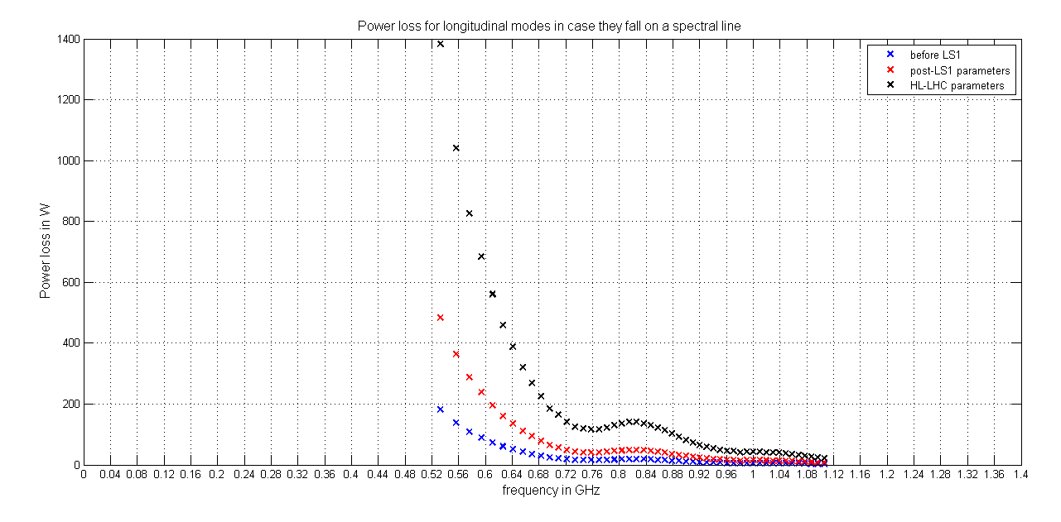
Power from resonant modes
Modes from R. Wanzenberg and O. Zagorodnova
Significant increase of power loss with HL-LHC parameters
→ even the modes at higher frequencies are significant (of the order of 20 to 50 W)

Slide 38
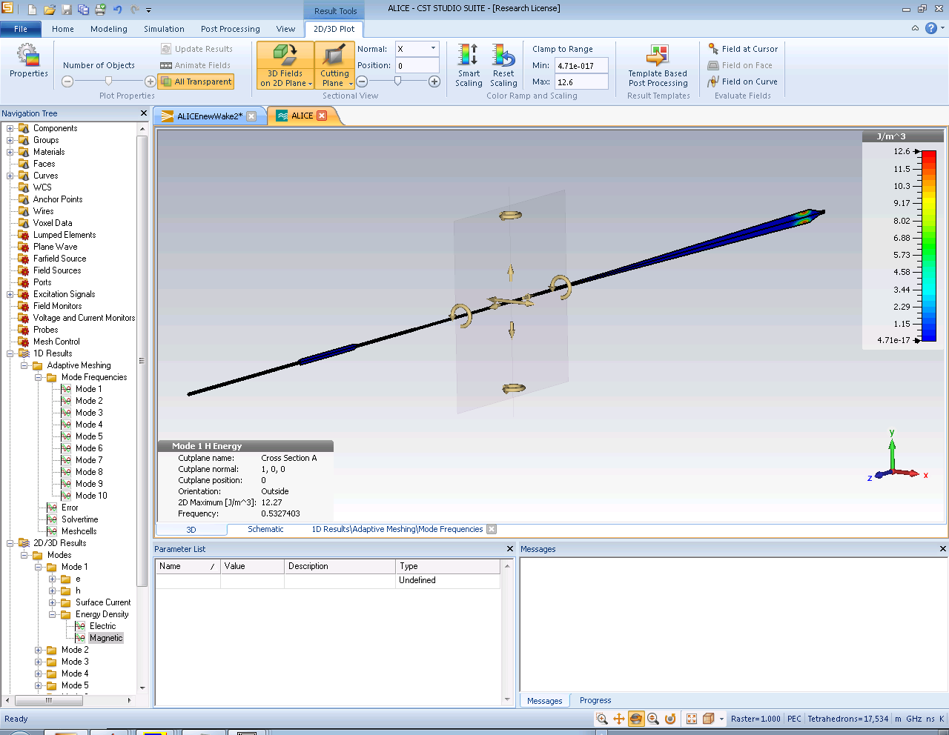
Location of modes?
Linked to the large diameter of the cone → localized there
No changes foreseen in this area, so these modes are not affected by the upgrade

Slide 39
BGV

Slide 40
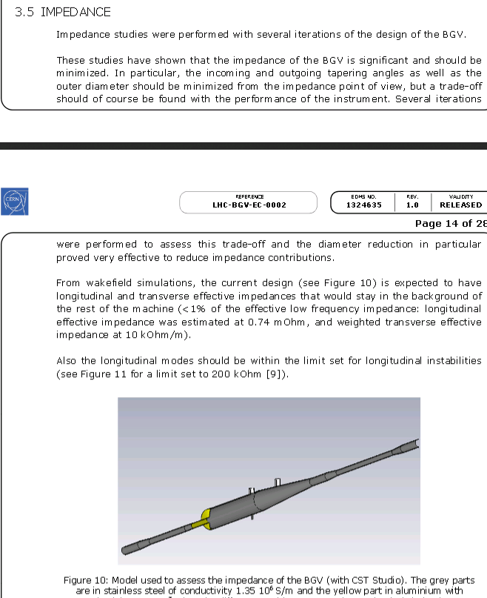

Slide 41
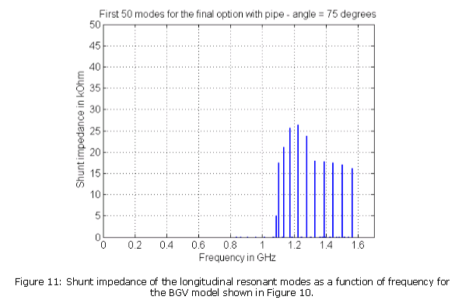

Slide 42
