Slide 1
Operational Beams for the LHC
(in the injector complex)
H. Bartosik, D. Manglunki, Y. Papaphilippou and G. Rumolo
LHC Performance Workshop
Chamonix, September 22nd, 2014

Slide 2
Acknowledgements
G. Arduini, T. Argyropoulos, M. Bodendorfer, T. Bohl, R. Bruce, C. Cornelis, H. Damerau, J. Esteban-Müller, A. Findlay, R. Garoby, S. Gilardoni, B. Goddard, S. Hancock, K. Hanke, G. Iadarola, B. Mikulec, E. Shaposhnikova, R. Steerenberg, PS complex & SPS Operation crews

Slide 3
Outline
  LHC requirements for the injectors
  Single bunch beams
  25 ns and 50 ns physics beams
  Doublet scrubbing beam and 8b+4e beam
  LHC Ion beam
  LHC beams’ status and planning
  Conclusions
H. Bartosik and G. Rumolo, LBOC, 08/04/2014
H. Bartosik and G. Rumolo, Evian 2014
D. Manglunki, LIU-Ion LEIR review, 20/08/2014

Slide 4
Outline
  LHC requirements for the injectors
  Single bunch beams
  25 ns and 50 ns physics beams
  Doublet scrubbing beam and 8b+4e beam
  LHC Ion beam
  LHC beams’ status and planning
  Conclusions

Slide 5
(Proposed) LHC start up in 2015
M. Lamont, LMC, 10/09/2014
450GeV
6.5 TeV ?
Commissioning (low intensity/luminosity)
Vacuum conditioning (50ns/short trains 25ns)
(5-7 days)
50ns
(intensity ramp up + physics)
Scrubbing with 25ns
(2 days)
LHCPROBE
LHCINDIV
(Van der Meer)
LHC50 (std)
up to 1.5 x 10¹¹ p/b *
LHC25 (std)
1.2 x 10¹¹ p/b *
LHC50 (std/BCMS)
up to 1.7 x 10¹¹ p/b *
450GeV
6.5 TeV ?
25ns scrubbing
(5 days)
25ns test ramps + commissioning (≈ 5 days)
Scrubbing with doublet beams (≈ 5 days)
LHC25 (std)
1.2 x 10¹¹ p/b *
LHC25doublet
1.6 x 10¹¹ p/doublet *
LHC25 (std/BCMS)
up to 1.3 x 10¹¹ p/b *
Use of low e-cloud filling patterns
Intensity ramp up & physics with 25ns
Or, if scrubbing not sufficient
Possible alternative
LHC25 (8b+4e)
up to 1.8 x 10¹¹ p/b *
LHC25 (std/BCMS)
up to 1.3 x 10¹¹ p/b *
* At LHC injection

Slide 6
Outline
  LHC requirements for the injectors
  Single bunch beams
  25 ns and 50 ns physics beams
  Doublet scrubbing beam and 8b+4e beam
  LHC Ion beam
  LHC beams’ status and planning
  Conclusions

Slide 7
LHCPROBE & LHCINDIV – specs @LHC injection
 | LHCPROBE | LHCINDIV
Intensity [p/b] | 5 x 10⁹ – 2 x 10¹⁰ | 2 x 10¹⁰ – 3 x 10¹¹
Transverse emittance, 1σ [μm] | 1 | < 2.5
Longitudinal emittance [eVs] | 0.35 | 0.35 – 0.5
  LHCPROBE (=LHCPILOT) usually with intensities ≤ 10¹⁰ p/b, transverse emittance not critical (but anyhow small)
  LHCINDIV parameter range also extended in MDs to produce single bunches with up to 4 x 10¹¹ p/b and/or with lower longitudinal emittances (down to 0.15 eVs) at SPS injection
    High-intensity variants for possible impedance or beam-beam studies

Slide 8
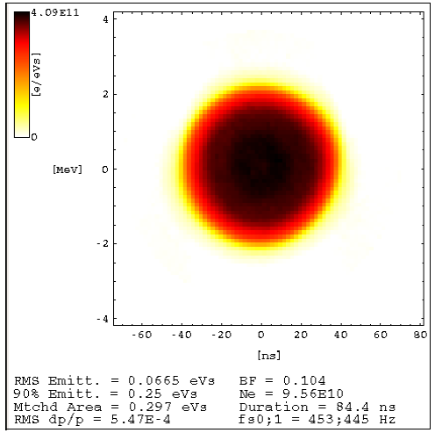
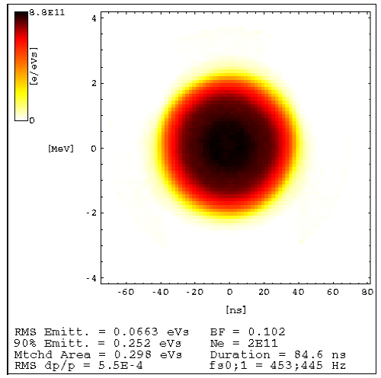
LHCPROBE & LHCINDIV
  Production mechanism improved in PSB since 2013, covering parameter range for both type of beams
    Reworking of controlled longitudinal blow up (C16 and C02 parameters) during first part of PSB cycle
    Unique knob (C16 voltage) for intensity control
    Preserving the 6D phase space volume for different intensity values
    Excellent shot-to-shot reproducibility and control of both intensity and longitudinal emittance
S. Hancock, CERN-ATS-Note-2013-040 MD
1x10¹¹ p
2x10¹¹ p

Slide 9
LHCINDIV for
Van der Meer scans
Single bunch beam parameters
Intensity [p/b] | 7 – 9 x 10¹⁰
Transverse emittance, 1σ [μm] | ≥ 2.5
Transverse distribution | Gaussian
To be reproduced in 2014/15 …
H. Bartosik and G. Rumolo, CERN-ACC-NOTE-2013-0008 MD
Procedure for producing Gaussian bunches for Van der Meer scans established in 2012
  Based on longitudinal AND transverse shaving in the PSB to obtain “large” emittance single bunches with under-populated tails
  Provides Gaussian bunches with the desired intensities in the SPS after scraping

Slide 10
Outline
  LHC requirements for the injectors
  Single bunch beams
  25 ns and 50 ns physics beams
  Doublet scrubbing beam and 8b+4e beam
  LHC Ion beam
  LHC beams’ status and planning
  Conclusions

Slide 11
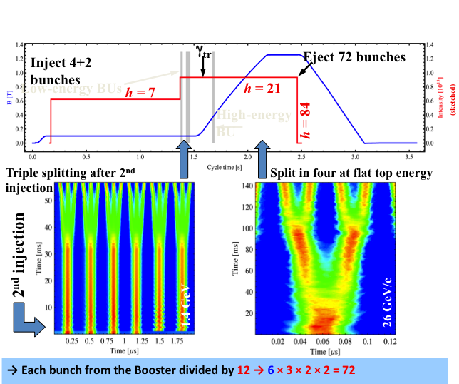

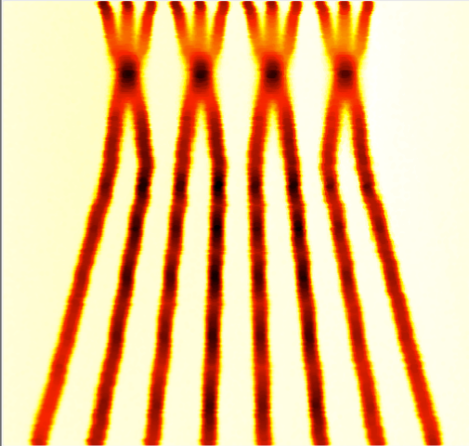
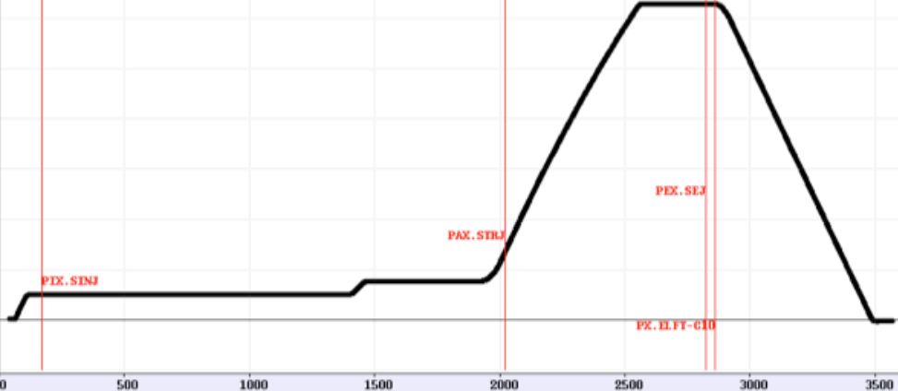
LHC25 and LHC50 (standard & BCMS)
Standard scheme:
(maximum number of bunches in LHC)
BCMS scheme:
(less bunches in LHC but higher brightness)
h = 9 →10 → 11→12 → 13 → 14 → 7 → 21
25 ns
50 ns
25 ns
50 ns
h = 21 → 42 → 84
4 bunches
+4 bunches
S. Gilardoni – Space Charge 2013
h = 9
h = 21
Evian workshop 2014
11
PS batches with 72 (36) bunches for 25ns (50ns)
PS batches with 48 (24) bunches for 25ns (50ns)
Triple splitting up to 2013 at 1.4 GeV
(moved to 2.5 GeV after LS1)

Slide 12
LHC50 (std & BCMS) – pre-LS1 status
50 ns beam at the SPS extraction in 2012/13 (Q20)
  Combined wire-scans at end of SPS flat bottom (values cross-checked @ LHC)
    Error bars include measurement spread, as well as systematic uncertainty (10%)
  Intensity measured at SPS flat top after scraping
  Transport through PS and SPS within intensity loss and emittance blow up budgets
Four trains of 36 bunches
Routinely used for physics in 2012
Three trains of 24 bunches
Sent to LHC only for test to prove luminosity gain
Budget | PS | SPS
Δε_{x,y} /ε_{x0,y0} | 5% | 10%
−ΔN/N₀ | 5% | 10%

Slide 13
LHC25 (std & BCMS) – pre-LS1 status
25 ns beam at the SPS extraction in 2012/13 (Q20)
  Combined wire-scans at end of SPS flat bottom (values cross-checked @ LHC)
    Error bars include measurement spread, as well as systematic uncertainty (10%)
  Intensity measured at SPS flat top after scraping
  Transport through PS and SPS 15% above budget for standard beam
Four trains of 72 bunches
Used for the LHC scrubbing run in 2012
Three trains of 48 bunches
Used for the LHC pilot physics run in 2012
Budget | PS | SPS
Δε_{x,y} /ε_{x0,y0} | 5% | 10%
−ΔN/N₀ | 5% | 10%

Slide 14
Pre-LS1 performance limits
Both standard production and BCMS beams already very close to the limits in injectors
50 ns beam
  Intensity/bunch: close to the limit of longitudinal instability in the PS
  Brightness: BCMS at the present space charge limit in the SPS
25 ns beam
  Intensity/bunch: close to the limit of RF power and longitudinal instability in the SPS
  Brightness: At the present space charge limit in the PS

Slide 15
LHC50/25 beam production after LS1
Recover 2012 performance
  Machines exposed to air → electron cloud → SPS scrubbing run
  RF manipulations in the PS performed at 2.5 GeV instead of 1.4 GeV in all LHC cycles (regularly used with BCMS beams in 2012)
    increases available bucket area
    tuning groups of cavities have changed → allows for further increase of bucket area
Potential for higher bunch intensity
  Possible benefits in the PS from
    upgraded 1-turn delay feedback for 10 MHz cavities (available at start-up 2014)
    upgraded longitudinal coupled-bunch feedback (commissioning starting in 2014)
  25 ns up to 1.3 x 10¹¹ p/b at SPS extraction as during 2012 MDs (limited by RF power and longitudinal instabilities in the SPS)
Potential for higher brightness (as from RLIUP workshop)
  PS: Alleviate space charge by longer bunches and larger momentum spread
    need longitudinal blow-up on the PSB ramp to produce required emittance
    use of h1+2 in phase at PSB extraction to keep these larger longitudinal emittance bunches within certain length (recombination kicker rise time constraint)
  SPS : further working point optimization for 50 ns BCMS beam

Slide 16

Post-LS1: PSB – PS transfer
Recombination kicker rise time:
Kinetic energy, E_{kin} | Rise time
1.4 GeV | 105 ns
 | E_{kin} | Bucket length | Max bunch length
h=7 (std) | 1.4 GeV | 327 ns | 220 ns
h=9 (BCMS) | 1.4 GeV | 255 ns | 150 ns
Longitudinal emittance per bunch at PS injection should not exceed
[Total Split Factor x 0.35 eVs]/1.1 (includes 10% margin for blow-up)
About 3 eVs (h=7) and 2 eVs (h=9) for RF manipulations at E_{kin}=2.5 GeV
[FB Split Factor x 1 eVs] for transition crossing in h=21
Matched value in the PSB (h1+2) to obtain the above bunch lengths
Notes:
3 eVs (h=7)/2 eVs (h=9) due to the acceptance bottleneck at the start of acceleration from 1.4 to 2.5 GeV;
(Total Split Factor 0:35 eVs)/1.1, as bunches at the PS extraction must have longitudinal emittance of 0.35 eVs with 10% blow up allowed in the PS;
Flat Bottom Split Factor 1 eVs for transition crossing on h=21, as bunches go smoothly through transition if their longitudinal emittance is below 1 eVs;
The matched value in the PSB with h=1+2 with available voltage and desired bunch length at extraction.

Slide 17
Post-LS1: PSB – PS transfer
Recombination kicker rise time:
Kinetic energy, E_{kin} | Rise time
1.4 GeV | 105 ns
 | E_{kin} | Bucket length | Max bunch length | Bunch length (pre-LS1)
h=7 (std) | 1.4 GeV | 327 ns | 220 ns | 180 ns
h=9 (BCMS) | 1.4 GeV | 255 ns | 150 ns | 150 ns
Longitudinal emittance per bunch at PS injection should not exceed
[Total Split Factor x 0.35 eVs]/1.1 (includes 10% margin for blow-up)
About 3 eVs (h=7) and 2 eVs (h=9) for RF manipulations at E_{kin}=2.5 GeV
[FB Split Factor x 1 eVs] for transition crossing in h=21
Matched value in the PSB (h1+2) to obtain the above bunch lengths
RF Manipulation: | @1.4 GeV | @2.5 GeV
50 ns (Std/BCMS) | 1.2/0.9 eVs | 1.9/0.9 eVs
25 ns (Std/BCMS) | 1.2/0.9 eVs | 2.8/1.5 eVs

Slide 18
Post-LS1: LHC25
(std & BCMS)
Std with new longitudinal parameters
BCMS with new longitudinal parameters
2012
2012

Slide 19
Beam parameters at LHC injection after LS1
2012 performance
25 ns | Intensity (p/b) | Emittance (μm)
Standard | 1.2 x 10¹¹ | 2.6
BCMS | 1.15 x 10¹¹ | 1.4
50 ns | Intensity (p/b) | Emittance (μm)
Standard | 1.7 x 10¹¹ | 1.7
BCMS | 1.7 x 10¹¹ | 1.1
Assuming transport in the PS and SPS within budgets like in 2012
Requires successful SPS scrubbing !
All beams to be prepared in 2014!

Slide 20
Beam parameters at LHC injection after LS1
with potential improvements from optimized PSB-PS transfer and intensity increase in SPS
2012 performance
25 ns | Intensity (p/b) | Emittance (μm) | Intensity (p/b) | Emittance (μm)
Standard | 1.2 x 10¹¹ | 2.6 | 1.3 x 10¹¹ | 2.4
BCMS | 1.15 x 10¹¹ | 1.4 | 1.3 x 10¹¹ | 1.3
50 ns | Intensity (p/b) | Emittance (μm) | Intensity (p/b) | Emittance (μm)
Standard | 1.7 x 10¹¹ | 1.7 | 1.7 x 10¹¹ | 1.6
BCMS | 1.7 x 10¹¹ | 1.1 | 1.7 x 10¹¹ | 1.1
Assuming transport in the PS and SPS within budgets like in 2012
Requires successful SPS scrubbing !
All beams to be prepared in 2014!
Setup of longitudinal blow-up along PSB ramp and h1+2 transfer to the PS during commissioning and MDs
Push SPS to intensity limit for 25 ns beams

Slide 21
Outline
  LHC requirements for the injectors
  Single bunch beams
  25 ns and 50 ns physics beams
  Doublet scrubbing beam and 8b+4e beam
  LHC Ion beam
  LHC beams’ status and planning
  Conclusions

Slide 22
Doublet beam
Injection of trains of 72 x 10 ns long bunches with 1.7e11 p/b on unstable phase and capture in two neighboring buckets in the SPS → successfully tested (no acceleration to 450 GeV) → e-cloud enhancement observed in the SPS
4
3
1st inj.
200 MHz RF Voltage [MV]
measurement!
2
1
0
4
-2
0
2
6
8
Time [ms]
Need to gain experience in the SPS with dedicated MDs in 2014 for complete parameter list at flat top
For more info see H. Bartosik, Chamonix 2014

Slide 23


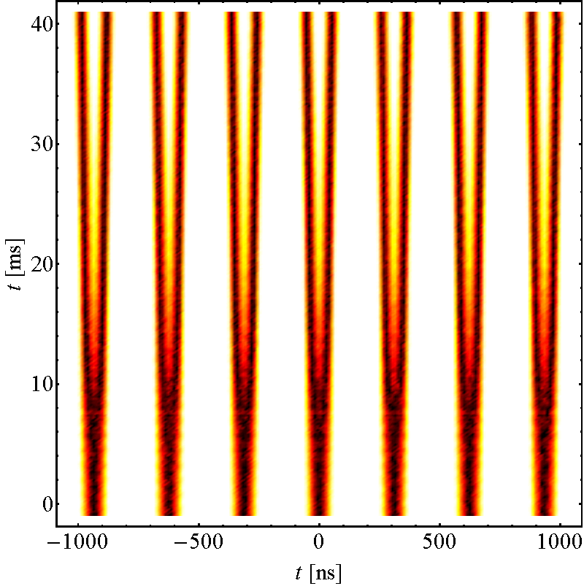
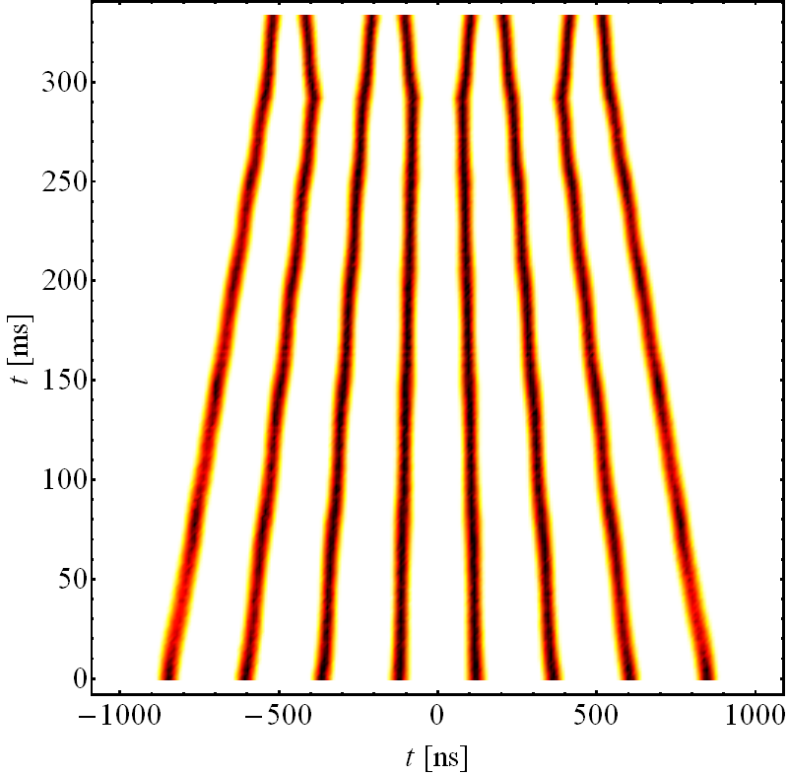
8b+4e scheme
H. Damerau, RLIUP 2013
Trains with 4 missing bunches every 8 bunches
  Allows for larger intensity per bunch and expected to reduce e-cloud effects
Standard scheme
bunch pattern:
6x(8b+4e) + 8b
BCMS scheme
bunch pattern:
3x(8b+4e) + 8b
Simulations shown.
Recent successful tests in the PS.
To be fully optimized in MDs during 2014-2015
25 ns (8b+4e) | Intensity (p/b) | Emittance (μm) | Bunch pattern
Standard | 1.8 x 10¹¹ | 2.3 | 6 x (8b+4e) + 8b
BCMS | 1.8 x 10¹¹ | 1.4 | 3 x (8b+4e) + 8b
For more info see G. Rumolo, Chamonix 2014

Slide 24
Outline
  LHC requirements for the injectors
  Single bunch beams
  25 ns and 50 ns physics beams
  Doublet scrubbing beam and 8b+4e beam
  LHC Ion beam
  LHC beams’ status and planning
  Conclusions

Slide 25
LHC ion performance in 2011
Pb-Pb goal in 2011: 30-50 μb⁻¹ in 4 weeks, with L_{peak} = 1.4x10²⁶ Hz/cm²
Achieved @ 3.5ZTeV : 150 μb⁻¹ with peak luminosity 5x10²⁶ Hz/cm² (half of the nominal)
  Increased LEIR brightness with nominal bunch population of 4.5x10⁸ Pb⁵⁴⁺ ions/bunch but smaller emittances
  Scaling with E², L_{peak} = 2x10²⁷ Hz/cm² @ 7ZTeV (twice the nominal)
    Good beam behaviour at low energy in PS due to excellent vacuum
    Modified production scheme: No splitting in PS, i.e.
    half as many bunches with twice the intensity/bunch
    Good behaviour of bunches on SPS flat bottom (RF Noise improved, IBS & space charge less critical than expected and with Q20 after 2013)

Slide 26
LHC ion performance in 2013 projected to 2015
For p-Pb run in 2013, LEIR bunch intensity further increased to 5.5x10⁸ Pb⁵⁴⁺ ions/bunch (1.2 times the nominal)
With same scheme as 2011, and performance of 2013, Pb-Pb peak luminosity of 3x10²⁷ Hz/cm² @ 7ZTeV can be expected
A 20% increase in peak luminosity (3.6x10²⁷ Hz/cm² @ 7ZTeV) can be gained by squeezing 20% more bunches in LHC
  Batch compression to 100ns in PS
  Two-bunch batches separated by 225ns in SPS (12 injections, to be optimised)

Slide 27
LHC ion scheme in 2011
Pb ions / LHC bunch
Nb of bunches
Harmonic number / Frequency
7 injections
4.5 10⁸
LEIR
(9 10⁸ Pb ions / 3.6 s)
2
2
200ns
3 10⁸
16–14-12-24
PS (NO splitting)
bunch spacing = 200ns
2
24-21
-169
200ns
200ns
2.2 10⁸
SPS at extraction,
after 12 transfers from PS,
Batch spacing = 200 ns
24
200 MHz
1.4 10⁸
LHC at injection,
after 15 transfers from SPS
358
400 MHz
1.2 10⁸
LHC in collision
358
β* = 1 m -> L = 5.10²⁶ cm⁻² s⁻¹

Slide 28
LHC ion scheme in 2015
Nb of bunches
Pb ions / LHC bunch
Harmonic number / Frequency
7 injections
LEIR
1.1 10⁹ Pb ions / 3.6 s)
2
2
100ns
16–18-21
PS batch compression
bunch spacing = 100ns
2
-169
100ns
225ns
2.2 10⁸
SPS at extraction,
after 12 transfers from PS,
Batch spacing = 225 ns
200 MHz
24
1.6 10⁸
LHC at injection,
after 18 transfers from SPS
400 MHz
432
100ns
225ns
1.4 10⁸
LHC in collision
432
β* = 0.5 m -> L = 3.6 10²⁷ cm⁻² s⁻¹

Slide 29
Outline
  LHC requirements
  Single bunch beams
  25 ns and 50 ns physics beams
  Doublet scrubbing beam and 8b+4e beam
  LHC Ion beam
  LHC beams’ status and planning
  Conclusions

Slide 30

Revised Injector schedule 2014

Slide 31
LHC beam status and planning
  Recover 2012 performance
    LHCPROBE (=LHCPILOT) and LHCINDIV
      In good shape in PSB and PS, 12-24 bunches taken in SPS for realignment campaign and RF setting-up (energy matching)
    LHC 25 and 50 ns standard
      Produced in PSB and PS (triple splitting achieved), fine tuning in progress
      Not taken yet in SPS (scrubbing in week 45)
    LHC 25 and 50 ns BCMS not taken yet
  Pushing intensity of 25ns beam and production of doublet beam
    To be established in (dedicated) MDs by the end of 2014 (scrubbing run II in 2015)
    Many other concurrent MD requests and setting up of Ar for NA ion physics
  8b+4e beam
    Recent successful tests in the PS
    Tests in the SPS probably not before 2015 due to limited MD time
  LHC ion beams not yet produced in LEIR but general problems solved
    To be optimized in 2014-2015
K. Hanke, Chamonix 2014

Slide 32
Outline
  LHC requirements for the injectors
  Single bunch beams
  25 ns and 50 ns physics beams
  Doublet scrubbing beam and 8b+4e beam
  LHC Ion beam
  LHC beams’ status and planning
  Conclusions

Slide 33
Conclusions
Single bunch beams
  New production scheme for better control of intensity and longitudinal emittance
25 ns and 50 ns beams
  Recovering the 2012 performance relies on successful scrubbing of the SPS
  Implementation of new beam production schemes for higher brightness in PSB and PS and higher intensity in SPS
  Second SPS scrubbing run in 2015
Doublet beam for LHC (and SPS) scrubbing
8b+4e beam as low e-cloud option
  Successful measurements in the PS
  Tests in SPS not before 2015 (limited MD time)
LHC ions
  Pb performance in 2013 and PS batch compression (100ns)
Injectors are already very busy: physics beams, LHC beams (old and new schemes!), ion beams in preparation for 2015, MDs …
lots of SPS MD time with very long cycle needed !!

Slide 34

Thank you for your attention

