Slide 1
Helmholtz Particle Physics Programme.
Joachim Mnich
R-ECFA Visit Germany
Bonn, May 9, 2014

Slide 2
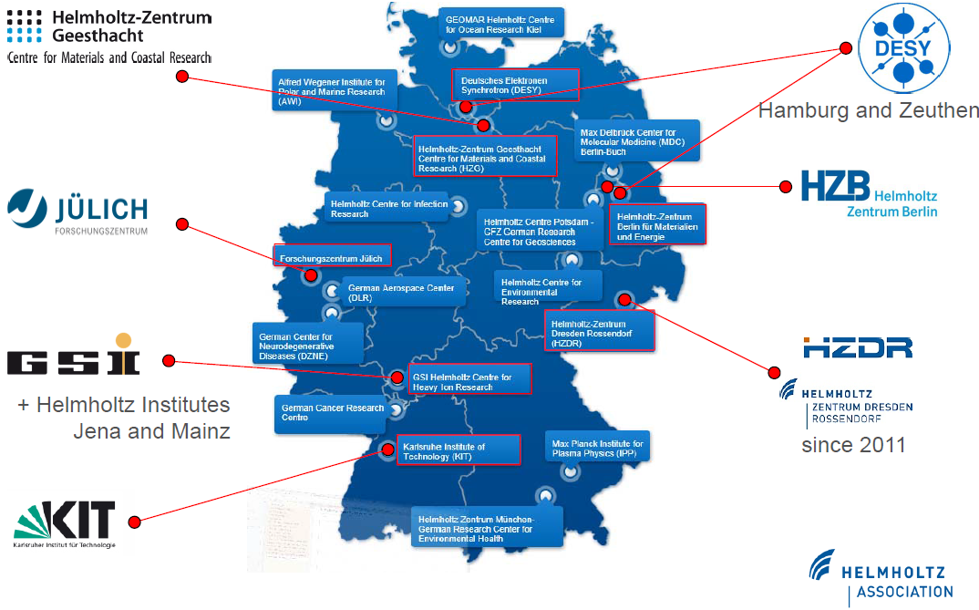
Helmholtz Association
18 large research centres in Germany
Structured in six research fields
  Aeronautics, Space and Transport
  Earth and Environment
  Energy
  Health
  Key Technologies
  Structure of Matter
  (→ Matter)
Budget (2013):
  2.4 G€ institutional funding
  (90% federal, 10% local)
  1.2 G€ Third-party funding

Slide 3
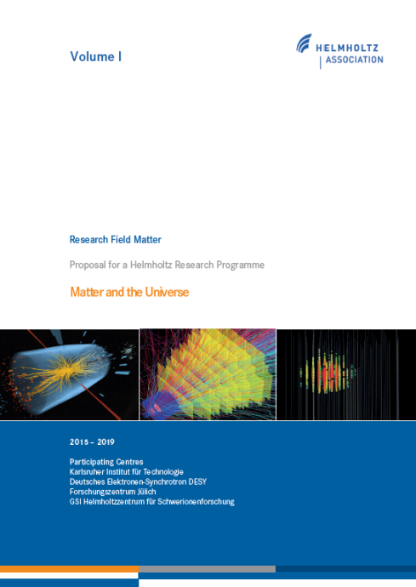
Particle Physics in Helmholtz
Restructuring of research field for next funding period (2015 -19)
Structure of Matter
4 programmes:
  Particle Physics
  Astroparticle Physics
  Hadrons and Nuclei
  Photon, Nuclei, Ions
Matter
3 programmes:
  Matter and Universe
  From Matter to Materials and Life
  Matter and Technology
  (Accelerator, Detector, Computing)
new
Helmholtz Centres in (astro)-particle physics:
  DESY
  KIT (Helmholtz part: computing and astro-particle physics)
  GSI (ALICE & FAIR)
  FZ Jülich (EDM experiment)

Slide 4
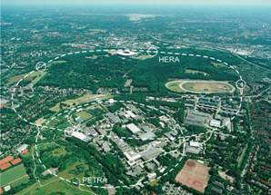
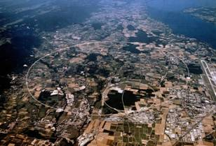
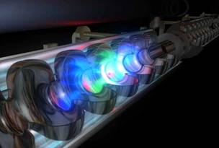
DESY Long-term Strategy in Particle Physics
HERA
LHC
ILC
Accelerators
Detectors
Physics
+ support through strong theory group
+ computing infrastructure
+ testbeam & other infrastructures
Use of DESY infrastructure for particle physics
  e.g. Tier-2/NAF, testbeam for detector R&D, ALPS II, …
Strategic role of DESY as national laboratory for particle physics

Slide 5
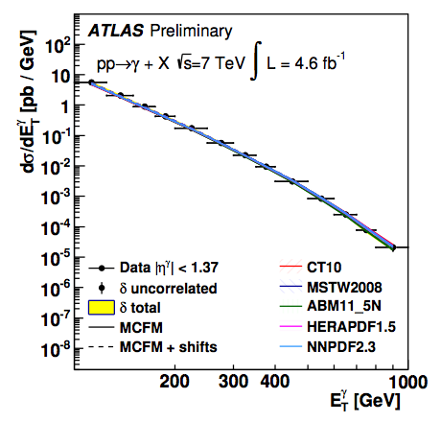
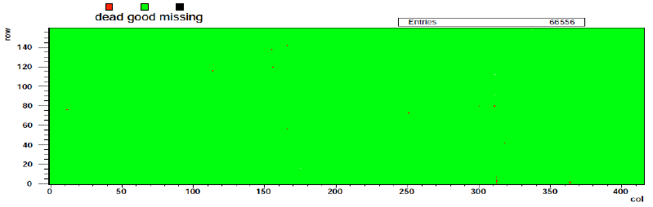
DESY at the LHC
Two large groups in ATLAS and CMS
  more than 60 scientists per group
  ~1/3 staff, ~1/3 postdocs,
  ~1/3 students + technical support
Building on large experience and expertise from HERA
  physics analysis, detector operation,
  computing, upgrades, management …
Example: CMS phase 1 pixel upgrade
  4th layer together with German CMS groups
Example proton structure
  HERAFitter to extract PDFs
First full-size module tested

Slide 6
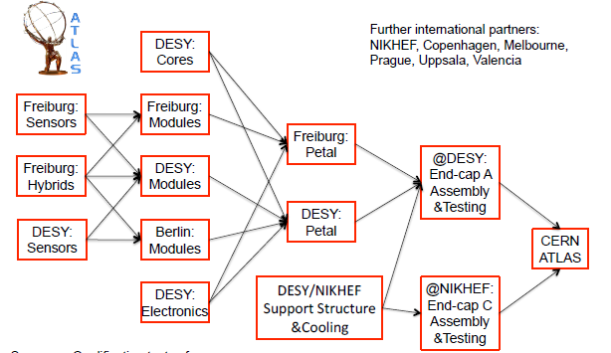
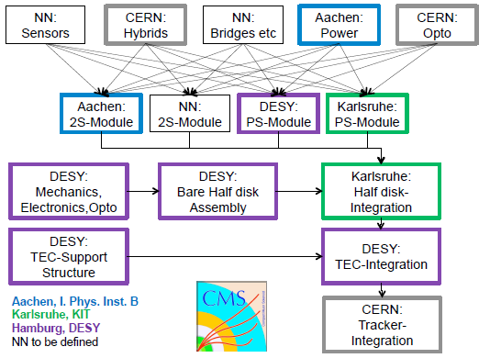
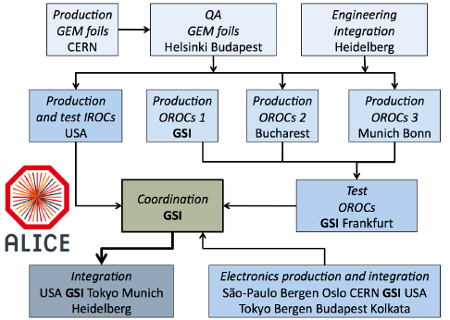
LHC Detector Upgrades
Future: Phase 2 upgrades
Proposal for Helmholtz Strategic Large Investments
  DESY, KIT, GSI: 28 M€
  Helmholtz part for ATLAS & CMS tracker and ALICE TPC (2018)
Close collaboration with German & international partners
  part of German concept for LHC upgrade presented to funding agencies
Crucial for future of particle physics in Helmholtz

Slide 7
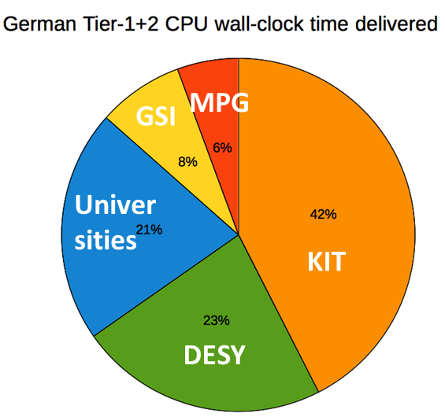
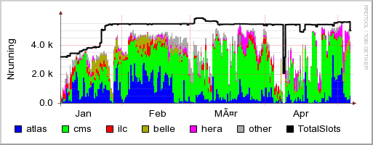
Computing
Helmholtz provides large share of LHC computing in Germany
  Tier-1 Centre at KIT (GridKa) for all experiments
  Tier-2 centres at DESY (ATLAS, CMS, LHCb) and GSI (ALICE)
National Analysis Facility (NAF) at DESY
Facilities used also for non-LHC experiments
Future:
  funding proposal to Helmholtz
  to secure Tier-1 and Helmholtz
  part of Tier-2 centres
NAF

Slide 8
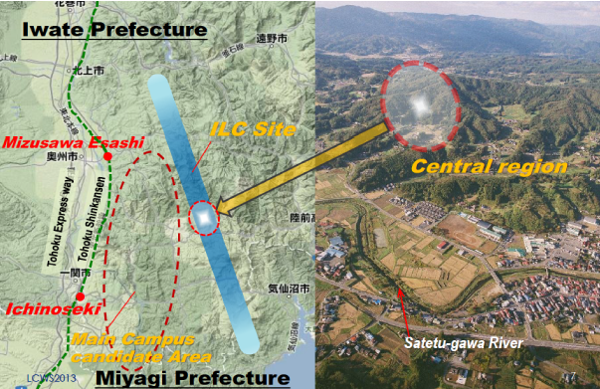
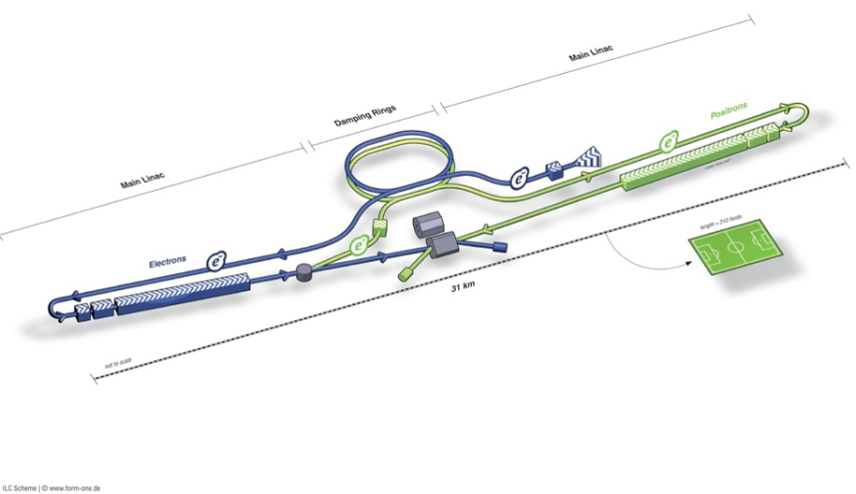
International Linear Collider
DESY is key to the development of a superconducting linear collider
  TESLA collaboration since 1990ies
  key contributions to the 2013 ILCTDR
  construction of the European XFEL
Example: industrial cavity production
  exceeds XFEL specs
  average gradient close to
  ILC needs (31.5 MV/m)
  plot based on 90 cavities,
  now 250 are tested
M. Harrison, Nov 2013

Slide 9
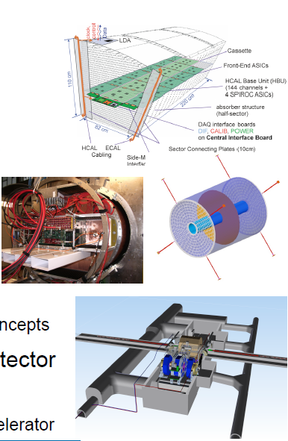
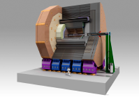
ILC Detector & Physics
ILD and SiD detector concepts
  co-spokespersons in both
  concepts from DESY
Hadron calorimeter
  CALICE collaboration to advance Particle Flow algorithms
TPC development
Integration laboratory for detector
  engineering expertise and support
  EDMS for detector and accelerator

Slide 10
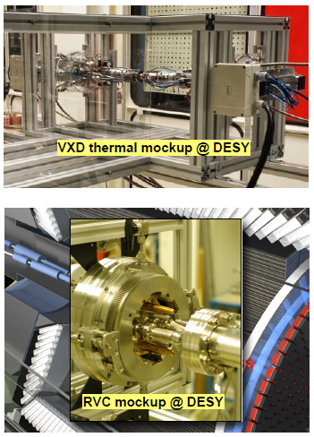
Belle (II)
Germany plays major role in Belle II
  10 institutes represent 2nd largest country after Japan
  deliverable is DEPFET vertex detector in 2016
DESY joined Belle II in 2011
  bringing in engineering expertise,
  e.g.heat management
  delicate installation into Belle II (remote vacuum connection)
DESY test Beam
  full vertex detector system test in Jan 2014
Computing
  Tier-1 at KIT
  Tier-2 & NAF at DESY

Slide 11
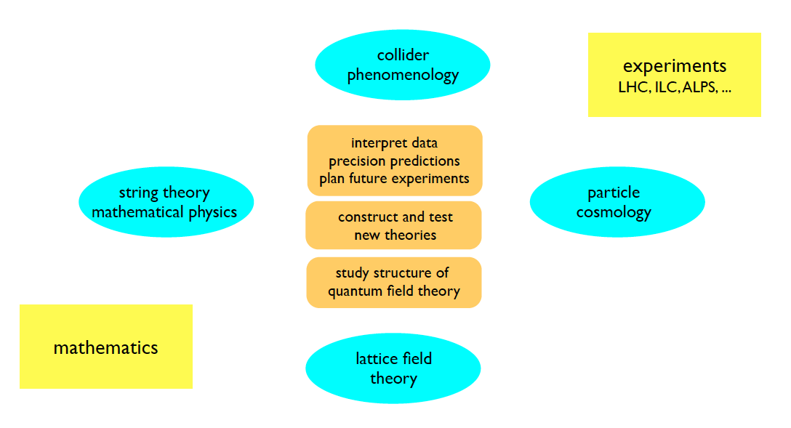

Particle Physics Theory in Helmholtz
Broad spectrum, firmly connected to the experimental programme
Closely integrated with local universities (Hamburg, Berlin, Karlsruhe)
Shapes theoretical particle physics in Germany & beyond
    Lectures, schools, conferences, workshops
    DESY fellowship programme (each year >300 applications from around the globe)
    Large fraction of theory staff in Germany have a DESY history

Slide 12
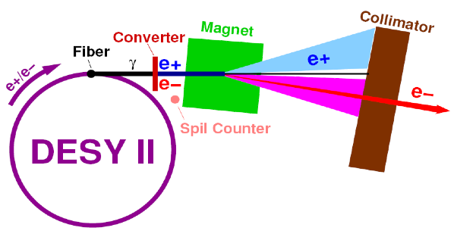
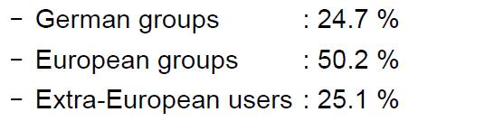
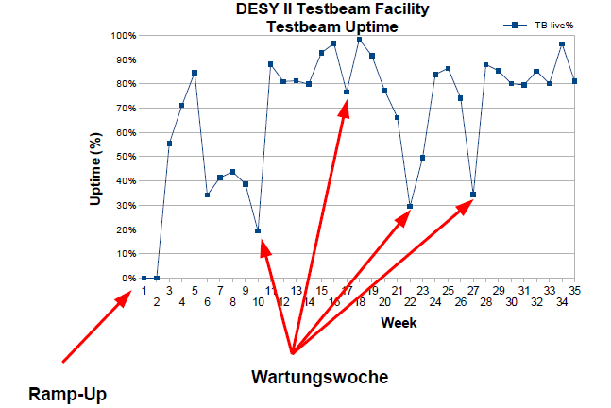
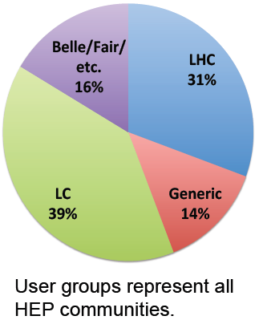
DESY Testbeam
Increasingly important facility for detector R&D
  approx. 400 users in 2013
Maintenance weeks

Slide 13
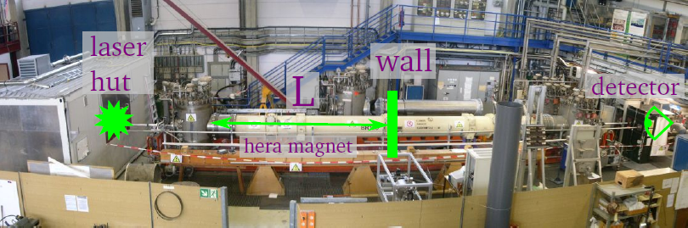
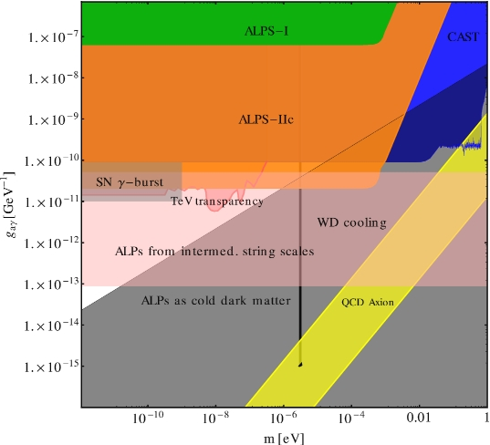
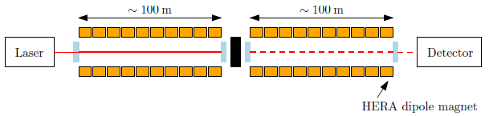
Axion-Like Particle Search
ALPS I experiment:
  „light shining through wall“ experiment
  published results early 2010
  to-date still best limit (from this type of experiment)
ALPS II
  regeneration cavity
  transition edge sensor
  2 × 10 straightened (!) HERA dipoles
  data taking expected in 2017

Slide 14
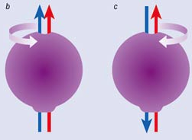
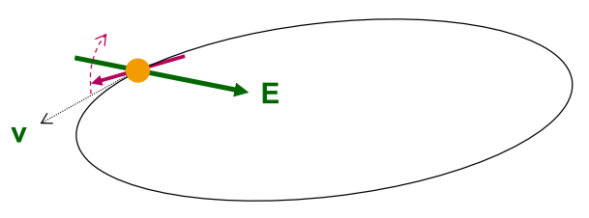
EDM Project at FZ Jülich
Electric Dipole Moment (EDM) sensitive to CP-violation beyond SM
New approach: EDM of charged particle
  polarized (p,d) beam in storage ring
Sensitivity goal 10⁻²⁹ e cm
  wrt. nEDM: < 10⁻²⁶ e cm (goal 10⁻²⁸ e cm)
Spin rotation due to torque in radial electric field
COSY at Forschungszentrum Jülich
  staged approach (during next 5 years)
  precursor experiment at COSY (goal 10⁻²⁴ e cm)
  design of designated EDM ring
Spin
EDM
+
T
+
-
-
CPV
EDM

Slide 15
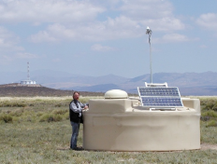
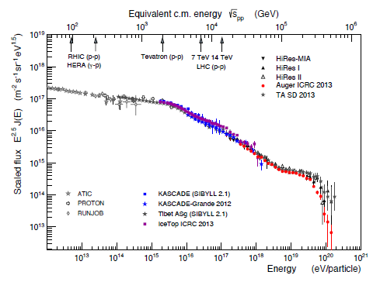
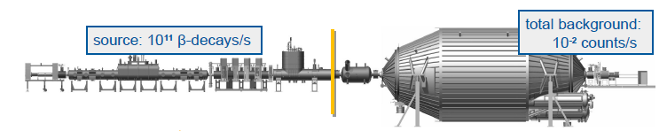
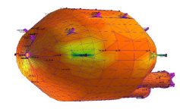
Astroparticle Physics in Helmholtz: KIT
AUGER:
  KIT is the leading institute in Germany
  > 40 scientists & PhD students
  strong role in detector upgrades
KATRIN:
  measure absolute neutrino mass scale with a sensitivity of 0.2 eV
  over 5 years (2016 - 21)
successful bake-out of spectrometer

Slide 16
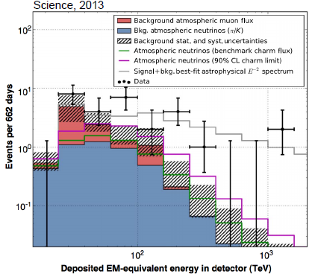
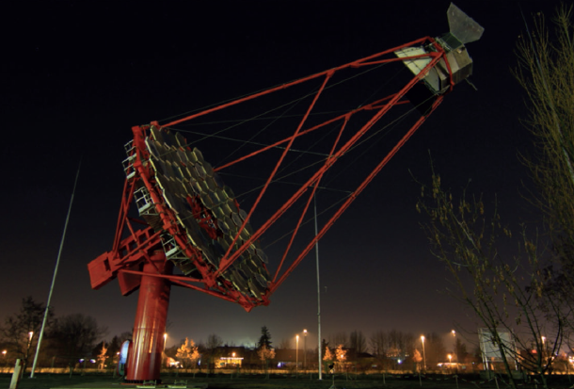
Astroparticle Physics in Helmholtz: DESY
IceCube
  DESY is second largest group in the collaboration
  Tier-1 data centre
Upgrade plans for IceCube:
  PINGU (neutrino mass hierachy)
  multi-km3 neutrino telescope,
  multi-km2 surface detector, …
Observation of extraterrestial neutrinos
CTA
  mid-size telescopes
  array control
  MC production
  …
Participation in HESS, MAGIC, Veritas
Telescope prototype close to Zeuthen

Slide 17
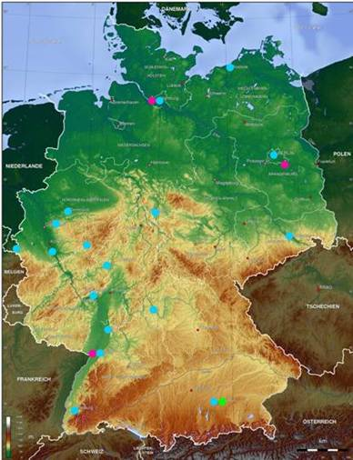
Helmholtz Alliance „Physics at the Terascale“
Network between Helmholtz centres, universities and Max-Planck institute
Generously funded by Helmholtz
  25 M€ for 2007-12 and 1 M€ for 2013-14
Alliance very successfully contributed to shape German particle physics
  ≈1000 people, >150 events
  numerous positions created in the field
Future
  keep structures and main elements
  schools and workshops
  with support from DESY and Universities
Similar Alliances exist in hadron & nuclei and astroparticle physics
  Common events?

Slide 18
Summary
Helmholtz centres important partners in German & international particle physics
  close collaboration with German universities and Max-Planck institutes
  5 years plan submitted and evaluated
Proposal for investment funds (LHC upgrade + computing) in preparation
DESY:
  successful evolution from laboratory with large on-site particle physics accelerator & experiments (HERA)
  to key partner in international collaborations (LHC, ILC, Belle)

Slide 19
Backup

Slide 20
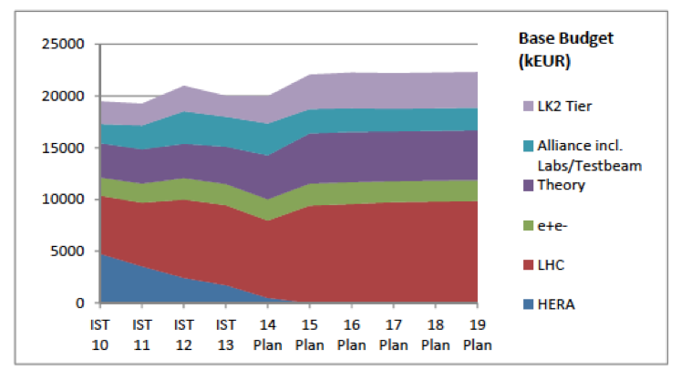
FUNDING DESY Particle Physics: Present & Future
Tier-2

Slide 21
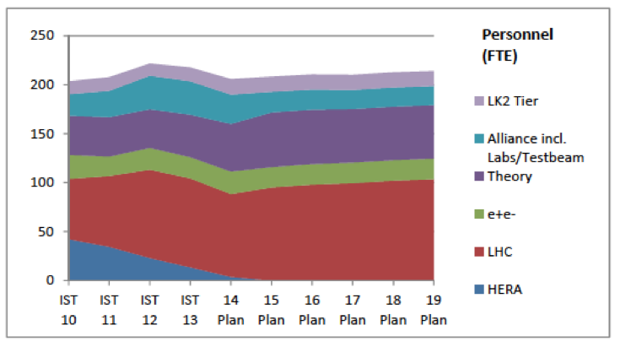
PERSONNEL DESY Particle Physics: Present & Future
Tier-2

