Slide 2
Database level monitoring Golden Gate
Maciej Grzybek

Slide 3

Outline
DB views for GG processes
  Extract (capture)
  Replicat (apply)
Streams Performance Advisor (UTL_SPADV)
Automatic Workload Repository (AWR)
Strmmon v2
Questions
Replication Technology Evolution for ATLAS Data Workshop

Slide 4

GoldenGate views: extract
GG specific:
  v$goldengate_capture
General purpose:
  dba_capture
  v$buffered_queues
  v$logmnr_session
  v$session
Replication Technology Evolution for ATLAS Data Workshop
Notes:
v$goldengate_capture: capture_num, instance_id, total_messages_captured, enqueued, capture_latency, pause_time
dba_capture: capture_name, applied_scn, error_message, capture_type, status
v$buffered_queues: queue_id
v$logmnr_session: capture_message_number
v$session: what event capture session is waiting for
Mixed streams and GGs

Slide 5

GoldenGate views: replicat
GG specific:
  v$gg_apply_coordinator
  v$gg_apply_reader
  v$gg_apply_server
  v$goldengate_table_stats
General purpose:
  dba_apply
  dba_apply_progress
  v$buffered_queues
  v$session
Replication Technology Evolution for ATLAS Data Workshop
Notes:
v$gg_apply_coordinator: total_received, assigned, applied
v$gg_apply_reader: dequeue_time
v$gg_apply_server: total_messages_applied
v$goldengate_table_stats: stats per table
dba_apply: apply_name, queue_name, error_message, status
dba_apply_progress: delay (apply-time – applied_message_create_time)
v$buffered_queues: queue_id
v$session: what event session is waiting for

Slide 6
Streams Performance Advisor
  Setup
    Deploy the package (UTL_SPADV)
      @?/rdbms/admin/utlspadv.sql
    Truncate table with monitoring data
      truncate table STREMAS$_PA_SHOW_COMP_STAT
    Create directory object for report
      create or replace directory temp as '/tmp'
  Start data-collecting job
    UTL_SPADV.START_MONITORING
  Stop the job
    UTL_SPADV.STOP_MONITORING
  Generate report
    UTL_SPADV.SHOW_STATS_HTML
    UTL_SPADV.SHOW_STATS
Replication Technology Evolution for ATLAS Data Workshop
Notes:
SPADV collects data consecutively by job with given interval.
Collected data is used to generate report on demand.
2. exec UTL_SPADV.START_MONITORING(interval =>30, retention_time => 200); -- interval = number of seconds between consecutive SPADV runs; retention = number of hours to retain monitoring results
3. exec UTL_SPADV.SHOW_STATS_HTML('TEMP',bgn_run_id=>1,end_run_id=>x,COMP_STAT_TABLE=>'STREAMS$_PA_SHOW_COMP_STAT', path_id=>y); -- x is the last run_id you want to include in report, y – if not null, limit report to only specified streams path

Slide 7
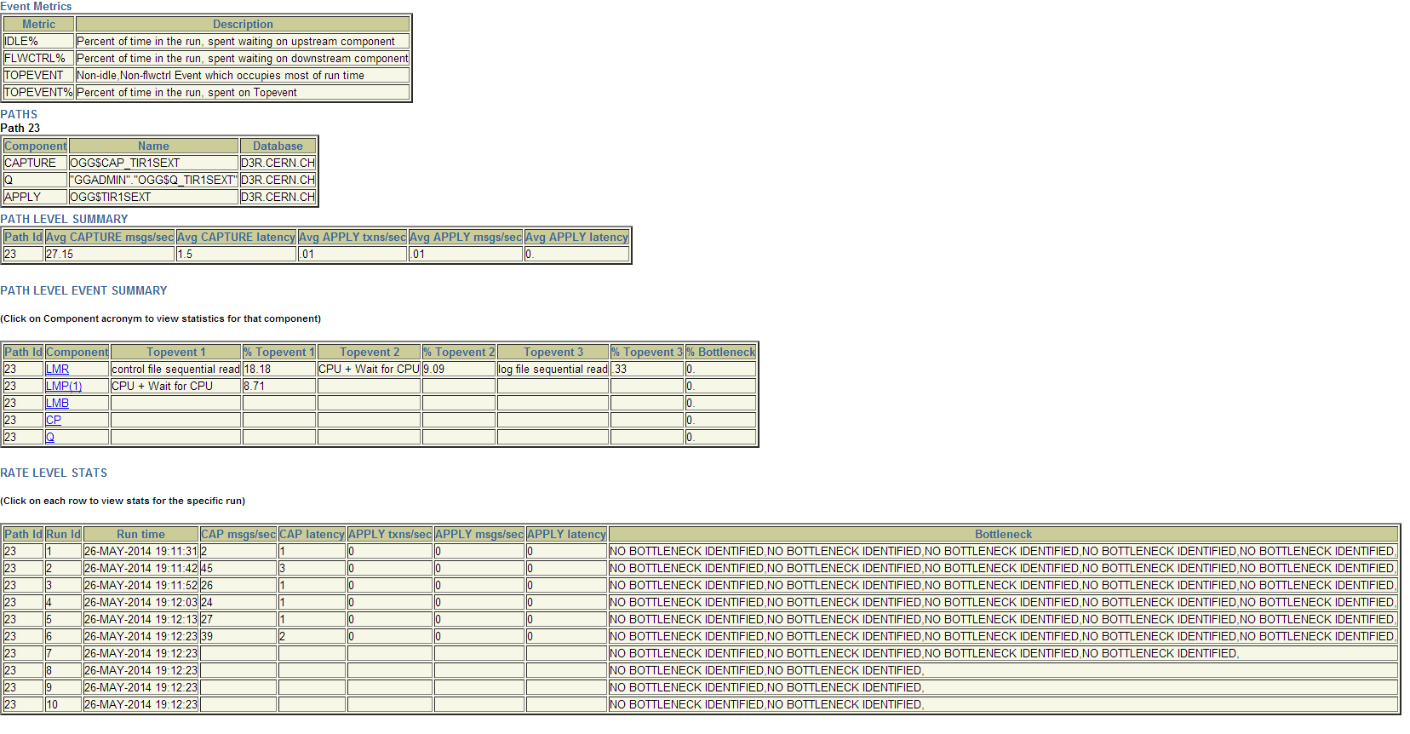
Streams Performance Advisor
Replication Technology Evolution for ATLAS Data Workshop
Notes:
Report consists capture msgs/s capture latency, apply txns/s, apply msgs/s, apply latency and info about events.
SPADV designed to be used with Streams so hardly copes with remote replication of GG. SPADV tries to match extract with replicat while there is no connection visible in DB (no queues used to transfer replicated data like on Streams).
ogg$ vs streams

Slide 8
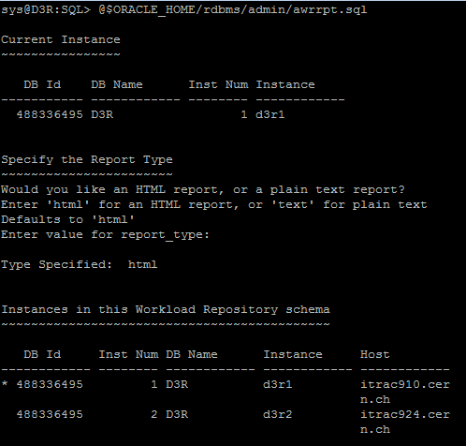
Automatic Workload Repository
  EXEC dbms_workload_repository.create_snapshot
  @$ORACLE_HOME/rdbms/admin/awrrpt.sql
Replication Technology Evolution for ATLAS Data Workshop
Notes:
Specify report type (html vs plain text)
Give the number of days
Snapshots are listed
Choose beginning and ending snapshot
Type output filename for the report.

Slide 9
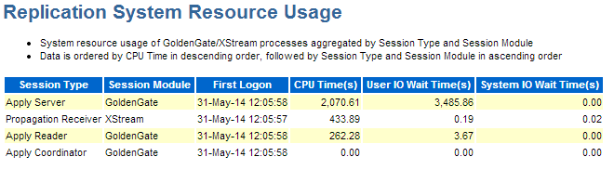
Automatic Workload Repository
Replication Technology Evolution for ATLAS Data Workshop
Notes:
Resources usage - might be helpful to check if there is CPU or IO bottleneck while replicating

Slide 10
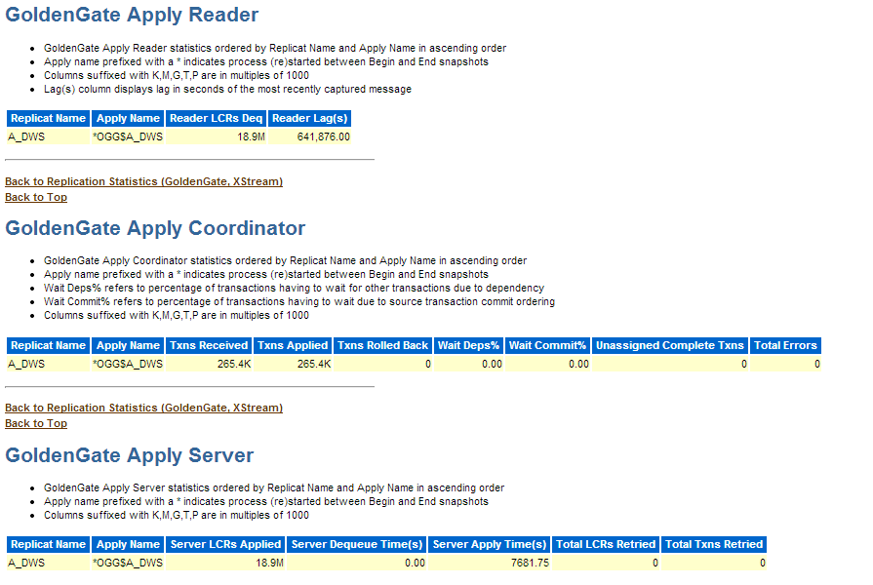
Automatic Workload Repository
Replication Technology Evolution for ATLAS Data Workshop
Notes:
Logical Change Records (LCRs) dequeued, reading lag
LCRs received, Transactions applied, errors occurred
LCRs applied, dequeueing time

Slide 11
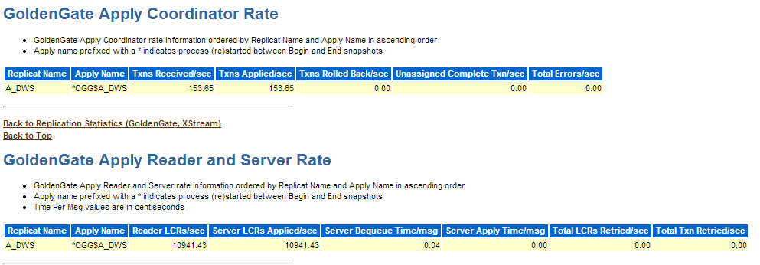
Automatic Workload Repository
Replication Technology Evolution for ATLAS Data Workshop
Notes:
TXNs/sec (received vs applied) to see if there is a problem with apply reader/process

Slide 12
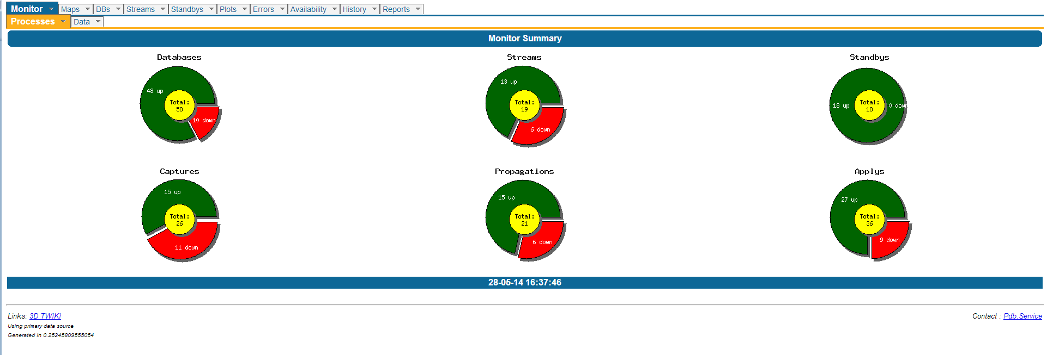
Strmmon v2
  GoldenGate supported
    Manual setup of capture -> apply
    No datapump monitoring (assuming integrated mode)
  Events information provided
  Notifications for GG events
Replication Technology Evolution for ATLAS Data Workshop

Slide 13
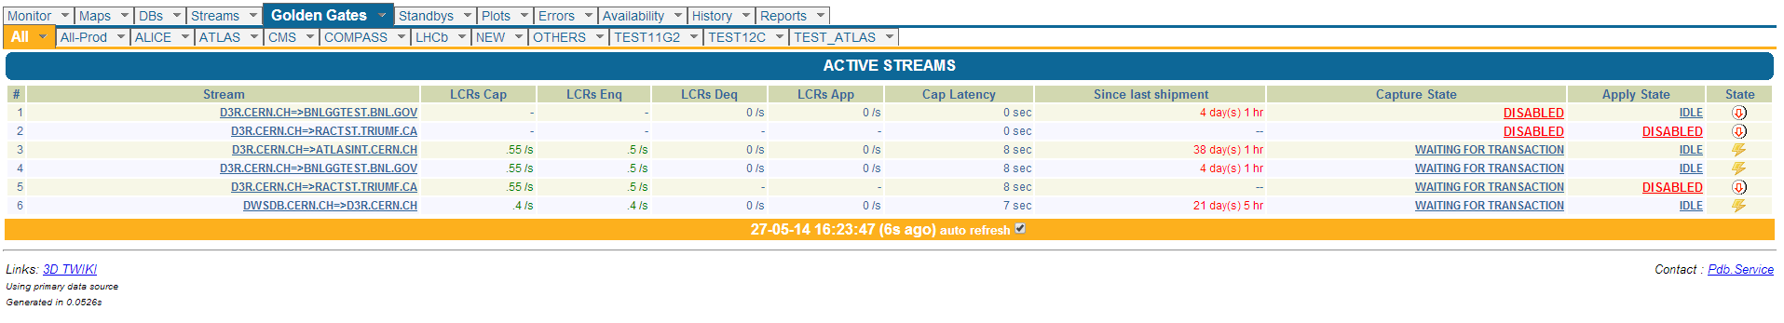
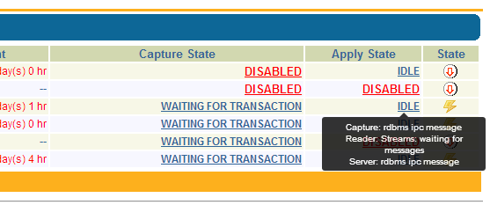
Strmmon: list + events
Replication Technology Evolution for ATLAS Data Workshop
Notes:
No propagation column, no data latency (replication time)

Slide 14
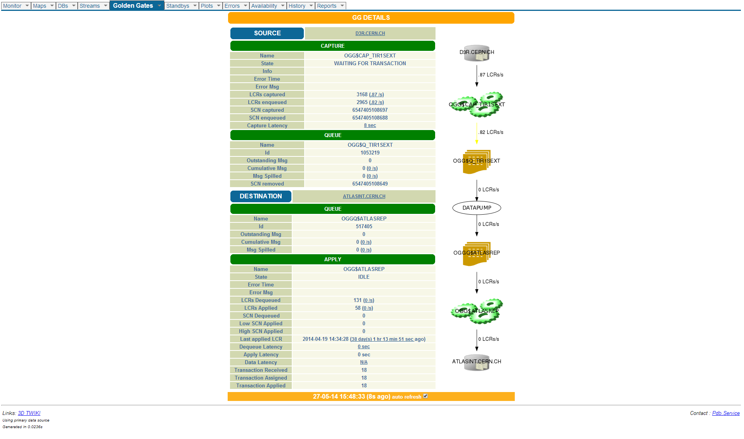
Strmmon: detailed view
Replication Technology Evolution for ATLAS Data Workshop
Notes:
No propagation section.
„Fake” datapump as a „connector” between capture and apply.

Slide 15

Strmmon: notifications
  Capture latency exceeded (70 mins)
  Apply latency exceeded (5400 secs)
  Propagation disabled on error - Streams
  ORA-26851 - propagation failure
  Spilled TXNs
  Long running transactions (300 secs)
  High CPU usage (>20)
  Capture error
  Apply error
Replication Technology Evolution for ATLAS Data Workshop

Slide 16
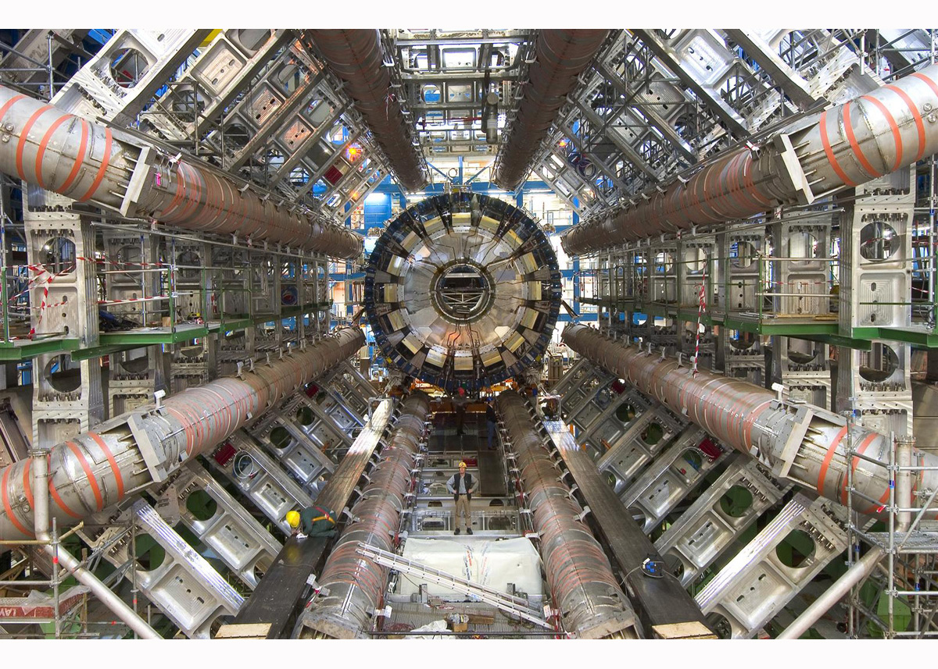

Questions?
Replication Technology Evolution for ATLAS Data Workshop

