Slide 1
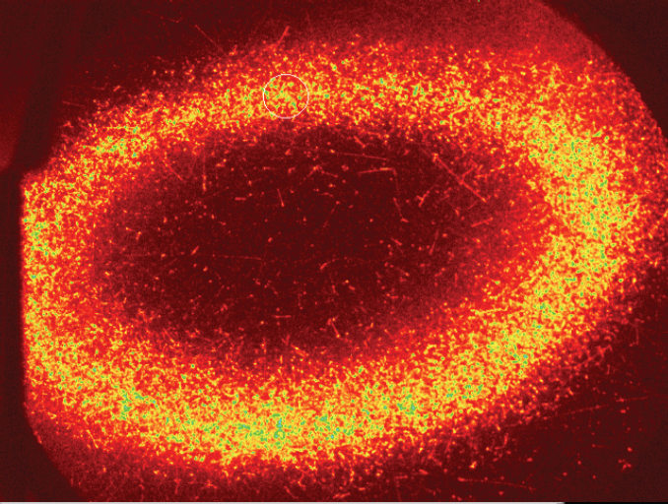
Particle and Plasma Diagnostics
Joel Fajans
Winter School on Physics with Trapped Charged Particles
19-30 January 2015
Ecole de Physique des Houches
Hollow antiproton plasma imaged on a microchannel plate,
ALPHA 2012

Slide 2
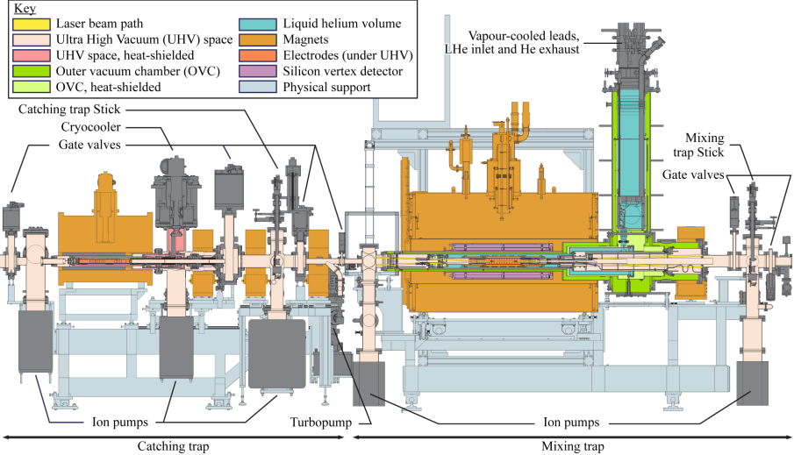
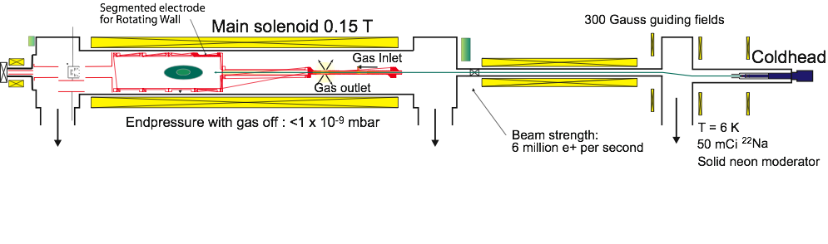
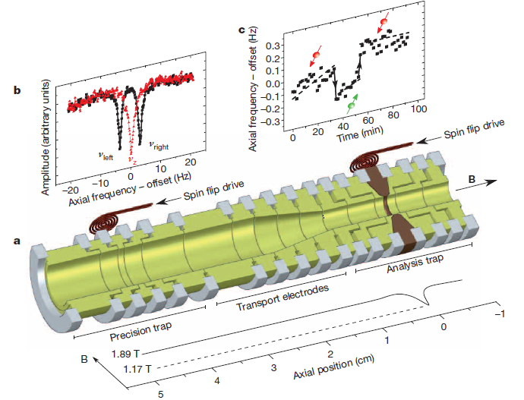
How Do You Make a Particle/Plasma Experiment Work?
Surko-Style Positron Accumulator
ALPHA-II Antihydrogen Apparatus
BASE (Anti)Proton Magnetic Moment Apparatus
Notes:
BEFORE NEXT SLIDE ASK AUDIENCE

Slide 3
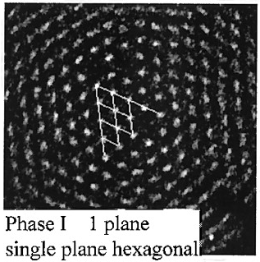
Interesting Parameters
Things we would like to know:
  Particle Number.
      Typical range: 10³ to 10⁹.
  What type of particles are present?
    Electrons, positrons, antiprotons, ions…
T. B. Mitchell, J. J. Bollinger, D. H. E. Dubin, X.-P. Huang, W. M. Itano,
R. H. Baughman, Science,282 1290 (1998)

Slide 4

Interesting Parameters
Things we would like to know:
  Particle Number.
      Typical range: 10³ to 10⁹.
  What type of particles are present?
    Electrons, positrons, antiprotons, ions…
  Radial Profile.
      Typical range: 0.2mm to 10cm.
    Can the system be parameterized by a single number, i.e. the radius?

Slide 5
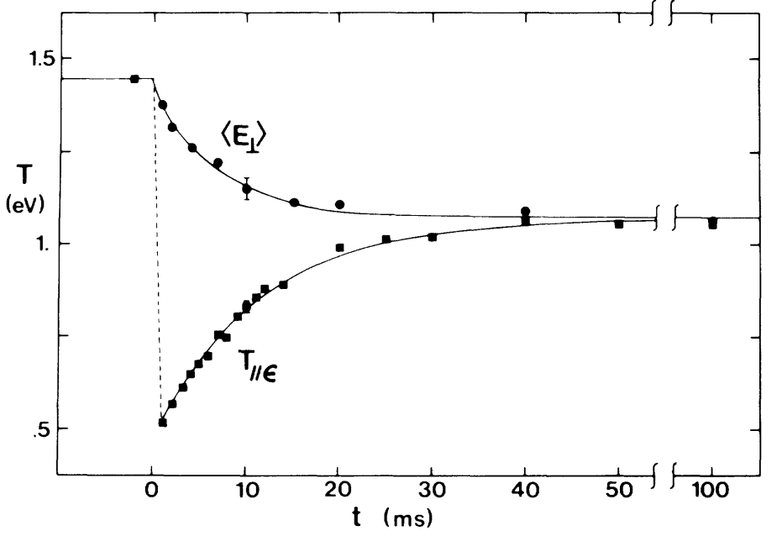
Interesting Parameters
Things we would like to know:
  Particle Number.
      Typical range: 10³ to 10⁹.
  What type of particles are present?
    Electrons, positrons, antiprotons, ions…
  Radial Profile.
      Typical range: 0.2mm to 10cm.
    Can system be parameterized by a single number, i.e. the radius?
  Length.
      Typical range: 0.5cm to 100cm.
  Density
    Typical range: 10³ to 10⁹cm⁻³.
  Temperature
      Typical range 10 to 10⁷K
      (0.5meV to 1000eV).
    Can system be parameterized by a
    single number, i.e. the temperature?
A.W. Hyatt, C.F. Driscoll and J.H. Malmberg "Measurement of the Anisotropic
Temperature Relaxation Rate in a Pure Electron Plasma," Phys. Rev. Lett. 59, 2975 (1987)

Slide 6
Destructive vs. Nondestructive Diagnostics
Nondestructive:
  Advantages
    Can work with the plasmas afterwards.
  Disadvantages
    Can be slow.
    Can leave a wave imposed on the plasmas.
    Can heat the plasmas.
    May be difficult to calibrate.
Destructive:
  Advantages
    Sometimes easier to calibrate.
  Disadvantages
    Destroys the plasmas.
    Because the plasmas are changed radically, may have large systematic errors.
Notes:
ASK STUDENTS FIRST

Slide 7
Non-Laser Based Diagnostics
Concentrate on particles/plasmas for which laser diagnostics don’t work.
  Electrons, positrons, protons, antiprotons.

Slide 8
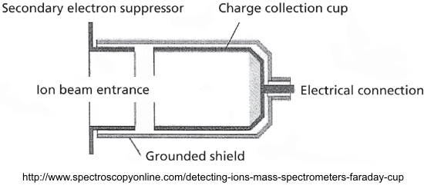
Particle Counting-Faraday Cups
Faraday cups are used to count charged particles.
  Have been in use for a very long time.
  Basic design is very simple.
Principal parts:
  Charge collection cup: Self evident.
  Grounded shield: Self evident
  Secondary electron suppressor:
    When the primary charged particle hit the cup, secondary electrons may be emitted
    Secondary electron suppressor is biased negative relative to the charge collection cup.
    Sends secondary electrons back to the cup.
Notes:
ASK STUDENTS FIRST

Slide 9
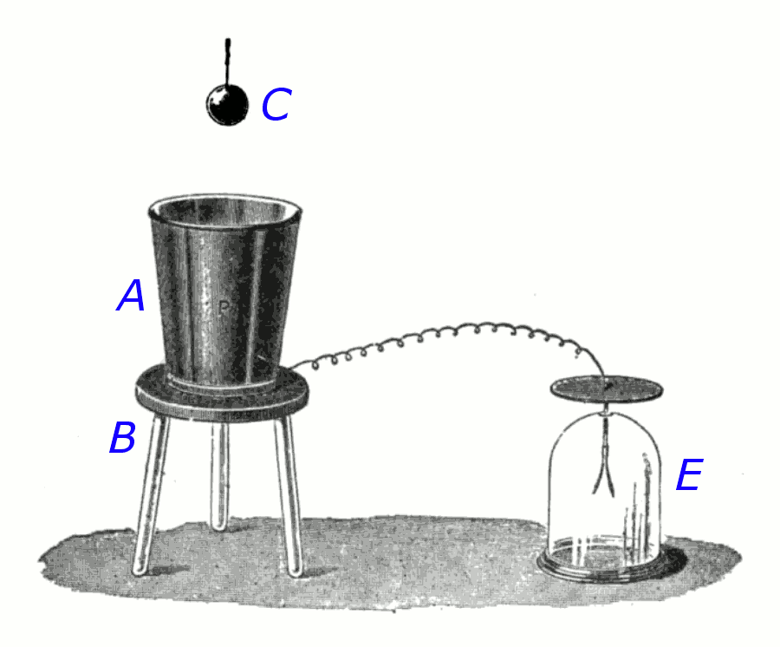
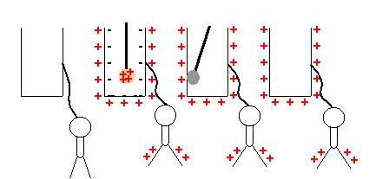
Why are Faraday Cups Called Faraday Cups?
Faraday’s Ice Pail
(Effect first observed by Benjamin Franklin in 1755)
http://en.wikipedia.org/wiki/Faraday's_ice_pail_experiment
http://dev.physicslab.org/Document.aspx?doctype=3&filename=Electrostatics_ShellsConductors.xml

Slide 10
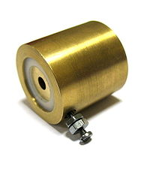
Faraday Cup Implementation
Complicated
Simple
http://en.wikipedia.org/wiki/Faraday_cup

Slide 11
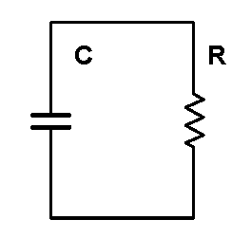
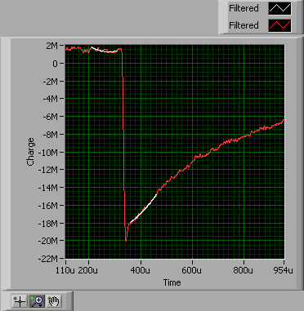




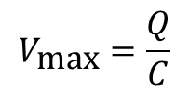
Faraday Cup Circuit
Circuit Model
Typical Circuit Response (ALPHA)
$$V\left(t\right)$$
$$V_{\text{max}}=\frac{Q}{C}$$
$Q$ is the charge deposited on the plate.
$$τ=RC$$
$$V\left(t\right)=V_{\text{max}}exp⁡(−t/{τ)}$$

Slide 12
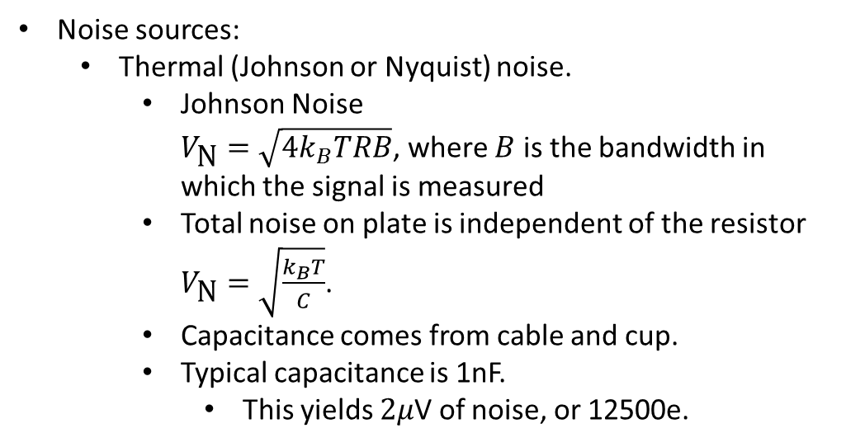
Faraday Cup Noise
Circuit Model
$$V\left(t\right)$$
Noise sources:
  Thermal (Johnson or Nyquist) noise.
    Johnson Noise
    $V_{\text{N}}=\sqrt{{4k}_{B}TRB}$, where $B$ is the bandwidth in which the signal is measured
    Total noise on plate is independent of the resistor
    $V_{\text{N}}=\sqrt{\frac{k_{B}T}{C}}$.
    Capacitance comes from cable and cup.
    Typical capacitance is 1nF.
      This yields $2μ$V of noise, or 12500e.
Notes:
Why is the noise on the plate independent of the resistor?

Slide 13
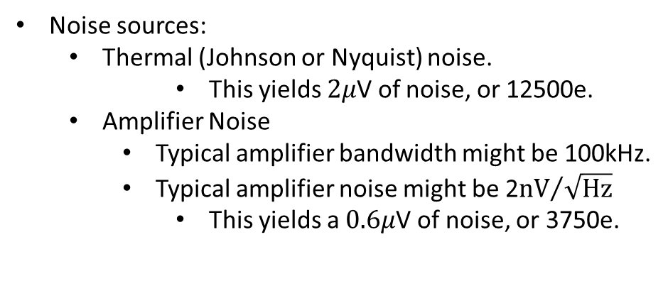
Faraday Cup Noise
Circuit Model
$$V\left(t\right)$$
Noise sources:
  Thermal (Johnson or Nyquist) noise.
      This yields $2μ$V of noise, or 12500e.
  Amplifier Noise
    Typical amplifier bandwidth might be 100kHz.
    Typical amplifier noise might be 2${\text{nV}}/{\sqrt{\text{Hz}}}$
      This yields a $0.6μ$V of noise, or 3750e.
For these parameters, thermal noise dominates.

Slide 14
Faraday Cup Noise
Circuit Model
Typical Circuit Response (ALPHA)
$$V\left(t\right)$$
Actual Noise: about 200k electrons.
Where does the noise come from?
  50/60Hz coupling.
  Noise pickup from nearby cables.
  Accidental “thermocouple” junctions.
  Bad solder joints.
  Bad connectors.
  Triboelectric effect.
    System acts like a microphone.
Notes:
Ask Students

Slide 15
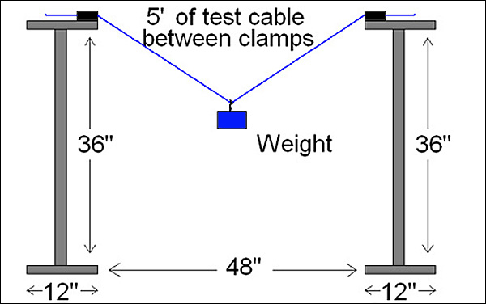
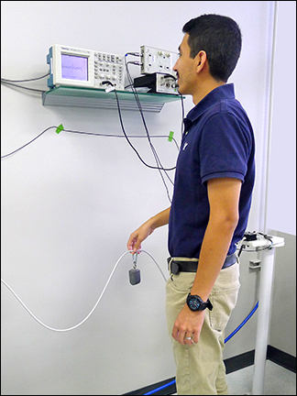
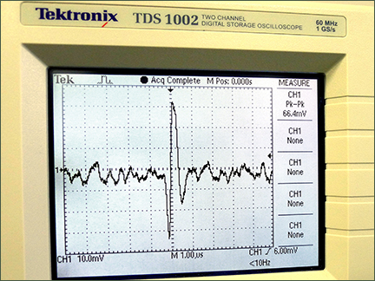
Triboelectric Noise Test
Weight is 40 times the weight of one foot of cable.
Diagram of triboelectric noise test
set-up specified in ANSI/AAMI 5.5.4 EC53
All images from http://www.affinitymed.com/news/2014/august.aspx
Notes:
Ask Students

Slide 16
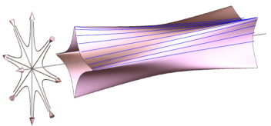
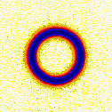
Radial Profile Diagnostic
Knowing the radius, and more generally the radial profile can be very helpful.
  Can be used to compute the plasma density. This is critical for studies of waves, 3-body recombination, calculating the collision frequency, etc..
  Can be used to check for and study instabilities.
  Can be used to determine basic plasma shape.
  Will tell you if the charge will fit through subsequent apertures.
Increasing Octupole Field: ALPHA 2008
Berkeley

Slide 17
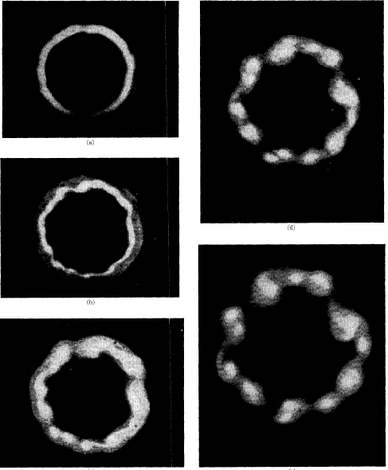
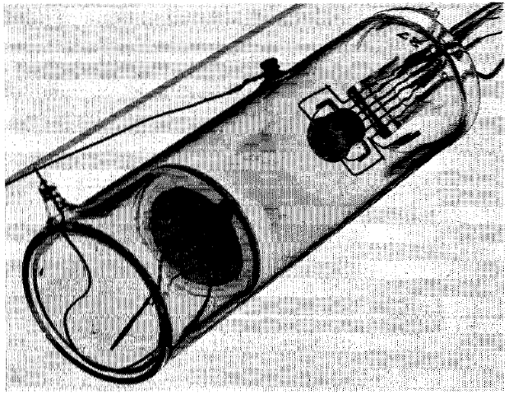
Radial Profile
Hollow beam electron gun
Phosphor Screen
Kyhl, R. L.; Webster, H. F., Breakup of hollow cylindrical electron beams, IRE Trans. Electron Dev., 3, 172 (1956).

Slide 18
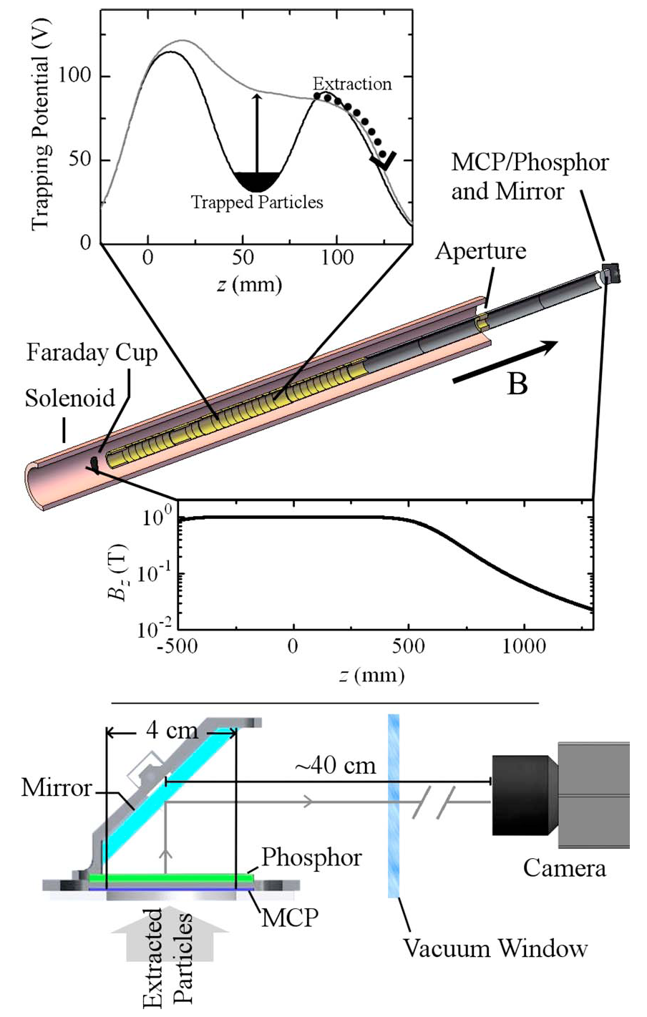
Radial Profile
Hollow antiproton plasma imaged on a microchannel plate,
ALPHA 2012
A. J. Peurrung and J. Fajans, A pulsed, microchannel plate-based, non-neutral plasma imaging system. Rev Sci. Instrum., 64:52, 1993.
G.B. Andresen, et al Antiproton, Positron, and Electron Imaging with a Microchannel Plate/Phosphor Detector, Rev. Sci. Inst., 80, 123701, 2009.

Slide 19
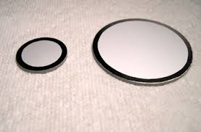
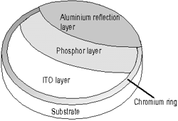
Phosphor Screens
http://www.beamimaging.com/pscreen.html
http://www.proxivision.de/products/phosphor-screen.html

Slide 20

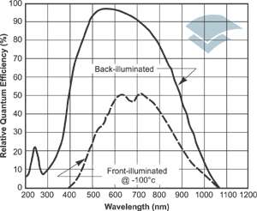
Phosphor Screen
type | composition | emission |  | decay
P43 | Gd₂O₂S:Tb | 540 nm | green | 1 ms
P46 | Y₃Al₅O₁₂:Ce | 530 nm | green | 300 ns
P47 | Y₂SiO₅:Ce,Tb | 400 nm | blue | 100 ns
Type | efficiency (lm/µA) |  |  |  | efficiency (W/mA) |  |  |  | efficiency (ph/el)
 | 6 kV | 10 kV | 12 kV | 15 kV | 6 kV | 10 kV | 12 kV | 15 kV | 6 kV | 10 kV | 12 kV | 15 kV
P43 | 0,24 | 0,43 | 0,54 | 0,71 | 0,43 | 0,77 | 0,97 | 1,28 | 185 | 330 | 420 | 550
P46 | 0,08 | 0,15 | 0,19 | 0,25 | 0,22 | 0,39 | 0,49 | 0,65 | 90 | 160 | 200 | 265
P47 | 0,06 | 0,11 | 0,14 | 0,18 | 0,62 | 1,35 | 1,71 | 2,24 | 212 | 380 | 480
http://www.proxivision.de/products/phosphor-screen.html
Detection Efficiency:
  Phosphor Efficiency.
  Detector (likely a CCD camera) efficiency.
Generally, slow phosphors are more efficient.
http://www.andor.com/learning-academy/
ccd-spectral-response-%28qe%29-defining-the-qe-of-a-ccd

Slide 21
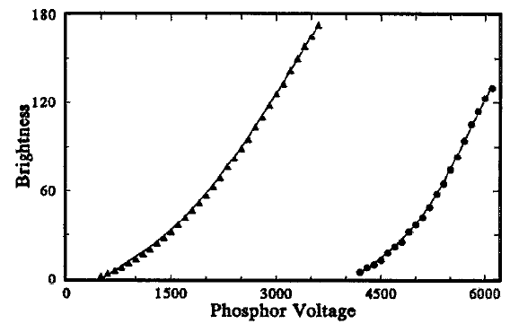
Phosphor Screen Brightness
No Al layer
With Al Layer
A. J. Peurrung and J. Fajans, A pulsed, microchannel plate-based, non-neutral plasma imaging system. Rev Sci. Instrum., 64:52, 1993.
Minimum voltage with a screen can be as low as about 1500V.
Approximately 100 photons per electron is typical.

Slide 22
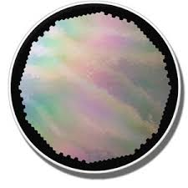
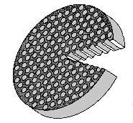
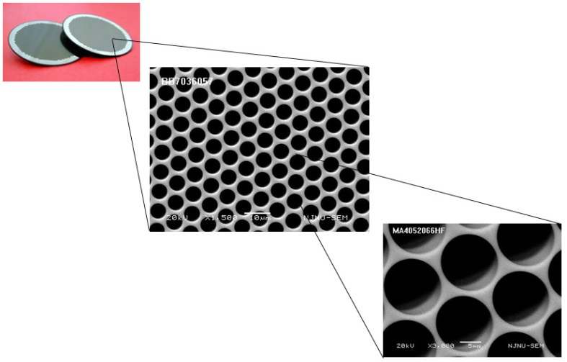
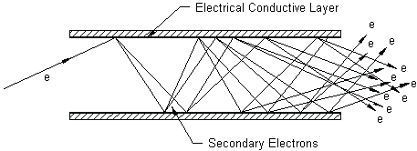
Microchannel Plates
photonis.com
http://www.tectra.de/MCP.htm
http://www.tectra.de/MCP.htm
Typical pore size 2 - 25µm
1000V
http://www.pe1hmm.nl/xx1080/Introduction%20to%20Image%20Intensifier%20Tubes.htm

Slide 23
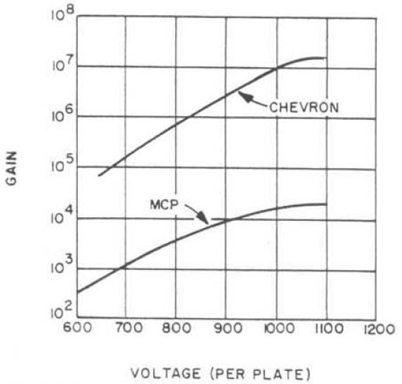
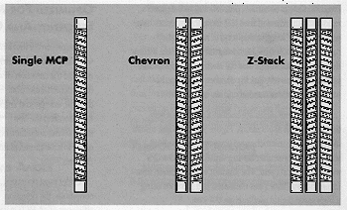
Microchannel Plate Gain
http://www.optimacorp.co.jp/BurleEO/MCP.htm
J. Wiza, Microchannel Plate Detectors, Nuclear Instruments and Methods, 162, 587 (1979).

Slide 24
What limits Microchannel Plate?
MCP starts to arc at high voltages.
Channel get exhausted.
http://www.pe1hmm.nl/xx1080/Introduction%20to
%20Image%20Intensifier%20Tubes.htm
J. Wiza, Microchannel Plate Detectors, Nuclear Instruments and Methods, 162, 587 (1979).

Slide 25
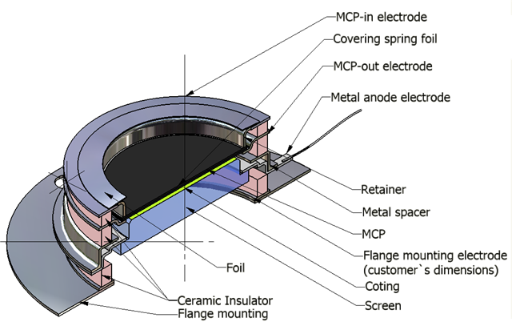
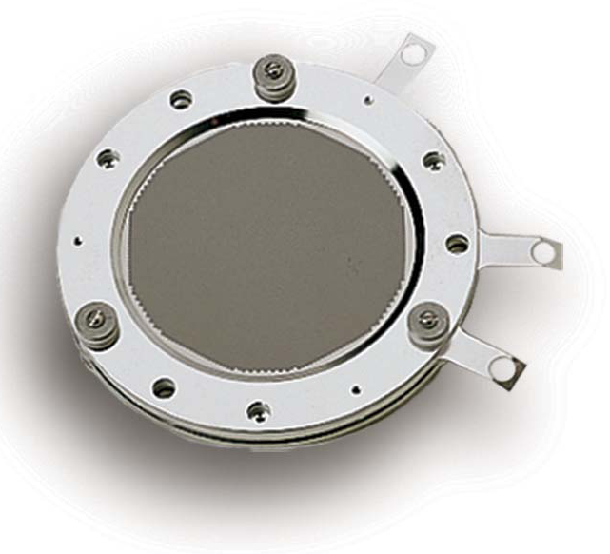
Microchannel Plate Systems
MCP Front: Typically between -100 to +100V.
MCP Back: Typically between 500V to 1200V.
Phosphor Screen: Typically 3000-10000V.
Photonis APD Detector Brochure
http://www.dmphotonics.com/MCP_MCPImageIntensifiers/microchannel_plates.htm
Don’t do this yourself.

Slide 26
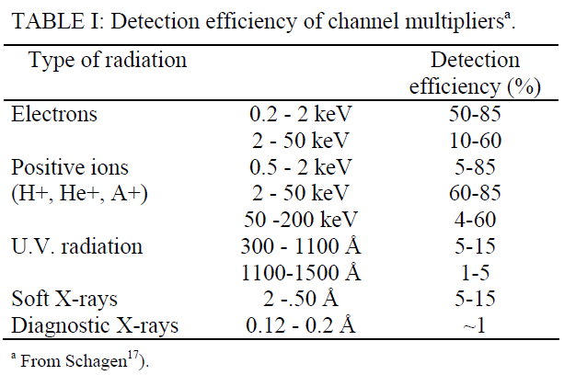
Microchannel Plate System Performance
J. Wiza, Microchannel Plate Detectors, Nuclear Instruments and Methods, 162, 587 (1979).
Coatings available to enhance detection efficiency
For UV and X-rays.

Slide 27
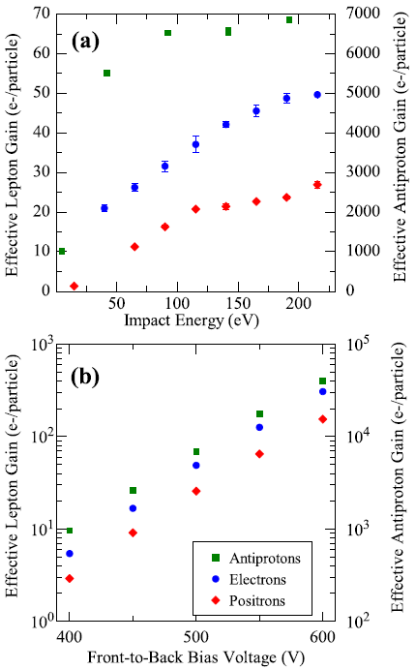
Microchannel Plate System Performance
J. Wiza, Microchannel Plate Detectors, Nuclear Instruments and Methods, 162, 587 (1979).
Hollow antiproton plasma imaged on a microchannel plate,
ALPHA 2012
ALPHA, Antiproton, Positron, and Electron Imaging with
Microchannel Plate/Phosphor Detector, Rev. Sci. Inst.,
80, 123701, (2009).

Slide 28
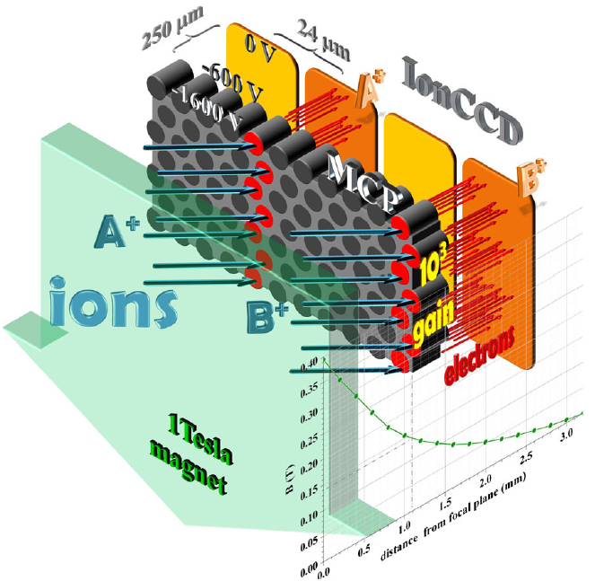
Other Radial Diagnostics
The dream….direct reading of charge onto a CCD-like chip.
  Electronics would have to be UHV compatible.
  No opportunity for service.
  Detector area likely to be small.
  Possibly complex electrical feedthrough issues.
O. Hadjar, W.K. Fowler, G. Kibelka, W.C. Schnute, Preliminary demonstration of an IonCCD as an alternative pixelated anode for direct MCP readout in a compact MS-based detector, J. Am. Soc. Mass. Spectrom., 23, 418, (2012).
Notes:
Back thinned CCD Fragile, uncommon.

Slide 29
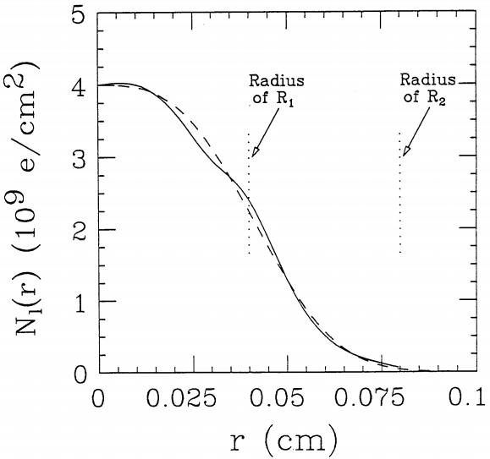
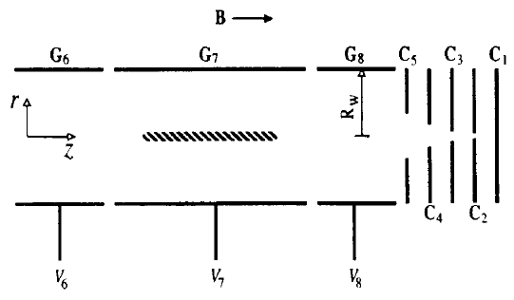
Other Radial Diagnostics
Multiple ring Faraday cups and possibly expansion by magnetic field reduction.
  Very crude.
  Very slow if magnetic expansion is used. Plasma may change during expansion.
  Usually requires many trials.
B. R. Beck, J. Fajans and J. H Malmberg, Temperature and anisotropic-temperature relaxation measurements in cold, pure-electron plasmas. Phys. Plasmas, 3:1250, 1996.
B.R. Beck, Measurement of the magnetic and temperature dependence of the electron-electron anisotropic temperature relaxation rate., Ph.D. Thesis, UCSD (1990).

Slide 30
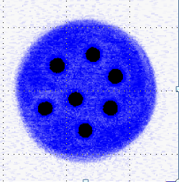

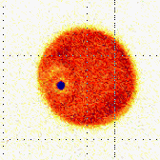
Other Radial Diagnostics
Magnetic field lowering and antiproton annihilation.
  Very crude.
    Plasma may change during expansion.
Total Charge and Inner Line Density Faraday Cups
  Requires the assumption of global thermal
  equilibrium.
Berkeley
Hollow antiproton plasma imaged on a microchannel plate,
ALPHA 2012
Berkeley
G. Gabrielse et al, Centrifugal separation of antiprotons and electrons, Phys. Rev. Lett., 105, 213002, (2010).
P. Oxley et al, Aperture method to determine the density and geometry of anti-particle plasmas, Phys. Lett. B 595, 60 (2004).

Slide 31
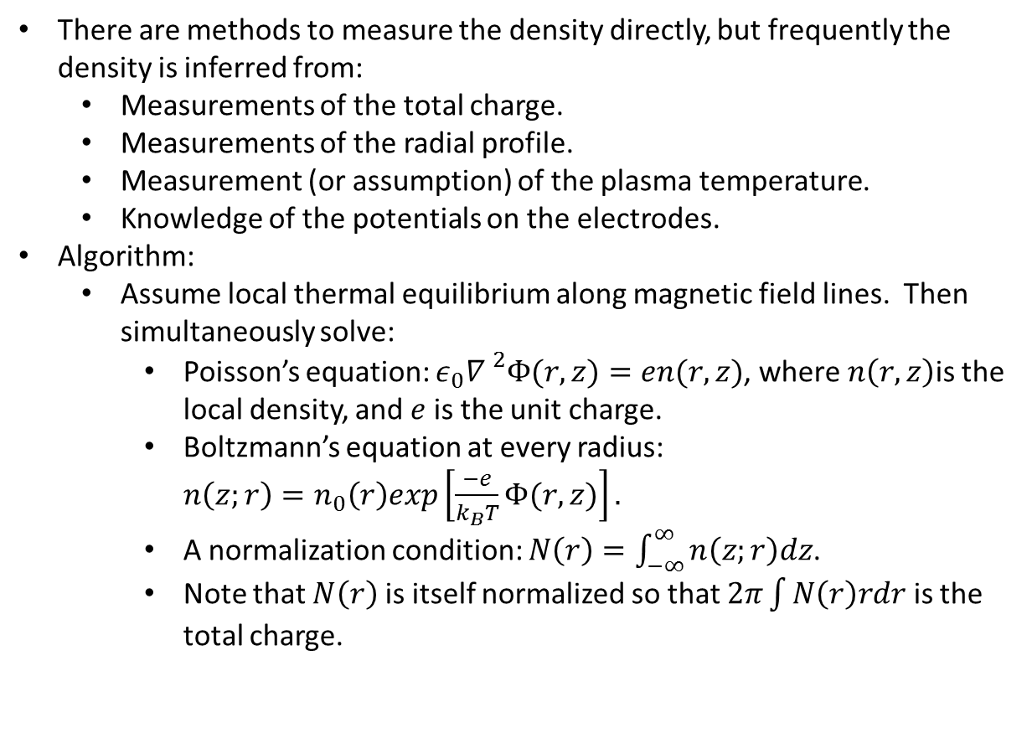
Density Reconstruction
There are methods to measure the density directly, but frequently the density is inferred from:
  Measurements of the total charge.
  Measurements of the radial profile.
  Measurement (or assumption) of the plasma temperature.
  Knowledge of the potentials on the electrodes.
Algorithm:
  Assume local thermal equilibrium along magnetic field lines. Then simultaneously solve:
    Poisson’s equation: ${ε_{0}∇ }^{2}Φ(r,z)=en(r,z)$, where $n\left(r,z\right)$is the local density, and $e$ is the unit charge.
    Boltzmann’s equation at every radius: $n\left(z;r\right)=n_{0}\left(r\right)exp\left[\frac{−e}{k_{B}T}Φ(r,z)\right].$
    A normalization condition: $N\left(r\right)=\int_{−∞}^{∞}{n\left(z;r\right)dz}$.
    Note that $N\left(r\right)$ is itself normalized so that $2π\int{N\left(r\right)rdr}$ is the total charge.
Notes:
Draw out radial problem/
Discuss global and local thermal equilibrium.

Slide 32
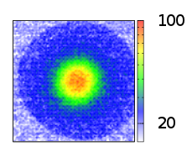
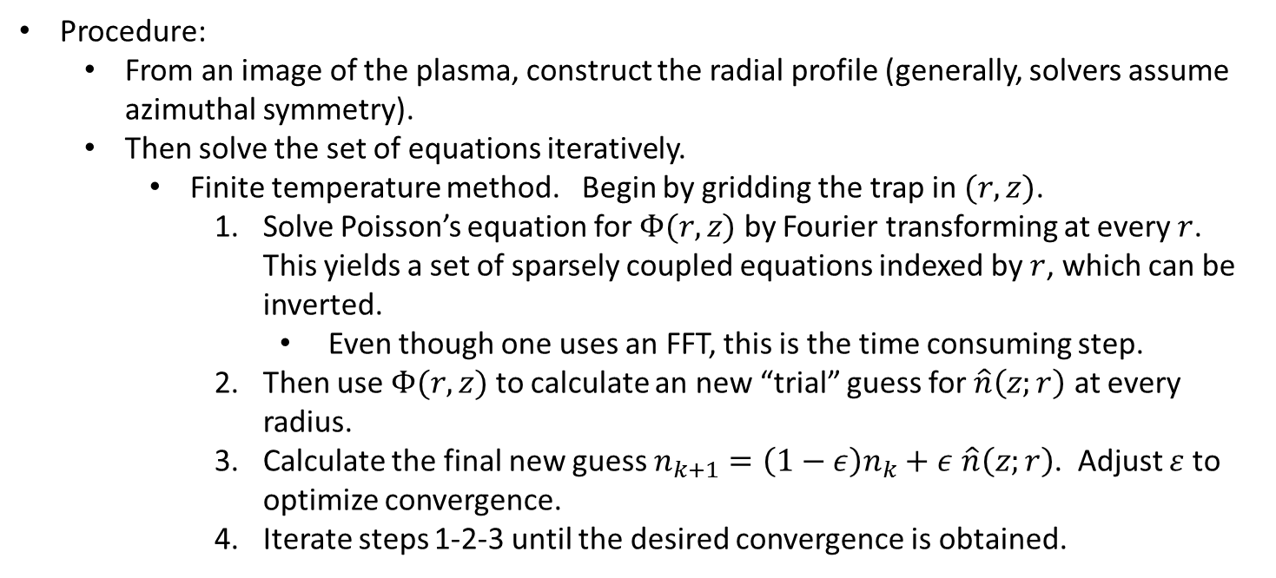
Density Reconstruction
Procedure:
  From an image of the plasma, construct the radial profile (generally, solvers assume azimuthal symmetry).
  Then solve the set of equations iteratively.
    Finite temperature method. Begin by gridding the trap in $(r,z)$.
      Solve Poisson’s equation for $Φ(r,z)$ by Fourier transforming at every $r$. This yields a set of sparsely coupled equations indexed by $r$, which can be inverted.
        Even though one uses an FFT, this is the time consuming step.
      Then use $Φ(r,z)$ to calculate an new “trial” guess for $\hat{n}\left(z;r\right)$ at every radius.
      Calculate the final new guess $n_{k+1}=\left(1−ε\right)n_{k}+ε$ $\hat{n}\left(z;r\right)$. Adjust $ε$ to optimize convergence.
      Iterate steps 1-2-3 until the desired convergence is obtained.
Notes:
Numerical derivative

Slide 33
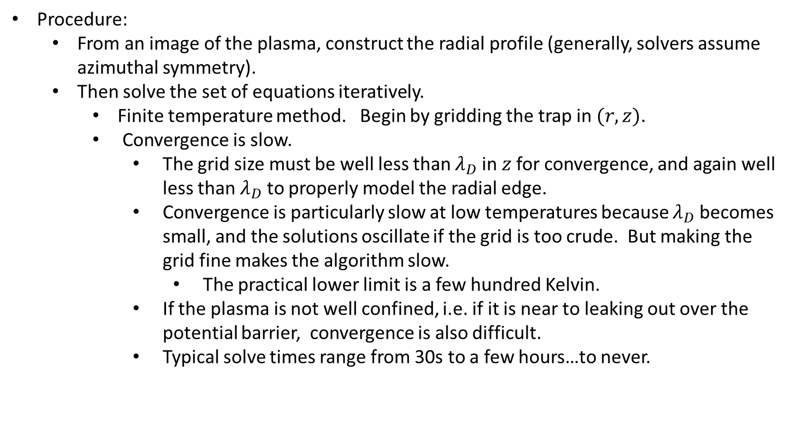
Density Reconstruction
Procedure:
  From an image of the plasma, construct the radial profile (generally, solvers assume azimuthal symmetry).
  Then solve the set of equations iteratively.
    Finite temperature method. Begin by gridding the trap in $(r,z)$.
    Convergence is slow.
      The grid size must be well less than $λ_{D}$ in $z$for convergence, and again well less than $λ_{D}$ to properly model the radial edge.
      Convergence is particularly slow at low temperatures because $λ_{D}$ becomes small, and the solutions oscillate if the grid is too crude. But making the grid fine makes the algorithm slow.
        The practical lower limit is a few hundred Kelvin.
      If the plasma is not well confined, i.e. if it is near to leaking out over the potential barrier, convergence is also difficult.
      Typical solve times range from 30s to a few hours…to never.

Slide 34
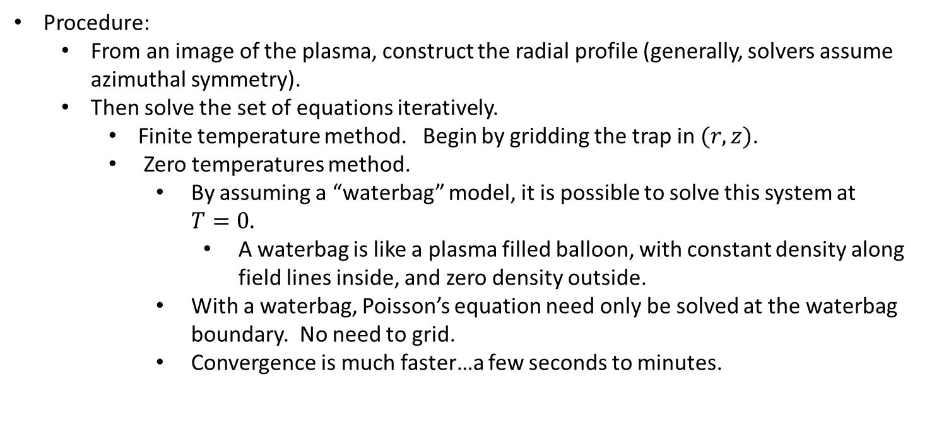
Density Reconstruction
Procedure:
  From an image of the plasma, construct the radial profile (generally, solvers assume azimuthal symmetry).
  Then solve the set of equations iteratively.
    Finite temperature method. Begin by gridding the trap in $(r,z)$.
    Zero temperatures method.
      By assuming a “waterbag” model, it is possible to solve this system at $T=0.$
        A waterbag is like a plasma filled balloon, with constant density along field lines inside, and zero density outside.
      With a waterbag, Poisson’s equation need only be solved at the waterbag boundary. No need to grid.
      Convergence is much faster…a few seconds to minutes.

Slide 35
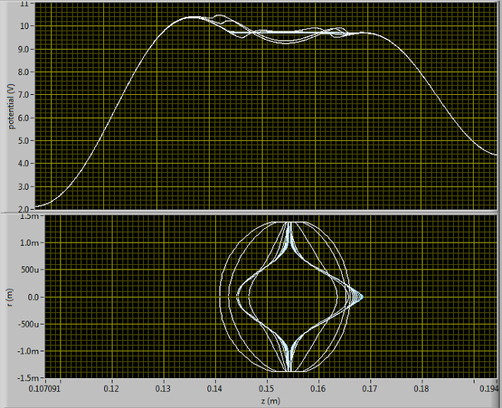
Density Reconstruction
Waterbag example: a barely confined plasma.

Slide 36
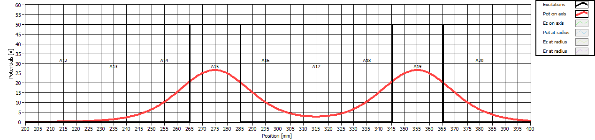
Temperature Diagnostic
Consider a non-interacting, finite temperature, charged gas held in a potential well.
Notes:
Contradiction between charged and non-interacting.

Slide 37

Temperature Diagnostic: Noninteracting Gas
Consider a noninteracting charged gas held in a potential well.
How many gas particles escape?

Slide 38

Temperature Diagnostic: Noninteracting Gas
Assume the particles in the gas are Maxwellian distributed.
  Distribution function:
  $f\left(E\right)=\frac{1}{\sqrt{πk_{B}T}}\frac{1}{\sqrt{E}}exp⁡\left[−\frac{E}{k_{B}T}\right]$.
Lower the barrier height to some level $V=eΦ$.
  Then the charge that can escape over the barrier is $Q\left(V\right)=\frac{1}{\sqrt{πk_{B}T}}\int_{V}^{∞}{\frac{1}{\sqrt{E}}exp⁡\left[−\frac{E}{k_{B}T}\right]}$.
    This is a complementary error function.
What is the slope on the log graph?

Slide 39

Temperature Diagnostic: Noninteracting Gas
Starting with:
$Q\left(V\right)=\frac{1}{\sqrt{πk_{B}T}}\int_{V}^{∞}{\frac{1}{\sqrt{E}}exp⁡\left[−\frac{E}{k_{B}T}\right]}$.
We want to calculate
$\frac{d ln⁡(Q\left(V\right))}{dV}=\frac{1}{Q(V)}\frac{d⁡(Q(V)}{dV}$.
Taking the derivative, we get:
$\frac{\frac{1}{\sqrt{V}}exp⁡\left[−\frac{V}{k_{B}T}\right]}{\int_{V}^{ ∞}{\frac{1}{\sqrt{E}}exp⁡\left[−\frac{E}{k_{B}T}\right]}}$
This can be rewritten as:
$\frac{\frac{1}{\sqrt{V}}exp⁡\left[−\frac{V}{k_{B}T}\right]}{exp⁡\left[−\frac{V}{k_{B}T}\right]\int_{0}^{ ∞}{\frac{1}{\sqrt{E+V}}exp⁡\left[−\frac{E}{k_{B}T}\right]}}=\frac{\frac{1}{\sqrt{V}}}{\int_{0}^{ ∞}{\frac{1}{\sqrt{E+V}}exp⁡\left[−\frac{E}{k_{B}T}\right]}}$

Slide 40

Temperature Diagnostic: Noninteracting Gas
This can be further simplified as:
$\frac{\frac{1}{\sqrt{V}}}{\int_{0}^{ ∞}{\frac{1}{\sqrt{E+V}}exp⁡\left[−\frac{E}{k_{B}T}\right]}}=\frac{1}{\int_{0}^{ ∞}{\frac{1}{\sqrt{1+E/V}}exp⁡\left[−\frac{E}{k_{B}T}\right]}}$
When we are reasonably far out on the tail, $E≪V$, so we can approximate the above expression to:
$\frac{1}{\int_{0 }^{ ∞}{exp⁡\left[−\frac{E}{k_{B}T}\right]}}=−\frac{1}{k_{B}T}$
Therefore, the slope of the log of the escaped charge is inversely proportional to the temperature.
A better approximation yields:
$\frac{d ln⁡(Q)}{dV}=\frac{−1.05}{k_{B}T}$

Slide 41

Temperature Diagnostic: Simple Complication
The wall potential is not the well potential:
  The on-axis potential maximum is typically about 50% of the wall potential.
    The exact ratio depends on the electrode radius to length radius.
  The potential in the middle of the trap is not zero.
Both these effect need to be accounted for in the voltage derivative.
These issues are increasingly important in short traps.

Slide 42


Temperature Diagnostic: Modest Complication

Slide 43

Temperature Diagnostic: Modest Complication
Plasma expands during release.
  1D adiabatic expansion: temperature declines to 41% of its original value in this example.
  Plasma may undergo 3D expansion: temperature declines to 74% of its original value in this example.
  Actual expansion may be between 1D and 3D.

Slide 44


Temperature Diagnostic: Collective Effects
The self field of a plasma severely complicates the theoretical description of this diagnostic.
  The potential of a solid infinite cylinder is
  $Φ\left(r\right)=\frac{en_{0}}{4ε_{0}}R_{}^{2}\left[1−\frac{r^{2}}{R^{2}}+2ln⁡\left(\frac{R_{W}}{R}\right)\right],$
  inside the plasma, and
  $Φ\left(r\right)=\frac{en_{0}}{2ε_{0}}R^{2}ln⁡\left(\frac{R_{W}}{R}\right),$
  outside the plasma, where $n_{0}$ is the density, $R$ is the plasma radius and $R_{W}$is the electrode wall radius.
Typical alpha parameters:
$$n_{0}={10}^{8} {\text{cm}}^{−3}$$
$$R=1\text{mm}$$
$$R_{W}=22.28\text{mm}$$
The self potential is largest on the axis.

Slide 45


Temperature Diagnostic: Radial Effects
Well is deeper off-axis.

Slide 46
Temperature Diagnostic: Collective Effects
Well is deeper off-axis.
The self potential is largest on the axis.
Both these effects lead to the plasma escaping on the axis first.

Slide 47


Temperature Diagnostic: From Where Does the Plasma Escape?
Initially, the plasma escapes from a central region on the order of several Debye lengths:
$λ_{D}=\sqrt{\frac{ε_{0}k_{B}T}{n_{0}e^{2}}}$
Eventually, the center erodes significantly.
Once this happens, many things go wrong.
  Nontail particle begin to escape. The diagnostic was predicated on only tail particles escaping.
  The plasma hollows out, and the plasma potential changes significantly.
$${\sim λ}_{D}$$
Plasma End View

Slide 48

Temperature Diagnostic: Useful Charge
Initially, the plasma escapes from a central region on the order of several Debye lengths:
$λ_{D}=\sqrt{\frac{ε_{0}k_{B}T}{n_{0}e^{2}}}$
Eventually, the center erodes significantly.
Once the center erodes, the subsequent charge contains little temperature information.
  The rate at which the charge comes out is determined largely by the plasma self space charge.
Because of the scaling of the Debye length with temperature, ever fewer particles contain temperature information as the temperature increases.
$${\sim λ}_{D}$$
Plasma End View
D. L. Eggleston, C. F. Driscoll, B. R. Beck, A. W. Hyatt, and J. H. Malmberg, Parallel energy analyzer for pure electron plasma devices, Phys. Fluids B 4, 3432 (1992).
B. R. Beck, Measurement of the magnetic and temperature dependence of the electron-electron anisotropic temperature relaxation rate, Ph.D Thesis, UCSD, 1990.

Slide 49

Temperature Diagnostic: Antiproton Temperatures
Andresen et al (ALPHA Collaboration), Evaporative Cooling of Antiprotons to Cryogenic Temperatures, Phys. Rev. Lett., 105 013003, 2010.

Slide 50

Temperature Diagnostic: Hot Lepton Temperatures

Slide 51

Temperature Diagnostic: Cold Lepton Temperatures

Slide 52

Temperature Diagnostic: Cold Temperatures and Noise
The straight line region is short, and somewhat arbitrary at low temperatures.
  Pickup and amplifier noise limits the bottom end.
  Roll over from self potential effects limits the top end.
To get into the tens of Kelvin region, one typically needs sensitivities on the order of hundreds to thousands of charges.

Slide 53
Temperature Diagnostic: Noise
The base temperature that one can measure is limited by amplifier and pickup noise.
  Acoustic noise from triboelectric effects is in the same band as the electrical pickup.
    This is particularly a problem in cyrogenic experiments.
  Consider:
    Mounting amps very close to the pickup. This may mean that the amps are:
      In vacuum.
      At cryogenic temperatures.
  Alpha uses a MCP preamp very successfully. This is the same system as we use for our radial profiles.

Slide 54
Temperature Diagnostic: Cold Temperatures and Noise
Fitting a straight line seems arbitrary, but isn’t.
Fits are consistent to about 20%.
Systematic effects are on the order of 20% to 100%.
Notes:
Takes persuading.

Slide 55

Multi Species Temperature Diagnostic
ALPHA, Centrifugal Separation And Equilibration Dynamics In An Electron-Antiproton Plasma, Phys. Rev. Lett. 106, 145001 (2011)
As the plasma cools, it separates. Good, qualitative diagnostic.

Slide 56




Beam Temperature Diagnostic: Pepperpot
Beam emittance detector.
http://www.davidshure.com/
item/d3111b-silver-pepper-pots
http://www.dreebit.com
http://www.dreebit.com
http://www.ischebeck.net/media/Beam%20
Profile%20Images/slides/PepperPot.html

Slide 57

Nondestructive Diagnostics
If you can’t use lasers, how can you talk to a plasma?
Use waves or modes.
  Theory pioneered by Dan Dubin, and will be discussed by Francois.
  Two modes particularly useful.
    Sloshing mode: Used for calibration.
    Breathing mode: Can be used to
    determine density, aspect ratio,
    temperature.
M.D. Tinkle, R.G. Greaves, C. Surko, Lower order longitudinal modes
of single-component plasmas. Phys. Plasmas, 2, 2880, (1995).

Slide 58


Modes Diagnostics
Put a plasma into a harmonic well.
  Actually, doesn’t need to be too harmonic
Which pickup is used for which mode?

Slide 59

Modes Diagnostics
Measure the frequencies of both modes.
Measure the total charge.
From these measurements, use some somewhat nasty equations involving Legendre functions of the first and second kind to determine the aspect ratio, length and density of the plasma.
M.D. Tinkle, R.G. Greaves, C. Surko, Lower order longitudinal modes
of single-component plasmas. Phys. Plasmas, 2, 2880, (1995).

Slide 60
Modes Diagnostics
Closer look:
  The theory predicts the mode frequency well, particularly for the second mode. (The first mode is used for calibration, and is defined to be exact.)
  The inverse prediction, which is what we want, is not particularly good.
M.D. Tinkle, R.G. Greaves, C. Surko, Lower order longitudinal modes
of single-component plasmas. Phys. Plasmas, 2, 2880, (1995).

Slide 61

Modes Diagnostics
Why is the inverse prediction off?
  The equations are numerically unstable, particularly for high aspect ratio plasmas (high $α)$.
  The equations do not take into account the trap wall, which has significant effect.
    Numerical solutions have been attempted, but the inclusion of these effects is variously reported as “essentially impossible”¹ and straightforward.²
    In my personal experience, the inversion problem does not satisfy elementary self-consistency checks for high $α$ plasmas. Others disagree.
¹Francis Robicheaux, personal communication.
²Speck, Density and geometry of single component plasmas, Phys. Lett. B, 650, 119 (2007).
M.D. Tinkle, R.G. Greaves, C. Surko, Lower order longitudinal modes
of single-component plasmas. Phys. Plasmas, 2, 2880, (1995).

Slide 62

Modes Diagnostics
Why is the inverse prediction off?
  The basic theory assumes the plasmas are cold.
  The theory has been extended for warm plasmas.
  This makes for a useful, relative, temperature diagnostic.
M.D. Tinkle, R.G. Greaves, C. Surko, Lower order longitudinal modes
of single-component plasmas. Phys. Plasmas, 2, 2880, (1995).
Notes:
Here, the aspect ratio is already known.

Slide 63


Modes Temperature Diagnostic
  The modes are a useful, relative, temperature diagnostic.
    Base $Δf_{2}$is unknown.
ALPHA, In situ electromagnetic field diagnostics with an electron plasma in a Penning–Malmberg trap, New J. Phys., 16, 013037 (2014).
Notes:
Measured shift of, say, 40kHz here leads to a large uncertainty in the temperature.

Slide 64


Thermal Modes Diagnostics
Using nontrivial apparatus, the thermal spectrum of the mode in the plasma can be measured.
N. Shiga, F. Anderegg, D.H.E. Dubin, C.F. Driscoll and R.W. Gould , Thermally excited fluctuations as a pure electron plasma temperature diagnostic, Phys. Plasmas 13, 022109:, (2006).

Slide 65

Thermal Modes Diagnostics
Using nontrivial apparatus, the thermal spectrum of the mode in the plasma can be measured.
From the power in the spectra, the temperature can be inferred.
This is the perfect nondestructive temperature diagnostic…
  Except:
    Calibration is difficult.
    Probably requires a very quiet environment.
    May require amplifiers whose noise temperature is lower than the temperature of the plasmas under measurement.
N. Shiga, F. Anderegg, D.H.E. Dubin, C.F. Driscoll and R.W. Gould , Thermally excited fluctuations as a pure electron plasma temperature diagnostic, Phys. Plasmas 13, 022109:, (2006).

