Slide 2
PS Low-level Electronics and Tests
H. Damerau
Finemet Review Meeting
09/09/2014
Many thanks to T. Bohl, M. Haase, M. Migliorati, M. Paoluzzi, D. Perrelet, C. Rossi

Slide 3
Overview
Introduction and motivation
  Coupled-bunch feedback and beam-loading compensation
  Beam tests with existing feedback before LS1
Beam-loading compensation feedback
  Impedance of Finemet cavity, design constraints and choices
  Narrow-band tracking filters, delay compensation
Plans for coupled-bunch feedback
  Decoupling of coupled-bunch damping and beam-loading compensation
First measurements with beam
Conclusions and outlook

Slide 4
Overview
Introduction and motivation
  Coupled-bunch feedback and beam-loading compensation
  Beam tests with existing feedback before LS1
Beam-loading compensation feedback
  Impedance of Finemet cavity, design constraints and choices
  Narrow-band tracking filters, delay compensation
Plans for coupled-bunch feedback
  Decoupling of coupled-bunch damping and beam-loading compensation
First measurements with beam
Conclusions and outlook

Slide 5
Introduction and motivation
Longitudinal coupled-bunch oscillations with LHC-type beams during acceleration and on flat-top
Present feedback using 10 MHz cavities as kickers covers only two modes
Insufficient for LHC-type beams after LIU upgrades
New digital coupled-bunch feedback
Finemet cavity installed in SS02 during LS1 (M. Paoluzzi et al.)
LLRF feedback loop to reduce cavity impedance
Direct feedback around amplifiers, but moderate gain due to large bandwidth can be added

Slide 6
Feedback loops around Finemet cavity
The LLRF for the wide-band kicker (will) comprise(s) two distinct loops:
  Coupled-bunch feedback
    Input: Wall current monitor signal
    Output: Drive signal to cavity
Compensate beam-loading
    Wide-band feedback around amplifier → limited reach due to bandwidth
    Feedback to reduce cavity impedance at revolution frequency harmonics
    Input: Gap return signal from cavity
    Output: Drive signal to cavity
Priority was with beam-loading compensation loop so far
Signal processing for coupled-bunch feedback part to be added

Slide 7
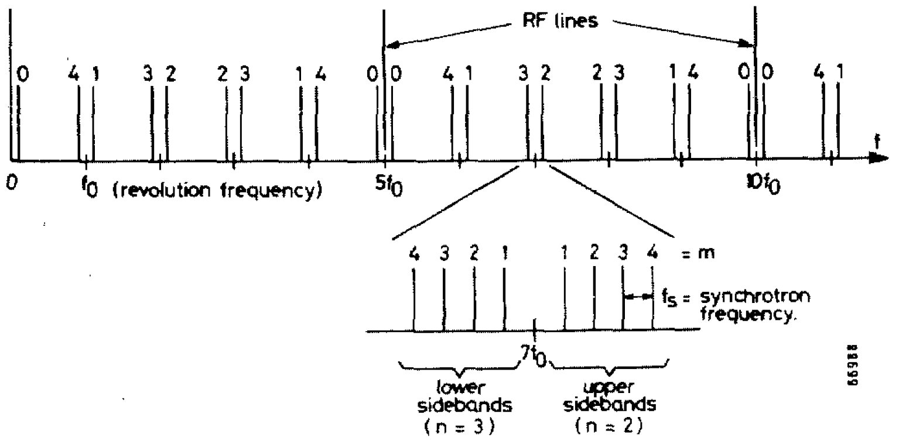
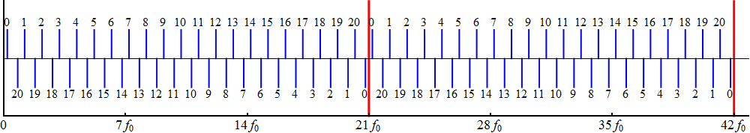
Coupled-bunch oscillations, freq. domain
Synchrotron frequency sidebands of the f_{rev} harmonics:
F. Pedersen, F. Sacherer, PAC77, pp. 1397-1399
In the case of LHC-type beams in the PS (h = 21)
upper
lower

Slide 8
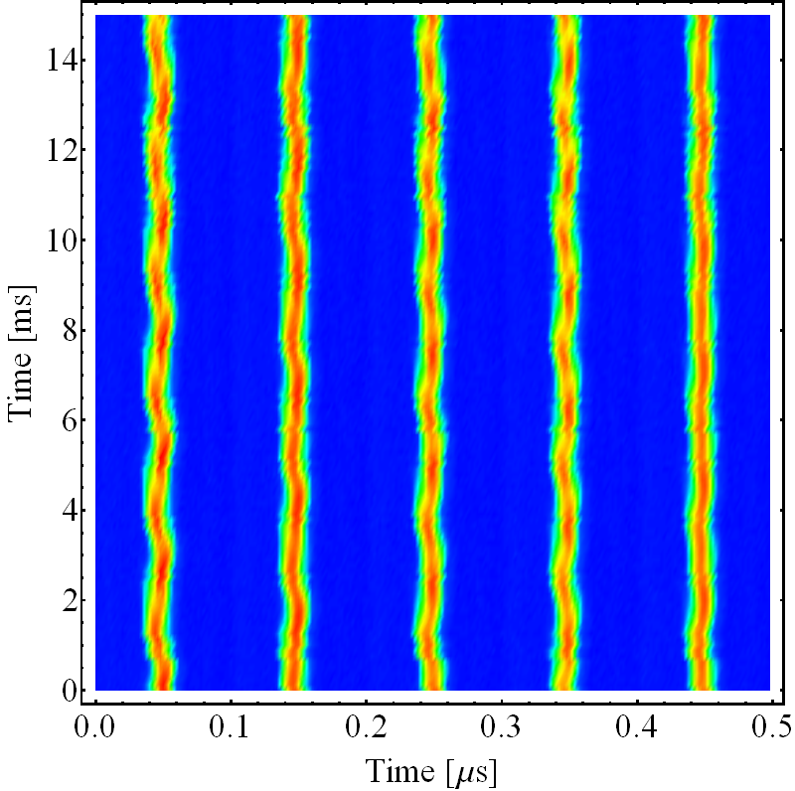
Coupled-bunch oscillation damping
Bunches oscillate with different phases (and amplitudes)
Example of an n = 12 mode (Δφ ≈ 206°)
Mode number n defined by phase advance from bunch-to-bunch:
Δφ = 2π n/h
Kick
f_{rf}
Kicker baseband
Preferred detection
Measure
Coupled-bunch oscillations show up as side-bands of nf_{rev} or (h-n)f_{rev}
Finemet cavity for coupled-bunch damping: kick at 0.4...5 MHz

Slide 9
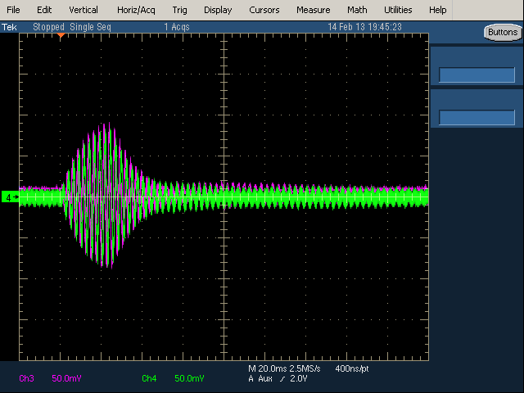
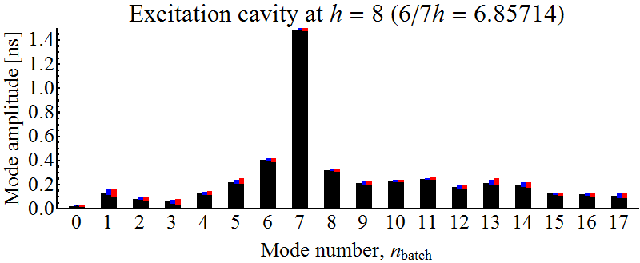
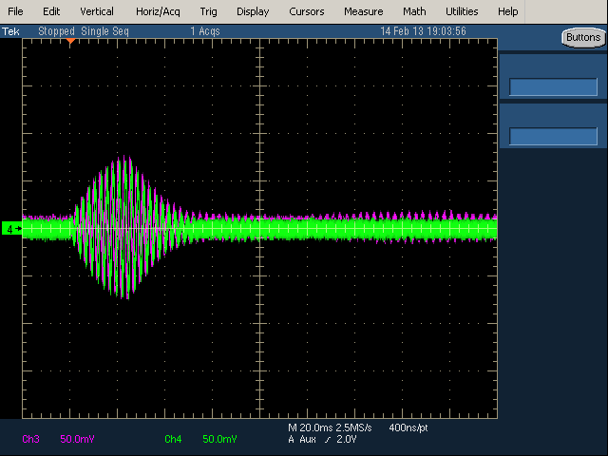
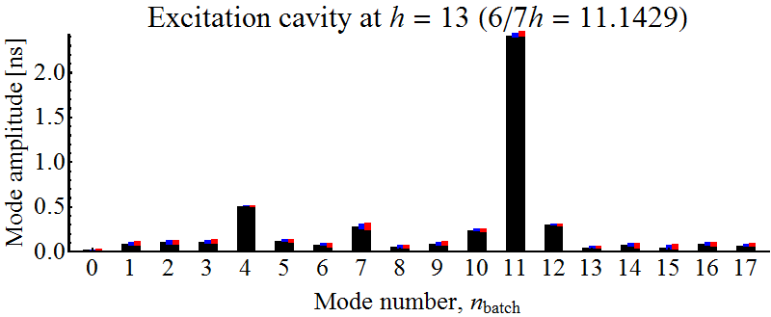
Excitation and damping of coupled-bunch oscillations → cross-damping
Detect at h = 13 → damp with C10-11 at h = 8
Detect at h = 8 → damp with C10-11 at h = 13
Tested basic features in view of new feedback kicker
Damping on different harmonic than detection works

Slide 10
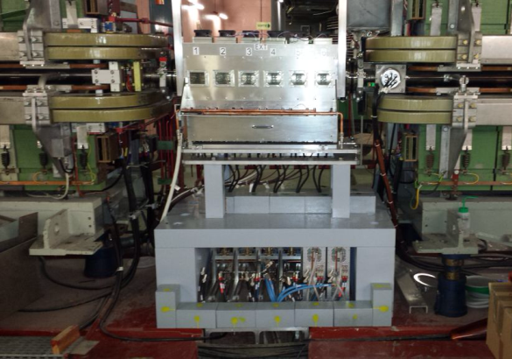
Low-level and high-power RF for PS damper
  Single LLRF driving all six cells
6×
Cavity return sum
Comb. + att.
-3 dB
Beam-loading compensation
Wall current monitor
Coupled-bunch feedback
Splitter + amp.
f_{clk} = 256 f_{rev}
Two feedbacks: 1. Beam → Finemet cavity, 2. Cavity return → cavity
No detrimental effect on beam stability expected
But: beam-loading reduction essential to reduce power from beam

Slide 11
Overview
Introduction and motivation
  Coupled-bunch feedback and beam-loading compensation
  Beam tests with existing feedback before LS1
Beam-loading compensation feedback
  Impedance of Finemet cavity, design constraints and choices
  Narrow-band tracking filters, delay compensation
Plans for coupled-bunch feedback
  Decoupling of coupled-bunch damping and beam-loading compensation
First measurements with beam
Conclusions and outlook

Slide 12
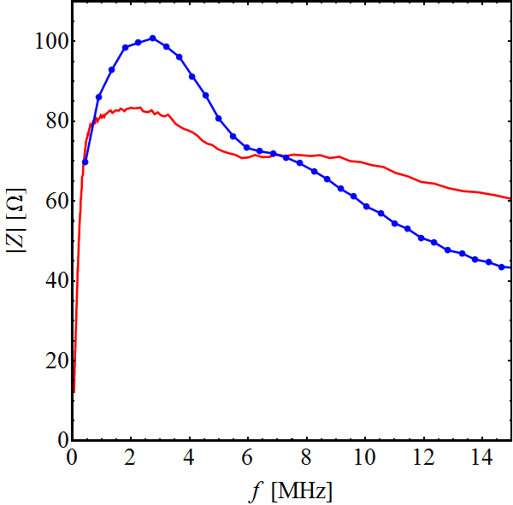
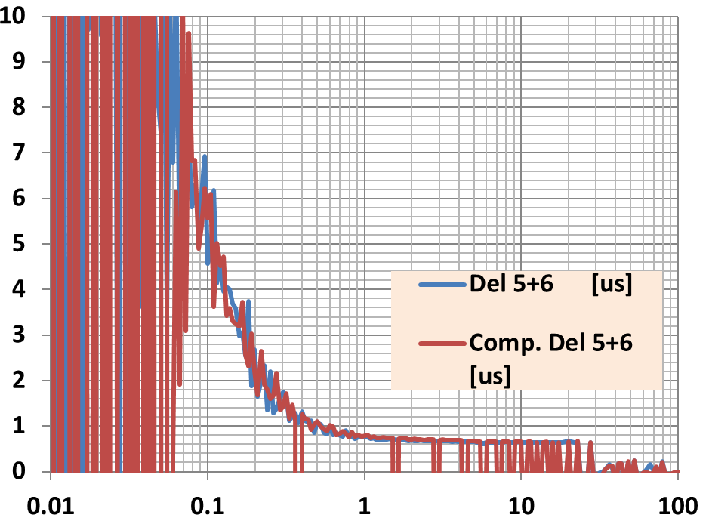
Cavity impedance of PS Finemet cavity
Impedance per cell with amplifier
Delay of cells 5+6
Delay [μs]
M. Paoluzzi
Network analyzer
From beam induced voltage (low intensity)
Frequency [MHz]
No tuning, impedance unchanged during acceleration
Impedance quasi constant within 10% frequency range
With 20 dB reduction → ~10 Ω/cell (cf., e.g., wall current monitor: 6 Ω)
Harmonic dependent delay, especially for low harmonics
Damping needed at many harmonics: ~ f_{rev} to 40 f_{rev}

Slide 13
Options for LLRF beam-loading feedback
Feed-forward | 1-turn delay feedback | Narrow-band filters
Successful tests at JPARC Main Ring (F. Tamura et al.) High reduction (> 26 dB) of beam induced voltage Difficult to measure without beam Little experience with digital feed-forward systems at CERN | New system successfully commissioned on 10 MHz cavities (D. Perrelet et al.) Few adjustment parameters → excellent for changing impedance of sweeping cavities Set-up without beam Same gain for different harmonics → compromise Phase compensation filter for high gain at large bandwidth needed | Same hardware as 10 MHz 1-turn delay feedbacks No need for physical delay Gain, delay and phase adjustable per harmonic Combinable with coupled-bunch feedback Set-up without beam Potential issues with reduction of transients → to be investigated Many parameters to be adjusted → only easy for cavity with fixed impedance
F. Tamura et al., IPAC14, p. 3385
D. Boussard et al., EPAC88, p. 985
→ Bank of narrow-band tracking filters seems good compromise

Slide 14
Narrow-band tracking filters
  Band pass filter with high gain at f_{rev} harmonic
    Flexible, adapts to delay/phase curve of cavity: gain, delay and phase adjustable for each harmonic
    Avoid need for programmable delay (single clock, no delay lines, etc.)
  Filter bank for multiple harmonics (firmware)
  Similar to coupled-bunch feedback → correction from coupled-bunch part can be injected after low-pass filters
sin(h_{FB} f_{rev}t + φ)
sin(h_{FB} f_{rev}t)
Low-pass
Cavity return
Cavity drive
ADC
DAC
Low-pass
cos(h_{FB} f_{rev}t + φ)
cos(h_{FB} f_{rev}t)

Slide 15
Overview
Introduction and motivation
  Coupled-bunch feedback and beam-loading compensation
  Beam tests with existing feedback before LS1
Beam-loading compensation feedback
  Impedance of Finemet cavity, design constraints and choices
  Narrow-band tracking filters, delay compensation
Plans for coupled-bunch feedback
  Decoupling of coupled-bunch damping and beam-loading compensation
First measurements with beam
Conclusions and outlook

Slide 16
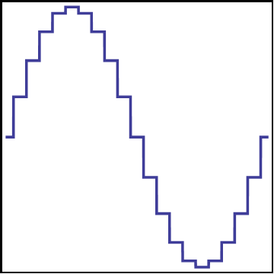
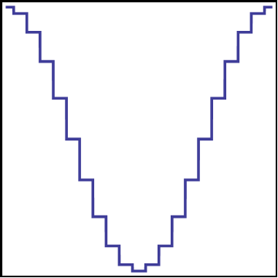
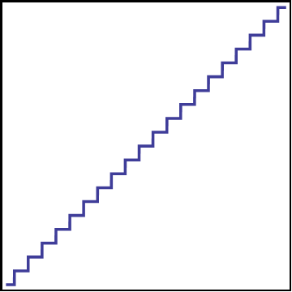
New azimuth register numerical oscillators
  Signals at various harmonics again synchronous with h = 1, but:
    No need for a tagged clock
    Main phase accumulator on h = 1 only reset once (or once per cycle)
    Additional standard direct digital synthesizer (DDS) for non-integer h
h
φ
Reset
sin
f_{clk}
Counter
cos
  Clock frequency choice: 2⁸ f_{rev} = 256 f_{rev} → 111.7 MHz to 122.1 MHz
  ‘Multi-harmonic source system on chip’
  Prototype firmware already contains up to 36 azimuth register sources on a single

Slide 17
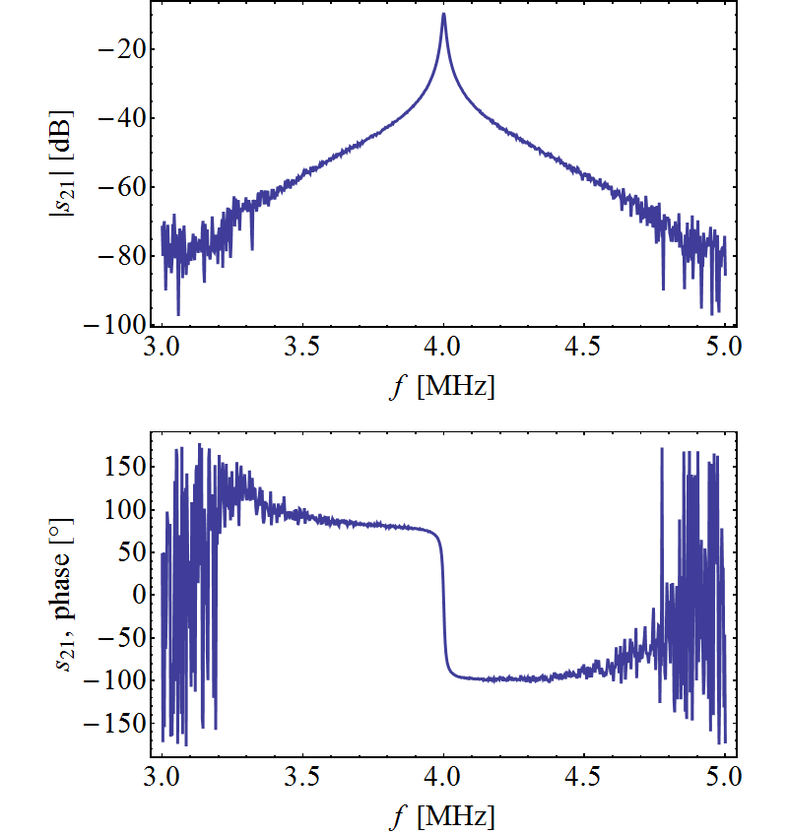
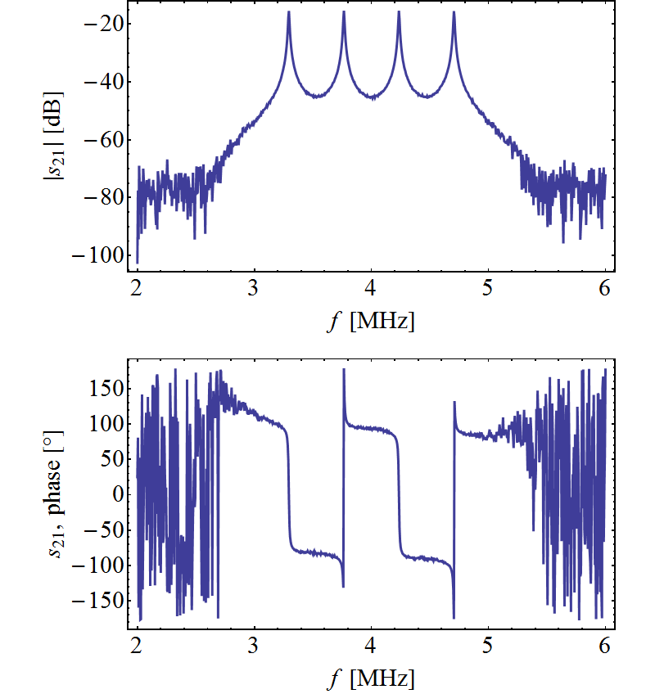
Open loop transfer function
Prototype firmware
Single h tracking filter
4 adjacent harmonics
  180° phase advance at each filtered harmonic
  Filter group delay ~ 1.4 μs (below 1 turn)

Slide 18
Delay compensation
  The ~ 700 ns delay of the cavity must be compensated to keep the filter phases correct during acceleration
  At 10 MHz, 1% frequency change would introduce ~25° phase shift
    ‘Delay without delay’, positive and negative
    Virtual delay by de-phasing the RF sources for delay τ
  sin (ωt) → sin (ω(t ± τ)) = sin (ωt + φ) with φ = ± ωτ
    Need to de-phase RF sources by φ = ± 2π h f_{rev} τ
    Trivial for delays τ = n t_{clk}: φ = ± 2π h f_{rev} n t_{clk} = ± 2π h/h_{clk} n = const.
    f_{rev} is measured by counters on main clock at h = 256
    Multiplication in real time in programmable logic
A. Ozturk, PS/RF/Note 99-05

Slide 19
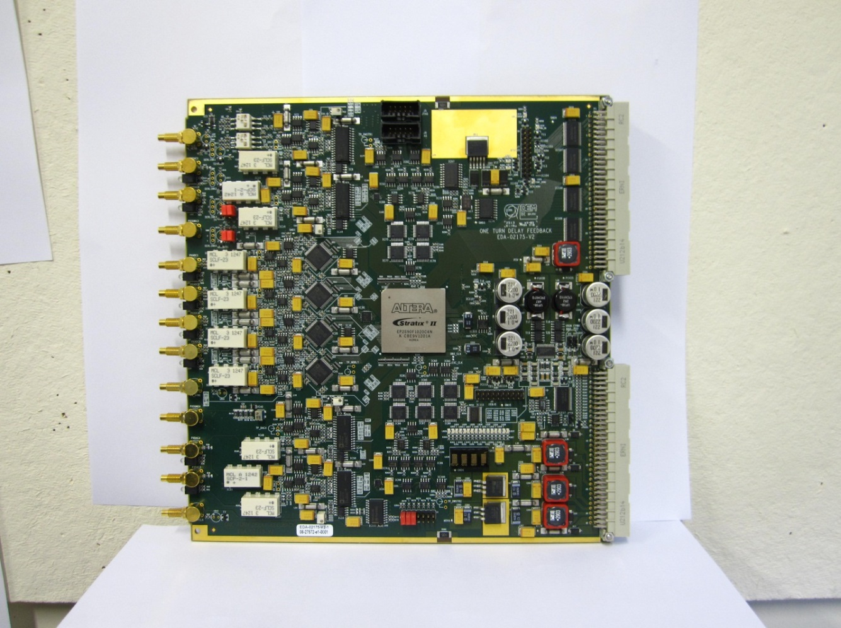
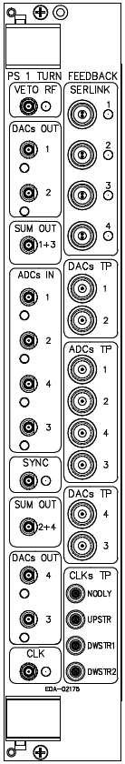
Set-up for first measurements
  Prototype firmware for beam-loading compensation
    4 tracking filters at programmable harmonics (h = 7, 8, 9, 10 by default)
    Single swept clock at 256 f_{rev}
    Automatic measurement of clock frequency for delay compensation
    Possibility to inject additional RF signal (coupled-bunch damping)
  Running on 1-turn delay feedback hardware (D. Perrelet)
  New front-end close to high power racks (short delay) installed
  Coupled-bunch filtering part to be added
  Coverage of more harmonics (copy-paste)

Slide 20
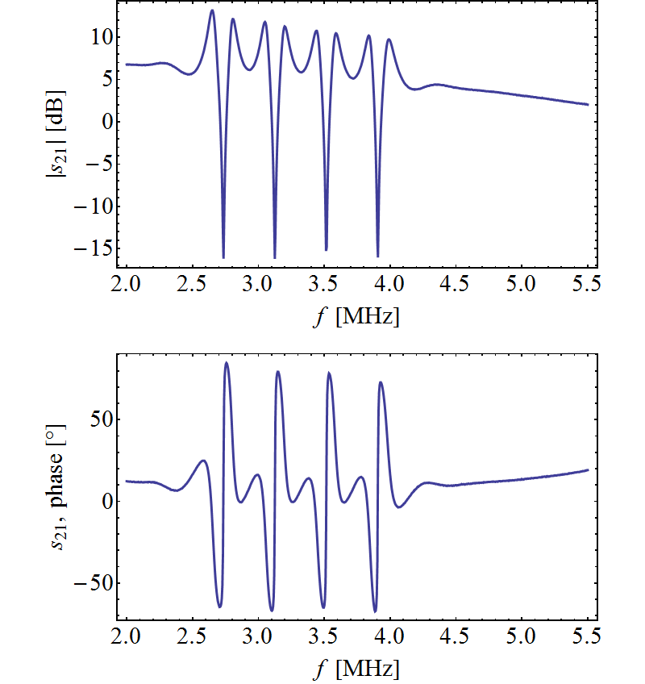
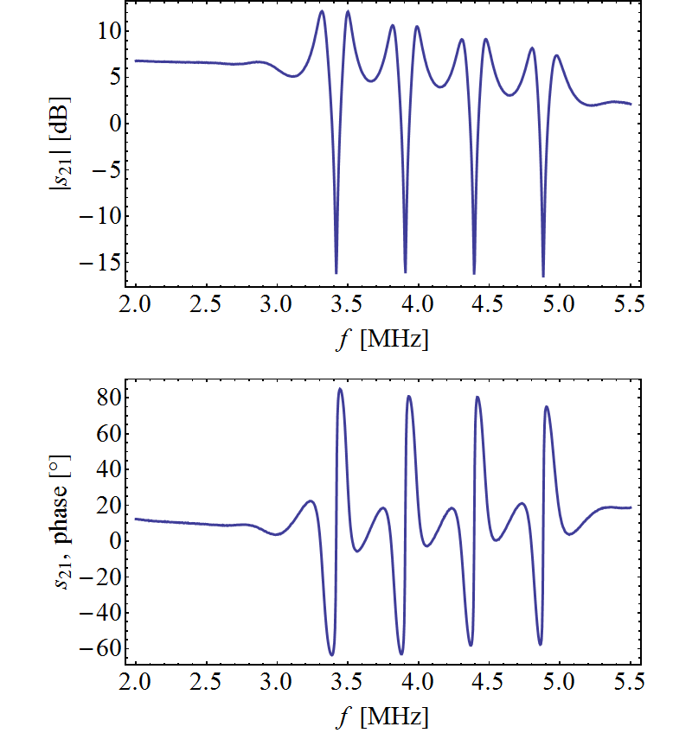
Closed-loop transfer function with cavity
f_{clk} = 100 MHz (f_{rev} = 391 kHz)
f_{clk} = 125 MHz (f_{rev} = 488 kHz)
h = 7
h = 10
h = 7
h = 10
Prototype firmware
Delay compensation works fine, symmetric notches while clock changing by Δf_{rev}/f_{rev} ≈ 25%
Maximum feedback gain achieved at h = 7, 8 , 9 , 10: ~20 dB

Slide 21
Overview
Introduction and motivation
  Coupled-bunch feedback and beam-loading compensation
  Beam tests with existing feedback before LS1
Beam-loading compensation feedback
  Impedance of Finemet cavity, design constraints and choices
  Narrow-band tracking filters, delay compensation
Plans for coupled-bunch feedback
  Decoupling of coupled-bunch damping and beam-loading compensation
First measurements with beam
Conclusions and outlook

Slide 22
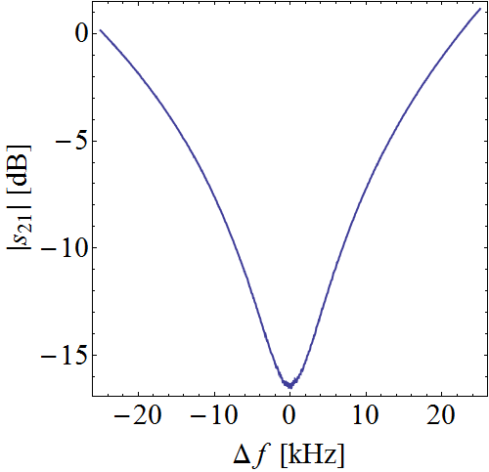
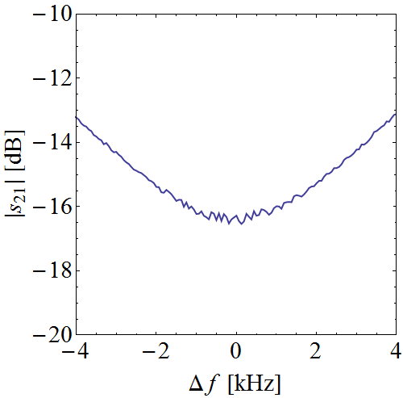

Add coupled-bunch feedback?
  Narrow notches at f_{rev} harmonics well decoupled
  But they are wide with respect to synchrotron frequency
Single notch
Close to hf_{rev}
Δf ≈ ±f_{s}
Synchrotron frequency side-bands close to hf_{rev}
Beam-loading compensation feedback appears as constant numeric factor to coupled-bunch signal processing

Slide 23
Both feedbacks together (1 harmonic)
sin(h_{FB} f_{rev}t + φ)
sin(h_{FB} f_{rev}t)
Low-pass
Cavity return
Cavity drive
ADC
DAC
Low-pass
cos(h_{FB} f_{rev}t + φ)
cos(h_{FB} f_{rev}t)
cos((h_{RF}-h_{FB})f_{rev}t + φ)
f_{s} side-band filter
Wall current monitor
ADC
  Signal processing for single harmonic
  Required multiple times
f_{s} side-band filter
sin((h_{RF}-h_{FB})f_{rev}t + φ)

Slide 24
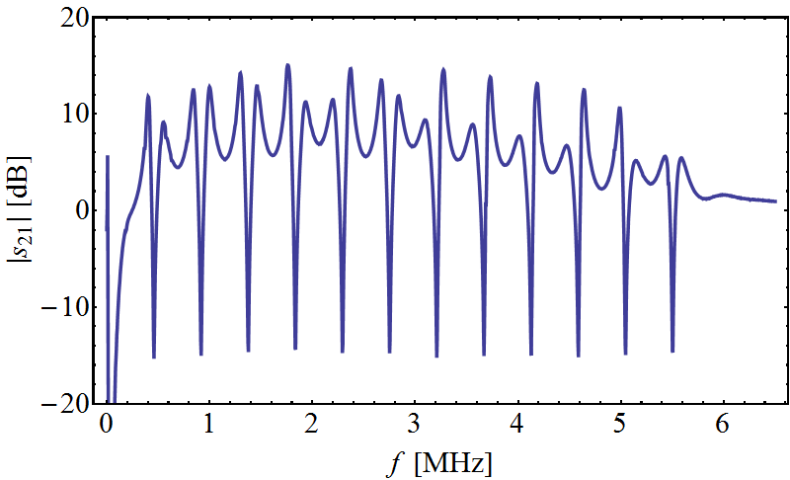
How many harmonics?
 | Couple-bunch feedback | Beam-loading compensation
Signal processing chains | 10 | ~40
Detection harmonic | h_{det} = 11…20 5 to 10 MHz | h_{det} = h_{kick} = 1…~40 0.4 to ~20 MHz
Damping harmonic | h_{kick} = 1…10 0.4 to 5 MHz
Measured cavity transfer function, 1…12 f_{rev}
  Full configuration needed 10 times
  For any further harmonics, only beam-loading reduction, needed ~30 times

Slide 25
Overview
Introduction and motivation
  Coupled-bunch feedback and beam-loading compensation
  Beam tests with existing feedback before LS1
Beam-loading compensation feedback
  Impedance of Finemet cavity, design constraints and choices
  Narrow-band tracking filters, delay compensation
Plans for coupled-bunch feedback
  Decoupling of coupled-bunch damping and beam-loading compensation
First measurements with beam
Conclusions and outlook

Slide 26
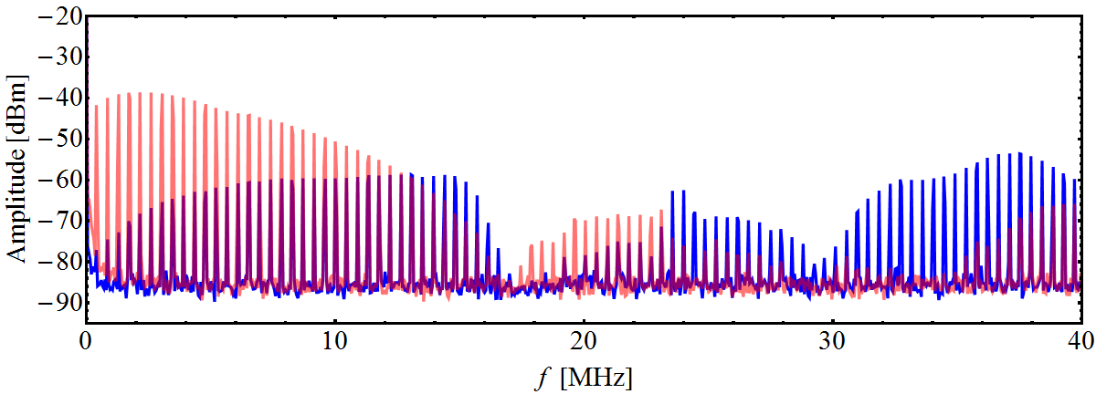
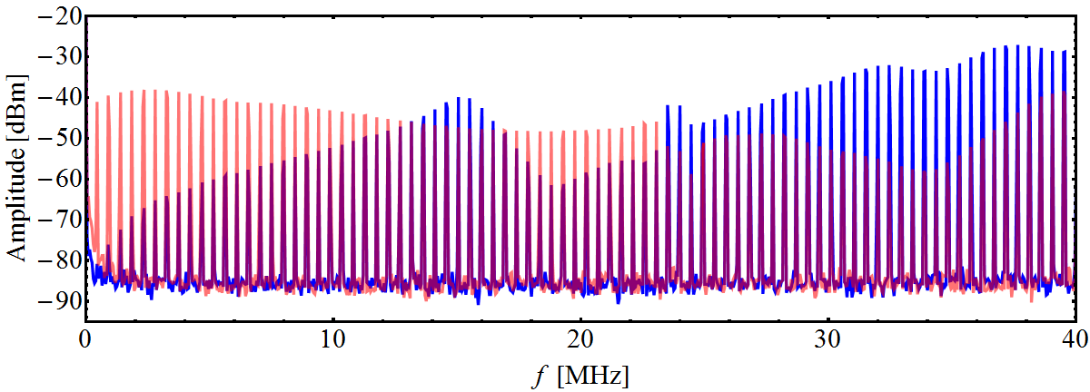
First measurements with beam
  Spectrum of beam induced voltage (passive probe)
Gap relay open
Gap relay closed
At injection
At transition
  Important signal from beam at passive probe around ~40 MHz
  No effect on beam stability observed (cf. 40 MHz cavities)
  Gap relay only efficient below ~10 MHz → need damping circuit

Slide 27
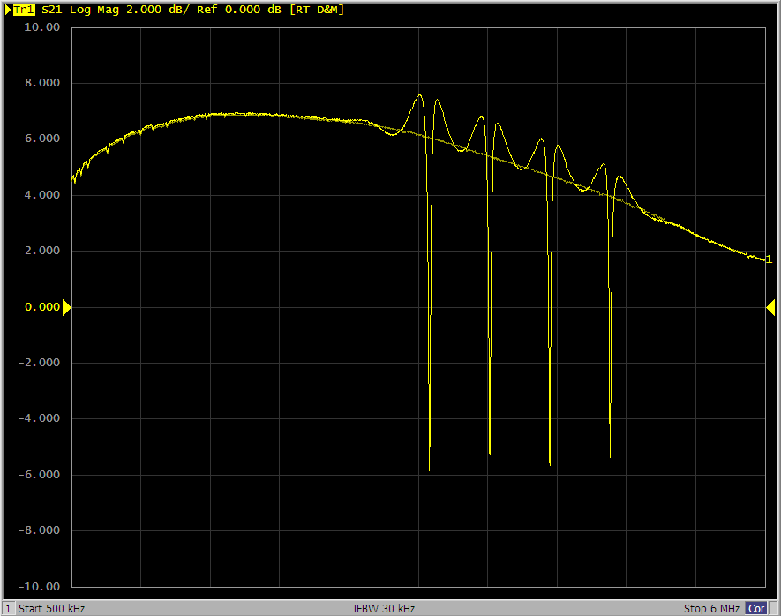
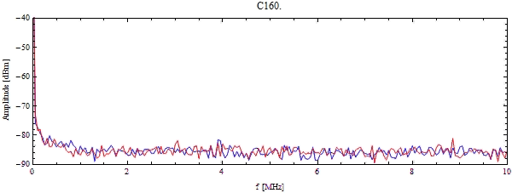
First measurements with beam
  Moderate feedback gain (very first test!)
  Transfer function measurement: ~ 10…12 dB
  Spectrum of beam induced voltage in Finemet cavity
  26GeV-test cycle, single bunch accelerated on h = 8
Open/closed loop transfer function
500 kHz 6 MHz
  Impedance reduction observed with beam as expected

Slide 28
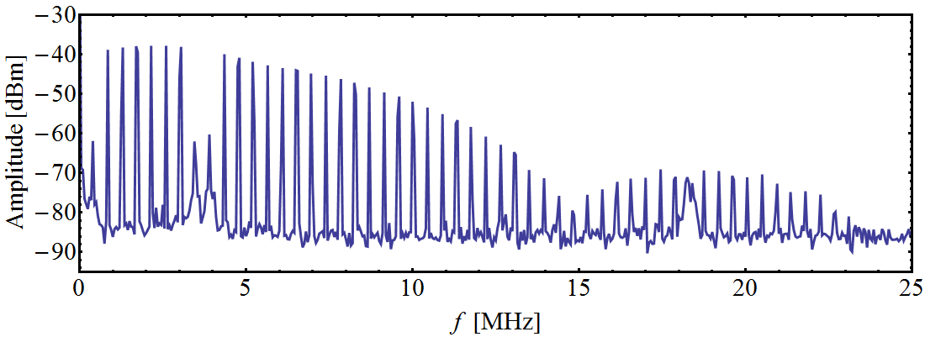
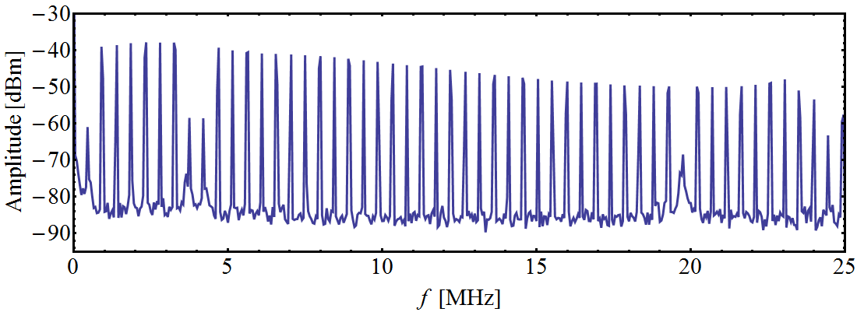
Frequency range and feedback gain
  Test of maximum feedback gain and frequency range
h = 1
h = 8, 9
h = 42
  Beam induced spectrum (passive probe)
At injection
At transition
  Close to 20 dB reduction achievable from 0.45 MHz to 20 MHz

Slide 29
Overview
Introduction and motivation
  Coupled-bunch feedback and beam-loading compensation
  Beam tests with existing feedback before LS1
Beam-loading compensation feedback
  Impedance of Finemet cavity, design constraints and choices
  Narrow-band tracking filters, delay compensation
Plans for coupled-bunch feedback
  Decoupling of coupled-bunch damping and beam-loading compensation
First measurements with beam
Conclusions and outlook

Slide 30
Summary
Design of beam-loading reduction feedback for the Finemet cavity
  Bank of narrow-band feedbacks, one per harmonic
  Expected gain ~ 20 dB in addition to fast feedback around amplifier
  Based on feedback circuit → feed-forward may be added if needed
  ≥ 12 signal processing chains (harmonics) integrated on one board
First tests without and with beam successful
  ‘Delay compensation without delay’ validated
  Beam induced voltage reduction consistent with gain from transfer function measurement
  Close to 20 dB reduction of beam induced voltage from 0.45 to 20 MHz
Beam induced voltage at passive gap voltage probe with relay closed
  Damping circuit being investigated, no effect on beam stability

Slide 31
Outlook
Measurements with beam:
  Spectrum of beam induced voltage with and without wide-band feedback around amplifiers
  Beam induced voltage with gap relay closed during intensity increase
  Excitation with coupled-bunch feedback part
Firmware development to be continued:
  Improve resolution of numerical oscillators (12 bit → 16 bit)
  Improve handling of numerical overflow
  Increase number of harmonics treated simultaneously
  Implement coupled-bunch damping part of feedback
Integration to control system

Slide 32

THANK YOU FOR YOUR ATTENTION!

Slide 33
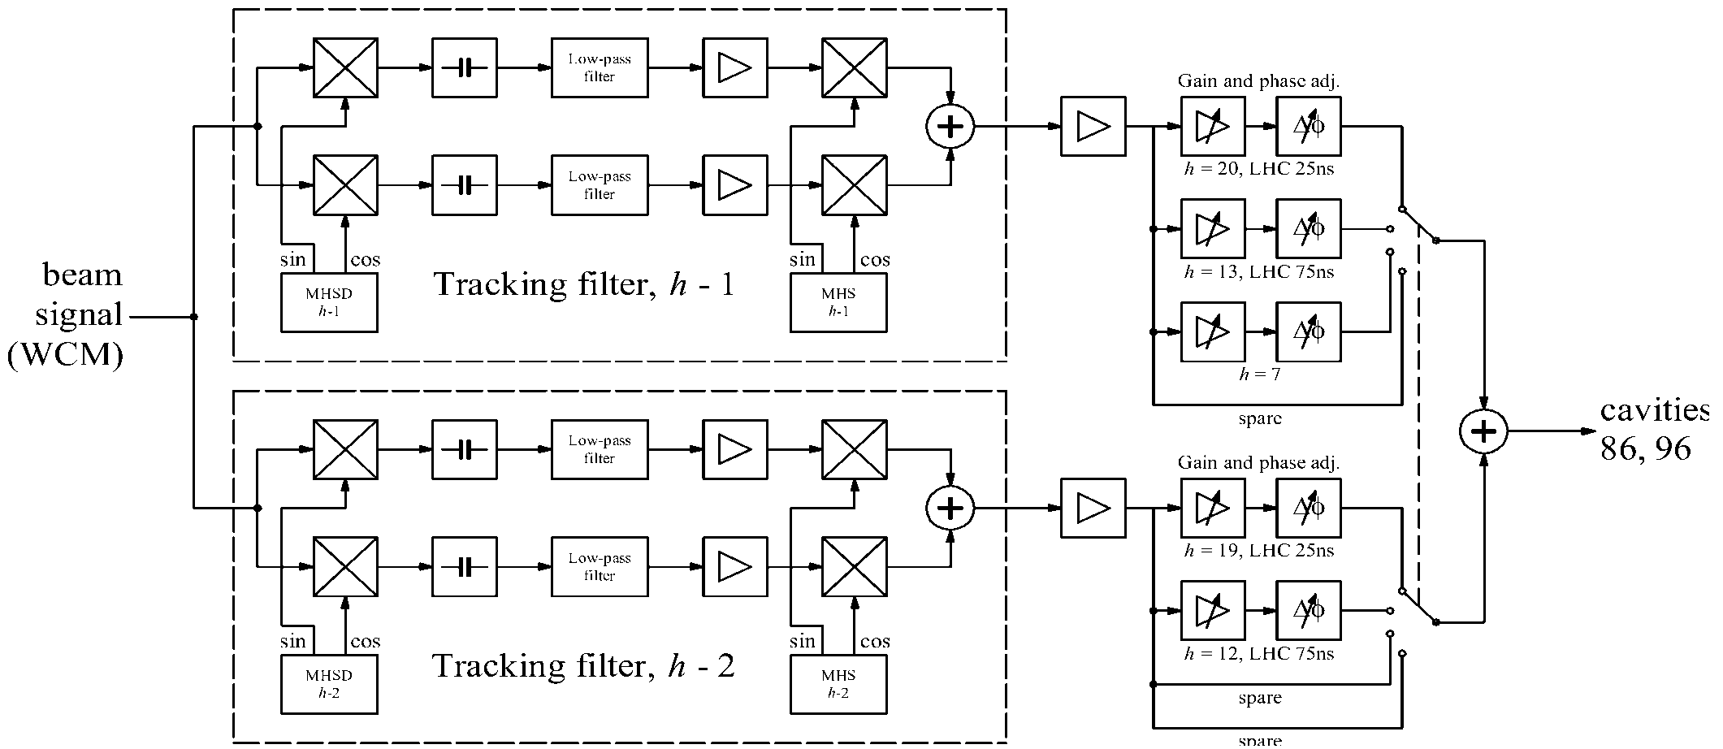
Operational PS coupled-bunch feedback
J.-L. Vallet, https://ab-div.web.cern.ch/ab-div/Meetings/APC/2005/apc050609/JL_Vallet_slides.pdf
Analogue signal processing, two channels
Two accelerating cavities as feedback kickers → limits to modes h – 1 and h - 2
New wide-band Finemet cavity as kicker
Digital feedback electronics
Cover all modes

Slide 34

New cavity (#25) in the PS ring
Wide-band (0.4 – >5.5 MHz, V_{RF} = 5 kV) cavity based on Finemet material
No acceleration, but damping of coupled-bunch oscillations
6-cell cavity unit
SS02
Accelerating gap
Power amplifiers (solid state)
M. Paoluzzi
Cavity installed in SS02, amplifiers on 2 gaps
First installation of transistor power amplifiers close to beam in PS

Slide 35
Beam induced voltage in Finemet cavity
Beam induced voltage in Finemet cavity observed
Amplitude higher than expected for present intensities
No effect of cavity observed on the beam
40 MHz ringing following each bunch passage
Verified:
  Closure of gap relay
  Attenuation of gap voltage divider

Slide 36
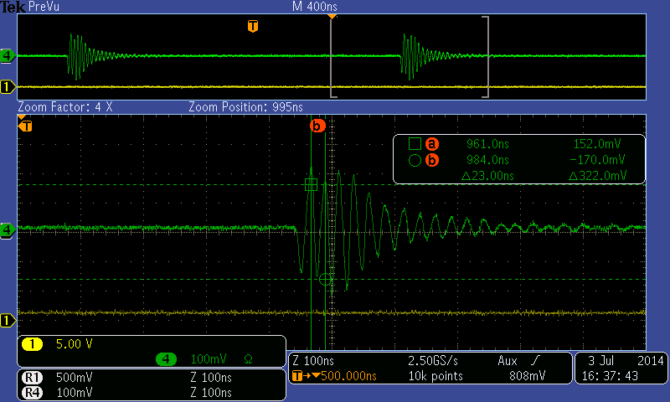
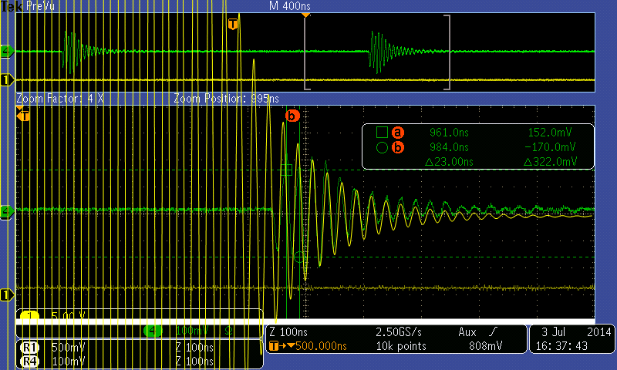
Ringing at around 40 MHz
26GeV test cycle, single bunch, h = 8, close to transition
Resonance frequency ~ 39 MHz, quality factor ~ 12
Measurements correct? Probe attenuation at 40 MHz?

Slide 37
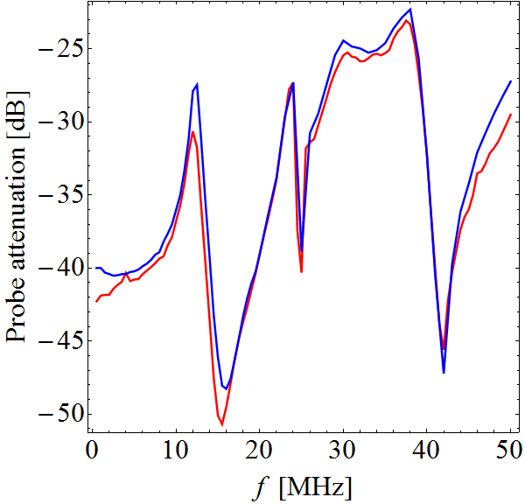
Check probe attenuation around 40 MHz
Lab measurement
In-situ gap 3
(07/07/2014)
M. Paoluzzi
50 Ω in parallel to gap
High impedance (~1 kΩ)
-21 dB
Lab and (both) in-situ measurements similar
Low probe attenuation (resonance?) around 38 MHz

Slide 38
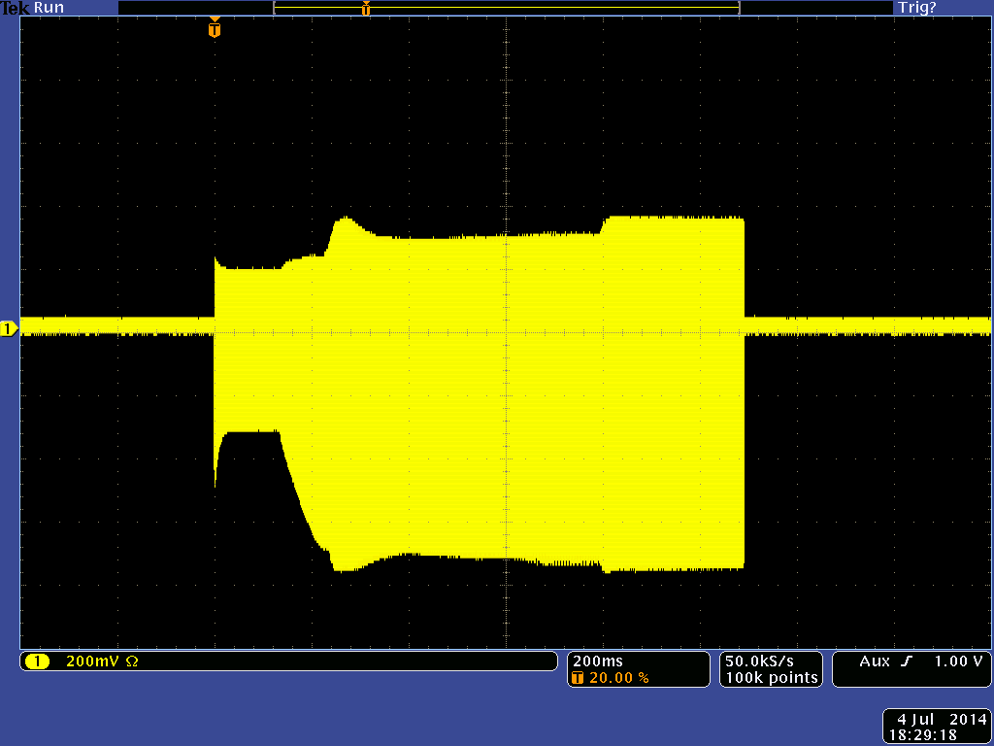
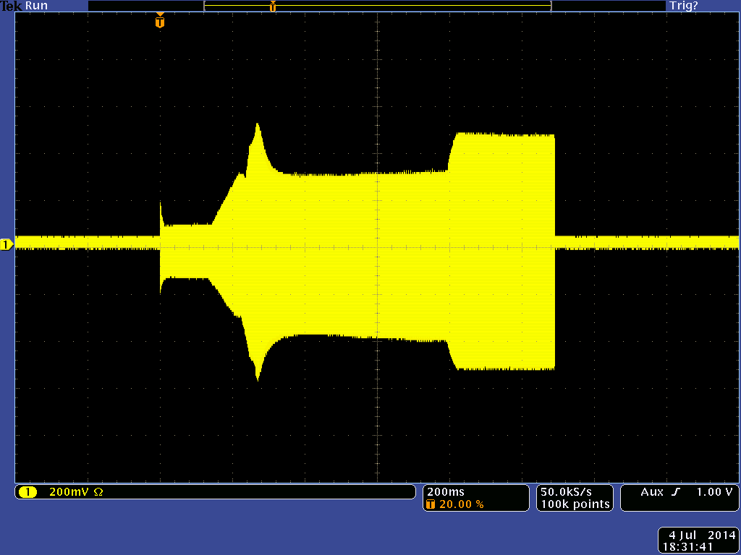
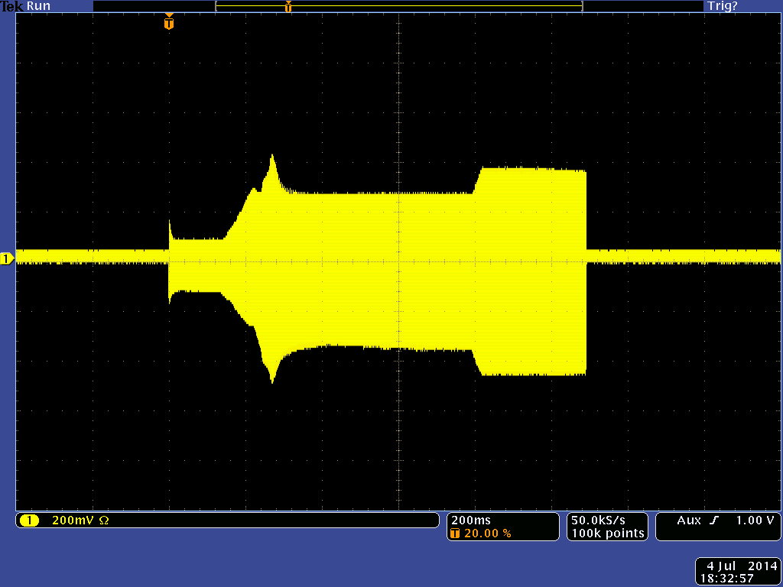
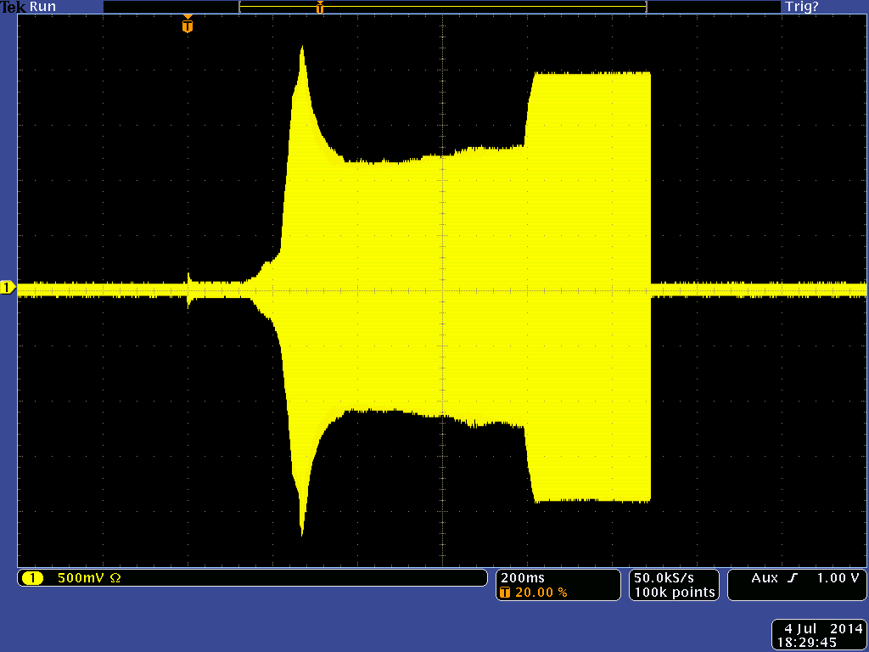
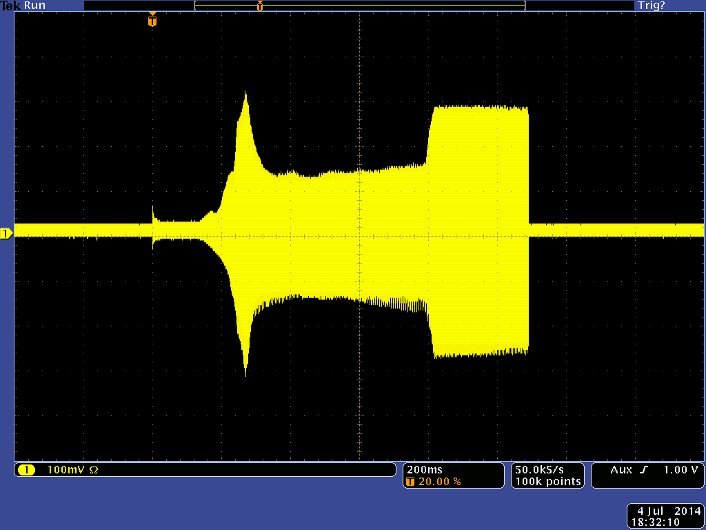
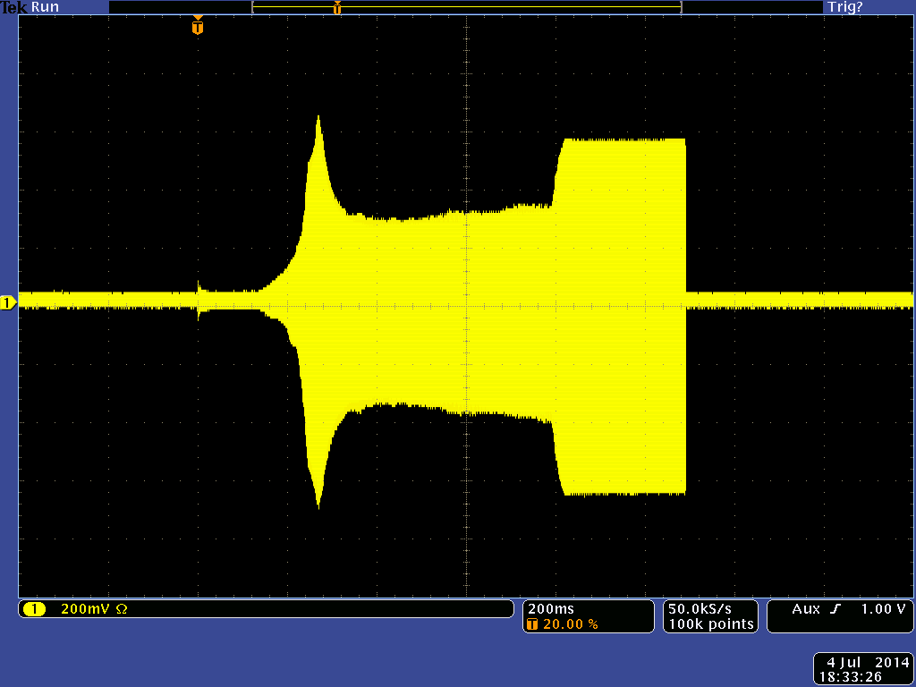
Full bandwidth, gap relay open/closed
Gap 3
Gap 5
Gap 6
200 mV/div
200 mV/div
200 mV/div
Open
Passive probe + 10 dB
500 mV/div
100 mV/div
200 mV/div
Closed
Higher voltage with gap relay closed? → 40 MHz resonance?

Slide 39
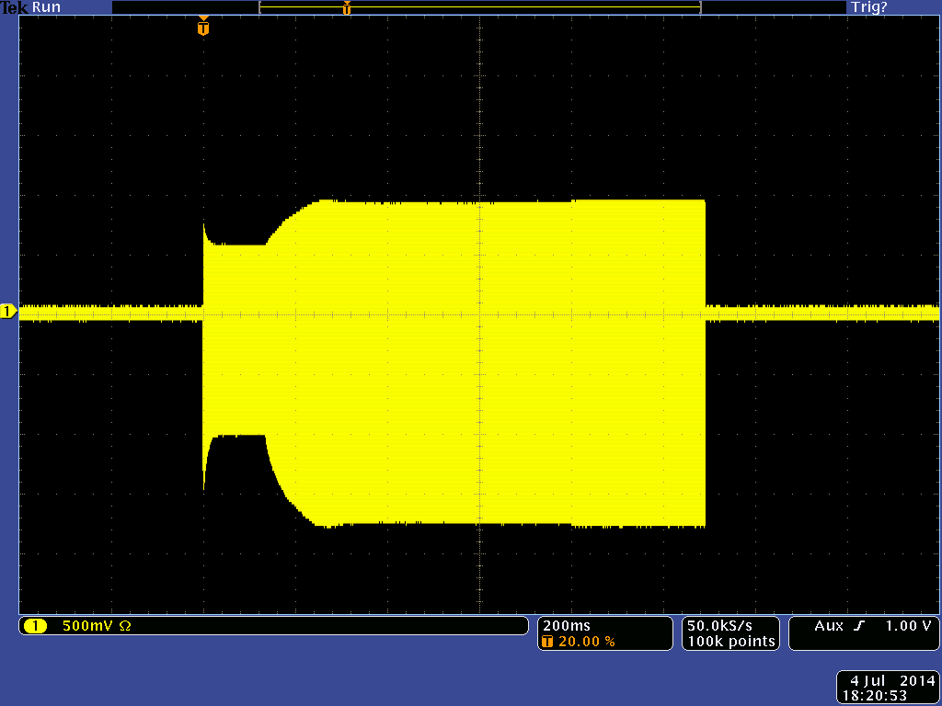
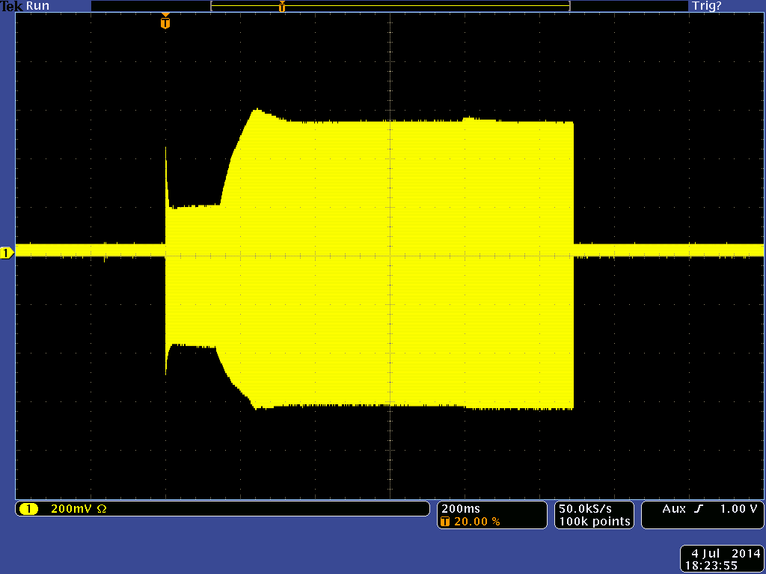
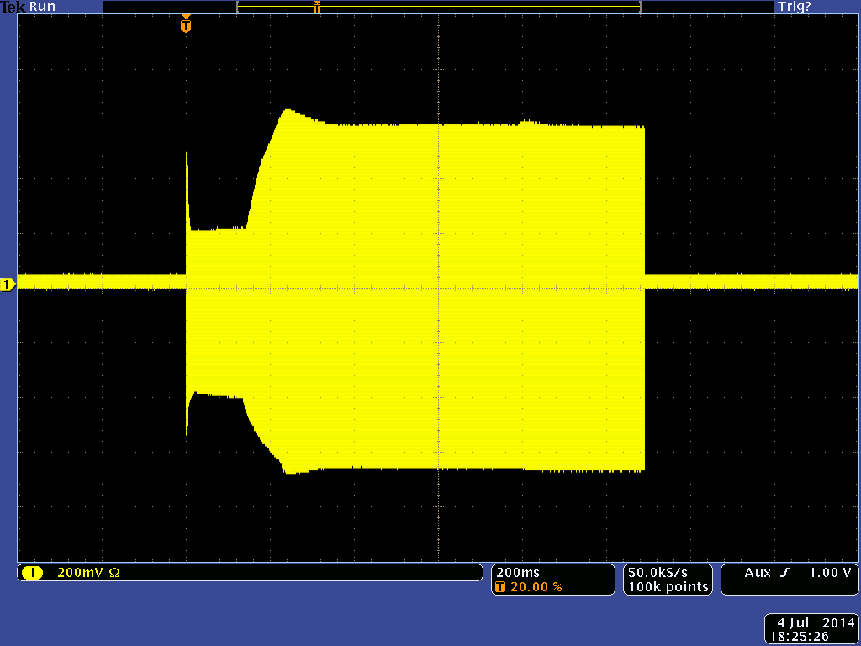
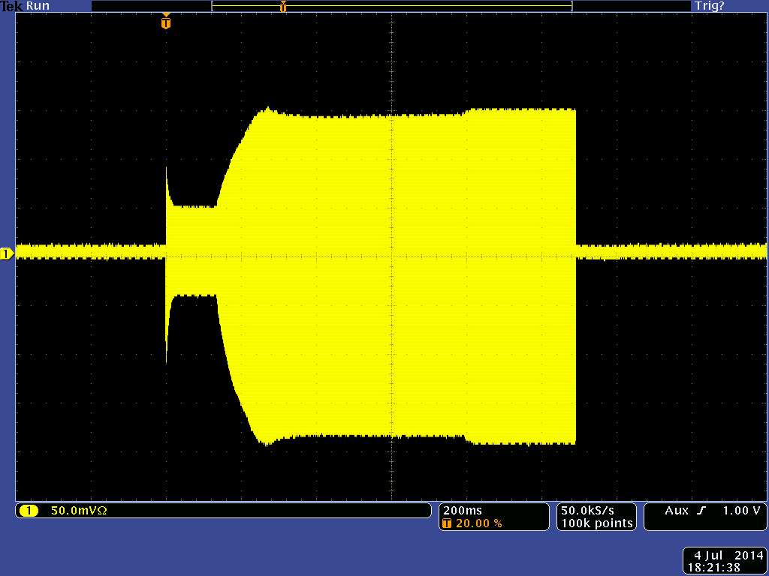
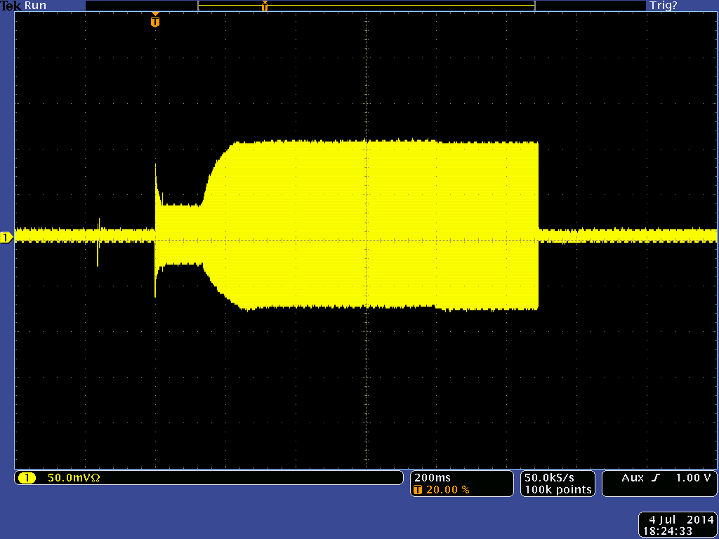
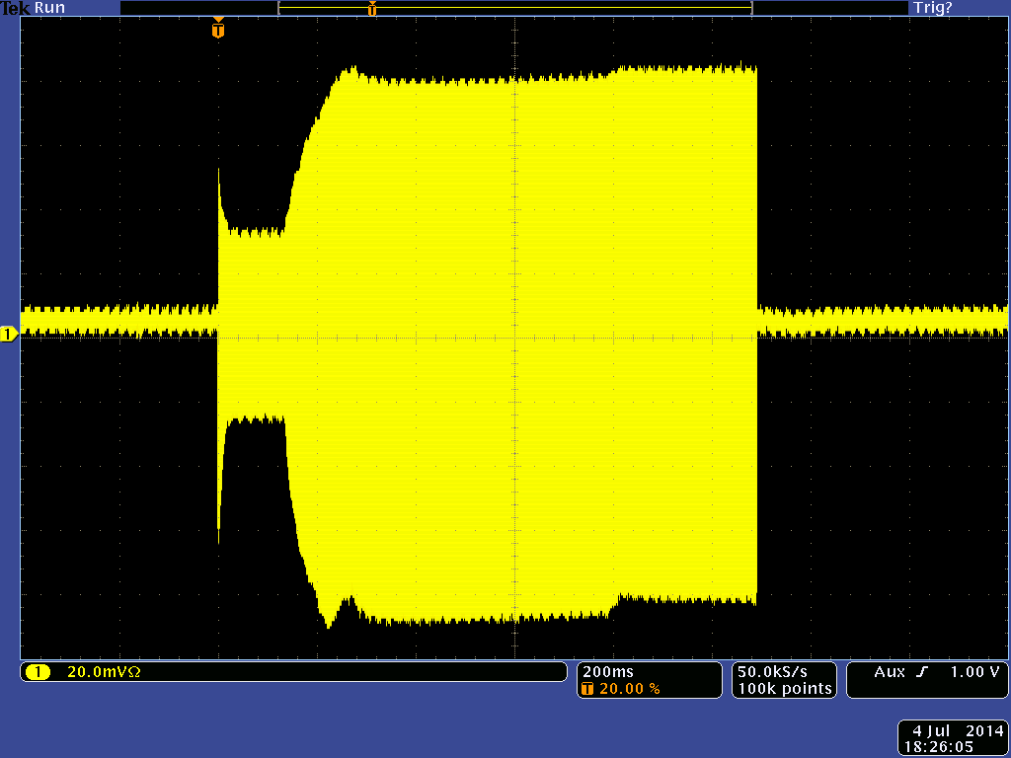
10.7 MHz low pass, gap relay open/closed
Gap 3
Gap 5
Gap 6
500 mV/div
200 mV/div
200 mV/div
Open
Passive probe + 10.7 MHz low-pass
50 mV/div
50 mV/div
20 mV/div
Closed
Gap relay reduces beam induced voltage in low frequency range by almost one order of magnitude

Slide 40
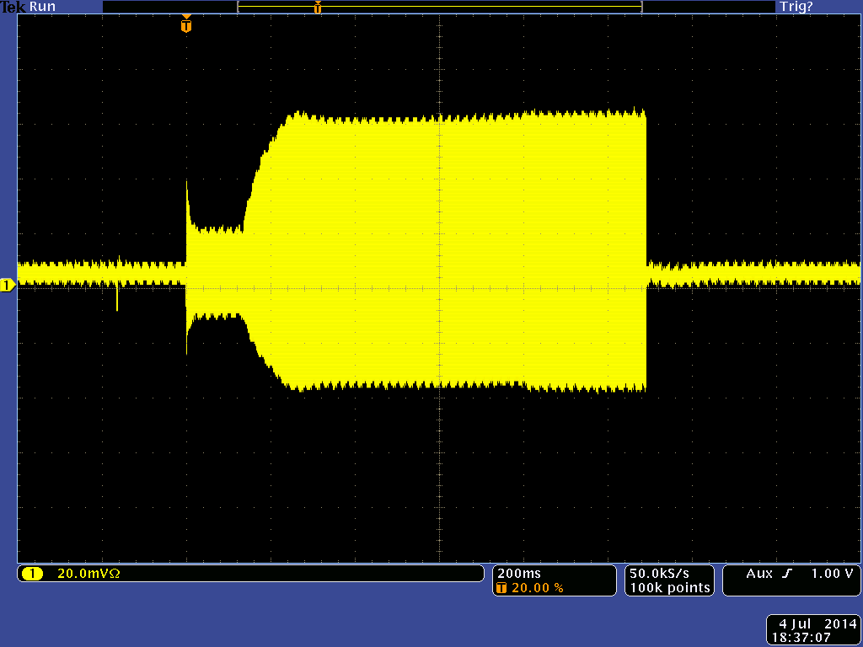
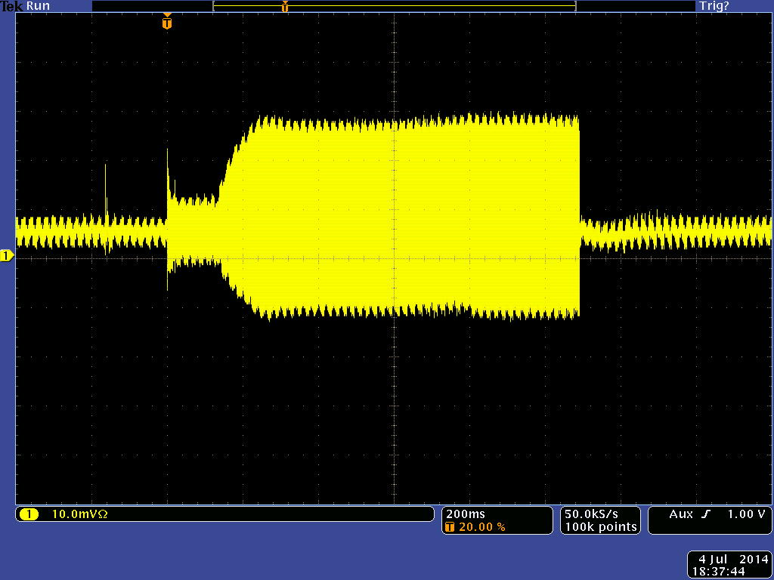
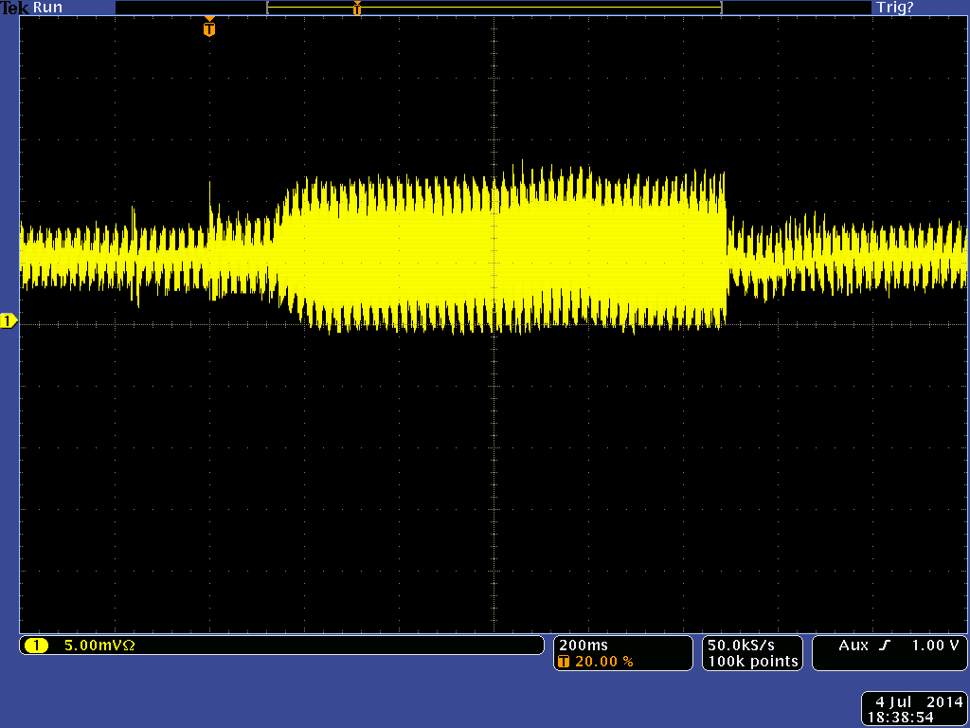
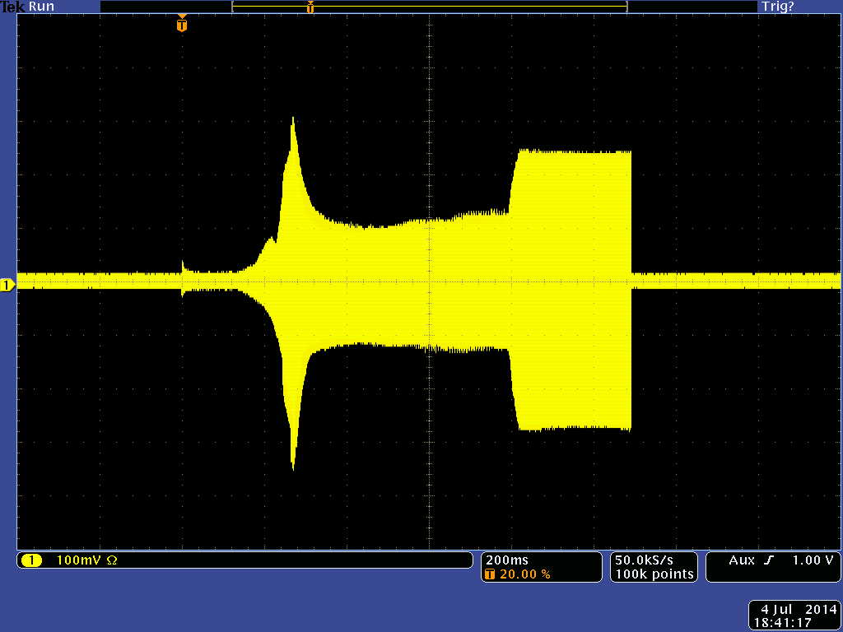
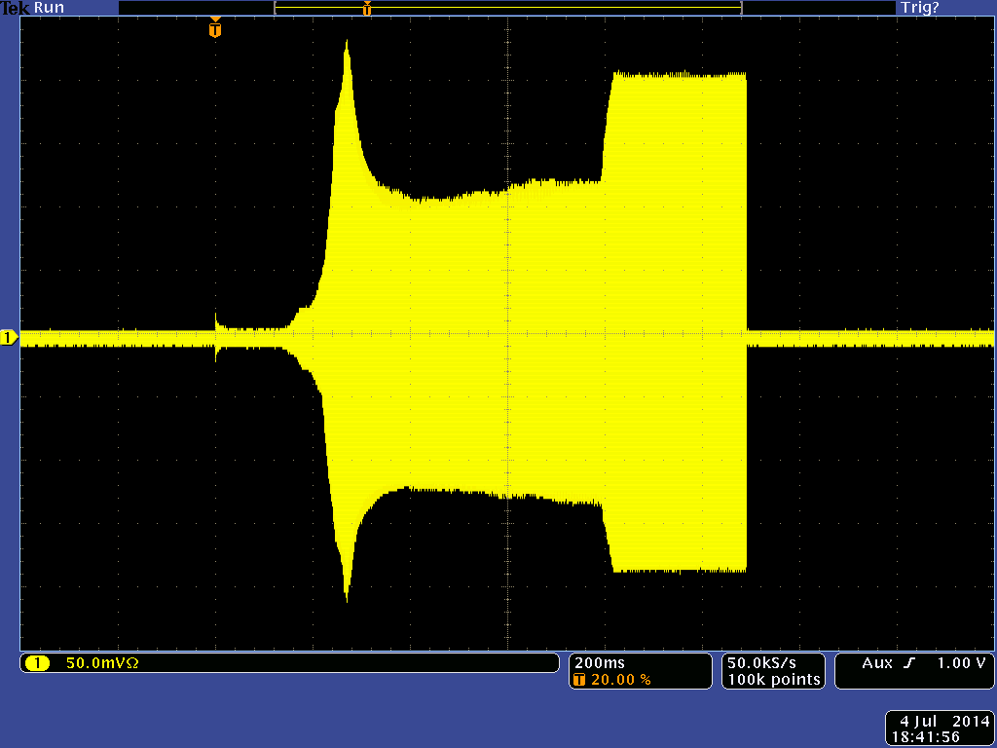
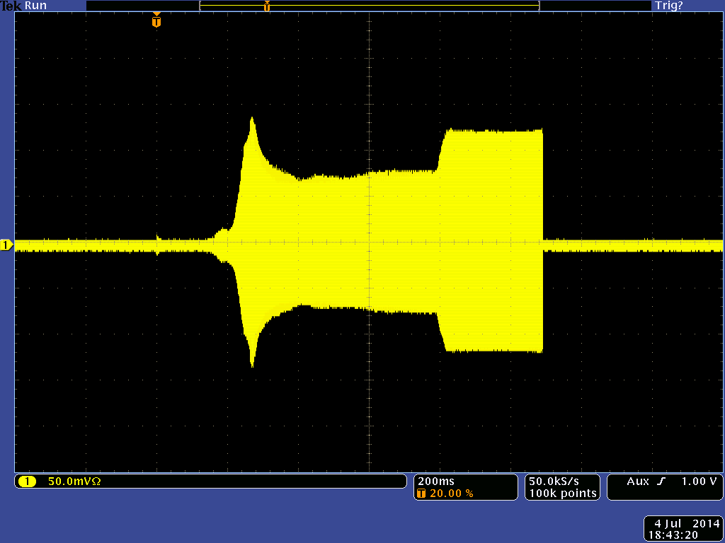
Local short circuit test below gaps
Gap 1, wire
Gap 2, screw
Gap 4, copper strip
20 mV/div
10 mV/div
5 mV/div
10.7 MHz low-pass
100 mV/div
50 mV/div
50 mV/div
Full band-witch
10 dB add. att
Copper strip directly below the cavity closes gap most efficiently
Temporarily implemented on four gaps

Slide 41


Spectrum of beam induced voltage, gap 6
Amplifier inactive
Gap relay open and closed
Amplifier active
Passive probe + 20 dB, 26 GeVTest cycle
  Gap relay above ~20 MHz less efficient than expected

Slide 42

Low pass filtering and transposition
  Two stage low pass filter:
  Cascaded integrator-comb (CIC) filter
  Leaky integrator filter
    1st order low-pass to reduce higher pass bands of CIC filter
Low-pass (transposed to 4 MHz)
  Attenuation at adjacent harmonic (500 kHz): > 45 dB
  Good decoupling between narrow-band feedback loops

Slide 43
Numerical oscillators for down/up conversion
  Starting point: multi-harmonic source (MHS) of beam control
  Signals at various harmonics, synchronous with respect to h = 1, but:
    Needs clock tagging
    Main phase accumulator synchronously reset when changing h
Simplified overview of existing multi-harmonic sources
φ
R. Garoby, PS/RF/Note 97-10
sin
h
cos
f_{clk}
Latch
Reset (using tag)

Slide 44






Excitation (feedback at h_{FB} = 14, 18b)
Single side-band → single mode

Slide 45




Mode scan with 18 bunches in h = 21
Excite each mode individually and measure mode spectrum
Some modes can be excited very cleanly, others as a mixture; artefact?

Slide 46




Mode scan with 21 bunches in h = 21
Excite each mode individually and measure mode spectrum
Clean observation of all possible modes

Slide 47


Damping rate versus gain and intensity
Versus gain
Measured damping rate with feedback on
Corrected for natural damping
Zero damping at zero gain
Natural damping in-dependent from gain
Versus intensity
Damping increases with intensity, more signal for given CB oscillation amplitude
Saturation leads to non-zero damping with zero N_{p}?

Slide 48



Damping rate versus ε_{l} and cycle time
Versus ε_{l} (RMS)
Uncorrected: damping efficiency increases for larger ε_{l}
Reduced natural stability for smaller ε_{l}
Corrected damping independent from ε_{l}
During cycle
~26 GeV
~26 GeV
Damping efficiency reduces at higher energy
To be checked with simulations
~9 GeV
~9 GeV

Slide 49


Kick voltage measurement
Time resolved spectrum of C10-11 cavity return
Extract an normalize relevant harmonic
Excitation
Excitation
Time
Damping
h = 17
18
19
20
21
22
23
24
h = 25
Amplitude modulation from carrier (at hf₀) and f_{s} side-band (hf₀ ± f_{s})
Fit gives initial damping amplitude and time (+ f_{s} and phase)

Slide 50

Kick voltage versus oscillation amplitude
Excite a coupled-bunch oscillation and measure its amplitude
Observe maximum damping voltage required
Only order of magnitude for kick voltage
Overestimate expected as feedback normally started before oscillations are well developed
Basic specifications of kicker cavity:
Frequency range | 0.4 to 5.5 MHz
RF voltage per sideband, V_{mode} | ~ 1 kV
Maximum total RF voltage, V_{max} | ~ 5 kV
Un-damped shunt impedance at n·f_{rev} | < 200 Ω
M. Paoluzzi, H.D., CERN-ACC-NOTE-2013-0019

