Slide 1
Enabling cache for
monitoring application
Alexandre Beche

Slide 2
Outlines
Deployment model
Caching technologies + how they fit to monitoring applications
  Memcached
  Varnish
Benchmark
Configuration
Conclusion

Slide 3


This presentation is not…
…A benchmark between different caching technologies.
Only two technologies has been tested:
  Memcached (Backend cache)
  Varnish (Frontend cache)

Slide 4


Deployment model of monitoring applications
User request data
  Using a LB alias
Request can goes on different servers
Web servers get data from the same DB
Application DB

Slide 5
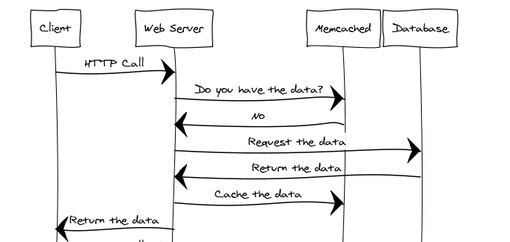
Memcached
memcached
Application DB

Slide 6
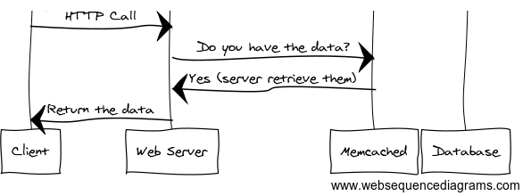
Memcached
memcached
Application DB

Slide 7
Consistent and efficient caching
memcached
memcached
Application DB
Cache is load once per host
Possible inconsistency

Slide 8
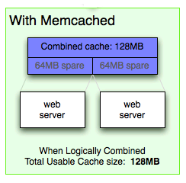
Consistent and efficient caching
memcached
memcached
memcached
Application DB
Application DB
Cache is load once per host
Possible inconsistency
Cache is load once per cluster
Data are 100% consistent

Slide 9
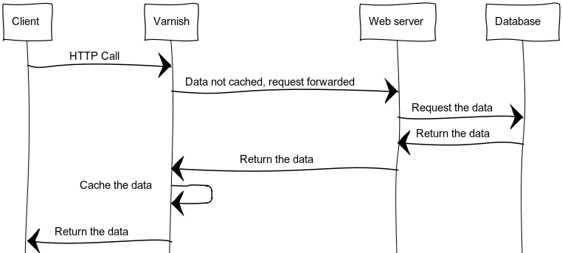
Varnish
Varnish
Application DB

Slide 10
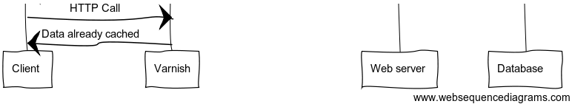
Varnish
Varnish
Application DB

Slide 11
Caching proxy
Less stress on server
Varnish:
  Store the whole request
Memcached:
  Store data from the DB
  Guarantee consistency
Varnish
Varnish
Memcached
Application DB

Slide 12
Benchmark using ab
(credits to Olga)
Bench has been done for the “most popular” query
  Default page
Bench specifications:
  Run 100 requests
  Variable number of concurrent clients (from 1 to 100)
  Each request is roughly 10kB of data
  Average on 100 executions has been kept
Test 3 scenarios:
  Without any cache
  Memcache only
  Memcache + varnish

Slide 13
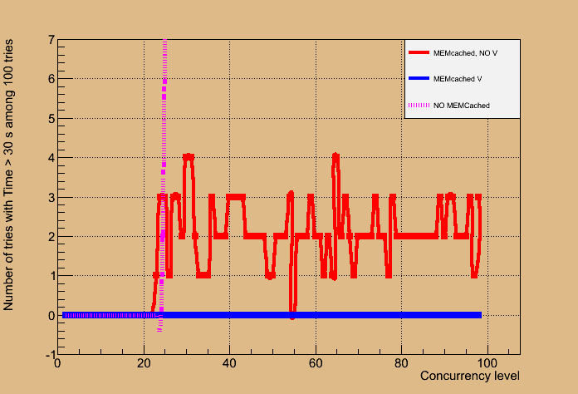
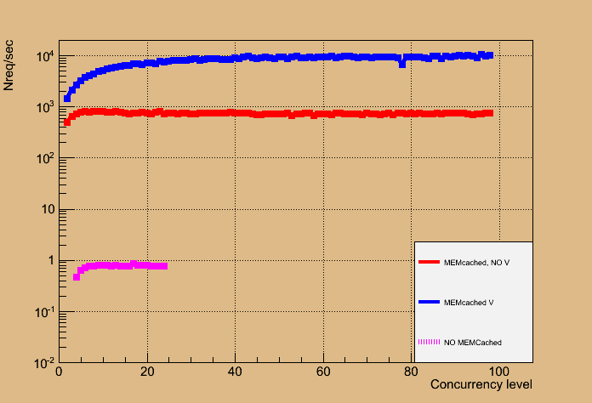
Benchmark using ab
(credits to Olga)
25 concurrent access max without caching
Few failures when only memcached
Varnish improves memcached’s performance

Slide 14
Enabling caching
Memcached:
  0-conf: install the RPM and start the service
  Comes for “free” with Django apps (decorator)
  Require development effort for legacy dashboard applications (all actions need to be adapted)
Varnish:
  Trivial configuration to run it on port 80 and get httpd on 8080 (or anything else)
  All HTTP request will be cached

Slide 15
Conclusion
Two main caching technologies has been tested:
  Backend caching and caching proxy
  Different roles
Bench are awesome but “useless”:
  Monitoring apps will never have this load
Is caching useless then? NO!!!
  Most popular queries can be pre-cached for allowing fast response.

