Slide 2


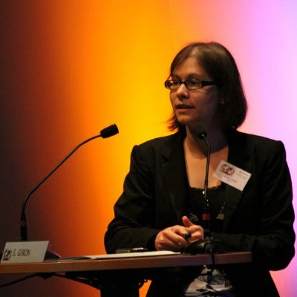
Radiation protection study for the HIE-ISOLDE project
S. Giron*, A.-P. Bernardes, A. Dorsival, D. Voulot and J. Vollaire**
* Marie-Curie Fellow now at EDF (France)
** Presenting

Slide 3
Outline
Radiation Protection challenges of HIE-ISOLDE
Shielding design for the post-accelerator
  X-ray measurements
  FLUKA calculations for the post-accelerator
Ion interactions after post-acceleration
  Operational parameters for HIE-ISOLDE
  Activation calculations
Radiation Monitoring System upgrade
Conclusions

Slide 4
RP challenges of HIE-ISOLDE
Field emission in RF cavities lead to X-rays
  Accelerating structures within a shielded enclosure
  BUT many feed-trough for services
  Keep the current radiological classification of the hall
Beam accelerated above the Coulomb barrier
  Possibility to have nuclear reactions
  Strong wish to keep the current working practices (access to experimental setup during operation)
RIB implantation (risk increases with intensity)
  Hot-spot for gamma emitters
  Contamination risks when opening the vacuum chamber or working on vacuum related equipment

Slide 5
Outline
Radiation Protection challenges of HIE-ISOLDE
Shielding design for the post-accelerator
  X-ray measurements
  FLUKA calculations for the post-accelerator
Ion interactions after post-acceleration
  Operational parameters for HIE-ISOLDE
  Activation calculations
Radiation Monitoring System upgrade
Conclusions

Slide 6
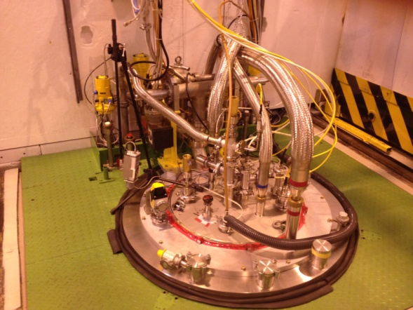
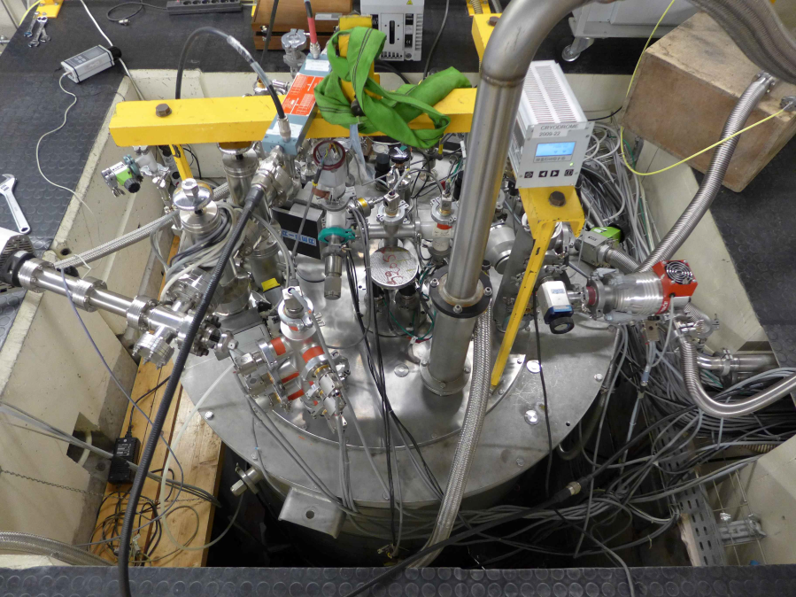
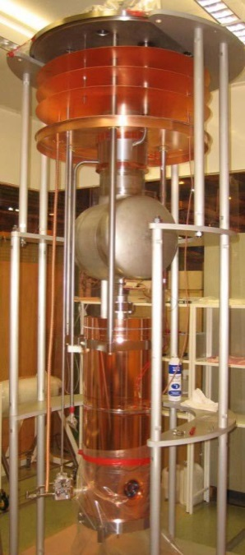
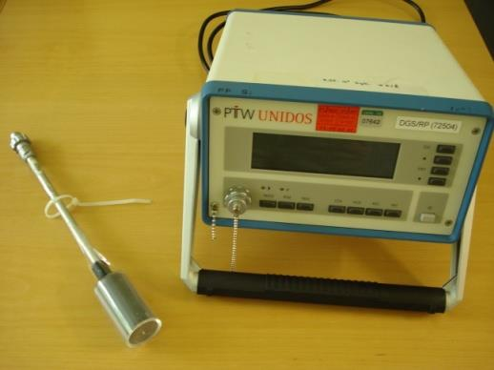
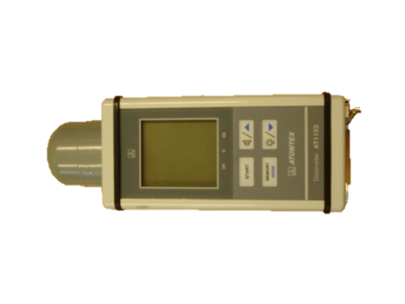
X-ray measurements
Measurements in SM18
Measurements in Orsay
Time dependent measurements + passive dosimeters

Slide 7
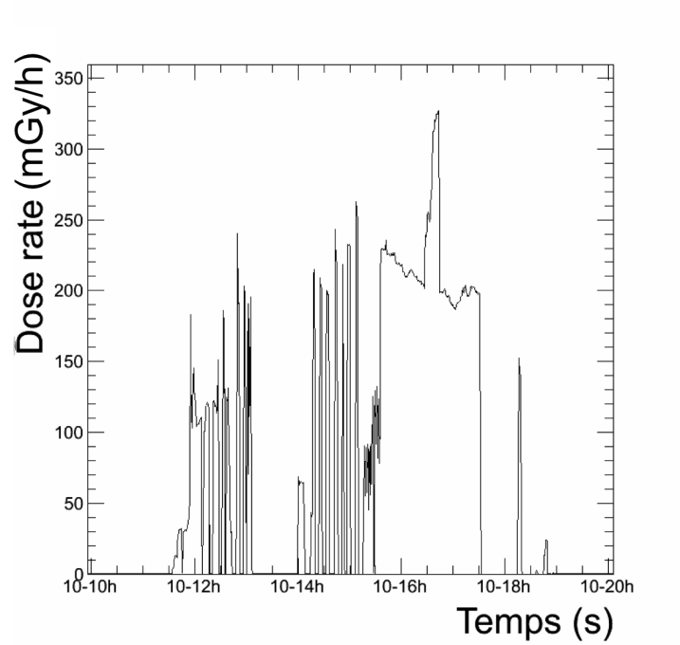
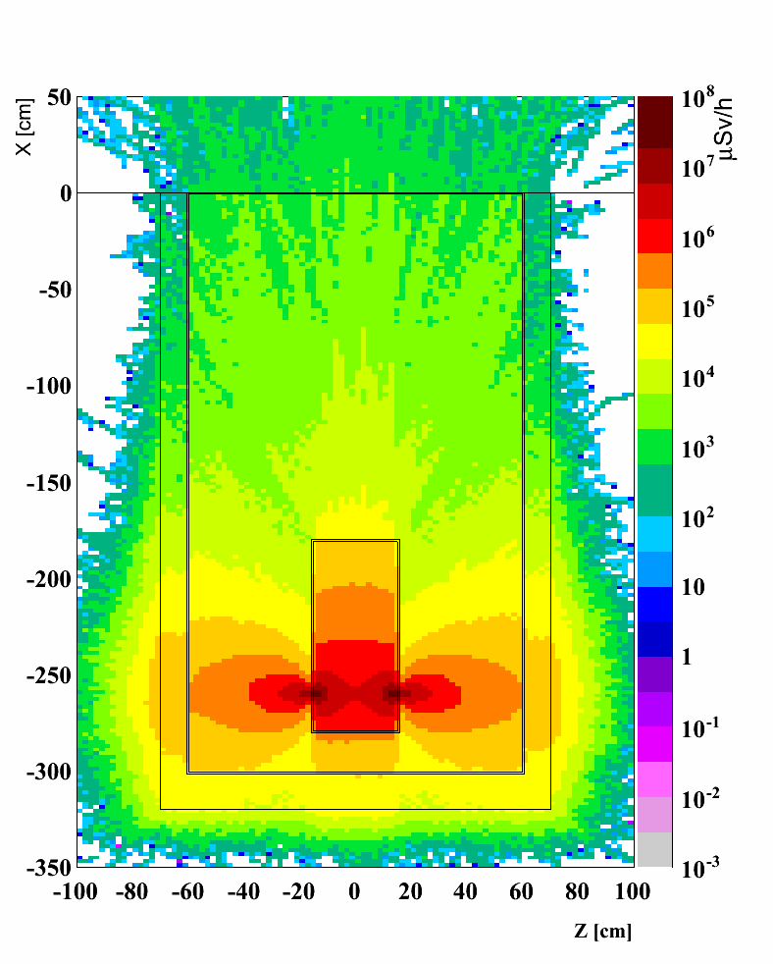
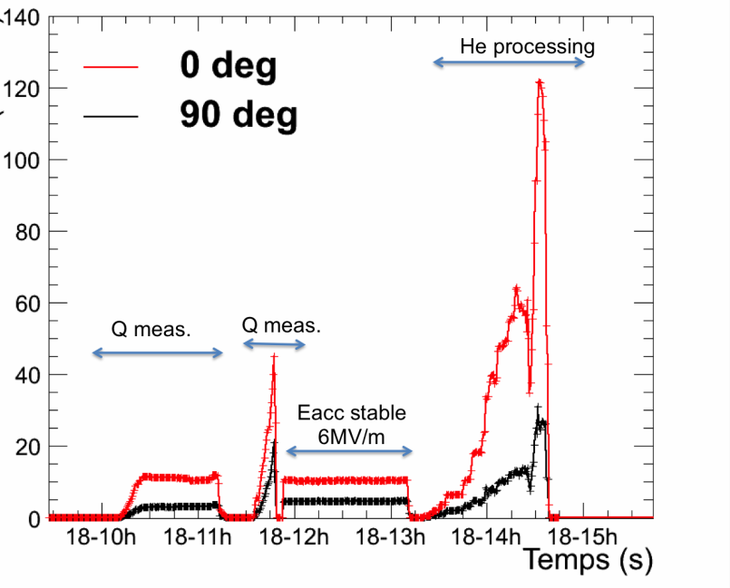
X-ray measurement results
Measurements in different phases (conditioning, Q…)
Implementation of the SM18 setup in FLUKA
  Emission of electrons at the beam axis level
  Electron emission rate derived from the measured dose rate
Measurements in Orsay
Measurements in SM18
FLUKA simulation
Dose Rate (mGy/h)

Slide 8
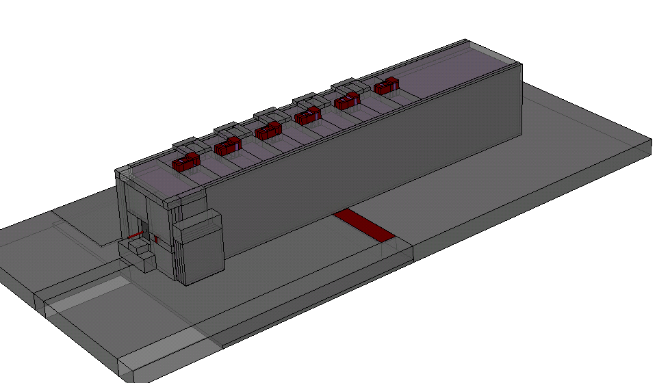
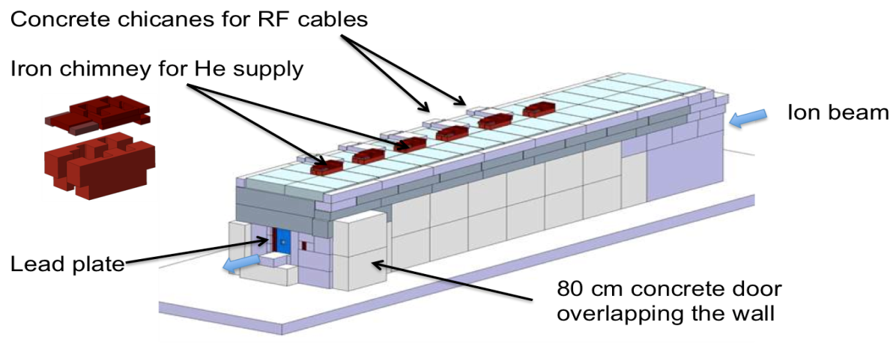
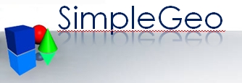
FLUKA calculations
Detailed model of the accelerator implemented in FLUKA
Source term based on X-ray measurements (900 keV e⁻)
Considering the most penalizing case (conditioning of all cavities at the same time)
3D model
FLUKA geometry

Slide 9
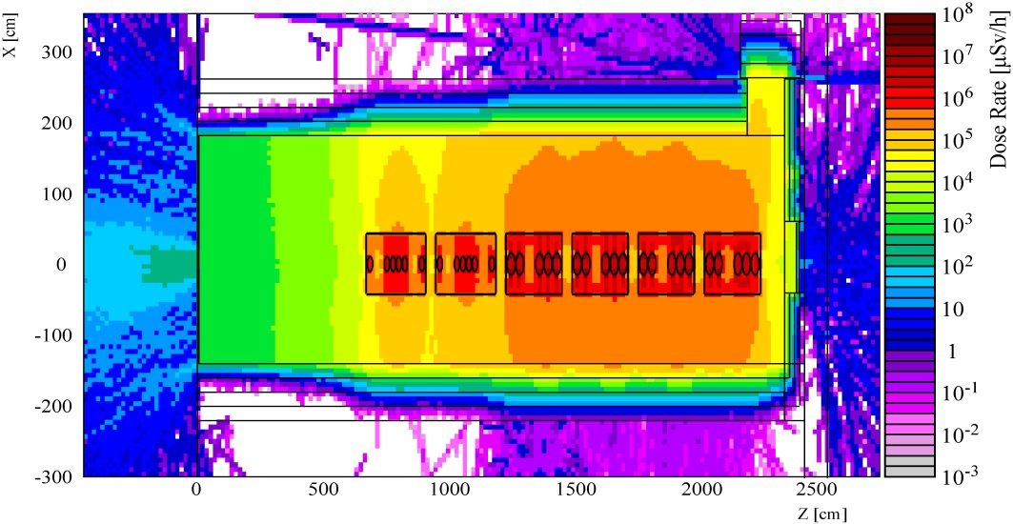
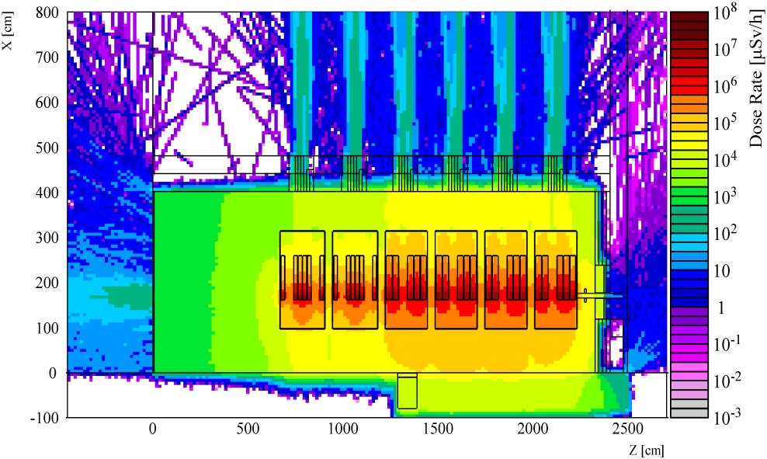
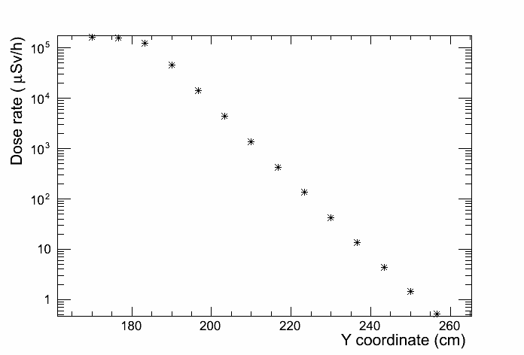
Some results
RF interlocked with access
10⁵ dose reduction factor
Exclusion area on the roof (RF on)
Simulations for Phase 1 and 2
Conservative scenario…

Slide 10
Outline
Radiation Protection challenges of HIE-ISOLDE
Shielding design for the post-accelerator
  X-ray measurements
  FLUKA calculations for the post-accelerator
Ion interactions after post-acceleration
  Operational parameters for HIE-ISOLDE
  Activation calculations
Radiation Monitoring System upgrade
Conclusions

Slide 11
Operational parameters
RIBs delivered at very low intensity (~ppA)
Stable beam (C, N, O, Ne or Ar) for setup from REXEBIS rest gas or gas injection
  20 e-pA (beam tuning on a weekly basis)
  Exceptionally (typically once a year) up to 500 e-pA for commissioning and for machine development
Gas injection is done by experts only and can be destructive (in case of gas leaked in EBIS)
1 p-e pA = 6.25x10⁶ particle-charge /s

Slide 12
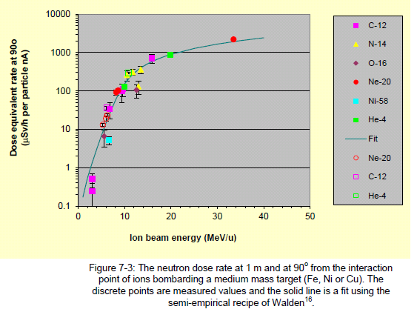
Prompt dose rate
Analytical approach for different combinations of beam/target
Neutron dose rate @ 1 m and 90 degree
Verified with FLUKA
(approach described in ISAC-II safety file)
Area Classification | Ambient Dose Rate (permanent workplaces) | Ambient Dose Rate (Low occupancy)
Supervised Radiation Area | <3 μSv/h | <15 μSv/h
Simple Controlled Radiation Area | <10 μSv/h | <50 μSv/h

Slide 13
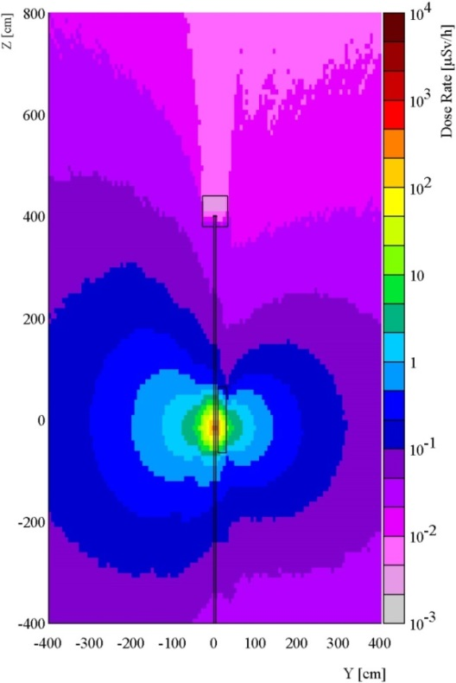
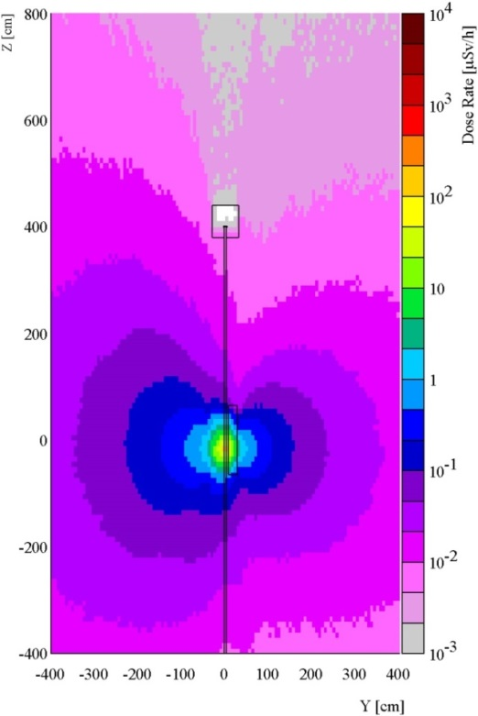
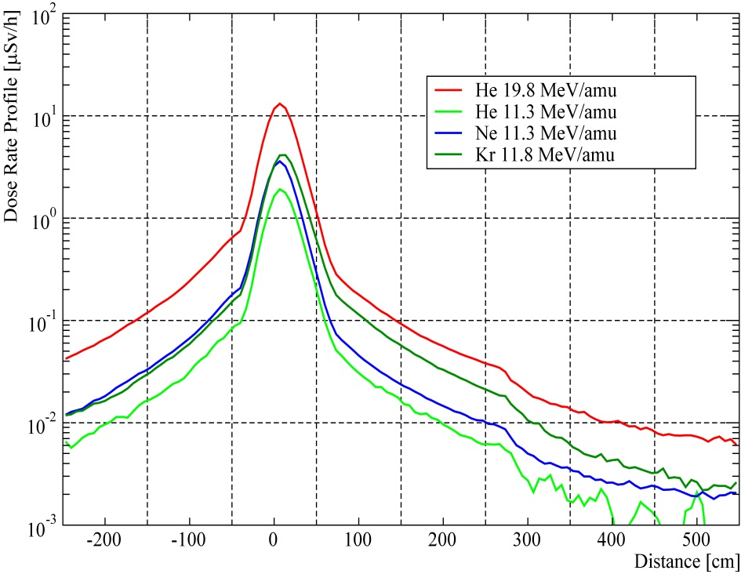
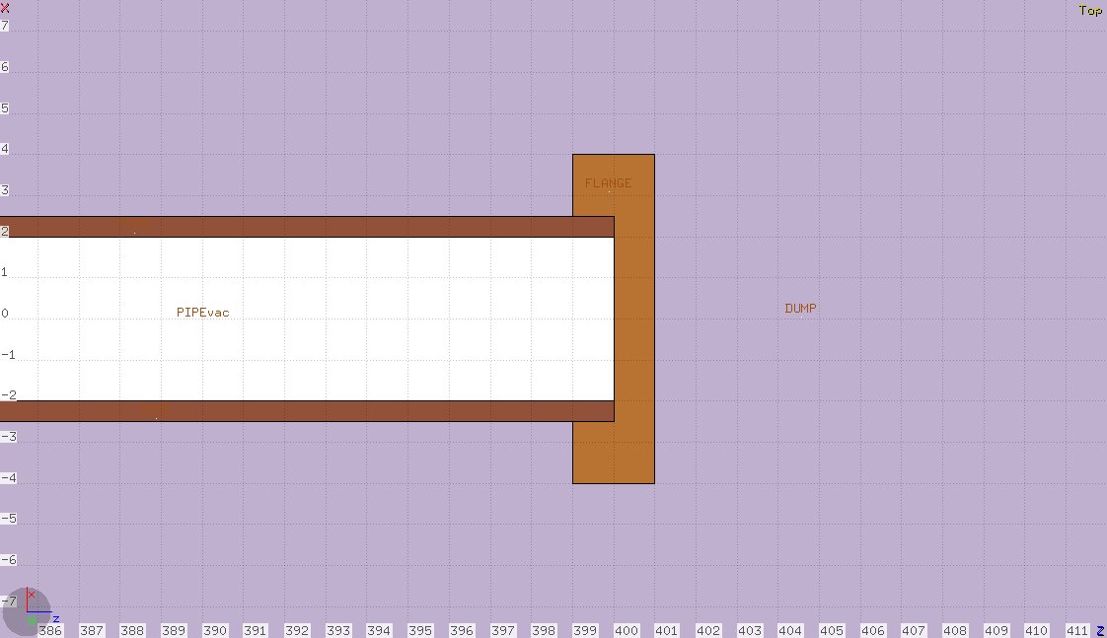
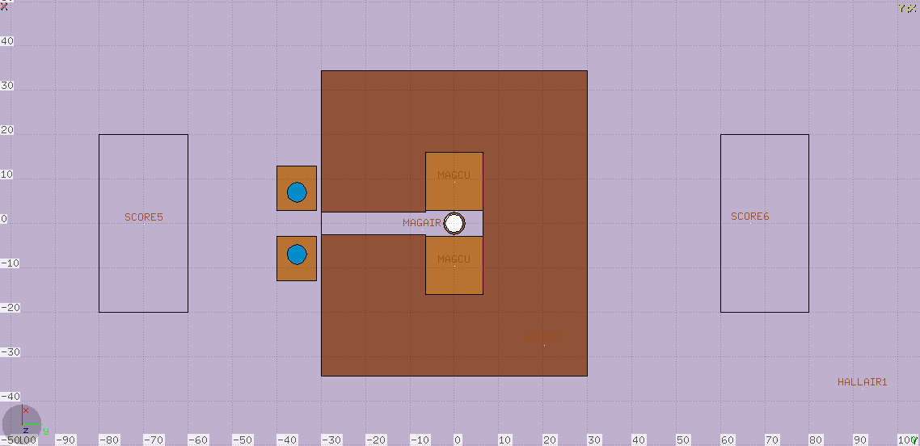
Ion interactions (FLUKA)
Example full beam loss of 1 ppA
Helium
19.8 MeV/amu
Helium
12 MeV/amu
Generic geometries
(dipole, flange or FC)
Example full beam loss of 1 ppA
Very good agreement with the analytical approach
used in the ISAC-II safety file

Slide 14
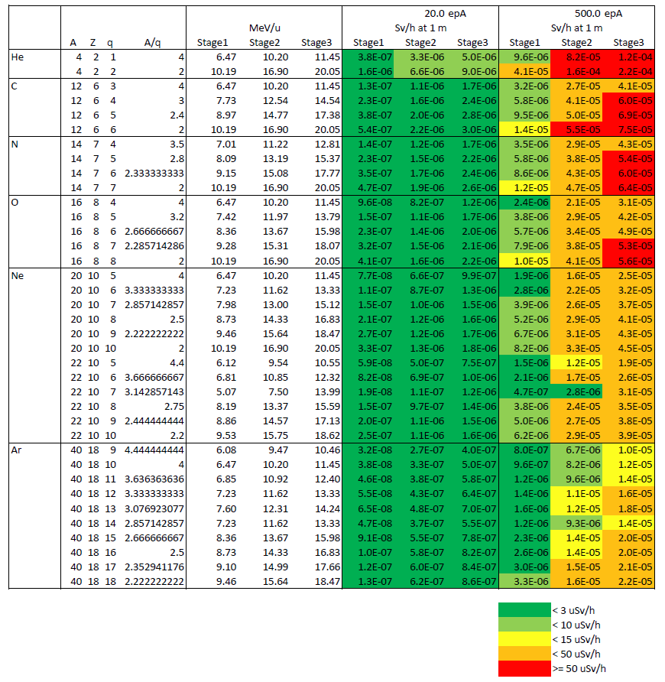
Classification / mitigations
Optimization (posting)
for beam tuning with 20 epA
Special measure for emittance measurements (beam permit, exclusion areas ….)
Experimental setups remain accessible during operation and standard tuning periods
Dose rate @ 1 m / 90 degree in Sv/h

Slide 15
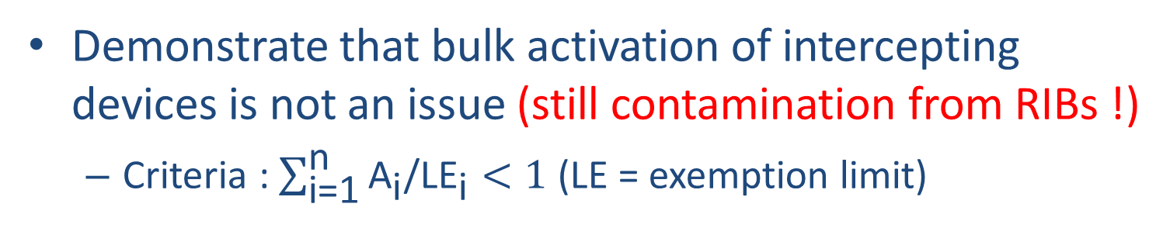
Beam induced activation
Demonstrate that bulk activation of intercepting devices is not an issue (still contamination from RIBs !)
  Criteria : $\sum_{\text{i}\text{=1}}^{\text{n}}{{\text{A}}_{\text{i}}\text{/}{\text{LE}}_{\text{i}}}<1$ (LE = exemption limit)
 | Nuclide | T_{1/2} | LE_{i} (Bq) | A_{i} (Bq) | A_{i}/LE_{i}
Copper target | ⁷³As ⁶⁸Ga ⁶⁸Ge ⁶⁵Zn ⁶³Ni ⁶⁰Co ⁵⁷Co ⁵⁶Co ⁵⁵Fe ⁵⁴Mn ³H | 80.3 d 67.7 m 270.8 d 244.2 d 100.1 y 5.3 y 272.0 d 77.3 d 2.7 y 312.5 d 12.3 y | 4E+04 1E+05 8E+03 1E+02 7E+04 1E+02 1E+03 1E+02 3E+04 1E+02 1E+05 | 4.5E+00 ± 0.96 % 3.1E+01 ± 1.53 % 3.1E+01 ± 1.53 % 2.5E+01 ± 1.02 % 8.6E+00 ± 1.43 % 1.2E+01 ± 3.25 % 3.5E+01 ± 1.37% 1.2E+00 ± 2.37% 5.5E+01 ± 1.36% 1.6E+01 ± 2.20% 1.3E+02 ± 0.99% | 1.1E-04 3.1E-04 3.9E-03 2.5E-01 1.2E-04 1.2E-01 3.5E-02 1.2E-02 1.8E-03 1.6E-01 1.3E-03
 |  |  |  |  | Sum = 0.00141
No activation of the water in the dipole cooling circuit

Slide 16
Outline
Radiation Protection challenges of HIE-ISOLDE
Shielding design for the post-accelerator
  X-ray measurements
  FLUKA calculations for the post-accelerator
Ion interactions after post-acceleration
  Operational parameters for HIE-ISOLDE
  Activation calculations
Radiation Monitoring System upgrade
Conclusions

Slide 17
Monitoring upgrade
Additional radiation monitors needed to ensure the proper area classification
  Unsufficient number of monitor in some areas
  New projects
Old monitoring system not scalable (ARCON)
New architectural options
  gamma monitoring (GRAMS)
  RAMSES (LHC standard)
Scheduling: LS1 was a good time window

Slide 18
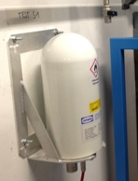
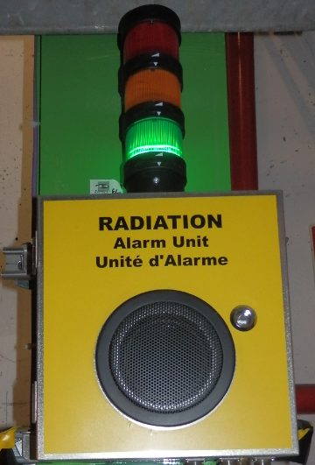
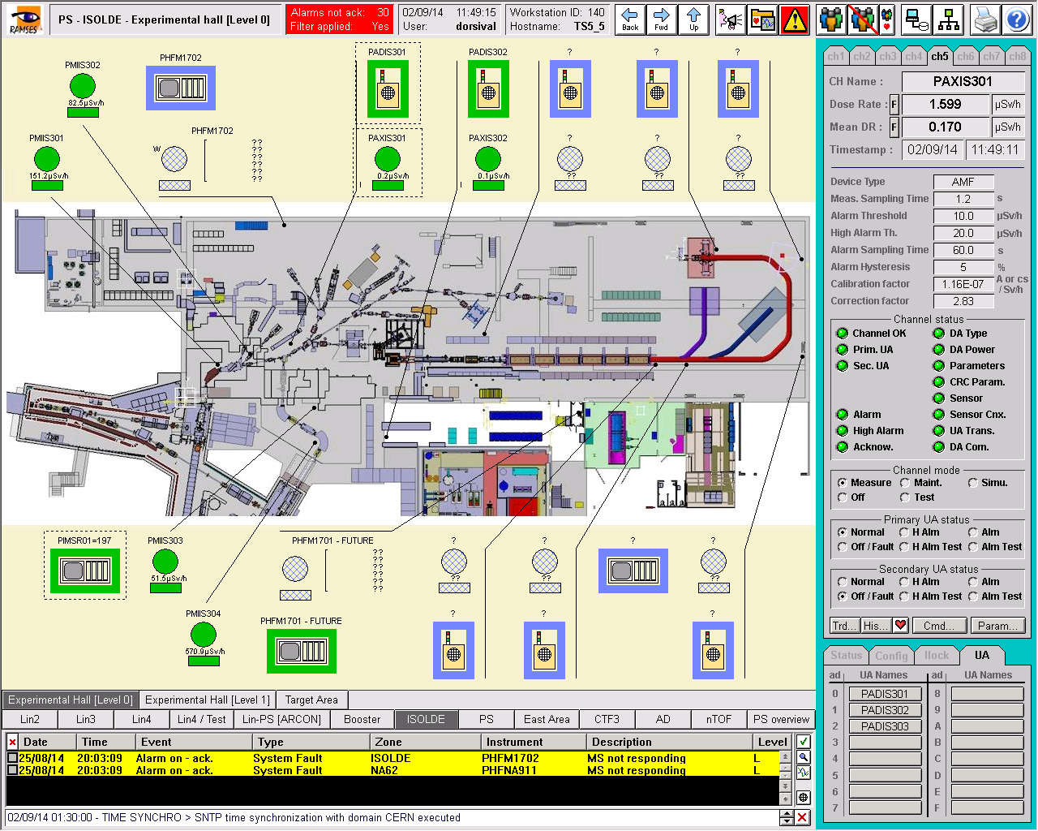
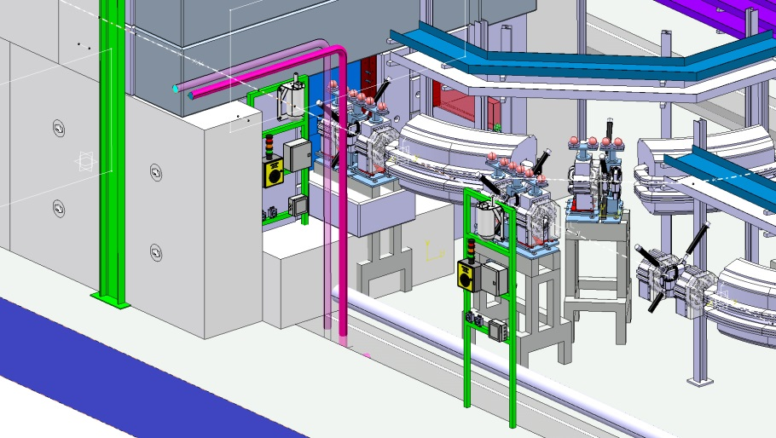
New RAMSES system
Ionisation chambers, induced activity / X-ray monitors, Hand foot monitors…..

Slide 19
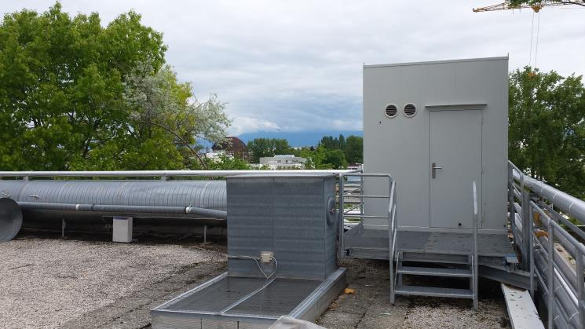
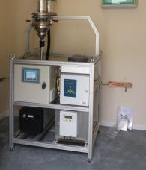
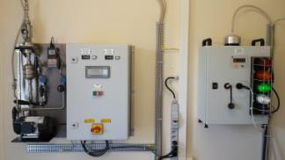
Environmental monitoring
Monitoring of facility releases
Aerosols
Sampler
Gas monitor
Iodine Sampler
Radon/Thoron
Monitor
INEMIA project

Slide 20
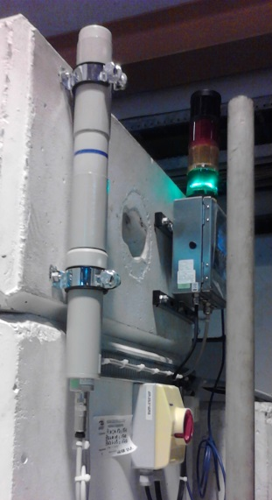
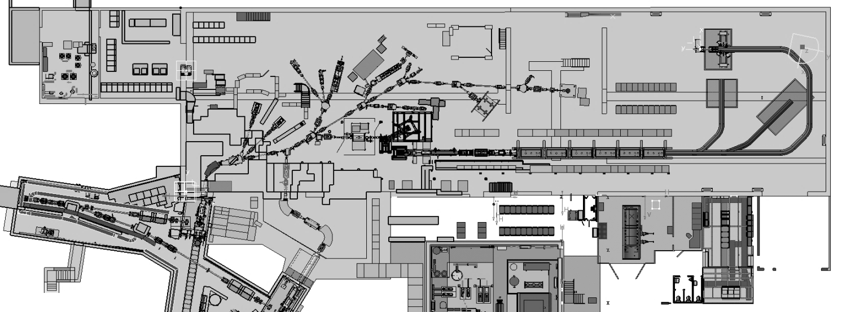
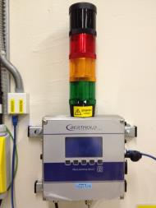
GRAMS in the hall
PAGIS602
PIMSM10=170PAGIS416
PADIS410
PIMSM04=170PAGIS405
PADIS404
PIMSM06=170PAGIS408
PADIS406
PAGIS415
PIMSM01=197PAGIS601
PADIS601
PIMSM08=170PAGIS412
PADIS408
PIMSM09=170PAGIS414
PADIS409
PAGIS406
PAGIS411
PAGIS404
PAGIS409
PAGIS410
PAGIS413
PIMSM01=170PAGIS401
PADIS401
PIMSM02=170PAGIS402
PADIS402
PIMSM03=170PAGIS403
PADIS403
PIMSM05=170PAGIS407
PADIS405
PIMSM11=170PAGIS501
PADIS509

Slide 21
Conclusions
Complete radiological analysis for the new post-accelerator
  Post-accelerator shielding (X-ray measurements and FLUKA calculations)
  Prompt dose due to ion beams interactions
New monitoring system will facilitate future upgrades of ISOLDE (MEDICIS, TSR….)
Thanks to partners visited in the frame of the CATHI program (INFN Legnaro, Triumf, GANIL, IPNO, CEA where Sandra made her secondment…)

Slide 22
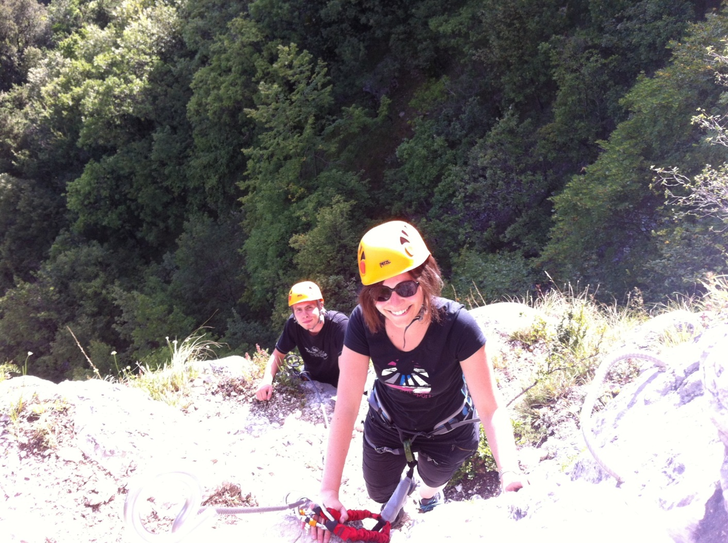
Questions ?

Slide 23
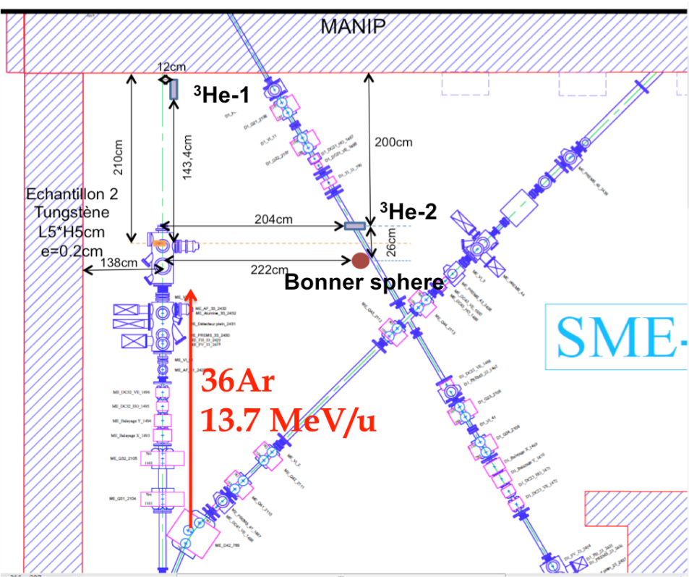
Experimental benchmark
Uncertainty on beam intensity prevent to be conclusive
 | Interaction model | Evaporation model | Evolution model
PHITS 2011.2b-5 | BME | SDM | DCHAIN SPD2001
 |  | GEM
FLUKA 2.64 | QMD | New evap model (heavy fragments) | RADDECAY

Slide 24
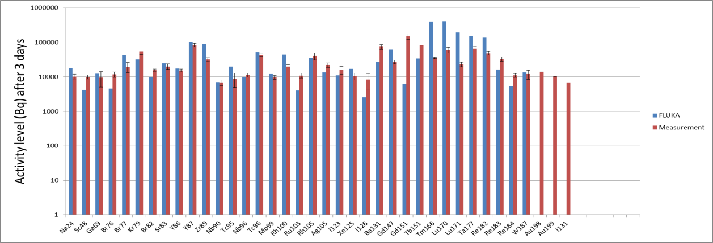
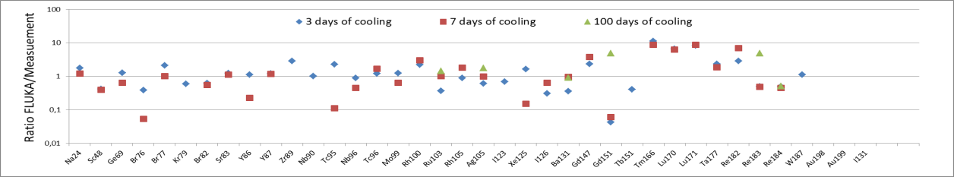
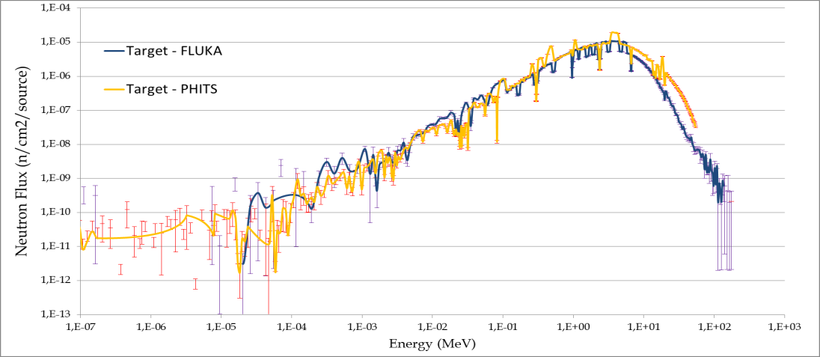
Experimental benchmark
Uncertainty on beam intensity
prevent to be conclusive

