Slide 1




High Resolution Separator
Mathieu Augustin (EN-RBS-STI)
HIE-ISOLDE Workshop
September 2014
Powerpoint Templates
Notes:
The HRS is one of the two isotope separators, part of the ISOLDE facility located alongside CERN PS Booster. It is a mass spectrometer...etc. It has a significant role for experiments in which isobaric contamination from abundantly produced isotopes can be a major disturbance to measurements.

Slide 2
Outline
The High Resolution Separator and its current situation
The new constraints
Design proposals
Magnet features
The technology: pole face winding coils
The testbench

Slide 3
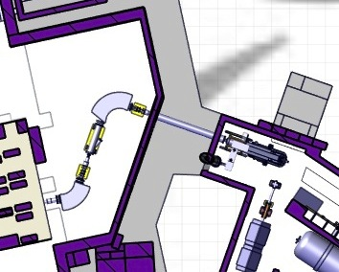
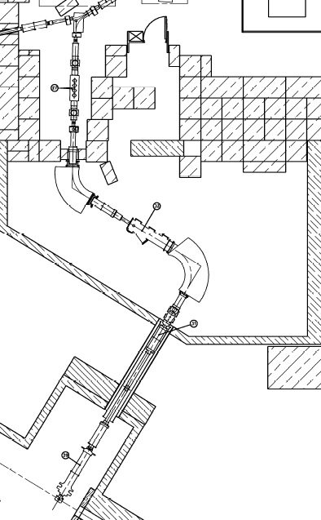
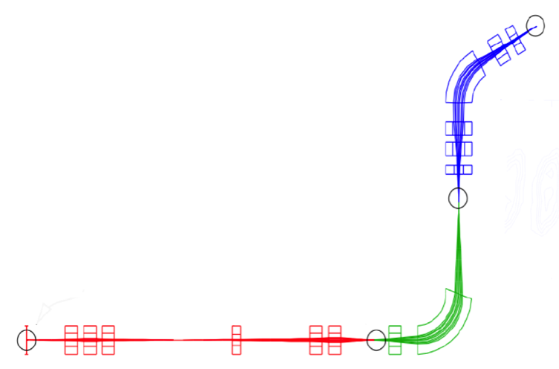
The High Resolution Separator
Current status
RFQBC
MG60
MG60
MG90
Layout view of the separator room
(courtesy of V. Barozier
Beam
source
MG90
Optical layout of HRS (courtesy of T. Giles)
Beam
source
Layout view of the separator room
Notes:
Include current separation of HRS (beam distrib)

Slide 4
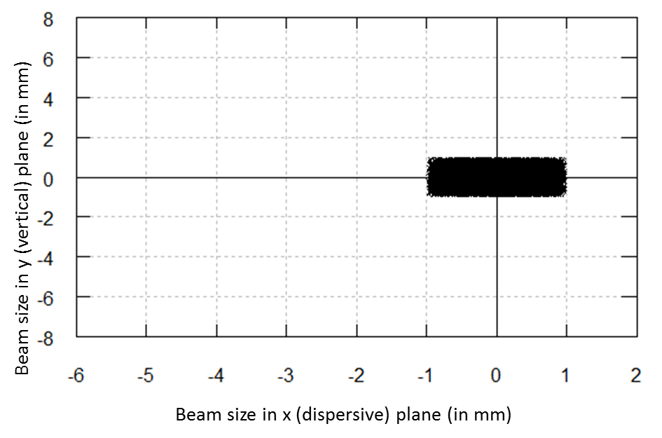
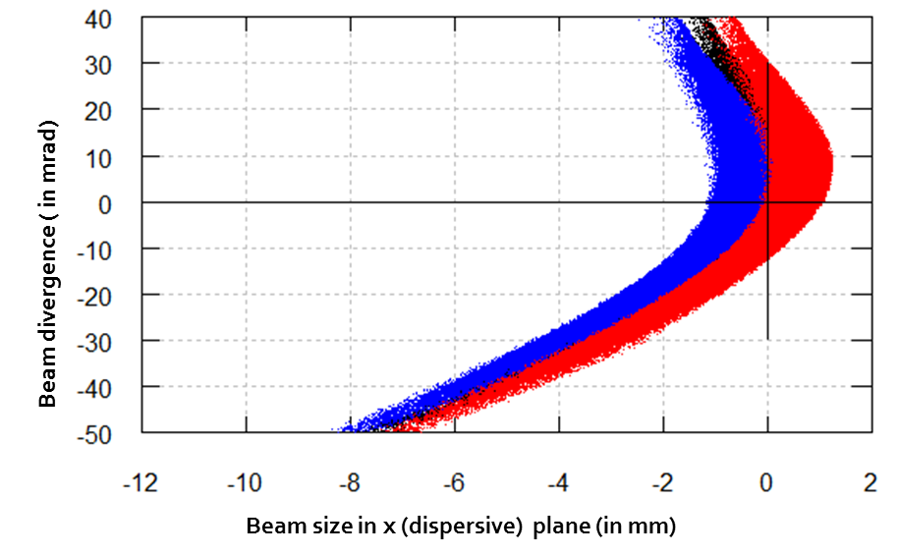
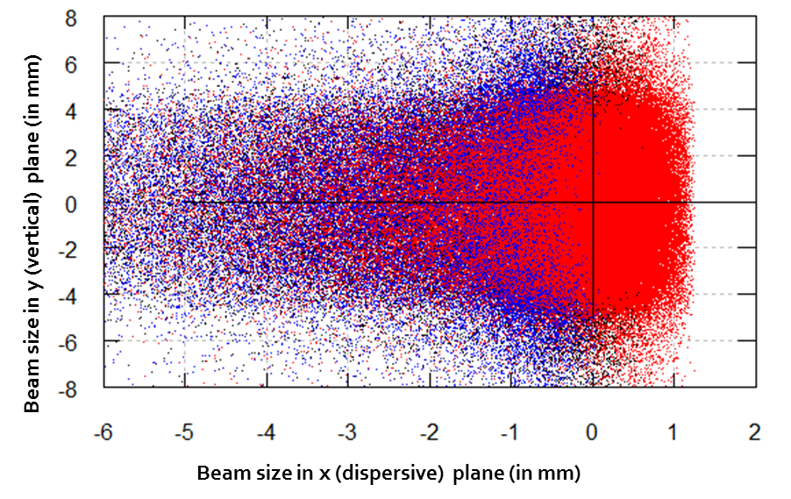
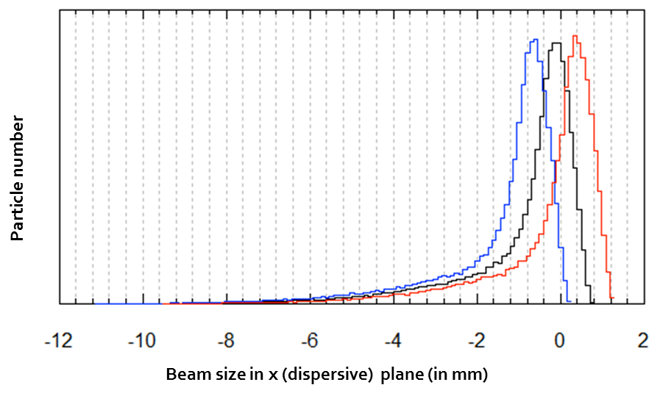
The High Resolution Separator
Current HRS optical performances
OBJECTIVE :
  Resolution R=M/ΔM=20 000
Layout view of the separator room
(courtesy of V. Barozier
Attainable mass resolution R=5000
for beam source of emittance ε=20π.mm.mrad
Notes:
Include current separation of HRS (beam distrib)

Slide 5
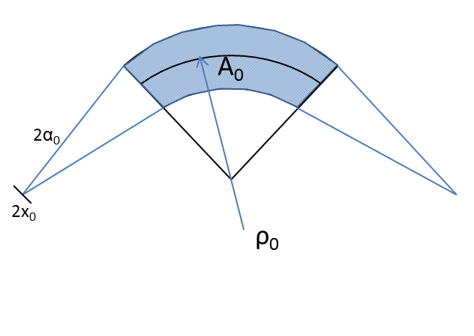
The High Resolution Separator
How to reach high resolution ?
Dispersion D
Beam emittance
M_{x} magnif. Factor
x₀ beam size at source
Eliminate higher order terms
(=aberrations)
Notes:
Dispersion : area occupied by the beam in the magnet

Slide 6
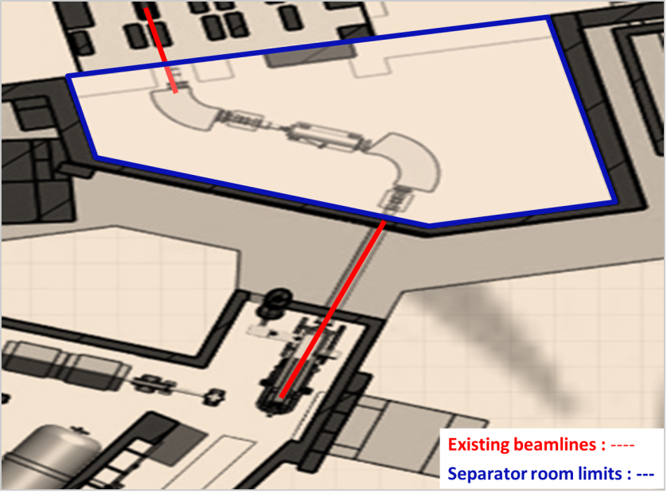
Beam emittance factor
➔ RFQ displacement
The High Resolution Separator
RFQ-CB displacement
RFQ
Moving of the RFQ-CB
Ensuing constraints :
  Beamlines installations and positioning
  Separator room size
Layout view of the separator room
OBJECTIVE :
  Resolution R=M/ΔM=20 000
  for a beam source emittance ε=3π.mm.mrad

Slide 7
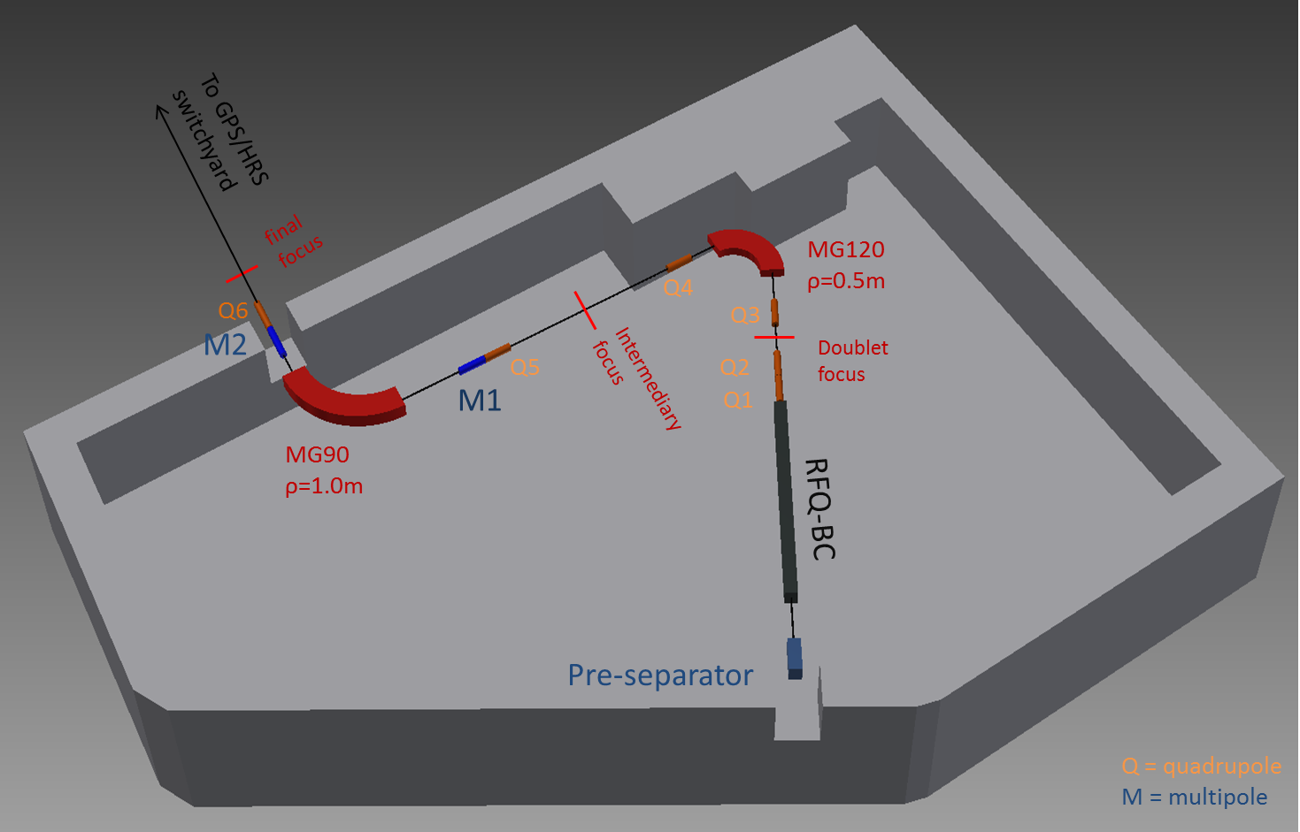
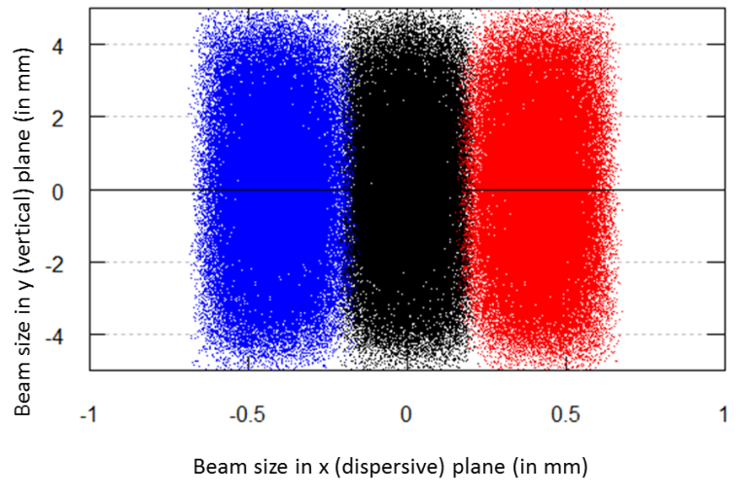
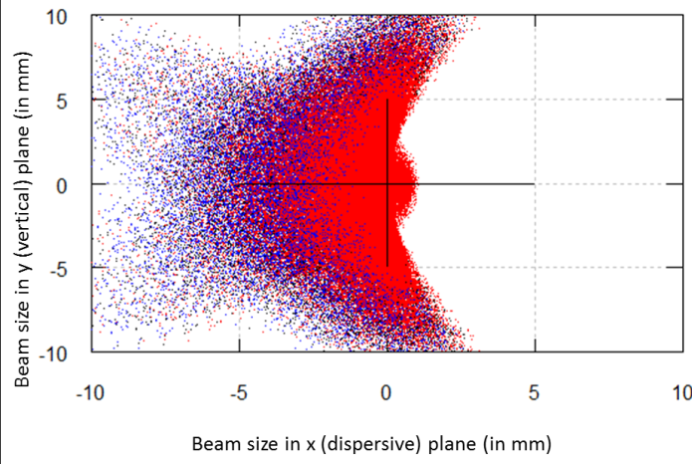
Design proposal #1
Resolution at int.
focus = 20 000
Resolution at final.
focus = 1 000
Schematic 3D view of the layout #1
Notes:
Good dispersion but bad resolution of higher order effects
Overaall resolution low at fina lfocus
Basic principles of the design : quad doublet : their function (quick), advantage (higher order terms)
Multipoles element bracketing the 90deg magnet

Slide 8
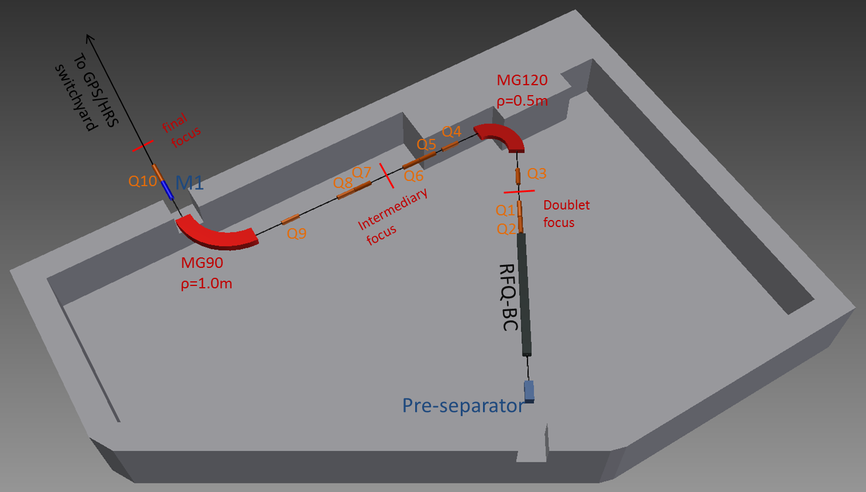
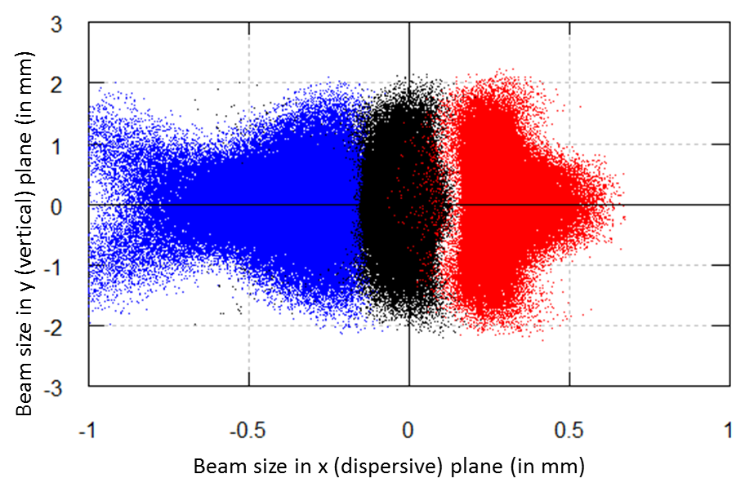
Design proposal #1bis
Resolution at int.
focus = 20 000
Resolution at final
focus = 16 000
Schematic 3D view of the layout #1bis
Notes:
Good dispersion but bad resolution of higher order effects
Overaall resolution low at fina lfocus
Basic principles of the design : quad doublet : their function (quick), advantage (higher order terms)
Multipoles element bracketing the 90deg magnet
Neighbouring beam heavily distorted : hard to tune

Slide 9
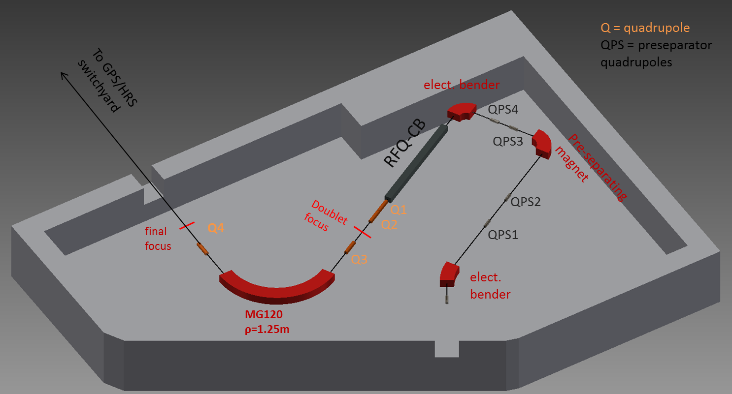
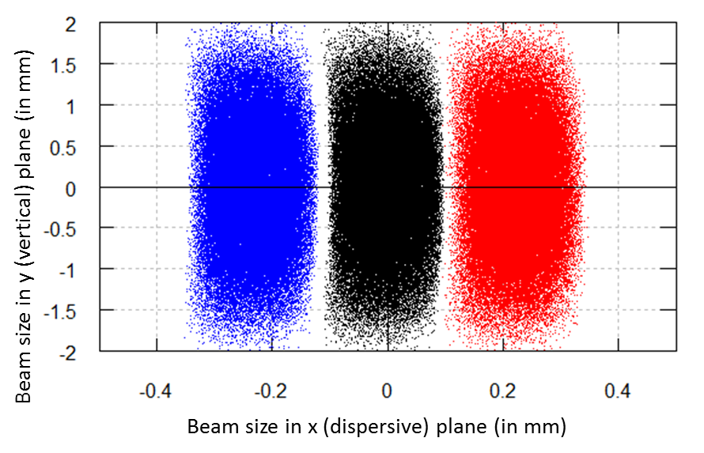
Design proposal #2
Resolution at final
focus = 20 000
Schematic 3D view of the layout #2
Beam emittance ε=3π.mm.mrad
R = 20 000 for more than 99% transmission of pure beam
R ~ 23 000 for 90% transmission of pure beam
Notes:
For a beam source emittance ε=3 π.mm.mrad, numerical simulations performed with program COSY Infinity indicate that the resolution at first order amounts to R=23 500, and at third order to R= 23 000. Monte Carlo simulation results are shown hereunder, for a beam set of 100 000 particles, at neighbouring masses such that m/∆m=20 000. Results show a transmission of slightly more than 99% of pure beam out of 100 000 particles for mass M=100. If one is ready to lose some beam, numerical simulations show that the resolution can be pushed up to R ~ 23 000 for a transmission of 90% of pure beam.

Slide 10
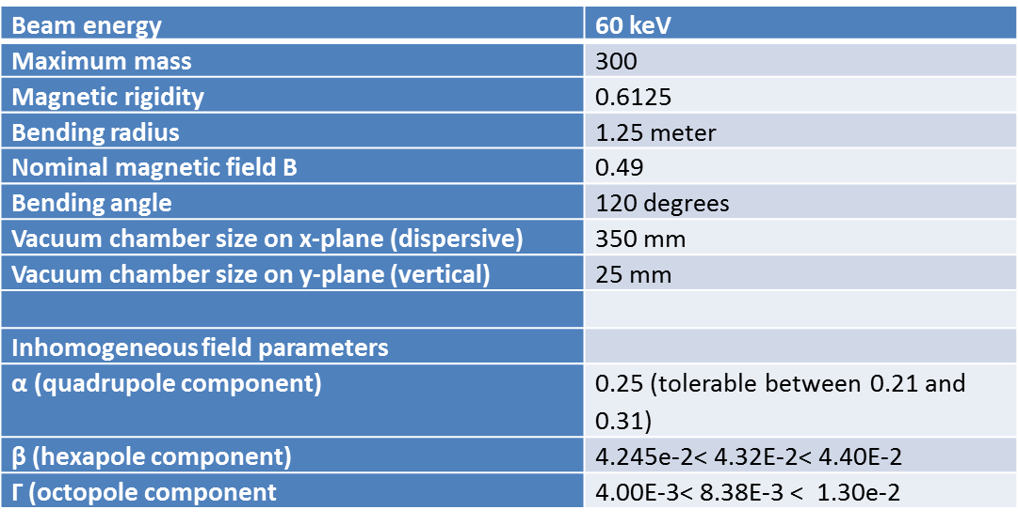
Magnet features
Optical parameters
List of parameters for the
mechanical design of the magnet
Notes:
Considering the high bending angle, using a entrance/exit profile would lead to the use of at least 30 degrees (to check)
Complicated for the beamline (next elements such as quad)
Inhomogeneous field gives more flexibility in the choice of the quadrupole component
Easy tuning done with knob (to inject current in order to simulate the value of coefficientS)
Back up slide for effects of hexa and octopole on tails of beam distribution. Helps for reaching High Resolution (compare to HRS current casE)

Slide 11
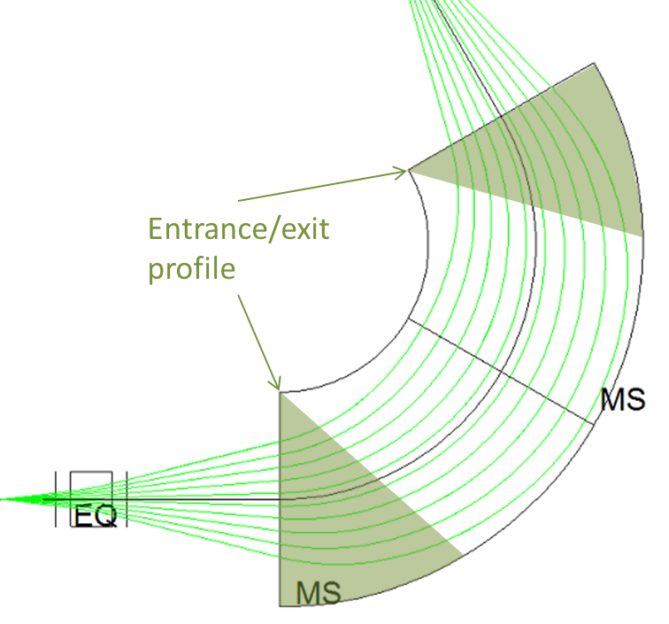
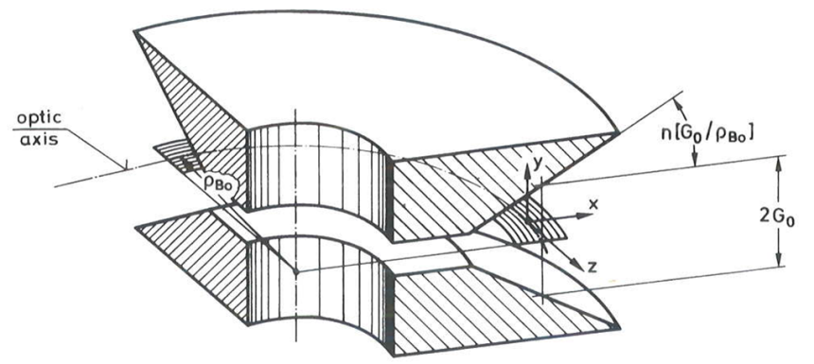
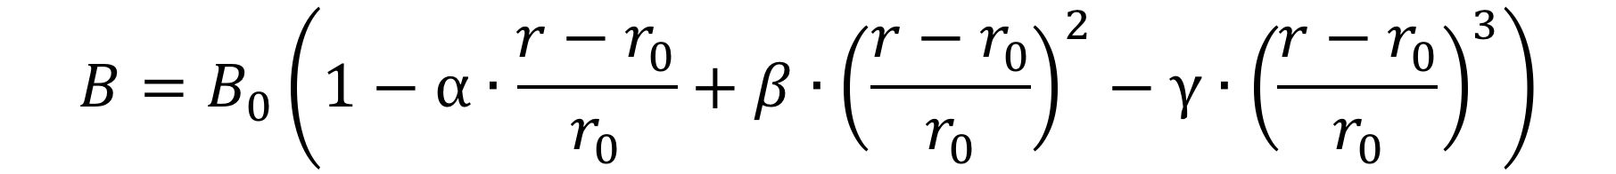
Magnet features : optical parameters
No entrance/exit angular profile
Radially Inhomogeneous Magnetic field :
(with α, β and γ respectively being the
quadrupole, sextupole and octopole components)
Beam enveloppe for design #2 in lab coordinates (x,z), featuring a magnet using entrance/exit profiles (producing a quadrupole component)
Example of magnet design, producing a radial inhomogeneous field, using inclined pole faces.
Plane pole faces → easier to machine
Inhomogeneous field produced with pole face windings
Notes:
Considering the high bending angle, using a entrance/exit profile would lead to the use of at least 30 degrees (to check)
Complicated for the beamline (next elements such as quad)
Inhomogeneous field gives more flexibility in the choice of the quadrupole component
Easy tuning done with knob (to inject current in order to simulate the value of coefficientS)
Back up slide for effects of hexa and octopole on tails of beam distribution. Helps for reaching High Resolution (compare to HRS current casE)

Slide 12
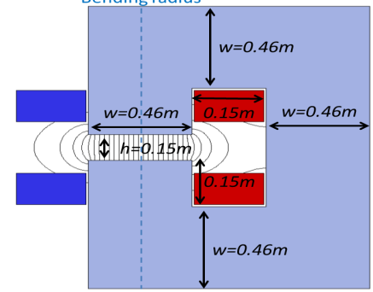
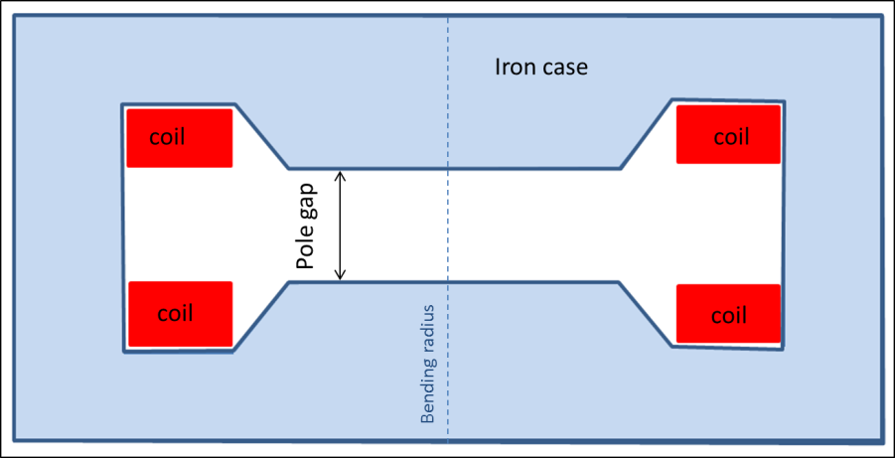
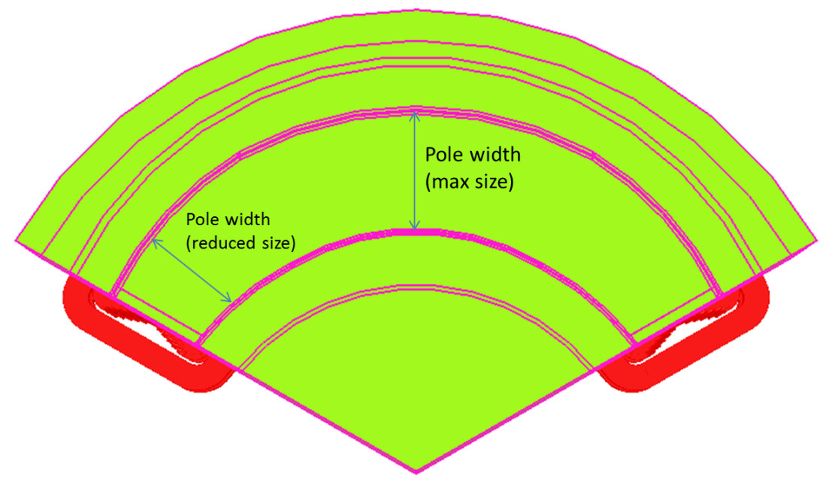
Magnet features
H type magnet → mechanically more stable, possibility of better pole face machining
Yoke made of laminated steel
→ reduction of eddy currents, allowing an increase in cycling speed (~1min VS 15min)
Changing pole face width
→ saving of material (~8%)
Notes:
Considering the high bending angle, using a entrance/exit profile would lead to the use of at least 30 degrees (to check)
Complicated for the beamline (next elements such as quad)
Inhomogeneous field gives more flexibility in the choice of the quadrupole component
Easy tuning done with knob (to inject current in order to simulate the value of coefficientS)
Laminated steel : more complicated to build,b ut nowadays handable
Reduces cycling speed : 15min
Back up slide for effects of hexa and octopole on tails of beam distribution. Helps for reaching High Resolution (compare to HRS current casE)

Slide 13
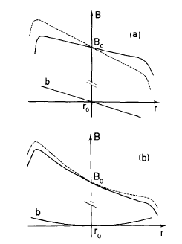
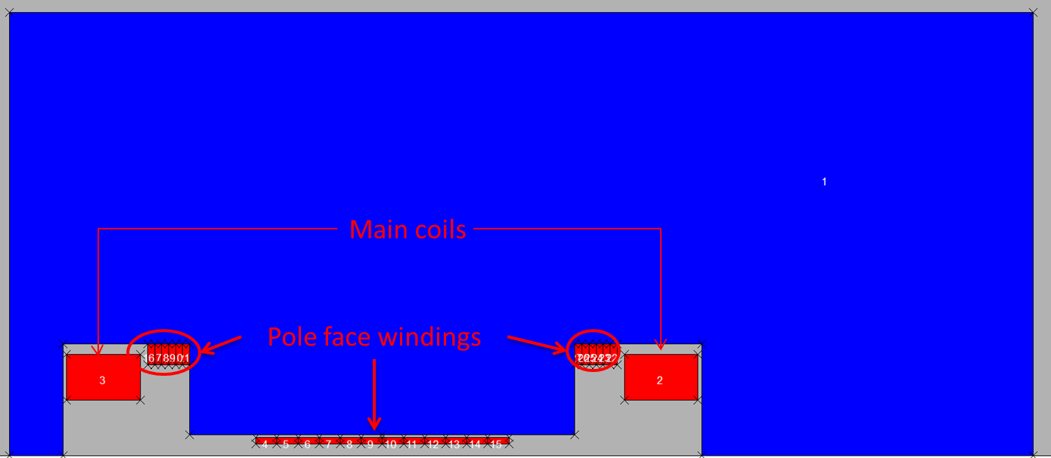

The High Resolution Separator
Pole face windings
Iron case
Effect of pole face winding for α and β component in the main field distribution. Dashed curves represent the additional field necessary to modify α and β
Schematid view in cross section of the new HRS magnet (H-type), featuring the pole face windings technology (picture credit to M. Breitenfeldt
Optimize currents in the conductors to match the field composition
➔
Current density in the conductor : up to 1A/mm2 (with air cooling)
➔for the studied magnet : 0.2 A/mm2 were necessary
Higher order term coefficients are adjustable by changing current
➔High degree of freedom
Notes:
Space available due to the expected low height of the beam.
23mm at worst in height, the gap foreseen is 60mm.
Technology avoids tedious pole shimming to reach the correction coefficients.
Just rogowski profile is performed for adjusting magnetic length and avoiding field leaking (or fringe fields)
Calibration needed for the first time :
Once calibration is done, task should be easier
EXTRA:
Size of coils calculated including the cooling water ducts
With max magnetic field of 0.5T, ampere turns per coil calculated to be NI=N*h / 2 eta * mu0 = 12.3 kA
Pole gap as small as possible, but needs space for beam, vacuum chamber and pole face windings → h=60mm

Slide 14
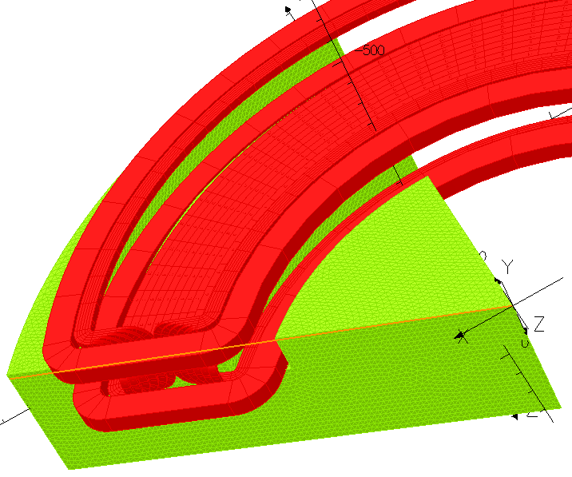
The High Resolution Separator
Pole face windings
Iron case
Schematic view in cross section of the new HRS magnet (H-type), and partial view in 3D, featuring the pole face windings technology (picture credit to M. Breitenfeldt)
Avoid field lines saturation ➔ adapting the design

Slide 15
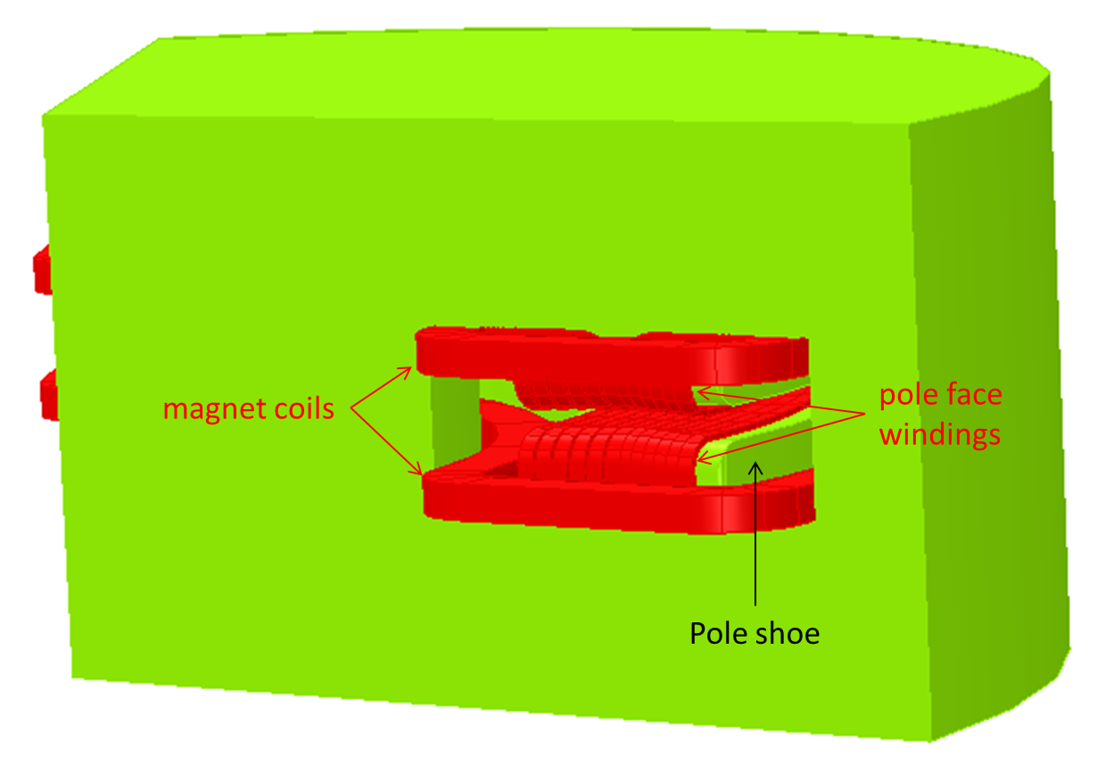
The High Resolution Separator
3D view of the new HRS magnet (H-type), featuring the pole face windings technology (picture credit to M. Breitenfeldt)

Slide 16
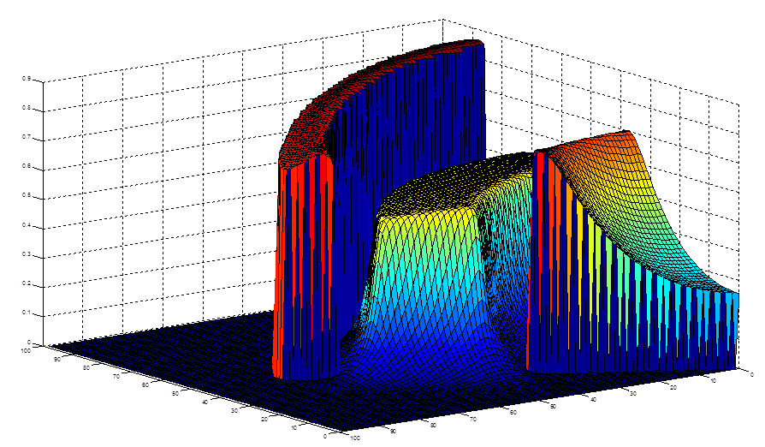
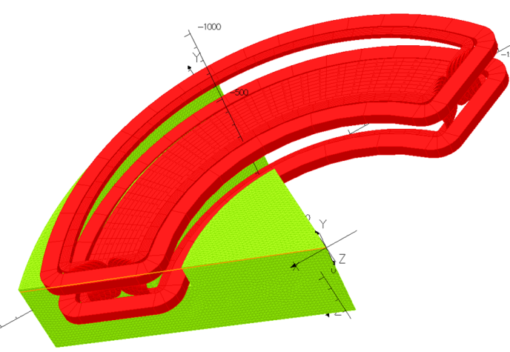
The High Resolution Separator
3D magnetic field map of the new HRS magnet for a section of a magnet, computed with Opera software (picture credit to M. Breitenfeldt)
Poleface windings allow the adjustment of the magnetic field along the beam axis.
Rogovski profile at pole entrance and exit adjusts magnetic length.
Excitation of return yoke is not exceeding 0.9T for max field at beam axis (0.5T)
→ the excitation is in the linear regime.

Slide 17
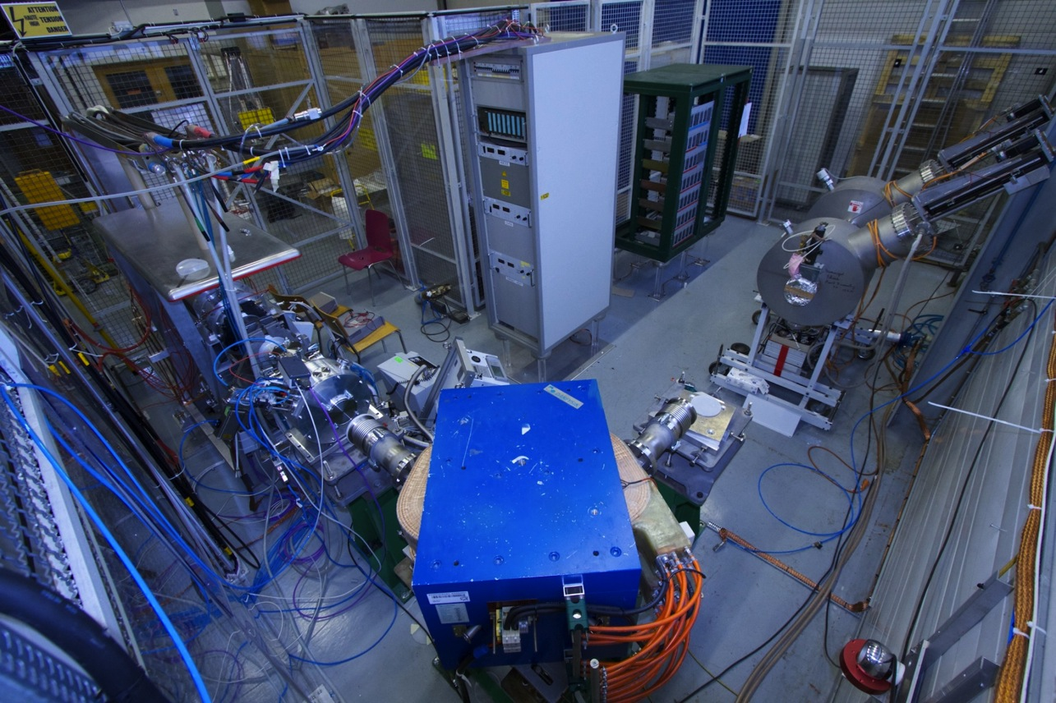
The Offline Separator

Slide 18
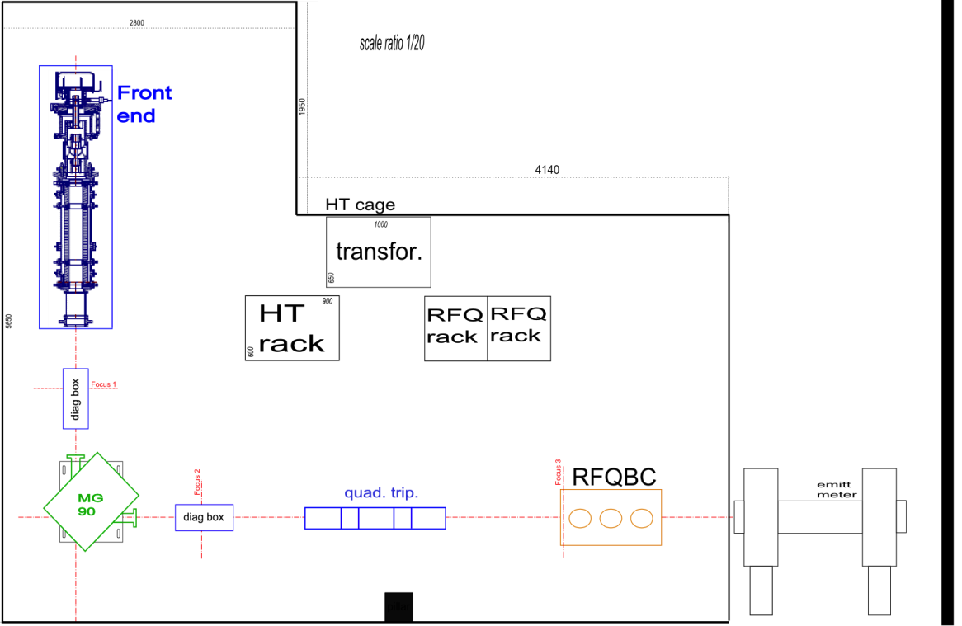
The Offline Separator
Front End
Magnet 90
Diagnostics
RFQ-CB (soon)
October 2013 : FE8 made its first beam : 30 nA at 40 kV with surface ion source !
March 2014 : First separation tests successful

Slide 19
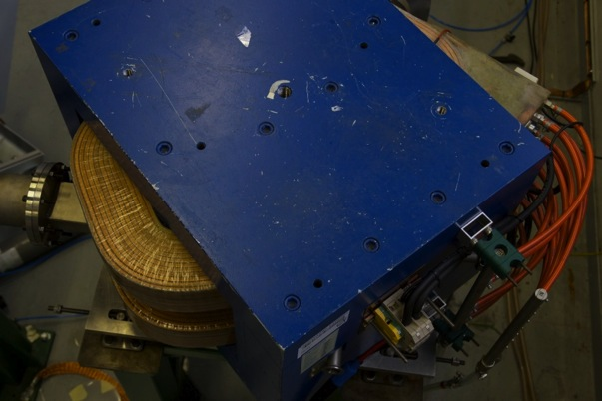
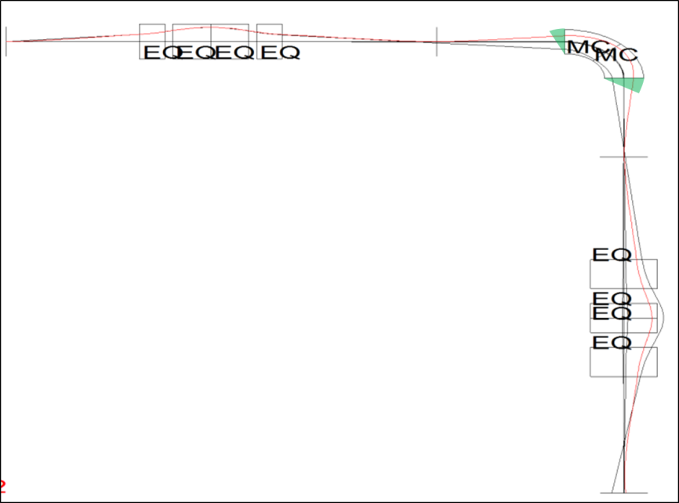
The Offline Separator
Objectives
Current magnet is of flat pole type,
with entrance/exit profile (later used as pre-separator?)
Design of a new offline magnet ongoing,
featuring pole face windings
Objective : validate the technology

Slide 20
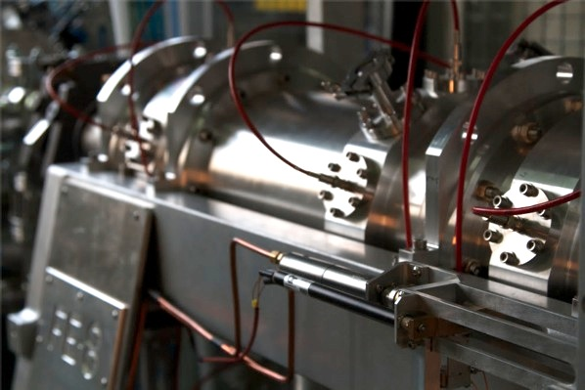
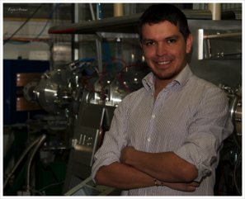
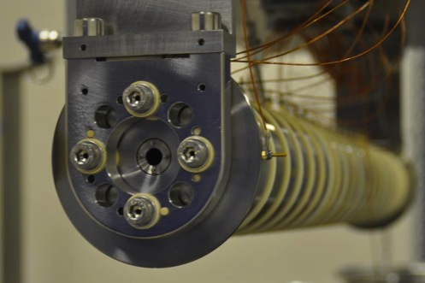
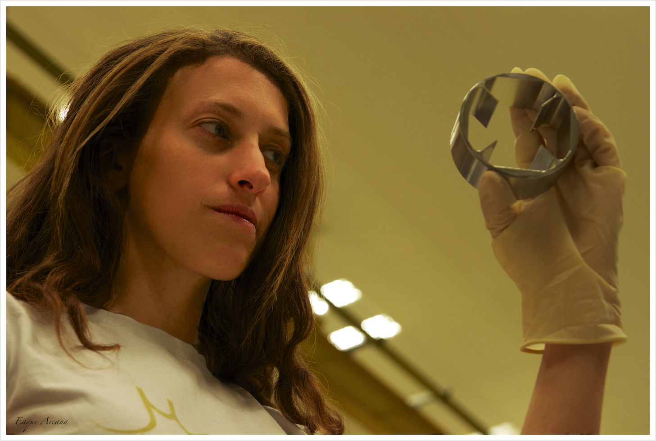
The Offline Separator
Objectives
ISOLDE FRONT END 8
Beam production
Tests and characterization of
different ion sources
THE RFQ-CB
Investigation of functional parameters :
      injection/extraction system efficiency
      Emittance and beam parameters

Slide 21

Conclusion
ON THE ROAD TO A NEW HIGH RESOLUTION MAGNET…
A workable layout, including all necessary items
Design choice for the magnet features
Functional test bench for validating the technology
Pole face winding
source parameters
Notes:
Workable layout
Design choice for the layout
Design choice for the magnet construction
Offline as a testbench for validating thesep oints (source and pole face windings)

Slide 22

Acknowledgements
My supervisor Tim Giles
All the Marie Curie Fellows,
and CERN staff
The Marie Curie Actions
The research project has been supported by a Marie Curie Initial
Training Network Fellowship of the European Community’s
Seventh Programme under contract number (PITN-GA-2010-264330-CATHI)

Slide 23
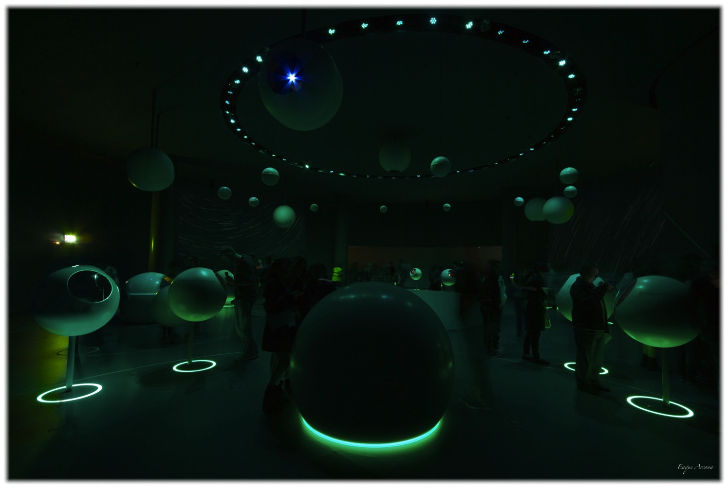
Thank you for your attention

Slide 24
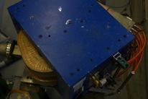
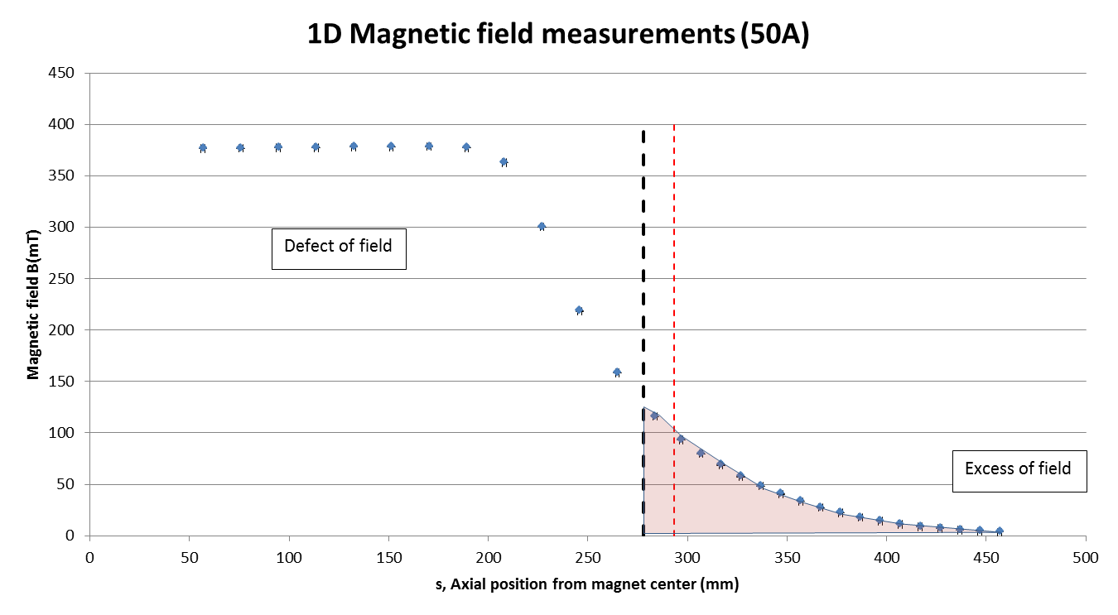
The Offline Separator
0D characterization of dipole magnet
Magnet symmetry line
Vacuum chamber flange edge
Pole shoe face
Geometrical bending start

Slide 25
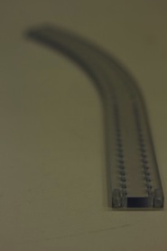
The Offline Separator
Dipole magnet
Characterization of dipole magnet
  Magnetic characterization
  1D magnetic field map
Separation test
Stability of magnetic field
Notes:
Plasma ion source was used (MK5, model of plasma ion source)
Reason why you see CO (carbon monoxyde) in the beam

Slide 26
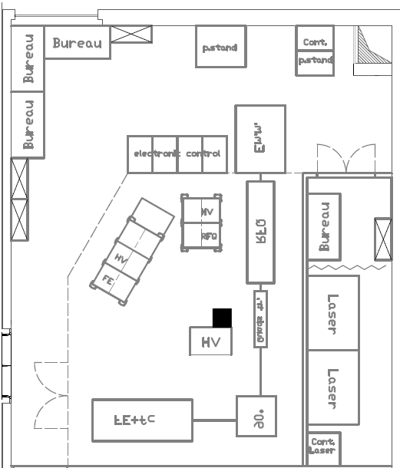
The Offline Separator
In the future…
Foreseen layout of ISOLDE offline #2 (courtesy of S. Marzari)

Slide 27
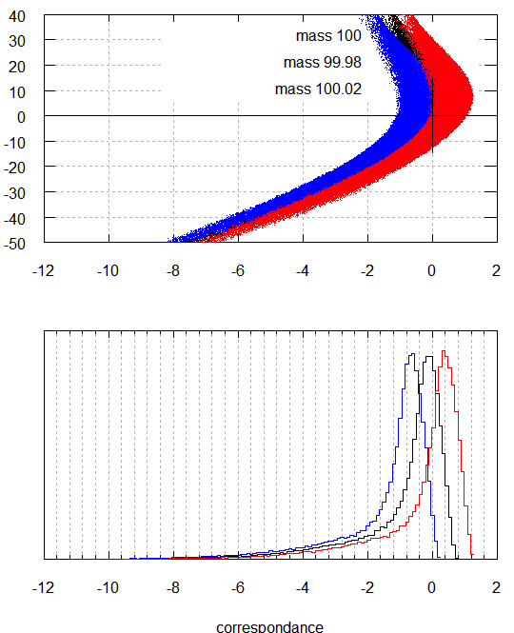

The High Resolution Separator
Optical simulations
source of emittance
ε=20π mm.mrad
Considered masses :
  M₀=100
  M₁=100.02
  M₂=99.98
Computation performed at 3rd order
Dispersion D=2700mm
Resolving power :
R=M/ΔM=5000
Octave computation of the current HRS
Optical layout of HRS (courtesy of T. Giles)

Slide 28
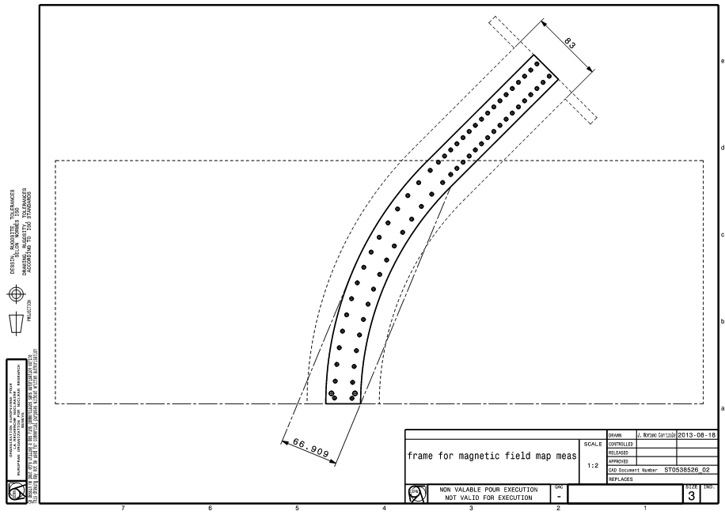
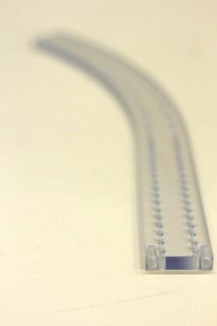
The Offline Separator
Frame for characterization
Magnet flange
Magnet case
Vacuum chamber
Magnet symmetry line
s
Notes:
There was the need to obtain a characterization of the magnet, as we had no data about this magnet.
NOw, having a precise magnetic field map takes long time and complicated devices : train matching the shape of vacuum chamber, long run of measurements with high precision etc…. We were told 1 year and a half to construct etc…

Slide 29
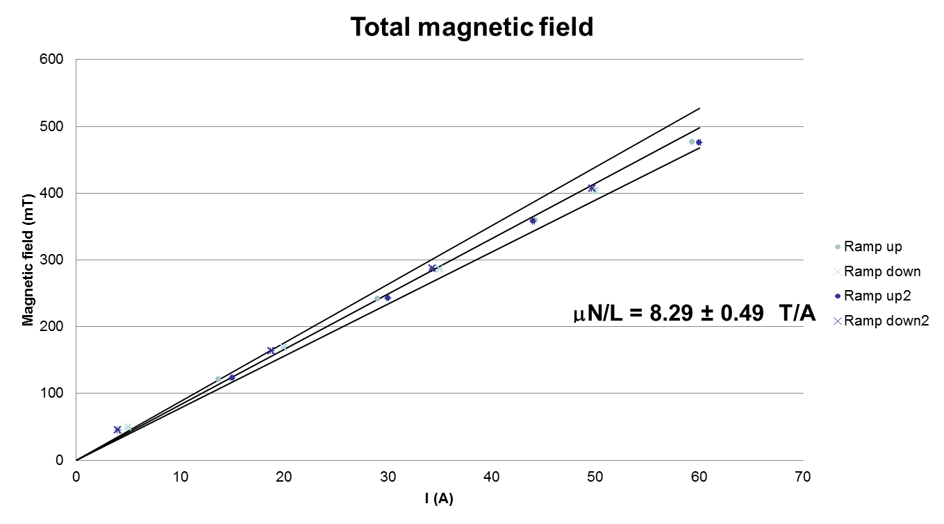
The Offline Separator
0D characterization of dipole magnet
m
Use of a Hall (teslameter) probe and
a polycarbonate frame
Notes:
Conditions to remind :
2 ramps, each time up and down, for checking the measurements.

Slide 30
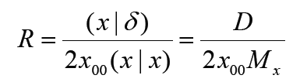
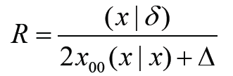
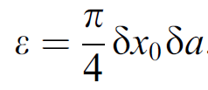
The High Resolution Separator
Resolution parameters
Resolving power
(ideal case)
Aberrations decrease the resolving power
Δ total amount of aberrations
M_{x} lateral magnification factor
D dispersion
In order to obtain high resolution, a large value of (x|δ) and small values of (x|x) and Δ are desirable
Ion source emittance
Factors limiting the
attainable mass resolution :
  Ion source emittance
  Optical aberrations
  Beam instrumentation

Slide 31
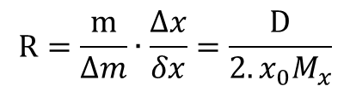



The High Resolution Separator
Reaching high resolution
Dispersion
$$Q=R∙2x_{0}∙a_{0}=\frac{A_{0}}{ρ_{0}}$$
Q quality factor, Ao area occupied by the beam in the magnet
increasing resolution R for given source (transmission) means increasing the term A0/po
$$R=\frac{m}{∆m}∙\frac{∆x}{δx}=\frac{D}{2.x_{0}M_{x}}$$
Beam emittance
$$ε=π∙x_{0}∙a_{0}$$
$$R=\frac{D}{2.x_{0}M_{x}+∆_{aberr}}$$
Eliminate higher order terms
(=aberrations)

Slide 32









Design proposal #1 : details
Beam enveloppes in dispersive and the vertical plane

Slide 33





Design proposal #2 : details

Slide 34





Design proposal #1bis : details
Beam enveloppes in dispersive and the vertical plane

Slide 35

Done for 133deg magnet, po=1m, alpha=0.58

Slide 36

Magnet features
No entrance/exit angular profile
Magnet with a Radially Inhomogeneous Magnetic field :
(with α, β and γ respectively being the quadrupole, sextupole and octopole components)
Plane pole faces → easier to machine
Yoke made of laminated steel → reduction of eddy currents, allowing an increase in cycling speed (~1min)
H type magnet → mechanically more stable, possibility of better pole face machining
Changing pole face width → saving of material (~8%)
$$B=B_{0}\left[1−α\left(\frac{r−r0}{r0}\right)+β{\left(\frac{r−r0}{r0}\right)}^{2}+γ{\left(\frac{r−r0}{r0}\right)}^{3}\right]$$
Notes:
Considering the high bending angle, using a entrance/exit profile would lead to the use of at least 30 degrees (to check)
Complicated for the beamline (next elements such as quad)
Inhomogeneous field gives more flexibility in the choice of the quadrupole component
Easy tuning done with knob (to inject current in order to simulate the value of coefficientS)
Back up slide for effects of hexa and octopole on tails of beam distribution. Helps for reaching High Resolution (compare to HRS current casE)

Slide 37

tracking in OPERA 3D
Preliminary

