Slide 1
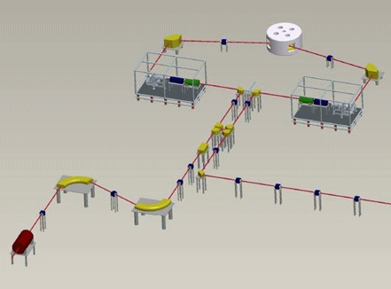
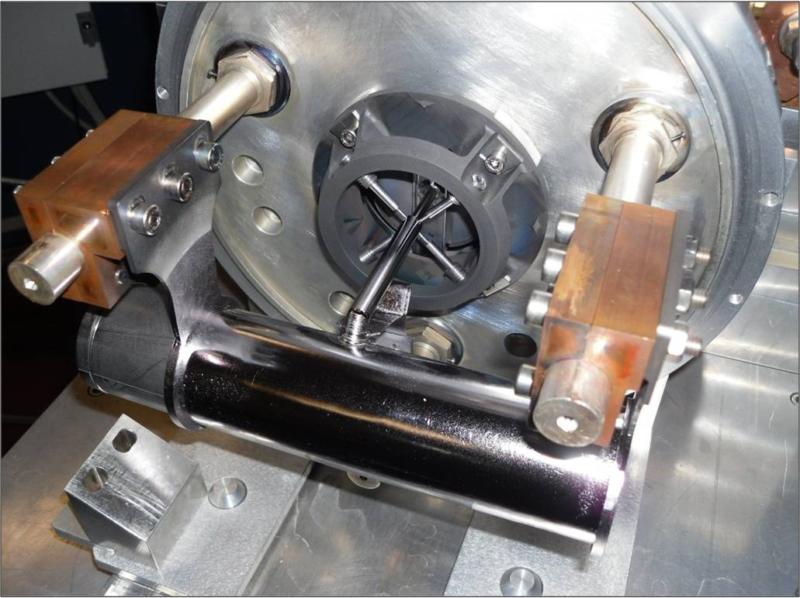
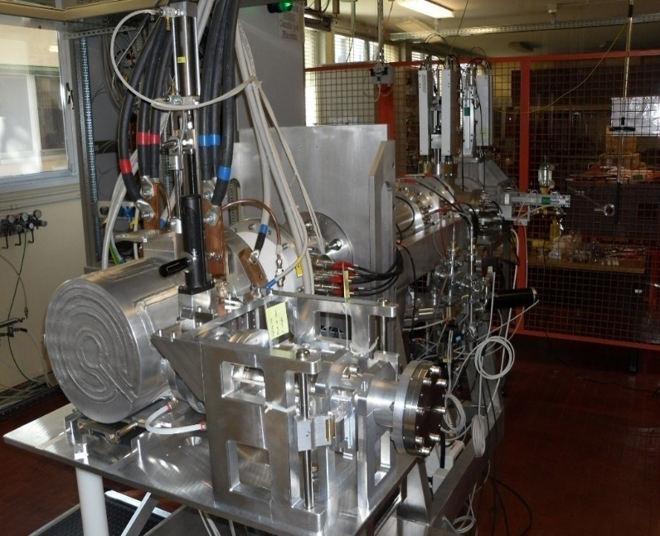
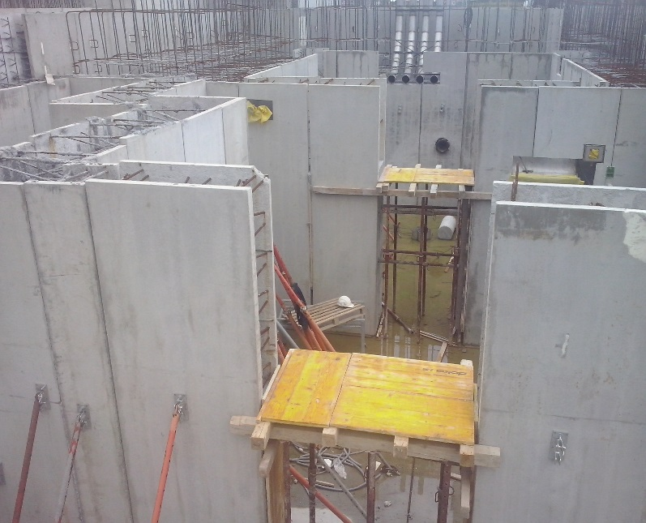

Recent results on the development for the SPES target-ion source complex
Alberto Andrighetto
INFN – Laboratori di Legnaro
Cathi Meeting
25 September 2014 ; Barcelona

Slide 2
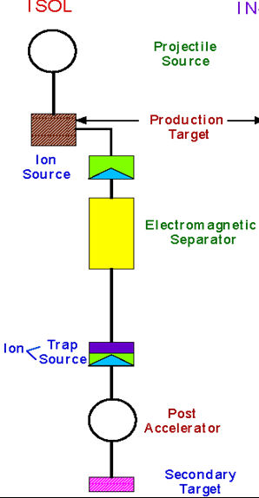
Outline
- The SPES RIB production station.
- Laboratories and organization.
Mass
Separator
- Working groups results.
Charge
Breeding
- Conclusions.

Slide 3
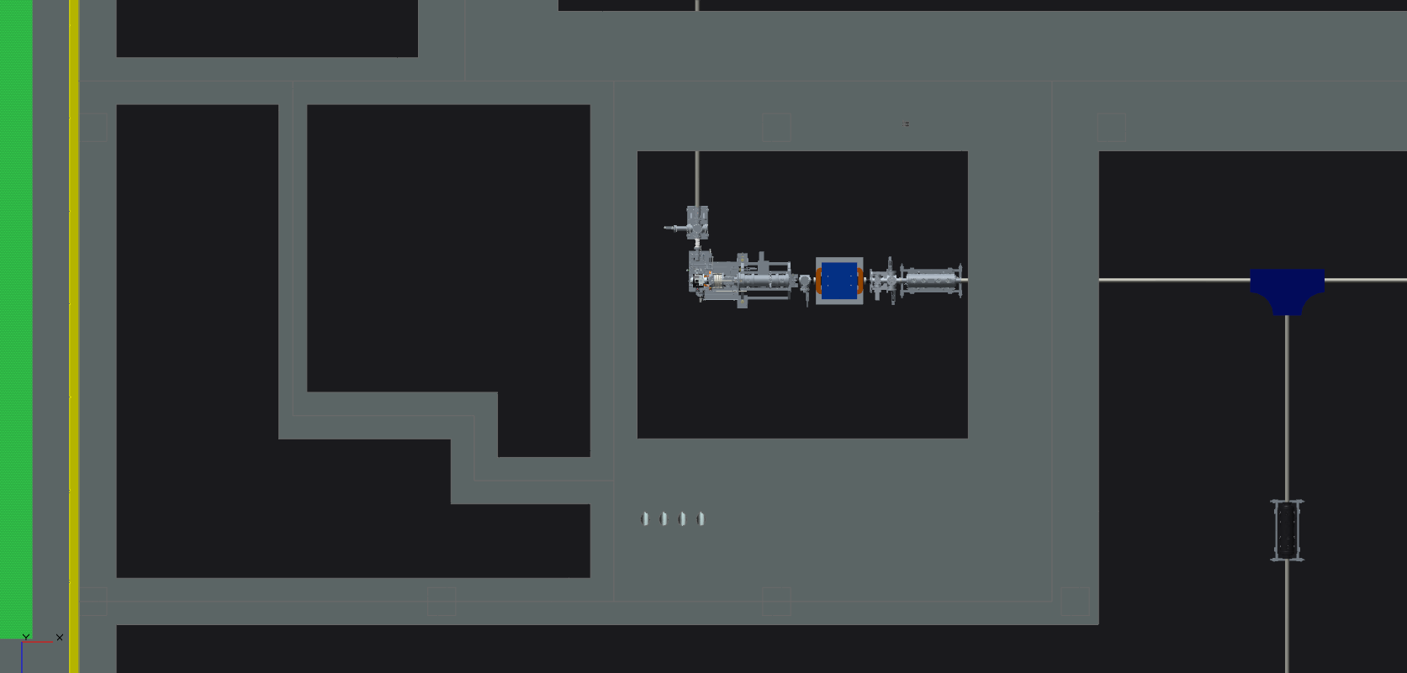
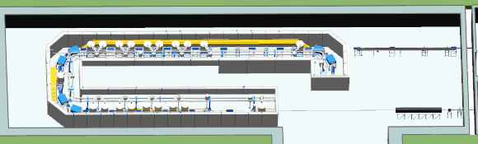
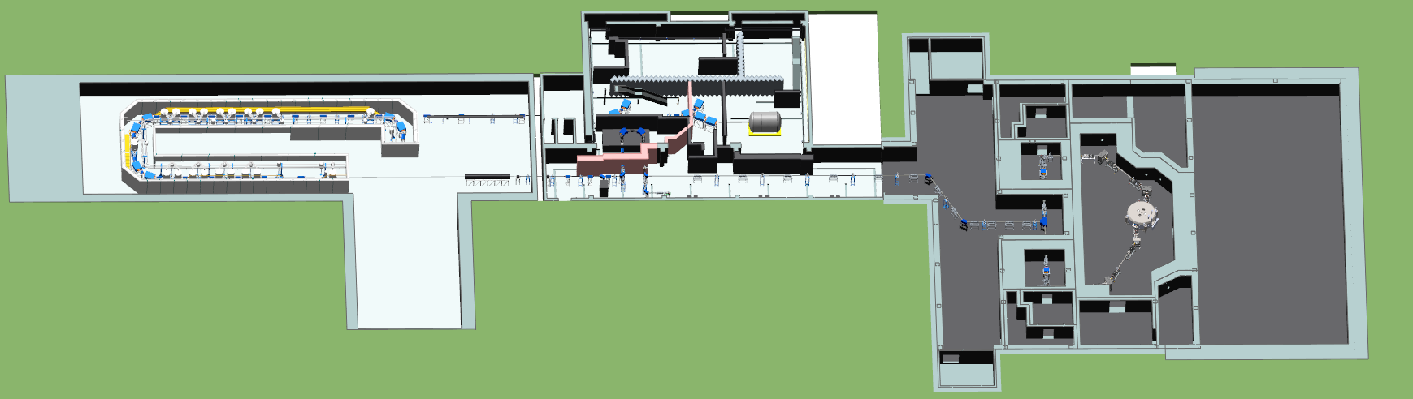
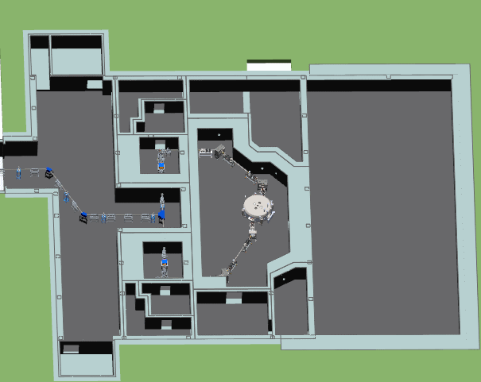
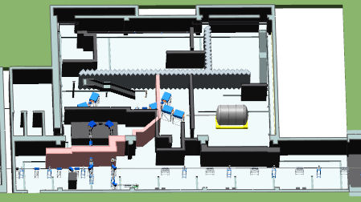
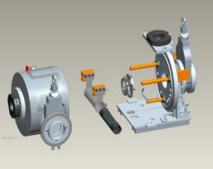
The RIB production area overview
Handling area
RIB Production area
AGV
Transition area
Front end
90° dipole
Wien Filter
Chamber unit storage

Slide 4
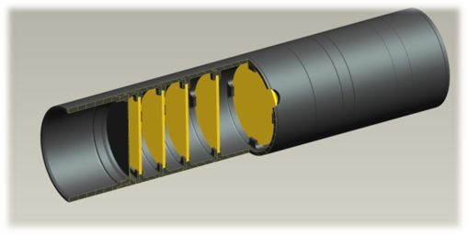
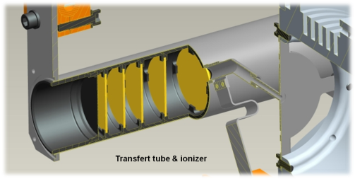

The TIS device
7 UCx coaxial disks:
thickness: 1.3 mm
diameter: 40 mm
SPES Target :
Optimized for 8 kW power dissipation
(E= 40 MeV, I= 200 μA)
Graphite box:
external diameter: 49 mm
average length: 200 mm
3 graphite dump disks
Tantalum tube:
external diameter: 50 mm
thickness: 0.35 mm
length: 200 mm
SPES Heater, Ionizer & Chamber
Ionizer & transfer tube:
thickness: 1 mm
height: 34 mm
Inner diameter: 3 mm
Aluminum target unit

Slide 5
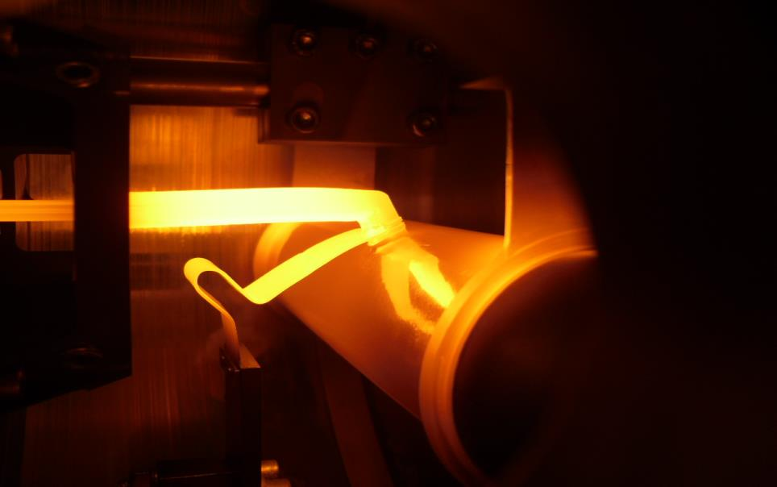
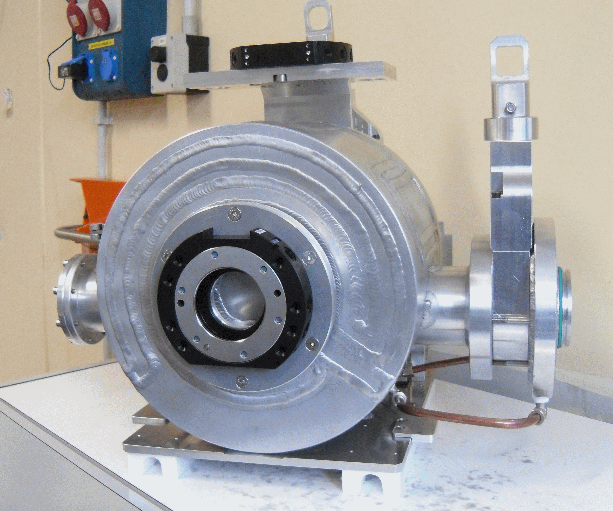

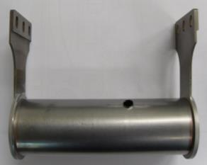
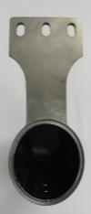
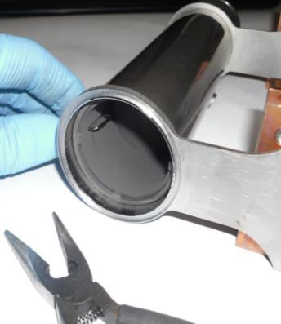
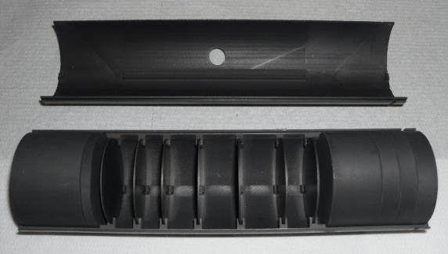
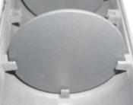
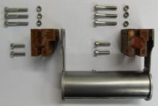
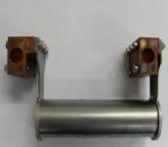
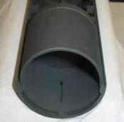
The TIS on operation
I_{Target}= 700A -> 1200A max
I_{Line}= 200A -> 600A max

Slide 6
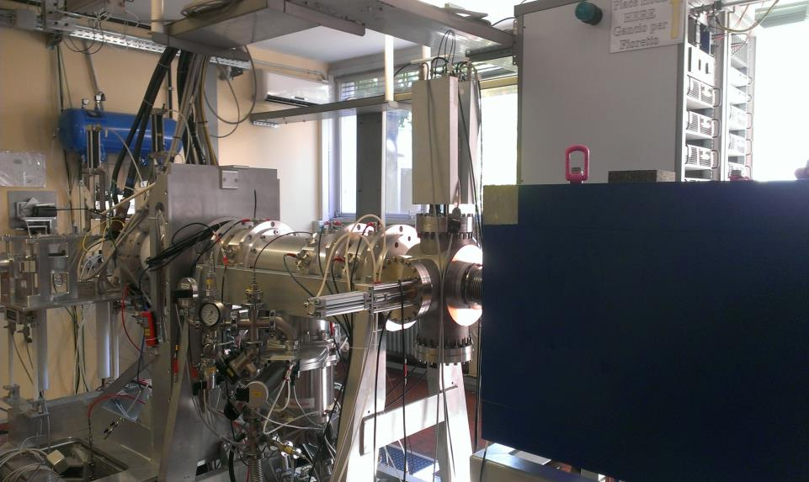
The SPES (off-line) RIB station
Evolution of ISOLDE FE6
Triplets
TIS
Wien filter
Dignostic box

Slide 7
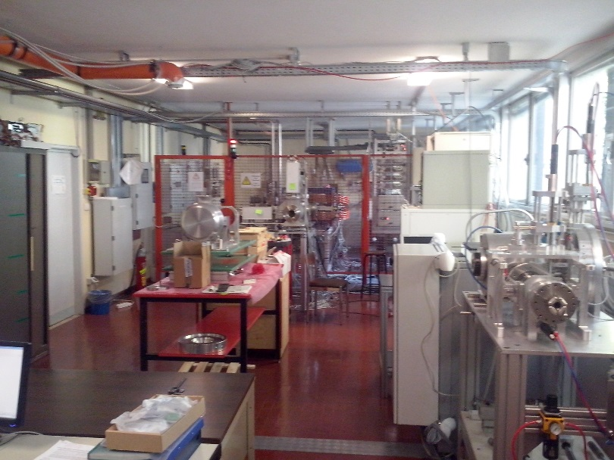
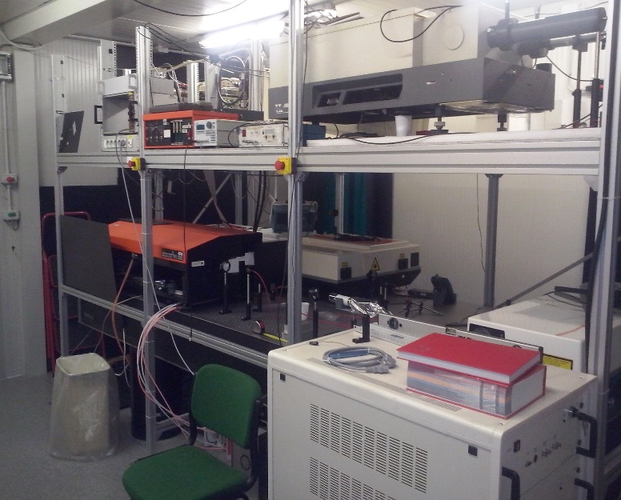
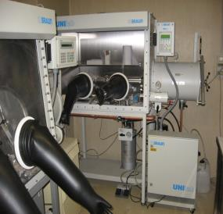
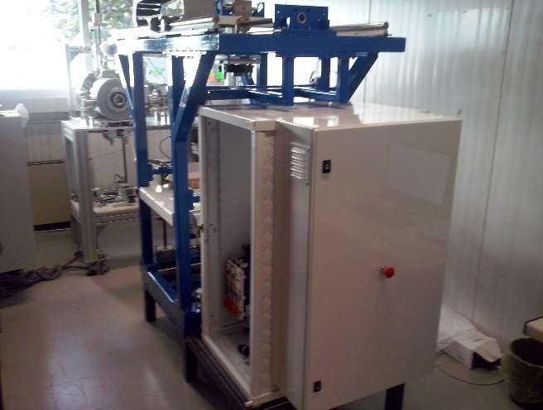
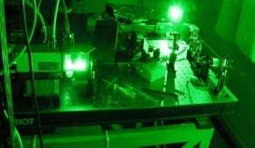
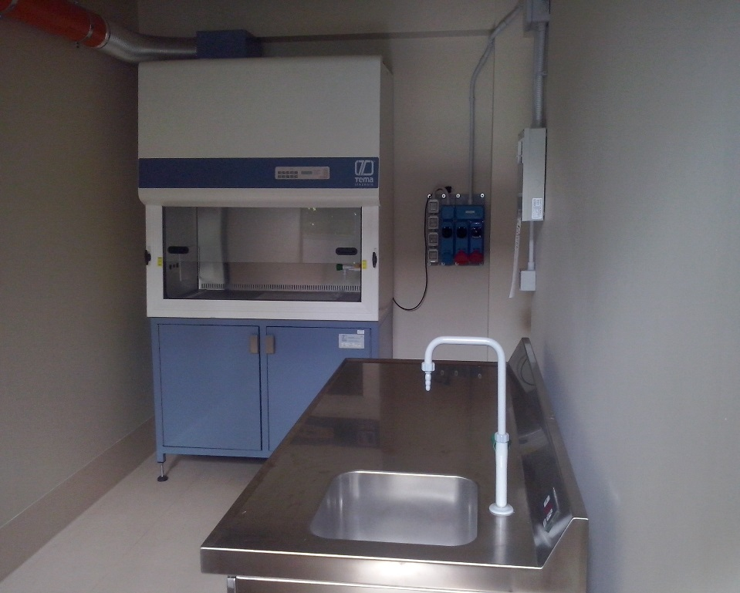
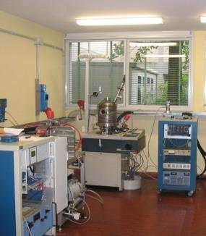
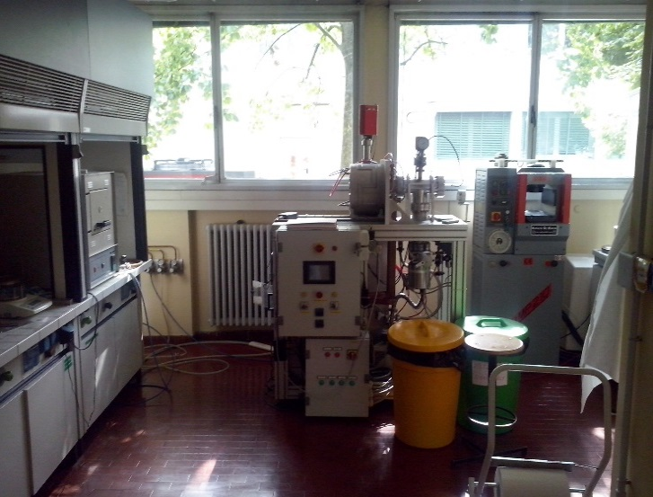
The TIS SPES (8) Laboratories
Test Bench LNL Lab
New LNL laser Lab
UCx Chemistry PADOVA Lab
Pavia laser Lab
New ‘class A’ LNL Lab
Handling LNL Lab
Carbide Chemistry LNL Lab
HT LNL Lab

Slide 8

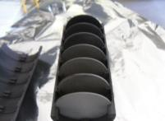
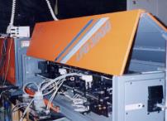
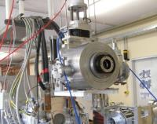
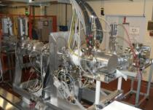
The TIS five Working Groups
WG-1: Target and Ion Sources
WG-2: Target Materials
WG-3: Laser
WG-4: Handling
WG-5: Front End

Slide 9
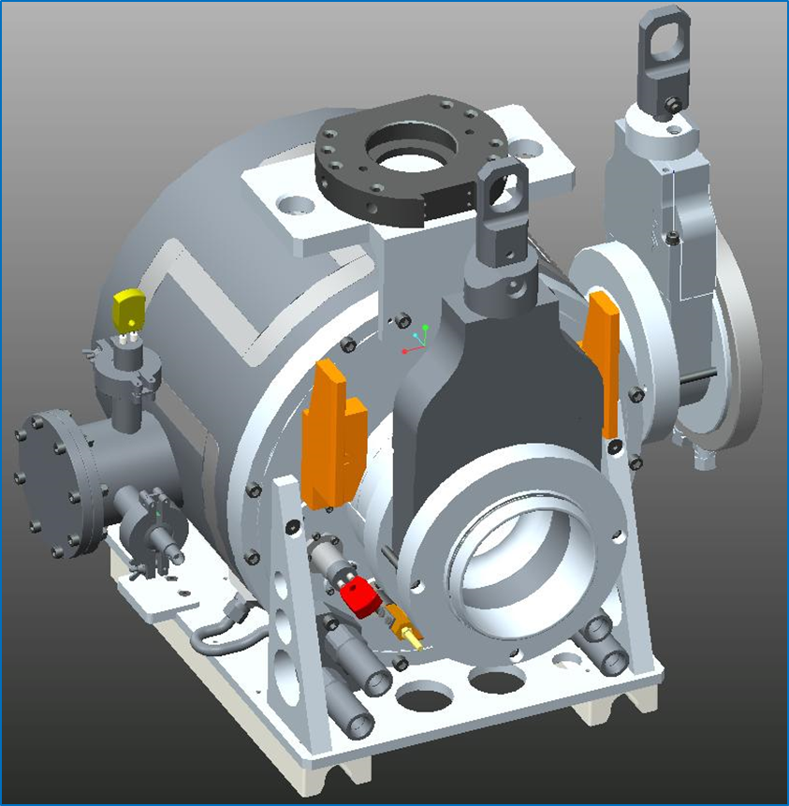
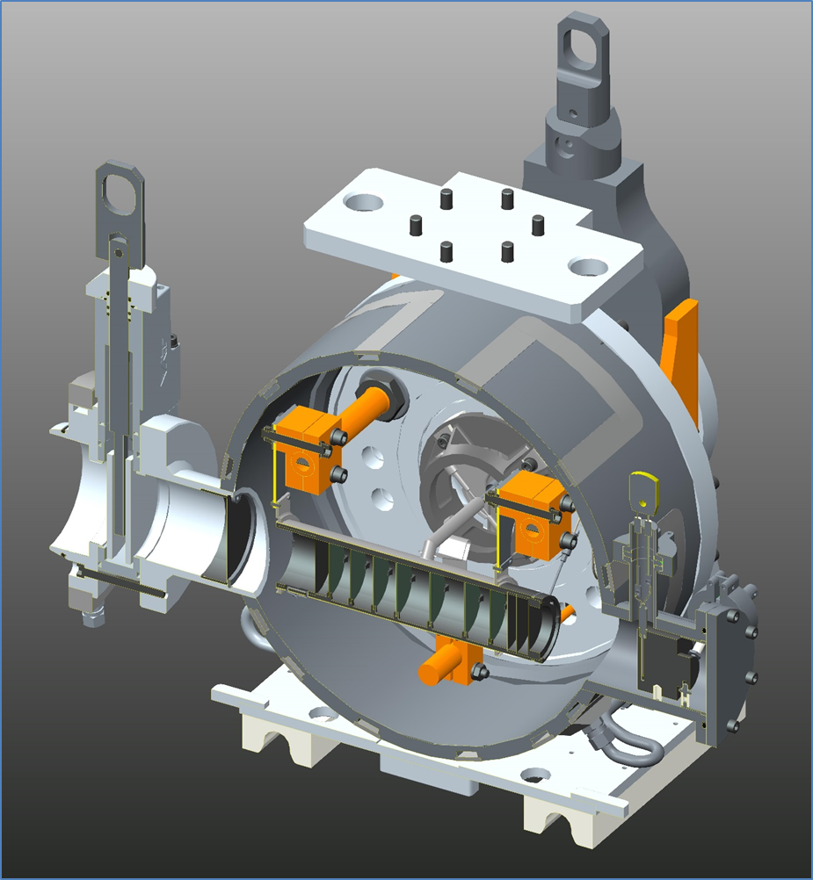
TIS: Definition of the unit device 1/6
Thermocouple (type C)
Thermocouple output (type C)
Graphite window
BNC output (current sensor)
Flexible heater
Graphite dump

Slide 10
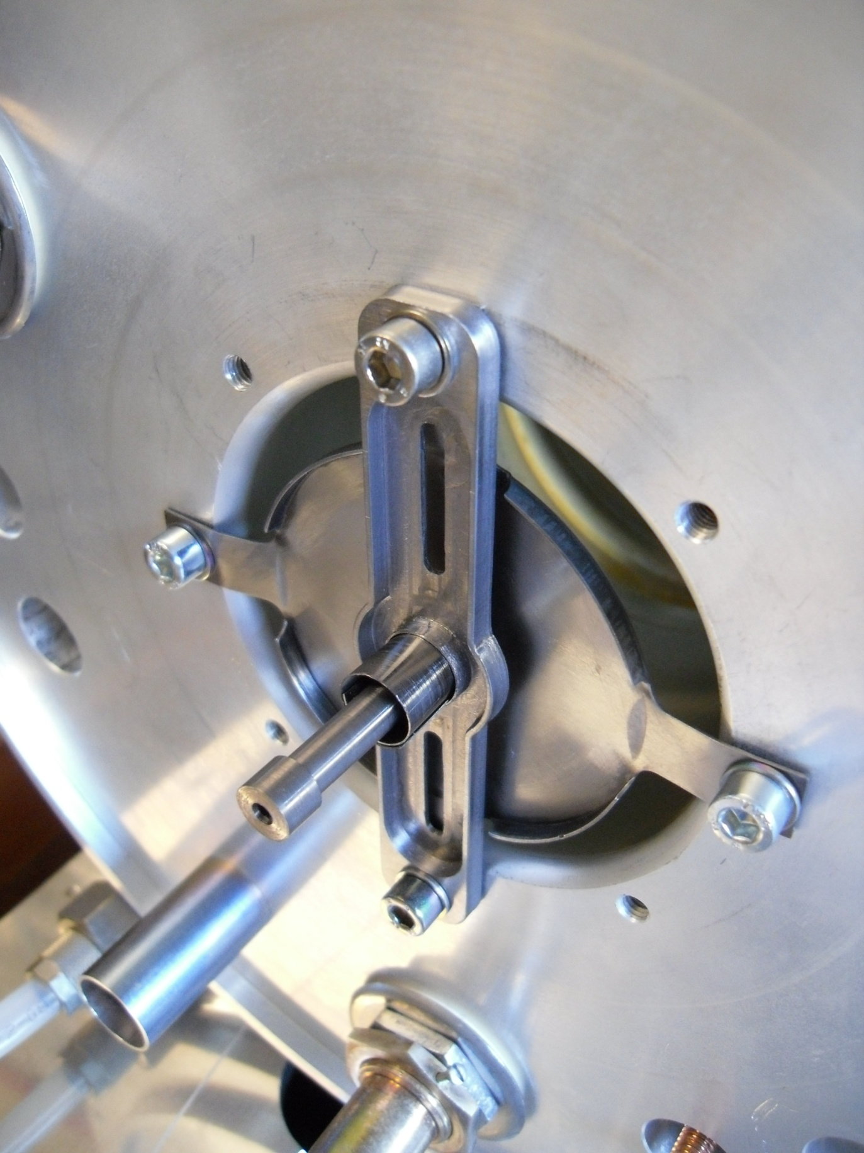
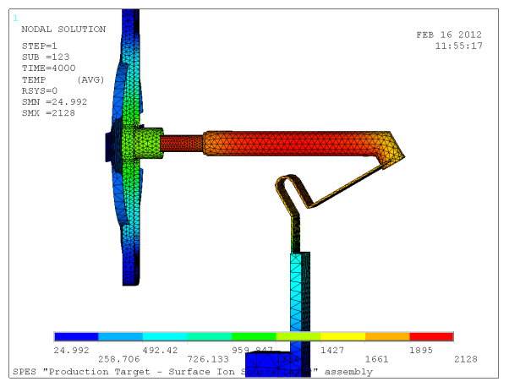
TIS: Ion Source Developments 2/6
The SPES SIS Ion source
Re Ionizing Cavity and Ta Ionizing Cavity
support
ionizing cavity
plate
connector
thermal screen
OFF-LINE TESTING
efficiency and emittance measurements with accurate temperature monitoring
WG-01

Slide 11
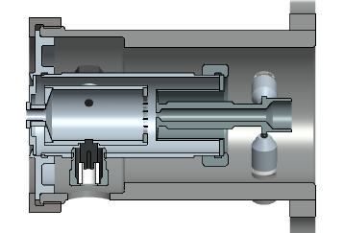
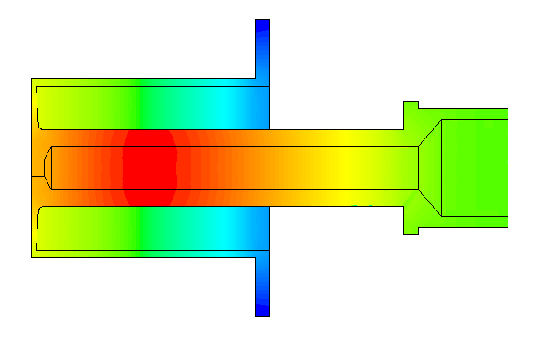
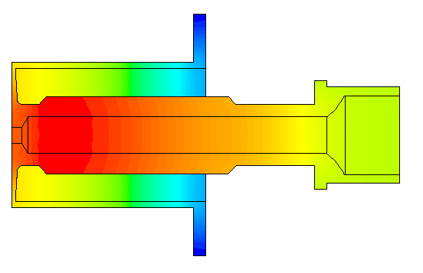
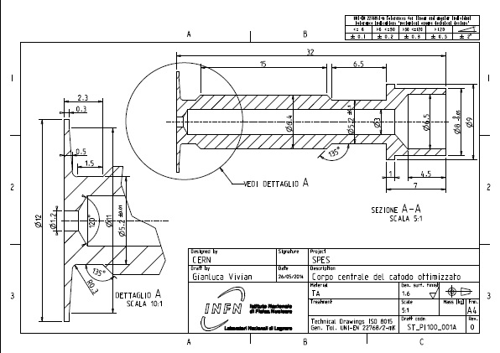
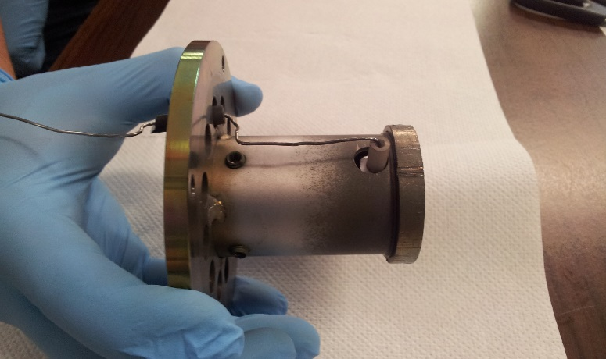
TIS: Ion Source Developments 3/6
The SPES PIS Ion source
OPTIMIZED CATHODE GEOMETRY
hot spot close to the anode interface (thermionic electron production)
OPTIMIZED EXTRACTION REGION
low transversal emittance values
(now under testing at LNL)
WG-01

Slide 12
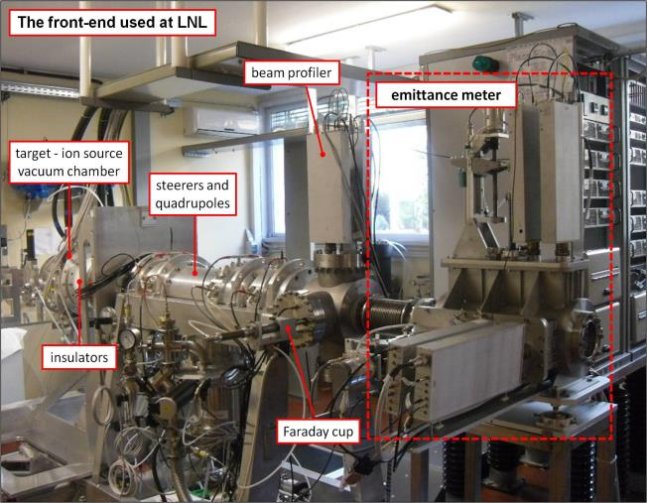
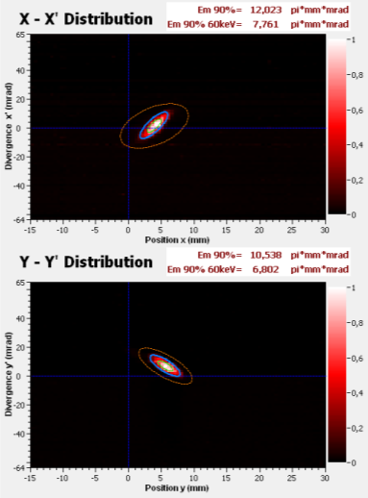
TIS: Ion Source Developments 4/6
> Emittance measurements for SIS and PIS (@ 25kV extraction voltage)
SIS (Cs beam)
PIS (Ar beam)
ε_{RMS} ≈ 5 π mm mrad (ε_{90%} ≈ 20 π mm mrad)
ε_{RMS} ≈ 10 π mm mrad (ε_{90%} ≈ 40 π mm mrad)
WG-01

Slide 13
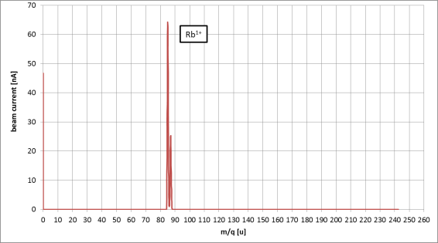
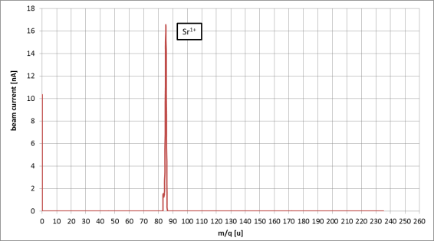
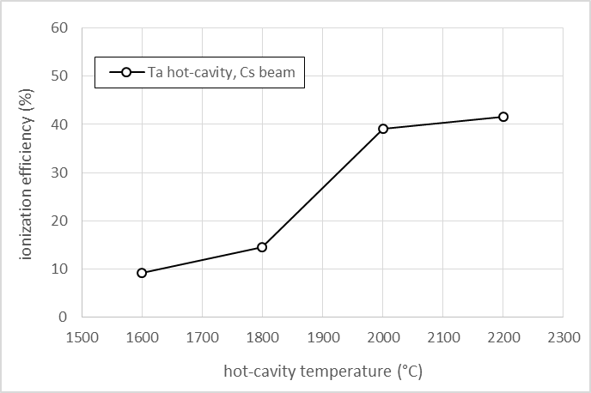


TIS: Ion Source Developments 5/6
> Efficiency measurements for SIS
Ta - SIS efficiency data (off-line measurements)
T = 2200 °C
WG-01

Slide 14


TIS: Ion Source Developments 6/6
> Efficiency measurements for PIS
Ionization efficiency measurements for Ar (25 kV)
- Anode voltage = 150 V
- Anode magnetic field ≈ 300 G
- Total beam current ≈ 3 µA
WG-01

Slide 15






Target: Experimental test 1/4
1) scaled (d = 13 mm) SiC SPES tested @ ORNL (2007), – 40 MeV, 12 µA p beam, for thermal & release study
2) scaled (d = 13 mm) UC_{X} SPES tested @ ORNL (2010-2011) – 40 MeV, 50 nA p beam, for relase study
 | 2010 Standard UC_{X} | 2011 Low density UC_{X}
Density (g/cm³) | 4.25 | 2.59
Diameter (mm) | 12.50 | 13.07
Thickness (g/cm²) | 0.41 | 0.41
Calculated porosity (%) | 58 | 75
WG-02

Slide 16



Target: Experimental test 2/4
Actilab ENSAR JRA collaboration
3) scaled (d = 14 mm) UC_{X}-CNT discs tested @ CERN (2009) and IPNO (2013) for release efficiency studies
 | UC_{X}-CNT (synthesis at CERN, 2009)
Density (g/cm³) | 1.30
Diameter (mm) | 14.10
Thickness (mm) | 1.30
Calculated porosity (%) | 88
Test @ CERN (2009)
Test @ IPNO (2013)
WG-02

Slide 17






Target: Experimental test 3/4
4) Full scale (40 mm.) SiC @ Ithemba, p=66 MeV, 60 microA for thermal dissipation studies
On-line testing of the SPES target architecture @ iThemba (May 2014)
iThemba LABS: funded to build an RIB station like SPES (10 kW multi-foil target)
WG-02

Slide 18



Target: Experimental test 4/4
On-line testing of the SPES target architecture @ iThemba (2013-2014)
66 MeV, up to 60 μA - proton beam on a SiC target (Tmax on SiC =1600°C)
Target
Temperature
Beam Dump Temperature
Vacuum
Scattering chamber (build @LNL)
Beam Power
Heater
Power
WG-02

Slide 19



Laser: The LNL Laboratory 1/2
In 2013 a new SPES laser laboratory was build
A tunable dye laser system ready for atomic spectroscopy study
WG-03

Slide 20


Laser: Activities at LNL 2/2
Design/construction of new
Time of Flight Spectrometer
Fiber optic mixer (2 dyes to HCL)
System ready for Ge spectroscopy study.. (Oct ‘14)
WG-03

Slide 21

Handling: The SPES overview 1/4
Two systems are foreseen in order to increase the handling security level
Vertical device
Target chamber unit
Target Front End
Horizontal device
WG-04

Slide 22




Handling: The Horizontal system 2/4
Thanks to L. Sarchiapone
< 50 µSv/h
WG-04

Slide 23






Handling: The vehicle AGV based 3/4
Devices under construction at the LNL mechanical workshop
WG-04

Slide 24




Handling: R6D for Puller Handling 4/4
Puller
toy
WG-04

Slide 25




Front End: Beam transport trace-back 1/5
ion source
extraction area
steering area
focusing area
diagnostic area
WG-05

Slide 26






Front End: extraction optimization 2/5
Optimization of FE optics in order increase the RIB transport
l = 4 mm
1) Anode optimization
Quadrupoles:
SIS (and LIS)
PIS (presence of non-linear effects)
Source:
PIS
SIS (and LIS)
Wien Filter:
Mass resolution Transport efficiency
Φ = 1.5 mm
2) Puller optimization
Tested with a reduction of 40% of emittance
(ε = 6 π mm mrad @ 25 kV)
Old configuration
New configuration
Main goal: PIS emittance comparable with SIS without losing in efficiency
WG-05

Slide 27


Front End: design for On-line version 3/5
RAD-HARD version
Critical material List
Teflon with glass fibres -> alumina
Polyethylene -> peek
Viton O-rings -> EPDM
Plastic cable insulator -> air (close the target)
Normal motors -> RAD HARD motors
Off-line FE
On-line FE
WG-05

Slide 28



Front End: Study on damage 4/5
Use of the LENA (PV) reactor for material testing (collaboration started on June 2014)
Reactor for research TRIGA Mark II (250 kW) – LENA since 1965
WG-05

Slide 29
Front End: Planning for damage test 5/5
Preliminary program of Italian collaboration: SPES, LENA, INFNPV, UNIBS
1. Compilation of materials of interest for the SPES project to be rad-hard tested;
-> working in progress
2. Evaluation by MCNPX, FLUKA codes of the radiation fields and cumulated dose expected on the critical components inside the ISOL bunker -> working in progress
3. Characterization of the obtainable radiation fields in the TRIGA Mark II in order to reproduce as close as possible the expected inside the SPES bunker. -> early 2015
4. Planning of irradiation campaigns at L.E.N.A. reactor on sample of SPES critical materials. . -> early 2015
5. Tests on irradiated samples physical and operational properties of materials corresponding to different levels of irradiated dose; . -> late 2015
6. Post-irradiation study of irradiated samples in order to evaluate the radiation damage (mainly for polymers). . -> late 2015
Possibility to extend the collaboration with external partners (Is fully welcome!)
WG-05

Slide 30




Conclusions: the collaboration network…
ITHEMBA
RISP-KOREA
ORNL- HRIBF
CERN- ISOLDE
INFN- Pavia
SPES
Exotic Beam
INFN- Milano
GANIL-SPIRAL 2
INFN- Bologna
INFN- LNS
ORSAY-ALTO
INFN- Padova
UNISI
UNIPV
UNIPD
UNITN
DSF
DEI
DIM
DIM
DSC
DEI
CONTROLS
LASER
ION SOURCES
MATERIALS
HANDLING
Notes:
25/09/2014
30

Slide 31

Conclusions: the group…
Few results without them…

Slide 32

and finally..
Thanks for your attention!

