Slide 1




CATHI final review meeting
Target Area Infrastructure
Cooling and Ventilation
Andrea Polato* - CERN EN-CV-PJ
29 November 2013
*
The research project has been supported by a Marie Curie Early Initial Training Network Fellowship of the European Community’s Seventh Programme under contract number (PITN-GA-2010-264330-CATHI)

Slide 2
Contents
Work Package ESR 13: Cooling and Ventilation Design Study;
Ventilation
Cooling
Conclusions

Slide 3
WORK PACKAGE ESR13:
COOLING AND VENTILATION DESIGN STUDY

Slide 4
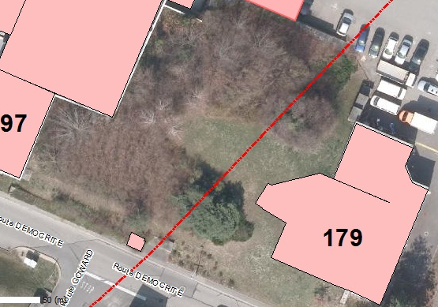
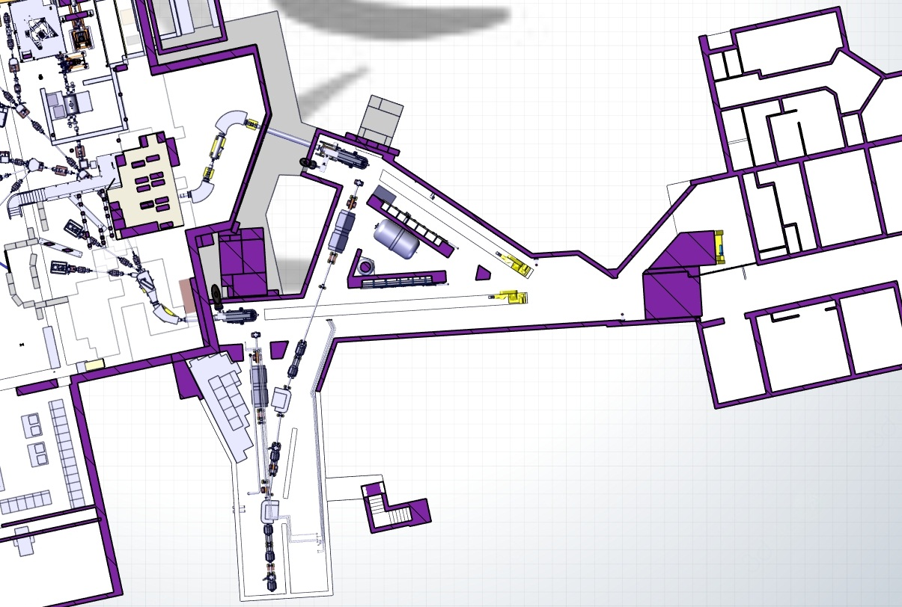
WORK PACKAGE TITLE
ISOLDE Target Area and Class-A Laboratory Upgrade

Slide 5
VENTILATION

Slide 6
VENTILATION SYSTEM:
REASONS FOR THE SYSTEM UPGRADE

Slide 7

REASONS FOR THE SYSTEM UPGRADE
Proton beam intensity upgrade;
Improvement of the tunnel confinement;
Independency among Tunnel and Class A Laboratory;

Slide 8
REASONS FOR THE SYSTEM UPGRADE: INTENSITY UPGRADE
Today the activity releases in atmosphere are in line with the CERN objectives
Question:
What will happen after the intensity upgrade?
Currently with a beam intensity of 2 μA:
Average activity released at the ISOLDE stack: 5x10⁵ Bq/m³;
Total air flow through the ISOLDE stack (class A + Tunnel + HRS&GPS): 7500 m³/h;
Standing at the historical parameters, the average contribution in terms of effective dose of ISOLDE on the reference population
3 μSv/year (overall CERN objective 10 μSv/year);
The increase of beam intensity (from 2 μA to 6 μA) and energy (from 1.4 GeV to 2 GeV) will have an effect on the releases and, as a consequence:
An intervention on the ventilation system would result in lower emissions

Slide 9
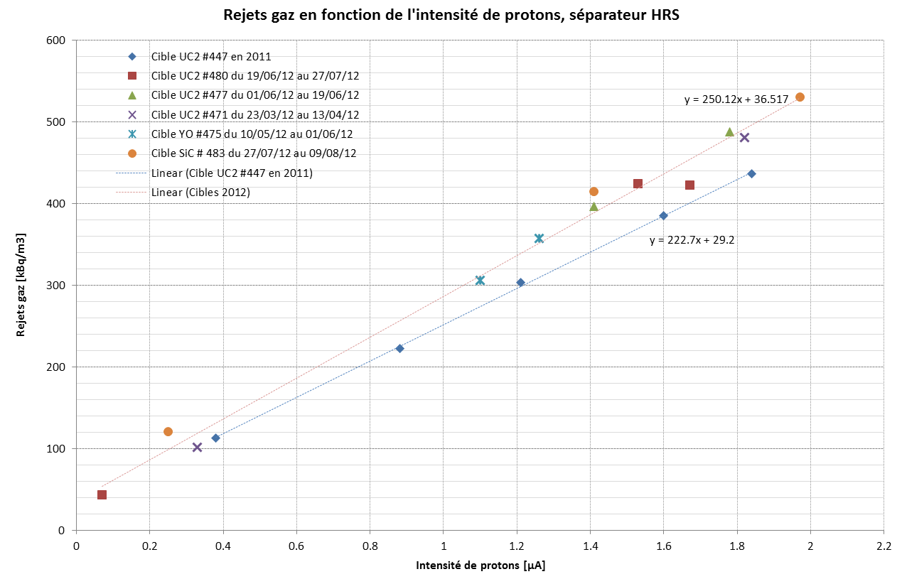
REASONS FOR THE SYSTEM UPGRADE: INTENSITY UPGRADE
The activity released increases linearly with intensity (Courtesy of A. Dorsival):
* The effect of the increase in the beam energy from 1.4 GeV to 2 GeV on the releases is still under evaluation

Slide 10
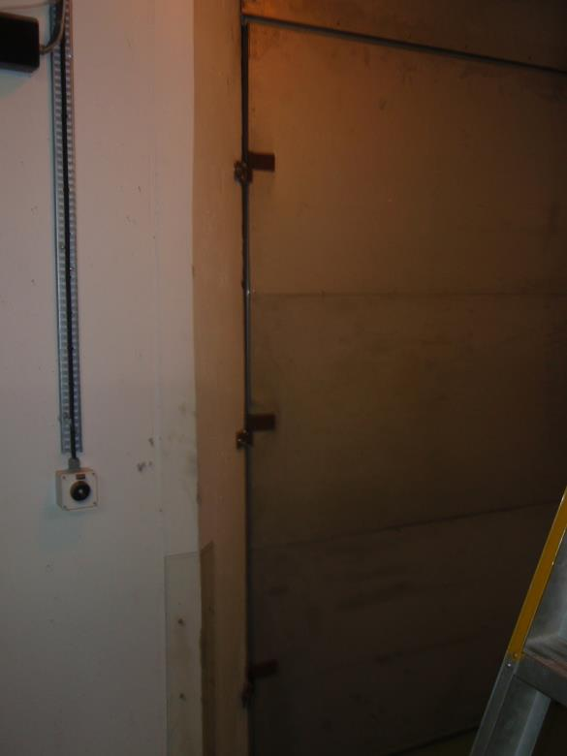
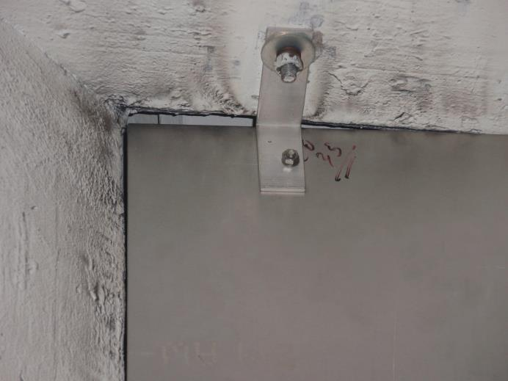
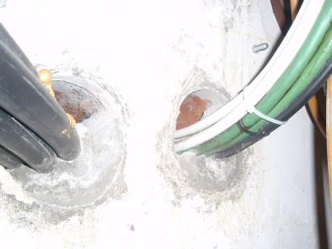
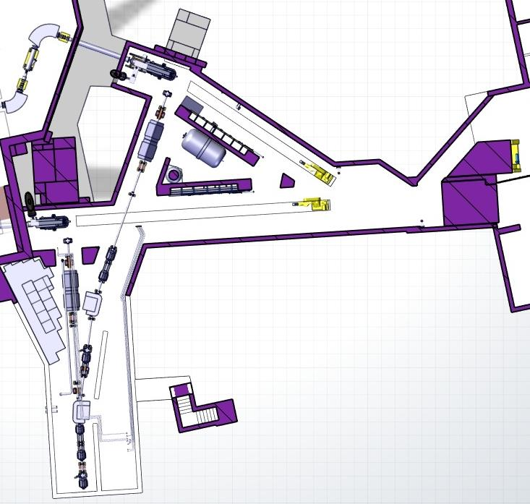
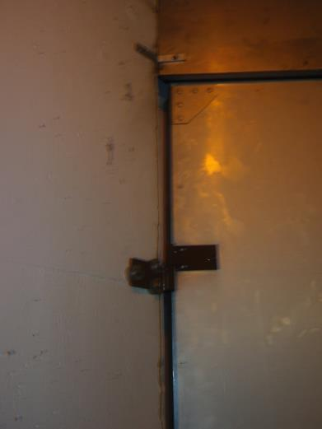
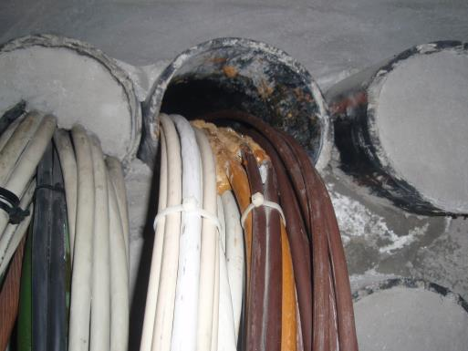
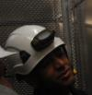
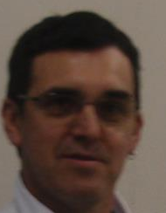
REASONS FOR THE SYSTEM UPGRADE: TUNNEL CONFINEMENT
The concept of confinement (i.e. keeping contaminated air inside a defined volume) combines both a dynamic part (ventilation) and a static part (structure leak tightness)
Question
What is the status of the static confinement?
50 mm
2.2 m/s
Access Door
7 m/s
6 m/s
200 mm
10
÷
30 mm
0.4 ÷2.5 m/s
Cable trenches
150 mm
1 m/s
30
Cable trenches
Precious help from:
H. Sabri
A. Garcia
Notes:
40 m³/h for the triangle hole on the upper corner of the door
Cable passage at 1 m/s 65 m³/h
Cable passages at 6m/s and 7 m/s respectively: 400 m³/h and 450 m³/h

Slide 11
REASONS FOR SYSTEM UPGRADE: TUNNEL CONFINEMENT
A ΔP= -75 Pa is generated inside the Tunnel with respect to the outdoors;
In order to get to this value an extraction flow of nearly 3000 m³/h is required;
Considering the tunnel volume of 1000 m³, it works out a leak rate of 2 vol/h
In nuclear installations, the average value for leak rates should range around 0.4 vol/h;
This difference is due to the poor static confinement of the Tunnel;
Consequences:
Size of the confinement equipment (fan, ducts, filters, regulation dampers);
Expenditures in terms of electrical energy to handle the confinement;
Amount of activity released in atmosphere;

Slide 12

REASONS FOR THE SYSTEM UPGRADE: TUNNEL VS. CLASS A LABORATORY INDEPENDENCY
Class A Laboratory and ISOLDE Tunnel are supplied by two separated HVAC systems
Question
Are the two ventilation systems independent?
Real case of the problems encountered during the installation of new ISOLDE robot:
In order to allow the installation of the service cables, the ventilation of the Class A lab has been temporarily stopped;
Tunnel Extraction has been kept running
Result:
Bldg. 170
CLASS A LABORATORY
ISOLDE TUNNEL
`
Normally there is air flow from class A lab to Tunnel
The particular degraded mode caused an unforeseen backflow of the air from the Tunnel to the class A Laboratory

Slide 13
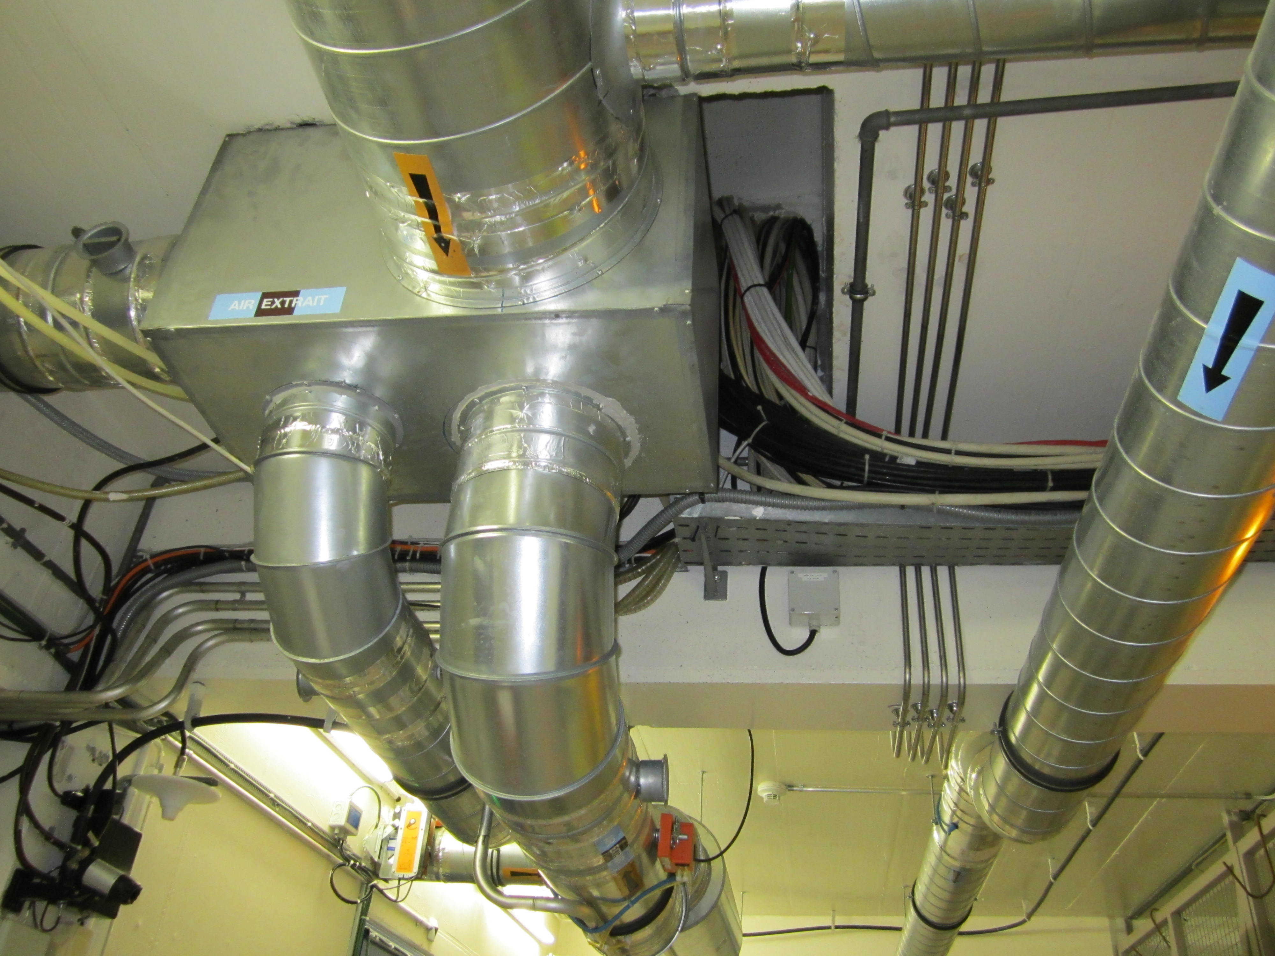
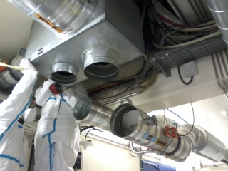
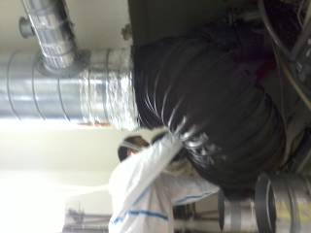
REASONS FOR THE SYSTEM UPGRADE
Real case of the problems encountered during the installation of new ISOLDE robot

Slide 14
VENTILATION SYSTEM:
TECHNICAL SOLUTIONS PROPOSED:
MEDICIS LABORATORY

Slide 15
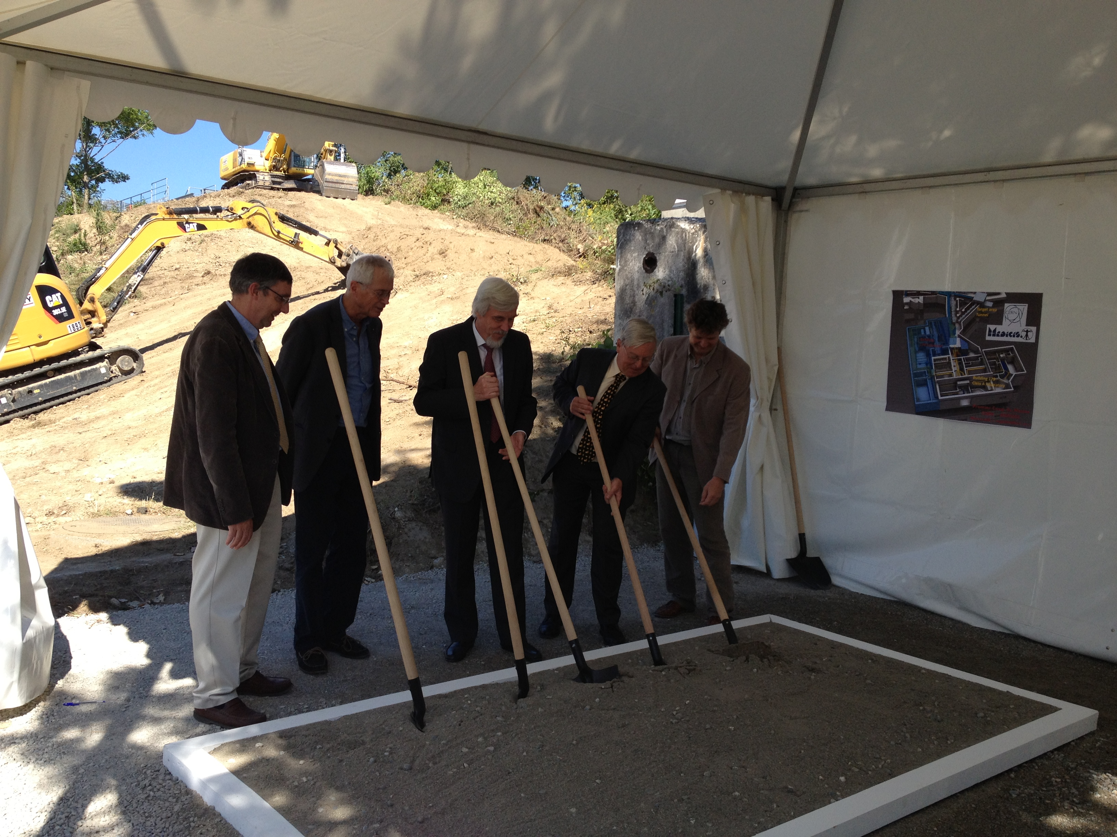
TECHNICAL SOLUTIONS PROPOSED: MEDICIS LABORATORY
The project for the extension of the Class A Laboratory in order to host the MEDICIS Laboratory
Constituted an occasion to propose some technical solutions to improve:
The separation between ISOLDE Tunnel and class A Laboratory;
The leaktightness of the tunnel;
Medicis groundbreaking ceremony of the 4th of September 2013

Slide 16
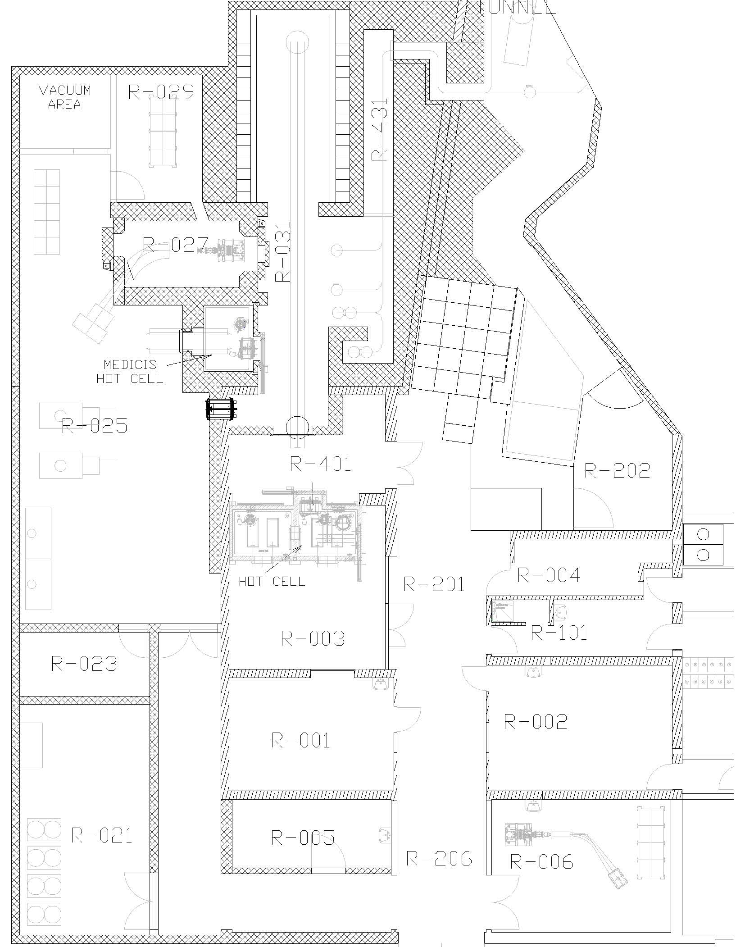
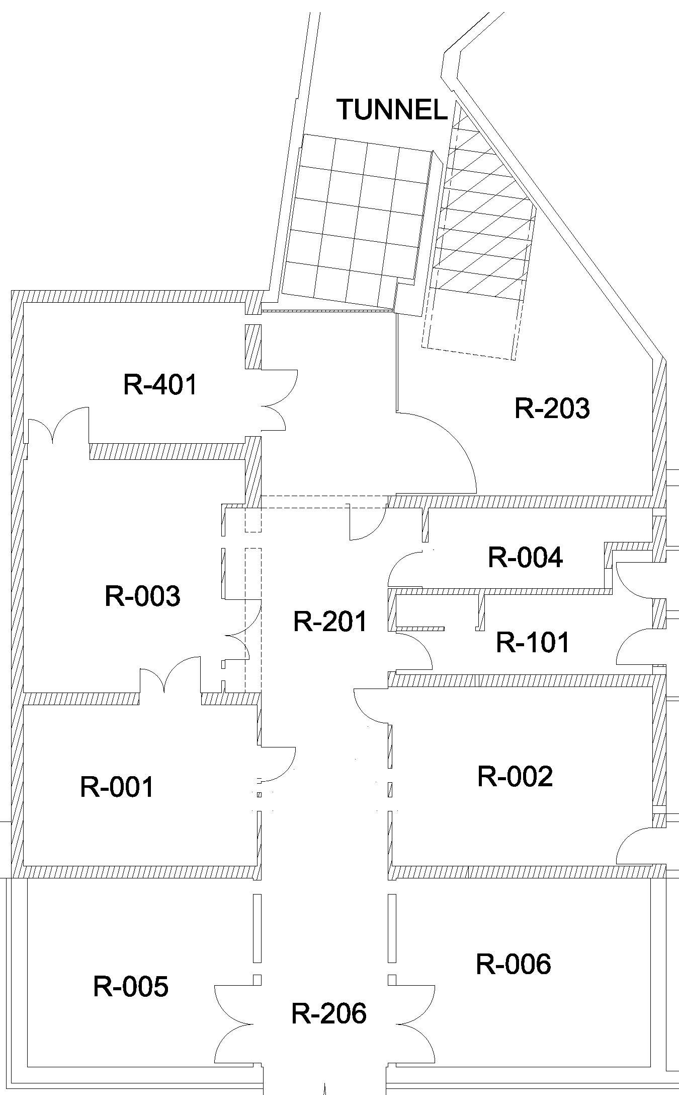
Class A Laboratory Extension:
240 m² extension (from 265 m² to 505 m²);
New rooms for:
  Waste disposals (R021, Vacuum Area);
  MEDICIS experiment (R025, R027, R029 and R023);
  Target decay before dismantling (R031);
  Airlocks (R202, R431);
  Process Enclosures (Hot Cell and MEDICIS Hot Cell);
New ventilation and confinement system for the whole building:
  New Ventilation technical room;
  Redundant equipment to increase availability of the system
  Differentiated extractions for laboratory and process (hot cells + glove boxes);
  Integration of the existing ventilation network into the new one;
  Updated definition of the pressure hierarchy;
  New airlock chambers for the separation from the Tunnel;

Slide 17
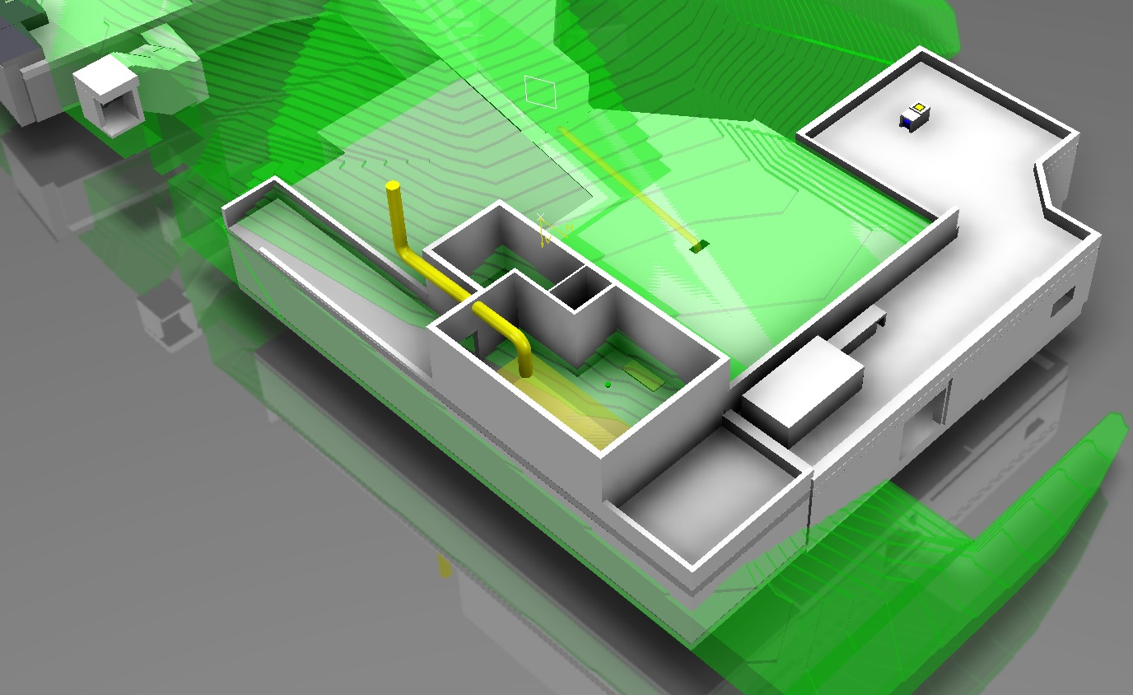
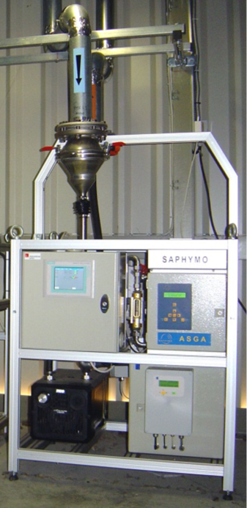
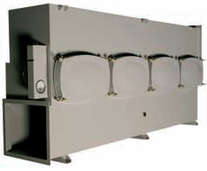
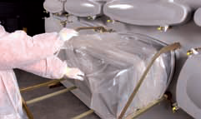
  Ventilation Technical Room
  Dedicated stack for the release of the extraction into environment;
  Dedicated station to monitor the activity releases;
  No interferences with the tunnel extraction;
  No risk of unpredicted backflows in case of ventilation stops;
  Interface between Class A lab and Tunnel still present
Courtesy: V. Barozier
CLASS A LABORATORY
ISOLDE TUNNEL
Techn. Room
Bldg. 170
`

Slide 18
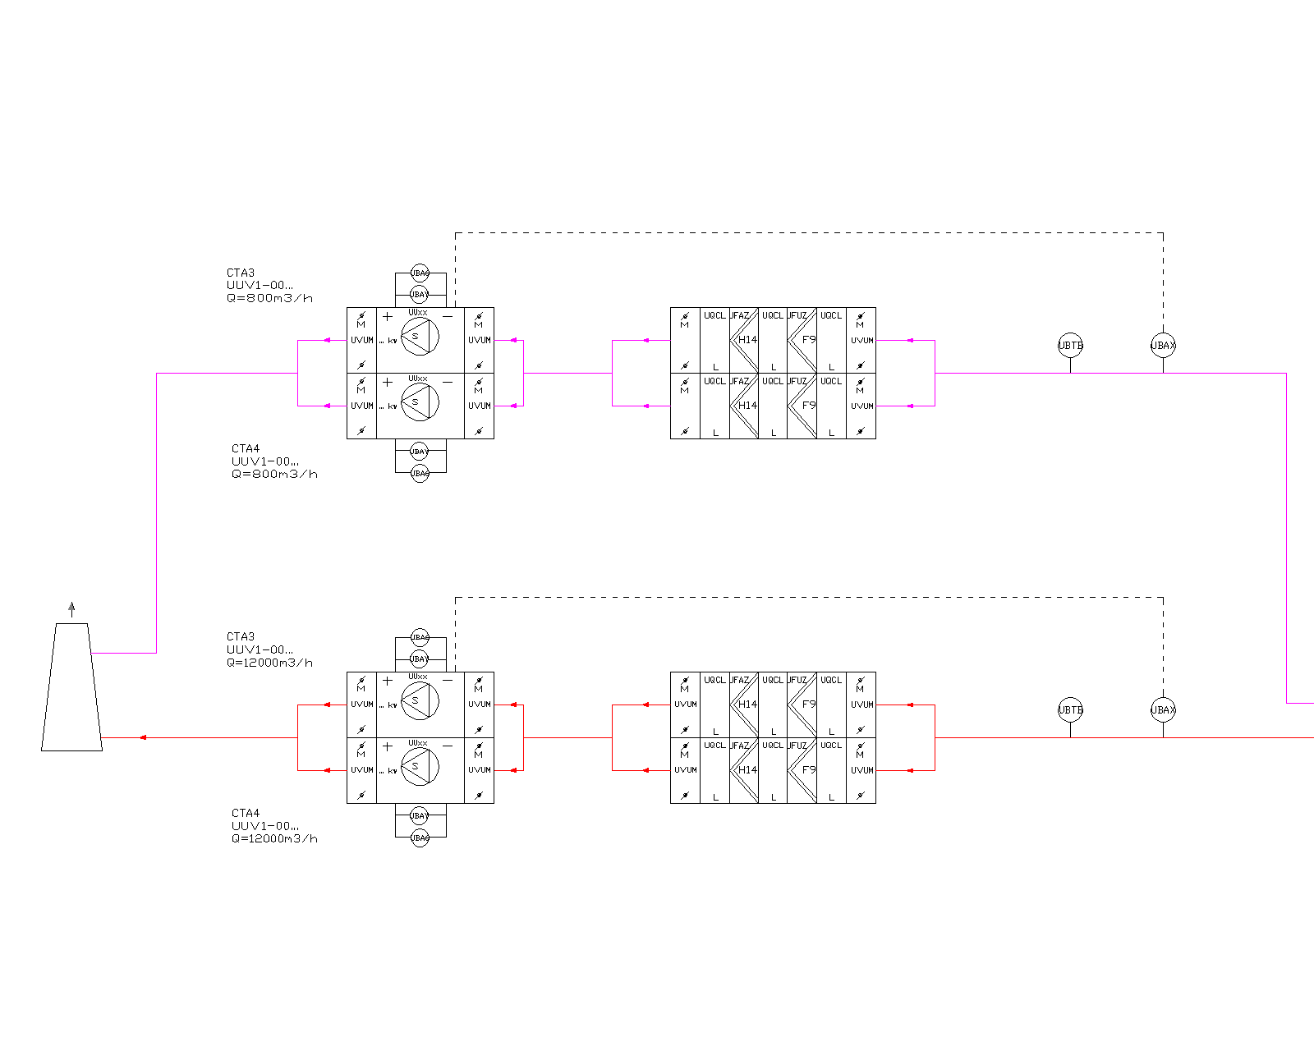
  Redundant equipment

Slide 19
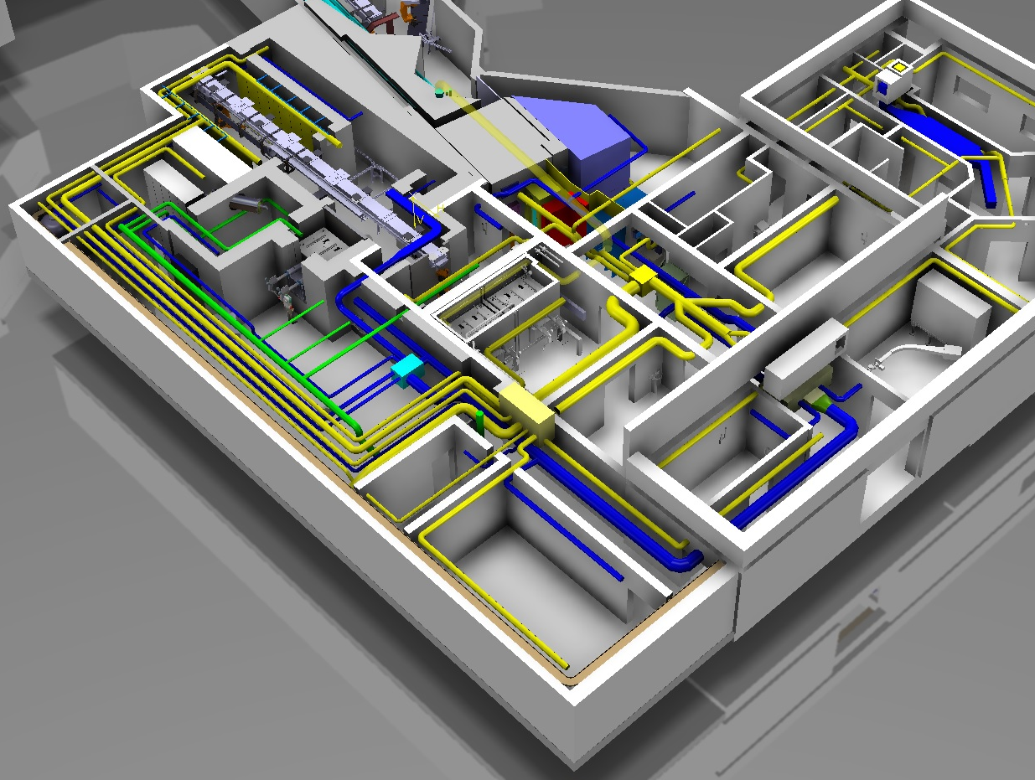
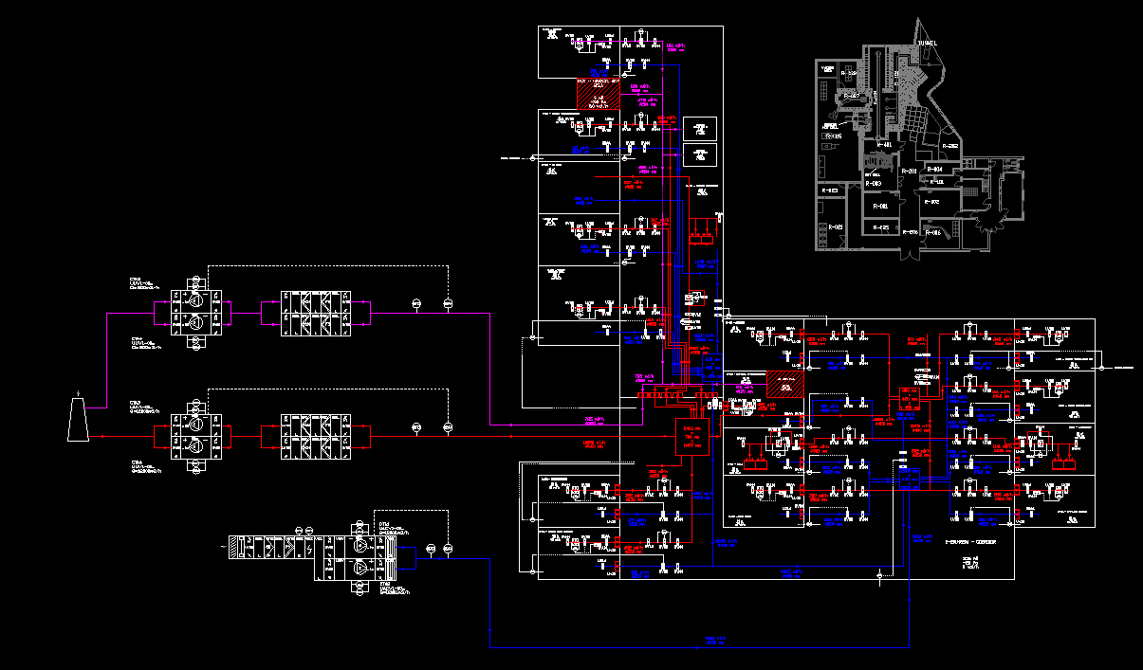
Courtesy: V. Barozier

Slide 20
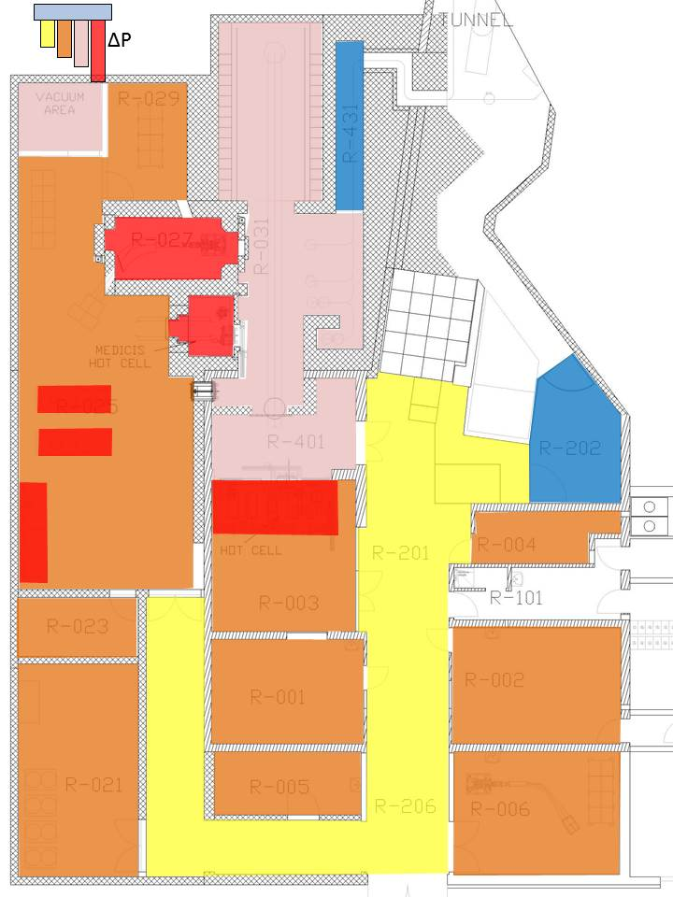

Slide 21
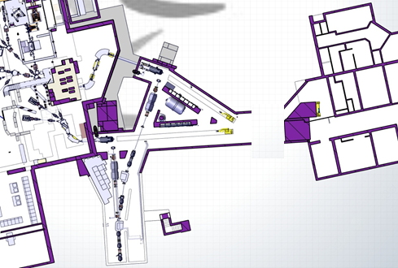
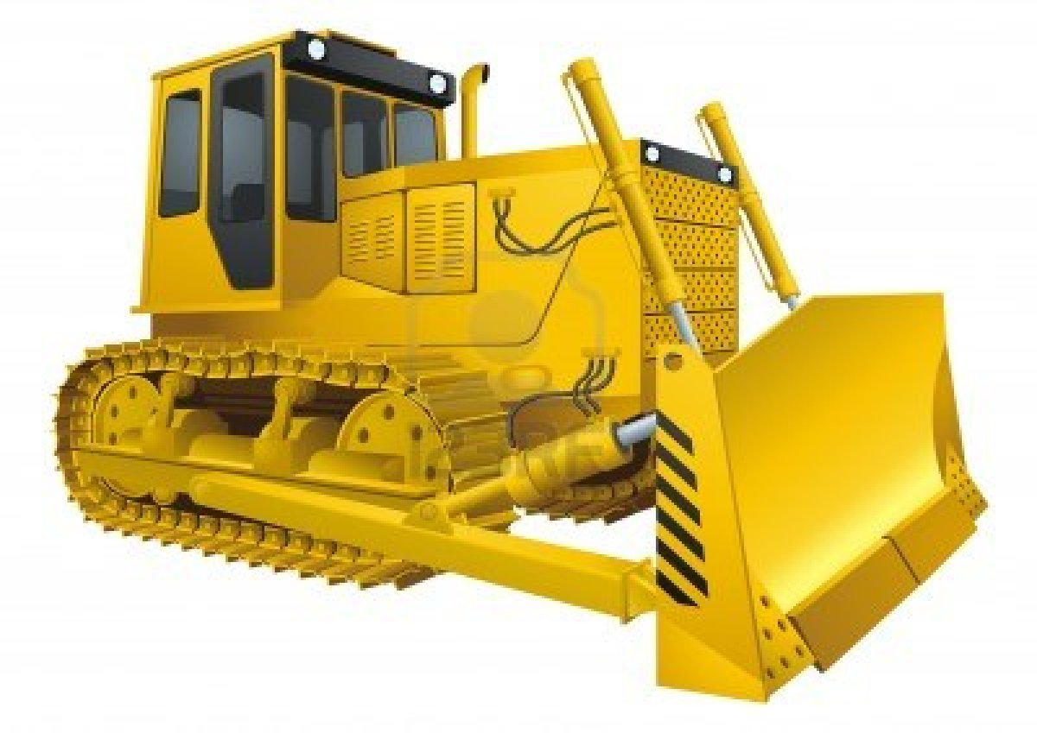
Airlock chambers
Purpose of the airlocks:
Create a volume between Tunnel and Class A Laboratory in such a way to:
  Avoid activated air backflows from the Tunnel to the Class A Laboratory;
  Prevent the Class A Laboratory evacuation in case of Tunnel ventilation stop (and vice versa);
  Enhance a more flexible pressure regulation in the two buildings;
Increase the leaktightness of the structure;
How to do it?
Conceptually, the solution is:
NOT FEASABLE
An alternative approach is needed
Ideally:
CONNECTION TO THE OUTDOORS
CLASS A LAB
- 20 Pa
CLASS A LABORATORY
- 20 Pa
ISOLDE TUNNEL
-75 Pa
AIRLOCK CHAMBER
0 Pa
ISOLDE TUNNEL
-75 Pa

Slide 22
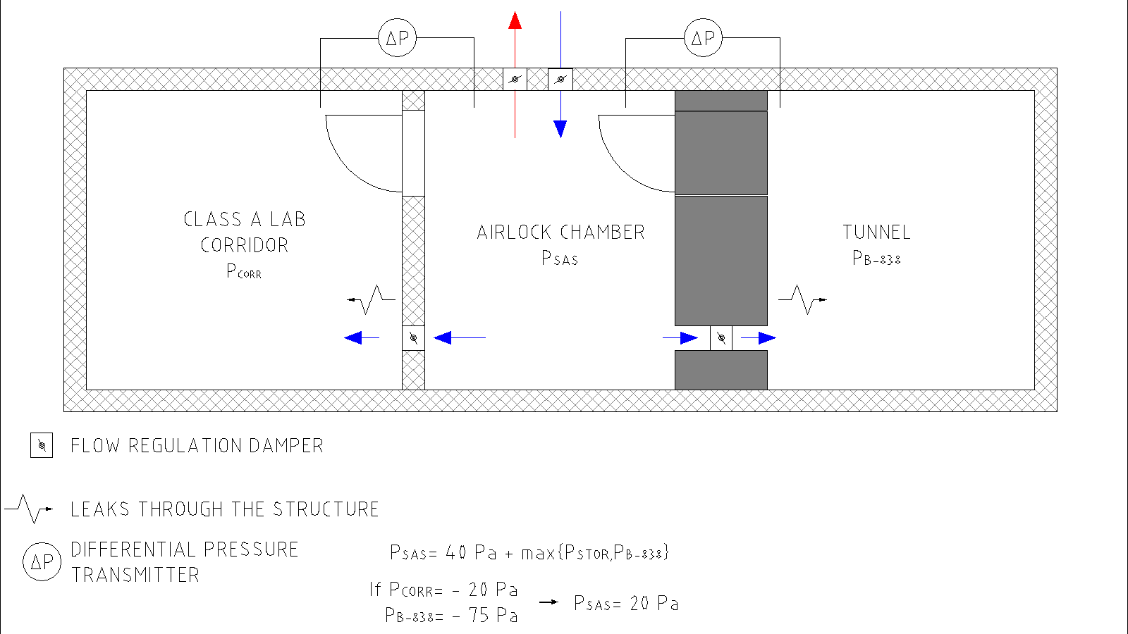
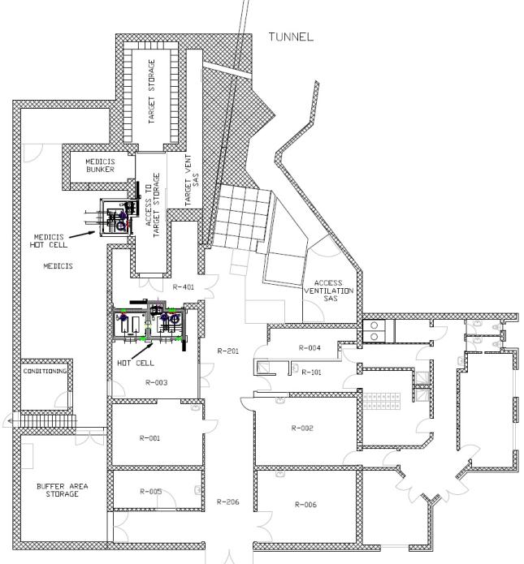
Airlock chambers
Pressure inside the airlocks will be set in such a way to be over pressurized (ΔP= 40 Pa) with respect to the higher among the pressures of the interfacing volumes;
Class A Laboratory will not “see” what’s happening inside the Tunnel and vice-versa;
The adoption of the airlock will imply a better sealing of the areas, thus improving the leaktightness of the tunnel;

Slide 23
VENTILATION SYSTEM:
TECHNICAL SOLUTIONS PROPOSED:
TUNNEL VENTILATION

Slide 24
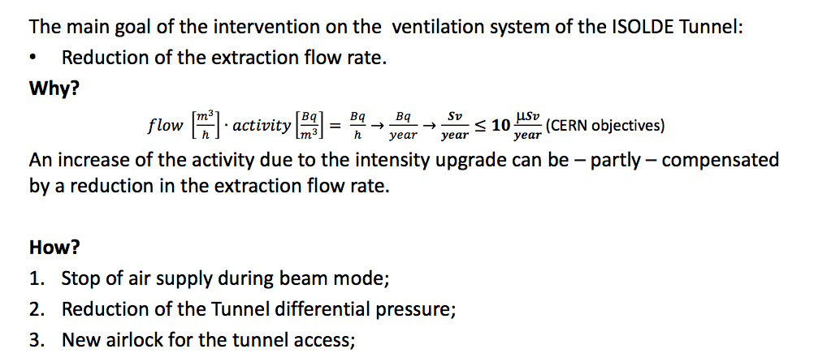
TECHNICAL SOLUTIONS PROPOSED: TUNNEL VENTILATION

Slide 25
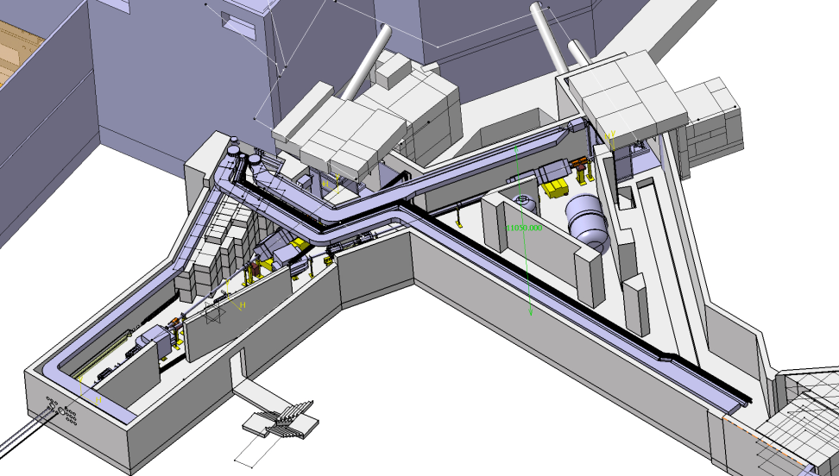
STOP OF THE AIR SUPPLY DURING BEAM MODE
Current Beam Mode ventilation parameters:
  Supply air flow: 1100 m³/h;
  Extraction air flow: 2900 m³/h;
????
Apparently no reasons for having an air supply during beam mode
Proposed Beam Mode ventilation parameters:
  Supply air flow: 0 m³/h;
  Extraction air flow: 1800 m³/h;

Slide 26
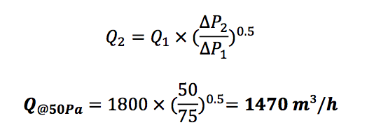
REDUCTION OF THE TUNNEL ΔP
Considering that:
  An extraction air flow:
1800 m³/h;
  Is necessary to keep a differential pressure:
ΔP= -75 Pa
And considering that:
  According to the Swiss Ordinance ORaP 814.554 the differential pressure shall be, for the Class A sectors:
ΔP≤ -50 Pa
What would be the flow necessary to ensure the minimum differential pressure?

Slide 27
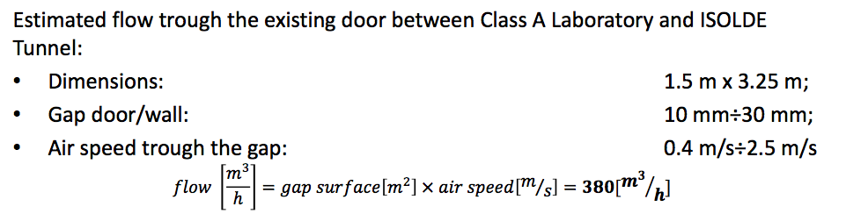
Airlock chambers
Using the standard NF EN 12207-2000 for the doors leak tightness classification:
Dimensions: 1.4 m x 3.25 m;
ΔP_{AIRLOCK-TUNNEL}: 70 Pa;
EN 12207 class | Leak rate @ ΔP= 100 Pa (m³/h x m²) | Leaks @ ΔP= 100 Pa (m³/h) | Leaks @ ΔP= 70 Pa (m³/h)
1 | 50 m³/h x m² | 228 m³/h | 220 m³/h
2 | 27 m³/h x m² | 123 m³/h | 119 m³/h
3 | 9 m³/h x m² | 41 m³/h | 40 m³/h
4 | 3 m³/h x m² | 14 m³/h | 13 m³/h

Slide 28
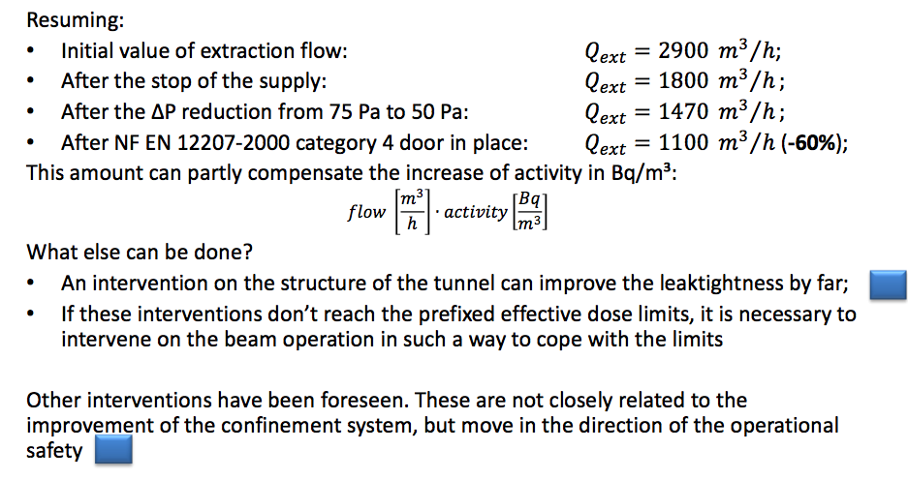
TECHNICAL SOLUTIONS PROPOSED: TUNNEL VENTILATION

Slide 29
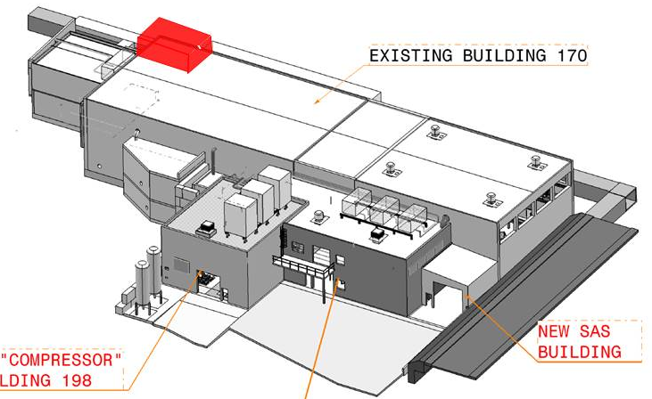
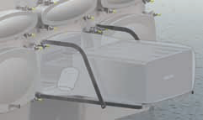
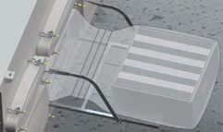
New Tunnel extraction AHU
Redundant fans;
Redundant double stage filters;
Bag-in/bag-out filters casing for safe maintenance operations.
Technical Room:
New technical room for the nuclear extraction from the tunnel;

Slide 30
COOLING

Slide 31
COOLING SYSTEM:
CURRENT COOLING SYSTEM

Slide 32
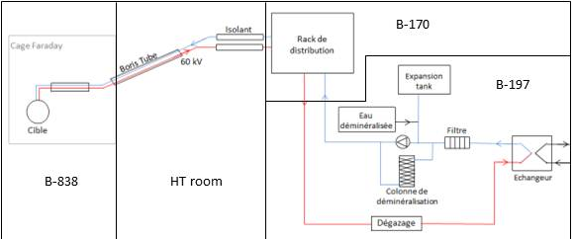
CURRENT COOLING SYSTEM

Slide 33
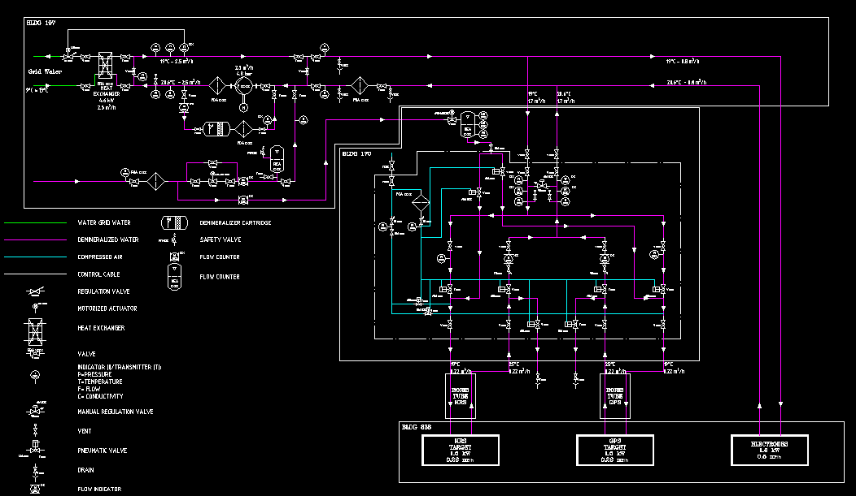
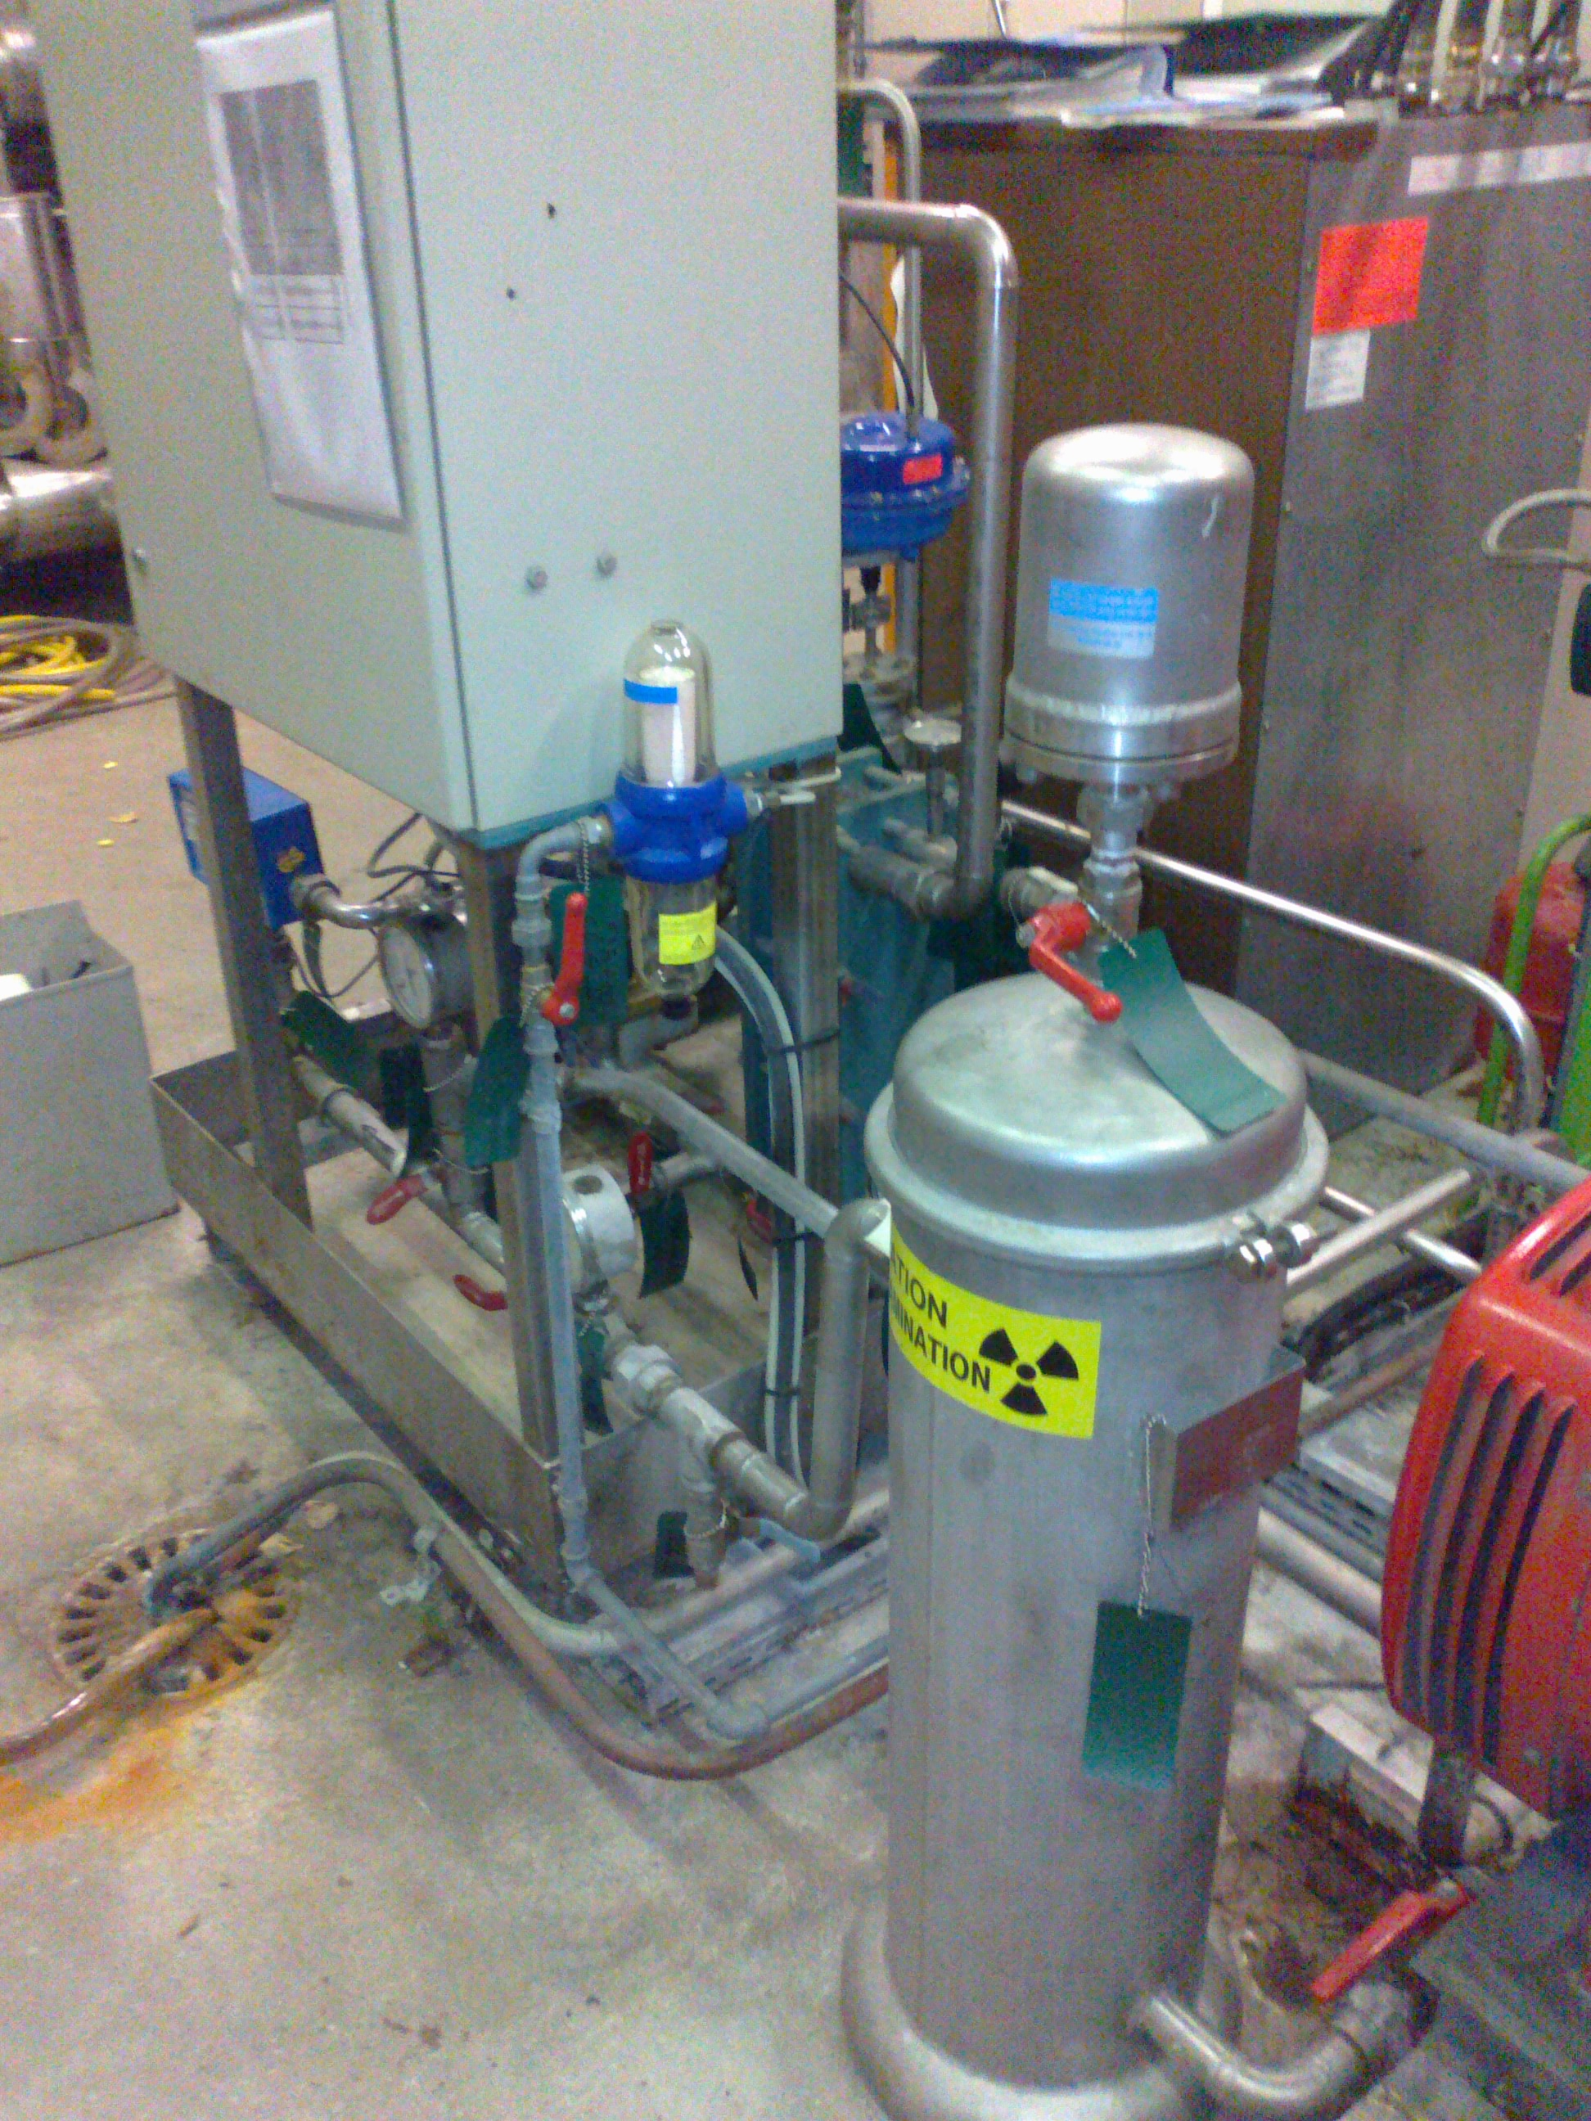
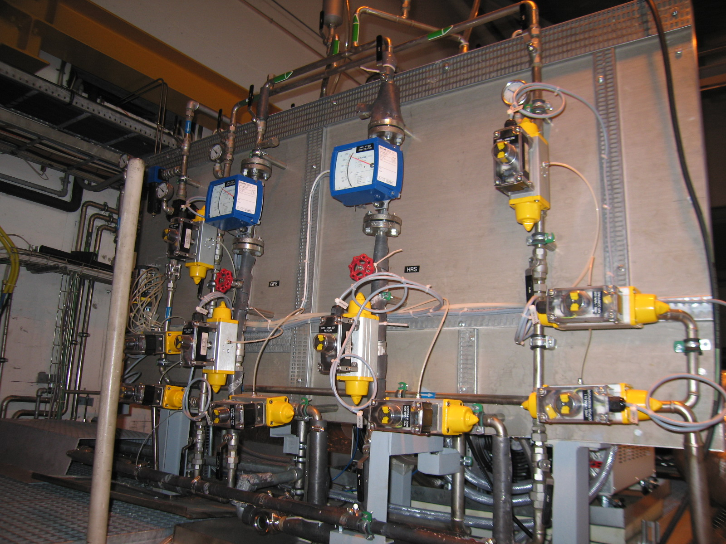
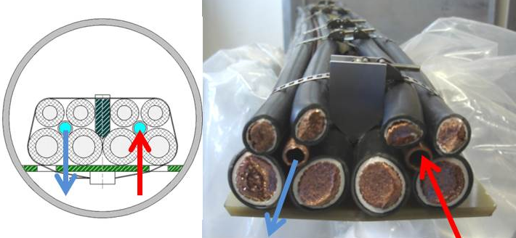
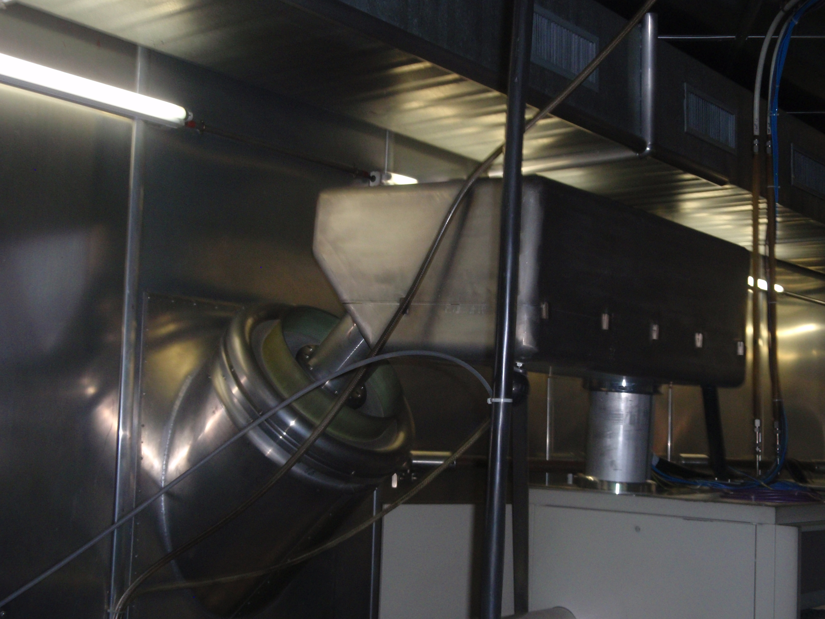
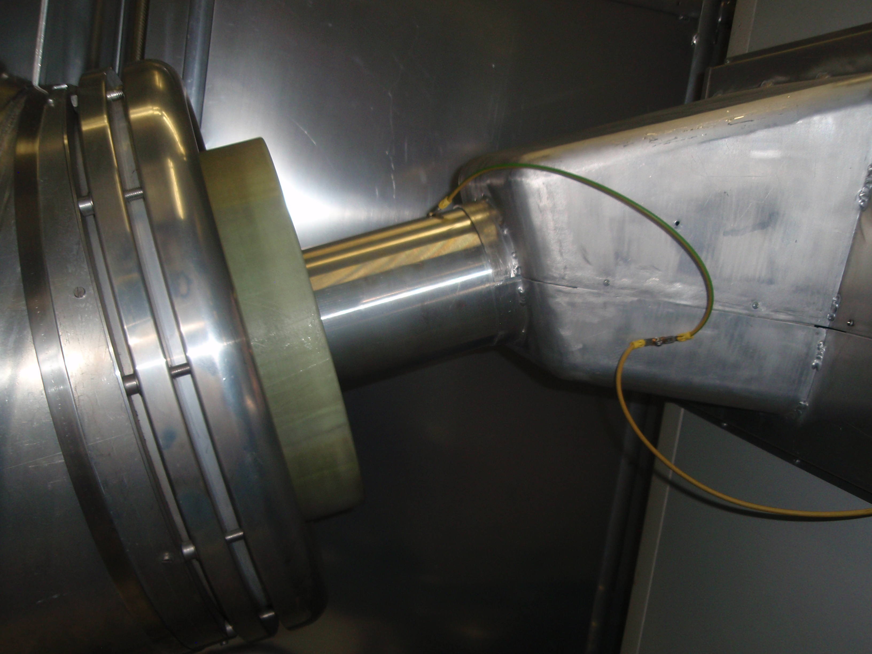
CURRENT COOLING SYSTEM

Slide 34
COOLING SYSTEM:
REASONS FOR THE SYSTEM UPGRADE

Slide 35
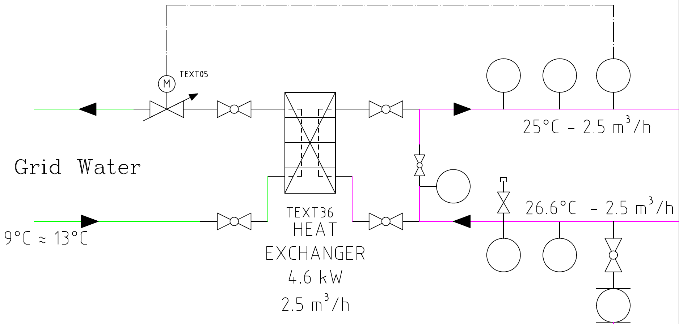
REASONS FOR THE SYSTEM UPGRADE
The use of an open circuit as a primary cooling loop, should be avoided, because of its high consumption of fresh water

Slide 36
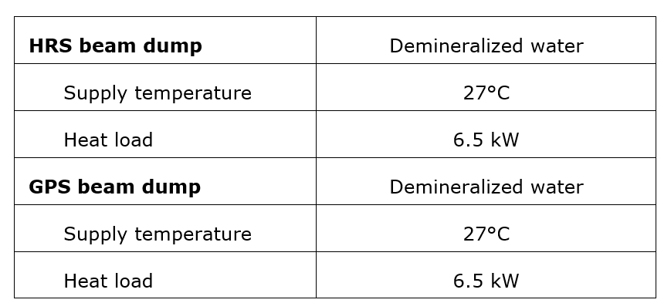
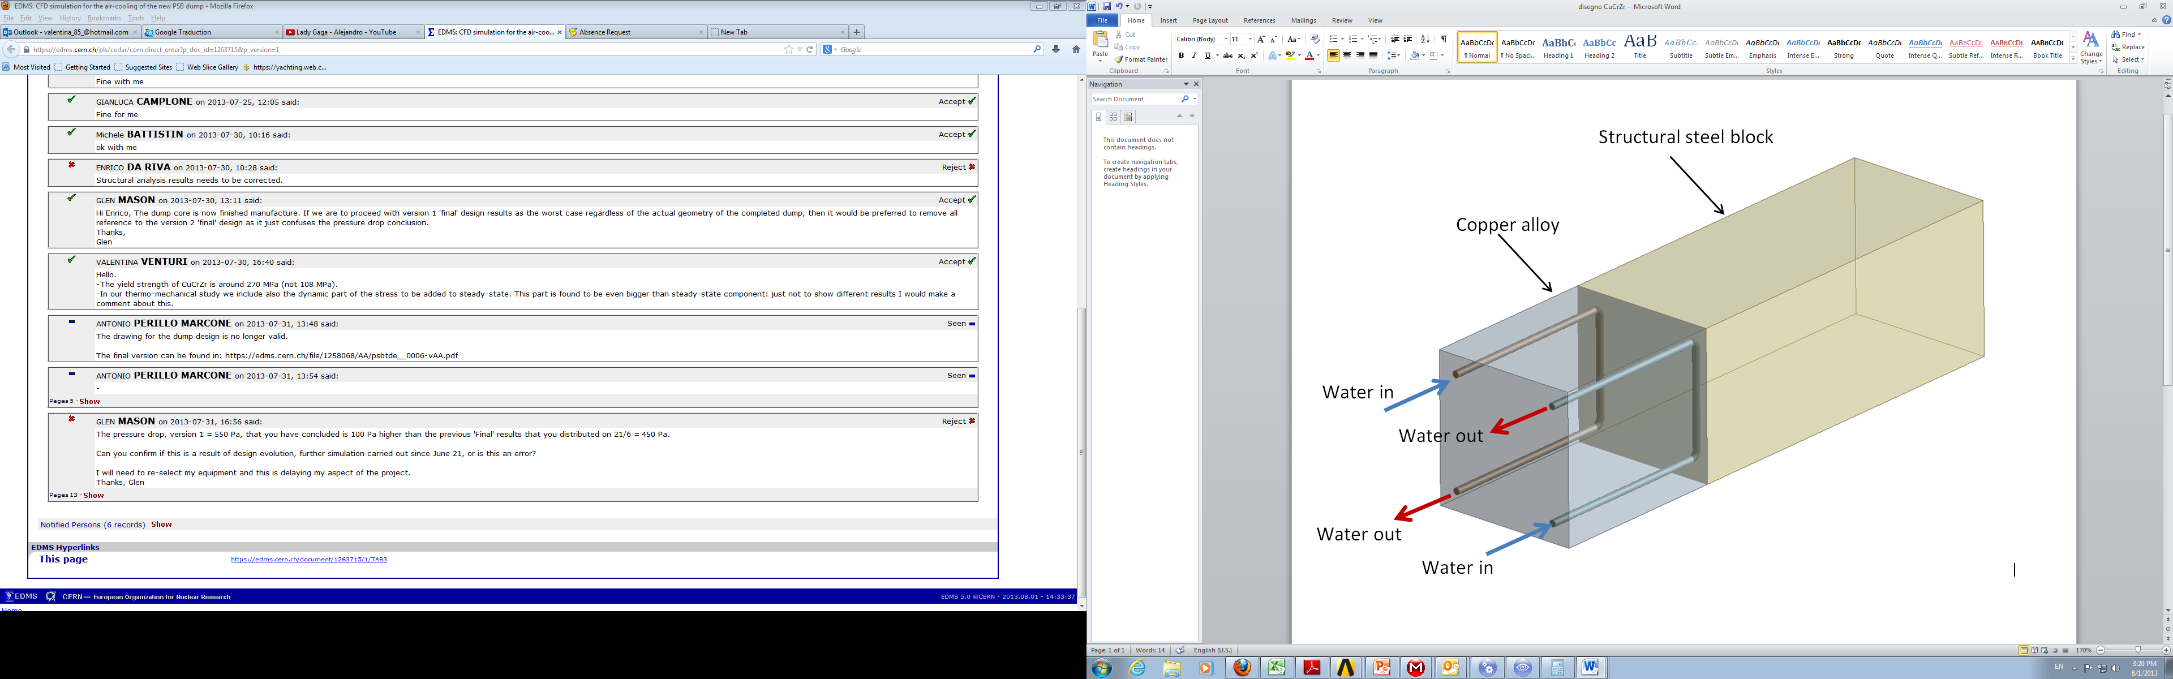
REASONS FOR THE SYSTEM UPGRADE
New Beam Dumps for HRS and GPS, shall be actively cooled

Slide 37
COOLING SYSTEM:
TECHNICAL SOLUTIONS PROPOSED

Slide 38
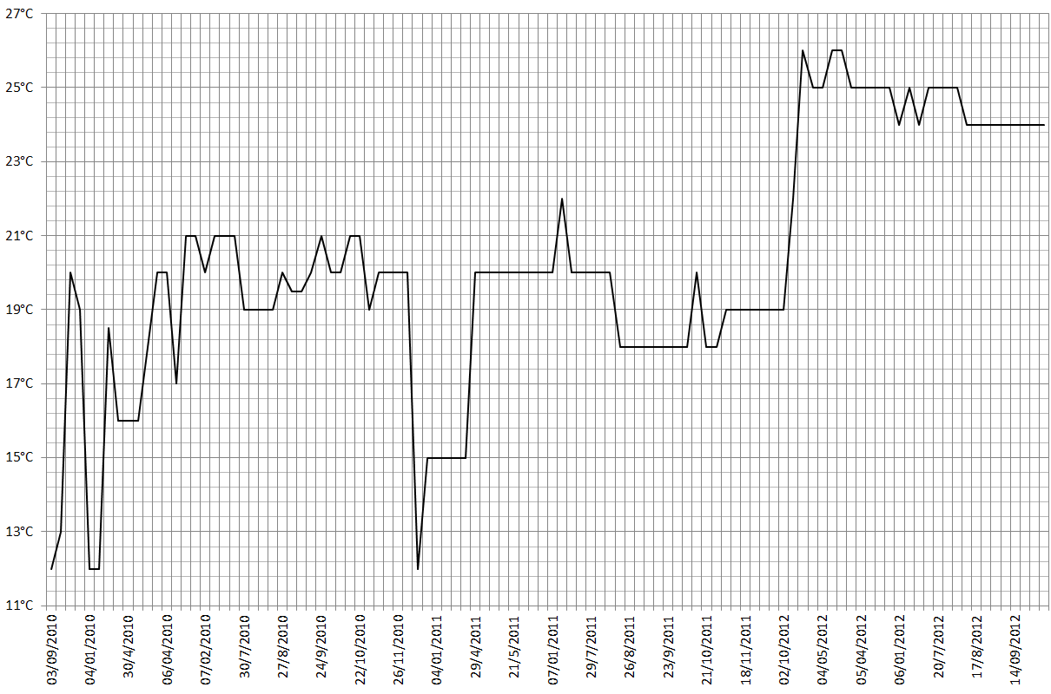
TECHNICAL SOLUTIONS PROPOSED
Looking at the temperatures of the secondary loop in 2010, 2011 and 2012 it was noticed that
targets can work without problems also at temperatures of more than 25°C.

Slide 39
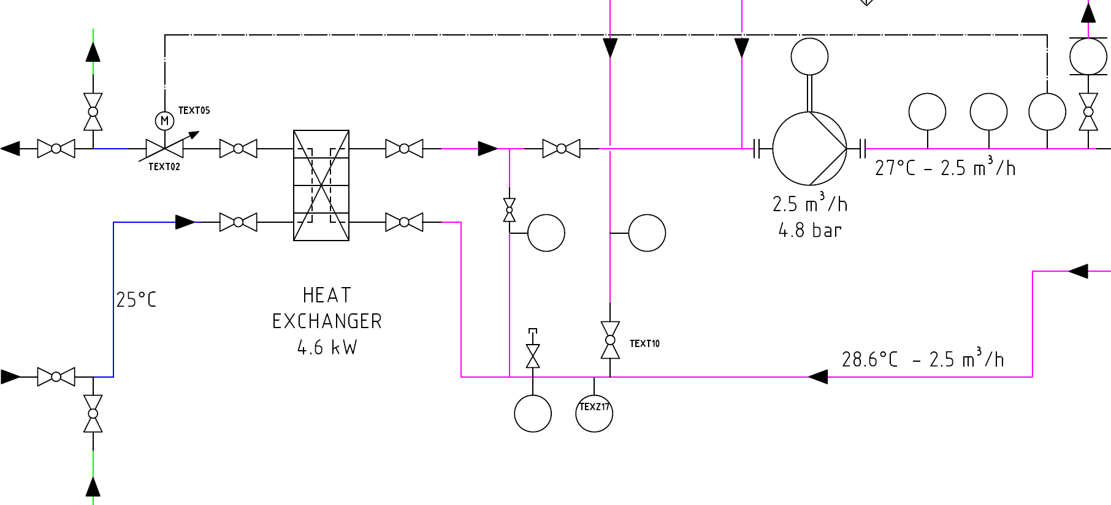
TECHNICAL SOLUTIONS PROPOSED
new cooling towers for the ISOLDE facility
Targets cooling system can be integrated into the cooling tower loop
Water from the towers will be supplied at 25°C
Connections on the cooling towers pipes have been already foreseen for the implementation of the upgrade.

Slide 40
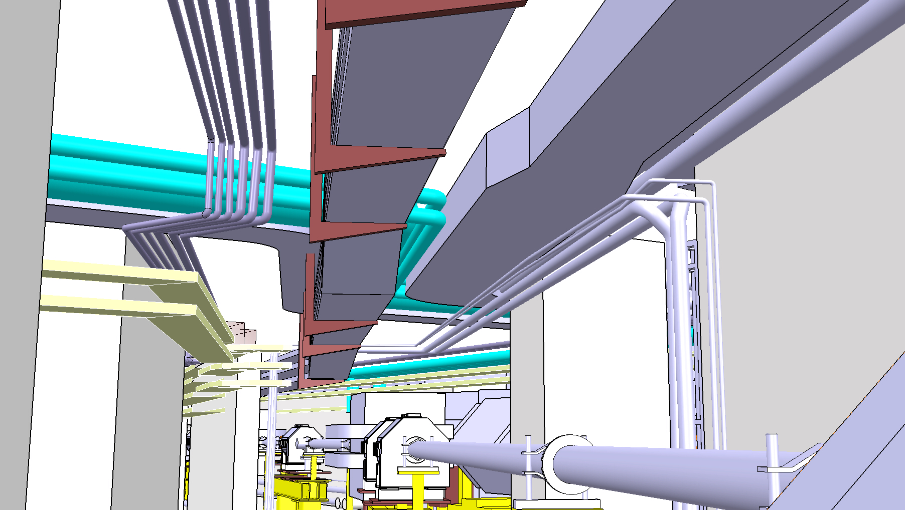

TECHNICAL SOLUTIONS PROPOSED
Concerning the Beam Dumps cooling
A demineralized water loop present in the tunnel.
The loop is sized to remove a total of 230 kW (demineralized supply temperature 27°C) from the magnets installed in the ISOLDE tunnel.
It is possible to integrate the beam dumps cooling system in the magnets cooling loop in consideration also of the beam dumps heat load of small entity with respect to the magnets’ loop capacity

Slide 41


TECHNICAL SOLUTIONS PROPOSED
The works for the installation of the new robot in the ISOLDE tunnel imposed a change of the routing of the cooling water pipes.

Slide 42

TECHNICAL SOLUTIONS PROPOSED
These works gave to opportunity to install on the pipes two connections, where in the future connect the beam dumps

Slide 43
CONCLUSIONS

Slide 44
CONCLUSIONS
VENTILATION SYSTEM
  New MEDICIS Project constitutes a great occasion to develop some solutions in line with the ESR13: Cooling and Ventilation Design Study, in particular:
    Separation of the ISOLDE Tunnel and the Class A Laboratory (new MEDICIS ventilation + airlocks);
    The improvement of the Leaktightness of the tunnel (airlocks);
  The solutions proposed for the tunnel ventilation moves in the sense of the reduction of the activity releases. Nevertheless this is not a simple ventilation task, but should involve also:
    Civil engineers, to improve the leaktightness of the area;
    ISOLDE irradiation planning, in order to define in detail the irradiation campaigns in order to cope with the effective dose objectives;
COOLING SYSTEM
  New solutions for the upgrade of the targets cooling system were described and studied;
  The presence of the beam dumps to be active cooled was also taken into consideration

Slide 45
THANK YOU FOR YOUR ATTENTION
QUESTIONS?

