Slide 1
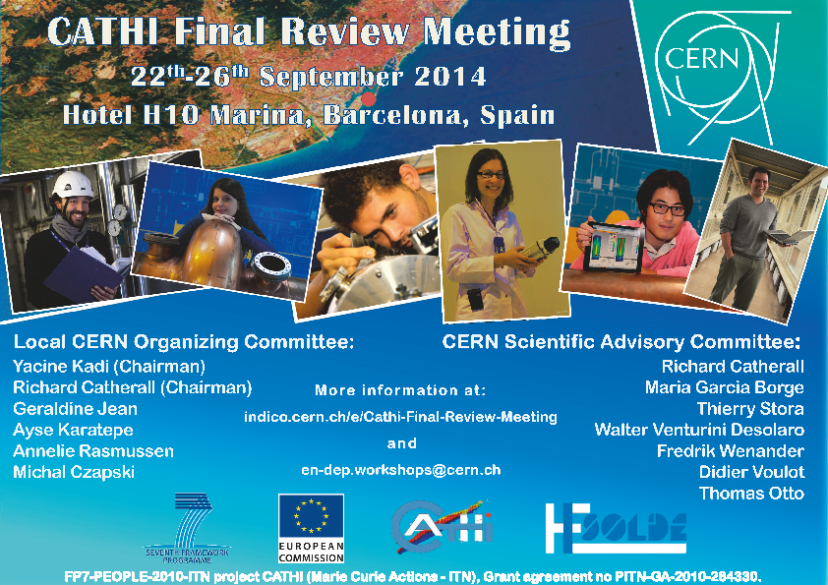

Slide 2




Administrative
Support
Receipts
Attendance certificates
Any other information
Ayse
Annelie

Slide 3
WIFI access
Direct in your rooms
In the meeting room
  H10 Salones pl 0
  Password: convencionesicaria
Posted on the notice board at the back of the room

Slide 4
Dining
Buffet lunch provided on Tuesday and Thursday
Coffee breaks just outside this room
Workshop dinner
  The restaurant location and menu is available on the Indico website.
  Private room on the second floor
  Rendez vous at 20:30 at the restaurant Barceloneta
    You make your own way there
    A bus is provided for the return journey ~23:30

Slide 5
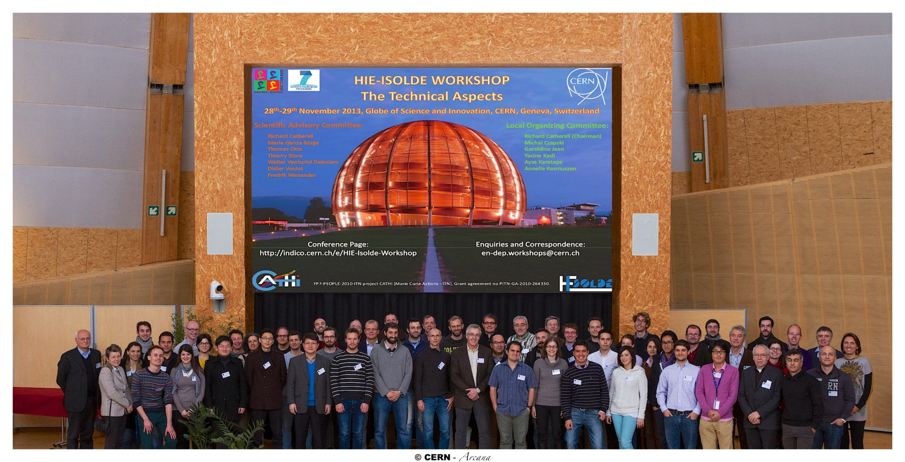
Photo
At 16:25 during the afternoon coffee break
Tim Giles: the official photographer

Slide 6
Welcome
Final CATHI Review Meeting
  Required by the European Commission
  Also an opportunity to follow the progress on the HIE-ISOLDE project
  Bring together the Radioactive Ion Beam community to share developments and ideas

Slide 7
Acknowledgements
Yacine Kadi
  Project Coordinator
The local organizing committee
  Annelie Rasmussen, Ayse Karatepe, Geraldine Jean, Michal Czapski…
Marie Curie European Project Officers
  Amelie Courcy, Marcella Groholova, Markus Rester
  CERN MC coordinator: Seamus Hegarty
Invited speakers, associated partners and all the MC Fellows

Slide 8
Absences
Andrea Polato -> Ana-Paula Bernardes
Serena Cimmino -> Stefano Marzari
Sandra Giron -> Joachim Vollaire
Alejandro Garcia Sosa -> Daniel Esteban
Martino Colciago -> Mark Butcher
Mario Hermann -> A. Dorsival + C. Babcock

Slide 9
This is a workshop!
Please participate
  Comments, questions and feedback are always welcome
Please respect your allocated time
  Eg. 20 minute talk = 15 + 5
  Enjoy!

