Slide 1



CATHI
Marie Curie Initial Training Network
Cryogenics, Accelerators and Targets at HIE-ISOLDE
Yacine Kadi & Seamus Hegarty
CATHI Project Co-ordinators
Final Review Meeting, 22-26 September 2014
Notes:
Supervisor is Sergio Calatroni

Slide 2
Outline
CATHI and HIE-ISOLDE
Scientific Overview
Networking
Administrative & Management Issues
Conclusions and Prospects

Slide 3
CATHI and HIE-ISOLDE
CATHI – Cryogenics, Accelerators and Targets at HIE-ISOLDE:
The HIE-ISOLDE project at CERN represented an ideal R&D opportunity to train young engineers over a range of disciplines relevant to the accelerator and nuclear industry.
CERN and the Associated Partners of CATHI offered excellent hands-on and academic training.
ISOLDE provided a multi-disciplinary environment on a scale that encouraged collaboration and teamwork.

Slide 4
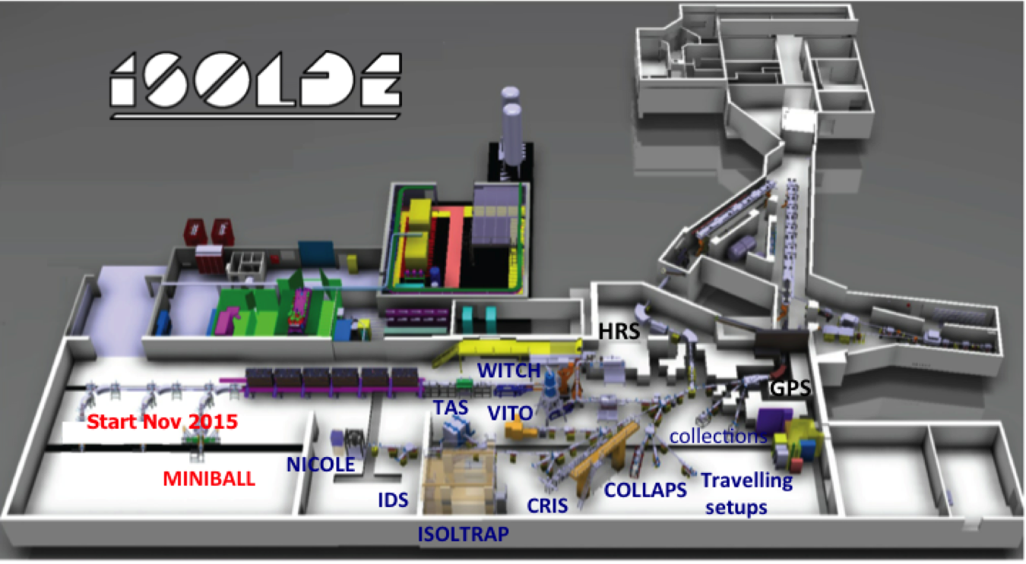
HIE-ISOLDE aims at increasing the energy of the RIB up to 10AMeV and their intensity by a factor 10
Energy Upgrade:
The HIE-ISOLDE project concentrates on the construction of the SC LINAC and associated infrastructure in order to upgrade the energy of the post-accelerated radioactive ion beams to 5.5 MeV/u in 2016 and 10 MeV/u by 2017-2018
Intensity Upgrade:
The design study for the intensity upgrade, also part of HIE-ISOLDE, started in 2012, and addresses the technical feasibility and cost estimate for operating the facility at 15 kW once LINAC4 and Upgraded PS Booster are online.
Beam Quality Upgrade:
RFQ cooler and buncher
Solid state lasers for RILIS Higher mass resolving
power HRS

Slide 5
Research Training Themes
(21 Fellows over 4 years)

Slide 6
HIE-ISOLDE
Working Group Structure

Slide 7
CATHI: a rare mono-site ITN
1 of 3 mono-site ITNs funded in FP7
    One of the others was at CERN (ACEOLE)
4.8 M€ = BIG money from Brussels
    425 k€ for Fellow training
    355 k€ for Networking
    480 k€ for Fellow R&D and Prototyping
    145 k€ for Managament Costs
3 = number of Project Officers (more than usual…)
    Very helpful
    Firm about contractual reporting issue
2 = Commissioner visits CATHI took part in
1 = monthly frequency & duration in hours of Carla’s CATHI meetings (not a minute more!)
>1000 = number of EDH documents signed !

Slide 8
CATHI: The Fellows
16 + 1 Early-Stage Researchers
4 Experienced Researchers
28.6% females (EC target 40%)
Recruitment:
    150 Applications
    Interviews at CERN and by video
    Recruitment done in time
    Good geographical spread
Contribution to schools (ASP14), Conferences (EMIS12, SRF13, THEC13) & workshops (ISOLDE)
Notes:
Nice to see CATHI getting a mention in the CERN Bulletin for being involved in the African School of Physics in Dakar last month. ESRs Carla Babcock and Jacobo Montano were active participants as workshop leaders and speakers (and I understand that they also stepped in at the last minute to help as some speakers were unable to attend at the last minute)

Slide 9
CATHI: The Training
Hands-on research training complemented by formal training:
  CERN Training Programmes
          Academic Training
          CERN Seminars
          CERN Accelerator School
          Technical Training
  International Conferences
          LINAC, IPAC, SRF, ICIS, EMIS, RNB, IEEE Real-Time………
  Training during secondment
          Up to 30% of contract duration
  Complementary Training
          CERN Management and Communication courses
          Other external training courses

Slide 10
Outline
CATHI and HIE-ISOLDE
Scientific Overview
Networking
Administrative & Management Issues
Conclusions and Prospects

Slide 11
Scientific Highlights (1/9)
Notes:
Thanks to partners manage to produce good cavities
Due to late recruitment of ER1 activities re-oriented towards validating of the tuning strategy
All milestones achieved
Given the extent of the R&D => need now to concentrate on the write up of the main deliverables
Extensive use of the CATHI R&D and prototyping budget together with WP6

Slide 12
Scientific Highlights (2/9)
Notes:
Acknowledge support from the Associated Partners including TRIUMF but also the close collaboration with industry (AVS).
One of the work package which also benefited from substantial in-kind support from Spanish Government
All but 1 milestones achieved
Need to concentrate now on the write up of the final version of the deliverables (in particular D12)
Substantial amount of publications

Slide 13
Scientific Highlights (3/9)
Notes:
Due to delay in the project: late start of the commissioning => deliverables only slightly modified in order to adapt to actual situation (1 milestone was modified)
Fostered Partnership Agreement between CERN and DTU signed in November 2013 on better understanding of permanent magnet couplings

Slide 14
Scientific Highlights (4/9)
Notes:
New additional partners
Extended R&D and Integration = delay in the write up of the deliverables

Slide 15
Scientific Highlights (5/9)
Notes:
All Milestones & Deliverables completed. Pitty will not be able to assist in the commissioning of the new Machine !

Slide 16
Scientific Highlights (6/9)
Notes:
Deliverables and Milestones had to be slightly re-organised namely due to late start of the Design Study for the Intensity Upgrade
Still missing quite a few documents
Extensive use of the CATHI R&D and prototyping budget

Slide 17
Scientific Highlights (7/9)
Notes:
Completed: all milestones and deliverables submitted
Extended collaboration with Associated and non-Associated Partner

Slide 18
Scientific Highlights (8/9)
Notes:
Extensive use of the CATHI R&D and prototyping budget
Extended collaboration with Associated and non-Associated Partner
HRS studies slightly behind schedule

Slide 19
Scientific Highlights (9/9)
Notes:
Extended collaboration with Associated and non-Associated Partner

Slide 20
Scientific Overview
More details will follow in the individual presentations of the CATHI fellows
What’s next:
    Concentrate on final write up

Slide 21
Outline
CATHI and HIE-ISOLDE
Scientific Overview
Networking
Administrative & Management Issues
Conclusions and Prospects

Slide 22
WORKING TOGETHER
CATHI partners
      Pre-existing relationships and/or collaborations
      CERN services tailored to support international collaborations
EU funding covered People:
      Researcher salaries + social conditions
      Training & Mobility
      ITN Management
      Organization of workshops, conferences, schools, outreach
      Did cover a small fraction of the research project costs (prototype development)

Slide 23
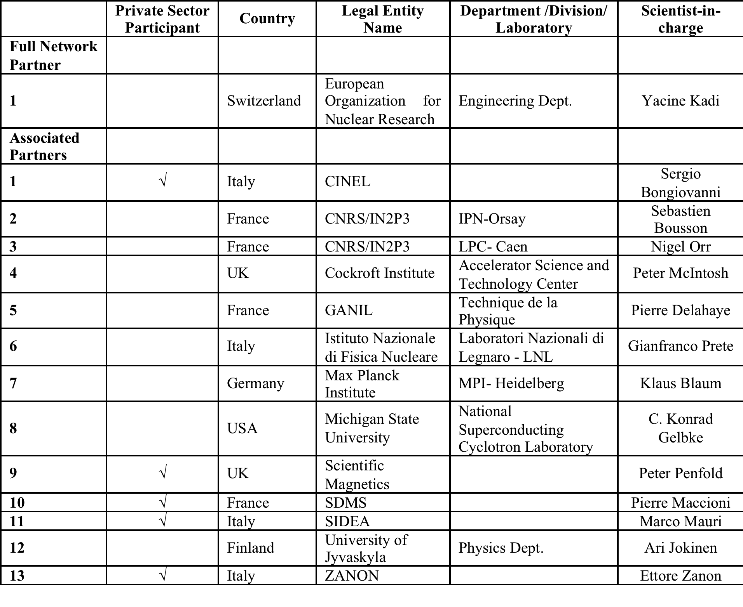
List of Participants

Slide 24
New Associated Partners

Slide 25
Outline
CATHI and HIE-ISOLDE
Scientific Overview
Networking
Administrative & Management Issues
Conclusions and Prospects

Slide 26
Recruitment of Fellows: Time plan

Slide 27
Administrative & Management
Issues
There were no deviations from the original contract
Slight re-adjustment of Deliverables and Milestones to account for the delay in the project
Some secondment periods had to be re-scheduled (new partners, late recruitment, etc…)
Given the difficulty in recruiting ER1, task was covered by CERN staff => ER1 re-oriented on cavity tuning strategy and cryomodule test
3 ESRs enrolled on a PhD programme.
Additional recruitment of 1 ESR was made possible

Slide 28
Periodic Reviews
Mid-Term Review: “I would like to congratulate to you, at the mid-term stage you have shown very good progress of your research and well running project network….. the project is excellent, fellows are happy in your network, they see it as a great opportunity for their research career”
2nd Progress Report: “the CATHI Progress Report for Period 2 is accepted. The information provided in the report and attachment is clear and complete. It allows us to conclude that until now, the project seems to be running according to the plan”

Slide 29
Conclusions
The presence of the CATHI fellows was paramount for the HIE-ISOLDE project:
      Replace missing staff deployed on other high-priority projects (LS1, LHC Upgrade, L4, LIU, etc…)
      Represent 1/3rd of the total manpower of the project and almost 2/3rd in the case of the Design Study !
      Help establish or re-inforce existing collaborations
Created a good spirit and teamwork within the project

Slide 30
From FP7 to Horizon 2020
From Marie Curie Actions to
Marie Skłodowska-Curie Actions
No more mono-site ITNs ☹
From Initial to Innovative Training Networks
    ESRs only
    More industrial (non-academic) involvement
The challenge to secure more funding for stimulating projects continues
Next ITN application deadline: 13 Jan 2015!

Slide 31
And finally…
Over 4 years of FUN + interesting work ☺
A great group of ESRs and ERs all at CERN
A project that has never been forgotten by our first Project Officer Marcela Groholova
Fellows finding jobs ☺
Keep in touch!
Have fun in Barcelona – Seamus « sorry I can’t be there »

Slide 32

Thank you very much for your attention
HIE-ISOLDE web site -> http://hie-isolde-test.web.cern.ch
CATHI-ITN web site -> https://espace.cern.ch/Marie-Curie-CATHI/default.aspx

