Slide 1


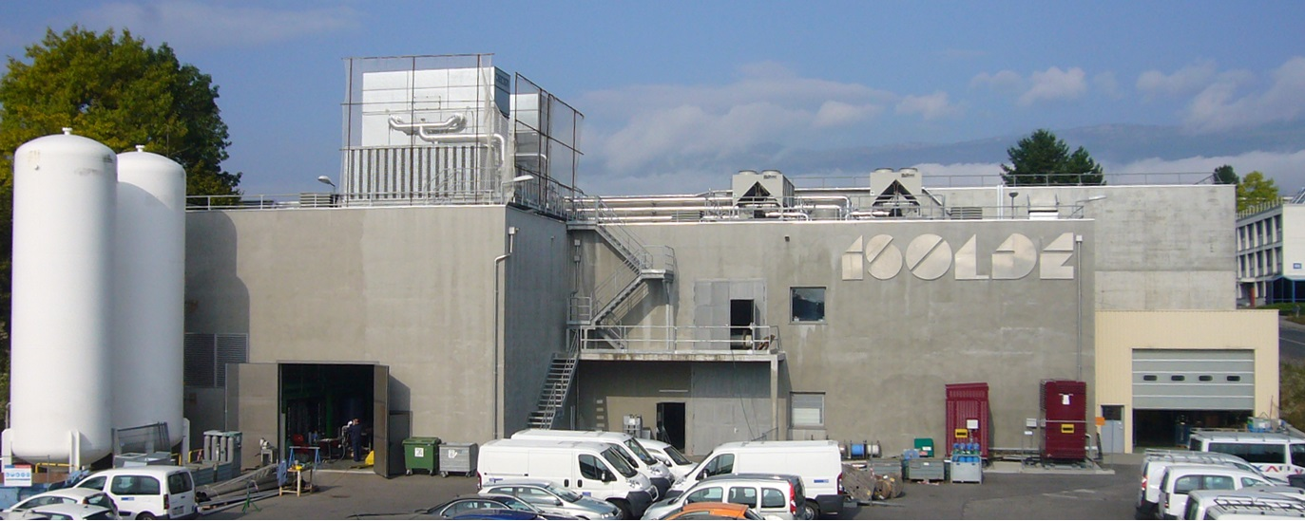

HIE ISOLDE Installation Progress
CATHI Final Review, 22-26 Sept. 2014, Barcelona, Spain
Erwin Siesling for the HIE ISOLDE integration team

Slide 2
Outline
  HIE Installation Progress:
  Stage 1 installation and planning
  Progress since HIE workshop Dec. 2013
  Ongoing activities
  What to expect for this and next year
  Construction and Physics in parallel: Safety

Slide 3
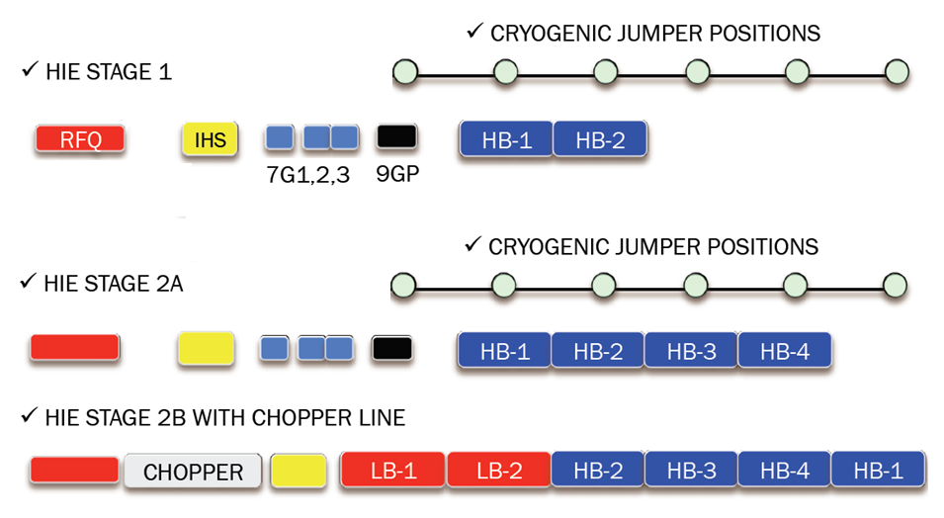
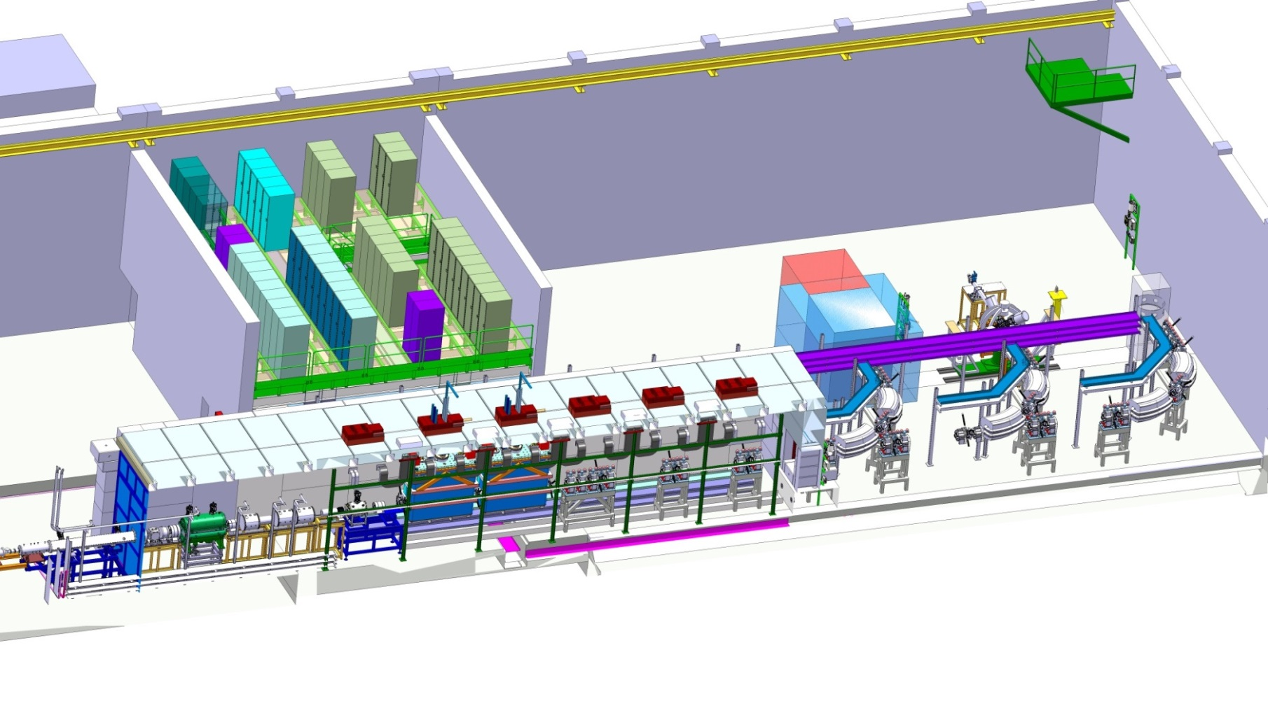
Stage 1 Installation
HIE stage 1:
2016?
10MeV/u
>2017?
HIE physics
2015 with 1 CM: ~4MeV/u
2016 with 2 CM: 5.5MeV/u

Slide 4
Stage 1 simplified Installation Planning
Start Isolde shutdown
17 dec 2012
End LS1:Start Low E physics
July 2014
HIE physics
October 2015
We are here
Sept 2014
2011
2012
2013
2014
2015
2016
Q1
Q2
Q3
Q4
Q1
Q2
Q3
Q4
Q1
Q2
Q3
Q4
Q1
Q2
Q3
Q4
Q1
Q2
Q3
Q4
Q1
Q2
Q3
Q4
Civil
HEBT
Cryo
Civil hall & tunnel
Main services
~4MeV/u
Cabling
5.5MeV/u
Ventilation
RF
Demi water
Electrical syst.s
CM 1&2
Timeline:
CM 1
CM 2
sd
sd
Long Shutdown
sd
sd
17 Dec 2012 - Q3 2014
Beam commissioning
7 weeks
shutdown
Isolde Ops
HIE installations and tests (Isolde normal operations)
Machine Check-Out
(Isolde normal operations)
Beam Commissioning
(Isolde normal operations)

Slide 5
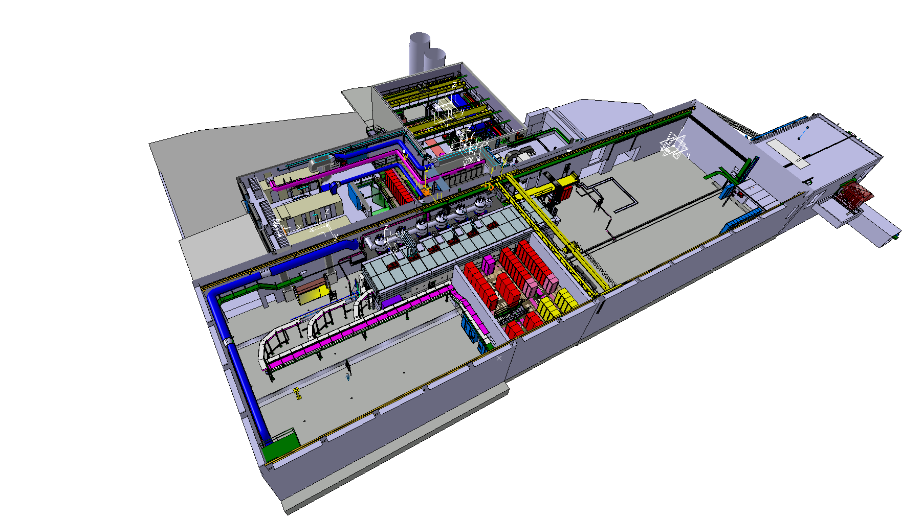
HIE Installation Progress
Compressor building 198
ISOLDE target zone
Water station B197
ISOLDE Low Energy
Cold Box building 199
HIE SC Linac
Equipment platform
High Energy Beam Transfer lines HEBT

Slide 6
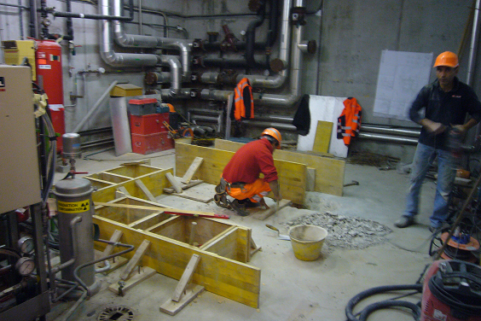
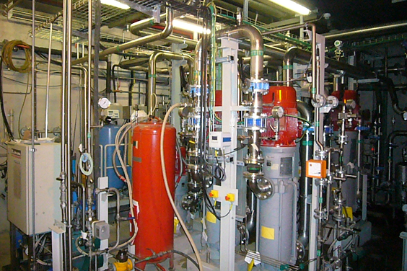
(HIE) ISOLDE water station
Compressor building 198
ISOLDE target zone
Water station B197
ISOLDE Low Energy
Cold Box building 199
HIE SC Linac
Equipment platform
High Energy Beam Transfer lines HEBT
ISOLDE water station:
New 27C demi water station operational April ‘14 In time for ISOLDE Low Energy re-start.

Slide 7
HIE ISOLDE Service Buildings
Compressor building 198
ISOLDE target zone
Water station B197
ISOLDE Low Energy
Cold Box building 199
HIE SC Linac
Equipment platform
High Energy Beam Transfer lines HEBT

Slide 8
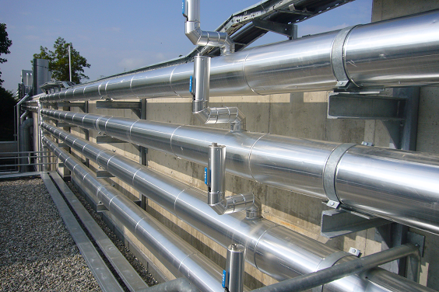
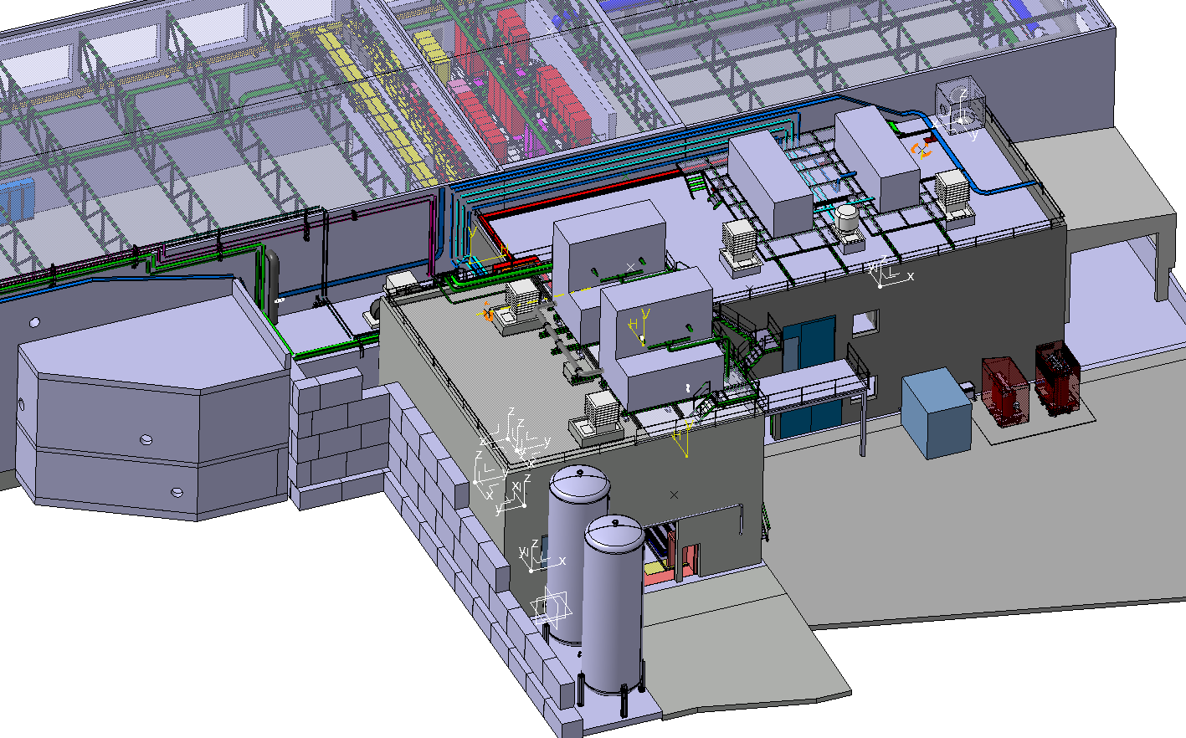
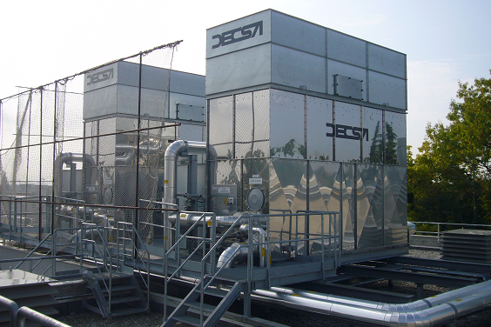
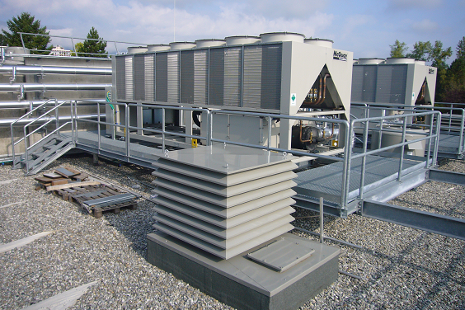
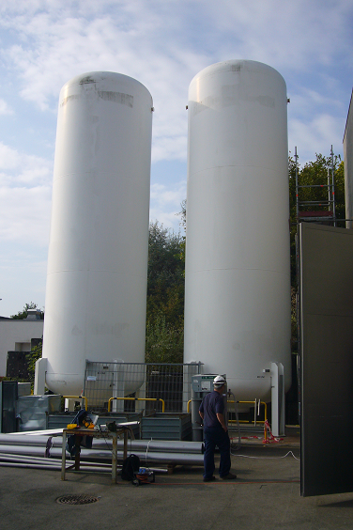
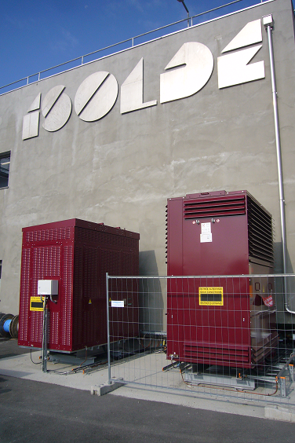
Outdoor progress
Cooling & ventilation:
Tubing demi and chilled water installed and isolated. Cooling towers and chillers tested and operational.
Cryo: He buffer tanks installed.
EL systems: 400V and 3.3kV transformers installed and cabled.

Slide 9
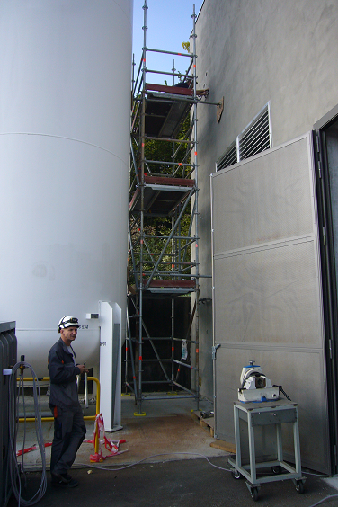
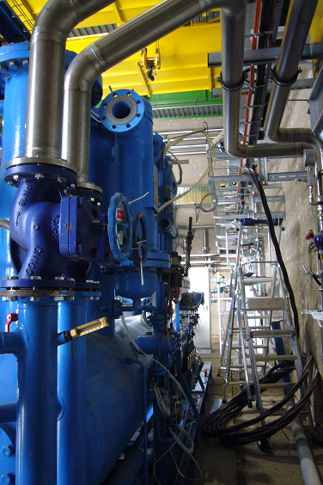
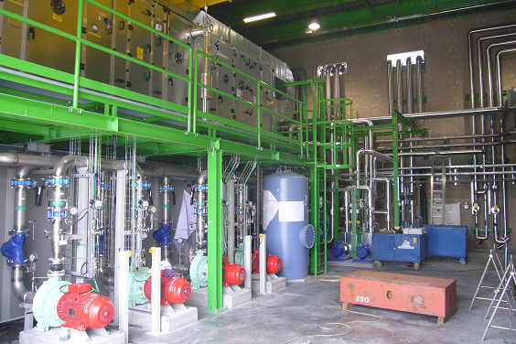
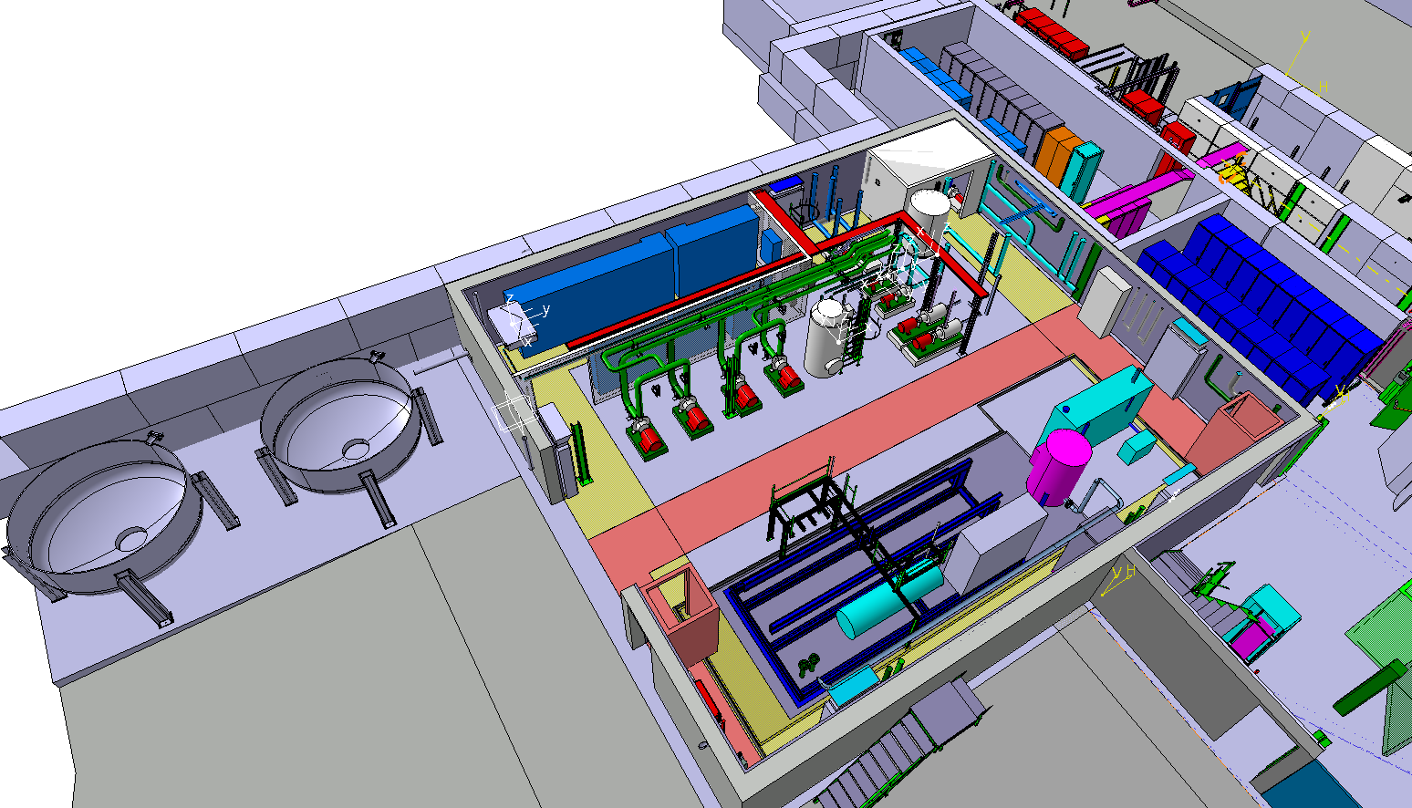
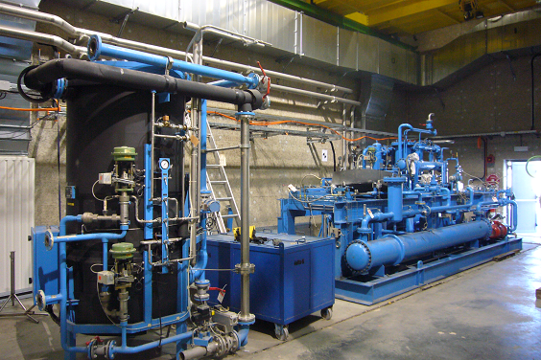
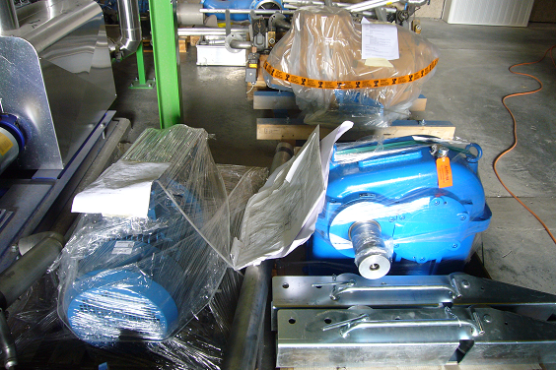
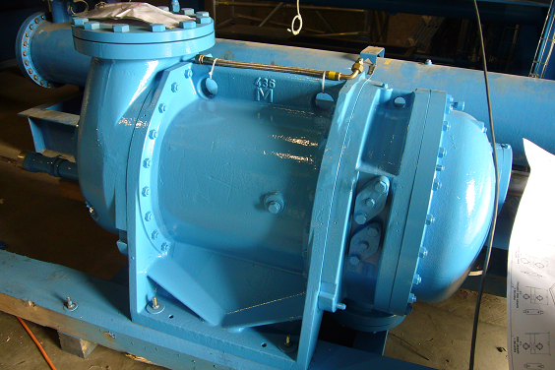
Compressor building 198
Cooling & Ventilation: Water and HVAC installations finished and systems operational.
Acoustic tests for the building done.
Cryo System: Compressor frame and adsober in place. Cabling done. Piping ongoing. Refurbished ALEPH Compressors and new pump have arrived, ready for installation.

Slide 10
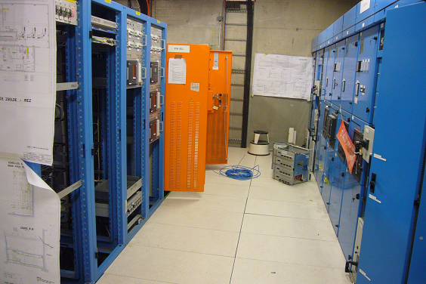
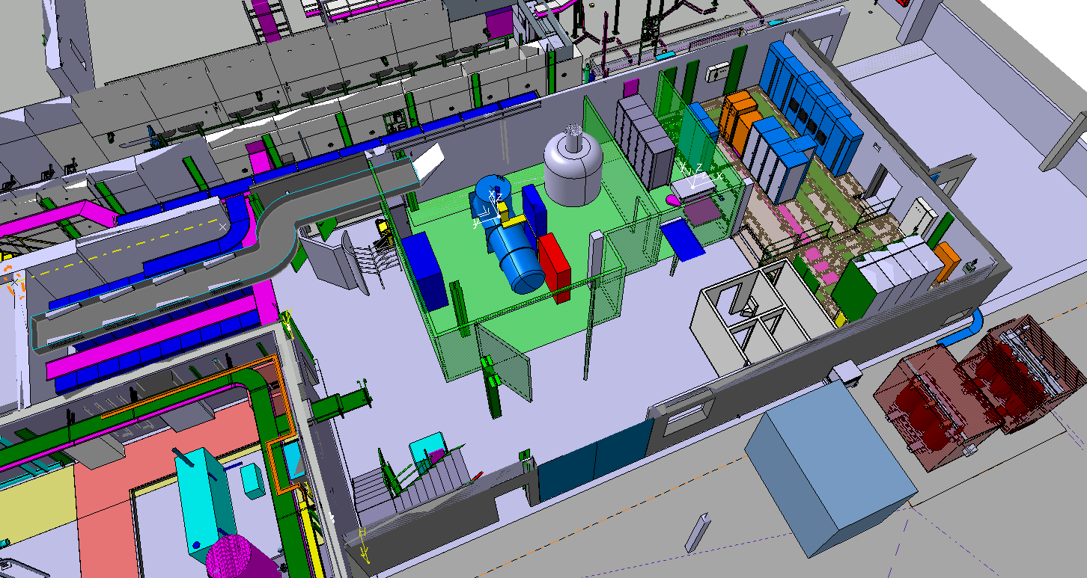
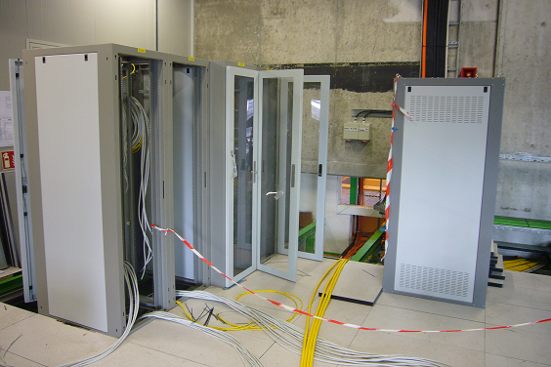
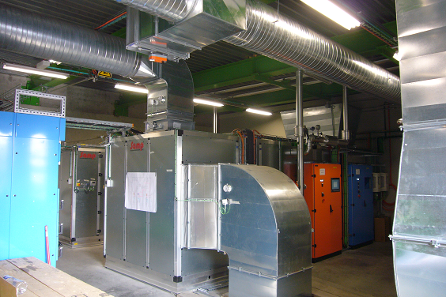
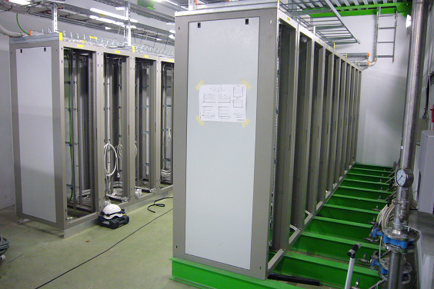
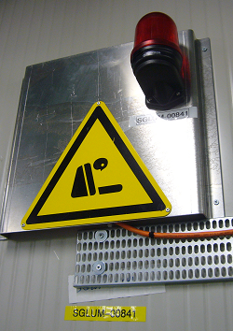
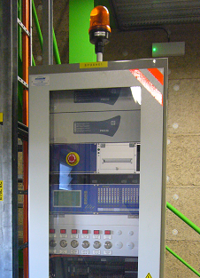
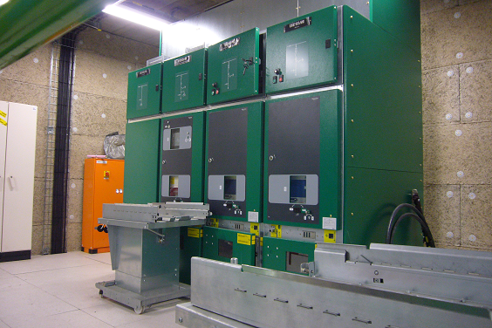
Cold Box building 199
EL: 400V and 3.3kV distribution cabinets in place, cabling ongoing.
CV: HVAC systems in place and tested.
Safety: ODH and fire detection systems in place.
RF: LLRF, slow control and amplifier racks in place and being cabled.
Cryo: control racks in place. Cabling ongoing.
Ethernet: racks in place. Cabling ongoing.
EPC: Solenoid power supplies (2x) in place.

Slide 11
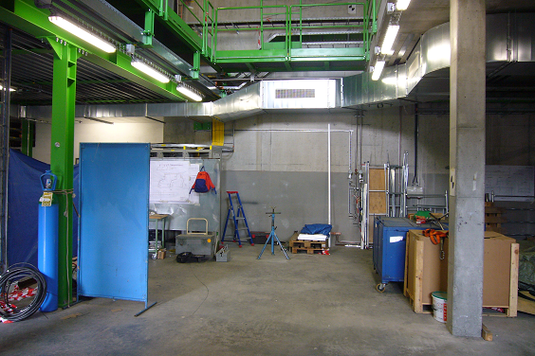
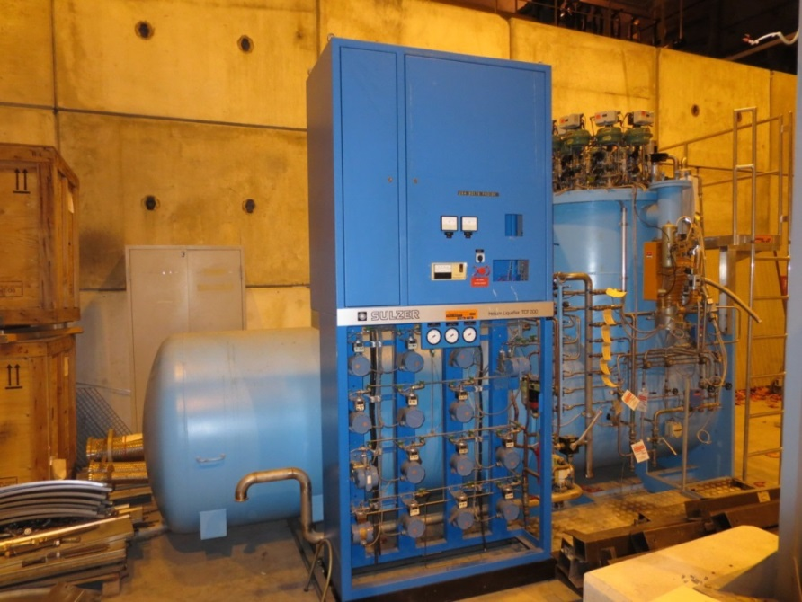
Cold Box building 199
Cryo Cold Box: ex-ALEPH being refurbished at the contractor (LINDE)
Expecting back at CERN by the end of October.

Slide 12
ISOLDE hall 170
Compressor building 198
ISOLDE target zone
Water station B197
ISOLDE Low Energy
Cold Box building 199
HIE SC Linac
Equipment platform
High Energy Beam Transfer lines HEBT
HIE ISOLDE in hall 170:
Civil engineering, metal structures, cooling and ventilation, cabling and equipment installation

Slide 13
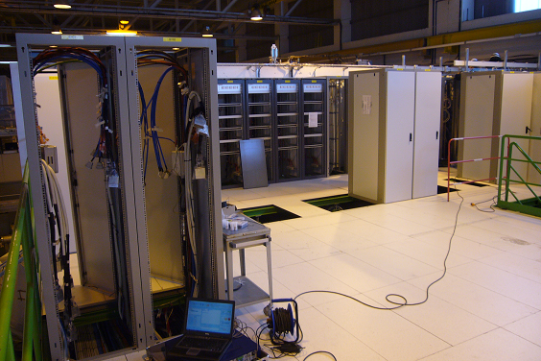
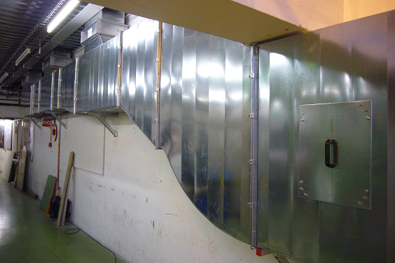
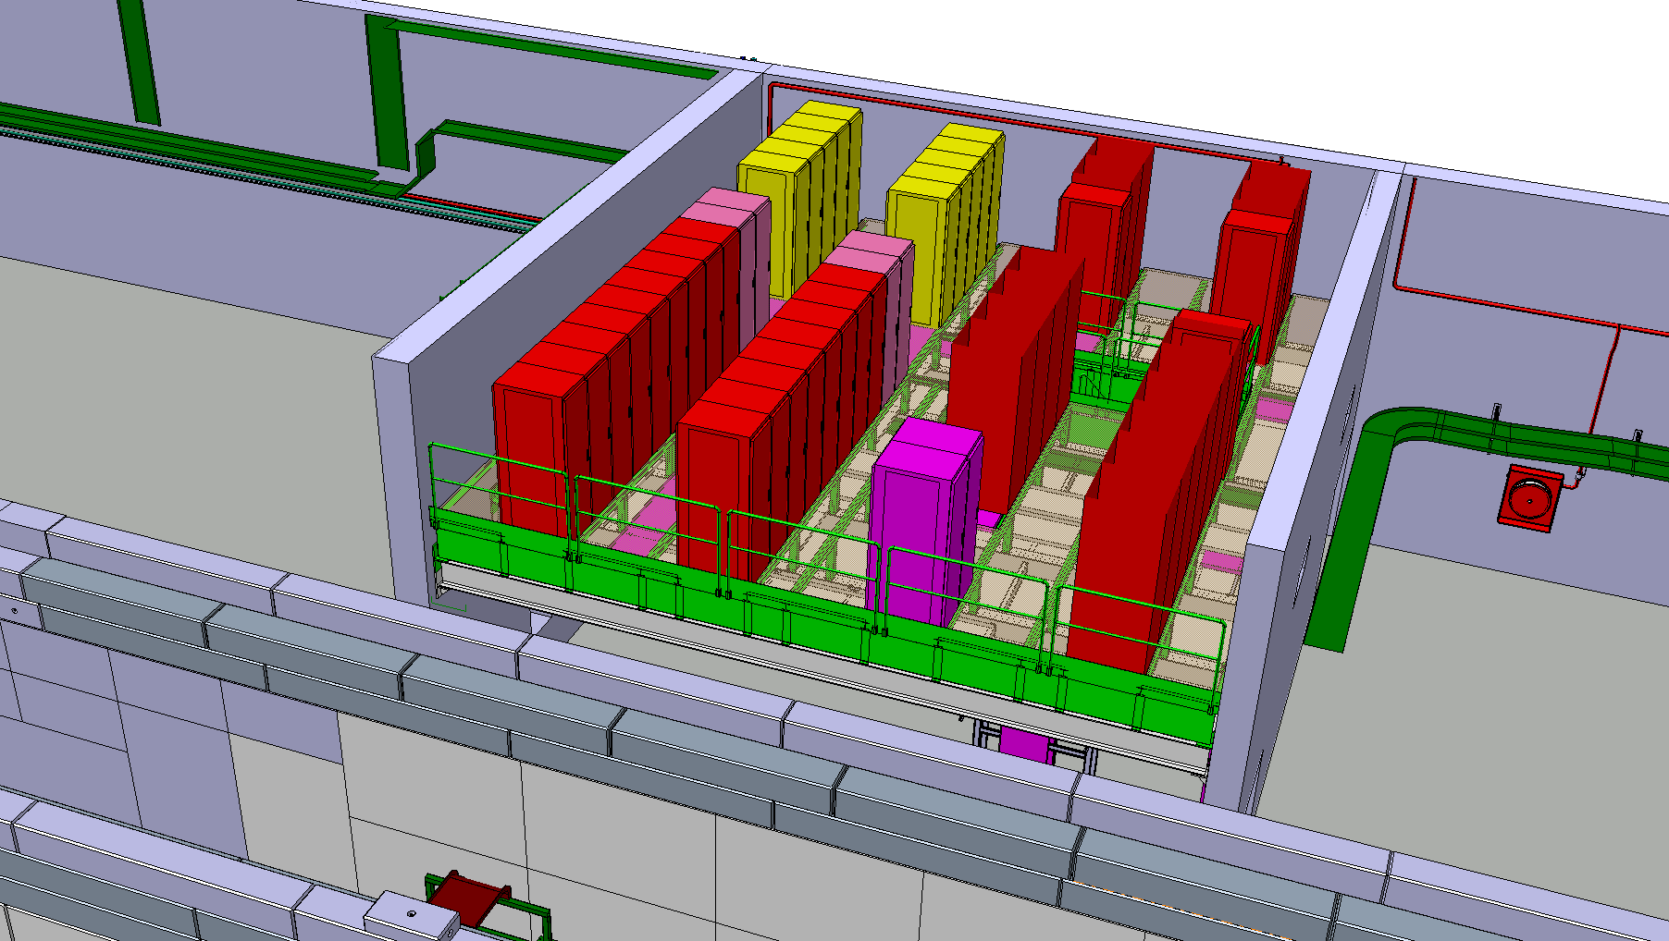
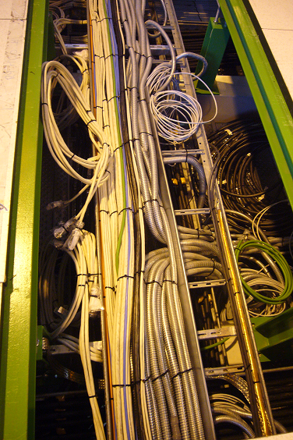
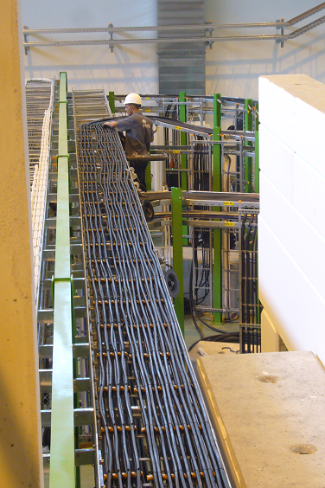
Equipment platform
Rack platform:
Racks WIC, VAC and EPC (correctors) installed. Cable trays all in place. DC, vacuum, BI and interlock cabling to HEBT and machine done.
CV: Rack platform specific ventilation air ducts being installed.
AC cabling ongoing. Equipment (EPC, BI, WIC) to arrive as of end September.

Slide 14
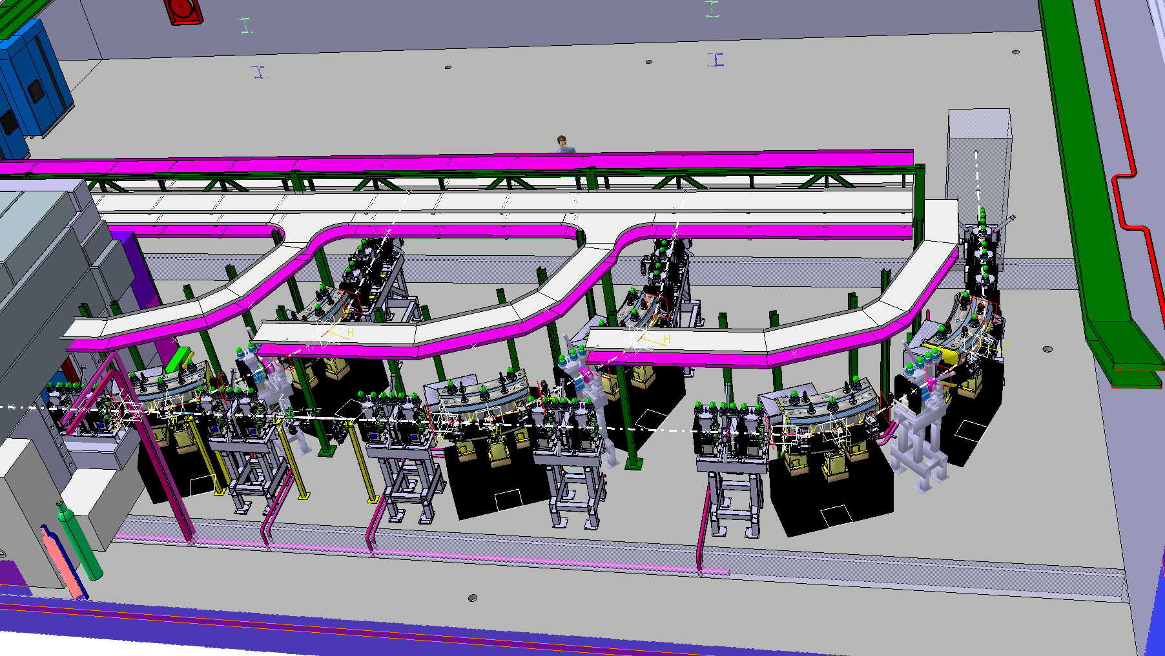
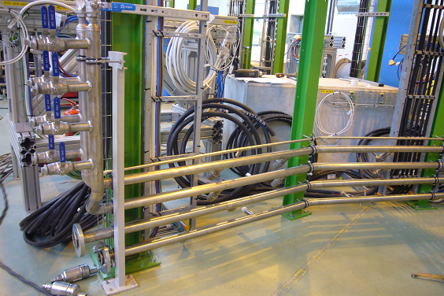
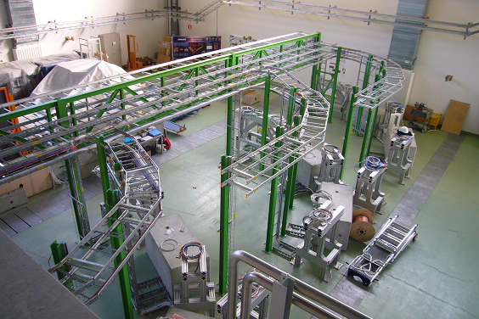
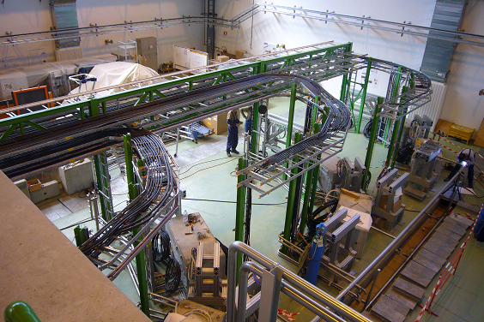
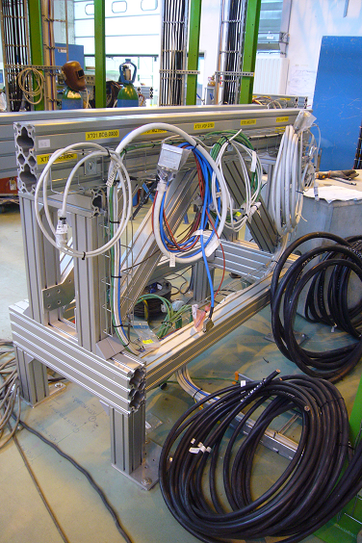
HEBT infrastructure
XT01
XT02
XT03
XT03:
No elements but full infrastructure will be in place
S. Maridor
HEBT cable trays and cables installed (DC, vacuum, BI and interlocks).
Alu and concrete elements supports in place and shimmed.
Water cooling and vacuum infrastructure finishing. Support tables and dipole jacks Oct. Followed by elements installation Oct. 2014 – Jan. 2015

Slide 15
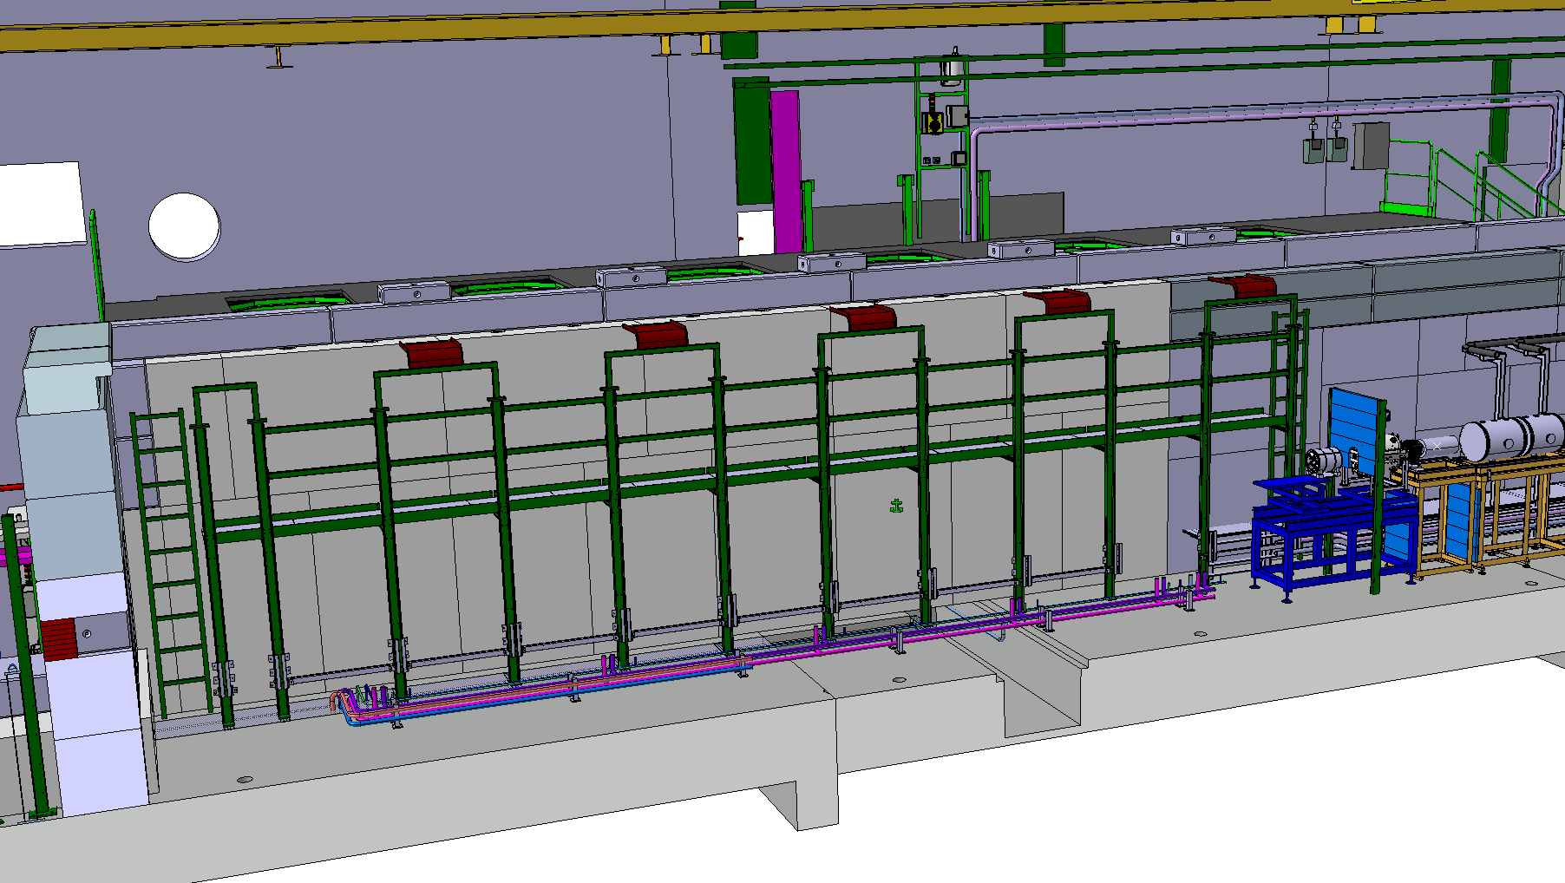
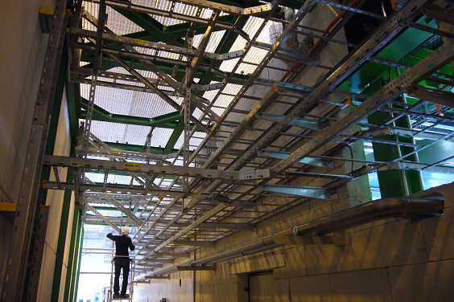
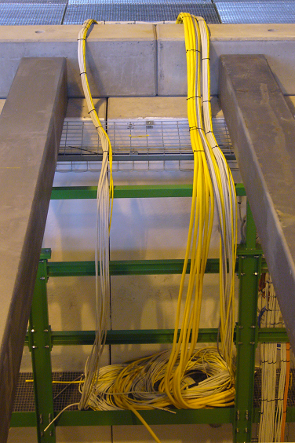
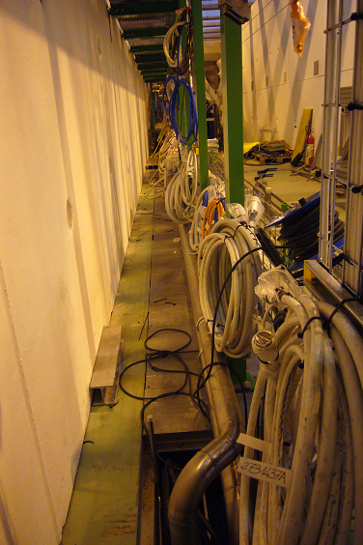
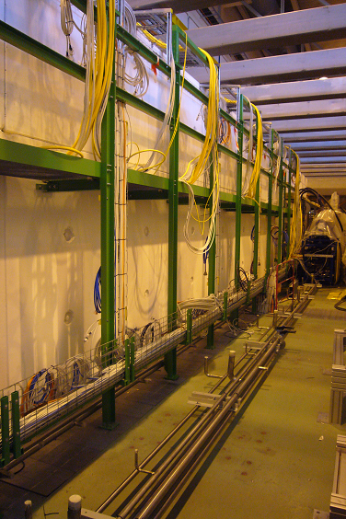
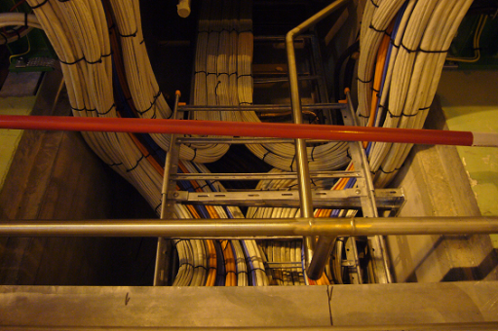
Infrastructure HIE tunnel
S. Maridor
Jumper boxes platform installed. Cable trays underneeth in place.
Cabling in- and outside tunnel largely finished. RF flexwell cables starting.
Tunnel vacuum and water infrastructure being finished.

Slide 16
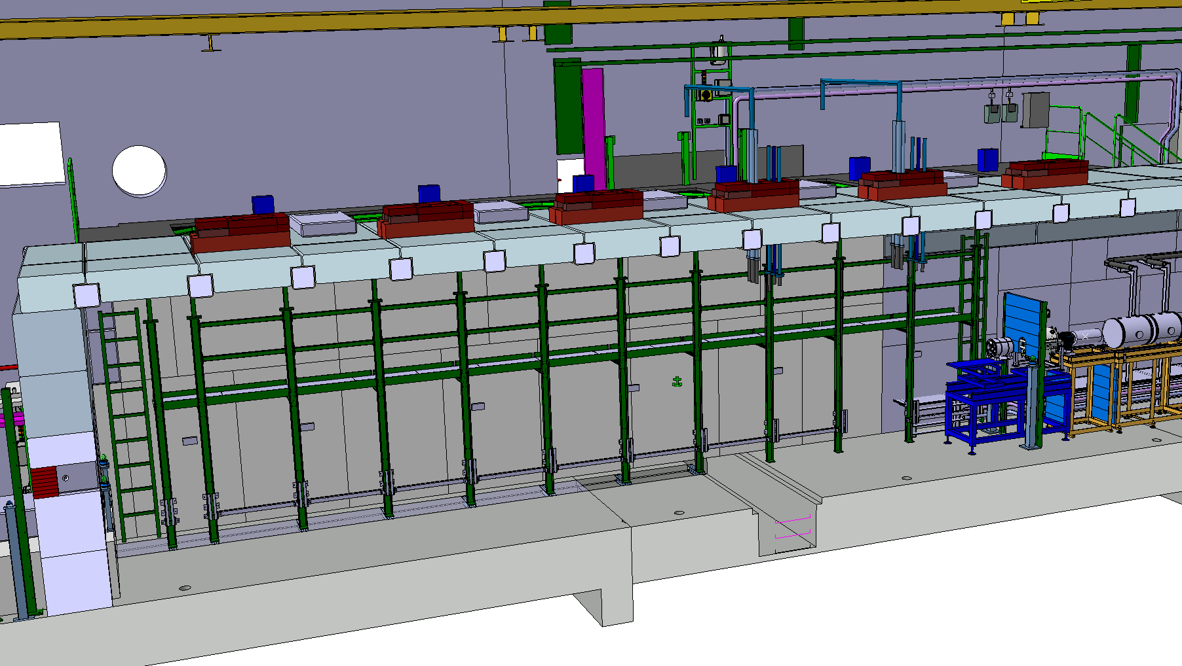
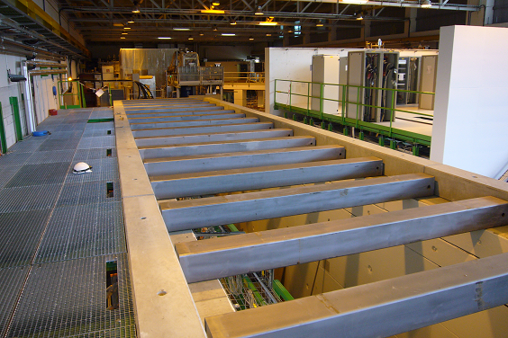
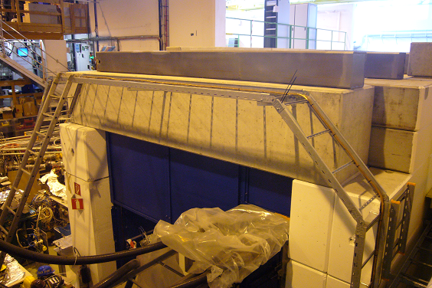
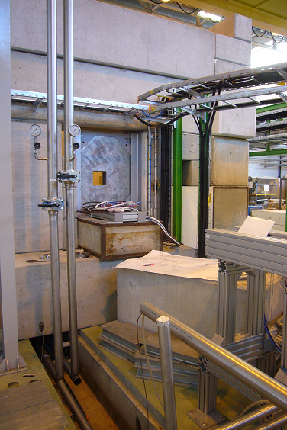
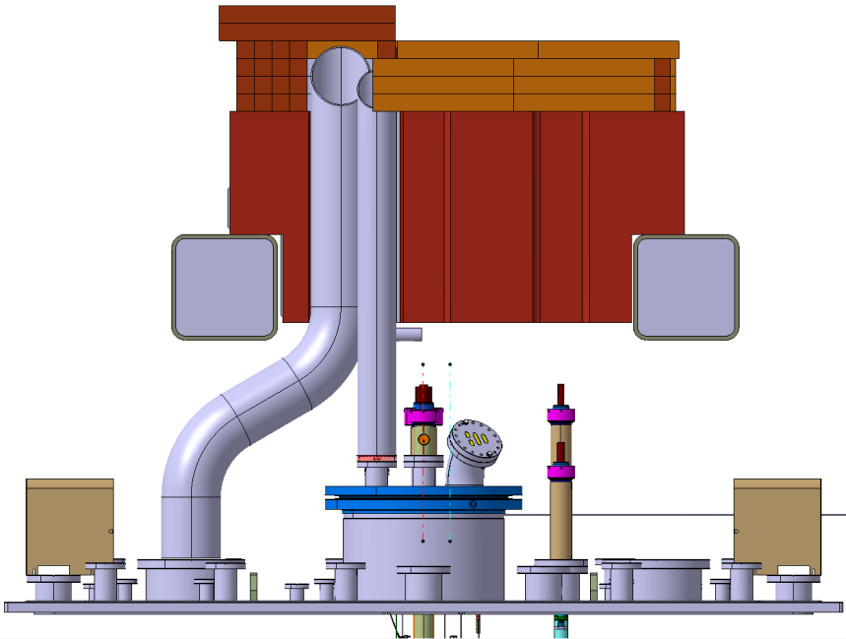
HIE shielding tunnel
S. Maridor
Chimney parts fabricated – ready for concrete filling.
Roof beams filled with concrete and installed.
Side- and end-walls solutions found and closed.
Awaiting concrete roof parts for fitting tests (end Sept)

Slide 17


HIE LINAC elements
Linac elements- & CM-supports in tunnel in place – by end September
RF flexwell cabling: Oct/Nov
Elements installation Oct. 2014 – Jan. 2015

Slide 18

HIE LINAC elements
40mm chamber
S. Maridor
Cryo Cold Line & Jumper Boxes installation: Nov 2014 – Jan 2015
Cryo Module 1 installation: April – June 2015
Scenario: Physics at ~4MeV/u with 1 CM as of October 2015

Slide 19

HIE LINAC elements
Intertank unit containing:
Short diagnostic box
Corrector
BCAMs
Vacuum equipment
Supports, adjustment tables & lifting equipment
Installation after CM1: June 2015

Slide 20

HIE LINAC elements
S. Maridor
Cryo Module 2 installation: Shutdown 2015/16: Jan – March 2016
(Stage 1 completed)
Scenario: 2nd commissioning at 5.5Mev/u with 2 CM‘s as of May 2016

Slide 21

ISOLDE hall 170: Safety
  Construction and Physics in parallel: Safety !
ISOLDE Control Room
Worksite Access: ISOWORK No User access!
ISOLDE Low Energy Physics
User Access: ISOHALL
HIE ISOLDE Installation Works

Slide 22
Conclusions
  HIE Installation Progress Sept 2014:
  Progress since the HIE workshop December 2013
  Installation has continued according to plan with a steady progress and minor delays
  Ongoing activities and those to come
  High activity in the hall and service buildings will continue with finishing the infrastructure.
  The installation of the HEBT and Linac elements will start as of next month and the arrival of the first Cryo Module is planned for the second quarter of 2015 followed by the installation of the second Cryo Module during the shutdown 2015/16.
  Dense periods of hardware testing and commissioning of the new equipment and HIE Linac and HEBT lines are planned for the summer of 2015 with first HIE Physics expected in the Autumn of 2015.
  Safety:
  Challenge: Construction of HIE ISOLDE with ISOLDE Low Energy Physics in parallel.
  Access: ISOLDE experimental hall divided into a working zone and experimental zone.
  Wear of safety equipment is adjusted accordingly.

Slide 23
Acknowledgement
GS/SE : DANIEL PARCHET, ELISEO PERES-DUENAZ, ROLAND ARNOUL
EN/MEF : STEPHANE MARIDOR, ELEFTHERIOS ZOGRAFOS, GUILLAUME KAUTZMANN, JEAN-CHRISTOPHE GAYDE
BE/ABP / OP : FREDERIK WENANDER, DIDIER VOULOT
PH/SME : MARIA BORGE, MAGDA KOWALSKA
EN / TE/HDO : YACINE KADI, FABIO FORMENTI, VOLKER MERTENS
BE/RF : DANIEL VALUCH, WALTER VENTURINI, LUCA ARNAUDON, ERIC MONTESINOS
EN/CV : PAUL PEPINSTER, FREDERIC BORRALHO
EN/EL : RENE NECCA, JEAN-CLAUDE GUILLAUME, GEORGI GEORGIEV, JEAN- PIERRE BILLON-GRAND, MICHELE MARTINO, CHRISTOPHE COUPAT
TE/CRG : NICOLAS DELRUELLE, JOS METSELAAR
EN/STI : RICHARD CATHERALL, ANA-PAULA BERNARDES
GS/DI : CYRILLE BEDEL, YANNICK BERAUD (EN/MEF)
TE/MSC : YANN LECLERCQ, LLOYD WILLIAMS, VITTORIO PARMA, JEREMIE BAUCHE
DSG/RP : JOACHIM VOLLAIRE, SANDRA GIRON, ALEXANDRE DORSIVAL
TE/ABT : BRENNAN GODDARD, MATTHEW FRASER
TE/VSC : GIOVANNA VANDONI
BE/BI : ENRICO BRAVIN, WILLIAM ANDREAZZA, ESTEBAN CANTERO
EN/MME : ANTTI KOLEHMAINEN, MARC TIMMINS
TE/MPE : RICHARD MOMPO

Slide 24
Thank you for your attention

Slide 25

HIE RF systems status
RF systems
LLRF
10 LLRF controller cards produced and tested (April ’14)
- Procurement for another 15 launched
Shielded racks installed in bldg. 199 (summer ‘14)
RF cables, connectors, directional couplers purchased and delivered
Coaxial cable installation campaign start mid September ‘14
Slow Control & RF interlocks
Assembly & test of controls for 5 cavities in SM18 ready by Oct ‘14
Assembly & test of controls for 2 Cryo Modules ready by Dec ’14
Air cooled Amplifiers (for SM18 bunker)
All 6 delivered
Water cooled Amplifiers (for SC linac)
First pre series by end March to be qualified at CERN.
Delivery of the 12 remaining by Sept‘14
RF Installed and tested by Spring ’15
LLRF test stand

Slide 26
HIE vacuum status
Vacuum
Vacuum chambers Dipoles and circular chambers
Design finished
Production started for bending, order placed week 38 for all others
Delivery as of Oct (Nov for the dipoles)
Vacuum components
Standard CERN components (CERN contracts)
Delivery completed
Installation Nov ‘14 - Jan ‘15

Slide 27
HIE EPC status
Power convertors
Dipoles – COMET_2p (a.k.a. S500) - CERN design and manufacturing (partial)
2 units installed by (mid) Nov ’14 (CERN assembly)
Remaining 5 units produced first quarter 2015 (outsource schedule to be finalized)
first 2 units (outsourced) installed by mid-Feb ’15 (estimated)
Quadrupoles – COBALT
3 units available by mid-Oct & installed by Nov ’14
21 series installed Jan ‘15 and 20 series March ‘15 (production rescheduled)
  Hardware tests can be performed with the 3 available units
Correctors – CANCUN 50
Full delivery of 34 units by (end) October ‘14 (need only 22 units for phase1)
Installation first half finished by (end) October ’14 (hardware tests of all circuits can be performed with it)
Second half finished (end) Nov ’14
S500 power convertor

Slide 28



HIE Magnet status
Magnets
All contracts placed; magnet manufacturing budget within estimates
Production
Dipoles: 1 pre-series mid-September 2014, 3 series expected until December 2014 (magnets for XT00-XT01 delivered by November 2014)
Quadrupoles: 1 pre-series delivered June 2014, 2 series delivered July 2014, 21 series expected until February 2014 (magnets for XT00-XT01 delivered by December 2014)
Correctors: 1 pre-series delivered June 2014, 2 series delivered August 2014, 10 series expected until October 2014 (magnets for XT00-XT01 delivered by September 2014)
Magnetic measurements
Acceptance tests to confirm manufacturing up to specifications
More in depth characterization of the field on pre-series magnets for beam optics
Installation Oct ‘14 - Jan ‘15
HEBT dipole
corrector
quadrupole

Slide 29


HIE instrumentation status
Instrumentation
Two types of diag. boxes: Short (SC Linac) and Long (HEBT)
Long boxes for the HEBT
To be ready for installation Nov ‘14 (see talk Esteban Cantero)
Installation Nov – Dec ‘14 (XT01), Dec ‘14 – Feb ‘15 (XT02)
HIE (short) diagnostic box
Instrumentation Electronics
Diag. box control
Received and tested (20 units) by October 14
Installed by Dec ’14
Energy and bunch length (PIPS detectors)
Two options considered for the electronics
Not mandatory for operation
Control Software ready by Oct ‘14

