Slide 1
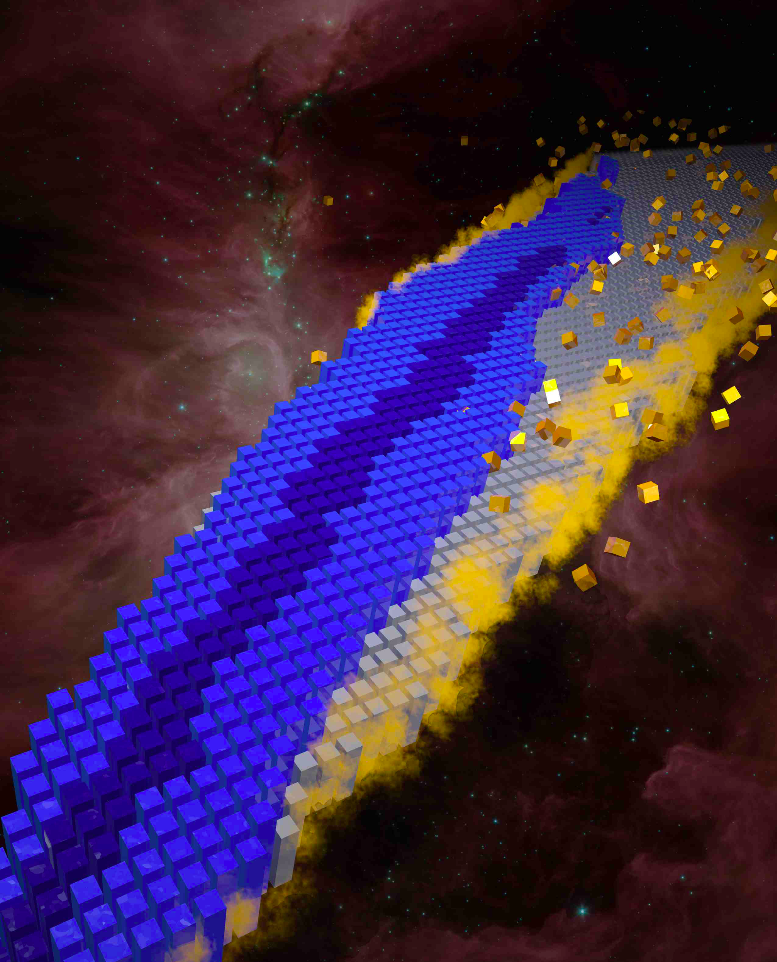
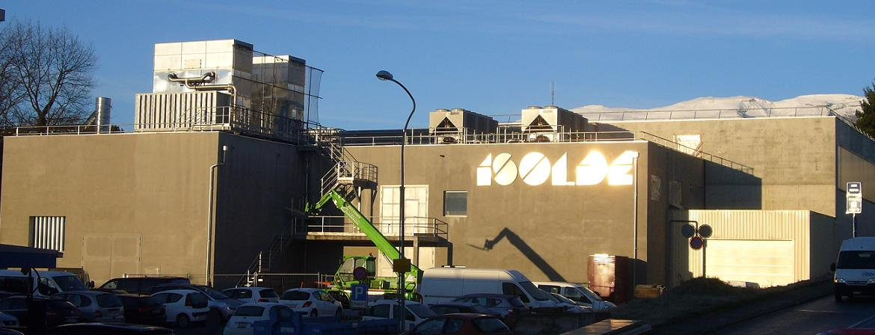
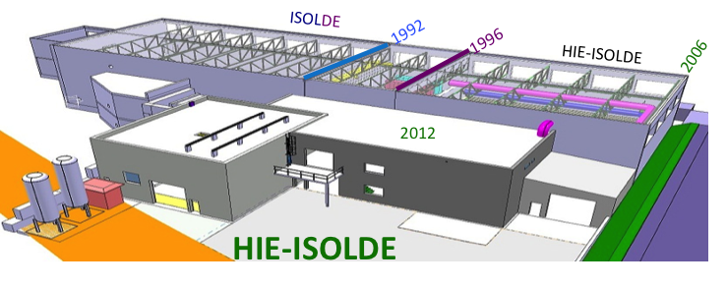
Maria J. G. Borge
ISOLDE-PH, CERN
(Isotope Separator On-Line)
Exploring the Nuclear Landscape
with HIE-ISOLDE
ISOLDE
1992
Maria J. G. Borge , CERN, PH-Dept

Slide 2
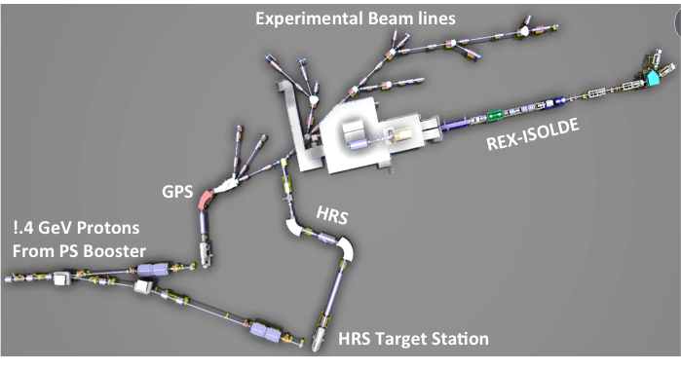
ISOLDE Facility : a few facts
ISOLDE is the CERN radioactive beam facility (approved 50 y ago!)
Provides low energy or post-accelerated beams
Run by an international collaboration since 1965. Presently 13 members (B, CERN, Dk, E, F, Ge, Gr, I, India, N, R, S, UK)
> 500 Users from 100 Institutions, 50 experiments / year

Slide 3
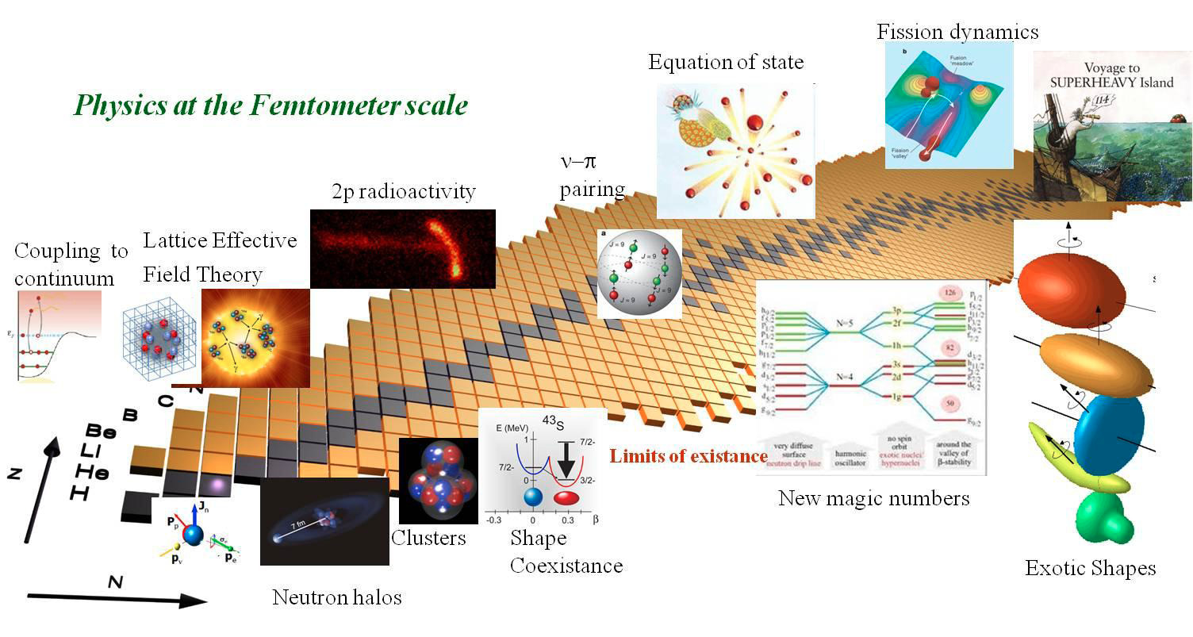
Hot Topics in Nuclear Physics
Physics at
the Femtometer scale

Slide 4
Production of Radiactive Beams @ ISOL Facilities
Primary Nuclear Reaction
  Fragmentation:
  Fission
  Spallation
  Fluka Calculation
P beam on UC-Target
Spallation
Observables:
Ground-state properties: mass, radius, J, μ, Q moments
Half-lives and decay modes
Transition probabilities
Cross sections
fission
fragmentation

Slide 5
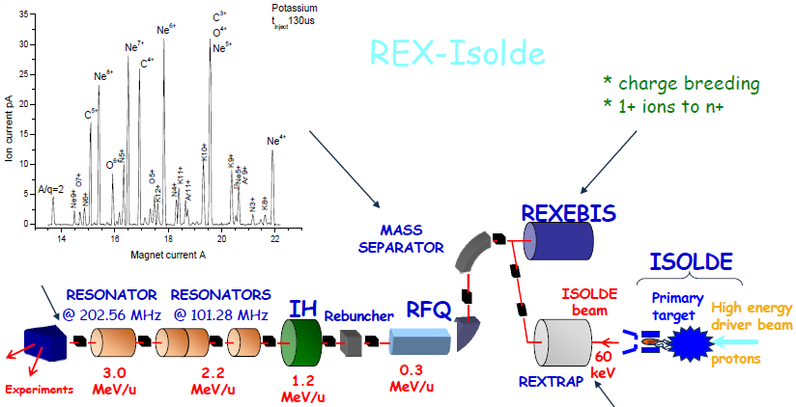
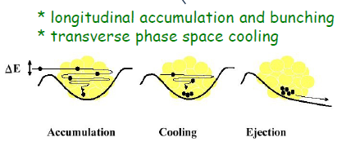
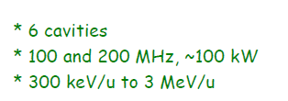
REX-ISOLDE
Total efficiency : 1 -10 %
1⁺ to A/Q = 3 – 4.5
Courtesy of D. Voulot

Slide 6

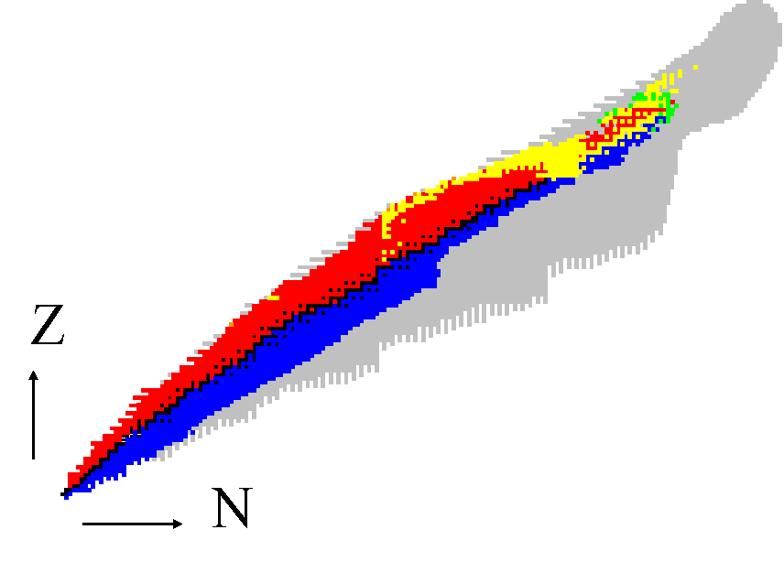
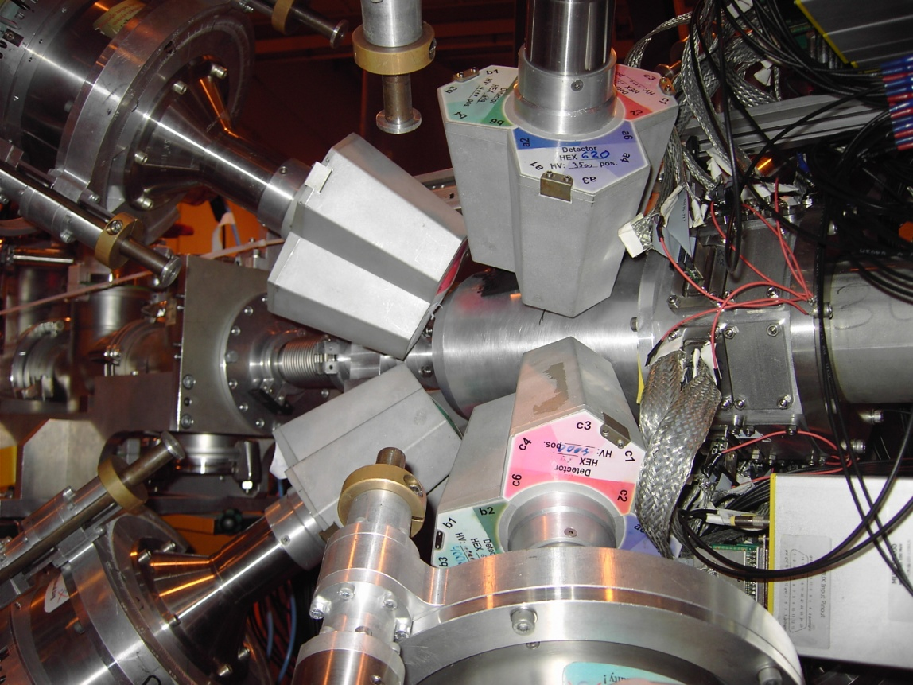
Physics program @ REX
REX-ISOLDE started in 2001
108 different beams already used at REX of 1300 available!
Coulomb excitation with Miniball:
collectivity versus individual nucleon behaviour
MINIBALL
^{184,186,188}Hg
Probing shape coexistence
Ε_{eff} = 7.8%
82
20
40
50
^{222,224}Ra^{; 220,222}Rn
Probing Pear Shape
Gaffney Nature 2013
82
beam
¹¹⁰Sn; Cederkäll, PRL 2007
^{106,108}Sn, Cederkäll, PRL 2008
50
^{122,124,126}Cd
^{138,140,142,144}Xe
^{140,148,150}Ba
Evolution of collectivity around ¹³² Sn
⁷⁰Se, shape coexistence, Hurst PRL 2007
⁹⁶Sr, ⁸⁸Kr, ⁹²Kr, PRL 2012
28
Probing large scale shell model, Van der Walle, PRL2007
^{74,76,78,80}Zn
^{67,69,71,73}Cu, Stefanescu et al., PRL 2008
^{68,70}Cu, isomeric ⁶⁸Cu, Stefanescu , PRL 2007
^{30,31,32}Mg, Niedermaier PRL2005, H. Scheit
20

Slide 7
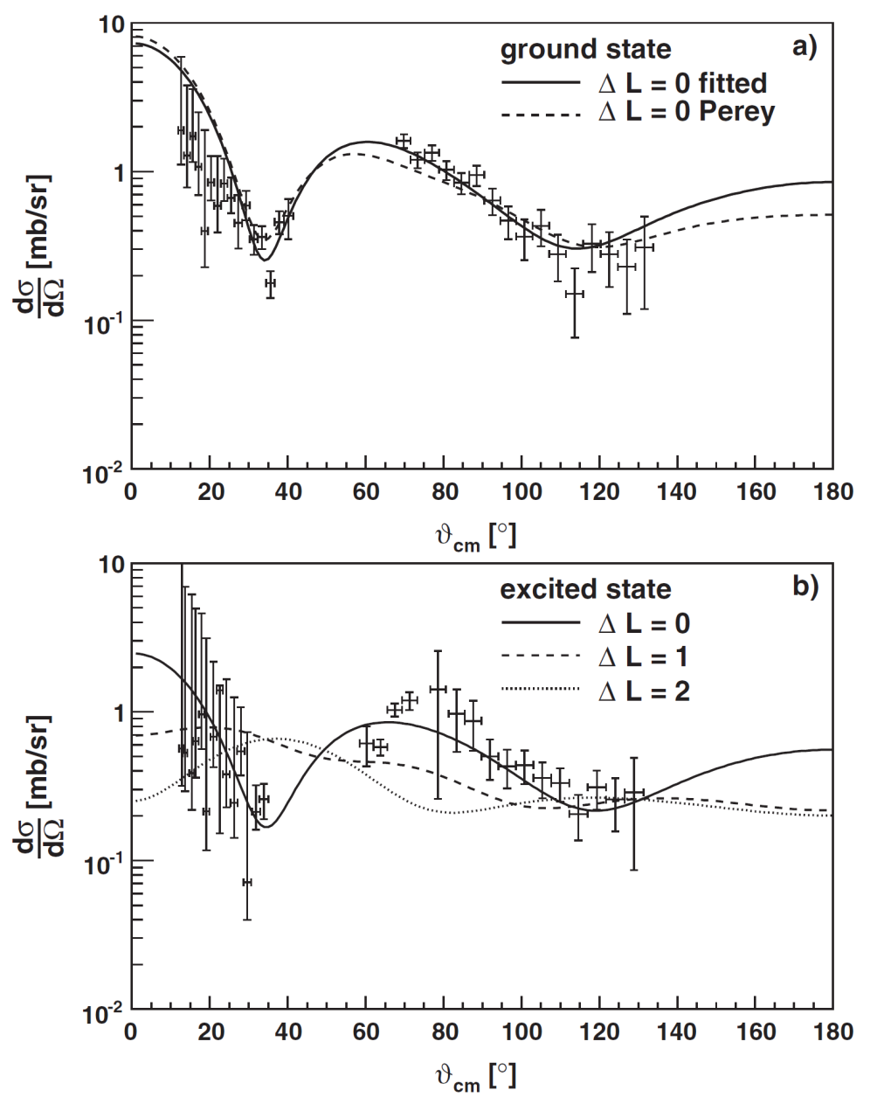
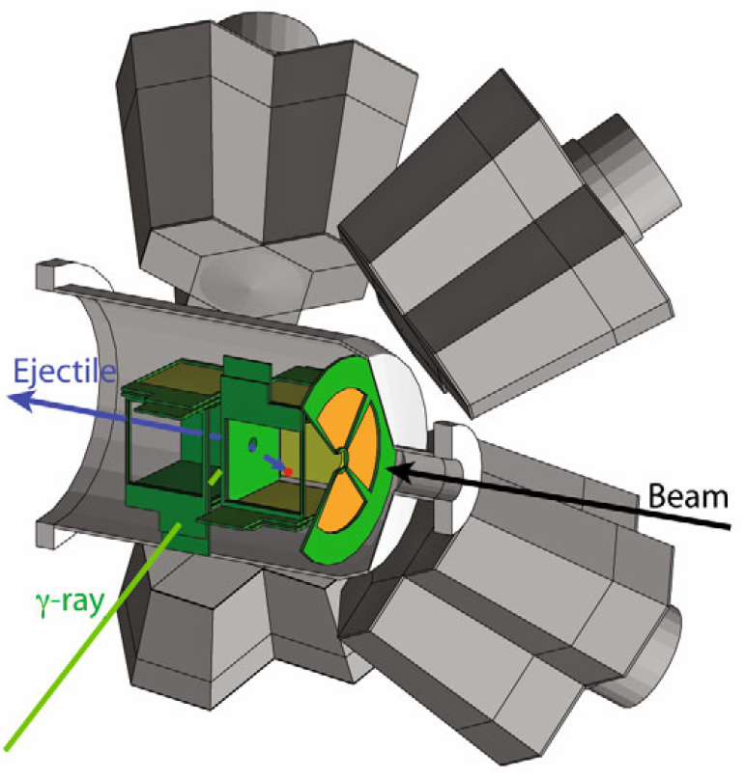
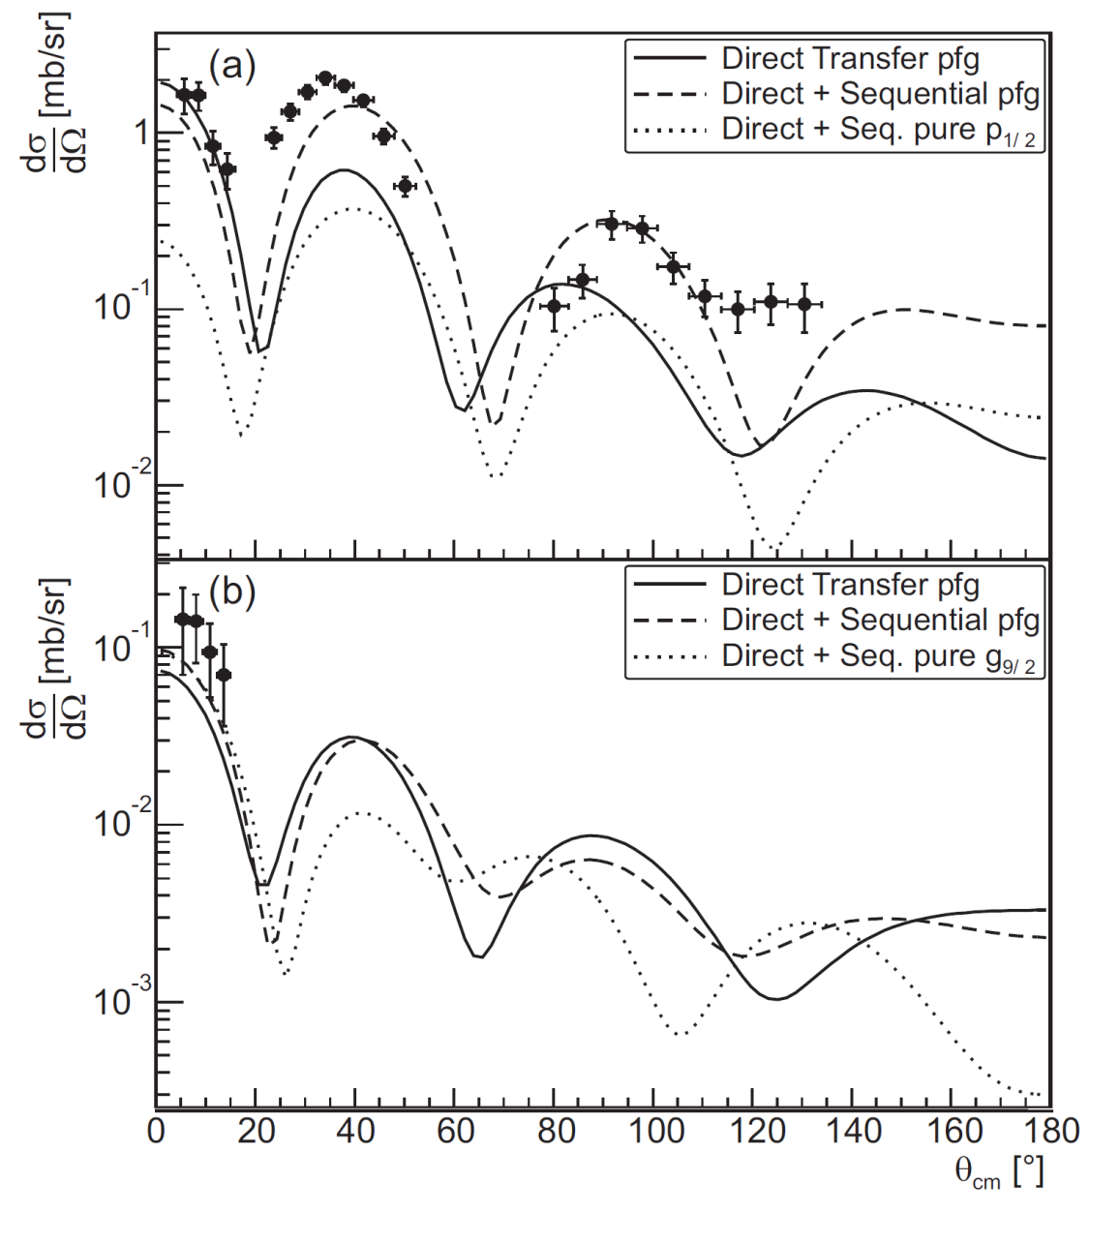
Transfer Reactions @ REX
Few-nucleon transfer reaction studies:
  single-particle properties
  halo and cluster structures
³⁰Mg(t,p)³²Mg (N=20)
20
40
50
82
MORE ENERGY NEEDED!!!!
82
50
t(⁷²Zn,p)⁷³Zn Hellgartner
t(⁴⁴Ar,p)⁴⁶Ar Nowak
d(⁶⁶Ni,p)⁶⁷Ni Diriken
t(⁶⁶Ni,p) ⁶⁸Ni Elseviers
d(⁷⁸Zn,p)⁷⁹Zn Orlandi
28
d(³⁰Mg,p)³¹Mg, K. Wimmer, PRL 2010
Light nuclei, halos & clusters
d(⁸Li,p)⁹Li*; Tengborn PRC (2011) d(⁹Li,p)¹⁰Li
Zn(^{10,11}Be, ^{10,11}Be) Zn, Di Pietro, PRL (2010)
d(¹¹Be,p)¹²Be Johansen PRC (2013)
20

Slide 8
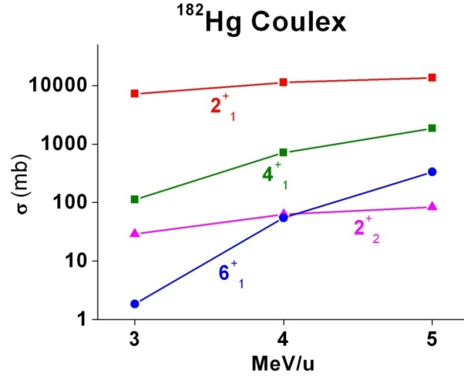
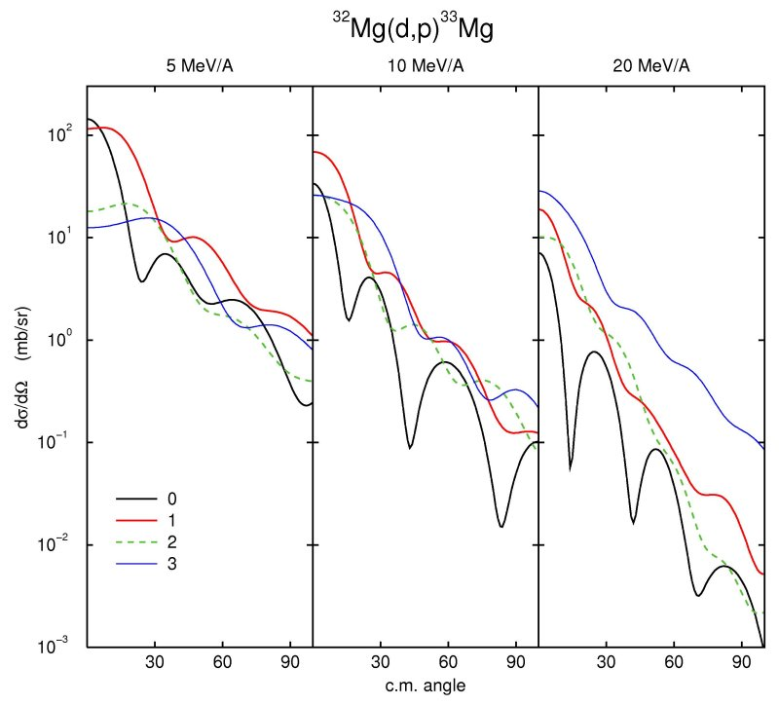
Design study: Intensity & Beam quality & Efficiency
Phase 1&2: Energy upgrade to 5.5 MeV /A 10 MeV /A
Advantages of HIE-ISOLDE
³²Mg(d,p)³³Mg
Access to a wealth of spectroscopic information
From the absolutes intensities of 4⁺/2⁺ (multistep coulex)
⇒Access to the sign of deformation
θ_{cm}
Single particle information through the spectroscopic factors
High energy needed to learn about the “l” transfer

Slide 9
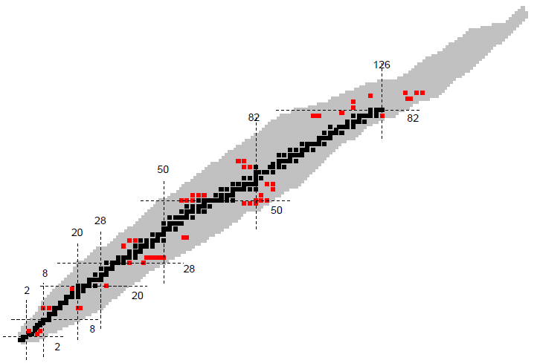

Physics @ HIE-ISOLDE
May 2010: 34 LoI submitted
1 Nov 2012: INTC endorsed the increase of 2 GeV-proton energy for ISOLDE
27 experiments already approved
600 shifts already allocated for day 1 physics
protons
Isospin symmetry
Collectivity versus Single Particle
Magic numbers far from stability
Shape Coexistence
Quadropole and octupole degrees of freedom
neutrons

Slide 10
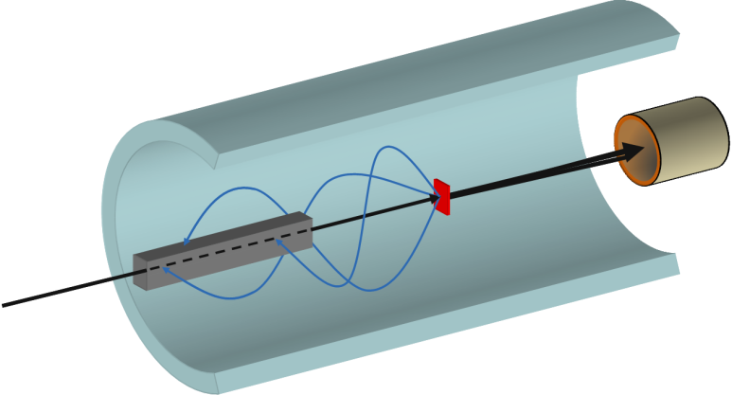
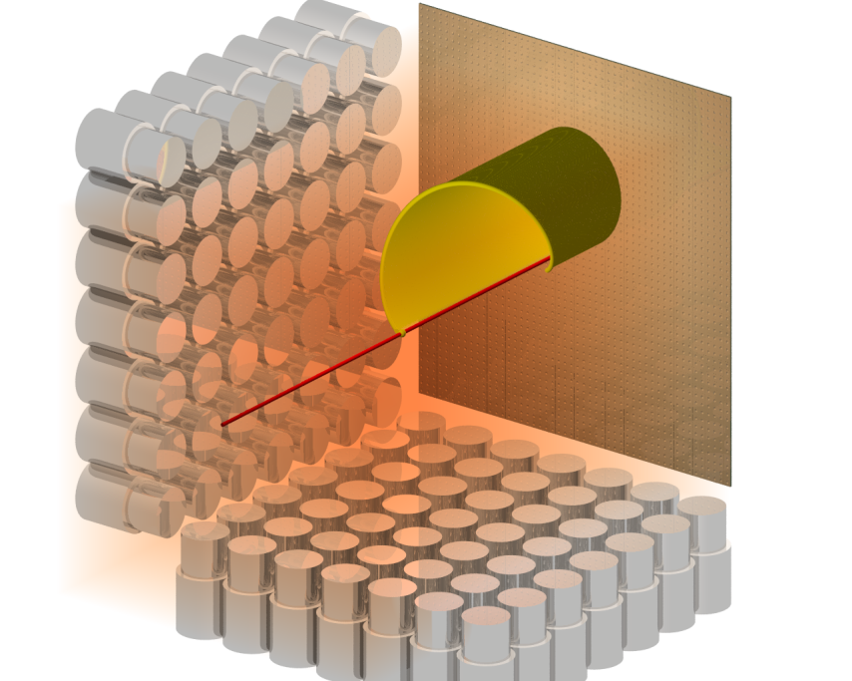
Instrumentation
Miniball + T-ReX (upgrade planned) :
COULEX + Transfer
Multipurpose reaction chamber
CORSET chamber for Fusion-fission reactions
SPEDE: added to Miniball+T-REX
Helios type device: transfer @ TSR
MAYA/ACTAR: resonant scattering + transfer.
For LS2: TSR storage ring,
22
2
1
1
1
amplification
zone
magnetic
field
segmented
plane
incoming
beam
gas volume
electric
field

Slide 11
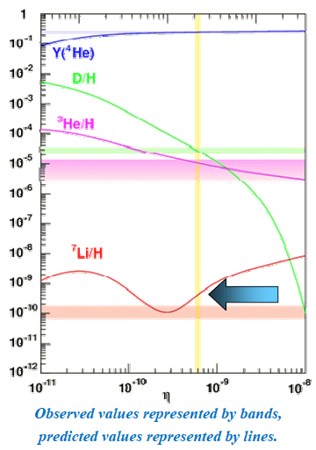

Adressing the ⁷Li cosmological Problem(IS554)
A factor of 4 in abundance of primordial ⁷Li abundance while good agreement of ²H, ^{3,4}He.
Theory
Observation
Explore the alternative of resonance enhancement of nuclear reactions ➔Via ⁷Be(d,p)2α Explore at higher energies
The destruction of ⁷Be can be high due to the narrow resonance in ⁹B at 16.7MeV (5/2⁺)
  This resonance can be very strong
  At the limit of quantum mechanically allowed value for the deuteron separation width
  Er = 170 -220 keV ;
  Deuteron Separation width Γ_{d} = 20 – 40 keV
  Achieved if the interaction
  radius for deuterium > 9 fm
Experiment ⁷Be(d,p) and (d,d) at 35 MeV at T-REX

Slide 12
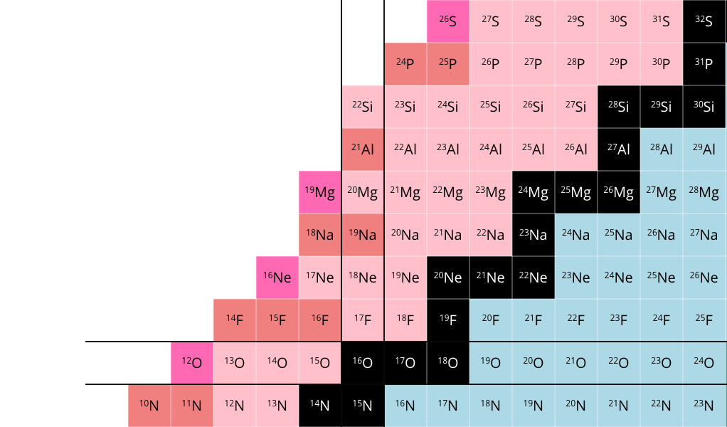
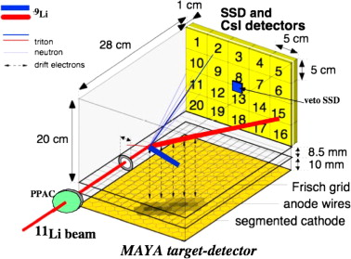
Study of n=8 gap beyond stability (IS564)
Study of the unbound proton-rich nucleus ²¹Al with resonance elastic and inelastic scattering using an active target
The N=8 shell gap at the proton-drip line known up to ²⁰Mg
The next isotope in the chain is ²¹Al -> no experimental data
-Upper limit of T_{1/2}<35 ns
M. G. Saint-Laurent, et al., PRL 59, 33 (1987).
Unknown Spin and Parity -> ²¹O (5/2+)
N=8
²⁰Mg (5.5 MeV/u)
MAYA filled with C₄H₁₀
DC+Si+CsI for ΔE-E Diamond for veto
MAYA
ADVANTAGES compared to conventional thick target method:
Background from C can be discriminated.
Inelastic and elastic can be separated.

Slide 13
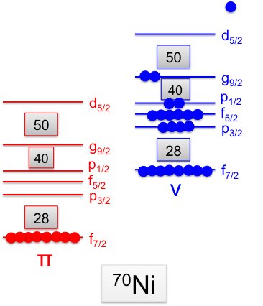
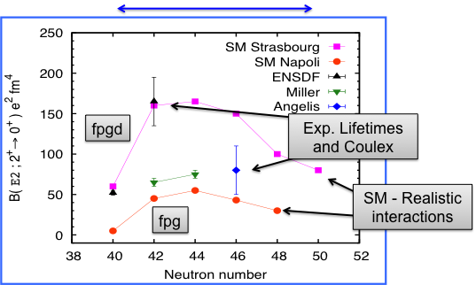
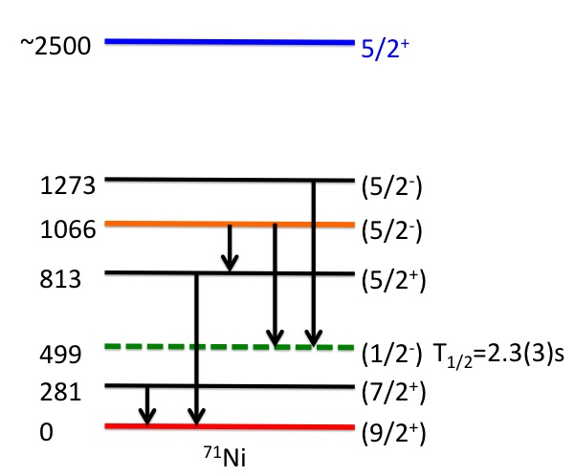
Shell Evolution in Ni-isotopes (IS555)
Large theoretical and experimental discrepancies. For Ni –isotopes beyond N= 40.
g_{9/2}
(d,p)
?
Transfer reaction to characterize the 5/2⁺ state in ⁷¹Ni by looking to proton angular distribution with T-REX

Slide 14
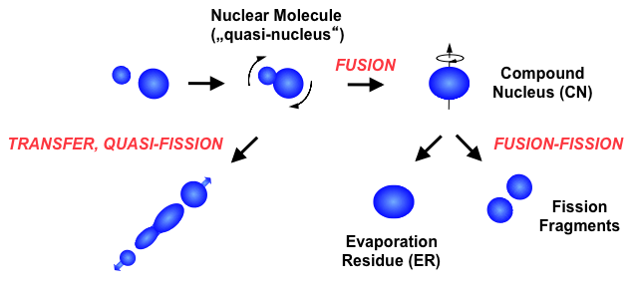
Search for the new magic numbers above ²⁰⁸Pb?(IS550)
Z = 114, 120 or 126
N = 184
Shell closures indicated by an increase of fission barriers and half-lives
Influence expected in quasi-nuclei
?
● Nuclei with N ≈ 184 are still far
● Nuclei with Z > 118 are still unknown
Study of quasi-fission and fusion-fission with ^{94,95}Rb projectiles with Corset
⁹⁵Rb + ²⁰⁹Bi → Z₁ + Z₂ = 120, N₁ + N₂ = 184
TOF
(MCP detectors)
Si stop detector
Beam
rotatable
Asymmetric component → transfer, quasi-fission
Symmetric component → fusion-fission
0.5 – 1 m
ΔΩ ≈ 50 msr

Slide 15
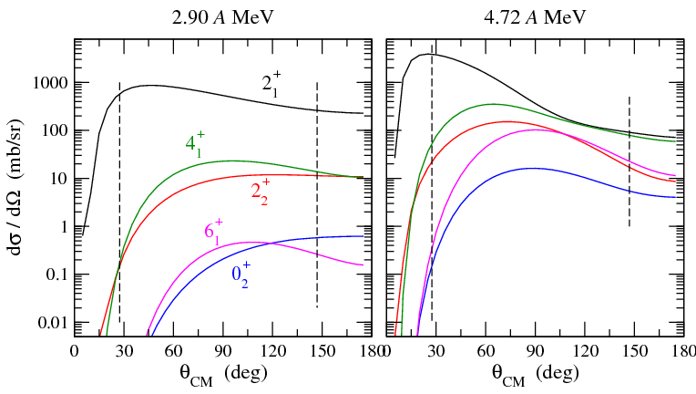
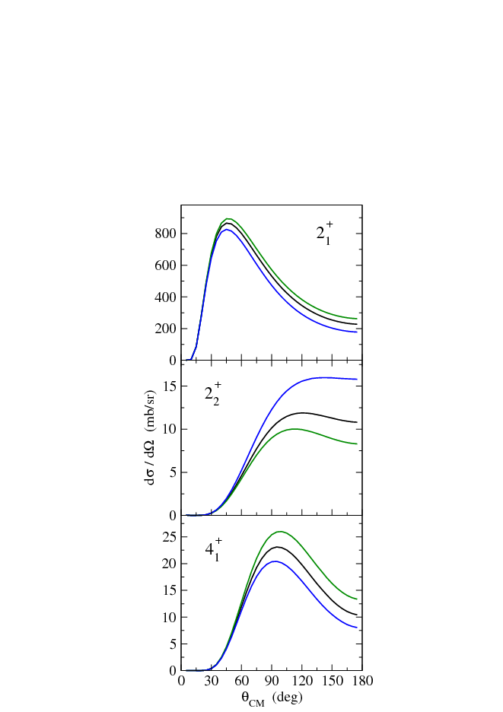
Shape transition & shape Coexistence in neutron deficient Nuclei
large gain for multi-step excitation for
higher beam energies from HIE-ISOLDE
πh_{11/2}
πh_{11/2}
²
16⁺
νh_{11/2}
(23/2⁻)
⁻²
νh_{11/2}
⁻¹
946
994
14⁺
(19/2⁻)
(19/2⁻)
14⁺
More and more precise matrix elements
Type of deformation:
  Quadrupole (oblate, prolate, triaxial or mixing)
  Octupole
Collectivity in the vicinity of closed shell nuclei
  Nucleon-nucleon correlation
Test local symmetries
1124
1089
751
751
12⁺
15/2⁻
(15/2⁻)
12⁺
466
442
619
634
(11/2⁻)
189
10⁺
3211
10⁺
3172
11/2⁻
176
¹³⁹Pm₇₈
5.2 ns
19.4 ns
¹⁴¹Sm₇₉
₆₁
₆₂
?
excitation cross sections for ¹⁴⁰Sm + ²⁰⁸Pb
experimental excitation energies
matrix elements from theory
¹⁴⁰Sm₇₈
₆₂
no experimental B(E2) values
low-lying (0⁺) state
indication for
shape coexistence ?
excited band built on
different shape ?

Slide 16
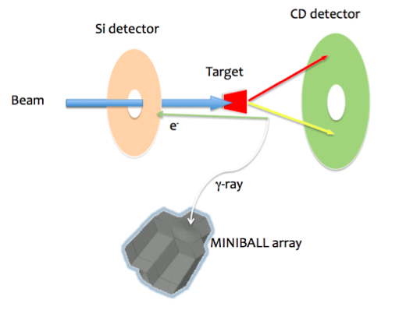
New candidates for EDM Measurements (IS552)
The observation of a non‐zero EDM indicates T‐violation beyond the Standard Model.
Octupole‐deformed nuclei will have enhanced nuclear “Schiff” moments due to the presence of nearly degenerate parity doublets (seen in odd mass nuclei) and large collective octupole deformation.
Presently |d(¹⁹⁹Hg)| < 3.1×10⁻²⁹ e.cm, PRL 102 (2009) 101601
Octupole deformed nuclei will have 100-1000 higher sensitivity compared with stable nuclei
Spede
Characterization of ²²¹Ra
increased of a factor of 5 from 3 to 5,5 MeV/u
Measurements of γ and e- conversion to determine the ΔE of parity doublet.
Cooled 25 segmented Si-det

Slide 17
Conclusions
Plenty of challenging physics waiting for the starting of HIE-ISOLDE!
Many new groups and devices have been attracted by the increase of energy of the post-accelerated beams.
Phase 1: Start of the physics program in autumn 2015
The physics cases approved expand over the wide range of post-accelerated beams available at ISOLDE with more than six hundred shifts approved for day one physics.
With this upgrade ISOLDE will be the place of choice for any experiment requiring a post-accelerated radioactive beam!
Thanks for your attention !
Notes:
The nuclear physics community is expecting that CERN will provide this facility on time.

Slide 18
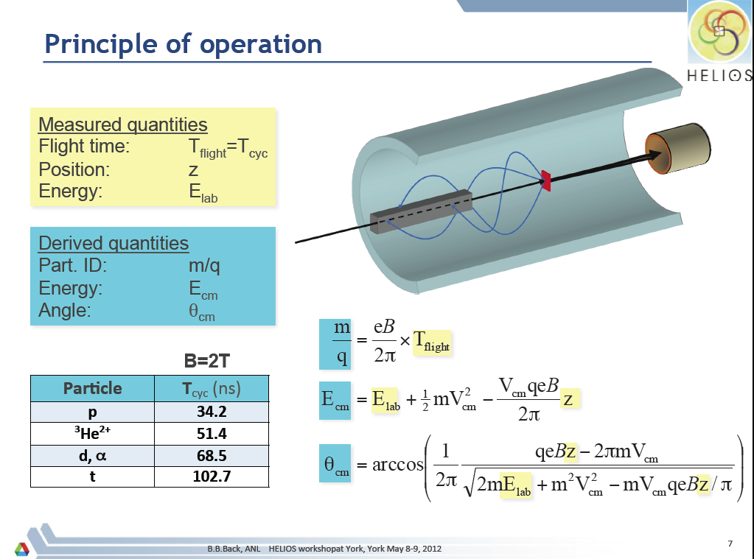
Notes:
The idea behind a solenoidal spectrometer. Transfer reactions in inverse kinematics take place at the centre of a large solenoidal field. Light ions follow helical trajectories in the field and are detected along the axis. The time-of-flight gives particle ID straightforwardly – this motivates the prebuncher before the HIE-LINAC. The lab energy and position of recorded ions gives E_cm and theta_cm.

Slide 19
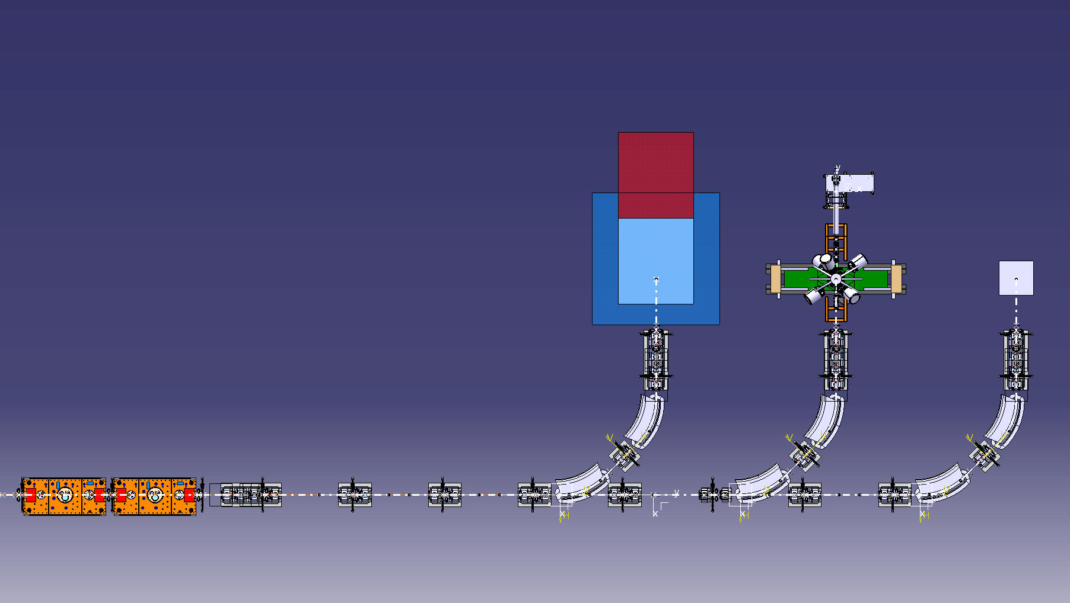

Proposed Three beamlines
Layout can accommodate 3rd experimental station
Fully modular (3x repeat of same solution)
Shorten XT00 line by 20 cm for
Exp. Station 3
Money
Miniball &TREX
Movable Experiments
5 Dipoles (TESLA)
22 Quadrupoles (ELYTT) Oct 2014
13 Steeres (ANTEC)

Slide 20
HIE-ISOLDE Opportunities:
Reaction | Physics | Optimum energy
(d,p), (³He,α), (³He,d), (d,n),… transfer | Single-particle configurations, r- and rp-process for nucleosynthesis | 10 MeV/u
(³He,p), (d,α), (p,t), (t,p) | pairing | 5-10 MeV/u
Few-nucleon transfer | Structure of neutron-rich and proton-rich nuclei | 8 MeV/u
Unsafe Coulomb excitation | High-lying collective states | 6-8 MeV/u
Compound nucleus reactions | Exotic structure at drip line | 5 MeV/u
Coulomb excitation, g-factor measurements | Nuclear collectivity and single-particle aspects | 3-5 MeV/u
(p,p’γ), (p,α), … | nucleosynthesis | 2-5 MeV/u

Slide 21
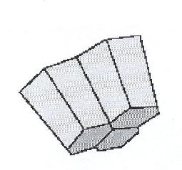
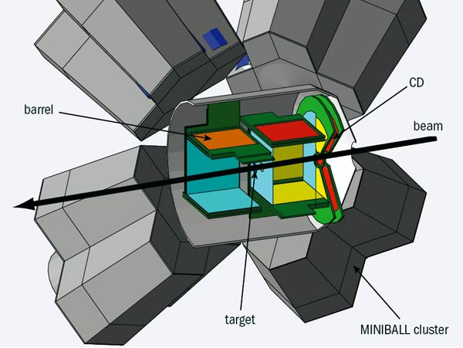
Coulomb excitation & Transfer @ Miniball
Miniball setup: highly efficient gamma detectors and particle detector
Ge γ detectors
CD – detector
Double sided Si strip detector
ΔE-E detector
Beam dump
PPAC
detector
REX-
ISOLDE
E <3 MeV/u
target
Beam
Beam
impurities
Observables: Transition energies and intensities
Information: reduced transition matrix elements
=> Study collectivity and deformations
Miniball + T-REX setup (Si detector barrel): gamma detectors and particle identification
Typical reactions: one or two-nucleon transfer (d,p), (t,p) … In inverse kinematics
Observables
energies of protons (+ E_{g}) (single-particle) level energies
angular distributions of protons (+ γ-rays) spin/parity assignments
(relative) spectroscopic factors particle configurations
Notes:
study single-particle properties of nuclei
= > Similar configurations = large overlap of wave functions =
Large probability of transfer reaction

Slide 22
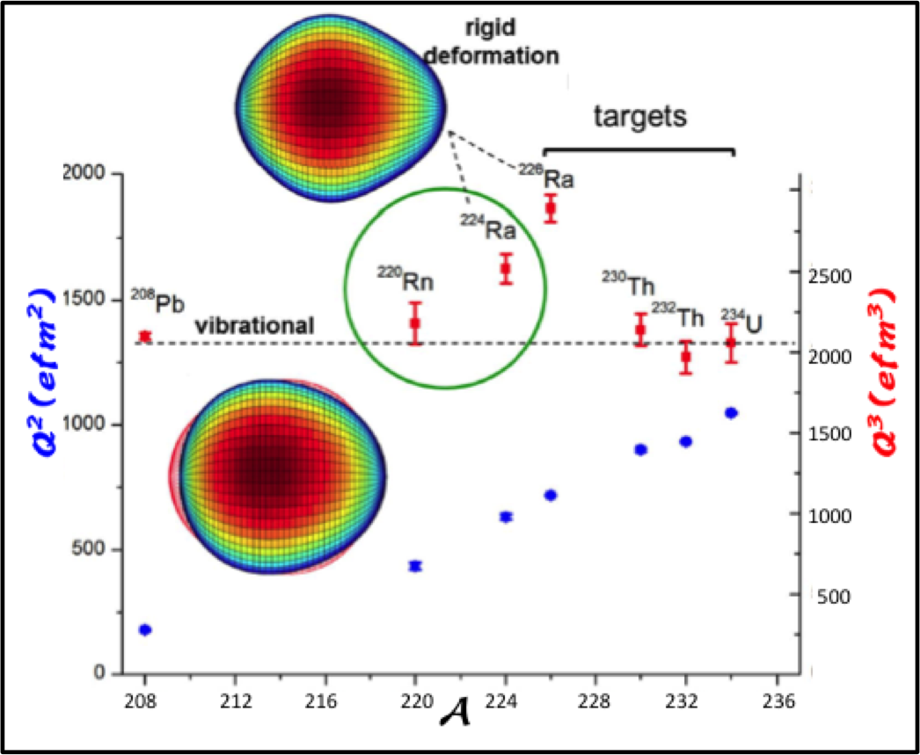
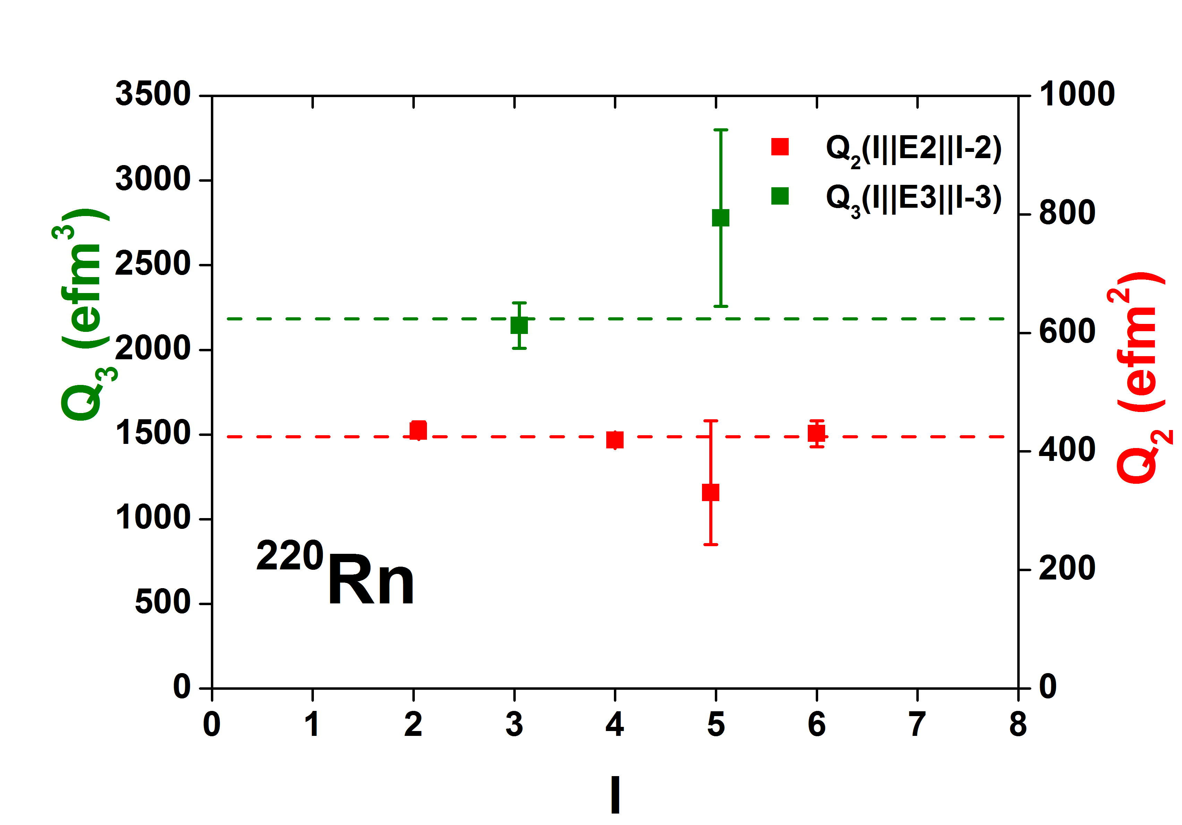
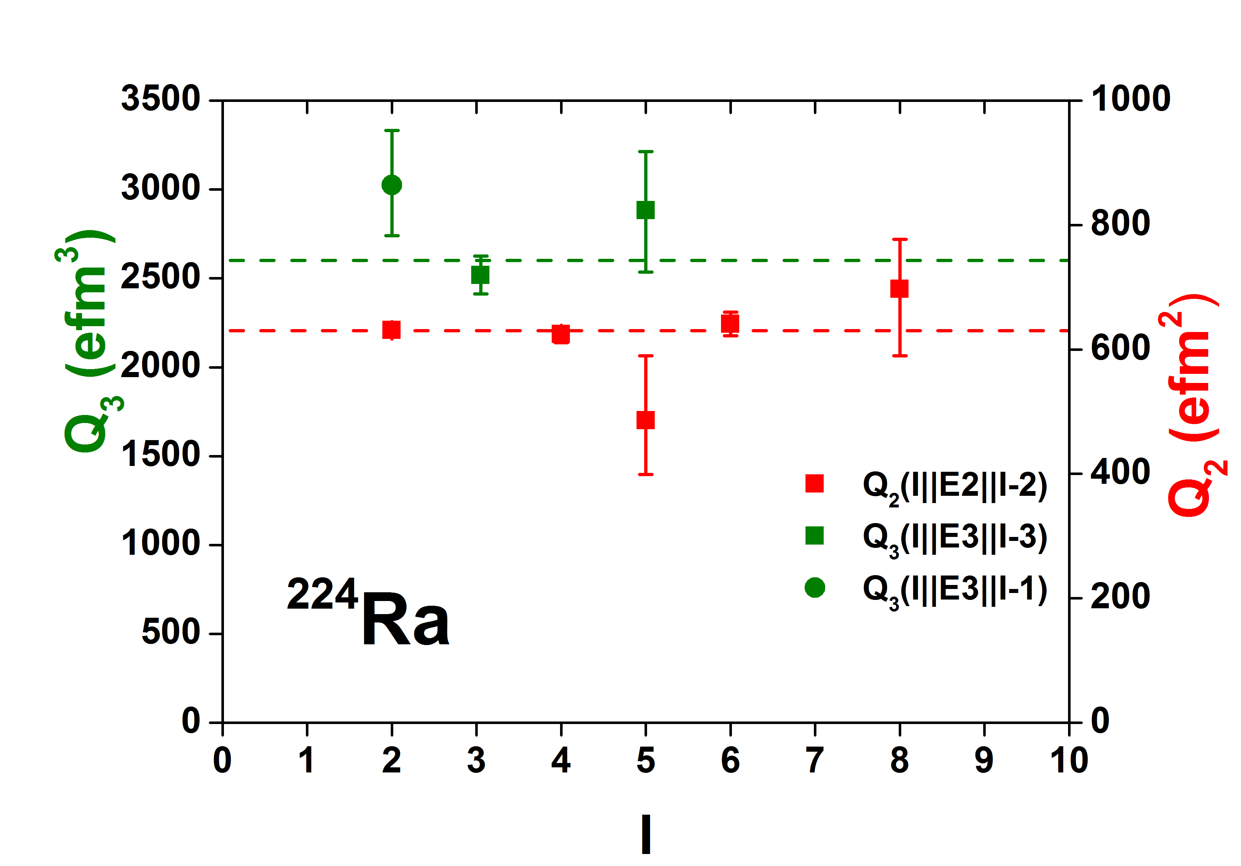
Searching for pear-shaped nuclei at ISOLDE
Coulomb excitation to directly access E3 transition strengths
λ = 2
λ = 2
Octupole correlations enhancement
B(E3) ≳ 30 s.p.u. gives significant β₃
L. P. Gaffney, et al. (2013). Nature, 497(7448), 199–204.
Notes:
1/3 of all nuclei are bound mostly if they are settle away sphericity into deformed elongated quadrupole shape.
Quantum correlations between nucleons are expected occasionally to favour more exotic shapes.
These special nuclei serve to test these specific correlations.
In quadrupole deofrmed experimental observables are the E2 transitions and Q-moments
In case of pear shapè there are additional E1 and E3 moments.
While the first are very small the E3 are collective > 10 single particle units.
So far the E3 moment has only been determined for 226Ra.
Particular correlations arise when particular momentum J are near the Fermi surface.
Excitation of coherent correlated pairs of nucleons between these states drives the whole nucleus into a pear shape.
Strong octupole correlation leading to pear shapes can arise when nucleons near the Fermi surface occupy states of opposite parity with orbital and total momentum differeing in 3h.
In these cercunstances interleave parity bands with enhanced E1 transitions.

Slide 23
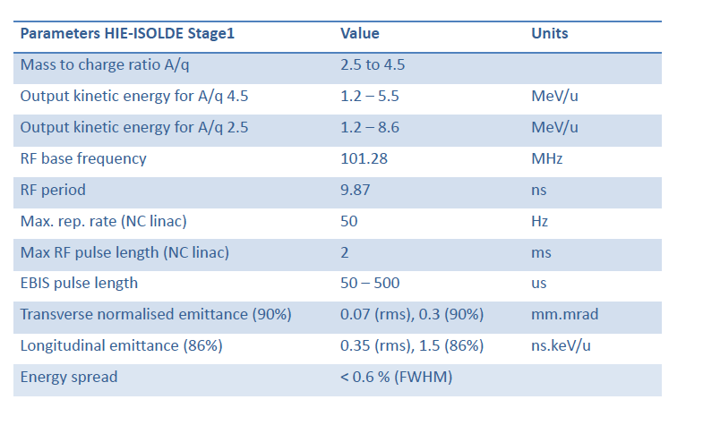
HIE-ISOLDE Beam parameters

Slide 24
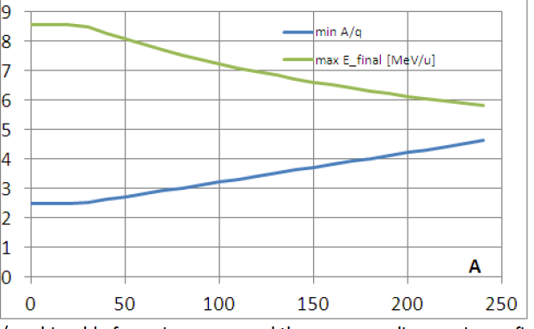
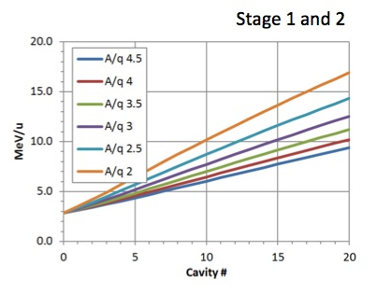

Beam Parameters
A/q = 4.5 and energy 5.5 MeV/u are the nominal parameters of the facility.
Higher energy and lower A/q ➔ Decrease in efficiency
        Increase in breeding time
Assuming 6 MV/m
A/q = 4.5 E =1. 2 – 5.5 MeV/u
A/q = 2.4 E= 1.2 - 8.6 MeV/u

Slide 25
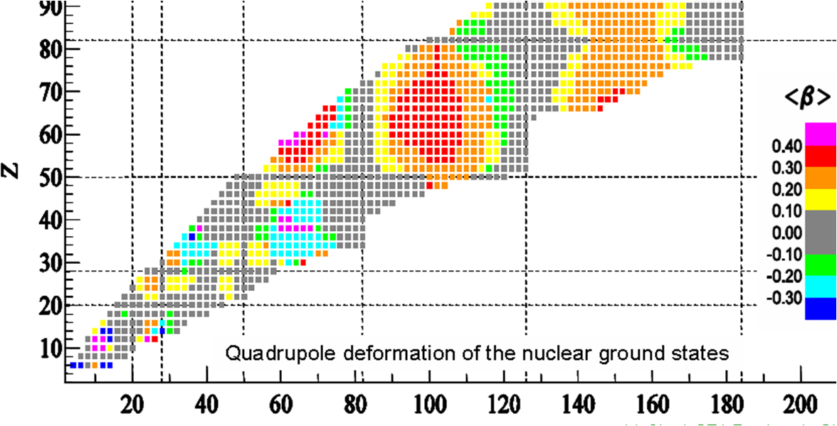
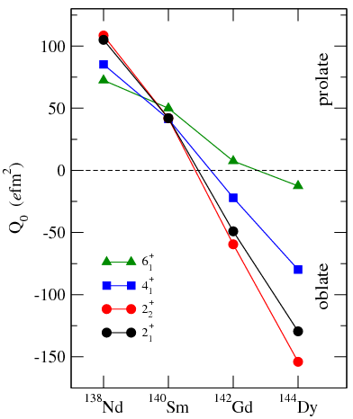
Shape Coexistence
Calculations HFB-Gogny
Calculations predict transition from
prolate to oblate shape with increasing
proton number along N=78
Regions of shape transitions and coexistence
measurement of collective properties
stringent test of nuclear structure theory
Experimental:
Lifetime measurements ⇒ B(E2)
Coulomb excitation ⇒ B(E2), Q_{s}

Slide 26
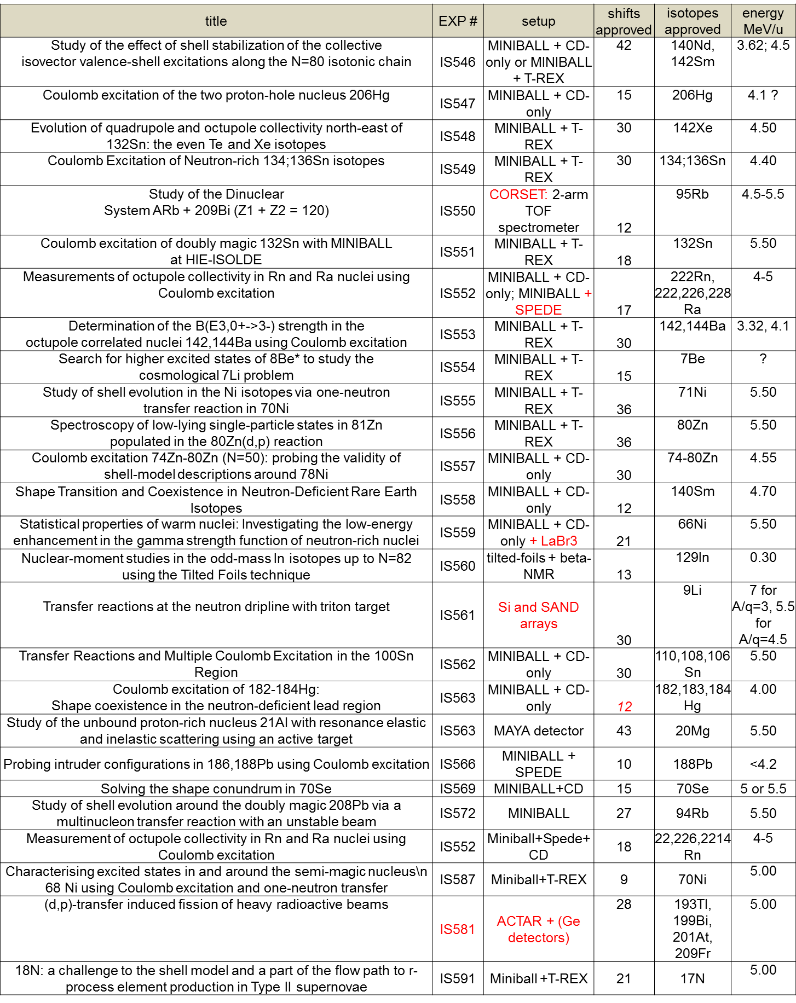
Accepted HIE-ISOLDE experiments(I)

Slide 27
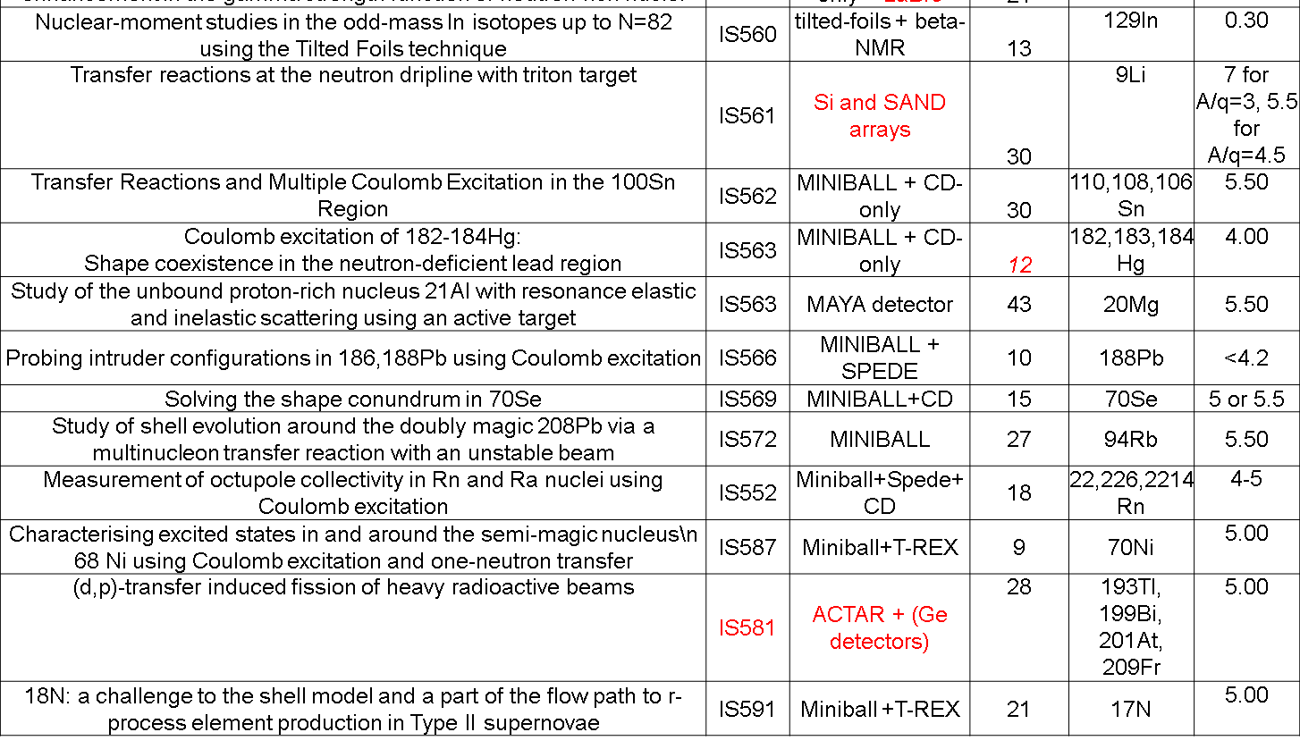
Accepted HIE-ISOLDE experiments(II)

Slide 28
²²⁰Rn
Vibrational or dynamic deformation
Static, asymmetric deformation
²²⁴Ra
L. P. Gaffney, et al. (2013). Nature, 497(7448), 199–204. doi:10.1038/nature12073
Hangout with CERN: Going pear-shaped (http://www.youtube.com/watch?v=x8Jdu9O2RhU&feature=em-uploademail) MORE than 1000 viewers
Notes:
Different of cross section with different Z targets is apparent
Gamma corrected by doppler shift and only recorded if the recoiling nucleus was detected simultaneously.
Spectra revael strong population of ground state band of positive parity and octupole band of negative parity.
GOSIA code is used to deduced the matrix elements.
The values of E2 and E3 intrinsic moments are given are given the dashed lines define the average.
One can sse that Q3 is large for 224Ra and comparable to 226Ra

Slide 29

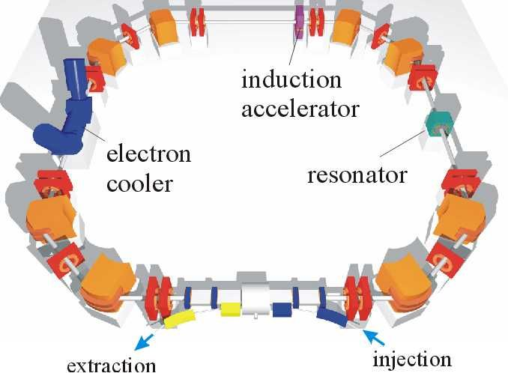
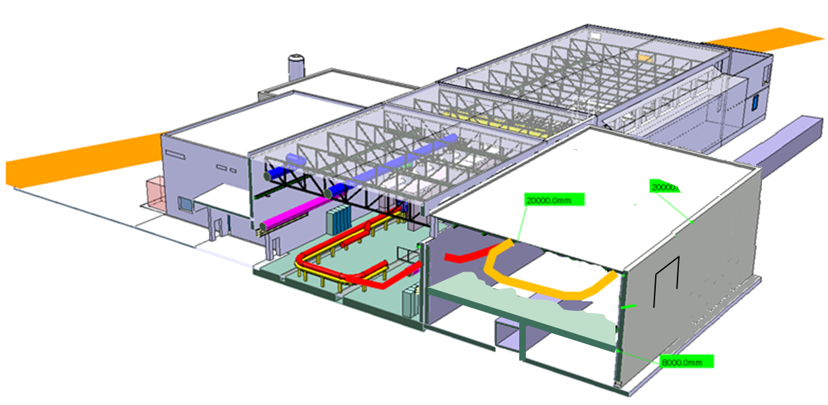
TSR @ HIE-ISOLDE
Physics programme
Astrophysics
Capture, transfer reactions
⁷Be half life
Atomic physics
Effects on half lives
Di- electronic recombination
Nuclear physics
Nuclear reactions
Isomeric states
Halo states
Laser spectroscopy
Neutrino physics
Advantages
to in-flight storage rings
  High intensity
  Cooler beams
  Much faster
With respect to “direct” beams
  Less background
  (target, beam dump)
  Improved resolution
  CW beam
26 m
36 m

Slide 30
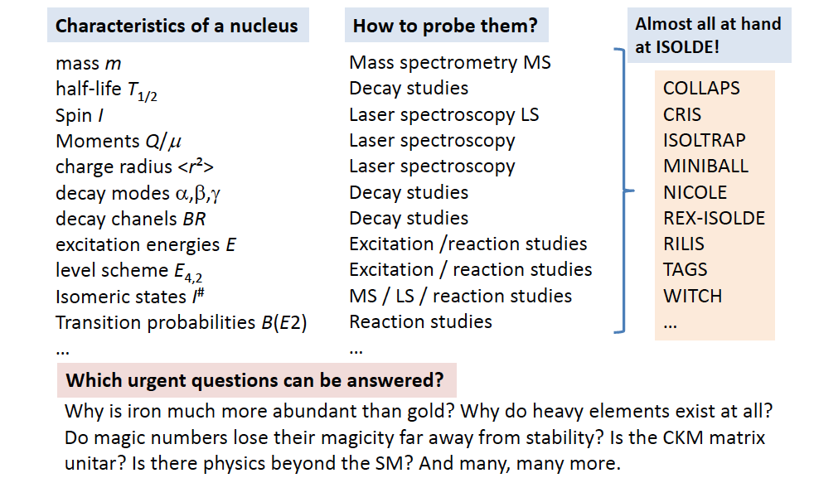
ISOLDE Basics

Slide 31
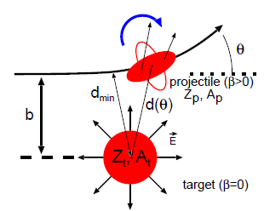
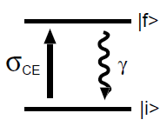
Coulomb excitation
Miniball setup: highly efficient gamma detectors and particle detector
Ge γ detectors
CD – detector
Double sided Si strip detector
ΔE-E detector
Beam dump
PPAC
detector
REX-
ISOLDE
E <3 MeV/u
target
Beam
Excitation of a projectile nucleus (radioactive) by the electromagnetic field of the target (made of stable nuclei)
Beam
impurities
Observables: Transition energies and intensities
Information: reduced transition matrix elements
=> Study collectivity and deformations

