Slide 1



The R&D on HIE‐ISOLDE superconducting quarter‐wave resonators
Pei Zhang
(BE-RF-SRF, CERN)
CATHI Final Review Meeting, 23rd Sep 2014
*This work received support from a Marie Curie Early Initial Training Network Fellowship of the European Community's 7th Programme under contract number PITN-GA-2010-264330-CATHI.

Slide 2
Outline
Cavity frequency tuning strategy & realization
Cavity RF cold test
Multipacting study
Collaboration work with other CATHIers
Pei Zhang
CATHI Final Review Meeting
Sep 23rd, 2014
Page 2

Slide 3
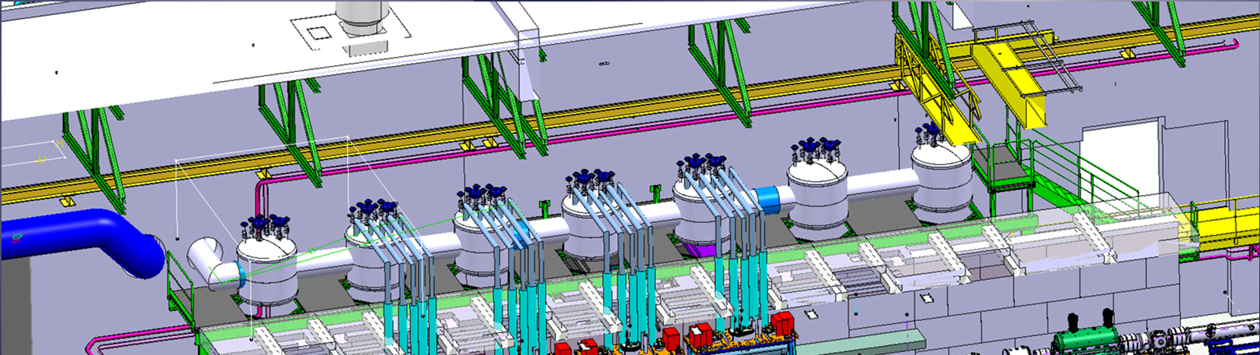
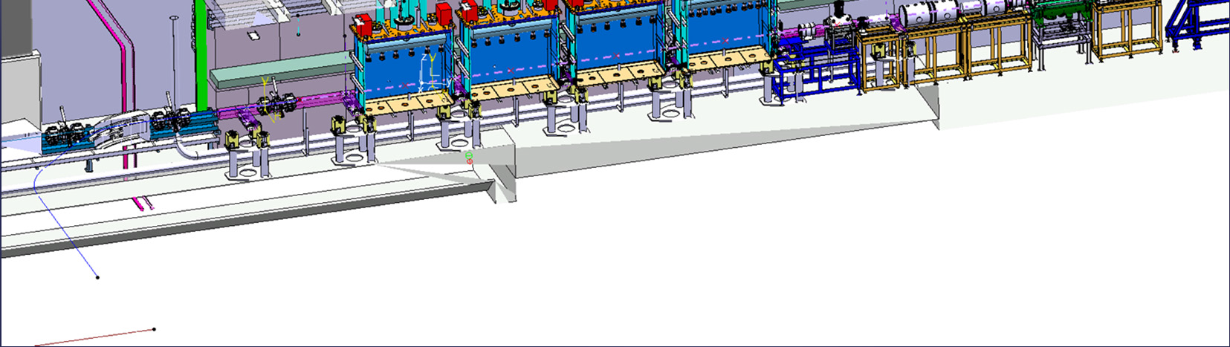
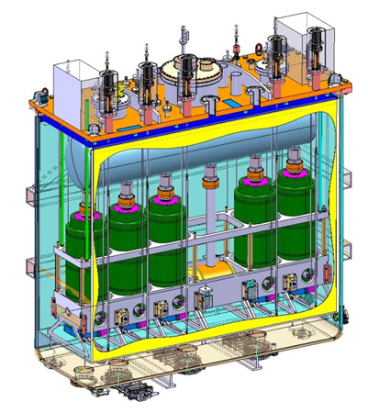
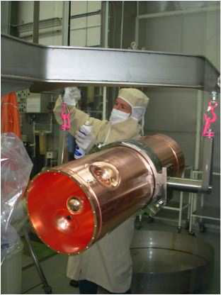
HIE-ISOLDE Linac
Boost the radioactive beam energy from 3MeV/u to 10MeV/u by using SC linac.
Quarter-wave resonator
Niobium sputtered on copper
Pei Zhang
CATHI Final Review Meeting
Sep 23rd, 2014
Page 3

Slide 4
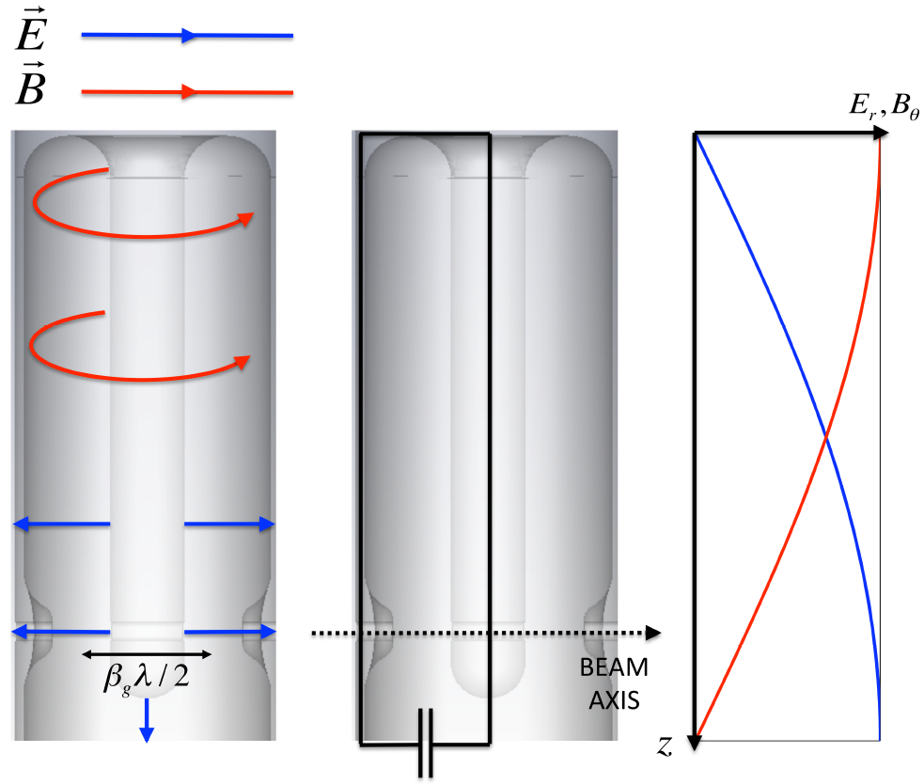
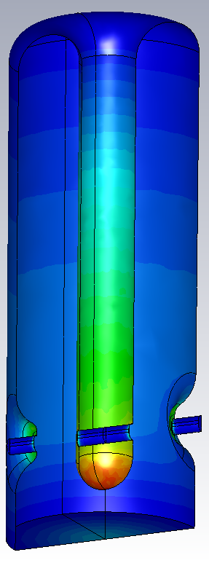
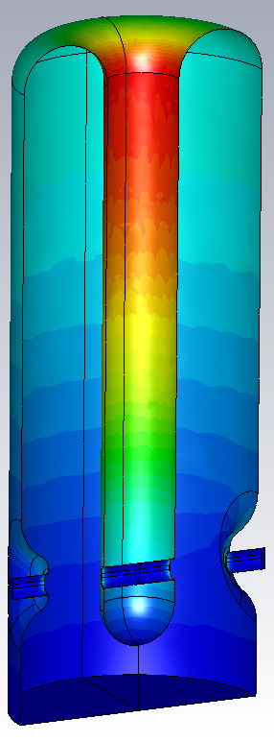
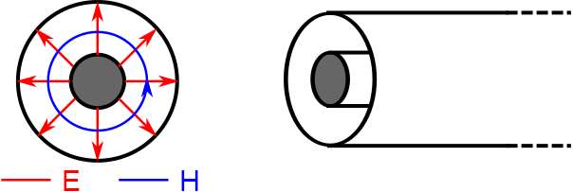
High-β QWR
|E| field
|H| field
Frequency | 101.28 MHz
E_{acc} | 6 MV/m
β_{optimum} | 10.9%
R/Q | 553 Ω
E_{peak}/E_{acc} | 5.0
B_{peak}/E_{acc} | 95.6 G/(MV/m)
G=R_{s}Q | 30.7 Ω
U/E_{acc}² | 0.207 J/(MV/m)²
P_{c} at 6MV/m | 10W
Courtesy M. Fraser
Pei Zhang
CATHI Final Review Meeting
Sep 23rd, 2014
Page 4

Slide 5
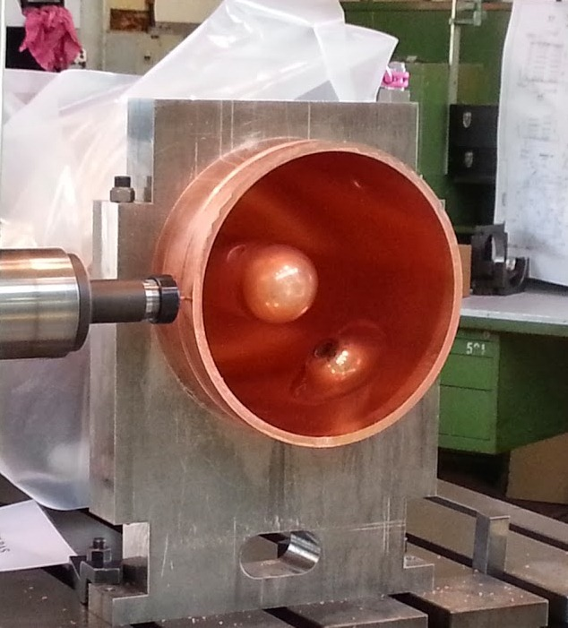
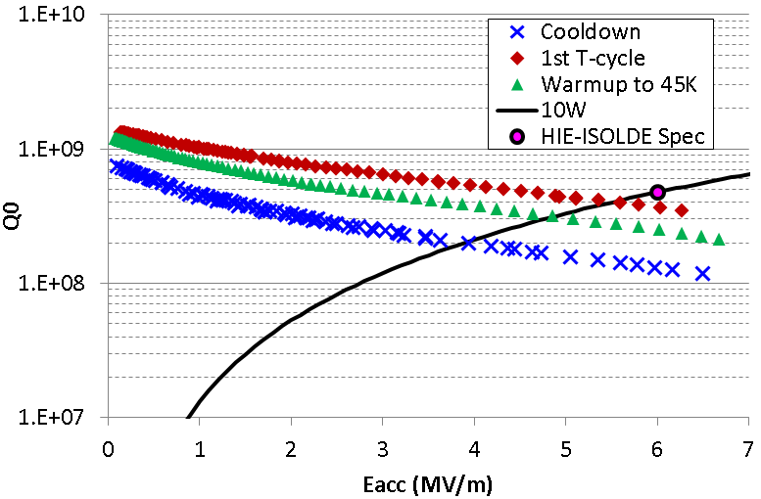
Cavity production flow
Cavity reception
Frequency tuning
Surface treatment
Niobium coating
Niobium Stripping
Cryostat preparation
RF cold test
Cavity storage
Pei Zhang
CATHI Final Review Meeting
Sep 23rd, 2014
Page 5

Slide 6
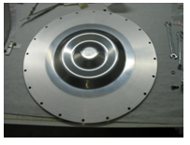
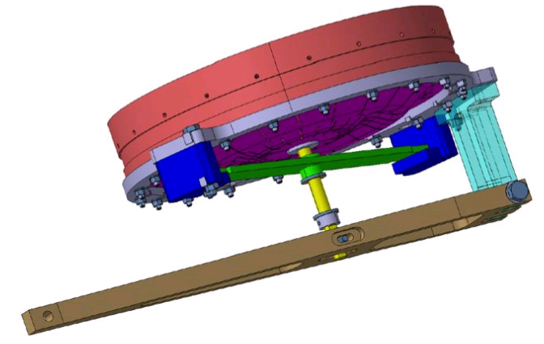
Original frequency tuning strategy
Design frequency: 101.28 MHz (4.5K in vacuum)
Mechanical tolerance (0.1mm)
Lorentz detuning
Cooldown process variability ± 5kHz
Microphonics
Tuning system
Large tuning range
Complicated production
High production cost
Pei Zhang
CATHI Final Review Meeting
Sep 23rd, 2014
Page 6

Slide 7
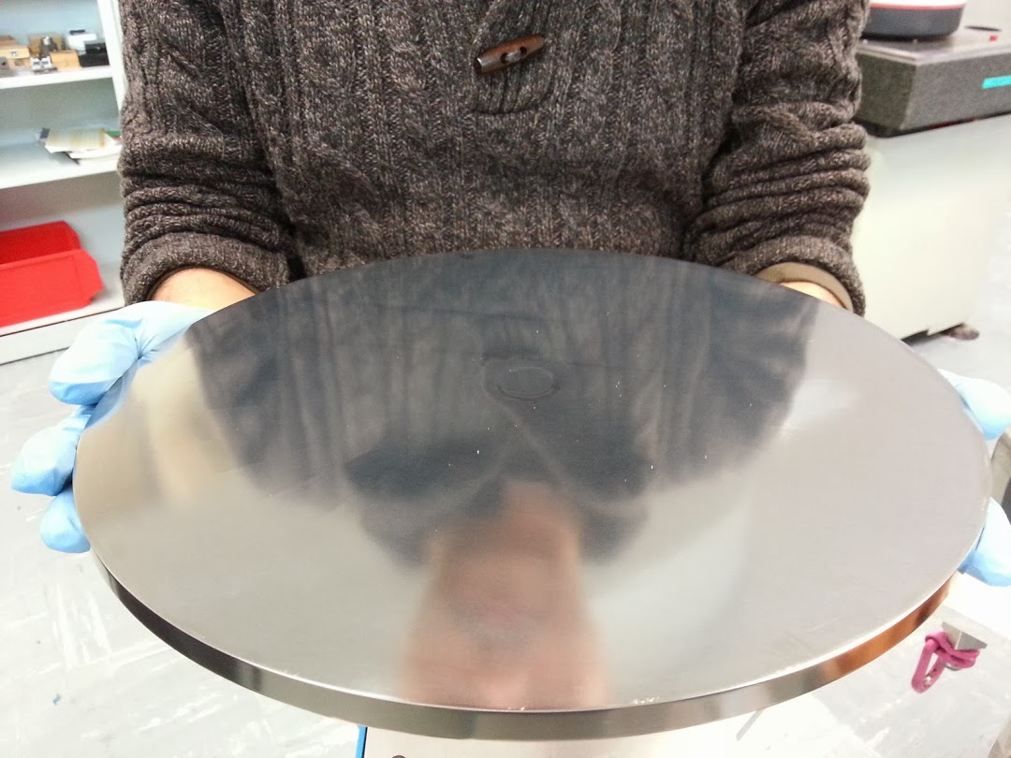
New frequency tuning strategy
P. Zhang et al., “Frequency Sensitivity to Cavity Geometry Errors of …”, CERN-ACC-NOTE-2014-0022, 2014.
Max Δf: 42kHz
Pre-tuning
Lorentz detuning
Mechanical tolerance (0.1mm)
Cooldown process variability ± 5kHz
Microphonics
Tuning system
Simplified (€ reduction)
Lower Epeak
lower loss on the plate
Pei Zhang
CATHI Final Review Meeting
Sep 23rd, 2014
Page 7

Slide 8
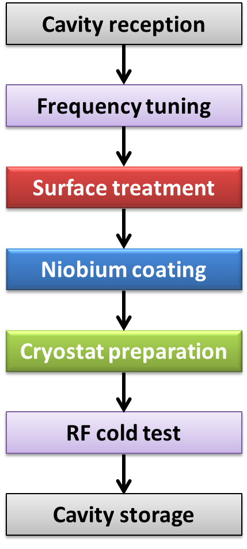
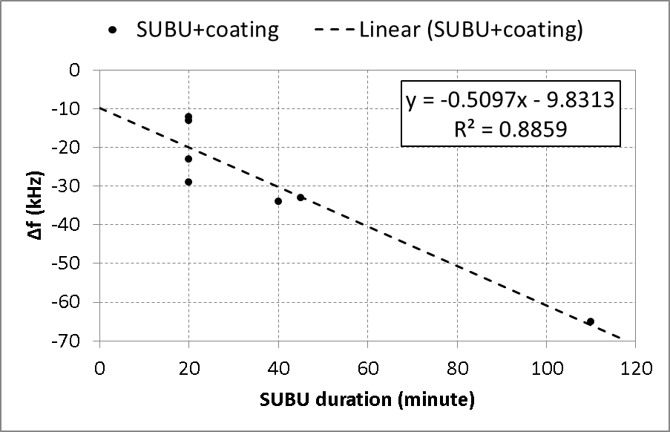
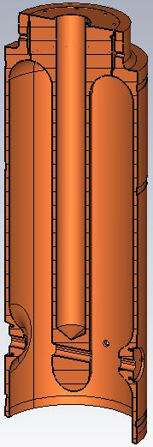
Mystery of frequency
Degreasing
Chemical etching
Cavity heat up to ~630⁰C causes geometry changes
Influencing variable | Freq. shift
Chemical etching 40’ | -27 ± 3 kHz
Niobium coating | -7 ± 5 kHz
Pei Zhang
CATHI Final Review Meeting
Sep 23rd, 2014
Page 8

Slide 9
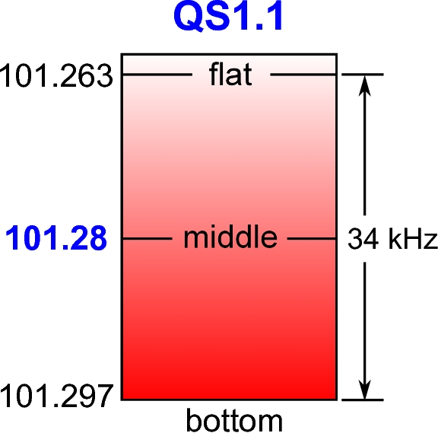
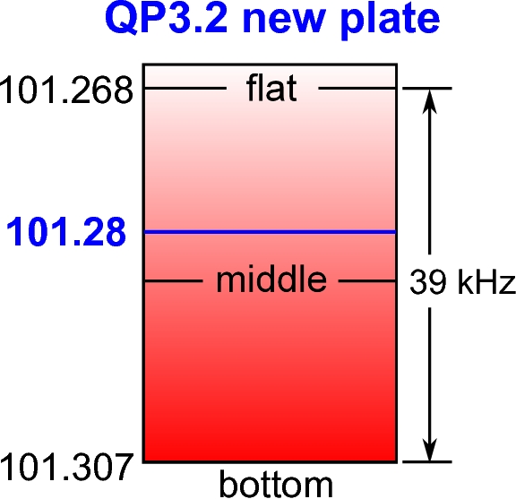
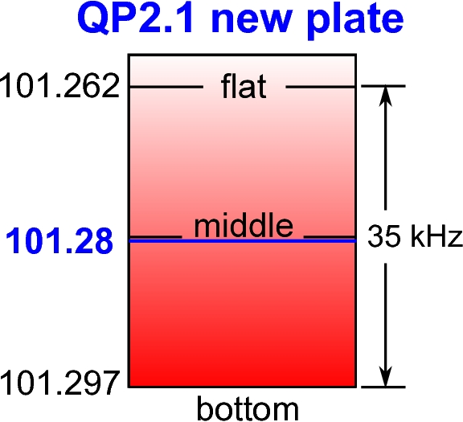
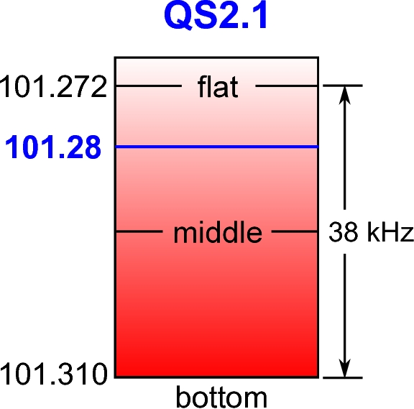
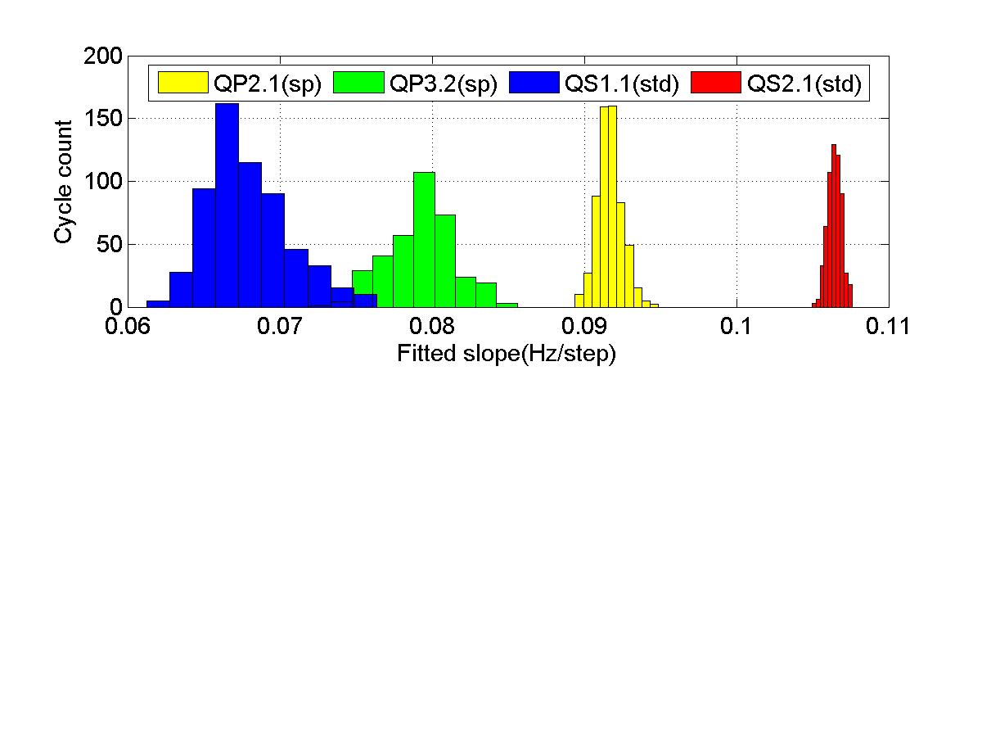
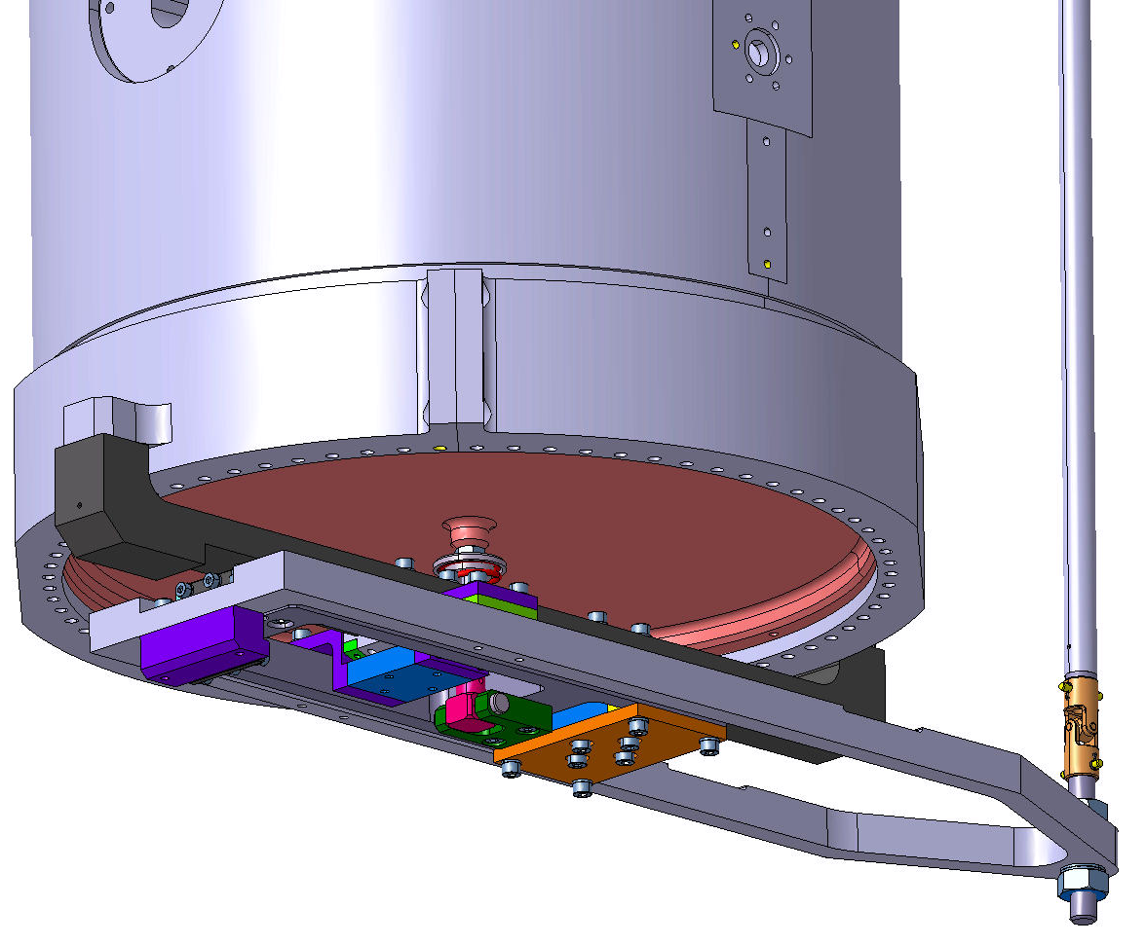
Frequency tuning
The new tuning strategy has been successfully applied.
Resolution: ~0.1 Hz/step
Pei Zhang
CATHI Final Review Meeting
Sep 23rd, 2014
Page 9

Slide 10
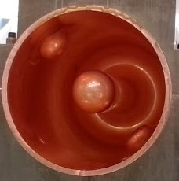
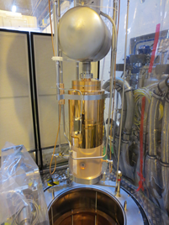
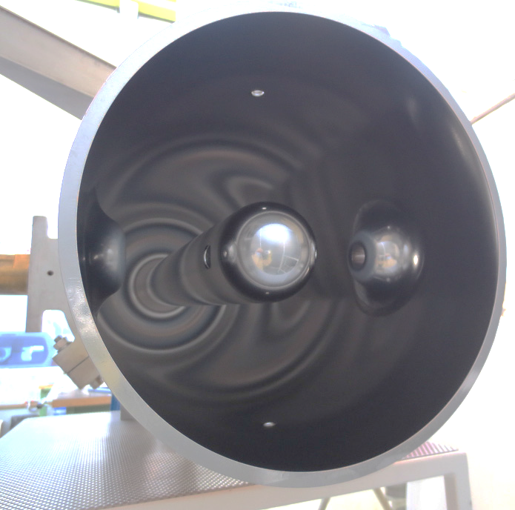
RF Cold test
Cavity reception
Frequency tuning
Surface treatment
Niobium coating
Cryostat preparation
RF cold test
Cavity storage
Pei Zhang
CATHI Final Review Meeting
Sep 23rd, 2014
Page 10

Slide 11
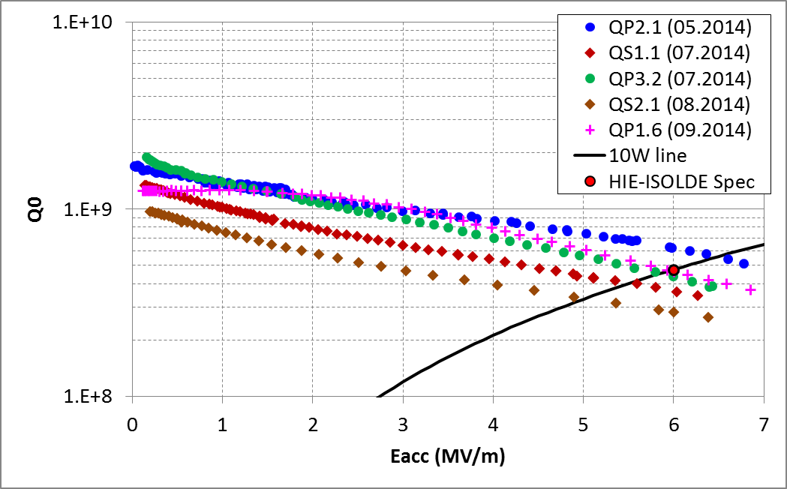
Q0 vs. Eacc
QP: prototype cavity
QS: series production cavity
Pei Zhang
CATHI Final Review Meeting
Sep 23rd, 2014
Page 11

Slide 12
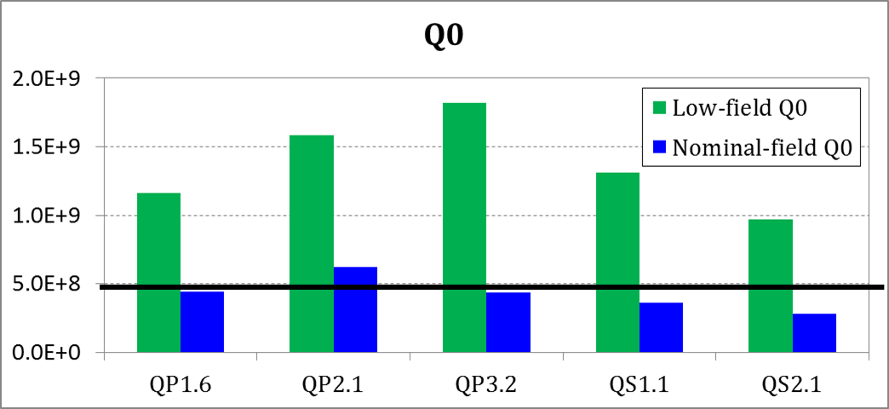
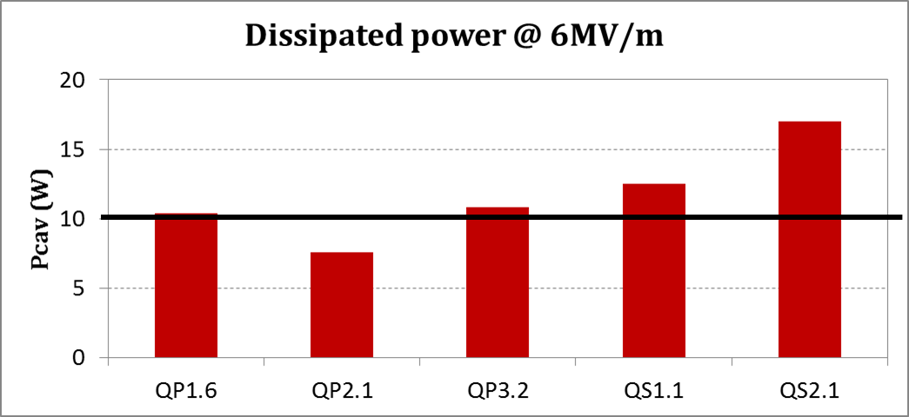
Q0 and Pcav
4.77E+8
10 W
Pei Zhang
CATHI Final Review Meeting
Sep 23rd, 2014
Page 12

Slide 13
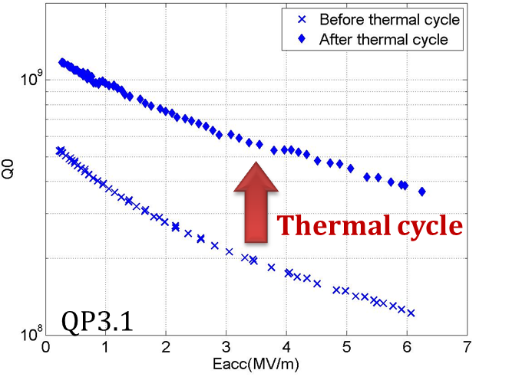
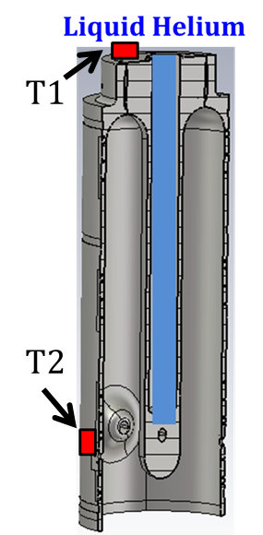
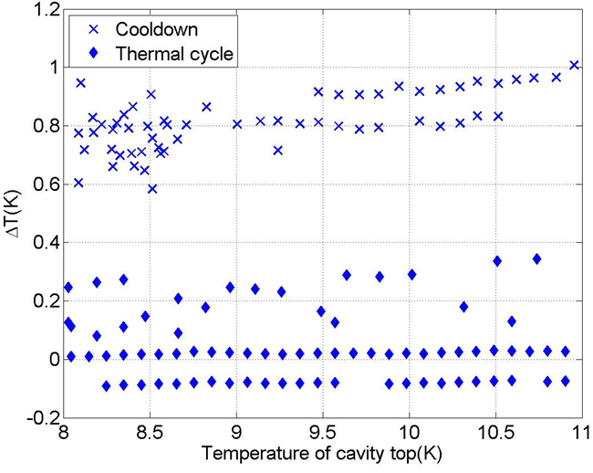
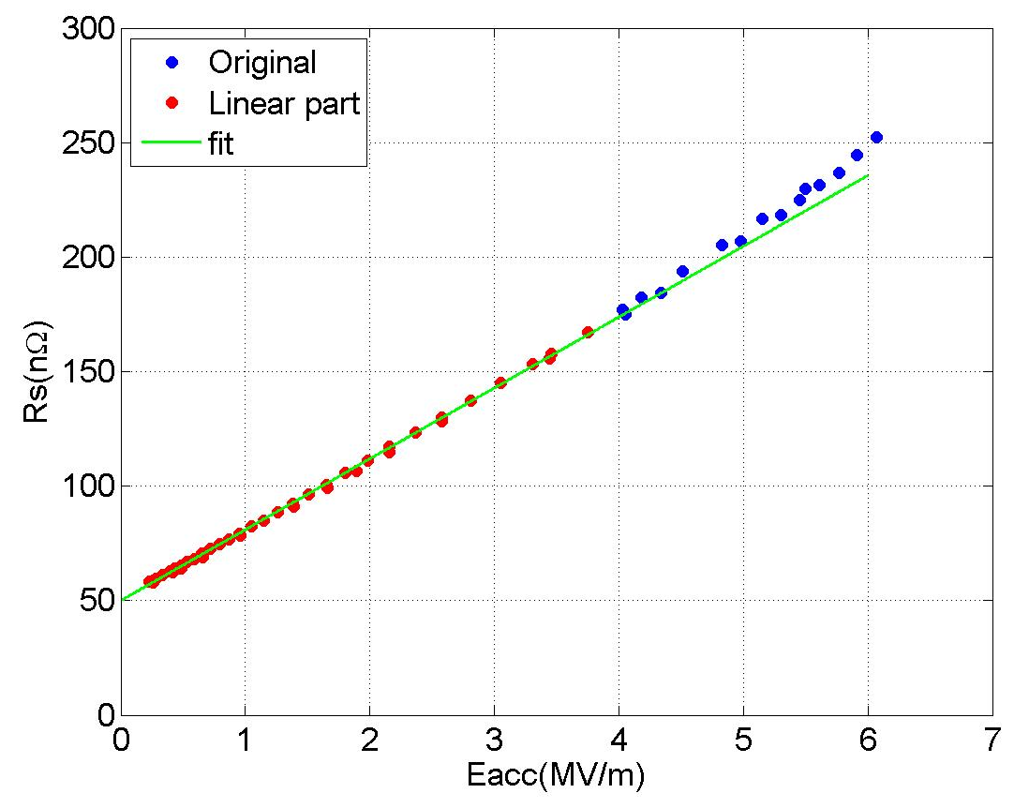
Thermal gradient
Thermal gradient: T2 – T1
Surface resistance
Pei Zhang
CATHI Final Review Meeting
Sep 23rd, 2014
Page 13

Slide 14
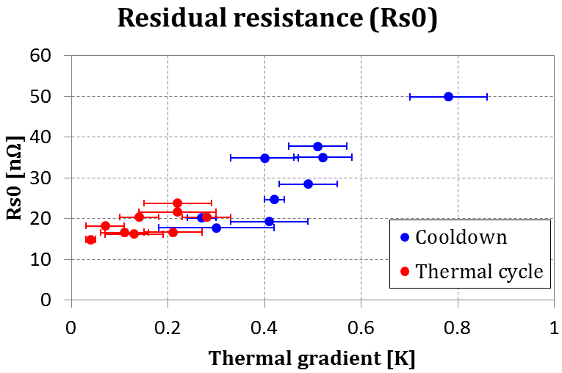
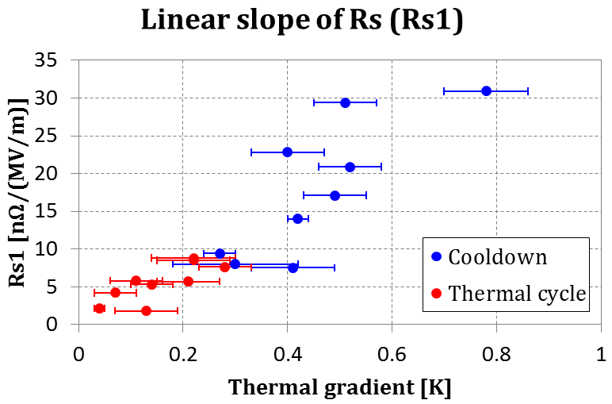
Surface resistance vs. thermal gradient
Pei Zhang
CATHI Final Review Meeting
Sep 23rd, 2014
Page 14

Slide 15
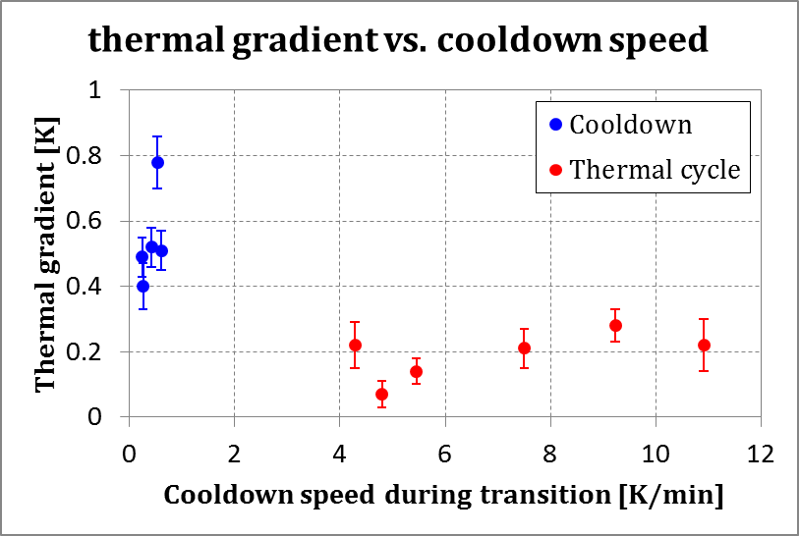
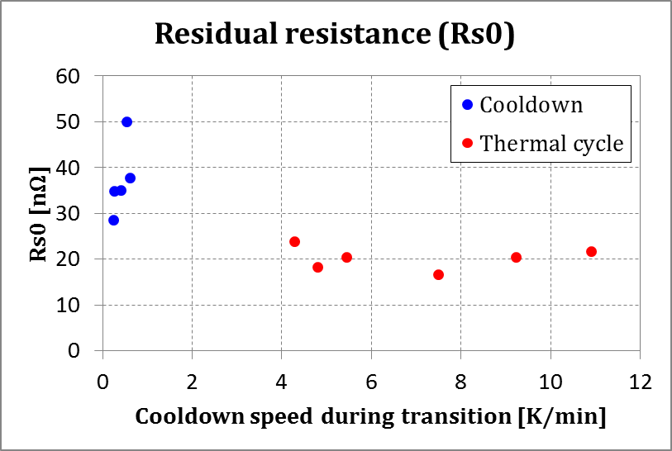
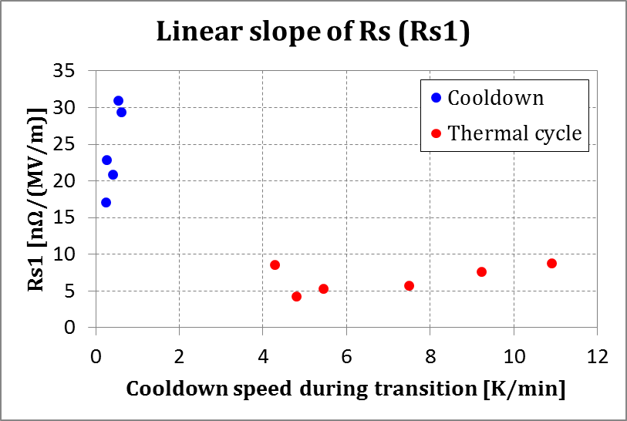
Surface resistance vs. cool-down speed
Thermal gradient [K]: T2 – T1
Cool-down speed [K/min]: average speed from 10.5K to 8.5K
Pei Zhang
CATHI Final Review Meeting
Sep 23rd, 2014
Page 15

Slide 16
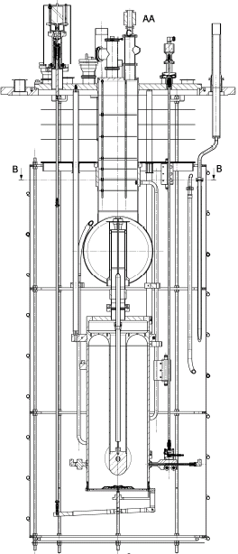
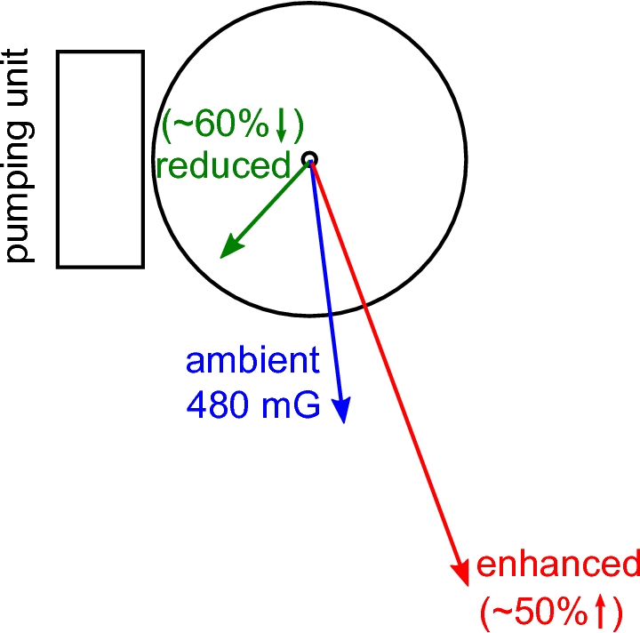
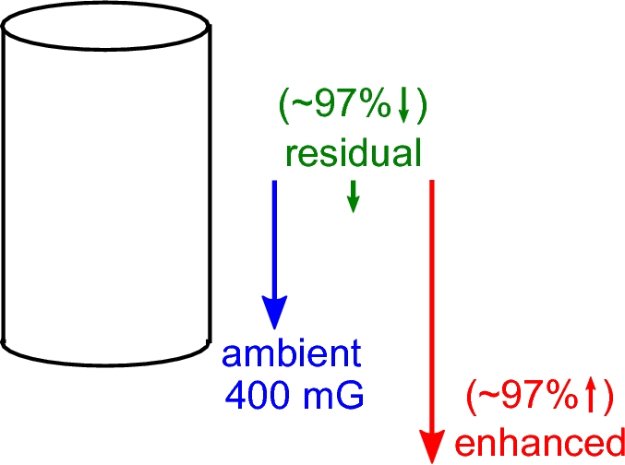
Study of trapped magnetic flux
Trapped magnetic flux causes additional power loss.
Horizontal plane
Vertical plane
Total reduction: 625 mG → 180 mG (~70% ↓)
Total enhancement: 625 mG → 1155 mG (~85% ↑)
Pei Zhang
CATHI Final Review Meeting
Sep 23rd, 2014
Page 16

Slide 17
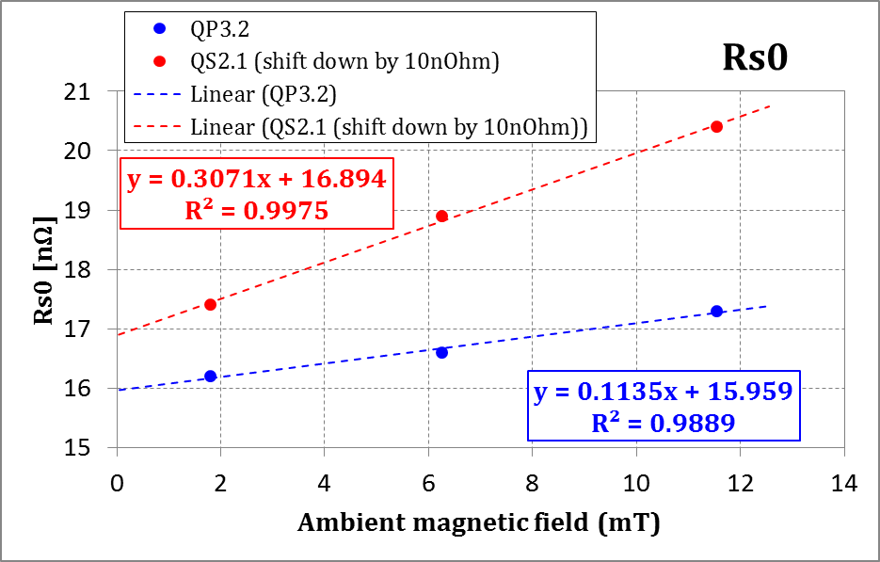
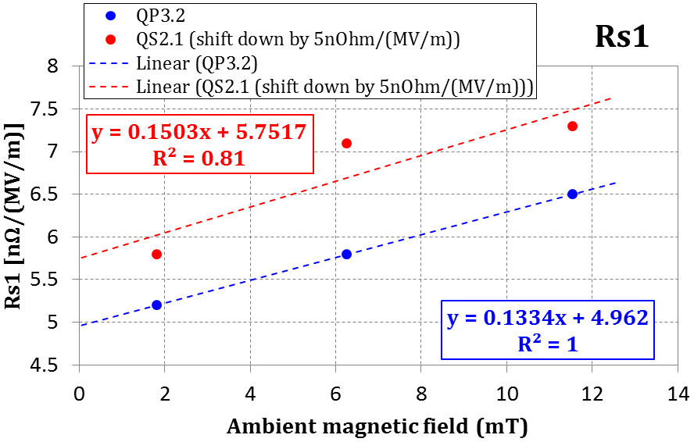
Surface resistance vs. ambient magnetic field
For every 1mT ambient magnetic field increment
 | Rs0 [nΩ] | Rs1 [nΩ/(MV/m)]
QP3.2 | 0.11 | 0.13
QS2.1 | 0.31 | 0.15
Ambient magnetic field
 | 0mT | 12mT
QP3.2 | ~11% ↓ | 10% ↑
QS2.1 | ~6% ↓ | 5% ↑
Pei Zhang
CATHI Final Review Meeting
Sep 23rd, 2014
Page 17

Slide 18
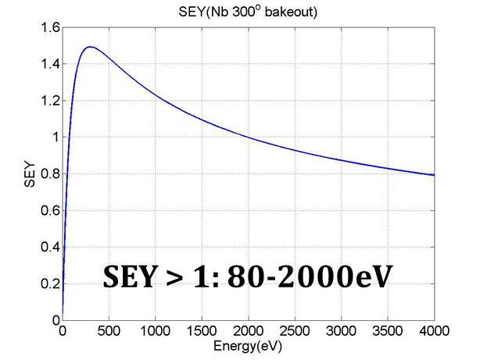
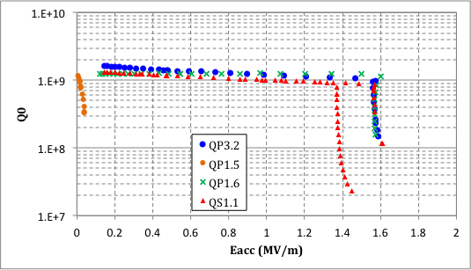
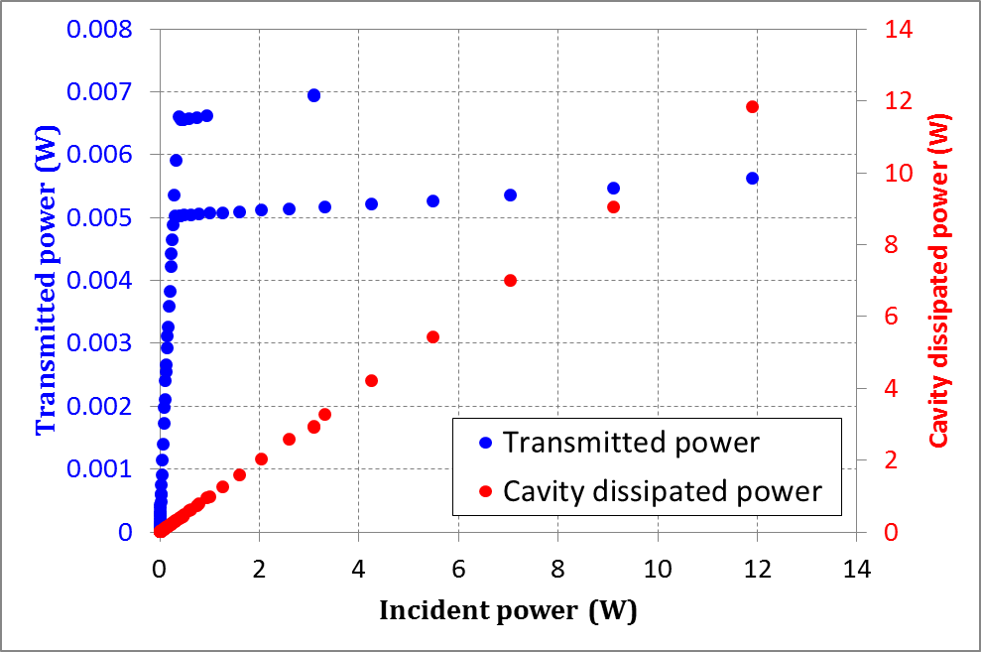
Multipacting
Multipacting seen during every cavity test
- Eacc ~ 1.5 MV/m
- Eacc ~ 0.05 MV/m
MP can eliminated by RF conditioning
QS1.1
Pei Zhang
CATHI Final Review Meeting
Sep 23rd, 2014
Page 18

Slide 19

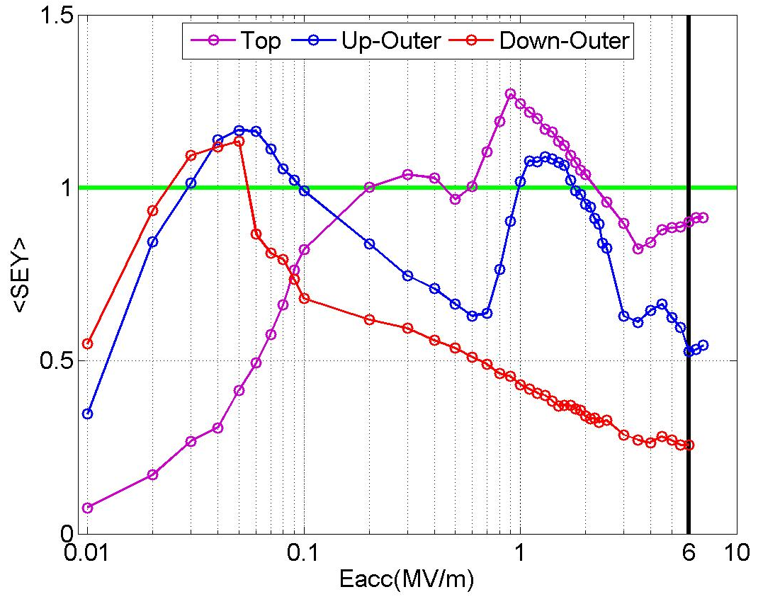
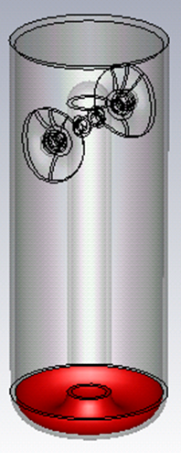
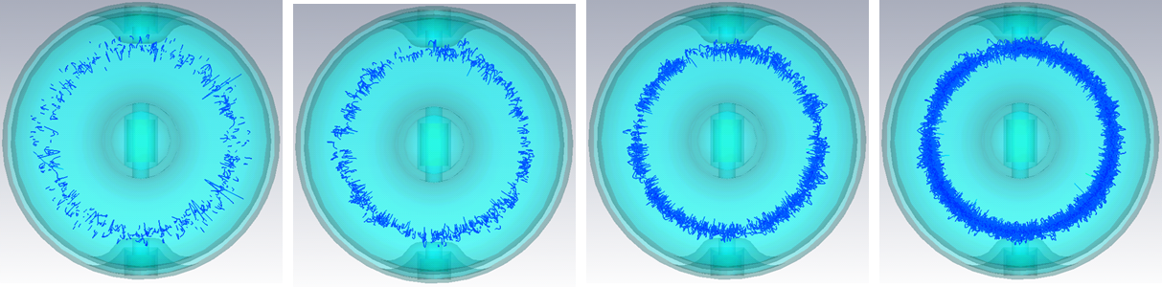
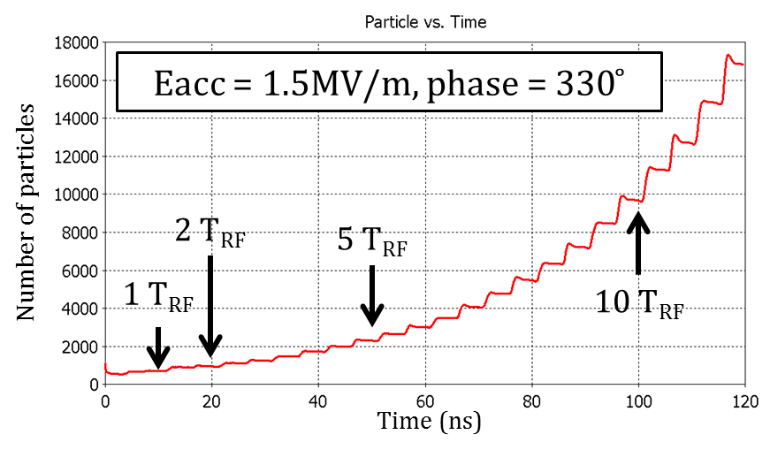
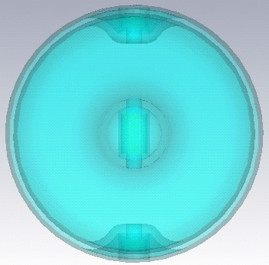









MP by CST Particle Studio
1RF
2RF
5RF
10RF
Two MP barriers found
- Eacc ~ 1.2MV/m @ cavity top
- Eacc ~ 0.05MV/m @ cavity body
Pei Zhang
CATHI Final Review Meeting
Sep 23rd, 2014
Page 19

Slide 20







MP by SLAC ACE3P suite
Two MP barriers found
- Eacc ~ 1.4MV/m @ cavity top
- Eacc ~ 0.05MV/m @ cavity body
Pei Zhang
CATHI Final Review Meeting
Sep 23rd, 2014
Page 20

Slide 21
Collaboration with other CATHIers
Pei Zhang
CATHI Final Review Meeting
Sep 23rd, 2014
Page 21

Slide 22




Field emission (with I. Kobzeva)
Electron emission
Energy of the electron hit the bottom plate
Max energy: 880keV
Peak: 830keV
Pei Zhang
CATHI Final Review Meeting
Sep 23rd, 2014
Page 22

Slide 23


Aluminium sputtering (with E. Cantero)
Aluminium slit
Beam direction
Neon beam and aluminium slit are used to measure ion beam size
²⁰Ne⁵⁺
²⁷Al
The contamination of sputtered aluminium atom in the cryo-module
Pei Zhang
CATHI Final Review Meeting
Sep 23rd, 2014
Page 23

Slide 24

Aluminium sputtering (with E. Cantero)
Fully random emission
Ne beam current: 100pA
Ne sputter on Al yield: 0.109
Average beam size measurement time: 2 min/hour
Time to coat a 1mm² monolayer Al: ~1 year
Time to coat a 1mm² monolayer Al inside cavities
- Narrow opening Al incident: 3 years
- Fully random Al incident: 97 years
Pei Zhang
CATHI Final Review Meeting
Sep 23rd, 2014
Page 24

Slide 25
Summary
New frequency tuning strategy successfully applied
- Mystery of frequency shift unveiled
RF cold test of the cavities smoothly going on
- R&D on cooldown dynamics & flux trapping started
Collaborations with other CATHIers
Pei Zhang
CATHI Final Review Meeting
Sep 23rd, 2014
Page 25

