Slide 1




SRF Cavity Review:
Focus on some low beta cavities developments in Europe and WW
Sébastien Bousson
CNRS/IN2P3/ IPN– Paris-Sud University

Slide 2
Outlook
  A (very) brief history of SRF
  Main SRF developments in Europe for protons /ions accelerators
    Spiral-2
    IFMIF
    ESS
  Worldwide SRF “at a glance”: C-ADS, FRIB
  Conclusion
* HiE-ISOLDE is the other important SRF project in EU but not depicted in this overview since there is dedicated talks in this same meeting

Slide 3
What is not covered…
Not an exhaustive review, but one could refer to the following on-going activities to be complete:
In Europe:
  for MYRRHA (spoke, elliptical)
  several R&D programs in INFN Legnaro, U. Frankfurt, IPN Orsay, CEA Saclay, STFC, INFN Milano…
  for SPL (elliptical): CERN, CEA, IPN Orsay
Worldwide:
  for ADS programs (India, Japan)
  R&D programs in Fermilab, Jlab & ODU, Univ. Beijing, Triumf…
  for machine upgrades: @ANL, @SNS, @TRIUMF
  for project/construction: RAON (Korea), SARAF (Israel)
  for deflecting cavities (crab): BNL, SLAC, ODU, Daresbury

Slide 4
A bit of history…
SRF Technology for accelerators:
Has started in 1961 when W. Fairbank (Standford University) proposed for the first time a superconducting accelerator
In 1964 W. Fairbank, A. Schwettman, P. Wilson (Standford University) have first accelerated electrons with a SC lead cavity
In 1970, J. Turneaure (Standford University) reached Epk=70 MV/m and Qo ~10¹⁰ in a 8.5 GHz cavity !
Between 1968 and 1981, Mc Ashan, J. Turneaure, A. Schwettman, T. Smith, P. Wilson (Standford University) developped and constructed the SCA (e⁻)
SRF Technology then gained maturation:
With facilities : CEBAF (@ Jlab) and LEP-II (CERN)
With the TESLA collaboration (mid 90s) : important effort to develop the SRF technology (TTF, FLASH) up to a real industrial scale with XFEL

Slide 5
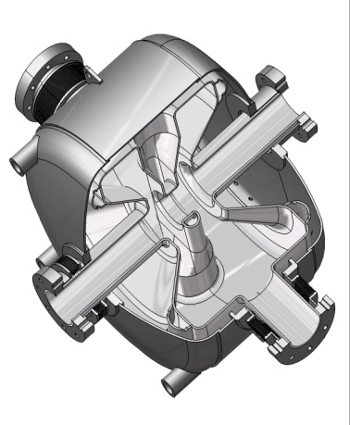
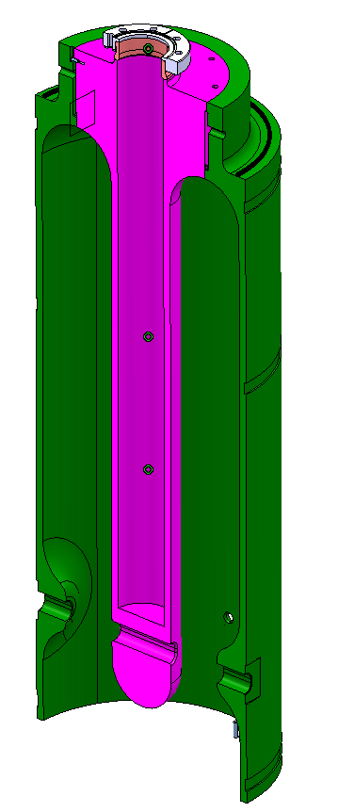
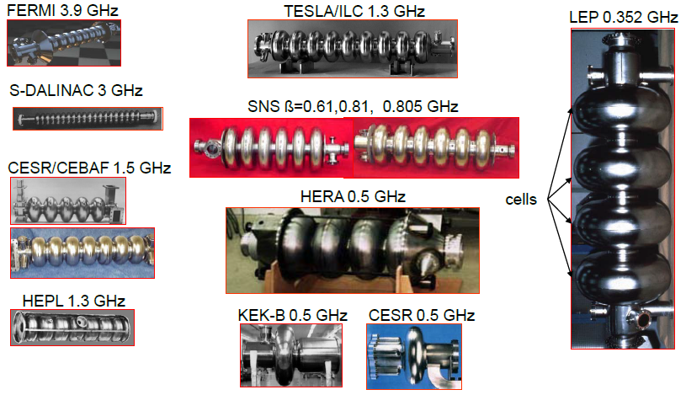
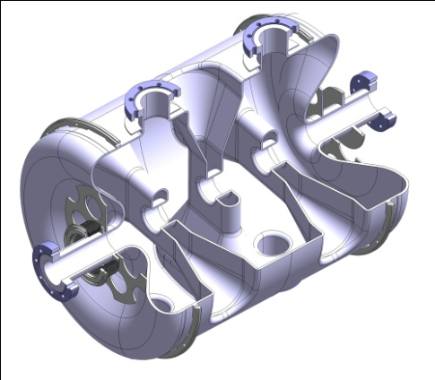
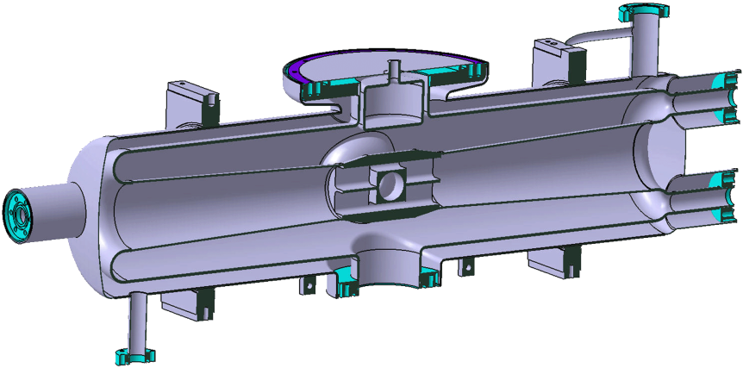
A bit of history…
2 SRF categories: electron cavities (β=1, elliptical in 99% of the cases)
proton/ion cavities (β<1, multiple shapes)
Same core technology, but design and optimization issues very different
QWR
Single spoke
Triple spoke
HWR

Slide 6
SRF Developments in Europe for protons and ions Accelerators

Slide 7
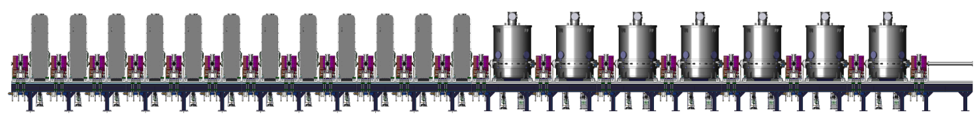
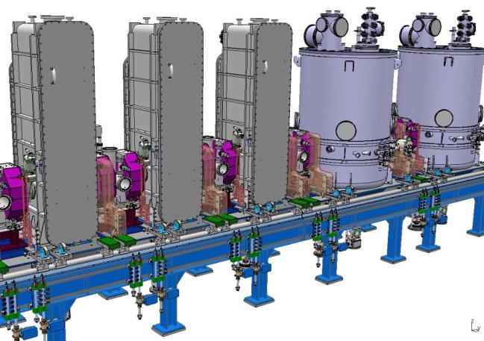
SPIRAL-2 (GANIL, CEA, CNRS)
Project objectives: construction of a 40 MeV deuterons accelerator (which can also accelerate q/A = 1/3 and 1/6) as a driver for RIB production
L~35 m
Beta 0.07 energy section
Beta 0.12 energy section
Cryomodule | A | B
Valve-to-valve length [mm] | 610 | 1360
# cavities | 12 | 14
f [MHz] | 88.05 | 88.05
β_{opt} | 0.07 | 0.12
Epk/Eacc | 5.36 | 4.76
Bpk/Eacc [mT/MV/m] | 8.70 | 9.35
r/Q [Ω] | 599 | 515
Vacc @ 6.5 MV/m & β_{opt} | 1.55 | 2.66
Lacc [m] | 0.24 | 0.41
Beam tube ∅ [mm] | 38 | 44
lattice
1940 mm
lattice
1190 mm
Cryomodule A | Cryomodule B | Power coupler
CEA Saclay | IPN Orsay | LPSC Grenoble

Slide 8
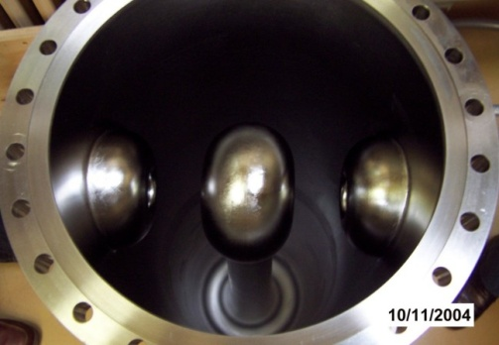
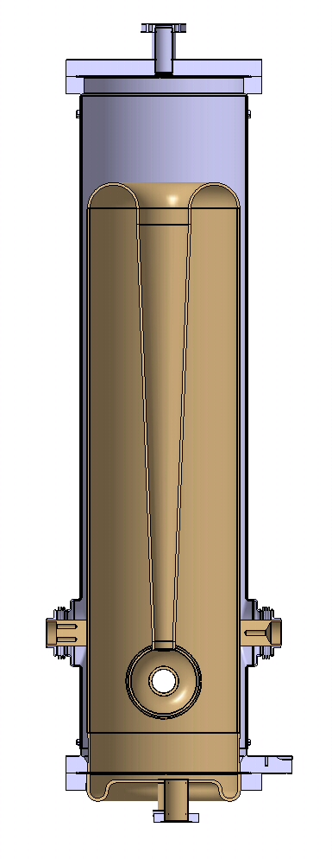
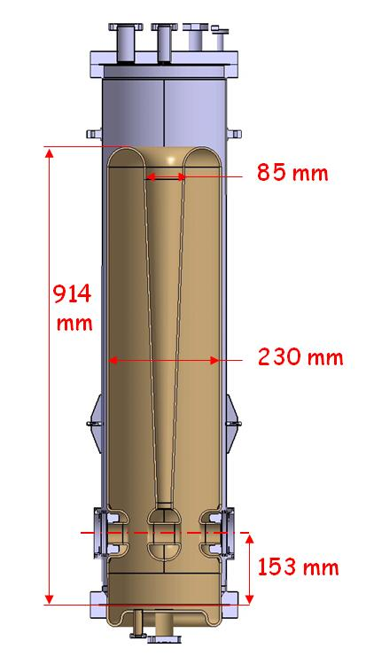
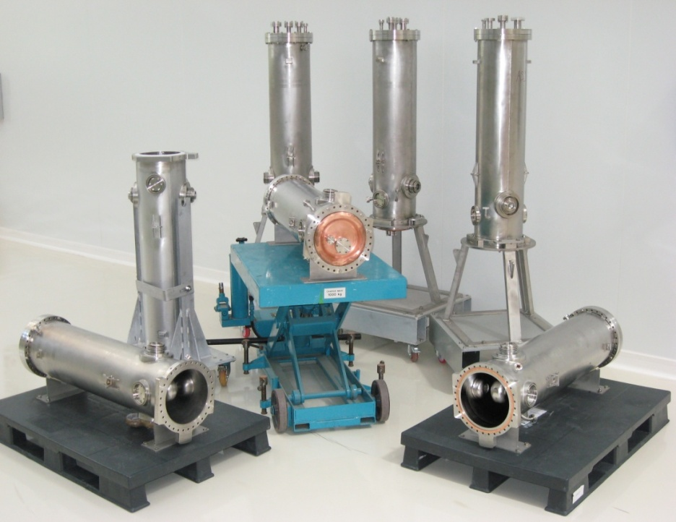
SPIRAL-2 (GANIL, CEA, CNRS)
Low beta cavities (“A” type): developped by CEA Saclay: QWR with dismountable copper bottom flange
Zanon and SDMS cavities
Courtesy P. Bosland
13 cavities fabricated in total

Slide 9
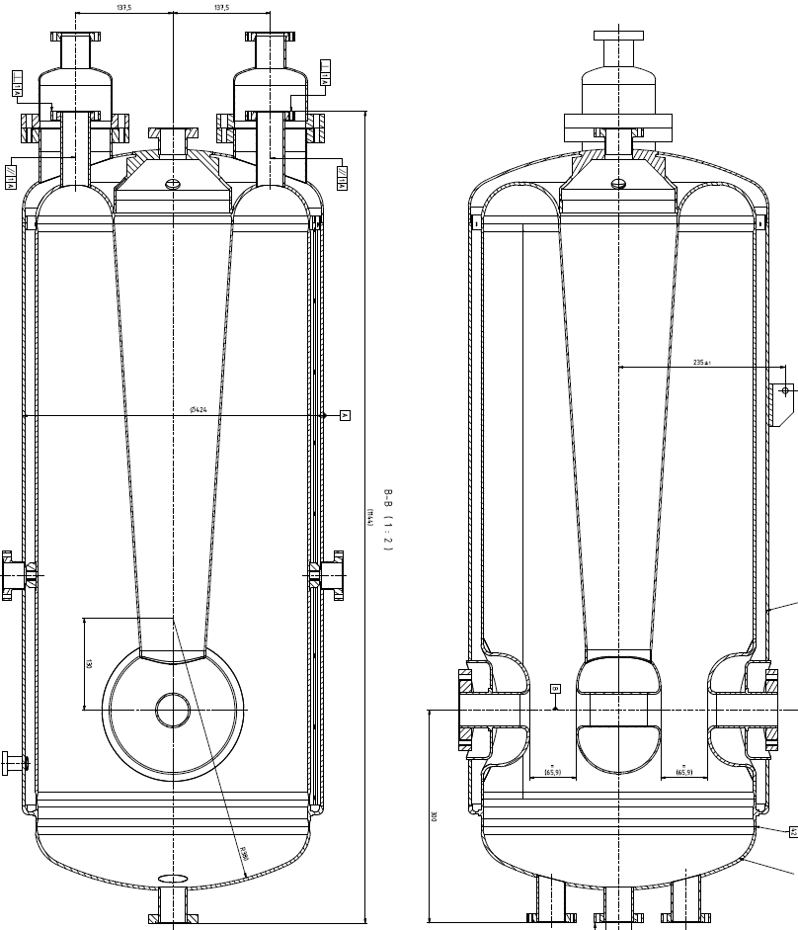
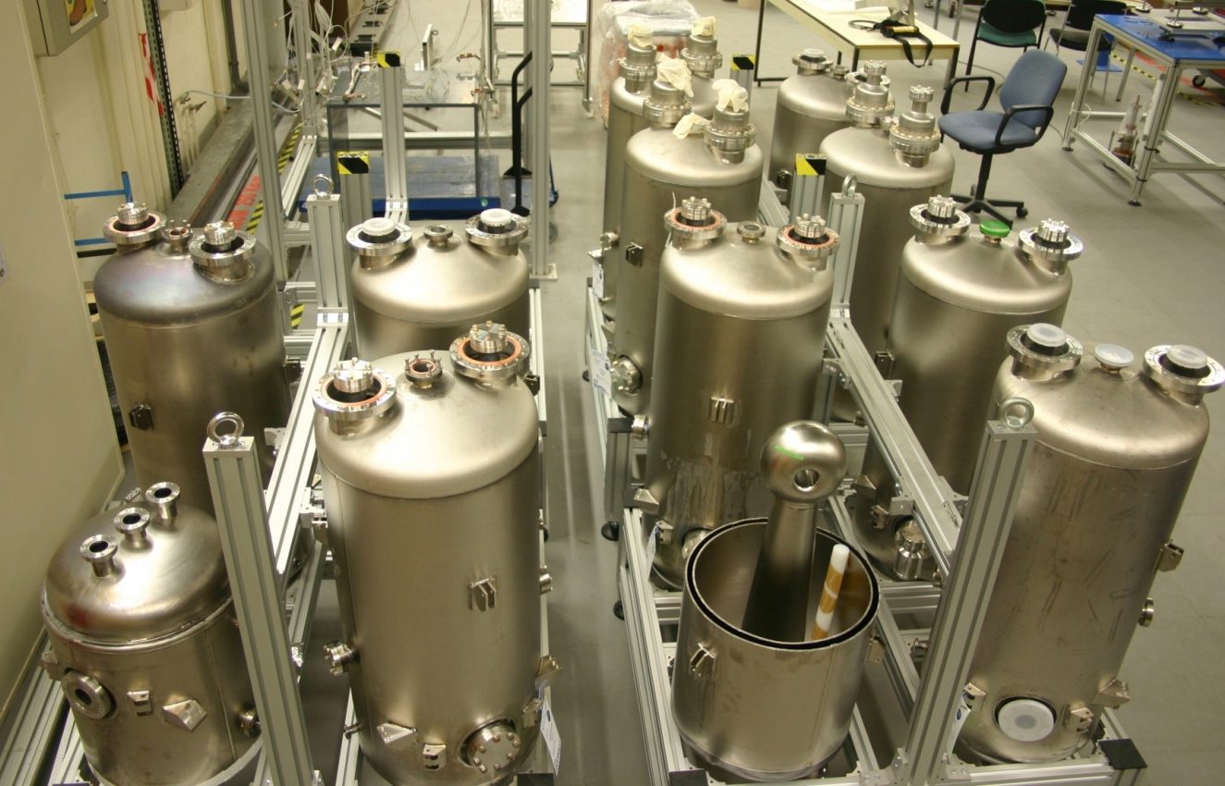
SPIRAL-2 (GANIL, CEA, CNRS)
High beta cavities (“B” type): developed by IPN Orsay: QWR with welded Nb bottom flange, Titanium He tank (4 mm), SS cavity flanges.
Total produced: R&D phase: 1 prototype +2 pre-series
Series production: 16 (made by Research Instruments)

Slide 10
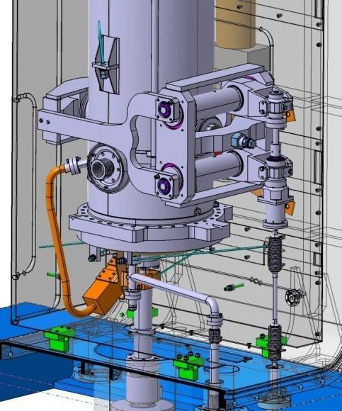
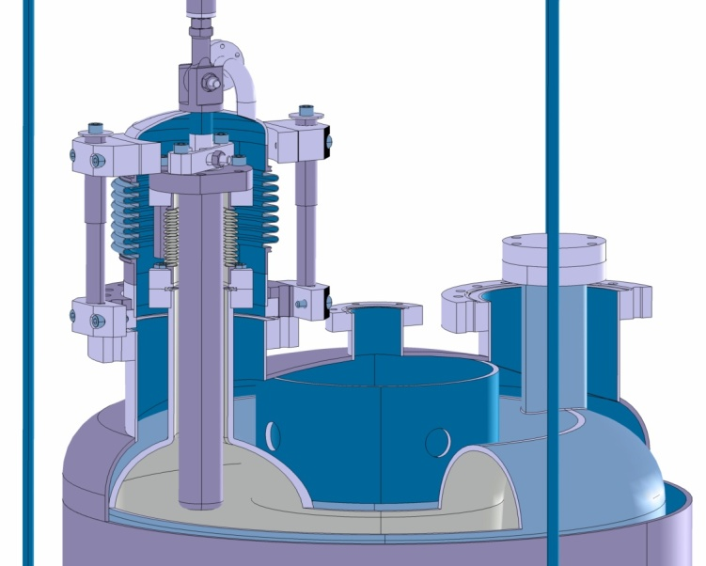
SPIRAL-2 (GANIL, CEA, CNRS)
Low β Cold tuning system
High β Cold tuning system
Mechanical tuner, push system
Tuning by insertion of an Nb rod
2 ports on the top of the cavity:
a) One static plunger
b) One moving plunger
Sensitivity ~1 kHz/mm with Ø 30 mm plunger
Introducing one plunger by 50 mm(Ø 30 mm)
First “coarse” tuning: + 50 kHz
then fine tuning: +/- 4 kHz
Good linearity: 0.15 Hz/motor step
Sensitivity: ~28 kHz/mm
Full range: +25 kHz

Slide 11
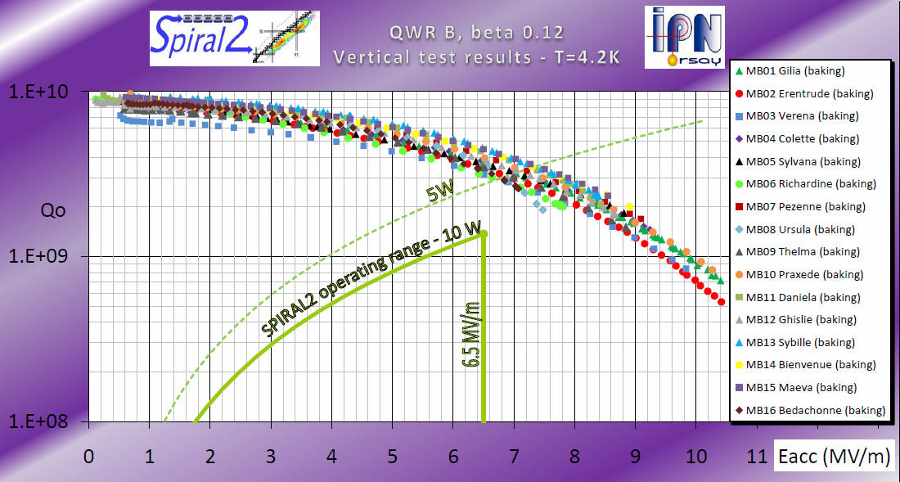
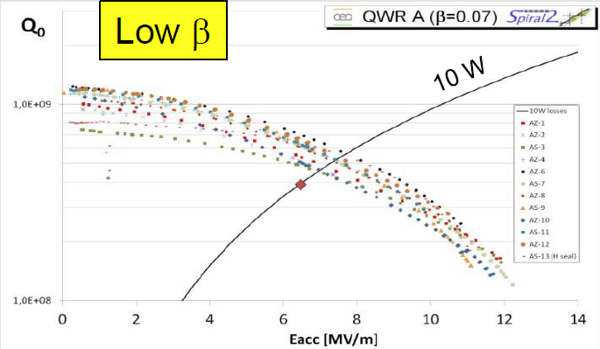
SPIRAL-2 (GANIL, CEA, CNRS)
Performance Goal : 6.5 MV/m and 10 W max.
Preparation: standard BCP, HPR @ 100 bar, class 10 clean room assembly
All cavities exhibits multipacting. MP Barriers above 1 MV/m are easily processed. FE level and onset is variable, but when present, it is always processed in VT.
Low β cavities: all cavities tested are in the spec. Some have Eacc > 10 MV/m !
High β cavities: all series cavity tested and in the spec with important margins !
Cryomodule production:
8/12 low β CMs and 5/7 high β assembled, tested and delivered to Ganil

Slide 12
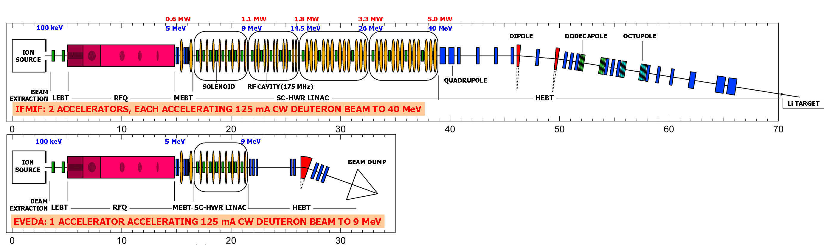
IFMIF-LIPAC (CEA, CIEMAT)
Project objectives: characterization of materials with intense neutrons flux (10¹⁷ n/s) for the future Fusion Reactor DEMO (~150 dpa). Based on two CW 40 MeV deuterons SC linac, 125 mA each.
IFMIF
EVEDA (demonstrator)
 | Parameters | Target Value | Units
 | Frequency | 175 | MHz
 | β value | 0.094
 | Accelerating field E_{a} | 4.5 | MV/m
 | Unloaded Quality factor Q₀ for R_{s}=20 nΩ | 1.4×10⁹
 | Freq. range of HWR tuning syst | ± 50 | kHz
 | Max. transmitted RF power by coupler (CW) | 200 | kW
 | External quality factor Q_{ex} | 6.3×10⁴
Cavity type: Half-wave resonators
Courtesy F. Orsini

Slide 13
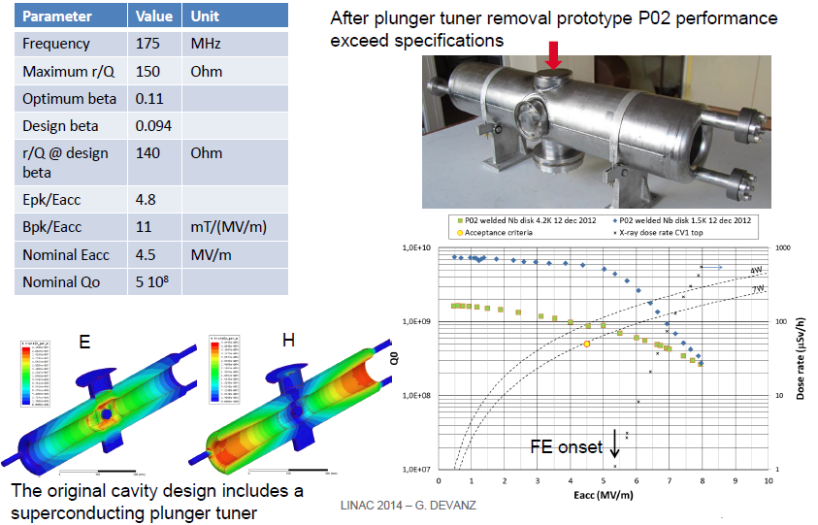
IFMIF-LIPAC (CEA, CIEMAT)
G. Devanz
Linac 2014
New cold tuning system: compression tuner (cavity body deformation)

Slide 14
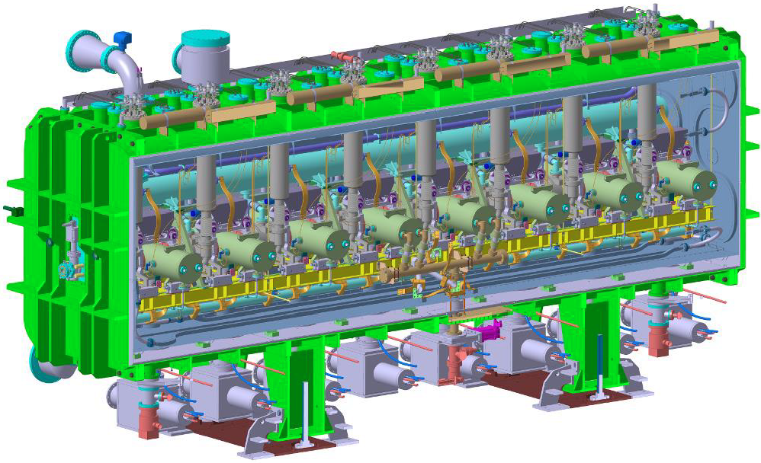
IFMIF-LIPAC (CEA, CIEMAT)
Courtesy G. Devanz
Cryomodule: 8 HWR + 8 solenoïd package (solenoïd, steerer, BPM)

Slide 15

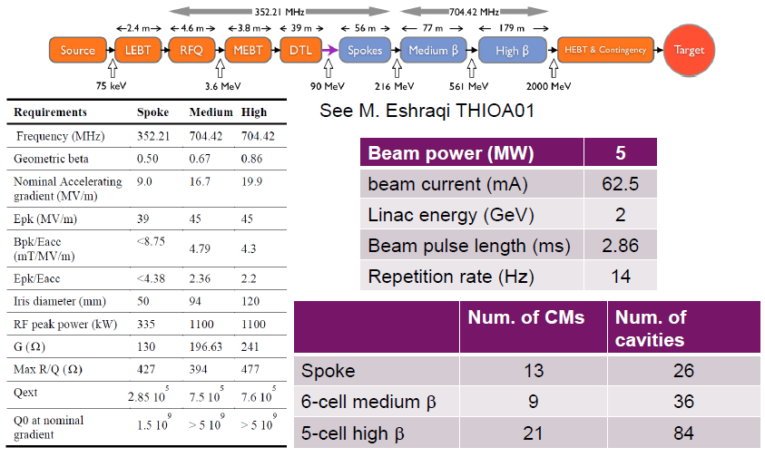
ESS (17 Eu countries)
ESS Linac: SRF Technology from 90 MeV to 2 GeV

Slide 16
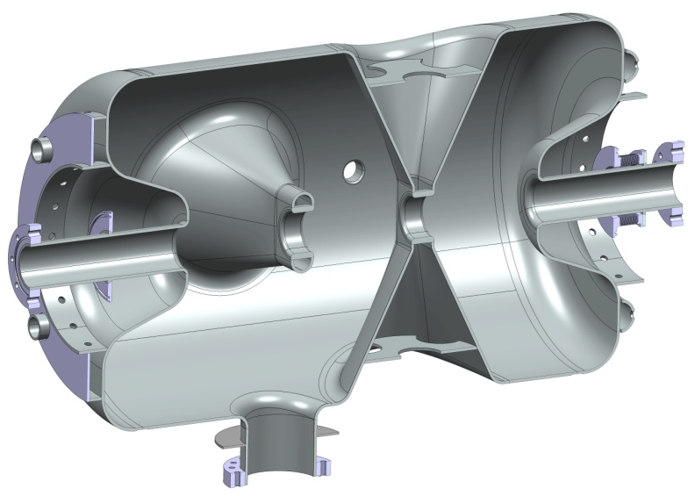
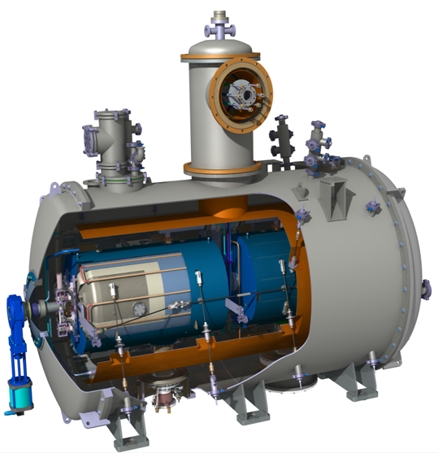
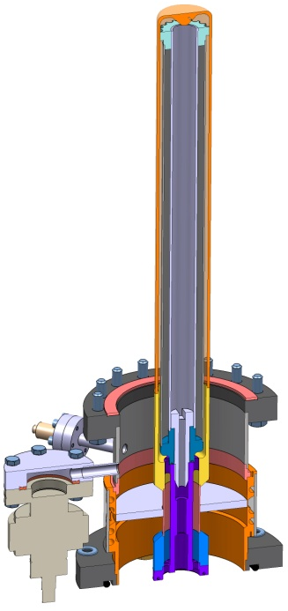
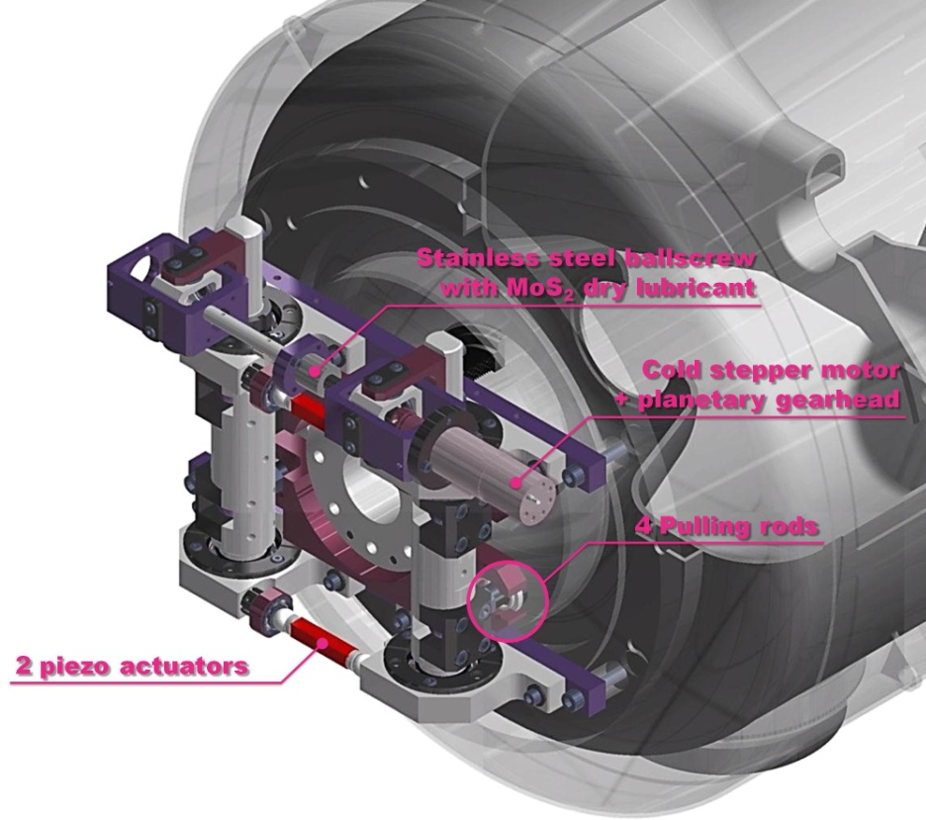
ESS (17 Eu countries)
ESS Linac: Spoke section
Double Spoke
SRF Cavities
Double spoke cavity
(3-gaps), 352.2 MHz, β=0.50
Goal: Eacc = 9 MV/m [Bp= 72 mT ; Ep = 39 MV/m]
4 mm (nominal) Niobium thickness
Titanium Helium tank, Ti stiffeners
Lorentz detuning coeff. : -4.4 Hz/(MV/m)²
Tuning sentivity Δf/Δz = 128 kHz/mm
3 prototypes under fabrication (delivery sept & oct 2014)
Cold tuning system
Power Coupler
Slow tuner (stepper motor):
Max tuner stroke: 1.28 mm
Max tuning range: 170 kHz
Tuning resolution: 1.14 Hz
Fast tuning by 2 piezos actuators
Noliac 50x10x10 or PI 36x10x10 mm
Applied voltage up to +/- 120 V
Estimated tuning range: ~ 1 kHz
2 prototypes already fabricated
Ceramic disk, 100 mm diameter
400 kW peak power
Antenna & window water cooling
Outer conductor cooled with Lhe
Doorknob transition from coaxial
to ½ height WR2300 waveguide
4 prototypes under fabrication
(delivery in early October 2014)

Slide 17
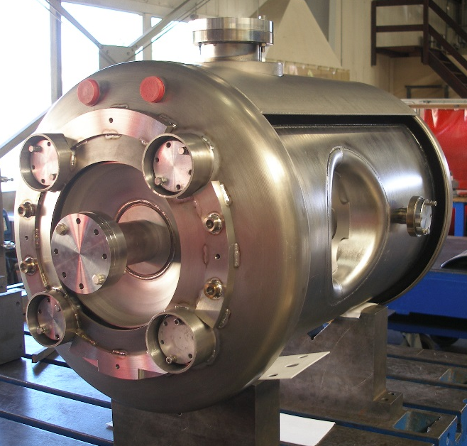
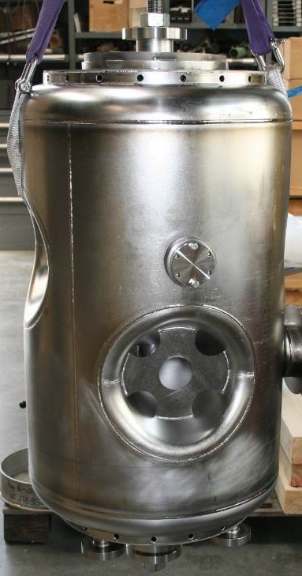

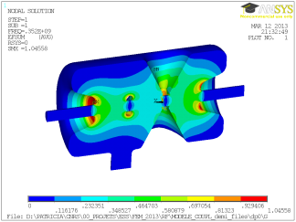
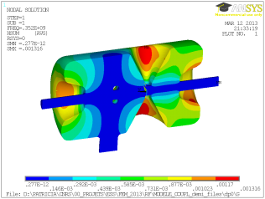
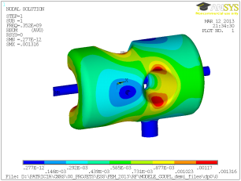
ESS (17 Eu countries)
DOUBLE-SPOKE CAVITIES
Frequency [MHz] | 352.2
Beta_optimal | 0.50
Operating gradient [MV/m] | 9
Temperature (K) | 2
Bpk [mT] | 61
Epk [MV/m] | 38
G [Ohm] | 133
r/Q [Ohm] | 427
Lacc (=beta optimal x nb of gaps x λ /2) [m] | 0.639
Bpk/Eacc [mT/MV/m] | 6.8
Epk/Eacc | 4.3
P max [kW] | 300
Spoke cavities for ESS

Slide 18
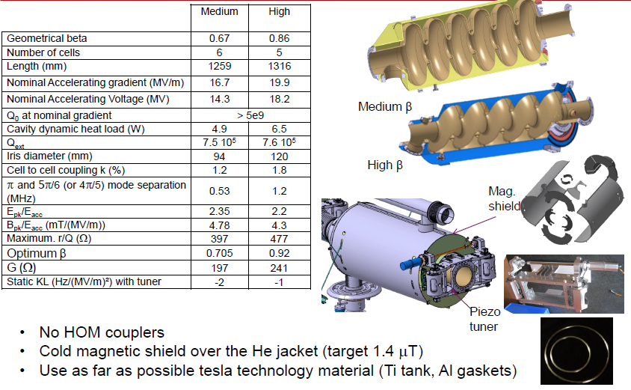

ESS (17 Eu countries)
ESS high energy sections: 704 MHz elliptical cavities
Courtesy G. Devanz

Slide 19
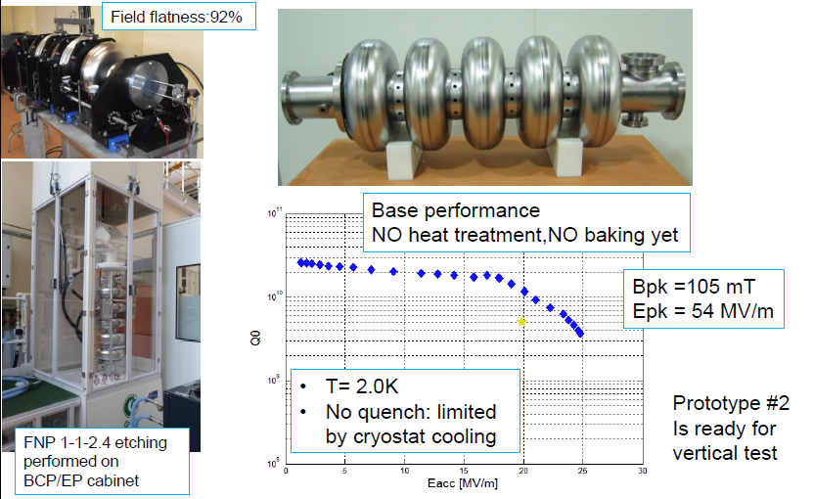
ESS (17 Eu countries)
ESS high energy sections: 704 MHz elliptical cavities
Courtesy G. Devanz

Slide 20
Main SRF Developments worldwide for protons and ions accelerators

Slide 21
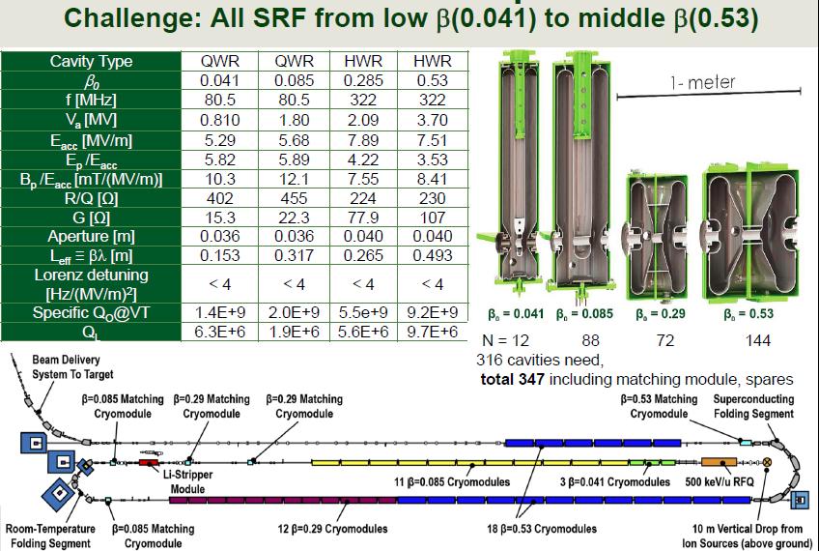

FRIB (MSU)
FRIB: Produce RIB using a 400 kW CW HI driver linac (p to U) up to 200 MeV/u.
Courtesy K. Saito

Slide 22
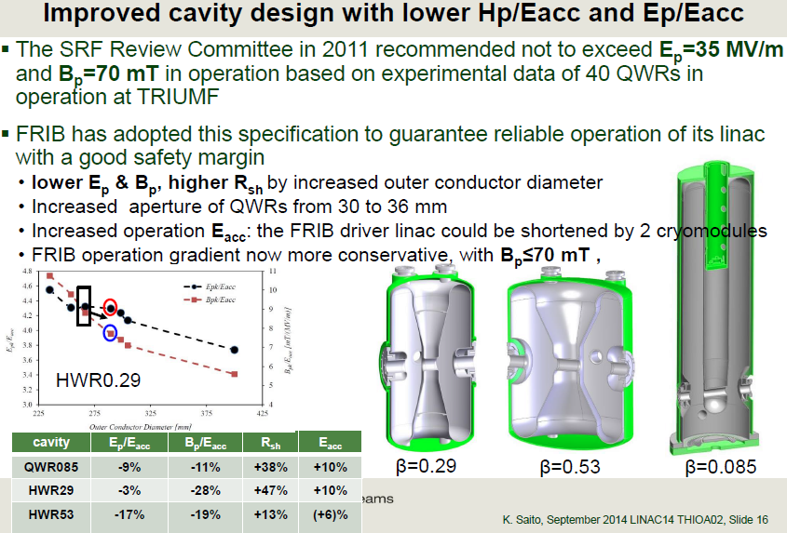
FRIB (MSU)
Courtesy K. Saito

Slide 23
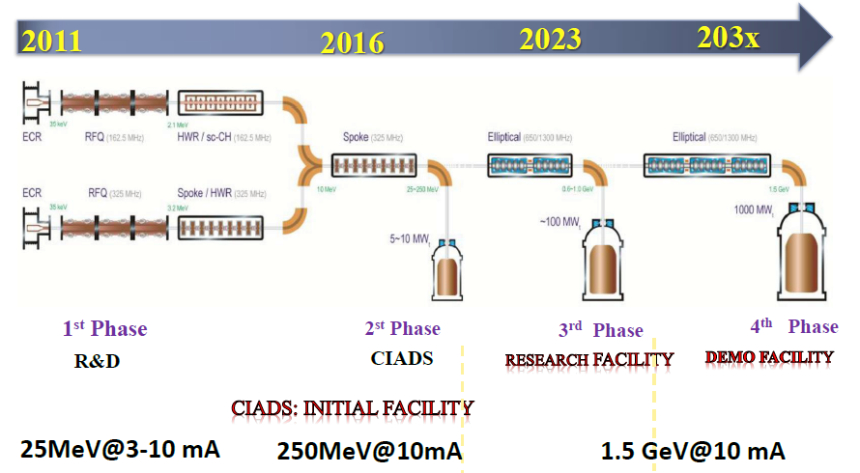
Chinese-ADS (IMP & IHEP)
C-ADS: Roadmap of the project
Courtesy H. Zhao

Slide 24
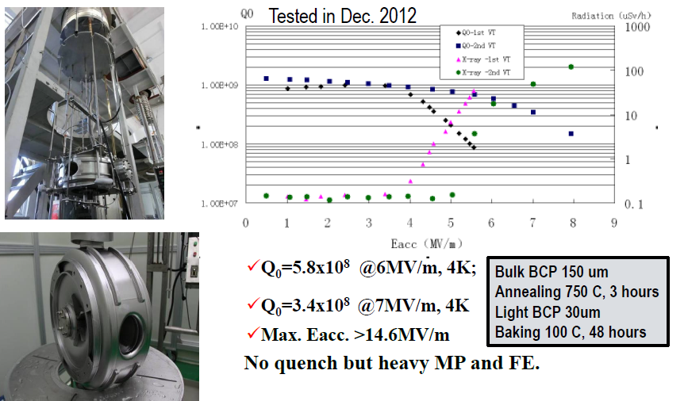
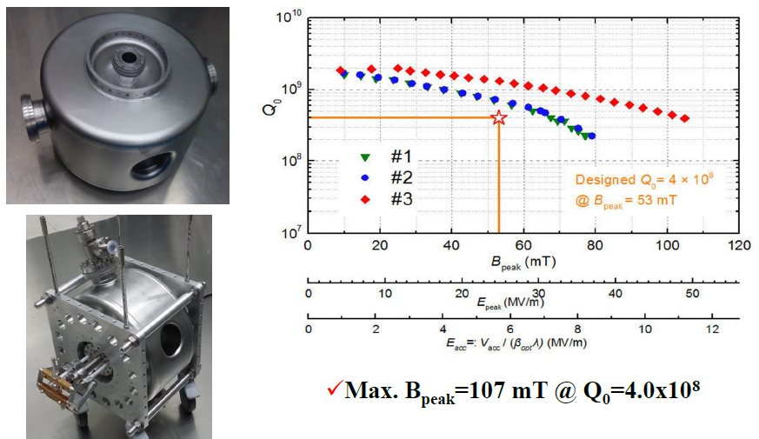
Chinese-ADS (IMP & IHEP)
Injector I: Spoke012
Main Linac: Spoke021
Courtesy H. Zhao

Slide 25
Conclusions

Slide 26
Conclusion
SRF technology for accelerators
  Is a technology of choice for high power acceleration / high duty cycle, thanks to intrinsic efficiency and its maturity gained over the past 25 years.
  Can efficiently accelerate high (and low…) power ion beam starting from a few MeV/u (starting at β ~ 0.05)
  The type of cavity and implementation in the accelerator needs to be carefully chosen according to beam specifications and requirements: range of β, beam current, variety of beam species to accelerate, final energy, reliability, upgradability, … and cost !
  The cavity type or design IS NOT the whole story: coupling the power to the beam, tuning the cavity, prepare the cavity (dust is a tough and invisible enemy !), integration in a cryomodule are even more potential sources of problems.

Slide 27
Conclusion
β < 1 superconducting cavities
  SC RF developments is very active in Europe (and worldwide), especially (this is quite recent) for developing low beta cavities ; many projects are under study or construction and drive intense R&D programs on such accelerating structures.
  -> Potential for real technological synergies between projects.
  There are many issues faced by all projects for these structures: field emission, multipacting, tuning capabilities, mechanical stiffness, and all required a dedicated study because all cavities are different (cavity type, frequency, β, coupling or tuning solutions)…
  Progress done are tremendous, and in some cases, peak fields achieved start to be comparable with the ones obtained on electron cavities.

Slide 28
Conclusion
Some Trends & Future
  Still increasing number of labs worldwide developing SRF Technology, (specially low beta) due to the variety of potential applications.
  But most of the labs involved in project development (engineering) rather than upstream R&D (fundamental research on SRF)
  SRF Technology is mature, and we are starting to touch the limits of bulk niobium technology -> need alternatives (thin films: various deposition methods, various SC material).
  Several very high power projects (IFMIF, ESS,…) for which the limiting technology is the power coupler -> topic of highest interest in the coming decade.
  Many Spoke-type cavities developments worldwide, even at β=1

Slide 29
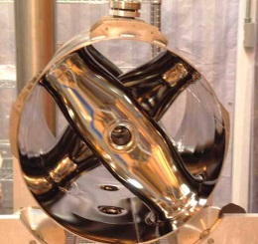
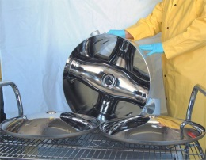
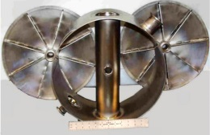
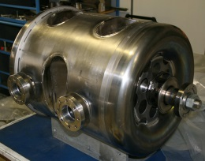
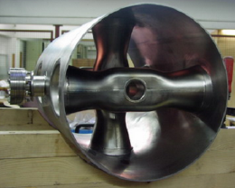
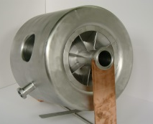
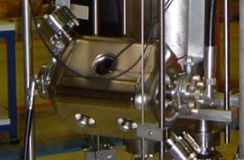
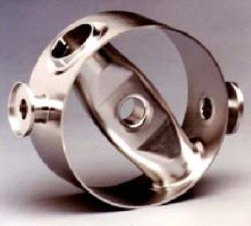
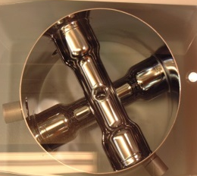
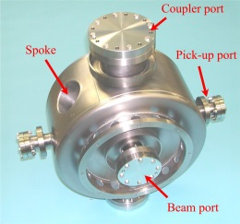
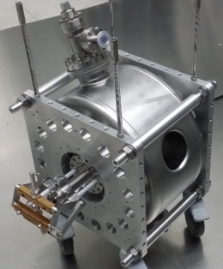
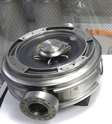
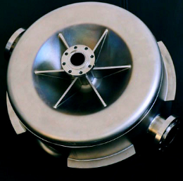





Conclusion (4)
ANL (USA)
ANL (USA)
From G. Olry
ANL (USA)
IPN (F)
FZJ (D)
IPN (F)
FZJ (D)
ANL (USA)
ANL (USA)
LANL (USA)
IHEP (C)
PKU (C)
IHEP (C)
ANL (USA)
From Big Bang to 1992
x2
x5
x2
ODU/JLAB (USA)
IMP (C)
From 1992 to 2004
ODU/JLAB (USA)
Fermilab (USA)
1 cavity
+6 cavities
x2
From 2004 to nowadays
x12
+ >30 cavities

Slide 30
THANK YOU !

