Slide 1

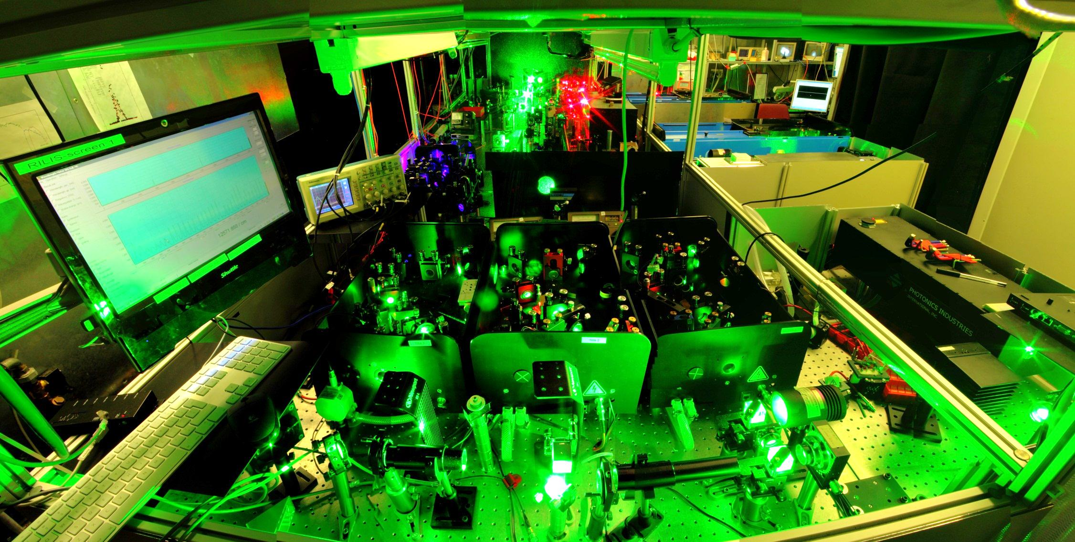
Extending the scope of the ISOLDE Laser Ion Source

Slide 2
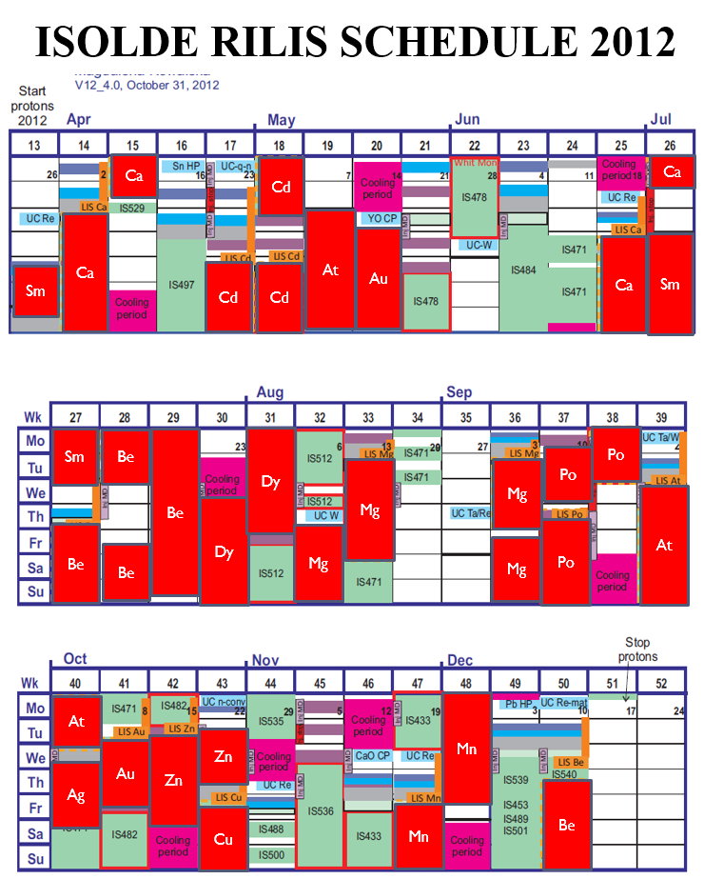
The Resonance Ionization Laser Ion Source - RILIS
2012
13 elements
3060 h laser on time
24 runs
344 RILIS operator shifts (24/7)
RILIS is the most requested ion source available at ISOLDE
RILIS is ultra selective while efficient
B.Marsh, Isolde Workshop and Users Meeting, CERN, 2013

Slide 3
The Resonance Ionization Laser Ion Source - RILIS
Ionization and extraction
Stepwise laser ionization scheme
target
ion source
extractor
mass separation
auto-ionizing state
ionization potential
laser beams
Rydberg state
kV
experiments
excited states
target material
Z selective
ions
protons
neutrals
ground State
Laser tuned to Z = 85
At
Isotope of interest
²⁰⁵At
Magnet set to A = 205

Slide 4
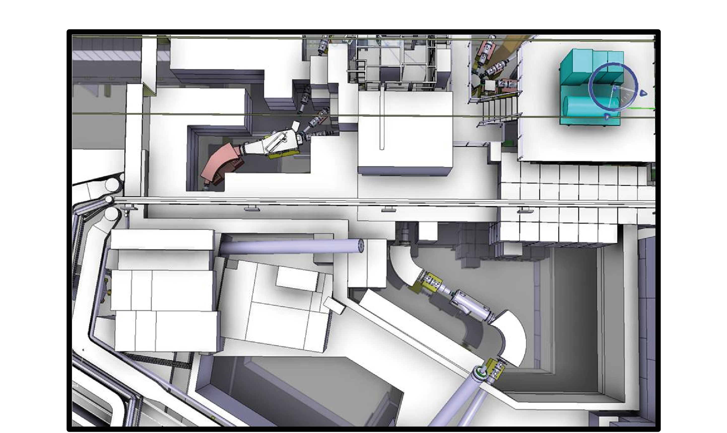
The Resonance Ionization Laser Ion Source - RILIS
RILIS
CABIN

Slide 5
Contents
History & Laser Upgrades
Technical improvements
Ongoing RILIS developments

Slide 6
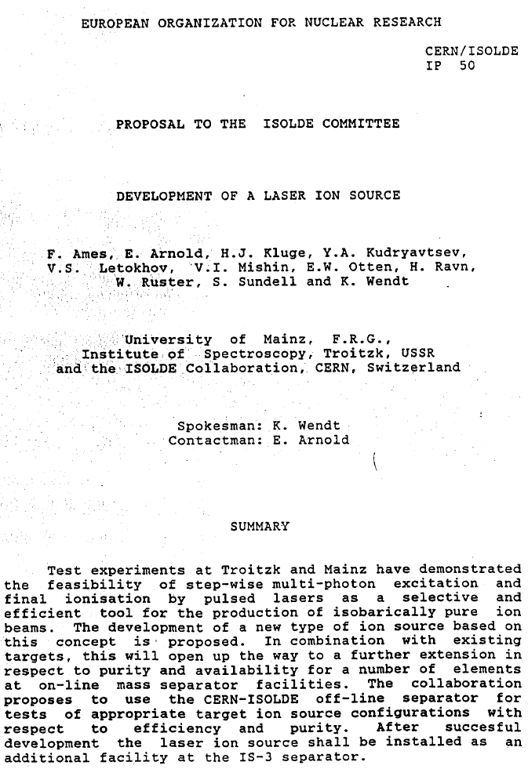
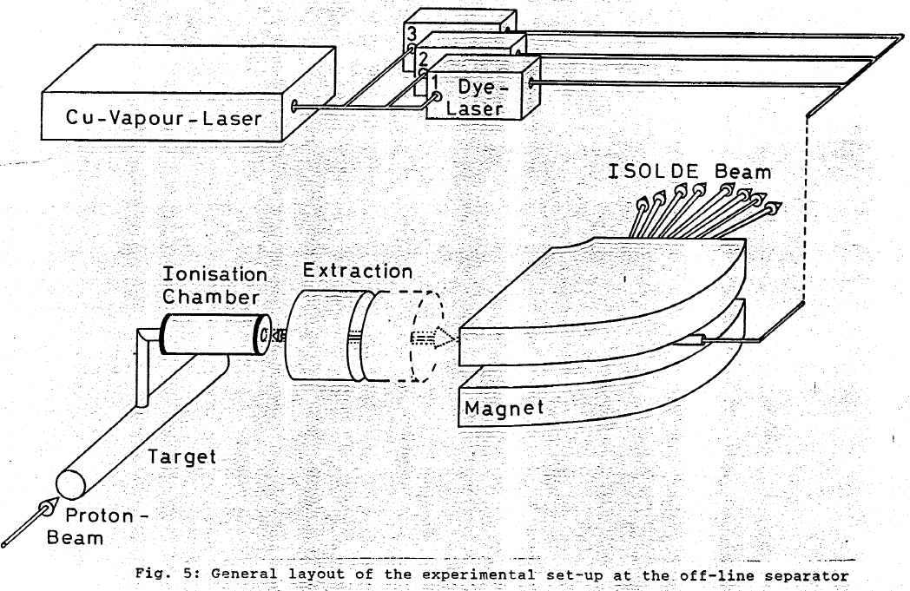
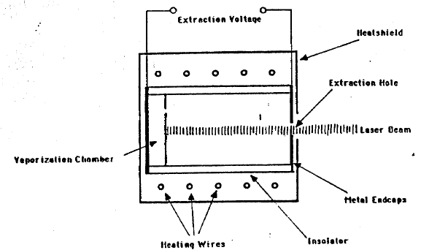
Laser ion source Proposal (1988)

Slide 7
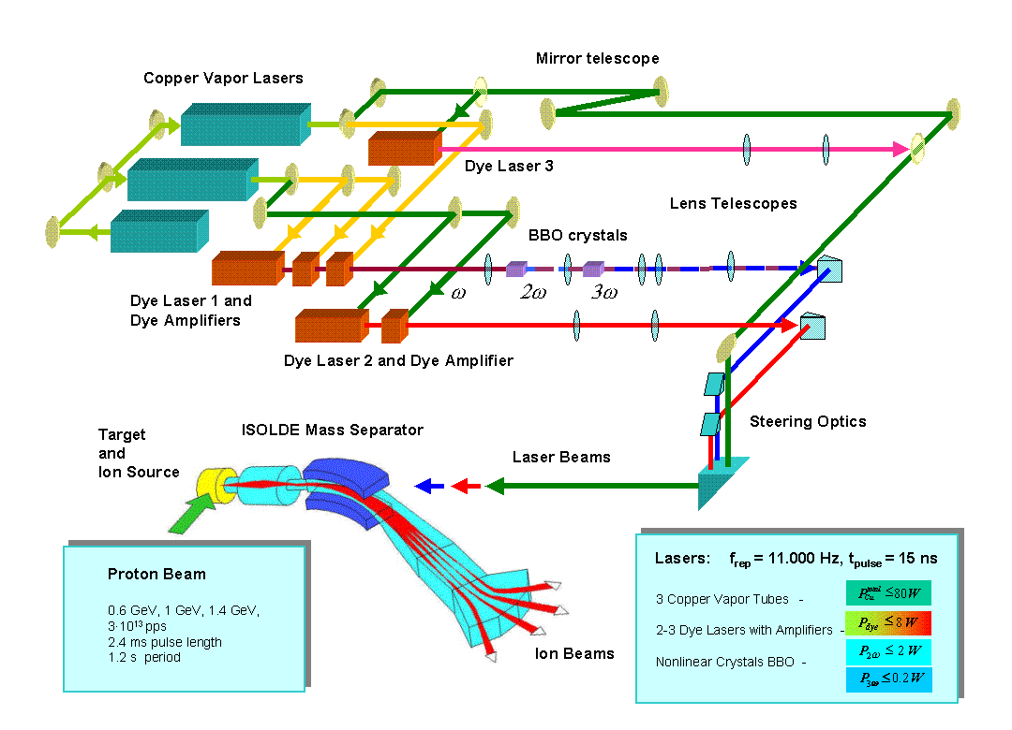
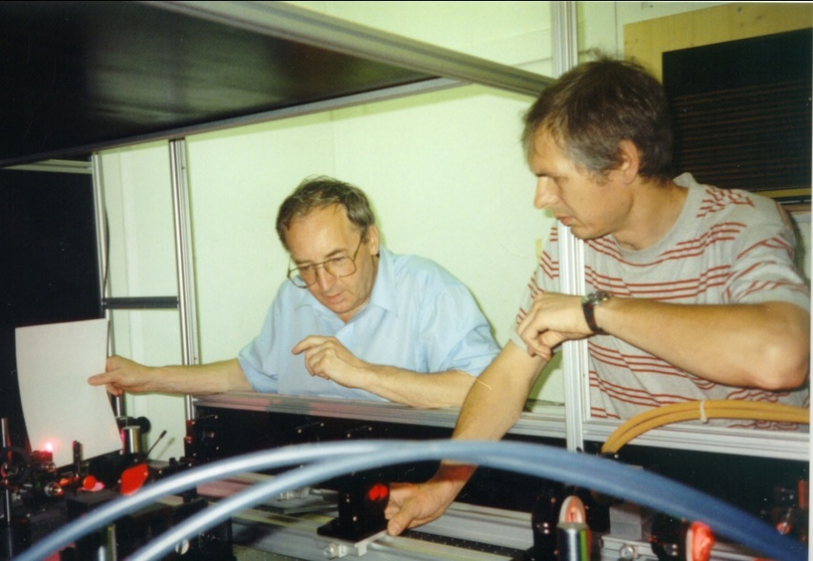
RILIS at PSB ISOLDE
1993
Slava Mishin
Valentin Fedosseev
Mishin, V., Fedoseyev, V. , Kluge, H., Letokhov, V., Ravn, H., Scheerer, F., Shirakabe, Y. et al. (1993).
Chemically selective laser ion-source for the CERN-ISOLDE on-line mass separator facility. NIM B: 73(4), 550–560.

Slide 8

RILIS operation in 1994-2007
2250 h
1763 h
Reduction of planned RILIS operation time for 2007 down to 1500 hours has been was recommended in the conclusions of the 2007 ATC/ABOC days.
No laser trouble happened during scheduled operation, all required service and repair work was performed between runs

Slide 9

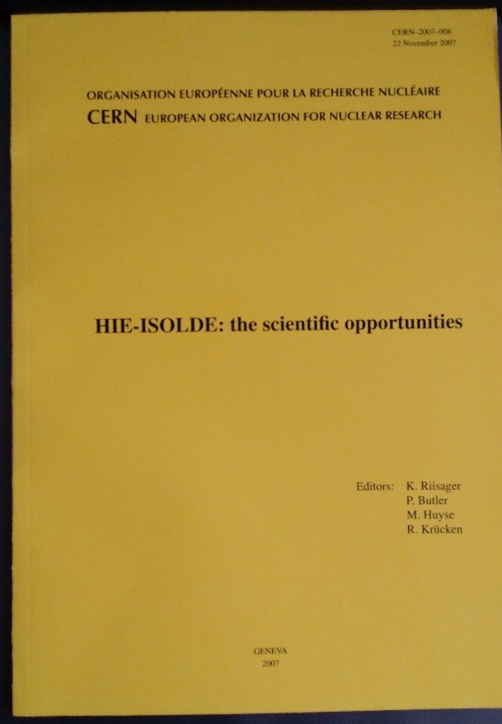
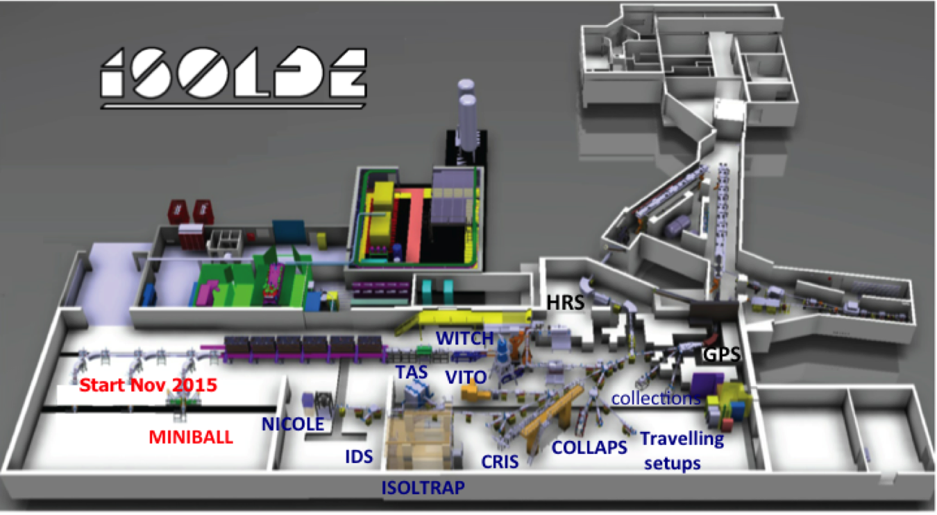
HIE-ISOLDE aims at increasing the energy of the RIB up to 10AMeV and their intensity by a factor 10
Energy Upgrade:
The HIE-ISOLDE project concentrates on the construction of the SC LINAC and associated infrastructure in order to upgrade the energy of the post-accelerated radioactive ion beams to 5.5 MeV/u in 2016 and 10 MeV/u by 2017-2018
Intensity Upgrade:
The design study for the intensity upgrade, also part of HIE-ISOLDE, started in 2012, and addresses the technical feasibility and cost estimate for operating the facility at 15 kW once LINAC4 and Upgraded PS Booster are online.
Beam Quality Upgrade:
RFQ cooler and buncher
Solid state lasers for RILIS Higher mass resolving
power HRS

Slide 10
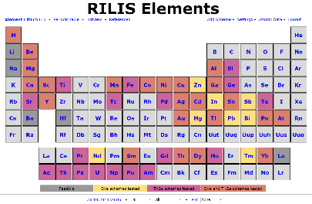
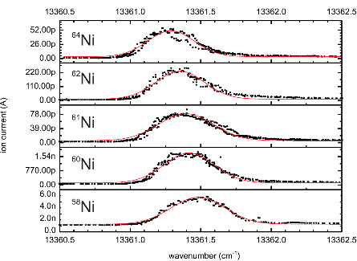
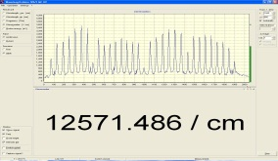
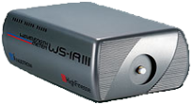
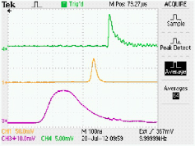
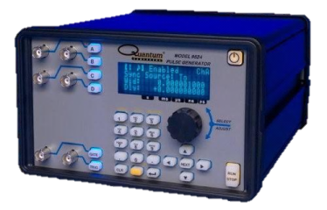

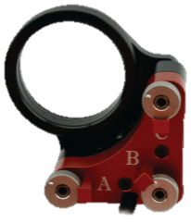
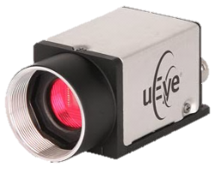
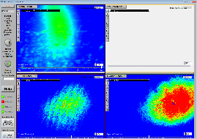
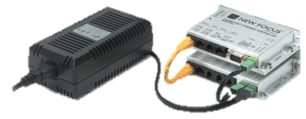
RILIS Requirements
Diversity of elements
tunable lasers
ENERGY
~10GHz line width covers HFS and Doppler broadening
Rilisdb: Web 2.0, open to everybody
www.cern.ch/riliselements
UV …VIS… NIR
Accuracy: 40 µeV
Flux and fluence conditions
Atom confinement
geometry
34mm
TIME
3mm
Laser pulse overlap
precise in ~ns range
Pulse repetition rate:
10KHz
10-50ns pulse width
Saturate resonant transitions
If hard to saturate apply the following
Ion signal (a.u.)
The more power the better
POWER
Power (w)
Ensure overlap with atoms
Focus at 20m distance
-> 0.7µrad angular resolution in RILIS
Consider drifts,
SPACE

Slide 11
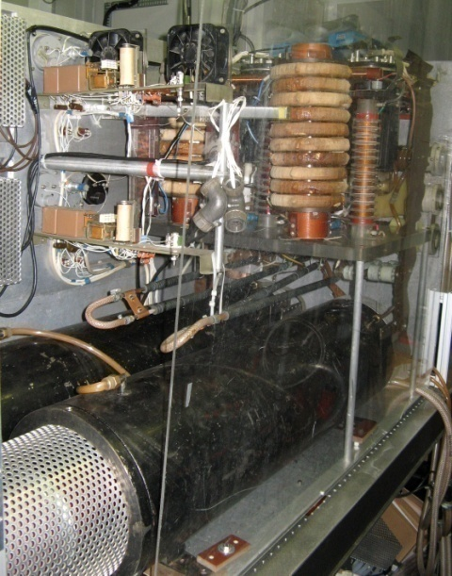
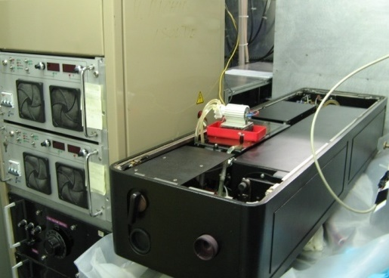
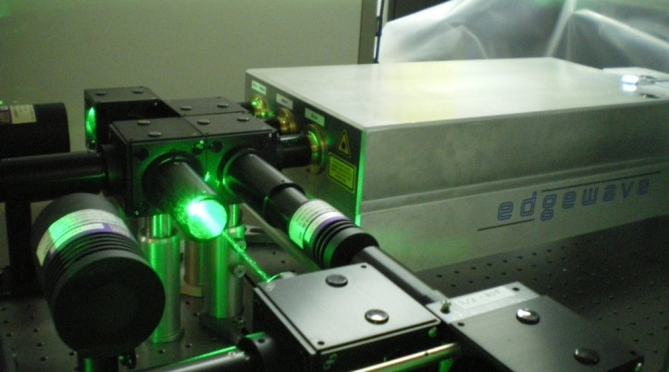
Copper Vapour Laser upgrade
2007/2008
CVL
Solid State Laser (Nd:YAG)
15 ns @ 11 kHz
8 ns @ 10 kHz
Green Beams
45 W @ 511 nm
Yellow Beams
35 W @ 578 nm
Green Beams
75 W (+28 W)
@ 532 nm
UV Beam
20 W @ 355 nm
2 hr start time
Pulse-to-pulse instability (jitter)
Aging equipment
Procurement of consumables is difficult
Risky combination:
30 min start up time
Reliable long term power output
High tension ~ 16 kV
High temperature ~ 1500 C
Cooling water
Catches fire (sometimes)
“The ISOLDE RILIS pump laser upgrade and the LARIS Laboratory”
B. Marsh et al: Hyperfine Interactions, Volume 196, Issue 1-3, pp. 129-141 (2010)

Slide 12
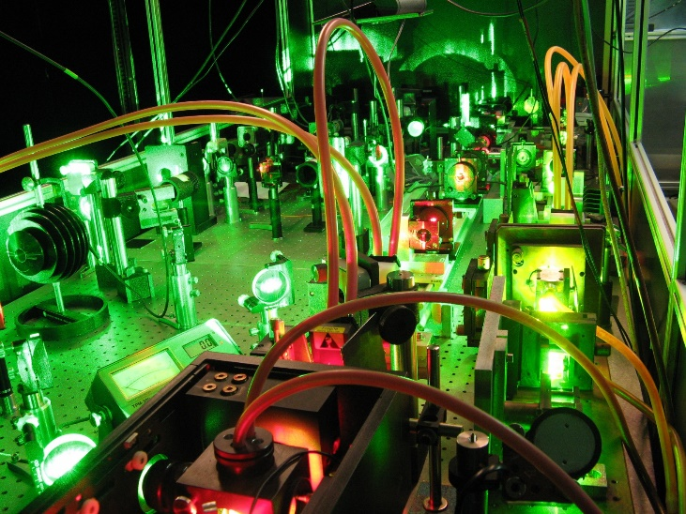
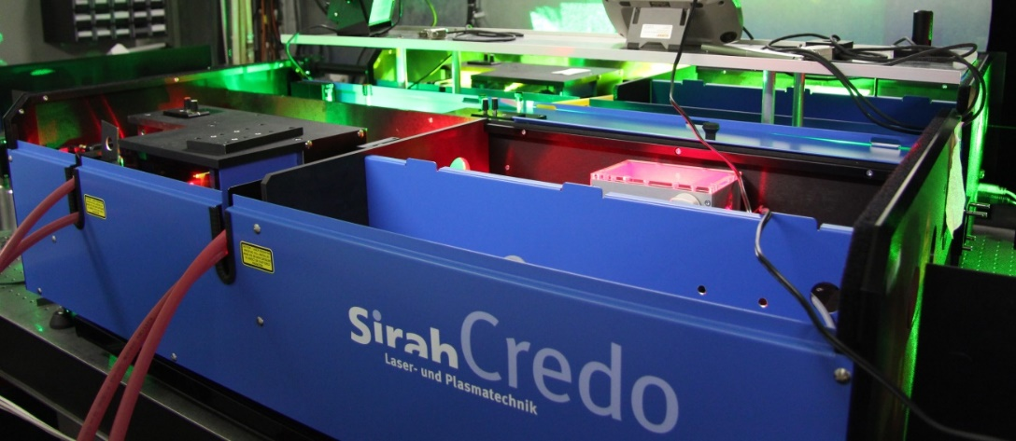
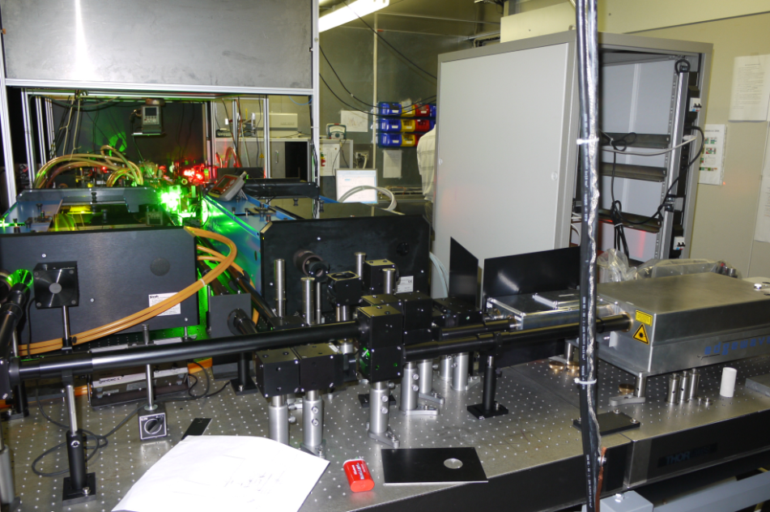
The new RILIS dye lasers
dye lasers:
2 x broadband (6 GHz)
1 x narrow band (1 GHz)
2010/2011
Laser table Jan. 2011
> 10 different dyes used

Slide 13
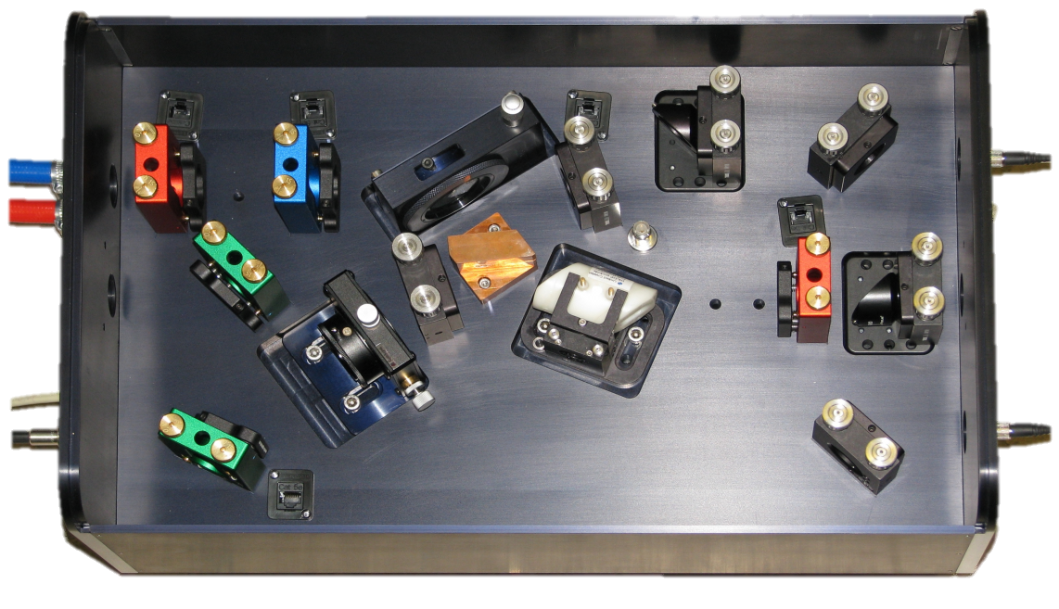
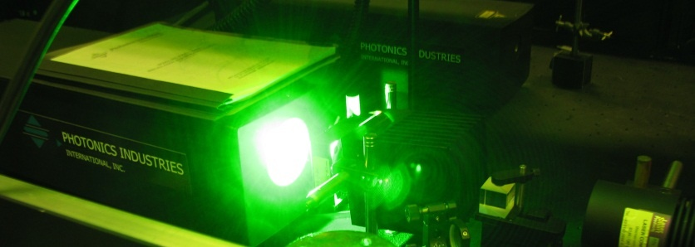
The RILIS Ti:Sa lasers
2010/2011
Pump laser: Nd:YAG (532 nm), Photonics
Repetition rate: 10 kHz
Pulse length: 180 ns
Power: 60 W
Change of mirror sets in resonator
No amplifier yet available
No ageing
100 mm
Ti:Sa lasers:
Line width: 5 GHz
Pulse length: 30-50 ns
Wavelength tuning range:
Fundamental (ω) 690 - 940 nm (5 W)
2nd harmonic (2ω) 345 - 470 nm (1 W)
3rd harmonic (3ω) 230 - 310 nm (150 mW)
4th harmonic (4ω) 205 - 235 nm (50 mW)
S Rothe et al, A complementary laser system for ISOLDE RILIS, 2011 J. Phys.: Conf. Ser. 312 052020

Slide 14
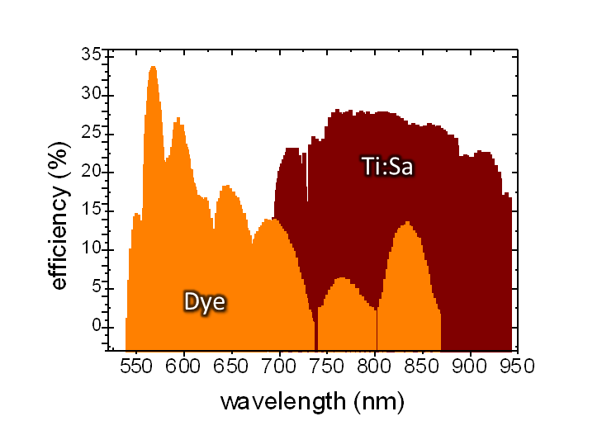
Comparison dye vs. Ti:Sa system
 | Dye | Ti:Sa
Active Medium | > 10 different dyes | =1 Ti:sapphire crystal
condition of aggregation | liquid (org. solvents) | solid-state
Tuning range | 540 – 850 nm | 680 – 980 nm
Power | < 12 W | < 5 W
Pulse duration | ~8 ns | ~50 ns
Synchronization | optical delay lines | q-switch, pump power
# of schemes developed | 47 | 37
Maintenance | renew dye solutions | ~ none
Dye
Ti:Sa
2x Dye
2x Ti:Sa
3x Ti:Sa
3x Dye
4x Ti:Sa
Ti:Sa system is complementary

Slide 15
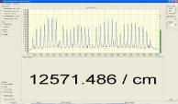
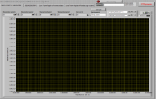
Integration of Ti:Sa to the dye RILIS
Nd:YAG
Dye 1
λ – meter
SHG
Dye 2
THG
10 kHz Master clock
Dye 3 (narrowband)
RILIS Dye Laser System
GPS/HRS
Delay generator
RILIS Ti:Sa Laser System
Target &
Ion Source
Nd:YAG
Ti:Sa 1
SHG/THG/FHG
Ti:Sa 2
Faraday cup
Experiments
Ti:Sa 3 (narrowband)
λ – meter
LabVIEW based DAQ
pA – meter

Slide 16
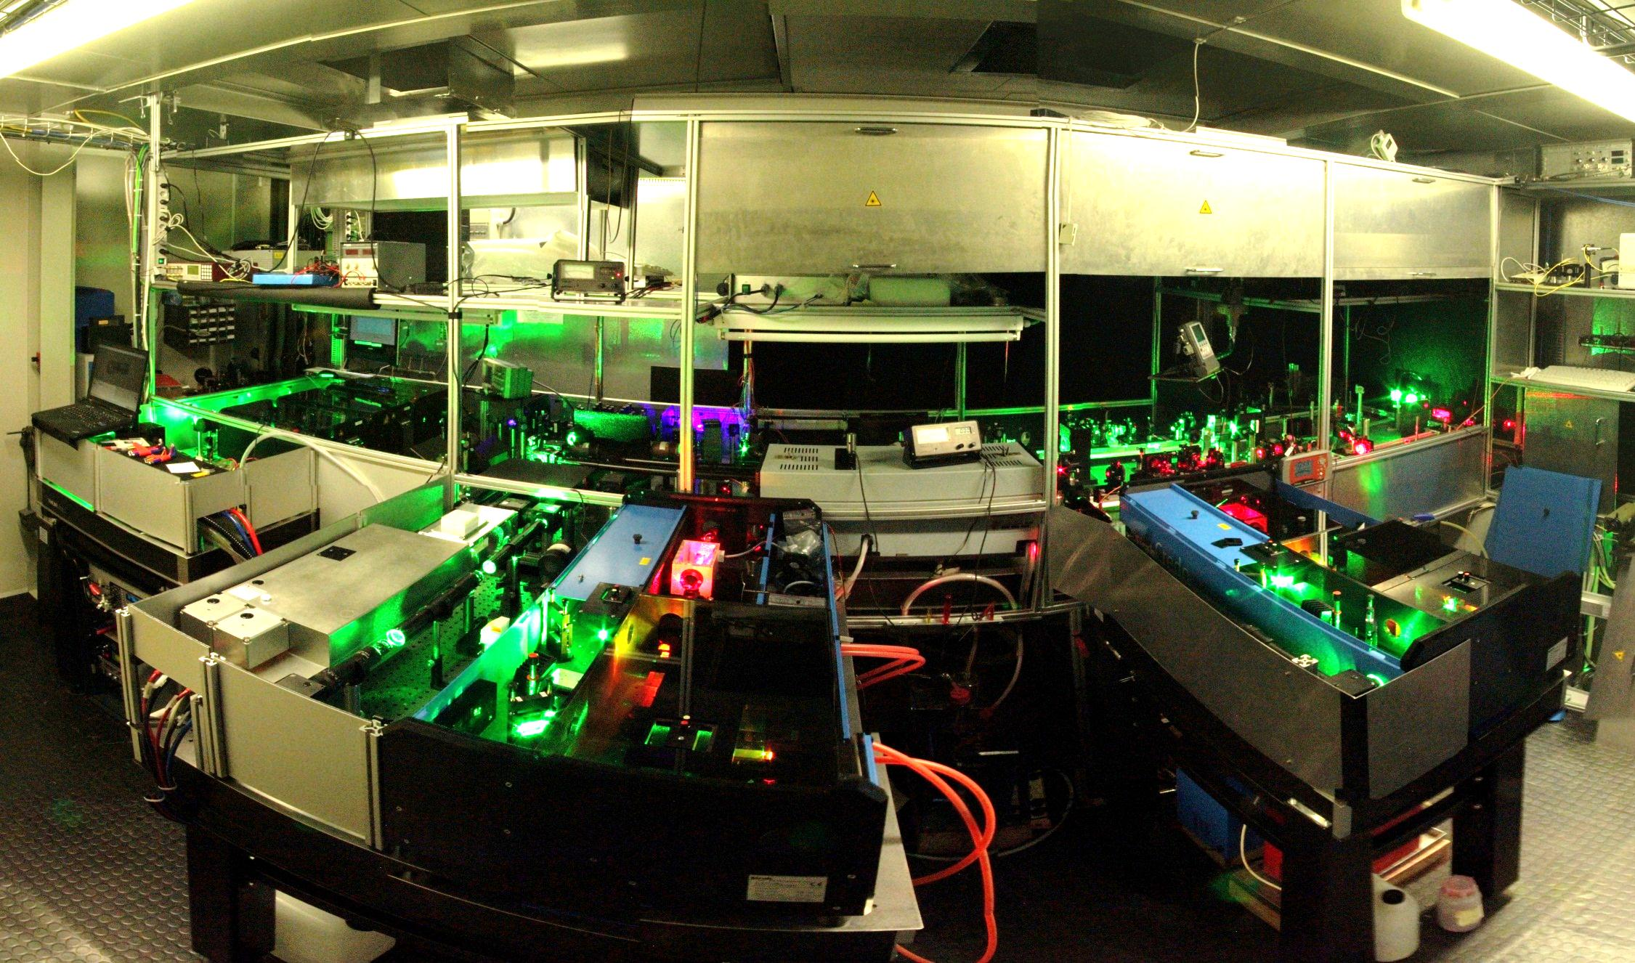
RILIS laser room
2012

Slide 17
RILIS laser room
2012

Slide 18
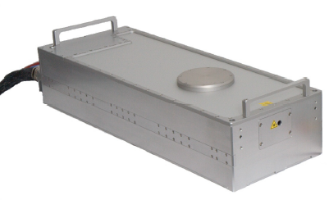
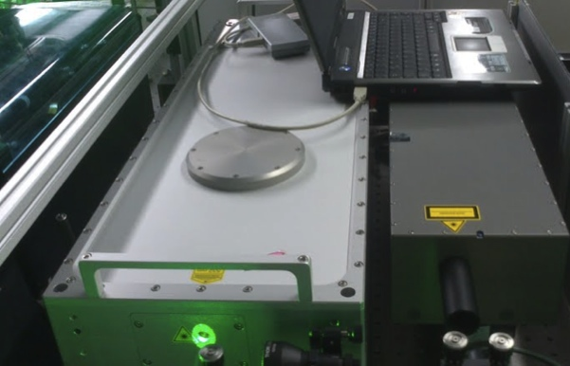

Independent laser for non resonant ionization
The Upgrade continues: The BLAZE!
2014
40W at 10 kHz
17ns Pulse
Low Jitter
Gaussian beam
Much better transmission
efficiency to ion source
Blaze laser tested at RILIS in Dec 2012, purchased with 50% CATHI funds, installed 2014
Laser | Laser Power (on table) | Reference beam power in 3 mm aperture | Transport efficiency
Edgewave | 43 W | 370 mW | 33 %
Blaze | 15 W | 350 mW | 88%
Blaze | 40 W | 800 mW | 76%
A similar efficiency improvement should be expected for the 18 RILIS elements that use non-resonant ionization for the final step!
Power dependent thermal lensing in the beam transport optics is to be eliminated
Can be used for Dye and Ti:Sa pumping as a back-up laser
B. Marsh et al., Suitability test of a high quality Nd:YVO industrial laser for the ISOLDE RILIS installation.
CERN-ATS-Note-2013-007 TECH

Slide 19
RILIS room extension
LS1
Required for / facilitate:
Safety
Reference cell installation
Dye handling
Upgrade of beam observation system
Installation of extra YAG laser
Improved ventilation system
Comfort/ergonomics
Existing laser room + SAS
RILIS
28 m²
Laser table
REF
REX EBIS
254 cm
DESK
320 cm
IS COOLER
HV cage
6 m²
100 cm

Slide 20
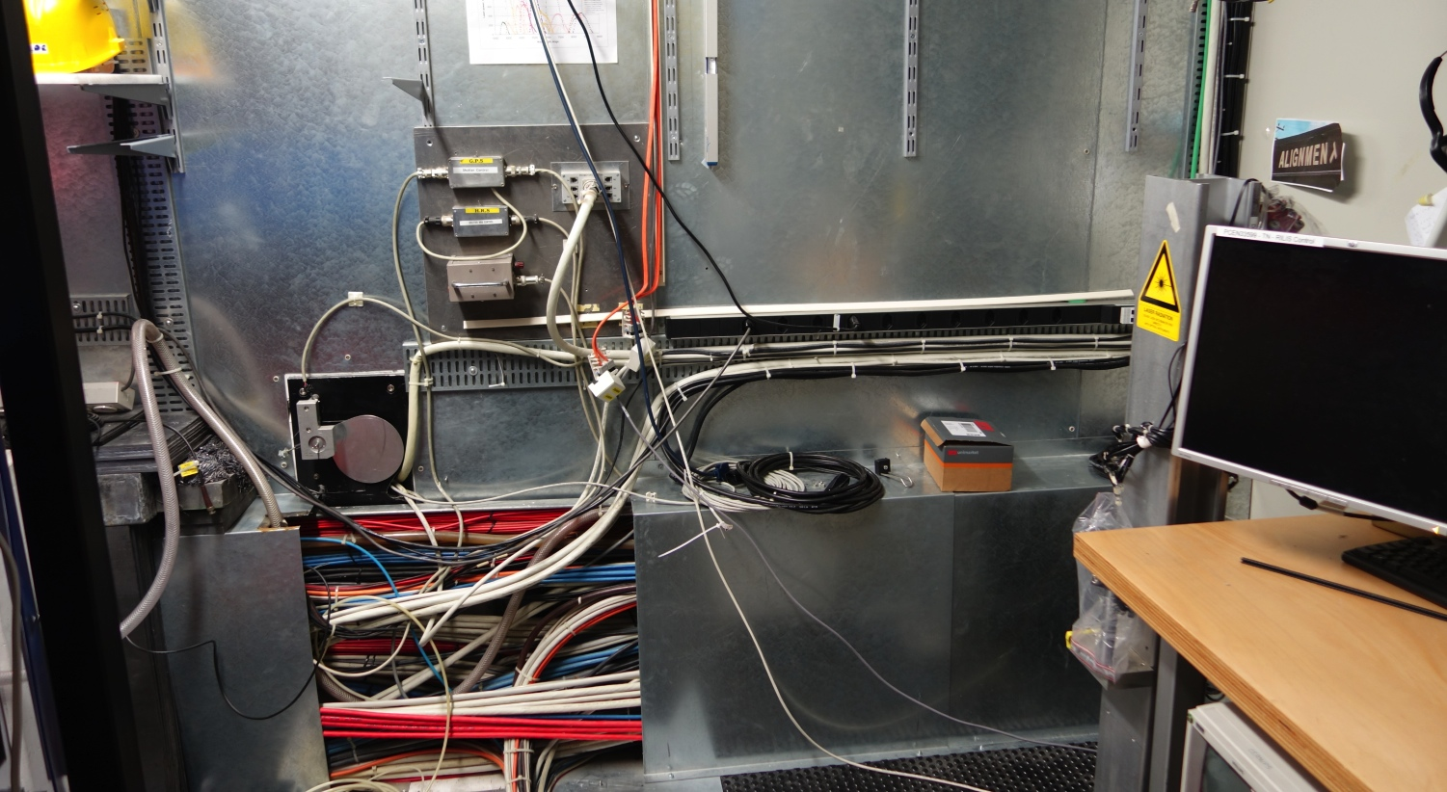
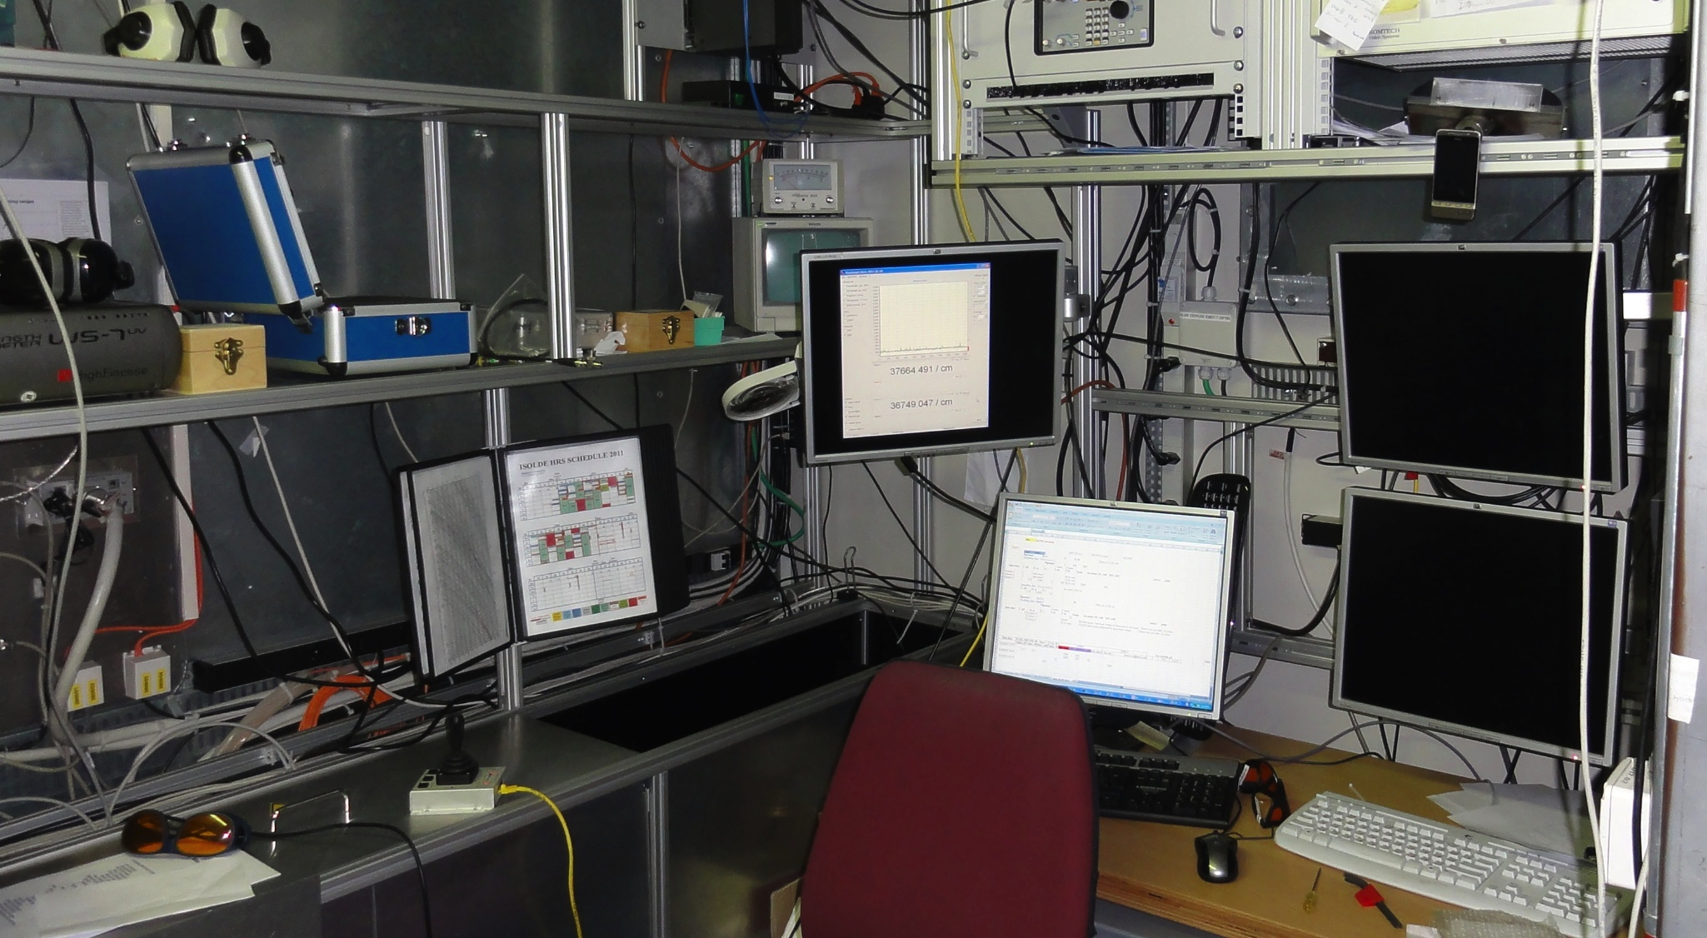
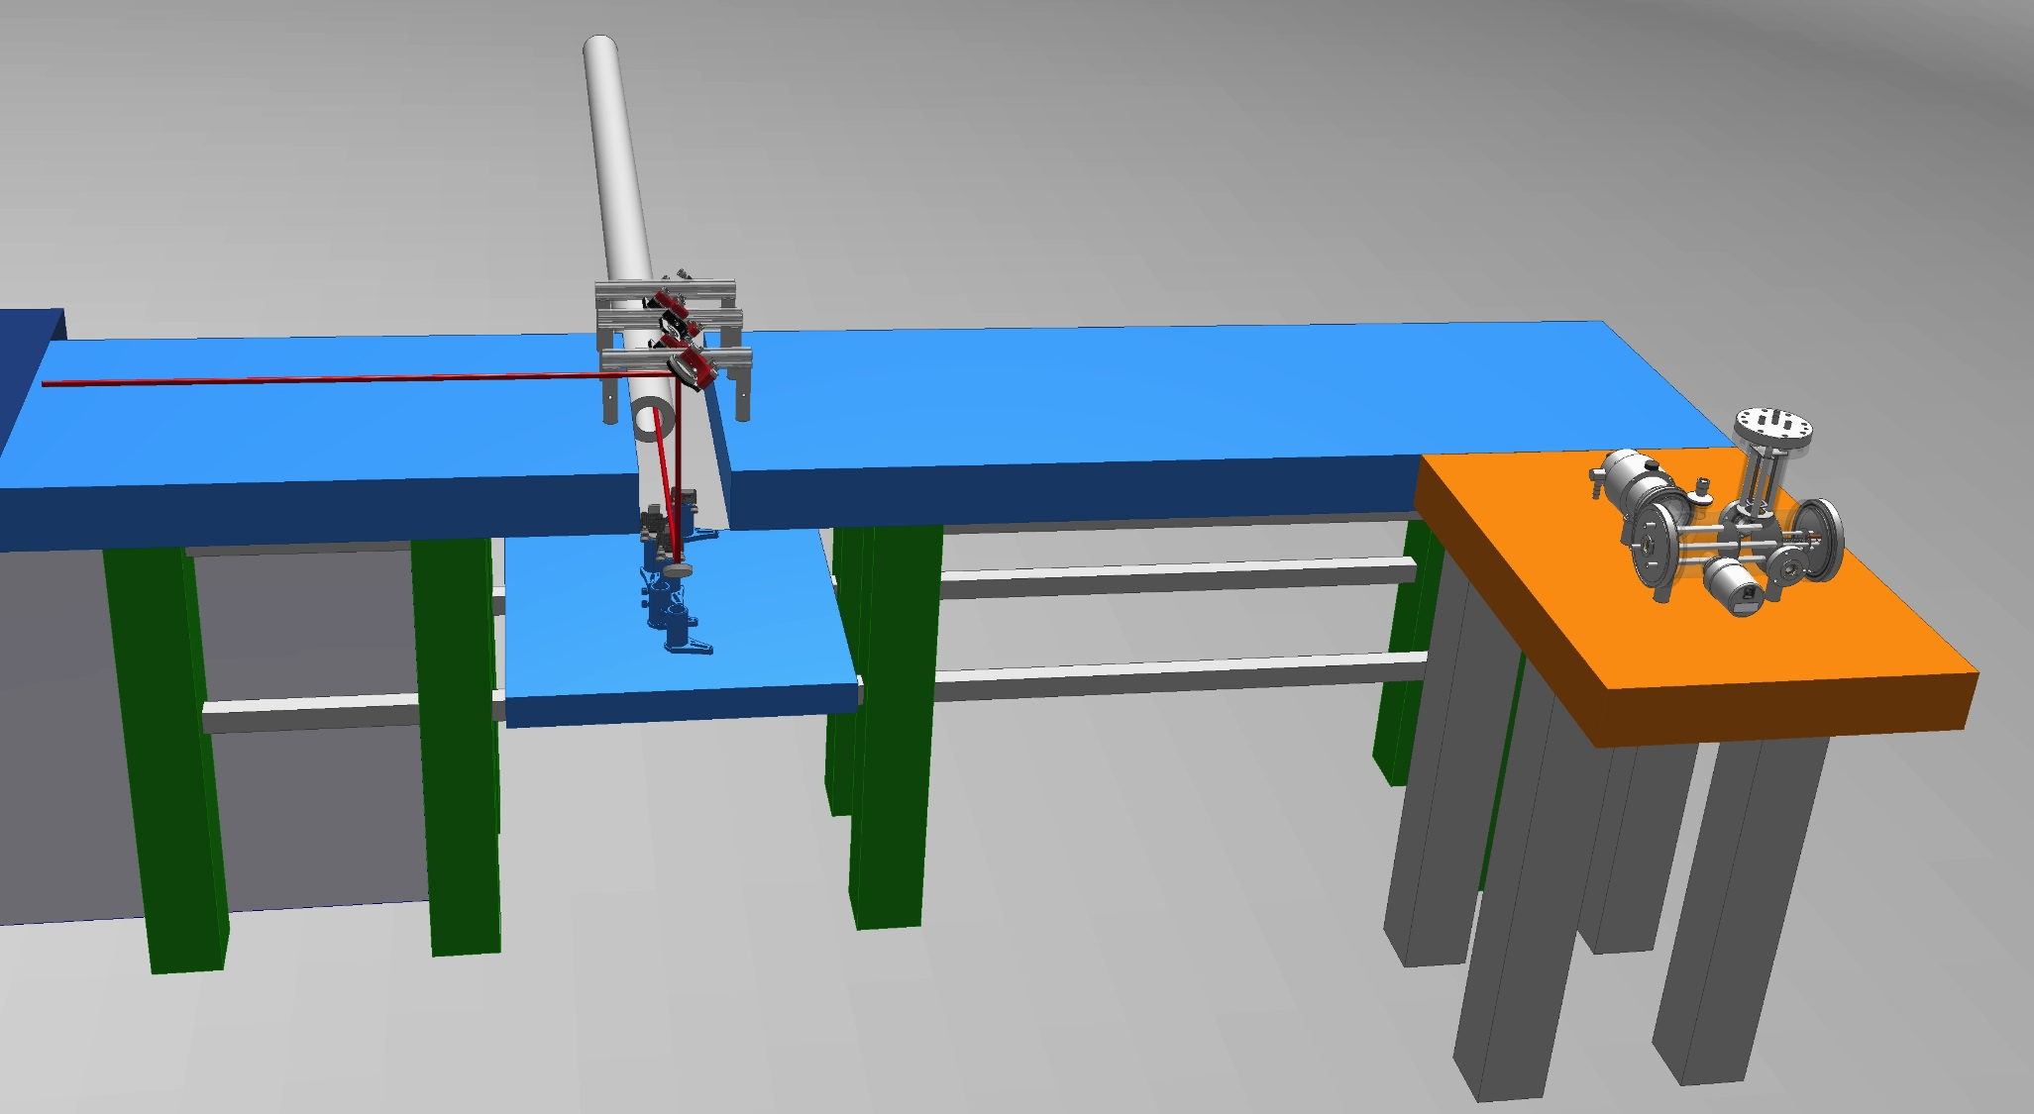
New GPS laser beam launch & reference system (GLARE)
LS1
Benefits:
4 beams to GPS
Fewer power losses
Improved ergonomics
RELATED projects/tasks:
New reference beam area
New beam stabilization system
Reference cell installation
STATUS:
Installed and operational

Slide 21
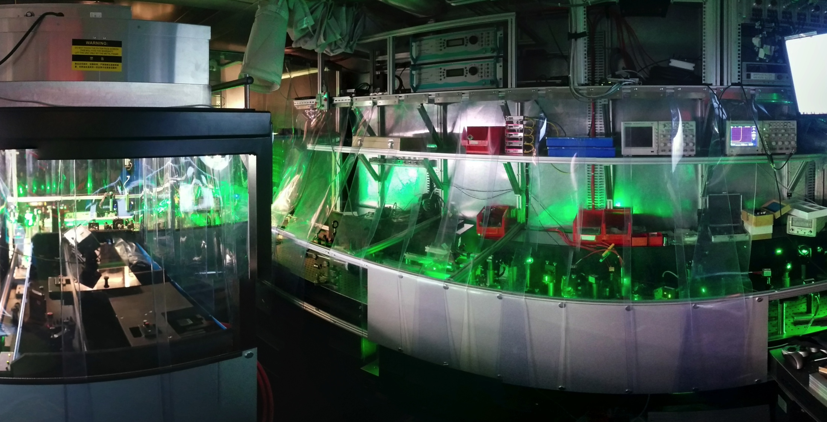
New GPS laser beam launch & reference system (GLARE)
LS1
Benefits:
4 beams to GPS
Fewer power losses
Improved ergonomics
RELATED projects/tasks:
New reference beam area
New beam stabilization system
Reference cell installation
STATUS:
Installed and operational

Slide 22
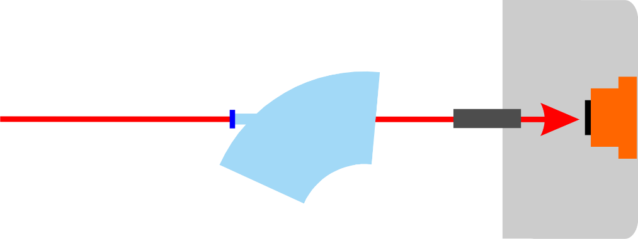
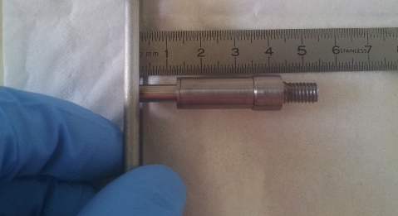
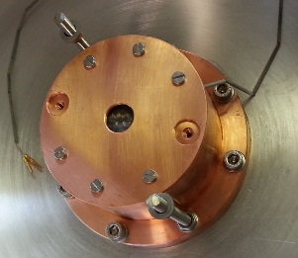
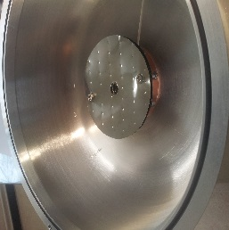
The RILIS Powermeter target unit
LS1
Target Unit
Mounted as first target on HRS after LS1. Lasers successfully aligned. Unit Functioning as expected.
facilitates laser alignment - normally only possible with ion beam
helps to clarify laser beam transport issues (thermal lensing)
enables remote check of status of magnet windows when in doubt, reducing interventions to separator areas
Thanks to:
Bernard, Ermanno & our 2013 summer student Sasha
Magnet window
RILIS lasers
HRS/GPS
Tungsten ionizer acts as light source for pre-alignment after shutdown
Laser power meter measures laser power delivered through ion source
readout via existing thermocouple infrastructure

Slide 23
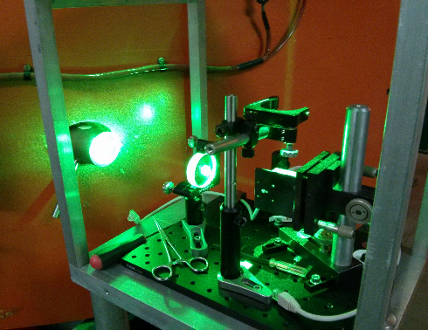
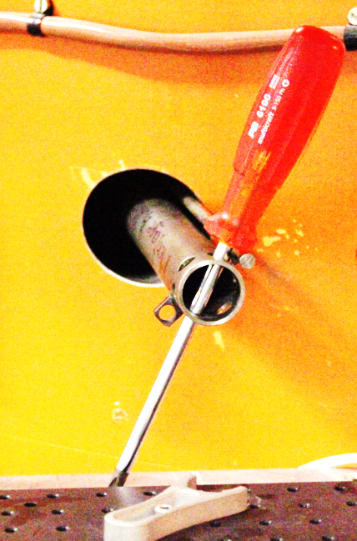
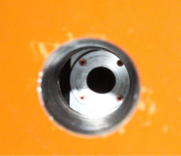
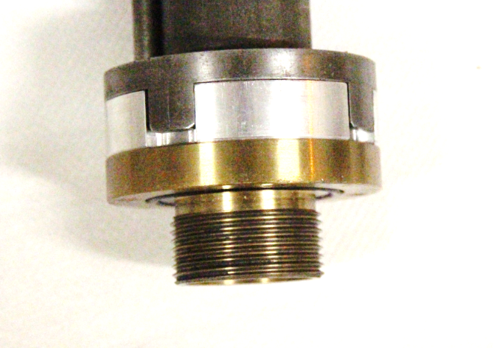
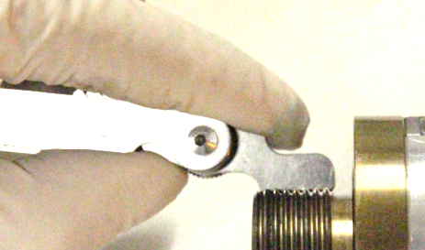
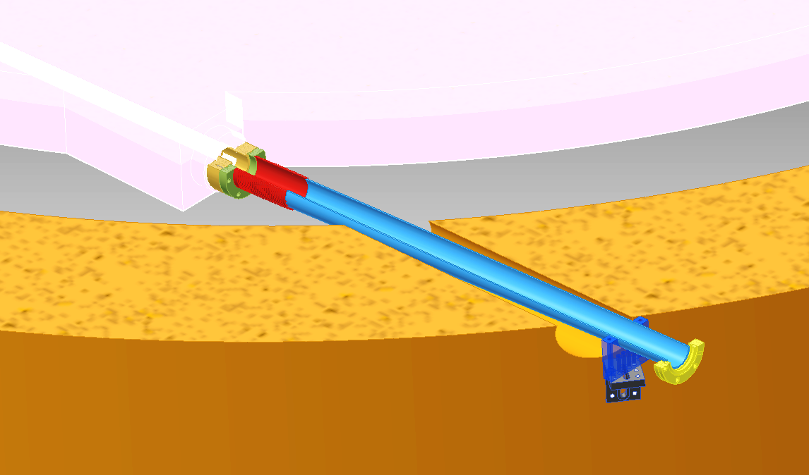
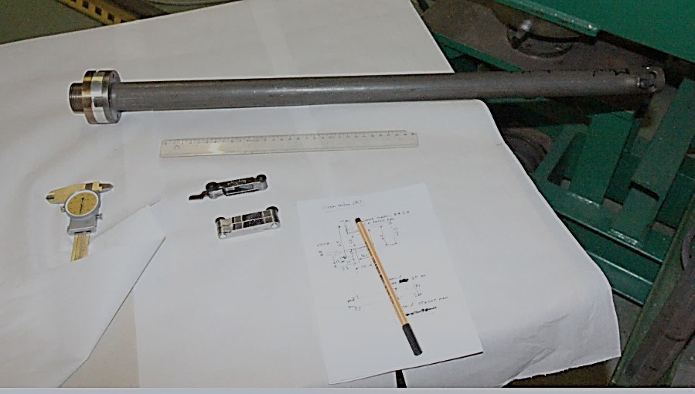
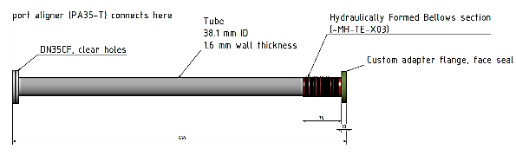



HRS.MAG.90 laser window upgrade
LS1
New features add safety and usability
ease of access for inspection
use of a standard CF mounted viewport (stocked item)
no special tools required for exchange
preserve thread in HRS Al vacuum tank
adding port aligner makes window useful as additional reference point for RILIS
Photo thanks to C.Seiffert
People involved: RILIS, Erwin, Stefano, Alexandre, Giovanna, Ermanno

Slide 24





HRS.MAG.90 laser window upgrade
LS1
New HRS window tube, port aligner and prism mount

Slide 25

Laser Ion Source Trap (LIST)
2006-2012
Suppression of surface ions by electrostatic repeller
Highly selective laser ionization inside the LIST
Ion guiding towards extraction by transverse rf-trapping field
Shielding of laser interaction region from high field gradient of extraction electrode
S.Richter, D.Fink; Laser 2013, Poznan

Slide 26

Laser Ion Source Trap (LIST)
2006-2012
²⁴Mg
²⁵Mg
²⁶Mg
²⁷Al
²³Na
ion current [A]
mass [u]
Suppression of surface ions by electrostatic repeller
Highly selective laser ionization inside the LIST
Ion guiding towards extraction by transverse rf-trapping field
Shielding of laser interaction region from high field gradient of extraction electrode
S.Richter, D.Fink; Laser 2013, Poznan

Slide 27






The Reference chamber: An atomic beam unit for RILIS
~20 m
target & ion source
quartz plate
4% reflected beams
RILIS cabin
Fibre of laser light to the RefCell
Demonstrated at the OFFLINE
Reference chamber
designed at U Mainz
ultra portable & simple atomic beam unit
Tested at
Laser off
Laser on
T.Kron
Installation at RILIS in 2014
measure reference spectra for stable isotopes in In-Source laser spectroscopy
Reduces time for data taking
Increases precision
Application for on-line RILIS monitoring
Scheme development
T. Day Goodacre

Slide 28








On-call operation (not yet)
3 requirements for On-Call operation:
1) Machine protection / safety
2) Performance monitoring
3) Automation
To avoid risk of equipment
damage or danger to personnel.
This must be a ROBUST system
(PC independent).
Remote monitoring of key
parameters with an alert system
to request operator intervention.
To maintain RILIS performance
therefore reducing the frequency
of operator interventions.
NON ESSENTIAL
ESSENTIAL
Concept outline: R.E.Rossel, Implementation M.Butcher (EN-STI-ECE)
Slide by B.Marsh

Slide 29



RILIS Measurement & Control – The REACT framework
R.E. Rossel, et al, Data acquisition, remote control and equipment monitoring for ISOLDE RILIS
Nucl. Instr. and Meth. in Phys. Res. B

Slide 30





RILIS@VADIS and VADLIS
VADIS aperture 1.5mm
178Hg Activity
LOI: I-153
In-source laser spectroscopy of mercury isotopes
More time required at OFFLINE !
Tom Day Goodacre Students’ Coffee 10/9/2014 46

Slide 31


2+ Ba ionization at RILIS
Removes possible Caesium contamination
Laser ON
Laser OFF
Tom Day Goodacre Students’ Coffee 10/9/2014 46

Slide 32


2+ Ba ionization at RILIS
Tested with RILIS at GPS
Laser ON
Laser OFF
Laser OFF
Tom Day Goodacre Students’ Coffee 10/9/2014 46

Slide 33








Fast beam gating tests at ISOLDE OFFLINE
LS1
100µs
Ca
Ga
10µs
Factor 10 selectivity improvement basically for free
To get higher improvement one requires shorter pulses
Increase Voltage spread using high resistive cavities
(suggested by S.Mishin)
Use PWM to heat the source
Pieces are machined by Ermanno, require tests at pump stand and OFFLINE
Prototype of pulser (Thx to Pascal Fernier)
is ready to be tested OFFLINE

Slide 34


Permanent Laser Installation at ISOLDE OFFLINE 2
2015 ?
Stefano
Test new RILIS cavities / ion source designs and modes of operation
Verify compatibility of RILIS with future target concepts and separator/pre separator/ISCOOL configurations
quality control of RILIS based ion sources (e.g LIST) before on-line use.
DAI and DR for purchasing a pump laser is ready

Slide 35


Acknowledgements: CERN – KTH Collaboration
KTH – Royal Institute of Technology
Stockholm, Sweden
Lars-Erik Berg
Olli Launila
Fabian Österdahl
Marica Sjödin
Ulf Sassenberg
Thomas Pauchard
Göran Tranströmer
Johanna Vannesjö
KTH – Royal Institute of Technology &
Knuth and Alice Wallenberg Foundation
Stockholm, Sweden

Slide 36



Acknowledgements
Current RILIS based core team at CERN (EN-STI-LP)
Valentin Fedosseev
Bruce Marsh
Thomas Day Goodacre
Ralf Erik Rossel
Sebastian Rothe
Former Members
Marica Sjödin
Daniel Fink
Nobuaki Imai
Maxim Seliverstov
Temporarily Supported by
Maxim Seliverstov
Pavel Molkanov
Anatoly Barzakh
Dmitry Fedorov
Yuri Volkov

