Slide 1
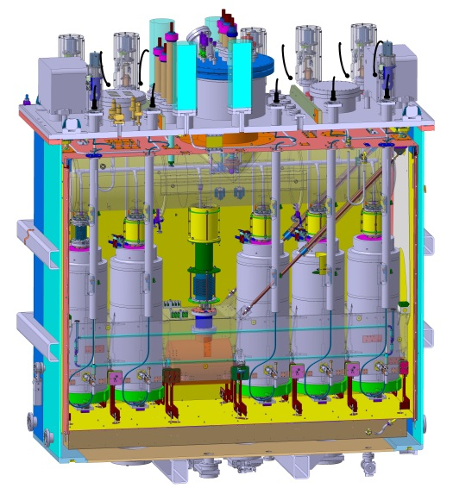
Status of the assembly of the HIE-Isolde highB Cryomodule
Cathi Final review meeting : 23 Sept. 2014
Y.Leclercq, on behalf of the Cryomodule design, procurement, preparation and assembly teams.
  M.Therasse, W.Venturini, JA. Bousquet, G.Barlow, JB. Deschamps, L.Fabre, F.Vial, Ph.Canard, S.Caille, F.Oddoz. M.Bouhammou, L. Williams, A.Chrul, G.Vandoni, P.Demarest, A.Harrison, JC. Gayde, M.Struik, JA. Ferreira Somoza, P.Zang, D.Smekens, D.Ramos, J.Dequaire, P.Minginette, M.Gourragne, G.Kautzmann, JC. Gayde, N. Delruelle, R.Ferriere, L. Valdarno, V.Parma, L.Mora

Slide 2
Outline
Context
Design
Procurement status
Assembly organization
Road map and assembly status

Slide 3
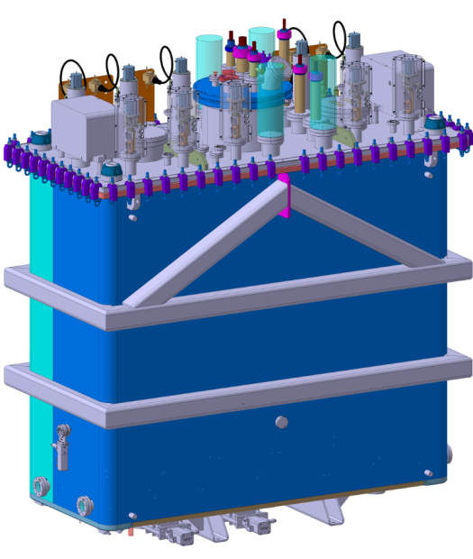
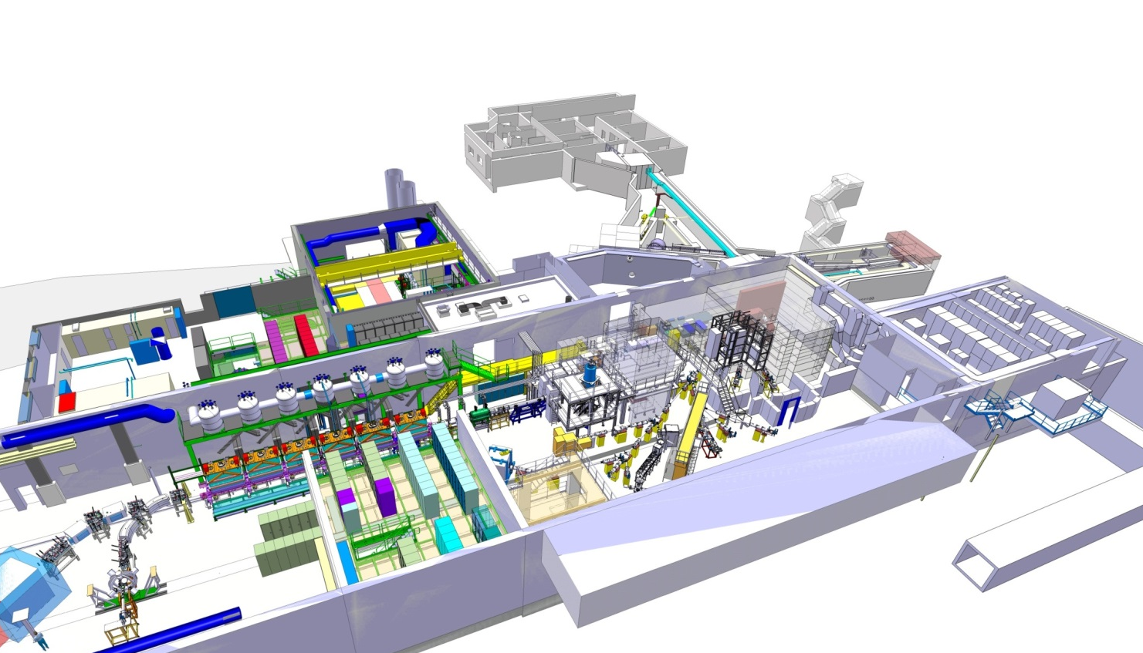
The HIE-Isolde project
Upgrade of the REX-Isolde facility
Linac
      Phase1 :
        2 highB cryo-modules
      Phase2 :
        4 highB cryo-modules
      Phase3 :
        4 highB cryo-modules + 2 lowB cryo-modules

Slide 4
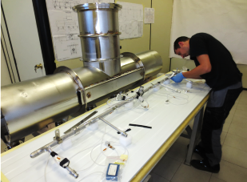
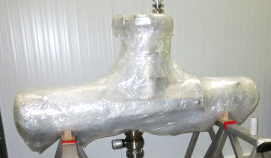
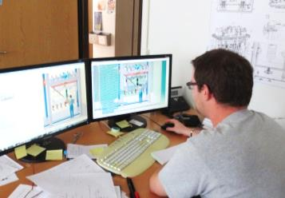
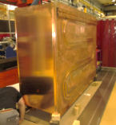
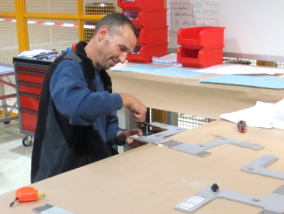
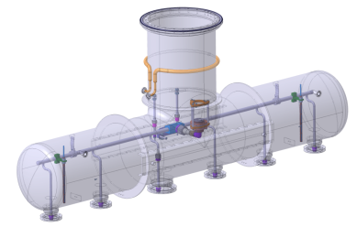
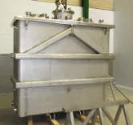
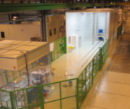
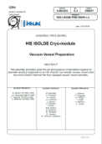
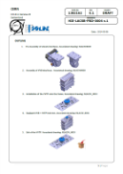
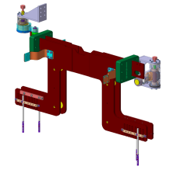
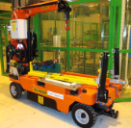
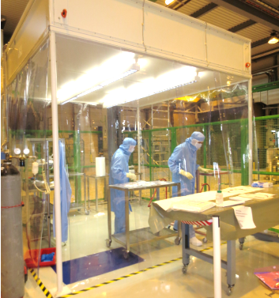
Cryomodule path to installation
Specifications
Detailed design
Drawing
Procurement
Tech. Spec.
Follow-up
Acceptance tests
2
Design
1
Parts preparation
3
For final testing
Reception
X-ray, leak-tests…
Blank assembly
Sorts to procedures
UHV cleaning
Quality Assurance
Trained resources
Specific tooling
Infrastructure
Logistic
4
Assembly
Procedures
Dust cleaning Assembly

Slide 5
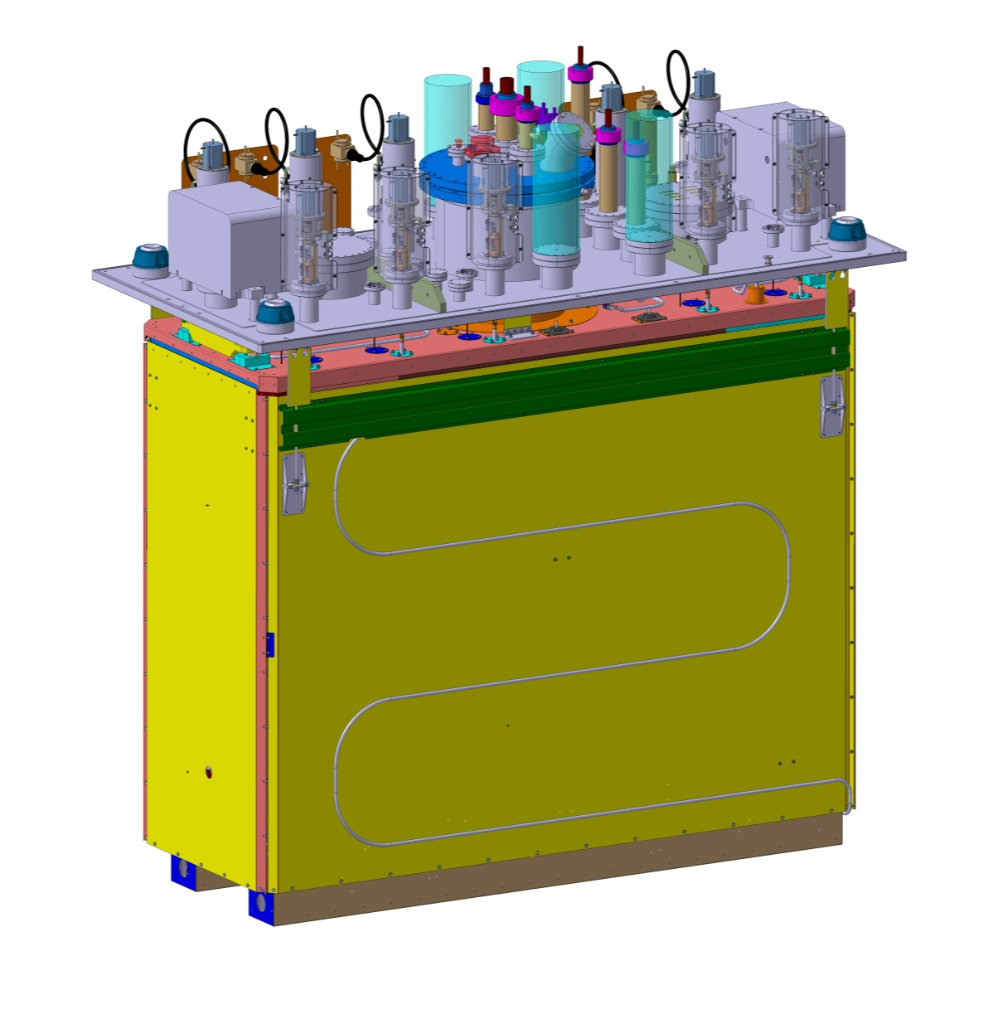
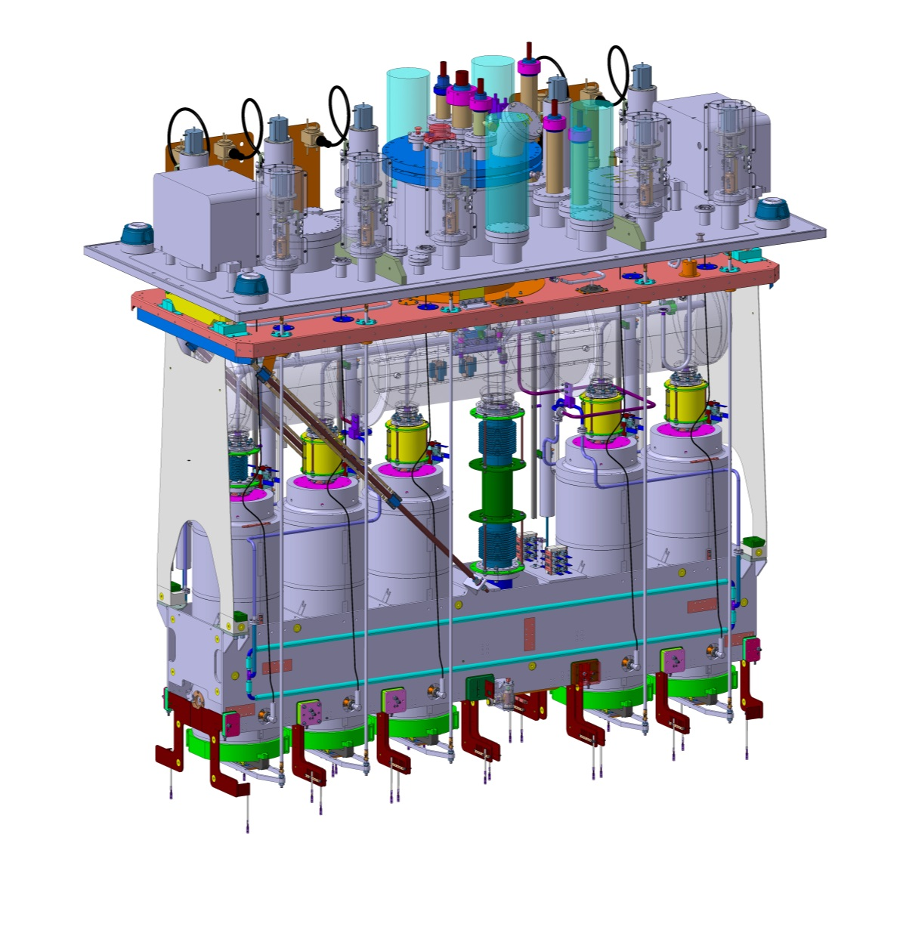
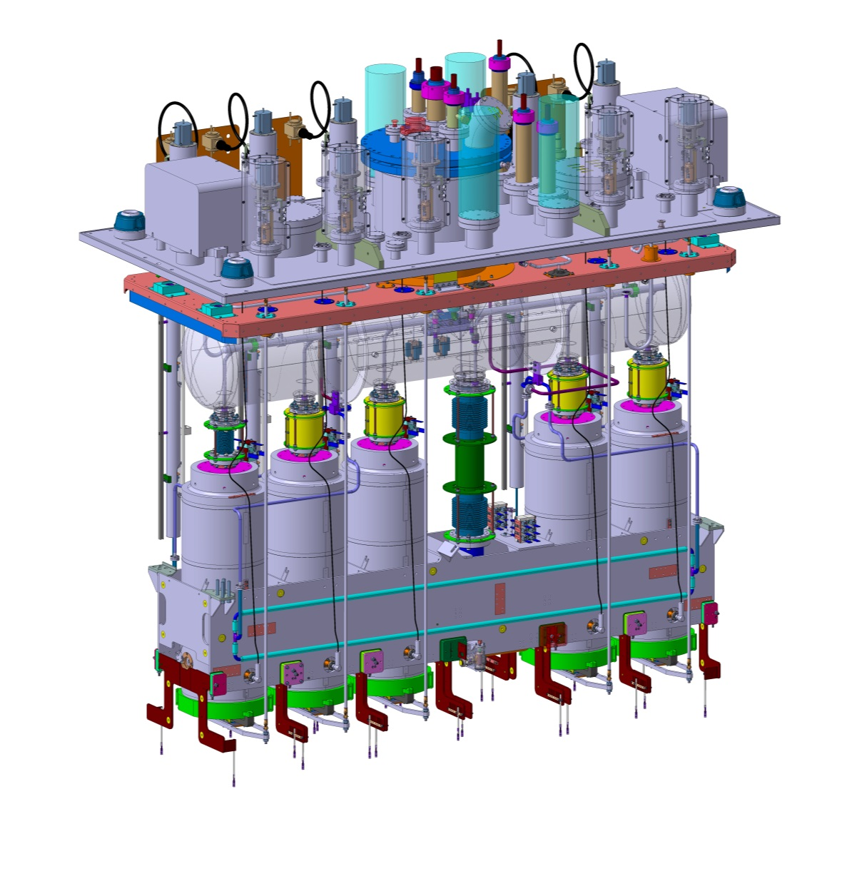
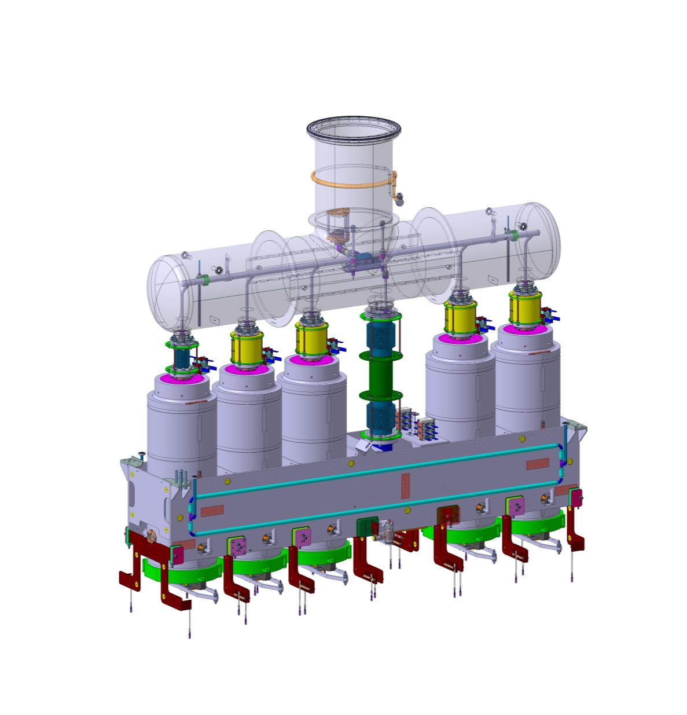
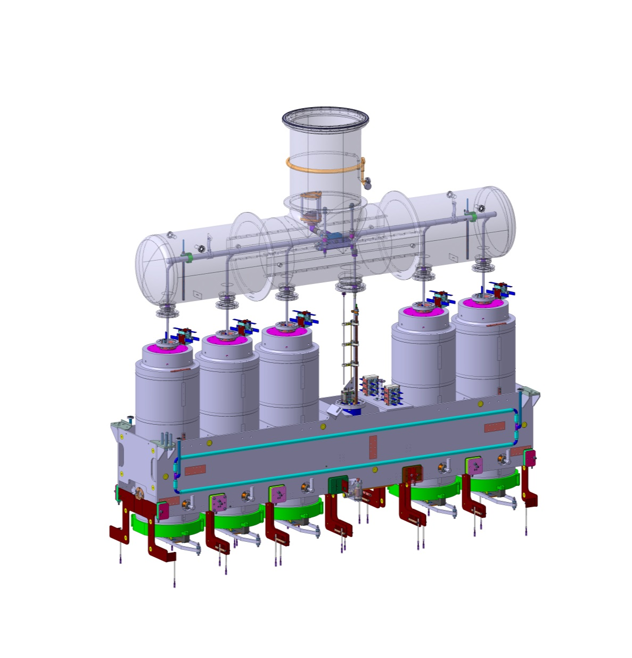
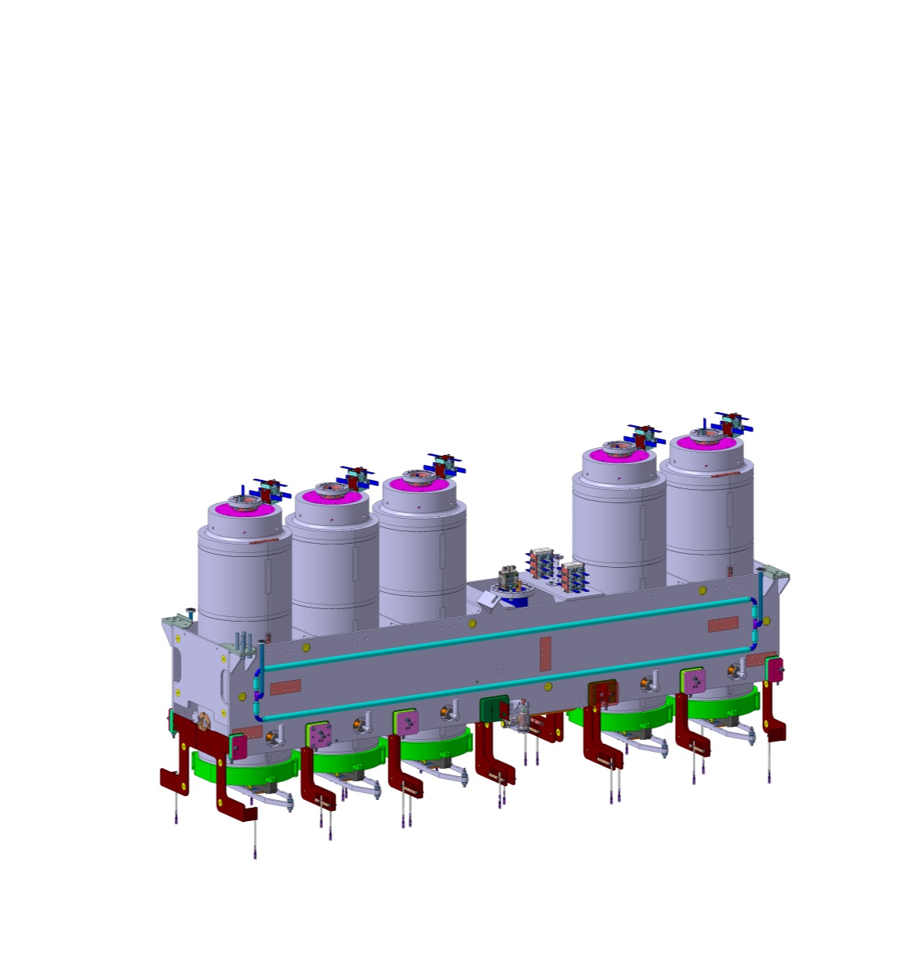
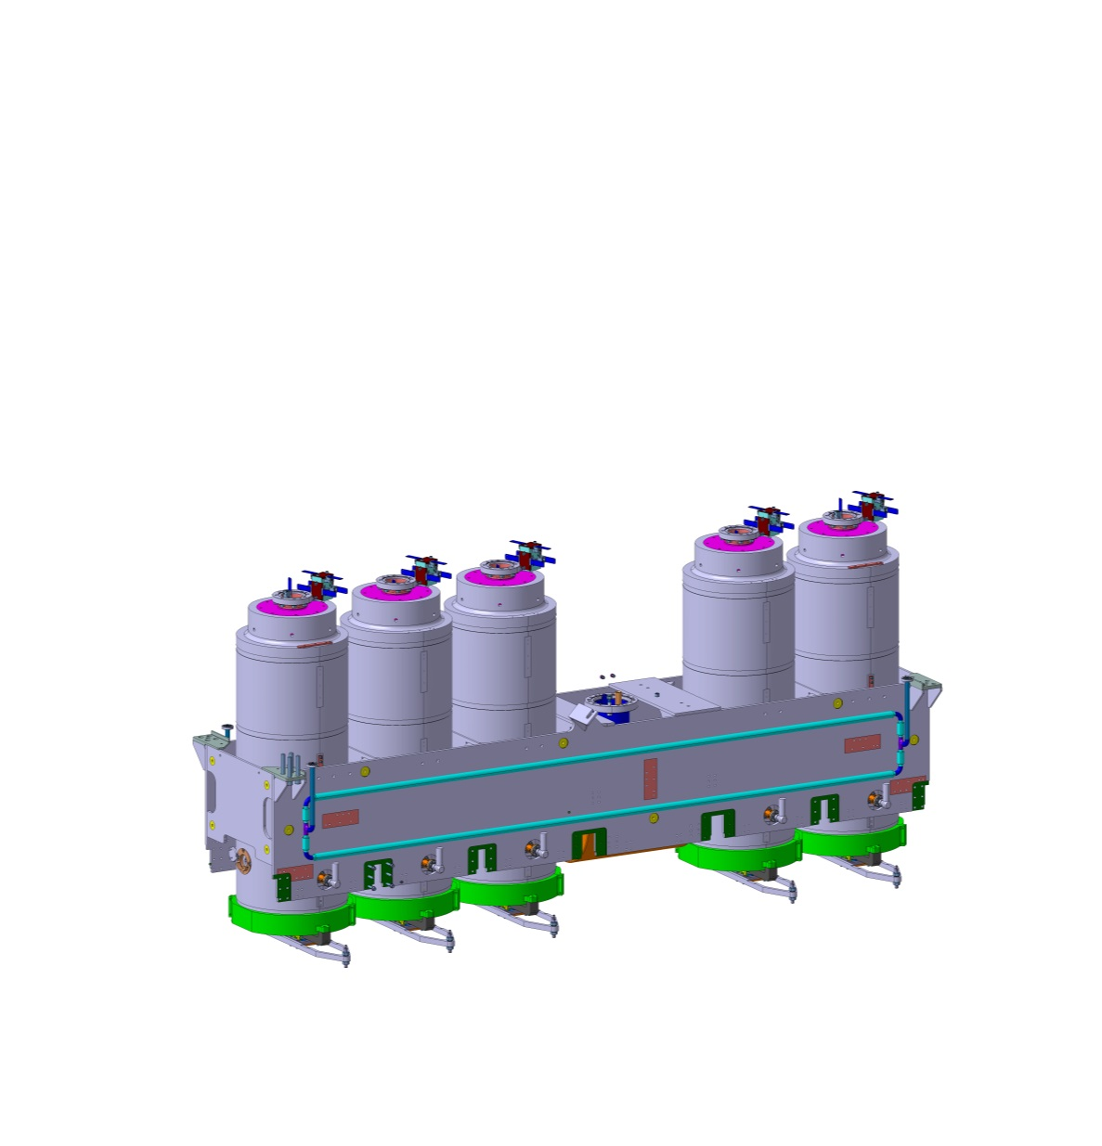
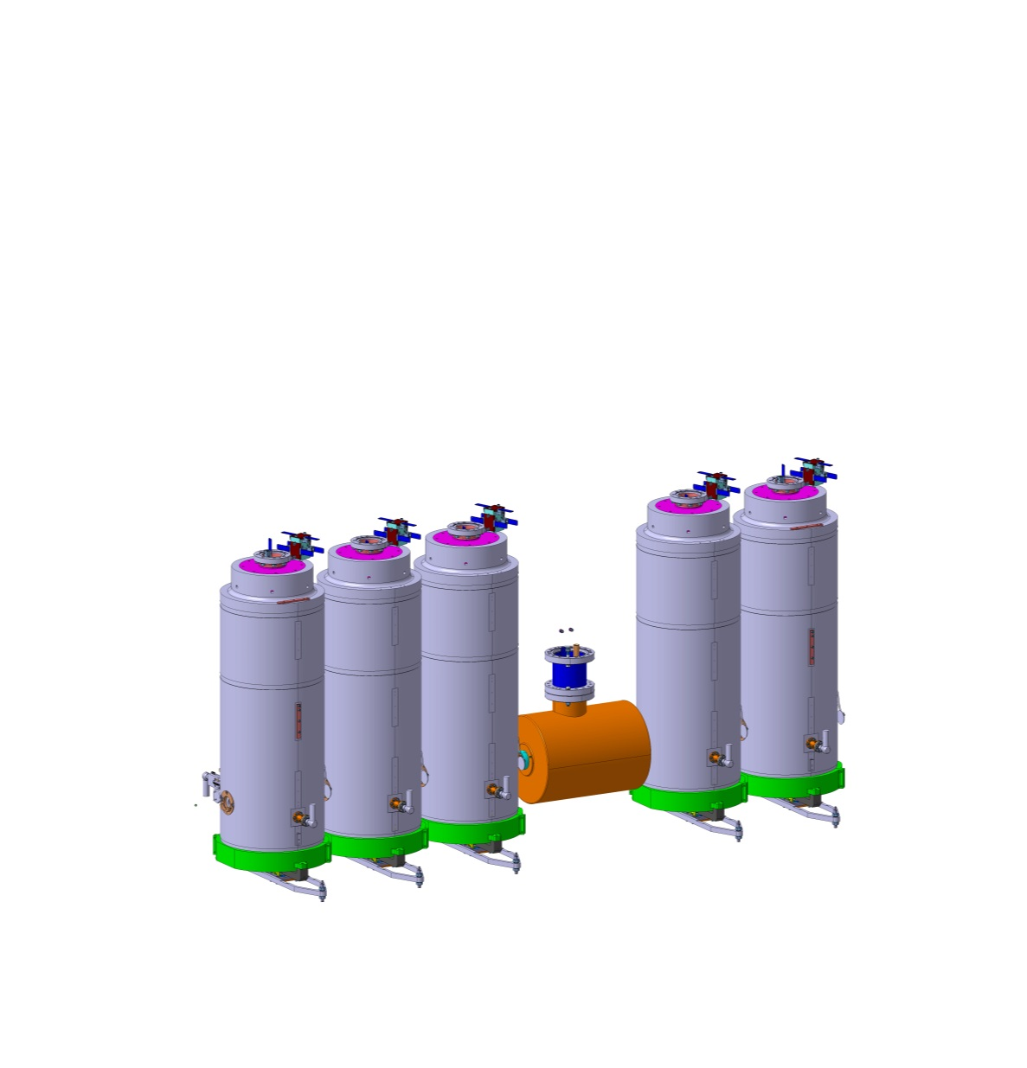
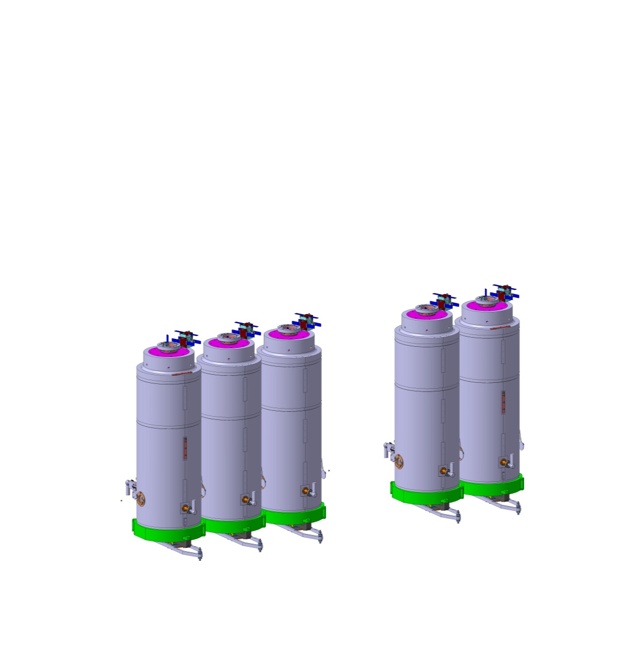

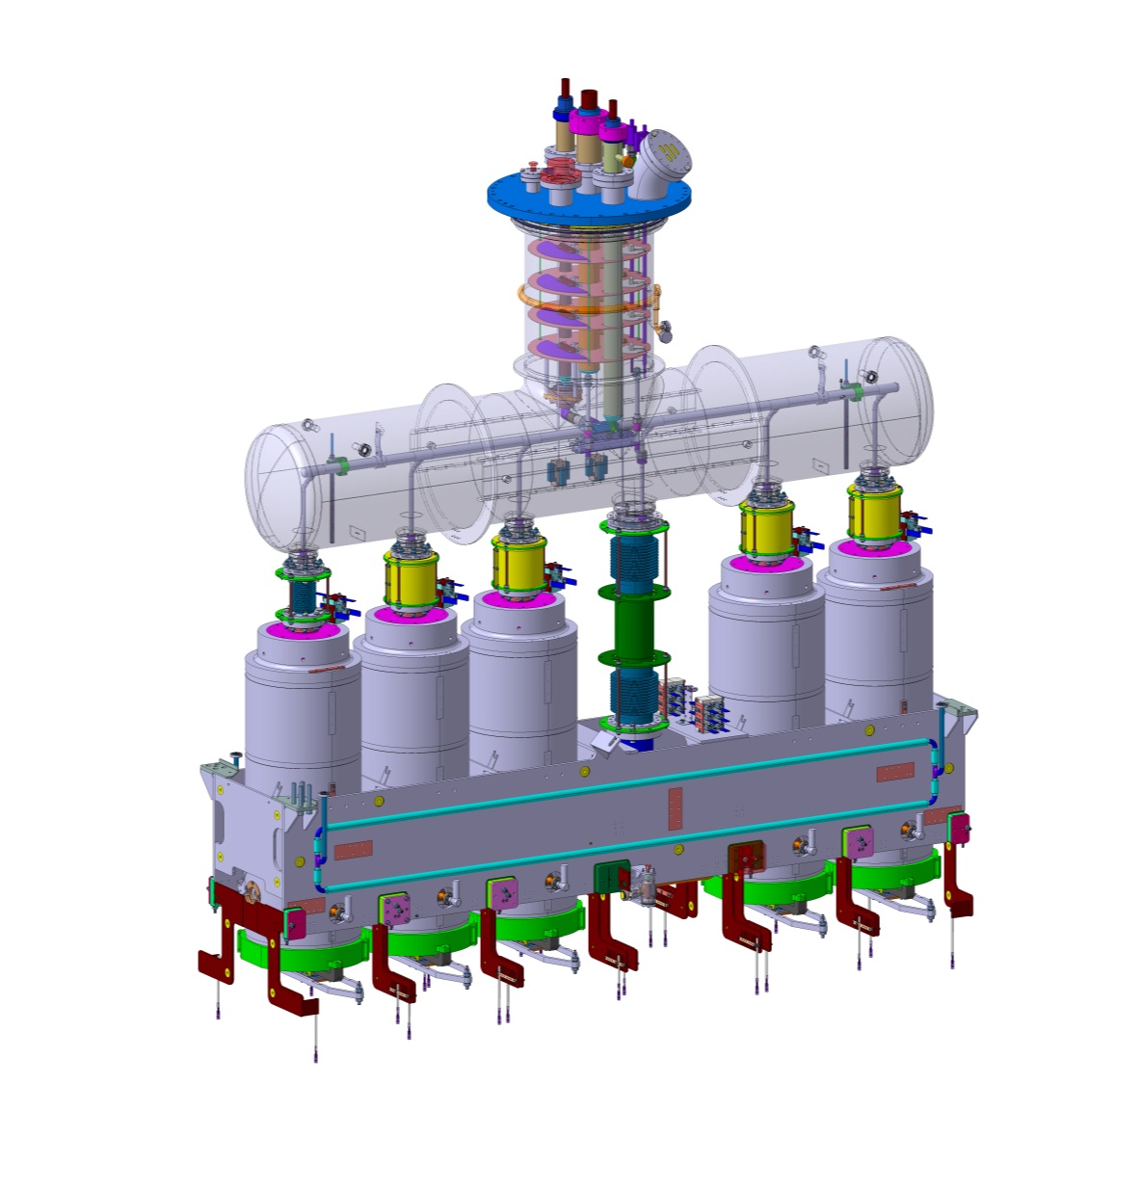
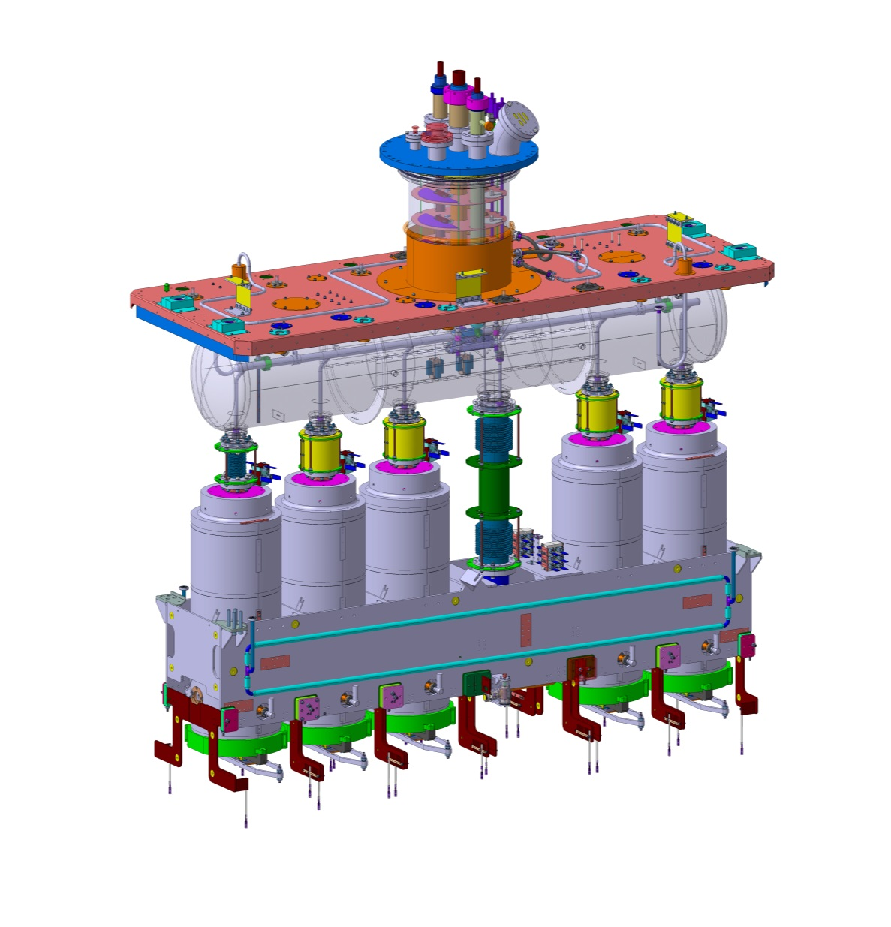
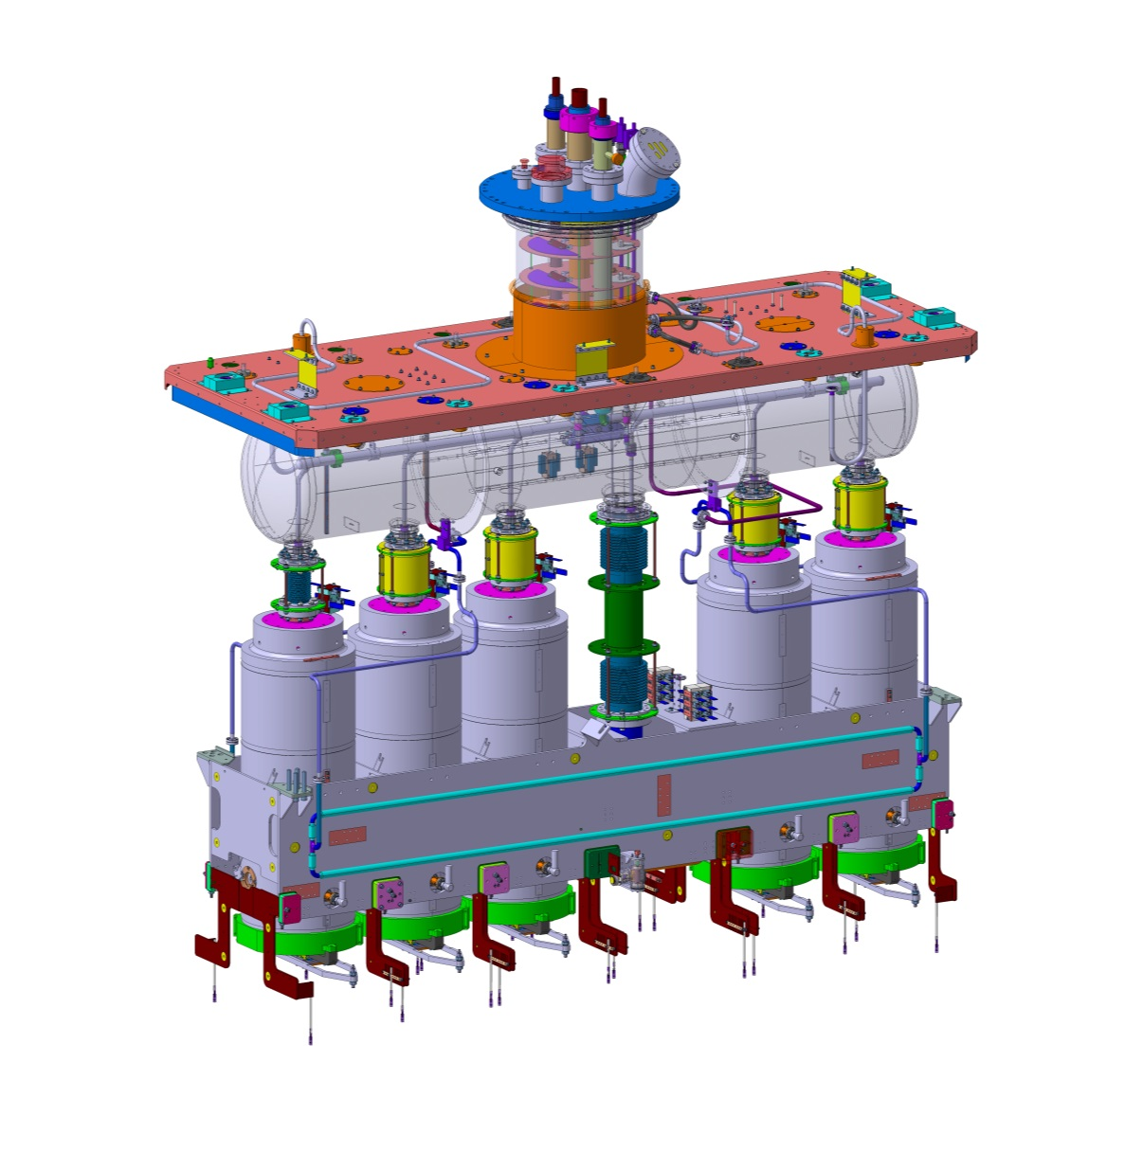
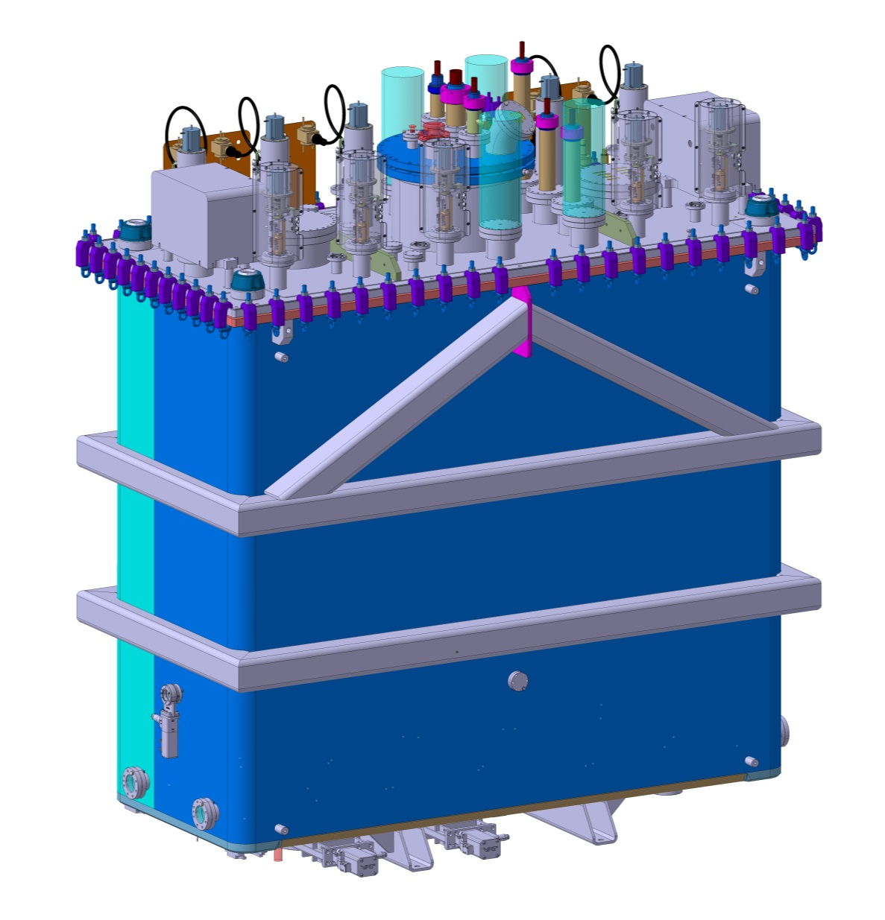
Design : Cryomodule
5 QWR cavities (BE/RF)
    Tuners, couplers, instrumentation
1 solenoid (TE/MSC)
    116A – 13.5T².m – NbTi
    Immersed in 4.5K LHe 1.5 bara
    Vapor-cooled current leads
    Resistive splice
Supporting frame assembly
    Actively cooled at 4.5K
    316L structure
    Live monitoring of positions
Helium reservoir, circuits and interfaces
    150l of LHe, 1.5 bara nominal, 4.5K
    Instrumentation
Top plate and services
    Services : 53 ports
    Seal interface
Thermal shield
    Actively cooled to 55-75K Ghe, 13 bara
    Nickel plated copper
Vacuum vessel
    15mm thick 316L plates
    Vacuum interfaces
    10-8 mbar.l.s-1

Slide 6
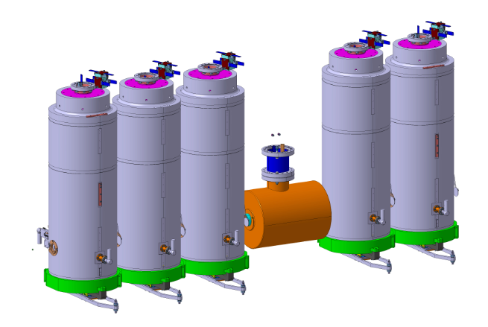
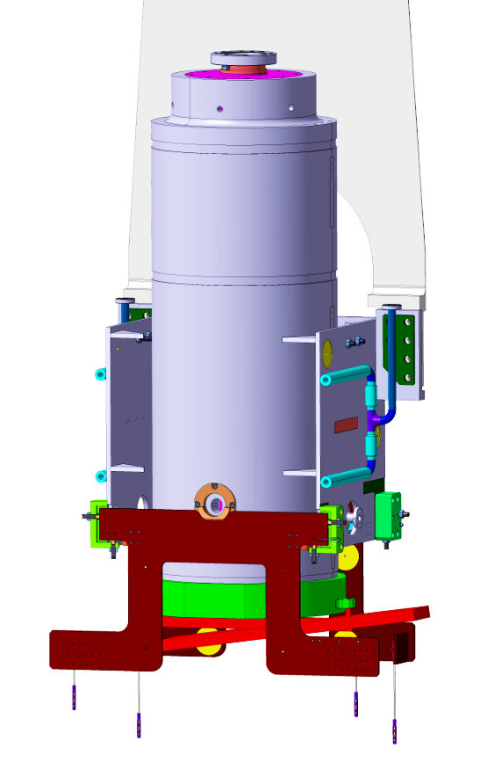
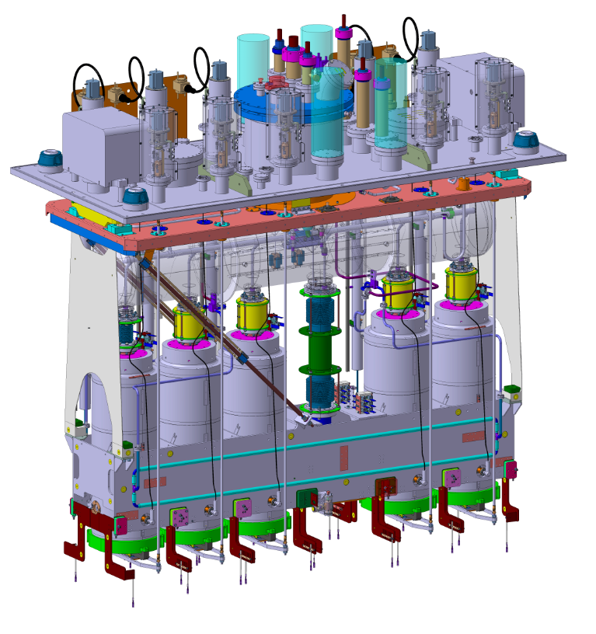
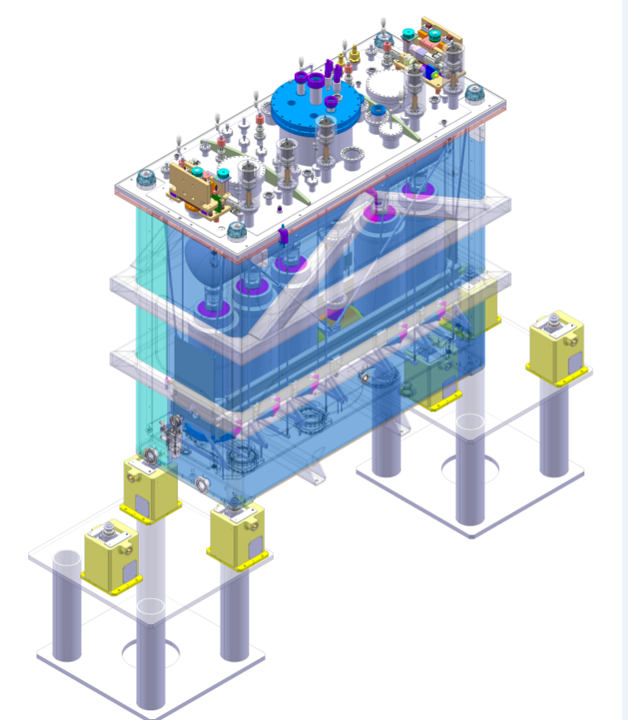
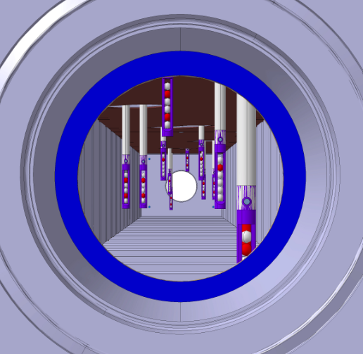
Design: alignment
Mechanical Co-axiality with beam axes
      Cavities beam axis in Ø 0.6 mm
      Solenoid beam axis in Ø 0.3 mm
Technical solution
      Multi level adjustment systems
        Individual, frame, cryomodule, solenoid (option for CM1)
      Live monitoring of components position

Slide 7
Design: Vacuum and cleanliness
Space constraints
  ➔ Common insulation and beam vacuum at 10-8 mbar
  ➔ UHV cleanliness standards
Vacuum level and quality : 1.10-8mbar
Degreasing cleaning
Cleaning and inspections
  Electropolishing for particle inspections
  Nickel-plating for UV light inspections
  Smooth surfaces and edges for wiping
  Specific shutters for cavities beam ports
  No MLI
Contamination (vacuum and particles)
  UHV cleaning for all parts/tooling
  Kolsterizing for all fittings
  Welding design
  Materials and finish choices
  No welding/brazing authorized during assembly
  Clean room assembly
  Plastic packing at all steps
Design
Procurement
Parts preparation
Detailed procedures
Cavity sensitivity to particles : ISO5 level
Particle cleaning and inspection

Slide 8
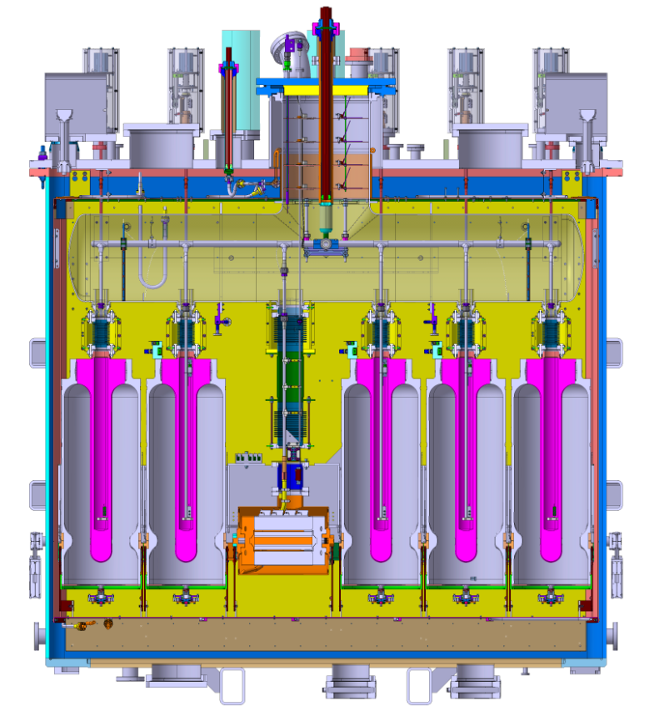
Design: cryogenics
  Cryogenic circuits
    GHe 55-75K Circuit :
      13 bara nominal
    LHe – Ghe 4.5K
      1.3 bara nominal, 150 l of liquid Helium
      Protected for mass flow up to 4.9 kg/s
  Cool-down procedure
      Thermal shield cooled first for cryopumping.
      Cavities cooled at last
Reservoir
Cav. #5
Cav. #4
Cav. #3
Cav. #2
Cav. #1
Solenoid
4.5K
20K
75K
300K
Frame
Thermal shield
Vacuum vessel

Slide 9
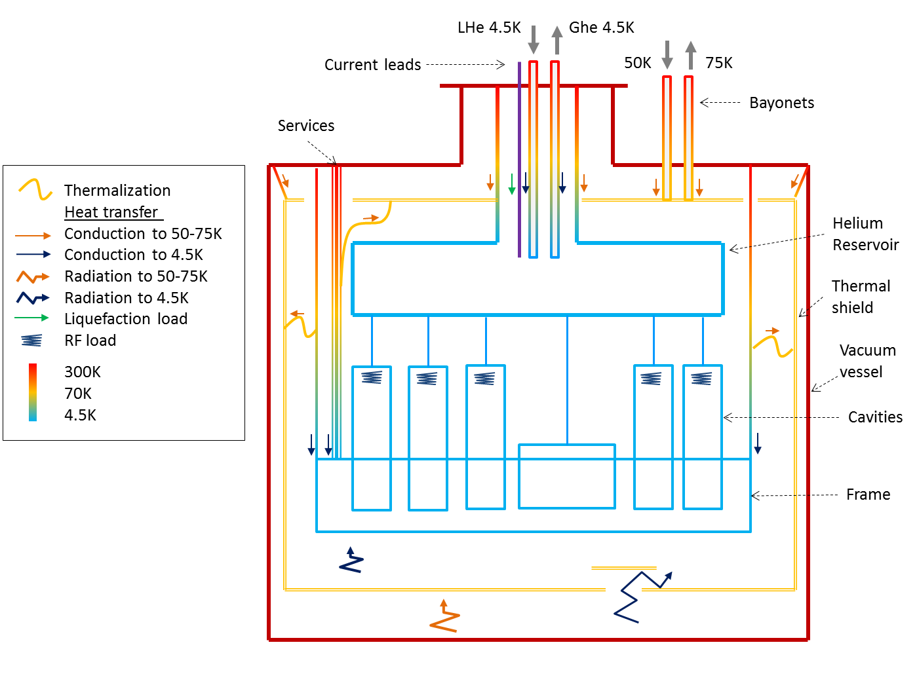
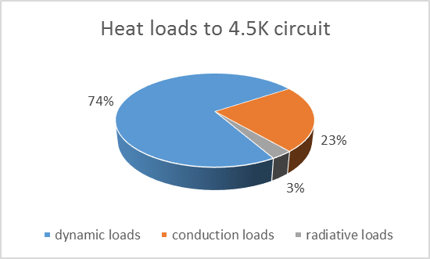
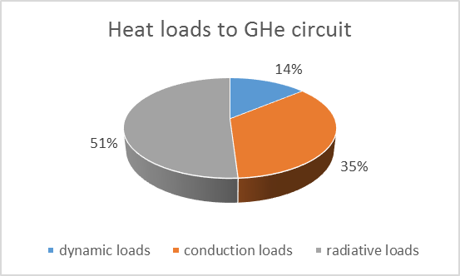
Design: cryogenics
Heat loads and thermal paths
Figures
Contributions
High emissivity for heat absorbers
 | Min [W] | Max [W]
To GHE circuit 50-75K | 367 | 555
To LHE circuit 4.5K + liquefaction load 0.03 g/s | 70 | 83
Estimations of the dynamic heat loads

Slide 10
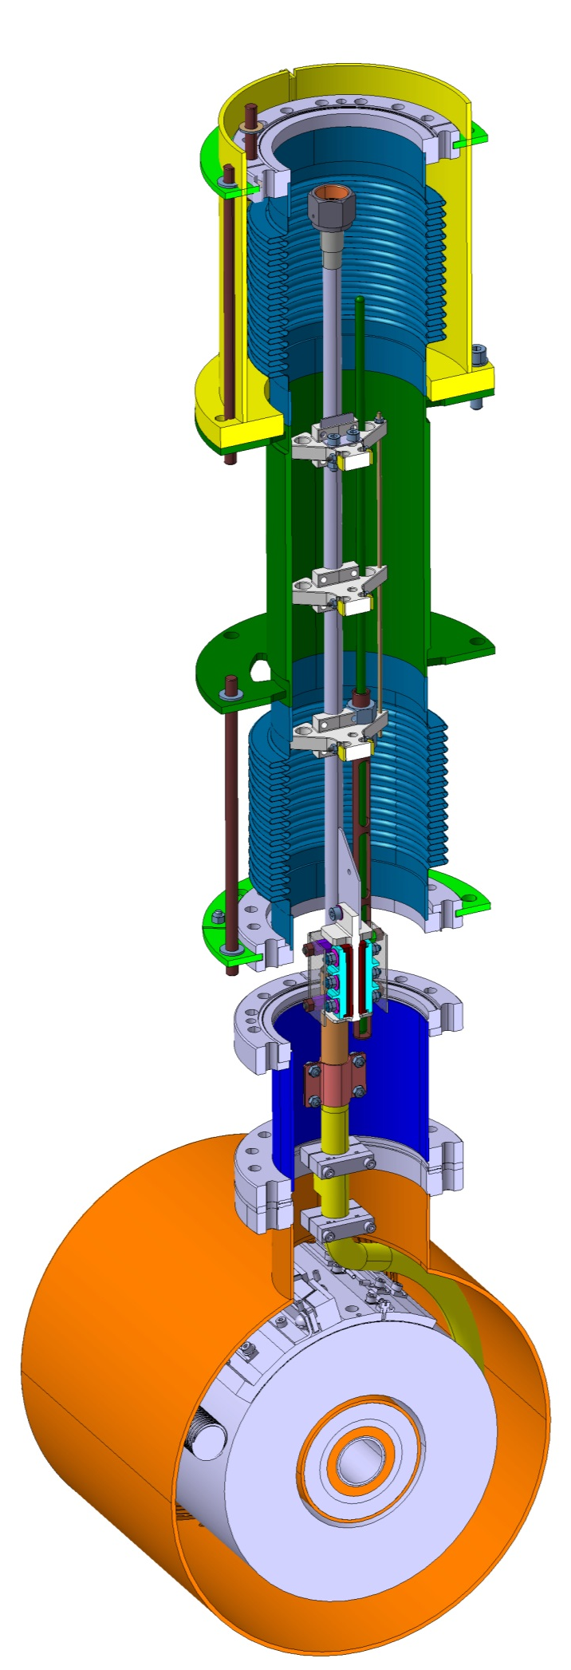
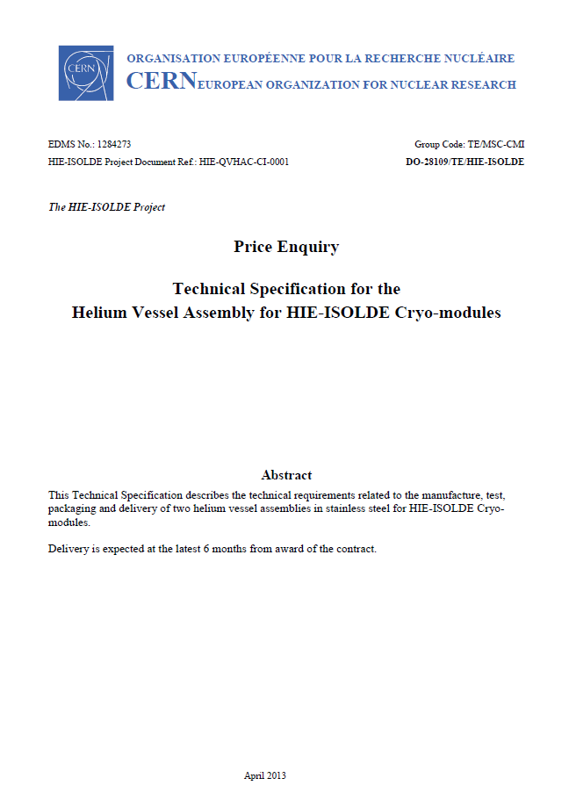
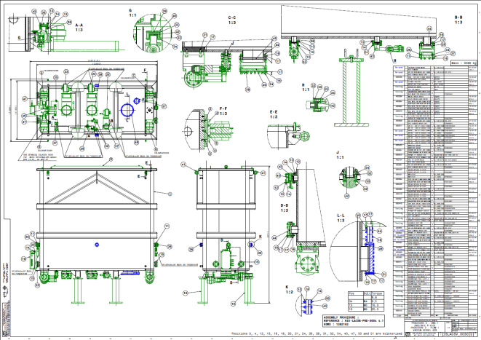
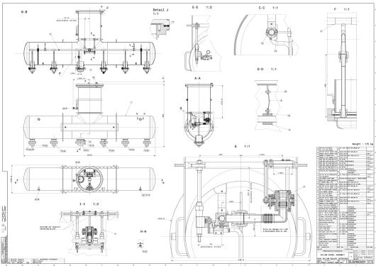
Design: summary
  Status:
    Detailed design : Complete
    Technical specifications : Complete
    Procurement drawings : Complete
      Cryomodule : >450 drawings
      Tooling : >400 drawings
    Assembly drawings : in progress

Slide 11
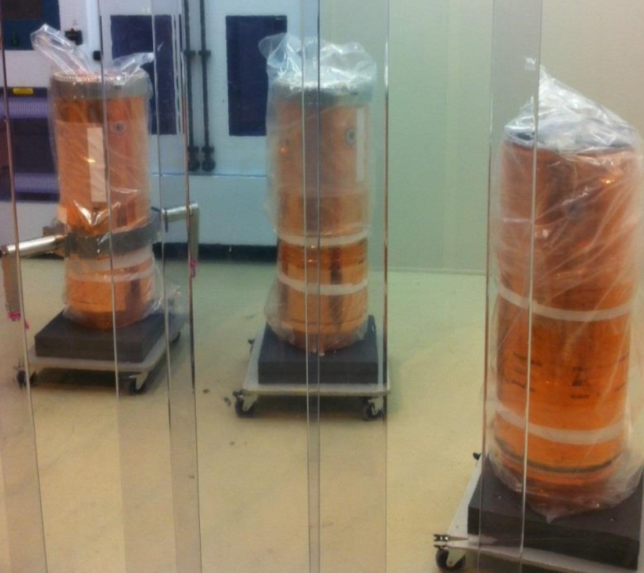
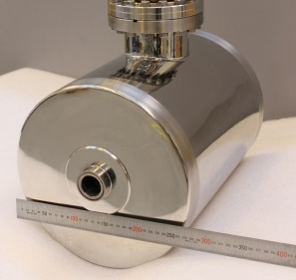
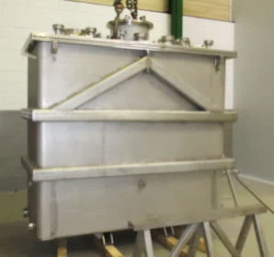
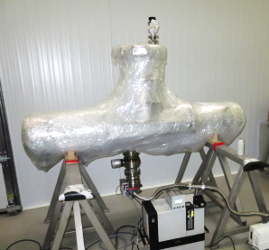
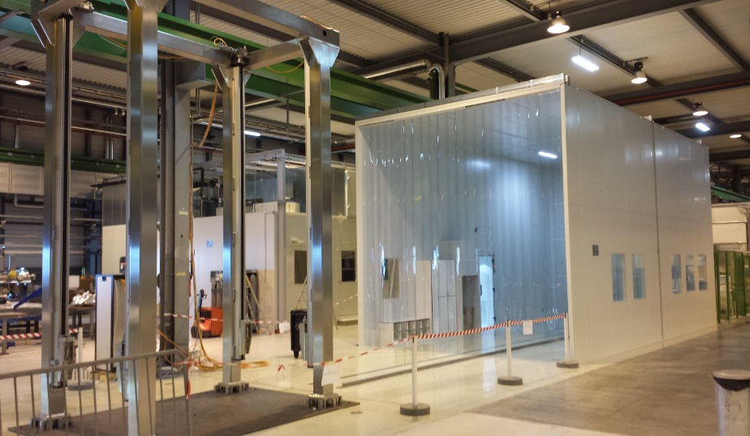
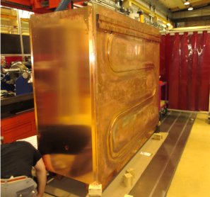
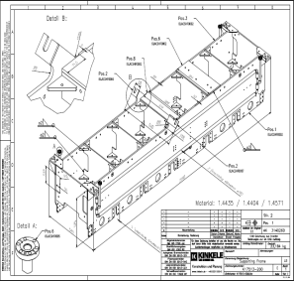
Procurement
Figures:
    >10 000 parts
    > 500 references
Main components status
    Cavities (see dedicated pres.)
    Solenoid
    Vacuum vessel
    Helium vessel : by w41
    Thermal shield : by w40
    Frame : by w42
    Clean rooms
    Specific main tooling
Procurement in line with assembly needs

Slide 12
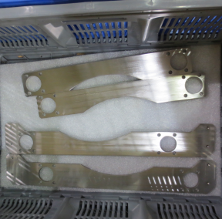





















Procurement :
    And many others…
Upper suspension
Frame fixing plates
Mechanical adjusters
Valves
Cavity shutters
Ω plates supports and thermalization
LHe level gauges
Instr. connectors
Hyfroformed bellows
Ω plates
Chimney
Stratification screens
Current leads
Viewports
Target thermalization
Bayonets fittings
Cavity supports
Supporting jacks
Spread loaders
Cryogenic piping

Slide 13


















Parts preparation
  Key to successful assembly
  Infrastructure available
  Team in place
  Still optimizing the organization
Part reception
Part reception
Part identification
Part identification
Part inspection
Inspection : quantities, visual finishing, blank assembly
General checks and blank assy
Specific external tests
Fixing
Preparation area
Tests follow-up
Fixing
Sorting to procedure
Storage after UHV cleaning
UHV cleaning
Parts list for cryomodule procurement and preparation
Storage
Delivery to Clean room

Slide 14















Assembly : procedure
EDMS1382162
EDMS1382233
1. Vacuum vessel assembly
EDMS1382525
EDMS1382232
2. Thermal shield and vacuum assembly
EDMS1390607
EDMS1390606
3. Chimney Assembly

Slide 15











Assembly procedure : main steps
EDMS1390614
4. Top plate assembly
EDMS1390616
5. Upper thermal shield and helium tank
EDMS1391442
EDMS1391441
6. Helium tank, top plate and chimney assembly

Slide 16










Assembly procedure : main steps
In progress
7. Installation of the support frame
EDMS1391444
8. Installation of the solenoid
In progress
9. Installation of cavities

Slide 17







Assembly procedure : main steps
In progress
10. Installation of cavities aux.
In progress
11. Cryomodule vessel closure
In progress
12. Final assembly qualification before delivery to RF testing

Slide 18



Assembly area
3 clean rooms areas available
    “Baldaquin”: Class ISO5
    “Main clean room” : Class ISO7 and ISO5
Equipped with specific tooling

Slide 19









Assembly work
  Support team
    Procedures in progress
    Assembly drawings in progress
  Clean room team
    2+1 per clean room
    Acquiring experience
Vacuum vessel preparation procedure
Chimney assembly in the baldachin

Slide 20


CM1 Assembly Roadmap
(in work)
Late start of assembly
20w : need close steering
Work started in August, so far on schedule.
Completion of Chimney assembly
Start of Vacuum vessel assembly

Slide 21
Summary
Design
  Design complete, Assembly drawings synchronized with assembly procedures
  Now support to components production and CM assembly
Procurement (components and tooling)
  10 000 items delivered or being procured in line with need
  Most of main components delivered
Preparation of components before clean room
  Key to successful assembly (blank assemblies, cleaning…)
    Components preparation & storage is essential (limit clean-room work, identify NC ahead…)
Assembly
  Started in August, still in running-in phase (need to acquire experience)
  Clean rooms available, new clean room technicians learning the job
Assembly roadmap
  Objective is assembly of CM1 in 20 weeks (challenging)
  Strong organization and partnership in place at CERN: responding well
  Experience in the coming weeks will provide us confidence

Slide 22




Questions

Slide 23
Spare slides

Slide 24
Assembly coordination
Two main poles : Preparation area / Assembly area
Procurement team
Design team
QA
Survey
experts
Acceptance
NC
expertise
Spec. for preparation
Consultancy
drawings
Vacuum
experts
expertise
Parts delivery
Preparation team
Parts:
Cleaned
Tested
Sorted
Assembly team
Equipment
Know-how
Transport
Cleaning facilities
Workshops
Clean room activity support
BE-RF

Slide 25




Quality assurance
Procurement
  Follow-up during manufacturing
  Wide manufacturing file
    (welding qualifications, material certificate…)
Assembly
  Control sheets during assembly
  MTF structure (in progress)
    To the scale of the project
    NC’s attached to MTF steps
Industrial Travellers being developed
Control sheet for Chimney and vacuum vessel assembly
Instrumentation control during manufacturing
Draft of MTF structure
in progress

Slide 26





Procurement : other tooling
Main components
      Vacuum vessel cover
          Received
      Chevre
          Received and HSE approved
      Leak test tool
          Manufacturing in progress
          Delivery by w41
      Elevator
          Received
Vacuum vessel cover
Chevre / Chimney-MPT
Leak test tool
Feet
Elevator

Slide 27






Procurement requirements
Size dependent:
  For parts >2m
    Vacuum
      Tightness : 1.10-9 mbar.l.s-1
      Cleanliness
        Degreasing : ultrasonic bath
        Dust cleaning : at Cern
        Delivery packing : 3 plastic layers
  For parts <2m
    Vacuum
      Leak tightness : <1.10⁻⁹ mbar.l.s-1
      Cleanliness
        Degreasing : at Cern (TE-VSC)
        Dust cleaning : at Cern
        Delivery packing : 1 layer
Delivery exceptions
    Instrumentation cabling/connectors
      ISO5 cleanliness level
    Hydroformed bellows
      ISO5 cleanliness level
Helium vessel cleaning at manufacturer’s premises
Delivery packing for Vacuum vessel
Industrial cleaning for standard parts; <2m
ISO5 cleanliness delivery for specific parts

Slide 28



Under design: cavity protection shutter
shutter
support
Inter-cavity space

Slide 29
Storage and preparation area SMA18

Slide 30


Slide 31
Procurement status summary
Component Quantity Status
Cryomodule
Vacuum vessel For 2CM 1st received
Thermal shield For 2CM Manufacturing w40
Helium reservoir For 2CM Manufacturing w41
Mech. Adjusters For 3CM 1CM received
Suspension system For 2CM 2CM received
Load spreaders For 2CM 2CM received
Bellows For 3CM 3CM received
Thermal shield flexibles For 3CM 3CM received
Bayonets (TE-CRG) For 6CM 6CM received
Chimney For 2CM 2CM received
Frame For 2CM Manufacturing w42
Coupler ancillaries For 1CM Manufacturing w40
Tuners ancillaries For 1CM Manufacturing w40
Cavities For 1CM see W.Venturini presentation
RF power cables For 1CM Manufacturing w43
RF pick-up cables Information pending
Solenoid For 4CM 1CM received
Fittings, bolts… For 3CM 3CM received
O-rings, Helicoflex, Cu gaskets For 2CM 2CM received
Current leads For 2CM 2CM received
Splice parts For 2CM Manufacturing w44
Cryogenic piping For 2CM 2CM received
Cryogenic sensors/gauges For 2CM 2CM received
Cryogenic instrumentation For 2CM 2CM installed
Omega alignment plates For 2CM 2CM received
Suspension system For 2CM 2CM received
Cavities supporting spheres For 2CM 2CM received
Survey viewports For 2CM Testing @Cern w38
Monitoring targets For 2CM Manufacturing w43
Cryogenic safetydevices (TE-CRG) For 2CM Order out w43
Vacuum safety devices Information pending
Vacuum valves For 2CM 80% received
Vacuum gauges For 2CM 2CM received
Vacuum cryo T-sensors For 2CM 2CM received
Vacuum instrumentation For 2CM Manufacturing w40
Bellows ancillaries For 2CM Manufacturing w44
Helium vessels ancillaries For 2CM 2CM installed
RF cable thermalization For 2CM Manufacturing w44
Diagonal rods thermalization For 2CM Manufacturing w44
Component Quantity Status
Ω plates thermalization For 2CM 2CM received
Solenoid extension For 2CM Manufacturing w44
Helium fittings For 2CM Manufacturing w44
Omega plate supports For 2CM 2CM received
Current leads For 2CM 2CM received
Jacks For 6CM 6CM received
Tooling
Clean room Cleaning w38
Baldachin Available
Railing system Available
Lifting Frame Cleaning w37
Cavities/solenoid Trolley Manufacturing w40
Multi Purpose Trolley Received
Top plate leak test tooling Manufacturing w41
Plaque test en charge Received
Chimney support assy. for trolley Received
Lifting support for chimney eq. Received
He tank insertion blocks Drawing ready w41
Double targets support for V plate Manufacturing w41
Target L support Manufacturing w41
sets of wheels for v-vessel Received
set of wheels for Cavity trolley Manufacturing w40
Motorization v-vessel/CST Received
Vacuum vessel feet Received
Vacuum vessel cover Received
Thermal shield onto lifting frame fixation system Received
Crow's foot spanner set (for VCR connection) Received
Steps (for work in height into the cleanroom) Received
Personal elevator Received
Cleanroom harness Received
Chimney frame pre assembly Received
Cavity crane (Chevre) Received
Survey targets supports for assembly Testing @ Cern
Survey targets supports M12 Received
Consumable for clean room Received
Ultrasonic bath Received
Hand tools Received
Laser tracker (EN-MEF) Received
Vacuum test equipment (TE-VSC) Procuring

Slide 32
Work organization : organigram
Cryo-module Project
V.Parma, TE-MSC
(W.Venturini, BE-RF)
Assembly Quality Control
L.R.Williams, TE-MSC
(M.Therasse, BE-RF)
Cryo-module Assembly
Y.Leclercq, TE-MSC
(M.Therasse, BE-RF)
Assembly Process Follow-up & Documentation
J.A.Bousquet, BE-RF
CM Design Support
J.Dequaire (Intitek), TE-MSC
QA, NC & MTF
A.Chrul, TE-MSC
Cleanliness QC & clean-room Training
M.Therasse, M.Gourragne, BE-RF
Clean-Room Team
G.Barlow, J.B.Deschamps, TE-MSC;
F.V., L.F., AL4030
Handling & Transport
EN-HE
Vacuum checks
G.Vandoni, (J.Somoza)
P.Demarest, A.Harrison, TE-VSC
Survey alignment/checks
J.Ch.Gayde + team of 4 EN-MEF
Components Cleaning
M.Thiebert & team, TE-VSC
Storage, Logistics & Components Preparation
Ph.Canard & team (S.C.,F.O.,M.B), TE-MSC
Components/tools re-work
(Bd.180, Bd927 workshops)
TE-MSC
Electrical tests
M.Struik, TE-MSC
RF cavities/aux. tests
M.Therasse (P.Zang), BE-RF
CM Components
M.Therasse, BE-RF
D.Smekens, TE-MSC
D.Ramos, TE-MSC
Y.Leclercq, TE-MSC
L.R.Williams, TE-MSC
…
Person in charge
(replacement)

Slide 33



Design: Instrumentation

Slide 34

Design: safety pressure devices
Vacuum vessel protection
  P<1.5bara
  He mass flow : 4,7 kg/s
Helium volume protection
  PS=3.5 bara
  Heat load : 76 kW
  He mass flow: 4.9 kg/s
Updated safety devices layout

Slide 35
Work organization :
3. preparation team : SMA18
Part reception
Part reception
Part identification
Inspection : quantities, visual finishing, blank assembly
Part identification
Part inspection
Specific external tests
Fixing
General checks and blank assy
Tests follow-up
Fixing
Sorting to procedure
UHV cleaning
Logistic/Storage in SMA18 is essential for efficient assembly work in clean room !
Storage after UHV cleaning
Storage
Delivery to Clean room
Parts list for cryomodule procurement and preparation

Slide 36

Design : Cavities & Solenoid
Cavities and ancillaries
  See dedicated presentation for details
Solenoid and ancillaries
  Properties: 116 A – 13.5 T2.m - NbTi
  Self protected
  Supplies:
    Vapor-cooled current leads
    Resistive splice
    Lhe 4.5K

Slide 37











Procurement : summary
Still in progress
In line with assembly planning
Figures
  >10 000 parts
  > 500 references
Software developed at TE-MSC for parts database management
Machining leak test tool
Custom parts manufacturing follow up
Acceptance test for adjusters
Welding of helium and vacuum vessels
Parts list for cryomodule procurement and preparation

Slide 38

Parts preparation
Key to successful assembly
Dedicated area
Blank assemblies
Fixing
UHV cleaning
Storage and delivery

