Slide 1
HIE-ISOLDE
Monitoring and Alignment Tracking for Hie-IsoLDE
System presentation
Jean-Christophe Gayde EN/MEF-SU
Guillaume Kautzmann EN/MEF-SU

Slide 2
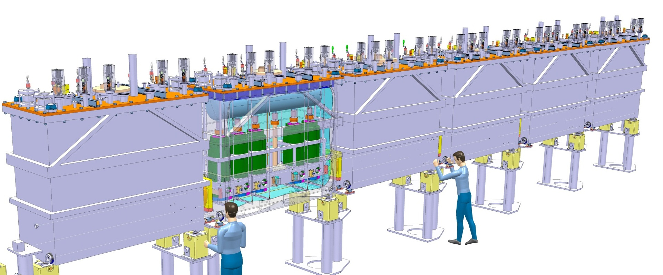
Alignment specifications
General
Alignment and monitoring of the Cavities and Solenoids in the Cryomodules w.r.to a common nominal beam line (NBL) along the Linac
Permanent system
Precision asked along radial and height axis at 1 sigma level :
  300 microns for the Cavities
  150 microns for the Solenoids
~16 m
NBL
+/-150 micr
+/-300 micr

Slide 3
Alignment specifications
Alignment System
CONCEPT
Creation of a closed geometrical network continuously measured
Observation and position reconstruction of Cavities and Solenoid in this Network
SYSTEM
RF cavities and solenoid equipped with targets
Interface Atmosphere / High Vacuum → Precise viewports
BCAM cameras fixed to inter-module metrological tables
External Lines => Position and orientation of metrological tables and BCAMs
Internal Lines => Position of the targets inside the tank
RF Cavity
Solenoid
BCAM
External Line
Pillars
Pillars
Cryo-module
Metrologic Table
Internal Line
BCAM observations

Slide 4
Alignment specifications
Alignment System
Top view
Overlapping zone of BCAM obs. on external lines
Double sided targets observations on internal lines
=> Redundancy
Side view
Ext. line
Overlapping
Pillar
Pillar
BCAM
BCAM to BCAM observations
Metrological Table
BCAM to Pillar observations

Slide 5
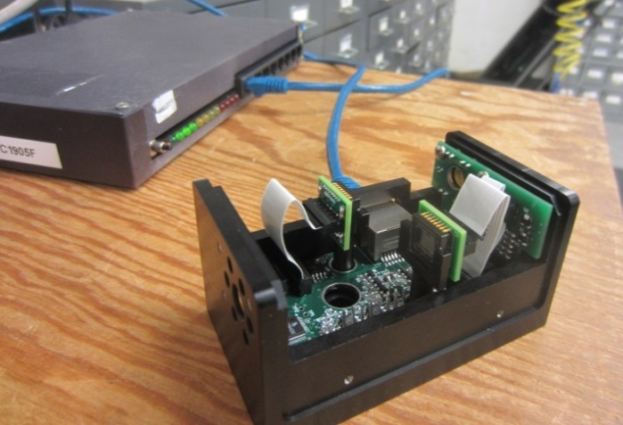
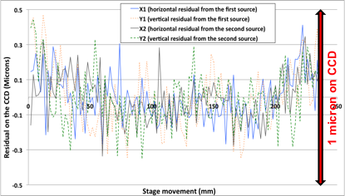
HBCAMs
Developed on 1999 by Brandeis University for ATLAS Muon alignment
OSI (Open Source Instruments)
Original BCAM → HBCAM
Camera focal length: 72 mm → 49 mm – 50 mm
Sensor: 336 x 243 pixels 10 micr → 659p × 494p, 7.4 microns
Field of view: 40 mrad x 30 mrad → ~ 100 x 70 mrad
Sources: Laser Diodes 650 nm + Calibration of their power
+ Additional synchronized illumination system
Thanks to: J. Bensinger
K. Hashemi
http://alignment.hep.brandeis.edu/
http://www.opensourceinstruments.com/
Mounting: "Plug-in" isostatic system under the chassis
Double sided model → Chain of BCAMs
Resolution: 5 micro radians constructor (OSI)
→ Same range
Accuracy of 50 micro radians to absolute
→ Same range
Cable length BCAM/Driver > 60 m
+ Connection on the side
Delivered calibrated (focal length, position diodes, geometric relationship with plate support)
5

Slide 6
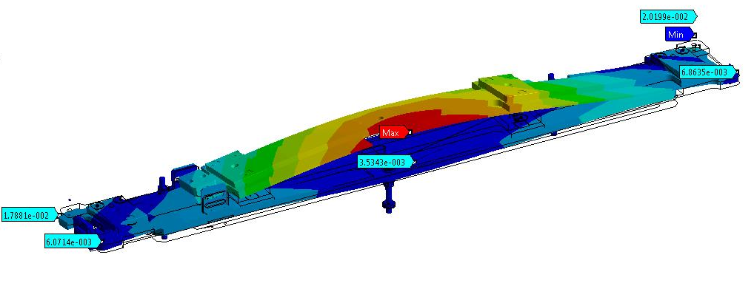
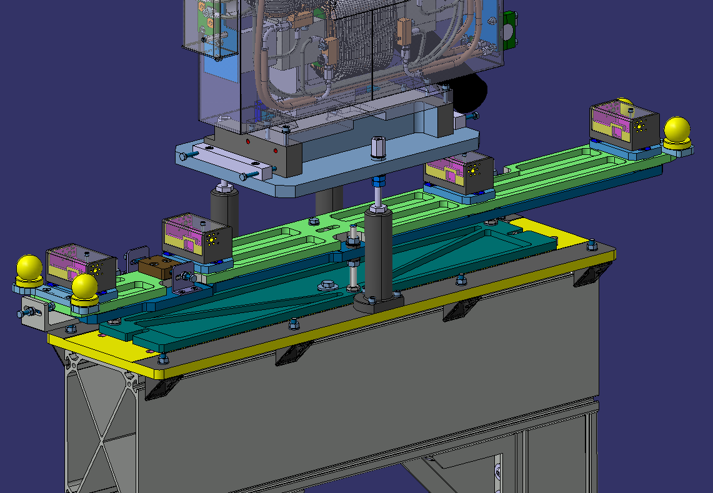
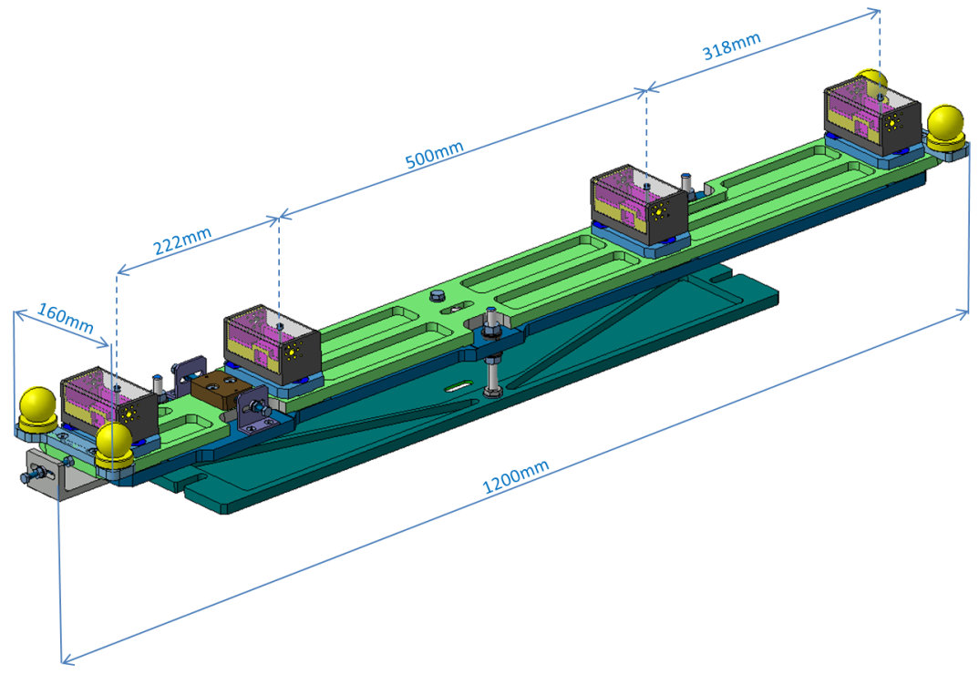
Metrologic table
Integration in a busy space
Metrology of the HBCAM supporting interface and fiducial marks
Table inserted as an ensemble
Holes to lighten the table (~11kg with adjustment)
Supporting decoupled from the DB and the Steerer
→ Close to final design, price inquiry launched
Thanks to: E. Urrutia (EN-MME)
G. Vandoni (TE-VSC)

Slide 7

Targets
High Index Glass Balls
Developed by OHARA Inc., Kanagawa, Japan
Material : S-LAH79
Off the shelf
Available from diameter 1mm to 10mm
Diameter Tolerance (μm) : 0/-3
Sphericity (μm): 2
Refracting index of 1.993 for HBCAM Lasers (650nm)
Thanks to: M. Šulc (Liberec Universtiy, Czech Republic)

Slide 8
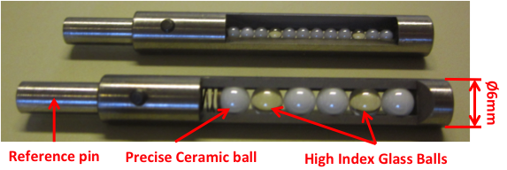
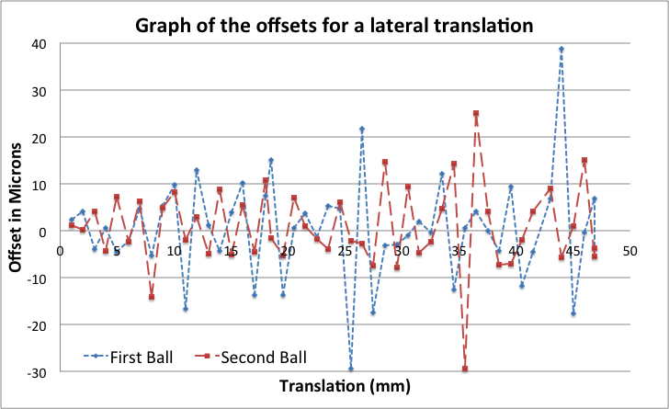
Targets
High-Index Glass
High Index glass balls based TARGETS:
Based on high index glass balls (Ø2 or 4mm)→ Retro reflective effect
Double Sided
Flashed by HBCAM Lasers
Possibility of multi-balls targets
Good geometrical results
High vacuum compatible: tested
Cryogenic conditions (5K) compatible: tested
Distance to target:
1.2 m
Scan over 40% of the field of view
Precision of the reconstructed movement: ~10 microns at one sigma level
Expectation: around 10 urad
20 microns

Slide 9
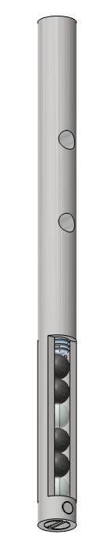
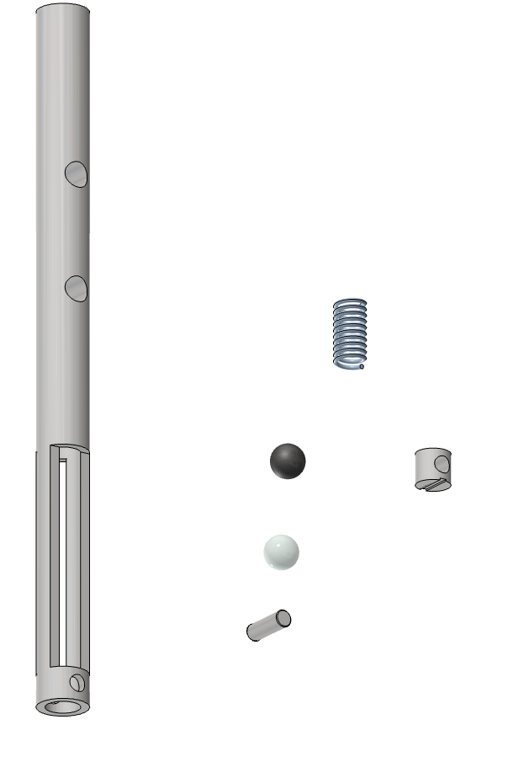
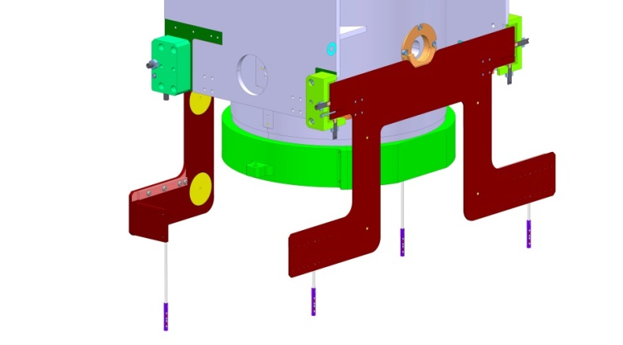
Targets
High-Index Glass
1 x
Stainless steel spring
4 x
Ø4mm Ceramic Ball
Final design:
Ø4mm Glass ball
Target loading by the bottom
External diameter 6mm
Titanium body
5 different lengths/CM
→ Order to be placed soon
2 x
Ø4mm glass Ball
Titanium target body
1 x
1 x
Ø2mm Stainless steel pin
1 x
Titanium target plug

Slide 10
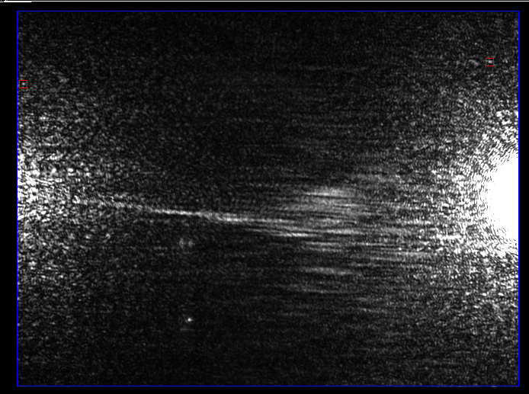
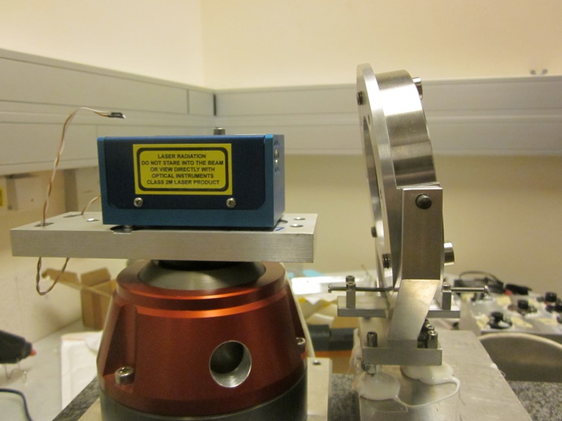
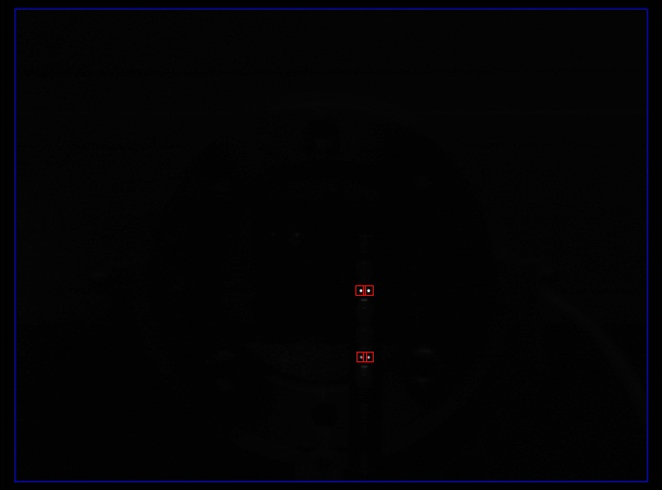
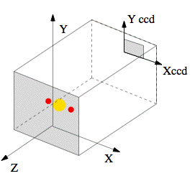
Viewports
A viewport with an angle:
    Viewport with 5 degree angle w.r.t. the HBCAM axis
    → Avoiding parasitic reflection for passive target observation
    → Viewport mounted with a 5 deg. angle in the flange
    Minimum rotation values:
    Around Y 4 deg.
    Around X 3 deg.

Slide 11
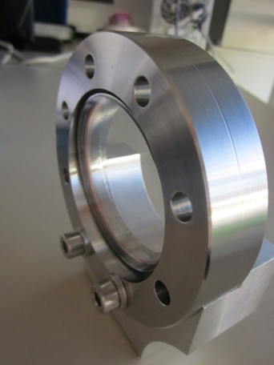
Viewports
With the help of :
G. Vandoni (TE-VSC)
Atmosphere / Vacuum interface
Parallel plates window
Studied and validated for:
  Wedge angle
  Parallel plate effect
  Deformation due to vacuum
Angle w.r.t HBCAM axis ≈ 5 deg
integrated in the viewport design
Special request to the manufacturer
effect corrected by software
→ Viewport for 2 CM delivered and validated

Slide 12
Software
Coordinate Systems
Each element has a specific coordinate system atached
Hierarchical scheme of coordinates systems :
  Topmost: HIE system → Link to the NBL
  For each table: Table system → Link between the HBCAMs
  For each HBCAM: Mount system → Calibration parameters
  CDD System → Observations
  Pivot point, lasers sources,....

Slide 13
Software
Adjusted Parameters
Translations and rotations for each table need to be estimated: 6 parameters per table in the setup
Relations between mount systems on the same table are fixed
→ Tables considered as a floating rigid body

Slide 14
Software
Data flow
Description of the full system by 3 XML files
Geometrical conf.
Sensor Param
Observation conf.
Correction for frame thermal retractions
T from CERN DB
Automatically generates
LWDAQ Script
Only temperature data
LWDAQ
Complete
Geometrical conf.
PRE-PROCESSING
HBCAM calibration parameters
Observations on targets
Observation and computation scheme
Pre-Processing:
Viewport crossing correction
Glass ball target center reconstruction
Measurements averaging
- etc…
Input file for LGC V2
Least square adjustment
LGC V2
Data formatting
Results sent to DB and to Control room

Slide 15
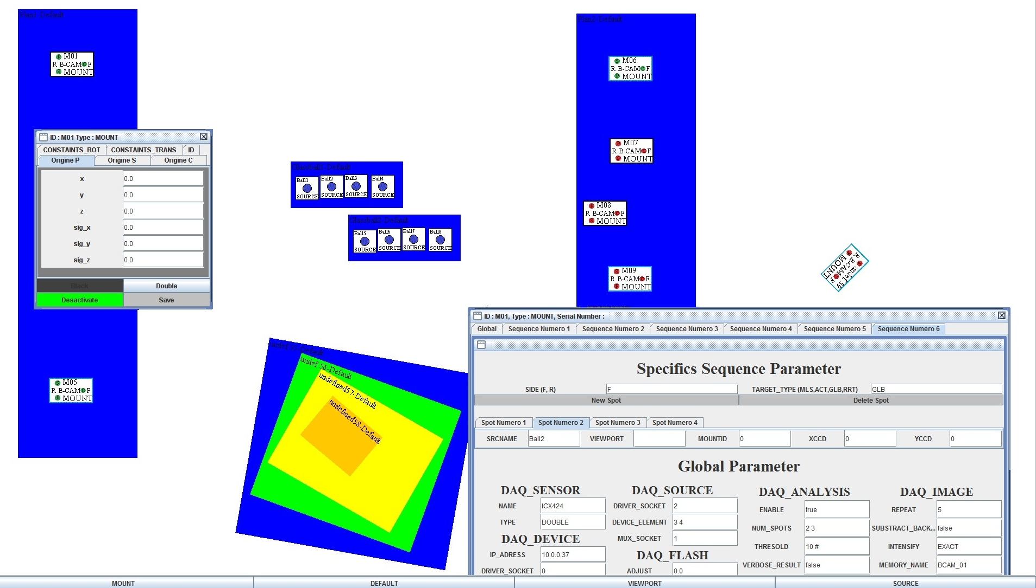
Software
GUI
GUI developed
→ Automated generation of the XML Files
Geometrical (frame hierarchy,..)
Observation configuration
…

Slide 16
Conclusion
ALIGNMENT SYSTEM MAINLY VALIDATED
HBCAMs
  Proved and used devices
  HBCAM developed, validated and procured
METROLOGICAL TABLE
  Integrated in the Inter-Tank area
  Close to final design
VIEWPORTS
  Fit well to the theory → Easy BCAM observation corrections
  High optical quality needed
  Delivered and validated
TARGETS
  Passive high index glass balls
  Targets ordered
SOFTWARE
  Development on-going
  Use of LGC V2

Slide 17

HIE-ISOLDE
Alignment and Monitoring System
Acknowledgement:
This research project has been supported by a Marie Curie Early Training Network Fellowship of the European Community’s Seventh Framework Programme under contract number (PITN-GA-2010-264330-CATHI).
Thanks for your attention

Slide 18
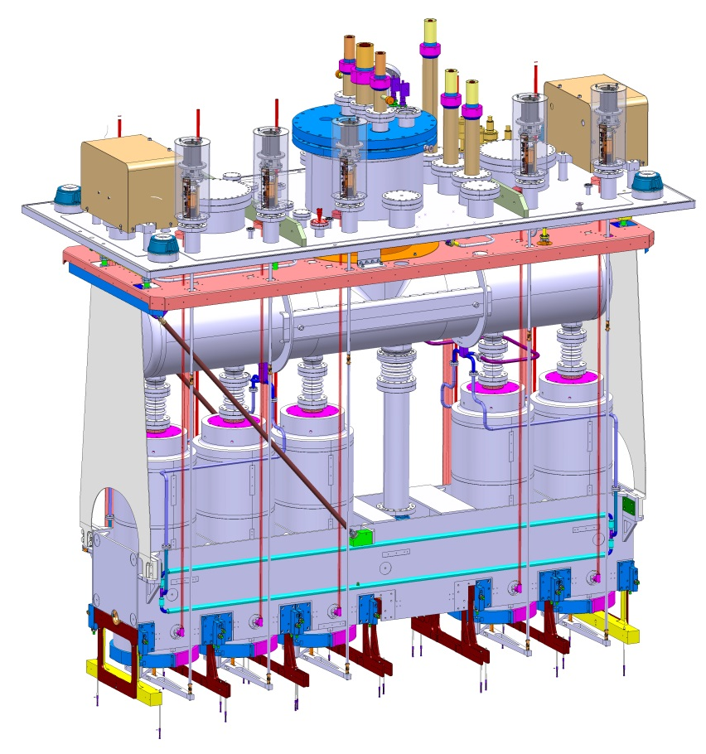

Supporting and adjustment
Cryomodule assembly in ISO Class 5 clean room
Survey sockets → Assembly / CM pre-alignment
Frame suspension and adjustment
Cavity and solenoid isostatic support: Sphere – V-shape
Precise adjustment
Solenoid adjustment allowed in operational conditions
Used as Target support

Slide 19
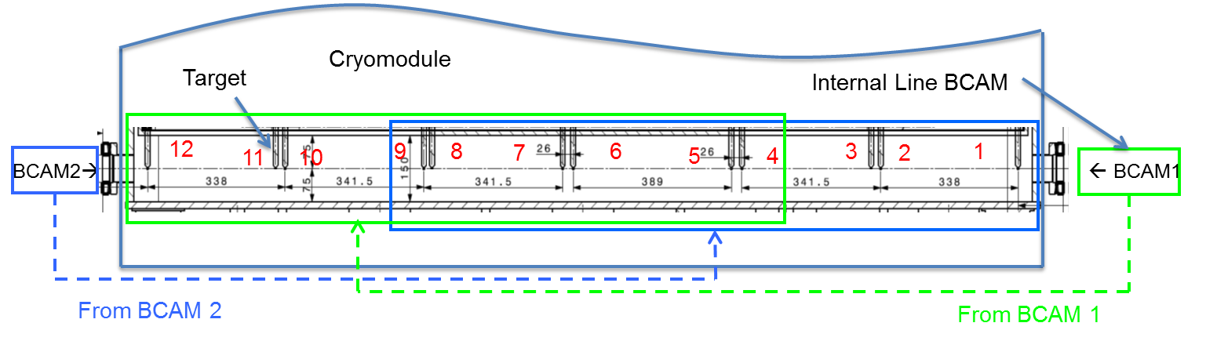
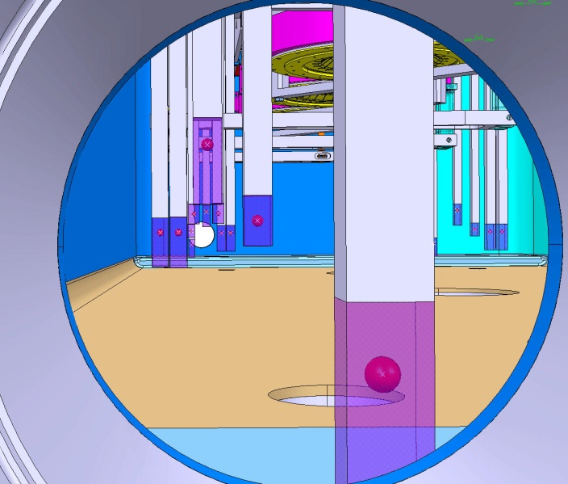
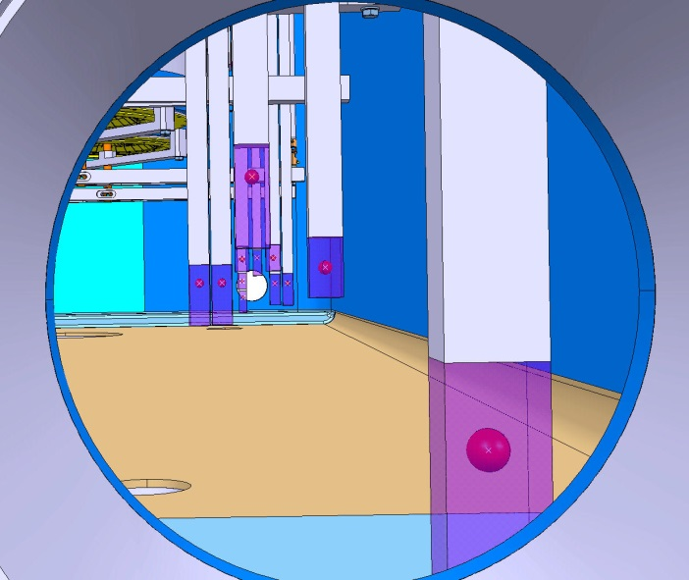

Targets
Integration
From HBCAM2
From HBCAM1
HBCAM vs BCAM Field of view

Slide 20
Targets
Overview
Constraints → HIGH VACUUM - CRYO CONDITIONS - SIZE
Studied Target Types
  Silica Silica optical fiber end
      - feed-through needed, one-sided target
      + easy light level control, OK with cold and vacuum (tested)
  Silica Silica optical fiber ended by a ceramic ball
      - feed-through needed, connection fiber/ball
      + visible from all positions, good diffuser
  Retro-reflective targets
      - illumination needed, all targets in one shot
      + double-sided, passive target, no feed-through

Slide 21
Targets
High Index Glass Balls
High index glass ball:
Developed by OHARA Inc., Kanagawa, Japan
Material : S-LAH79
Off the shelf
Available from diameter 1mm to 10mm
Diameter Tolerance (μm) : 0/-3
Sphericity (μm): 2
Refracting index of 1.993 for HBCAM Lasers (650nm)

Slide 22
HIE-ISOLDE
Glass ball theory
Study carried out by M. Šulc, Technical University of Liberec

Slide 23
HIE-ISOLDE
Glass ball theory

Slide 24
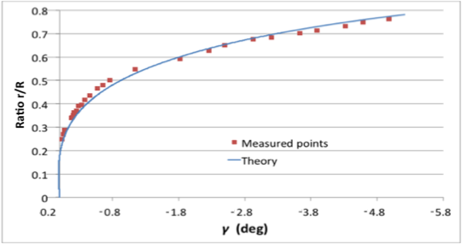
HIE-ISOLDE
Test results
Fit well to the theory

Slide 25
Targets
Outgassing
Test done by Mario Hermann (TE/VSC)
Outgassing at background level. Test done with an equivalent of 20 Ø4mm balls or 80 Ø2 mm balls.

Slide 26
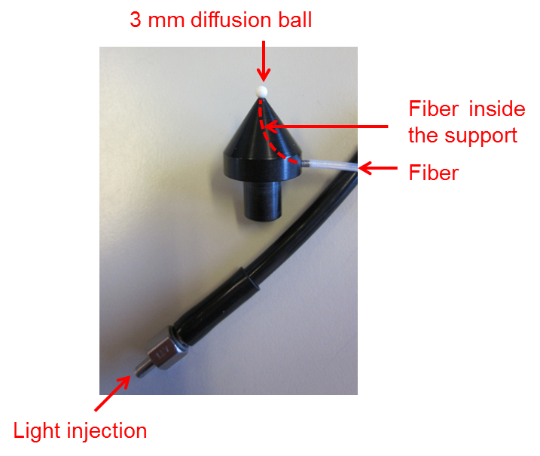
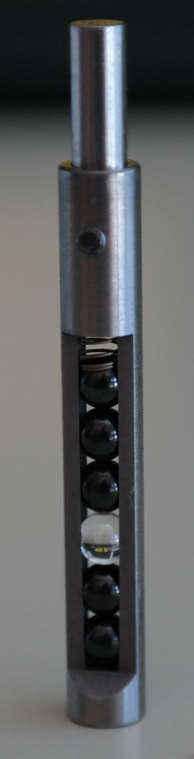
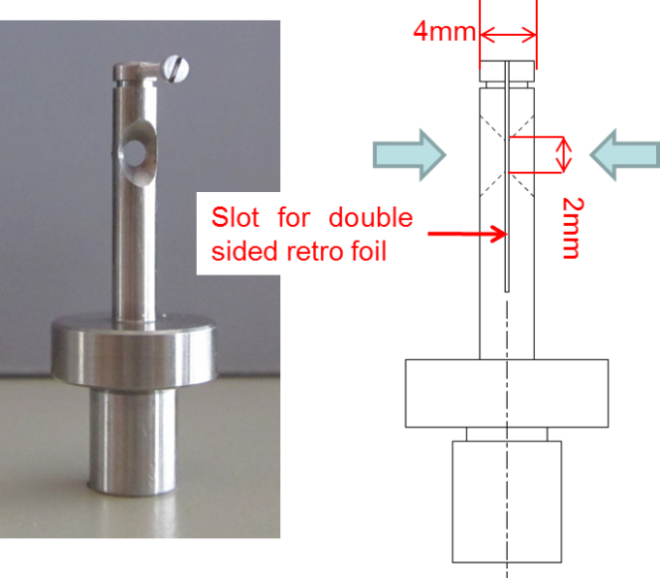
Targets
Double-sided
Three types of “double sided” targets considered
Laser illuminated ceramic balls
Retro-reflective bi-directional target
Retro-reflective high-Index Glass ball target
Test prototype for an illuminated ceramic ball synchronized to the acquisition system
But Active targets
Double sided retro-reflective target Prototype
But Not High-Vacuum compatible

Slide 27
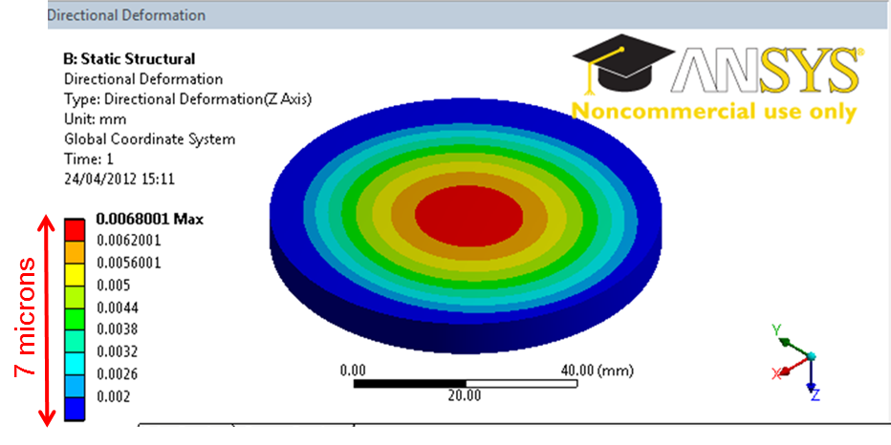
Viewports
Wedge angle
    10 microrad wedge angle acceptable
    Parallel Plate Effect
    Incident angle change of 1gon (0.9deg) → 37 microns radial object “displacement”
    Match the theory by a few microns → Easy observation correction by software
Window | Given wedge angle (microrad) from window’s technical data | Wedge angle observed (microrad) | Influence on target at 1m (micr) | Influence on target at 2m (micr)
A | 25 | 5 | 2.5 | 5
B | 50 | 10 | 5 | 10
C | 500 | 300 | 150 | 300
    Vacuum deformation
    Less than 7 microns deformation at the center
    Less than 0.015 degree of angular deviation
    Deformation measurements Liberec University (CZ):
      Results match the calculated deformations by a few microns
      Same deformation on both side → Parallelism kept

Slide 28
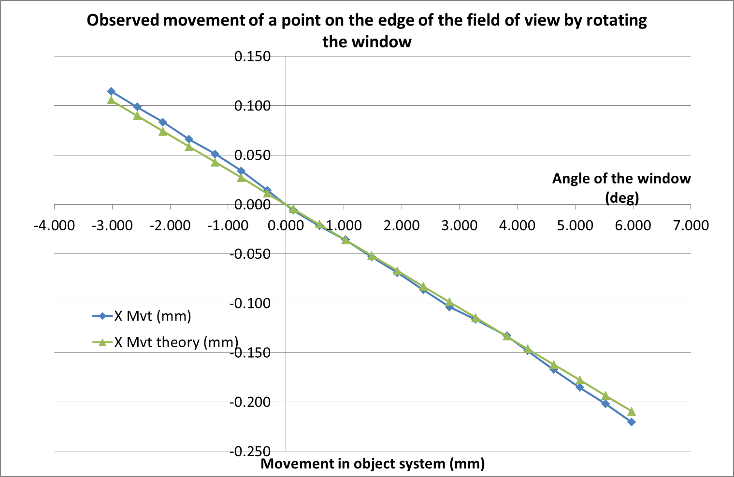
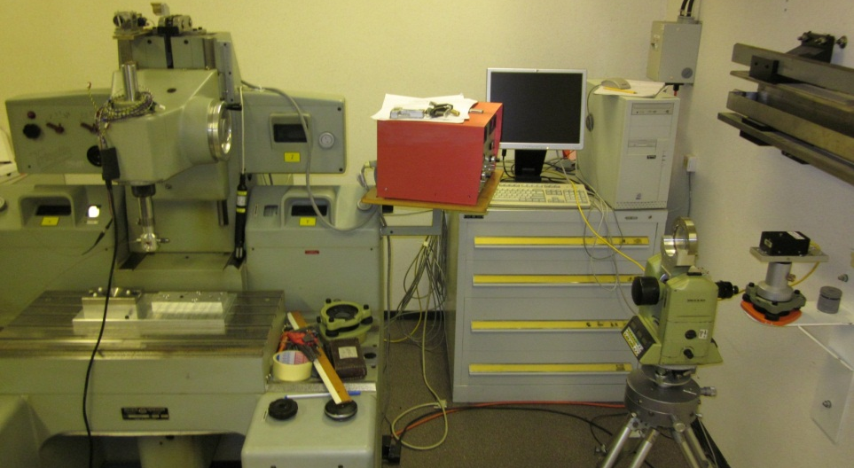
HIE-ISOLDE
Alignment and Monitoring System
Parallel plate effect on image at different incident angles
50 microns
Optical fiber attached to a Coordinate-measuring machine controlled with an interferometer
Window mounted on a theodolite (rotation) and a translating holder
BCAM W0226
Difference Theory/observed:
Average: 0 micr
Standard deviation: 6 micr
BCAM to Target distance: 1.3 m
Incident angle change of 1gon (0.9deg) → 37 microns radial object “displacement”
Match the theory by a few microns → Easy observation correction by software
Adjustment of the Window within less than 1 degree → Ease the correction

Slide 29
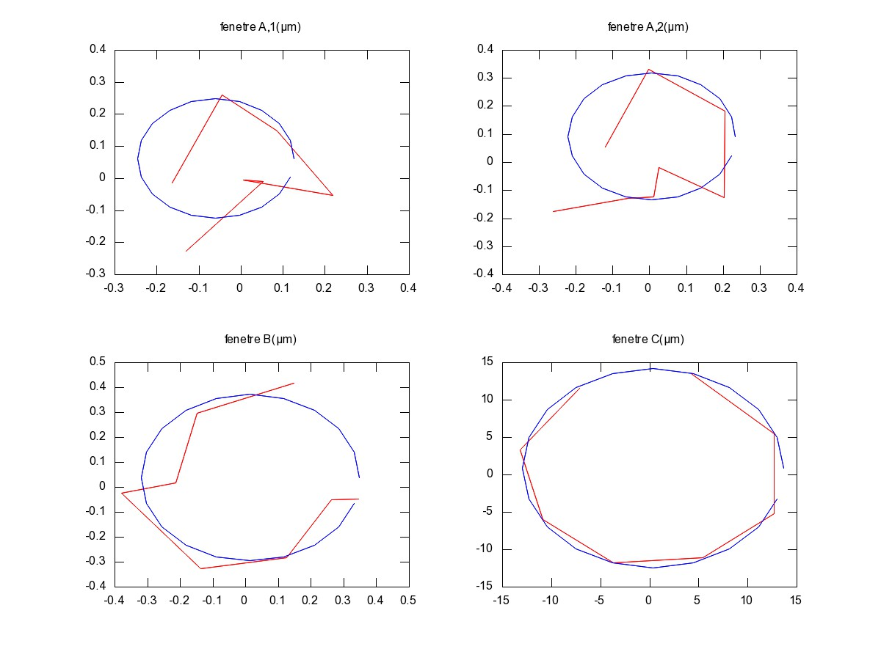
HIE-ISOLDE
Alignment and Monitoring System
Wedge angle and wedge angle effect evaluation
Principle: Measure a fix point through the window → Rotation of the window around the main axis → Observation of the point image coordinate change → Calculation of the wedge angle
Window A,1 (micr)
Window A,2 (micr)
Window B (micr)
Window C (micr)
Window | Given wedge angle (microrad) from window’s technical data | Wedge angle observed (microrad) | Influence on target at 1m (micr) | Influence on target at 2m (micr)
A | 25 | 5 | 2.5 | 5
B | 50 | 10 | 5 | 10
C | 500 | 300 | 150 | 300
Tests: Nicolas Gauthé
In red: measurements on the CCD
In blue: best fit circle
10 microrad wedge angle acceptable
Viewports better than manufacturer data

Slide 30
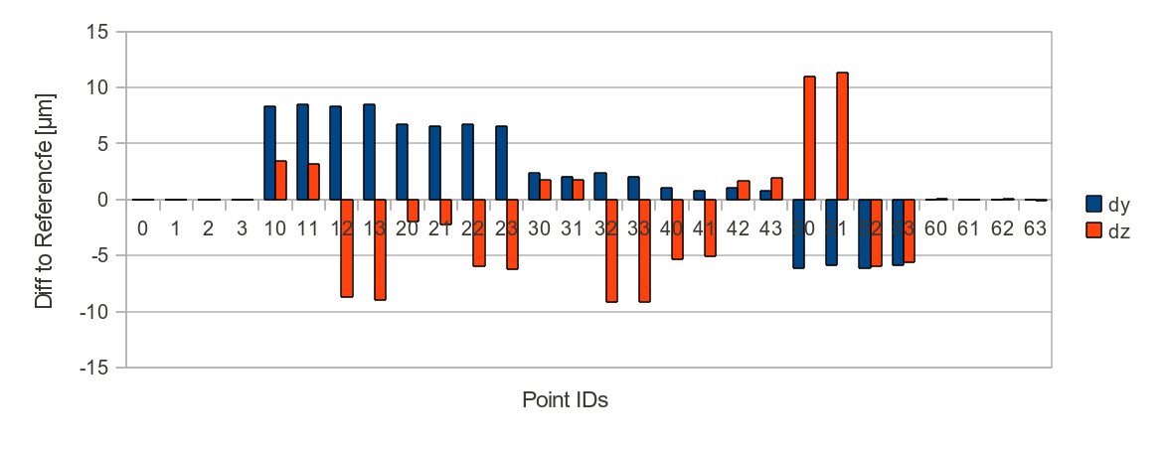
Software
Simulation results
20 microns
Σ₀²=0.0117 | σty [μm] | σtz [μm] | σrx [μrad] | σry [μrad] | σrz [μrad]
0 | 0.49 | 0.53 | 1.54 | 3.51 | 1.2
1 | 9.19 | 10.72 | 34.5 | 4.16 | 3.78
2 | 12.72 | 15.38 | 38.2 | 3.59 | 3.39
3 | 13.67 | 16.87 | 38.02 | 2.82 | 2.69
4 | 12.73 | 15.6 | 38.27 | 3.56 | 3.39
5 | 9.21 | 11.01 | 34.54 | 4.18 | 3.78
6 | 0.9 | 1.07 | 3.18 | 3.93 | 1.23
Overlapping improves the results by a factor 2
Still some error budget for the reconstruction of the targets

