Slide 1

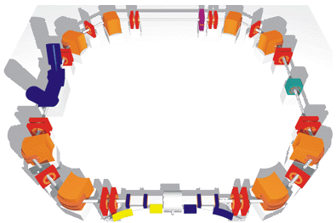
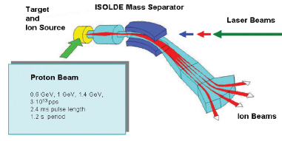


ISOLDE
TSR
+
Fredrik Wenander
CATHI Review Meeting
Barcelona 23/9-2014

Slide 2
Relativism
FCC
e⁻ + e⁺ option
FCC
p + p option
$$?
Circumference (cumbersomeness)
10000
1000
1000
100
TSR@ISOLDE
My retirement
Now
2018
2030
2040
Year
The area of the dot corresponds to the cost

Slide 3
High-energy and low-energy storage rings
Storage Rings for Physics with Exotic Nuclei
High-energy
Low-energy
ESR @ GSI
CSRe @ IMP
RI-RING @ RIKEN
CR @ FAIR
HESR @ FAIR
NESR @ FAIR
RESR @ FAIR
HIAF
TSR @ ISOLDE
CRYRING @ ESR
Easy access to highest charge states
Highly-charged ions at low-energies
TSR beams originates from opposite side of the energy spectrum
Courtesy Y. Litvinov

Slide 4
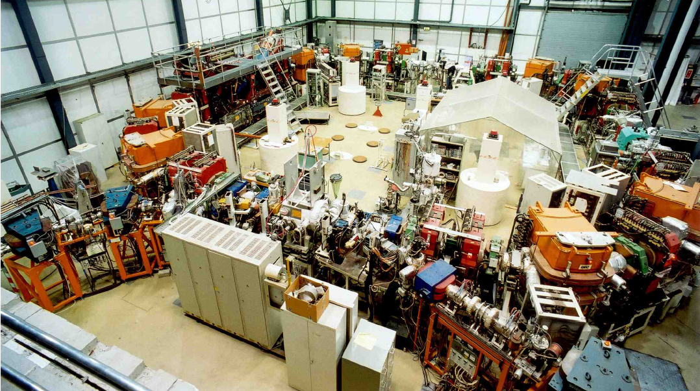
Test Storage Rings at Heidelberg
experiment
resonator
ECOOL
* In operation since 1988
* Mainly for atomic physics studies and accelerator development
* One nuclear physics experiment – FILTEX
(internal polarized
H₂ gas target)
extraction
injection
Courtesy MPI-K
Circumference: 55.42 m
Vacuum: ~few 1E-11 mbar
Acceptance: 120 mm mrad
Multiturn injection: mA current
Electron cooler: transverse T_{cool} in order of 1 s
RF acceleration and deceleration possible
Typical energy ¹²C⁶⁺: 6 MeV/u
www.mpi-hd.mpg.de/blaum/storage-rings/tsr/index.en.html

Slide 5
A storage ring at an ISOL facility
Advantages
Compared to in-flight storage rings
Higher intensity
Cooler beams / Shorter cooling time
  Compared to direct* beams
Less background
(target container, beam dump)
Improved resolution
(smaller beam size, reduced energy straggling in target)
CW beam
Luminosity increase for light beams
Physics programme
  Astrophysics
  Capture, transfer reactions
  ⁷Be half life
  Atomic physics
  Effects on half-lives
  Di-electronic recombination
  Nuclear physics
  Nuclear reactions
  Isomeric states
  Decay of halo states
  Laser spectroscopy
  Neutrino physics
* reaction experiments with non-circulating,
‘thick’ target after linac

Slide 6
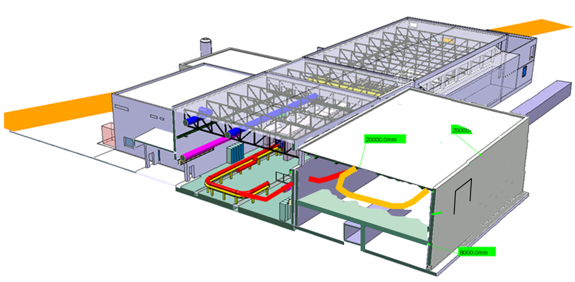
Building layout
Presently at MPI-K, Heidelberg, a large hall is housing the TSR with enough space around it for experiments and equipment that need to be close to the ring. The basement underneath the ring is used for power supplies and other necessary equipment.
36m
service tunnel
26m
10m (7m between floor and crane hook)
Proposed layout to fit the TSR:
Installation above the CERN service-tunnel.
Tilted beam-line coming up from the machine.
4.73m above Isolde hall floor
6
Courtesy E. Siesling

Slide 7
Machine performance

Slide 8
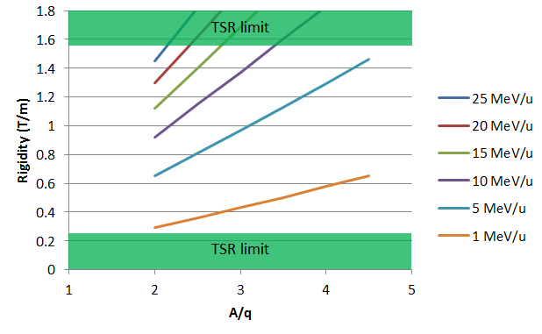
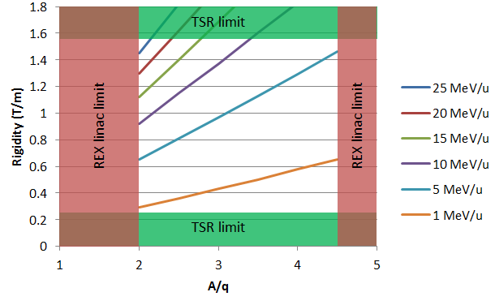
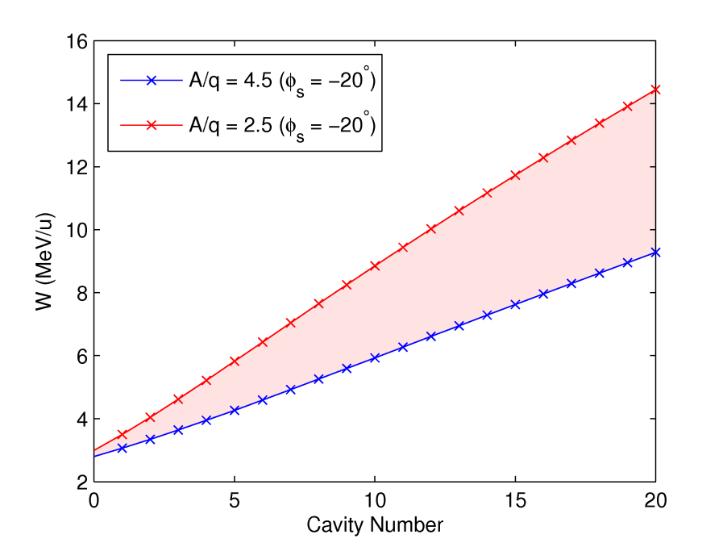
Ring beam energy
Storage
energy
TSR magnetic rigidity
range: 0.25-1.57 Tm
REX linac 2<A/q<4.5
Rigidity (Tm)
5 MeV/u sufficient for lifetime and nuclear
structure studies
A/q = 2.5
W = 14.5 MeV/u
βγ = 0.177
HIE stage 2a
Beam can be accelerated (and decelerated) inside the ring
☹ Takes several seconds though
A/q =4.5
W = 9.3 MeV/u
βγ = 0.140
Courtesy M. Fraser

Slide 9
e-cooling
  E-cooling needed for:
  Reducing momentum spread
  Stacking of multi-turn injection
  Compensate for energy loss in target
  Reducing beam size
Δp/p ~ 5E-5 (rms)
Δp/p < 1E-5 (rms) for N<1000
HIE-ISOLDE Δp/p ~ 1E-3 (rms)
one dimensional
ordering
Measurement done
with 7 MeV protons
at the LSR storage ring,
Kyoto University
equilibrium
IBS and cooling
T. Shirai et al. PRL 98, 204801 (2007)

Slide 10
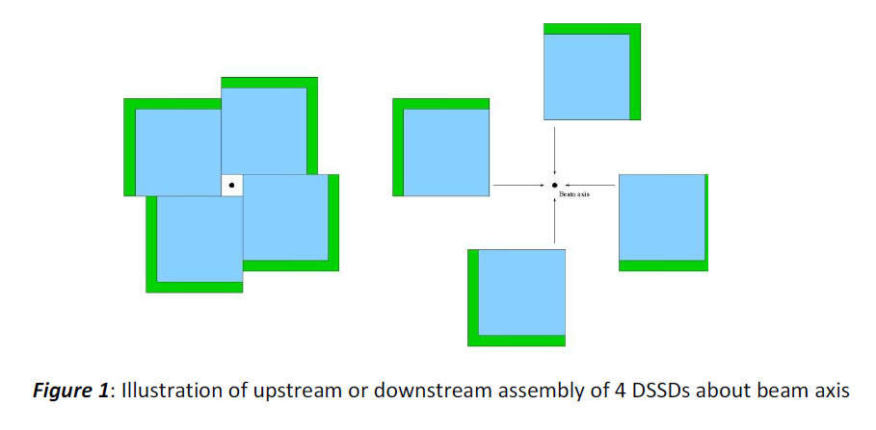
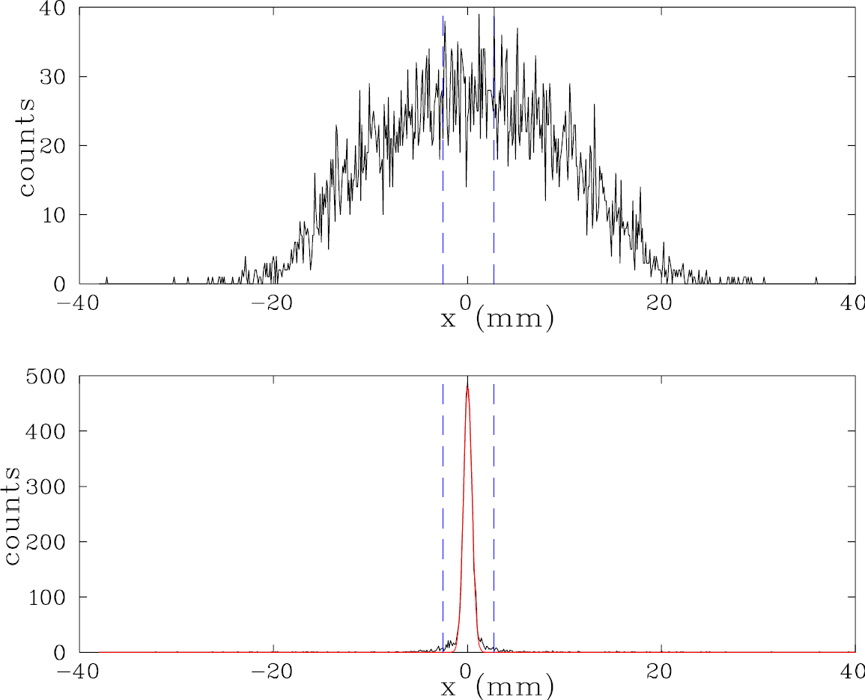
e-cooling
  E-cooling needed for:
  Reducing momentum spread
  Stacking of multi-turn injection
  Compensate for energy loss in target
  Reducing beam size
Assembly of 4 movable DSSD positioned
up- or downstream of target point
Before cooling
From T. Davinson
and P. Woods
After cooling
M. Beutelspacher,
Diploma thesis,
University Heidelberg,
1997
Radial beam extension

Slide 11
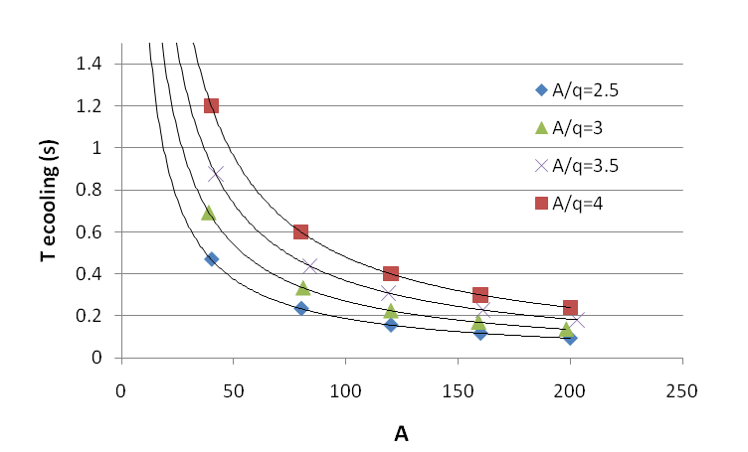
e-cooling
  E-cooling needed for:
  Reducing momentum spread
  Stacking of multi-turn injection
  Compensate for energy loss in target
  Reducing beam size
in the velocity range
0.03<ß<0.16
ion | T_{cool} (s) | nuclear τ_{n} (s) | fraction of particles left after cooling
⁸B³⁺ | 2.7 | 0.77 | 3 %
¹⁰C⁴⁺ | 1.9 | 19.3 | 90 %
¹⁶C⁴⁺ | 3 | 0.747 | 2 %
T_{cool} – horizontal cooling time for beam with
large diameter
Proposed ions for laser spectroscopy

Slide 12
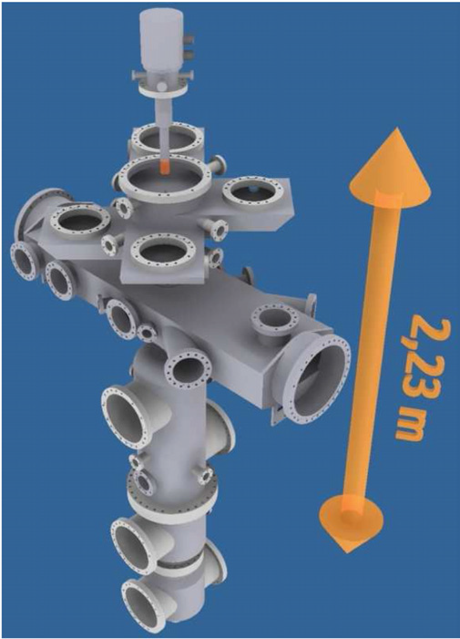
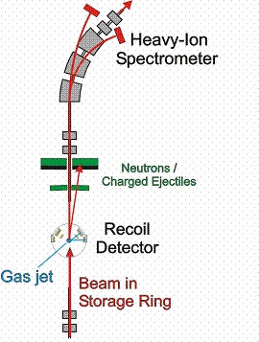
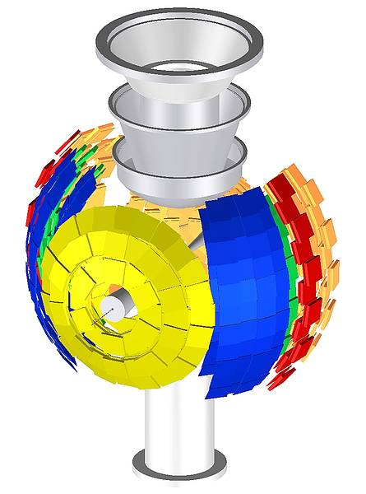
In-ring experiments¹
* SAS allows for either electron, gas-jet or no target to be installed.
* Experimental setups installed on precision rails, moveable in and out from ring.
Layout of the new target inlet chamber design with the existing interaction chamber and target dump system for the ESR in Darmstadt.
From EXL collaboration
Gas-jet target
* Not existing, being studied
* Targets with thicknesses of
∼ 10¹⁴ atoms/cm² for light gases
as H₂, d, ³He and ⁴He
TSR gas-jet study group being formed
1. See M. Grieser et al., EPJ Special Topics May 2012, vol 207, Issue 1, pp 1-117

Slide 13
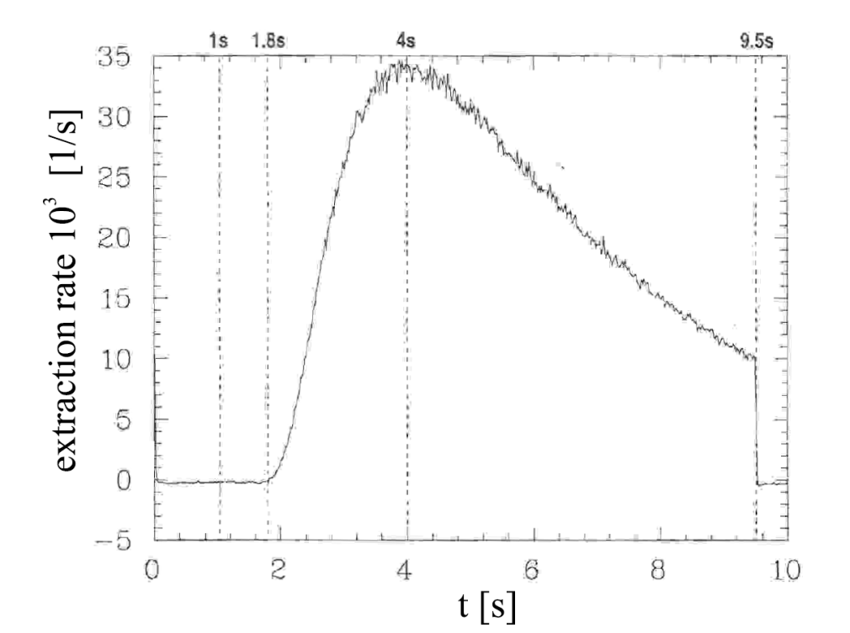
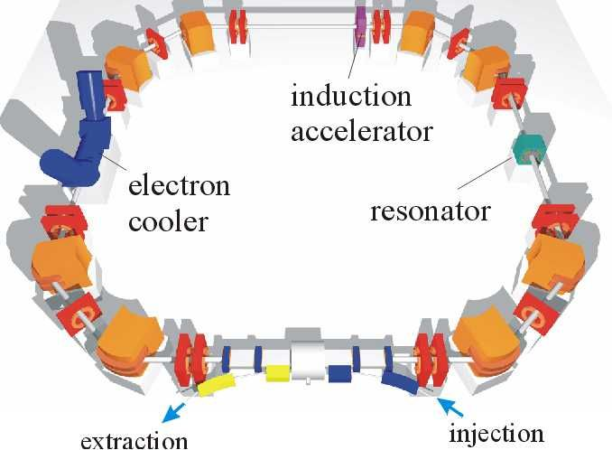
Slow extraction
Extraction times
between 0.1 s and 30 s
Efficiency (cooled beam) ≈ 90%
Properties similar to those
of the cooled beam
M. Grieser
Normal procedure for ¹²C⁶⁺
Inject at Q_{x}=2.64
e-cool for 1 s
Shift Q_{x} close to resonance 8/3
Apply 30 kHz noise on kickers
Emittance increase -> beam extraction
cooling ≈0.5 s
injection
≈10⁵ ions
stacking ≈τ
13
extraction ≈5 s

Slide 14
Many different ways of operating the machine
Injection rate
e-cooling
≈0.5 s
injection
Reaction measurements
gas-jet switched on
measurement ≈ 1-2 s
CB
REXTRAP trapping + cooling
cooling 0.2-1 s
injection
e-cool stacking
measurement, acceleration, mass separation
(no target inside the ring)
Based on R. Raabe presentation

Slide 15
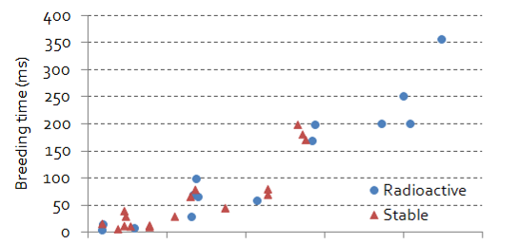
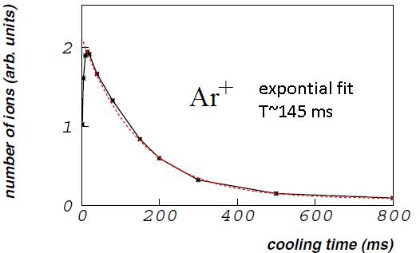
Storage in REXTRAP essential
* T_{_rep_rate} < 0.5 Hz not unusual due to e-cooling and/or in-ring beam exploitation
EBIS breeding time
T_{breed} < T_{rep_rate} in many cases
+ ample time to reach high charge states
A
0 50 100 150 200 250
Holding time in REXTRAP
⁶⁰Ni⁺ and ⁸⁷Rb⁺ kept for >1.5 s
Concerns
Short-lived ions
Space-charge effects (ω_{c} changes; eff. decrease)
Noble gases and ions with high I.P. such as F, Cl, Br
P. Delahaye et al., Nucl Phys A746 (2004) 604

Slide 16
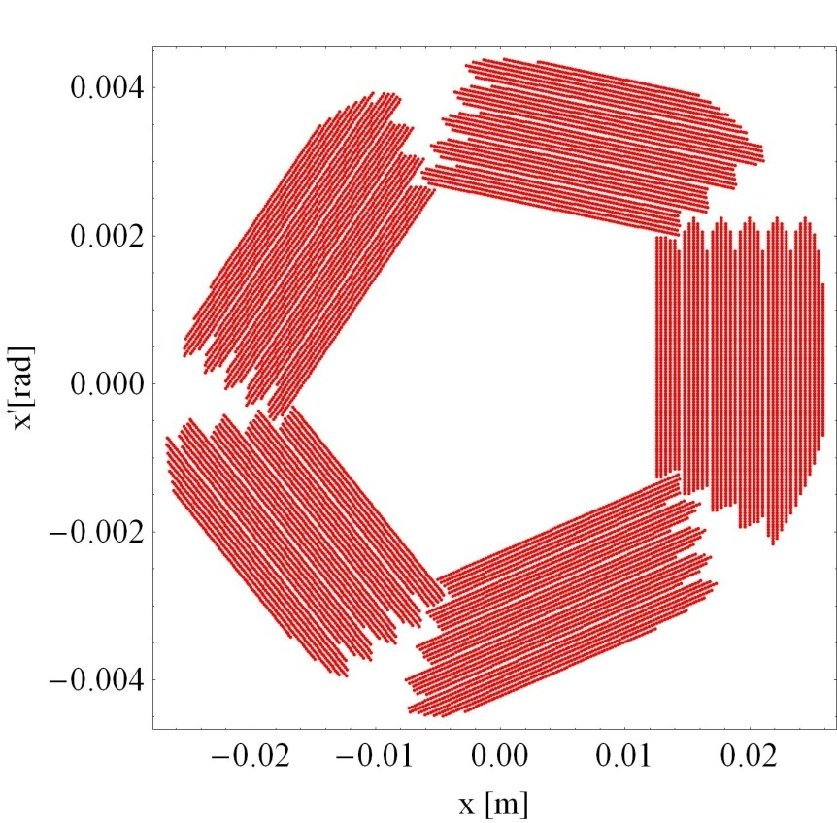
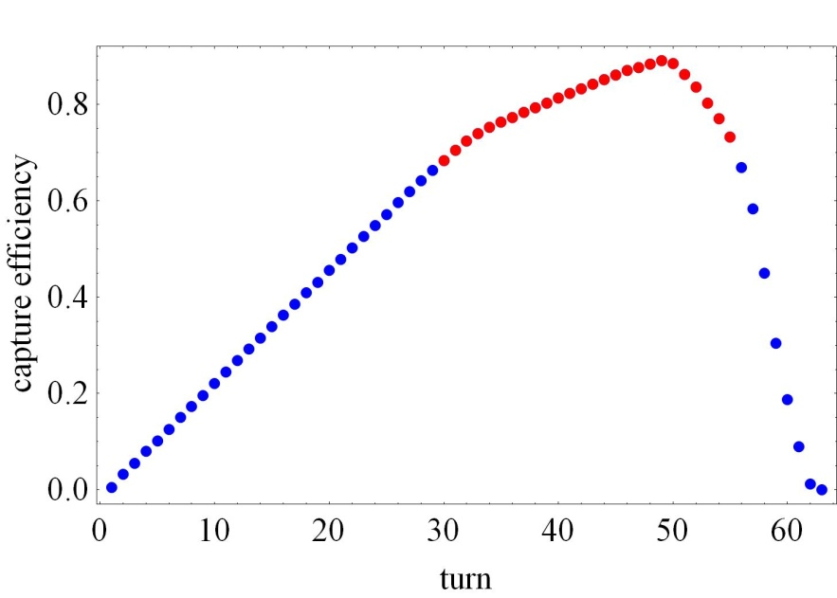
Ring injection time
High injection efficiency of outmost importance
Multi-turn injection
Slide from M. Grieser
transverse phase space
ε≈0.8
collisions with
the septum foil
collisions with
the acceptance
Δt=length
injector pulse
closed orbit at
the septum foil
Δt ≈ 25 turns
typically ≈ 33 μs at 10 MeV/u
closed orbit
= 4 mm·mrad
Q_{x}=2.8

Slide 17
Beam-line layout

Slide 18
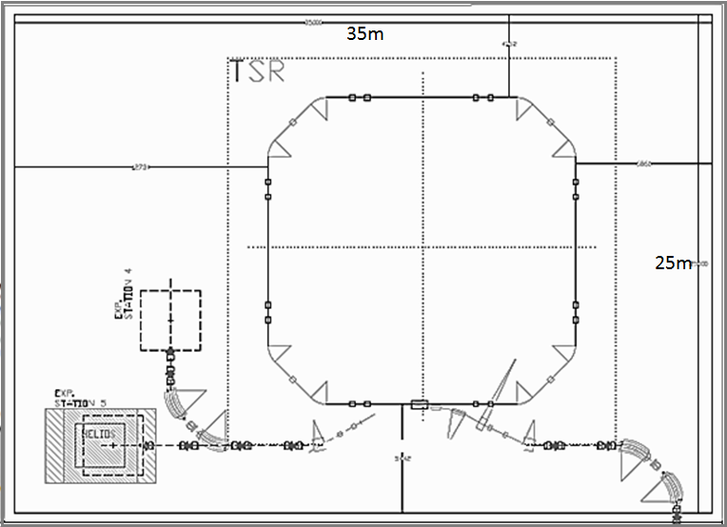
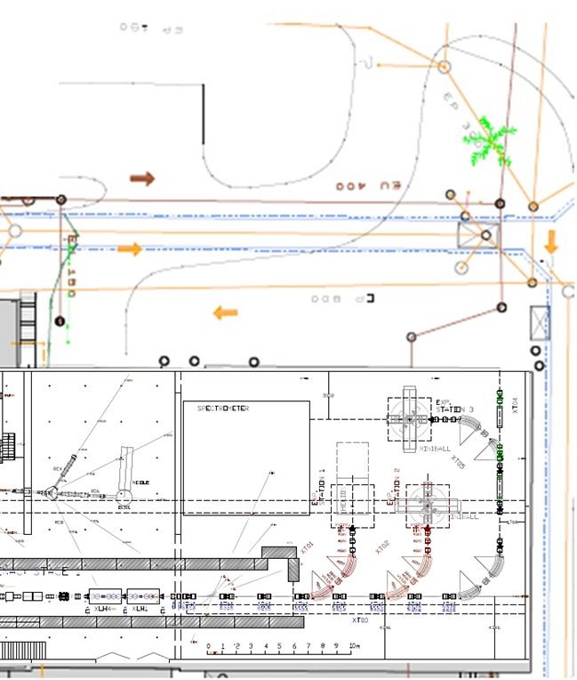
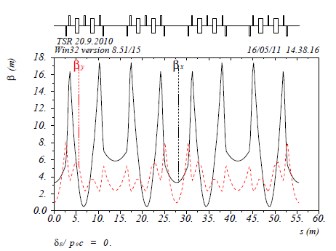
Beam-line layout
35 m
4.15 m
1. Achromatic injection line
* Links HIE-ISOLDE to TSR ring via XT04
* Considers HIE-ISOLDE and TSR
floor level difference of 4.73 m
2. Standard HIE-EBIT elements
Position at
Heidelberg
6.86 m
12.73 m
extraction
lines
e-cooler
In-ring
experiment
25 m
3. Tentative layout for two experimental stations.
horizontal achromat
existing at
Heidelberg
XT04
M. Grieser
HIE-ISOLDE
HEBT area
vertical achromat
Injection
septum
e-cooler
Target
station
RF
system
Beam profiler
HIE-ISOLDE linac
Heidelberg layout

Slide 19
Charge breeder upgrade

Slide 20
Charge states out of REX
  Benefits from high q
  Rigidity TSR
  Storage lifetimes
  Cooling times
  Experiments
REXEBIS charge breeding times for a selection of elements of relevance for TSR@ISOLDE experiments
Ion | Z | q | A/q | Breeding time (ms)
⁷Be | 4 | 3 | 2.33 | 20
¹⁸F | 9 | 9 | 2 | 100
⁷⁰Ni | 30 | 25 | 2.33 | 350
¹³²Sn | 50 | 39 | 3.38 | 700 *
¹⁸²Pb | 82 | 53 | 3.43 | 1000 *
¹⁸²Pb | 82 | 64 | 2.84 | EBIS upgrade needed
* to be tested
☺ REXEBIS charge breeder capable of producing sufficiently low A/q (or beam rigidity for < 10MeV/u) for most elements

Slide 21
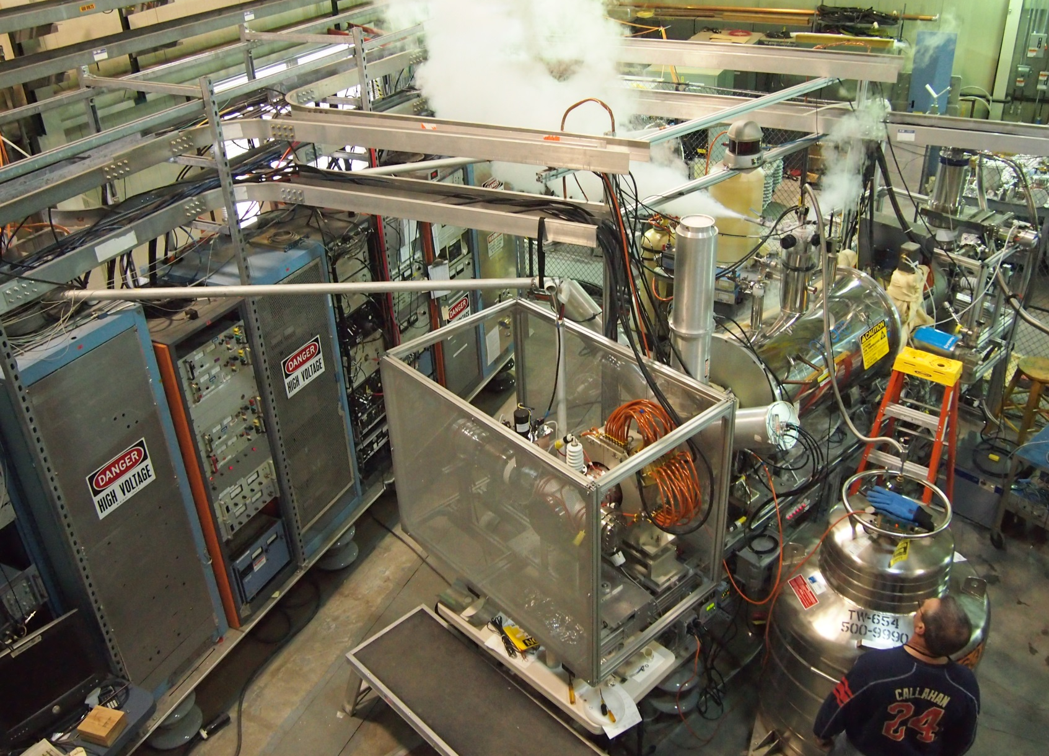


Charge states out of REX
  Benefits from high q
  Rigidity TSR
  Storage lifetimes
  Cooling times
  Experiments
* to be tested
☹ But some experiments might require:
* Fully stripped to Z~60
* Few-electron system, e.g. for Th/U
Addressed by HEC² EBIS
see A. Shornikov’s talk

Slide 22
Technical integration study

Slide 23
Technical integration study
Two approaches 1. CERN homologation (full-fledged ‘standardization’)
2. Keep-system-as-is (low-budget option with minimal changes)
Dismantling and reassembly
General safety
Control system and applications
Civil engineering and infrastructure
1. Obsolete electronics
Improve sensitivity
2. Change for Finement® type
3. Exchange bakeout system
4. Improve electrical safety
5. External targets on elements
Inj-ext septum
Magnets⁴
Induction accelerator
Beam diagnostics¹
In-ring experiments
18 work packages
Alignment and survey⁵
Power converters
Vacuum³
Radioprotection
Scrapers
Extraction line
Red: fully replaced
Blue: complemented and improved
Green: accepted or minor upgrades
Orange: not part of costing
RF²
E-cooler
Recommendations by CERN specialists for scenario 1

Slide 24
Technical integration study - conclusions
The radiological concern of importing the ring is minimal.
Well advanced civil engineering plan with associated infrastructure exists.
No technical show stoppers for the implementation – standard solutions identified.
CERN integration proposal
Keep-system-as-is
a. First cost and manpower estimate believed to be conservative. However, no contingency included.
b. Most CERN groups have insisted on hardware changes and CERN standardization and discourage a 3 years transition period.
Total cost and manpower for transfer and integration into a CERN facility:
15.2 MCHF 27.5 FTE (man year)
a. Would need to keep all subsystems as they are since many are interlinked with the control system.
b. Would have limited / no support by CERN groups; longer dependence on MPIK Heidelberg.
The approximate cost and manpower need
for the Keep-system-as-is scenario are:
11.8 MCHF 17.1 FTE (man year)
The cost saving might appear low. Reasons:
* The main cost drivers are the injection line, buildings and infrastructure.
* Some spares, complementing parts and replacement parts are absolutely necessary.
* Includes the mandatory electrical protection of magnets connections.
* Includes sensitivity improvement of the beam diagnostics.
NB. The figures have not been considered the CERN management

Slide 25
General conclusions
  TSR matches the HIE-ISOLDE characteristics
  A storage ring at an ISOL facility: a unique instrument
broad range of elements and isotopes
wide energy range
e-cooled beams
several tools for beam manipulation and detection
First storage ring with ISOL-facility!
  The technical aspects of the integration have been studied
  Now awaiting response from the management…

Slide 26
Thanks for your attention!
Credits to
M. Grieser MPI-K
Experimentalists K. Blaum, P. Butler, R. Raabe, Y. Litvinov, P. Woods…
TSR@ISOLDE collaboration
CERN support groups

