Slide 1
CERN-MEDICIS:
Production d’isotopes selon l’approche « ISOLDE » pour la recherche médicale: A NEW INSTALLATION
Thierry Stora - Stefano Marzari
Sept 2014

Slide 2
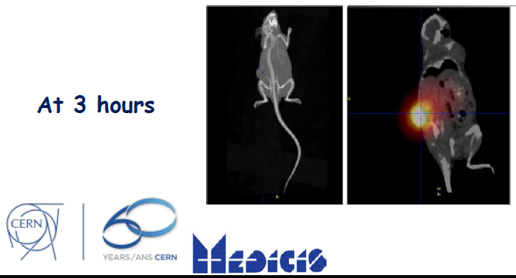
The idea behind
CERN-MEDICIS (MEDical Isotopes Collected from ISOLDE)
… For Medical diagnostic and Treatment of tumors…

Slide 3
It made its way
to the local newspapers

Slide 4
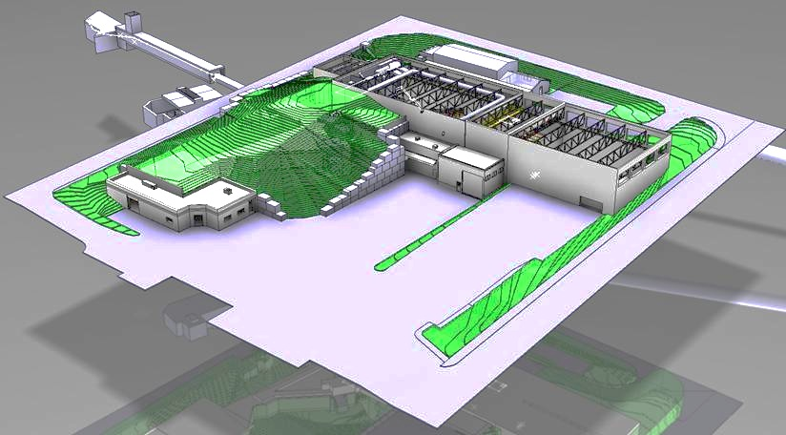
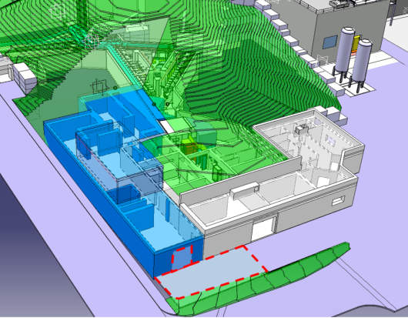
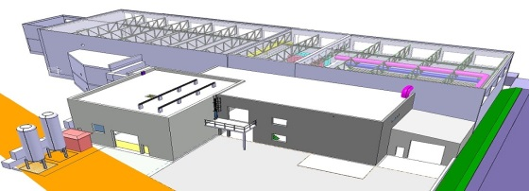
Ongoing upgrades
Long-Shutdown 1 (~18 months)
Ca 50% of PSB Protons are sent for the ISOLDE physics program
Bld 508
(soon a TSR ?)
Tunnel :
Proton Synchrotron Booster
transfer line to ISOLDE
Target building (Class A)
HIE-ISOLDE
MEDICIS building

Slide 5

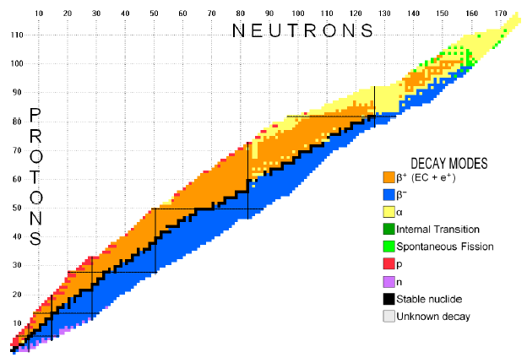
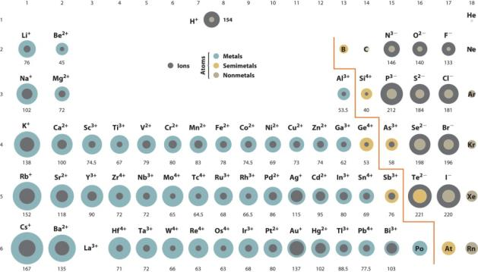
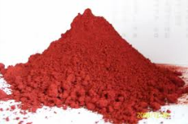
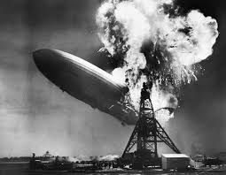
Production of Radioactive ion Beams

Slide 6
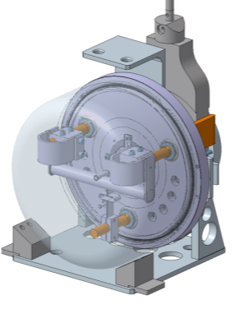
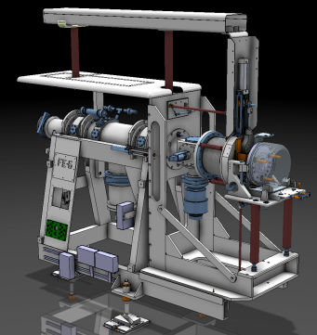
The ISOL method
spallation
1.4 GeV protons
fragmentation
fission
Target unit
Front End (target station)

Slide 7
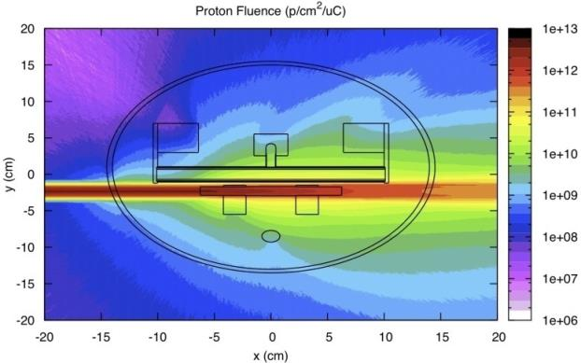
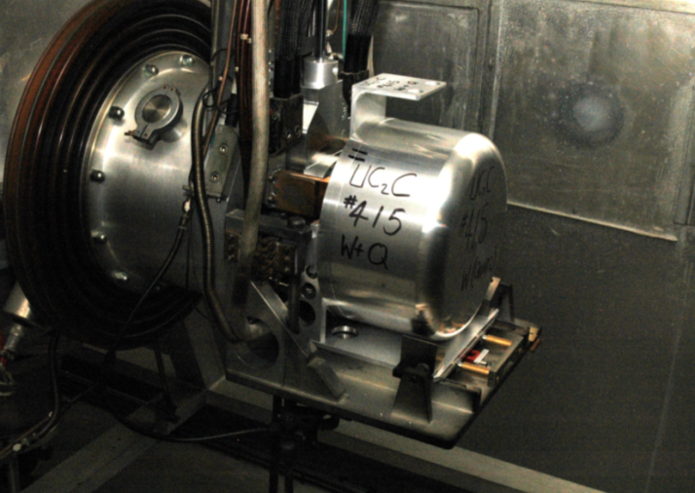
The MEDICIS fingerprint
90% are
going to the dump:
We can recycle them !

Slide 8
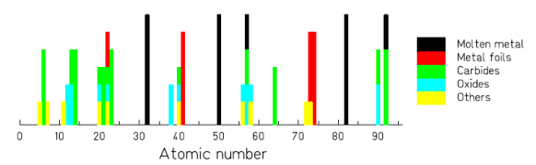
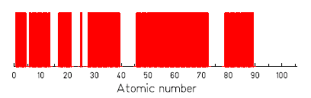
1000+ isotopes of 70+ chemical elements
Exotic isotopes down to t_{1/2} ~ 10 ms)
Intensities up to 10¹¹ ions/s
30+ types of targets
Transfer lines
10+ ion sources

Slide 9
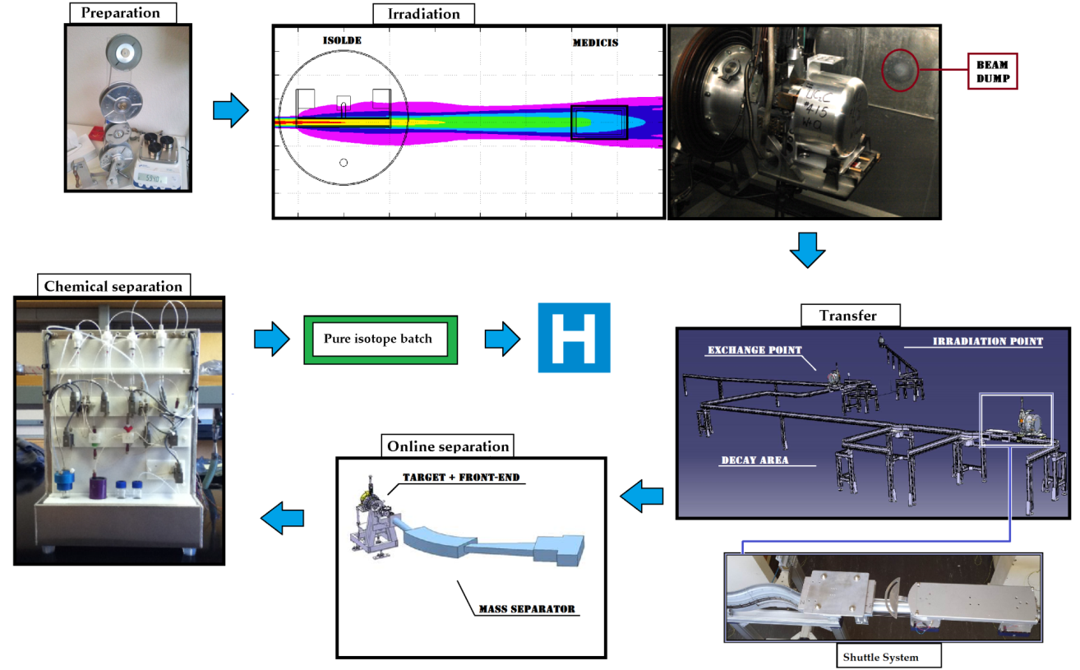
The complete cycle of MEDICIS

Slide 10
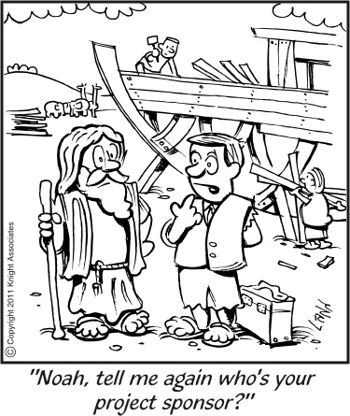
The Project

Slide 11
The planning proposal *
*subject to modification…
 | Construction | 2013-2015
PHASE I | Commissioning : No beam | end 2015
PHASE II | Commissioning with beam and light targets to gain operational experience | 2016
PHASE II B | Isotope production with light targets | mid 2016
PHASE III | Extending to heavy targets up to Tantalum | end 2016
PHASE IV | Collection of short lived alpha emitters (e.g. 149Tb) | 2017
PHASE IVB | Operation with Lasers
PHASE V | Operation with Uranium targets/possible proton beam upgrade | 2018

Slide 12
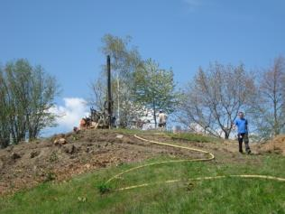
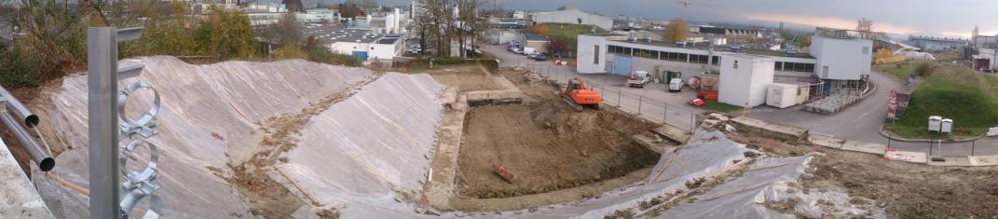
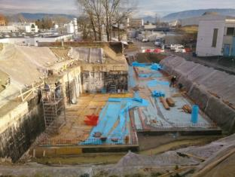
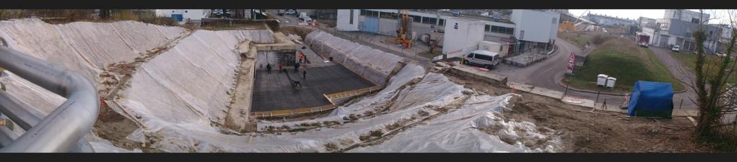
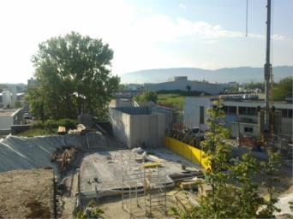
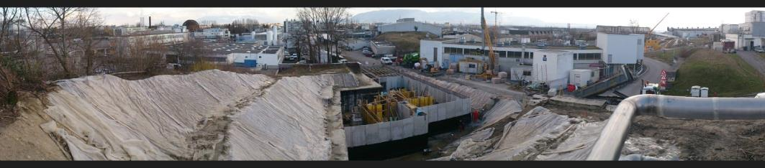
Building construction…

Slide 13
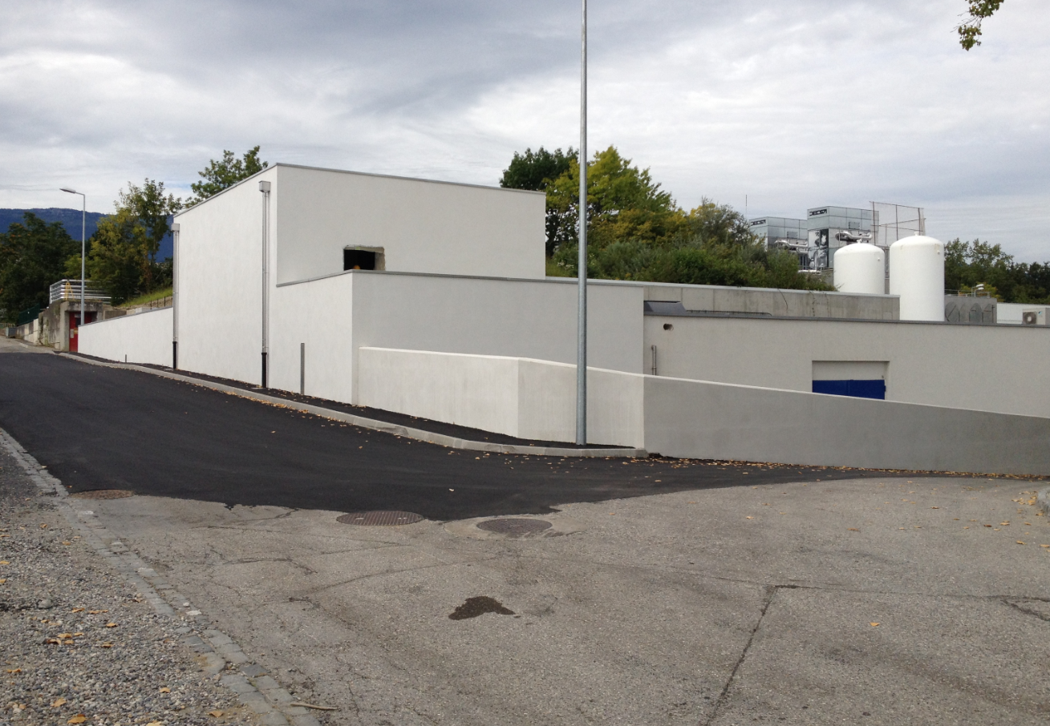
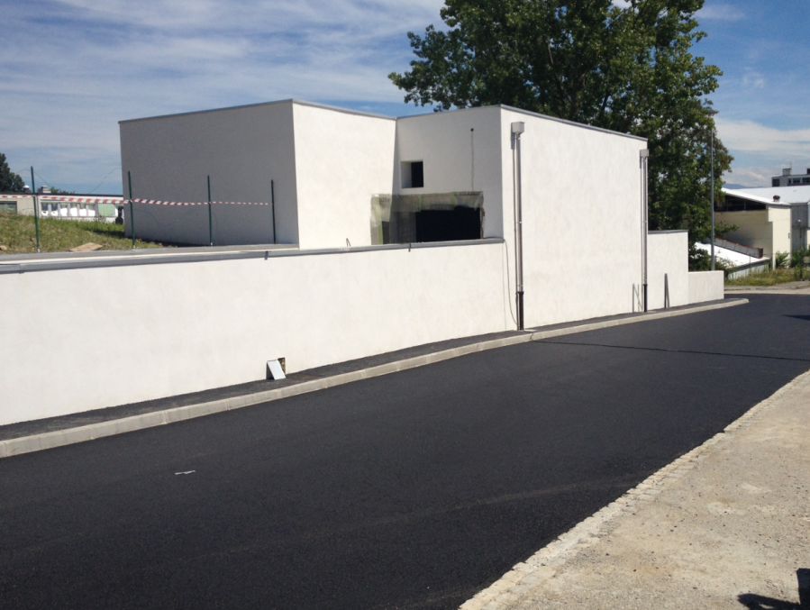
Building (atcual)

Slide 14
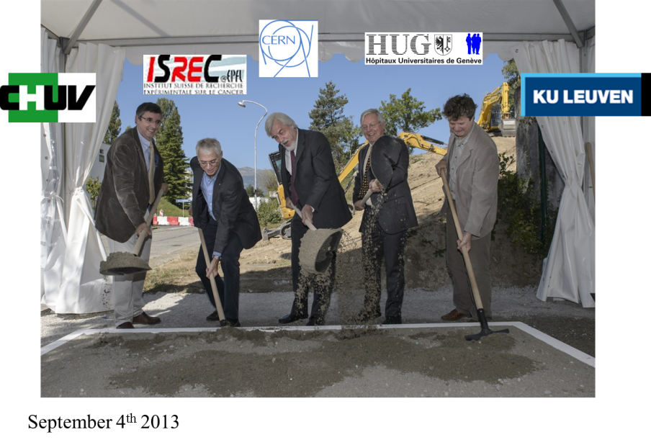
The Ground-breaking

Slide 15
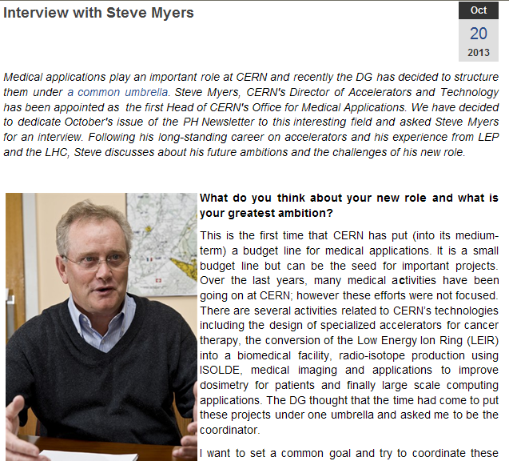
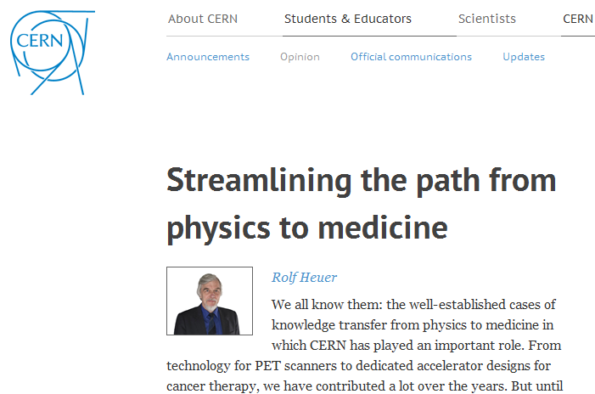
A new office for biomedical applications at CERN
Kick-off meeting : 22 Nov 2013
Brainstorming in Divonne Les Bains 15-16 Feb. 2014

Slide 16
Overview of the team
The MEDICIS team at CERN:
T. Stora (MEDICIS), S. Marzari (Building, WPs), R. Catherall (HIE-DS coord, WPs), A.P. Bernardes (g-al safety, WPs), K. Kershaw (remote systems, WPs), Z. Lawson (KT aspects)
M. Vagnoni (RCS), R. Augusto (Fluka), A. Polato (CV), E. Perez-Duenas (Bld), V. Barozier (Intégration), R. Necca (EL), J.L. Grenard (Robot), C. Mitifiot, M. Stachura (Bio R&D), J. Vollaire (RP), A. Dorsival (RP), EN-MEF (tbc, doors), Y. Martinez (isotope separator), T. Wijnands (quality), etc
tbcont’d

Slide 17
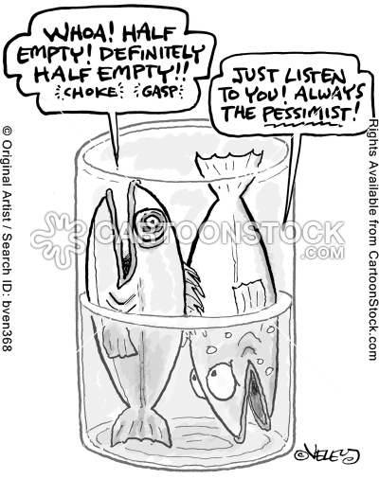
Some recent news

Slide 18
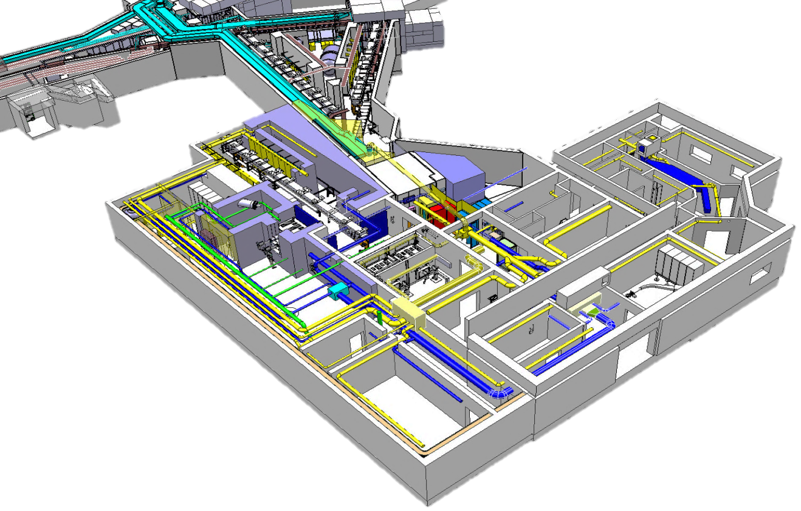
Integration

Slide 19
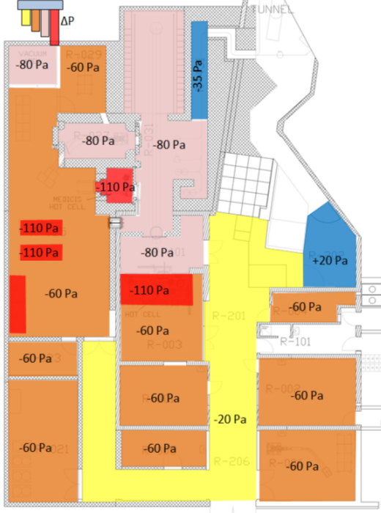
Ventilation : an important aspect
Next steps:
Final validation (meeting with OFSP)
Installation
Connection in 2014-2015

Slide 20
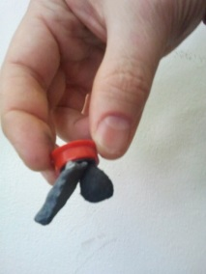
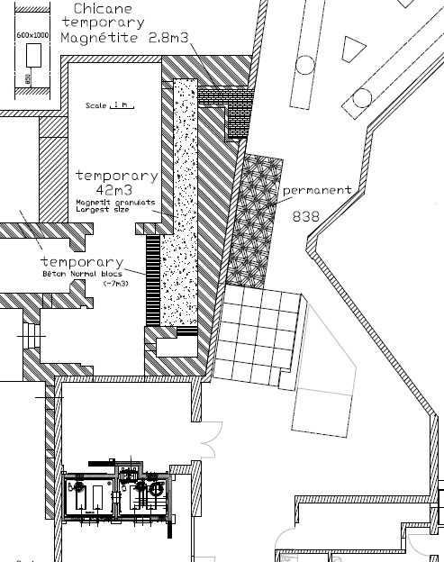
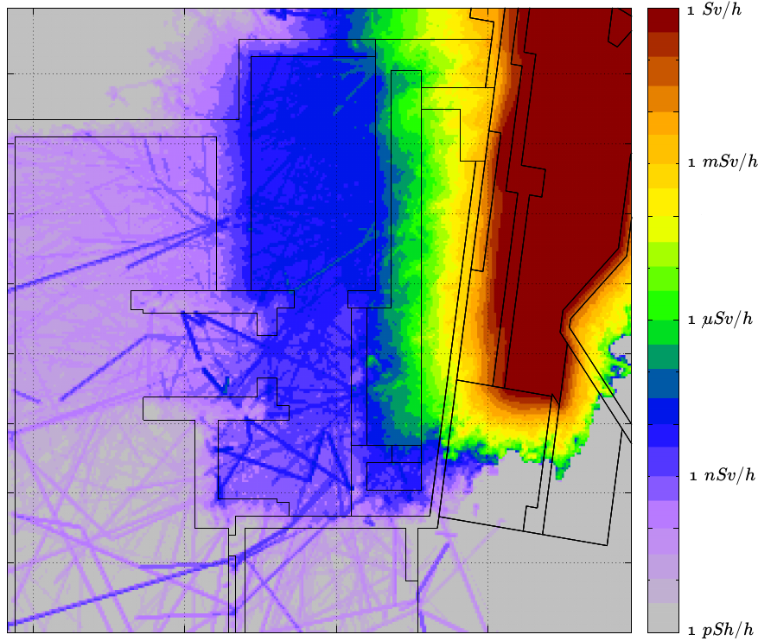
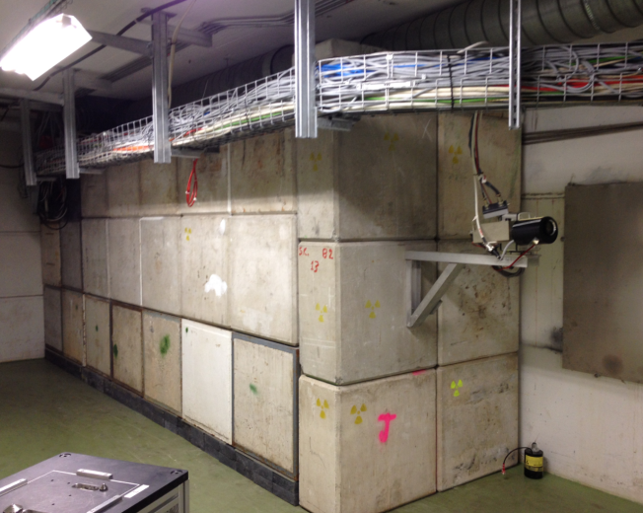
Magnetite concrete for temporary and permanent shielding

Slide 21
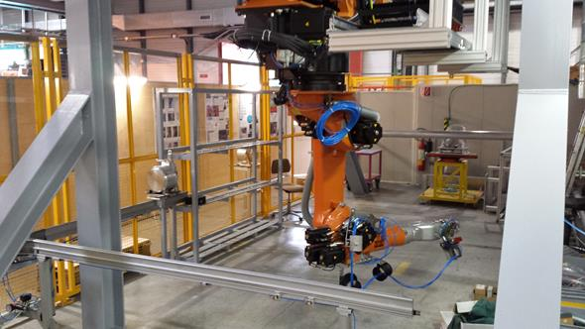
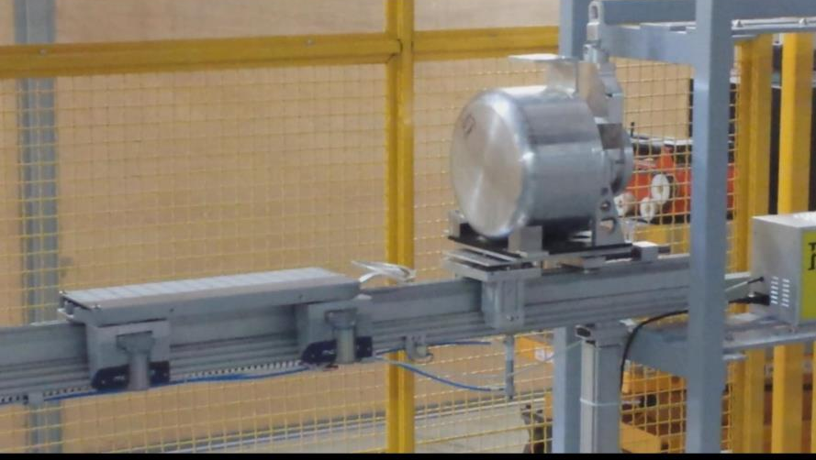
The robotic system
Tested during open days

Slide 22
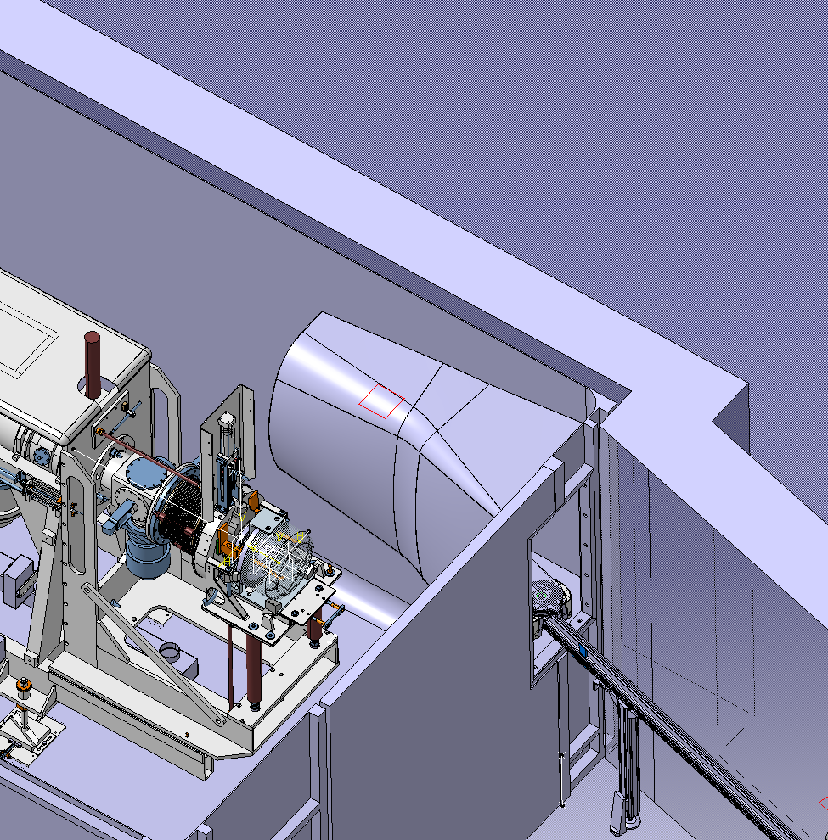
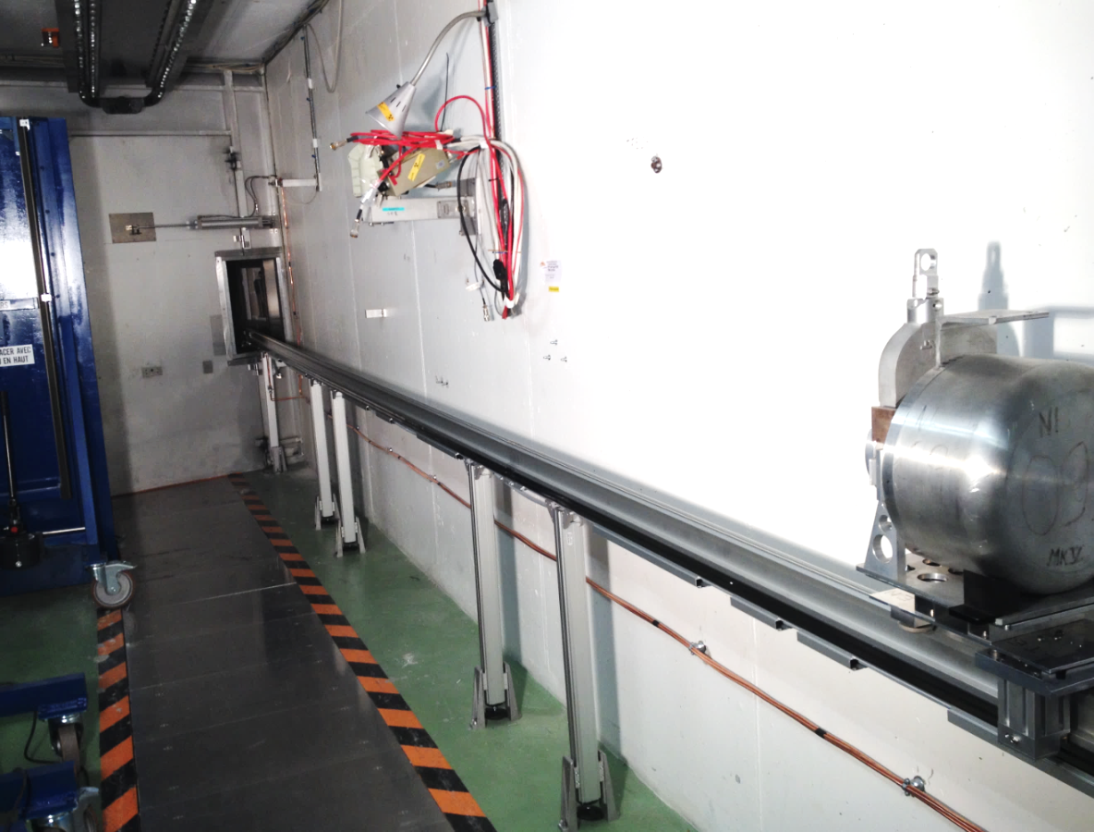
Tests with beam done (tbc…)

Slide 23
The LISOL separator at KU Leuven

Slide 24
CERN-MEDICIS
What for?

Slide 25

External partners
Dr. Forni (Clin. Carouge, Geneve)
Prof. Morel, Prof. Buehler, Prof. Y. Seimbille, Prof. Ratib (HCUGE, Geneve)
Prof. D. Hanahan (ISREC, EPFL, Lausanne)
Prof. F. Buchegger, Prof. J. Prior (CHUV, Lausanne)
Prof M. Huyse, prof. P. van Duppen (KUL, Univ. Leuven)
Prof. S. Lahiri (SINP, Kolkata)
Prof. I. dos Santos (CT2N, Lisbon)
Prof. E. Piperkova (Nucl. Medicine, Sofia)
Ongoing discussions
S. Buono (AAA)
Prof. K. Wendt (JGU)
Myrrha
ESS
Prof. F. Haddad (ARRONAX)

Slide 26


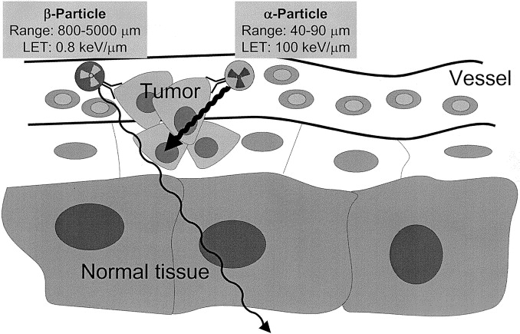
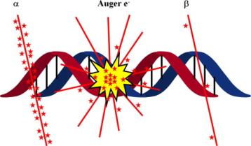
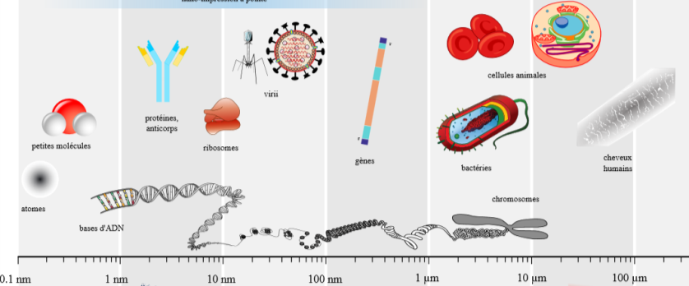
Crossing radioactivity with chemical properties

Slide 27
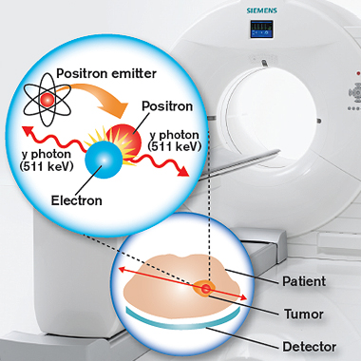
PET scan imaging

Slide 28
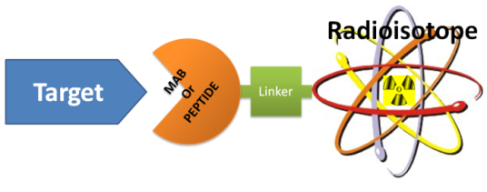
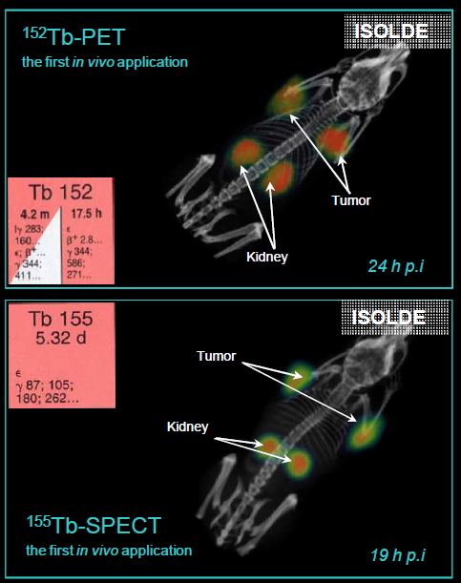
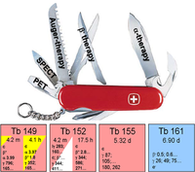
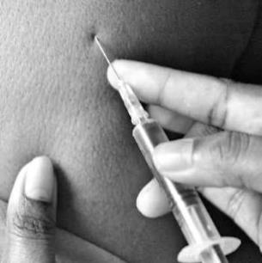
Concept of theranostics pairs
C. Muller et al.
jnumed.112.107540v1

Slide 29
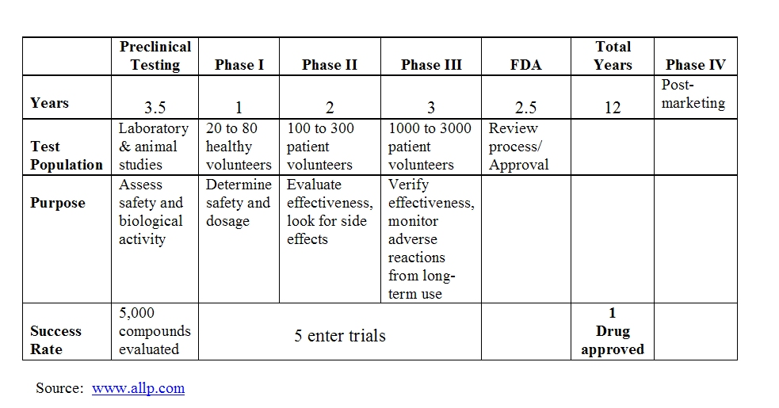
Drug development cycle

Slide 30

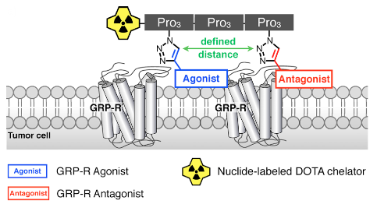
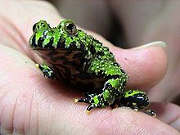

Trials in 2012
152Tb
Collected
at ISOLDE
Bombesin analog from
Bombina bombina
Prostate
Cancer
cells

Slide 31
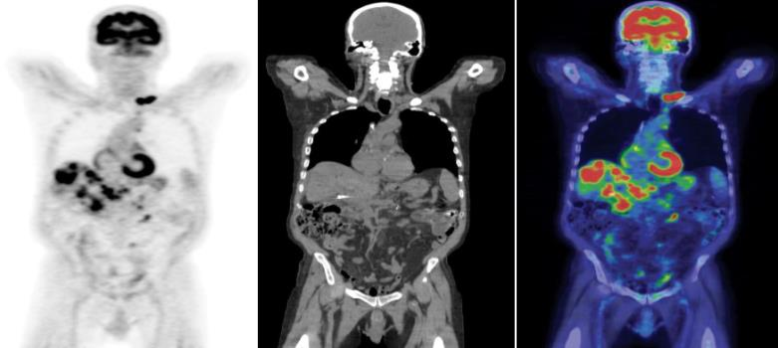




Development of surgical methods
Brachytherapy

Slide 32


1st yearly John Grace/MEDICIS collaboration meeting/public lecture on 15th October, Globe of Innovation 6:30pm
Prof Doug Hanahan
Director of the Swiss Institute for Experimental Cancer Research
Fellow of the Academy of the American Association for Cancer Research (AACR)
AACR’s Lifetime Achievement Award

Slide 33













People at CERN
CE
KT
STI
EL
Rail conveyor
RP
HE
MEF
CV
Fluka

