Slide 1
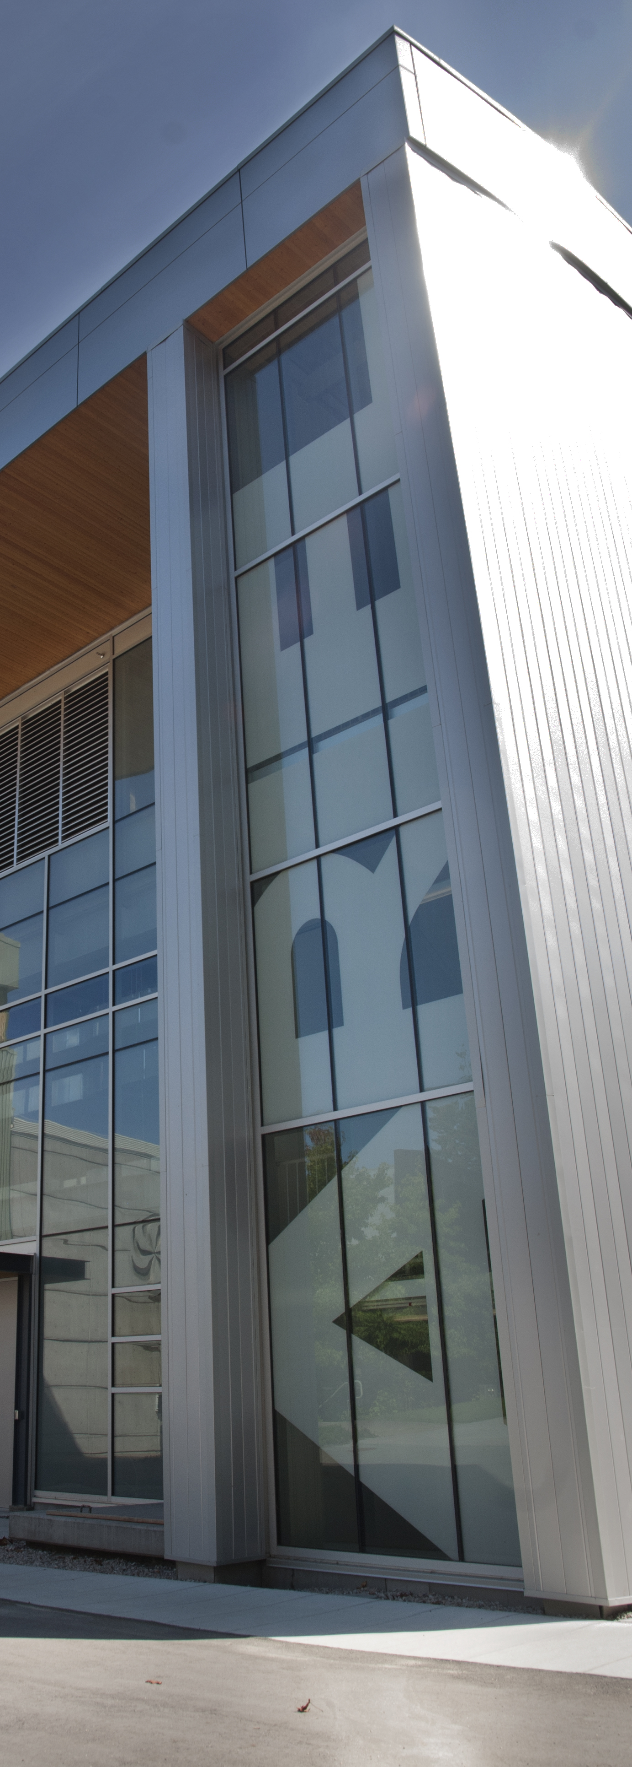
RIB at TRIUMF: From ISAC to ARIEL
Colin Morton | Beam Delivery Group Liaison/Coordinator | TRIUMF

Slide 2
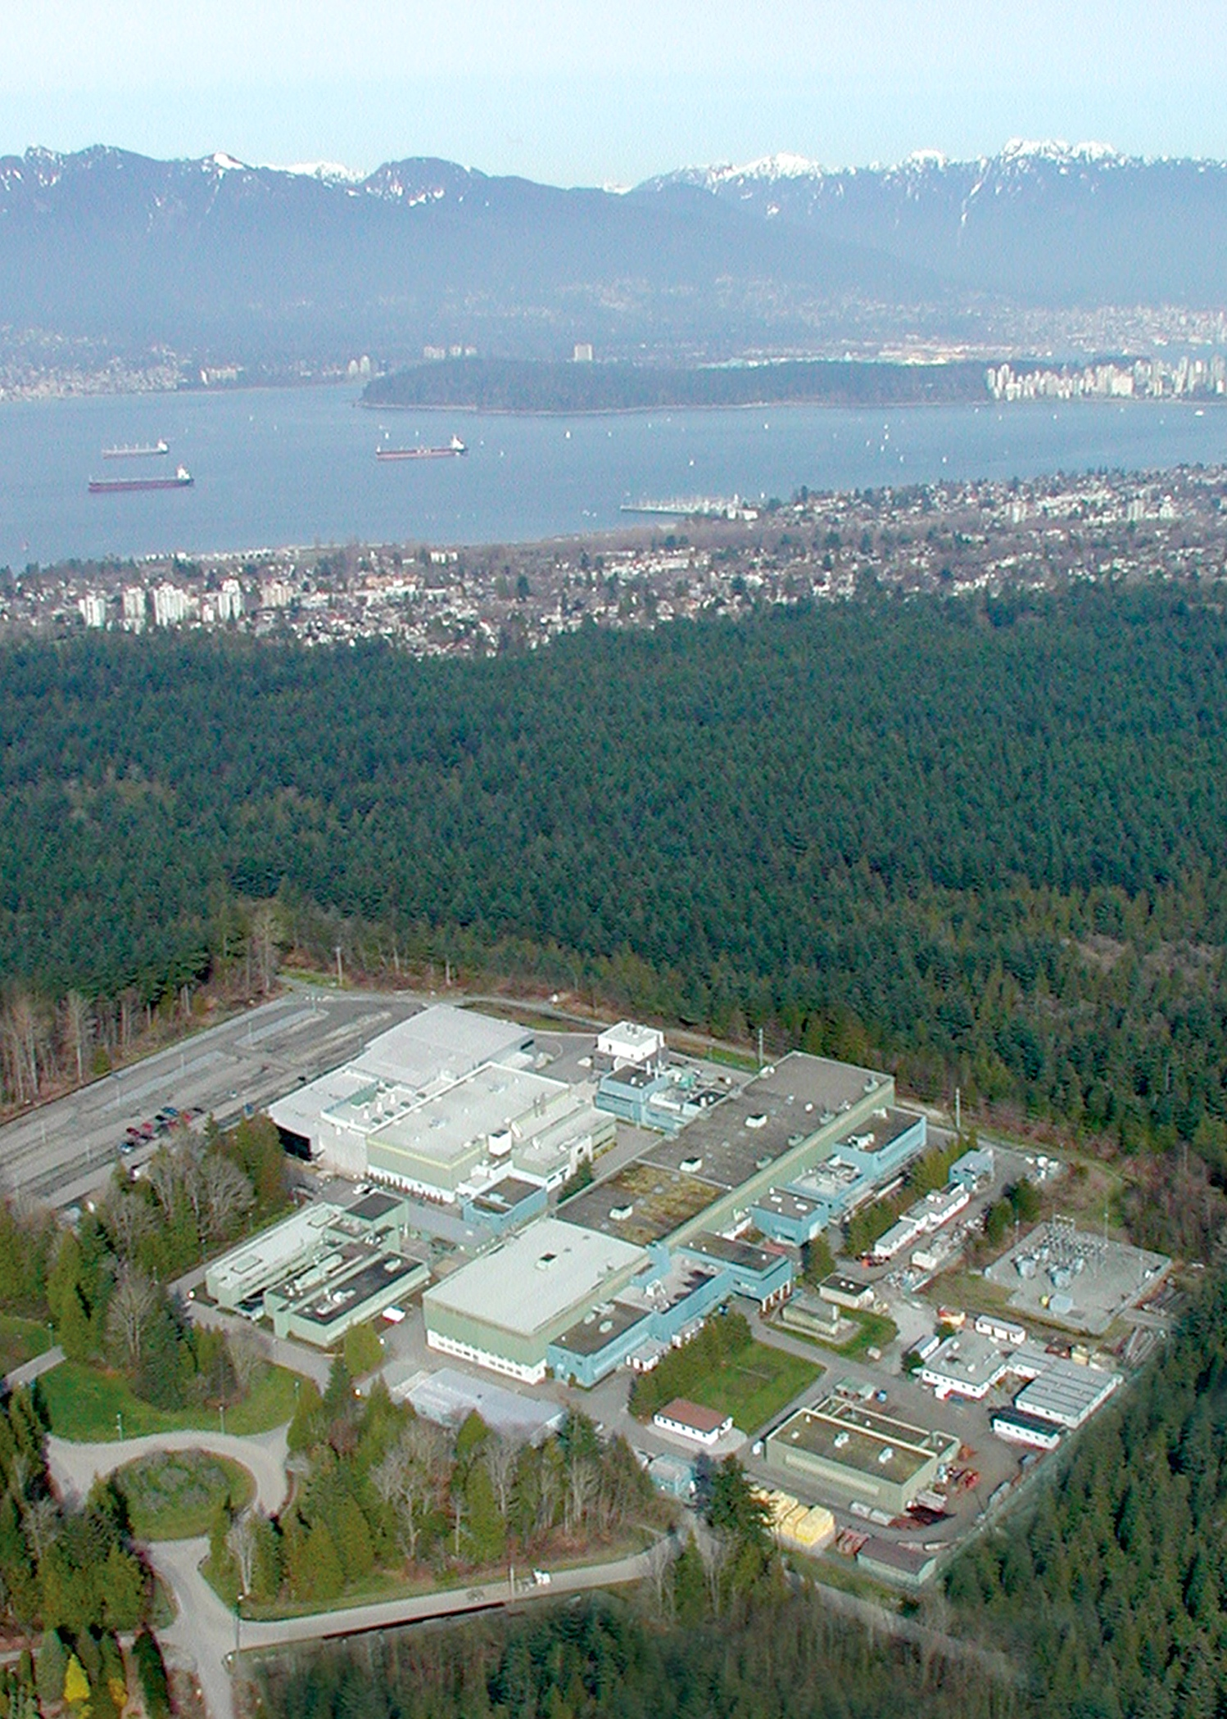
What is TRIUMF?
Canada’s national laboratory for particle and nuclear physics
Programs in nuclear medicine and materials science
Accelerators and accelerator-based research

Slide 3
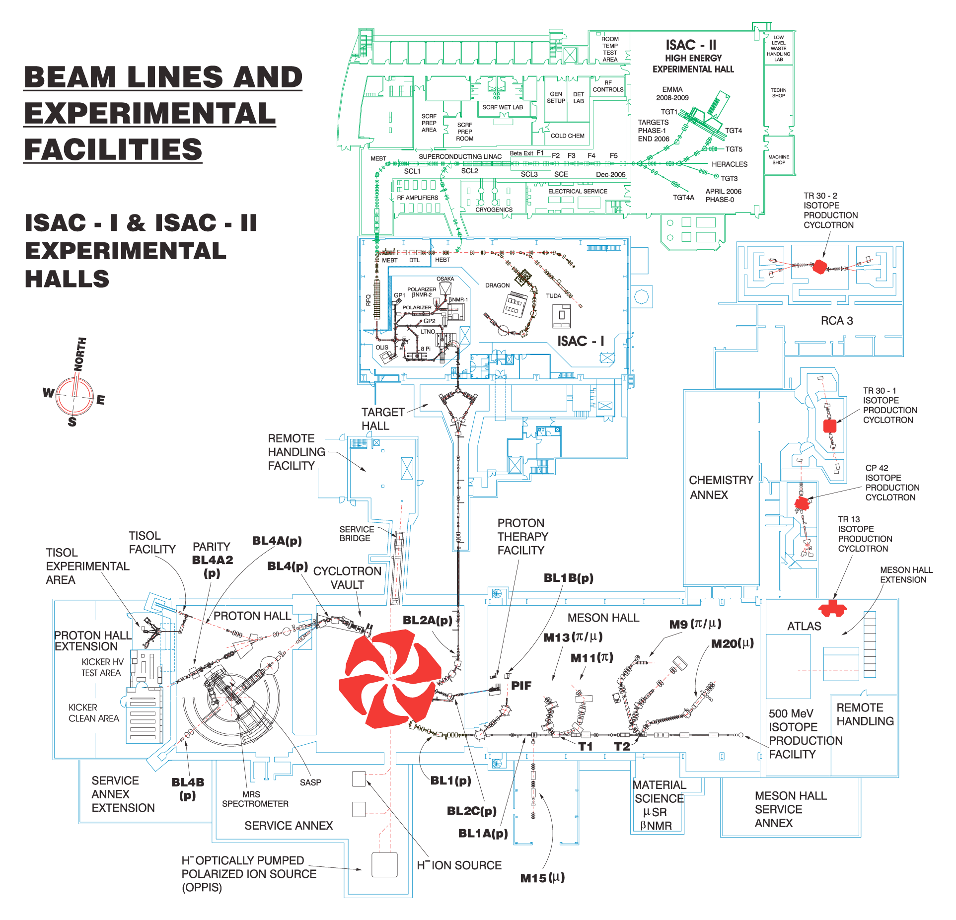
Isotope production
520 MeV main cyclotron
PET

Slide 4
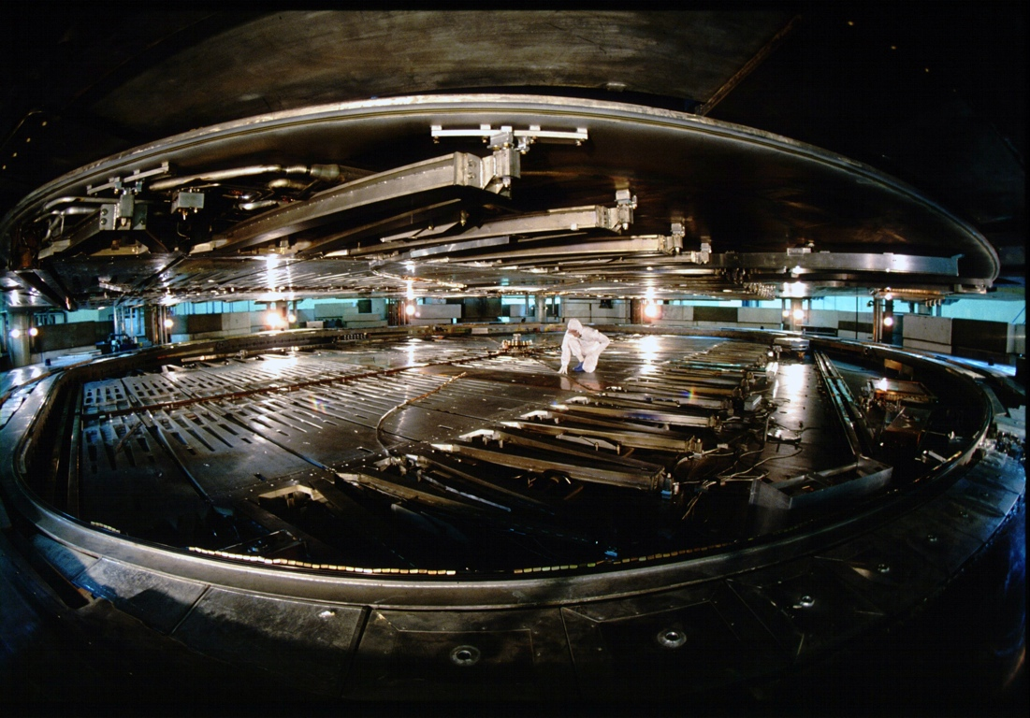
TRIUMF 520 MeV cyclotron:
18 m diameter
4000 t magnet
H⁻ – multiple p⁺ beams

Slide 5
ISAC
p⁺ irradiation
Meson production

Slide 6
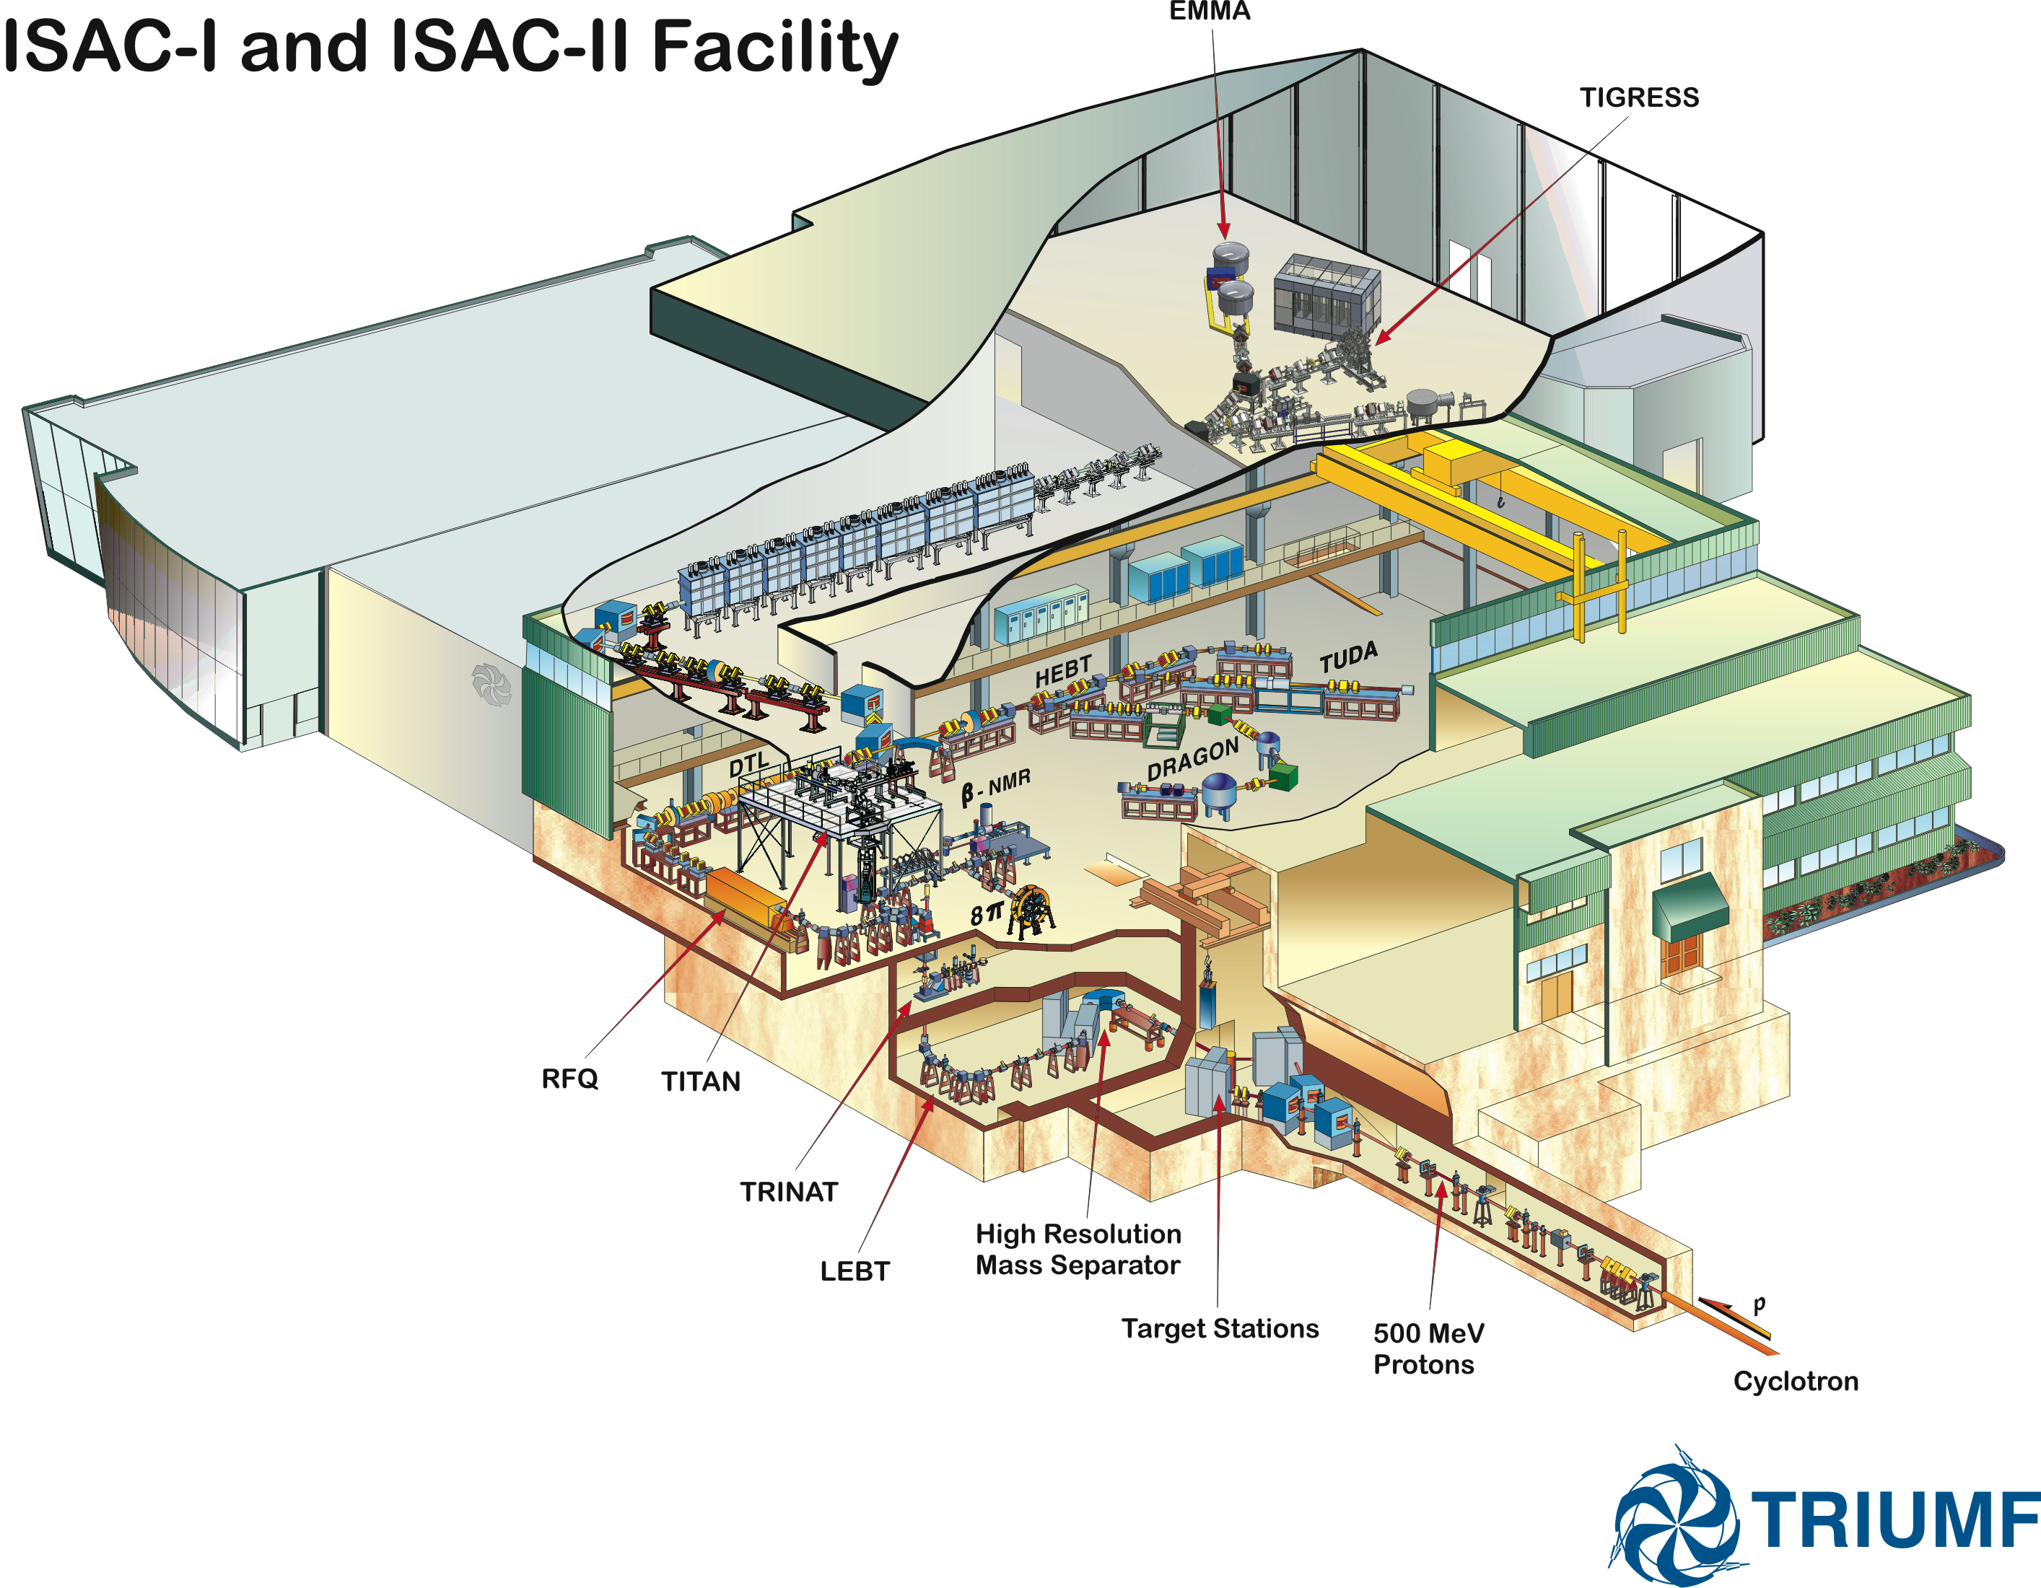
Targets:
  Ta, Nb foils
  SiC, TiC, ZrC
  NiO
  Actinides: UO₂, UC_{x}, ThO (this fall)
Ion sources:
  Surface
  FEBIAD
  RILIS
  IG-LIS (RILIS + RF ion guide)
480–520 MeV p⁺
Up to 100 µA
~50 kW beam power on target

Slide 7
ISAC operating envelope, 2000–2010

Slide 8
ISAC operating envelope, 2000–2010

Slide 9
ISAC operating envelope, 2000–2010

Slide 10
ISAC operating envelope, 2000–2010
RFQ limit: A/q<30
q=1, so A<30

Slide 11
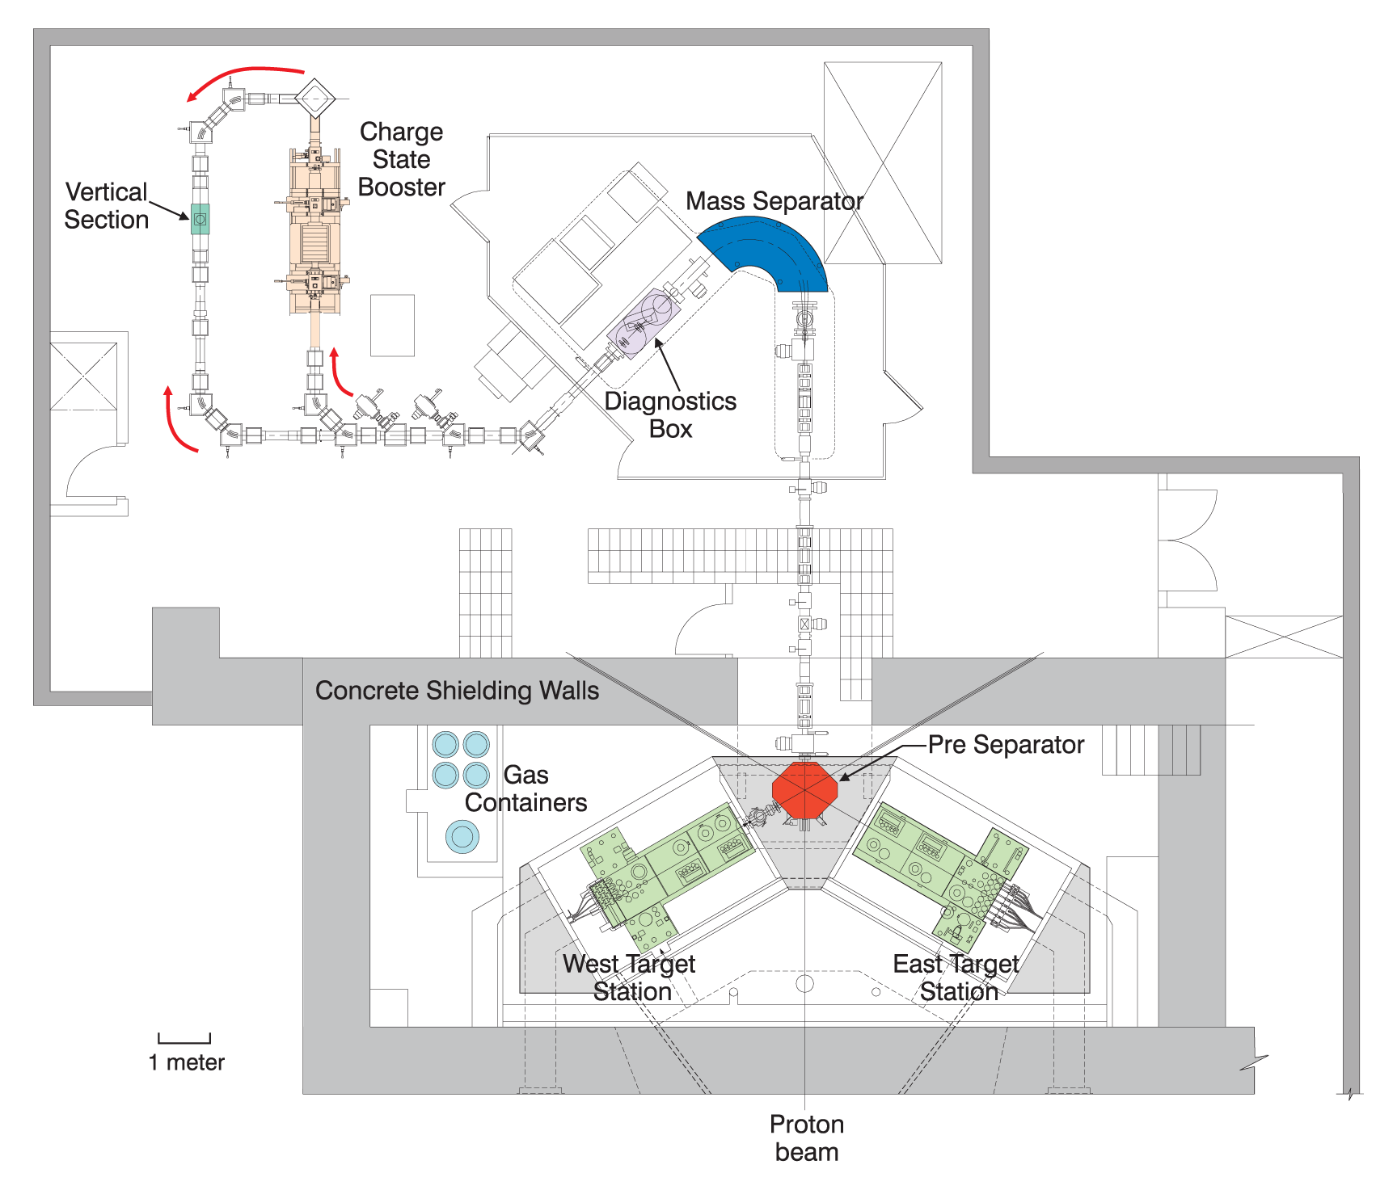
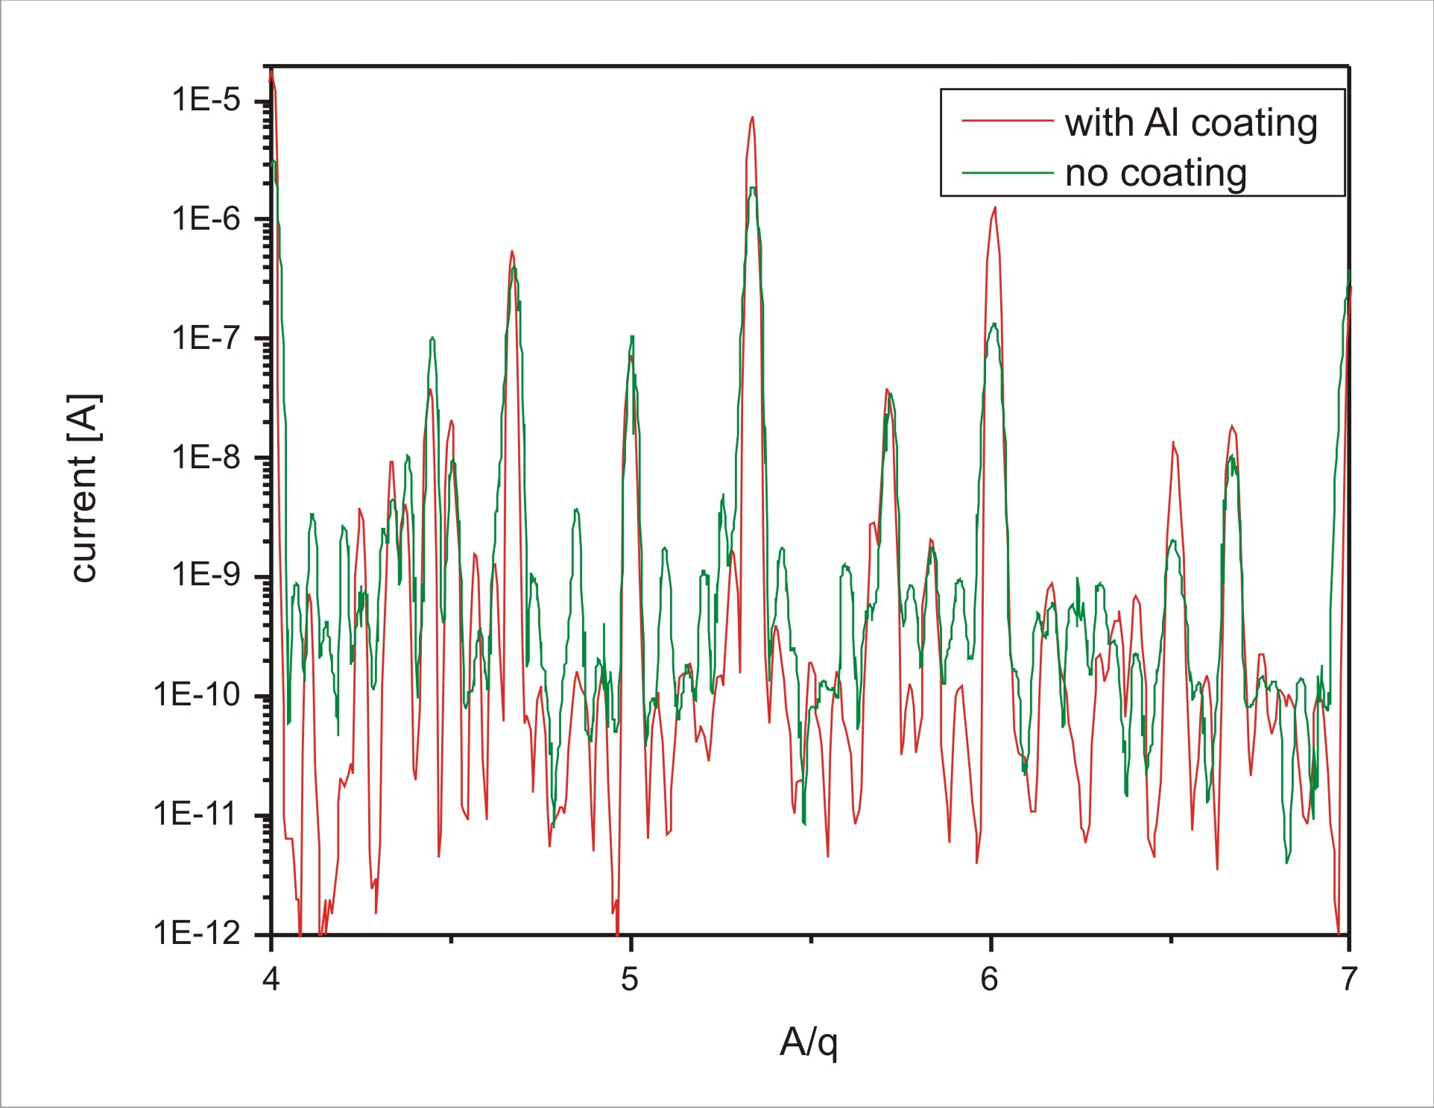
Beyond A=30…
Need to increase q, lower A/q before acceleration
Charge State Booster (CSB)
  Pantechnik PHOENIX ECRIS charge breeder
  Boosts RIB to high charge states, A/q < 7
  10s to 1000s of pA of stable-beam background
Notes:
Modified Pantechnik Phoenix ECRIS held at source bias. Singly charged RIB are injected, come to a soft landing in the ionization region, are charge-bred to high charge states and are extracted to the initial beam energy.

Slide 12
…to high-mass beam delivery
New equipment:
  Al liner for CSB plasma chamber
  Bragg detector for particle ID and beam setup
New techniques:
  Time-of-flight separation using the low-energy prebuncher and RFQ
  A/q separation using the beamline magnets between the DTL and ISAC-II
  Stripping at 1.5 MeV/u to select charge states with favourable signal/noise ratios
New tools:
  Tune scaling utilities
  Web-based tools for planning high-mass delivery
Notes:
Note: The ISAC accelerator chain was not designed for separation. Can achieve resolving powers of several hundred with each technique.

Slide 13
ISAC operating envelope, 2014
3 high-mass,
high-energy exp’ts to date (2013/2014)
Several more approved
Notes:
94,95,96Sr to TIGRESS (two runs); 38K to DRAGON
User community given guidance re. preparing proposals for high-mass delivery

Slide 14
ISAC to date
1996: ISAC construction begins
1998: first RIB at ISAC
2000: first accelerated RIB at ISAC-I
2007: first RIB with ISAC-II SC-LINAC
Now: 3000+ hours/year of RIB to users
  ~32–36 weeks, 8–10 targets, 15–20 experiments + development
  Broad range of isotopes
  Low-energy beams from ~10–60 keV; high-energy beams from 150 keV/u to >6.5 MeV/u (A/q=6)

Slide 15
Top-notch science

Slide 16
The challenge? Meeting demand
Two-year backlog of experiments
Huge specific demand for ⁸Li (β-NMR)
Beam delivery improvements:
  Improved scheduling to minimize interruptions
  Better coordination with experimenters
  Finding overlooked sources of downtime
However:
  Efficiency gets you 30–50% more beamtime – not factors of two or three
  We need something more.

Slide 17

New ISOL infrastructure to build on past success
TRIUMF’s flagship facility
Focus of both the 2010–2015 and 2015–2020 five-year plans
Goal: to more than triple the amount of RIB available at ISAC

Slide 18
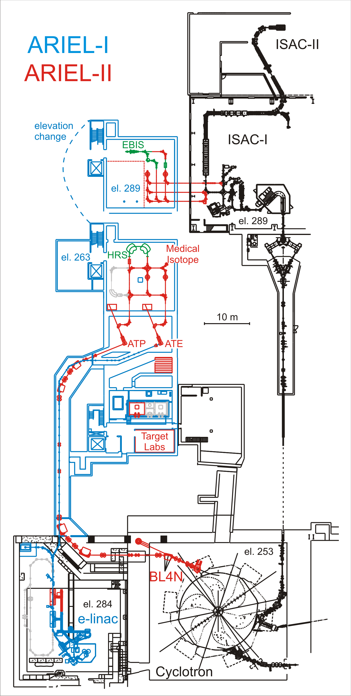
ARIEL: A facility in two acts
ARIEL-I (2010–2015)
  Civil construction for both ARIEL-I and ARIEL-II facilities
  Electron linac up to 25 MeV, 100 kW – centrepiece of the project
ARIEL-II (2015–2020)
  Completion and use of the entire facility

Slide 19
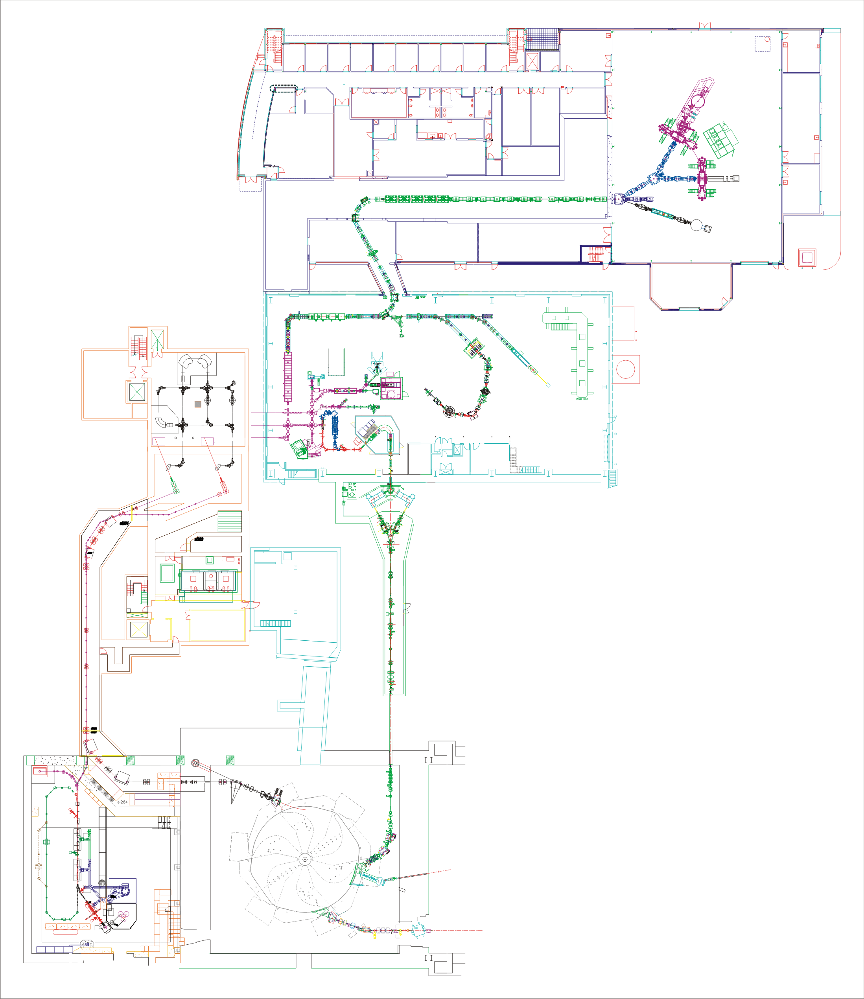
Existing
ISAC
ARIEL-I
ARIEL-II
ARIEL LEBT
Target stations
3 drivers
3 target stations
3 independent ISAC experimental areas
  Two low-energy
  ISAC-I + ISAC-II HE
3 simultaneous RIB to experiments
ARIEL building
BL2A
BL4N
e-linac
Cyclotron

Slide 20
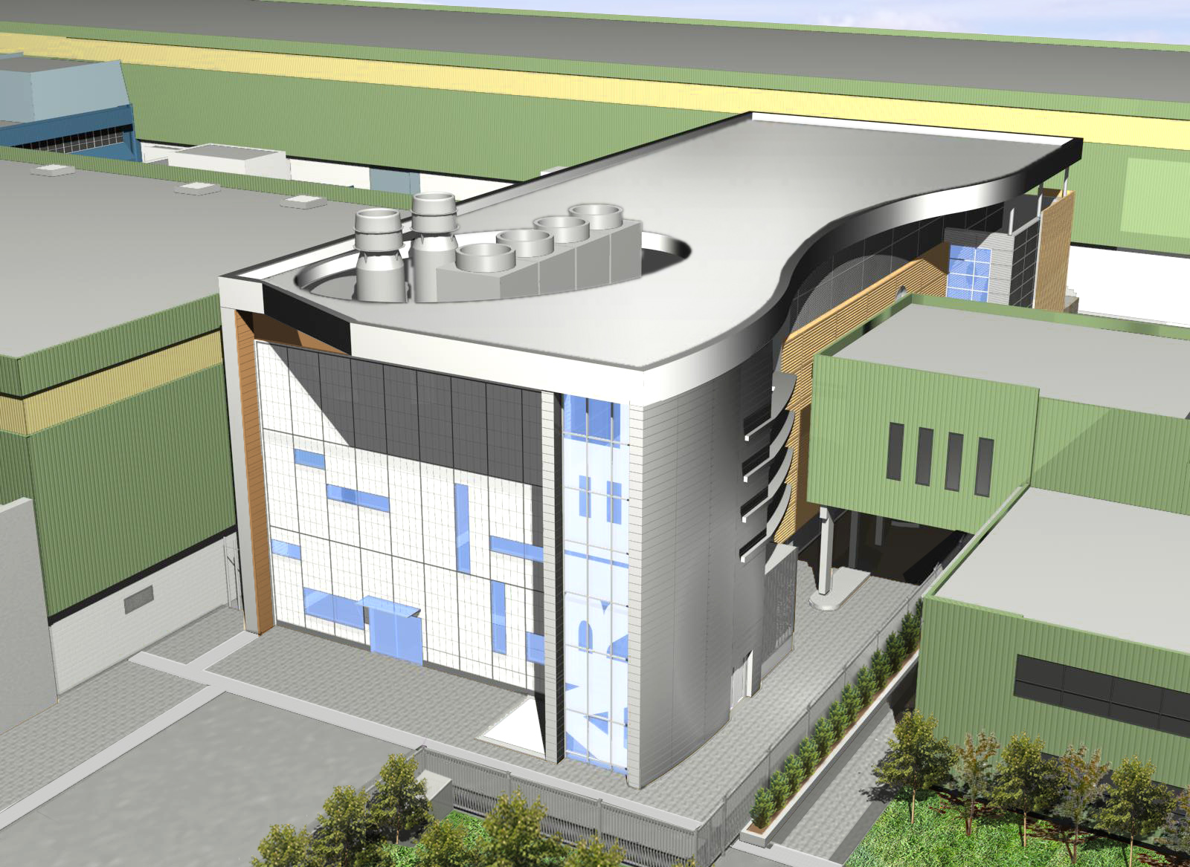
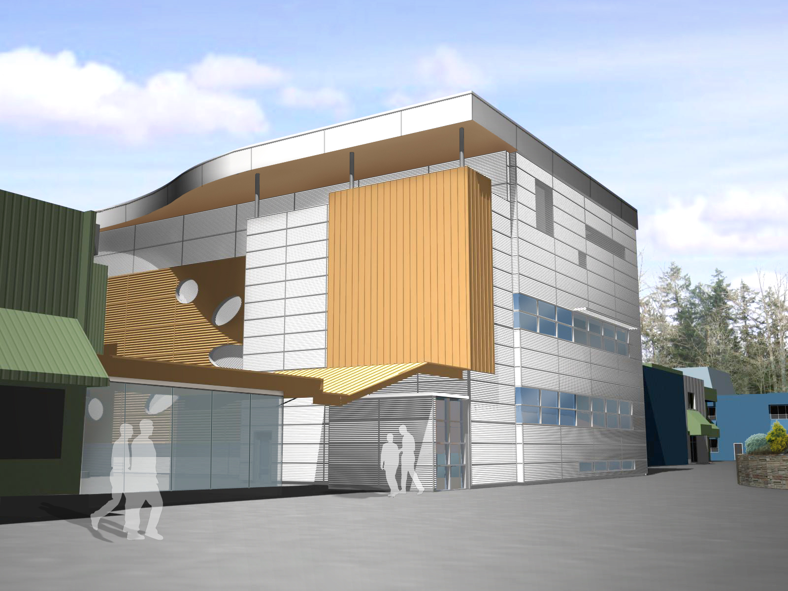
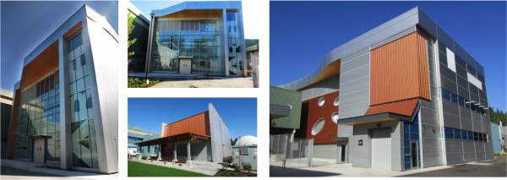
ARIEL-I: Civil construction
Building finished Sept. 2013
Also:
  Cryogenics building
  Conversion of Proton Hall for e-linac (e-Hall)
Notes:
Time-lapse video of ARIEL building construction is on Vimeo (http://vimeo.com/triumflab).

Slide 21
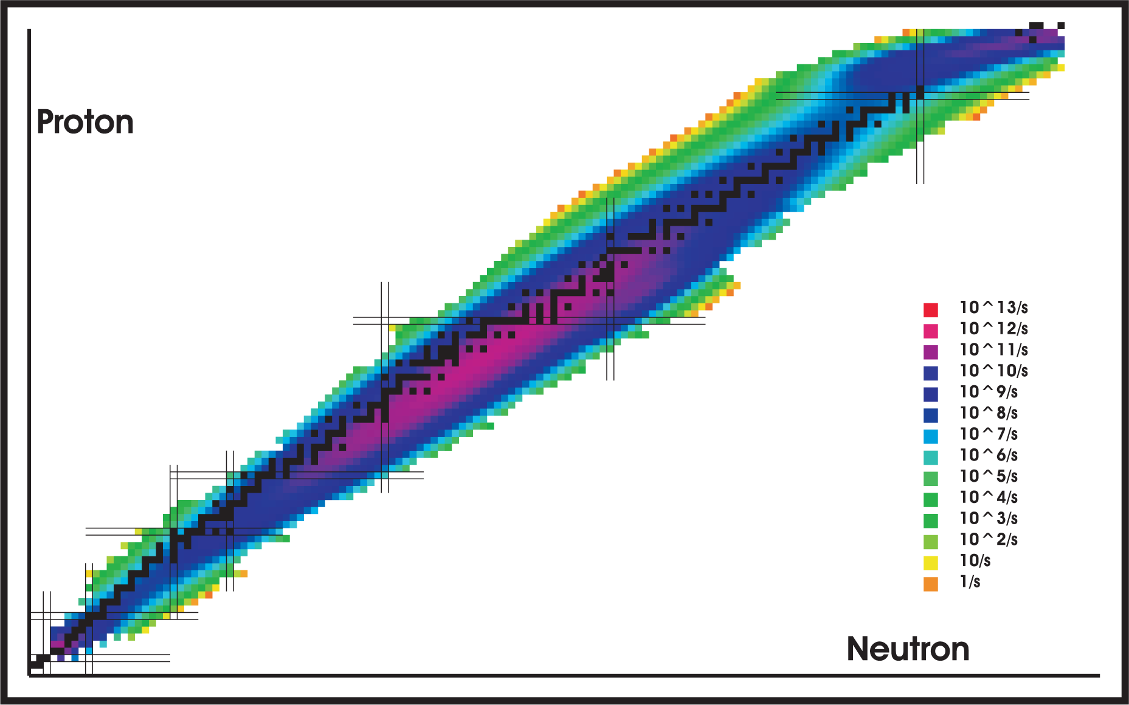
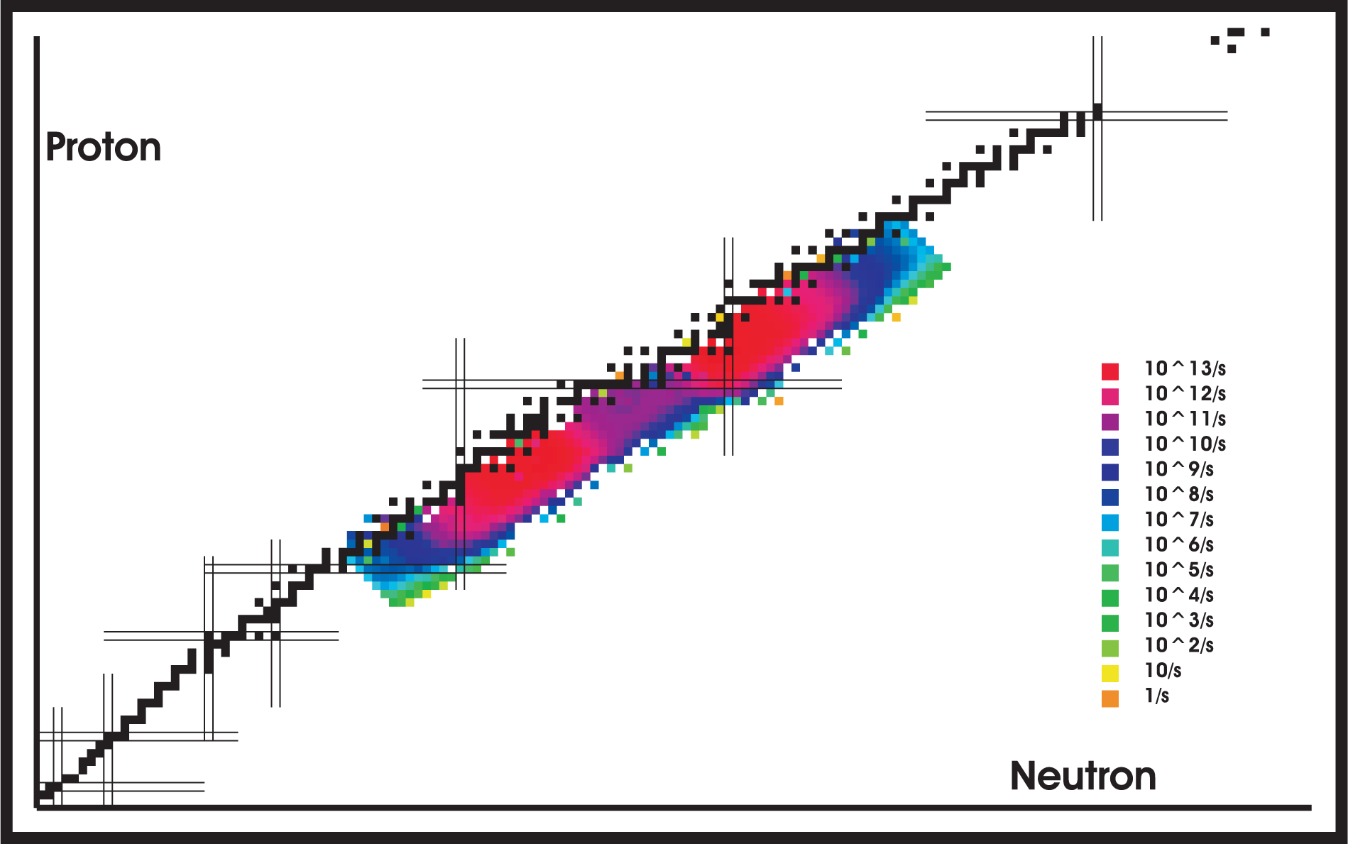
ARIEL-I: e-linac
State-of-the art SC linac
  TESLA (ILC) technology
  25 MeV, 100 kW now
  50 MeV, 500 kW later
Why electrons?
  RIB production by photofission – high production of neutron-rich species with less isobaric contamination, no spallation products
10 µA, 500 MeV p⁺
25 g/cm² UC_{x}
10 mA, 50 MeV e⁻
Hg converter
15 g/cm² UC_{x}

Slide 22
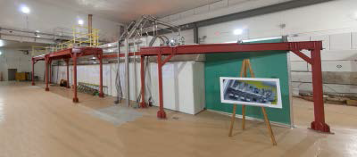
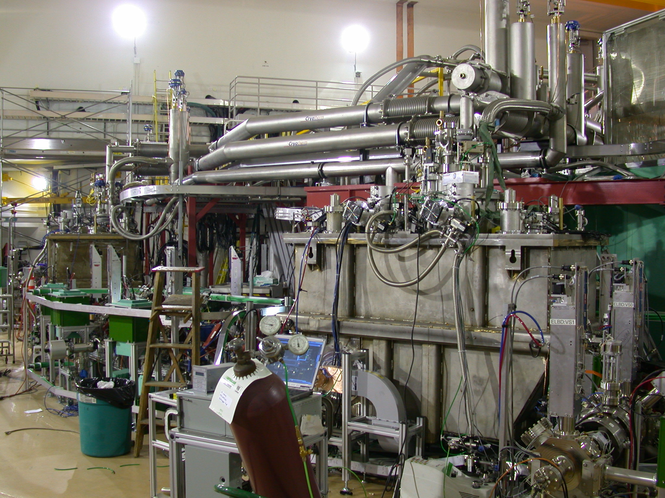
ARIEL-I: e-linac status
In the last year:
  Cryogenics acceptance testing completed
  e-gun and LEBT installed and commissioned
  MEBT installed
  2 klystrons and HV supplies installed and commissioned
  Injector and accelerator cryomodules assembled, installed, and commissioned
January, 2014
September, 2014

Slide 23
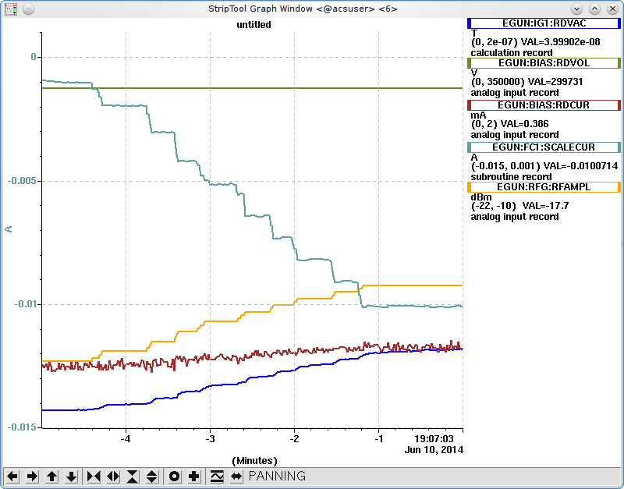
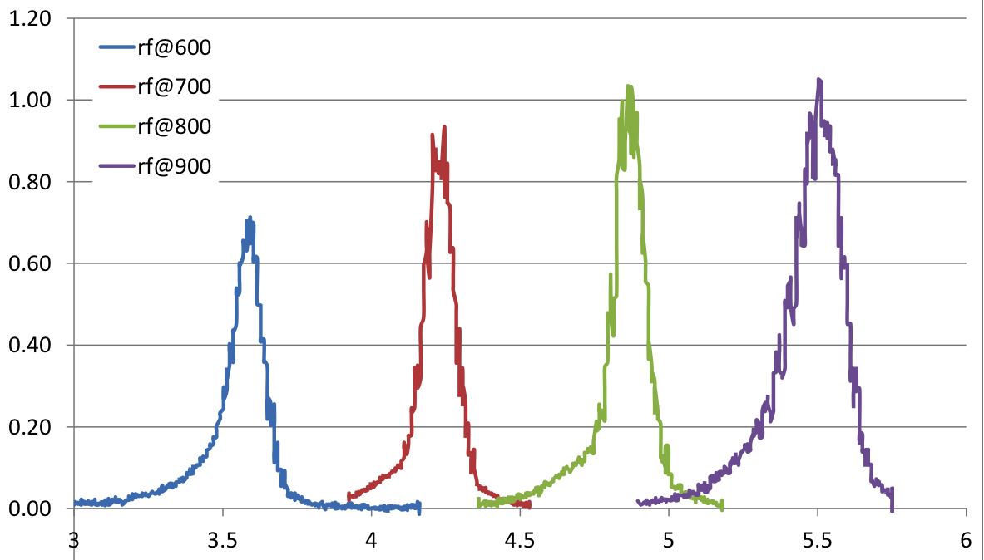
ARIEL-I: e-linac status
Commissioning underway
e-gun operated up to 10 mA peak current
Beam accelerated to 10 MeV beam dump
20 MeV test planned for next week
L. Merminga (NS2014)
Intensity (normalized)
Energy (MeV)

Slide 24
ARIEL-II: Overview
Overall goal:
  Delivery of three simultaneous RIB to users
Technical objectives:
  High-intensity photoconverter/target development
    Solid converter for beam power below ~100 kW
    Liquid converter for beam power above ~100 kW
  Expanded expertise in SRF, targets, etc.
Project structure:
  Five phases with timing determined by scientific priority, technical readiness, resource availability

Slide 25
ARIEL-II scientific deliverables
Phase | Will deliver isotopes…
1 | …as probes of magnetism at interfaces and surfaces of new functional materials using β-NMR.
2 | …to elucidate our fundamental understanding of atomic nuclei by enabling studies of the evolution of structure and dynamics of very neutron-rich nuclei approaching the r-process path.
3 | …for molecular imaging of diseases and treatment of cancer in the ARIEL collection station and isotopes for developing a standard model for nuclear physics.
4 | …to search for new forces in nature. It will also mark the milestone of three simultaneous rare isotope beams delivered to users.
5 | …to determine how the heavy elements from iron to uranium were produced in the universe.
Notes:
From the ARIEL-II CFI funding proposal

Slide 26
Why a phased approach?
Phasing ARIEL-II allows construction and science to alternate during the project
  Fastest way to new science
  Extends TRIUMF’s scientific reach with each phase
  Delivers continuous stream of results, discoveries, and papers through the duration of the project
ARIEL-II has been planned to minimize disruption to ISAC operation and beam delivery

Slide 27
ARIEL-II Phase 1: Materials science with β-NMR
Goal:
  Photo-production of ⁸Li in BeO using bremsstrahlung photons from stopping a 100 kW electron beam in a solid target, and delivery to β-NMR at ISAC
Requirements:
  ARIEL e-linac –
  25 MeV, 100 kW
  Electron target
  station (ATE)
  Pre-separator
  and LEBT
LEBT
Pre-separator
Target station
Notes:
Isotopes “as probes of magnetism at interfaces and surfaces of new functional materials using β-NMR.”
First multi-user capabilities.

Slide 28
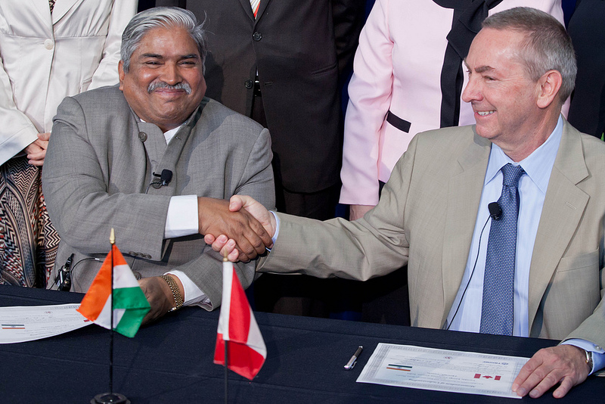
ARIEL-II Phase 1: Materials science with β-NMR
Collaboration with VECC (Kolkata)
  MoU signed August 2013
  $10.4M – includes two ARIEL target modules (to be tested at ARIEL) and front-end beamlines
Notes:
Dr. Nigel Lockyer (former Director of TRIUMF) and Dr. Dinesh Srivastava (VECC)

Slide 29
ARIEL-II Phase 2: Photofission for r-process studies
Goal:
  Production and delivery of neutron-rich fission fragments using actinide targets with a solid photoconverter
Requirements:
  Electron target station (ATE) with actinide target
  Actinide chemistry lab
  RILIS source
Phase 2 greatly extends the range of RIB available
Notes:
Isotopes “to elucidate our fundamental understanding of atomic nuclei by enabling studies of the evolution of structure and dynamics of very neutron-rich nuclei approaching the r-process path.”

Slide 30
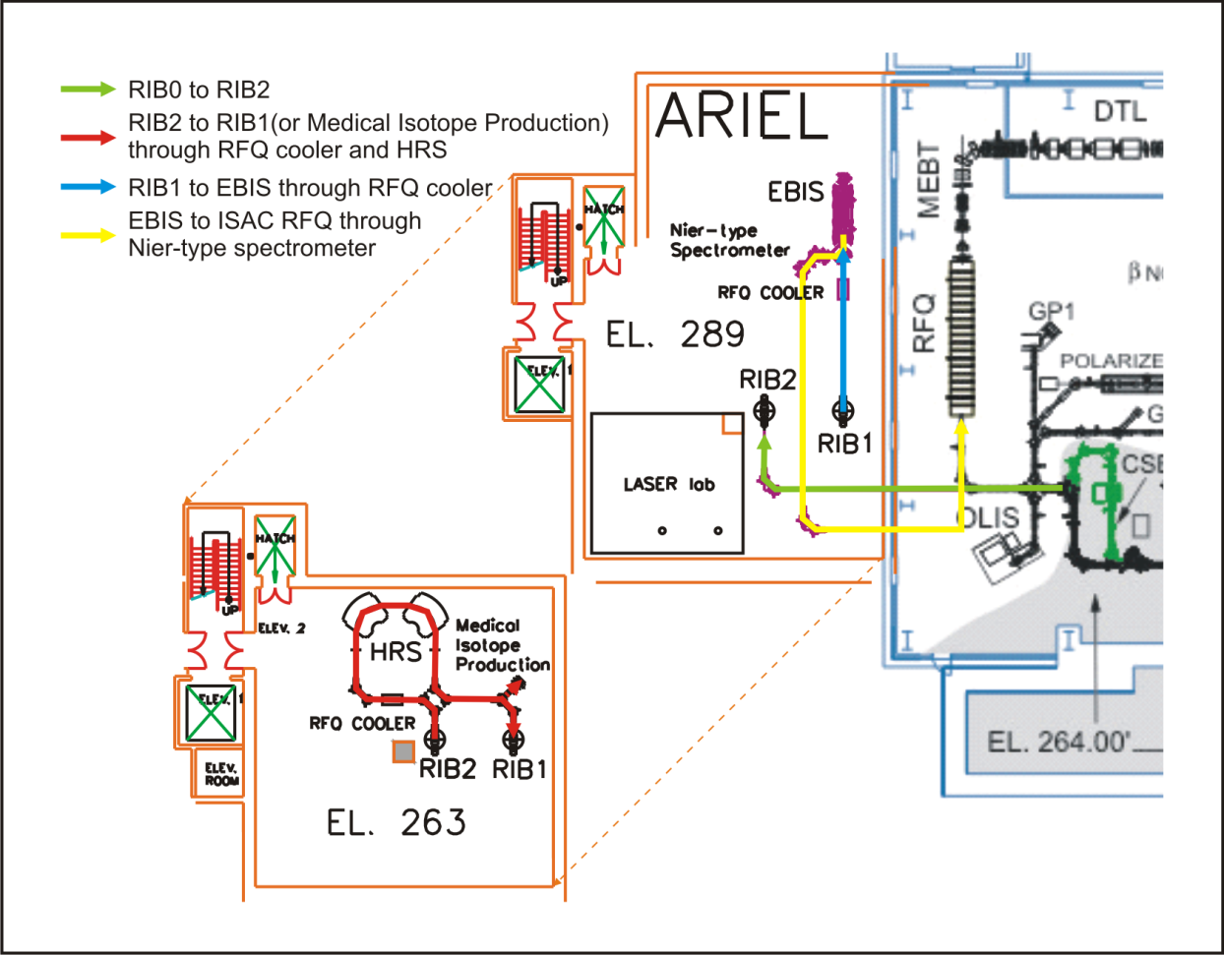
ARIEL-II Phase 3: Purified high-mass, high-energy RIB
Goals:
  Transport of high-mass RIB from ISAC to ARIEL and purification and charge-breeding of ISAC and ATE beams for delivery to high-energy experimental areas
  A collection station for medical isotopes
Requirements:
  CANREB – CFI-funded
  project including EBIS, HRS,
  RFQ coolers, etc.
  Low-energy beam transport
  through ARIEL
Notes:
Isotopes “for molecular imaging of diseases and treatment of cancer in the ARIEL collection station and isotopes for developing a standard model for nuclear physics.”
CANREB: CANadian Rare isotope facility with Electron Beam ion source”

Slide 31
ARIEL-II Phase 4: Actinide production for fundamental symmetries
Goal:
  RIB production using a new proton beamline (BL4N) delivering up to 100 µA of ~500 MeV protons to a dedicated actinide target station
Requirements:
  Proton beamline
  Proton target station (ATP) and actinide target
  Low-energy beam transport from ATP
Three simultaneous RIB delivered to users
Notes:
Isotopes “to search for new forces in nature.”

Slide 32
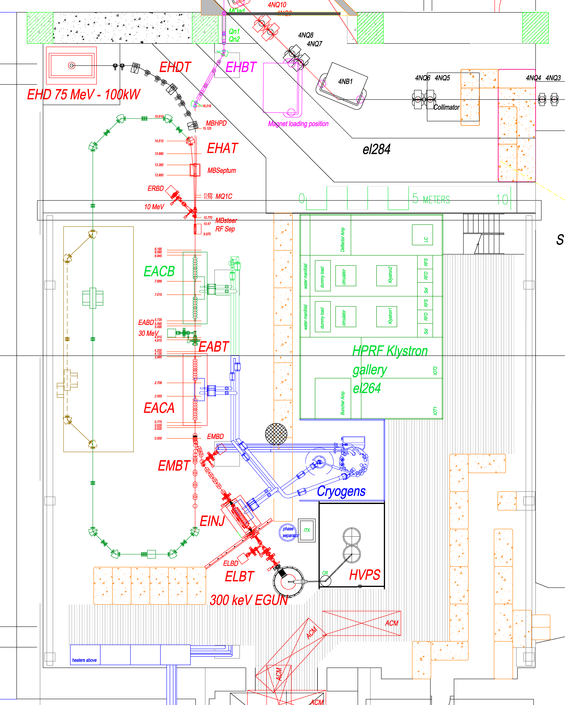
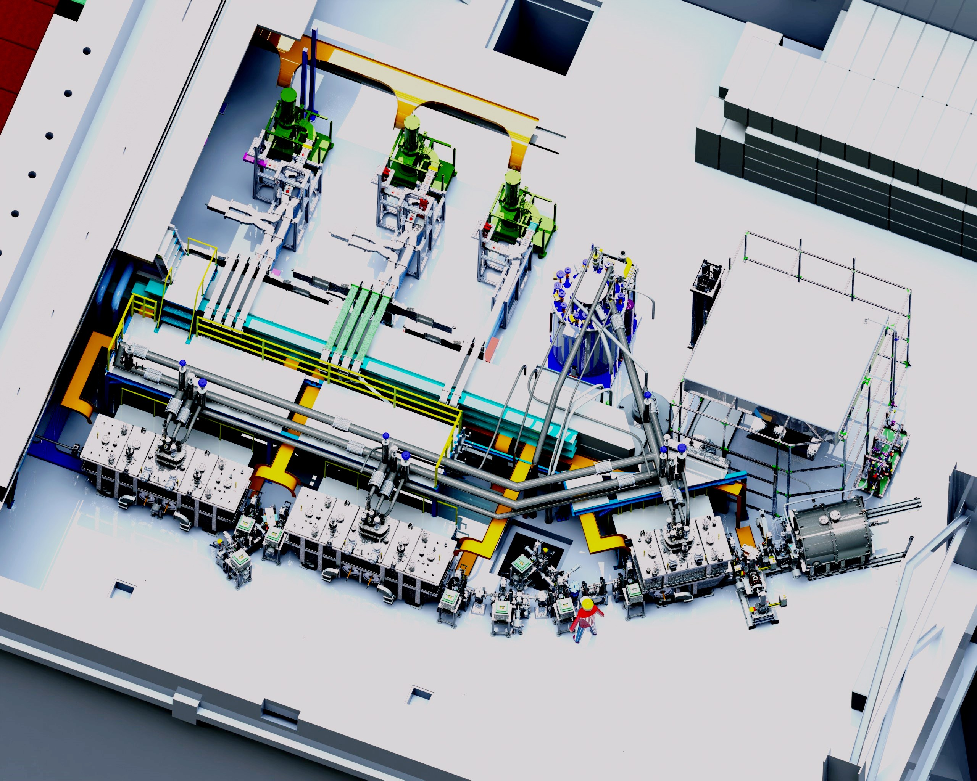
ARIEL-II Phase 5: Full-power e-linac
Goal:
  The full e-linac design specification of 50 MeV and 500 kW beam power for RIB production by photofission – 2×10¹³ fissions/second
Requirements:
  Second accelerator cryomodule
Opens up research into r-process nucleosynthesis with very neutron-rich isotopes
Notes:
Isotopes “to determine how the heavy elements from iron to uranium were produced in the universe. ”

Slide 33
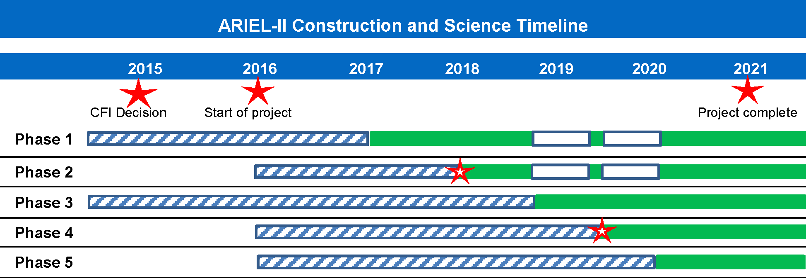
ARIEL-II schedule: Science at every phase
Phase 1: Materials science with β-NMR
Phase 2: Photofission
Phase 3: Medical imaging and treatment; high-mass beams
Phase 4: Fundamental symmetries
Phase 5: Full power of e-linac; r-process astrophysics
Notes:
CFI decision: ~$13.5M requested; total project cost ~$34M
Milestones: 2018 – photofission; 2019 – 3 RIB simultaneously
Interruptions: 2019 – BL4N and construction of ATP; 2020 – high-power converter development

Slide 34
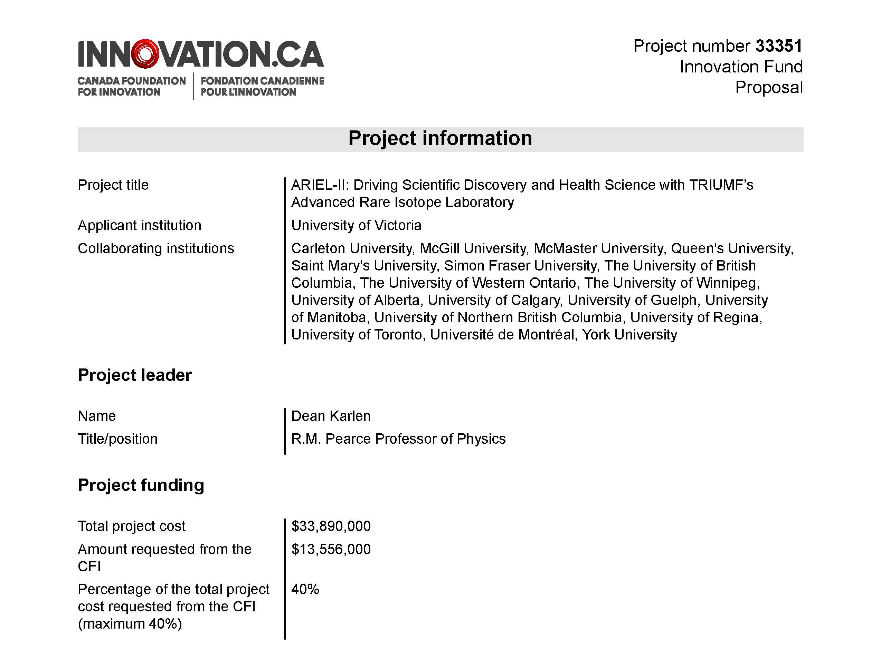
CFI proposal submitted – decision in October
Notes:
19 collaborating institutions from across Canada

Slide 35
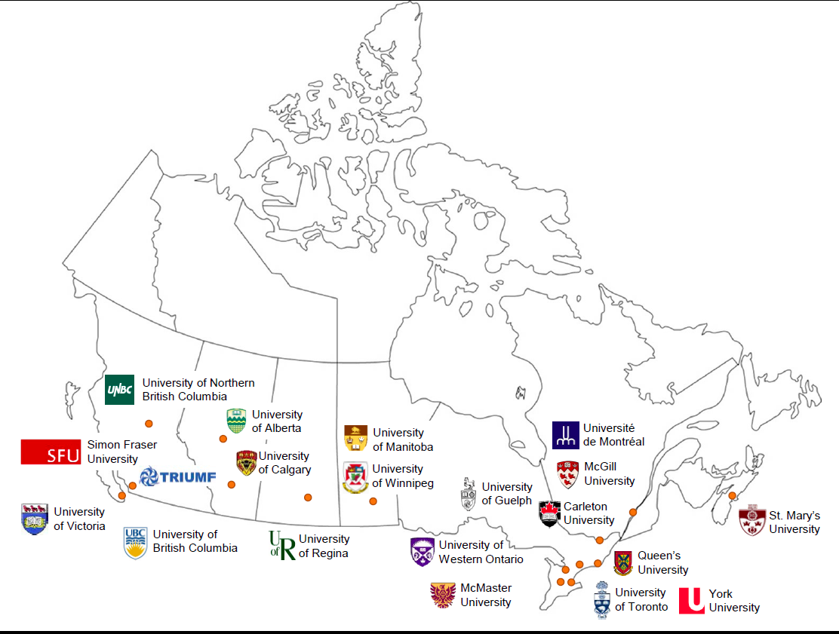
ARIEL-II Collaborators:
19 Canadian universities + TRIUMF
(from the ARIEL-II CFI proposal)

Slide 36
Summary
ISAC:
  3000+ hrs/year of RIB for users
  High-energy, high-mass program underway
  More demand than available beam time
ARIEL:
  Expanded ISOL capabilities – builds on ISAC success
  New drivers (electron and proton), targets, front ends; new EBIS (CANREB)
  Phased approach designed to maximize science output during construction
  2019: 3 simultaneous RIB to users

Slide 37
Acknowledgements
ISAC:
  TRIUMF Operations and technical support groups
  TRIUMF’s Beam Delivery group (F. Ames, J. Lassen, P. Kunz, M. Marchetto, R.E. Laxdal)
  High Mass Task Force (F. Ames, M. Marchetto, R.E. Laxdal, A. Garnsworthy*, G. Hackman*, P. Bender*, B. Davids*) (* = Science Division)
  ISAC’s experimental community
ARIEL:
  ARIEL, CANREB, and associated collaborations
This talk:
  R. Kruecken, L. Merminga, R.E. Laxdal, J. Lassen, M. Marchetto, TRIUMF’s Communications group

