Slide 1
CERN Summer School 2014
Introduction to Accelerator Physics
Part II
by
Verena Kain CERN BE-OP

Slide 2
Contents of today’s lecture
In the next three lectures we will have a look at the different components of a synchrotron.
Today:
Controlling particle trajectories in the transverse plane
  Linear beam optics, strong focusing

Slide 3
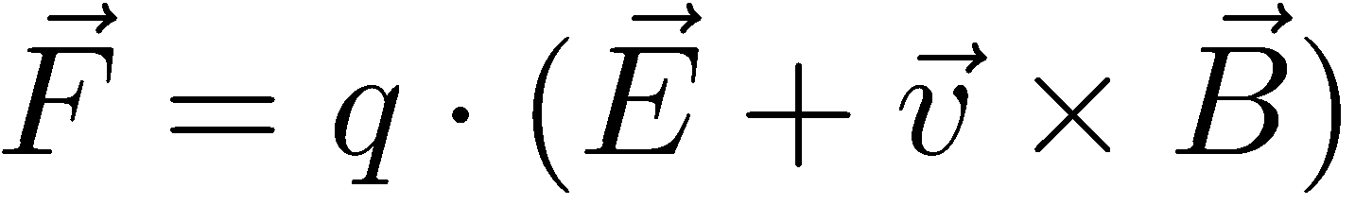
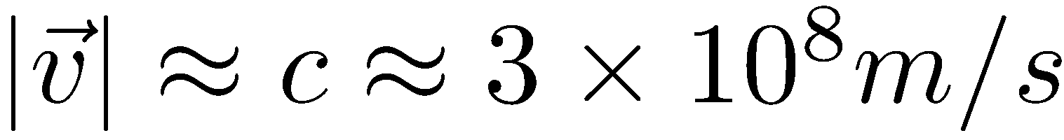
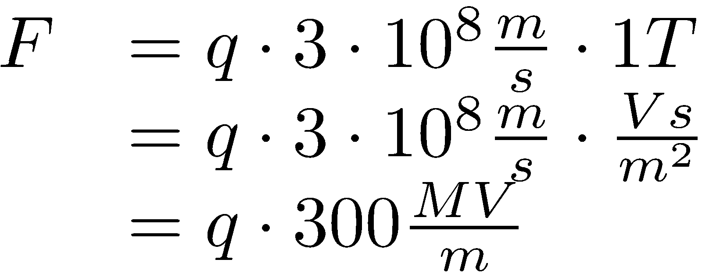
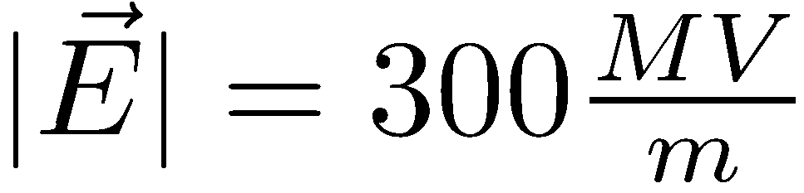
Which fields to influence particle trajectories?
Usually use only magnetic fields for transverse control
What is the equivalent E field of B = 1 T?
  Ultra-relativistic:
➔ To guide the particles we use magnetic fields from electro-magnets.
Lorentz Force
Equivalent electric field!!:

Slide 4
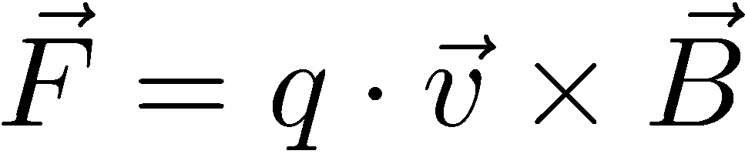
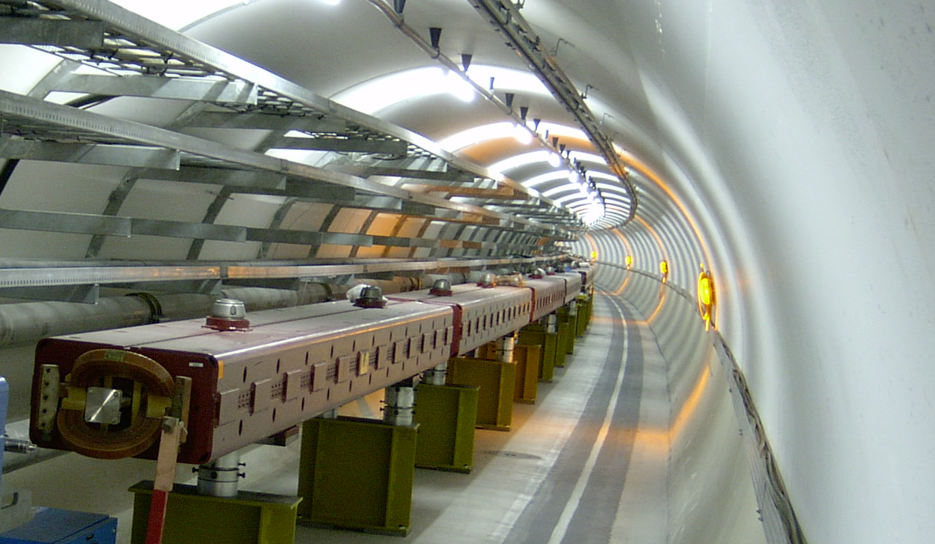
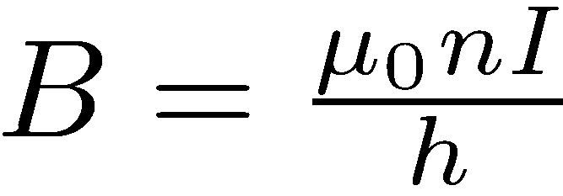
Dipole magnets: guiding magnets
Vertical magnetic field to bend in the horizontal plane
Dipole electro-magnets:
h

Slide 5
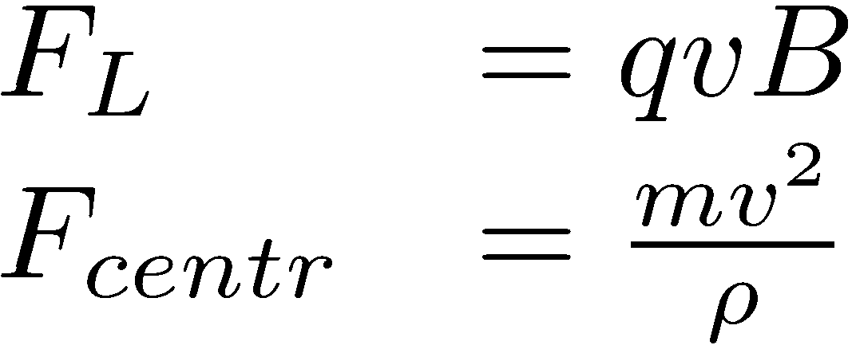
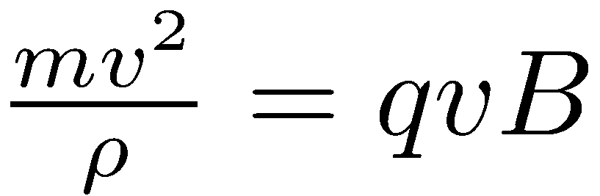
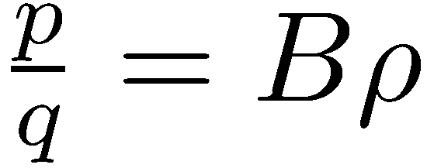

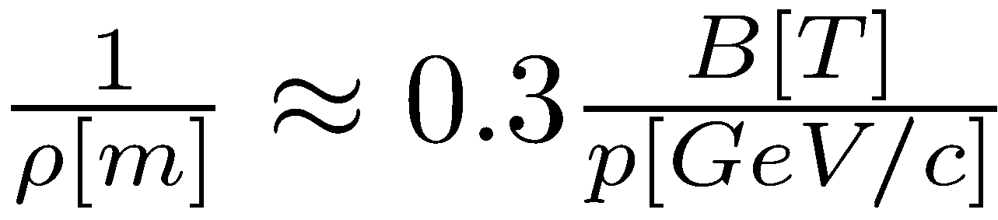
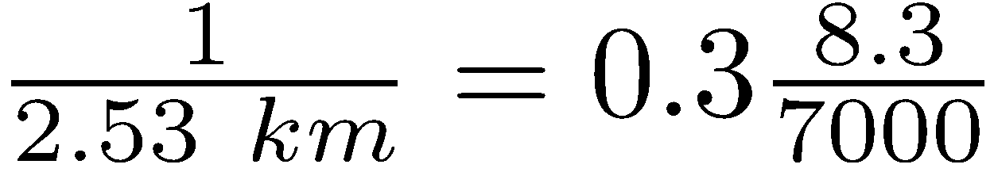
Dipole magnets: guiding magnets
Circular accelerator: Lorentz Force = Centrifugal Force
Useful formula:
Example for the LHC
  p⁺ @ 7 TeV/c
  8.3 T
Beam rigidity

Slide 6
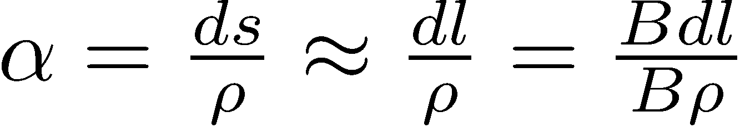
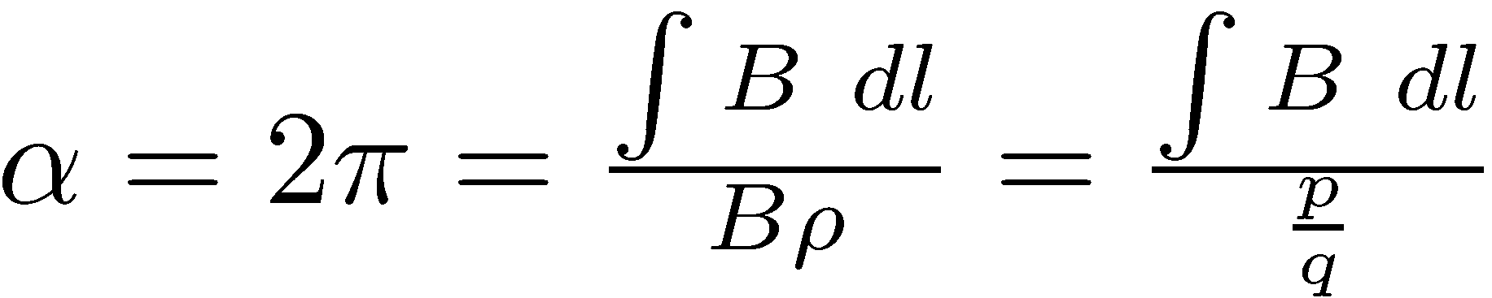
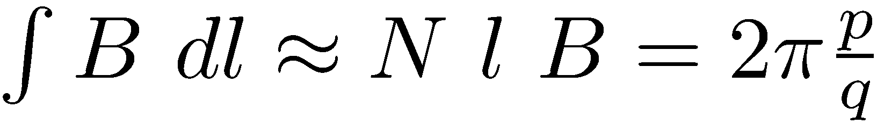
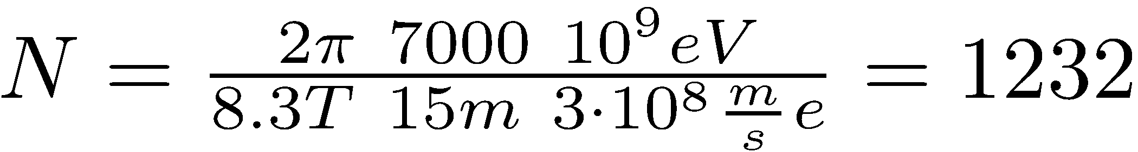
Define design trajectory (orbit)
Length of dipole magnet and field define total bending angle of magnet:
Circular accelerator: total bending angle:= 2π
How many dipole magnets do we need in the LHC?
  Dipole length = 15 m
  Field 8.3 T
ρ
α
ds

Slide 7
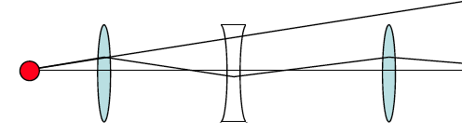

Focusing is mandatory for stability
Define design trajectory with dipole magnets
Trajectories of particles in beam will deviate from design trajectory
➔ Focusing
  Particles should feel restoring force when deviating from design trajectory horizontally or vertically
Design trajectory

Slide 8
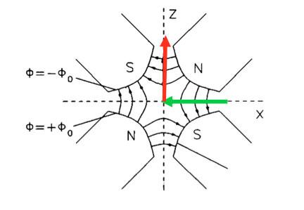
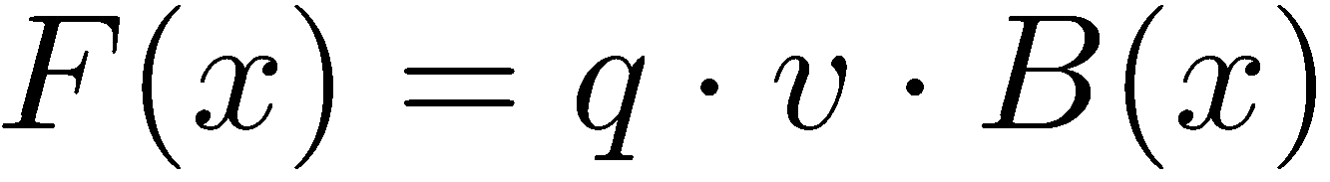
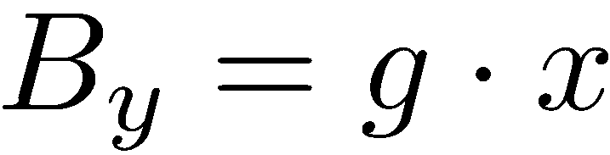

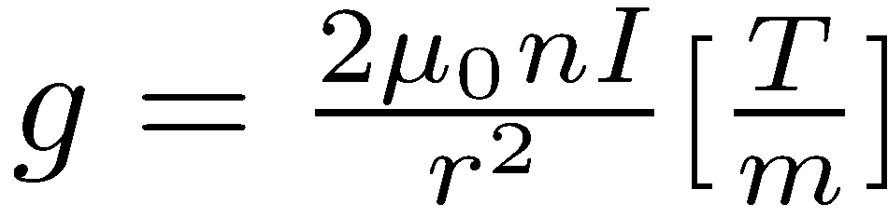
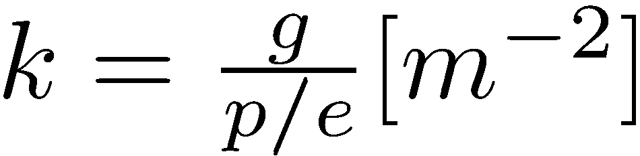
Focusing with Quadrupole Magnets
Requirement: Lorentz force increases as a function of distance from design trajectory
E.g. in the horizontal plane
We want a magnetic field that
Quadrupole magnet
Gradient of quadrupole Normalized gradient, focusing strength

Slide 9
Separate function magnets
Instead of adding a quadrupole field component to our dipoles
Separate function for increased flexibility
  Optimize magnets according to their job: bending, focusing
Add between the dipole magnets separate quadrupole magnets

Slide 10
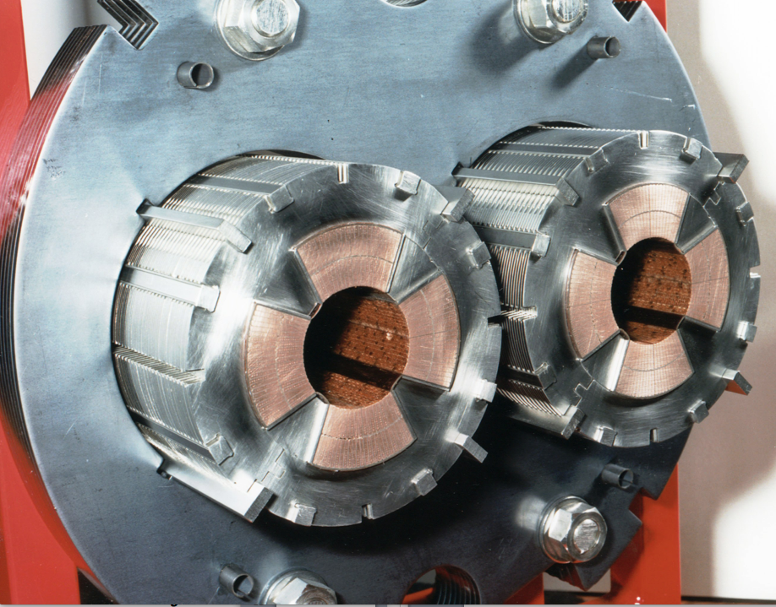
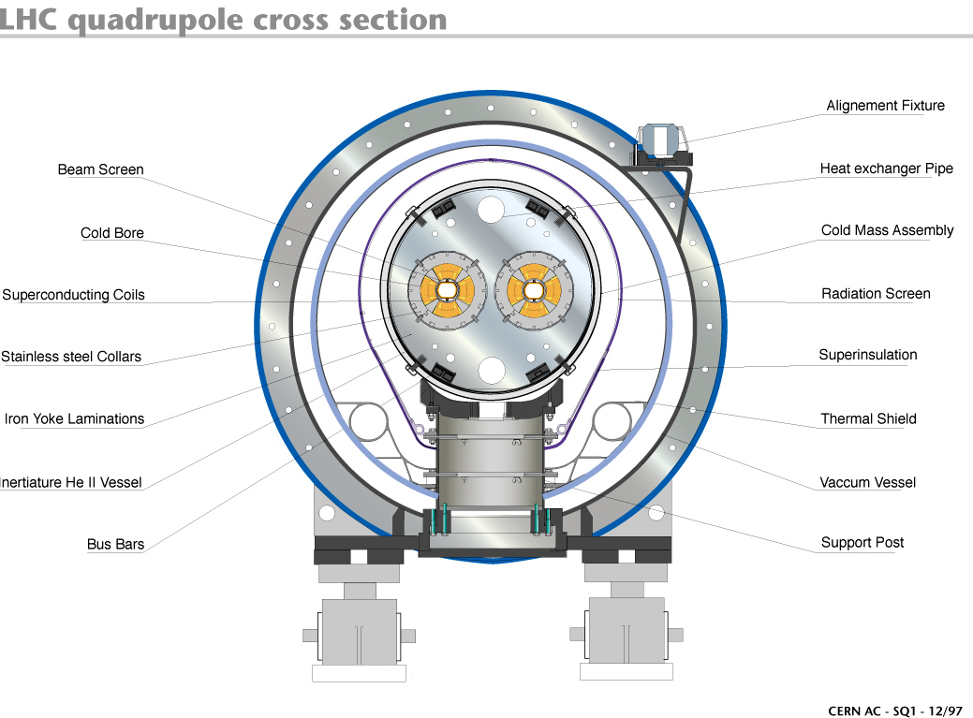
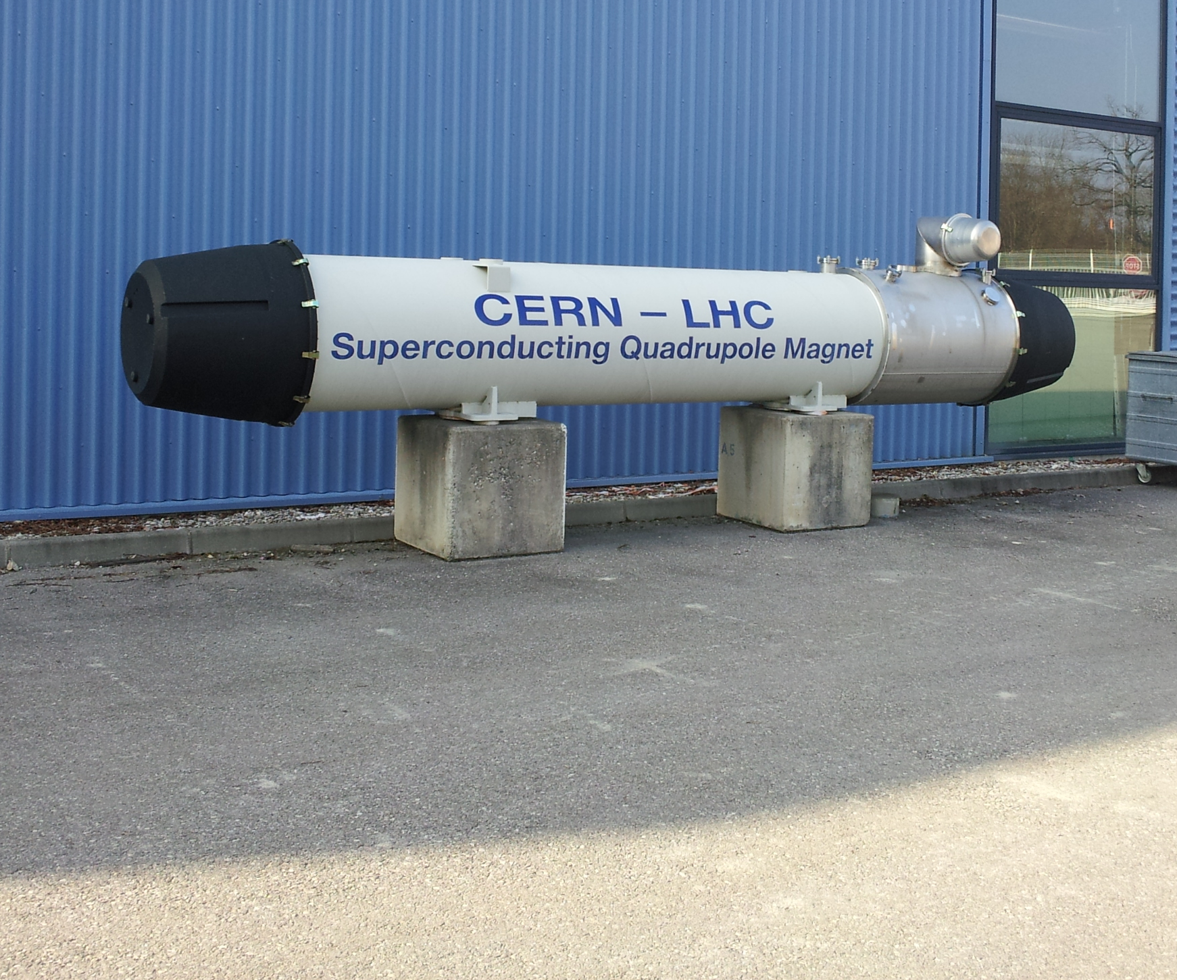
The LHC main quadrupole magnet
Length = 3.2 m
Gradient = 223 T/m
Peak field 6.83 T
Total number in LHC: 392

Slide 11
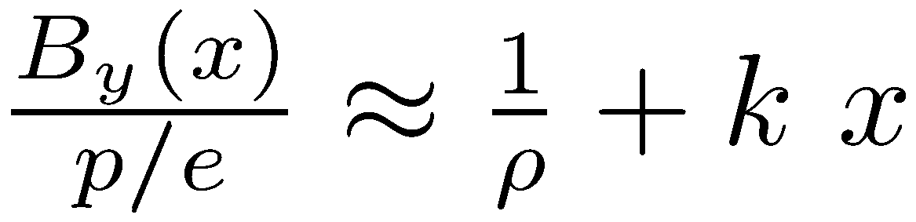
Towards the Equation of Motion
And now a bit of theory to see how we can calculate trajectories through dipoles and quadrupoles.
Taylor series expansion of B field:
Normalize and keep only terms linear in x
✗
✗

Slide 12
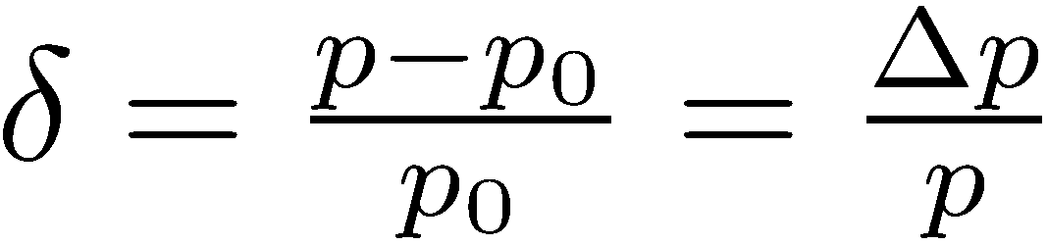
Towards Equation of Motion
Use different coordinate system: Frenet-Serret rotating frame
The ideal particle stays on “design” trajectory. (x=0, y=0)
And: x,y << ρ
The design particle has momentum p₀ = m₀γv.
…. relative momentum offset of a particle

Slide 13
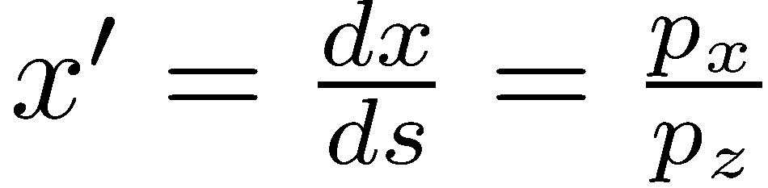
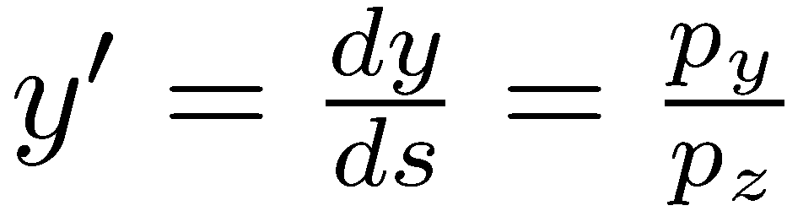
Towards Equation of Motion
A particle is described with 6 coordinates:

Slide 14
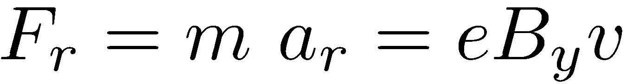
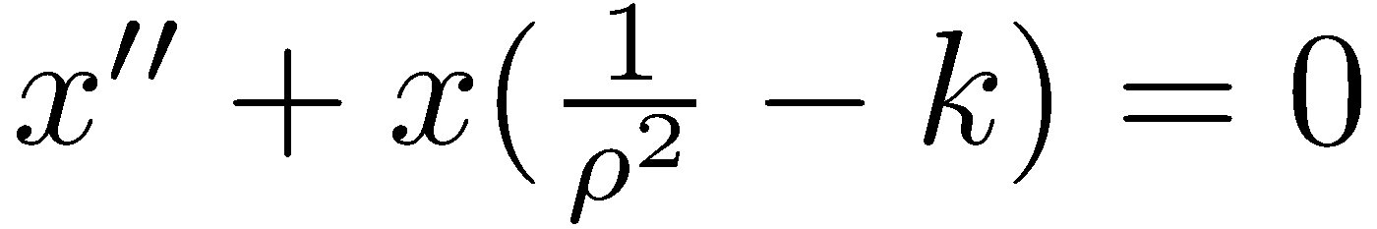
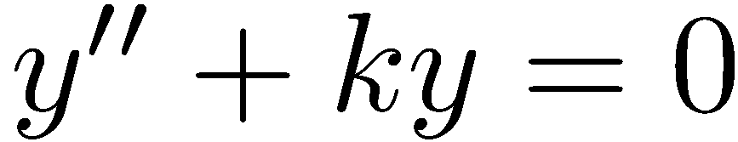
The Equation of Motion
All we have to do now is to write
in the Frenet-Serret frame,
develop with x,y << ρ , and keeping only terms linear in x or y for magnetic field
after a bit of maths: the equations of motion
Assuming there are no vertical bends,
Quadrupole field changes sign between x and y

Slide 15
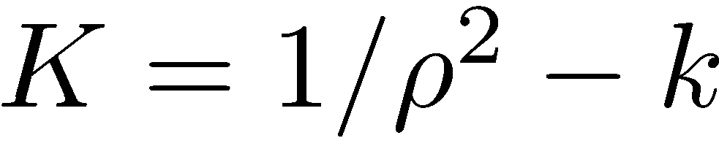

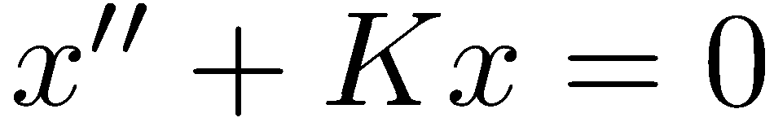
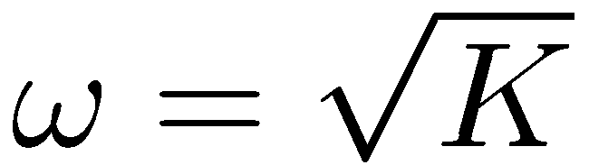
Solution of Equation of Motion
Let’s write it slightly differently:
horizontal plane:
vertical plane:
Solution can be found with ansatz
Insert ansatz in equation ➔
For K > 0: focusing
Equation of the harmonic oscillator with spring constant K

Slide 16
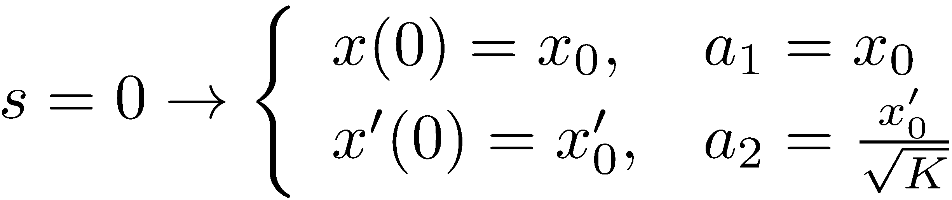
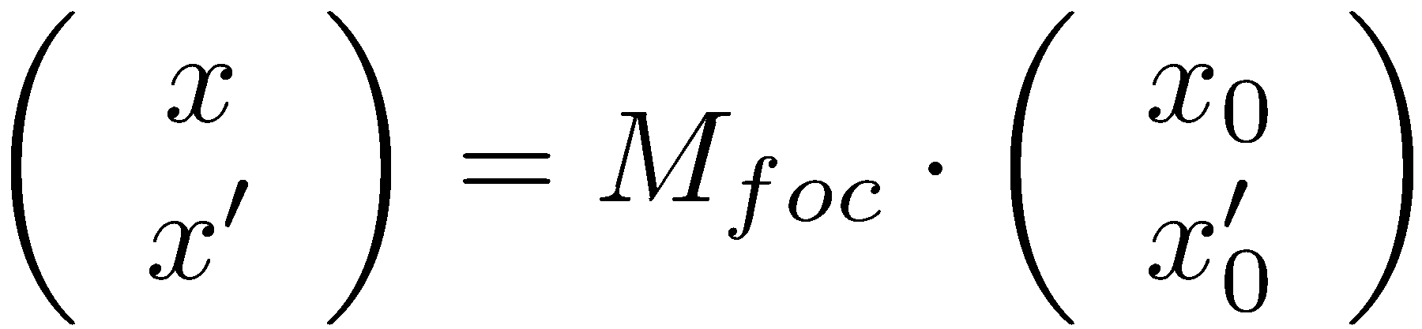
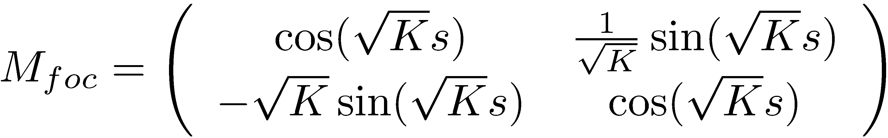
Solution of Equation of Motion
a₁ and a₂ through boundary conditions:
Horizontal focusing quadrupole, K > 0:
Use matrix formalism: TRANSFER MATRIX

Slide 17
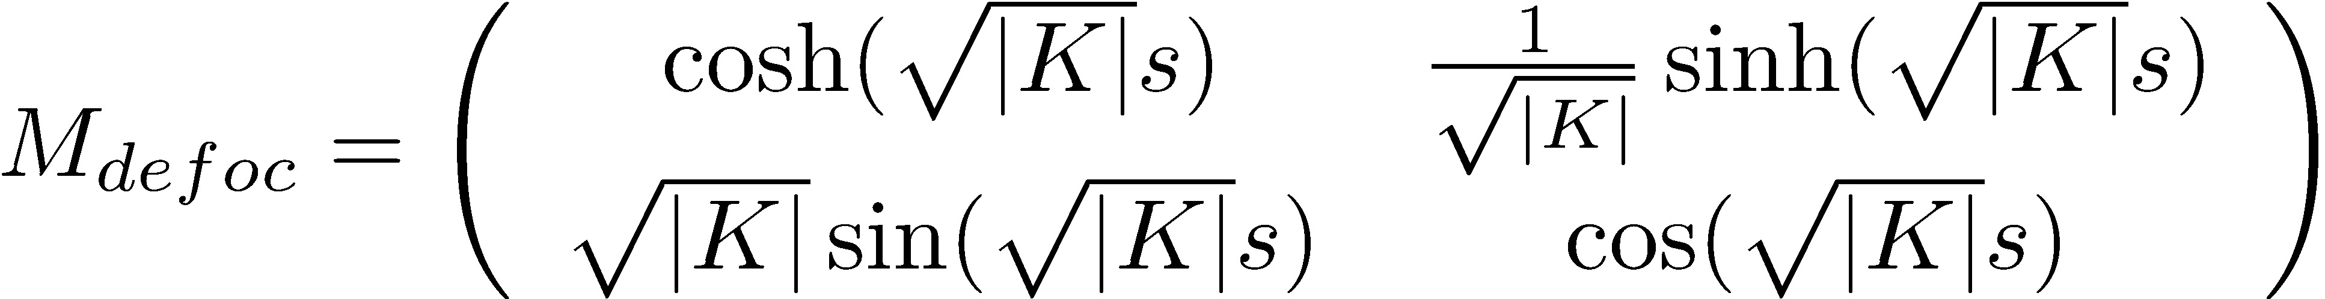
Solution of Equation for Defocusing Quadrupole
Solution of equation of motion with K < 0:
New ansatz is:
And the transfer matrix

Slide 18
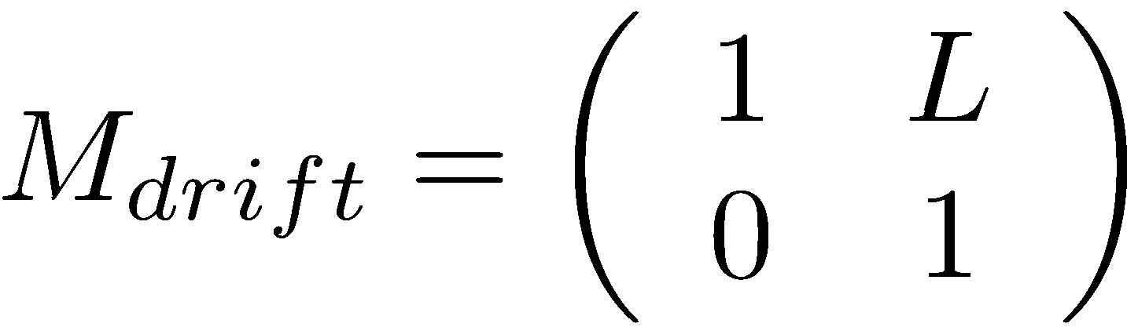
Summary of Transfer Matrices
….horizontal plane
Uncoupled motion in x and y
Focusing quadrupole, K >0:
Defocusing quadrupole, K< 0:
Drift space: length of drift space L
….vertical plane

Slide 19
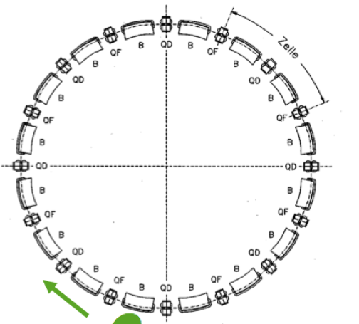
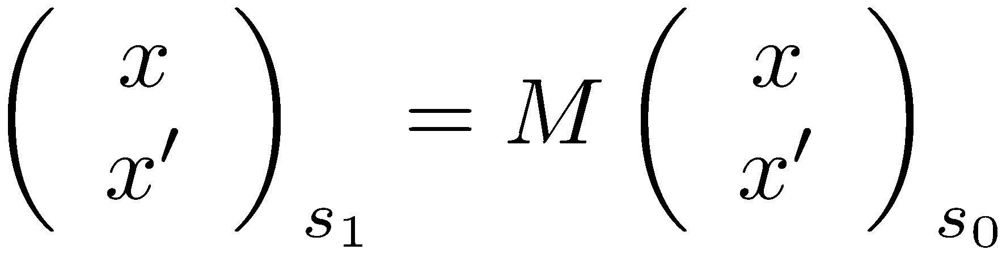
Step 1 – when designing a synchrotron
Design orbit with dipole magnets and alternating gradient lattice.

Slide 20
A few important concepts

Slide 21
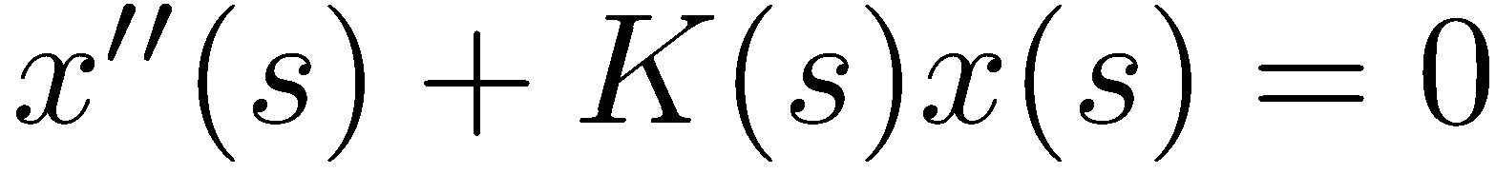
The Hill’s Equation
We had…
Around the accelerator K will not be constant, but will depend on s
Where
restoring force ≠ const, K(s) depends on the position s
K(s+L) = K(s) periodic function, where L is the “lattice period”
General solution of Hill’s equation:
Hill’s equation

Slide 22

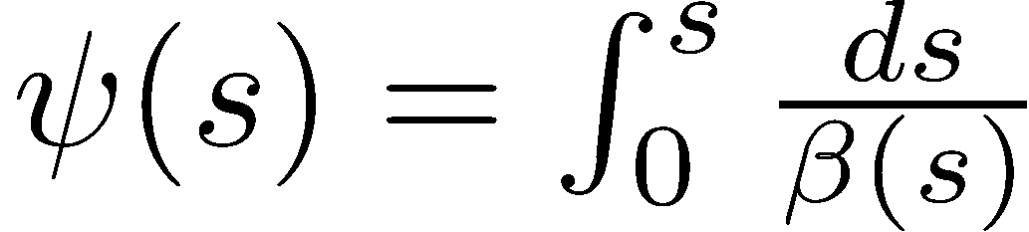
The Beta Function & Co
Solution of Hill’s Equation is a quasi harmonic oscillation (betatron oscillation): amplitude and phase depend on the position s in the ring.
The beta function is a periodic function determined by the focusing properties of the lattice: i.e. quadrupoles
The “phase advance” of the oscillation between the point 0 and point s in the lattice.
integration constants: determined by initial conditions

Slide 23
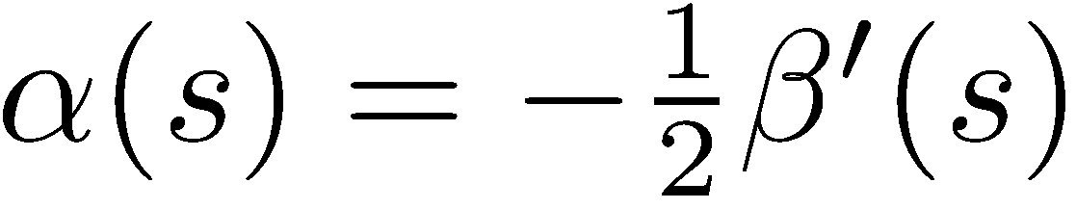
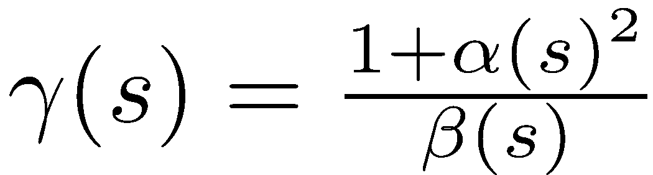
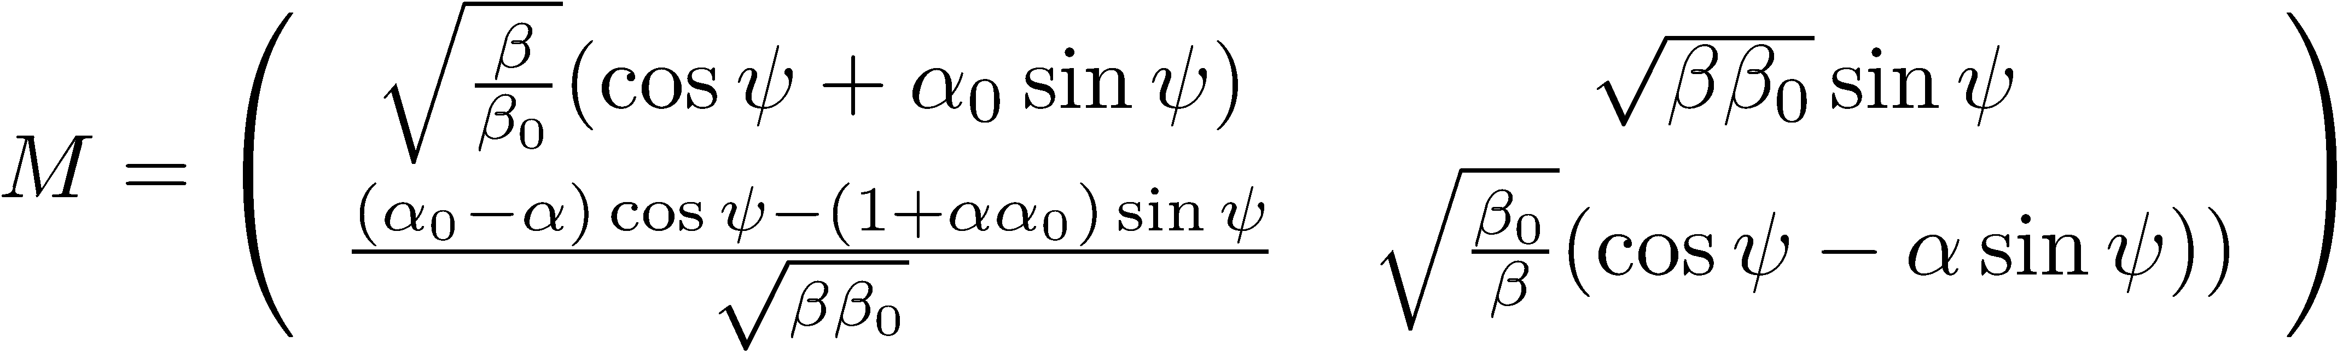
The transport matrix re-vistited
Definition:
Let’s assume for s(0) = s_{0,} ψ(0) = 0.
Defines φ from x₀ and x’₀, β₀ and α_{0.}
Can compute the single particle trajectories between two locations if we know α, β at these positions!

Slide 24
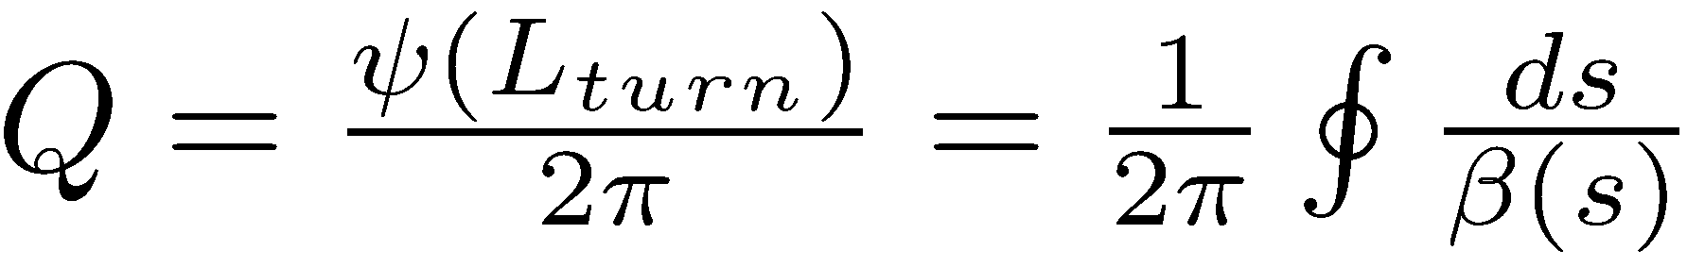
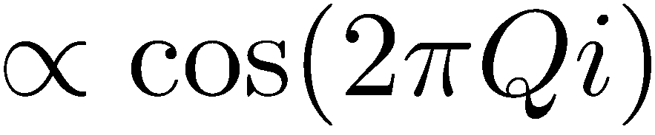
The Tune
The number of oscillations per turn is called “tune”
The tune is an important parameter for the stability of motion over many turns.
It has to be chosen appropriately, measured and corrected.
Measure beam position at one location turn by turn
Beam position will change with
With FFT get frequency of oscillation: tune

Slide 25

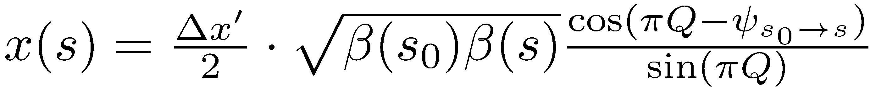
The Tune
The choice of phase advance per cell or tune and hence the focusing properties of the lattice have important implications.
Misalignment of quadrupoles or dipole field errors create orbit perturbations
The perturbation at one location has an effect around the whole machine
➔ diverges for Q = N, where N is integer.

Slide 26

The Tune and Stability
Quadrupoles can have gradient errors ➔ avoid half-integer tunes
Higher order field errors…
In the end avoid simple fractional tunes where Q = n/m with n,m small integers.
Choose a stable working area in the tune diagram.
Qy
Qx

Slide 27

Phase-space ellipse
With:
One can solve for
is a constant of motion: Courant-Snyder invariant
is parametric representation of an ellipse in the xx’space: phase-space
Shape and orientation of ellipse are given by α, β and γ: the Twiss parameters

Slide 28

Phase-space ellipse
The area of the ellipse is constant (Liouville):
The area of the ellipse is an intrinsic property of the beam and cannot be changed by the focusing properties.

Slide 29



Emittance of an ensemble of particles
Typically particles in accelerator have Gaussian particle distribution in position and angle.
Transverse profile measurement and Gauss fit
x'
x
Define beam emittance ε as ellipse with area in phase-space that contains 68.3 % of all particles. Such that
x

Slide 30





Liouville during Acceleration
Liouville’s Theorem from Hamiltonian Mechanics:
canonical variables q, p
e.g. q = position = x
p = momentum = γmv = mcγβ_{x}
The theorem:
We use x’:
The beam emittance shrinks during acceleration!!
➔

Slide 31




The FODO-Lattice
Alternating gradient focusing.
F=focusing O=nothing (or bend, RF structure,…) D=defocusing
A FoDo lattice consists of FoDo cells:
Focal length of quadrupole:
This is what the beta functions look like in a FoDo cell
Stability criterion for FoDo:
…don’t focus too strong!
Notes:
Thin lens approximation… ((1,1),(1/f,1)) Trace of total M > 2

Slide 32
The beta functions around the machine
An example…
β_{x}, β_{y}

Slide 33


Some numbers…
The LHC consists of 8 arcs. Each arc consists of 23(+2) FODO cells.
The regular FODO cell has the following characteristics:
FODO
Phase advance: 90°
Maximum beta: 180 m
The beam size changes along the cell!
Maximum horizontal beam size in the focusing quadrupoles
Maximum vertical beam size in the defocusing quadrupoles

Slide 34


Some numbers…
The emittance at LHC injection energy 450 GeV: ε = 7.3 nm
At 7 TeV: ε = 0.5 nm
Normalized emittance: ε* = 3.5 μm
Normalized emittance preserved during acceleration.
And for the beam sizes:
At the location with the maximum beta function (β_{max} = 180 m):
σ_{450GeV} = 1.1 mm
σ_{7TeV} = 300 μm
Aperture requirement: a > 10 σ
Vertical plane: 19 mm ~ 16 σ @ 450 GeV
~ 38 mm
~ 47 mm

Slide 35

Some numbers…
Need aperture margin for imperfections: e.g. orbit
Horizontal and vertical trajectory around the ring during commissioning. Corrected orbit peak ~ 4 mm.
Notes:
The bunch center is not going through the center of the vacuum chamber, but is offset. And around the offcenter trajectory one needs at leat +/- 3 sigma.
What can also see here is the number of oscillations around the ring…which corresponds to the tune.

Slide 36

What’s next?
We will have a look at longitudinal motion
Imperfections
Injection, Extraction

Slide 37
Annex

Slide 38
Coordinate Transformations – Curvilinear-Cartesian

