Slide 1

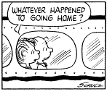
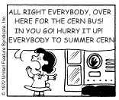
A short introduction to the
2014
Summer
Student
Labs
Niko Neufeld, CERN-PH / 4 July 2012

Slide 2
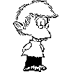


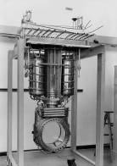
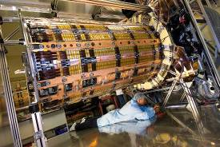
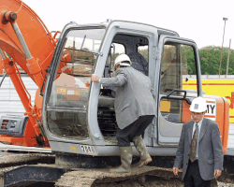
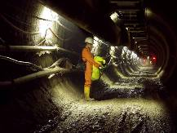
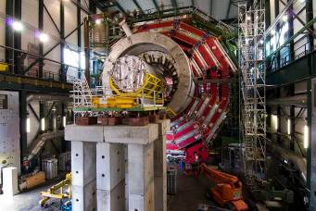
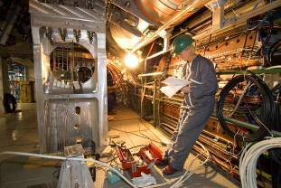
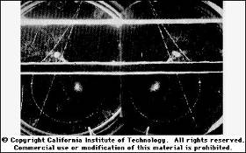
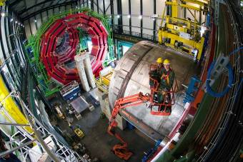
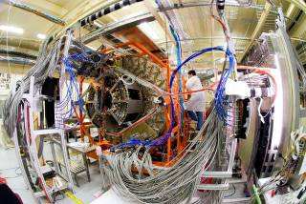
The Summer Student (Hardware) Labs
With the size of the experimental tools in high energy physics getting larger and more complicated, it is very hard in some short summer months to get a feeling of the different aspects of an experiment.

Slide 3












We would therefore like to invite you into some of our labs and try to show you in a few hours what we are doing there and why we are doing it.
Who are "we” ?
Bertrand Bellenot
Tom Blake
Ben Couturier
Carmelo d’Ambrosio
Marcos Fernandez-Garcia
Rikkert Frederix
Benjamin Fuks
Markus Gabrysch
Lau Gatignon
Thierry Gys
Christophe Haen
Andreas Hoecker
Sune Jakobsen
Konrad Jende
Christian Joram
Till Moritz Karbach
Simon Mataguez
Michael Moll
Axel Naumann
Niko Neufeld
Eraldo Oliveri
Leszek Ropelewsky
Peter Skands
Rainer Schwemmer
Tim Stelzer
Rob Veenhof
Welcome!

Slide 4
As a Menu, we can offer:
Cloud Chambers
Inorganic Scintillator Detectors
Organic Scintillator Detectors
Gas detectors
Silicon Detectors
Vacuum Photon Detectors
Time of Flight detectors
Data Acquisition
High Energy Physics Monte-Carlo Techniques
ROOT
http://jobs.web.cern.ch/programme/summer-student-programme/workshops

Slide 5
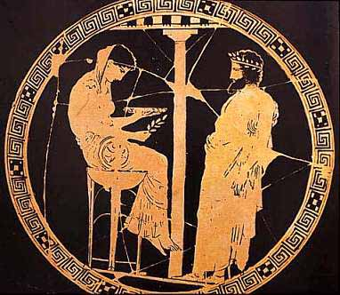
Pythia Tutorial
Contact: Peter Skands
Date and time: July 23rd 14:00 – 17:00
Up to 30 students
13/2-005
The New world encyclopaedia

Slide 6
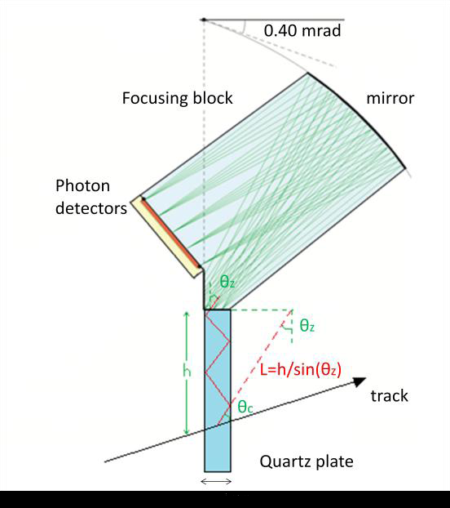
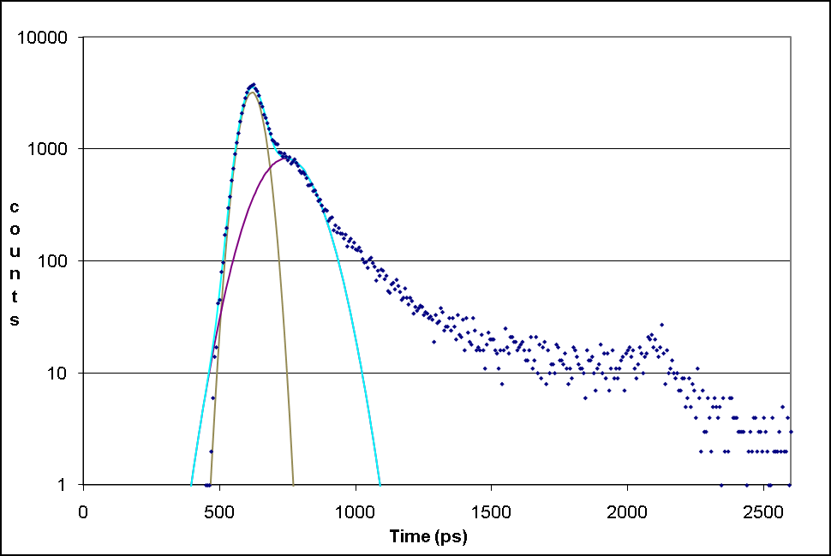
Very fast signal detection for TOF experiments
Contact person: Thierry Gys
Time : afternoon, 14:00 – 17:30
3 groups of 3 students
Dates : 4, 5, 6 of August
Place : 16-1-047
Please note that high voltages
are present on the set-up.
To allow Time-Of-Flight experiments to measure in the GeV/c momentum range, over ~10 metres distances, the time resolutions of such detectors have to exceed the ~10 ps barrier per measured track. You will be able to detect with a vacuum photo-detector, containing a Micro-Channel-Plate, time resolutions of the order of 50 ps per photon!

Slide 7
Root
Contact Persons: Axel Naumann and Bertrand Bellenot
3 afternoons with up to 60 students each time.
Building 60-6-015, at 14:00.
10th and 11th July.
You must bring your own laptop! You should install ROOT (5.27/04 from http://root.cern.ch/drupal/content/development-version-534)
OR have X11 and ssh to lxplus.

Slide 8
Cloud Chamber
Contact Persons: Konrad Jende
10 groups of 24 students
Meeting point: Meeting point is at the reception of building 33
July 16,23,25, 30 and August 1 – 2, Two sessions 14:00 – 15:30 and 16:00 – 17:30
BYODASAB
(Build your own Detector and save a bundle)

Slide 9
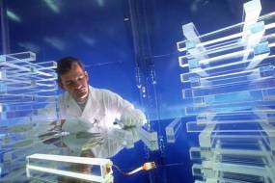
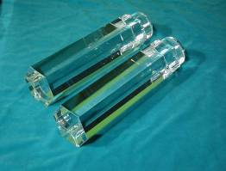
X- and Gamma- rays detection with a Hybrid Photon Detector
Contact person: Carmelo D’Ambrosio
Requirements: dosimeter
Time : afternoon, 14:00 – 17:30
3 groups of 3 students
Dates : 5, 6 and 7 August
Place : 29-1-021
Please note that gamma sources and
high voltages are present on the set-up.
New Scintillating Crystals are being developed for bio-medical applications, which were first developed for high energy physics or material science. With a new generation of photodetectors being made available for the same applications (HPDs, APDs, SDCs, etc.), these gamma detectors (crystal + photodetector) represent an important contribution in the evolution of instrumentation for physics and non-physics applications.

Slide 10
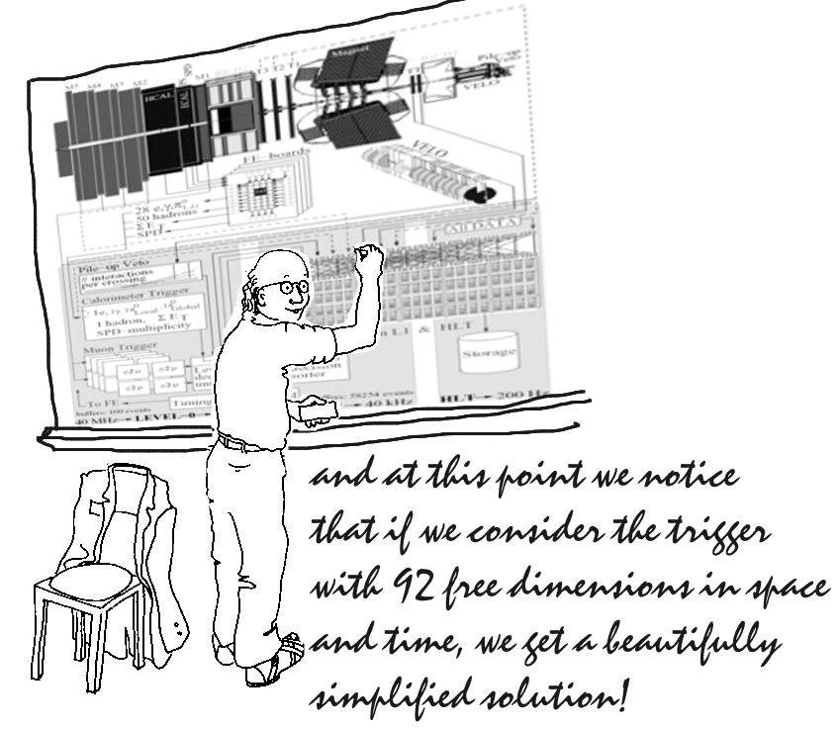
Data Acquisition (and fun with bits lost and found).
Contact persons:
Niko Neufeld, Christophe Haen and Rainer Schwemmer
Requirements: Some basic programming experiences
would be good - but that should not deter anyone.
4 sessions with 4 students
Time : one afternoon, 14:00 – 17:00
Dates : 14, 15, 21, 22 July
Place : Point 8
Meeting at 14:00 in 2-R-002
(transport arranged via email to Niko)
Real data acquisition at 1 MHz.
Follow the data through LHCb and try not to lose a single bit!
From the front-end electronics, through the readout boards, the network, the farm to tape - and not back.

Slide 11
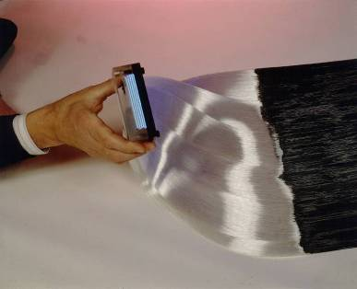
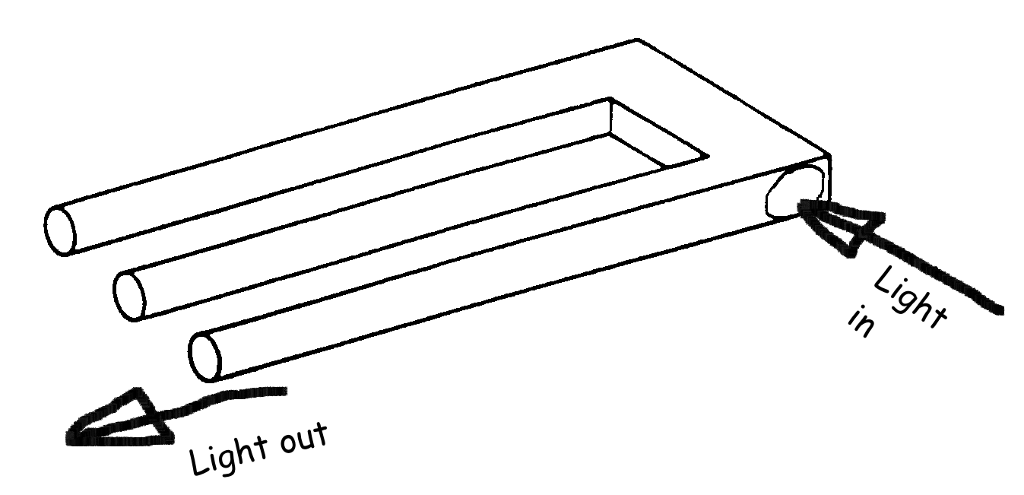
Characterization of a particle detector using cosmic particles
(it is the 100th anniversary of cosmics detection)
Contact Persons :
Sune Jakobsen and Christian Joram
3 afternoons with 3 students.
When: 12, 14 and 15 August 14:00 to 17:30
Where: Meeting room: 3-R-020.
What: Hands-on experience with photomultipliers, oscilloscopes, scintillators, light guides, wavelength shifters and monochromators.
- measure the photodetection efficiency (PDE) of a silicon photomultiplier (SiPM)
CERN photo CERN-EX-9201043
End part of the scintillating fibre detector of the CHORUS experiment. There are 1 million fibres and each fibre has a diameter of 500 .micron.m.

Slide 12
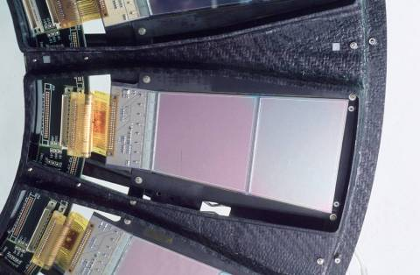
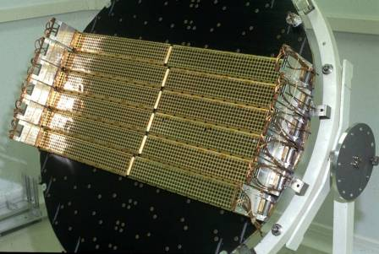
Characterization of irradiated silicon sensors.
Contacts: Michael Moll, Christian Gallrap, Hannes Neugebauer, Marcos Fernandez Garcia
3 afternoons with 3 students.
When: 5, 6, 7 August
+ common visit to the Si facility, 8th of August
contact: Alan Honma, Ian McGill
Where: Meeting room: 28-2-017
What: We will investigate how radiation damage is influencing the silicon tracking detectors in the LHC experiments. The following properties of irradiated and non-irradiated silicon detectors will be measured: Reverse current, detector capacitance, depletion voltage and charge collection efficiency. This will give you an impression on how much detectors in the LHC will suffer from radiation damage. In a concluding discussion we will look at some possibilities on how to make detectors radiation harder.

Slide 13
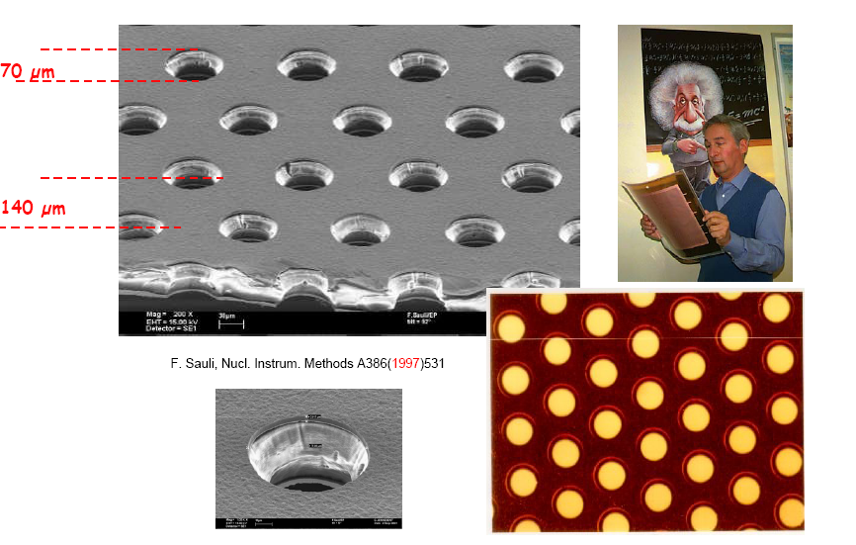
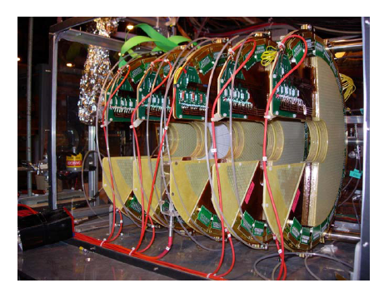
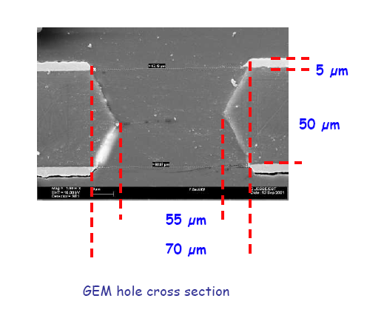
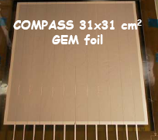
X-Rays Detection with a MPGD detector
Contact Persons: Leszek Ropelewsky, Eraldo Oliveri, Rob Veenhof
Requirements: Some Lab Experience, Dosimeter is mandatory
Time: three afternoons, 14.00 – 17.30
three groups of 8 students
Dates: 29, 30, 31 of July
Place:
Please note that x-rays source and high voltages
are present on the set-up
You will work in the Gas Detectors Development Group (GDD), a PH-DT group created in the late sixties by Georges Charpak, inventor of the Multiwire Proportional Chamber and 1992 Nobel Laureate for Physics, that has been active in the development and applications of advanced detectors for particle physics.
Intro to gas detection and operate real R&D prototypes, built for the development and characterization of MPGDs detectors for LHC experiments upgrades. Basic understanding of gaseous particle detection, signal formation and processing will be reviewed

Slide 14


Masterclasses in LHCb
Place: TBA
Time: TBA – one afternoon
Content: do a real HEP analysis in the most awesome of the
LHC-experiments ☺
Contact: Ben Couturier, Till Moritz Karbach
2 groups of X students, where X < 10
The presence of Maria Callas cannot be guaranteed

Slide 15

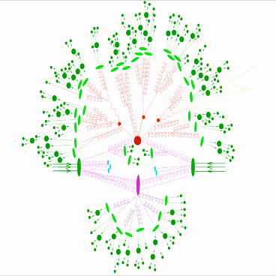
MadGraph
http://madgraph.hep.uiuc.edu/
Contact Persons: Rikkert Frederix, Benjamin Fuks
3 afternoons with up to 18 students each time.
Training Centre (bgs. 572), rooms 24 and 25, at 14:00 – 17:00.
15, 16 and 17 July.
1. High-Q2 Scattering 2. Parton Shower
3. Hadronization 4. Underlying Event
In this workshop we will
Discuss the various aspects of a hard-hadronic collision using a FLASH simulation.
Develop cutting edge Monte Carlo techniques necessary for simulating these collisions.
Use MadEvent’s new web-based capabilities to produce event simulations for processes important to LHC physics.

Slide 16
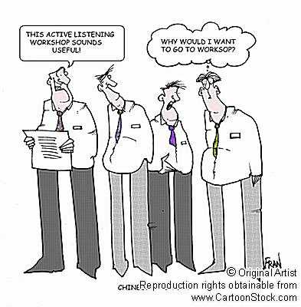
What you have to do :
①
Do what Sharon and Roxanaa will tell you to do by e-mail
and, remember, dates are not completely fixed!
③
②
Have fun!
Try not to forget
your rendez-vous…,

