Slide 1
Feasibility Test of
Longitudinal Stochastic Cooling for Heavy-Ions in the LHC
Michaela Schaumann (CERN, RWTH Aachen)
In collaboration with
J.M. Jowett (CERN) and M. Blaskiewicz (BNL)

Slide 2
The Idea
Install reduced longitudinal stochastic cooling system in the LHC (IR4) using
  existing Schottky Pickups at 4.8GHz,
  only 1 longitudinal cavity at 4.8GHz resonant frequency,
  + other required equipment (see later).
  Cool a low intensity Pb-test-bunch and observe the bunch length reduction over time.
  Parasitic experiment:
    Long commissioning time required!
    Gate on particular bunch in filling pattern.
    Take data for every fill.

Slide 3

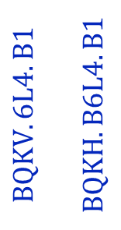



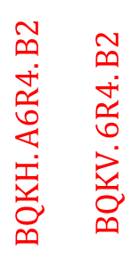
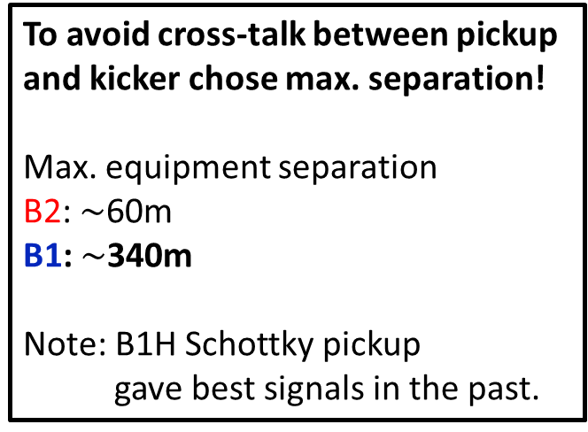
Tunnel Equipment in IR4
B1
B2
339m
58m
253m
IP4
s from
IP1
$$BQKV.6L4.B1$$
$$BQKH.B6L4.B1$$
$$BQKH.A6R4.B2$$
$$BQKV.6R4.B2$$
$$BQSV.7R4.B2$$
$$BQSV.5R4.B1$$
$$BQSH.7R4.B1$$
$$BQSH.5R4.B2$$
To avoid cross-talk between pickup
and kicker chose max. separation!
Max. equipment separation
B2: $\sim$60m
B1: $\sim$340m
Note: B1H Schottky pickup
gave best signals in the past.
Schottky Pickups
Potential Cavity
Locations

Slide 4
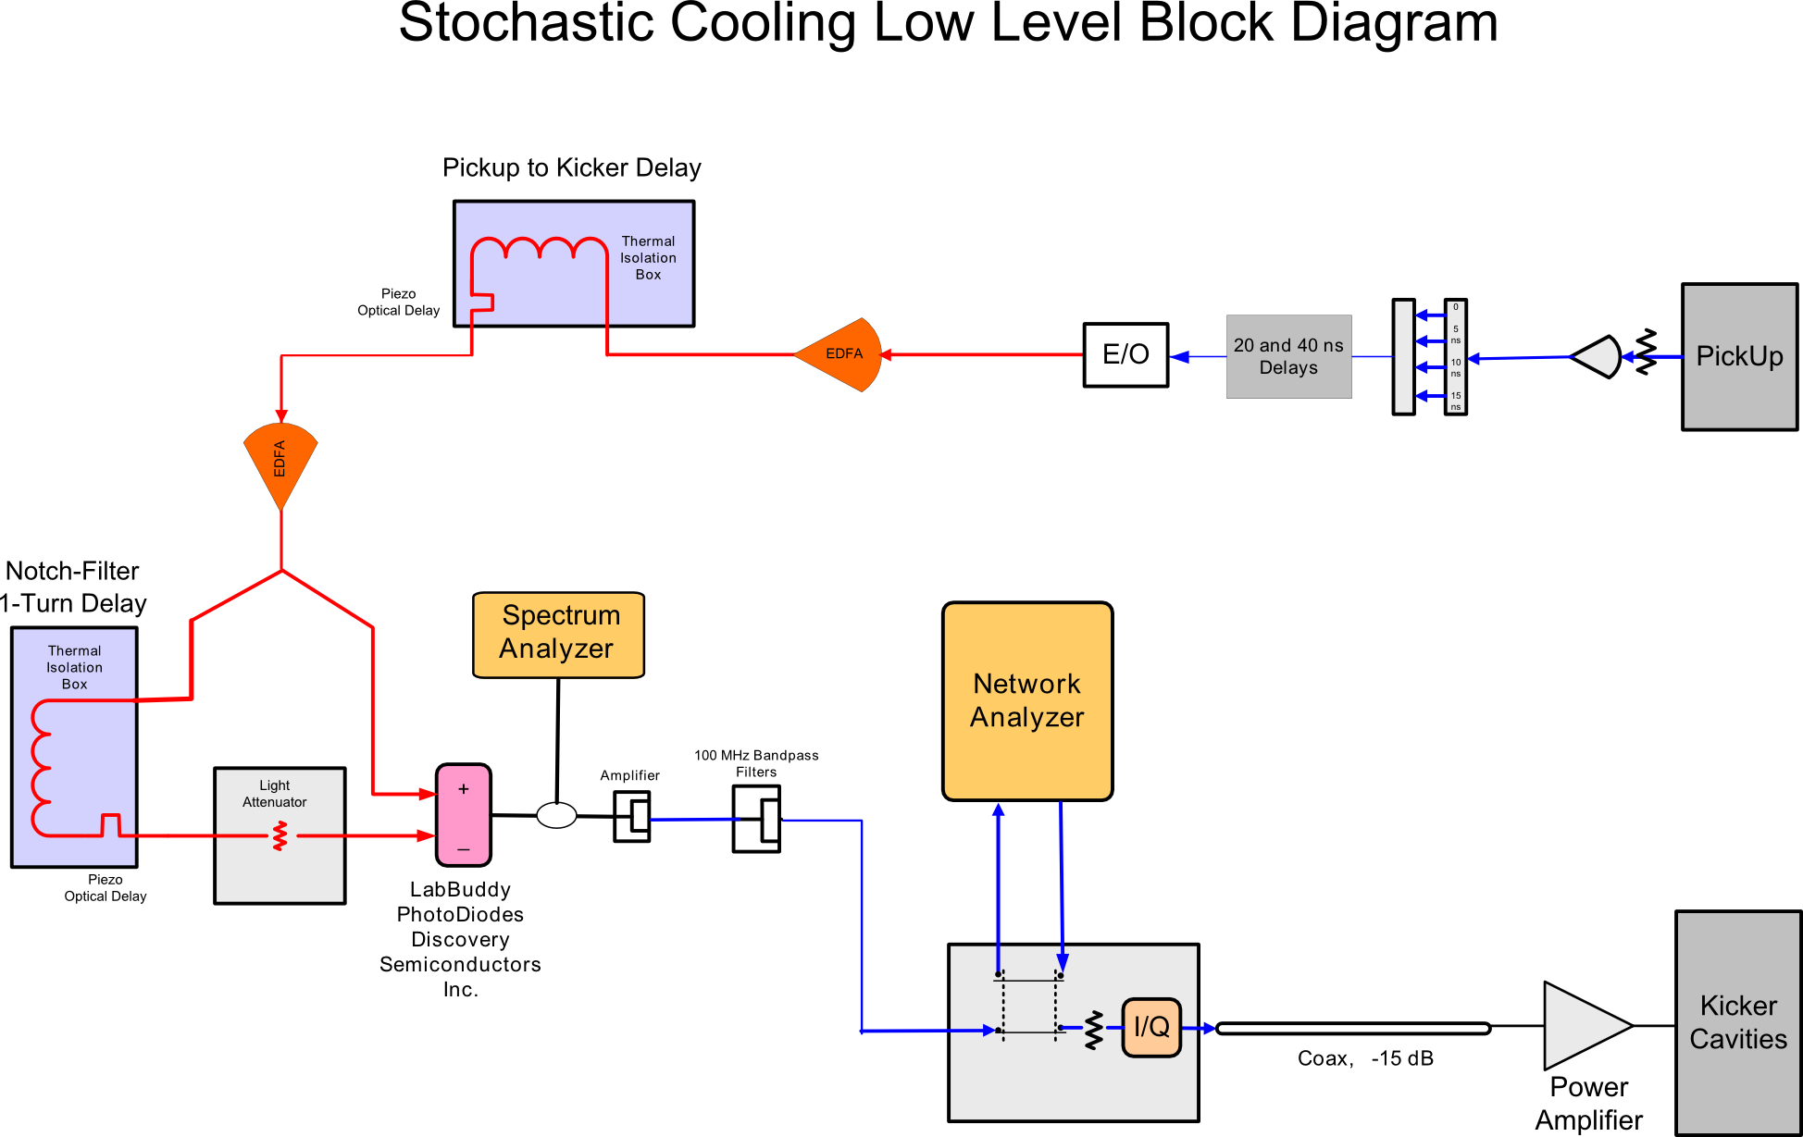
Signal Processing and Transportation
at Surface
in Tunnel
S
Signal
Processing
Notes:
Signal processing? What is needed?
What bandwidth for bandpass filter?

Slide 5
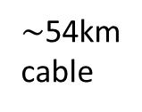
Required Hardware
Schottky Pickup at 4.8GHz operated in sum-mode
(Transversal filter)
E/O - Transformation to optical signal
Light amplification
Optical cable - Signal transportation to cavity location
Notch filter (1-turn-delay, combiner and transformation to electrical signal)
Narrow band-pass filter at 4.8GHz centre frequency
Spectrum and Network analysers
I/Q modulator for phase and amplitude adjustment
Coaxial cable to power amplifier
Power amplifier
Cavity
$\sim$54km
cable

Slide 6
Experiment Setup
Low intensity bunch for fast cooling.
Non-colliding bunch for clear signal.
Non-cooled witness bunch for reference:
  At 6.5Z TeV bunch length naturally shrinks due to radiation damping.
  To distinguish between cooled and non-cooled bunches the cooling rate must be faster than the radiation damping rate!

Slide 7
Experiment Setup
Pilot/First bunch of 1st Train
Additional Low Intensity Bunch
    Bunch with lowest intensity in filling scheme.
    If spacing to neighbouring bunches is to small, neighbours might be disturbed by cooling.
    Intensity can be chosen to enhance cooling.
    No disturbances for other bunches.
    Easy to add witness bunch was equal properties.
Injection
Flat Top
Injection
Flat Top
Bunch with longest possible observation time.
Only 30min observation.
    Colliding! Non-colliding bunch would show cleaner signal.
    Fill length for observation.
    Injection of first bunch just before abort gap.
    Over-inject with the last train – no change of filling scheme necessary.
    Only 30min observation.
    Modify injection scheme! -Potential reduction of total bunch number.
    Fill length for observation.

Slide 8
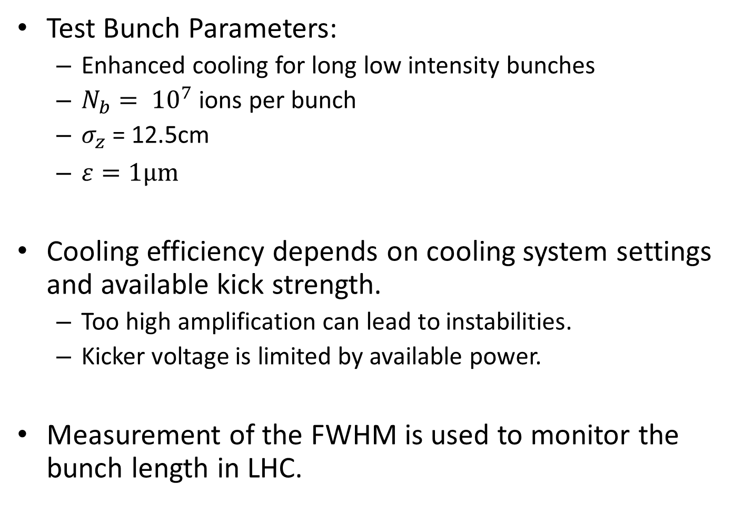
Simulations
Test Bunch Parameters:
  Enhanced cooling for long low intensity bunches
  $N_{b}= {10}^{7}$ ions per bunch
  $σ_{z}$ = 12.5cm
  $ε=1μm$
Cooling efficiency depends on cooling system settings and available kick strength.
  Too high amplification can lead to instabilities.
  Kicker voltage is limited by available power.
Measurement of the FWHM is used to monitor the bunch length in LHC.

Slide 9
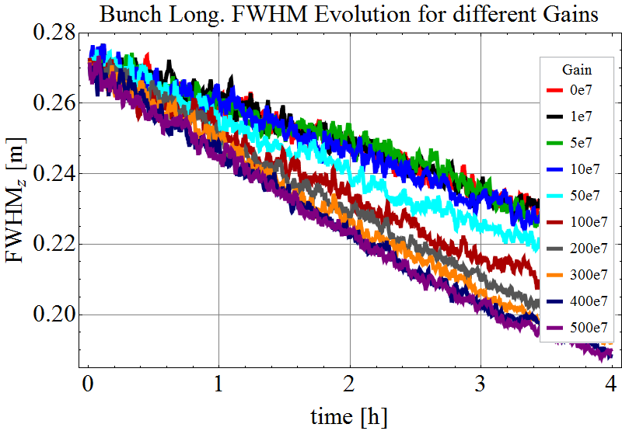
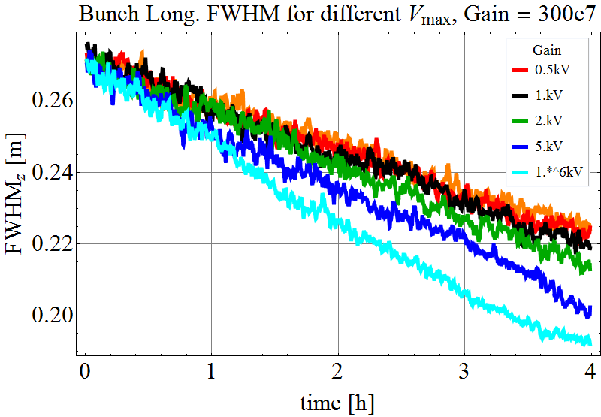
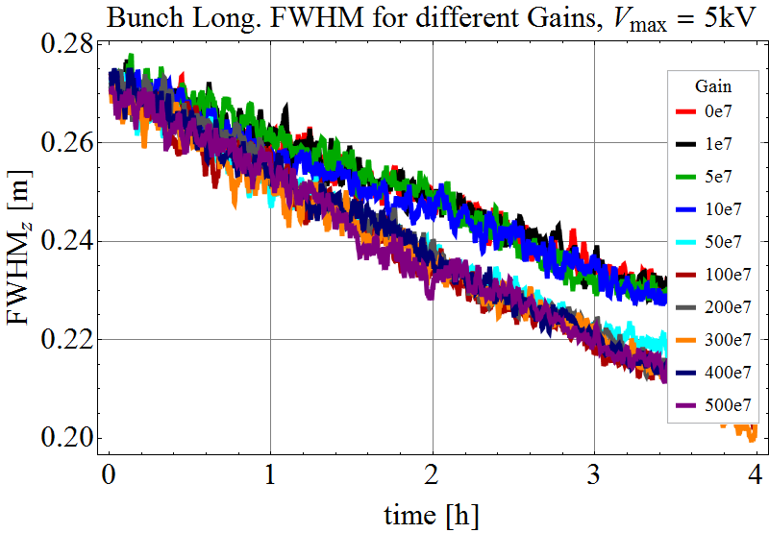
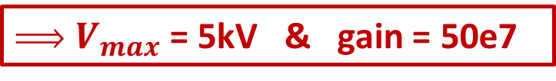
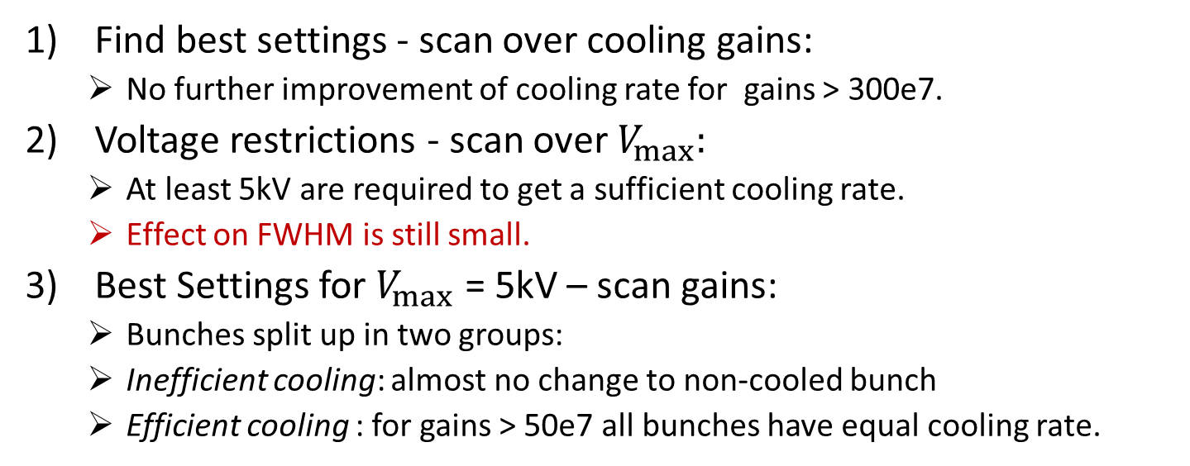
Cooling Simulation at Flat Top
FWHM
1) No Voltage limit
FWHM
2) Fixed gain
FWHM
3) Limited Voltage
Find best settings - scan over cooling gains:
  No further improvement of cooling rate for gains > 300e7.
Voltage restrictions - scan over $V_{max}:$
  At least 5kV are required to get a sufficient cooling rate.
  Effect on FWHM is still small.
Best Settings for $V_{max}$ = 5kV – scan gains:
  Bunches split up in two groups:
  Inefficient cooling: almost no change to non-cooled bunch
  Efficient cooling : for gains > 50e7 all bunches have equal cooling rate.
$ V_{max}$ = 5kV & gain = 50e7

Slide 10
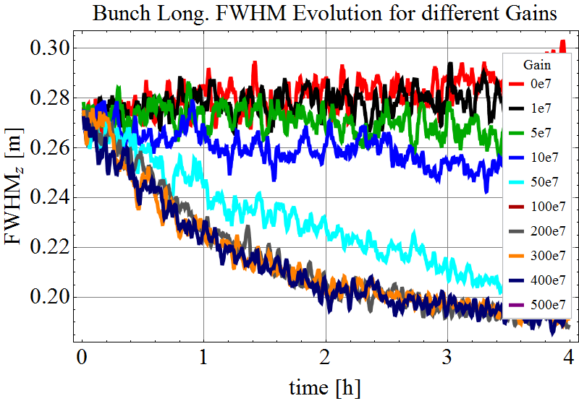
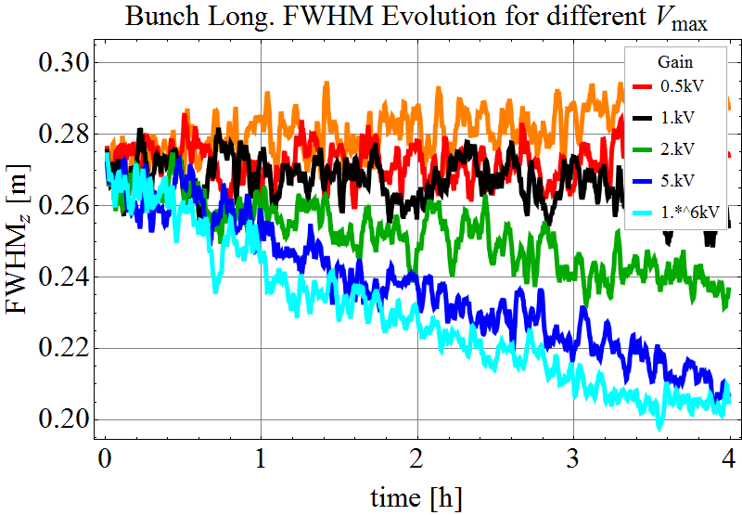
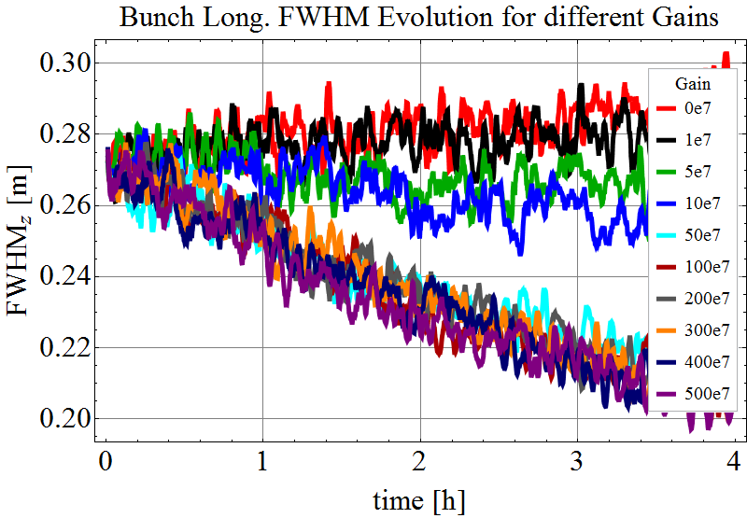
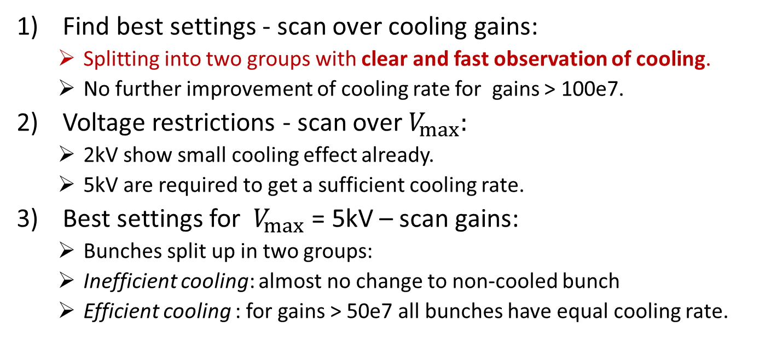
Cooling Simulation at Injection
FWHM
1) No Voltage limit
FWHM
2) Fixed gain
FWHM
3) Limited Voltage
Find best settings - scan over cooling gains:
  Splitting into two groups with clear and fast observation of cooling.
  No further improvement of cooling rate for gains > 100e7.
Voltage restrictions - scan over $V_{max}:$
  2kV show small cooling effect already.
  5kV are required to get a sufficient cooling rate.
Best settings for $V_{max}$ = 5kV – scan gains:
  Bunches split up in two groups:
  Inefficient cooling: almost no change to non-cooled bunch
  Efficient cooling : for gains > 50e7 all bunches have equal cooling rate.
$ V_{max}$ = 5kV & gain = 50e7 & fast and clear effect

Slide 11
Summary
Cooling of 1 low intensity bunch in B1 is proposed.
Using B1H Schottky pickup in sum-mode.
Install longitudinal cavity in one of the BQK.B1 positions.
As parasitic proof of principle experiment:
  Inject additional very low intensity bunch close to the abort gap at the beginning of the injection process.
  Observe cooling while the machine is being filled.
  Over-inject the cooled bunch with the last injected train before going into the ramp.
Hardware requires mostly standard installations.
  Signal processing, filters, cabling, amplifiers,…
  Pickup already exists and able to be operated in requested mode.
  Preliminary cavity design already available.
Highest cost contribution expected from cavity, power amplifier, spectrum and network analysers.

Slide 12
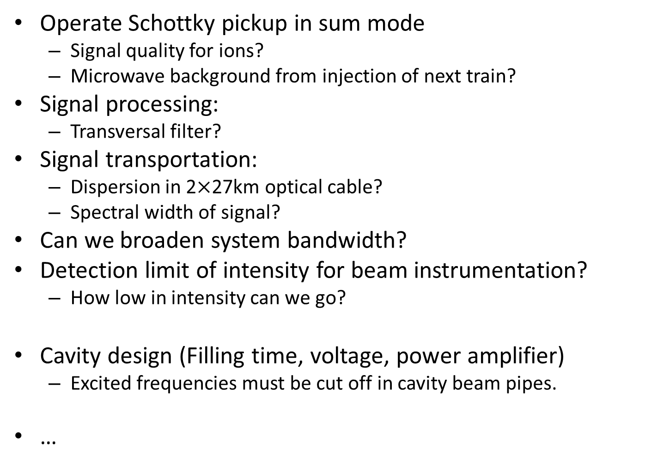
Open Questions
Operate Schottky pickup in sum mode
  Signal quality for ions?
  Microwave background from injection of next train?
Signal processing:
  Transversal filter?
Signal transportation:
  Dispersion in 2$×$27km optical cable?
  Spectral width of signal?
Can we broaden system bandwidth?
Detection limit of intensity for beam instrumentation?
  How low in intensity can we go?
Cavity design (Filling time, voltage, power amplifier)
  Excited frequencies must be cut off in cavity beam pipes.
…

Slide 13
Acknowledgments
M. Brennen, K. Mernick, S. Verdu Andres (BNL)

Slide 14
Back-up

Slide 15


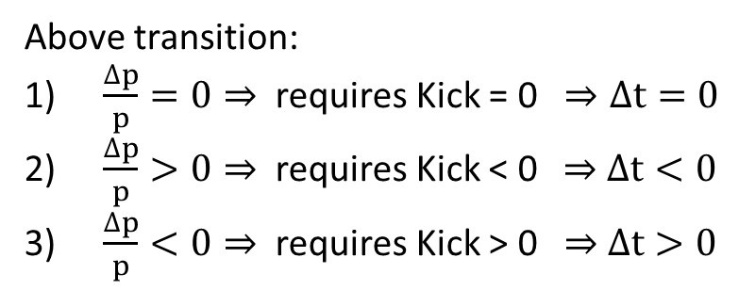


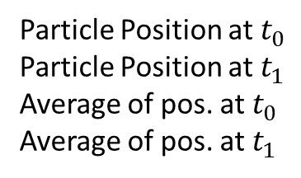
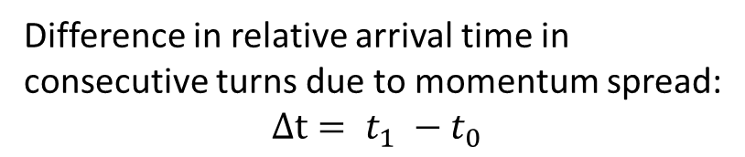
Longitudinal Stochastic Cooling Principle
Particle Position at $t_{0}$
Particle Position at $t_{1}$
Average of pos. at $t_{0}$
Average of pos. at $t_{1}$
Pickup
-
Signal
Kicker
Notch-Filter
Measure average arrival time of particle samples
Beam
$$t_{0}$$
Difference in relative arrival time in consecutive turns due to momentum spread:
$$Δt= t_{1} −t_{0}$$
$$t_{1}$$
Above transition:
$\frac{∆p}{p}=0⇒$ requires Kick = 0 $⇒Δt=0$
$\frac{∆p}{p}>0⇒$ requires Kick < 0 $⇒$ $Δt<0$
$\frac{∆p}{p}<0⇒$ requires Kick > 0 $⇒$ $Δt>0$
$Δt∝$ kick

Slide 16
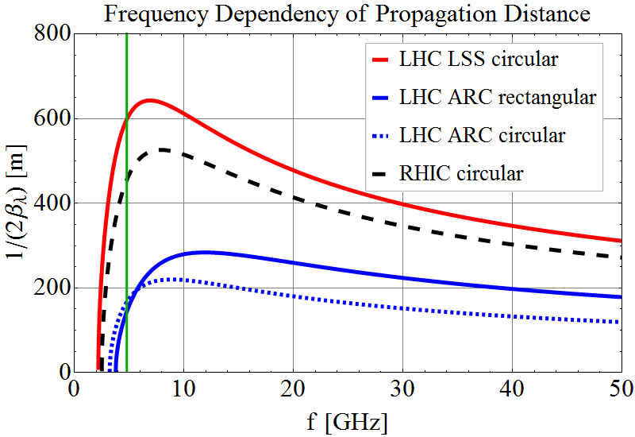
Propagation Distance

Slide 17
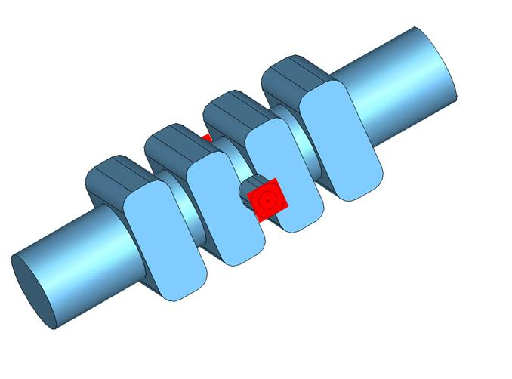
First Preliminary Cavity Design
  Resonant freq. = 4.8 GHz
  Kick voltage V = 3 kV (RMS?)
  Power consumption P = 38 W
  filling Time = 111 ns
  loaded Q = 1680
  R/Q = 142 Ohm
  Inner radius r = 20 mm
  Length L = 120 mm
  …
S. Verdu Andres (BNL)

Slide 18
Cooling System Commissioning and Operation
Measure resonant frequency of the cavity:
  If necessary adjust by changing temperature with heaters.
  Could be done without beam.
Check (beam) positions of pickup and cavity:
  Beam should be centred in pickup and cavity to achieve best signal, max. kick and avoid beam losses.
  Move pickup plates as close to the beam as possible to enhance signal.
Optimise delays and signal positions:
  Centre revolution line in pickup signal.
  Adjust 1-turn-delay of Notch-filter to get optimal difference signal (for correct amount and sign of kick).
Measure reference BTFs and adjust amplitude and phase of the kick with the I/Q modulator.
  Repeat BTF measurement and adjustment from time to time during the experiment to ensure optimal cooling.
  Cavity will be not available for cooling during the BTF measurement.

Slide 19
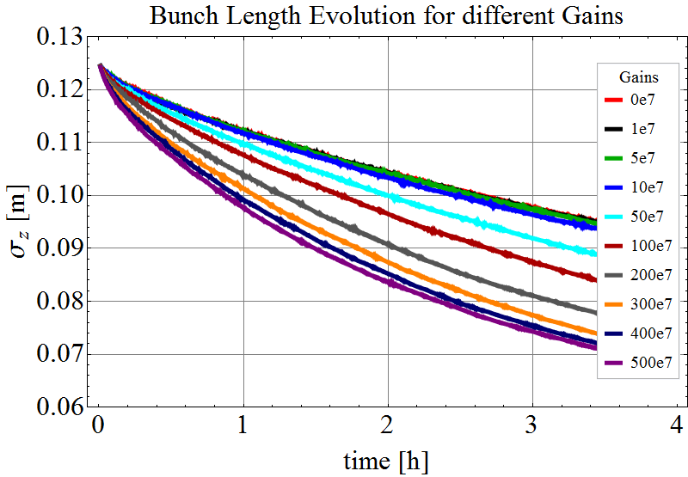
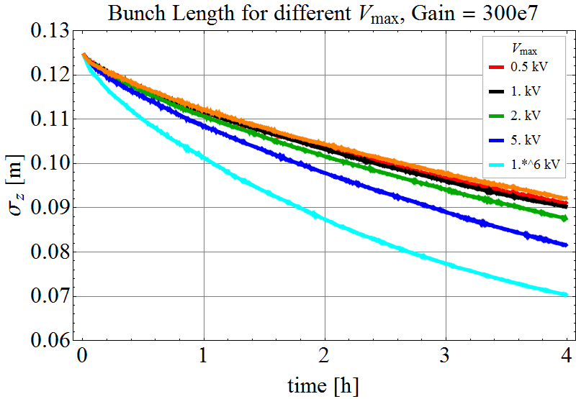
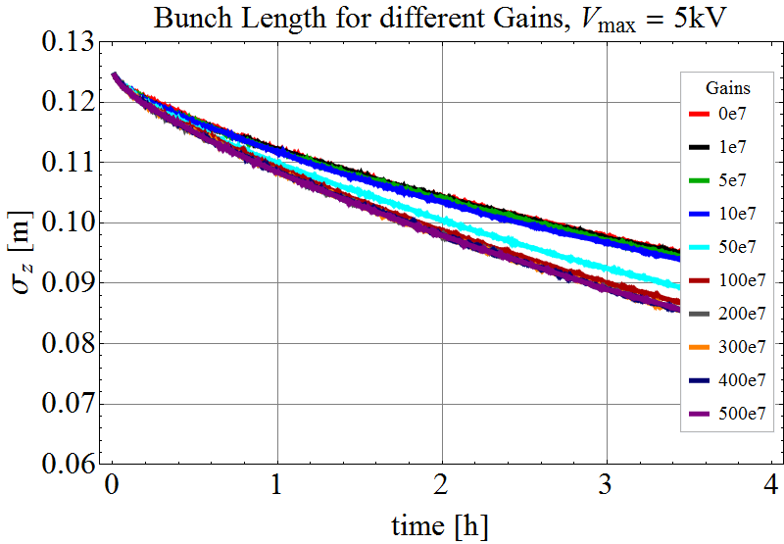
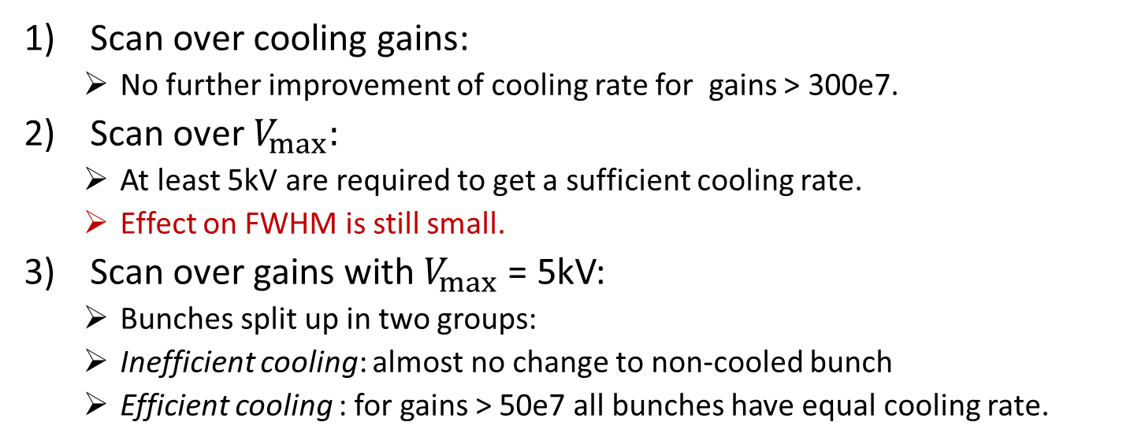
Cooling Simulation at Flat Top
Scan over cooling gains:
  No further improvement of cooling rate for gains > 300e7.
Scan over $V_{max}:$
  At least 5kV are required to get a sufficient cooling rate.
  Effect on FWHM is still small.
Scan over gains with $V_{max}$ = 5kV:
  Bunches split up in two groups:
  Inefficient cooling: almost no change to non-cooled bunch
  Efficient cooling : for gains > 50e7 all bunches have equal cooling rate.
$ V_{max}$ = 5kV & gain = 50e7

Slide 20
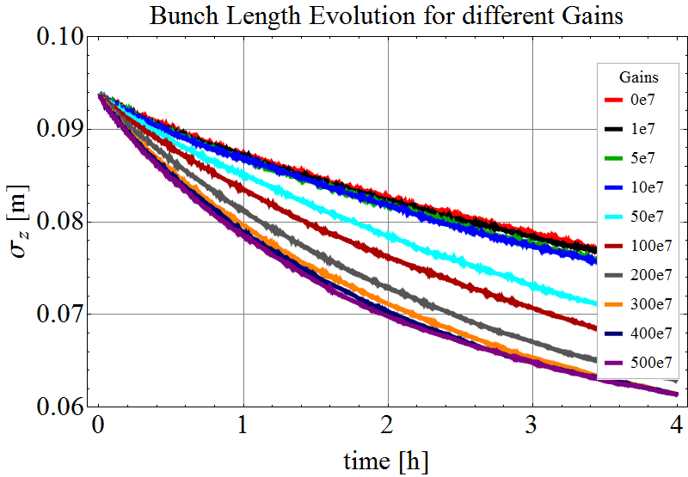
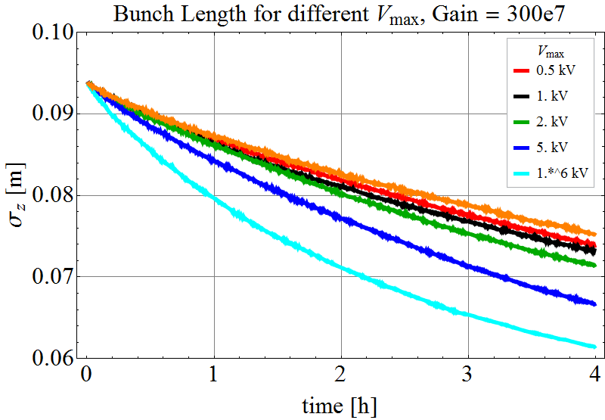
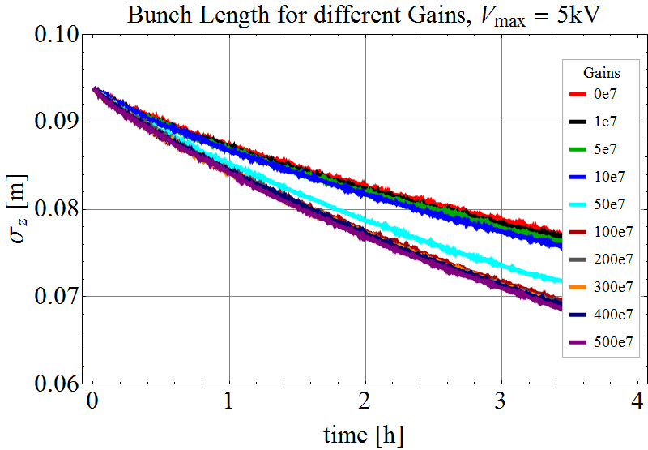
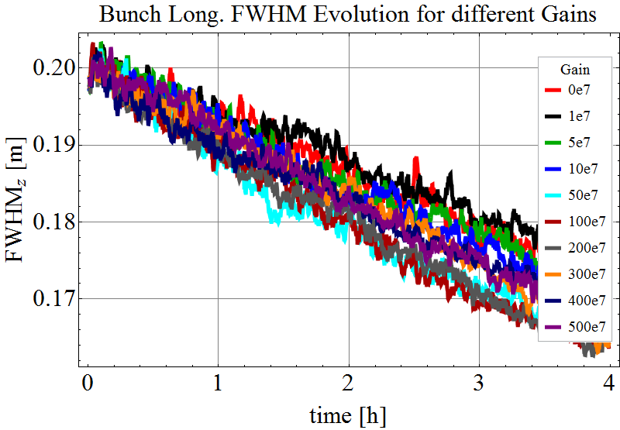
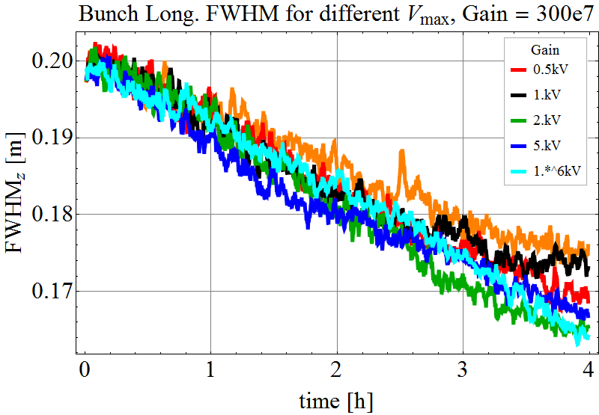
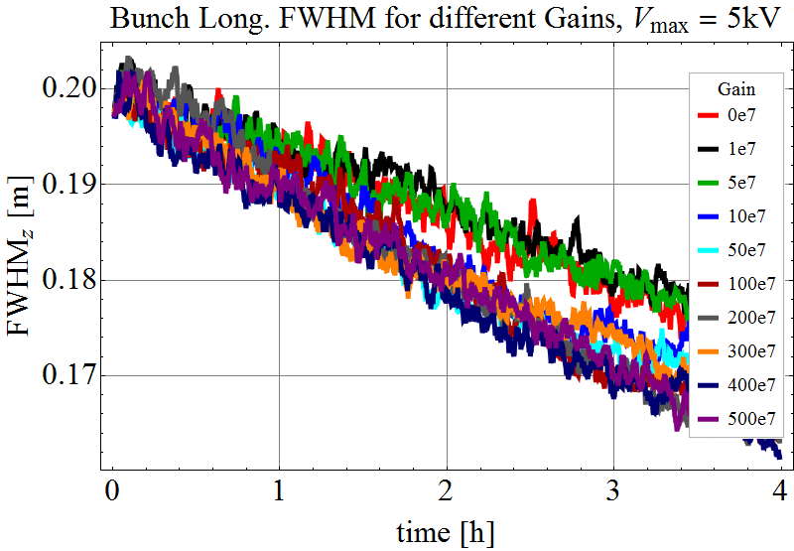
Cooling Simulation Flat Top – short bunches

Slide 21
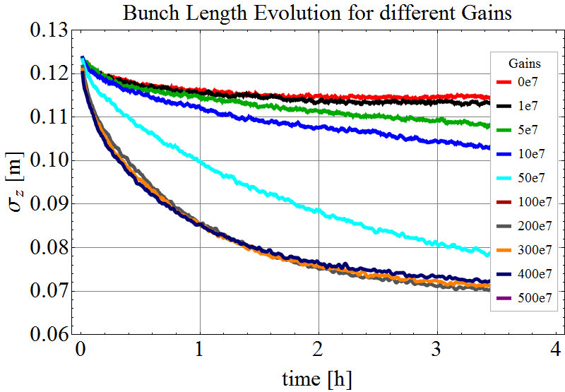
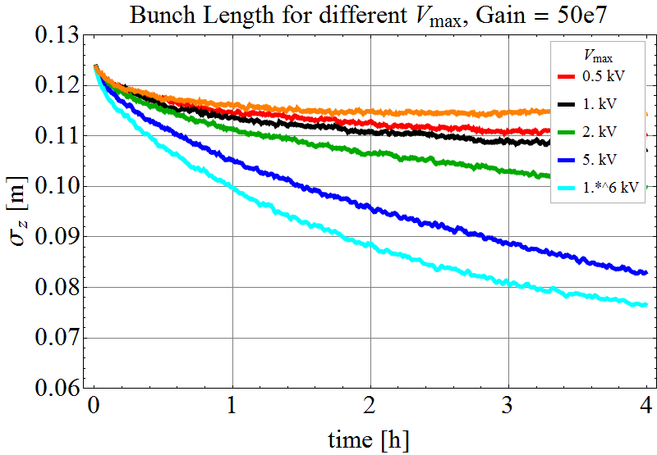
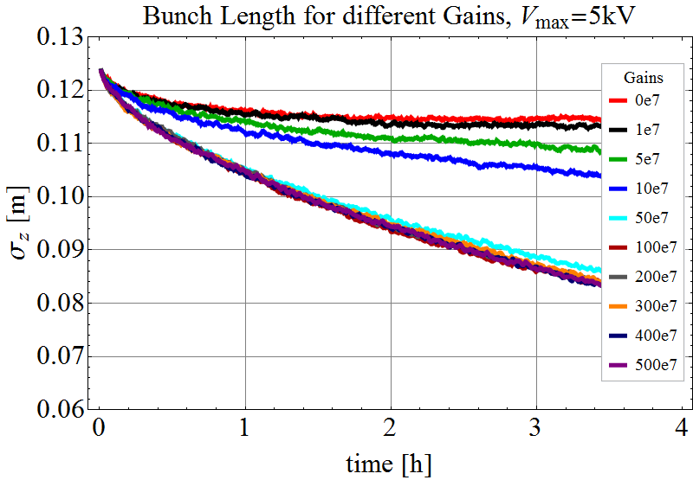
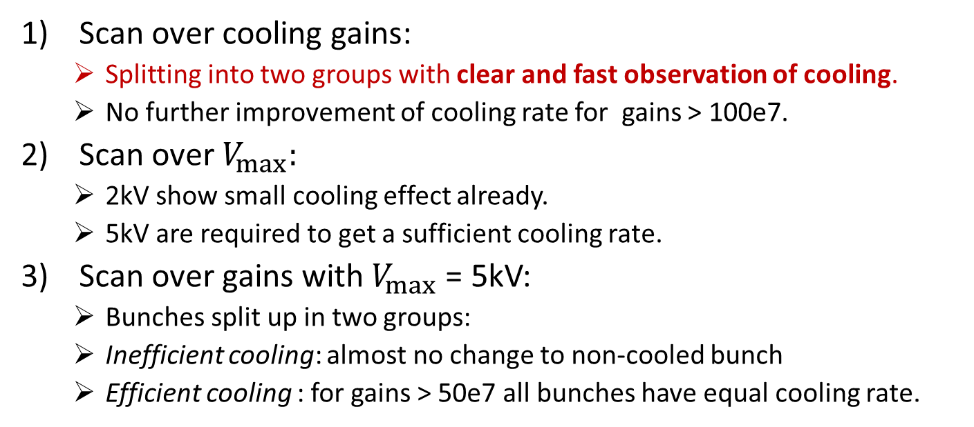
Cooling Simulation at Injection
Scan over cooling gains:
  Splitting into two groups with clear and fast observation of cooling.
  No further improvement of cooling rate for gains > 100e7.
Scan over $V_{max}:$
  2kV show small cooling effect already.
  5kV are required to get a sufficient cooling rate.
Scan over gains with $V_{max}$ = 5kV:
  Bunches split up in two groups:
  Inefficient cooling: almost no change to non-cooled bunch
  Efficient cooling : for gains > 50e7 all bunches have equal cooling rate.
$ V_{max}$ = 5kV & gain = 50e7 & fast and clear effect

Slide 22
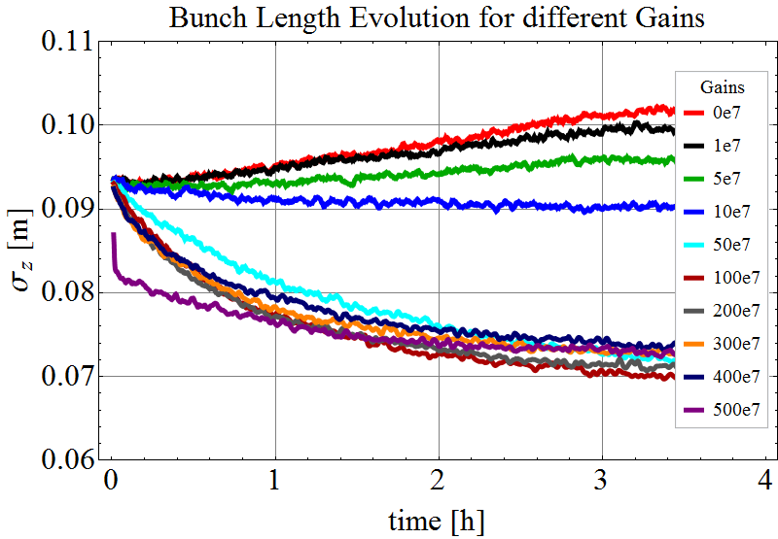
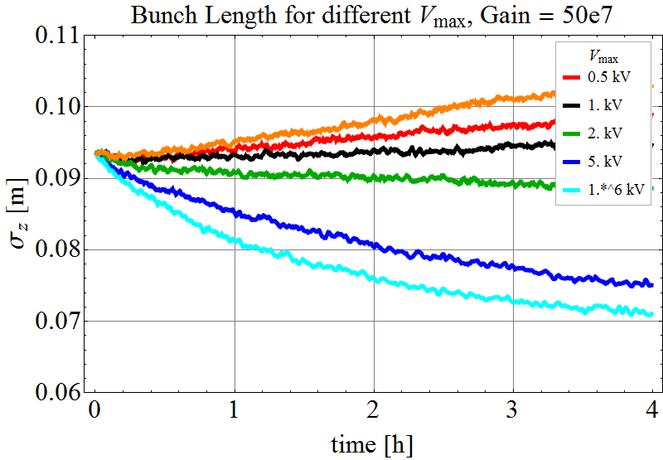
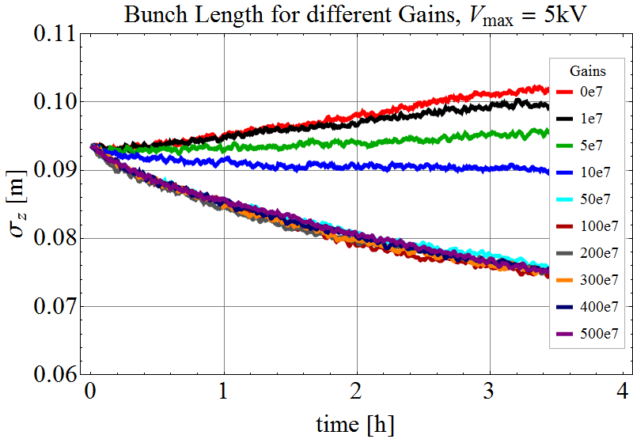
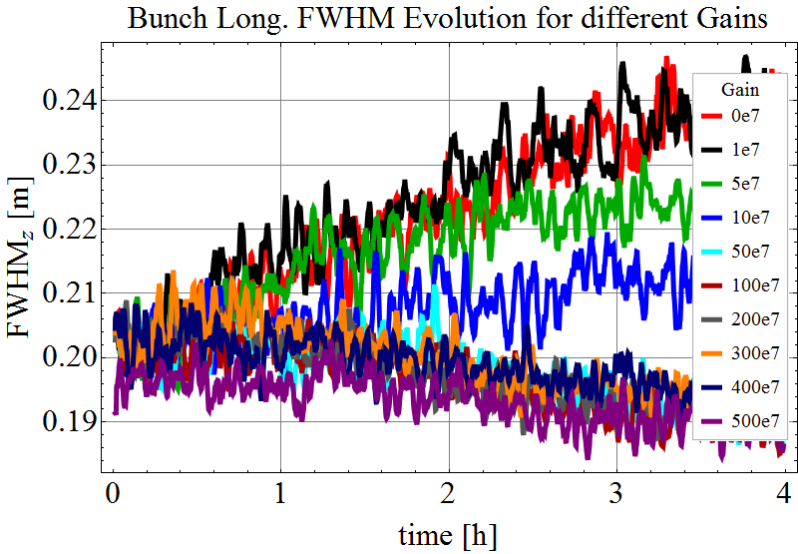
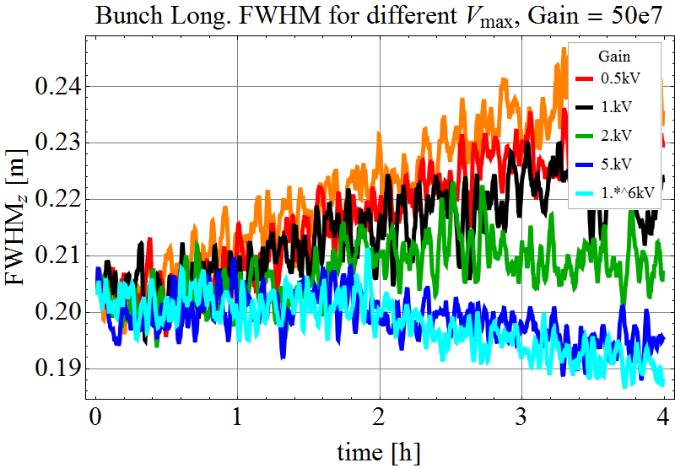
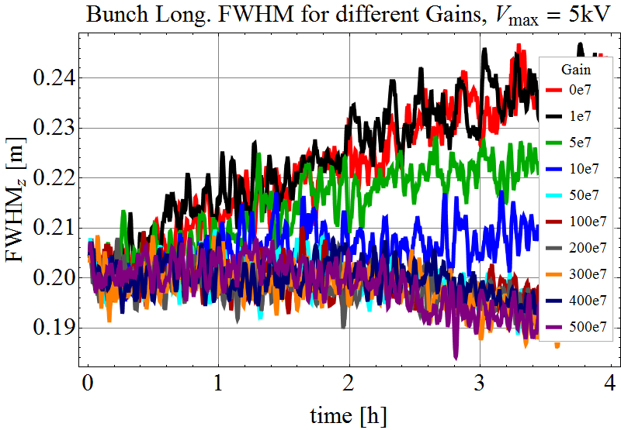
Cooling Simulation Injection – short bunches

