Slide 1
CERN “Education and Public Outreach”
New structure of DG-EDU
Konrad Jende
Teacher Programme Manager
CERN
DG-EDU

Slide 2
DG-EDU: missions
Visits service-guided tours
Exhibitions at CERN
Teacher programmes
Teaching resources
EU programmes
Traveling exhibitions
outside CERN
Public events
(fairs, conferences)
Teachers
General public
S’cool Lab
Virtual visits
Students

Slide 3
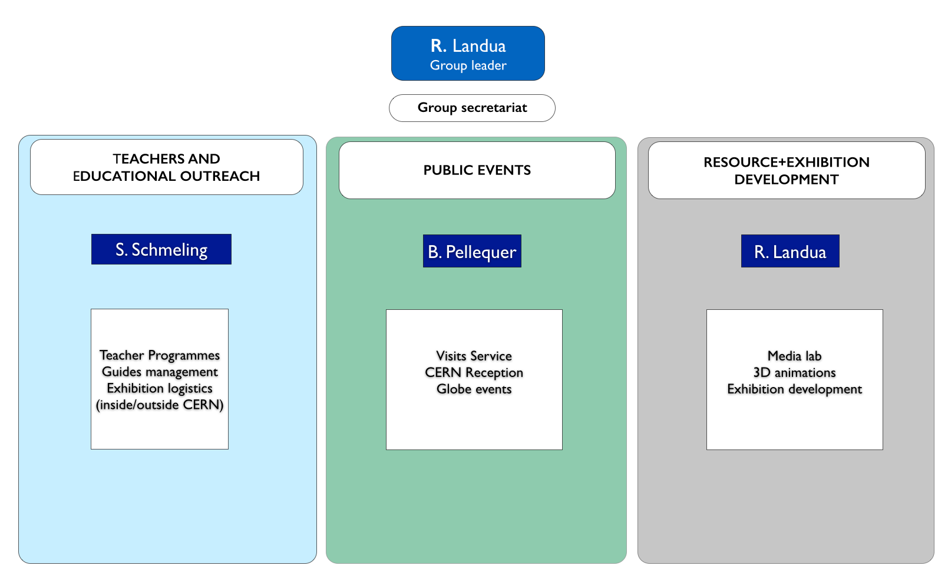
DG-EDU - simplified organigramme

Slide 4
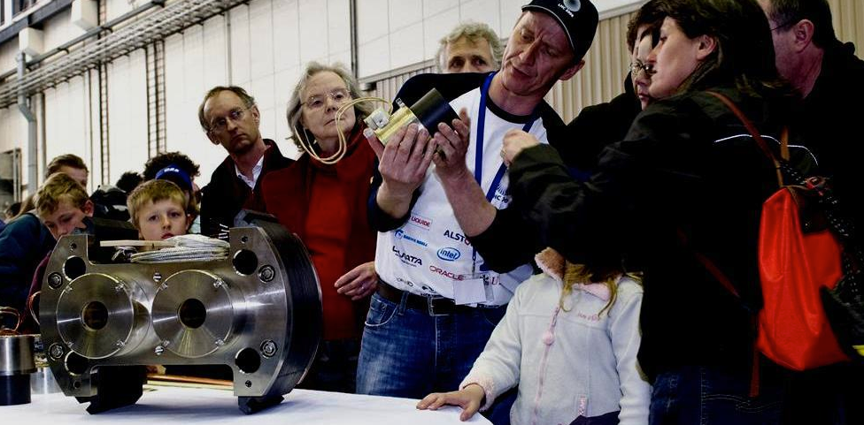
CERN visits: interacting with the general public
Huge demand > 200,000-300,000 per year
1/2 d visits, by volunteer guides
- Introduction talk (30’)
- LHC experiments, surface experiments,
control centre, test facilities)

Slide 5
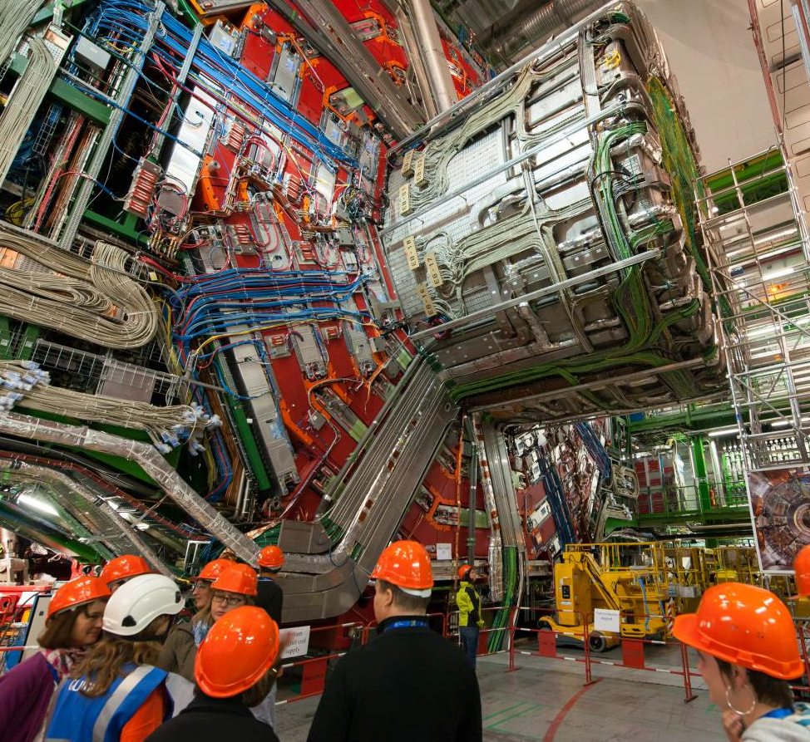
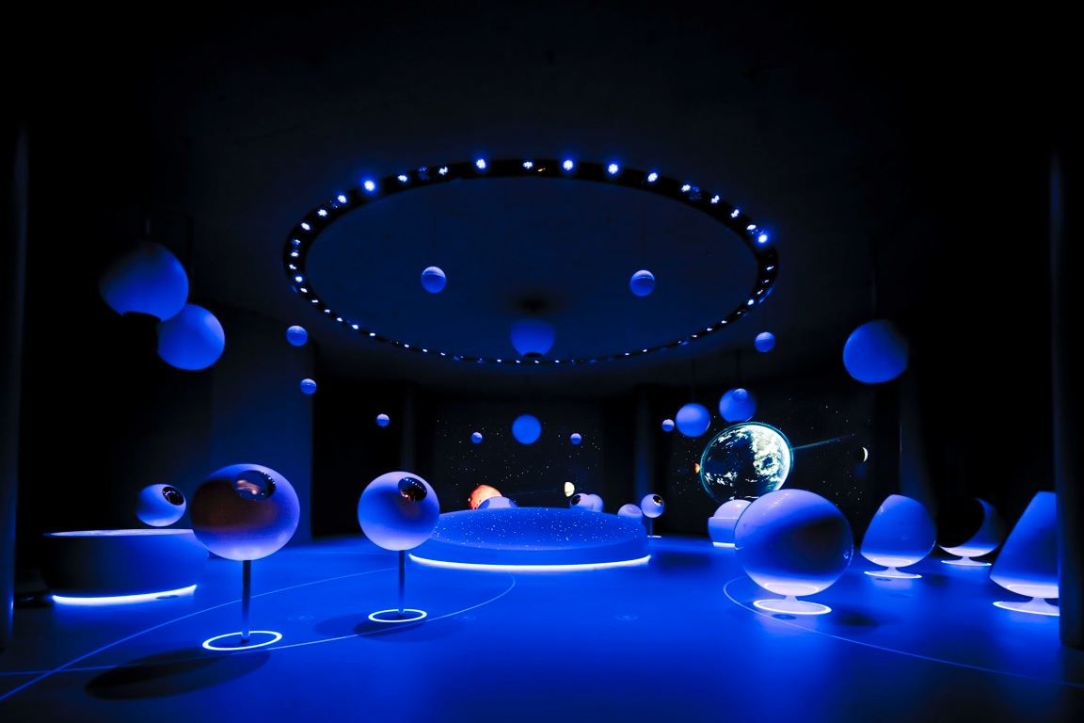
CERN visits: interacting with the general public
  80% of visitors > 500 km
  40% school classes
  CERN exhibitions: Universe of Particles, Microcosm
  NEW: S’COOL lab (2014)
  Universe of Particles
  65,000 exhibition visitors per year

Slide 6
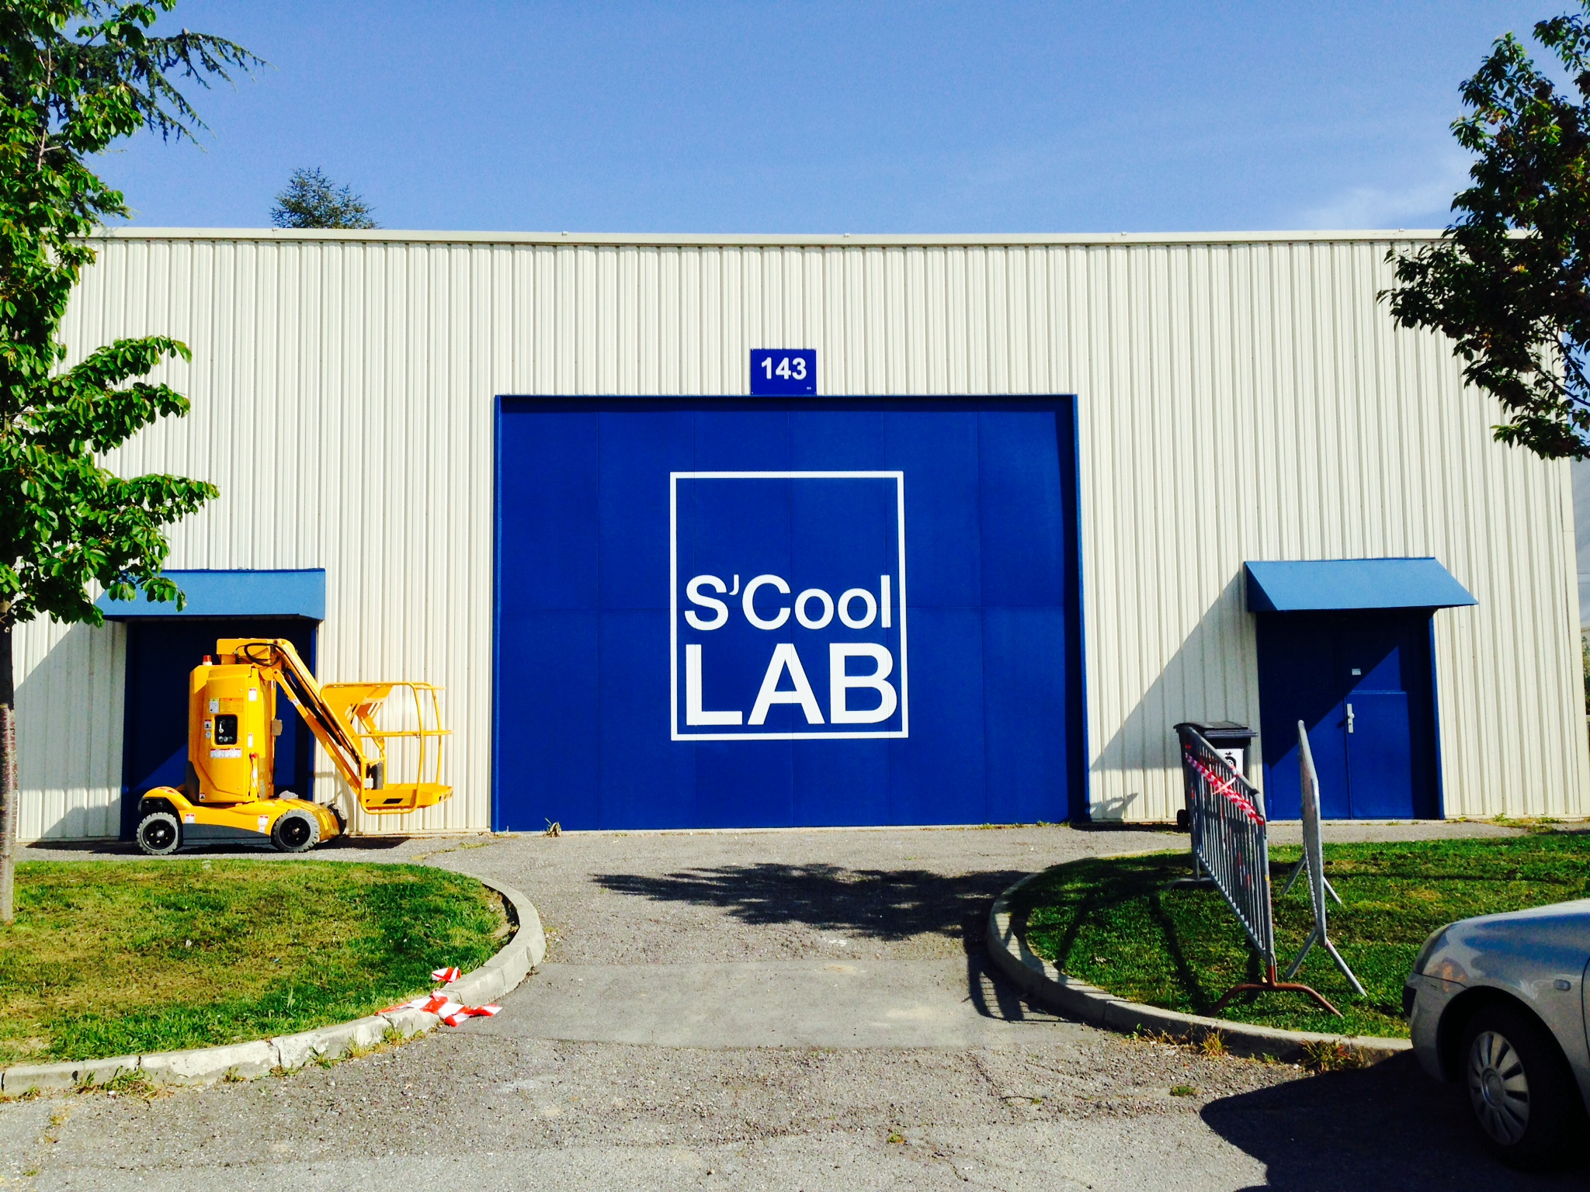
2014: CERN S’cool Lab inauguration

Slide 7
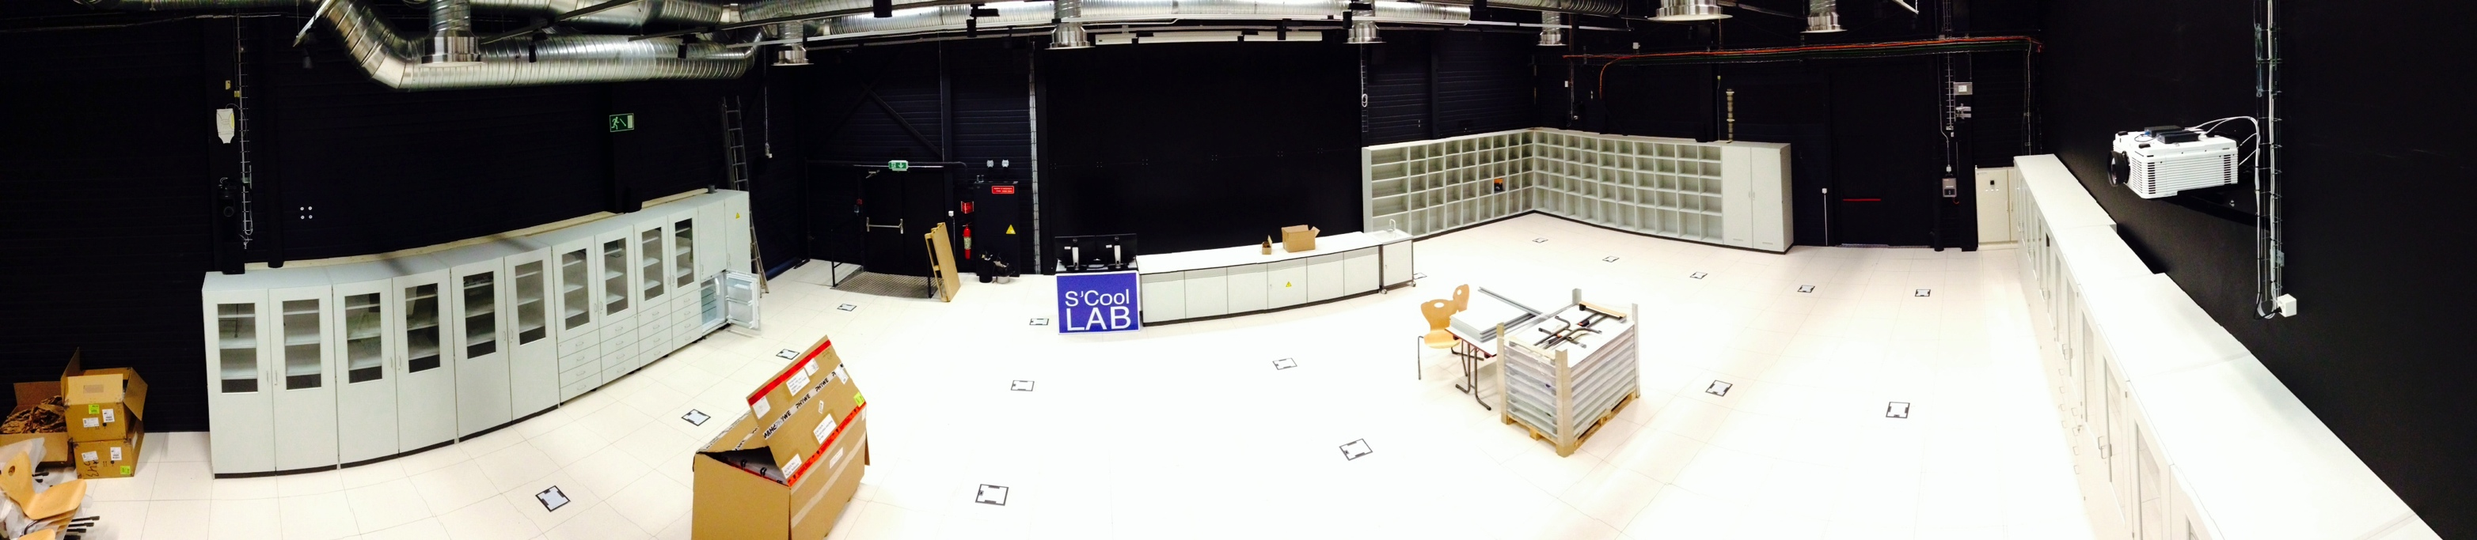
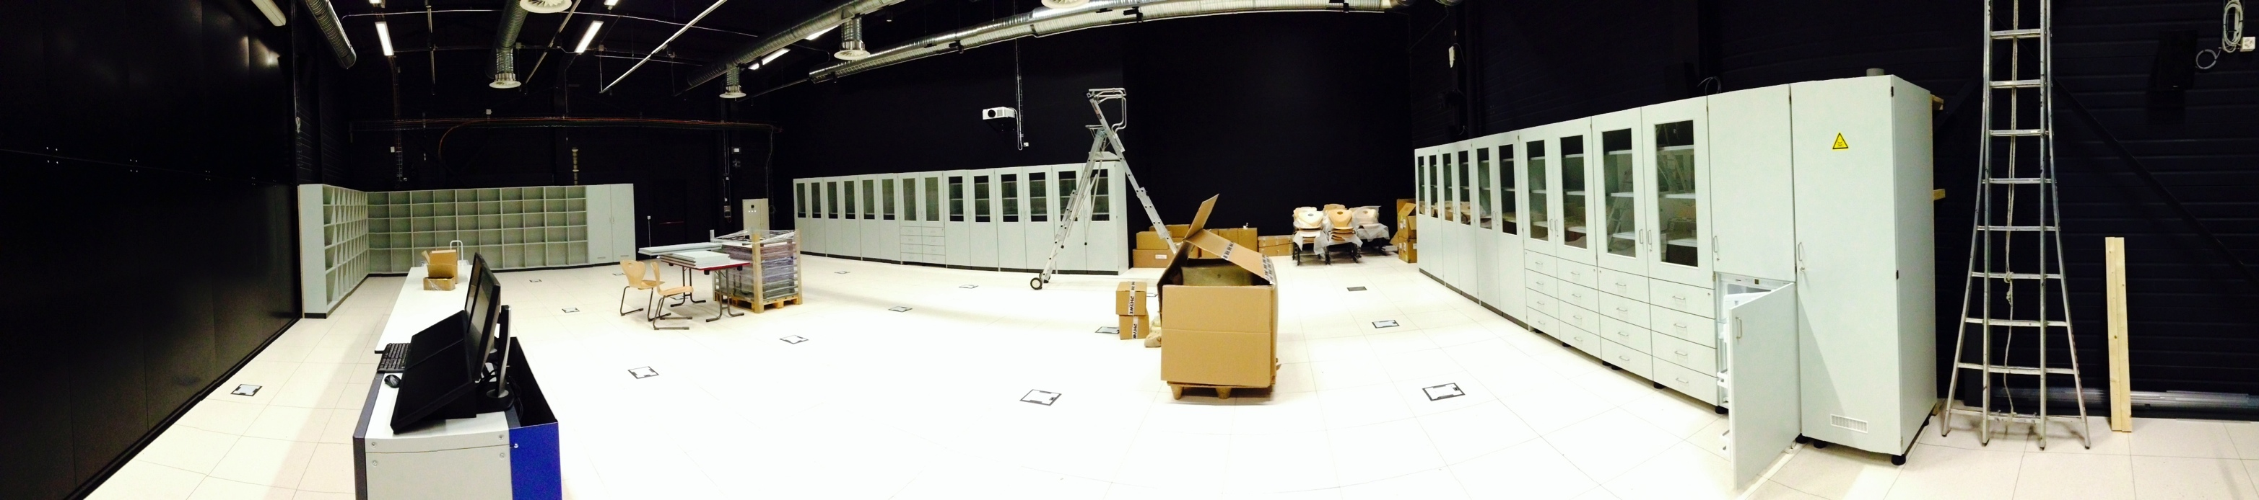
2014: CERN S’cool Lab inauguration
Modern physics experiments
Photoelectric effect
Rutherford experiment
Radioactivity
Franck-Hertz
Electron diffraction
Cloud chambers
Up to 30 students
Teacher + 2 supervisors
Pixel detectors (MediPix)
Cosmic ray detectors
X-ray scattering
Superconductivity
high Tc materials

Slide 8
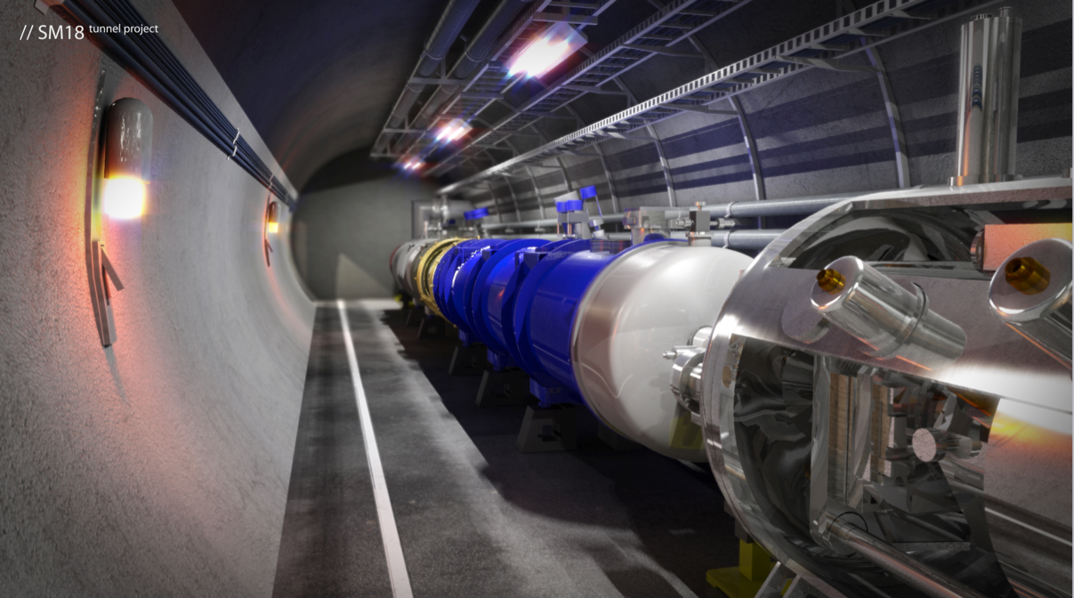
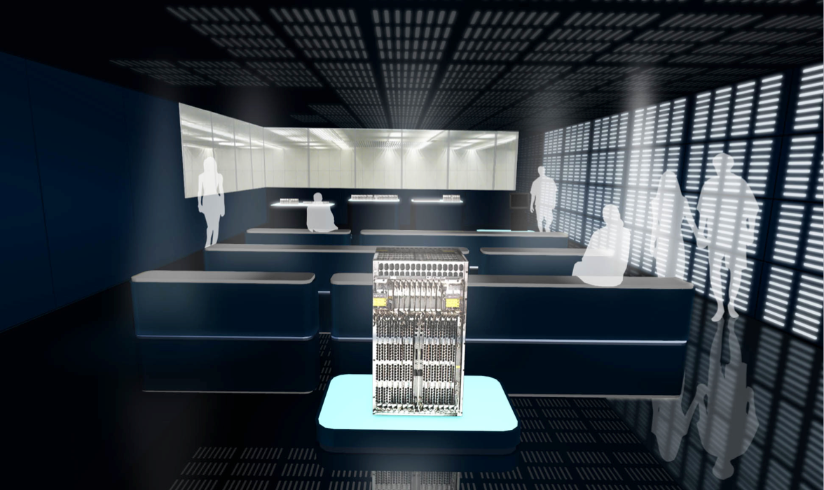
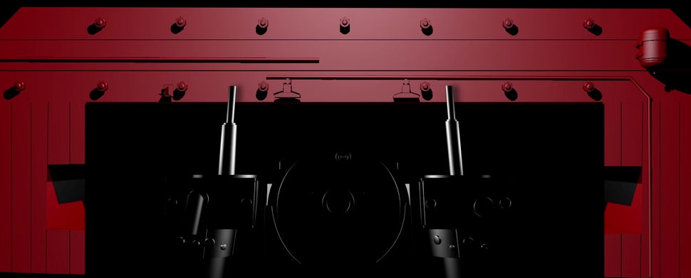
Improved CERN guided tours - 2014
Visit point project
- CERN Control Centre
- SM18 facility
- Computing Centre
- Synchrocyclotron
- CLIC/CTF3 + Detector
- Computing Centre
SM18 LHC mockup tunnel
Computing Centre - show room
Synchrocyclotron - Projection mapping

Slide 9
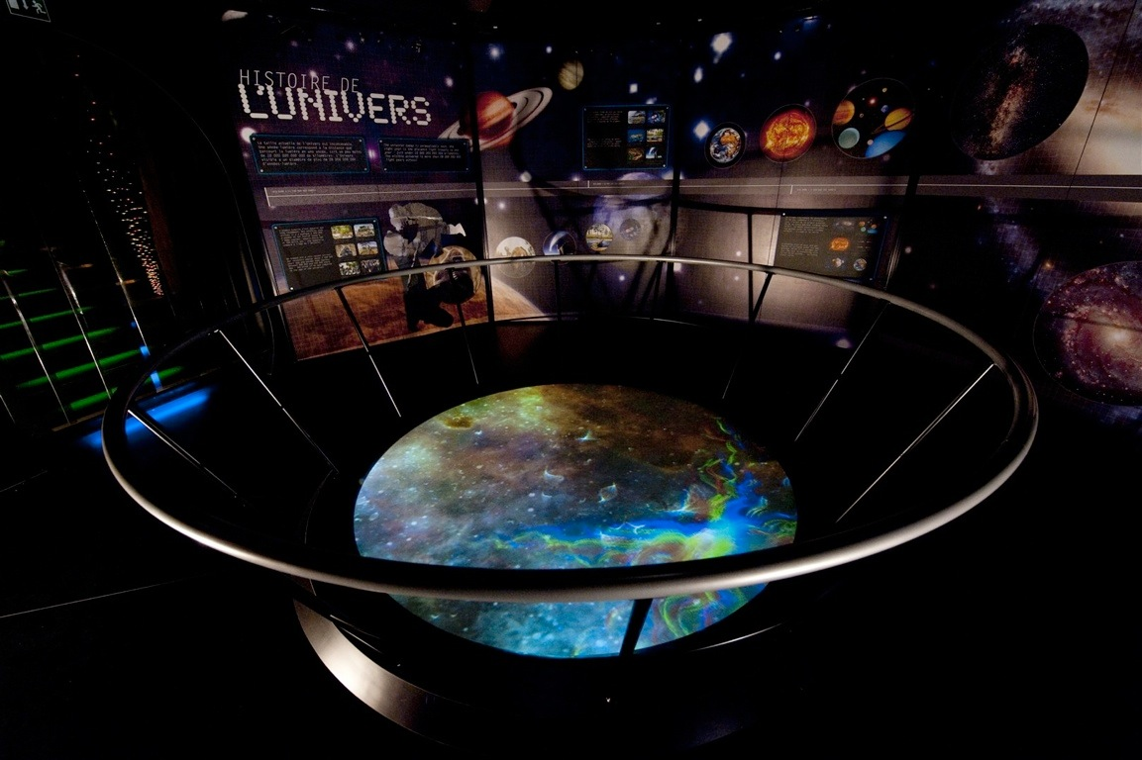
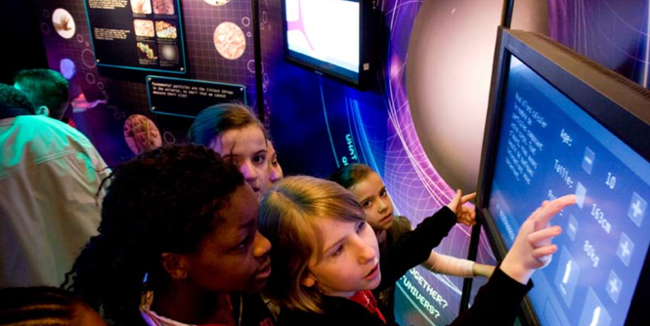
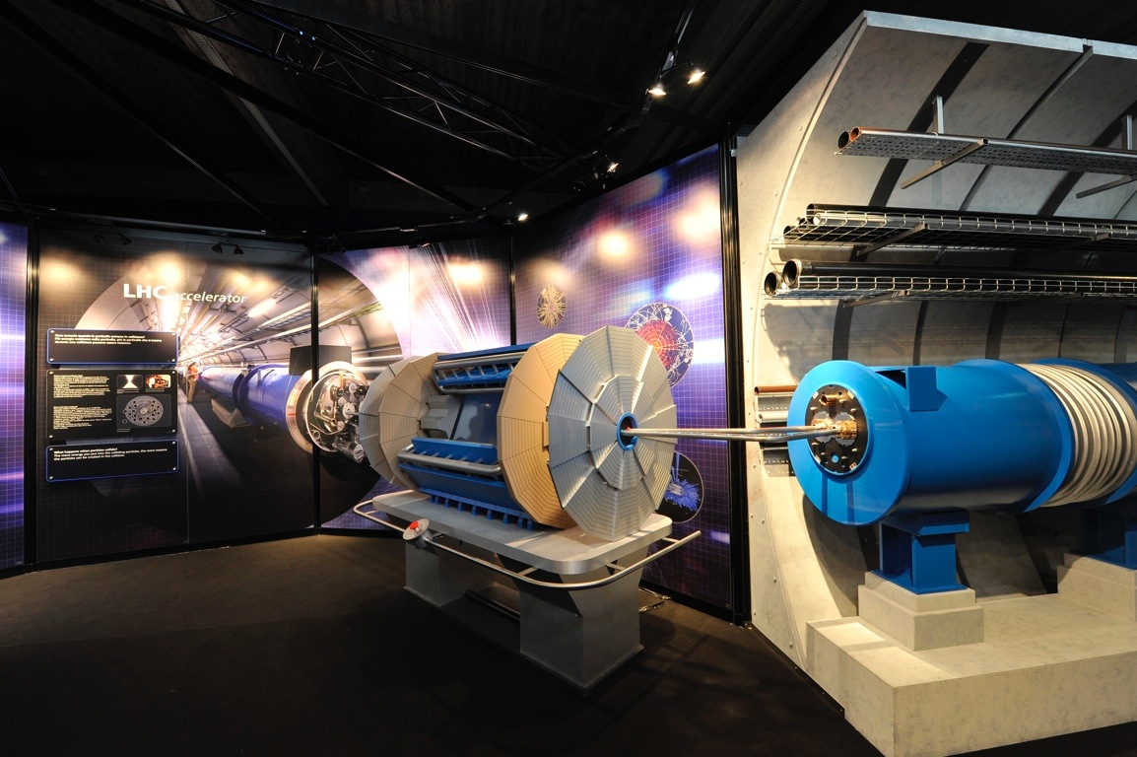
Traveling exhibition “Accelerating Science”
11 venues, ~200,000 visitors
“Accelerating Science” - Large exhibition (450 m² )
5 main themes:
Cosmology, Particle Physics, Mysteries of the Universe,
LHC accelerator & experiments, Applications

Slide 10
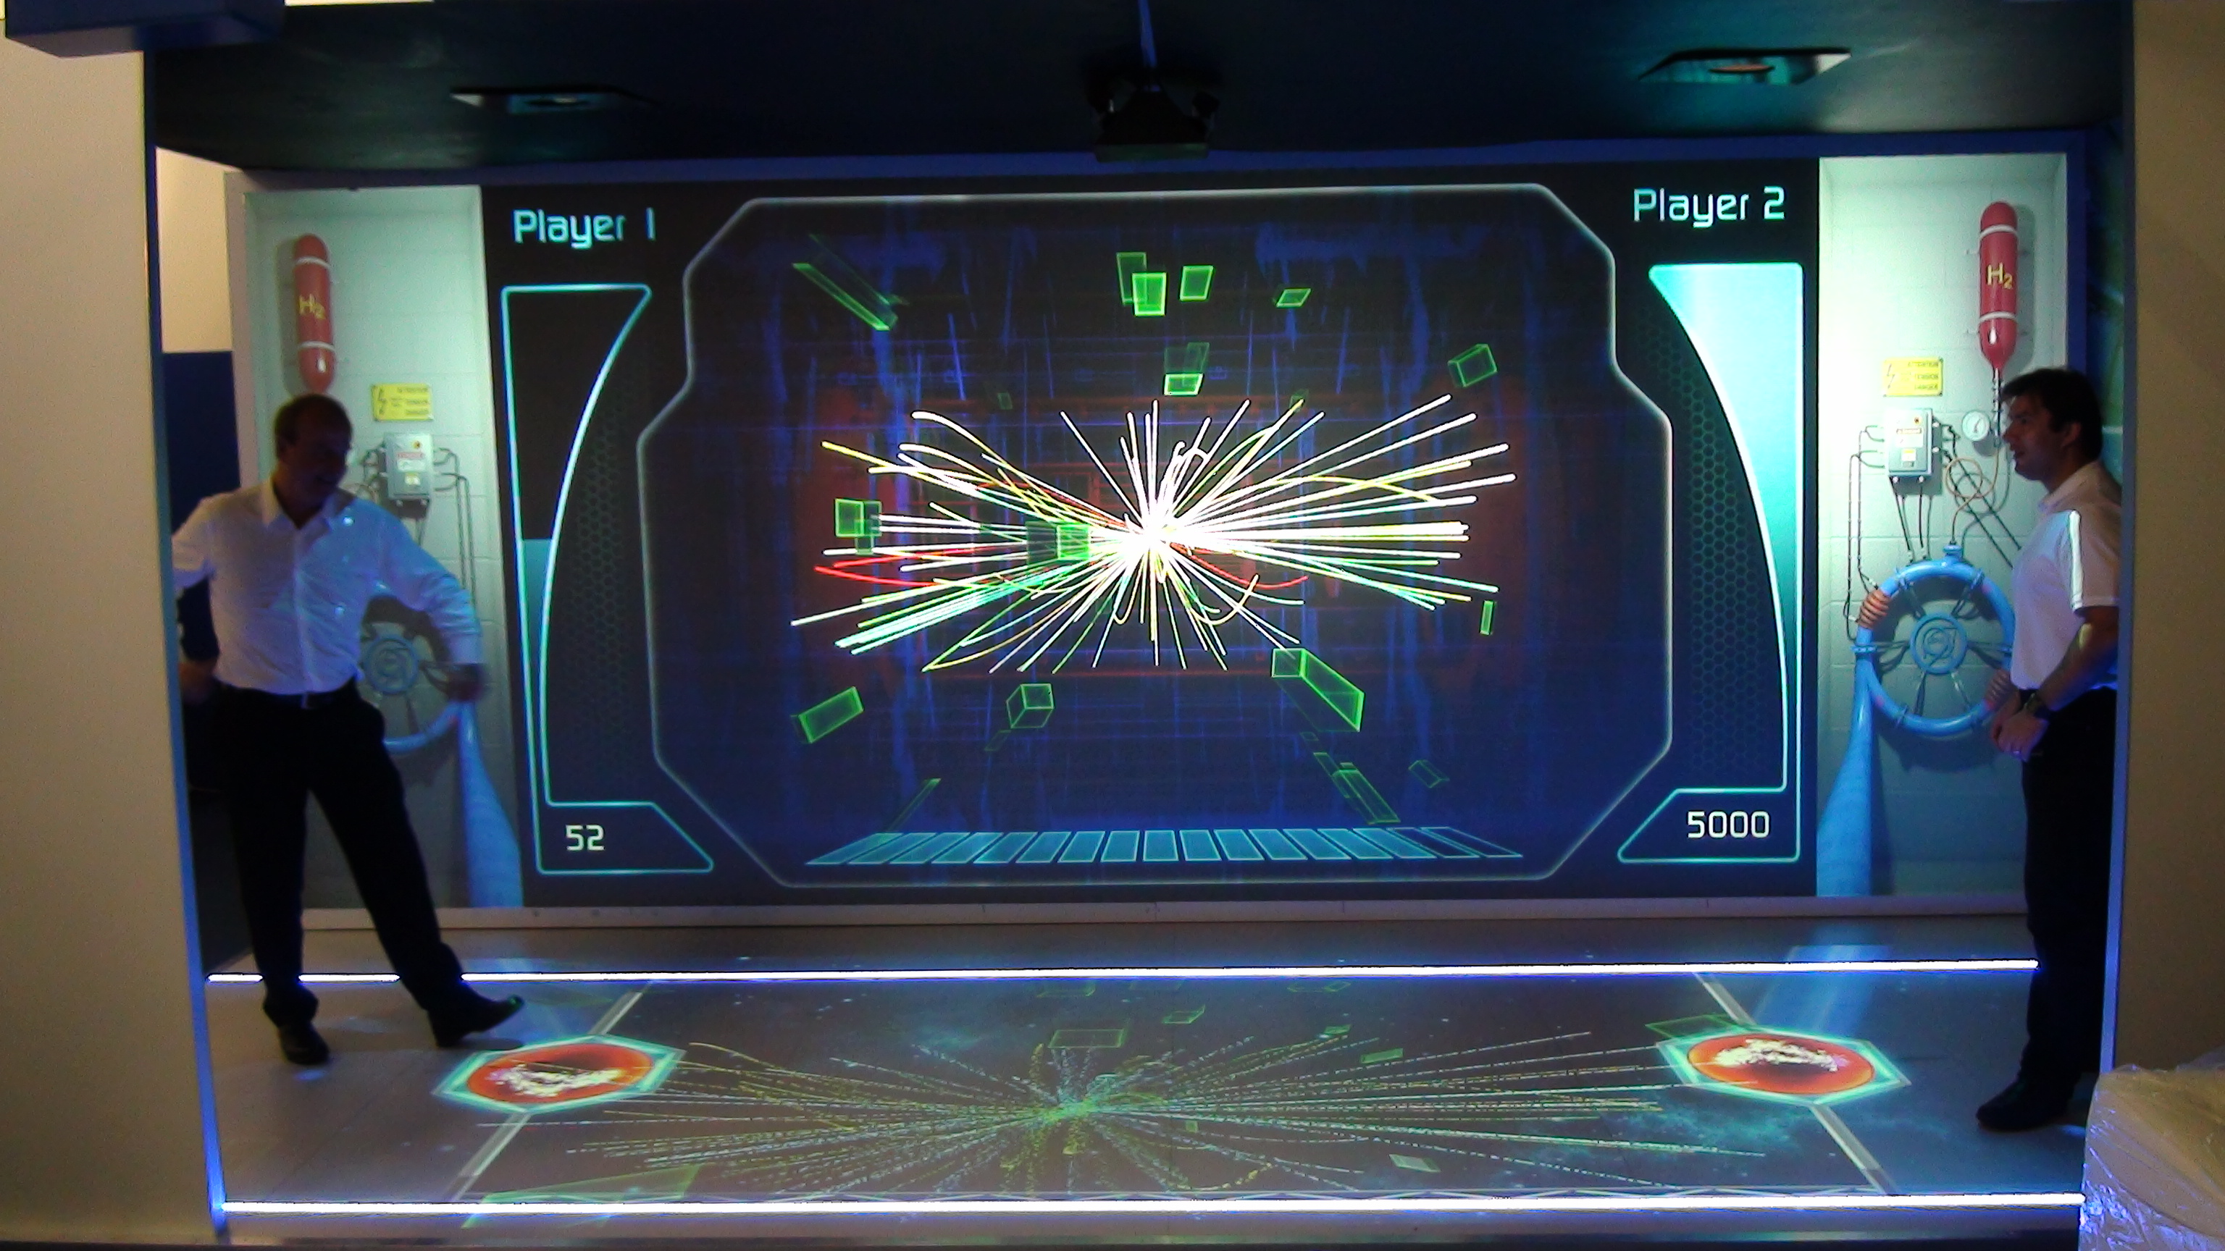
“Interactive LHC tunnel” x 3
Book fair, Oct 2012, Frankfurt LHC in France, Apr 2013, Annecy
Open Days, Sep 2013, CERN Automnales, Nov 2013, Geneva

Slide 11
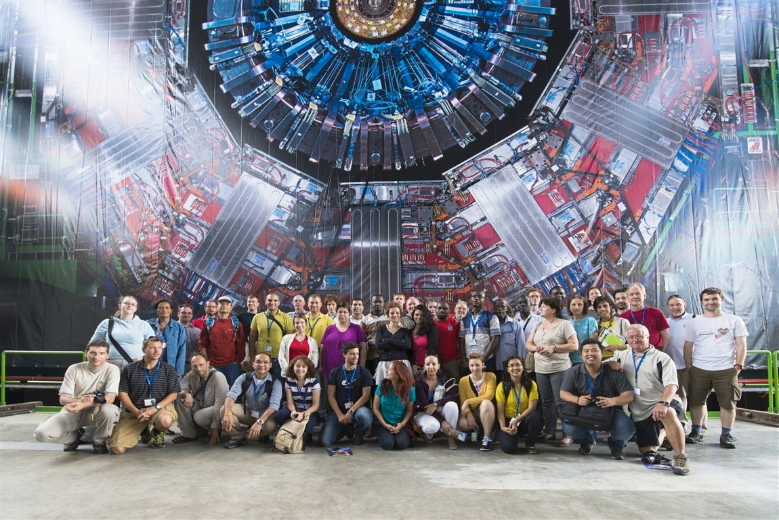
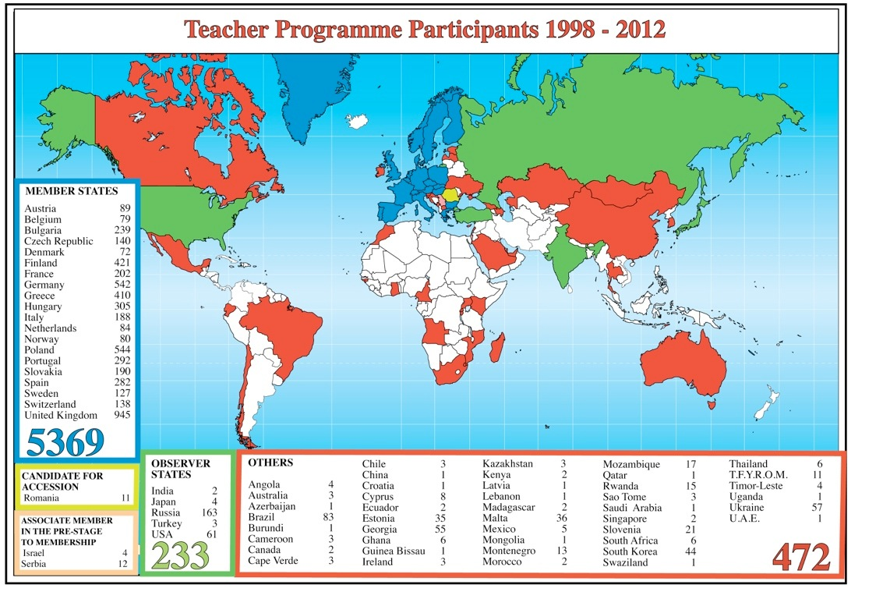
  Teacher Programmes: informing and motivating teachers
  25 one-week courses = 1000 + teachers per year
  Update knowledge about modern physics
  To inspire their students with frontier research
  More than 7,000 teachers since 2006
  Lectures - Guided tours - Discussion with researchers - Classroom activities

Slide 12
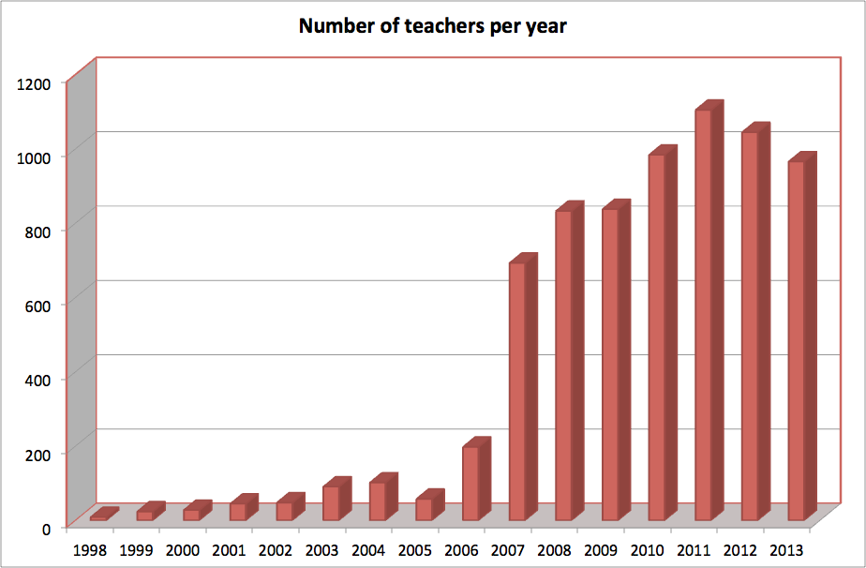
  Teacher Programmes: informing and motivating teachers
Very popular programme: ~1000 teachers/year
25-30 one-week courses • in native language of teachers - more than 7000 teachers since 2006 -
to inspire and motivate students with examples from modern physics
99 teachers from the Netherlands (2007-2013)

Slide 13
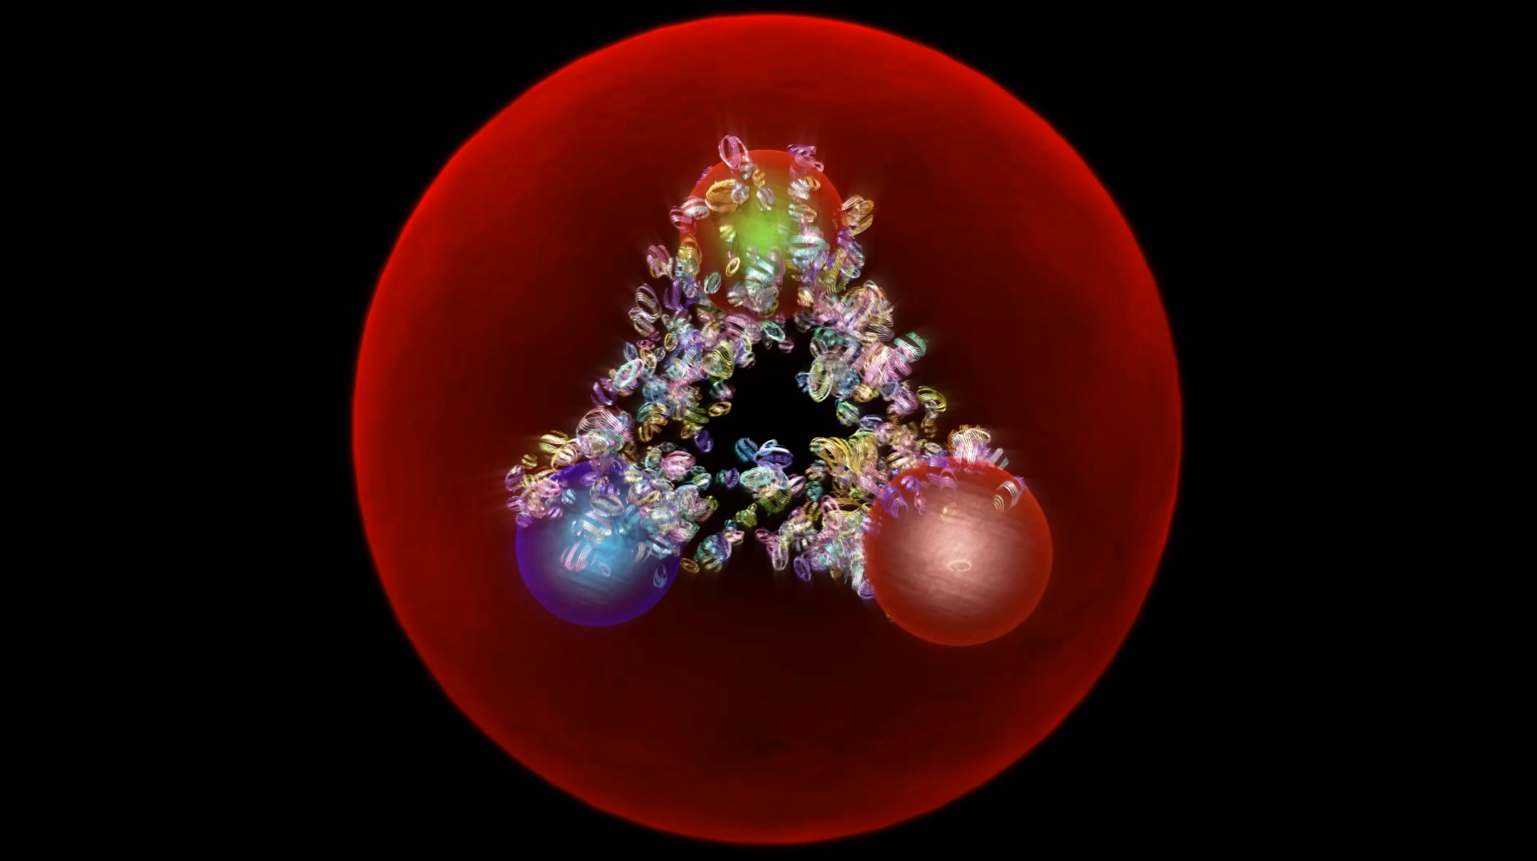

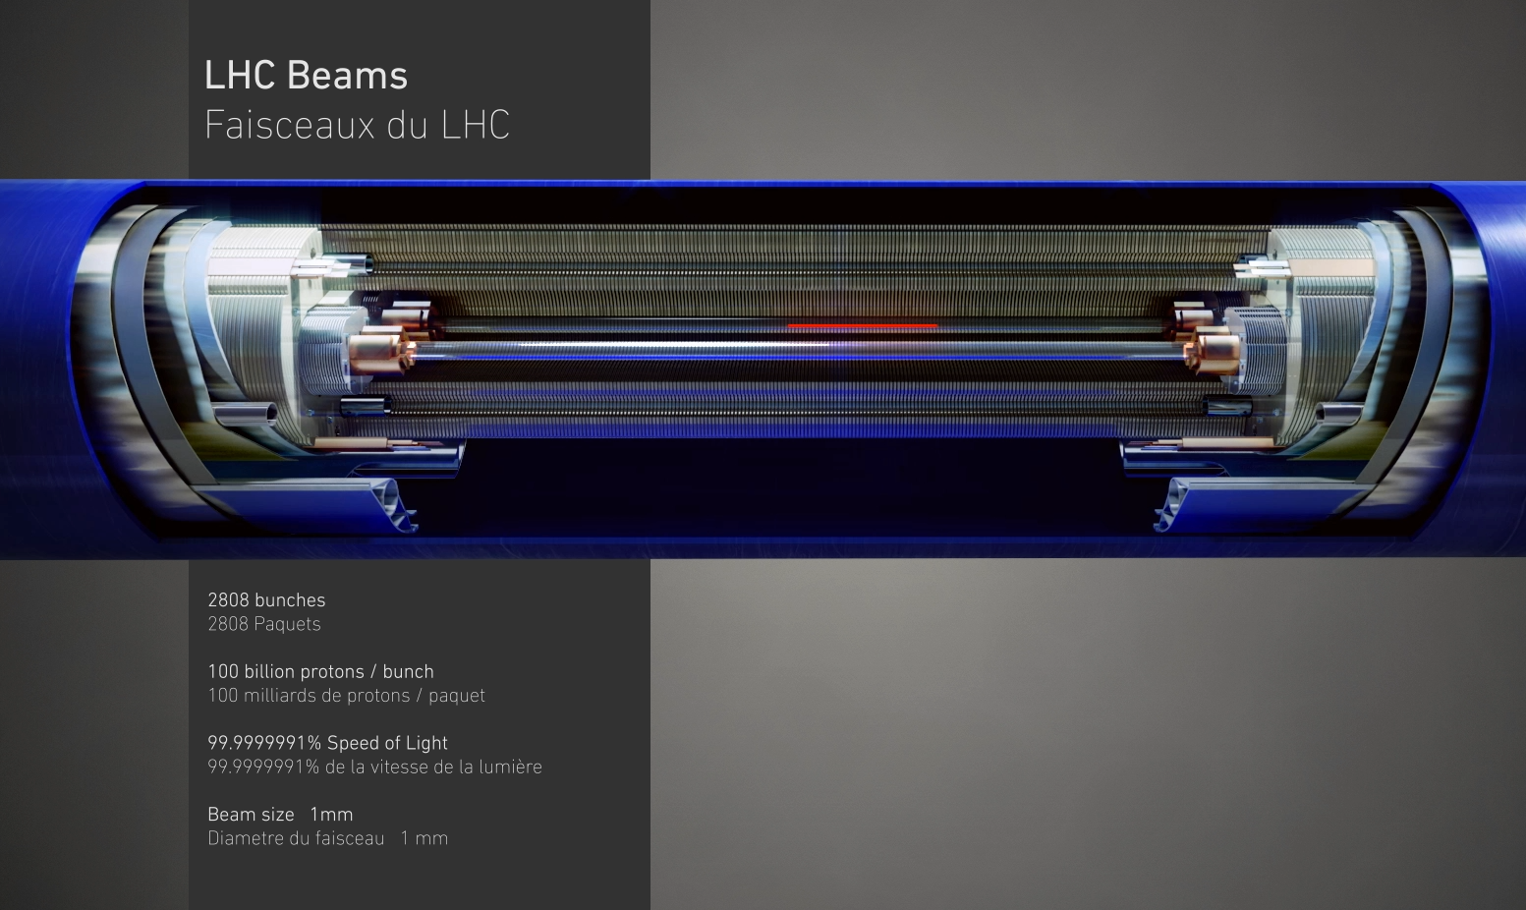
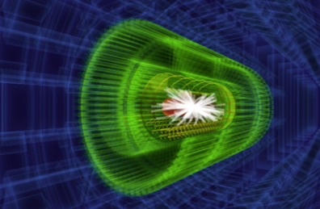
Media lab and animations
PHYSICS
3 D animations
Media Lab
Interactive animations
Augmented reality
Body tracking
Projection mapping
Reactable
Intelligent glass projections
LHC &
ACCELERATORS
3 D animations
CAMELIA/TEV
Interactive event analysis

Slide 14
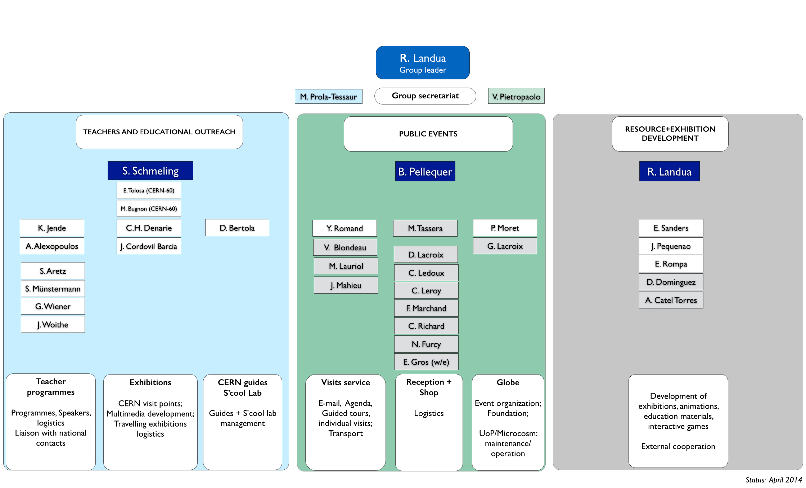
Organigramme DG-EDU

