Slide 1

7th IPPOG Meeting DESY/Zeuthen
Events
Steve Goldfarb, Thoman Naumann, Kate Shaw, Stafan Sint, Hans Peter Beck, Gabriel Stoicea, Beatrice Bressan

Slide 2
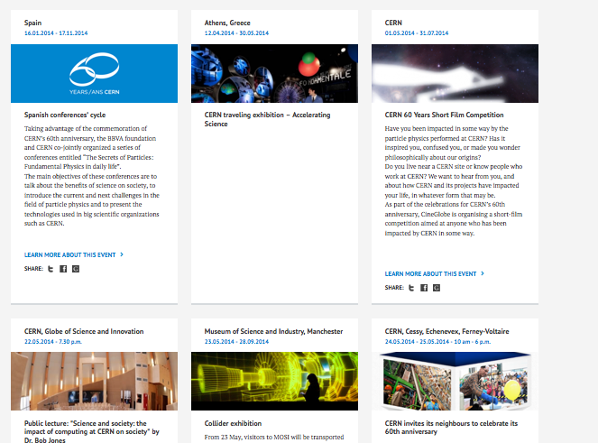
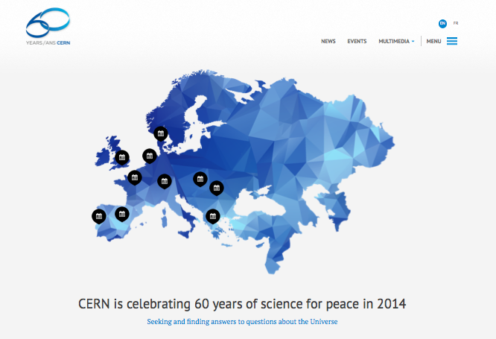
CERN 60th
Lots of events planned this year for CERN’s 60th around the world and at CERN
“60 years of Science for Peace”
http://cern60.web.cern.ch/en

Slide 3
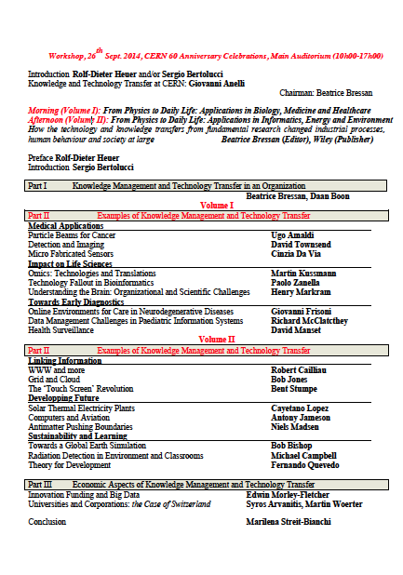
CERN 60th
Talks on Knowledge & Technology Transfer at CERN (Beatrice)
Some events in Germany
  Central event: 60 years of CERN a European success story, BIG Scienc
  German CERN DGs
  Talk show: Culture and use of particle physics
  Industry, history of physics between two Germanies, art, philosophy
  Video interviews with 20 physcists of all CERN generations
  Website www.weltmaschine.de

Slide 4
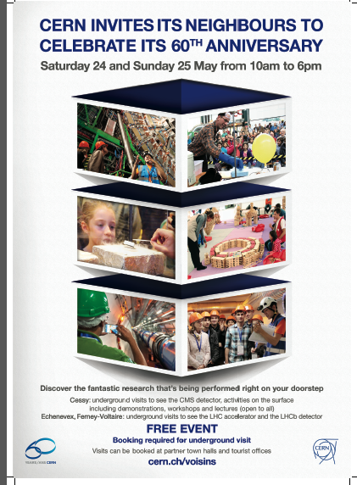
CERN 60th
CMS and LHCb open their doors Weekend of 24th 25th May
Plus CMS putting on an Education Day Monday 26th May
ALICE, ATLAS, CMS and LHCb discussing to hold some event later in the year to express the international and collaborative nature of CERN

Slide 5

Particle Fever
Great film following the inside story of six brilliant scientists seeking to unravel the mysteries of the universe
Been shown at events all over (CERN, UK, Germany, US)
Will be shown at ATLAS week in Sibiu
Only special events at present, no open distribution
Often has panel after the showing with various scientists for a Q&A session

Slide 6
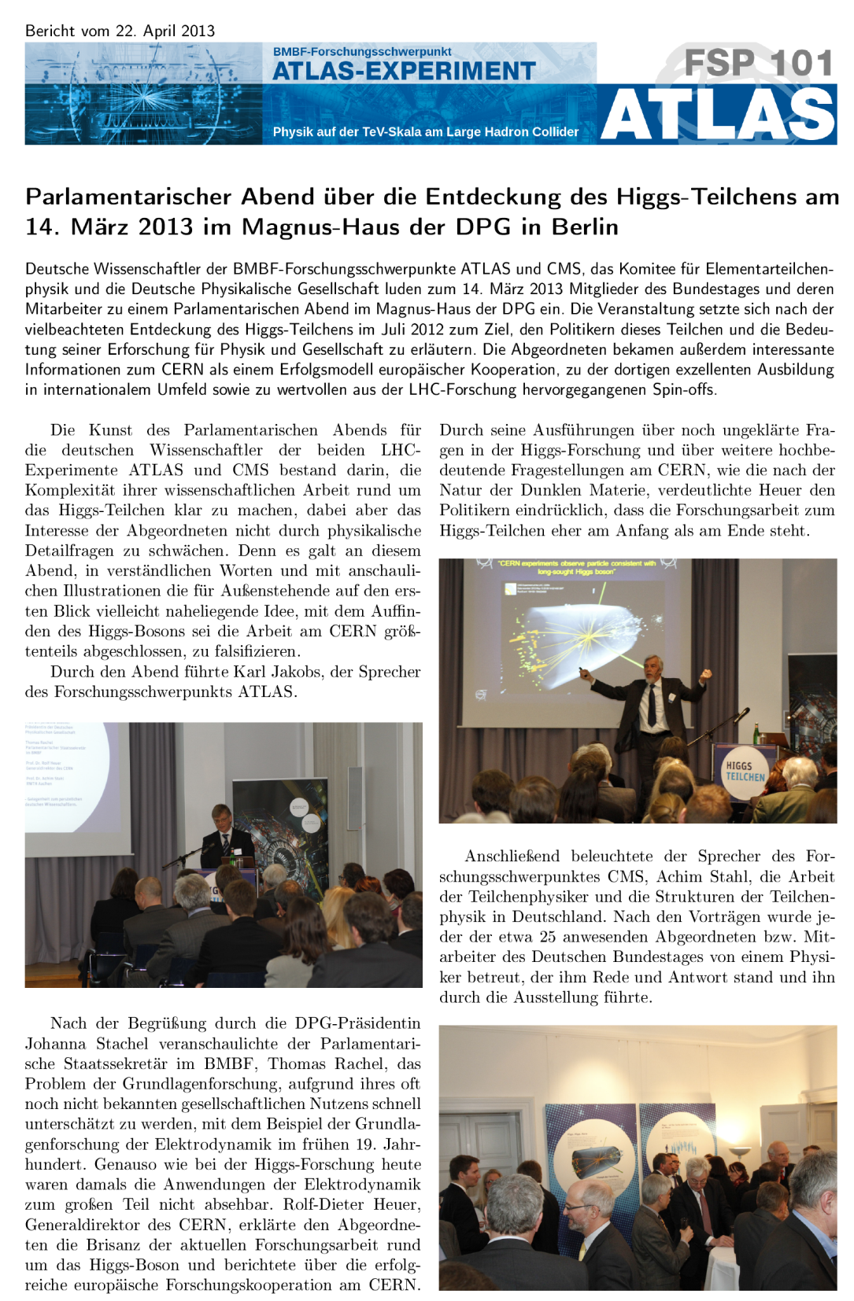
Parliamentary evenings
Germany and Switzerland holding events for decision makers
  Parliamentary Research Board at CERN
  Parliamentary Evening Berlin
  Swiss events integrated with 60th
Present goals and successes of particle physics
Themes also included science for peace, science in society
  PhD student will study what CERN has done for peace

Slide 7
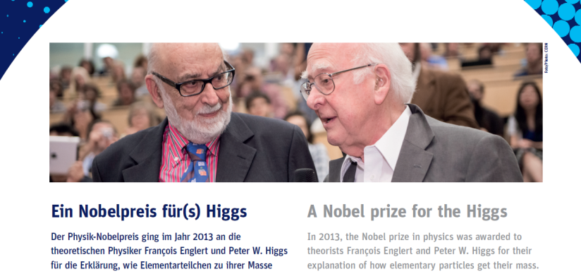
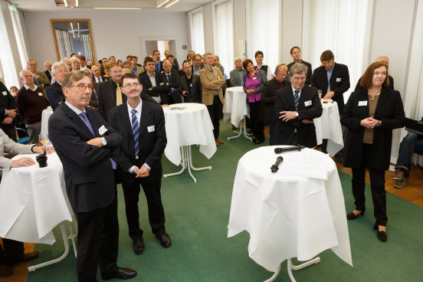

Nobel prize in Physics
Many events last year for the announcement of the Nobel prize in Physics going to Higgs and Englert
Germany held event with
  live stream from Stockholm
  German press
  physicists
  Swedish embassy
Great opportunity to discuss benefits of big science

Slide 8
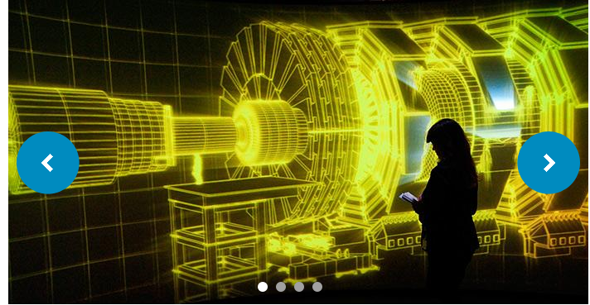
Collider exhibit in UK
London Science Museum: Jan – May 2014. Now moved to Manchester
Special screening of the film “Particle Fever” with a pre-screening Q&A about physics and filmmaking
Numerous other events with panel discussions

Slide 9
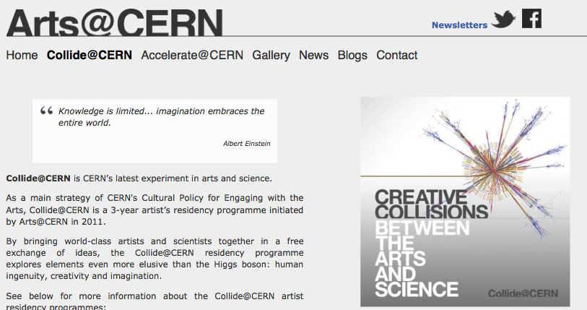
Collide@CERN

Slide 10

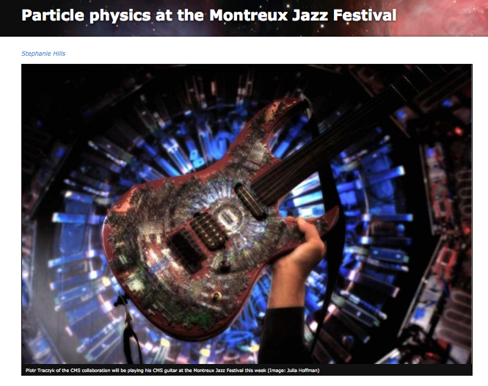
Local events in Geneva

Slide 11
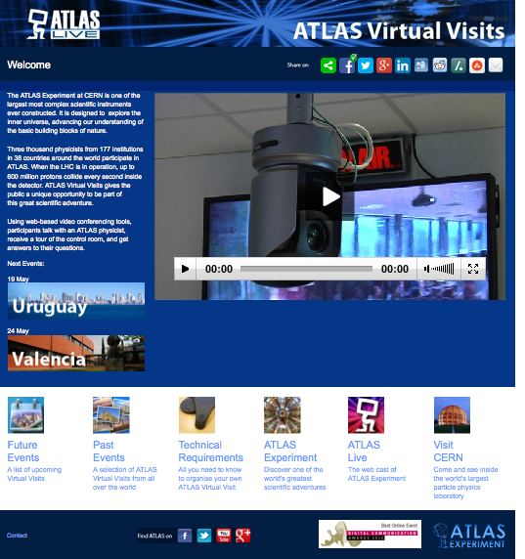
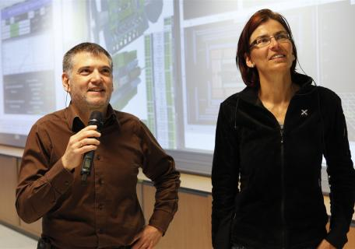
ATLAS Virtual Visits
Service to people who cannot visit ATLAS in person to have a ‘virtual visit
Host gives virtual visit from ATLAS Control room
Large number of Virtual Visits from ATLAS Control room to remote location
  Schools, universities
  Science festivals
  Events with policy makers
CMS also provides virtual visits, in the control room and underground!

Slide 12
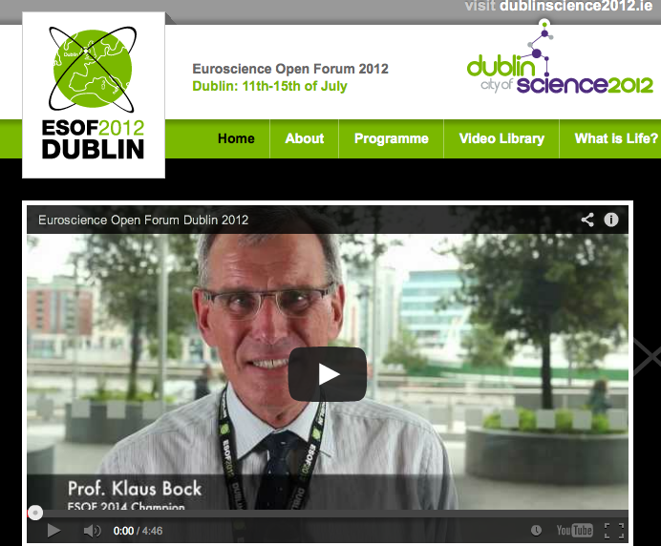
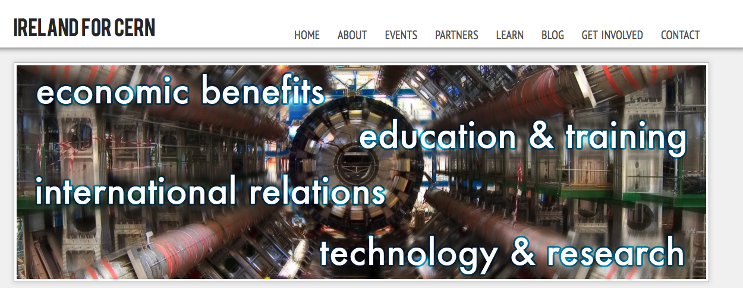
Ireland Events
ESOF Dublin 2012 (2 weeks after Higgs discovery)
Particle Physics – UCD collaboration with Liverpool LHCb group
Not a member of CERN
  Various movements to join
  http://irelandforcern.org/
  Ministers chosen to focus on applied science
Science Gallery in Dublin
  https://dublin.sciencegallery.com/
  Won money from Goggle to expand

Slide 13
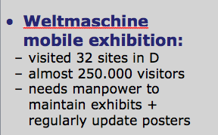
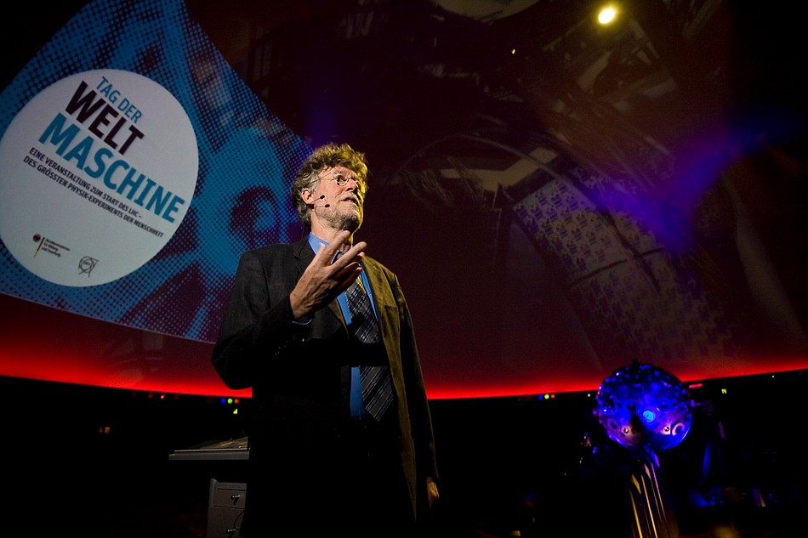
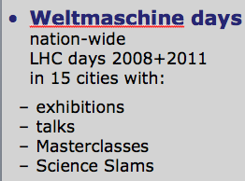
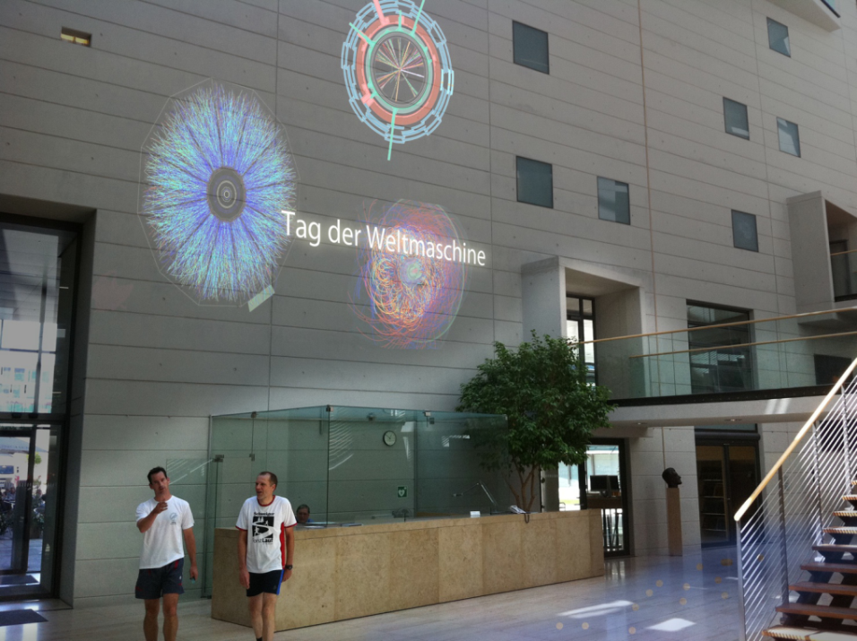
Other events in Germany
Planetarium
Hamburg
Max-Planck
Headquarter
Munich

