Slide 1
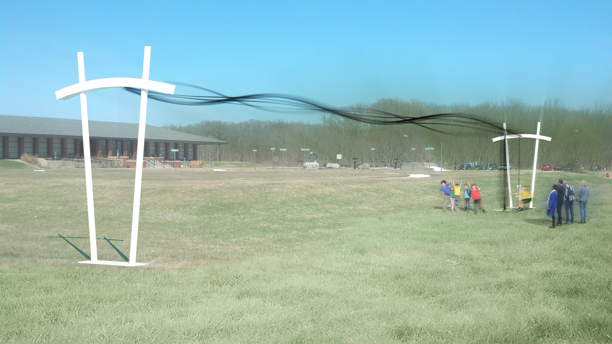
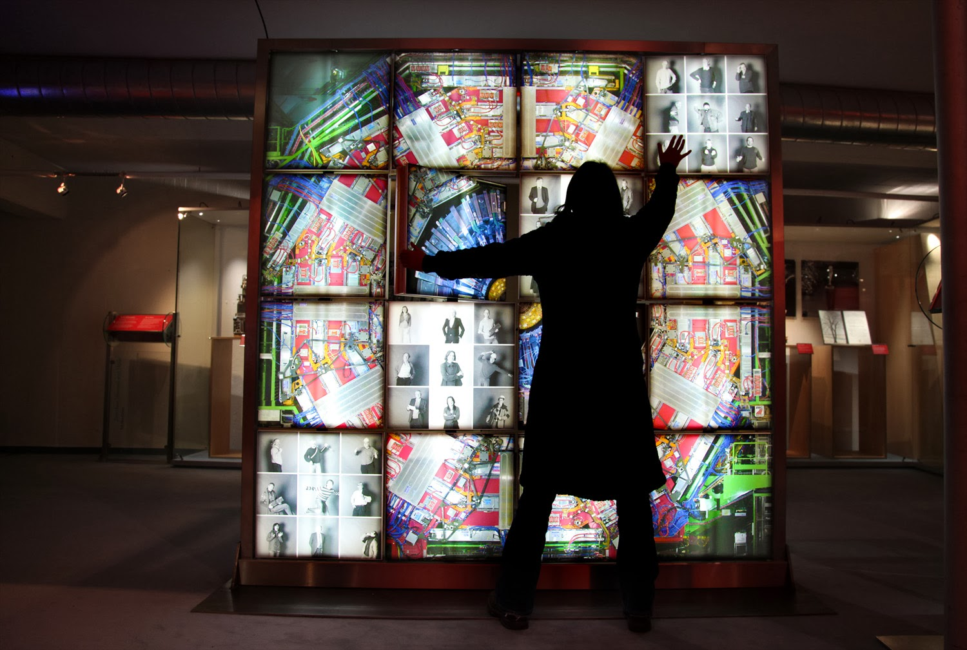
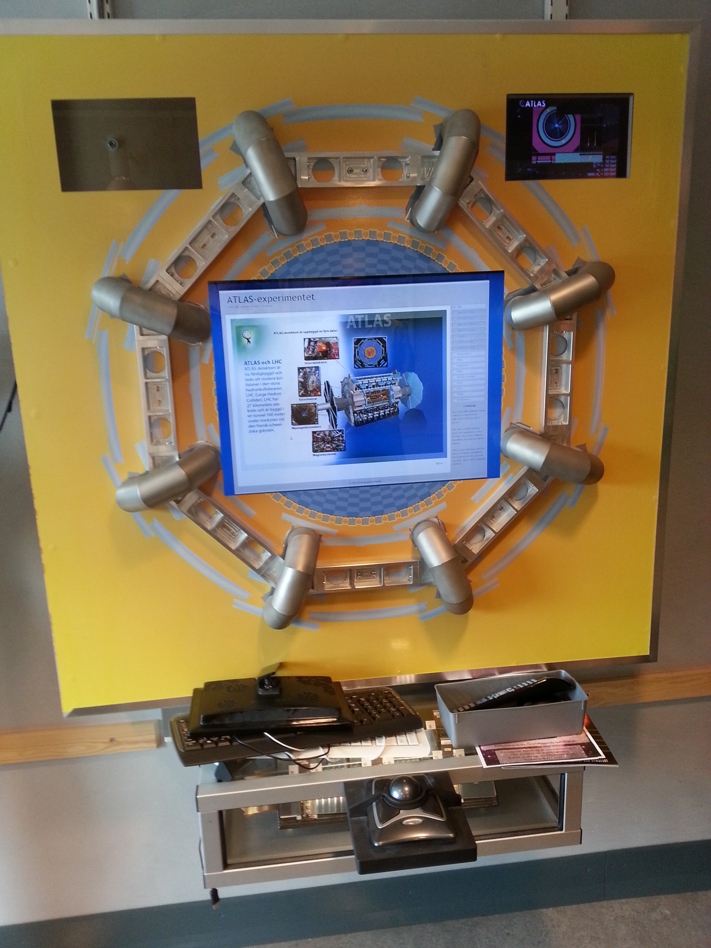
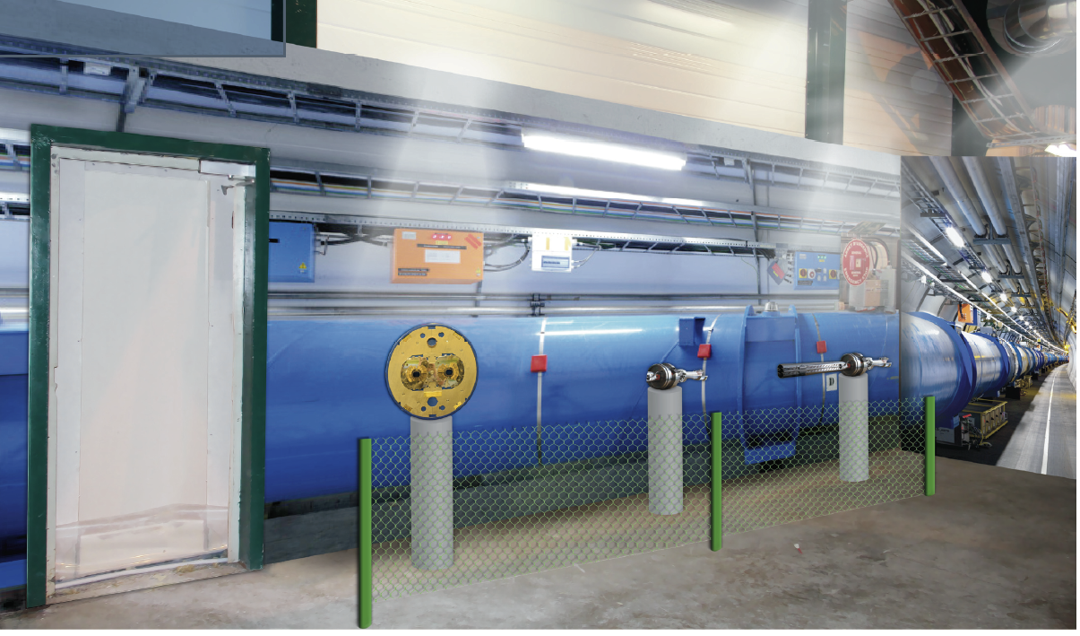
Panel: Exhibitions & Exhibits
Marzena – Natascha – Jonas - Marge

Slide 2
CMS: LHC Expo at CMS
Accommodation of the old coffee area (3 walls). On the way from the new visitors reception room to the underground lift. Industrial ambience.
1 wall already designed: LHC tunnel visualization, with real objects:
  Beam Position Monitor
  Dipole Slice
  Section of Dipole Coil
  Cold Section of Beam
  Pipe With Beam Screens
  Warm Section of Beam-Pipe with Getter

Slide 3


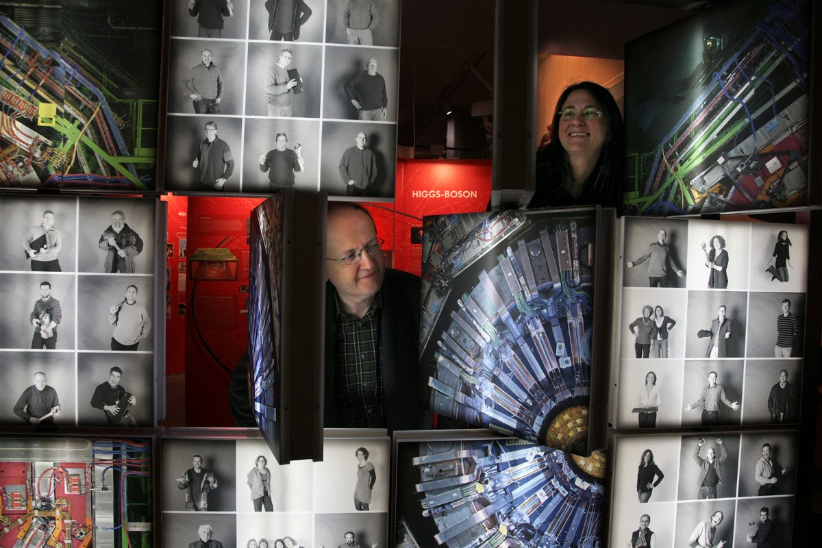
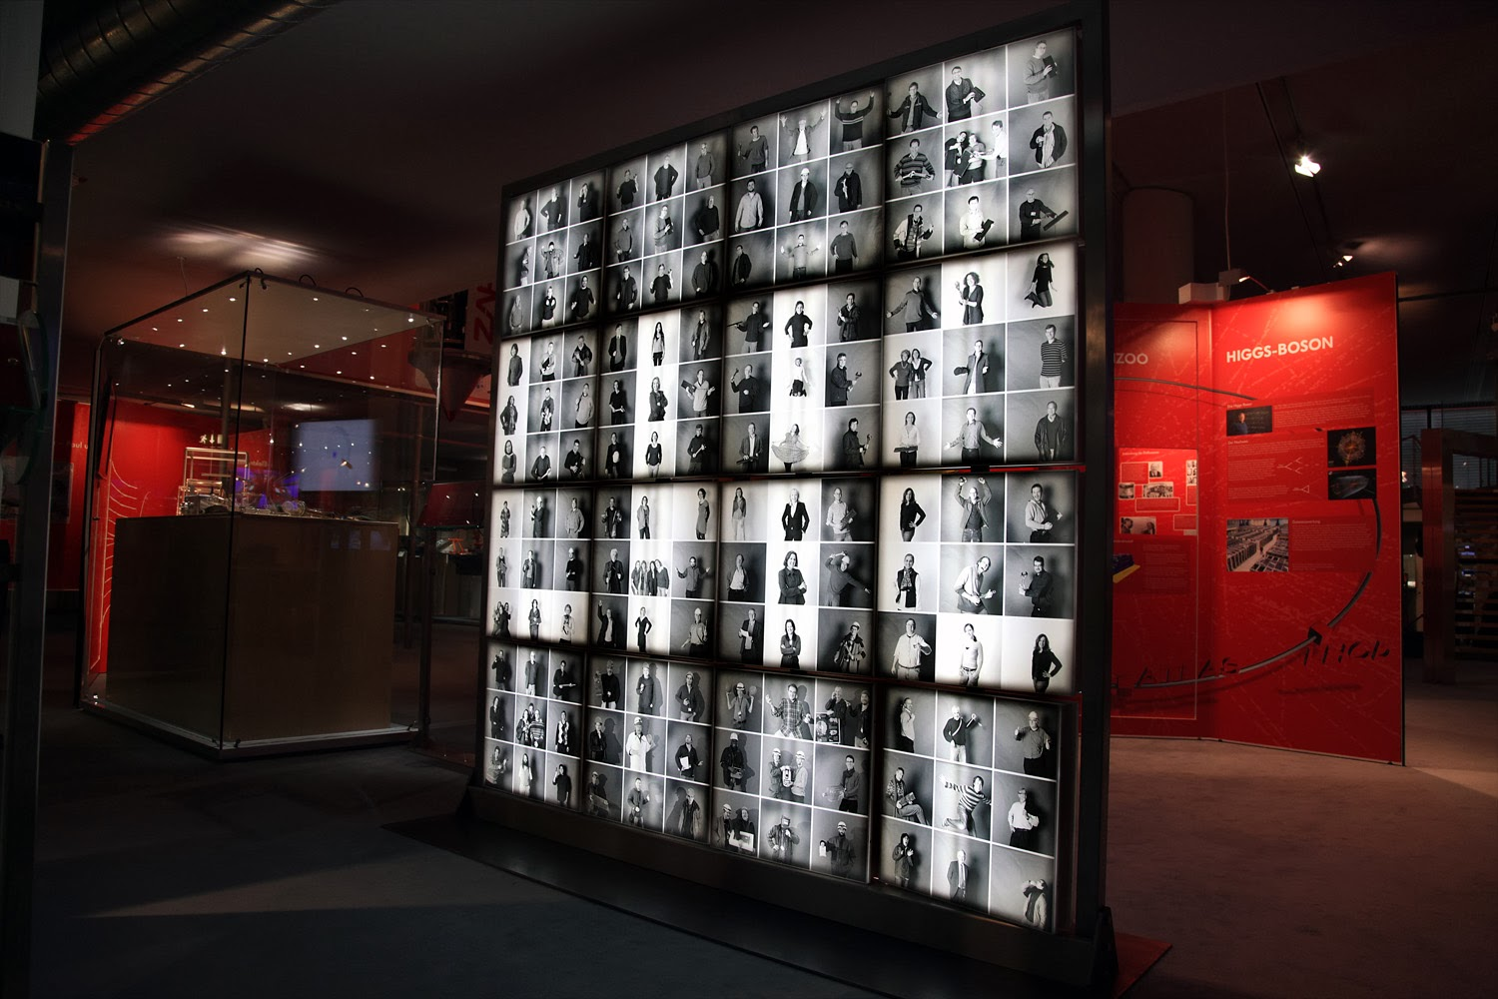
Austria: Rotating Photo Wall
German museum Bonn – Institute of High Energy Physics (HEPHY) Vienna
Built at the German museum Bonn, designed together with HEPHY and Michael Hoch
Will be used in the future for exhibitions of HEPHY
  Austrian Special Exhibition in the Science Center Welios (Wels)
  Oct.2014-Jan.2015

Slide 4
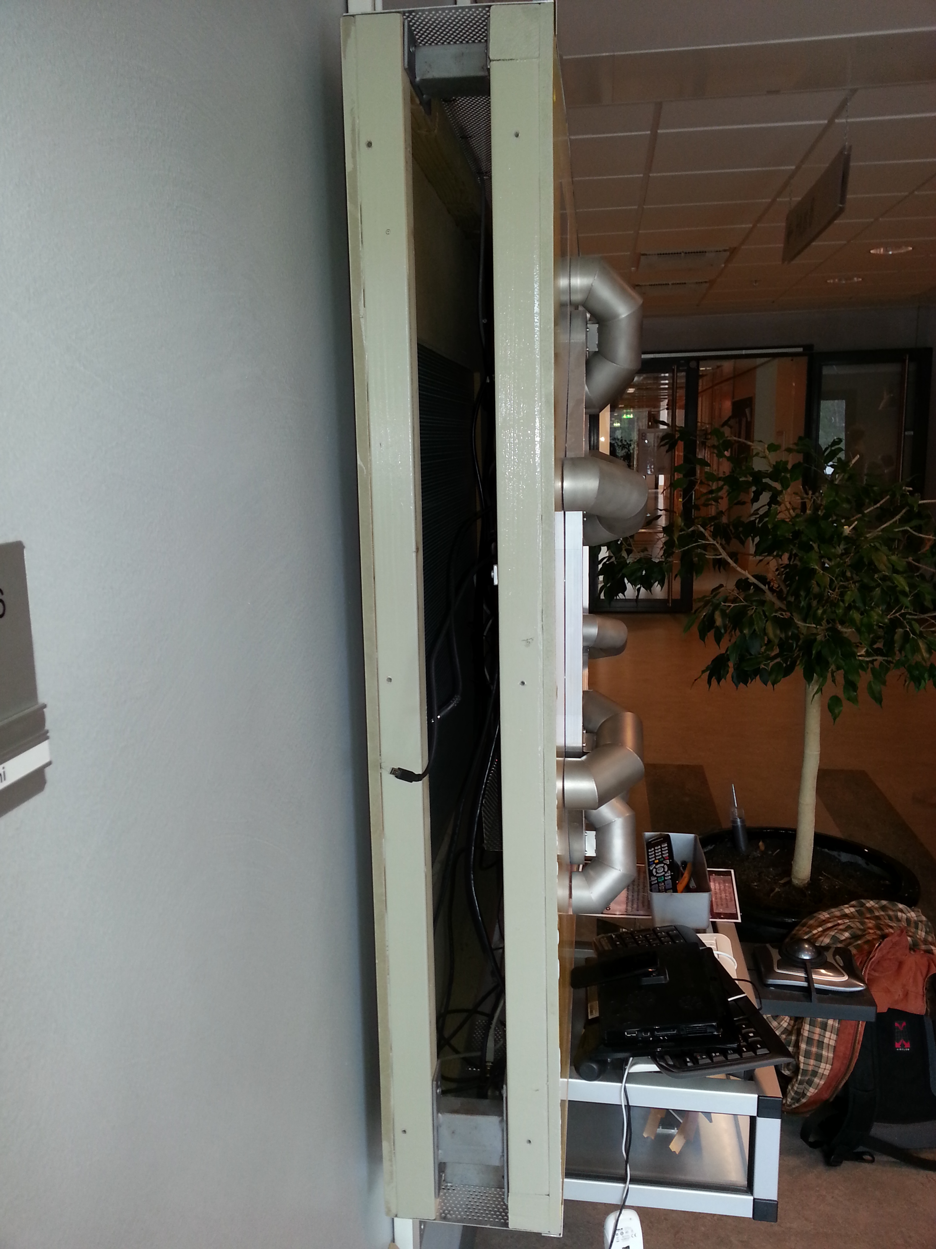
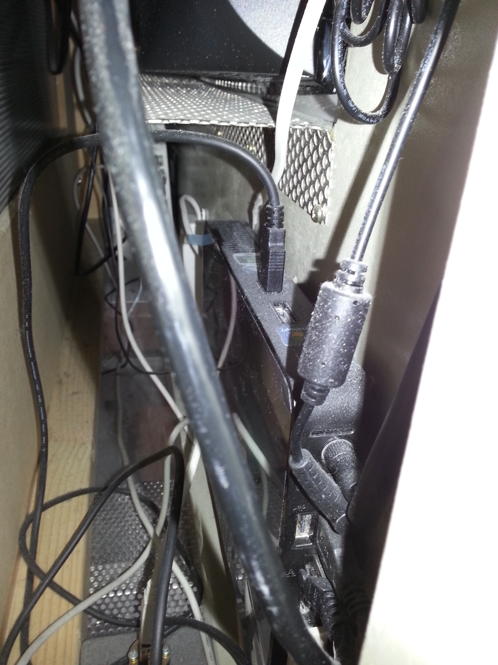
Sweden: Interactive ATLAS Kiosk
Interactive outreach and physics information.
Possible to take the ATLAS virtual tour.
Most work goes into preparing the content.
Building a replica should be easier.

Slide 5
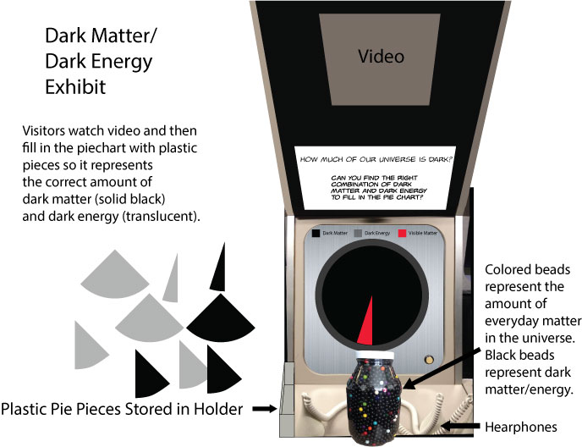
United States: Dark Matter

Slide 6
United States: Neutrinos

