Slide 1
IPPOG Resources Database
Achintya Rao
CMS Experiment

Slide 2
Background
Hosted at CERN: http://cern.ch/ippog/resources
Database formerly curated by Lisa McCarthy
Migrated from DocDB to Drupal
Initial design done by company in Meyrin
Currently unsupported

Slide 3
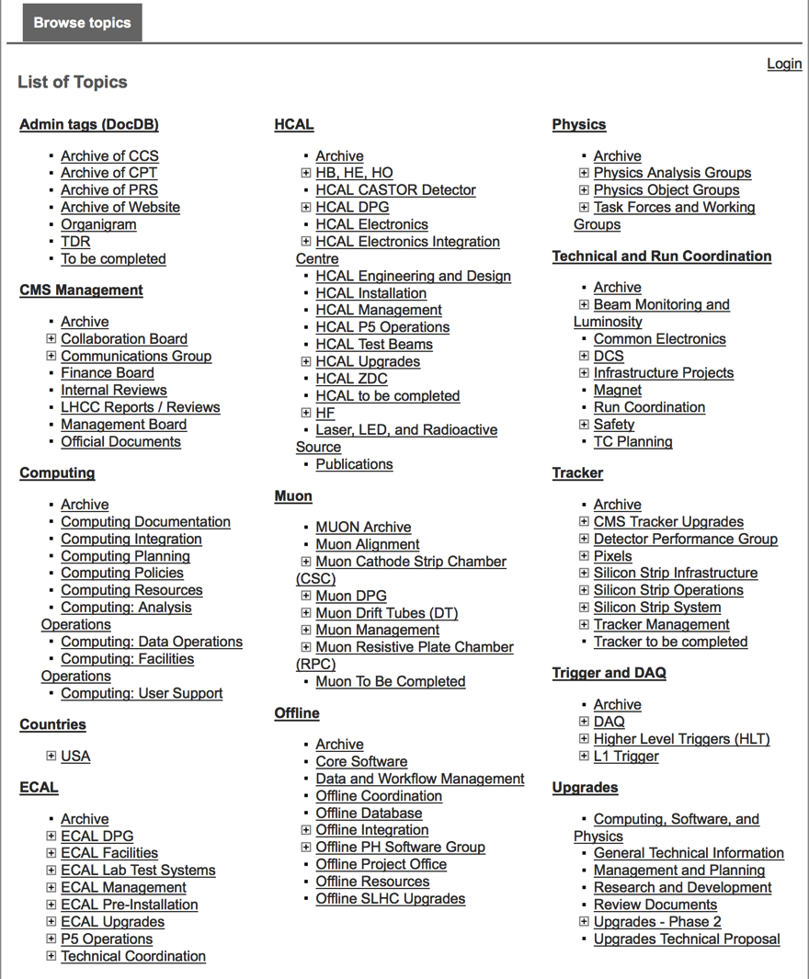
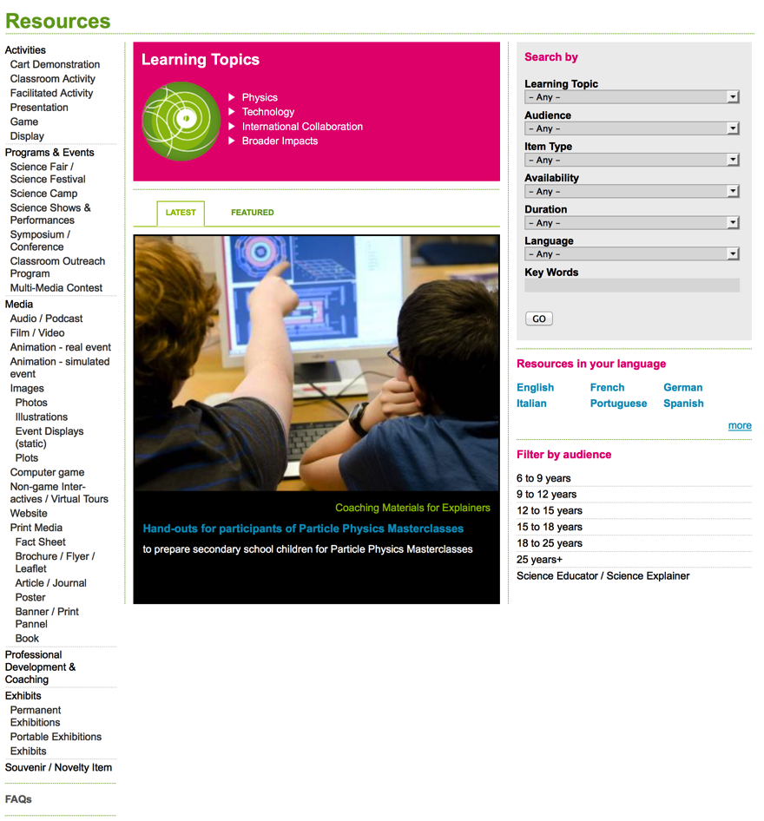
Background
From (DocDB)
To (Drupal)

Slide 4
At last IPPOG Meeting (CERN)
Marge B. + Achintya R. met Dan Noyes, CERN’s web editor
Website audit done by Dan and team
Results sent to Marge, Achintya and Dave B.

Slide 5
Dan Noyes’s recommendations
There is a security and stability issue with having local modules (which override the ones centrally managed by IT) that should be resolved urgently.
ACTION: Get in touch with Tim Bell's team and see whether one of the admins would be able to do this for you (strictly speaking they shouldn't but in practice I find they are always willing to help when they can).

Slide 6
Dan Noyes’s recommendations
The taxonomies are confusing.
I would recommend simplifying them - the 'categories' document that Marge sent me looks like a great start. I wouldn't even use the subcategories at this point until you're really clear how you want to use them.
Giving content submitters a limited list of these categories at submission time should be enough to allow end-users to browse the database.
If an end user really wants something specific then they will search for it (in which case you don't necessarily need the tags but really good titles and descriptions).

Slide 7
Dan Noyes’s recommendations
I would expose the content types more evidently. See this resource, for example:
http://ippog.web.cern.ch/resources/2013/lhc-and-higgs-boson-%0Bcommunicating-science-1
It's a PowerPoint presentation, but I couldn't see anywhere on the page that said it's a PowerPoint (although there's lots of other metadata about it).
I would favour limiting the exposed metadata to type/description/submitted/date information.

Slide 8
Dan Noyes’s recommendations
“Automation and scale” versus “curation and quality”
I would lean towards having a smaller, high-quality database of items rather than going for scale right off.
I know human resources are scarce, but having someone who approves / curates content for each category would be a good idea to help improve quality and usability

Slide 9
Achintya’s recommendations
Professional support needed, even if it is short-term.
Web design should be left to the experts.
The website was built by an outside company, but initial design came from our assumptions or expectations.
Now that we have user-experience data, we should re-think.

Slide 10
For full technical notes from Dan Noyes, contact achintya.rao@cern.ch

