Slide 1
CMS Outreach Report

Slide 2
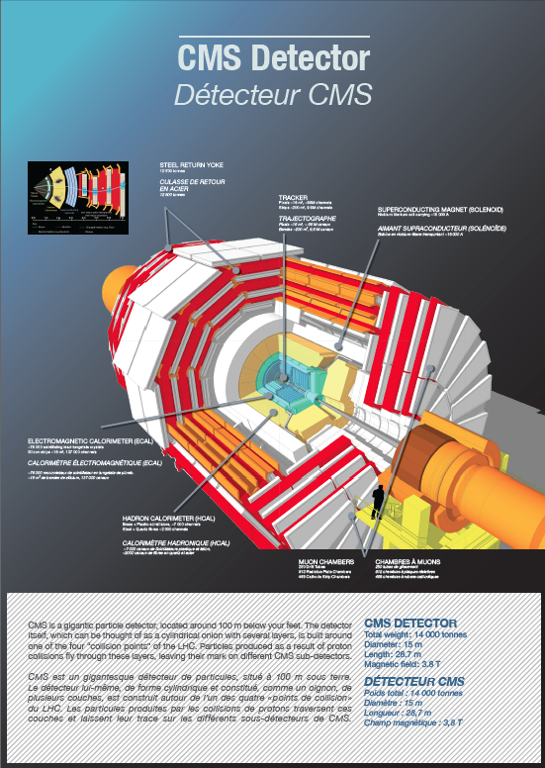
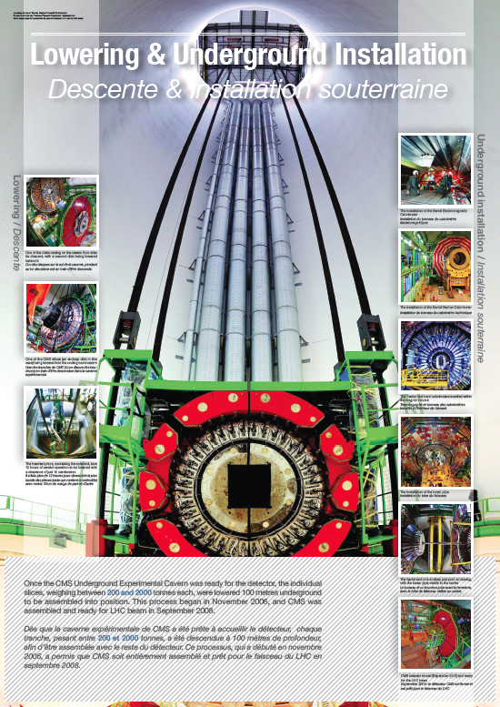
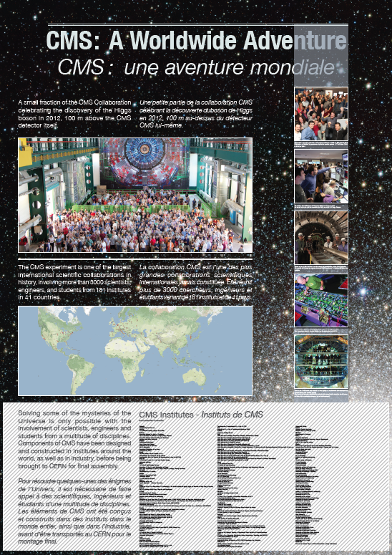
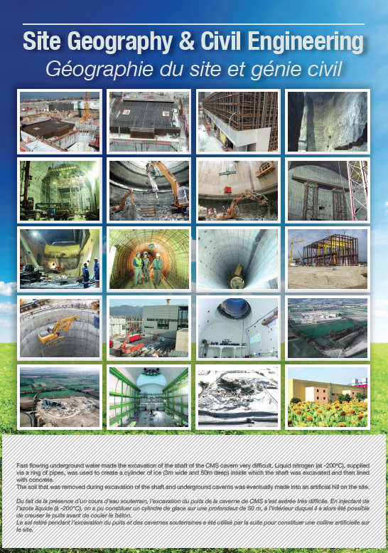
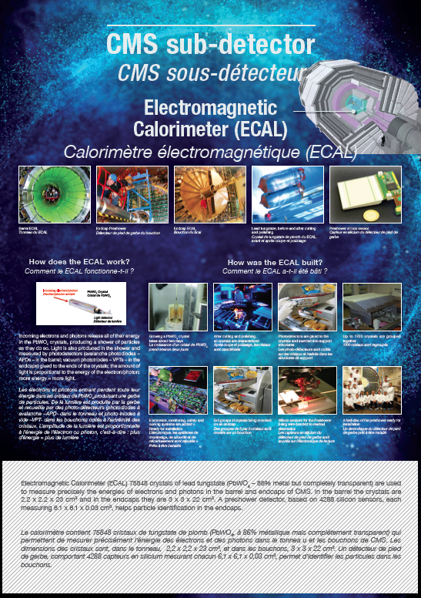
1. New set of CMS Posters
https://cms-docdb.cern.ch/cgi-bin/PublicDocDB/RetrieveFile?docid=12063

Slide 3
1. New set of CMS Posters
Produced for CERN Open Days 2013
Available for print in 2 formats: (1) 4x4m and (2) A0
Can be used by all CMS institutes for exhibitions / events…
Languages available:
  English
  French
  Italian (in progress)
  … (translations to other languages possible, contact: cms-outreach@cern.ch)

Slide 4
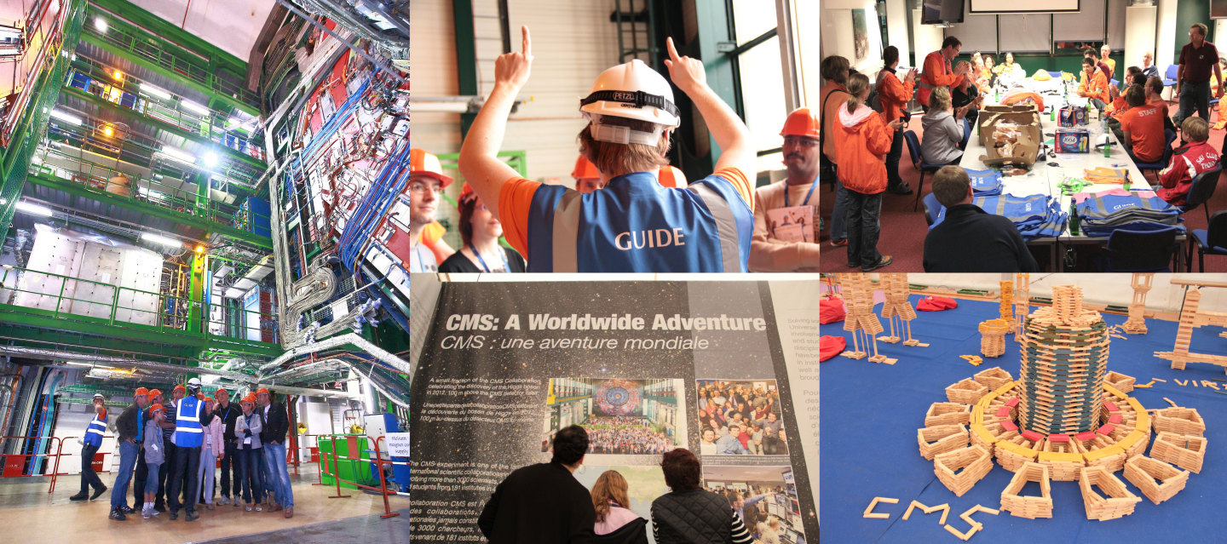
2. CERN 60th Anniversary
Neighbourhood Event at CMS, 24/25 May 2014

Slide 5
2. CERN 60th Anniversary
Neighbourhood Event at CMS, 24/25 May 2014
Organisation: CMS Communications + Technical Coordination
P5, P4 and P8 only
For local community
9:00 - 19:00 (last entry at 18:00)
New building inauguration on 24th morning (new visitors reception room!)
Underground visits (pre-booked tickets via local authorities)
Attractions on site:
  LHC Proton Football interactive game
  Kapla: building CMS from wooden blocks (for kids)
  Lego: explaining CMS with Lego (workshops for families)
  Geometers / Cryogenic show / Physics talks
  …

Slide 6
3. CERN 60th Anniversary
26 May 2014: visits for schools and CMS families
Schools (morning) and CMS relatives (evening)
  Only visits underground
  No surface activities

Slide 7
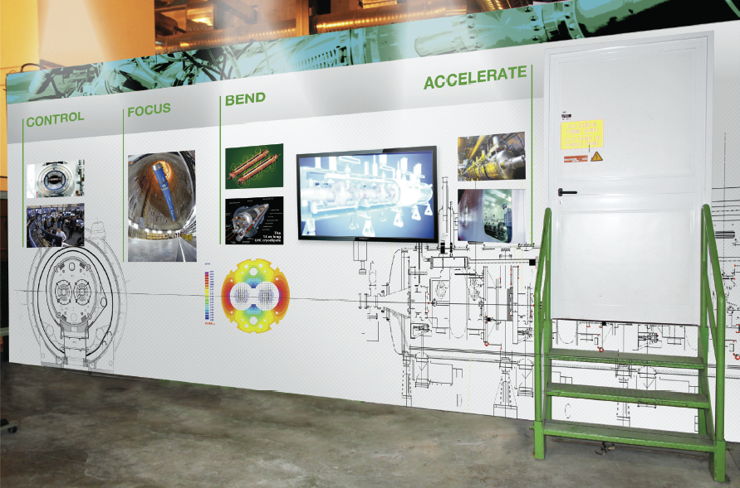
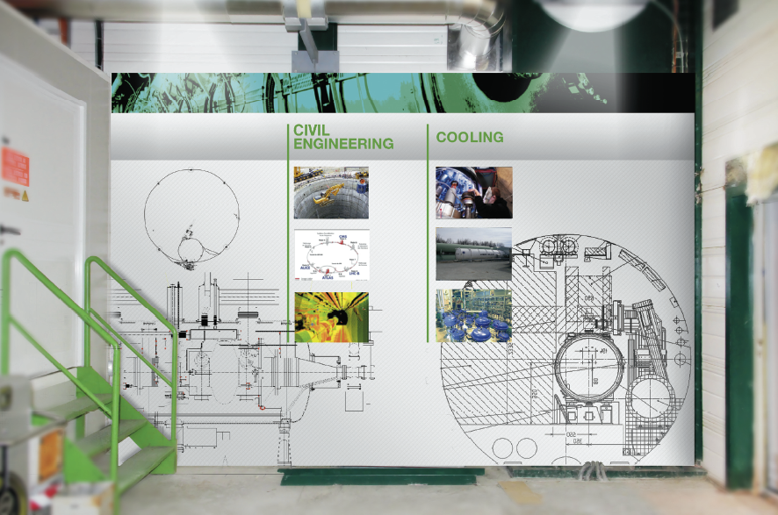
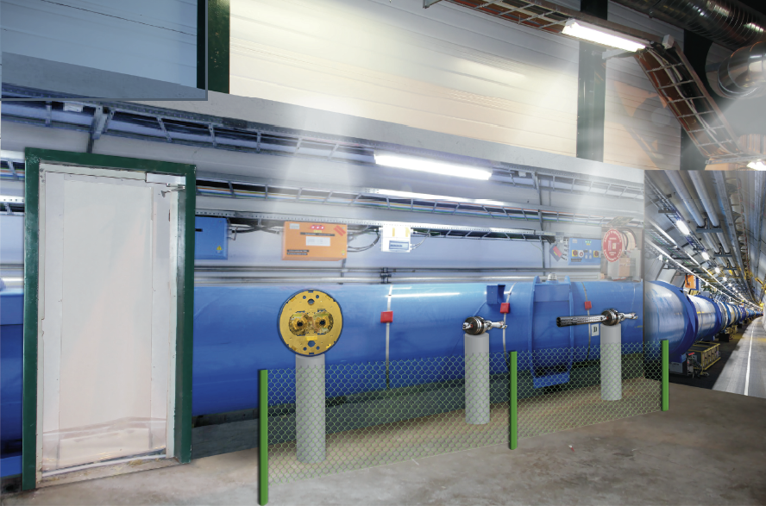
4. Plans for LHC expo at P5
LHC tunnel wall: look and feel as inside the tunnel (idea from the London Science Museum)
6 real LHC objects:
1) Warm section of beam-pipe with getter
2) Beam Position Monitor
3) Cold section of beam-pipe with beam screen
4) Dipole slice
5) Short cross section of collared dipole coil
6) Beam-pipe connection showing PIMs
Aimed to be ready for CERN 60’s anniversary event, end of May.

Slide 8
5. CMS Virtual Visits
Essential component of CMS E&O activities in:
  schools, science museums, science fairs, etc.
CMS organizes underground VVs since 2010. Yet, in 2014:
  joint effort with CERN EDU Group
    large-scale VVs by schools across Europe and beyond
    collaboration with IceCube, developing VVs programme for US and European schools

Slide 9
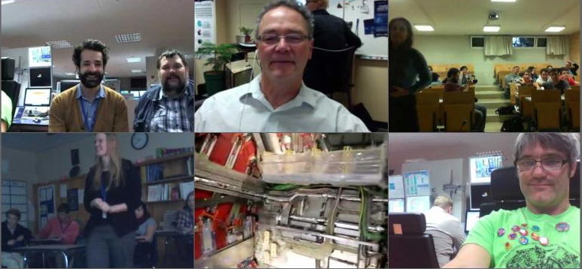
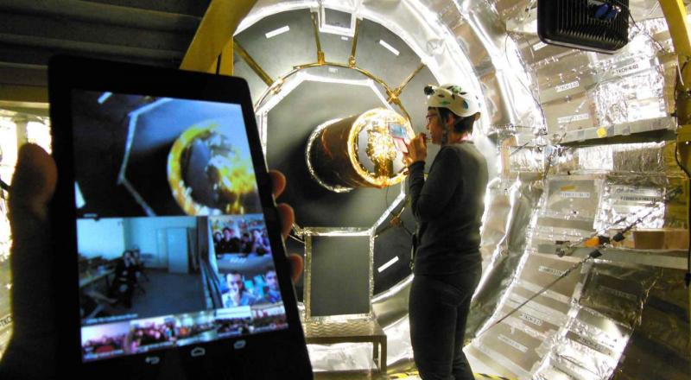
5. CMS Virtual Visits
23 Jan 2014
Angelos Alexopoulos and Zoltan Szillasi in the CMS Control Room, Jim Madsen at the Wisconsin IceCube Particle Astrophysics Center (WIPAC), students in Athens, Michael Hoch in the CMS Control Room, a detail of the CMS detector as shown by Noemi Beni, and students in the US.
http://home.web.cern.ch/students-educators/updates/2014/01/cern-connects-icecube-bring-science-schools
12 Feb 2014
CMS engineer Andromachi Tsirou leads a virtual tour of the CMS detector, with over 500 students tuning in from seven different locations in Greece.
http://home.web.cern.ch/students-educators/updates/2014/02/students-visit-heart-cms-detector

Slide 10
5. CMS Virtual Visits
Future plans:
  Dedicated CMS VVs website with booking system to meet high demand by schools
  Special CMS VVs for CERN 60 events
  Further collaboration with EU Projects (Open Discovery Space, Inspiring Science Education) to help:
    develop an integrated framework for enhancing and assessing the impact of CMS Education activities across Europe through:
      Supporting and monitoring follow-up activities in schools

Slide 11
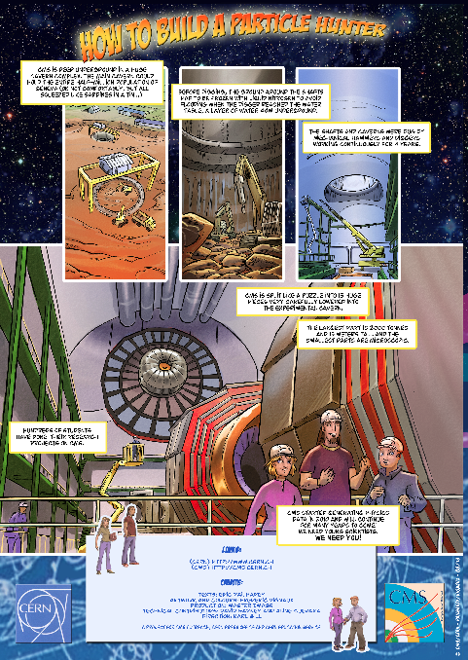
6. CMS Comic Book
Production of a regular 24-page comic book
Work with the same story writer as for the CMS Comic Brochure 2006
Messages, objectives and target audience defined within the working group built with CMS physicists
When produced, available for sale on Amazon, etc. (sale handled by the editor)
Main message: Knowledge, Future, Technology
Target audience: 16- to 23-year-olds
First story draft under review by the working group

Slide 12
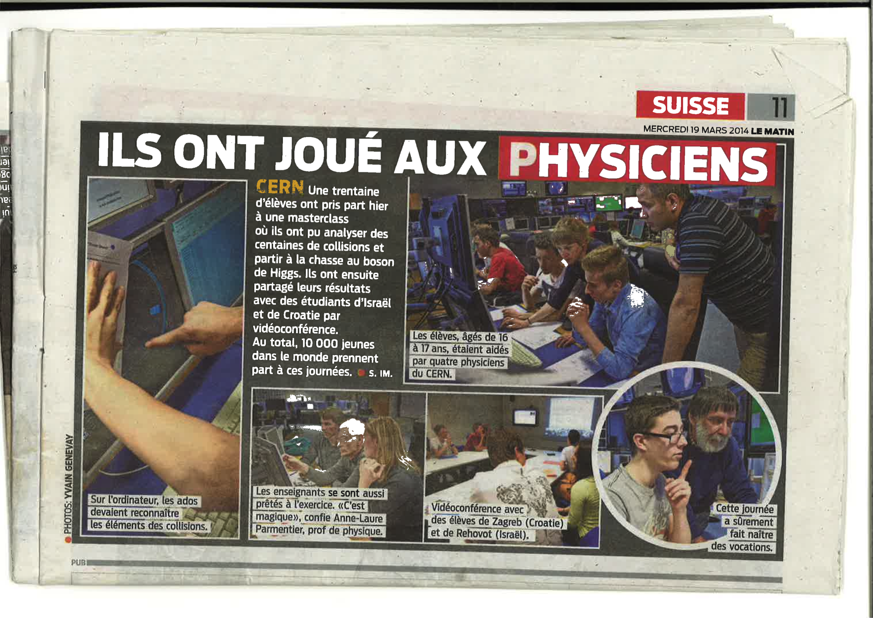
7. CMS Masterclass
In the CMS Centre (February/March)
CMS physicists moderating Masterclass in the CMS Centre featured in Le Matin (Geneva local press), 19 March 2014.
CMS physicist, Otman Charaf
CMS physicist, Jean Fay
http://cms.web.cern.ch/content/cms-public-data

Slide 13
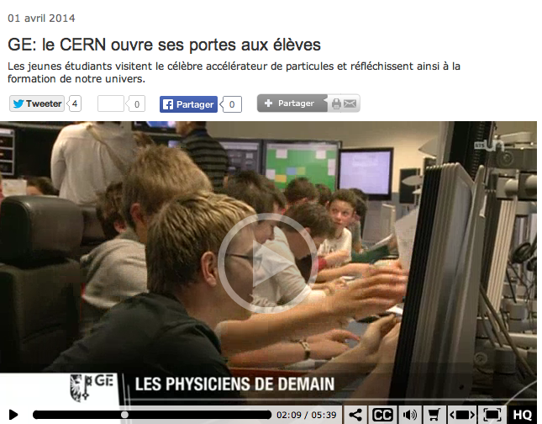
7. CMS Masterclass
In the CMS Centre (February/March)
TV reportage from, https://www.rts.ch/ (Radio TV Suisse)
http://www.rts.ch/video/info/couleurs-locales/5739506-ge-le-cern-ouvre-ses-portes-aux-eleves.html

Slide 14
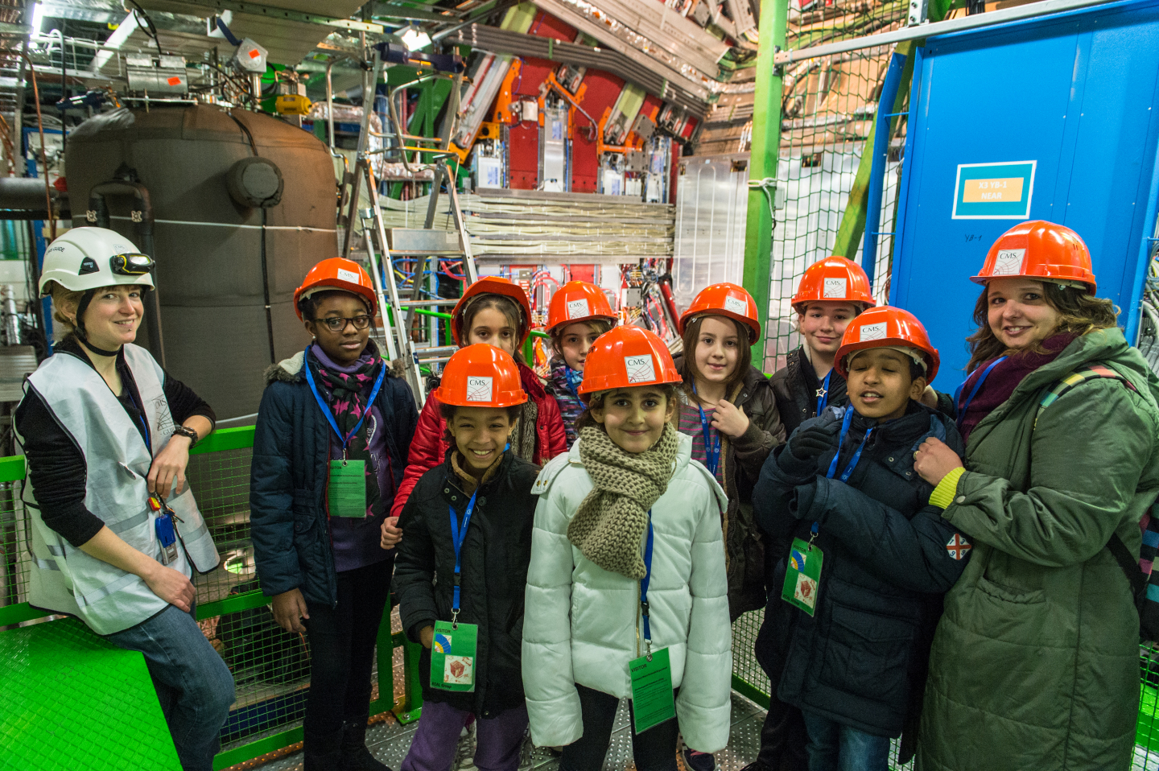
8. In the shoes of a researcher
Programme aimed at Primary Schools
Feb/Mar 2014: 4 groups of 9-12 years old kids from local schools visited CMS and interviewed CMS physicists
Project with CERN Local Communication
High degree of satisfaction

Slide 15
9. CMS Open Data
CMS already has released a small sample of data for use in E&O: used in masterclasses
CMS has approved for release a large (~30 TB) sample of 2010 data (under Creative Commons)
Example applications at different levels will be provided, from e.g. event display to virtual machine of CMS software (format is CMS AOD) with example code
Reliance on CERN services for storage, access, distribution, etc. (with input from CMS and other interested LHC experiments)
Plan: make release to coincide with CERN 60th with access to data and example applications via online portal

Slide 16
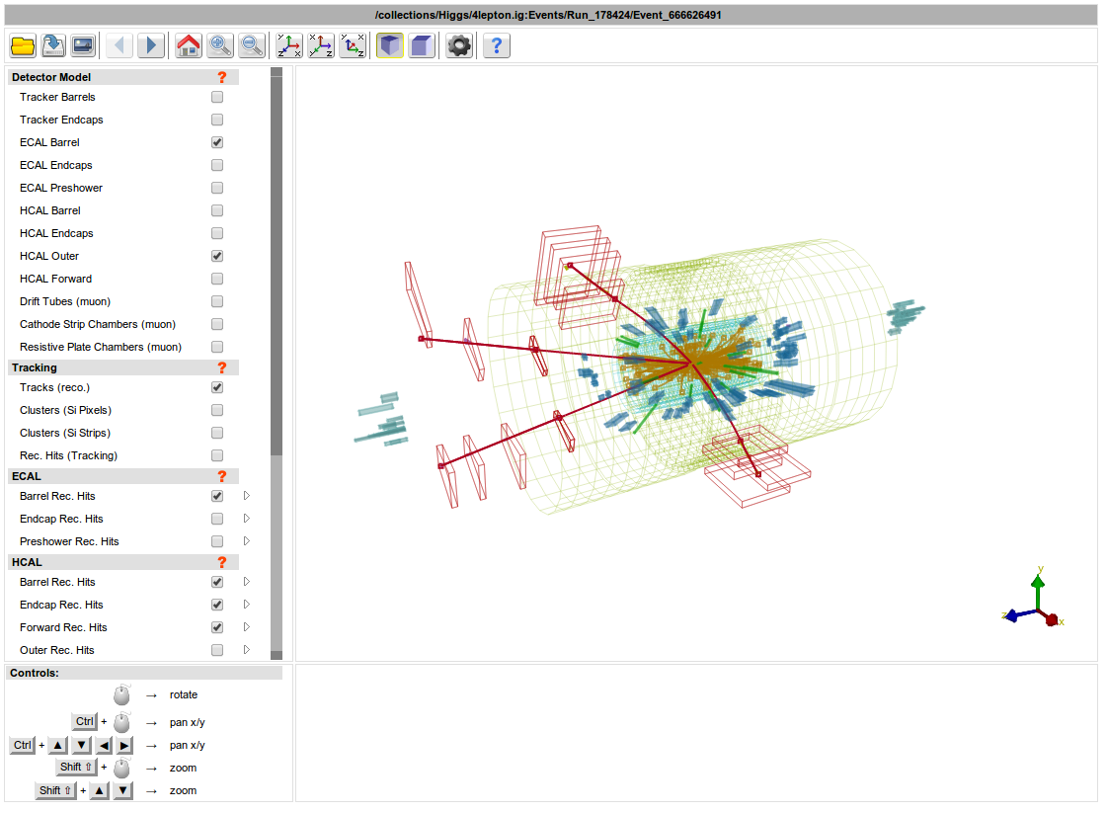
10. CMS graphics news (i)
Version of online event display now works on touch screens (depending on browser support) thanks to transition to WebGL

Slide 17
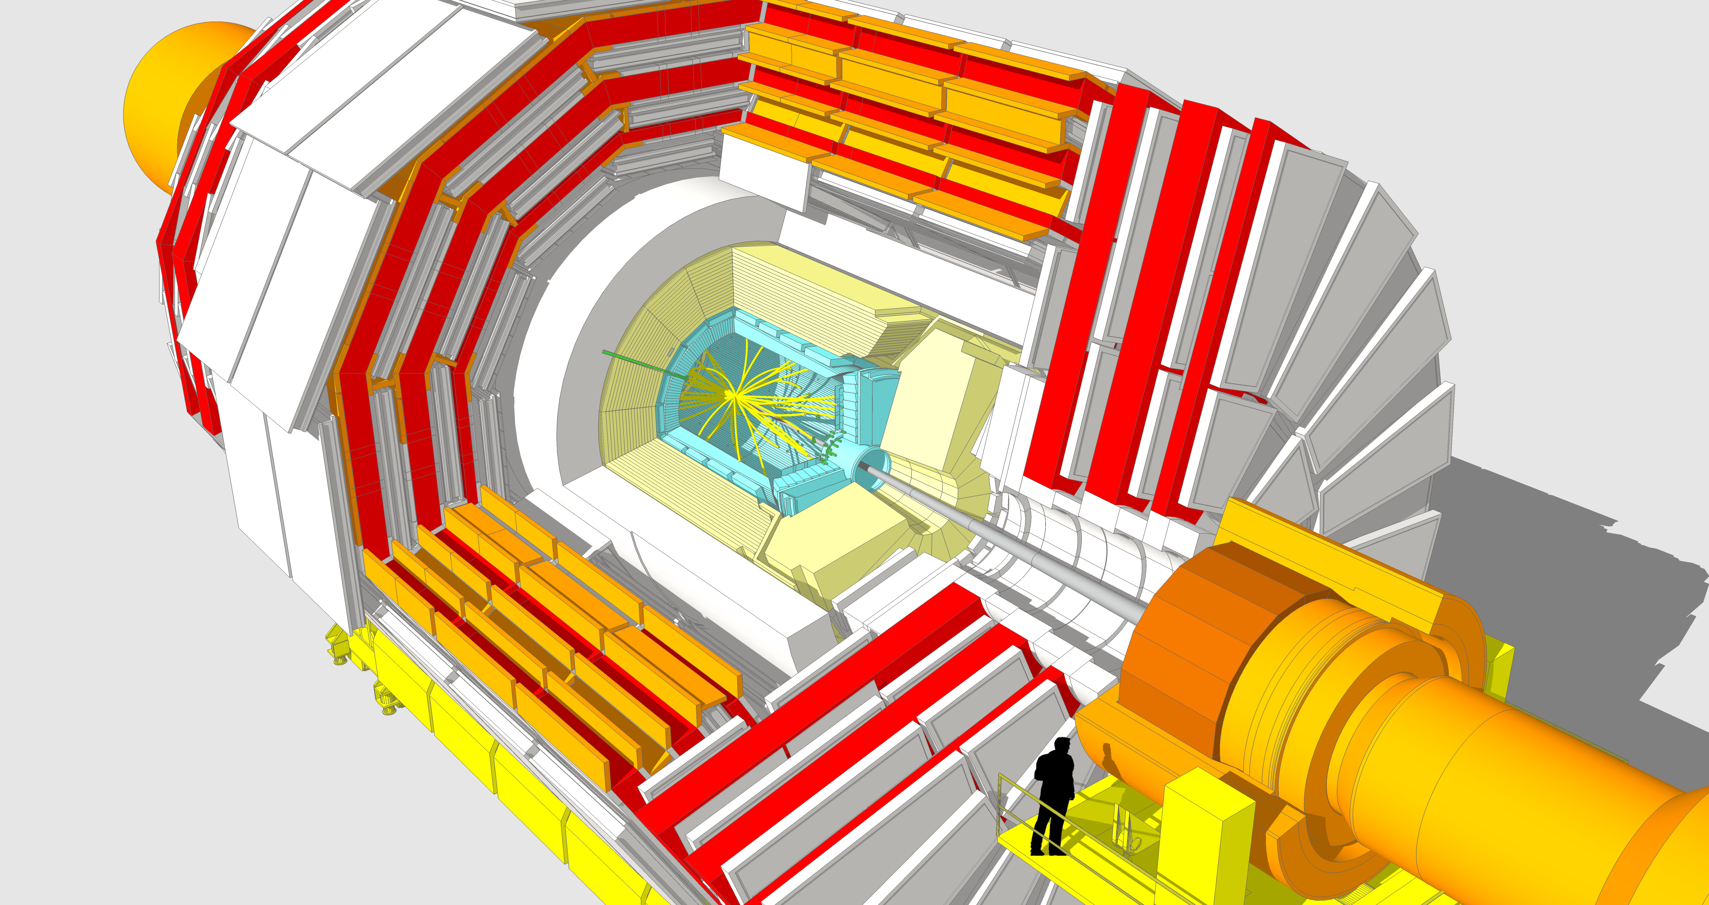
10. CMS graphics news (ii)
Events now supported in detailed CMS 2D images and 3D models using SketchUp

Slide 18
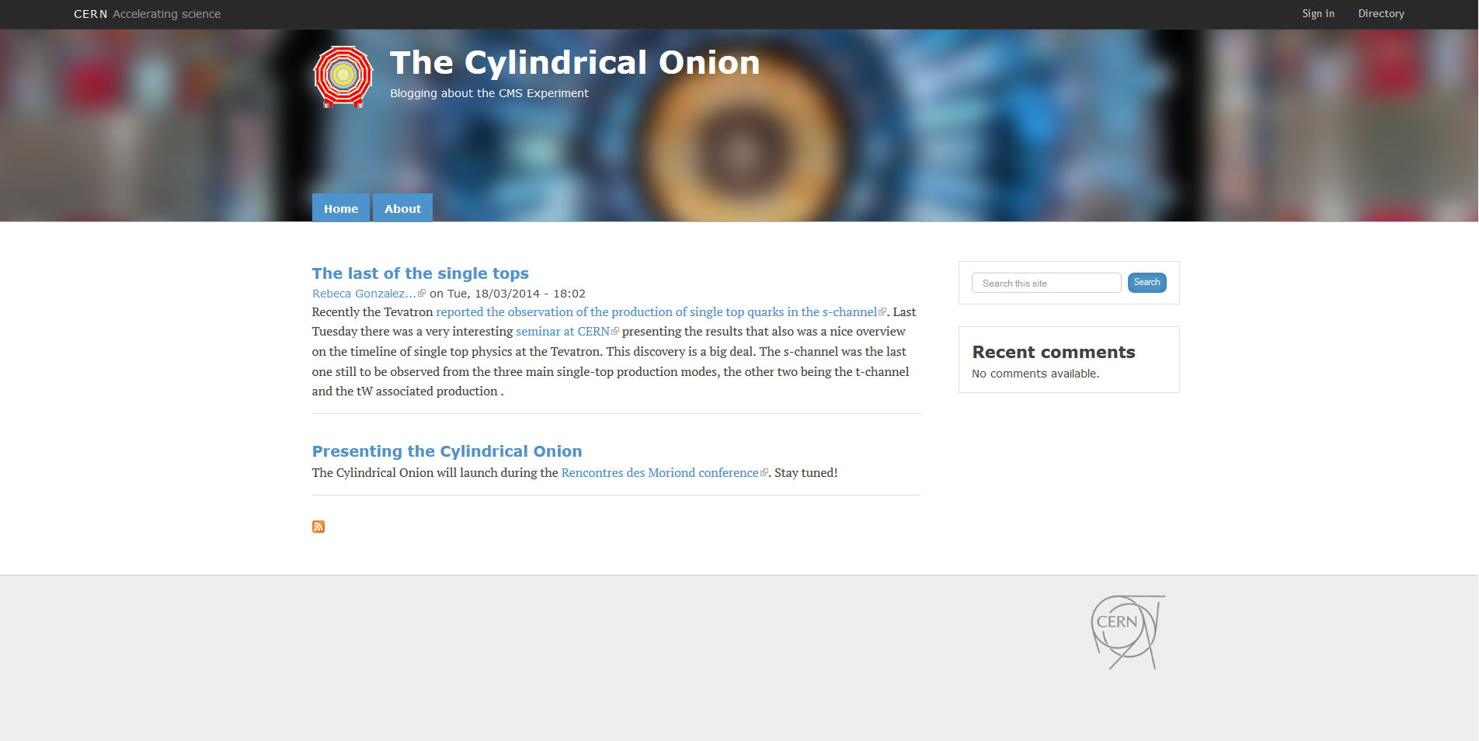
11. News and Blog
CMS blog: The Cylindrical Onion (cern.ch/cylindricalonion)
NOT an “official” CMS blog
Launched during Moriond 2014
As a startup measure, bloggers have been chosen and supported by CMS Comms Group. All blogposts are the responsibility of individuals. Must comply with CERN and CMS Blogging Guidelines
No editorial oversight from CMS
Two “streams”: General stories (physics, detector, upgrades etc.) and Outreach stories (events, exhibitions, Masterclasses, visits etc.)

Slide 19
12. Art@CMS, Science&Art
In 2013 over 22,000 people have seen our expos
  including US Congress
  London Science Museum and Deutsches Museum BonnSimilar activities are scheduled for 2014
  Painting expo in P5 during June CMS week

Slide 20

12. Art@CMS, Science&Art
Performed 2013:
VCI conference February / Vienna Austria
April Art@CMS vernissage at CERN P5
June Joanneum Graz Austria
July Art@CMS vernissage at CERN P5
September QUANTUM at CERN P5
September OD2013 group expo at CERN P5
Oct – Dec City of London, London UK
November – Science Night Aachen Germany
Nov – Jan Art in Science – Aachen Germany
November US HIGGS event 2013 Capitol Hill Washington USA
Nov – Jan Deutsches Museum Bonn, Bonn Germany
December Art@CMS vernissage at CERN P5
Exhibitions 2014 :
February 20th – April 8th Colegium Hungaricum / Vienna Austria
March 21st – April 4th WienerWunderKammer / Vienna Austria
April 4th Science Night Vienna CERN 60th Celebration Vienna Austria
June 6th Qualysoft Science – Technology – Art / Vienna – Budapest
June Art@CMS vernissage at CERN P5
July ICHEP Conference Science & Art / Valencia Spain (under discussion)
July 1st – 30th , S. Francis College, New York US
September 4th till Oct , WELIOS / Wels / Austria
September 26th – Oct 5th, Leonardo da Vinci Museum, Milano / Italy
December 10th – 16th CMS week Miami / Florida / US
More collaborations in negotiation for 2015
WELIOS / Wels / Austria – Jan – March 2015
Fermilab USA beginning 2015
MIT Boston USA start April 2015
Furthermore:
Forum de Meyrin / Switzerland
art@CMS
http://artcms.web.cern.ch/artcms

Slide 21
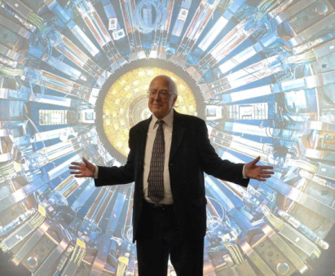
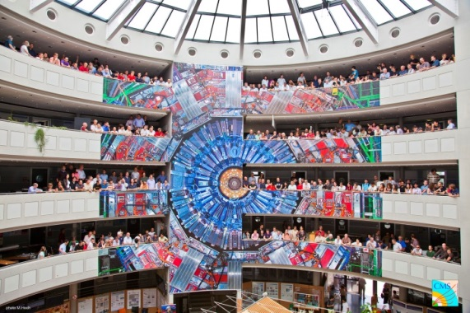
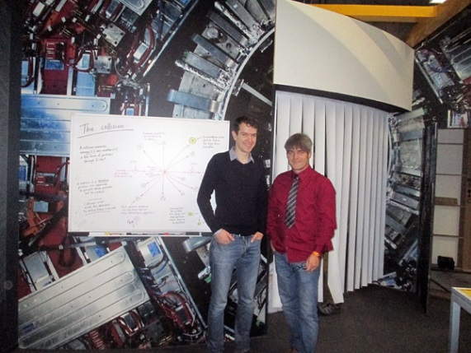
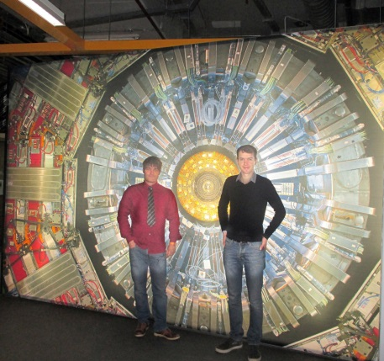
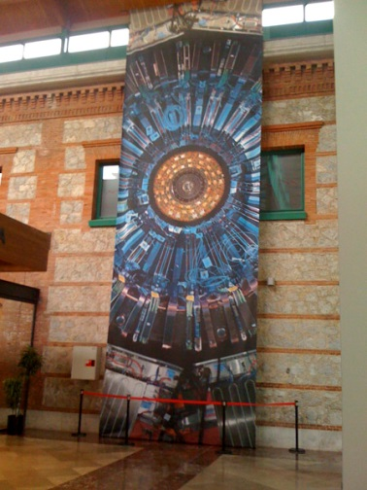
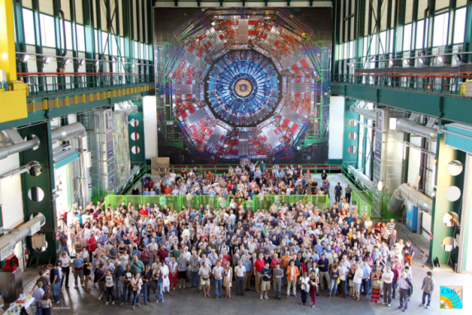
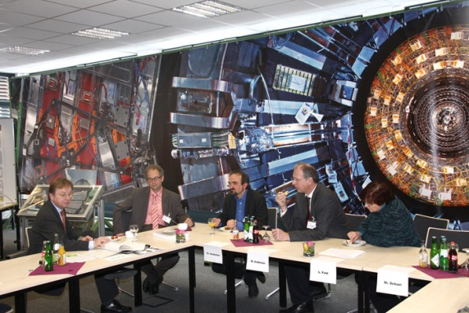
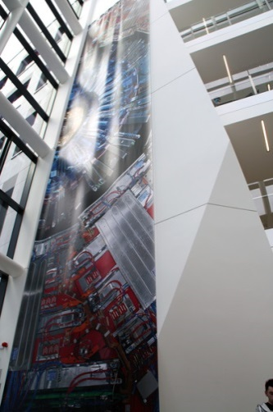
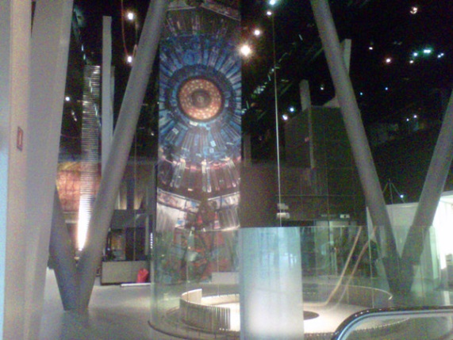
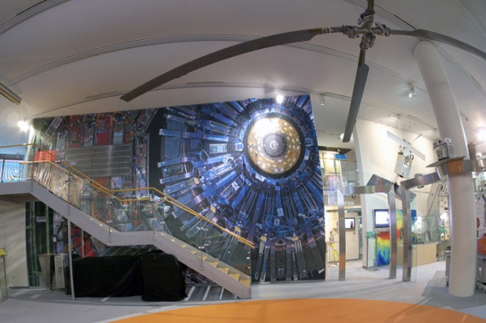
12. Art@CMS,
CMS image an icon for HEP
CERN Meyrin / Switzerland
Peter Higgs during the LHC exhibition inauguration London Science Museum UK
CERN LHC P5 / France
London Science Museum / UK
Biblioteca Cantabria
Santander / Spain
2008 ~250 Photos made by M. Brice & M. Hoch
2011 installation CERN Meyrin Bldg 40 [12m x 16m]
2012 installation CERN P5 CMS [18m x18m]
RWTH Aachen Germany [ 2.2m x 16m]
2013 Barcelona- CosmoCaixa/ Spain [3.2m x 12m]
16 646 visitors dates: 7/3/ - 26/3/ 2013
Santander Biblioteca Cantabria/ Spain [3.2m x 12m]
2100 visitors dates: 4/4/ - 24/4/ 2013
Deutsches Museum Bonn Germany [7m x 11m]
~ 30 000 visitors , ongoing expo, dates: Nov2013 – Aug 2014
Science Museum London / UK
~ 50 000 visitors ongoing expo, dates: Nov 2013 - 2014
Aachen RWTH Science night Germany [2.2m x 16m]
4500 visitors, date: Nov 2013
Dublin University College Ireland [3.5m x 16m]
ongoing expo, dates: Dec 2013- April 2014
RWTH Aachen / Germany
CosmoCaixa Barcelona \Spain
University College Dublin
Ireland
Deutsches Museum
Bonn Germany

Slide 22
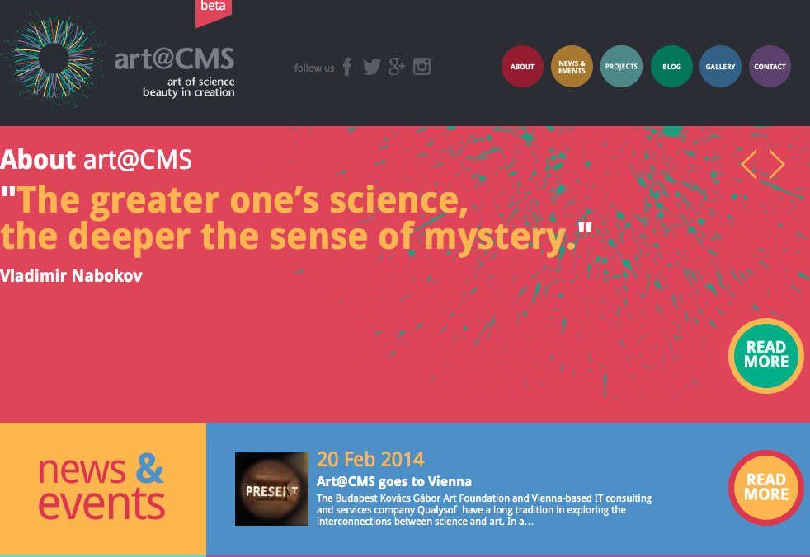
12. Art@CMS, Science&Art
Dedicated website with the support of EU Pathway project
Preparing a proposal for Horizon 2020
http://artcms.web.cern.ch/artcms/

Slide 23
Other activities
“Attractiveness of CMS” brochure for the International Committee
“CMS Higgs Boson Goose Chase” game production

