Slide 1
Recent Outreach news from UK
Report on STFC Outreach - Elizabeth Cunningham /Neville Hollingworth
http://www.ep.ph.bham.ac.uk/user/watkins/UKSTFCsummary.docx
CERN@school project - Becky Parker/Tom Whyntie
Overview
http://www.ep.ph.bham.ac.uk/user/watkins/CERNatschooloverview.pdf
Update
http://www.ep.ph.bham.ac.uk/user/watkins/CERNatschoolupdate.pdf
Few slides received from colleagues - Pete Watkins
http://www.ep.ph.bham.ac.uk/user/watkins/UKOutreachPete.pptx

Slide 2
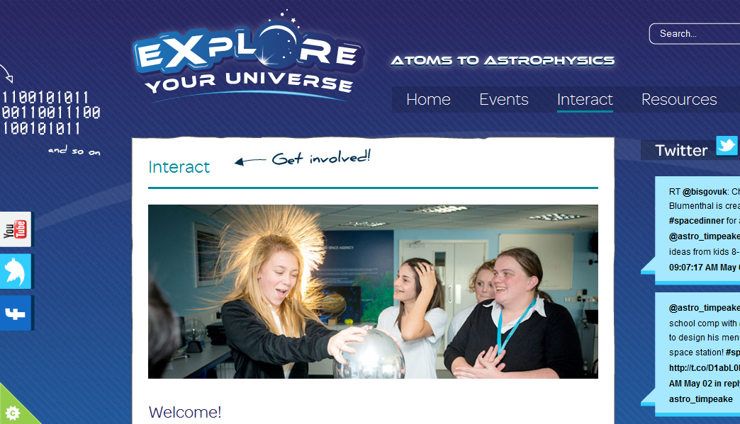
Improved links between Particle Physics/Astronomy outreach and Science Centres
Experimental kits at 12 science centres already – 10 more soon
Robin Clegg made many contributions to this project (retired April 2014)
http://www.exploreyouruniverse.org/

Slide 3
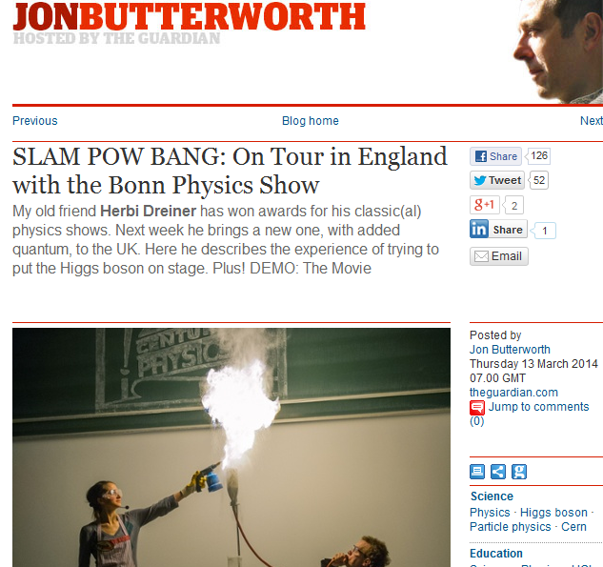
http://www.theguardian.com/science/life-and-physics/2014/mar/13/slam-pow-bang-on-tour-in-england-with-the-bonn-physics-show

Slide 4

May 22 2014

Slide 5


Slide 6
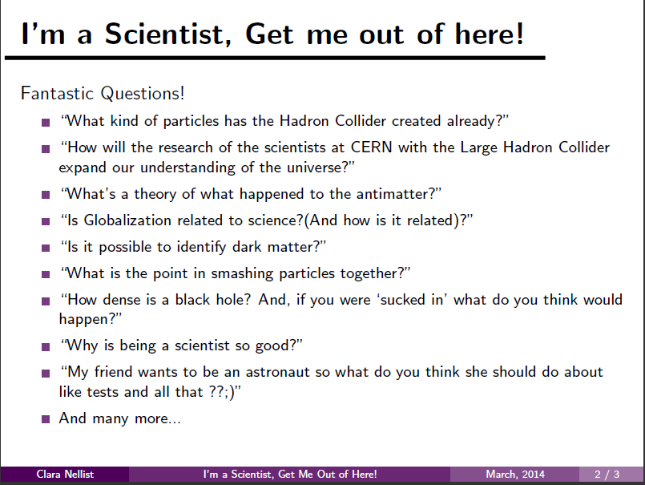

Slide 7
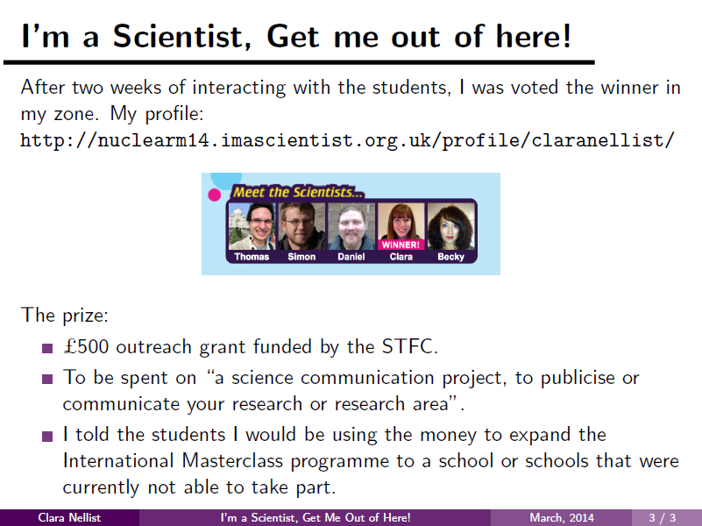

Slide 8
Six months Particle Physics Outreach – UK group
Schools liaison officer essential for these events
June Minerva workshop for UK teachers at Rugby School
June Particle Physics (A level) day for teachers held at the University
July Particle Physics day for students aged 15-16 during work experience week
July Summer school at University for students aged 17 includes Particle Physics talk
July Public lecture by Frank Close as part of University Research Conference
August Two week work placement for student on HISPARC cosmic ray project
August Work on Outreach posters and spark chamber project by six students
September British Science Festival - Two student/teacher workshops
December Mini Masterclass for 40 students (Main Masterclass in Spring)
Plus all the regular outreach talks for schools and the general public by many physicists and participation in EU outreach projects

Slide 9

Collider exhibition moves to Manchester - May to September 2014
Jeff Forshaw on Radio 5 live – discussing LHC and cosmology simulations
http://www.mosi.org.uk/whats-on/collider.aspx

