Slide 1
AEgIS and Antiprotonic Lithium
Conrad Roman :: Logan Kageorge

Slide 2
Quick Recap
AEgIS: Antimatter Experiment – Gravity, Interferometry, Spectroscopy
We want to simulate the energy degrading of an antiproton beam to prepare it for creating antiprotonic lithium

Slide 3
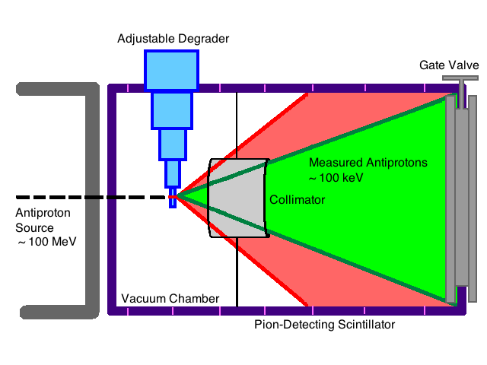
Our Old Schematic

Slide 4
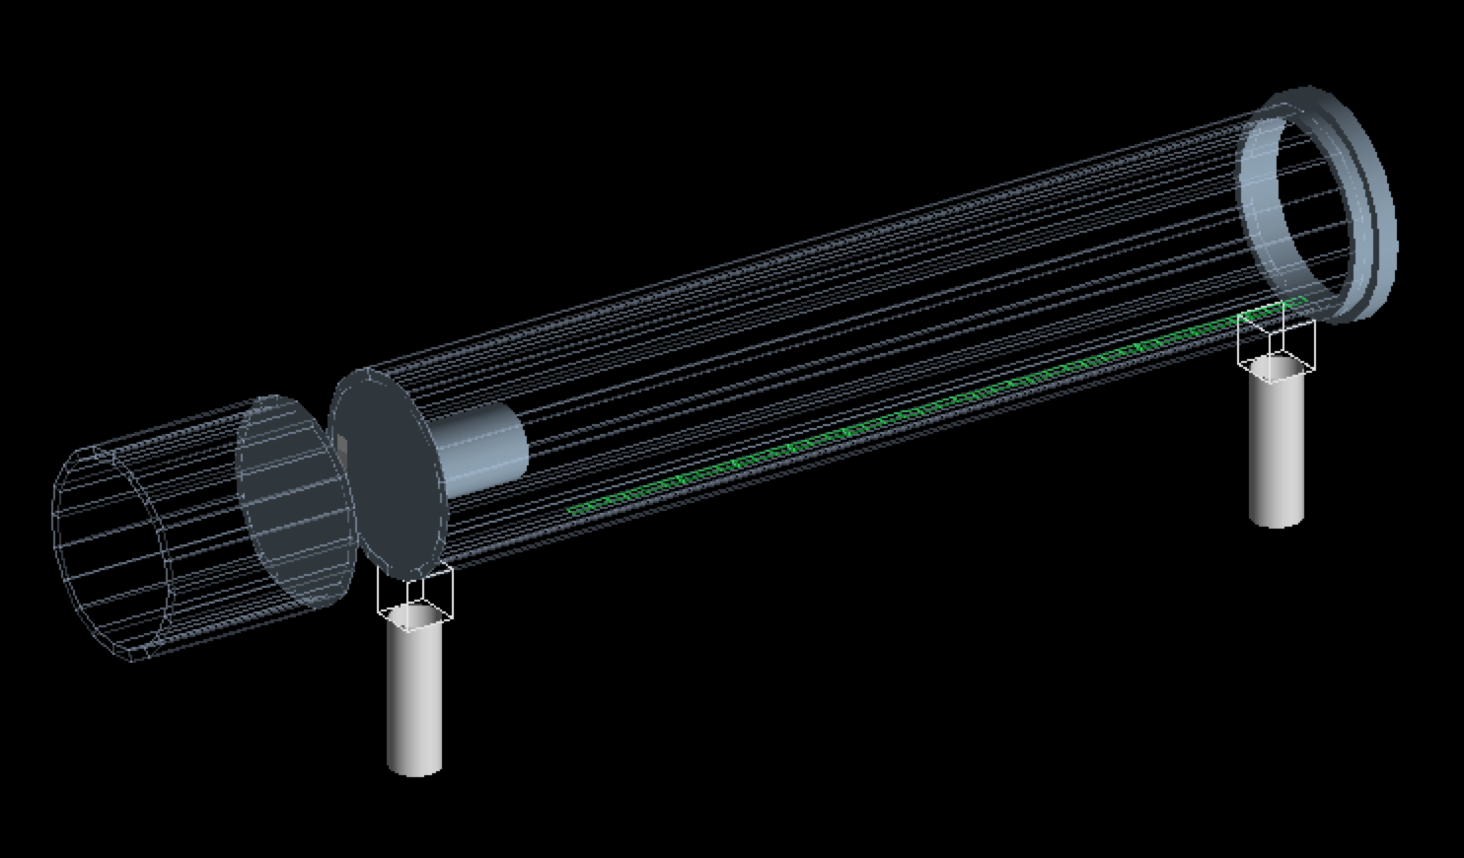

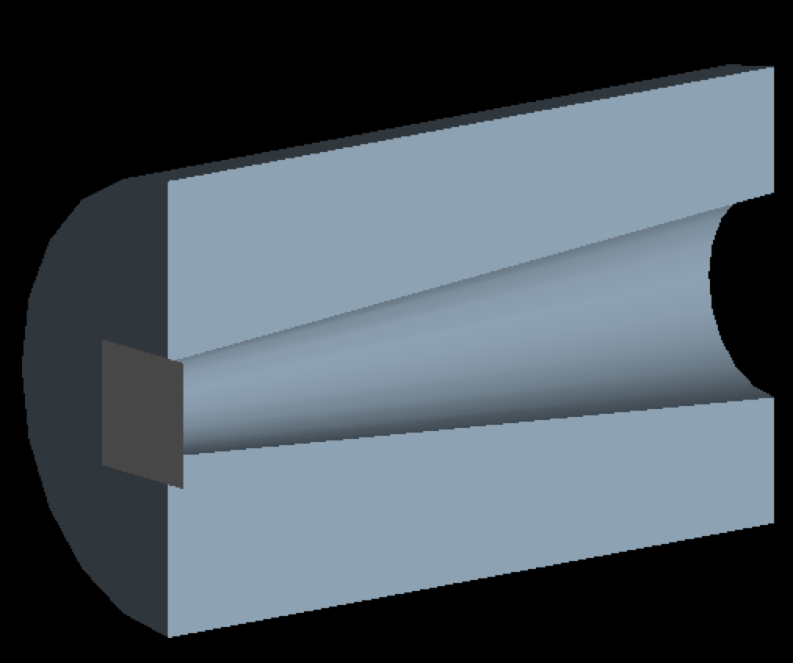
The New Simulation
Variable Degrader
Silicon Detectors
Collimator and Constant Degrader
Plastic Pion Scintillators

Slide 5
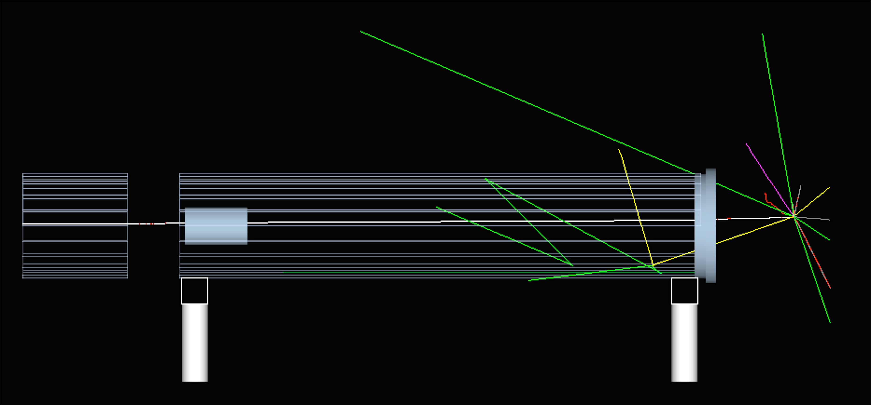
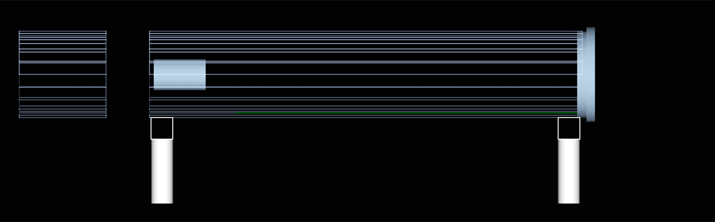
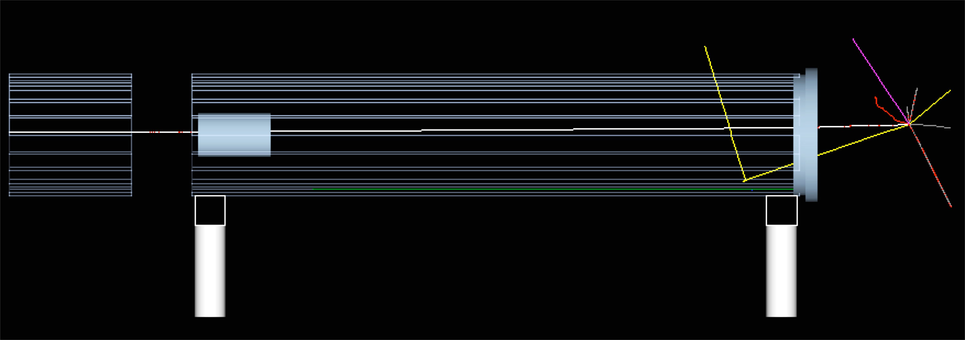
Unfiltered
Antiproton Photon
Neutron Proton
Electron Positron
Pi⁺ Pi⁻
Gamma Filter

Slide 6
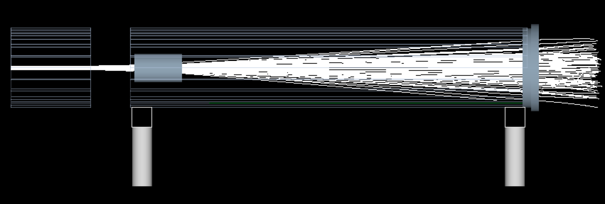
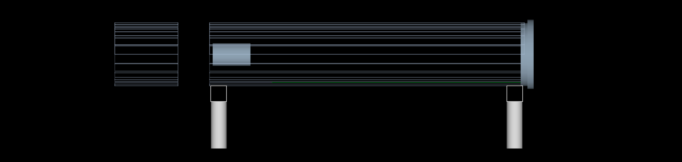
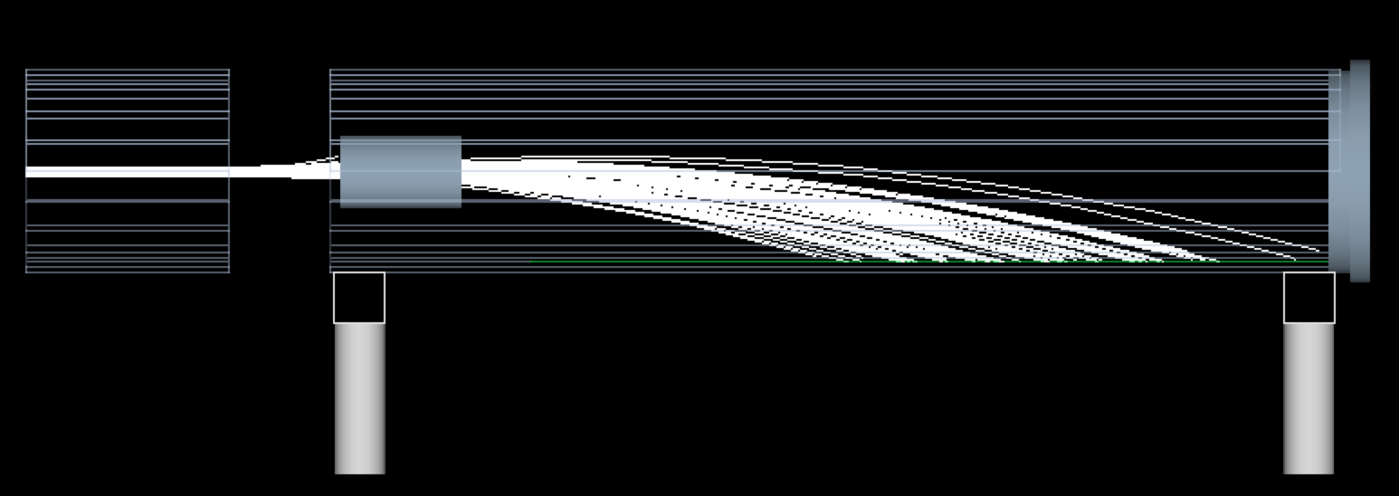
No Magnetic Field
B = 0.2 Tesla
B⊗ v
F

Slide 7
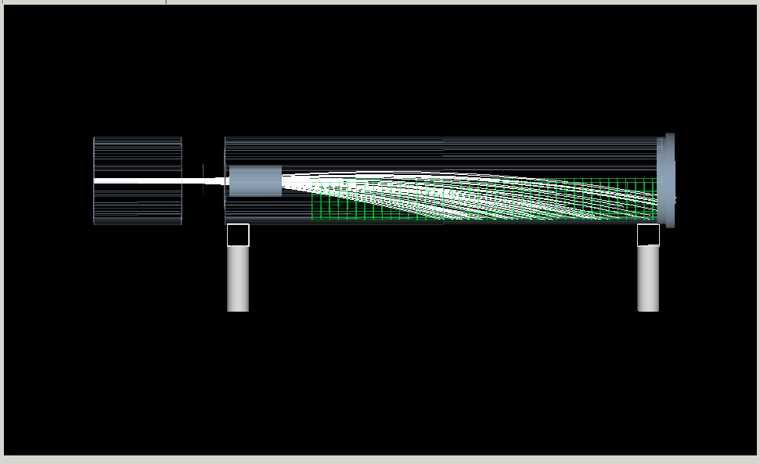
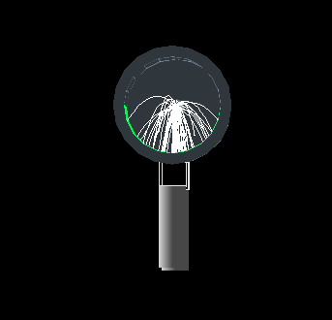
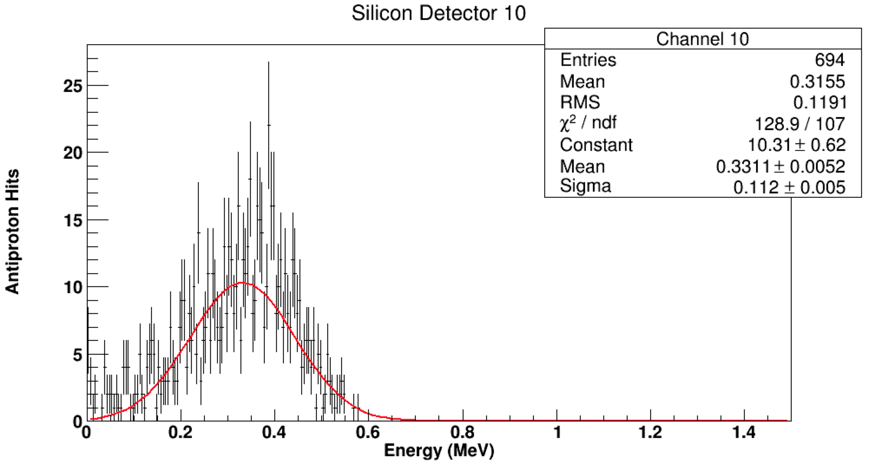
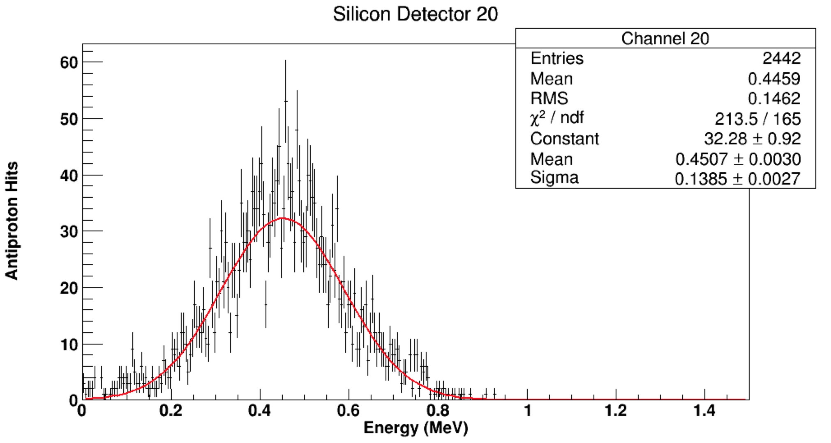
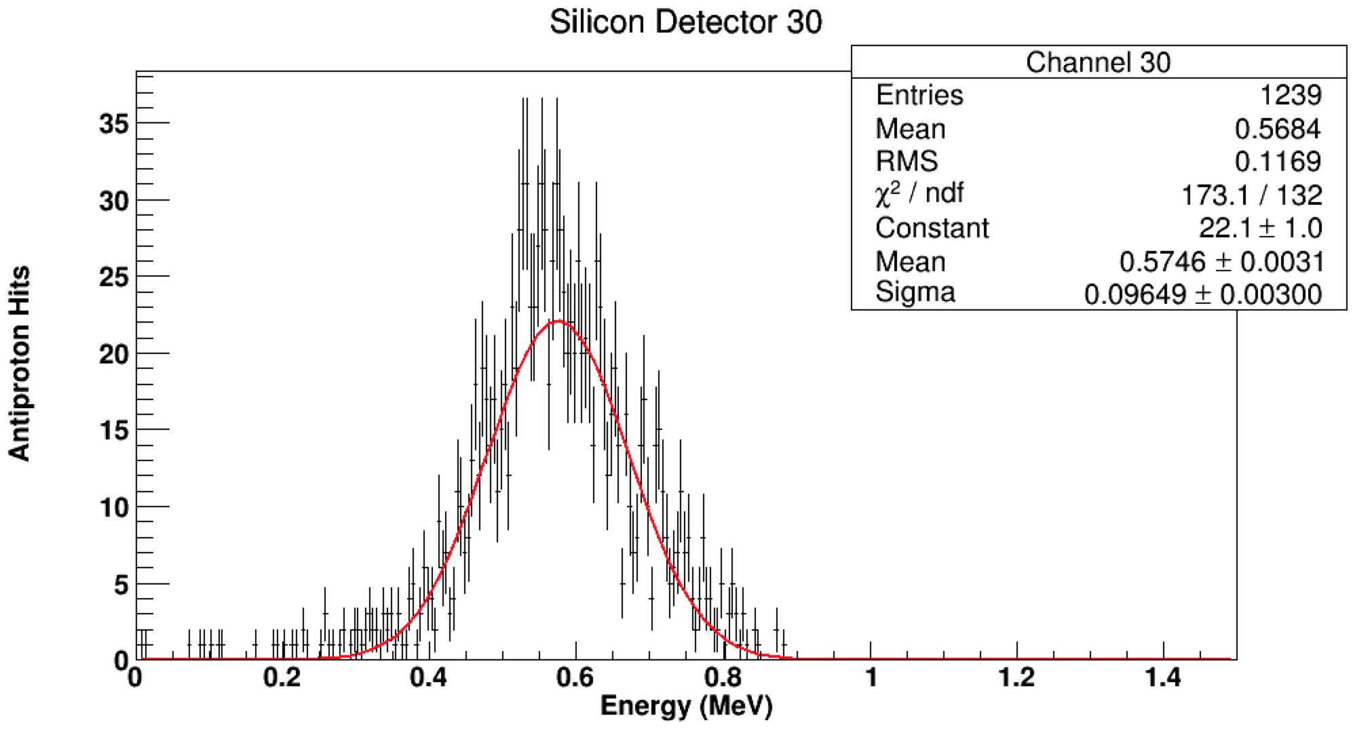
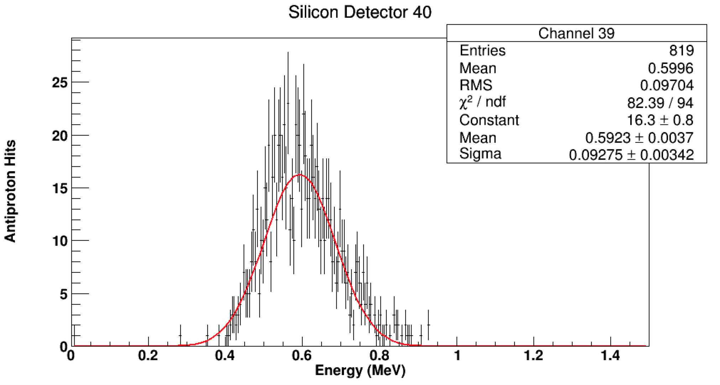

Slide 8
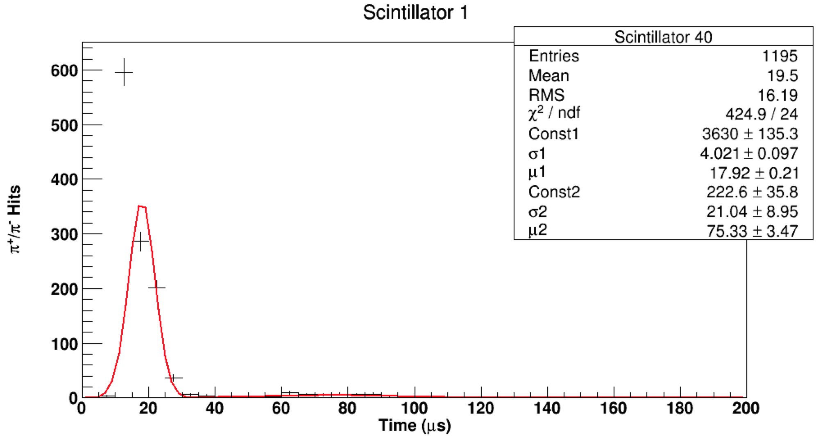
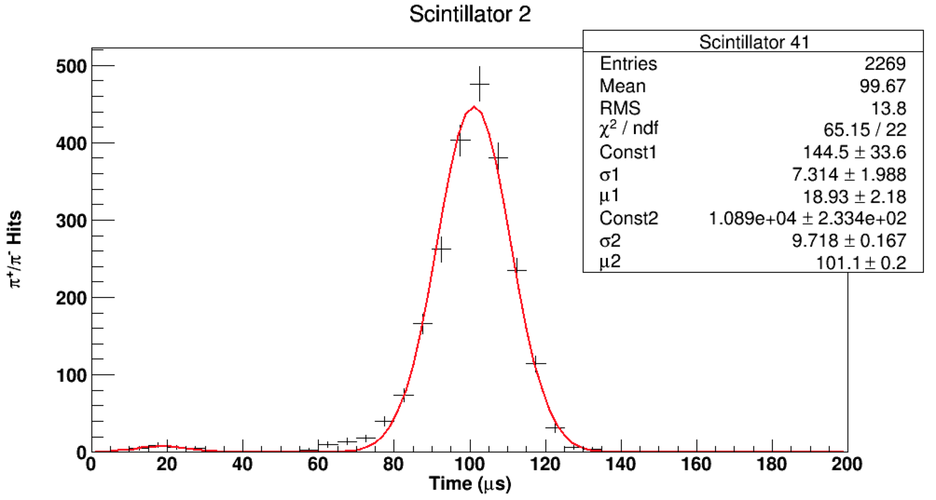

Slide 9
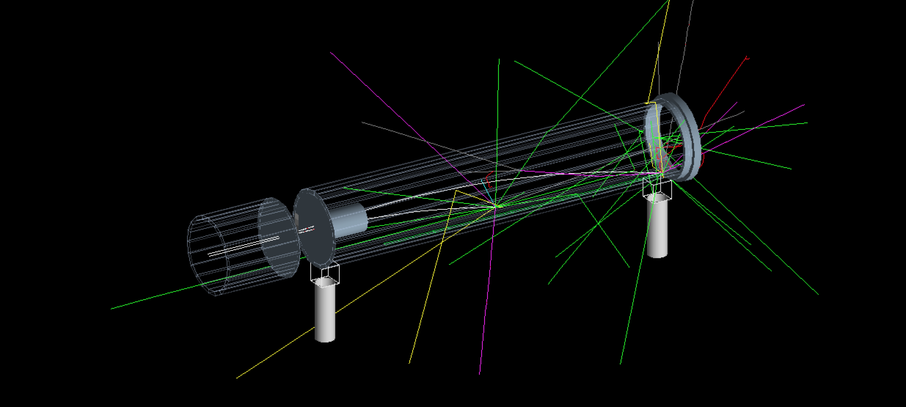
Goals
By running simulations, select the optimal thickness for both the constant and variable degrader
Create a detector (emulsion, lithium foil, etc. We’re not sure what we need to be measuring) for the end cap

