Slide 1
PS/SPD
Power Supplies
19 May 2014
Pascal Perret
LPC Clermont

Slide 2
ECAL Platform: Maraton
PS/SPD FE power supplies:
  0M05.0002M (+ OPFC.0001): 8+2
      12 Channel Maraton - (+5v/100A, 3v3/100A, -5v/50A, +5v/50A) - LHCb Calorimeter. Std type plastic input connector. For use in radiation tolerant crate applications:
        3 modules (6 channels)
    Could be re-used by ECAL/HCAL

Slide 3
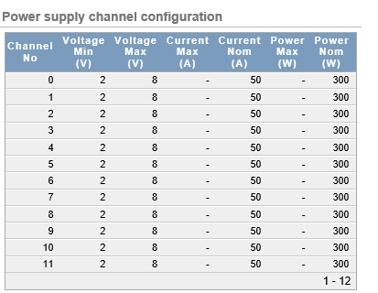
ECAL Platform: Maraton
PS/SPD VFE power supplies:
  0M22.0003 (+ OPFC.0001): 2+2
      12 Channel Maraton - 3U 19" power box, 385VDC input, 12 channel DC output, 2-8V, 300W nominal, 55A max, 50A continuous, analogue controlled interface. Water cooled, no magnetic screening.
        6 modules (12 channels)
    Could be re-used by SciFi

