Slide 1

IPPOG masterclass working group
May 15, 2014

Slide 2
Building an IceCube Collaboration outreach activity
Inspired by the International Masterclasses for hands-on particle physics.
Pilot project for 2014
  Five IceCube institutions: Universität Mainz, Germany; University of Delaware in Newark, DE, US; Université Libre de Bruxelles, Belgium; Vrije Universiteit Brussel, Belgium; and WIPAC at the University of Wisconsin–Madison, WI, US
  Almost 100 students, mostly 11th & 12th graders (two years before college)
  One analysis: replicate the analysis of first evidence for an astrophysical neutrino flux published in Science, Nov. 2013

Slide 3
Masterclass approach and resources
We want students to feel like “I could be an IceCuber!”
Activities grow in complexity while addressing main ideas of the analysis:
  what is signal and what is background
  how to select signal
  are these events astrophysical neutrinos and what is the significance of the measured flux
  can we say where these neutrinos come from
  what can we do, what do we need to improve these results
Several resources developed: website, icebreaker activities, analysis activities, wiki space

Slide 4
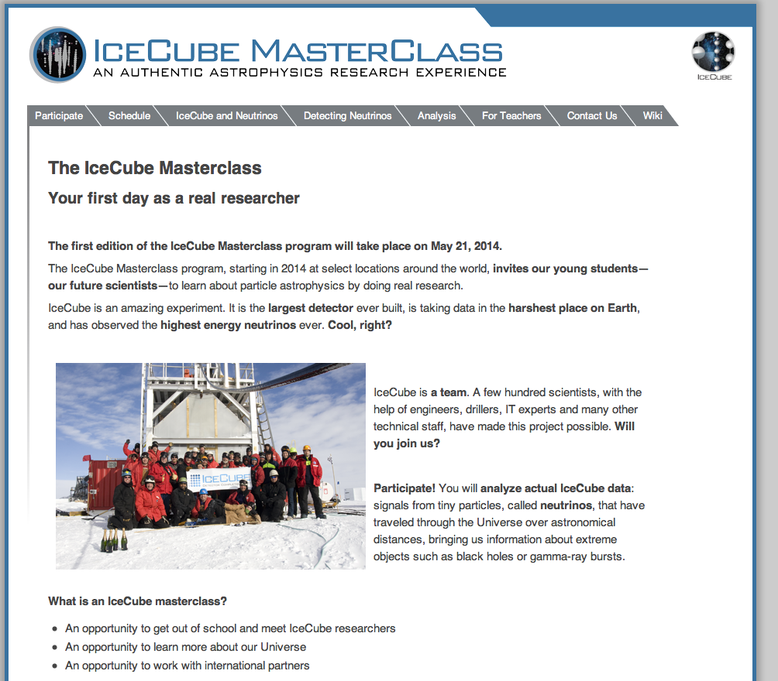

Slide 5
IceCube Masterclasses: future plans
Engage more institutions for 2015 IceCube Masterclass
Search for better dates. Consider joining the International Masterclasses.
Create multilingual content to enable a broader participation
Add a few more analyses to include other research results from IceCube: oscillations, dark matter or cosmic-ray anisotropy
Expand on developed resources to create classroom activities using IceCube research, both as extensions to the masterclass and as standalone activities.

