Slide 1
Spokesman’s update

Slide 2
Contents:
Update
Towards Step IV
RLSR and MPB
CM39

Slide 3
Update:
Spokesman’s update

Slide 4
Update:
Upstream spectrometer installed:
  See the video:
Coupling coil met its acceptance criteria:
  Can now move on to preparations for Step V;
Single-cell cavity:
  Now in MTA; testing can begin
Decay solenoid:
  New quench detector checked out OK;
  Power-supply change out can now start

Slide 5
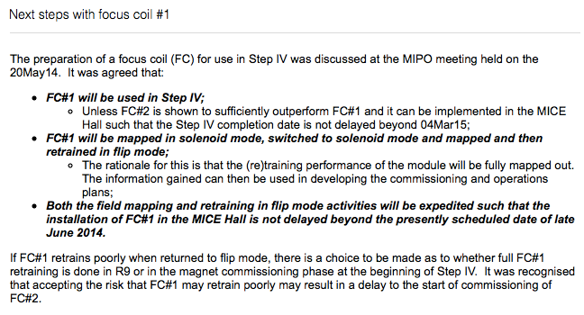
Update:

Slide 6
Towards Step IV
Spokesman’s update

Slide 7
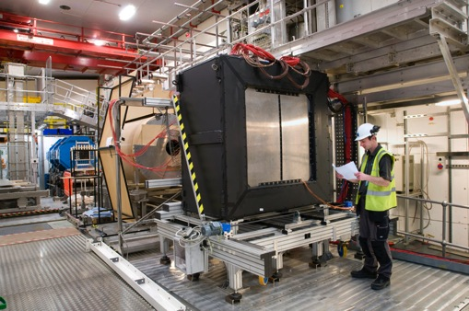
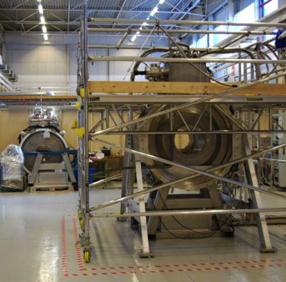
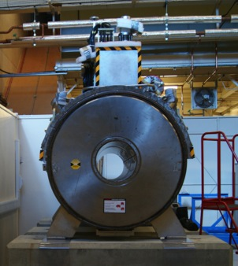
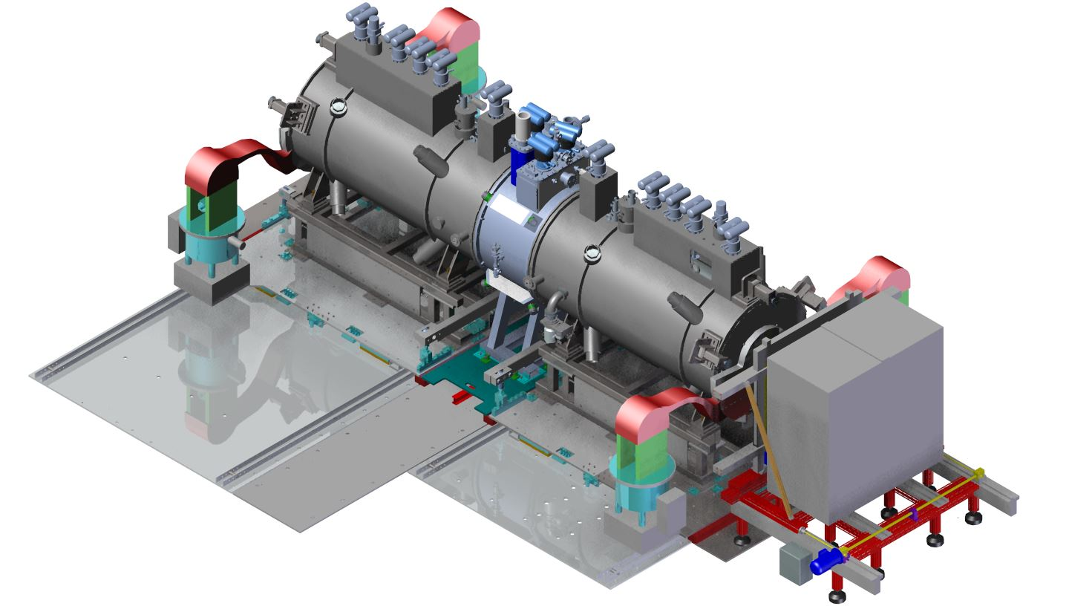
Step IV:
Spring ´15
Schedule shows Step IV construction complete s.t. running may start Spring 2015
  This is the priority;
    Must make every effort to:
      Preserve construction project schedule;
      Devise and implement S/w&C, Operations and Physics effort to match

Slide 8
Excellent discipline so far! Must keep to it!

Slide 9
RLSR/MPB outcomes:
Spokesman’s update

Slide 10
RLSR/MPB outcome:
Presentations and documents available from MICEmine:
  Follow Governance project
Reports from the two Panel/Board are there too
Hugely positive:
  Recognised/welcomed:
    Technical progress;
    Installation of equipment and services;
    S/w and computing status and progress;
    Physics and analysis progress;
    Progress in organisation
Some comments, then review of actions and recommendations

Slide 11
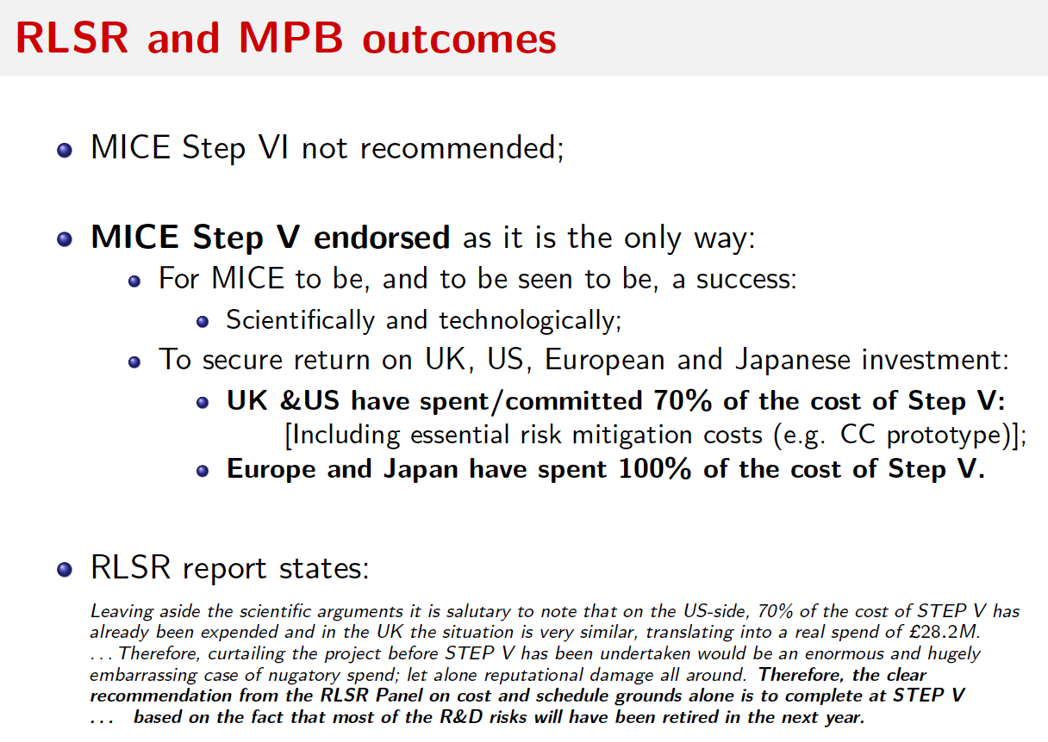

Slide 12
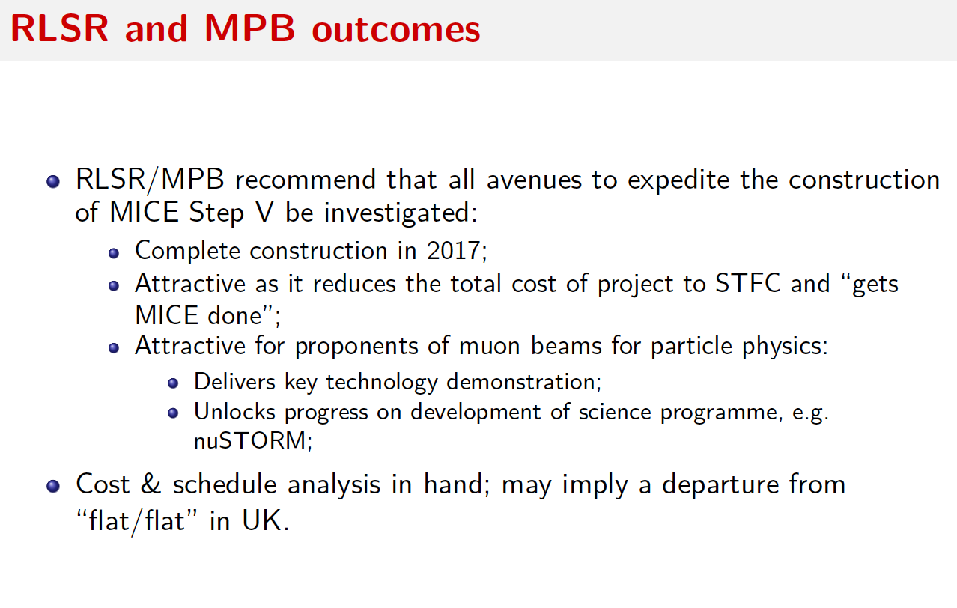

Slide 13
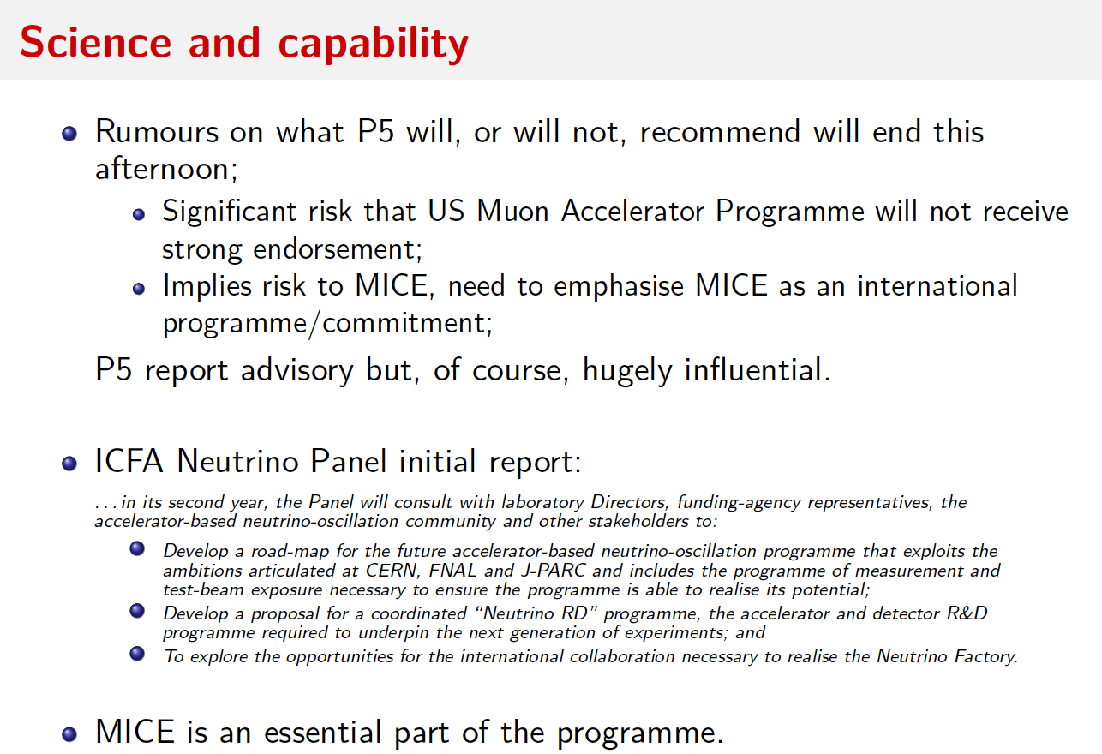

Slide 16
CM39
Spokesman’s update

Slide 17
CM39:
CM39:
  25—28 June 2014, St. Catherine’s College, Oxford;
  Block diagram (as last meeting):
    25Jun14: All parallel;
    26Jun14:
      Morning: parallel;
      Afternoon: plenary
    27Jun14:
      All plenary
    28Jun14:
      Before coffee: summary
      After coffee; to lunch: Executive Board
  Registration page:
    Almost ready. Will be circulated asap.

