Slide 1

Standard Model @ Hadron Colliders
III. Triple Bosons & Top Quark
P.Mättig
Bergische Universität Wuppertal

Slide 2
W mass result
D0 measurement same precision as previous world average
A huge achievement after 20 years of work!
High precision possible at proton colliders
Important constraint on Standard Model Higgs

Slide 3
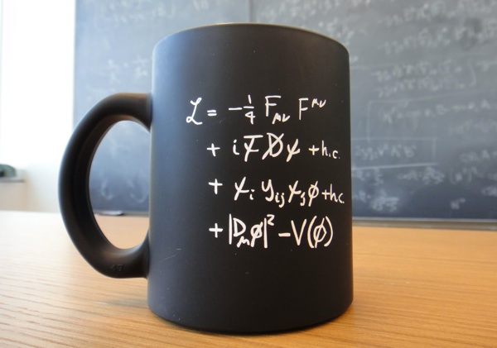
Into the heart of
gauge theories

Slide 4
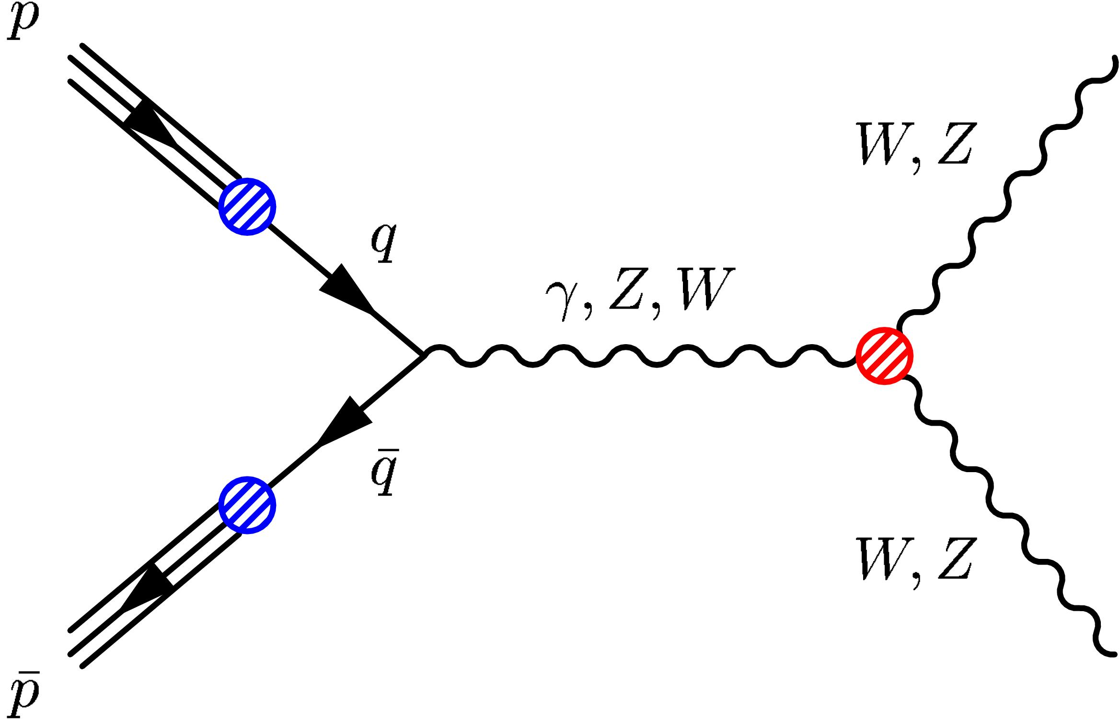
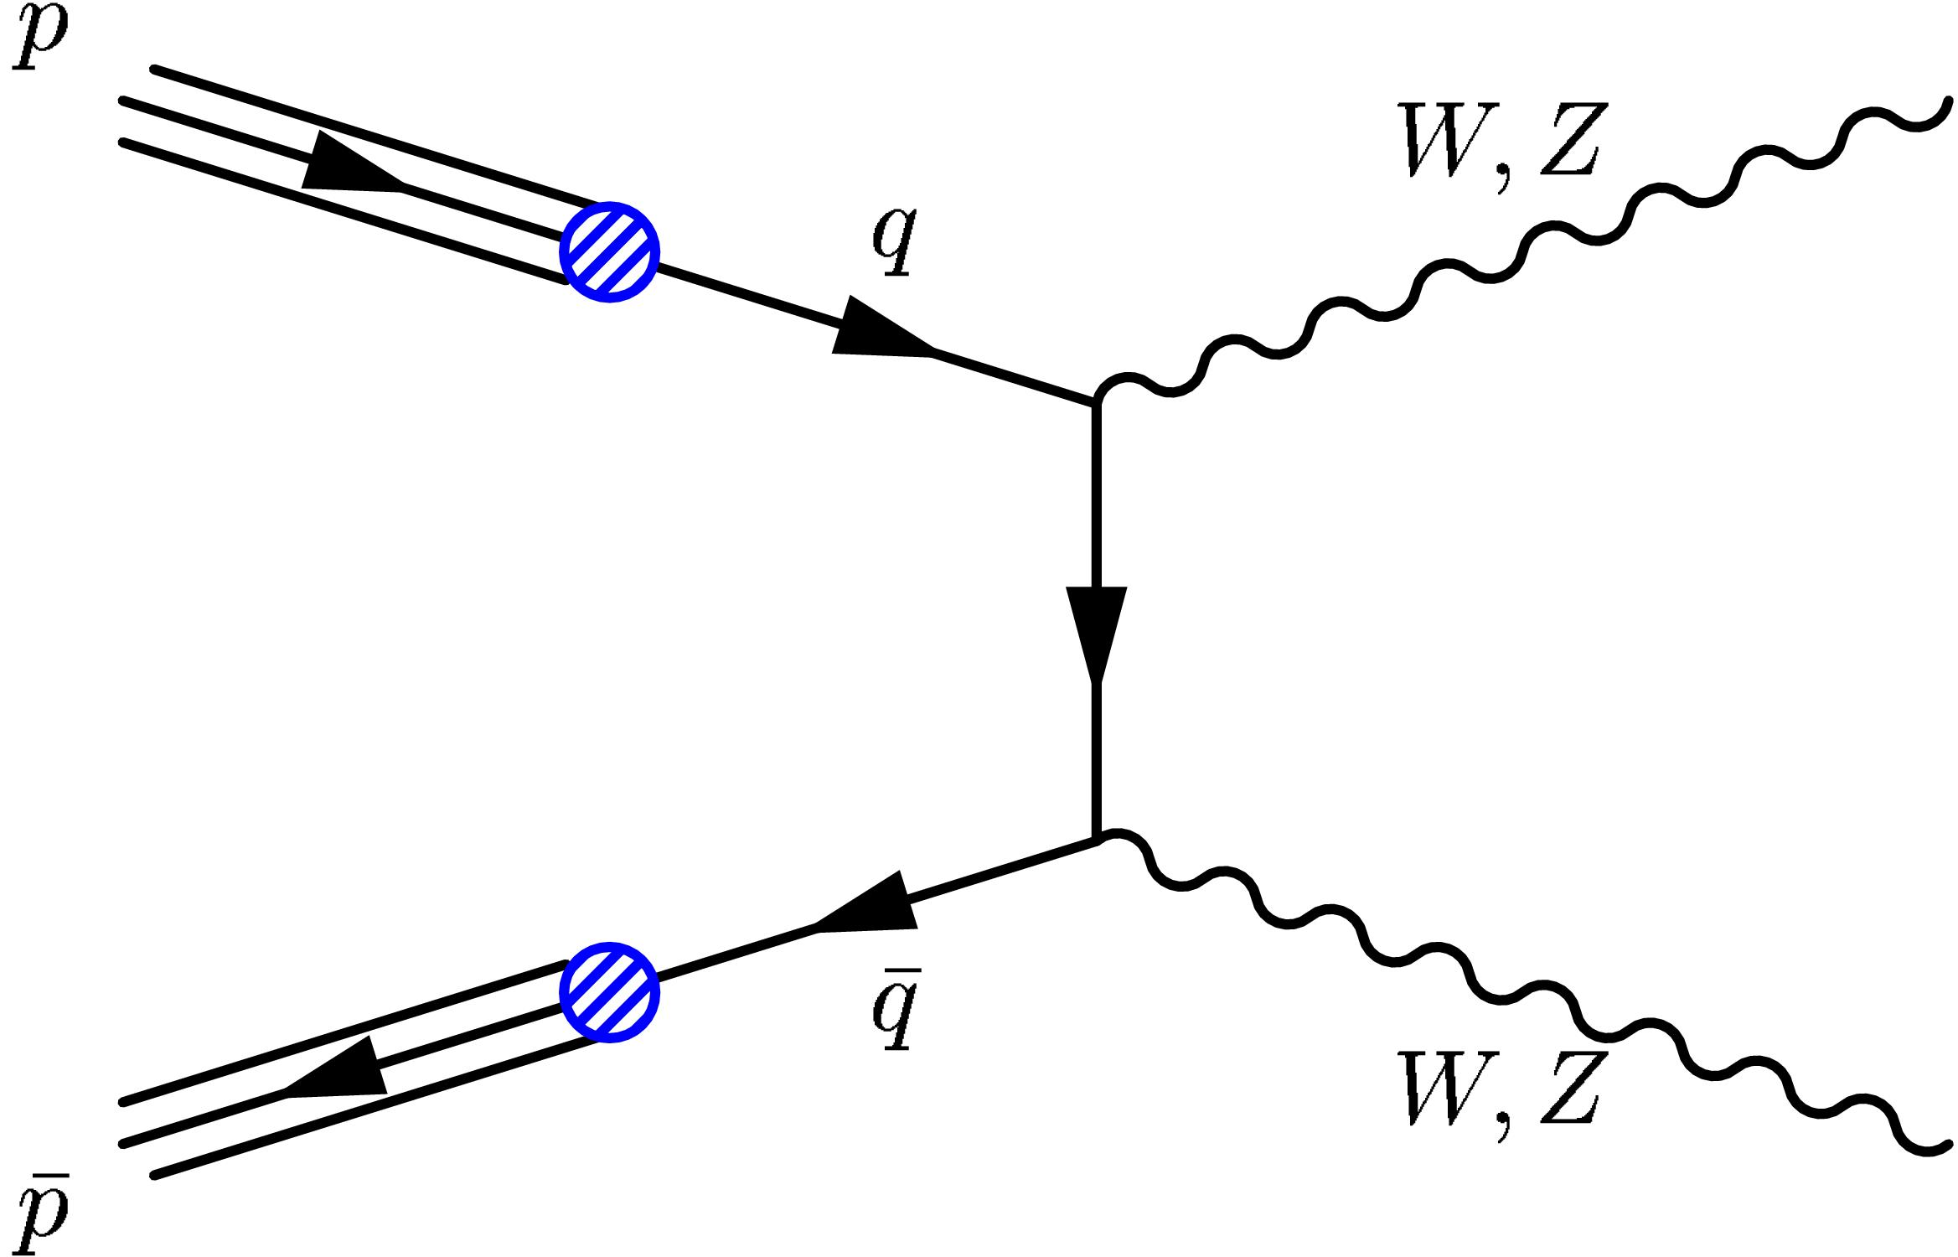
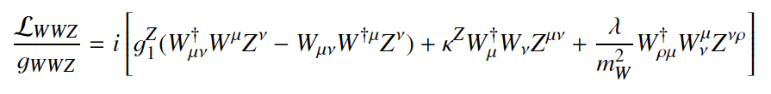
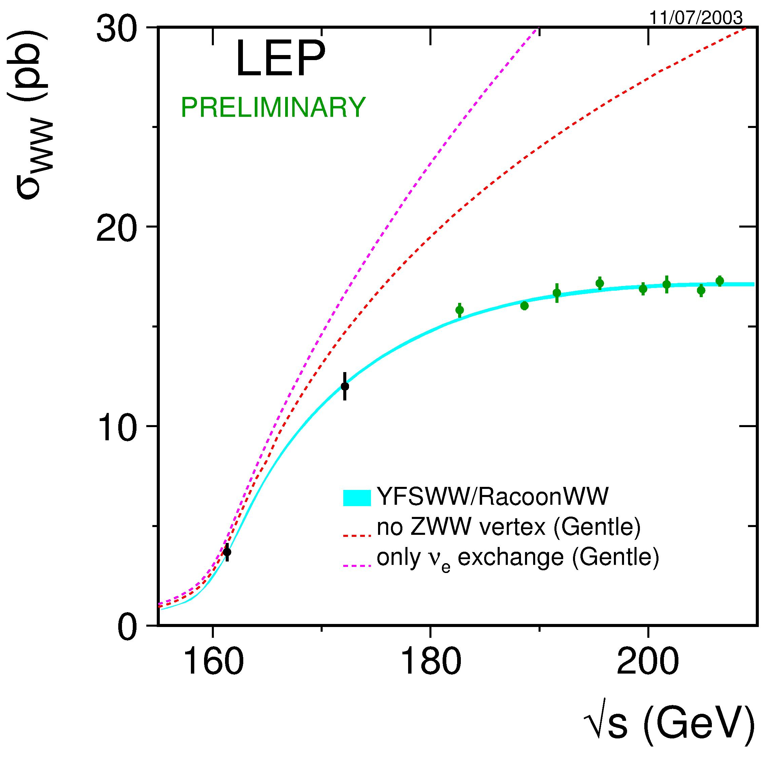
Looking for TGVs
(Triple Gauge Boson Vertices)
W – Boson weakly and electrically charged
➔ coupling to Z⁰ and γ
Very fine compensation of contributions
motivation to introduce Z⁰
Relates couplings to fermions and bosons
First measurements at e⁺e⁻ collider LEP
Onset of cancellation process seen
Quantify with ‘anomalous couplings’

Slide 5
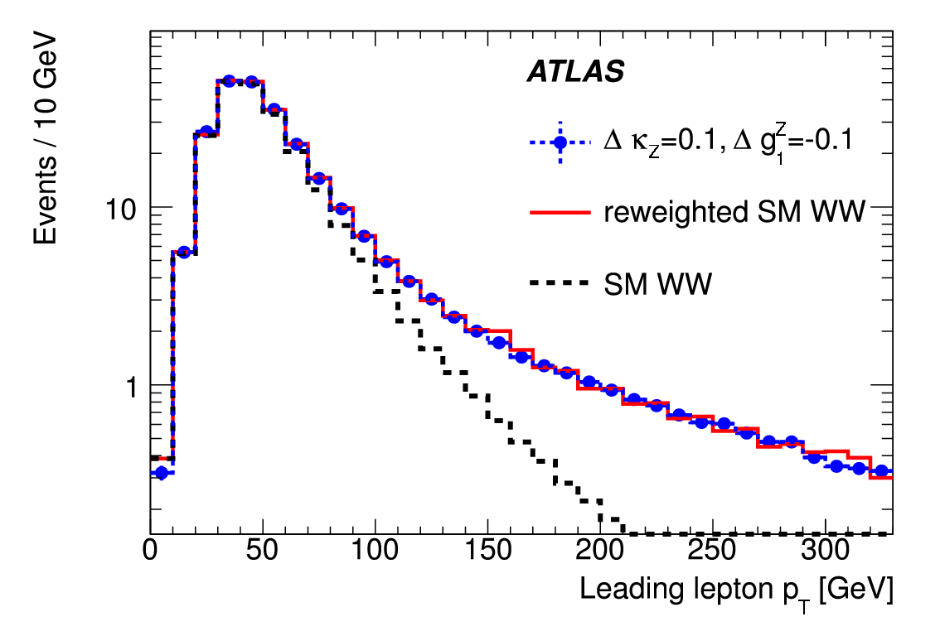
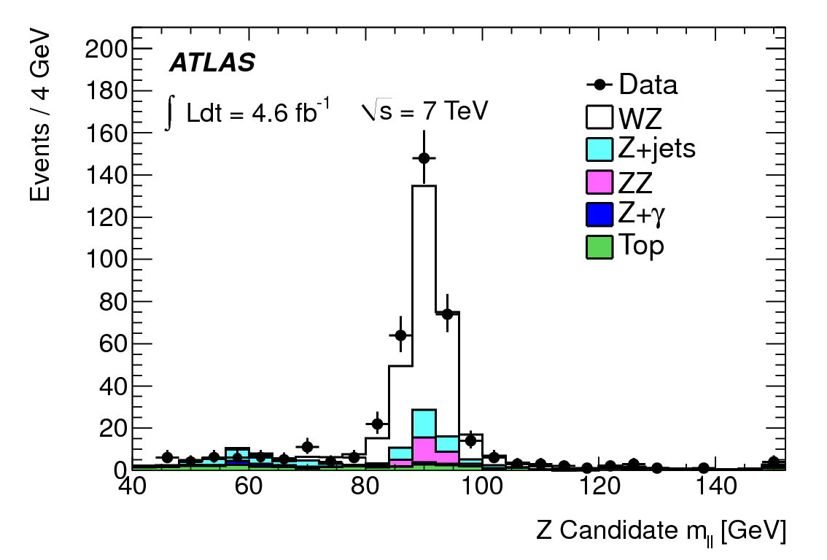
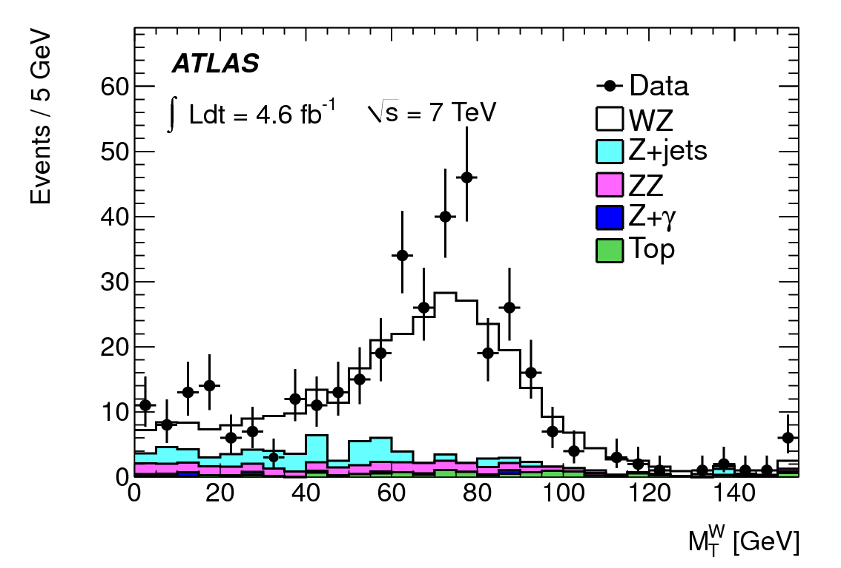
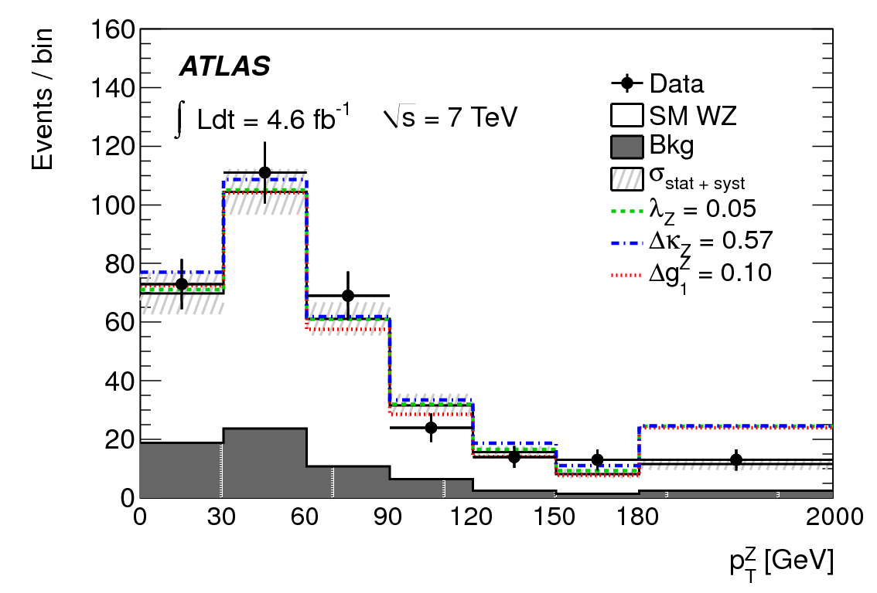
Signatures of anomalous couplings
Clearest signature in excess of events with high p_{T}
Selection of ZW events: three hard leptons + missing E_{T}
Step 1: Z⁰ ➔ e⁺e⁻, μ⁺μ⁻ Step 2: transverse mass Step 3: p_{T} of Z

Slide 6
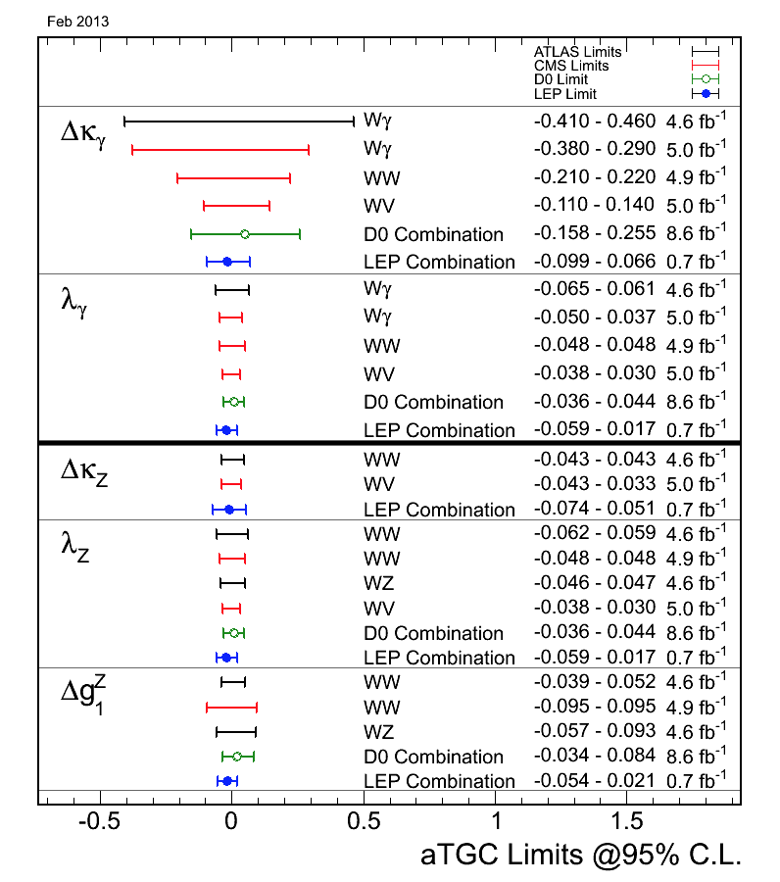
Anomalous 3 – boson couplings
Measurements agree with Standard Model expectation
Sensitivity to possible deviations at LHC approaches LEP: a few %
Increased statistics and higher energies during the next years will significantly boost precision

Slide 7
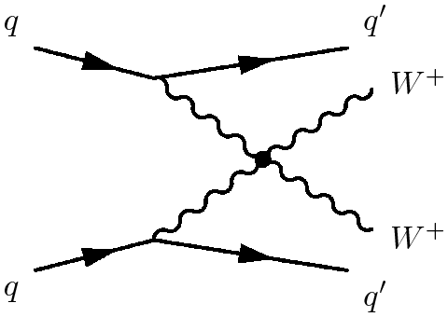
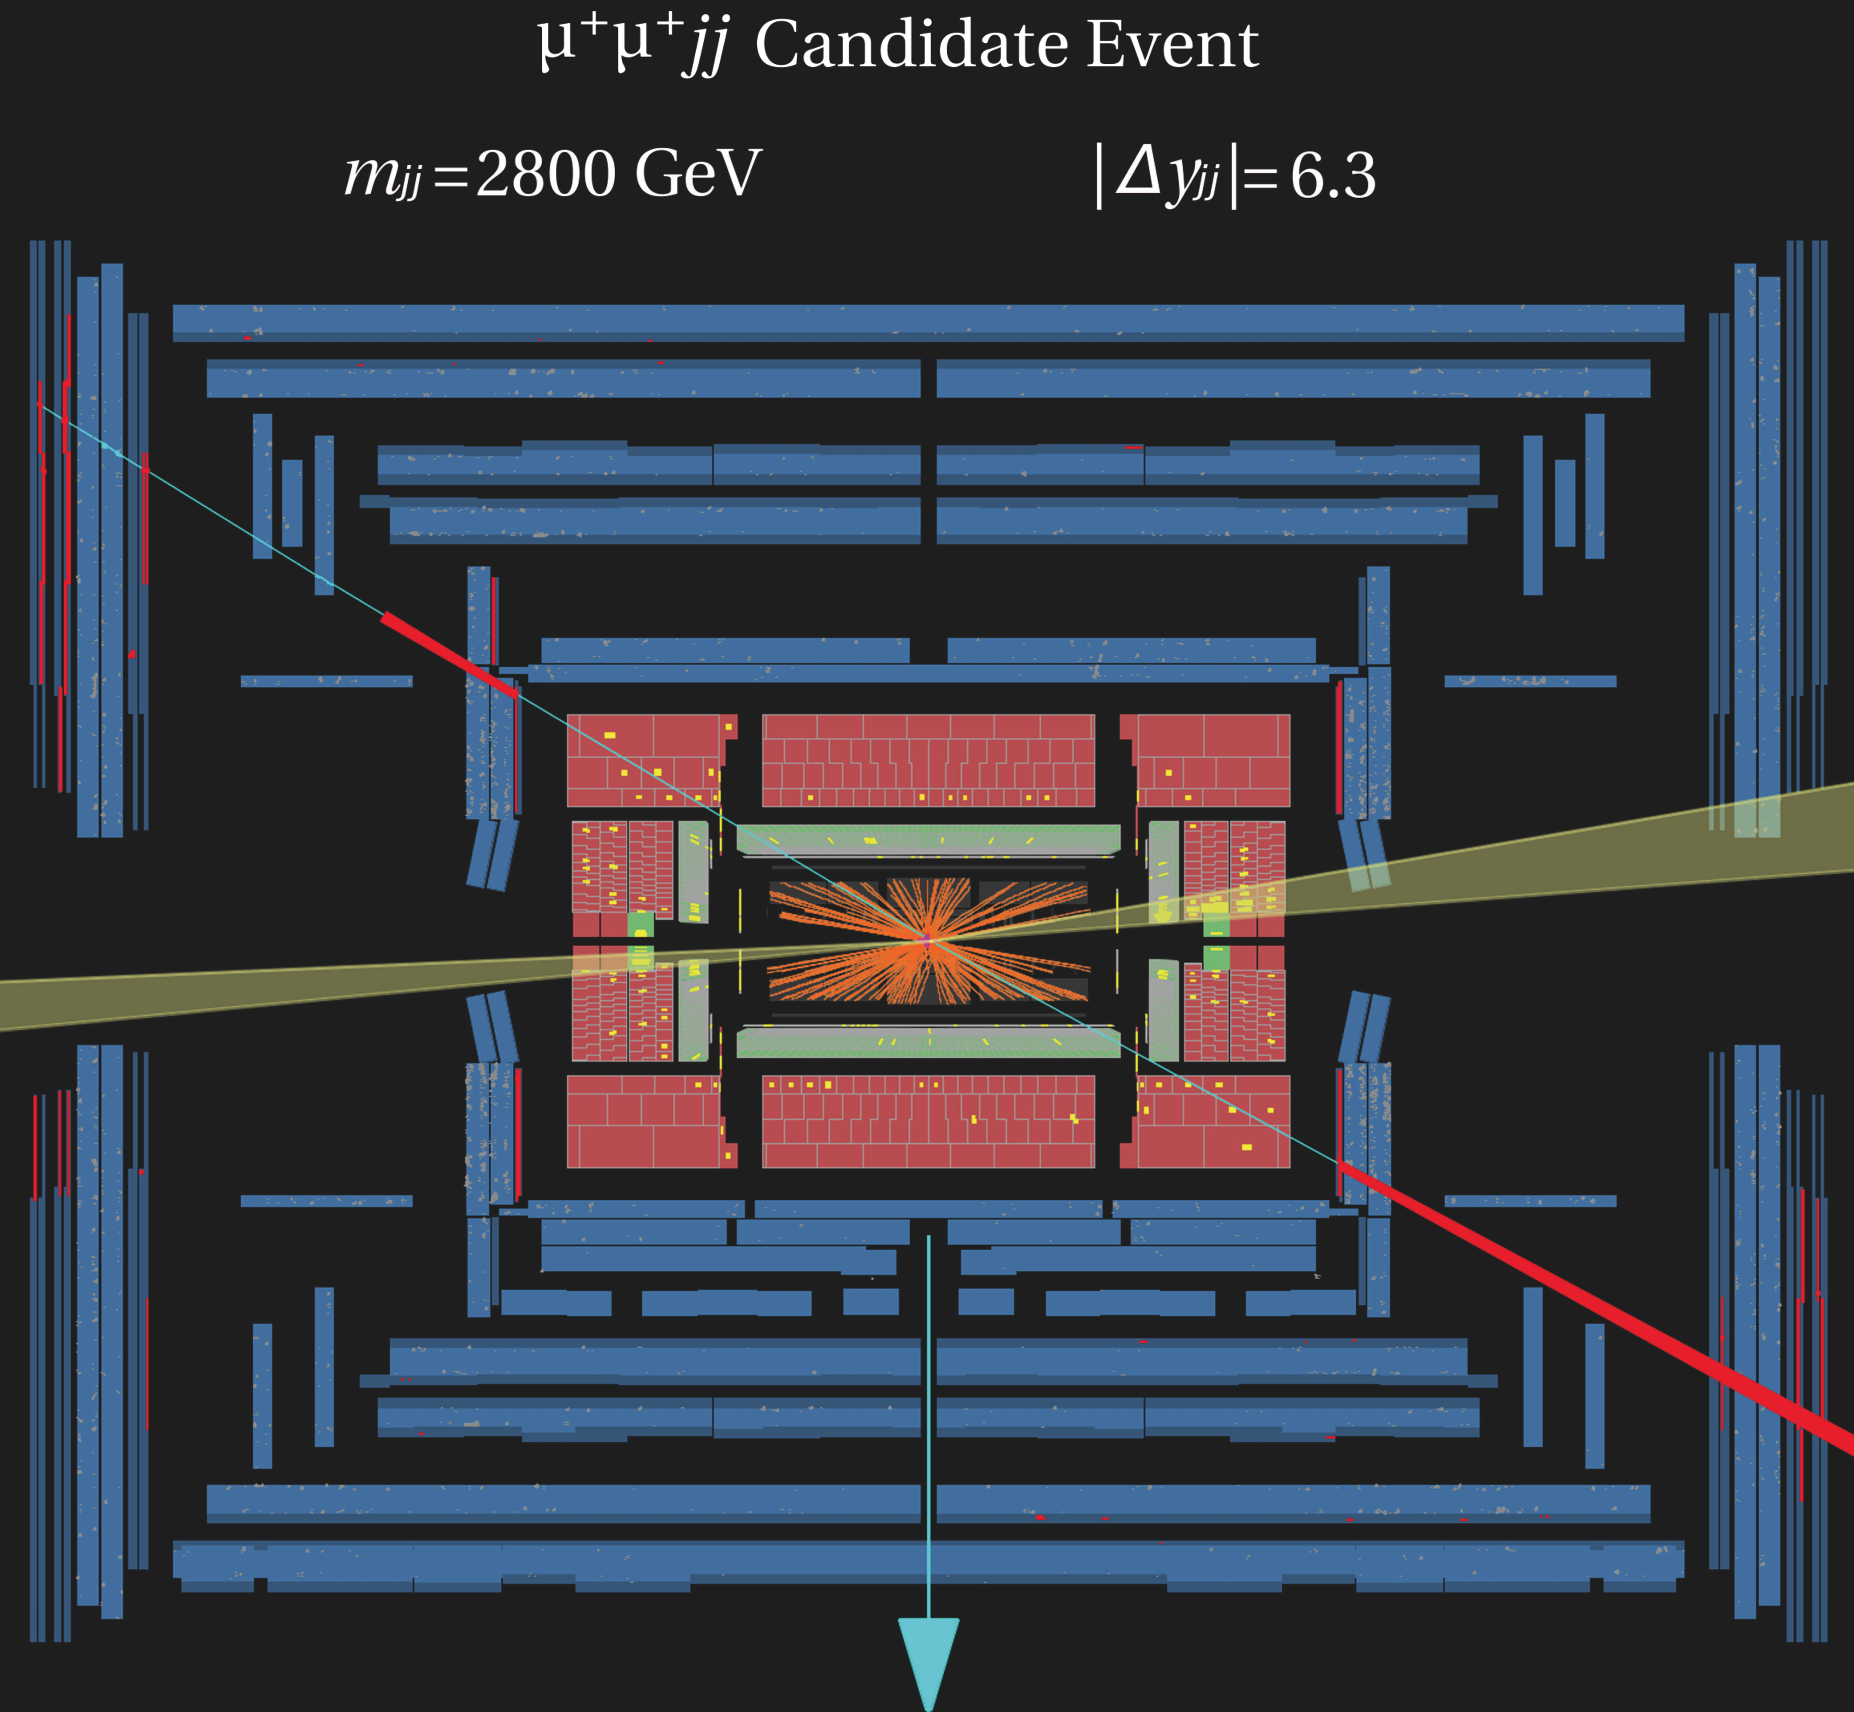
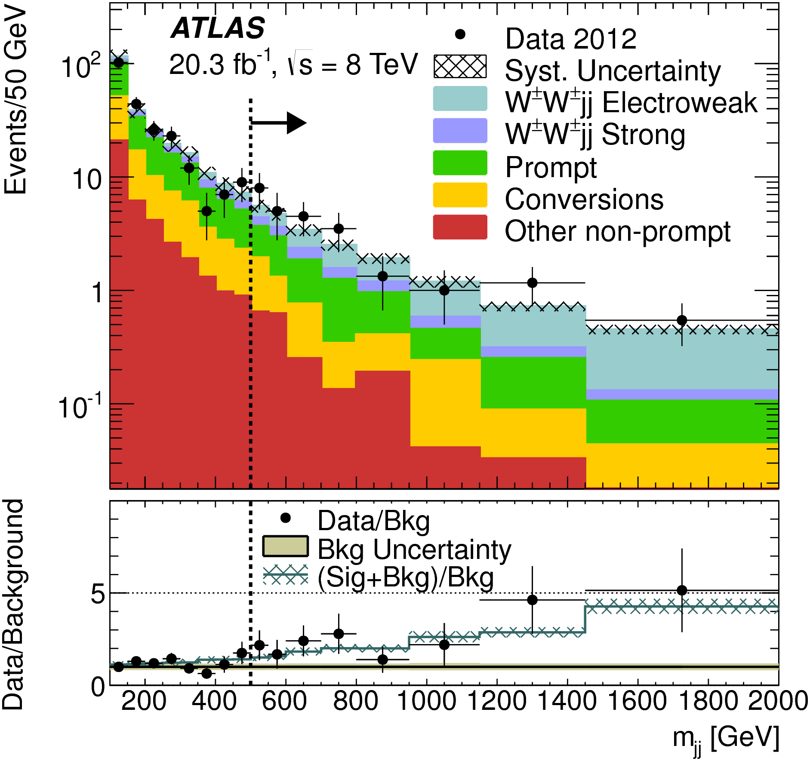
Special interest: W pairs from VBF
1960s: event rate for W_{L}W_{L} ➔W_{L}W_{L} explodes at 1.2 TeV
Higgs boson should cure this: theory works fine
Forward going jet
W – boson
fusion
Forward going jet
Require
high jj mass
+
high |Δy|
Expected background: 16.9
Expected WWjj: 15.2
Observed nb. Events: 34
➔ Evidence for VBF

Slide 8
Testing electroweak theory at LHC/Tevatron
Millions of Z⁰, W± allow tight constraints on
pdfs, strong interactions
Electroweak theory probed at multi – TeV scale: no deviation found
The mass of the W boson improved by
factor 2
Precision of Vector boson self interactions
(triple, quartic) will soon superseed LEP

Slide 9

Top quark
Basic facts

Slide 10
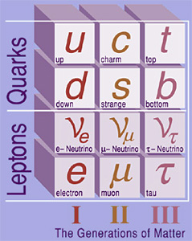
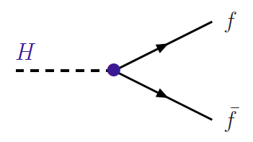
The mysterious top quark
Top quark: no internal structure
but heavy as a gold atom
i.e. coupling strength to
Standard Model Higgs Boson
➔ λ _{t} = 0.996±0.006
Suggests a special role of top quark?

Slide 11

A constrained giant?
Top quark has same role as up-quark
(electron, ν) …..
All are ‘matter’ particles, but
Does the top quark have the same properties as light fermions?
Coupling strengths to photons, gluons, W – bosons?
Charge
Weak parity violation
.......

Slide 12

A brief history of the top quark
Known to exist since 1973 ➔ search for 20 years
Phenomenological prejudice: around 15 GeV
(ss) = 1 GeV, (cc) = 3.1 GeV, (bb) = 9.4 GeV, ➔ (tt) = 30 GeV ??
motivation for several accelerators:
PETRA/PEP, TRISTAN, SppS, LEP, ....
No signature found!
Observed in 1995 at Tevatron,
a few 1000 top‘s collected
LHC currently produces ~ 50000 tt events/day
In net years: close to 1M/day

Slide 13
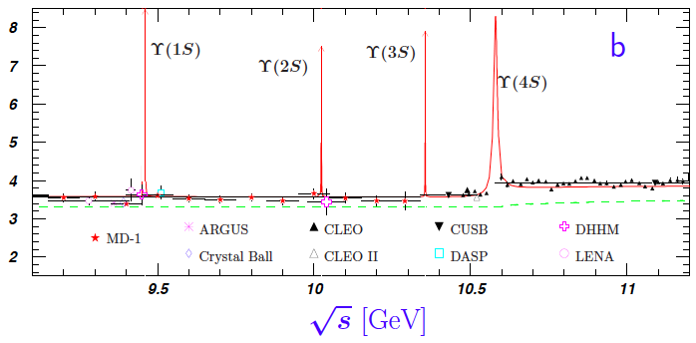
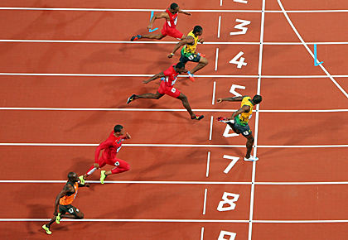
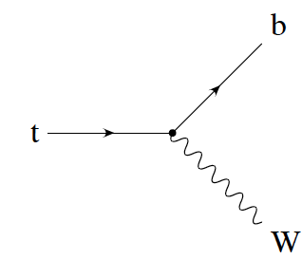
Phenomenology of heavy top
For lighter quarks:
strong interaction >> weak interactions
➔ colour neutral hadrons
competing interactions:
who‘s faster?
t
t
g
b
b
For top quark: strong interaction < weak interactions
➔top quarks decay before hadrons formed, ‚free quark‘

Slide 14
Phenomenology of heavy top
Decay properties of top quark unambigously predicted by SM
Decay fractions largely determined by fractions of W – decay
tt ➔ (only) 6 quarks
largest fraction, very high background
tt ➔ 4 quarks, charged lepton, neutrino
Some 30% ‚usable‘, low background
FAVOURED channel
tt ➔ 2 quarks, 2 charged l, 2 neutrinos
Only 5% ‚usable‘, very low
background, difficult to reconstruct
99.1% of all top quarks decay into a bottom quark!

Slide 15
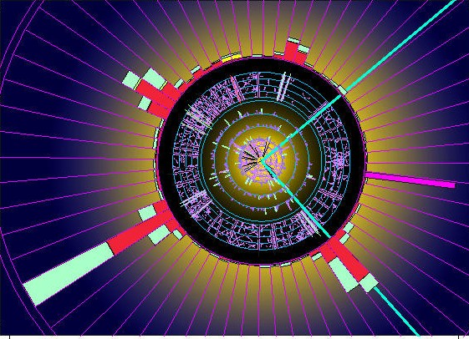
A semileptonic tt event

Slide 16

Surveying the top quark

Slide 17
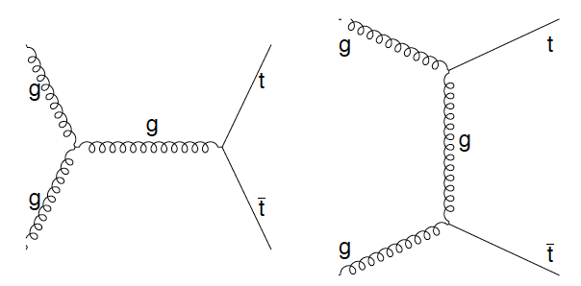
tt Cross Section
Test of QCD with massive quarks
Measure coupling strength gtt
Event selection
4 high p_{T} jets
isolated electron/muon
missing transverse energy
What fraction of tt events are retained after selection
Luminosity:
How many proton collisions?

Slide 18
Cross section determination
Experimental precision depends on how well
- background, efficiency, luminosity can be controlled
Key issue determine efficiency
Largest uncertainties:
modelling of top
parton distribution fct.
Background yield
Jet energy scale
selection efficiencies e, μ
Log σ
Selected p_{T} range
True jet p_{T}
Modelled p_{T}
Jet pt
Experimental uncertainty ∼ 2.3%
Luminosity uncertainty ∼ 3.1 % Total uncertainty 4.3%
Beam energy ∼ 1.7 %
Improvement by factor 2 – 3 within a year!

Slide 19
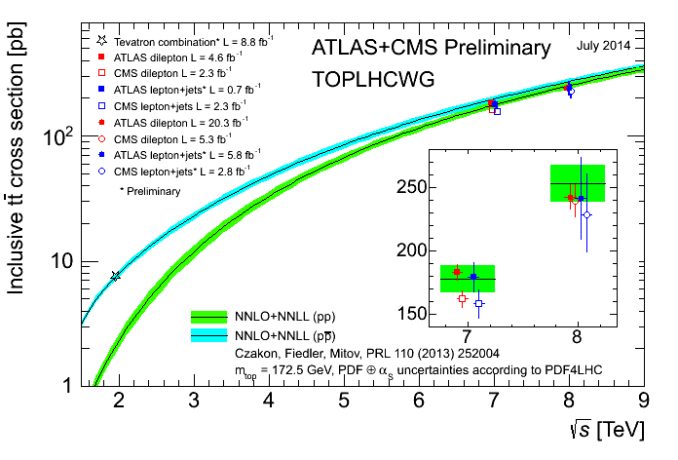
Cross section measuremnt
Theoretical uncertainty <5 % (significant improvement last 10y)
Theory & experiment uncertainty about equal
Very good
agreement
between data
and expectation

Slide 20
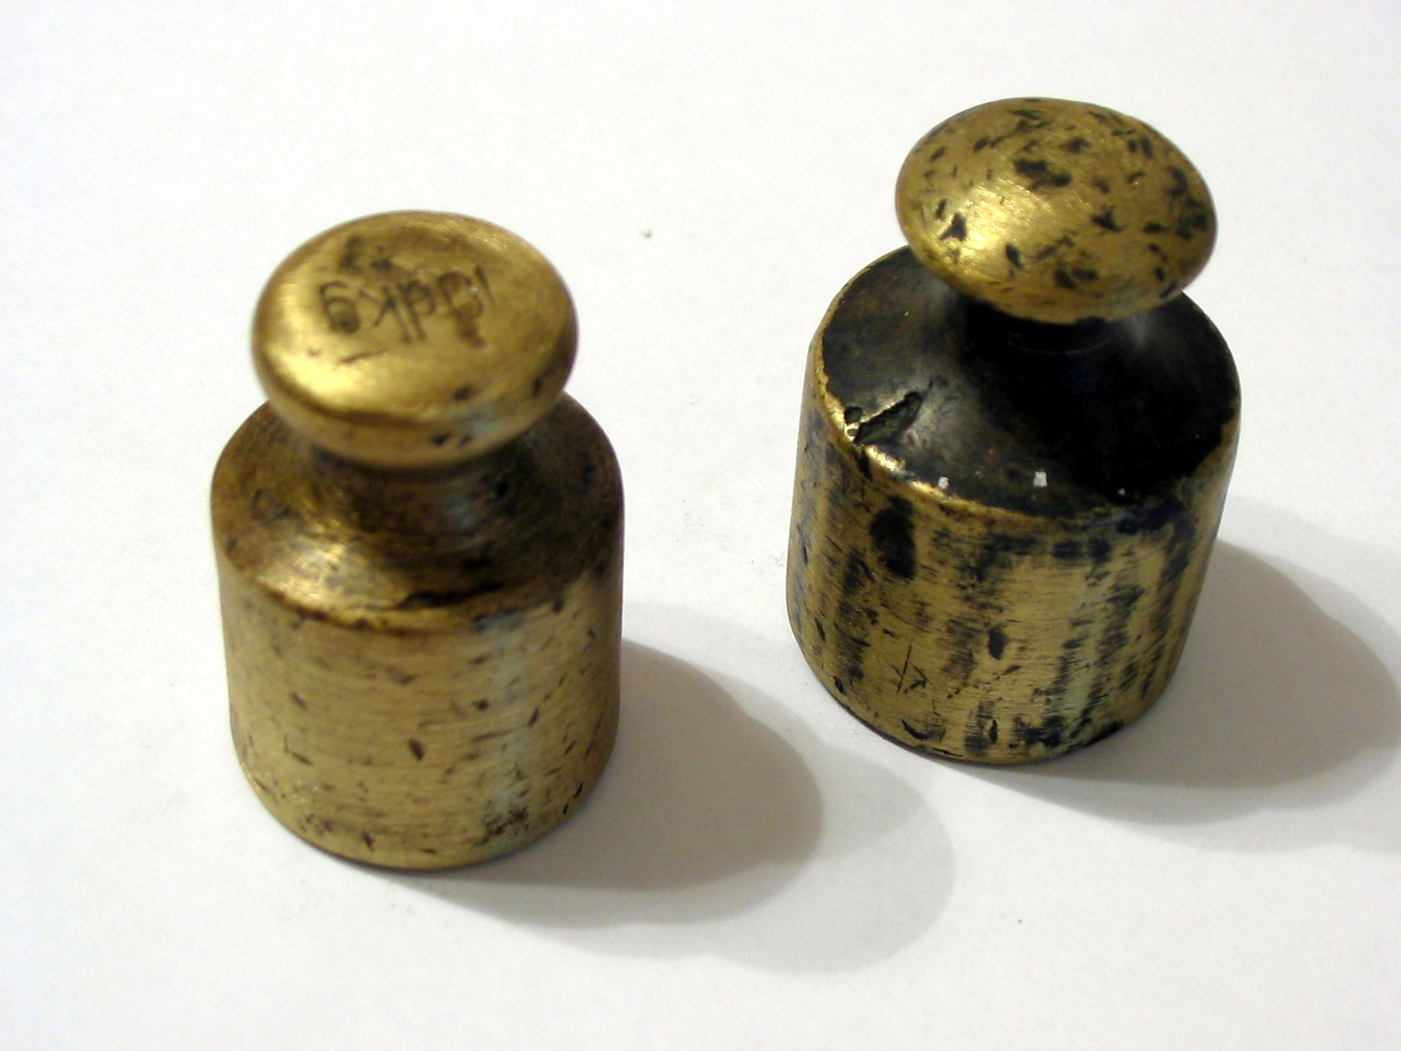
Weighting the top quark

Slide 21
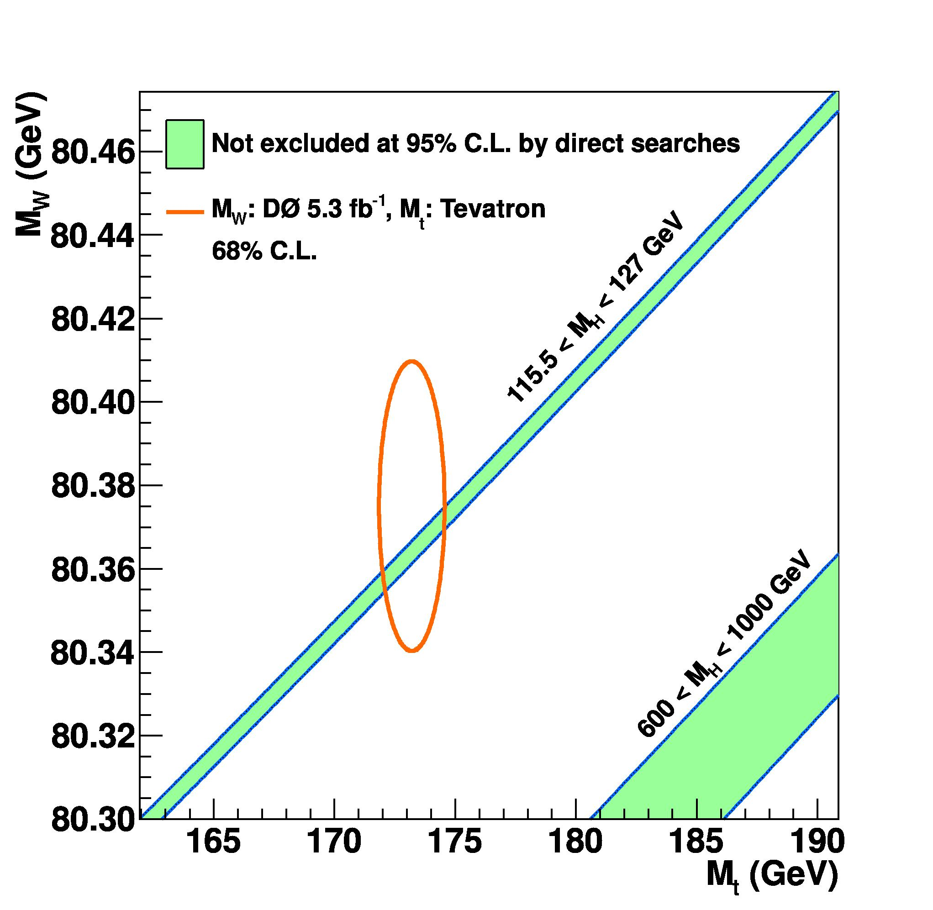
Mass of the top quark
A fundamental parameter of the Standard Model
A broad spectrum of decays and methods
Note: first time a quark mass can be
measured directly
(Lighter quarks to be inferred indirectly from hadron masses)

Slide 22
Top mass from l+jet decays
Favoured topology: tt ➔ 4 Jets (2 b –jets) + e/μ + ν
The problems:
How to get the z – component of ν
Out of 4 (or more) jets: which jet belongs to which top?
What is the energy scale of jets (and electrons)

Slide 23
Problem 1: p_{z}(ν)
Constraint from W - mass
Note: ν – mass completely negligible
Quadratic equation ➔ 2 solutions
physics: in 70% the solution with smaller p_{z} correct

Slide 24
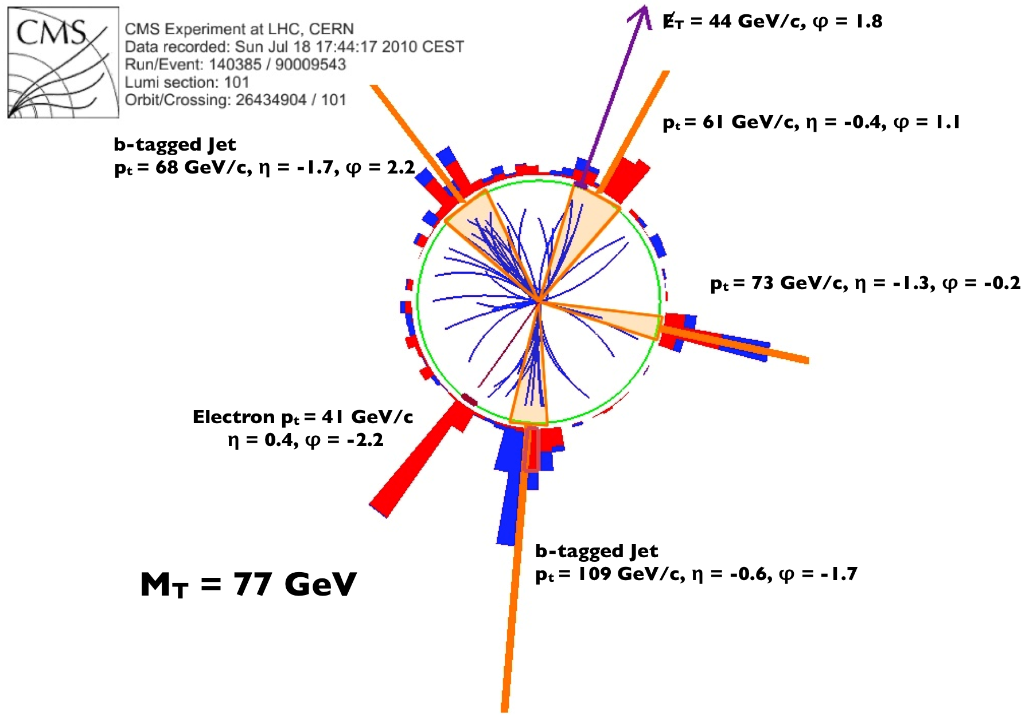
Problem 2: which jets?
Two facettes:
if more than 4 jets (initial state rad.)
mostly jets with highest p_{T}
if exactly 4 jets: which belongs to
which top quark?
4 jets ➔ 4 possible assigments
(j_{A}j_{B}J_{C}/j_{D}, j_{A}j_{B}j_{D}/j_{C,} ....)
Note: if b – jets identified, reduced to 2 possibilities
Important constraints
mass (jjj) = mass(jlν) (= M_{t})
mass (jj) = M_{W}

Slide 25
Problem 3: jet energy scale
Measure signals in calorimeter ➔ derive jet energy
Implies uncertainty!
➔ relates directly to top mass
Top – quarks offer ‚self calibration‘
M(jj) has to be equal M_{W}
change JES such that fulfilled
Still dominant uncertainty of M_{t}

Slide 26
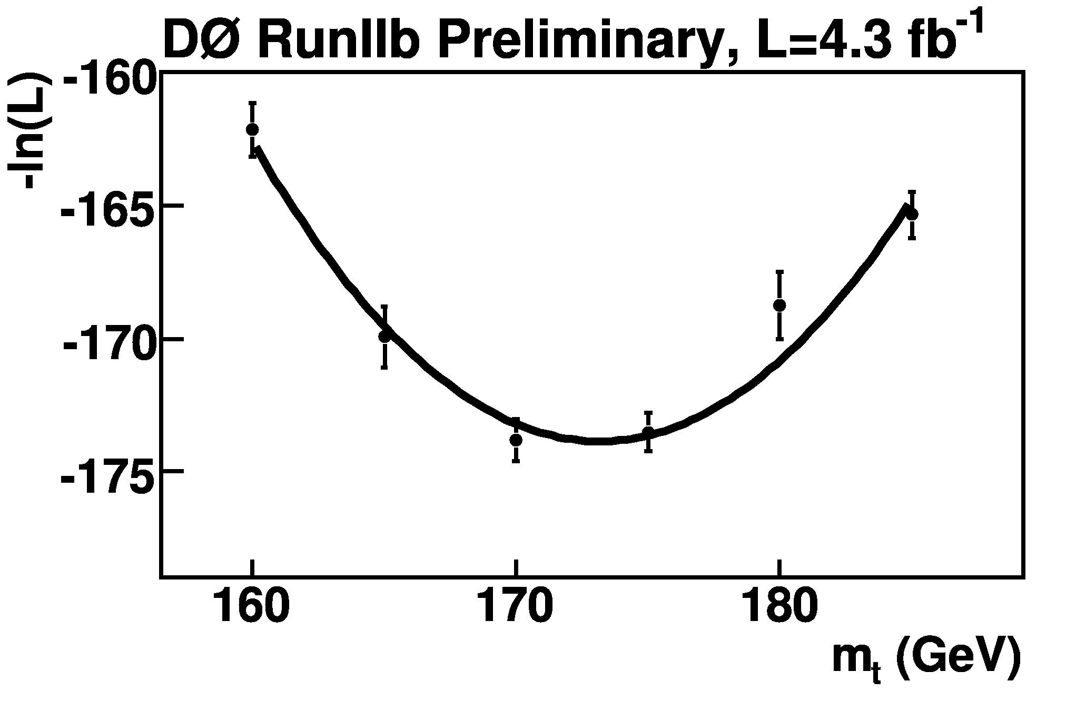
Use all information
Theoretical pred with
M₁(top)
Convolute with experimental effects
w₁
Theoretical pred with
M₂(top)
w₂
Sum over all events and find combine weights
......
Find M(top) with maximum weight
Recent CMS: 172.04±0.19±0.75 GeV
statistical & systematic uncertainty

Slide 27
Measurements of M_{top}
Combination of all measurements (March 2014)
173.3 ± 0.3 ± 0.7 GeV
0.4% precision!
Caveat:
Relation to ‘theoretical’ top mass somewhat uncertain
due to QCD models
Other methods developed

Slide 28
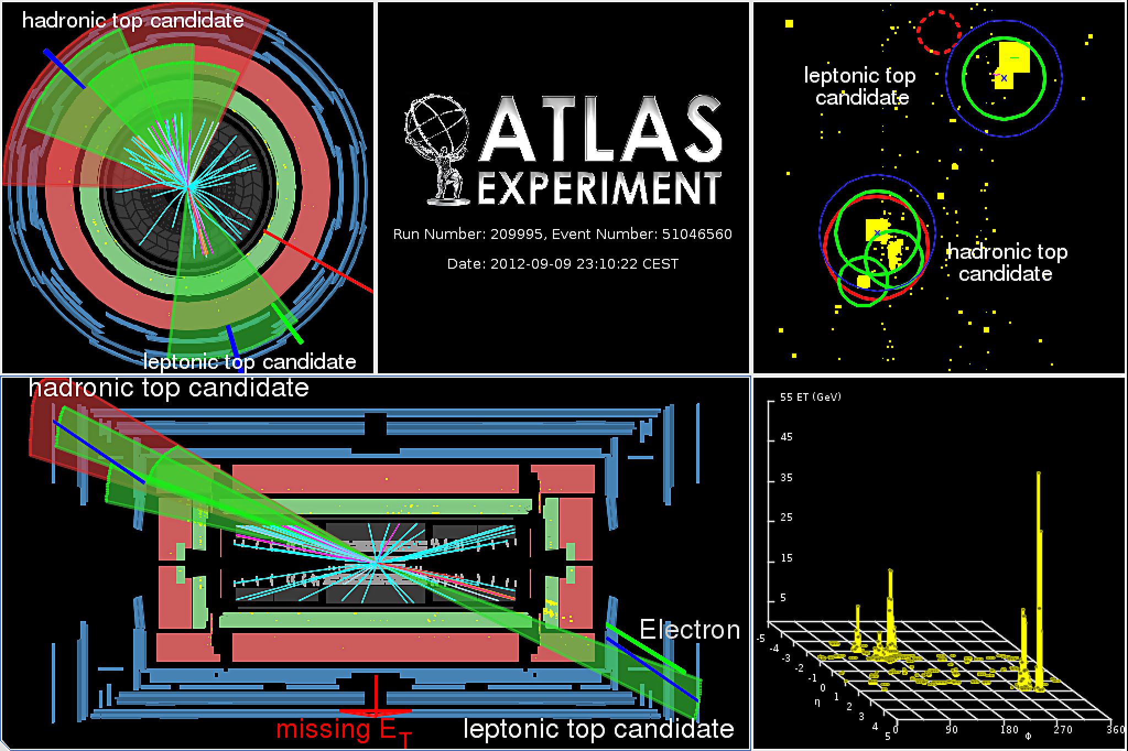
Top Quarks at Highest Energy
Top production at TeV energies:
Deviations from Standard Model?
Decay t →bqq at high p_{T:}
quarks tend to merge in one jet
Low p_{T} selection to be modified
One ‘Fat’ jet with substructures
Lorentz Boost
Several partons merge into a single jet

Slide 29
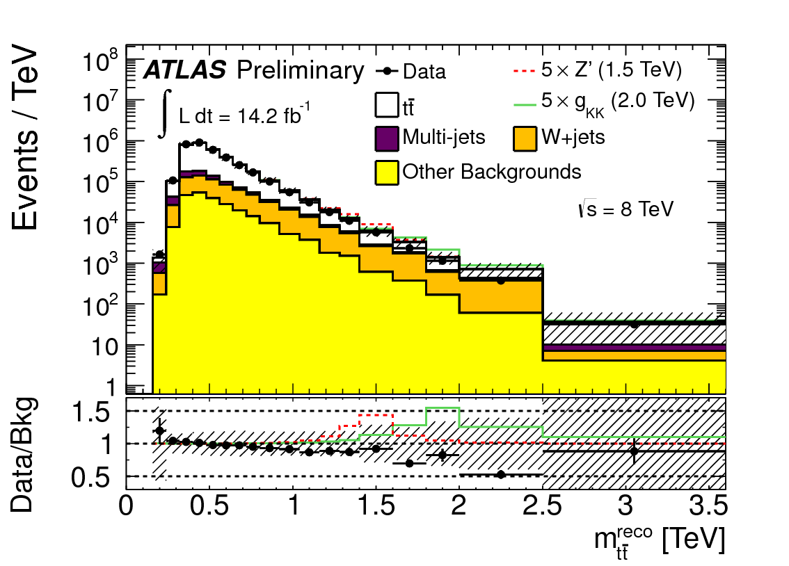
Searching for a tt - resonance
tt masses up to 3 TeV
well described by
Standard Model
strong interactions
Sensitivity to new ultra - heavy particles
X → tt
Postulated in many BSM scenarios
➔ at this stage no new particle observed

Slide 30
Testing top quarks at LHC/Tevatron
Proton colliders only source of information
Measurements and theory of cross section
by now uncertainty of ∼ 5%
Top mass directly measured to 0.4%
Theoretical interpretation limiting?
Top decays and production show no
deviation from SM expectation

Slide 31
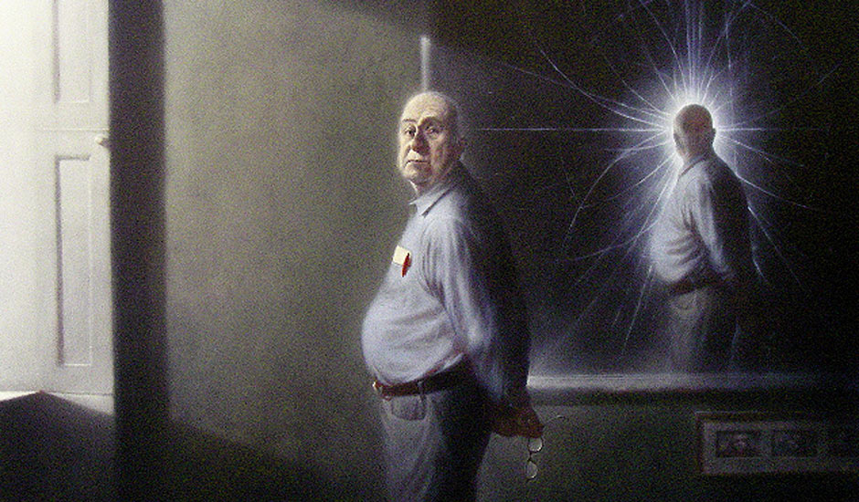
The Higgs mechanism - basics

Slide 32
Electroweak symmetry breaking
Masses of bosons and fermions (w/o new mechanism)
In conflict with local gauge invariance
Both for fermions and vector bosons
Also: boson masses lead to
a. infinite cross sections W_{L}W_{L}→ W_{L}W_{L}
b. or a strongly coupling between W‘s ➔ many W‘s, .....
Way out: introduce new scalar (spin 0) particle

Slide 33
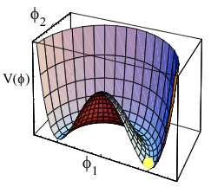
The solution ‚Higgs mechanism‘
The Standard Model answer:
Higgs fields
gives mass to bosons
provides means for fermion mass
implies elementary physical particle
gives mass to Higgs Boson
NOTE: no prediction of masses!
Introduce potential (by hand)
Two unknowns: λ, μ
Mass of W
Mass of Higgs
Mass of fermions
v: ‚vacuum expectation value‘
M_{W} ➔ v = 246 GeV

Slide 34
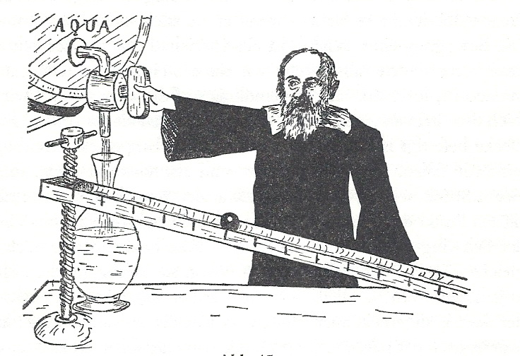

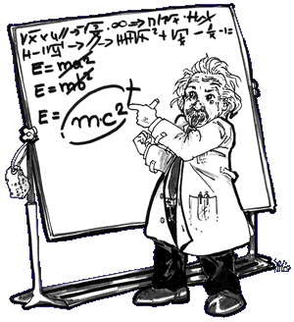
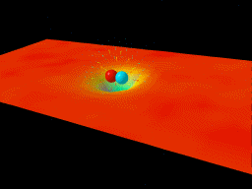
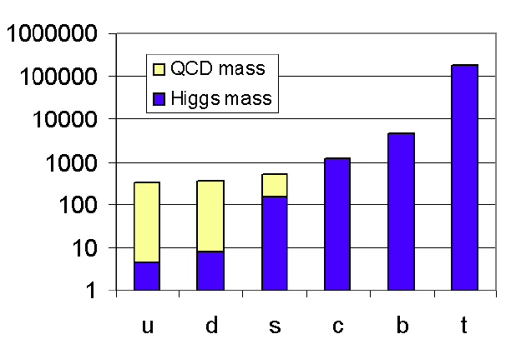
A few notes on mass
Mass always of basic importance
B.Müller
Derek Leinweber
➔
A dynamical generation of hadron masses ➔
99% of visible matter due to strong interaction
This principle does not work if particles are elementary!
Notes:
Derek Leinweber
B.Mueller nucl-th/0404015

Slide 35
The Higgs Boson: well known!
..... except its mass! (until 2012)
What is to be known to search for the Higgs boson:
how is it produced?
how strongly is it produced?
how does it decay?
Devise search strategy along this line

Slide 36
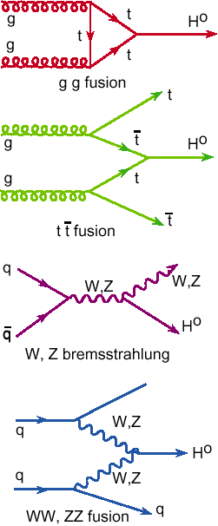
Higgs searches at Hadron Colliders

Slide 37
How the Higgs decays

Slide 38
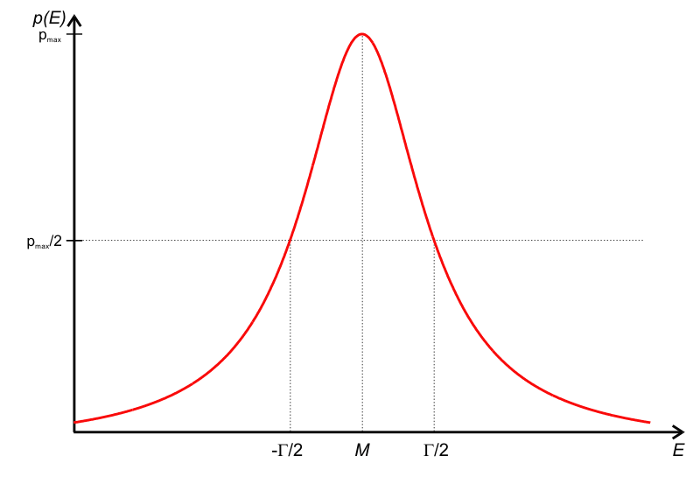
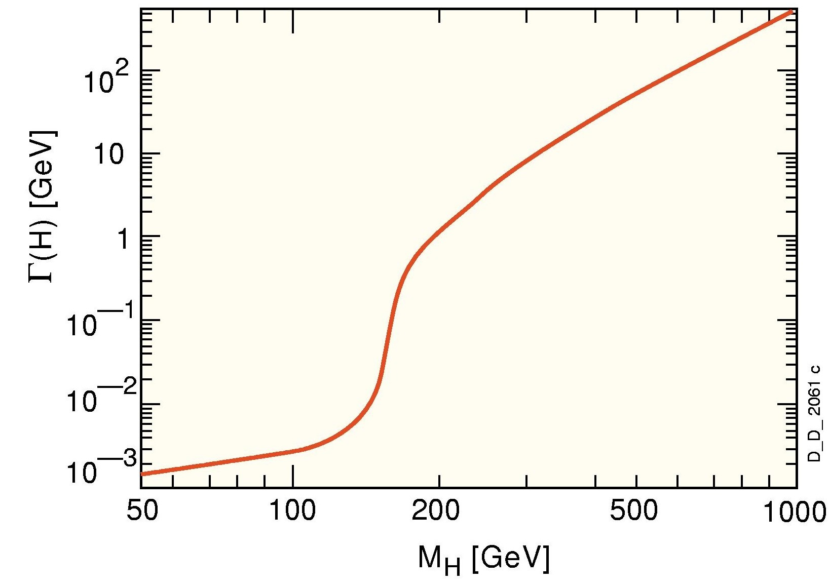
How strong is the coupling?
Width of higgs boson proportional to coupling
Γ(H) ~ M(H)
Threshold W/Z passed:
High coupling
Initial W/Z: high X-section
Very small width ...
Very small coupling!

Slide 39

How to interpret the measurements
Notes:
„Wir haben entdeckt, woraus das Nichts besteht!“
„...was immerhin Etwas ist.“

Slide 40
Test if data EXCLUDE hypothesis
Step 1: X-section at mass m_{H} that
can be excluded @ 95% CL
Step 2: Plot ratio
σ(exclusion)/
σ (Xsec of SM expectation)
If below 1:
Higgs excluded in mass range
If above 1:
Higgs cannot excluded since
either: ‚hint‘, ..... ‚signal‘
or: no sensitivity for exclusion
Compare to expectation (i.e. simulation assuming no signal)
IF expectation above SM Higgs X-section: no sensitivity to exclude
IF expectation below BUT data are high: a first hint

Slide 41
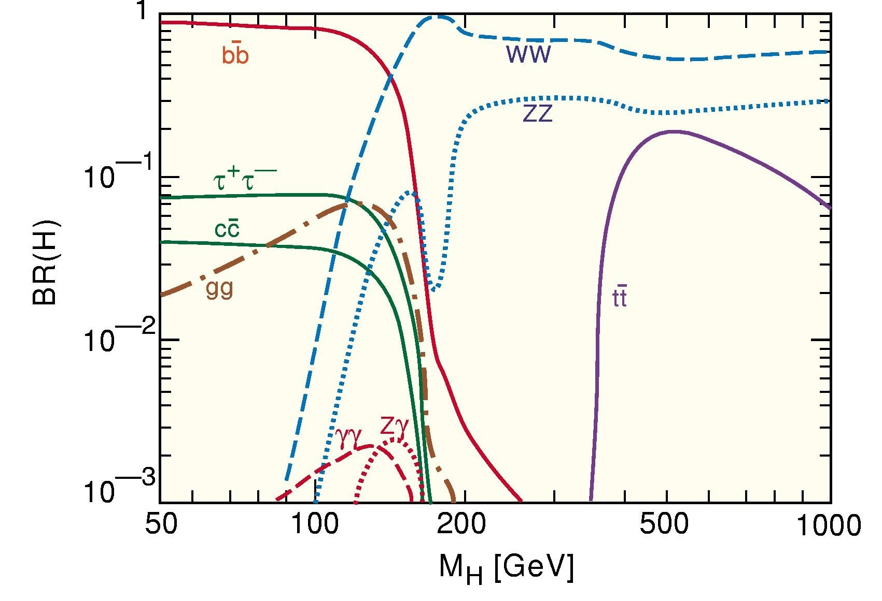
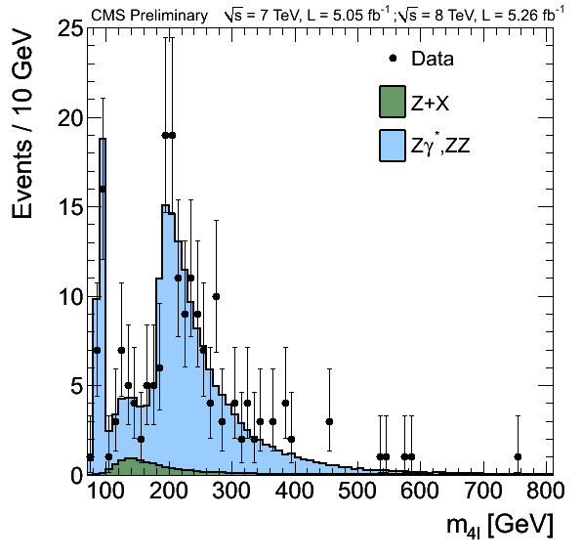
95% CL Limits ZZ → (l⁺l⁻) (l⁺l⁻)
Simulation with NO signal, but
luminosity, detector effects, ....
➔ EXPECTED limit
No sensitivity
Small σ*BR
Oscillations around
expectation:
more or less events
than background expectation
INTERESTING!
Data can exclude less than expected
by large margin
Regions of ratio < 1
EXCLUSION!

Slide 42
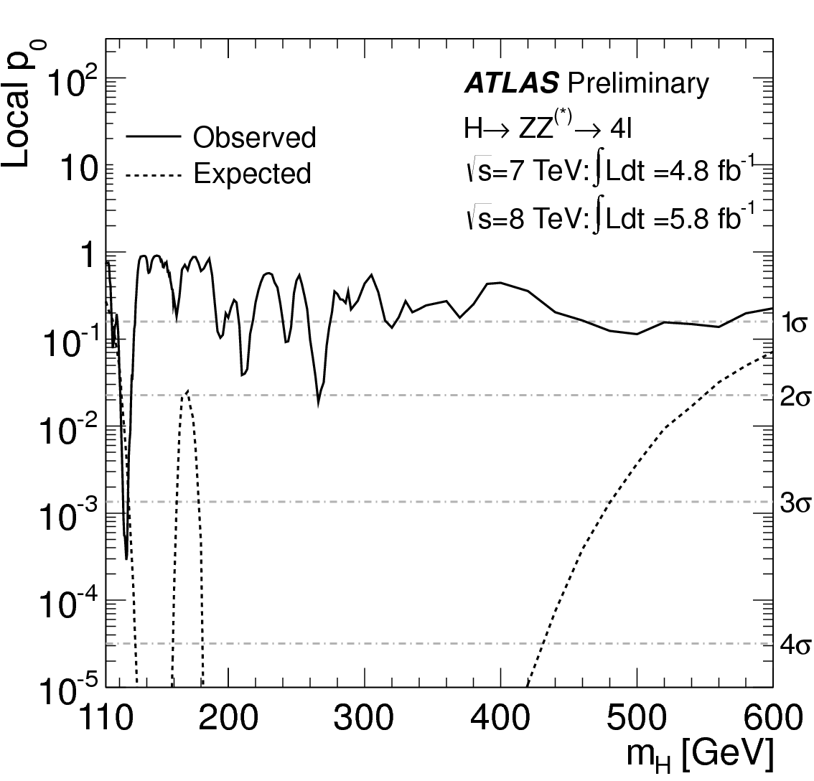
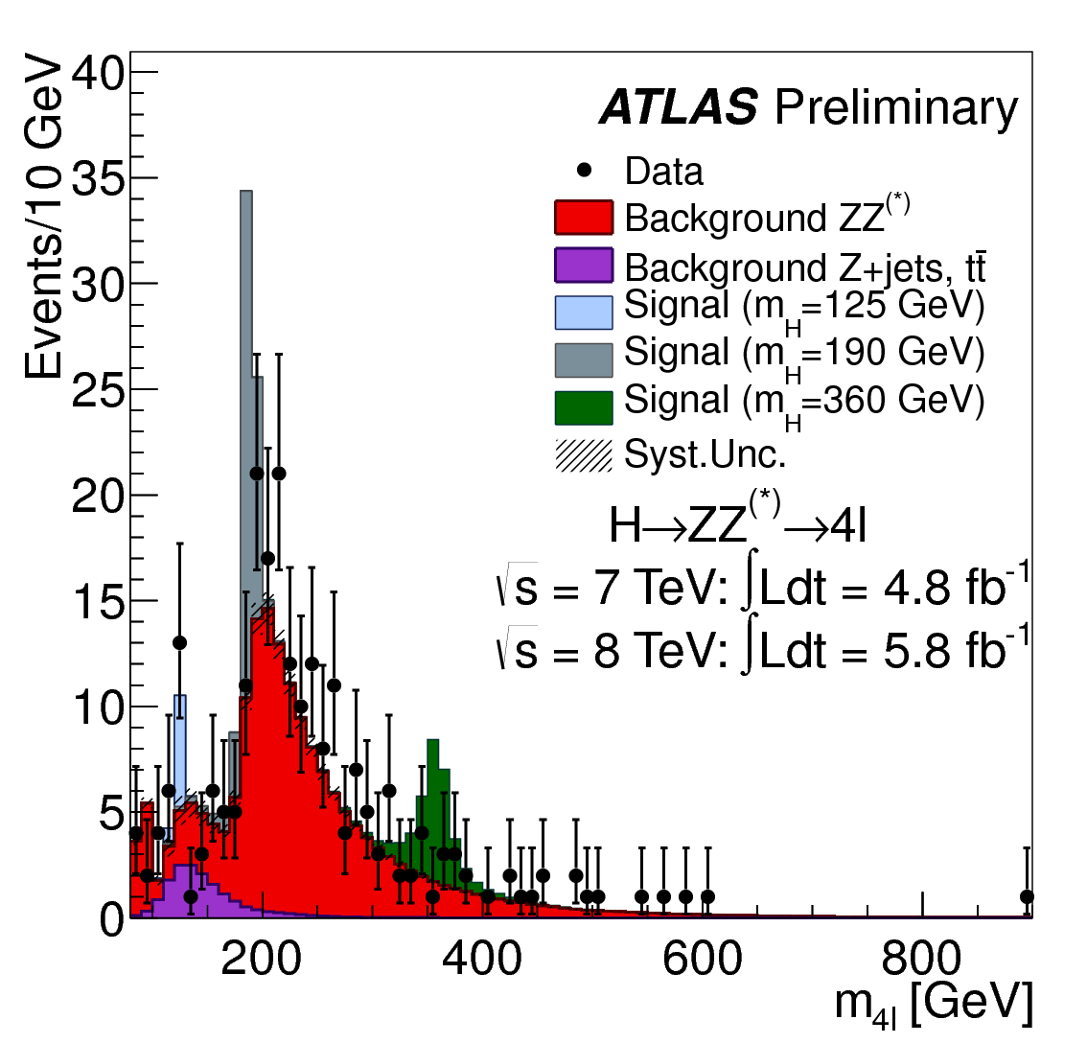
p - value probability of stat. fluctuation
‚p – value‘ : how likely is it that at a certain mass M_{H}
- the expected background fluctuates upward
- to produce at least the number of observed events
Observed dearth or excess
reflected in wiggles
Convention:
Signal observed if p > 5σ

Slide 43
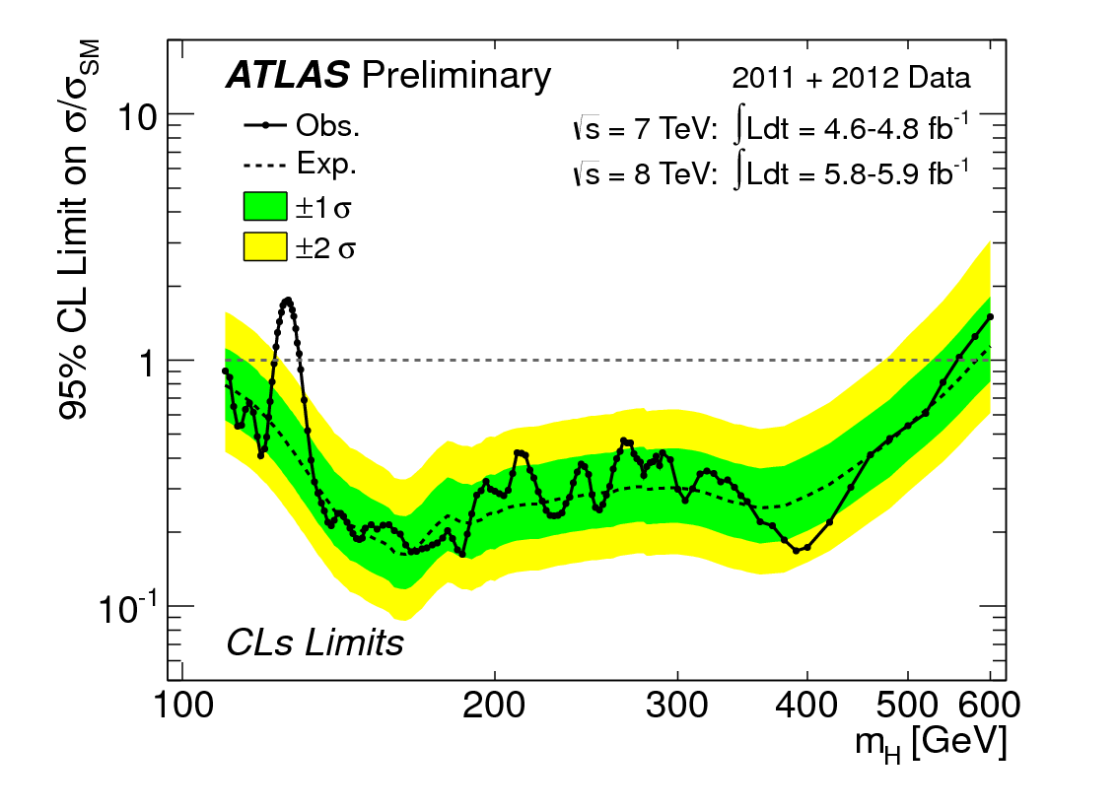
Combining all searches
High mass range:
ZZ ➔ l⁺l⁻l⁺l⁻
ZZ ➔ l⁺l⁻νν
ZZ ➔ l⁺l⁻qq
WW ➔ l⁺νl⁻ν
Higgs EXCLUDED 2·M_{W} < M_{H} < 558 GeV (CMS: 600GeV)
High mass Standard Model Higgs boson (almost) excluded

