Slide 1
RF hardware options
Very preliminary!
E. Jensen, 29-May-08

Slide 2
The 10 MHz route
Present PS 10 MHz system:
  10+1 cavities, 2 gaps/cavity, 10 kV/gap
  2.7 … 10 MHz tuning range
  longitudinal imp. 3.5 kΩ/gap, reduced to 110 Ω with FB. (total 70 kΩ w/o FB, 2.2 kΩ with FB)
  2.4 m length/cavity (24 m long straight sections)
Required in PS2 @ 10 MHz:
  500 kV (i.e. around 26 of these cavities or 60 m straight sections)
  13, 20, 40 and 80 MHz system, similar to present systems would also be required.
  If the space is available, this can be done; no significant R&D required.

Slide 3
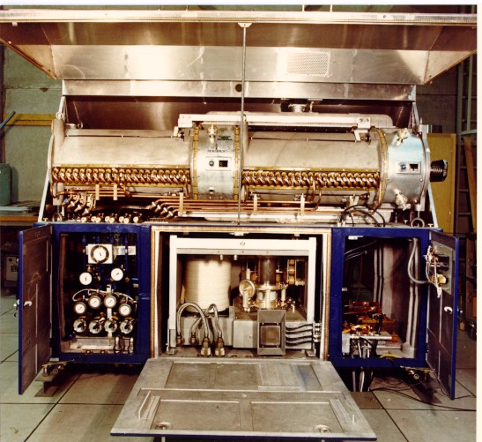
Present PS 10 MHz cavity
Installed around 1971

Slide 4
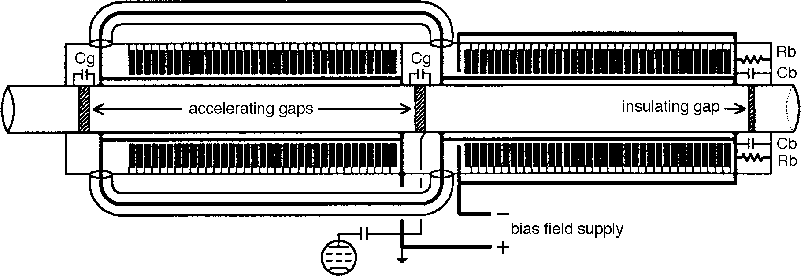
“standard” ferrite cavity
Tuning bias current circuit: azimuthal magnetization, ferrite toroid stacks in anti-series and with figure-of-8 current.
RF: 2 gaps (Cg) and input of coaxial lines (variable L) in parallel for the amplifier (in series for the beam). The RF magnetic field is azimuthal (parallel to DC magnetization).

Slide 5
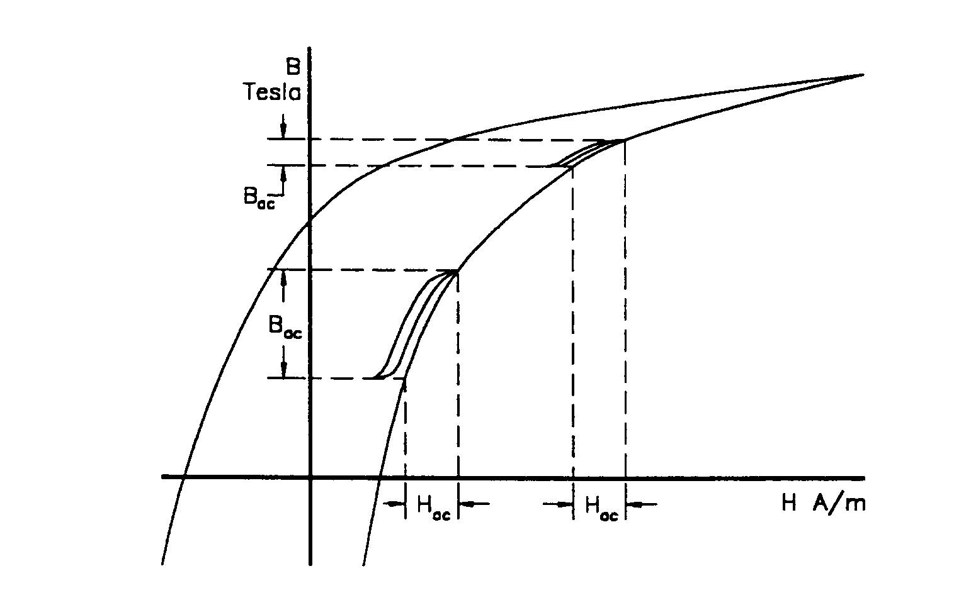
µ: slope of magnetization curve
But: area inside hysteresis loop corresponds to losses. Loaded Q about 30.

Slide 6
The 40 MHz route
Required:
1.5 MV, 18.5 … 40 MHz
Also required: new LEIR h=10 system, 10 … 18.5 MHz, ≈15 kV; not considered here (easier than the PS RF system). Straight section available in LEIR? Alternative?
Obvious question: can the concept of “standard” ferrite cavities be extrapolated to higher frequencies?

Slide 7
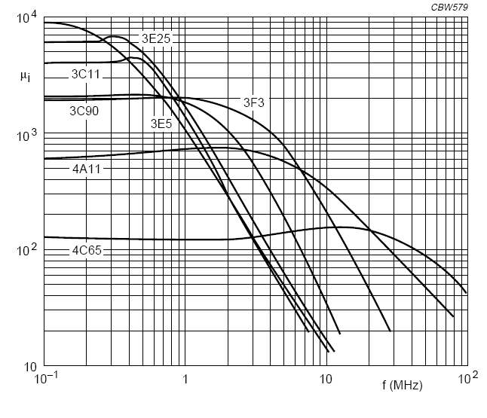
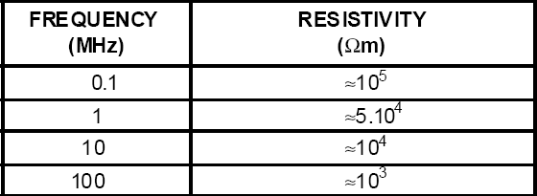
“Standard” ferrite cavity at higher f?
In principle yes, but
  µ_{i} decreases with f!
  smaller µ_{i}, smaller tuning range
  Losses grow with f!
e.g. decreasing resistivity for NiZn ferrites:

Slide 8
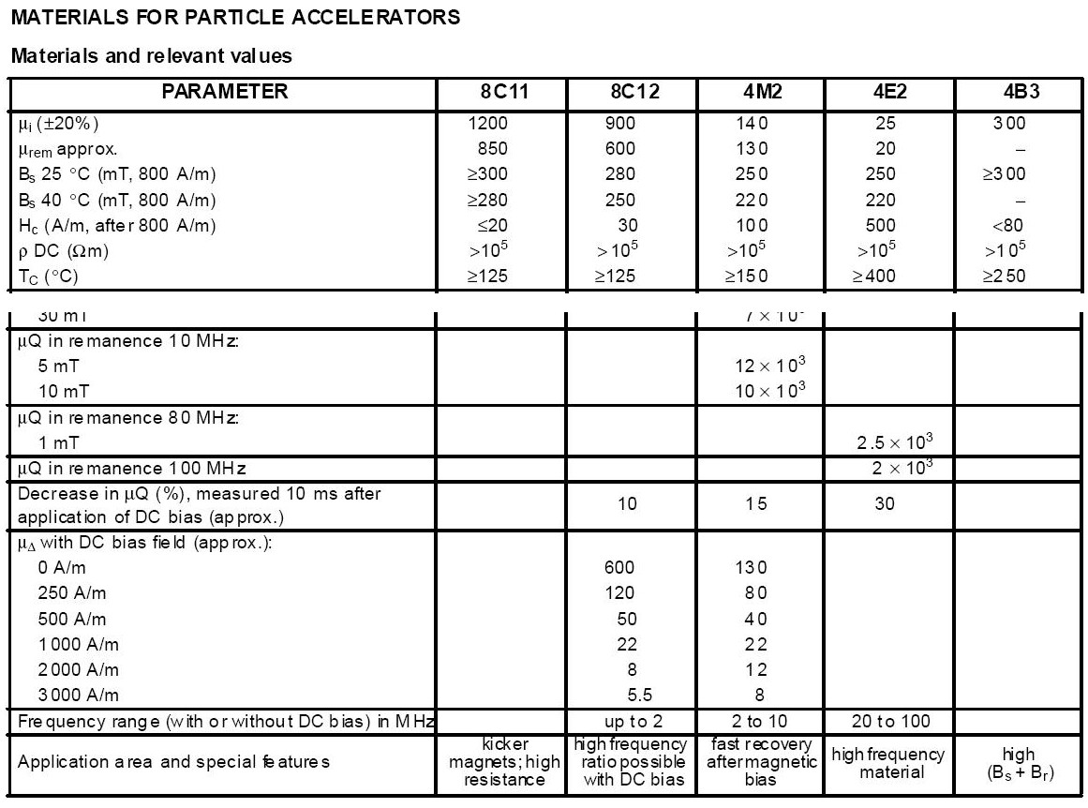
Excerpt from Ferroxcube® catalog

Slide 9
“Standard” ferrite cavity at higher f?
Due to reduced µ_{i}, the tuning range will become smaller.
Due to higher losses, the shunt impedance will become smaller, i.e. more power is needed for the same voltage.
This increased power will not only have to be produced, but also cooled away.
The table of existing systems confirms that a reasonable upper f-limit for “standard” ferrite cavities is around 20 MHz.
Alternatives? → Perpendicular bias!

Slide 10
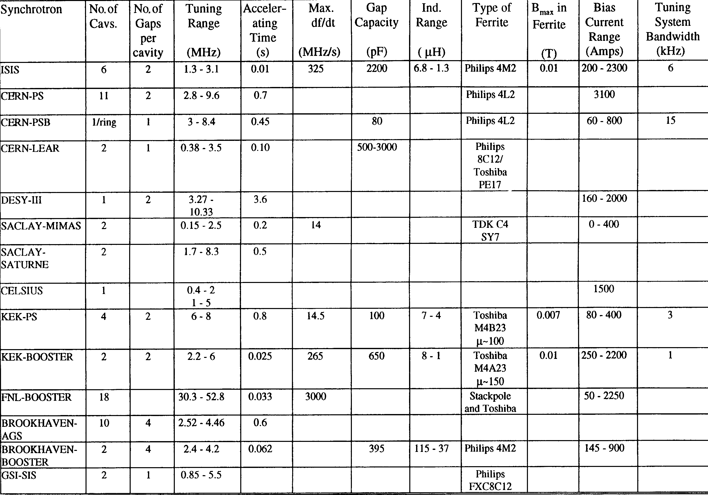
Some existing ferrite RF systems
0 - 800
now: CERN-AD
Perpendicular bias!

Slide 11
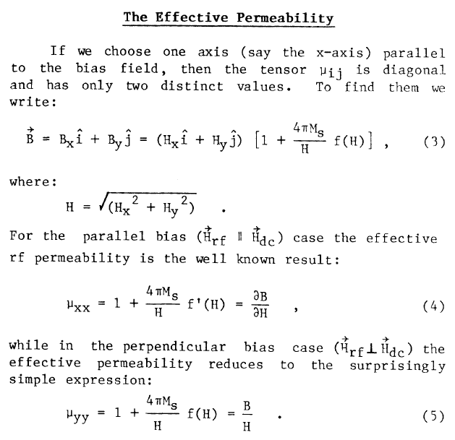
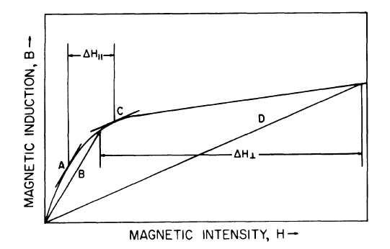
Perpendicular bias
Smythe 1983:
Advantage: always in saturation, i.e. reduced hysteresis loss → potentially higher Q

Slide 12
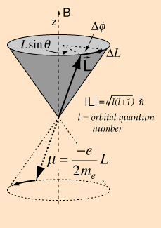
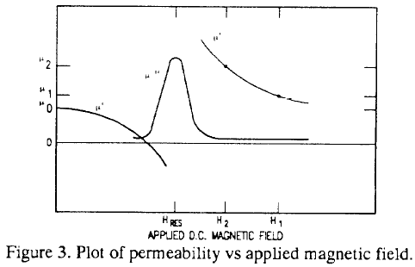
Gyromagnetic resonance
Poirier, PAC 1993:
resonance at:
At fields above the gyromagnetic resonance,
this is consistent with the dependence in saturation given by Smythe.
typical bias: 10 … 200 kA/m

Slide 13
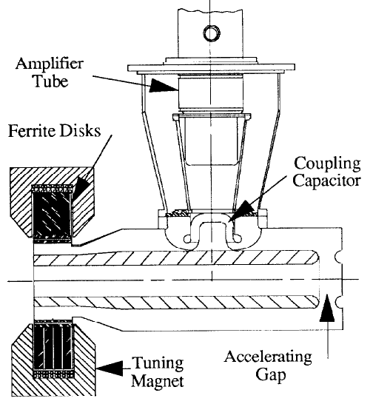
Perpendicular bias RF systems
FNAL Booster (2001)
  100 kV with 150 kW, 36 … 53 MHz, bias < 1000 A
LAMPFF, later SSCL LEB, 1984 - 1993
  127 kV with 150 kW, 47…60 MHz, Q above 1000
TRIUMF Kaon Factory Booster (1998)
  62 kV, 46 … 62 MHz
“generic” conceptual design:

Slide 14
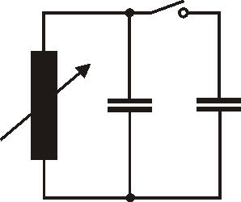
Concluded from these:
Systems around 50 MHz with a tuning range of 1.5 can be done.
For our f range (18 … 40 MHz), things would be simpler rather than more complicated.
With a switchable gap capacitor it should be possible to make the tuning range in 2 sub-ranges – is this acceptable?
27 … 40 MHz
18 … 27 MHz

Slide 15
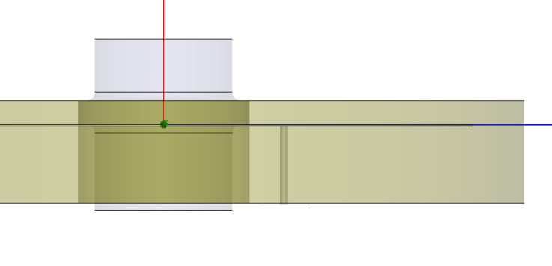
Can 1 octave tuning range be reached?
Simplified geometries tried in HFSS, e.g.
Preliminary result for a tuning curve:
Ferrite: YIG
(Yttrium-Iron-Garnet)
with (realistic)
Preliminary answer:
Octave can be reached, but: for bias below 5000 A/m, the Q becomes very small!

Slide 16
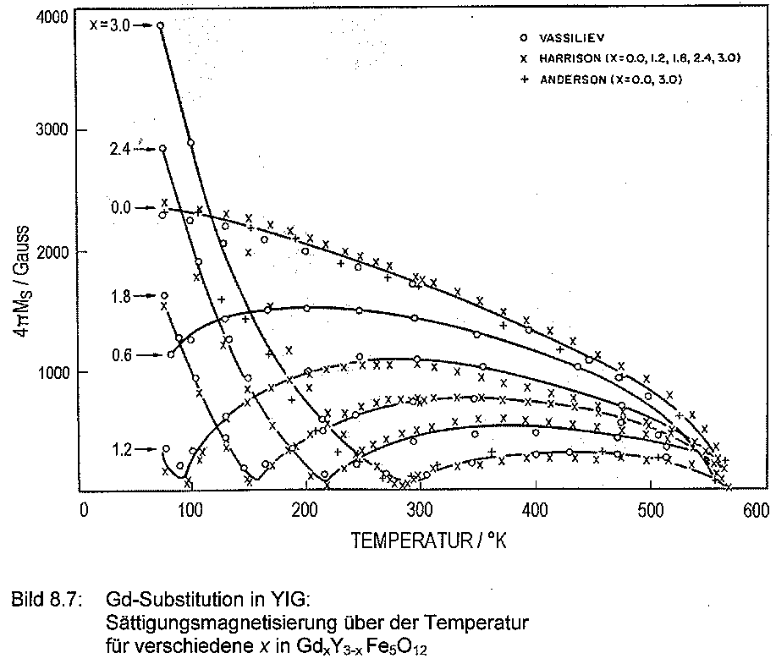
YIG ferrites can be taylored
E.g.:
Substitution of some Y with Gd (see plot), Vd or Ca reduces the saturation magnetization.
Substitution of some Fe with In reduces the linewidth.
from L. Michalowsky: “Weichmagnetische Ferrite”, expert verlag, Renningen, 2006

Slide 17
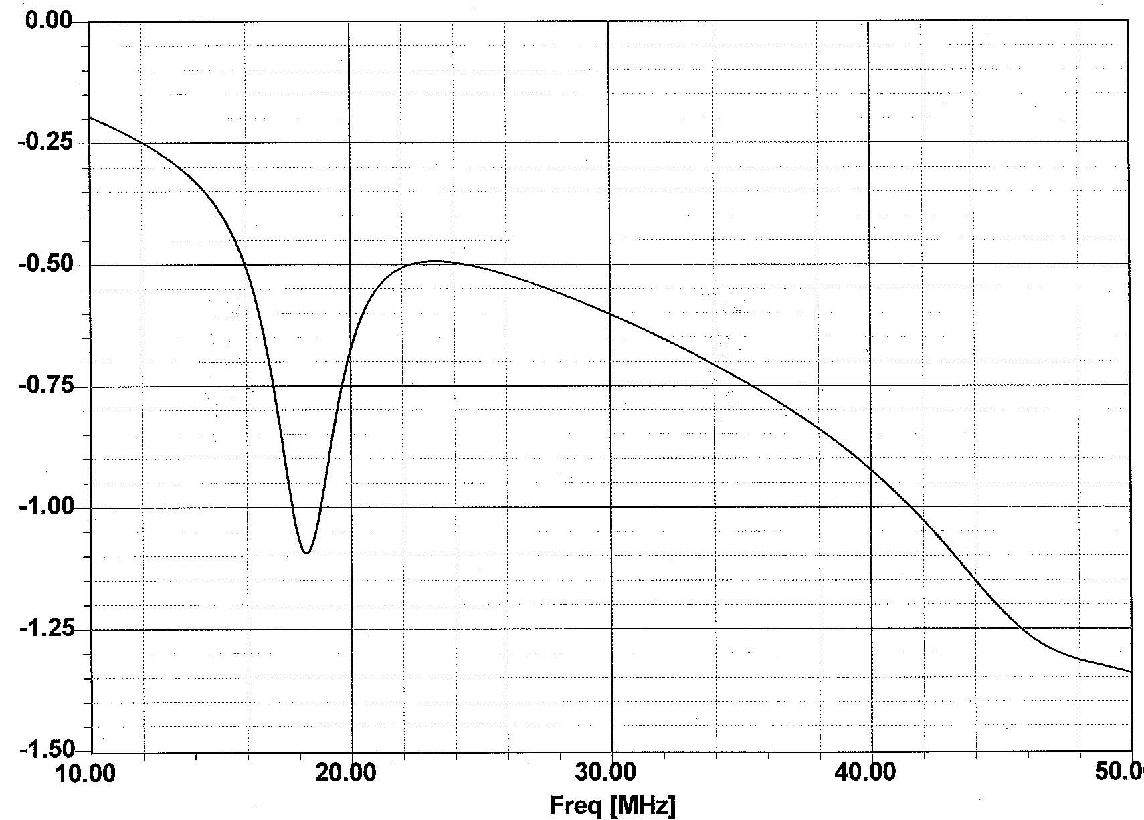
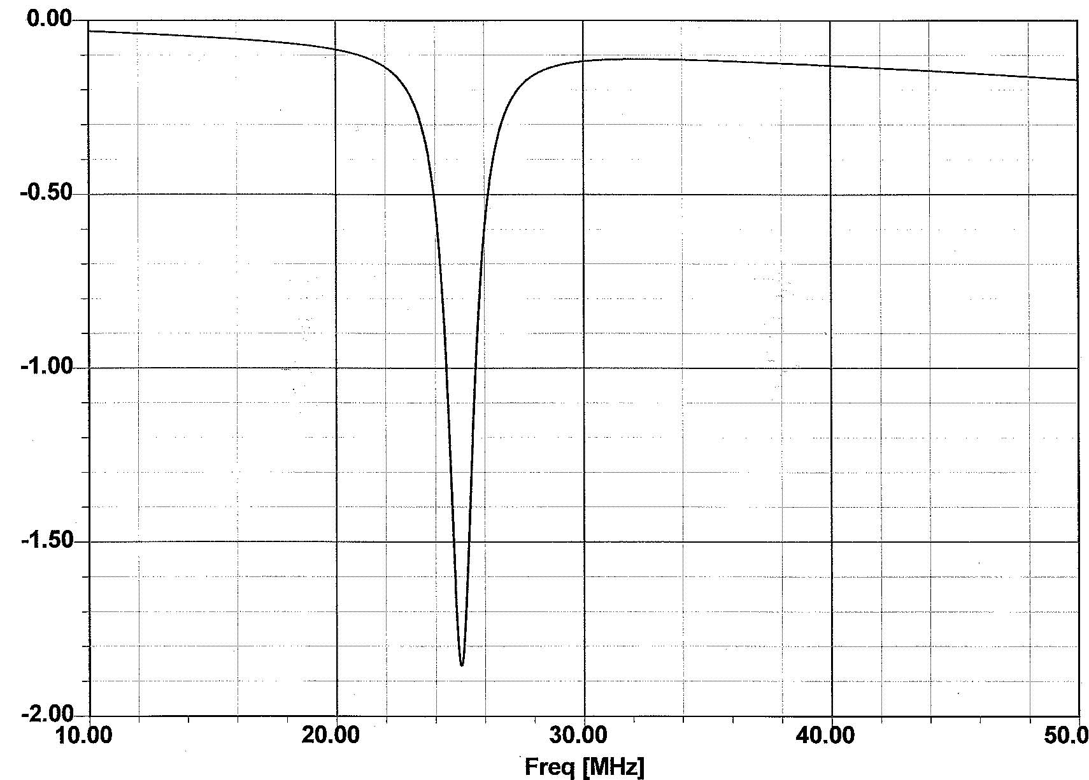
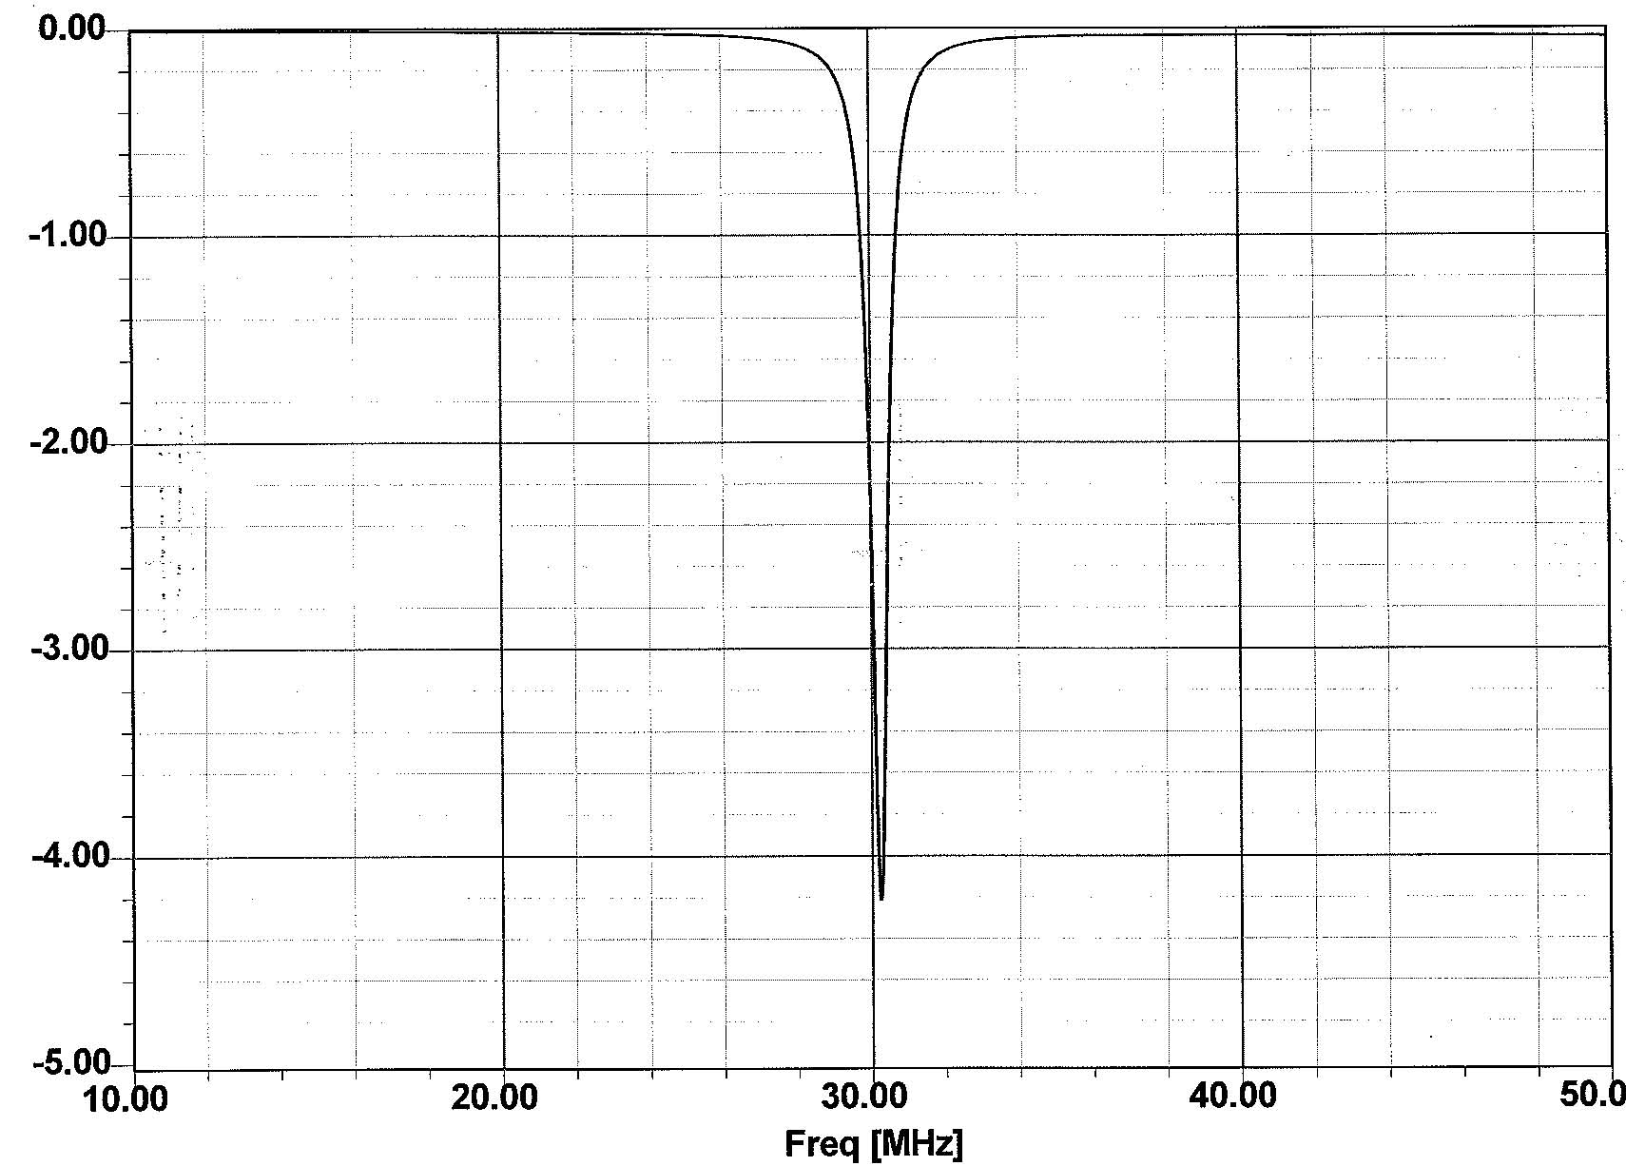
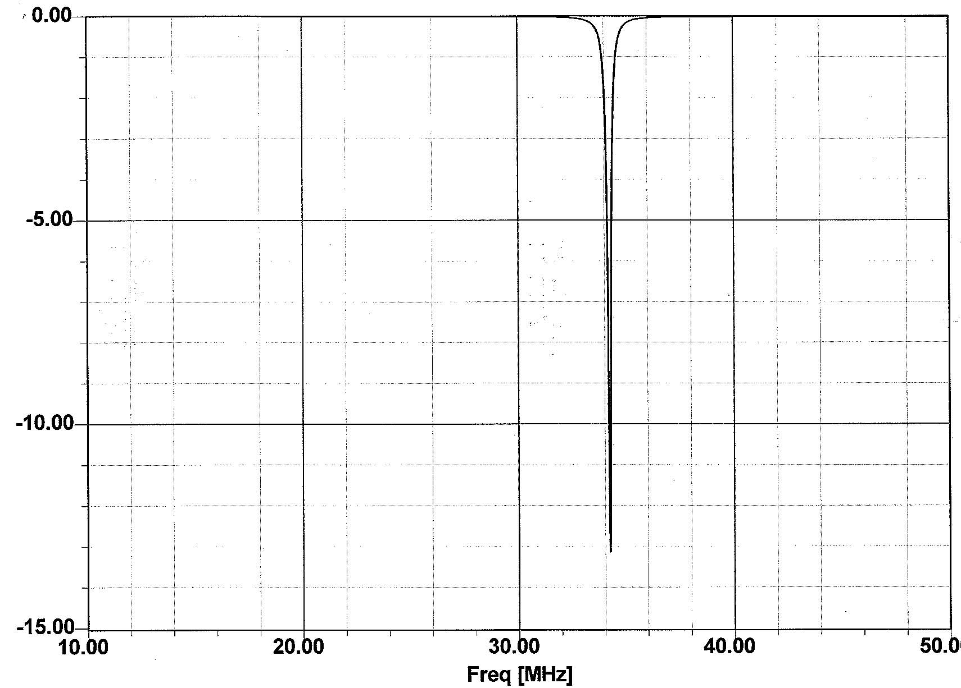
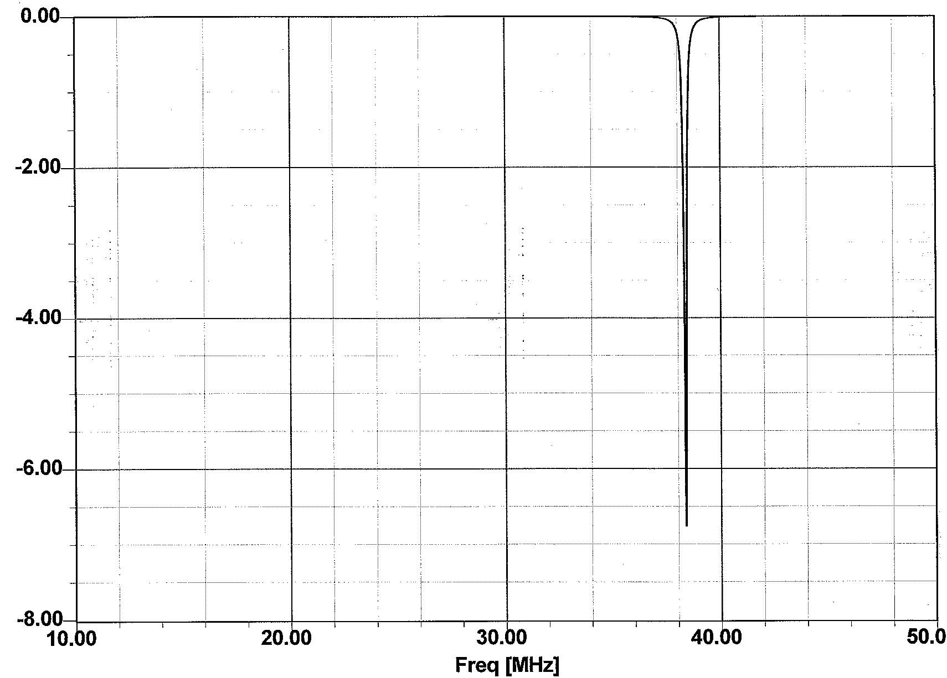
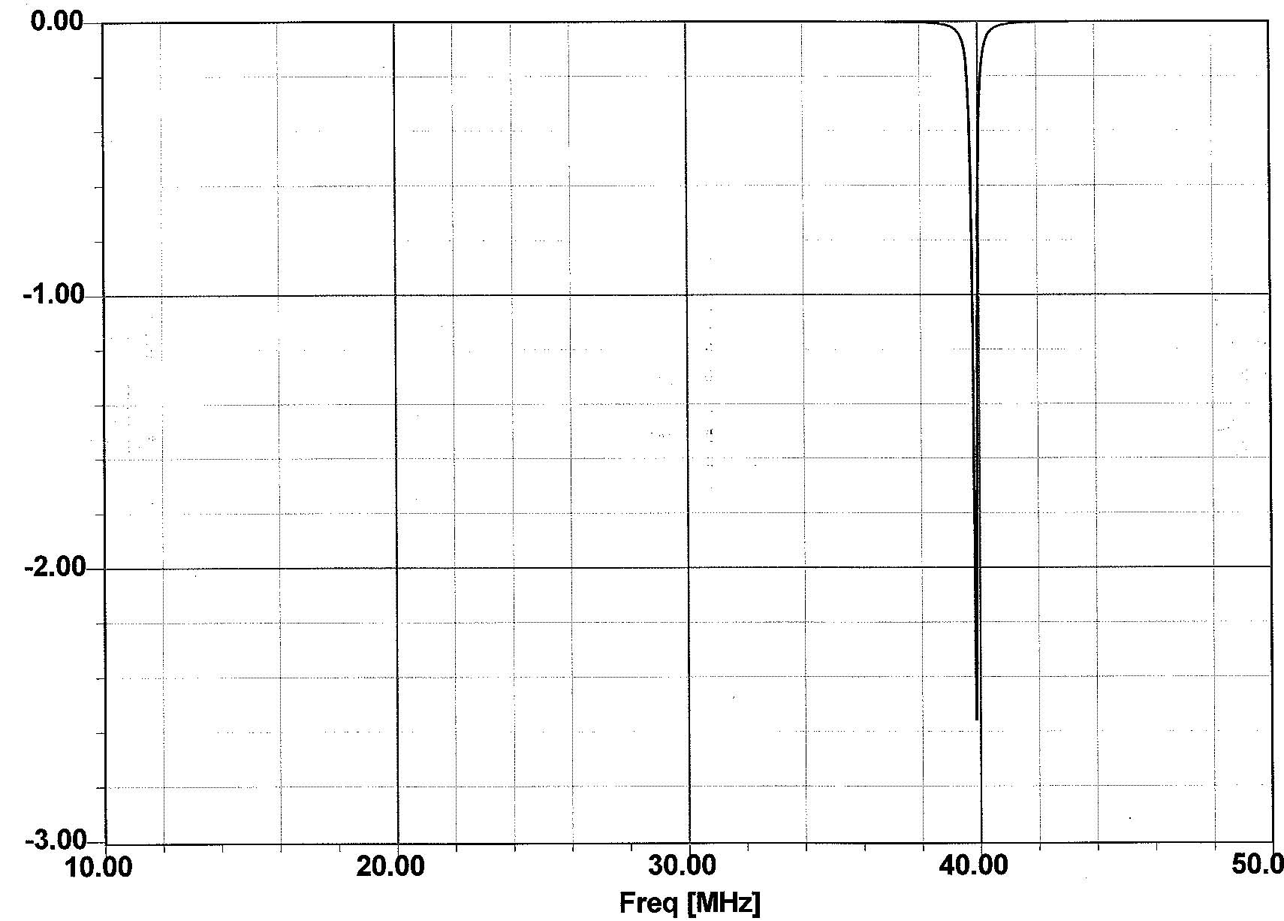
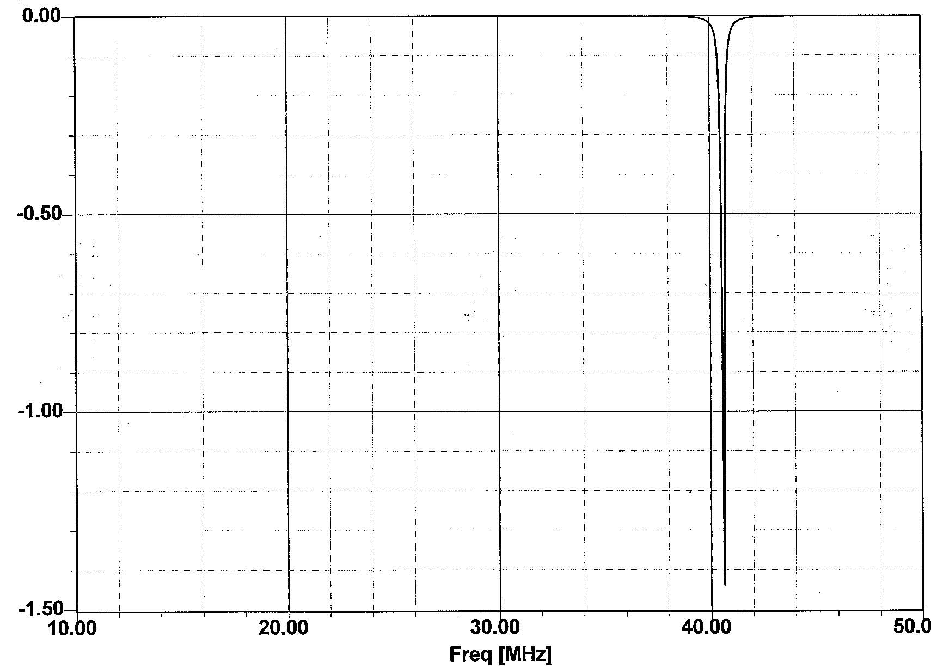
Preliminary HFSS results:
Bias: 2000 A/m
Bias: 5000 A/m
Bias: 10000 A/m
Bias: 20000 A/m
Bias: 50000 A/m
Bias: 100000 A/m
Bias: 200000 A/m

Slide 18
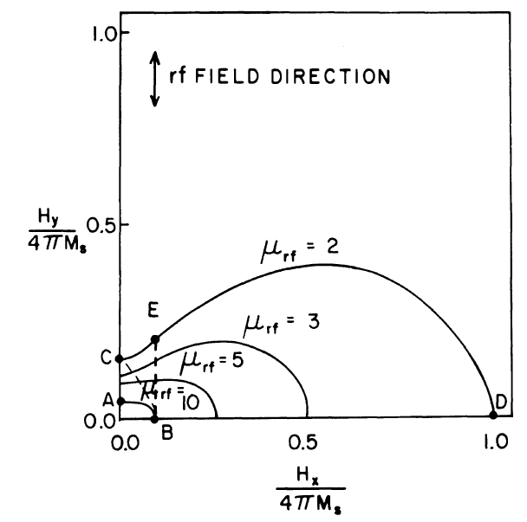
Parallel plus perpendicular biasing?
Smythe suggested in 1983 to use
  transverse bias to get into saturation (lower losses)
  add’l. parallel bias for tuning (less bias).
Could this work? (I’d like to try!)

Slide 19
Next steps
Characterize YIG ferrite samples with different saturation and line width under different bias conditions in our f-range. (This requires a dedicated test set-up).
This will allow to advance a cavity design.
My guess today: If the split f-range is possible, 40 kV, 50 kW units should be possible; this would require around 40 systems for the 1.5 MV requirement.

