Slide 1
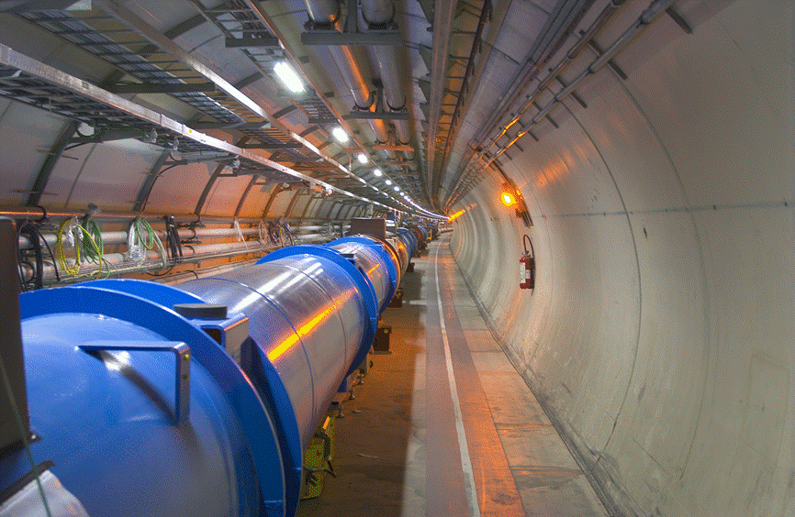
LHC Upgrade
O. Brüning
CERN, Geneva, Switzerland

Slide 2
Contents
Introduction
LHC layout overview and main parameters
Main challenges for the LHC operation
LHC Performance Summary
Upgrade Performance Goals
HL-LHC Upgrade Ingredients
Other, future upgrade plans (if time permits)

Slide 3
Introduction: LHC Goals & Performance
Collision energy: SM exploration requires E_{CM} > 1 TeV
p collisions E_{beam} > 4 TeV strong magnetic fields
and/or large storage ring
Instantaneous luminosity: # events in detector
rare events L > 10³³cm⁻²sec⁻¹ L > 10³⁴cm⁻²sec⁻¹
Integrated luminosity: L
depends on the beam lifetime, the LHC cycle and
‘turn around’ time and overall accelerator efficiency

Slide 4
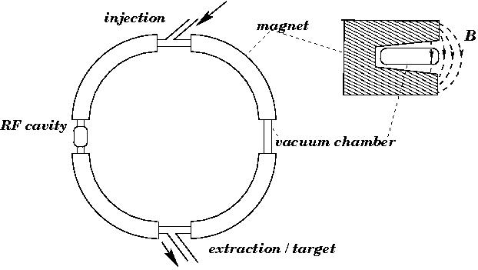
Introduction: the LHC is a Synchrotron
R = constant:
v = c B γ
More details in the lecture on Accelerators by Verena Kain
in the first week
LHC / LEP: ω₀ = 11.3 kHz

Slide 5
Introduction: the LHC is a Synchrotron
uniform B field: R = constant
for E >> E₀
realistic synchrotron: B-field is not uniform
-drift space for installation
-different types of magnets
-space for experiments etc
high beam energies require: -high magnetic bending field
-large circumference
-large packing factor

Slide 6
Introduction: Magnet Technology
physics goal: E = 7 TeV
existing infrastructure: LEP tunnel: circ = 27 km
with 22 km arcs
assume 80% of arcs can be filled with dipole magnets: F = 0.8
required dipole field for the LHC:
B = 8.38 T
(earth: 0.3 10⁻⁴ T)

Slide 7
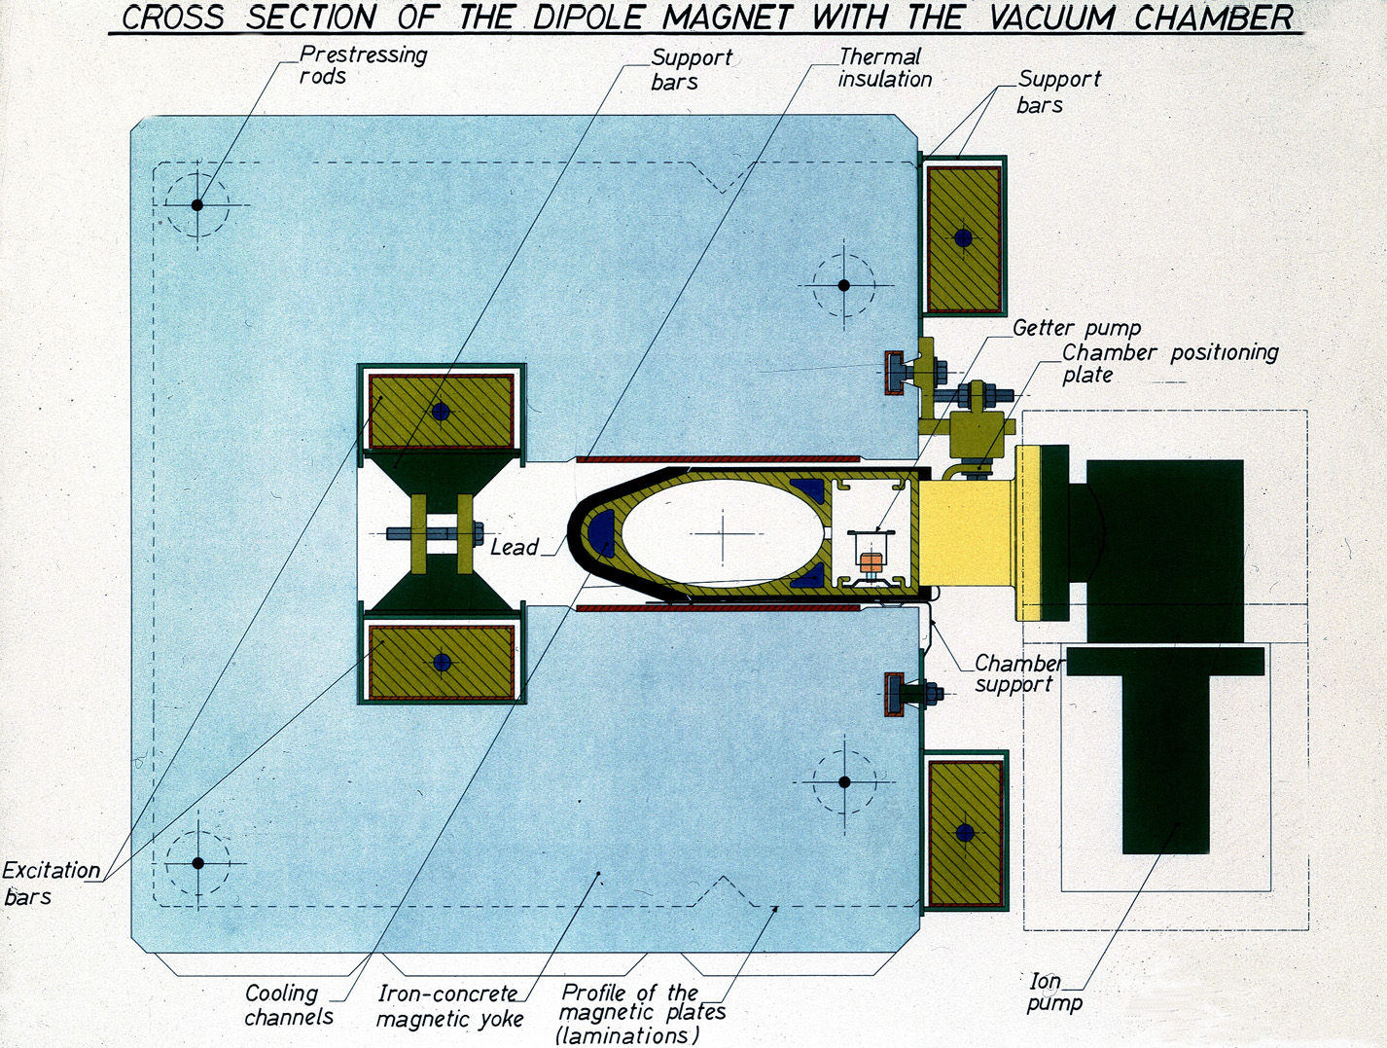
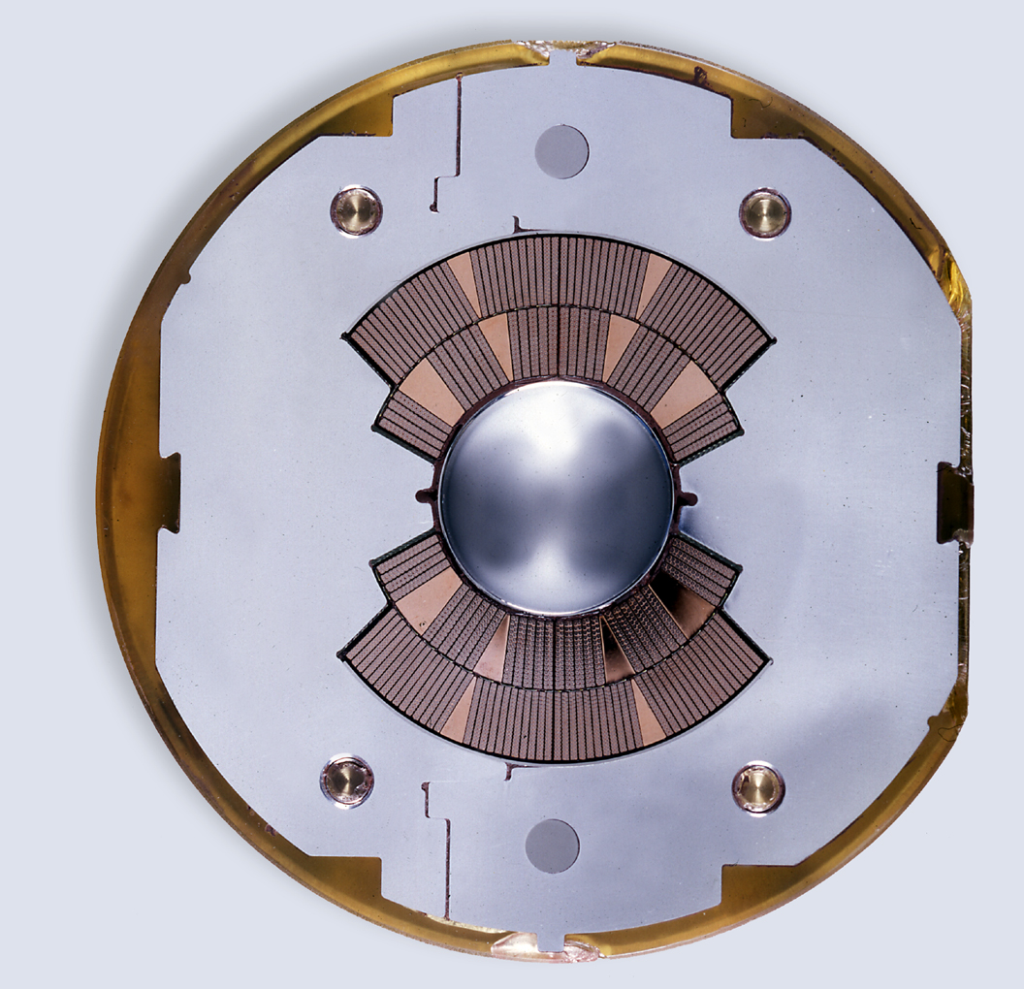
Introduction: Magnet Technology
high beam energies require large rings and high fields
1) Iron joke magnet design 2) air coil magnet design
-field quality given by pole face geometry -field quality given by coil geometry
-field amplified by Ferromagnetic material -SC technology avoids Ohmic losses
-iron saturates at 2 T -risk of magnet quenches
-Ohmic losses for high magnet currents -field quality changes with time

Slide 8
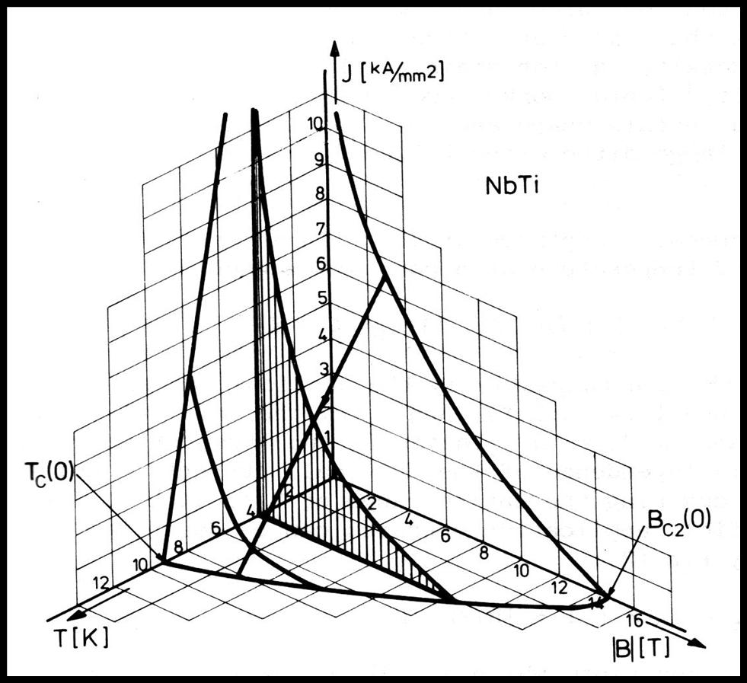
Introduction: Magnet Technology - Quench
Critical surface of NbTi:
-high ambient magnetic field
lowers the capability to sustain
large current densities
-low temperatures increase the
capability to sustain large
current densities
-LHC: B = 8.4 T;
More details on superconductivity and superconducting magnets in the lecture by Paolo Ferracin on Thursday and Friday
T = 1.9 K
j = 1 - 2 kA / mm² ➔ ca. 11kA
➔ 6MJoule / magnet (L = 100mH) ➔ energy for melting 10kg Cu
existing machines: Tev: B=4.5T; HERA: B=5.5T; RHIC: B=3.5T
He is superfluid below 2K and has a large thermal conductivity!
Notes:
Specific heat for Cu: 385 J/kg, melting point 1085 degrees Celsius, Latent heat fusion: 0.2MJ.kg -> 0.6MJ melts 1 kg Cu

Slide 9
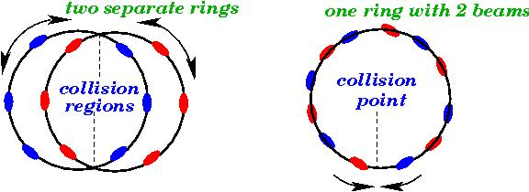
Introduction: 2-in-1 Magnet design
collider ring design requires 2 beams:
design with one aperture requires particles & anti-particles
Not efficient for a hadron collider! (Tevatron, Chicago USA)
2-ring design implies twice the hardware
LHC features novel 2-in-1 magnet design

Slide 10
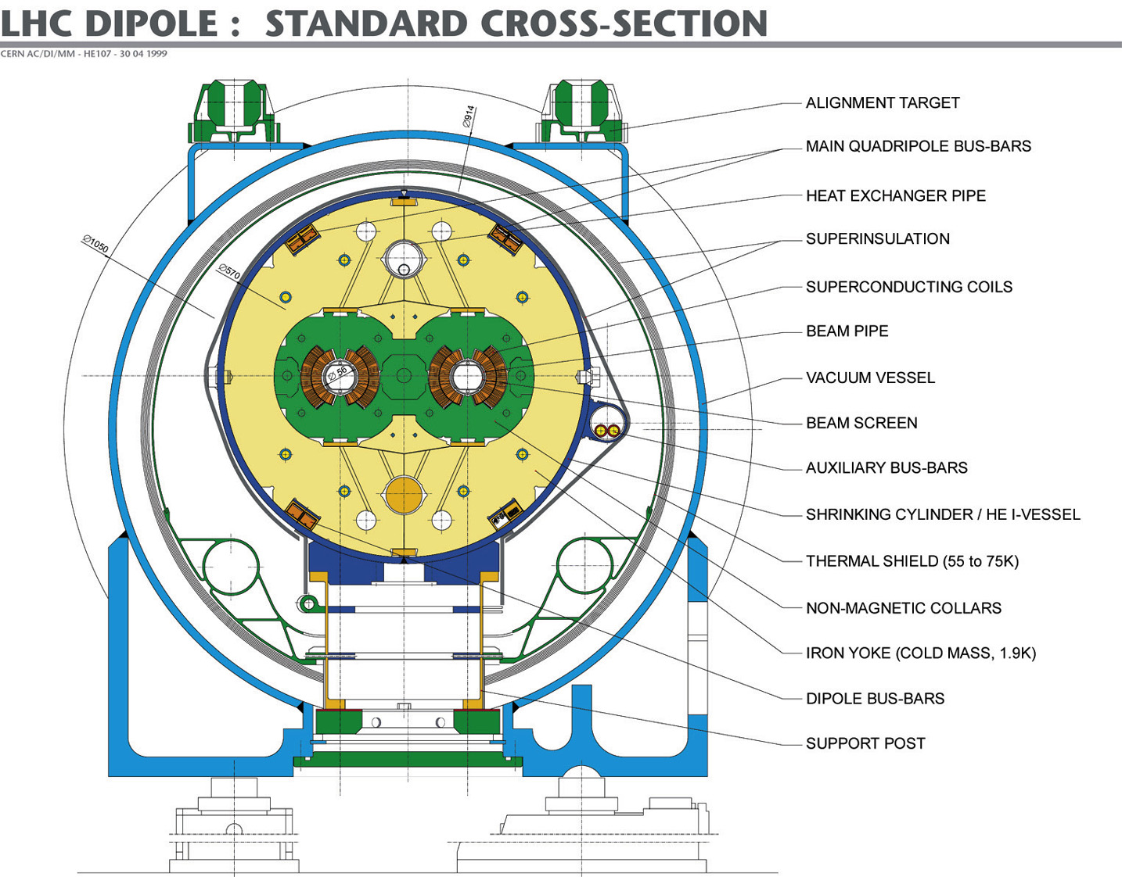
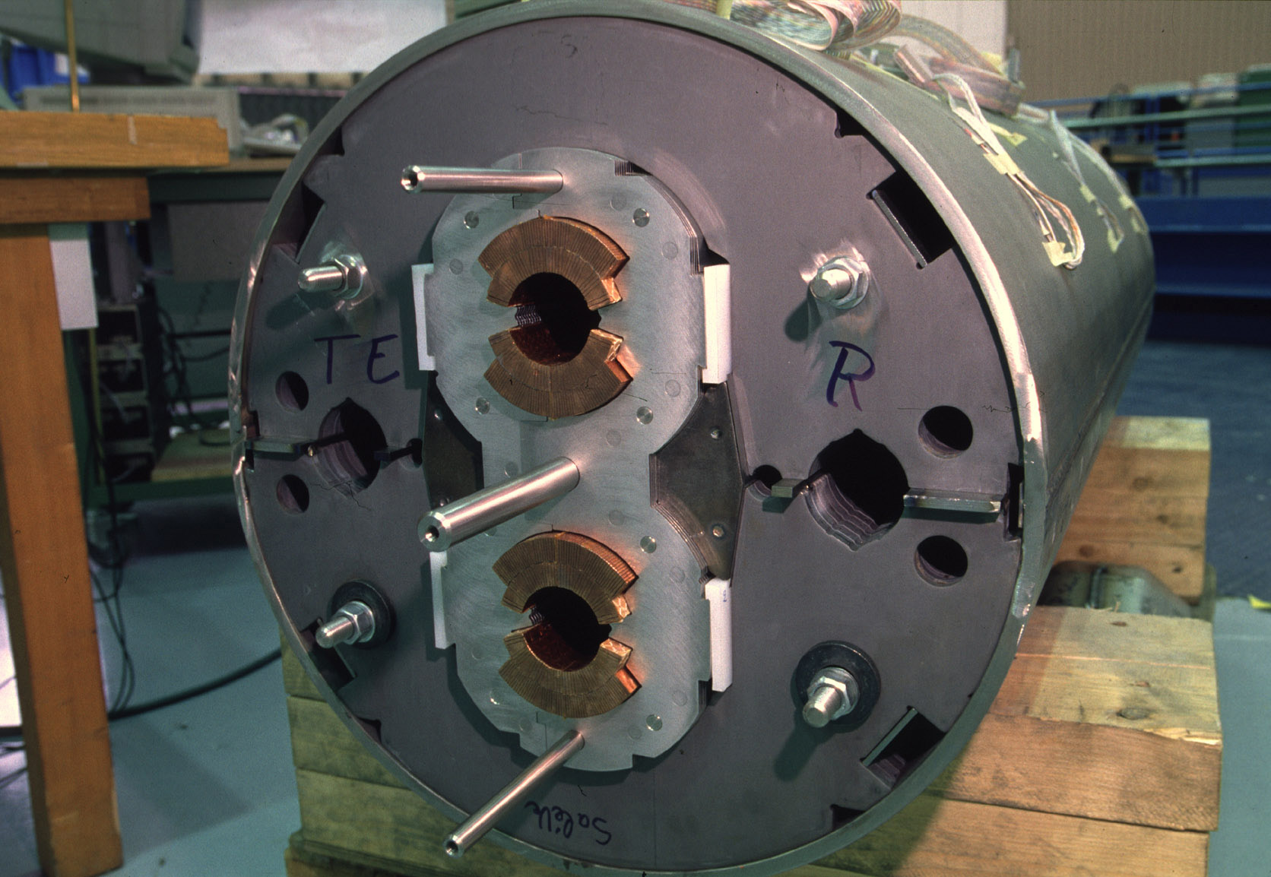
Introduction: 2-in-1 Magnet Design
2-in-1 dipole magnet design with common infrastructure:
-15 m long few interconnects (high filling factor)
but difficult transport (ca. 30 tons)
-compact 2-in-1 design allows p-p collisions in LEP tunnel
-corrector magnets at ends tight mechanical tolerances

Slide 11
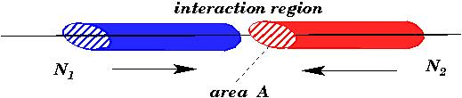
Introduction: Luminosity
colliding bunches:
with:
is determined by the magnet arrangement & powering
ε_{n} is determined by the injector chain
goal:
high bunch intensity and many bunches
small β at IP and high collision energy
L = 10³⁴ cm⁻²sec⁻¹

Slide 12
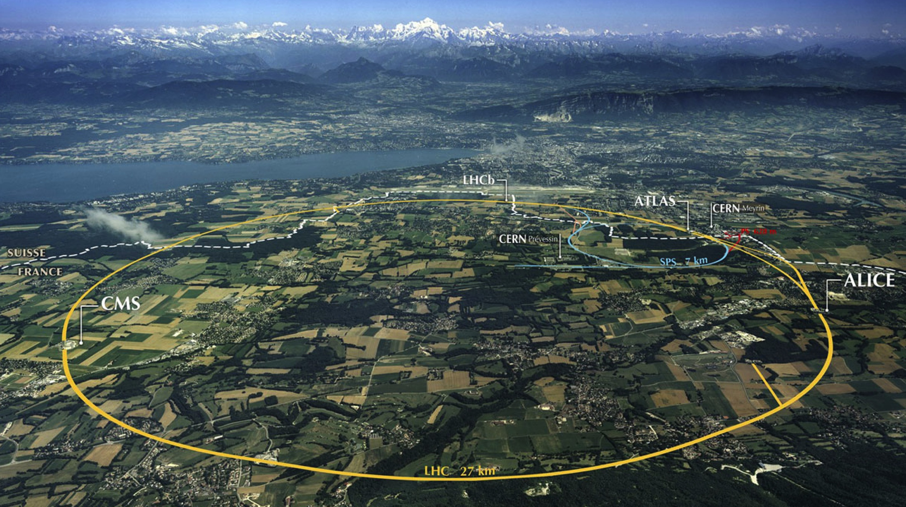
LHC: big, cold, high energy
Collimation
Injection B2
Beam dumps
Injection B1
Collimation
RF
1720 Power converters
> 9000 magnetic elements
7568 Quench detection systems
1088 Beam position monitors
4000 Beam loss monitors
150 tonnes Helium, ~90 tonnes at 1.9 K
140 MJ stored beam energy in 2012
370 MJ design and > 500 MJ for HL-LHC!
450 MJ magnetic energy per sector at 4 TeV
➔ ≈ 10 GJ total @ 7 TeV

Slide 13
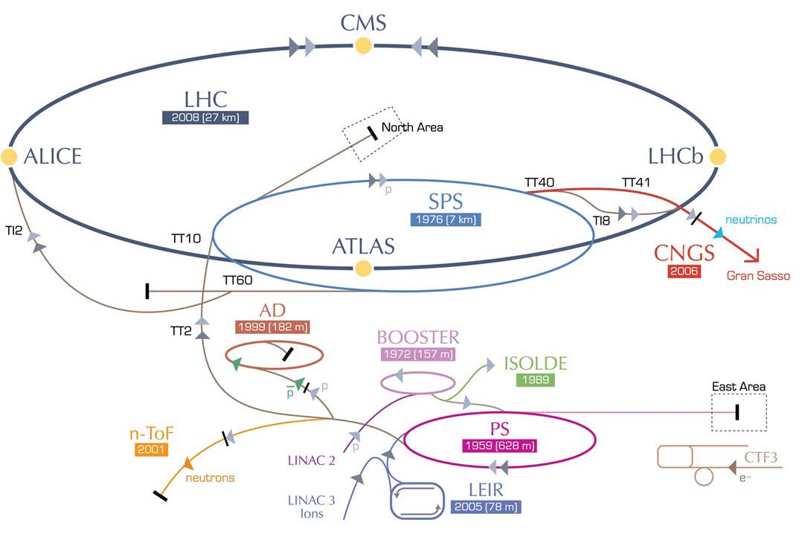
The LHC and its Injector Complex:
LHC: 450 -> 7000 GeV
SPS: 26 -> 450 GeV
PSB: 50 MeV -> 1.4 GeV
LINAC2: 50 MeV
PS: 1.4 -> 26 GeV

Slide 14
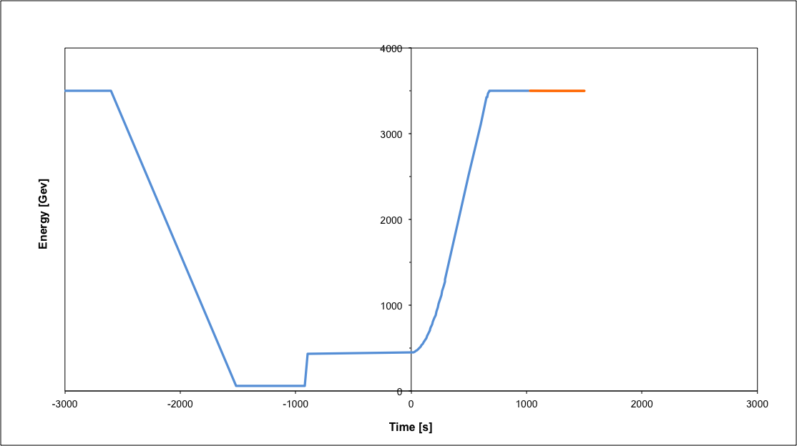
The Nominal LHC Operation Cycle:
Beam dump
Squeeze
Stable beams
Collide
Ramp down | 35 mins
Injection | ~30 mins
Ramp | 12 mins
Squeeze | 15 mins
Collide | 5 mins
Stable beams | 0 – 30 hours
Ramp
Ramp down/precycle
Injection
➔ Operational Turn around time of 2 - 3 hours ➔ Efficiency = time in physics / scheduled time

Slide 15
Main Challenges for the Operation
Magnetic field perturbations & field quality
Beam power and machine protection
Collective effects and impedance
Triplet aperture and beam-beam
Electron cloud effect
Unintentional beam aborts

Slide 16
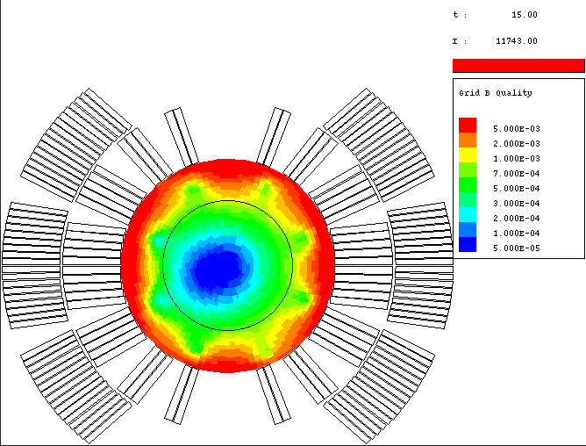
LHC Challenges: Magnet Field Errors
time varying field errors in super conducting magnets
Luca Bottura CERN, AT-MAS
I
11743A
769.1A
t
192.1 A

Slide 17
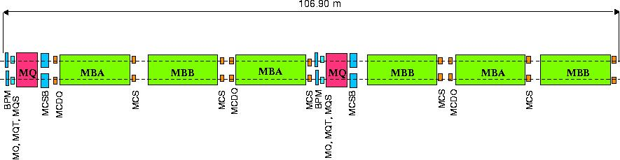
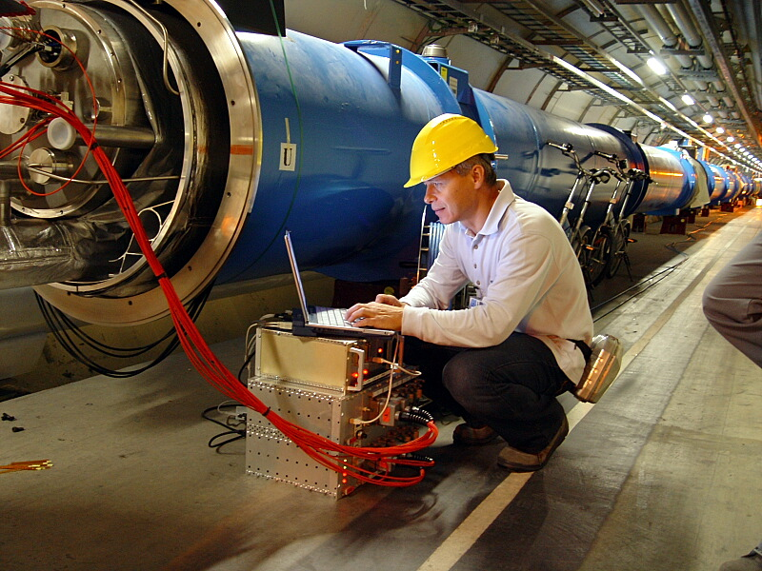
LHC Challenges: Magnet Field Errors
the LHC features 112 circuits / beam (+ orbit correctors)
all magnet circuits
are tested before and during
installation
adjustments during operation
➔ non-destructive beam instrumentation

Slide 18
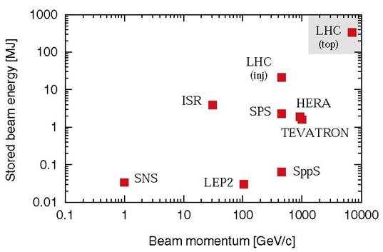
LHC Challenges: Beam Power
Unprecedented beam power:
potential equipment
damage in case
of failures
during
operation
In case of
failure the
beam must
never reach
sensitive
equipment!

Slide 19
LHC Challenges: Quench Protection
Magnet Quench:
➔ beam abort ➔ several hours of recovery
LHC nominal beam intensity: I = 0.5A => 3 10¹⁴ p /beam
Quench level: N_{lost} < 7 10⁸ m⁻¹
➔ 2.2 10⁻⁶ N_{beam}!
(compared to 20% to 30% in other superconducting rings)
requires collimation during all operation stages!
requires good optic and orbit control!➔ feedback loops

Slide 20

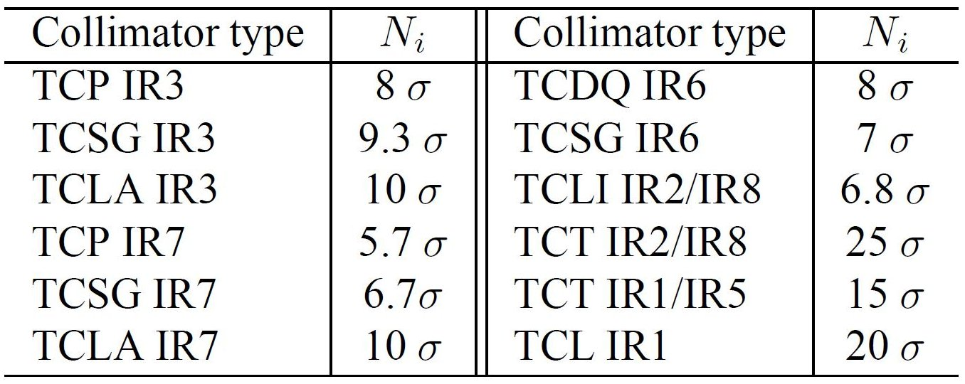
LHC Challenges: Collimation Efficiency
IV
III
1 (450GeV) ≈ 1mm
II
Triplet
I
Absorbers
Tertiary
Secondary
Dump Protection
1 (4TeV) ≈ 0.35mm
Primary
Dump Kicker
1 (6.5TeV) ≈ 0.25mm
5.7
6.7
10
7
15
beam
2011
‘Interm.’
Norway =
3.1mm
2012
‘Tight’ =
Iberian
Peninsula
2.2mm

Slide 21
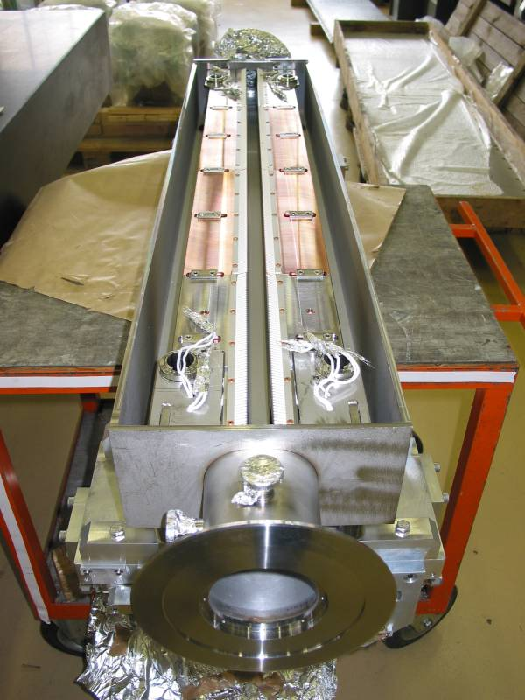
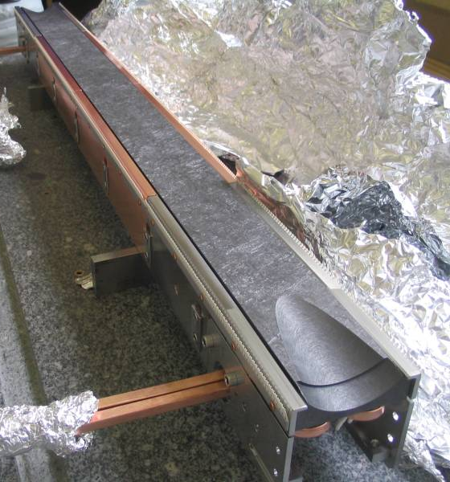
LHC Challenges: Machine Protection
Unprecedented beam power:
all absorbers and the collimation system
must be designed to survive an
asynchronous beam dump!
(total of up to 136 collimators & absorbers) Machine protection System!
Robust collimator jaw design
fiber reinforced graphite jaws
are more robust than Cu jaws
fiber reinforced graphite
has a higher impedance and
electrical resistivity

Slide 22
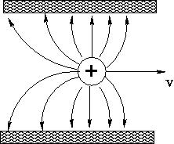
LHC Challenges: Collective Effects
resistive wall impedance:
image charges trail behind due to
resistivity of surrounding materials
➔ Wake fields drive beam instabilities
effect increases with decreasing gap
opening of the collimator jaws
depends strongly on jaw opening (3rd power)
impedance of Graphite jaws either limits the minimum
collimator opening ➔ limit for β* or the maximum beam current
phased collimation system for the LHC:
Phase 1: graphite jaws for robustness during commissioning
Phase 2: nominal performance (low impedance collimators & coating)

Slide 23
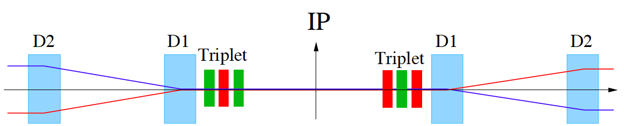
LHC Challenges: Triplet Aperture
Insertion Layout:
ca.130m
ca.50m
Symmetric drift space:
β_{max} proportional to L^{*2}/β∗
➔ β* = 0.5m ➔ σ ≈ 16μm at IP and σ ≈ 1.5mm inside triplet

Slide 24
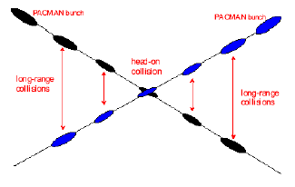
LHC Challenges: Parasitic Collisions
long range beam-beam:
Operation with ca. 2800 bunches ➔ approximately 30 unwanted collision points per Interaction Region (IR).
➔ Operation requires crossing angle
non-linear fields and additional focusing due to beam-beam
efficient operation requires large beam separation at unwanted collision points ➔ separation of 10 σ is at the limit of the triplet aperture for nominal β* values!
smaller β* values ➔ larger triplet apertures
➔ upgrade studies!!!

Slide 25
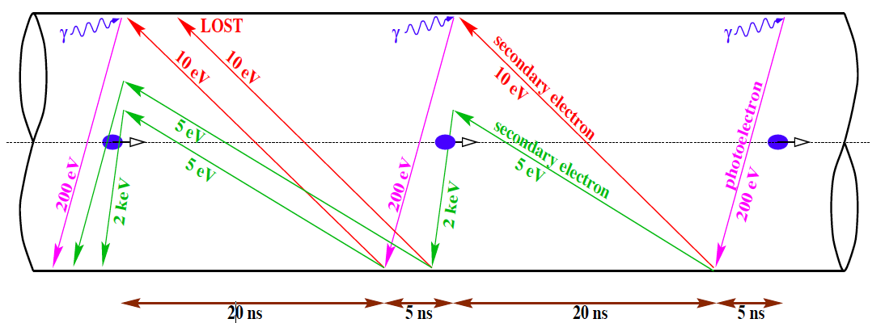
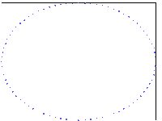
LHC Challenges: Electron Cloud
p
synchrotron light removes electrons
electrons are accelerated by the beam
e⁻ hit vacuum surface and generate secondary e⁻
electron cloud (shields beam field)
Effect disappears for large bunch spacing

Slide 26

cooling & e- heat for 25 ns spacing
L. Tavian,
2005
H. Maury Cuna,
2009
nominal
nominal
“ultimate”
spare
cooling
capacity
at zero
luminosity
(=total-SR
-impedance)
e-cloud heat
load for
SEY=1.3
spare cooling capacity for
0.55 m β*
going above N_{b}=1.7x10¹¹ & ultimate luminosity requires
dedicated IR cryo plants; limit then becomes N_{b}~2.2x10¹¹

Slide 27
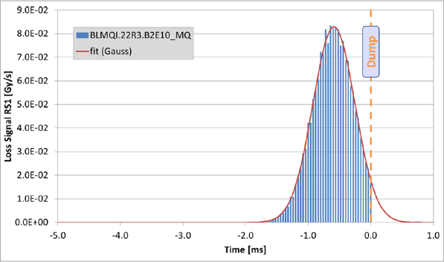
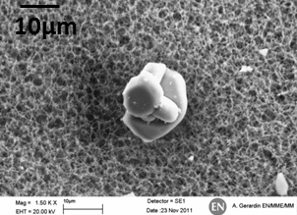
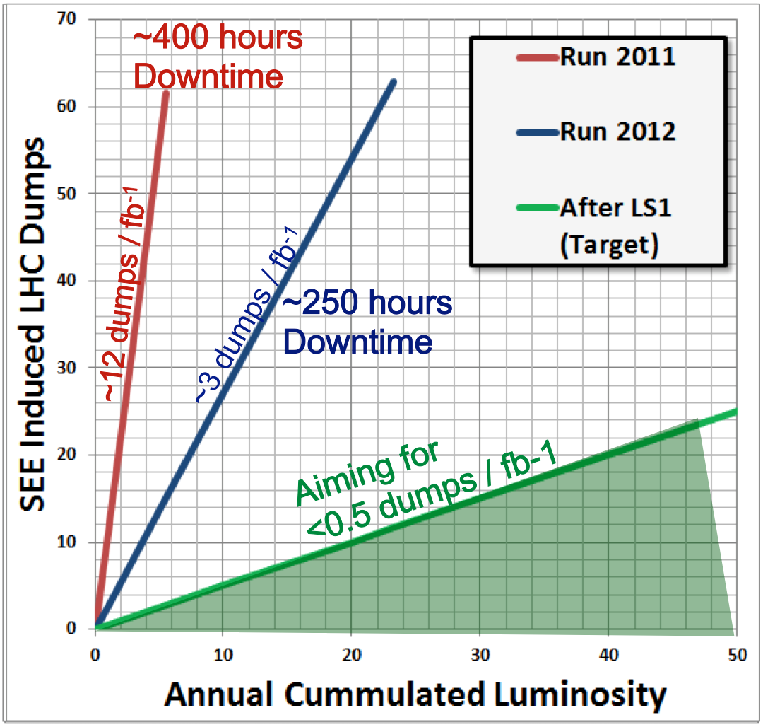
LHC Challenges: Unforeseen Beam Aborts
UFOs
20 dumps in 2012
Timescale 50-200 µs
Al₂O₃ at MKI
Conditioning observed
Worry about 6.5 TeV
Radiation to electronics
Concerted program of mitigation measures (shielding, relocation…)
Premature dump rate down from 12/fb⁻¹ in 2011
to 3/fb⁻¹ in 2012
Al
A. Gerardin, N. Garrel
EDMS: 1162034
O

Slide 28
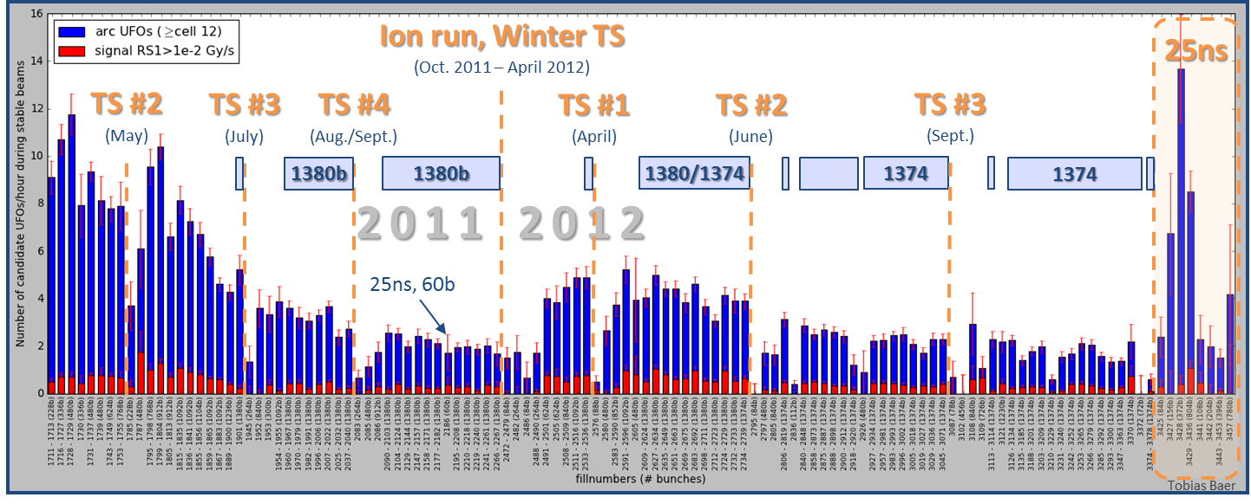
LHC Challenges: ARC UFO rate
2011: Decrease from ≈10 UFOs/hour to ≈2 UFOs/hour.
2012: Initially, about 2.5 times higher UFO rate than in October 2011. UFO rate decreases since then. Up to 10 times increased UFO rate with 25ns.
  Extrapolation to 7 TeV: 91 UFO related beam dumps (2011 data: 112 dumps)

Slide 29
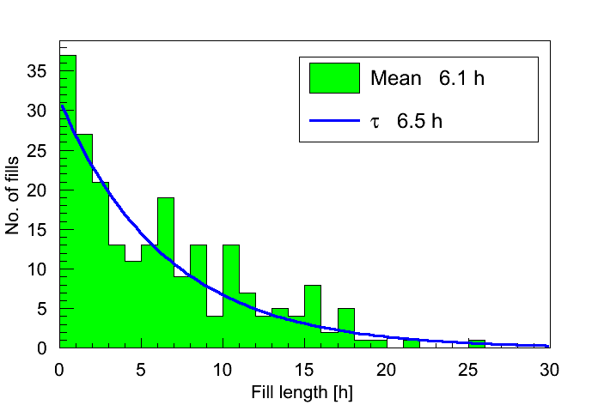
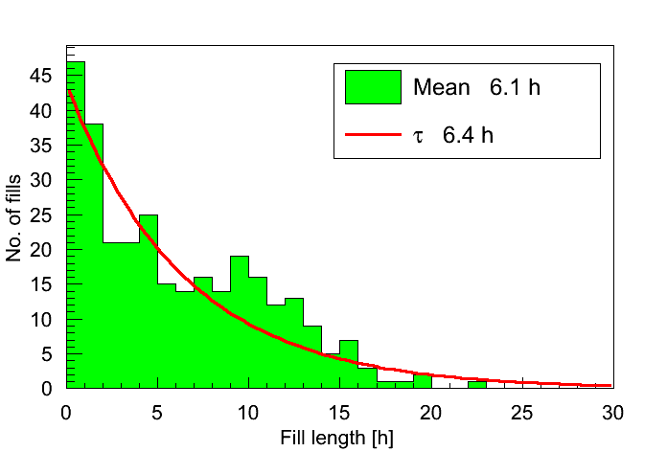
Challenge of Reaching US2 Goals:
Fill lengths in 2011 and 2012 ≈ exponentials.
  ~30% of the fills are dumped by operation.
2011
2012
➔ corresponds to ca. 40% machine efficiency (time actually spend in physics divided by scheduled time for physics operation)

Slide 30
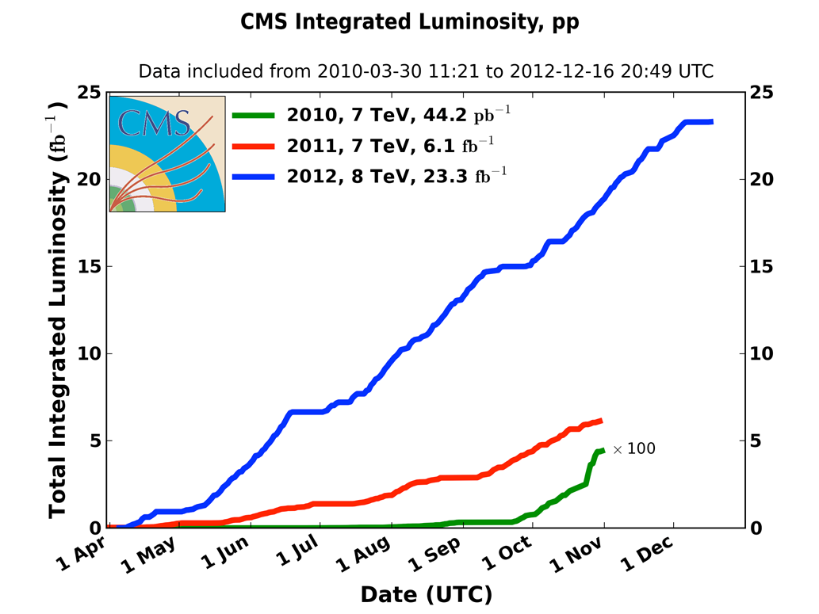
Integrated Luminosity 2010-2012
2010: 0.04 fb⁻¹
  7 TeV CoM
  Commissioning
2011: 6.1 fb⁻¹
  7 TeV CoM
  Exploring the limits
2012: 23.3 fb⁻¹
  8 TeV CoM
  Production

Slide 31
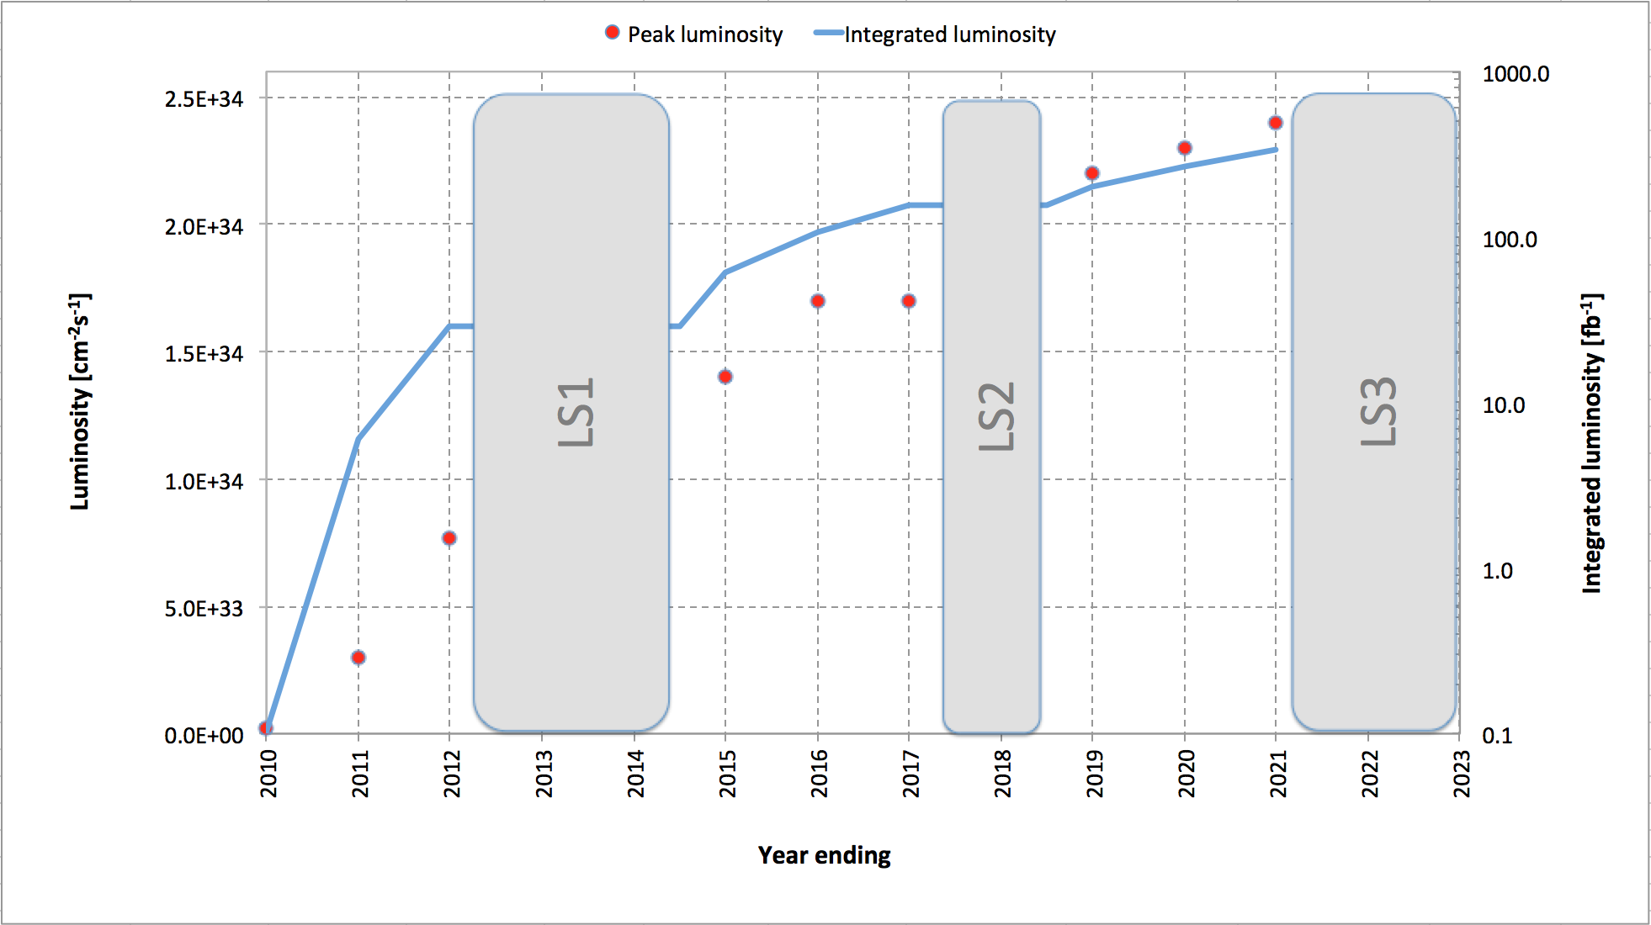
HL-LHC goal:
10 x performance
Increase after LS3
(5 x annual)
Performance Projections:
ca. 23fb⁻¹
prior
LS1
ca.
300fb⁻¹
by
LS3
ca. 40fb⁻¹ – 60fb⁻¹
per year between
LS1 and LS3

Slide 32
LHC Upgrade Goals:
Consolidation activity for assuring running of the LHC & injector complex up into late 2030ies
Prepare the LHC for a total luminosity of ≈ 3000 fb⁻¹
➔ Radiation and R2E
#Shielding and removing equipment from the tunnel
➔ Radiation hardness of magnets (lifetime) & shielding
#e.g. triplet and cleaning insertions
➔ Cryogenic and Cooling
Devise beam parameters for ca. 250 fb⁻¹ / year
System Upgrades for allowing a peak Luminosity of
L > 5 10³⁴ cm⁻² s⁻¹

Slide 33
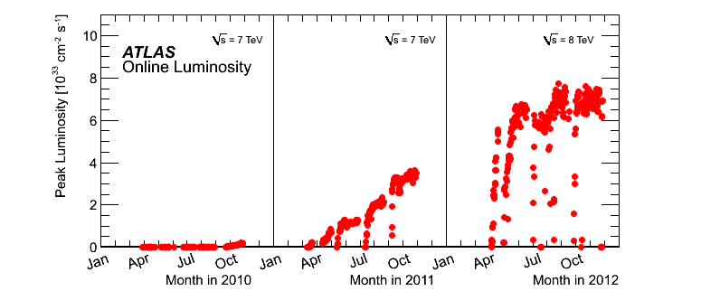
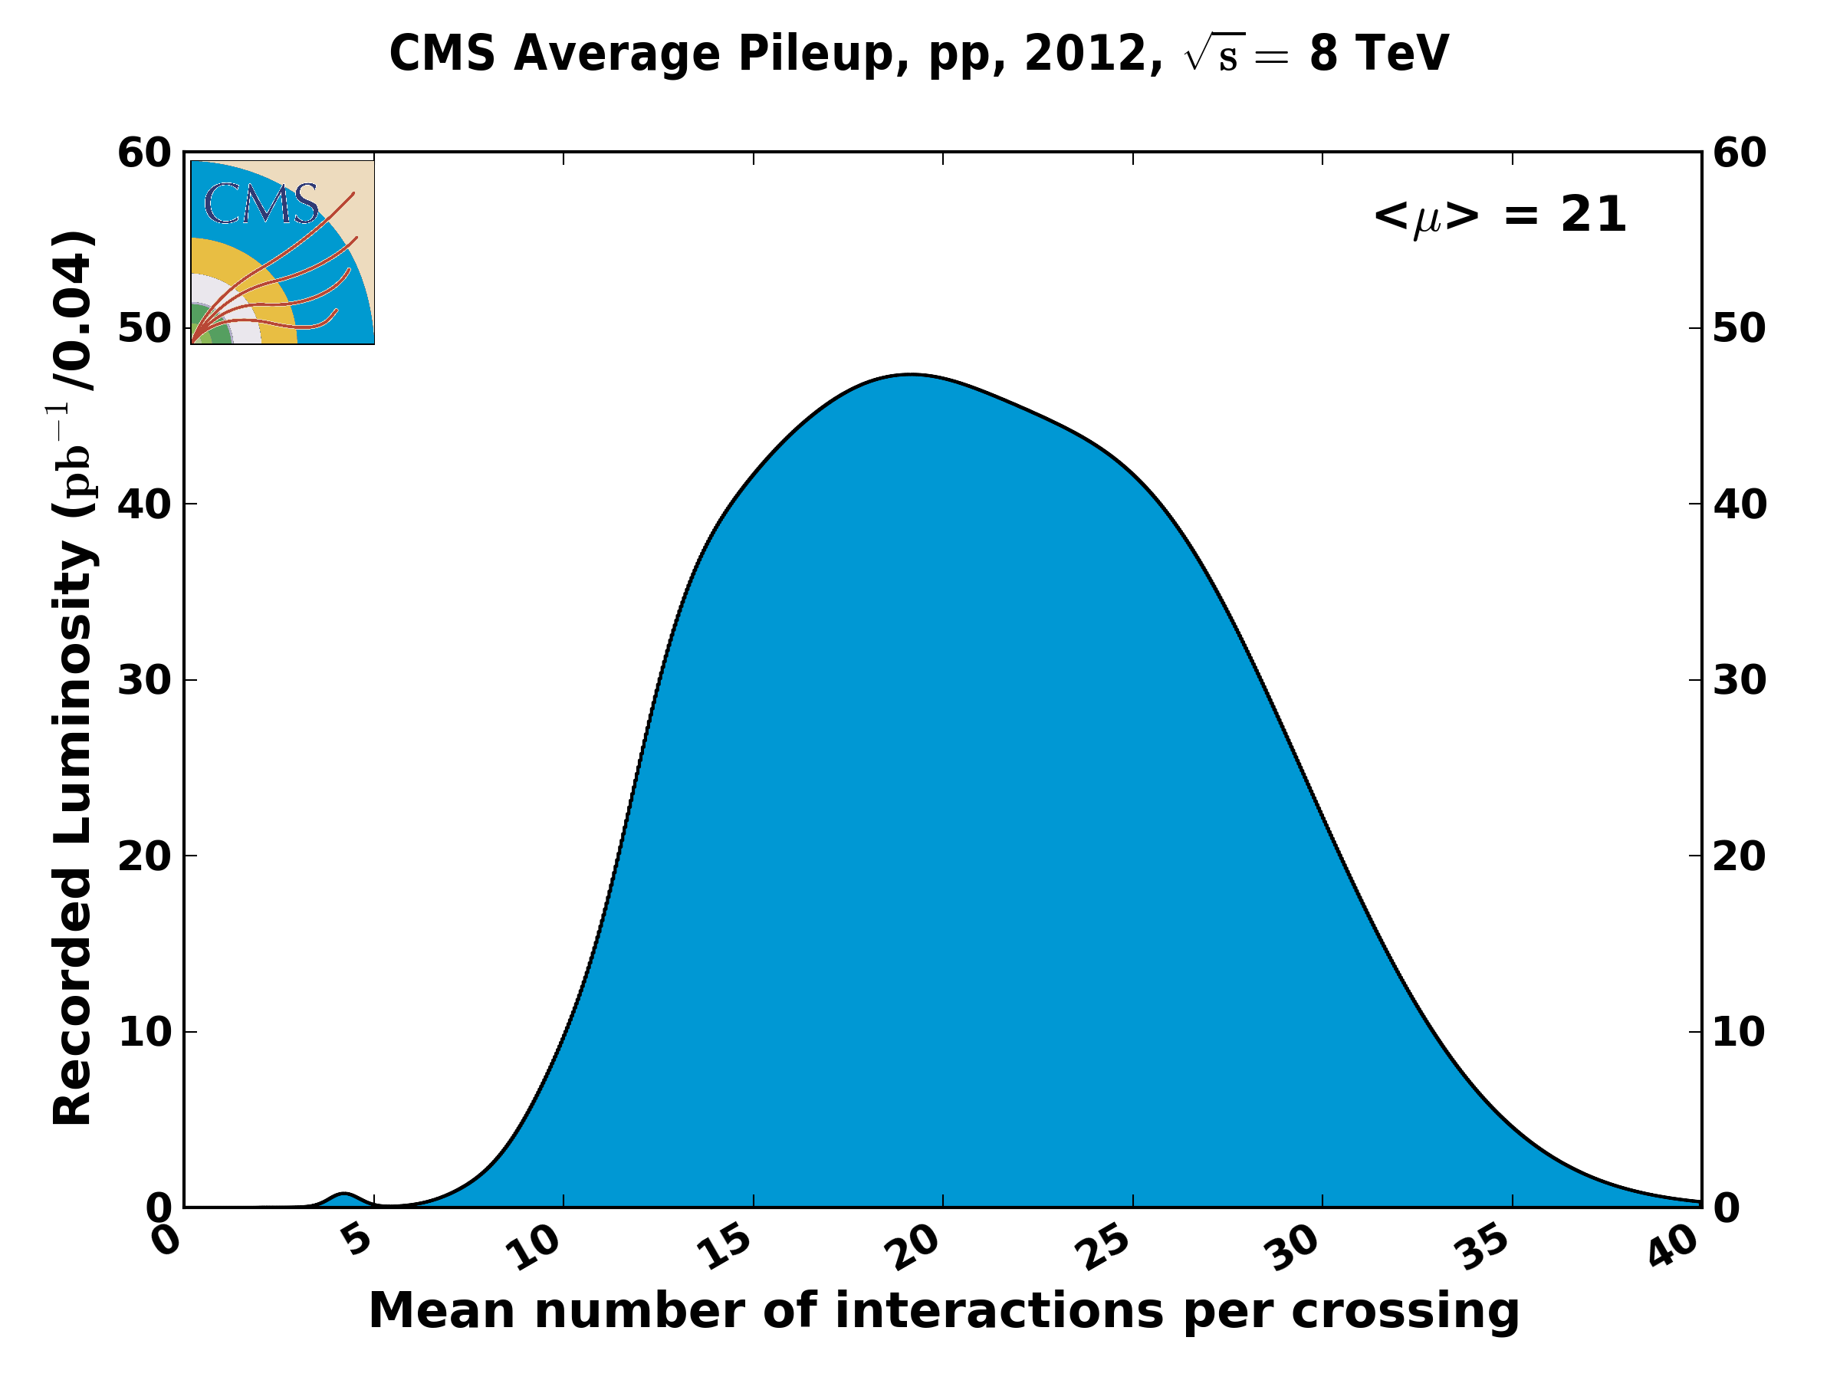
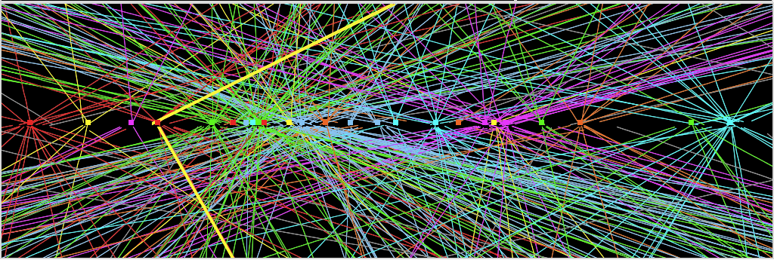
2011: average
12 events/xing,
with tails up to ~20
Use leveling techniques for keeping average
Pileup around 140 events per bunch crossing
➔ level luminosity at 5 10³⁴ cm⁻² s⁻¹
2012: ~30 events/xing
at beginning of fill
with tails up to ~ 40.
Z→ μμ event from 2012 data with 25 reconstructed vertices
Huge efforts over last months to prepare for high lumi and pile-up expected in 2012:
optimized trigger and offline algorithms (tracking, calo noise treatment, physics objects)
→ mitigate impact of pile-up on CPU, rates, efficiency, identification, resolution
in spite of x2 larger CPU/event and event size → we do not request additional computing
resources (optimized computing model, increased fraction of fast simulation, etc.)
Z→ μμ

Slide 34
LHC Upgrade Goals: Performance optimization
Luminosity (round beams):
1) maximize bunch brightness (Injector complex) ➔ [N_{b}/ε_{n}]
2) minimize beam size (constant beam power; aperture)
3) maximize number of bunches (beam power; e-cloud)
4) compensate for ‘R’
Event pileup & e-cloud
Operation at performance limit
choose parameters that allow higher than design performance
leveling mechanisms for controlling performance during run

Slide 35
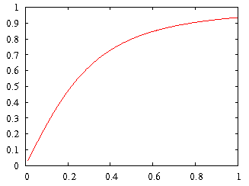
LHC Challenges: Crossing Angle
geometric luminosity
reduction factor:
effective cross section
large crossing angle:
➔ reduction of long range beam-beam interactions
➔ reduction of head-on beam-beam parameter
➔ reduction of the mechanical aperture
➔ reduction of luminous region
➔ reduction of instantaneous luminosity
➔ inefficient use of beam current

Slide 36
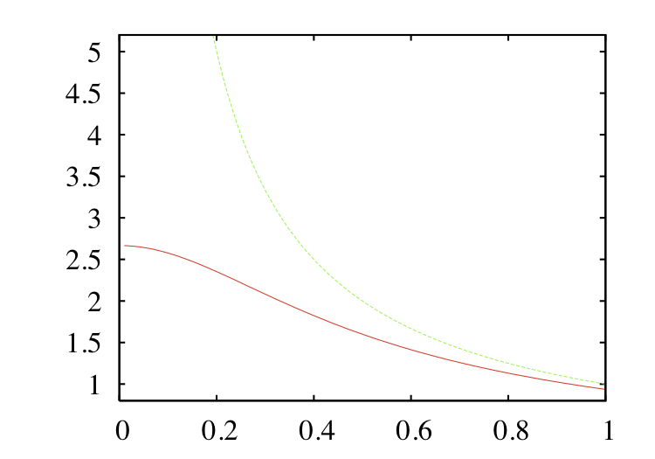
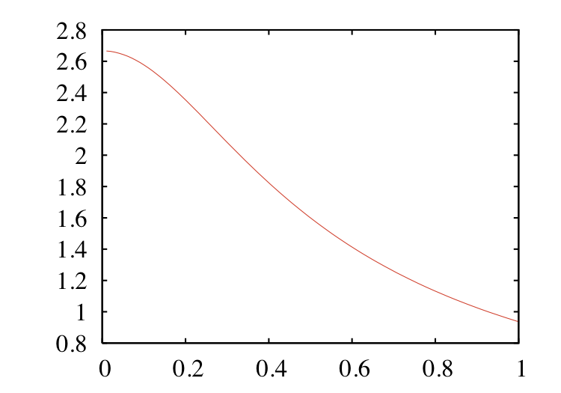
HL-LHC Upgrade Ingredients: β*
Geometric reduction factor: β* = 15cm ➔ 10 cm
1/β*
ca. 40% for β* 0.5m -> 0.25m
ca. 15% for β* 0.3m -> 0.2m
ca. 10% for β* 0.2m -> 0.1m
R(β*)/β*
β*

Slide 37
HL-LHC Upgrade Ingredients: Crab Cavities
Crab Cavities:
Geometric Luminosity Loss
Factor:
Reduces the effect of geometrical reduction factor
Independent for each IP
Noise from cavities to beam?!?
Little experimental evidence that it can work effectively
More details on the RF System for the LHC Upgrade in the lecture by Erk Jensen on Friday
effective cross section
Feasibility needs to be demonstrated in beam tests (SPS)
Underground Infrastructure requirements to be assessed!

Slide 38
HL-LHC Upgrade Ingredients: Triplet Aperture
Geometric reduction factor ➔ β* ≥ 10 cm
1/β*
ca. 40% for β* 0.5m -> 0.25m
ca. 15% for β* 0.3m -> 0.2m
ca. 10% for β* 0.2m -> 0.1m
Need Crab Cavities for full
Exploitation!!!
R(β*)/β*
β*
Triplet aperture:
➔ ca. twice the nom. aperture ➔ Large aperture magnets
➔ β* = 0.15m ➔ σ ≈ 3.5mm inside triplet!

Slide 39
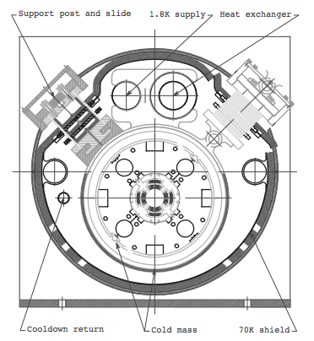
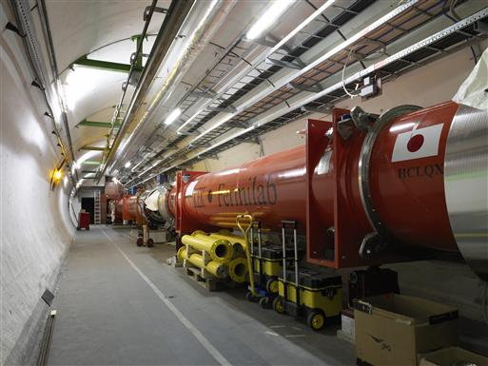
HL-LHC Upgrade Ingredients: Triplet Magnets
LHC triplet: 210 T/m, 70 mm coil aperture
➔ ca. 8 T @ coil (limit of NbTi technology)
➔ 1.8 K cooling with superfluid He (thermal conductivity)
➔ critical current density of 2.75 kA / mm²
At limit of NbTi technology (HERA & Tevatron ca. 5 T @ 2kA/mm²)!!!
LHC Production in collaboration with USA and KEK

Slide 40
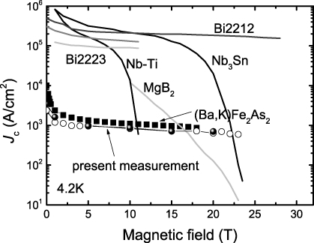
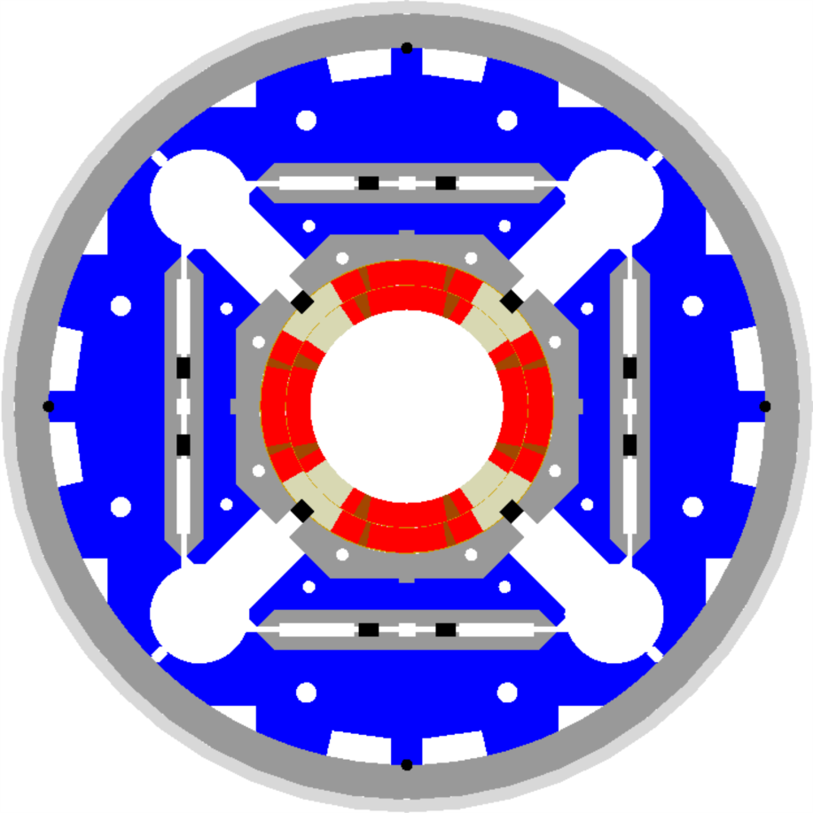
HL-LHC Magnets:
1.8K
LHC triplet:
210 T/m, 70 mm bore aperture
➔ 8 T @ coil (limit of NbTi tech.)
???
More details on superconducting magnet technology and the LHC dipole magnets in the lecture by Paolo Ferracin
HL-LHC triplet:
140 T/m, 150 mm coil aperture
(β* and crossing angle)
➔ ca. 12 T @ coil
  Requires Nb₃Sn technology
  ➔ ceramic type material (fragile)
  ➔ ca. 25 year development of a
  new magnet technology!
  US-LARP – CERN collaboration
US-LARP MQXF magnet design
Based on Nb₃Sn
technology

Slide 41
HL-LHC Upgrade Ingredients
Geometric reduction factor ➔ β* ≥ 10 cm & Crab Cavities
Triplet aperture ➔ New large aperture triplet magnets
Maximize the bunch intensity

Slide 42
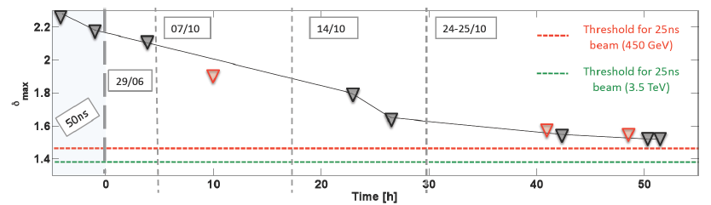
HL-LHC Bunch Intensity: e-Cloud
25 ns scrubbing run in December 2012 provided demonstration of beam scrubbing (reduction in secondary electron yield (SEY) with time due to e-bombardment)
But HL-LHC operation requires SEY < 1.3 for 2 10¹¹ppb!
Feasibility and time required for ‘beam scrubbing’ needs to be validated in next LHC operation RunII

Slide 43
HL-LHC Upgrade Ingredients
Geometric reduction factor ➔ β* ≥ 10 cm & Crab Cavities
Triplet aperture ➔ New large aperture triplet magnets
Bunch intensity ➔ N_{b} = 2.2 10¹¹ (limited in LHC by e-cloud)
➔ injector complex upgrade prerequisite for HL-LHC!!!
Event pile-up in detectors ➔ luminosity leveling
Beam Losses and Radiation ➔ shielding, Cryo upgrade &
relocation of electronics and PC
Collective effects and impedance ➔ Collimator Upgrade
Electron cloud effect ➔ beam scrubbing & feedback

Slide 44
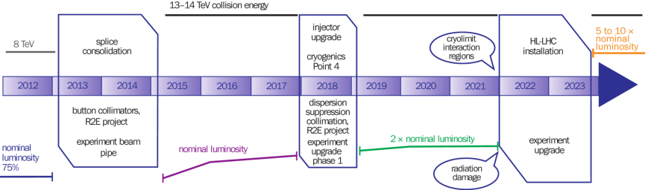
Time Table for HL-LHC Upgrade
(approved early 2011)
Plan modification approved Dec 2013
EYETS
LS2
LS3
0.75 10³⁴ cm⁻²s⁻¹
50 ns bunch
high pile up ∼40
1.5 10³⁴ cm⁻²s⁻¹
25 ns bunch
pile up ∼40
1.7-2.2 10³⁴ cm⁻²s⁻¹
25 ns bunch
pile up ∼60
Technical limits (experiments, too) like :

Slide 45
Upgrade Project Options beyond the HL-LHC:
Medium Term Future:
  Neutrino Program
  LHeC ep collider & Higgs factory
  SAPPHiRE γγ Higgs factory
Long Term Future:
  HE-LHC/VHE-LHC pp/AA collider
  Linear Collider (ILC & CLIC)
  FCC: 100TeV hadron collider and
  e⁺e⁻ Higgs factory
  ep collider…
More details on Project Studies beyond the LHC Upgrade in the lecture by Daniel Schulte (28 & 29 July) and
Patrick Janot (4 & 5 August)

Slide 46
HE-LHC and FCC Challenges
HE-LHC
Use of existing tunnel infrastructure!
Can perhaps bring a factor 2-3 increase in CM collision energy
Magnet technology (15 T – 20 T)?!?
Investment versus physics case?!?!
FCC
Still at early R&D and study stage (20 T magnets!!!)
(magnets, beam power and machine protection, injectors...)
New tunnel would provide synergies with other machines
(e.g. TLEP as a Higgs factory)

Slide 47
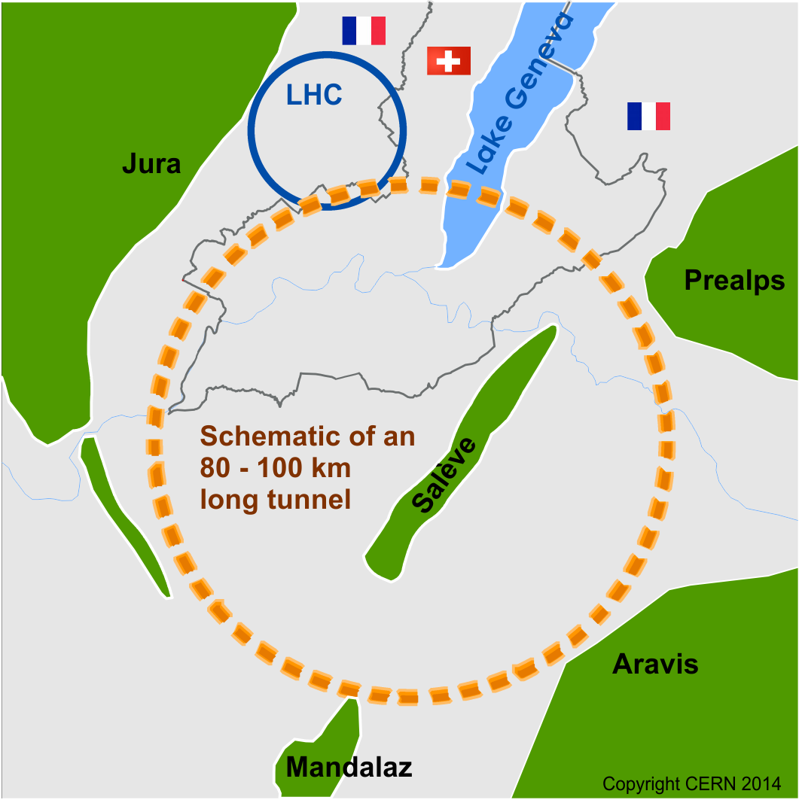
Future Circular Collider (FCC) study ; goals: CDR and cost review for the next European Strategy Update (2018)
International collaboration :
pp-collider (FCC-hh) → defining infrastructure requirements
including HE-LHC option: 16-20 T in LHC tunnel
e⁺e⁻ collider (FCC-ee/TLEP) as potential intermediate step
p-e (FCC-he) option
100 km infrastructure in Geneva area
~16 T ⇒ 100 TeV in 100 km
~20 T ⇒ 100 TeV in 80 km
M. Benedikt

Slide 48
Reserve Transparencies

Slide 49
HL-LHC Ingredients: Leveling
Transverse offsets of the beams at the IP.
  tested in 2011 with HL-LHC parameters single bunches and in 2012 with present LHC
  worry about beam-beam: instabilities, emittance growth
The use of crab cavities for manipulating the beam overlap of the two beams in the luminous region ➔ constant density!
Manipulation of the external crossing angle of the two beams
  e.g. with the help of partial compensation of the long-range beam-beam interactions in the common vacuum system with the help of wires
Dynamic change of the beta* ➔ full beam-beam effect for the beams!
Bunch length variation
Or combinations of the above

Slide 50
HL-LHC Performance Estimates
HL-LHC-LIU baseline parameters:
Parameter | nominal | 25ns | 50ns
N | 1.15E+11 | 2.2E+11 | 3.5E+11
n_{b} | 2808 | 2808 | 1404
beam current [A] | 0.58 | 1.12 | 0.89
x-ing angle [μrad] | 300 | 590 | 590
beam separation [σ] | 9.9 | 12.5 | 11.4
β* [m] | 0.55 | 0.15 | 0.15
ε_{n} [μm] | 3.75 | 2.5 | 3.0
ε_{L} [eVs] | 2.51 | 2.51 | 2.51
energy spread | 1.20E-04 | 1.20E-04 | 1.20E-04
bunch length [m] | 7.50E-02 | 7.50E-02 | 7.50E-02
IBS horizontal [h] | 80 -> 106 | 18.5 | 17.2
IBS longitudinal [h] | 61 -> 60 | 20.4 | 16.1
Piwinski parameter | 0.68 | 3.12 | 2.85
geom. reduction | 0.83 | 0.305 | 0.331
beam-beam / IP | 3.10E-03 | 3.3E-03 | 4.7E-03
Peak Luminosity | 1 10³⁴ | 7.4 10³⁴ | 8.5 10³⁴
Virtual Luminosity | 1.2 10³⁴ | 24 10³⁴ | 26 10³⁴
6.2 10¹⁴ and 4.9 10¹⁴
p/beam
sufficient room for leveling
(with Crab Cavities)
Virtual luminosity (25ns) of
L = 7.4 / 0.305 10³⁴ cm⁻² s⁻¹
= 24 10³⁴ cm⁻² s⁻¹ (‘k’ = 5)
Virtual luminosity (50ns) of
L = 8.5 / 0.331 10³⁴ cm⁻² s⁻¹
= 26 10³⁴ cm⁻² s⁻¹ (‘k’ = 10)
(Leveled to 5 10³⁴ cm⁻² s⁻¹
and 2.5 10³⁴ cm⁻² s⁻¹)
Events / crossing (peak & leveled L) | 19 -> 28 | 207 | 476 | 140 | 140
Notes:
50ns beam option provides HL-LHC performance levels at ultimate total beam currents; only the ‘large beta*’ option reaches beam-beam limit; IBS growth rates are a concern!; low beta option has 50% higher performance potential

Slide 51
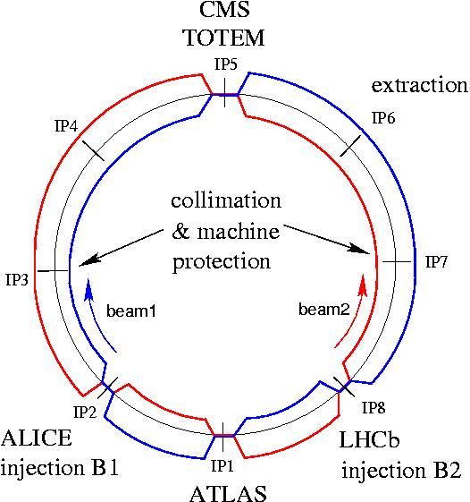
LHC Layout and Main Parameters
2-in-1 magnet design
p-p & Pb-Pb collisions
7 TeV p-beam energy
➔ > 1 TeV CM energy
➔ Higgs discovery
2 high L experiments with
L = 10³⁴ cm⁻² sec⁻¹
➔ 2808 bunches / beam
with 1.15 10¹¹ ppb
2 low L experiments:
ALICE (Pb-Pb) & LHCb

Slide 52
Main Challenges for the Operation
Mechanical aperture
Magnetic field perturbations & field quality
Beam power and machine protection
Collective effects and impedance
Triplet aperture and beam-beam
Electron cloud effect

Slide 53
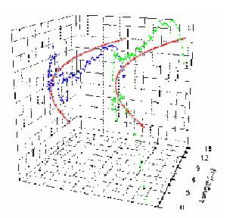
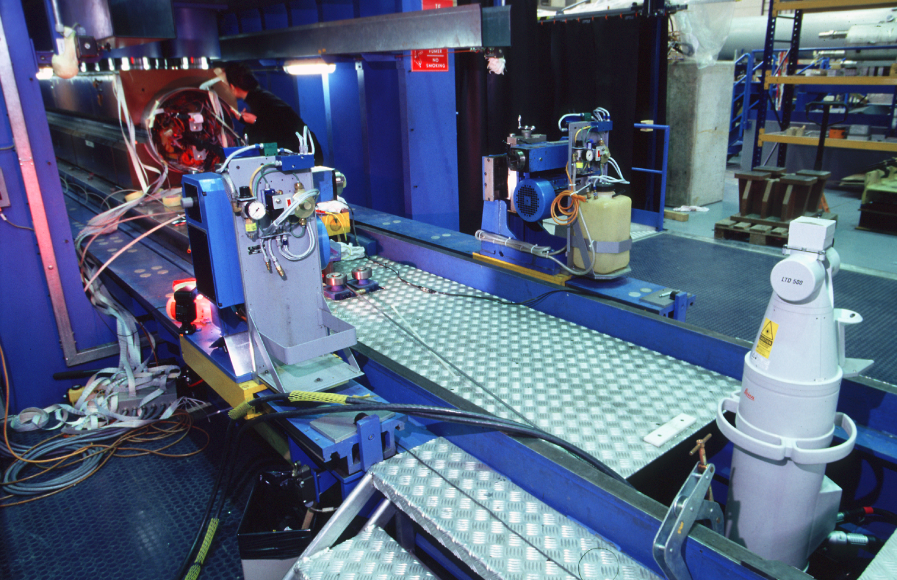
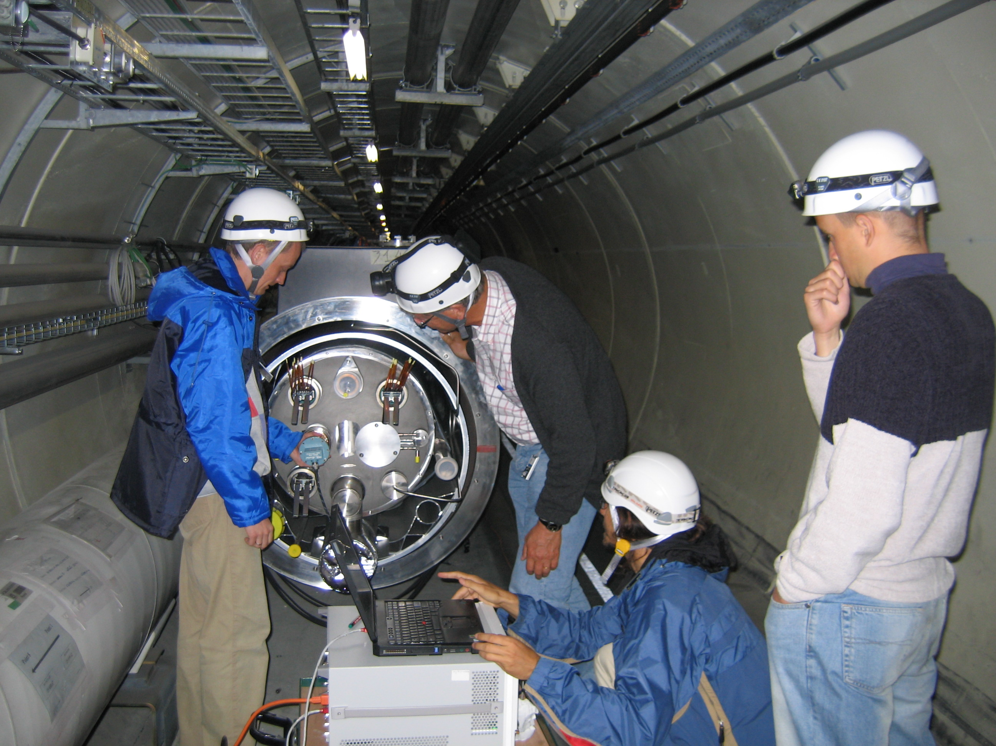
LHC Challenges: Aperture
all magnets are geometrically measured
classification & slot compatibility
for installation at critical locations
microwave reflectrometer:
detection of obstacles

Slide 54
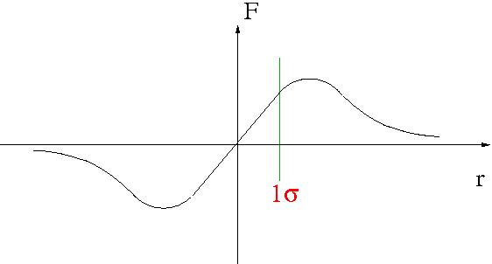
LHC Challenges: Field Quality & Resonances
linear beam-beam force:
additional focusing
for small amplitudes
perturbation is proportional to
bunch intensity!
strong non-linear field:
tune & perturbation depends on oscillation amplitude
bunch intensity limited by non-linear resonances

Slide 55


LHC Challenges: Field Quality & Resonances
tune: Q = number of oscillations per revolution
resonances: n Q_{x} + m Q_{y} + r Q_{s} = p; “order” = n+m+r
Q_{y}
Q_{y}
Q_{x}
Q_{x}
limited accessible area; limit for field quality and ΔQ tolerance

Slide 56
LHC Challenges: Field Quality & Resonances
LHC working point: n+m < 12
Q_{x} = 64.31; Q_{y} = 59.32
total tune spread must be
smaller than 0.015!
Q_{y}
Q_{x}
The LHC features 3 proton experiments with
Bunch intensity limited by beam-beam force:
nominal: N < 1.15 10¹¹
N < 1.5 10¹¹
ultimate: N < 1.7 10¹¹

Slide 57

LHC Challenges: Errors & Resonances
presistent current errors
change with time (30%)
-decay varies
between magnets
-control spread during
production
-average errors depend
on powering history
correction circuit powering must change during operation
-operation requires correction on % level
-> procedures; field error data base & beam instrumentation!

Slide 58
LHC Challenges: Electron Cloud 3/3
During 25 ns scrubbing run last December the reduction in the secondary electron yield (SEY) flattened out
A concentrated scrubbing run will probably be insufficient to fully suppress the EC from the arcs for 25 ns beams in future operation.

Slide 59

Summary of LHC Intensity Limits (7 TeV)
R. Assman @ Chamonix 2010
HL-LHC
R. Assmann
Single bunch stability limit

Slide 60

Changing 300x2 m both ATLAS & CMS
(recent requests from LHC-b & Alice to be examined)
More details on superconducting triplet magnets and Crab Cavities in the lectures by Paolo Ferracin and Erk Jensen
In total > 1.2 km of LHC for all IRs!!

Slide 61




Cryogenic Upgrade
6.5 kW@4.5K cryoplant
2 x 18 kW @4.5K cryoplants for IRs

Slide 62
LHC Challenges: Unforeseen Beam Aborts
Radiation to electronics
Concerted program of mitigation measures (shielding, relocation…)
Premature dump rate down from 12/fb⁻¹ in 2011
to 3/fb⁻¹ in 2012

Slide 63


LHeC: Baseline Linac-Ring Option
Challenge 1: Super Conducting Linac with Energy Recovery
& high current (> 6mA)
Two 1 km long SC
linacs in CW operation (Q > 10¹⁰)
requires Cryogenic
system comparable
to LHC system!
Challenge 2: Relatively large return arcs
    ca. 9 km underground tunnel installation
    total of 19 km bending arcs
    same magnet design as for RR option: > 4500 magnets

Slide 64
HE-LHC:
HE-LHC
20-T dipole magnets
SPS+
higher energy
transfer lines
2-GeV Booster
Linac4
CERN Summer School July 2013
Oliver Brüning/CERN AB-ABP 64

Slide 65

FCC:
FCC-hh
20-T dipole magnets
FCC-ee

Slide 66

80-100 km tunnel: Geneva option

