Slide 1
Protection of ALICE against head on collisions Introduction
A. Di Mauro (CERN)
MPP meeting, 16/05/2014

Slide 2
ALICE requirements for RUN2
Physics
Minimum bias ~ 2∙10²⁹ Hz/cm² (rate ~ 15 kHz)
If bkgd rate >> collision rate → MB ~ 2∙10³⁰ Hz/cm²
Rare triggers ~ 7∙10³⁰ Hz/cm² (rate ~ 500 kHz)
Max pile-up for RUN2: μ = 0.01
Detector safety
The 8 gaseous detectors (TPC, TRD, TOF, HMPID, MCH, MTR, PMD, CPV) are protected against sparking by current trip thresholds in HV power supplies
High luminosity is equivalent to large currents in the HV-PS
Increasing current trip thresholds could weaken the protection in case of “diverging events”
Max tolerable rate: ~ 700 kHz ~ 1 ∙10³¹ Hz/cm²

Slide 3
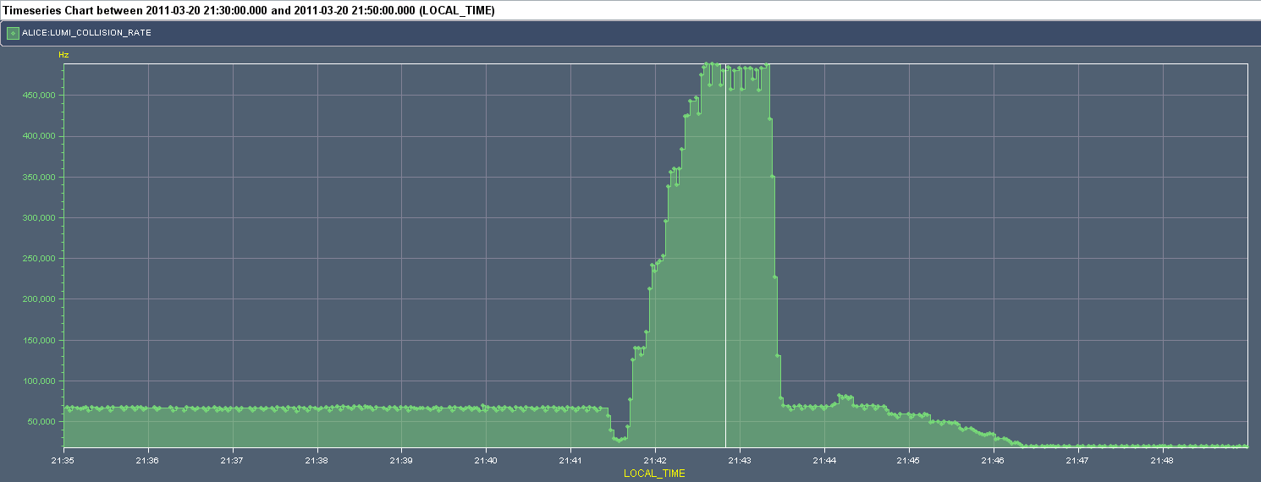
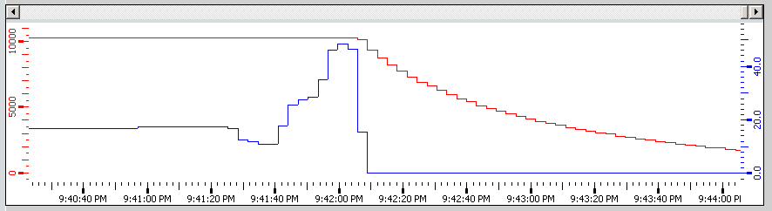
Lumi jump on March 20, 2011 @ 21:42
FILL 1640, Stable Beams
75ns_136b+4small_138_102_105_24bpi11inj
Beams head-on by mistake (scan in H plane!)
Target rate ~ 20 KHz
μ-TRIG RPC chambers tripped, all other gaseous detectors approached the trip limit

Slide 4
From BE-OP logbook 20/03/2011 21:47
“Optimized Alice (first started an optimization in H by mistake, cancelled). Then separated to the desired 0.36.
To avoid such mistakes in the future, correct Alice to the value they desire first, and only then declare stable beams.
To avoid they get too much luminosity, which risks tripping parts of their detectors...”

Slide 5
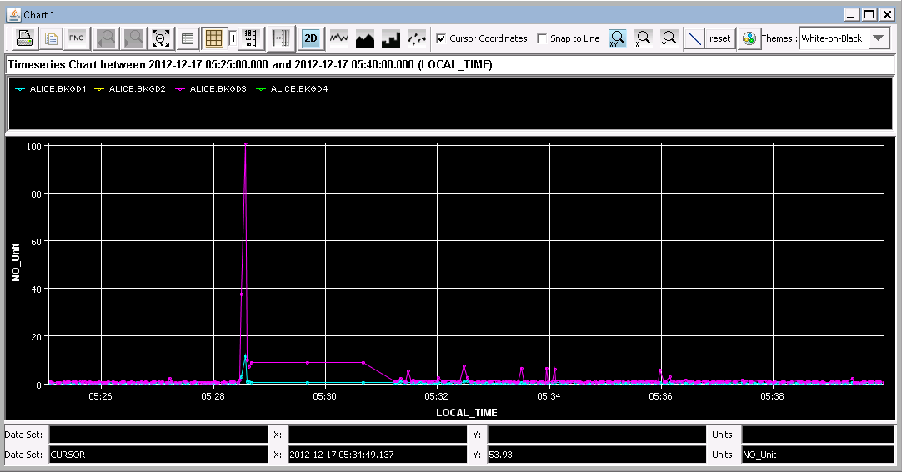
Lumi jump on Dec 17, 2012 @ 05:28
FILL 3457, Adjust
BCM RS32 (ALICE:BKGD3) just above dump threshold, all detectors were in stand-by

Slide 6
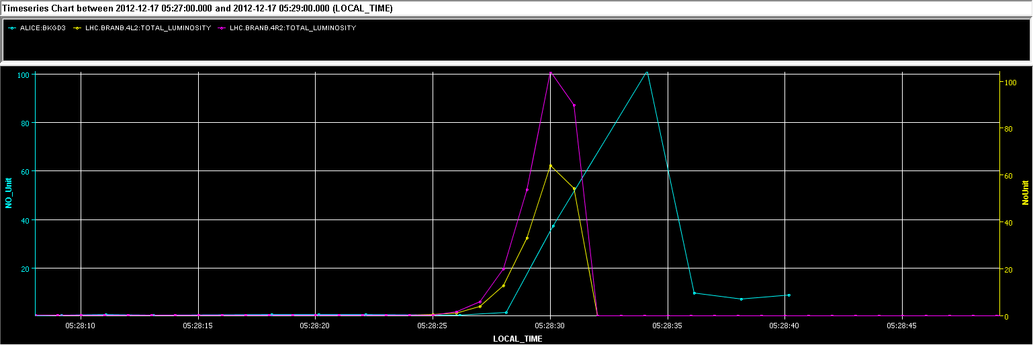
BCM thresholds
On FILL 3457 dump ALICE luminometer (V0 detector) was not ON → try to use BRANs to extrapolate collision rate/luminosity corresponding to BCM thresholds

Slide 7
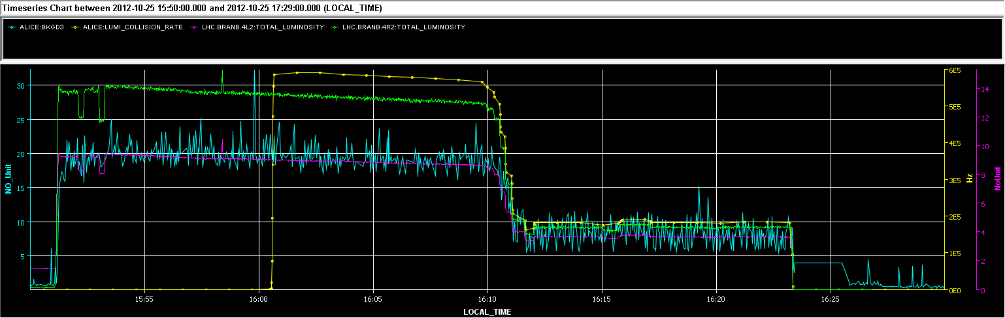
FILL 3220
FILL/DATE | ALICE BKGD3 (% of dump threshold, BCM RS32) | BRAN.4R2/4L2 | Collision rate | Luminosity
3220, 25/10/12 16:02 | 20% | 13/8.6 | 590 kHz | 8.4∙ 10³⁰ Hz/cm²
3220, 25/10/12 16:16 | 9% | 4.1/3.3 | 186 kHz | 2.7∙ 10³⁰ Hz/cm²
3457, 17/12/12 05:28 | 101% | 104/66 | 4.65/ 3.7 MHz | 6.6/ 5.3∙ 10³¹ Hz/cm²
(4R2 scales linearly with rate)

Slide 8
Possible solutions
Use lumi-levelling with “intrinsic” soft protection
Implement in DCS detectors ramp-down on sudden luminosity increase (could be not fast/smart enough)
Reduce BCM dump threshold to value equivalent to 10 ³¹ Hz/cm² ?
Any other option?

