Slide 1
Bubble Chamber Workshop
Group 2

Slide 2
Who is this presentation for?
Students in grade 12 or 1st year university (depends on the country and the program)
Prerequisite knowledge:
  Electric and magnetic fields
  Conservation of charge
  Conservation of linear momentum in 2D
  Lorentz force, trajectory of charged particles in perpendicular magnetic fields (i.e. hand rule!)

Slide 3
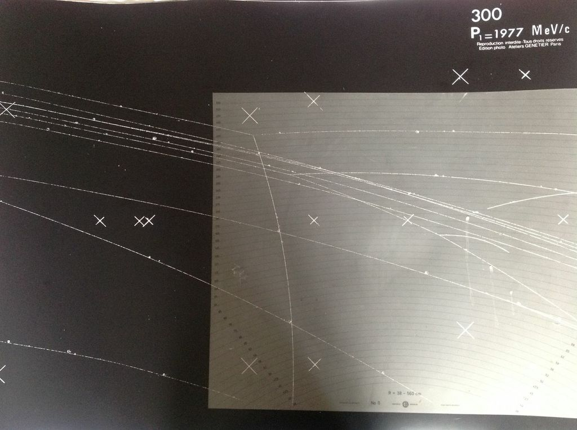
Resources

Slide 4
Activity
What do you see?

Slide 5
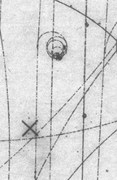
Mini-lesson
Which way are the smallest, spiraling tracks going within an individual photo? These are all made by electrons.

Slide 6
Activity
What are the other tracks doing? What are their charges? What is the charge of the incoming beam?

Slide 7
Mini-lesson
A bubble chamber is filled with liquid hydrogen gas.
The particles that make up the incoming beam collide with the protons in the hydrogen gas. Protons are always the target.
How do we apply conservation of charge to these interactions?

Slide 8
Activity: Applying cons. of charge
Go back to your photographs….does using conservation of charge predict the same charges as you got previously from using the radius?

Slide 9
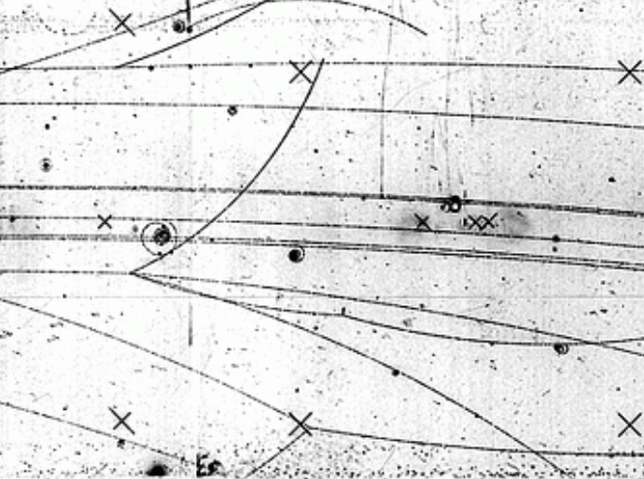

Slide 10
Mini-lesson
Radius can be used to determine the momentum of the particle that made a track

Slide 11
Activity
Measure the radius of each track.
Use the radius to determine the momentum of the particle that made each track.

Slide 12
Mini-lesson
How do we analyze the momentum of linear collisions in 2D?

Slide 13
Activity
Set x and y axis on your photograph. Using a protractor to measure angles, measure the total momentum in the x and in the y before and after the collision.

Slide 14
Mini-lesson
Why was momentum not conserved in some of the photographs?
  Interaction might not be in the plane of the photograph
  A neutral particle may have carried some of the “missing” momentum

Slide 15
Links to the LHC

