Slide 1

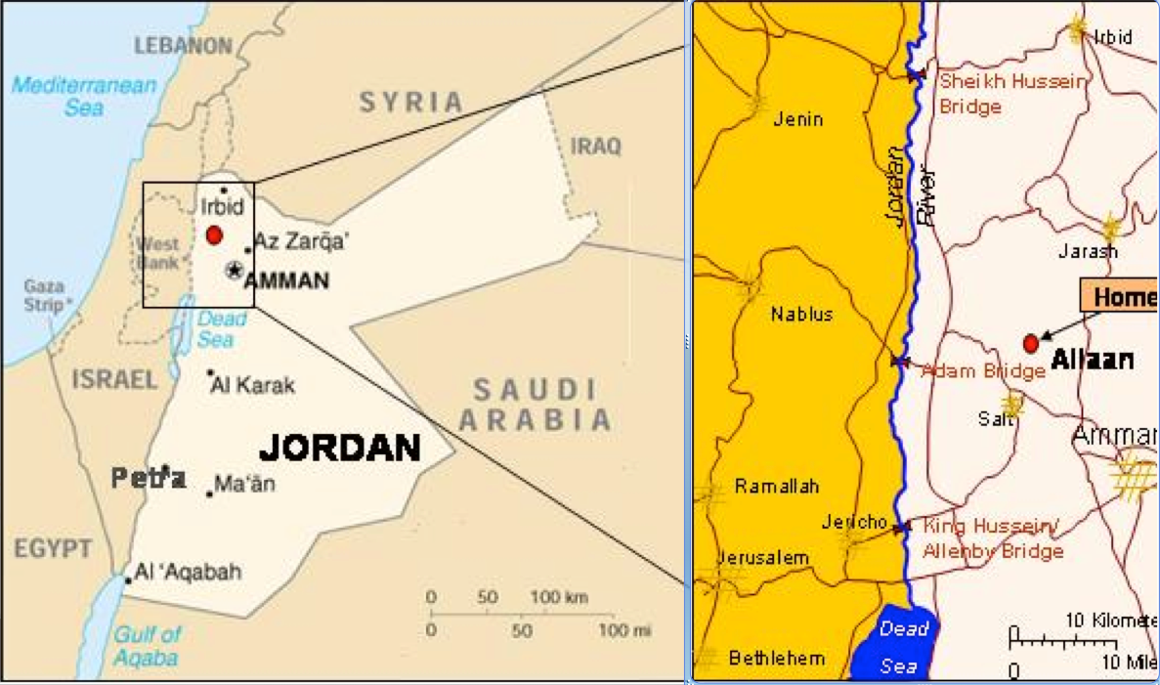
WORKING GROUP “SESAME”
Synchrotron Light for Experimental Science and Applications in the Middle East
A “CERN” in the Middle East
http://www.sesame.org.jo/sesame/

Slide 2

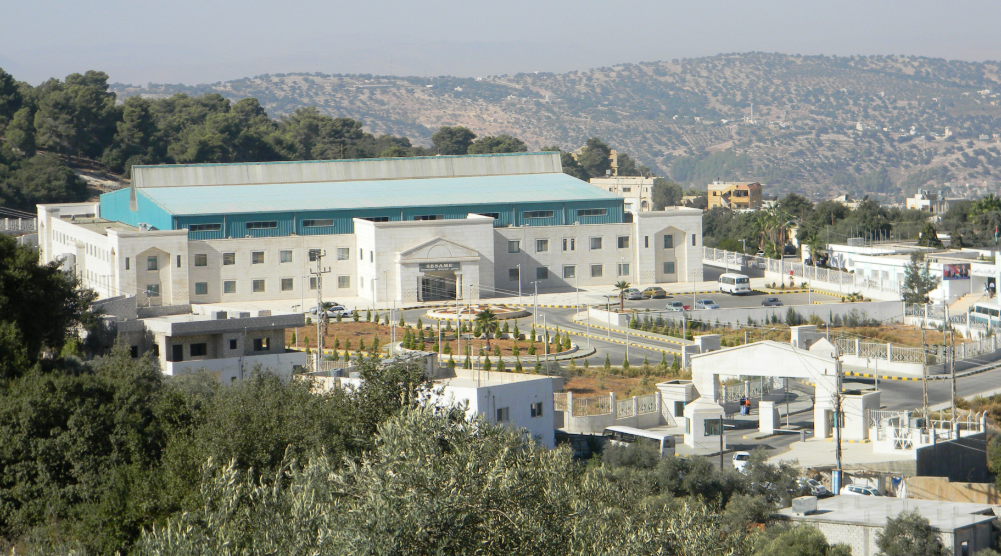
SESAME
International research centre in construction in Jordan
developed under the auspices of UNESCO and modelled on CERN
to enable world-class research by scientists from across the Middle East
- biology & medical sciences
- materials & environmental science & physics
- archaeology
build bridges between diverse societies
contribute to a culture of peace through international cooperation in science.

Slide 3
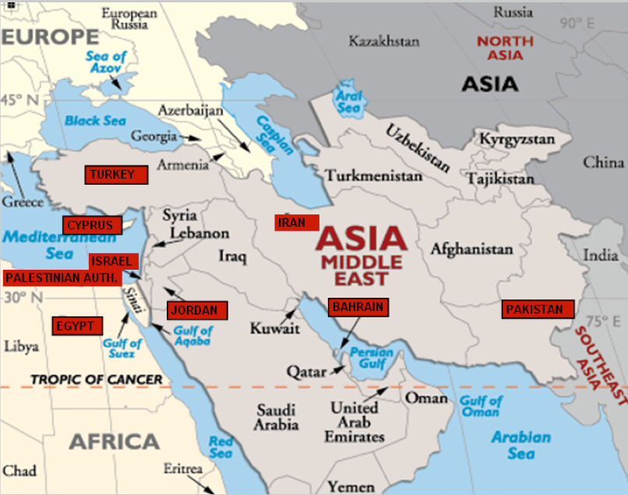
SESAME Members
Bahrain, Cyprus, Egypt, Iran, Israel, Jordan, Pakistan, Palestinian Authority, and Turkey

Slide 4
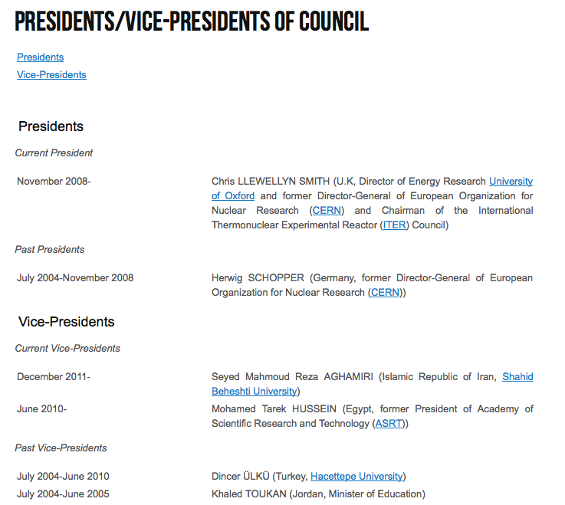

Slide 5
SESAME Working Group - ROAD MAP
Produce 2-3 lesson plans for your school classes on SESAME
Suitable for 14-15 year olds, possible extension to 16-18 years
Inspiring and motivating, not (too) much mathematics
Some possible ingredients: …..

Slide 6
1 - SESAME = Synchrotron Light Source
What is a synchrotron, how does it work (2.5 GeV electron storage ring)
What is synchrotron light - how is it produced?
What type of experiments can be done with it?
3-4 examples from different scientific disciplines
2 - SESAME Experiments
What type of experiments can be done with synchrotron light?
Examples from different disciplines:
Material science
Molecular biology
Archeology
Medicine
Environmental studies
Micromechanics

Slide 7
3 - SESAME = Peaceful collaboration, like at CERN
The history of SESAME (1997-2014)
The history of CERN - and parallels with SESAME
Collaborating countries, and their respective roles
Collaboration of scientists from different countries
Which university/research institute near you participates in SESAME?

