Slide 1
SESAME
Working Group 5
Boulous Nadia Reuven Yossi
Soleyman Itaf Mahmoud Emily

Slide 2
SESAME
Synchrotron-light for Experimental Science and Applications in the Middle East

Slide 3
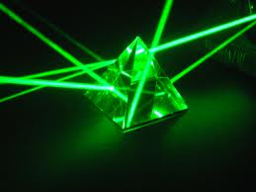


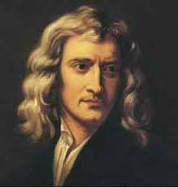
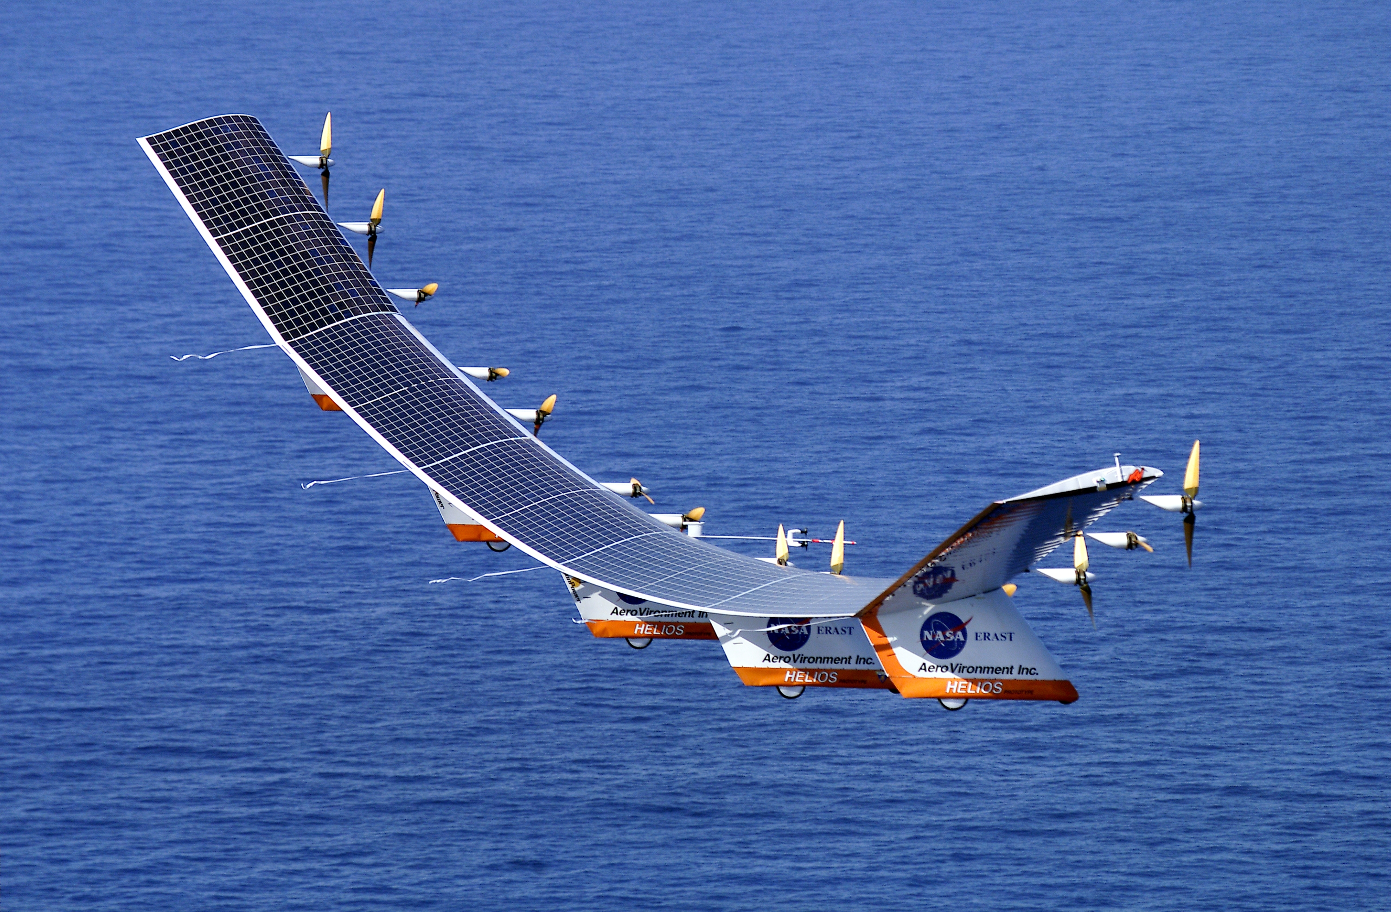
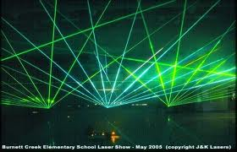

Slide 4
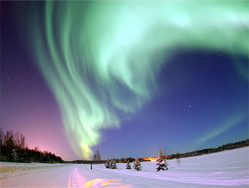


Slide 5
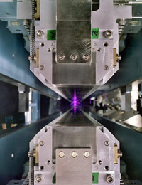
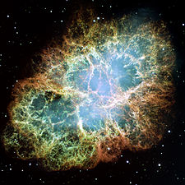
Synchrotron Light
Notes:
Synchrotron radiation is the name given to the radiation which occurs when charged particles are accelerated in a curved path or orbit. Classically, any charged particle which moves in a curved path or is accelerated in a straight-line path will emit electromagnetic radiation. Various names are given to this radiation in different contexts. For example, when is occurs upon electron impact with a solid metal target.
The Crab pulsar is slowing at the rate of about 10⁻⁸ sec per day, and the corresponding energy loss agrees well with the energy needed to keep the nebula luminous. Some of this luminosity takes the form of synchrotron radiation, requiring a source of energy for accelerating charged particles.

Slide 6
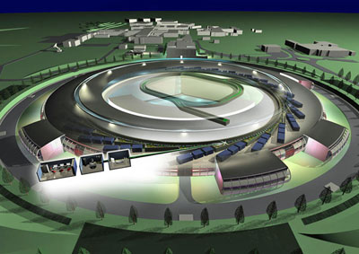
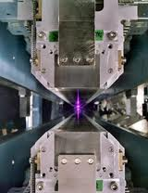

Slide 7
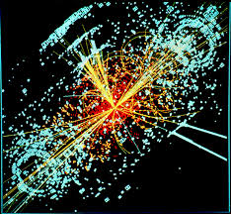

Slide 8

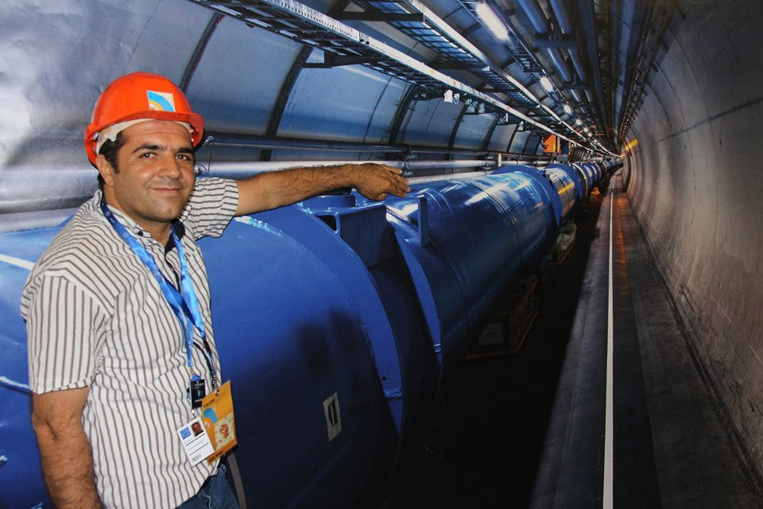

Slide 9
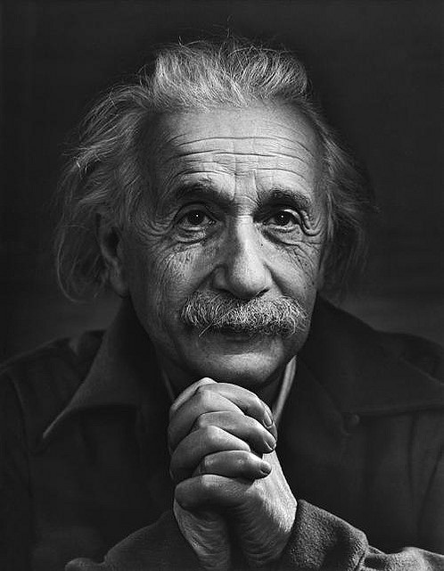
Peace cannot be kept by force, it can only be achieved by understanding.
- Albert Einstein

Slide 10

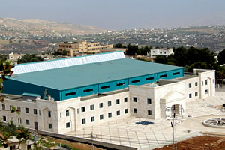

Slide 11











Slide 12
Lesson Plans
What is Synchrotron Light?
What are the applications of Synchrotron Light?
How is Synchrotron Light created?

Slide 13

What is Synchrotron Radiation

Slide 14
Objectives
Students should be able to:
Define Synchrotron radiation.
Comprehend the formation of it.
Mention the Synchrotron parts.
Comprehend how does it work.

Slide 15
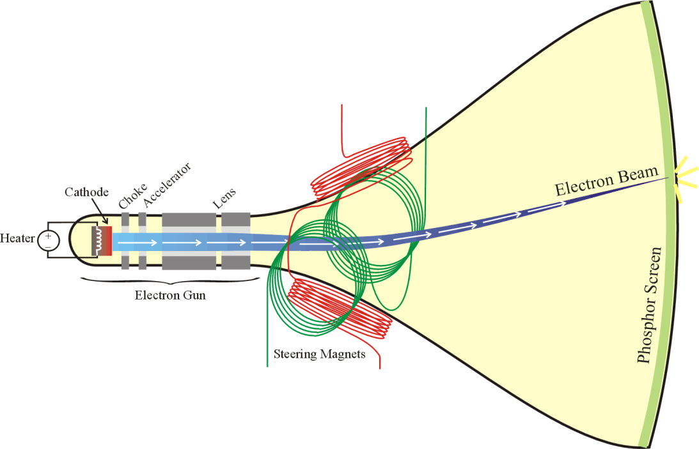
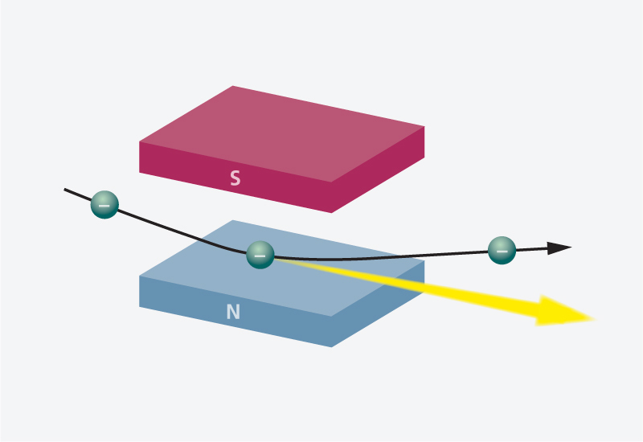

Synchrotron Radiation
For more details
Notes:
Brainstorming & Classroom Discussion, then after that, they should be able to define it.
Synchrotron radiation is the name given to the radiation which occurs when charged particles are accelerated in a curved path or orbit.

Slide 16
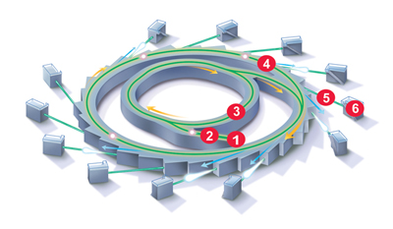
Parts of Synchrotron
(1) Electron gun (2) LINAC (3) Booster ring (4) Storage ring (5) Beamline (6) End station
Notes:
Explain the function of each part.
After that, they should be able to mention the parts.

Slide 17

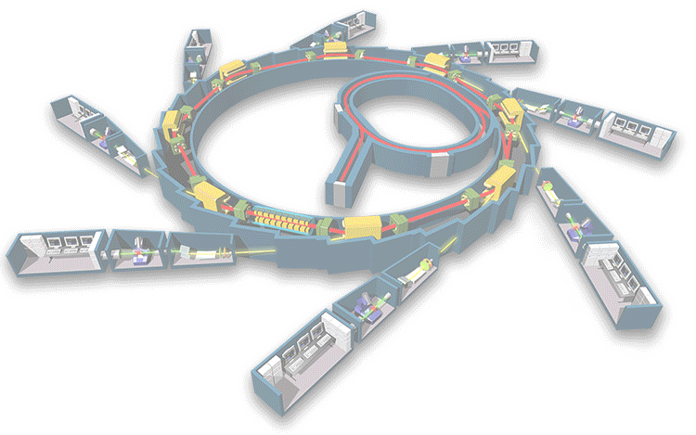
How does it work
Video
Notes:
Video, http://youtu.be/_xv_GwCgpAc
Spring8 in Japan

Slide 18


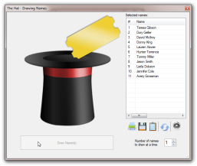

Slide 19


Slide 20


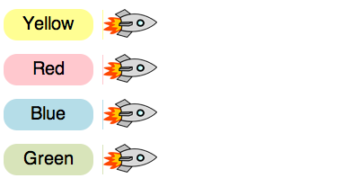
m.socrative.com
Room #
719562
Notes:
Game + Quiz via socrative

Slide 21



Different Teaching Resources
Cartoons Videos Animations
Pictures Models Websites
Software Internet

Slide 22
How is synchrotron light created?

Slide 23
Ask students what?
Ask students why?
Ask students how?
Notes:
Ask students what?
Ask students why?
Ask students how?

Slide 24
Outline
Relevant charged particles
Electron production
How to provide kinetic energy to electrons
How to confine electrons
Synchrotron radiation
Layout of the experimental area
Applications

Slide 25
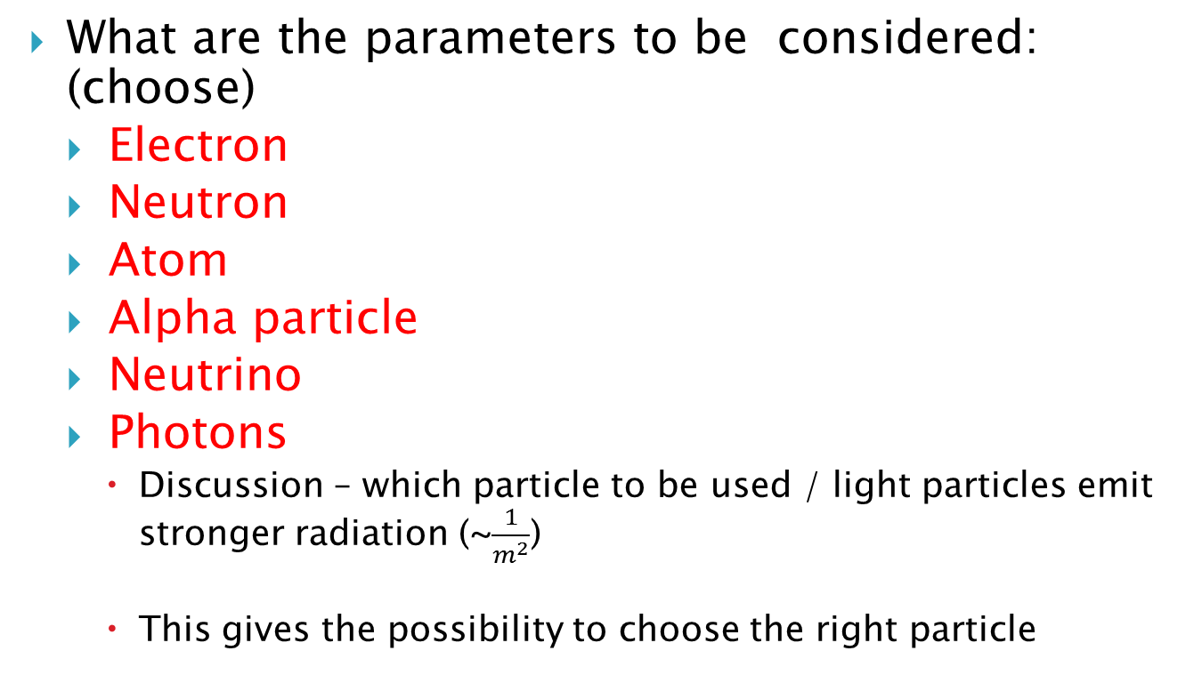
List of relevant charged particles
What are the parameters to be considered: (choose)
Electron
Neutron
Atom
Alpha particle
Neutrino
Photons
    Discussion – which particle to be used / light particles emit stronger radiation (~$\frac{1}{m^{2}}$)
    This gives the possibility to choose the right particle
Notes:
$$P\left(\frac{erg}{s}\right)=\frac{2e^{4}}{3m^{2}c^{3}}B^{2}{(Gauss)γ}^{2}$$
$$γ=\frac{1}{\sqrt{1−\frac{v^{2}}{c^{2}}}}$$

Slide 26
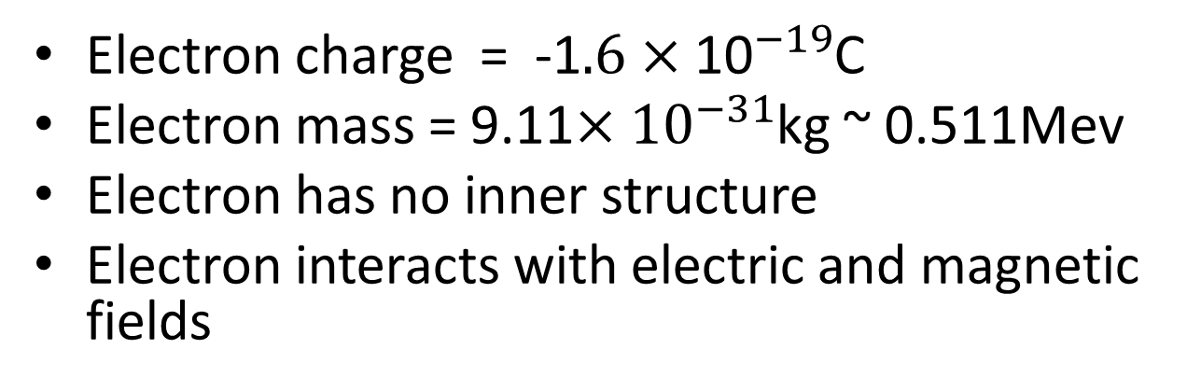
Concepts and definitions
Electron charge = -1$.6×{\text{10}}^{−19}$C
Electron mass = 9.11$×{10}^{−31}$kg ~ 0.511Mev
Electron has no inner structure
Electron interacts with electric and magnetic fields
Notes:
Discussion: when should we use electric forces and magnetic forces.
Two objectives: provide relativistic kinetic energy to the electrons (2.5 GeV) and confined them in a storage ring in order to use the radiation emitted by the electrons.
Charge, mass, Magnetic force.
$$\vec{F}=q\vec{v}×\vec{B}$$
$$F=m\frac{v^{2}}{R}$$
$$q∆V=∆E_{k}$$
Units: Joules, eV.
particles being shaked (accelerated) emit radiation

Slide 27
Time Varying Electrical Fields
Linear Acceleration
Circular accelerator
THE ACCELERATOR CHAIN

Slide 28
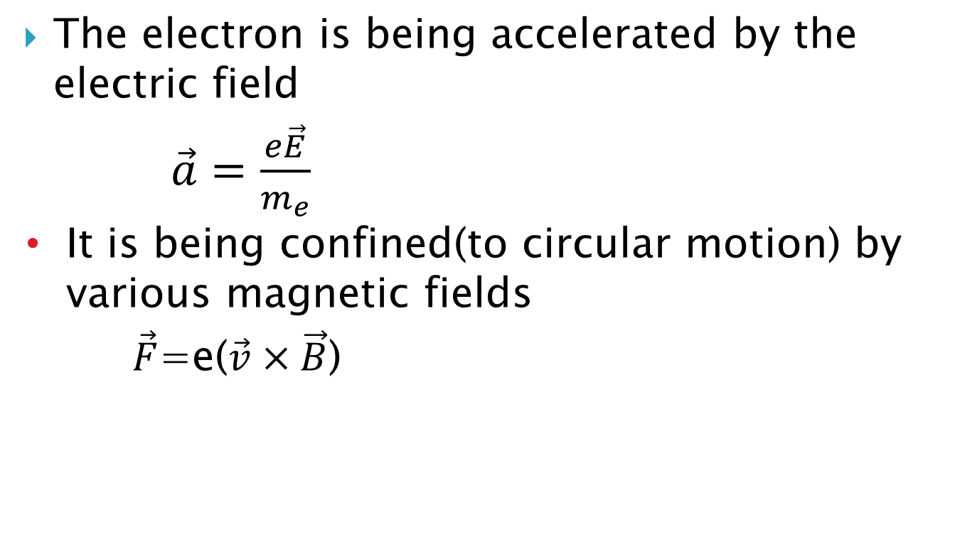
The electron is being accelerated by the electric field
      $\vec{a}=\frac{e\vec{E}}{m_{e}}$
      It is being confined(to circular motion) by various magnetic fields
          $\vec{F}$=e($\vec{v}×\vec{B}$)

Slide 29
Typical kinetic energy : Use of linear accelerator in order to “push” electrons to high energies.
Use of a booster. Why the linear part is not enough?
Estimate the gain in energy of an electron per cycle.

Slide 30
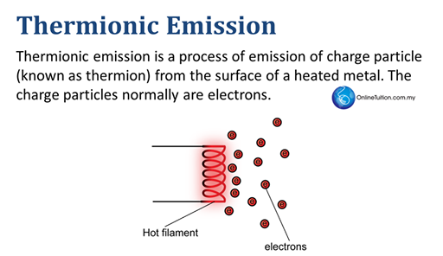
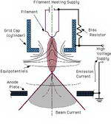
Electron production
Thermal energy of the emitted electrons ~ 0.05 eV
Notes:
How to produce an electron beam? actually, there are proton synchrotrons, as in CERN for example
What options should be considered?
What is thermionic emission

Slide 31
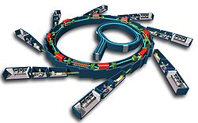
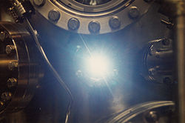
How to provide kinetic energy to electrons
Synchrotron animation
Notes:
Relativistic Lorentz contraction bumps the frequency by another factor of , thus multiplying the gigahertz frequency of the resonant cavity that accelerates the electrons into the X-ray range. Another dramatic effect of relativity is that the radiation pattern is distorted from the isotropic dipole pattern expected from non-relativistic theory into an extremely forward-pointing cone of radiation. This makes synchrotron radiation sources the most brilliant known sources of X-rays.

Slide 32
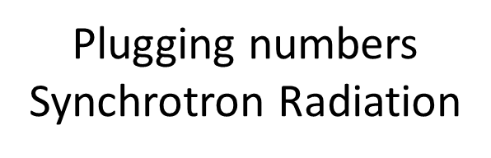
http://europa.eu/rapid/press-release_MEMO-13-460_en.htm
What is the typical energy of the X-rays produced by the circulating electrons?
What is the power of the X-rays?
http://www.sesame.org.jo/sesame/machine-and-beamlines/machine.html

Slide 33
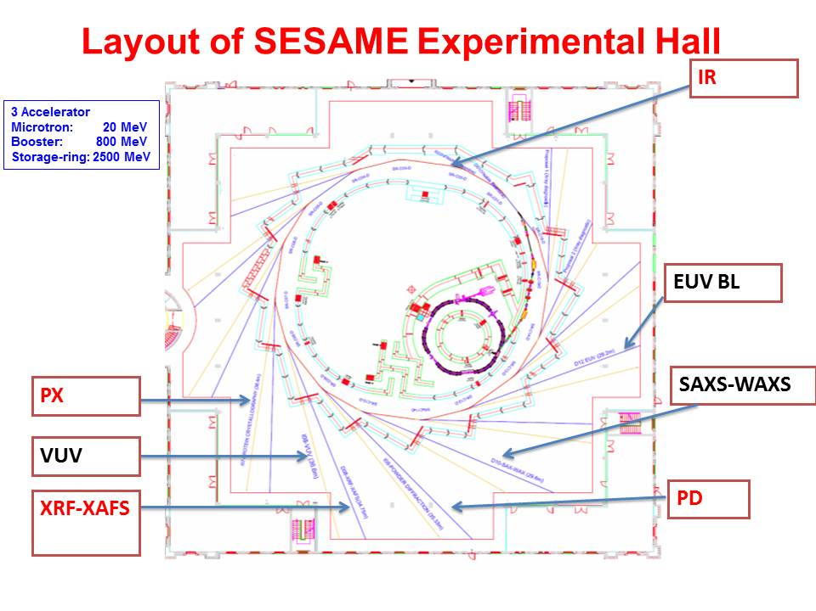

Slide 34


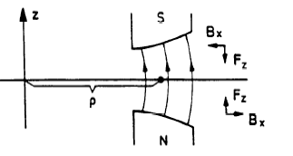
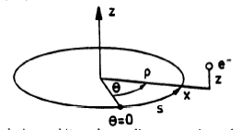
  The Synchrotron bunching
Groups of particles are circulating synchronously with the RF field in the accelerating cavities
- V +
RF Gap
Each particle is circulating around an ideal (theoretical) orbit: for this to work out, acceleration and magnet fields must obey stability criteria!!
HOW TO KEEP THE BEAM IN PLACE
Magnet

Slide 35

Synchrotron radiation
The storage ring. (is the beam gaining energy at that stage?)

Slide 36
Important issues not covered by our lessons
    The diagnostics
    The vacuum system
    Beam optics
    injectors
Notes:
Important issues not covered by our lessons
The diagnostics
The vacuum system
Beam optics
injectors

Slide 37
Applications

Slide 38
Applications
How do we do it?
Where can it be applied?

Slide 39
How do we do it?
Diffraction patterns of high energy X-Rays
X –Ray absorption spectrum
X-ray fluorescence

Slide 40
Where can it be applied?
Materials Sciences
Crystallography
Biology
Chemistry
Art History
Geosciences
Archeology
Physics

Slide 41

Examples
Material Science -------Looking at residual stresses

Slide 42
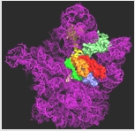
Ribosome Recycling and Termination of Protein Synthesis

Slide 43
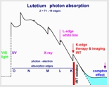
Indirect Radiation Therapy of Cancer with Synchrotron Radiation at the K-Edges of Heavy Metal Complexes and Target-Nanoparticles

Slide 44

Art History

Slide 45
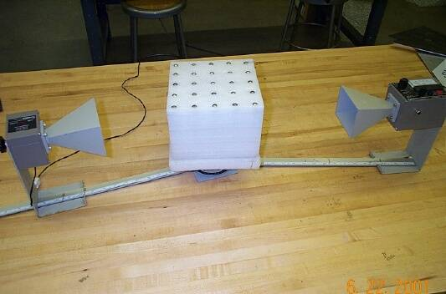
Possible Hands On Activity
Probing Atomic Crystals: Bragg Diffraction
OBJECTIVE: To learn how scientists probe the structure of solids, using a scaled-up version of X-ray Diffraction.
APPARATUS: Steel ball "crystal", microwave transmitter & receiver, goniometer (angle measuring device),

Slide 46
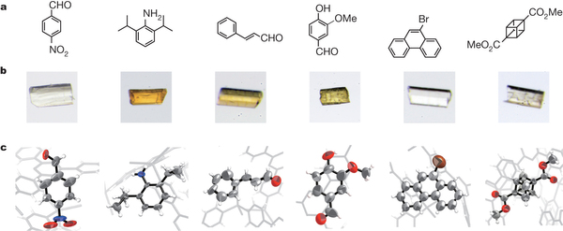
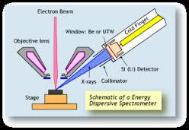
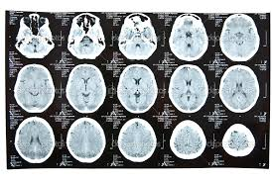
Applications
Crystalline analysis
Energy Dispersive X-Ray Diffraction
Tomography
http://www.sesame.org.jo/sesame/
Material Science
Notes:
Material Science
Medicine
Structural analysis of crystalline and amorphous materials
Energy Dispersive X-Ray Diffraction
Powder diffraction analysis
X-ray crystallography of proteins and other macromolecules
Magnetic scattering
Small angle X-ray scattering
X-ray absorption spectroscopy
Inelastic X-ray scattering
Soft X-ray emission spectroscopy
Tomography
X-ray imaging in phase contrast mode
X-ray standing wave experiments
Photolithography for MEMS structures as part of the LIGA process.
High pressure studies
residual stress analysis
X-Ray Multiple Diffraction
Photoemission spectroscopy and Angle resolved photoemission spectroscopy
Some of the advantages of synchrotron light that allow for these practical uses are:
High energy X-rays, short wavelength photons which can penetrate matter and interact with atoms.
High concentration, tunability and polarization thus ensuring focusing accuracy for even the smallest of targets.

Slide 47
Material Science
Medicine
Structural analysis of crystalline and amorphous materials
Energy Dispersive X-Ray Diffraction
Powder diffraction analysis
X-ray crystallography of proteins and other macromolecules
Magnetic scattering
Small angle X-ray scattering
X-ray absorption spectroscopy
Inelastic X-ray scattering
Soft X-ray emission spectroscopy
Tomography
X-ray imaging in phase contrast mode
X-ray standing wave experiments
Photolithography for MEMS structures as part of the LIGA process.
High pressure studies
residual stress analysis
X-Ray Multiple Diffraction
Photoemission spectroscopy and Angle resolved photoemission spectroscopy
Some of the advantages of synchrotron light that allow for these practical uses are:
High energy X-rays, short wavelength photons which can penetrate matter and interact with atoms.
High concentration, tunability and polarization thus ensuring focusing accuracy for even the smallest of targets.

Slide 48

Our Plan….

Slide 49
THANK YOU!
Danke SchÖn
با تشکر از شما
Gracias
ĎAKUJEME
شكرا
HVALA
DIOLCH YN FAWR
Grazie
ÞAKKA ÞÉR
Sipass
KÖSZÖNJÜK
Merci
СПАСИБО
धन्यवाद
teşekkür ederim
БЛАГОДАРЯ ВИ
TACK
ありがとうございました
תודה
DĚKUJEME
obrigado
ขอขอบคุณ
谢谢

Slide 50
Introduce The SESAME in my country
Physics Institutes in Iran
UIPT
The Union of Iranian Physics Teachers Society
IPM
Institute of Physic and Mathematic
PSI
Physics Society of Iran

Slide 51
IPM
CERN
PSI
UIPT
SESAME

Slide 52


University
students
IPM
CERN
PSI
UIPT
High schools students
SESAME

Slide 53
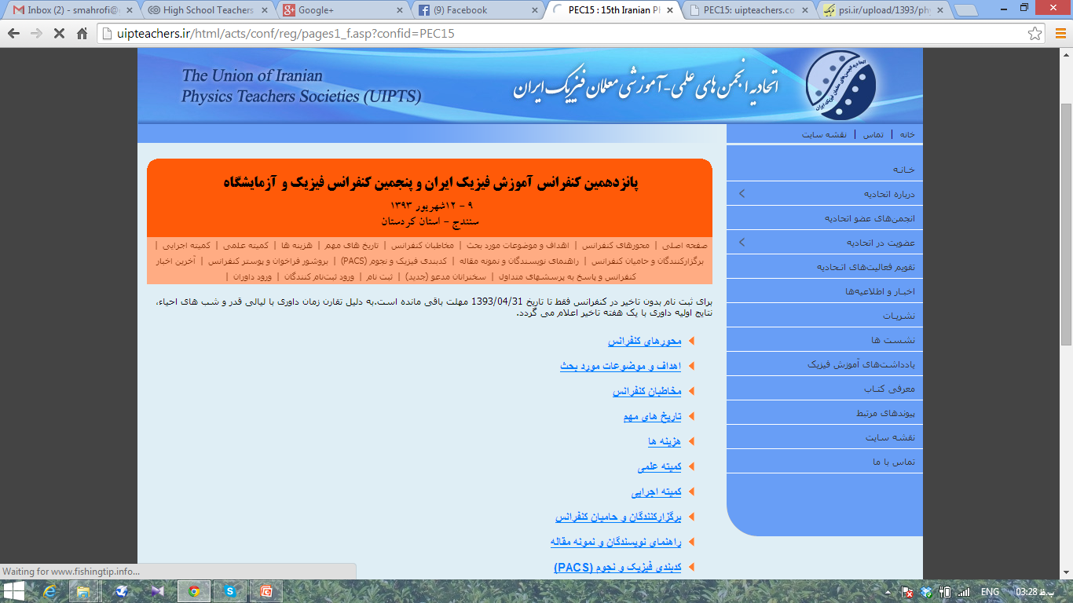

15TH Conference on Physics Education in Iran
SANANDAJ
SESAME

Slide 54
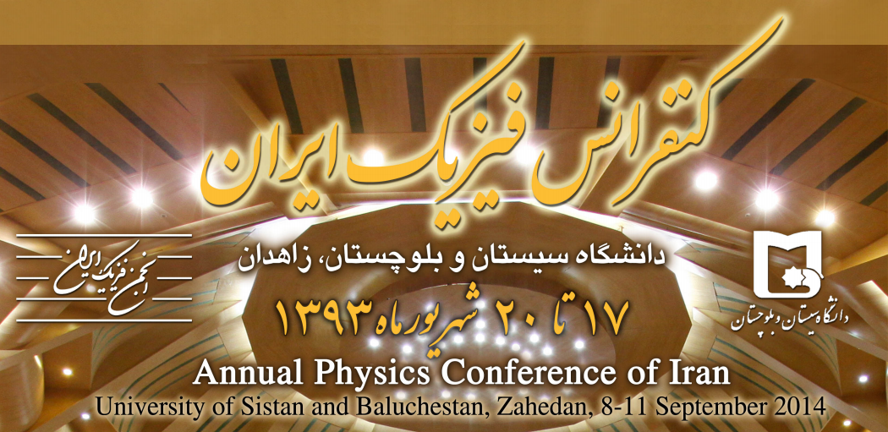
Annual physics conference of Iran
SESAME

Slide 55
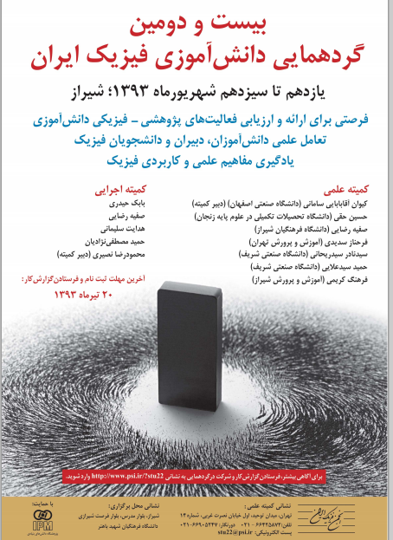
22TH Iranian High school student’s meeting for Physic
SESAME

Slide 56
m.socrative.com
Quick Survey
Room #
719562
Notes:
Game + Quiz via socrative

