Slide 1
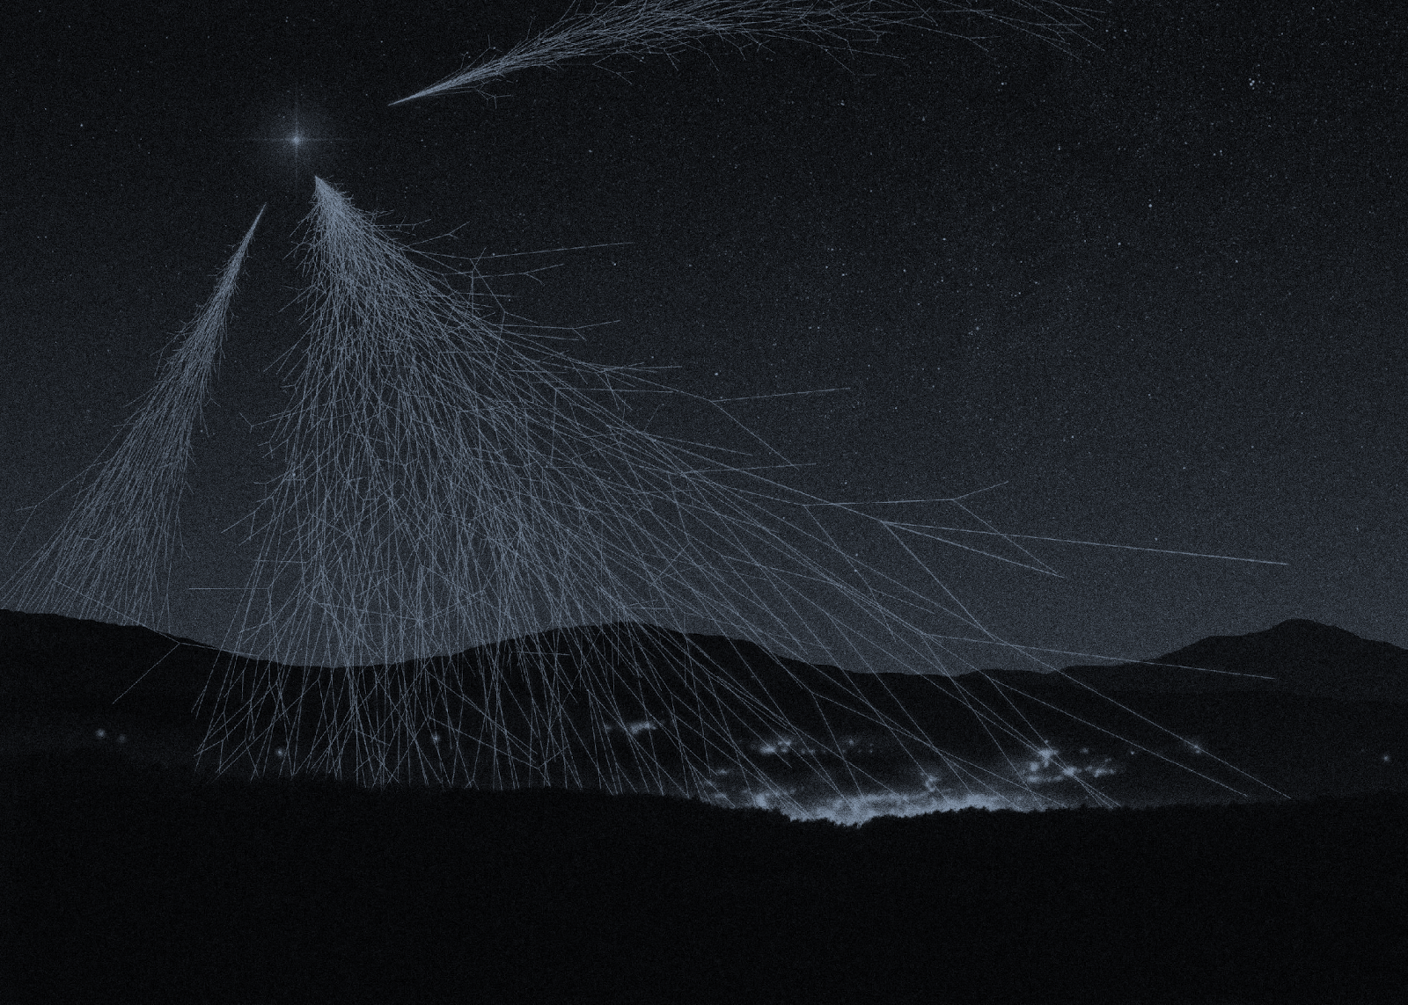
Cosmic Rays:
Ideas for High School Teachers
Cherie Bornhorst, Karin Foss, Gina Maria Horecica, Elpida Iliopoulou, Ozgul Saki, Yuichiro Eguchi, Waldemar Grabowski, Kevin Martz, Grzegorz Zakowicz,
HST2014 –WG3

Slide 2
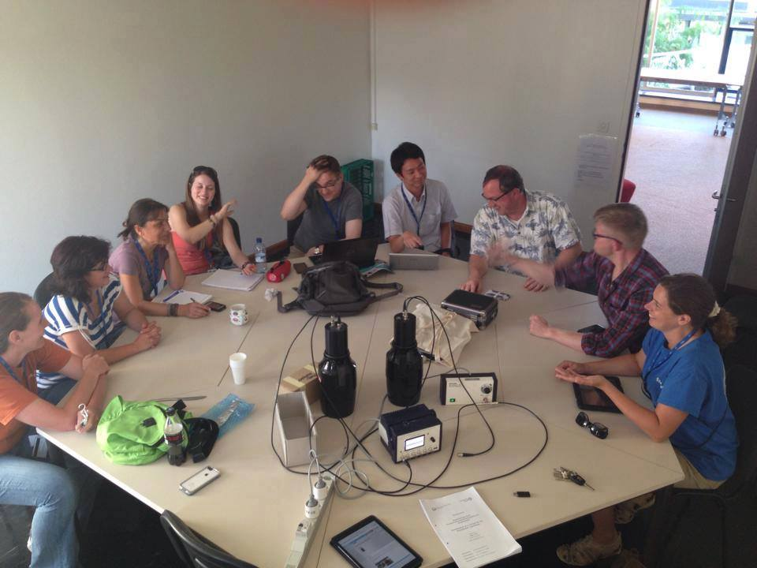
What are we doing today?
1. INTRODUCTION TO COSMIC RAYS
2. MEASURMENTS
3. RESOURCES
HST2014 –WG3

Slide 3
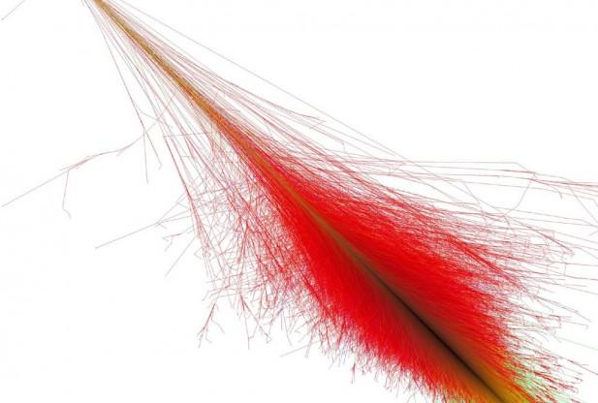
1. Introduction to cosmic rays
http://www.redorbit.com/media/uploads/2012/09/space-092612-003-617x416.jpg
HST2014 –WG3

Slide 4

Question for the group:
Cosmic rays...
A) Are emitted from radioactive minerals
B) Originate from our atmosphere
C) Are made up of Hydrogen and Helium nuclei
D) Contain more energy than the beam in the LHC
HST2014 –WG3

Slide 5
Route to Discovery
At the start of the 1900’s, French physicist Henri Becquerel discovered that certain elements are unstable, and would transmute into other elements, and in the process, emit what appeared to be particles. These “particles” were given the name “radiation” and the process itself referred to as “radioactive decay”.

Slide 6
Route to Discovery
It was noticed that an instrument called an “electroscope” would spontaneously discharge in the presence of radioactive materials. The rate of discharge of an electroscope is then used as a measure of the level of radiation. The electroscope thus became a standard instrument for studying radiation and radioactive materials in the first decades of the 20th century.

Slide 7
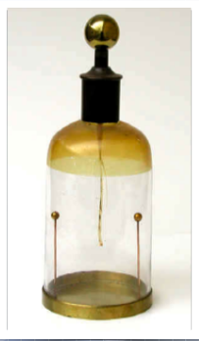
Route to Discovery
However, physicists noticed that electroscopes were found to discharge slowly even in the absence of radioactive matter!
This residual discharge could not be attributed to leakage. There appears to be a background radiation.
A gold-leaf Bennet-type electroscope (1880’s) manufactured by Ducretet.

Slide 8
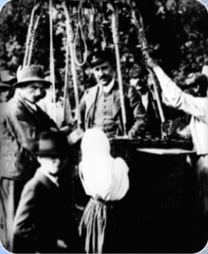
Discovery of Cosmic Rays
To study the source of this background, Austrian physicist Victor F. Hess made measurements of radiation levels at different altitudes with electroscopes aboard a balloon.
The motivation for this study was to distance the electroscopes from radiation sources in the Earth.

Slide 9
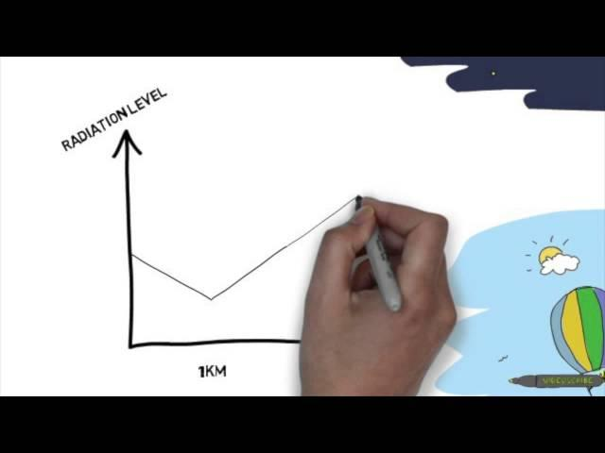
http://www.google.ch/url?sa=t&rct=j&q=&esrc=s&source=video&cd=1&cad=rja&uact=8&ved=0CCQQtwIwAA&url=http%3A%2F%2Fwww.youtube.com%2Fwatch%3Fv%3DEjh79FDLqL8&ei=lOzRU8HMIIqGywPTw4II&usg=AFQjCNHtaYovV87M0erhh3-Ngg6M6jSEUA&sig2=9lx44MfGastEf9RZCSRGNg&bvm=bv.71778758,d.bGQ
HST2014 –WG3

Slide 10
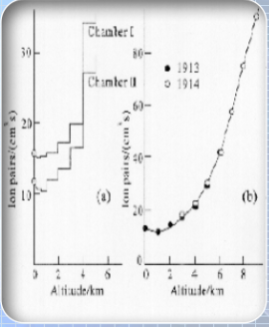
Discovery of Cosmic Rays
Hess went as high as 17,500 feet (over 5 km!) in his balloon without oxygen tanks.
Surprisingly he found that the radiation levels increased with altitude!

Slide 11
Discovery of Cosmic Rays
Hess interpreted this result to mean that radation is entering the atmosphere from outer space.
He gave this phenomenon the name “cosmic radiation” which later evolved to “cosmic rays”.
Hess was awarded the Nobel Prize in 1936 for his discovery of cosmic rays.

Slide 12
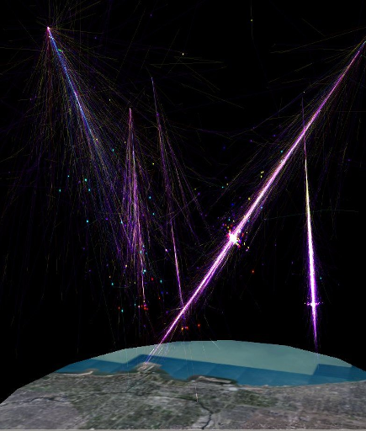
What are cosmic rays?
Elementary particles, nuclei, and EM Radiation of extra-terresterial origin.
  Called “primary” CRs
  Mostly protons or a (He) nuclei (other elements too, in much shorter supply)
When these hit another nucleus in the atmosphere and stop, more particles are knocked downward, causing a cascading effect called a “shower”
  Particles in the shower are called “secondary” CRs
HST2014 –WG3

Slide 13
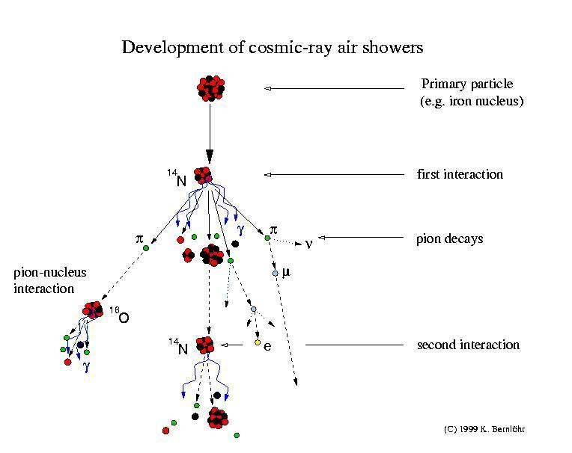
HST2014 –WG3

Slide 14
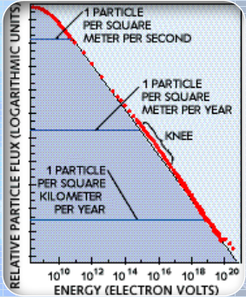
Primary Cosmic Rays
Lower-energy CRs are common, while high-energy CRs are rare
Just a reminder:
Flux – number of arriving particles per (unit area x unit time)
eV – (very small) unit of energy
  one volt times the charge of a single electron
  1 eV = 1.609 x 10⁻¹⁹ joules
HST2014 –WG3

Slide 15
The Mystery of UHECRs
Cosmic rays with energies above 10¹⁸ eV are referred to as “Ultra High Energy Cosmic Rays” (UHECRs)
These are microscopic particles with a macroscopic amount of energy. (For comparison: 1 Joule = 6.25 x 10¹⁸ eV)
The existance of such energetic particles remains a mystery!
HST2014 –WG3

Slide 16
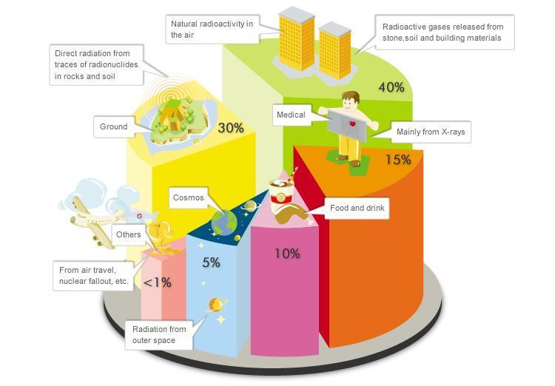
Notes:
http://labs.minutelabs.io/Mass-Energy-Scale/

Slide 17
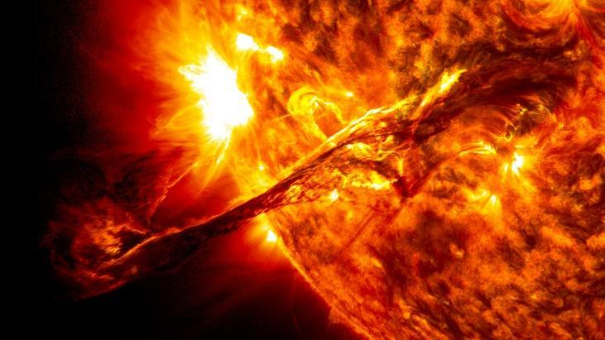
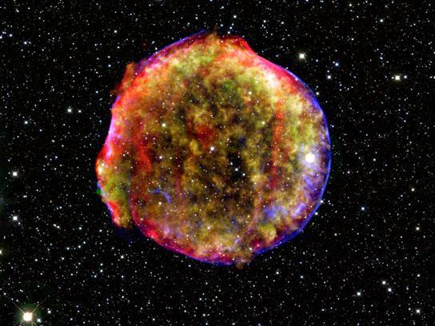
Where do they come from?
Low energy rays (less than 10 GeV) come from the sun.
Supernovae may be the source of particles up to 10¹⁵ eV. Nuclei receive energy from the shock wave of the supernova explosion.
The sources for ultrahigh cosmic rays, close to 10²¹ eV, which were observed in Japan in 1993, may be active galactic nuclei and gamma ray bursts.
  (www.phys.washington.edu)
HST2014 –WG3

Slide 18
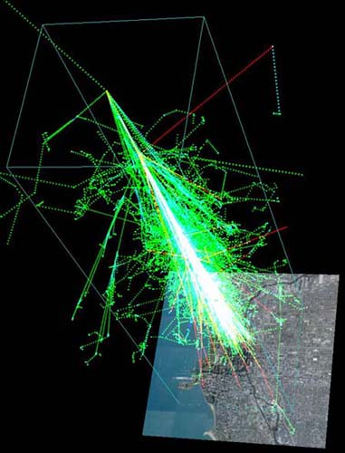
Secondary Cosmic Rays
“Shower particles”
  Electromagnetic (gamma rays)
  electrons, positrons
  Pions, muons
Can travel faster than the speed of light in air (they are still slower than the speed of light in vacuum)
~1 muon is striking every square centimeter of the Earth every second
  You are bombarded with these particles every day!
  Not all shower particles reach the ground.
HST2014 –WG3

Slide 19
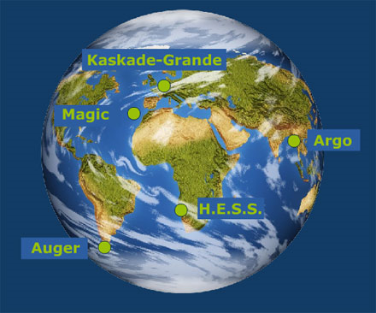
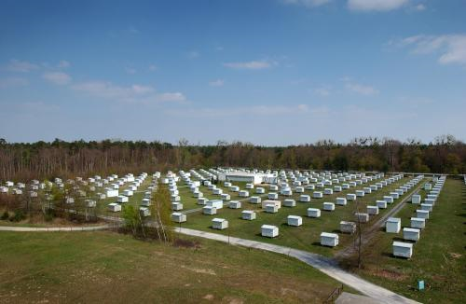
The atmosphere as a detector
When cosmic rays hit the atmosphere, the secondary particle shower they form can move at higher speeds than the speed of light in the air. Then, like the shock wave of a supersonic movement, a bluish flash of Cherenkov light is emitted. This light can be detected using very large Cherenkov telescopes, like H.E.S.S or MAGIC, giving information about the original cosmic ray.
The same effect can be obtained in water tanks such as in the Auger detector. The extensive air shower arrays like ARGO-YBJ or KASKADE-Grande also detect the direct signals left by the secondary particle showers.
HST2014 –WG3

Slide 20
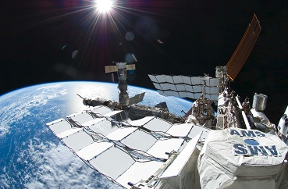
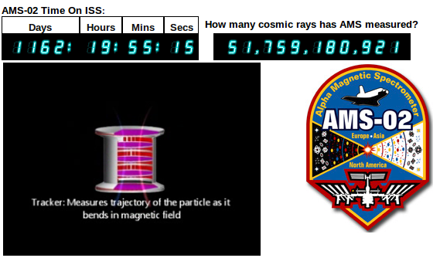
Searching in outer space
HST2014 –WG3

Slide 21
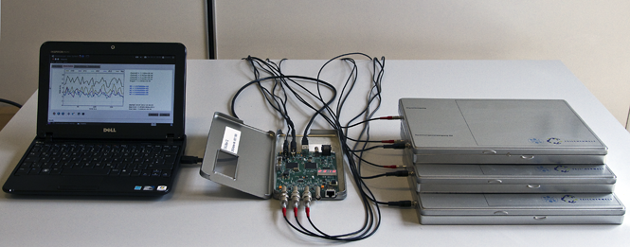
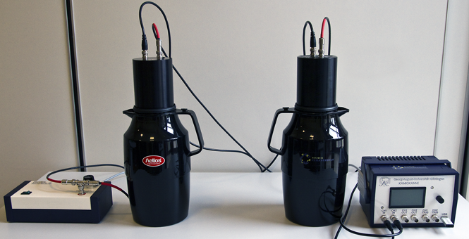
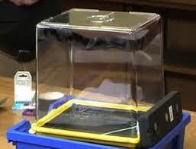
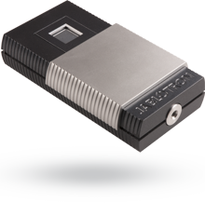
2. Experiments
HST2014 –WG3

Slide 22
CosMO Experiment
Medipix
Kamiokannen
Cloud chamber
HST2014 –WG3

Slide 23
CosMO Experiment
HST2014 –WG3

Slide 24
Components
three (3) plastic scintillator detectors with light guides
photomultiplier
high-voltage supply
one data acquisition card
one netbook for controlling the DAQ card and to store and analyze the data
measurement software "Muonic"
HST2014 –WG3

Slide 25
Calibration
Calibration is done by changing the voltage and measuring the count rate.
Usually, the change in voltage changes the count rate. At a certain range, the voltage does NOT change the count rate. This region is called the plateau because the rate approaches zero.
This works because the voltage does not affect the count rate (obviously) but allows us to eliminate noise.
Once you find the plateau, you choose a voltage in that region at which the detector will run.
HST2014 –WG3

Slide 26
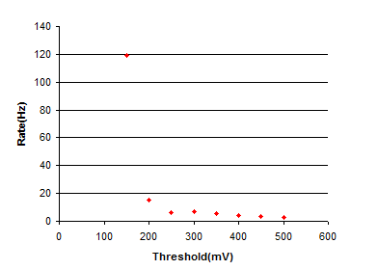
Single channel trigger rate as a function of threshold. The operating threshold for each scintillator is chosen on the plateau between 150 and 500mV.
HST2014 –WG3

Slide 27
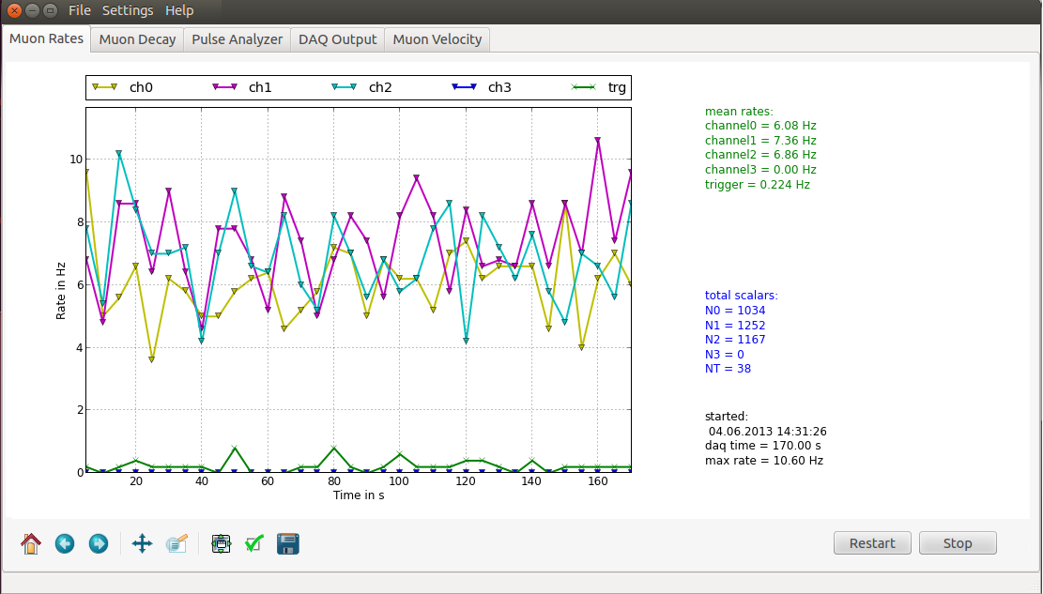
HST2014 –WG3

Slide 28
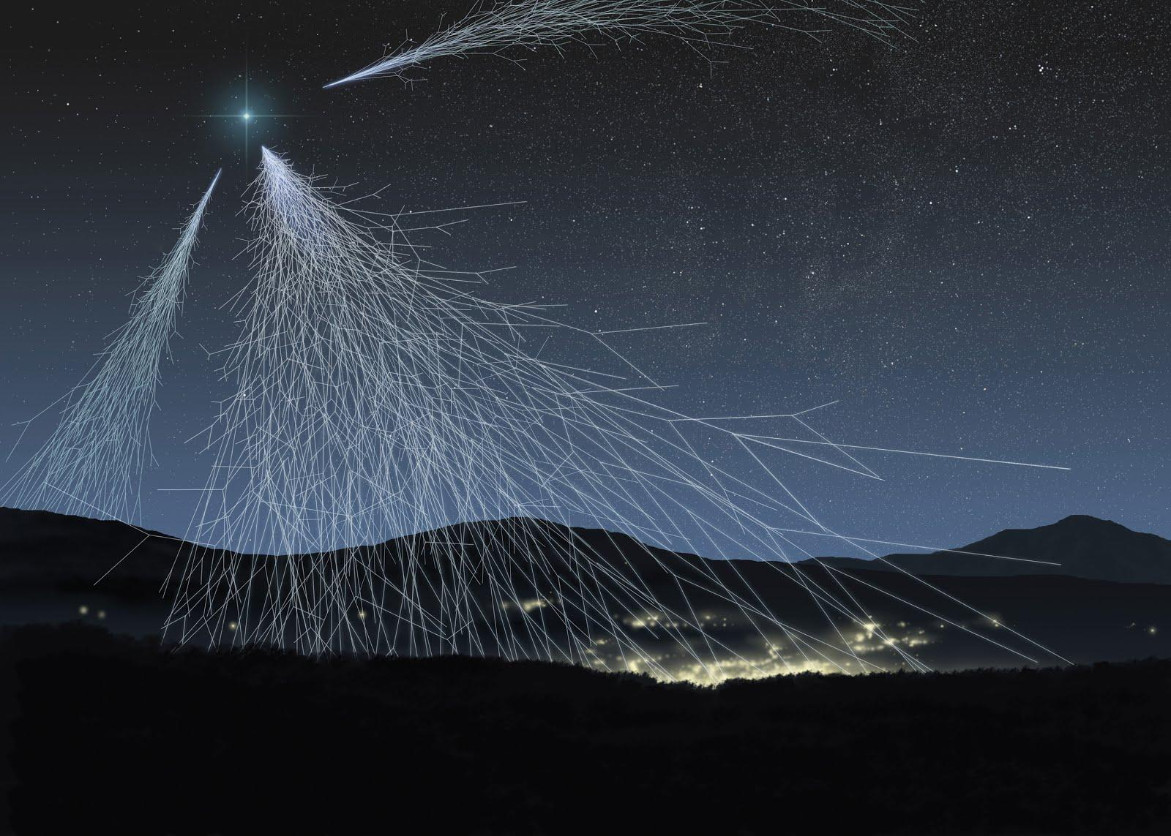
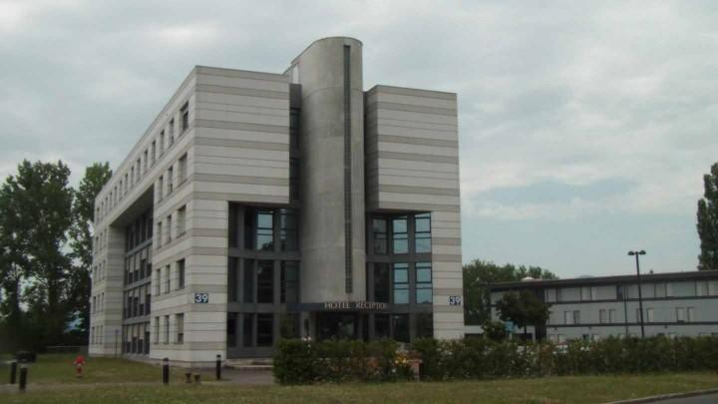
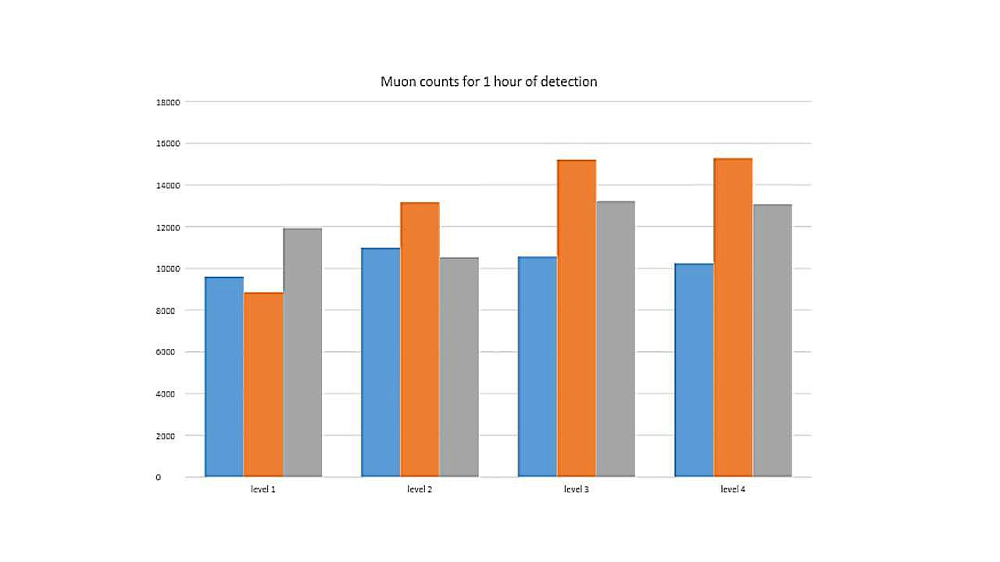
Data from CosMO Experiment
How does the muon count change
on the different floors of the hostel?

Slide 29
Possible measurements
  Particle rate measurement at varying distances as well as angles of the detectors.
  Particle shower measurement – the horizontal separation of the detectors can be varied for this.
  Measurement of the muon velocity.
  Measurement of the muon's mean life time.
HST2014 –WG3

Slide 30
Medipix
HST2014 –WG3

Slide 31
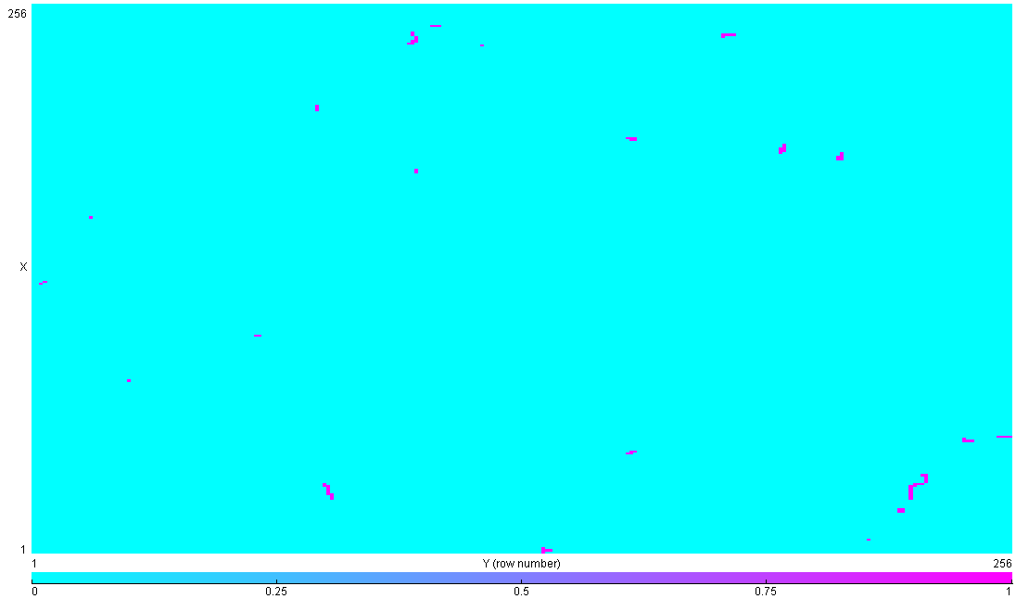
HST2014 –WG3

Slide 32
Components
MX-10 camera
Pixelman software and Experiment Guide on a memory stick
USB connecting cable
The Medipix can recognize tracks of particles - α, β, γ, MIP particles (e.g. muons from cosmic rays)
HST2014 –WG3

Slide 33
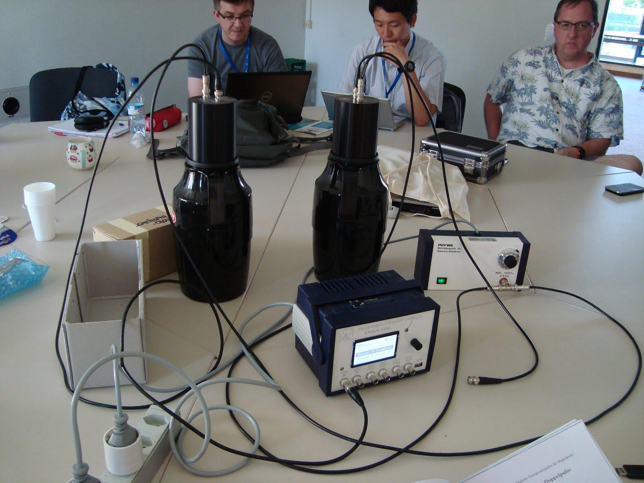
Kamiokannen
HST2014 –WG3

Slide 34
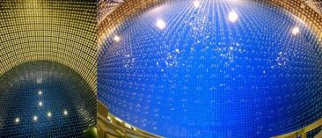
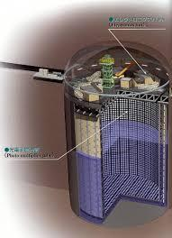

Kamiokannen
The name “Kamiokanne” is derived from the the Japanese Experiment "Kamiokande" and a thermos flask (or can, in German "Kanne"). The Japanese experiment and the can commonly exploit the Cherenkov effect to observe charged particles that travel almost at the speed of light.
http://www-sk.icrr.u-tokyo.ac.jp/sk/index-e.html
HST2014 –WG3

Slide 35
Components
  two cans (Dewar vessel with photomultiplier)
  one high-voltage supply for the photomultiplier
  one registration electronics for data taking
  one USB stick for data storage
  one computer for data analysis
HST2014 –WG3

Slide 36
Calibration
  Calibration is done with empty thermos at 2,4-7 mV threshold.
  Then the thermos is filled with water and the measurements are repeated.
HST2014 –WG3

Slide 37
Possible measurements
Muon rate measurement
Muon life time
Day vs night comparison
Muon rate vs altitude
Shielding experiments
HST2014 –WG3

Slide 38
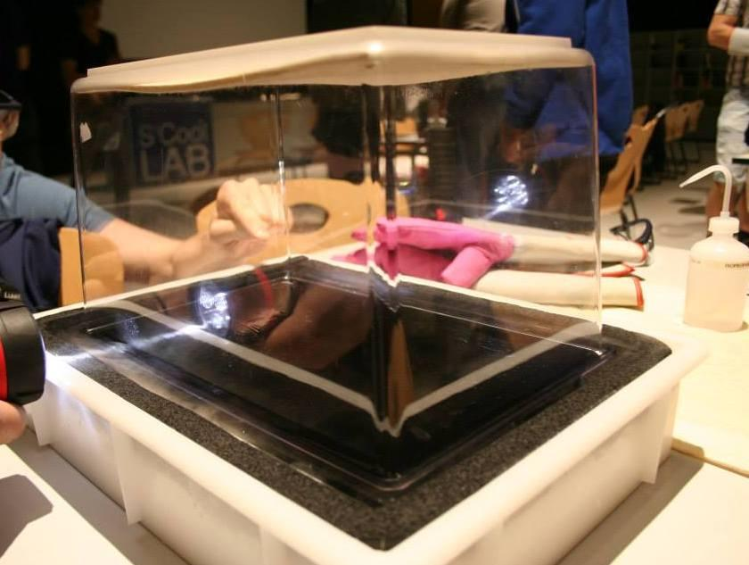
Cloud Chamber
HST2014 –WG3

Slide 39
Components
see-through box-like plastic container
a metal plate
thick felt
a small wooden box
torch
pure isopropyl alcohol
dry ice
HST2014 –WG3

Slide 40
Measurements
  Observation of cosmic rays
  Possible identification of the particles
HST2014 –WG3

Slide 41
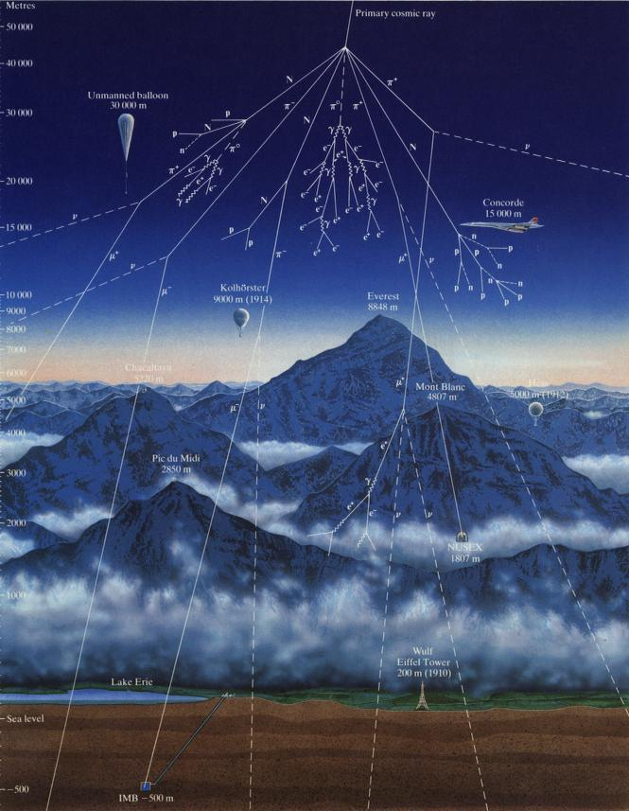
3. Resources
http://fafnir.phyast.pitt.edu/particles/cosmic_r.jpg
HST2014 –WG3

Slide 42
Internet Resources for Teachers
Computer Simulations:
Astroparticle.org - http://212.71.251.65/astroparticle//index.php?option=com_content&task=view&id=111&Itemid=102
Cosmus - http://astro.uchicago.edu/cosmus/projects/aires/
ASPIRE - Astrophysics Science Project Integrating Research and Education - University of Utah - http://aspire.cosmic-ray.org/
Cosmic Ray eLab - http://www.i2u2.org/elab/cosmic/teacher/
Milagro Animations
http://scipp.ucsc.edu/milagro/Animations/AnimationIntro.html
HST2014 –WG3

Slide 43
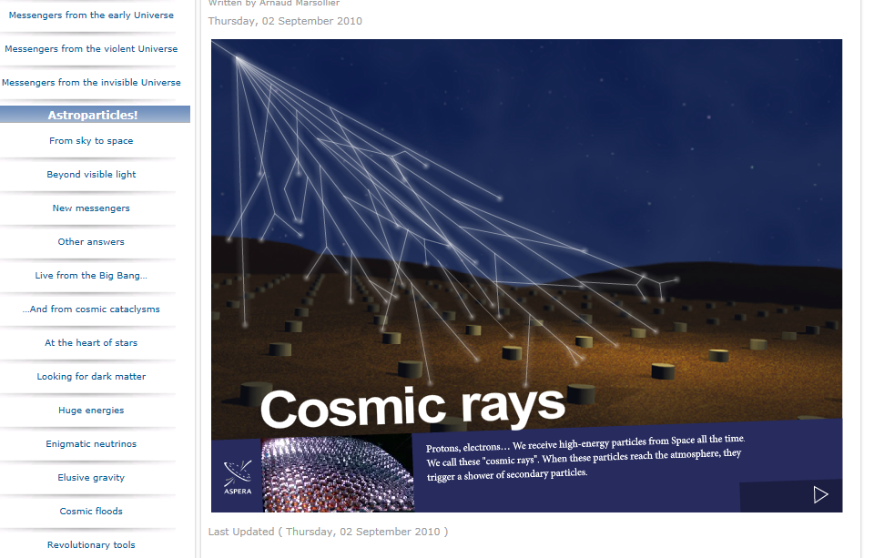
Astroparticle.org
Instructional tutorials, many videos and a simulation of cosmic rays entering our atmosphere.
HST2014 –WG3

Slide 44
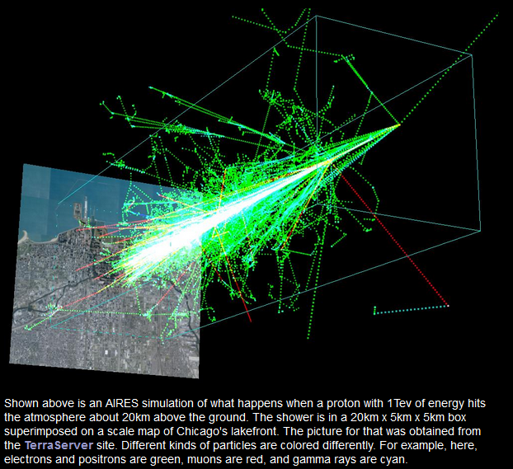
Cosmus
Shown here is an AIRES simulation of what happens when a proton with 1Tev of energy hits the atmosphere about 20km above the ground. The shower is in a 20km x 5km x 5km box superimposed on a scale map of Chicago's lakefront. The picture for that was obtained from the TerraServer site. Different kinds of particles are colored differently. For example, here, electrons and positrons are green, muons are red, and gamma rays are cyan.
HST2014 –WG3

Slide 45
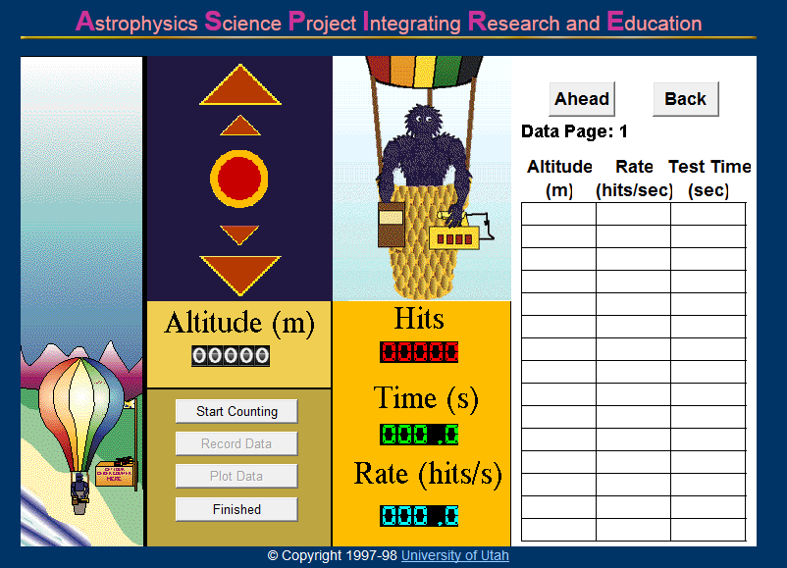
Aspire.com - 5 interactive lessons for beginners
Lesson 1: Number of Rays vs. Altitude
HST2014 –WG3

Slide 46
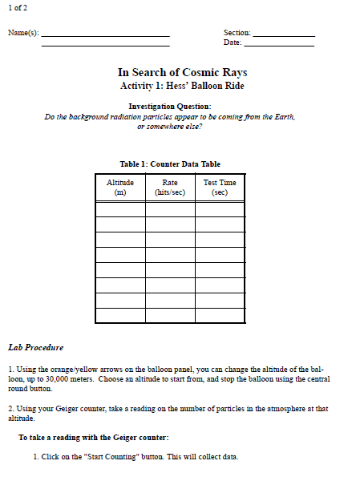
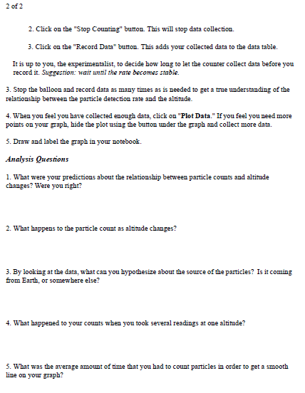
The first few lessons come with a printable lab sheet.
HST2014 –WG3

Slide 47
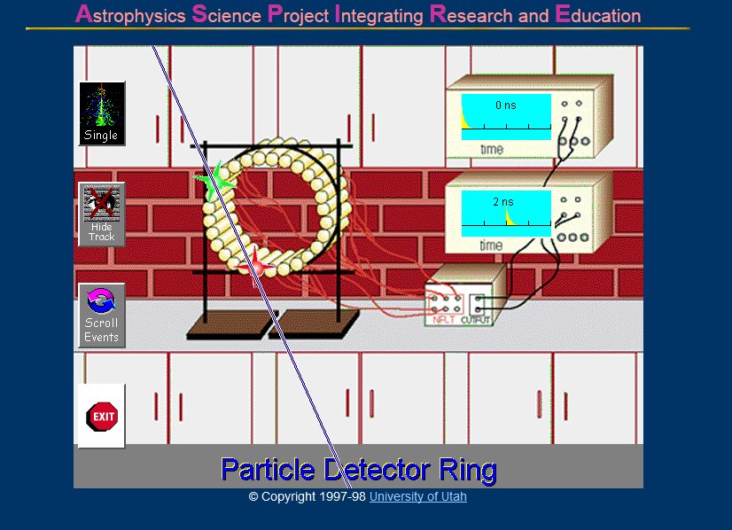
Lesson 2: Determining where the rays are originating.
HST2014 –WG3

Slide 48
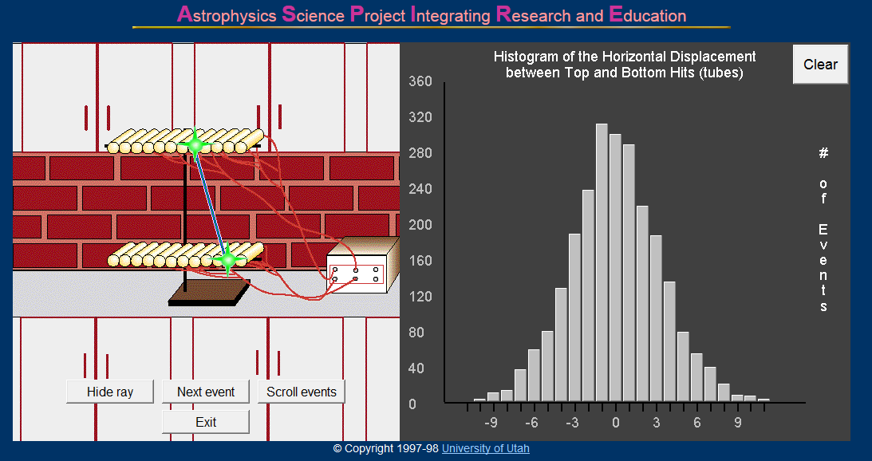
Lesson 3: Determining the Angle at which the rays hit, introducing histograms.
HST2014 –WG3

Slide 49
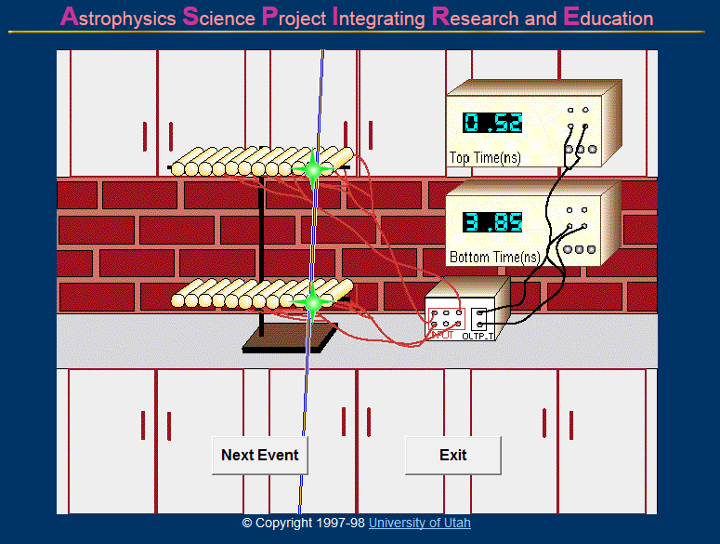
Lesson 4: Determining the Speed of a Cosmic Ray
HST2014 –WG3

Slide 50
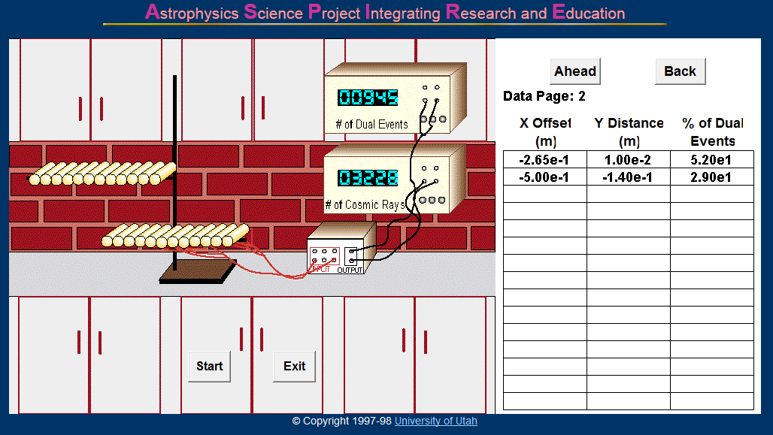
Lesson 5: Determining the best arrangement for maximum number of hits.
HST2014 –WG3

Slide 51
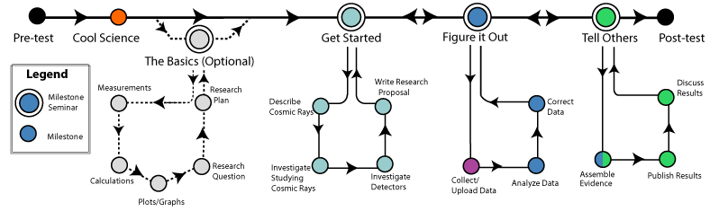
Cosmic Ray eLab
http://www.i2u2.org/elab/cosmic/teacher/
Students can pull data entered by others and perform experiments. There is a step-by-step process outlined that students can follow to use the scientific method.
HST2014 –WG3

Slide 52
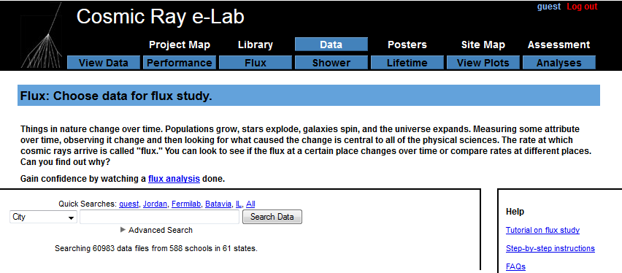
How to get data another teacher has uploaded:
HST2014 –WG3

Slide 53
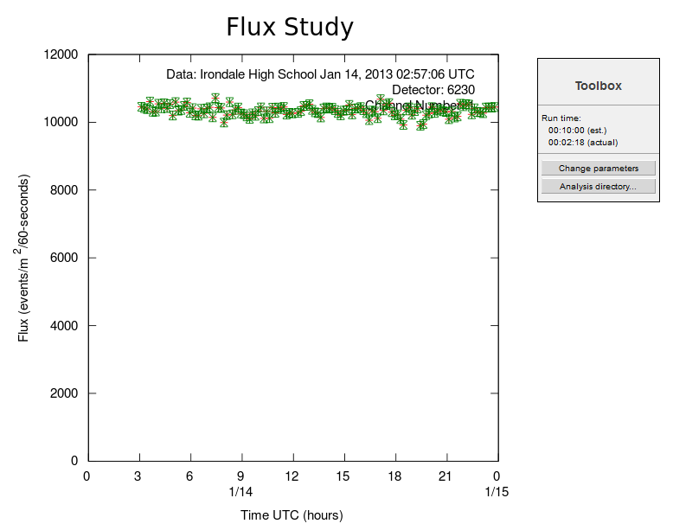
Students can determine the number of particles hitting the detector each second... could be run day vs. night.
HST2014 –WG3

Slide 54

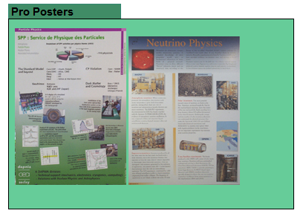
Students can create on-line for presentations to groups.
HST2014 –WG3

Slide 55
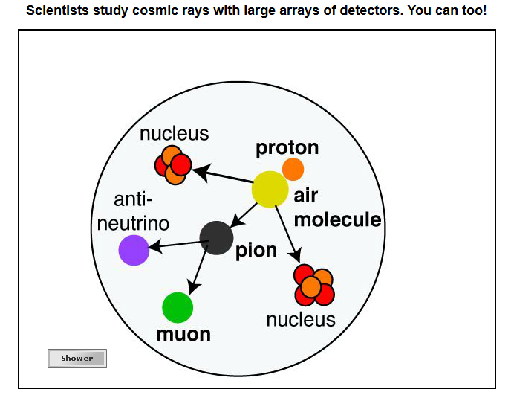
Cosmic Ray eLab: Under the tab “Cool Science” there is an animation to help students learn fundamental concepts.
HST2014 –WG3

Slide 56

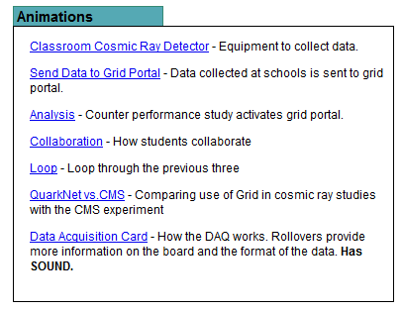
Cosmic Ray eLab: Under the “Library” tab there are more animations to help students learn with varying levels of complexity.
HST2014 –WG3

Slide 57
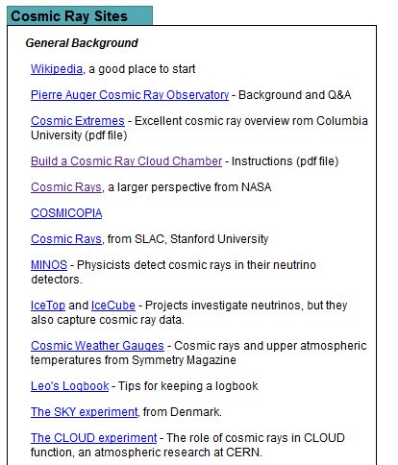
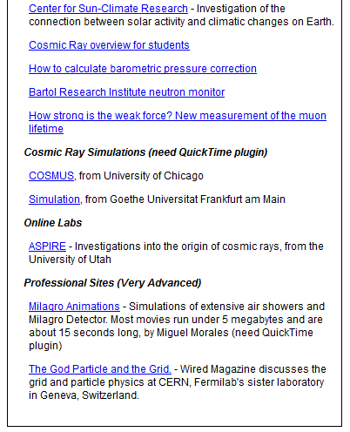
There is a list of other helpful links for all ability levels.
HST2014 –WG3

Slide 58

Milagro Animations (UC-Santa Cruz) - more detailed look at EAS - Extensive Air Showers. For example, if the shower were a line of particles hitting a pond at an angle. This deomonstrates the Cherenkov effect as well as refraction.
http://scipp.ucsc.edu/milagro/Animations/Pages/MilAnimTour/MilAnimTour1.html
HST2014 –WG3

Slide 59

It’s (almost) THE END… ;)
http://www.ep.ph.bham.ac.uk/DiscoveringParticles/detection/cosmic-rays/cosmic-rays.php
HST2014 –WG3

Slide 60


http://fire.wavestreamer.com:9411/listen.asx?sid=1
HST2014 –WG3

Slide 61

http://prediccs.sr.unh.edu/craterweb/craterliveradio.html
http://fire.wavestreamer.com:9411/listen.pls
http://fire.wavestreamer.com:9411/listen.asx?sid=1
HST2014 –WG3

Slide 62







Thank You! ;)
HST2014 –WG3

