Slide 1
Foundations of data-intensive science: Technology and practice for high throughput, widely distributed, data management and analysis systems
William Johnston
Senior Scientist and Advisor
ESnet
Lawrence Berkeley National Laboratory
APAN 38
LHCONE Workshop
Nantou, Taiwan
August 11-15, 2014

Slide 2
Data-Intensive Science in DOE’s Office of Science
The U.S. Department of Energy’s Office of Science (“SC”) supports about half of all civilian R&D in the U.S. with about $5B/year in funding (with the National Science Foundation (NSF) funding the other half)
  Funds some 22,000 PhDs and PostDocs in the university environment
  Operates ten National Laboratories and dozens of major scientific user facilities such as synchrotron light sources, neutron sources, particle accelerators, electron and atomic force microscopes, supercomputer centers, etc., that are all available to the US and Global science research community, and many of which generate massive amounts of data and involve large, distributed collaborations
  Supports global, large-scale science collaborations such as the LHC at CERN and the ITER fusion experiment in France
  www.science.doe.gov

Slide 3
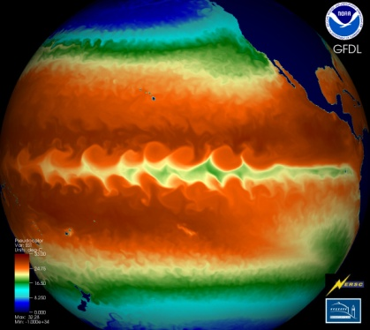
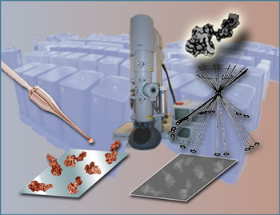

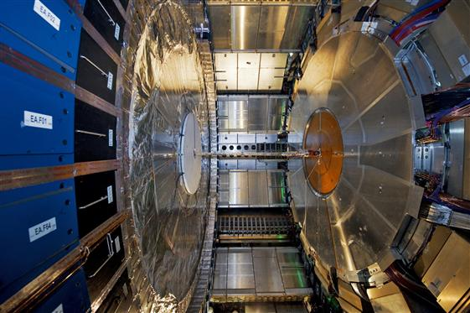
DOE Office of Science and ESnet – the ESnet Mission
ESnet - the Energy Sciences Network - is an SC facility whose primary mission is to enable the large-scale science of the Office of Science that depends on:
  Multi-institution, world-wide collaboration
  Data mobility: sharing of massive amounts of data
  Distributed data management and processing
  Distributed simulation, visualization, and computational steering
  Collaboration with the US and International Research and Education community
“Enabling large-scale science” means ensuring that the network can be used effectively to provide all mission required access to data and computing
ESnet connects the Office of Science National Laboratories and user facilities to each other and to collaborators worldwide
  Ames, Argonne, Brookhaven, Fermilab, Lawrence Berkeley, Oak Ridge, Pacific Northwest, Princeton Plasma Physics, SLAC, and Thomas Jefferson National Accelerator Facility,
  and embedded and detached user facilities
Notes:
3
Τηε ποιντ ηερε ισ τηατ μοστ μοδερν, λαργε−σχαλε, σχιενχε ανδ ενγινεερινγ ισ μυλτι−δισχιπλιναρψ, ανδ μυστ υσε γεογραπηιχαλλψ διστριβυτεδ χομπονεντσ, ανδ τηισ ισ ωηατ ηασ μοτιϖατεδ α ∃50−75Μ/ψρ (αππροξ) ινϖεστμεντ ιν Γριδ τεχηνολογψ βψ τηε ΥΣ, ΥΚ, Ευροπεαν, ϑαπανεσε, ανδ Κορεαν γοϖερνμεντσ.

Slide 4
HEP as a Prototype for Data-Intensive Science
The history of high energy physics (HEP) data management and analysis anticipates many other science disciplines
  Each new generation of experimental science requires more complex instruments to ferret out more and more subtle aspects of the science
  As the sophistication, size, and cost of the instruments increase, the number of such instruments becomes smaller, and the collaborations become larger and more widely distributed – and mostly international
  These new instruments are based on increasingly sophisticated sensors, which now are largely solid-state devices akin to CCDs
    In many ways, the solid-state sensors follow Moore’s law just as computer CPUs do: The number of transistors doubles per unit area of silicon every 18 mo., and therefore the amount of data coming out doubles per unit area
      the data output of these increasingly sophisticated sensors has increased exponentially
    Large scientific instruments only differ from CPUs in that the time between science instrument refresh is more like 10-20 years, and so the increase in data volume from instrument to instrument is huge

Slide 5
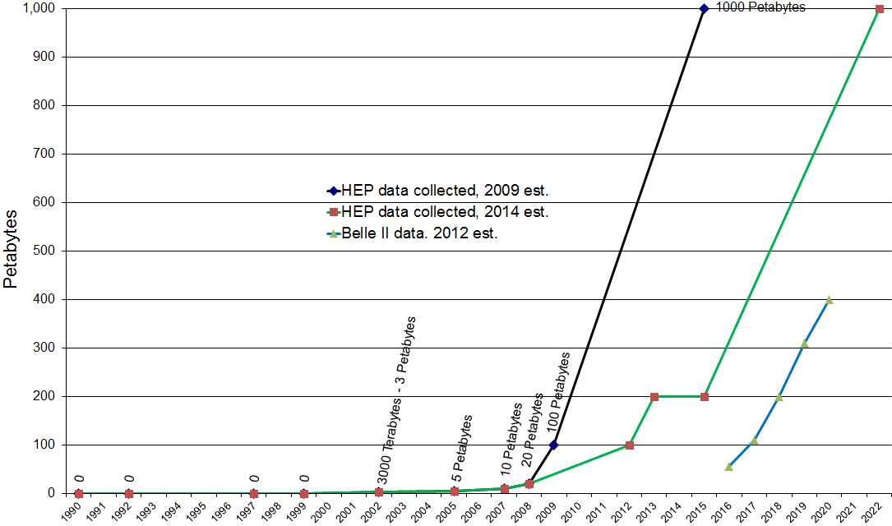
HEP as a Prototype for Data-Intensive Science
HEP data volumes for leading experiments with Belle-II estimates
Climate science involves a similar data volume, and probably growing faster
LHC down for upgrade
Data courtesy of Harvey Newman, Caltech, and Richard Mount, SLAC and Belle II CHEP 2012 presentation

Slide 6
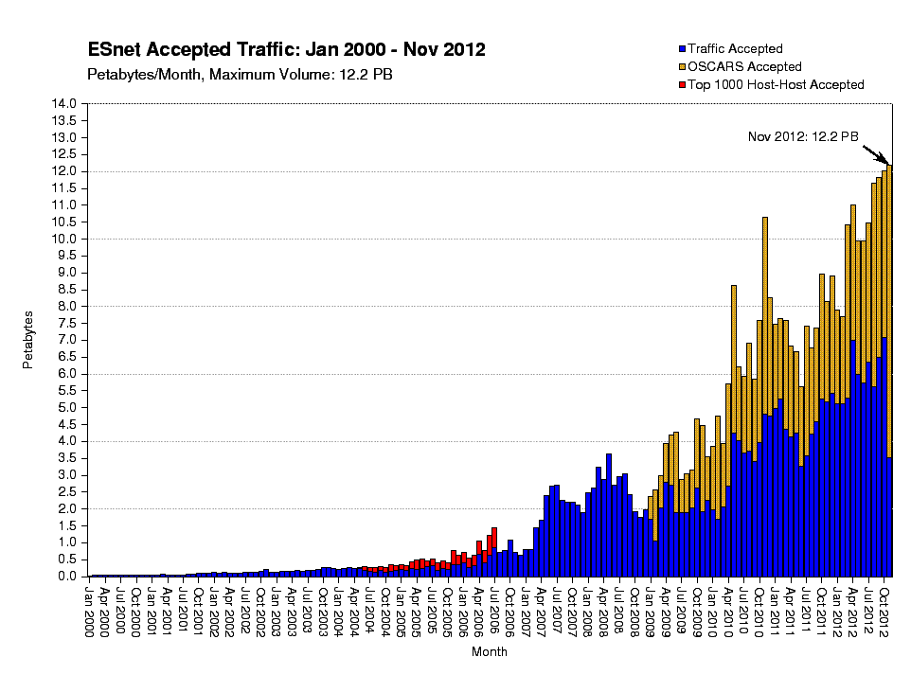
HEP as a Prototype for Data-Intensive Science
What is the significance to the network of this increase in data?
Historically, the use of the network by science has tracked the size of the data sets used by science
“HEP data collected” 2012 estimate (green line) in previous slide

Slide 7
HEP as a Prototype for Data-Intensive Science
As the instrument size and data volume have gone up, the methodology for analyzing the data has had to evolve
  The data volumes from the early experiments were low enough that the data was analyzed locally
  As the collaborations grew to several institutions, and the data analysis shared among them, the data was distributed by shipping tapes around
  As the collaboration sizes grew and became intercontinental, the HEP community began to use networks to coordinate the collaborations and eventually to send the data around
The LHC data model assumed network transport of all data from the beginning (as opposed to shipping media)
Similar changes are occurring in most science disciplines

Slide 8
HEP as a Prototype for Data-Intensive Science
Two major proton experiments (detectors) at the LHC: ATLAS and CMS
ATLAS is designed to observe a billion (1x10⁹) collisions/sec, with a data rate out of the detector of more than 1,000,000 Gigabytes/sec (1 PBy/s)
A set of hardware and software filters at the detector reduce the output data rate to about 25 Gb/s that must be transported, managed, and analyzed to extract the science
  The output data rate for CMS is about the same, for a combined 50 Gb/s that is distributed to physics groups around the world, 7x24x~9mo/yr.

Slide 9
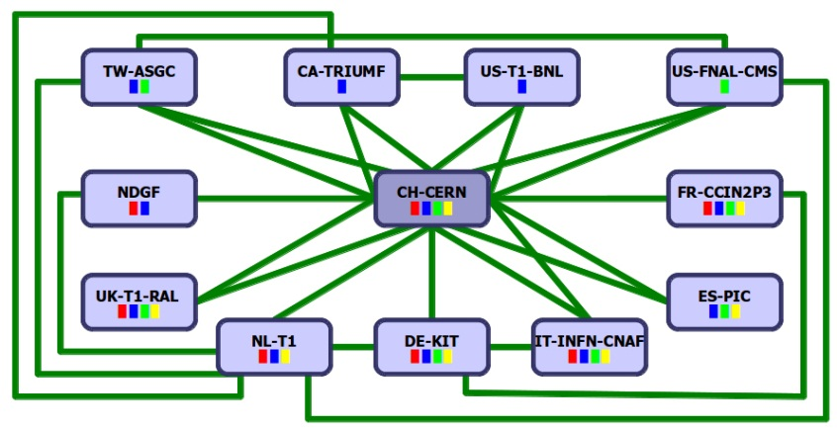
The LHC data management model involves a world-wide collection of centers that store, manage, and analyze the data
A Network Centric View of the LHC
(one of two detectors)
detector
O(1-10) meter
1 PB/s – 8 Pb/s
Level 1 and 2 triggers
O(10-100) meters
Level 3 trigger
LHC Tier 0
Tier 1 centers hold working data | Tape 115 PBy | Disk 60 PBy | Cores 68,000
Tier 2 centers are data caches and analysis sites | 0 | 120 PBy | 175,000
O(1) km
CERN Computer Center
500-10,000 km
50 Gb/s (25Gb/s ATLAS, 25Gb/s CMS)
Universities/
physics
groups
Universities/
physics
groups
LHC Tier 1
Data Centers
Universities/
physics
groups
Universities/
physics
groups
(WLCG 2012)
Universities/
physics
groups
3 X data outflow vs. inflow
Universities/
physics
groups
The LHC Optical Private Network (LHCOPN)
Universities/
physics
groups
Taiwan
Canada
USA-Atlas
USA-CMS
Universities/
physics
groups
The LHC Open Network Environment
(LHCONE)
Universities/
physics
groups
Nordic
CERN
France
UK
Spain
Universities/
physics
groups
Netherlands
Germany
Italy
Universities/
physics
groups
This is intended to
indicate that the physics
groups now get their data
wherever it is most readily
available
Universities/
physics
groups
Universities/
physics
groups
Universities/
physics
groups
Universities/
physics
groups
Universities/
physics
groups
Universities/
physics
groups
LHC Tier 2 Analysis Centers

Slide 10
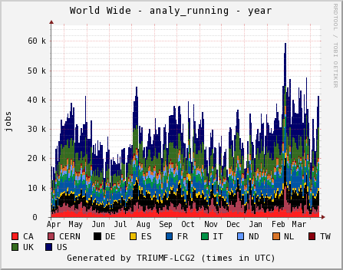
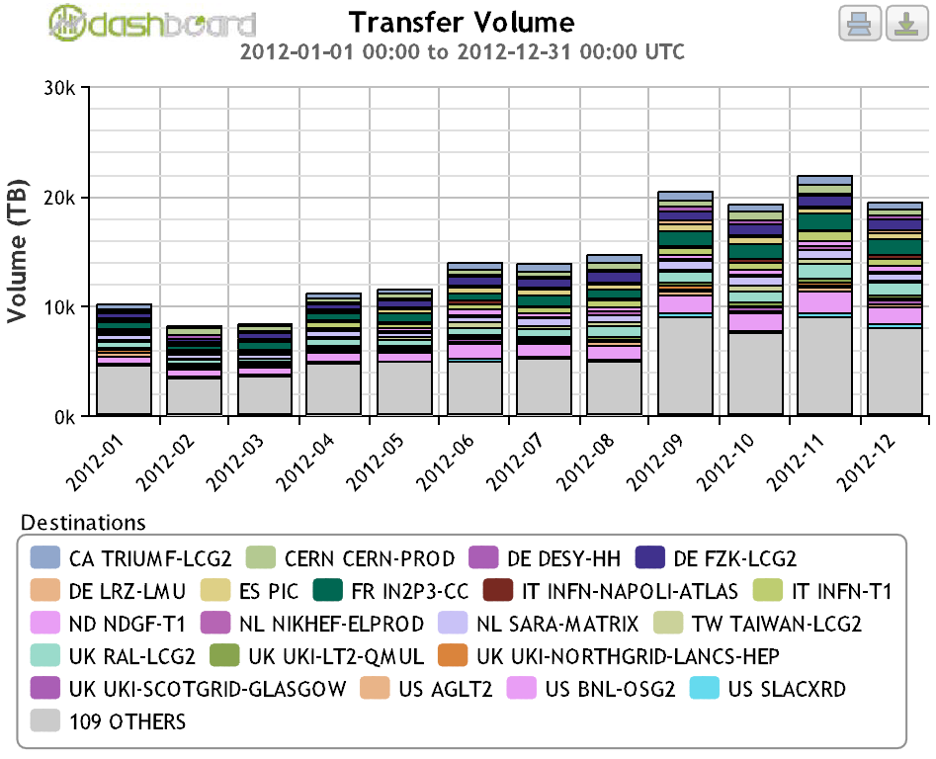
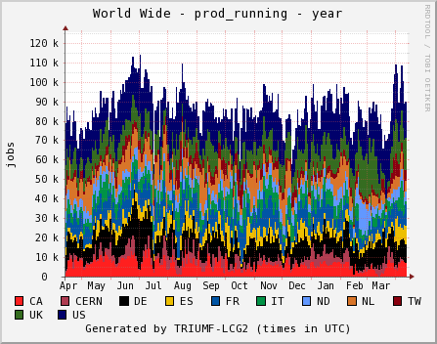
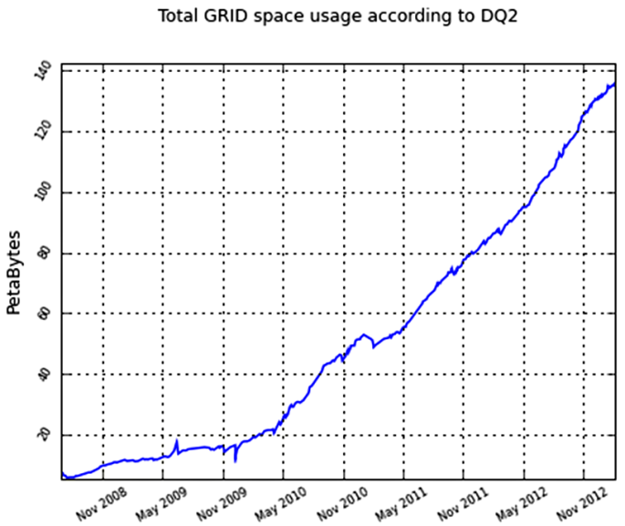
Scale of ATLAS analysis driven data movement
PanDA manages 120,000–140,000 simultaneous jobs - (O) 1,000,000 jobs/day
50,000
The PanDA jobs, executing at centers all over Europe, N. America and SE Asia, generate network data movement of 730 TBy/day, ~68Gb/s
type 1jobs
0
one year
100,000
730 TBytes/day
type 2
jobs
50,000
0
one year
one year
150
100
Petabytes
50
It is this scale of data movement going on 24 hr/day, 9+ months/yr, that networks must support in order to enable the large-scale science of the LHC
0
four years
Accumulated data volume on disk

Slide 11
HEP as a Prototype for Data-Intensive Science
The capabilities required to support this scale of data movement involve hardware and software developments at all levels:
  The underlying network
    1a. Optical signal transport
    1b. Network routers and switches
  Data transport (TCP is a “fragile workhorse” but still the norm)
  Network monitoring and testing
  Operating system evolution
  New site and network architectures
  Data movement and management techniques and software
  New network services
  Knowledge base
  Authentication and authorization
Technology advances in these areas have resulted in today’s state-of-the-art that makes it possible for the LHC experiments to routinely and continuously move data at ~150 Gb/s across three continents

Slide 12
HEP as a Prototype for Data-Intensive Science
ESnet has been collecting requirements for all DOE science disciplines and instruments that rely on the network for distributed data management and analysis for more than a decade, and formally since 2007 [REQ]
In this process, many of the issues noted above are seen across essentially all science disciplines that rely on the network for significant data transfer, even if the quantities are modest compared to projects like the LHC experiments
Therefore addressing the LHC issues is a useful exercise that can benefit a wide range of science disciplines

Slide 13
SKA data flow model is similar to the LHC
receptors/sensors
These numbers are based on modeling prior to splitting the SKA between S. Africa and Australia)
9.3 – 16.8 Pb/s
~200km, avg.
correlator / data processor
~1000 km
400 Tb/s
supercomputer
~25,000 km
(Perth to London via USA)
or
~13,000 km
(South Africa to London)
100 Gb/s
from SKA RFI
U.S. and European distribution points
Hypothetical
(based on the LHC experience)
Regional
data center
Regional
data center
Regional
data center
Universities/
astronomy
groups
Universities/
astronomy
groups
Universities/
astronomy
groups
Universities/
astronomy
groups
Universities/
astronomy
groups
Universities/
astronomy
groups
Universities/
astronomy
groups
Universities/
astronomy
groups
Universities/
astronomy
groups

Slide 14
Foundations of data-intensive science
This talk looks briefly at the nature of the advances in technologies, software, and methodologies that have enabled LHC data management and analysis
  The points 1a and 1b on optical transport and router technology are included in the slides for completeness but I will not talk about them. They were not really driven by the needs of the LHC but they were opportunistically used by the LHC.
  Much of the reminder of the talk is a tour through ESnet’s network performance knowledge base (fasterdata.es.net)
  Also included are
    the LHC ATLAS data management and analysis approach that generates and relies on very large network data utilization
    and an overview of how R&E network have evolved to accommodate the LHC traffic

Slide 15
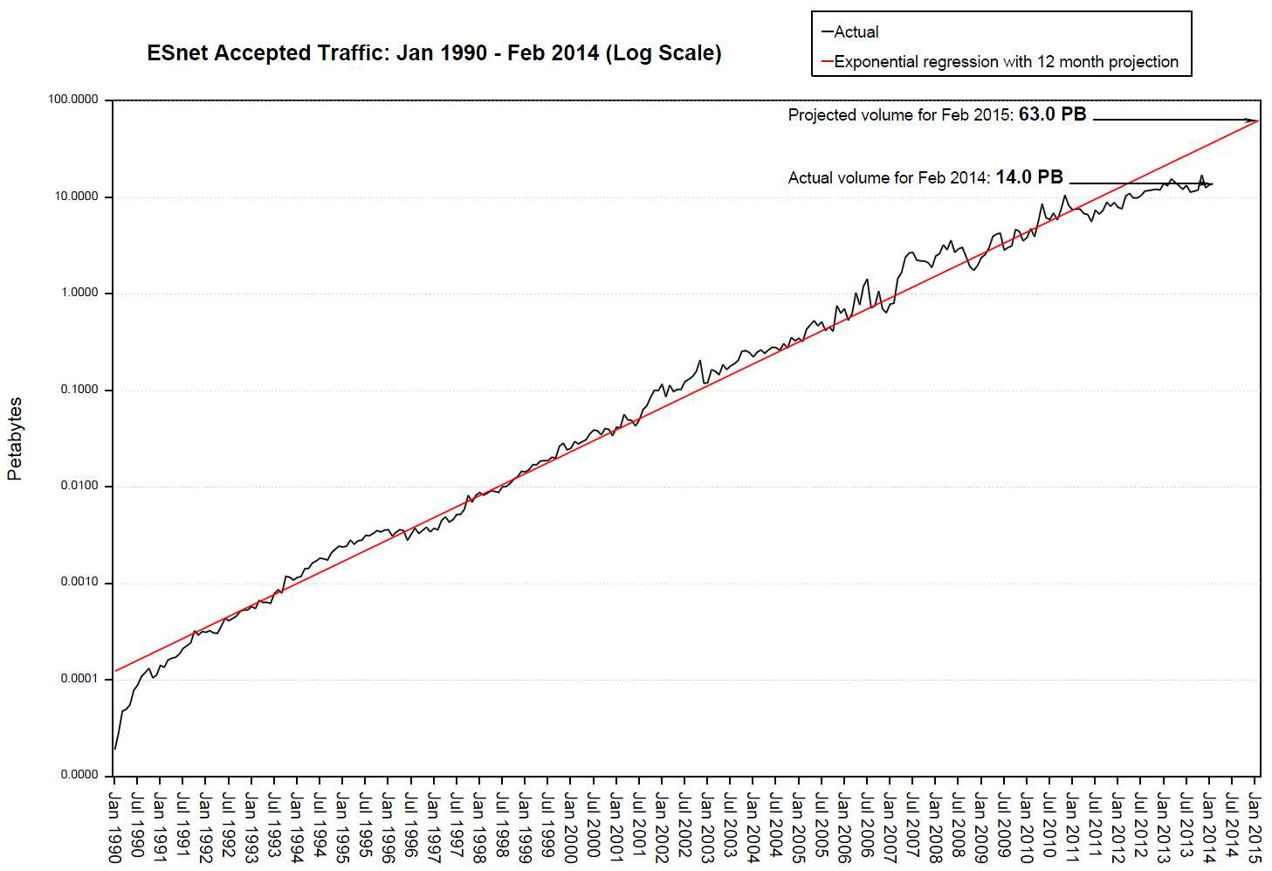
1) Underlying network issues
At the core of our ability to transport the volume of data that
we must deal with today, and to accommodate future growth,
are advances in optical transport technology and router technology
We face a continuous growth of data to transport
15
ESnet has seen exponential growth in our traffic every year since 1990 (our traffic grows by factor of 10 about once every 47 months)
Petabytes/month
10
5
0
13 years

Slide 16
We face a continuous growth of data transport
The LHC data volume is predicated to grow 10 fold over the next 10 years
New generations of instruments – for example the Square Kilometer Array radio telescope and ITER (the international fusion experiment) – will generate more data than the LHC
In response, ESnet, and most large R&E networks, have built 100 Gb/s (per optical channel) networks
  ESnet5 provides a 44 x 100Gb/s (4.4 terabits/sec - 4400 gigabits/sec) in optical channels across the entire ESnet national footprint
  Initially, one of these 100 Gb/s channels is configured to replace the current 4 x 10 Gb/s IP network
  This optical infrastructure is sared equally with Internet2, which also has 4 waves
What has made this possible?

Slide 17
1a) Optical Network Technology
Modern optical transport systems (DWDM = dense wave division multiplexing) use a collection of technologies called “coherent optical” processing to achieve more sophisticated optical modulation and therefore higher data density per signal transport unit (symbol) that provides 100Gb/s per wave (optical channel)
  Optical transport using dual polarization-quadrature phase shift keying (DP-QPSK) technology with coherent detection [OIF1]
    dual polarization
      two independent optical signals, same frequency, orthogonal
      two polarizations → reduces the symbol rate by half
    quadrature phase shift keying
      encode data by changing the signal phase of the relative to the optical carrier
      further reduces the symbol rate by half (sends twice as much data / symbol)
    Together, DP and QPSK reduce required rate by a factor of 4
      allows 100G payload (plus overhead) to fit into 50GHz of spectrum
    Actual transmission rate is about 10% higher to include FEC data
  This is a substantial simplification of the optical technology involved – see the TNC 2013 paper and Chris Tracy’s NANOG talk for details [Tracy1] and [Rob1]

Slide 18
Optical Network Technology
ESnet5’s optical network uses Ciena’s 6500 Packet-Optical Platform with WaveLogic™ coherent optical system to provide 100Gb/s wave
  88 waves (optical channels), 100Gb/s each
    wave capacity shared equally with Internet2
  ~13,000 miles / 21,000 km lit fiber
  280 optical amplifier sites
  70 optical add/drop sites (where routers can be inserted)
    46 100G add/drop transponders
    22 100G re-gens across wide-area
SEAT
BOST
FNAL
STAR
NEWG
BNL
BOIS
SC11
ANL
CHIC
CLEV
NEWY
Long Island
MAN and
ANI Testbed
EQCH
Internet2
LBNL
JGI
WSAC
SALT
NERSC
SUNN
SACR
CINC
WASH
PAIX
SNLL
DENV
KANS
LOUI
SLAC
LASV
STLO
ORNL
LOSA
ALBU
NASH
CHAT
O
PHOE
ATLA
ELPA
Geography is
only representational
JACK
HOUS

Slide 19
1b) Network routers and switches
Routers also use the latest in high-speed electronics
ESnet5 routing (IP / layer 3) is provided by Alcatel-Lucent 7750 routers with 100 Gb/s client interfaces
  2 Tb/s backplane
  100 Gb/s throughput per interface
  IP, MPLS, Ethernet services
  64,000 queues per module, 8 queues per subscriber
  3,000,000 routes (ESnet routers currently have about 500,000)
In ESnet continental U.S. network
  17 routers with 100G interfaces
    several more in a test environment
  59 layer-3 100GigE interfaces
  8 Lab-owned 100G routers
  7 100G interconnects with other R&E networks at Starlight (Chicago),
  MAN LAN (New York), and Sunnyvale (San Francisco)

Slide 20
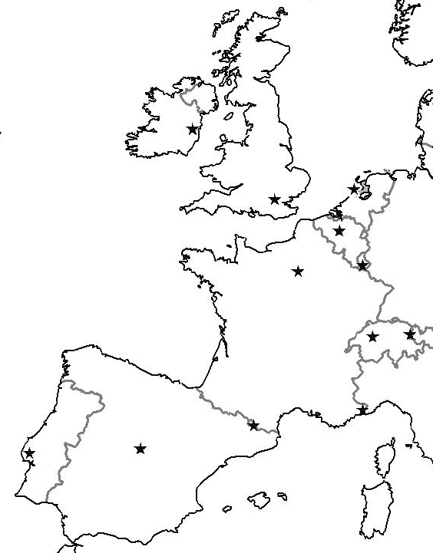
ESnet Winter 2014/15
ESnet is in the process of extending its core network into Europe to provide a coherent, high-reliability architecture for transporting science data
LOND
AMST
SEAsia
SEAT
CERN
AsiaPac
Europe
Canada
BOST
NEWY
STAR
NEWY
100
AOFA
AOFA
100
SACR
BOIS
100
SUNN
100
CHIC
10
100
Europe
Canada
WASH
DENV
KANS
WASH
SDSC
LSVN
Europe
L. Amer.
ALBQ
NASH
AsiaPac
AU
L. Amer.
ATLA
ELPA
HOUS
SUNN
ESnet PoP/hub locations
Routed IP 100 Gb/s
Routed IP 40 Gb/s
Express / metro / regional
100
ESnet managed 100G routers
Geographical representation is
approximate
Geography is
only representational
R&E network peering locations – US (red) and international (green)
commercial peering points
Notes:
20

Slide 21
2) Data transport: The limitations of TCP must be addressed for large, long-distance flows
Although there are other transport protocols available, TCP remains the workhorse of the Internet, including for data-intensive science
Using TCP to support the sustained, long distance, high data-rate flows of data-intensive science requires an error-free network
Why error-free?
TCP is a “fragile workhorse:” It is very sensitive to packet loss (due to bit errors)
  Very small packet loss rates on these paths result in large decreases in performance)
  A single bit error will cause the loss of a 1-9 KBy packet (depending on the MTU size) as there is no FEC at the IP level for error correction
    This puts TCP back into “slow start” mode thus reducing throughput
Notes:
21

Slide 22
Transport
The reason for TCP’s sensitivity to packet loss is that the slow-start and congestion avoidance algorithms that were added to TCP to prevent congestion collapse of the Internet
  Packet loss is seen by TCP’s congestion control algorithms as evidence of congestion, so they activate to slow down and prevent the synchronization of the senders (which perpetuates and amplifies the congestion, leading to network throughput collapse)
  Network link errors also cause packet loss, so these congestion avoidance algorithms come into play, with dramatic effect on throughput in the wide area network – hence the need for “error-free”
Notes:
22

Slide 23
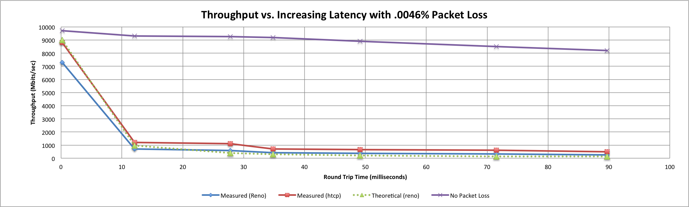
Transport: Impact of packet loss on TCP
On a 10 Gb/s LAN path the impact of low packet loss rates is minimal
On a 10Gb/s WAN path the impact of even very low packet loss rates is enormous (~80X throughput reduction on transatlantic paths)
Implications: Error-free paths are essential for high-volume, long-distance data transfers
Throughput vs. increasing latency on a 10Gb/s link with 0.0046% packet loss
10000
9000
8000
7000
6000
5000
4000
3000
2000
1000
0
No packet loss
Reno (measured)
(see http://fasterdata.es.net/performance-testing/perfsonar/troubleshooting/packet-loss/)
Throughput, Mb/s
H-TCP
(measured)
Reno (theory)
Network round trip time, ms (corresponds roughly to San Francisco to London)

Slide 24
Transport: Modern TCP stack
A modern TCP stack (the kernel implementation of the TCP protocol) is important to reduce the sensitivity to packet loss while still providing congestion avoidance (see [HPBulk])
  This is done using mechanisms that more quickly increase back to full speed after an error forces a reset to low bandwidth
“Binary Increase Congestion” control algorithm impact
Note that BIC reaches max throughput much faster than older algorithms (from Linux 2.6.19 the default is CUBIC, a refined version of BIC designed for high bandwidth, long paths)
RTT = 67 ms

Slide 25
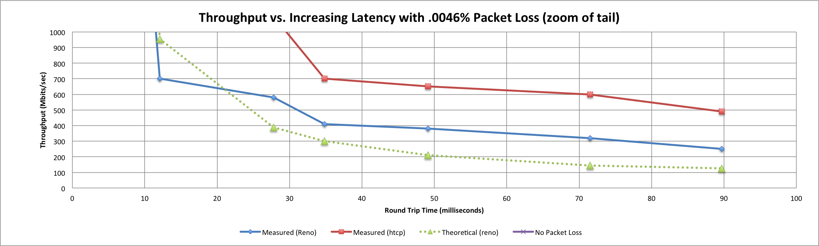
Transport: Modern TCP stack
Even modern TCP stacks are only of some help in the face of packet loss on a long path, high-speed network
Throughput vs. increasing latency on a 10Gb/s link with 0.0046% packet loss
(tail zoom)
1000
900
800
700
600
500
400
300
200
100
0
H-TCP (CUBIC refinement)
(measured)
Throughput, Mb/s
Reno (measured)
Reno (theory)
Roundtrip time, ms (corresponds roughly to San Francisco to London)
For a detailed analysis of the impact of packet loss on various TCP implementations, see “An Investigation into Transport Protocols and Data Transport Applications Over High Performance Networks,” chapter 8 (“Systematic Tests of New-TCP Behaviour”) by Yee-Ting Li, University College London (PhD thesis). http://www.slac.stanford.edu/~ytl/thesis.pdf

Slide 26
3) Monitoring and testing
The only way to keep multi-domain, international scale networks error-free is to test and monitor continuously end-to-end to detect soft errors and facilitate their isolation and correction
perfSONAR provides a standardize way to test, measure, export, catalogue, and access performance data from many different network domains (service providers, campuses, etc.)
perfSONAR is a community effort to
  define network management data exchange protocols, and
  standardized measurement data formats, gathering, and archiving
perfSONAR is deployed extensively throughout LHC related networks and international networks and at the end sites
(See [fasterdata], [perfSONAR], and [NetSrv])
  There are now more than 1100 perfSONAR boxes installed in around the world
Notes:
26

Slide 27
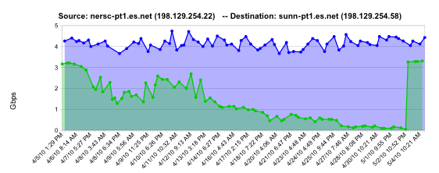
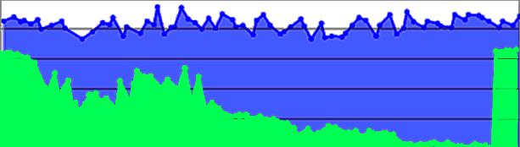
perfSONAR
The test and monitor functions can detect soft errors that limit throughput and can be hard to find (hard errors / faults are easily found and corrected)
normal performance
Soft failure example:
Observed end-to-end performance degradation due to soft failure of single optical line card
Gb/s
degrading performance
repair
one month
Why not just rely on “SNMP” interface stats for this sort of error detection?
  not all error conditions show up in SNMP interface statistics
  SNMP error statistics can be very noisy
  some devices lump different error counters into the same bucket, so it can be very challenging to figure out what errors to alarm on and what errors to ignore
    though ESnet’s Spectrum monitoring system attempts to apply heuristics to do this
  many routers will silently drop packets - the only way to find that is to test through them and observe loss using devices other than the culprit device

Slide 28
perfSONAR
The value of perfSONAR increases dramatically as it is deployed at more sites so that more of the end-to-end (app-to-app) path can characterized across multiple network domains
  provides the only widely deployed tool that can monitor circuits end-to-end across the different networks from the US to Europe
  ESnet has perfSONAR testers installed at every PoP and all but the smallest user sites – Internet2 is close to the same
  There are currently more that 1000 perfSONAR systems deployed world-wide
perfSONAR comes out of the work of the Open Grid Forum (OGF) Network Measurement Working Group (NM-WG) and the protocol is implemented using SOAP XML messages

Slide 29
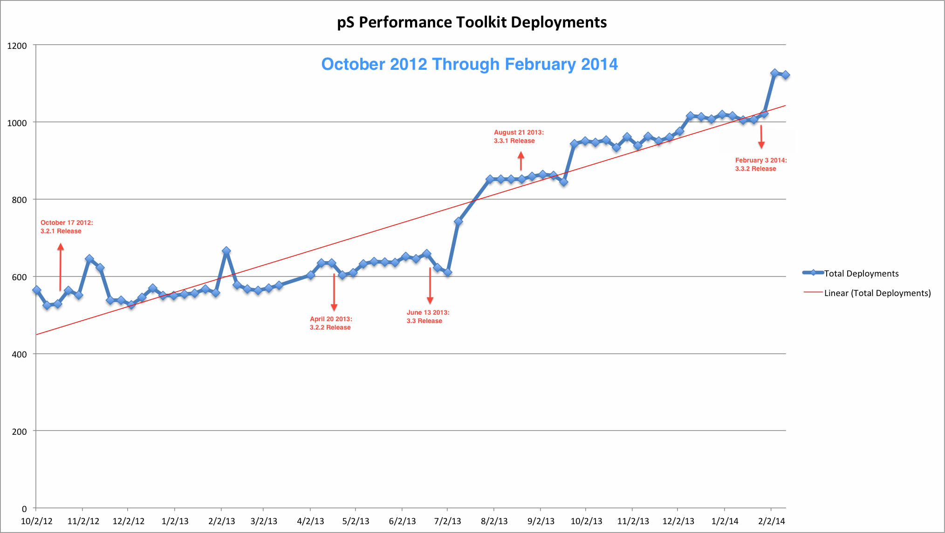
perfSONAR
Toolkit Deployment: over 1100 nodes as of Feb 2014
(Note: There is now enough critical mass to be really useful)

Slide 30
4) System software evolution and optimization
Once the network is error-free, there is still the issue of efficiently moving data from the application running on a user system onto the network
Host TCP tuning
Modern TCP stack (see above)
Other issues (MTU, etc.)
Data transfer tools and parallelism
Other data transfer issues (firewalls, etc.)

Slide 31
4.1) System software tuning: Host tuning – TCP
“TCP tuning” commonly refers to the proper configuration of TCP windowing buffers for the path length
It is critical to use the optimal TCP send and receive socket buffer sizes for the path (RTT) you are using end-to-end
Default TCP buffer sizes are typically much too small for today’s high speed networks
  Until recently, default TCP send/receive buffers were typically 64 KB
  Tuned buffer to fill CA to NY, 1 Gb/s path: 10 MB
    150X bigger than the default buffer size

Slide 32
System software tuning: Host tuning – TCP
Historically TCP window size tuning parameters were host-global, with exceptions configured per-socket by applications
  How to tune is a function of the application and the path to the destination, so potentially a lot of special cases
Auto-tuning TCP connection buffer size within pre-configured limits helps
Auto-tuning, however, is not a panacea because the upper limits of the auto-tuning parameters are typically not adequate for high-speed transfers on very long (e.g. international) paths

Slide 33
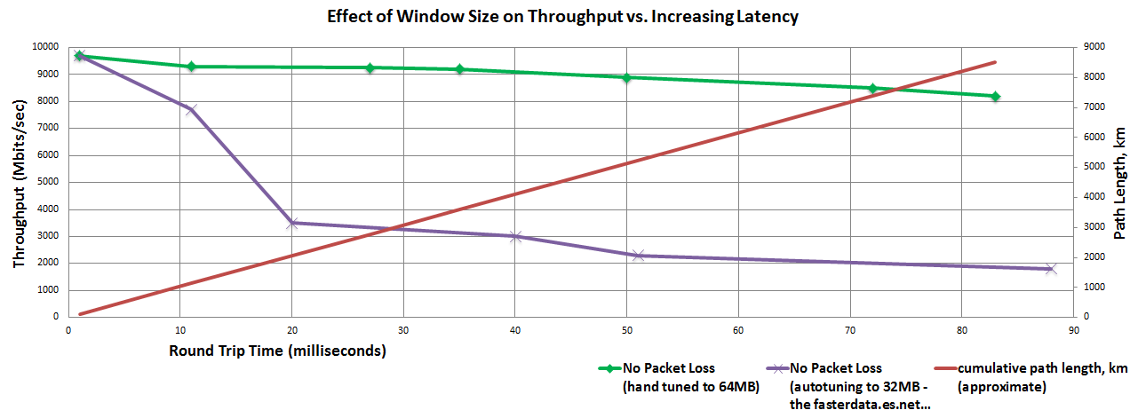
System software tuning: Host tuning – TCP
Throughput out to ~9000 km on a 10Gb/s network
32 MBy (auto-tuned) vs. 64 MBy (hand tuned) TCP window size
10000
9000
8000
7000
6000
5000
4000
3000
2000
1000
0
hand tuned to 64 MBy window
Throughput, Mb/s
auto tuned to 32 MBy window
Roundtrip time, ms (corresponds roughly
to San Francisco to London)
path length

Slide 34
4.2) System software tuning: Data transfer tools
Parallelism is key in data transfer tools
  It is much easier to achieve a given performance level with multiple parallel connections than with one connection
    this is because the OS is very good at managing multiple threads and less good at sustained, maximum performance of a single thread (same is true for disks)
  Several tools offer parallel transfers (see below)
Latency tolerance is critical
  Wide area data transfers have much higher latency than LAN transfers
  Many tools and protocols assume latencies typical of a LAN environment (a few milliseconds)
    examples: SCP/SFTP and HPSS mover protocols work very poorly in long path networks
Disk Performance
  In general need a RAID array or parallel disks (like FDT) to get more than about 500 Mb/s

Slide 35
System software tuning: Data transfer tools
Using the right tool is very important
Sample Results: Berkeley, CA to Argonne, IL
RTT = 53 ms, network capacity = 10Gbps.
    Tool Throughput
    scp: 140 Mbps
    patched scp (HPN): 1.2 Gbps
    ftp 1.4 Gbps
    GridFTP, 4 streams 5.4 Gbps
    GridFTP, 8 streams 6.6 Gbps
    Note that to get more than about 1 Gbps (125 MB/s) disk to disk requires using RAID technology
PSC (Pittsburgh Supercomputer Center) has a patch set that fixes problems with SSH
  http://www.psc.edu/networking/projects/hpn-ssh/
  Significant performance increase
    this helps rsync too

Slide 36
System software tuning: Data transfer tools
Globus GridFTP is the basis of most modern high-performance data movement systems
  Parallel streams, buffer tuning, help in getting through firewalls (open ports), ssh, etc.
  The newer Globus Online incorporates all of these and small file support, pipelining, automatic error recovery, third-party transfers, etc.
    This is a very useful tool, especially for the applications community outside of HEP

Slide 37
System software tuning: Data transfer tools
Also see Caltech's FDT (Faster Data Transfer) approach
  Not so much a tool as a hardware/software system designed to be a very high-speed data transfer node
  Explicit parallel use of multiple disks
  Can fill 100 Gb/s paths
  See SC 2011 bandwidth challenge results and http://monalisa.cern.ch/FDT/

Slide 38
4.4) System software tuning: Other issues
Firewalls are anathema to high-peed data flows
  many firewalls can’t handle >1 Gb/s flows
    designed for large number of low bandwidth flows
    some firewalls even strip out TCP options that allow for
    TCP buffers > 64 KB
  See Jason Zurawski’s “Say Hello to your Frienemy – The Firewall”
    Stateful firewalls have inherent problems that inhibit high throughput
    http://fasterdata.es.net/assets/fasterdata/Firewall-tcptrace.pdf
Many other issues
  Large MTUs (several issues)
  NIC tuning
    Defaults are usually fine for 1GE, but 10GE often requires additional tuning
  Other OS tuning knobs
  See fasterdata.es.net and “High Performance Bulk Data Transfer” ([HPBulk])

Slide 39
5) Site infrastructure to support data-intensive science
The Science DMZ
With the wide area part of the network infrastructure addressed, the typical site/campus LAN becomes the bottleneck
The site network (LAN) typically provides connectivity for local resources – compute, data, instrument, collaboration system, etc. – needed by data-intensive science
  Therefore, a high performance interface between the wide area network and the local area / site network is critical for large-scale data movement
Campus network infrastructure is typically not designed to handle the flows of large-scale science
  The devices and configurations typically deployed to build LAN networks for business and small data-flow purposes usually don’t work for large-scale data flows
    firewalls, proxy servers, low-cost switches, and so forth
    none of which will allow high volume, high bandwidth, long distance data flows

Slide 40
The Science DMZ
To provide high data-rate access to local resources the site LAN infrastructure must be re-designed to match the high-bandwidth, large data volume, high round trip time (RTT) (international paths) of the wide area network (WAN) flows (See [DIS])
  otherwise the site will impose poor performance on the entire high speed data path, all the way back to the source

Slide 41
The Science DMZ
The ScienceDMZ concept:
The compute and data resources involved in data-intensive sciences should be deployed in a separate portion of the site network that has a tailored packet forwarding path and security approach
  WAN-like technology
  Outside the site firewall – hence the term “ScienceDMZ”
    A security policy and implementation tailored for science traffic and implemented using appropriately capable hardware (e.g. that support access control lists, private address spaces, etc.
  With dedicated systems built and tuned for wide-area data transfer
  With test and measurement systems for performance verification and rapid fault isolation, typically perfSONAR (see [perfSONAR] and below)
This usually results in large increases in data throughput and is so important it was a requirement for last round of NSF CC-NIE grants

Slide 42
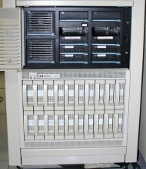
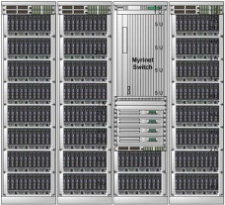

The Science DMZ
secured campus/site
access to Internet
Site DMZ
Web
WAN
DNS
border router
Mail
site firewall
(See http://fasterdata.es.net/science-dmz/ and [SDMZ] for a much more complete discussion of the various approaches.)
campus/site
access to
Science DMZ
resources is via
the site firewall
clean,
high-bandwidth
WAN data path
campus / site
LAN
Science DMZ
Science DMZ
router/switch
A WAN-capable device
dedicated systems built and tuned for wide-area data transfer
network monitoring and testing
high performance
Data Transfer Node
per-service
security policy
control points
computing cluster
campus / site

Slide 43
6) Data movement and management techniques
Automated data movement is critical for moving 700 terabytes/day between 170 international sites
In order to effectively move large amounts of data over the network, automated systems must be used to manage workflow and error recovery
The filtered ATLAS data rate of about 25 Gb/s is sent to 10 national Tier 1 data centers
The Tier 2 sites get a comparable amount of data from the Tier 1s
  Host the physics groups that analyze the data and do the science
  Provide most of the compute resources for analysis
  Cache the data (though this is evolving to remote I/O)

Slide 44
Highly distributed and highly automated workflow systems are central to data-intensive science
The ATLAS experiment system (PanDA) coordinates the analysis resources and the data management
  The resources and data movement are centrally managed
  Analysis jobs are submitted to the central manager that locates compute resources and matches these with dataset locations
  The system manages several million jobs a day
    coordinates data movement of hundreds of terabytes/day, and
    manages (analyzes, generates, moves, stores) of order 10 petabytes of data/year in order to accomplish its science
The complexity of the distributed systems that have to coordinate the computing and data movement for data analysis at the hundreds of institutions spread across three continents involved in the LHC experiments is substantial
CMS uses a similar system

Slide 45
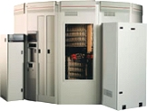
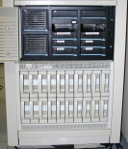

The ATLAS PanDA “Production and Distributed Analysis” system
uses distributed resources and layers of automation to manage several million jobs/day
CERN
ATLAS detector
Tier 0 Data Center
(1 copy of all data – archival only)
ATLAS production jobs
Regional production jobs
User / Group analysis jobs
CERN
ATLAS Tier 1 Data Centers:
11 sites scattered across Europe, North America, and Asia, in aggregate hold 1 copy of all data and provide the working dataset for distribution to Tier 2 centers for analysis.
Task Buffer
(job queue)
Policy
(job type priority)
2) DDM locates data and moves it to sites. This is a complex system in its own right called DQ2.
Data Service
Job Broker
1) Schedules jobs, initiates data movement
Job Dispatcher
PanDA Server
(task management)
Distributed Data Manager
Try to move the job to where the data is, else move data and job to where resources are available
4) Jobs are dispatched when there are resources available and when the required data is in place at the site
3) Prepares the local resources to receive Panda jobs
Site Capability Service
DDM
Agent
ATLAS analysis sites
(e.g. 70 Tier 2 Centers in Europe, North America and SE Asia)
DDM
Agent
DDM
Agent
Site status
Job resource manager:
Dispatch a “pilot” job manager - a Panda job receiver - when resources are available at a site
Pilots run under the local site job manager (e.g. Condor, LSF, LCG,…) and accept jobs in a standard format from PanDA
Similar to the Condor Glide-in approach
DDM
Agent
Pilot Job
(Panda job receiver running under the site-specific job manager)
Thanks to Michael Ernst, US ATLAS technical lead, for his assistance with this diagram, and to Torre Wenaus, whose view graphs provided the starting point. (Both are at Brookhaven National Lab.)
Grid Scheduler

Slide 46
Scale of ATLAS analysis driven data movement
PanDA manages 120,000–140,000 simultaneous jobs (PanDA manages two types of jobs that are shown separately here.)
50,000
The PanDA jobs, executing at centers all over Europe, N. America and SE Asia, generate network data movement of 730 TBy/day, ~68Gb/s
type 1jobs
0
one year
100,000
730 TBytes/day
type 2
jobs
50,000
0
one year
one year
150
100
Petabytes
50
It is this scale of data movement going on 24 hr/day, 9+ months/yr, that networks must support in order to enable the large-scale science of the LHC
0
four years
Accumulated data volume on disk

Slide 47
Building an LHC-scale production analysis system
In order to debug and optimize the distributed system that accomplishes the scale of the ATLAS analysis, years were spent building and testing the required software and hardware infrastructure
  Once the systems were in place, systematic testing was carried out in “service challenges” or “data challenges”
  Successful testing was required for sites to participate in LHC production

Slide 48

Ramp-up of LHC traffic in ESnet
The transition from testing to operation was a smooth continuum due to
at-scale testing – a process that took more than 5 years
LHC operation
LHC turn-on
LHC data system
testing
(est. of “small” scale traffic)

Slide 49
6) Evolution of network architectures (cont.)
For sustained high data-rate transfers – e.g. from instrument to data centers – a dedicated, purpose-built infrastructure is needed
The transfer of LHC experiment data from CERN (Tier 0) to the 11 national data centers (Tier 1) uses a network called LHCOPN
  The LHCOPN is a collection of leased 10Gb/s optical circuits
  The role of LHCOPN is to ensure that all data moves from CERN to the national Tier 1 data centers continuously
    In addition to providing the working dataset for the analysis groups, the Tier 1 centers, in aggregate, hold a duplicate copy of the data that is archived at CERN

Slide 50
The LHC OPN – Optical Private Network
While the LHCOPN was a technically straightforward exercise – establishing 10 Gb/s links between CERN and the Tier 1 data centers for distributing the detector output data – there were several aspects that were new to the R&E community
The issues related to the fact that most sites connected to the R&E WAN infrastructure through a site firewall and the OPN was intended to bypass site firewalls in order to achieve the necessary performance
  The security issues were the primarily ones and were addressed by
    Using a private address space that hosted only LHC Tier 1 systems (see [LHCOPN Sec])
      that is, only LHC data and compute servers are connected to the OPN

Slide 51

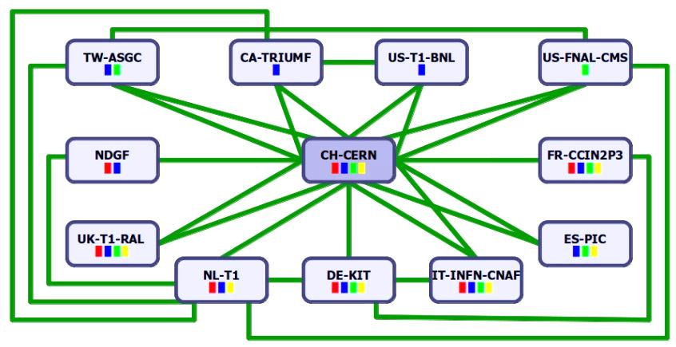
The LHC OPN – Optical Private Network
NDGF
DE-KIT
LHCOPN physical (abbreviated)
UK-T1_RAL
CH-CERN
CA-TRIUMF
NL-T1
FR-CCIN2P3
US-FNAL-CMS
US-T1-BNL
IT-NFN-CNAF
ES-PIC
TW-ASCG
LHCOPN architecture

Slide 52
The LHC OPN – Optical Private Network
N.B.
In 2005 the only way to handle the CERN (T0) to Tier 1 centers data transfer was to use dedicated, physical, 10G circuits
Today, in most R&E networks (where 100 Gb/s links are becoming the norm), the LHCOPN could be provided using virtual circuits implemented with MPLS or OpenFlow network overlays
  The ESnet part of the LHCOPN has used this approach for more than 5 years – in fact this is what ESnet’s OSCARS virtual circuit system was originally designed for (see below)
  However, such an international-scale virtual circuit infrastructure would have to be carefully tested before taking over the LHCOPN role

Slide 53
6) Evolution of network architectures (cont.)
Managing large-scale science traffic in a shared infrastructure
The traffic from the Tier 1 data centers to the Tier 2 sites (mostly universities) where the data analysis is done is now large enough that it must be managed separately from the general R&E traffic
  In aggregate the Tier 1 to Tier 2 traffic is equal to the Tier 0 to Tier 1
  (there are about 170 Tier 2 sites)
Managing this with all possible combinations of Tier 2 – Tier 2 flows (potentially 170 x 170) cannot be done just using a virtual circuit service – it is a relatively heavy-weight mechanism
Special infrastructure is required for this: The LHC’s Open Network Environment – LHCONE – was designed for this purpose

Slide 54
  The LHC’s Open Network Environment – LHCONE
LHCONE provides a private, managed infrastructure designed for LHC Tier 2 traffic (and likely other large-data science projects in the future)
The approach is a VRF-based overlay network whose architecture is a collection of routed “clouds” using address spaces restricted to subnets that are used by LHC systems
  The clouds are mostly local to a network domain (e.g. one for each involved domain – ESnet, GEANT (“fronts” for the NRENs), Internet2 (fronts for the US universities), etc.
  The clouds (VRFs) are interconnected by point-to-point circuits provided by various entities (mostly the domains involved)
In this way the LHC traffic will use circuits designated by the network engineers
  To ensure continued good performance for the LHC and to ensure that other traffic is not impacted – this is critical because apart from the LHCOPN, the R&E networks are funded for the benefit of the entire R&E community, not just the LHC

Slide 55




















LHCONE: A global infrastructure for the LHC Tier1 data center and Tier 2 analysis center connectivity
SimFraU
SCINET
(UTor)
NDGF-T1
UVic
UAlb
CANARIE
Canada
NDGF-T1b
NDGF-T1c
GLORIAD
(global)
TRIUMF-T1
NL-T1
NORDUnet
Nordic
McGill
SARA
Netherlands
KurchatovT1
ICEPP
U Tokyo
CERN-T1
Korea
SINET
Japan
MREN
(Chicago)
CERN
(CERNLight)
Geneva
KISTI
Korea
Chicago
(StarLight)
Amsterdam
TIFR
India
Geneva
AGLT2 (3)
UIUC
MWT2
CIC
OmniPoP
(Chicago)
Indiana
GigaPoP
KNU
DESY
KERONET2
Korea
SLAC
RWTH
Wup.U
DE-KIT-T1
ESnet
USA
GSI
DFN
Germany
FNAL-T1
New York
(MAN LAN)
CERN
Seattle
(PNWG)
BNL-T1
India
CENIC
USA
ASGC-T1+T2
Caltech
ASGC2
GÉANT
Europe
ASGC
Taiwan
Los
Angeles
AGLT2
MSU
IU
MIT
AGLT2
UM
AGLT2
WSU
UNL
UIUC
MWT2
UCSD
Washington
(WIX)
NCU
NTU
UWisc
UFlorida
NE
CC-IN2P3-T1
TWAREN
Taiwan
PurU
GLakes
SoW
IN2P3 (10 sites)
CEA
(IRFU)
Vandebilt
UNeb
RENATER
France
Internet2
USA
Harvard
PIC-T1
INFN (9 sites)
CNAF-T1
RedIRIS
Spain
GARR
Italy
UNAM
CUDI
Mexico
LHCONE VRF domain
LHCONE VRF aggregrator networks
NTU
End sites – LHC Tier 2/3
unless indicated as Tier 1
Sites that are standalone VRFs
Chicago
Regional R&E communication nexus
Communication links, 10, 20, 30, and 100Gb/s
See http://lhcone.net for details.
August 7, 2014

Slide 56
  The LHC’s Open Network Environment – LHCONE
LHCONE could be set up relatively “quickly” because
  The VRF technology is a standard capability in most core routers, and
  there is capacity in the R&E community that can be made available for use by the LHC collaboration that cannot be made available for general R&E traffic
LHCONE is essentially built as a collection of private overlay networks (like VPNs) that are interconnected by managed links to form a global infrastructure where Tier 2 traffic will get good service and not interfere with general traffic
From the point of view of the end sites, they see a LHC-specific environment where they can reach all other LHC sites with good performance
See LHCONE.net

Slide 57
LHCONE is one part of the network infrastructure that supports the LHC
A Network Centric View of the LHC
detector
O(1-10) meter
1 PB/s
CERN →T1 | miles | kms
France | 350 | 565
Italy | 570 | 920
UK | 625 | 1000
Netherlands | 625 | 1000
Germany | 700 | 1185
Spain | 850 | 1400
Nordic | 1300 | 2100
USA – New York | 3900 | 6300
USA - Chicago | 4400 | 7100
Canada – BC | 5200 | 8400
Taiwan | 6100 | 9850
Level 1 and 2 triggers
O(10-100) meters
Level 3 trigger
O(1) km
CERN Computer Center
500-10,000 km
50 Gb/s (25Gb/s ATLAS, 25Gb/s CMS)
Universities/
physics
groups
Universities/
physics
groups
LHC Tier 1
Data Centers
Universities/
physics
groups
Universities/
physics
groups
Universities/
physics
groups
Universities/
physics
groups
Universities/
physics
groups
Taiwan
Canada
USA-Atlas
USA-CMS
Universities/
physics
groups
Universities/
physics
groups
Nordic
CERN
France
The LHC Open Network Environment
(LHCONE)
UK
Spain
Universities/
physics
groups
Universities/
physics
groups
Netherlands
Germany
Italy
The is intended to
indicate that the physics
groups now get their data
wherever it is most readily
available
Universities/
physics
groups
The LHC Optical Private Network (LHCOPN)
Universities/
physics
groups
Universities/
physics
groups
Universities/
physics
groups
Universities/
physics
groups
Universities/
physics
groups
LHC Tier 2 Analysis Centers

Slide 58
7) New network services
Point-to-Point Virtual Circuit Service
Why a Circuit Service?
Geographic distribution of resources is seen as a fairly consistent requirement across the large-scale sciences in that they use distributed applications systems in order to:
  Couple existing pockets of code, data, and expertise into “systems of systems”
  Break up the task of massive data analysis and use data, compute, and storage resources that are located at the collaborator’s sites
  See https://www.es.net/about/science-requirements
A commonly identified need to support this is that networking must be provided as a “service”
  Schedulable with guaranteed bandwidth – as is done with CPUs and disks
  Traffic isolation that allows for using non-standard protocols that will not work well in a shared infrastructure
  Some network path characteristics may also be specified – e.g. diversity
  Available in Web Services / Grid Services paradigm

Slide 59
Point-to-Point Virtual Circuit Service
The way that networks provide such a service is with “virtual circuits” (also called pseudowires) that emulate point-to-point connections in a packet-switched network like the Internet
  This is typically done by using a “static” routing mechanism
    E.g. some variation of label based switching, with the static switch tables set up in advance to define the circuit path
      MPLS and OpenFlow are examples of this, and both can transport IP packets
  Most modern Internet routers have this type of functionality
Such a service channels big data flows into virtual circuits in ways that also allow network operators to do “traffic engineering” – that is, to manage/optimize the use of available network resources and to keep big data flows separate from general traffic
  The virtual circuits can be directed to specific physical network paths when they are set up

Slide 60

Point-to-Point Virtual Circuit Service
OSCARS is ESnet’s implementation of a virtual circuit service
(For more information contact the project lead: Chin Guok, chin@es.net)
Has been in production service in ESnet for the past 7 years, or so
See “Motivation, Design, Deployment and Evolution of a Guaranteed Bandwidth Network Service,” in TERENA Networking Conference, 2011 in the references
OSCARS received a 2013 “R&D 100” award

Slide 61
End User View of Circuits – How They Use Them
Who are the “users?”
  Sites, for the most part
How are the circuits used?
  End system to end system, IP
    Almost never – very hard unless private address space used
      Using public address space can result in leaking routes
      Using private address space with multi-homed hosts risks allowing backdoors into secure networks
  End system to end system, Ethernet (or other) over VLAN – a pseudowire
    Relatively common
    Interesting example: RDMA over VLAN likely to be popular in the future
      SC11 demo of 40G RDMA over WAN was very successful
      CPU load for RDMA is a small fraction that of IP
      The guaranteed network of circuits (zero loss, no reordering, etc.) required by non-IP protocols like RDMA fits nicely with circuit services (RDMA performs very poorly on best effort networks)
  Point-to-point connection between routing instance – e.g. BGP at the end points
    Essentially this is how all current circuits are used: from one site router to another site router
      Typically site-to-site or advertise subnets that host clusters, e.g., LHC analysis or data management clusters

Slide 62
End User View of Circuits – How They Use Them
When are the circuits used?
  Mostly to solve a specific problem that the general infrastructure cannot
    Most circuits are used for a guarantee of bandwidth or for user traffic engineering

Slide 63
Cross-Domain Virtual Circuit Service
Large-scale science always involves institutions in multiple network domains (administrative units)
  For a circuit service to be useful it must operate across all R&E domains involved in the science collaboration to provide and-to-end circuits
  e.g. ESnet, Internet2 (USA), CANARIE (Canada), GÉANT (EU), SINET (Japan), CERNET and CSTNET (China), KREONET (Korea), TWAREN (Taiwan), AARNet (AU), the European NRENs, the US Regionals, etc. are all different domains

Slide 64

Inter-Domain Control Protocol
There are two realms involved:
  Domains controllers like OSCARS for routing, scheduling, and resource commitment within network domains
  The inter-domain protocol that the domain controllers use between network domains where resources (link capacity) are likely shared and managed by pre-agreements between domains
Topology
exchange
Local InterDomain Controller
VC setup request
VC setup request
VC setup request
VC setup request
User source
VC setup request
Local IDC
Local IDC
Local IDC
Local IDC
User destination
FNAL (AS3152)
[US]
GEANT (AS20965)
[Europe]
DESY (AS1754)
[Germany]
ESnet (AS293)
[US]
AutoBAHN
DFN (AS680)
[Germany]
data plane connection helper at each domain ingress/egress point
OSCARS
data plane connection helper at each domain ingress/egress point
The end-to-end virtual circuit
  The domains exchange topology information containing at least potential VC ingress and egress points
  VC setup request (via IDC protocol) is initiated at one end of the circuit and passed from domain to domain as the VC segments are authorized and reserved
  Data plane connection (e.g. Ethernet VLAN to VLAN connection) is facilitated by a helper process
Notes:
64

Slide 65
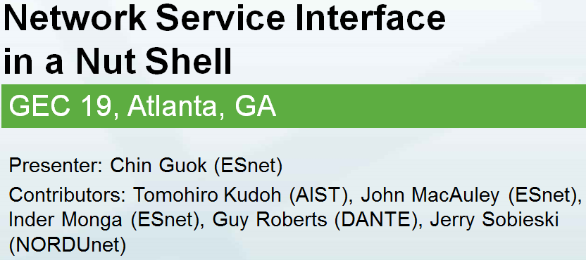
Point-to-Point Virtual Circuit Service
The Inter-Domain Control Protocol work that provided multi-domain virtual circuits has evolved into the Open Grid Forum’s Network Services Interface (NSI)
  Testing is being coordinated in GLIF (Global Lambda Integrated Facility - an international virtual organization that promotes the paradigm of lambda networking)
  The LHCONE Architecture working group is conducting an experimental deployment in the LHCONE community
Functionally, the primary difference between IDCP and NSI is that NSI has a mechanism for setting up the paths of a multi-domain circuit simultaneously using a central “aggregator”
  Much faster and more reliable than the chain method of IDCP

Slide 66
NSI Fundamental Design Principles (1/3)
“Network Service Interface” is a framework for inter-domain service coordination
Examples:
Connection Service (NSI-CS)
Topology Service (NSI-TS)
Discovery Service (NSI-DS)
Switching Service (NSI-SS)
Monitoring Service
Protection Service
Verification Service
Etc.
Supports advance reservations
Network Services Agent (NSA)
Requester
Agent (RA)
NSA
Network Services Interface
Provider
Agent (PA)
NSA
Network Resource Manager (NRM)
NRM
NSI Network Service Domain
66

Slide 67
NSI Fundamental Design Principles (2/3)
2. Designed for flexible, multi-domain, service chaining
ultimate RA
Supports Tree and Chain model
of service chaining
NSA
Fits in well with Cloud/Compute model of provisioning as well as Network/GMPLS model
Aggregator NSA
NSA
Aggregator/uPA
Aggregator/uPA
Aggregator/uPA
uRA
ultimate PA
NSA
uPA
NSA
uPA
NSA
NSA
NSA
NSA
NSA
Domain A
Domain B
Domain C
Domain A
Domain B
Domain C
NSI Topology
NSI Topology

Slide 68
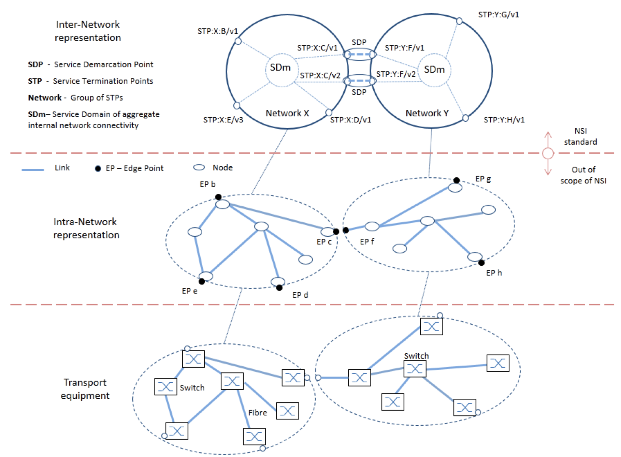
NSI Fundamental Design Principles (3/3)
3. Principles of Abstraction applied – to network layers, technologies and domains
Service Termination Points (STP) and Service Demarcation Points (SDP) are abstract and technology independent

Slide 69
NSI Connection Service (v2.0)
NSI is an advance-reservation based protocol
  A reservation of a connection has properties such:
    A-point, Z-point (mandatory)
    Start-time, End-time (optional*)
    Bandwidth, Labels (optional)
A reservation is made in two-phase
  First phase: availability is checked, if available resources are held
  Second phase: the requester either commit or abort a held reservation
  Two-phase is convenient when a requester requests resources from multiple providers, including other resources such as computers and storages
  Timeout: If a requester does not commit a held reservation for a certain period of time, a provider can timeout
Modification of a reservation is supported.
  Currently, modification of start_time, end_time and bandwidth are supported
  *NB: Restricted to PA policies

Slide 70

NSI Service Type and Definition
Introduction of Service Type and Service Definition removes the dependencies of service specification from the core NSI CS protocol.
This allows the NSI CS protocol to remain stable while permitting changes to the services offered by NSA within the network.
Abstraction of physical properties of the underlying data plane can be achieved by the Service Definition.
Common service
The providers need to agree among themselves the service they wish to offer to the customer. For example they may wish to offer an Ethernet VLAN Transport Service (EVTS). The service must be common to all providers and all providers must agree in advance a minimum service level that they are all able to meet.

Slide 71
NSI NSA Implementations
AutoBAHN – GÉANT (Poznan, PL)
BoD - SURFnet (Amsterdam, NL)
DynamicKL – KISTI (Daejeon, KR)
G-LAMBDA-A - AIST (Tsukuba, JP)
G-LAMBDA-K – KDDI Labs (Fujimino, JP)
OpenNSA – NORDUnet (Copenhagen, DK)
OSCARS – ESnet (Berkeley, US)

Slide 72
OGF NSI Information
OGF NSI Working Group Site
  http://redmine.ogf.org/projects/nsi-wg/
NSI Project Page
  https://code.google.com/p/ogf-nsi-project/
NSI Documents
  NSI Framework: http://redmine.ogf.org/dmsf_files/13168?download=
  NSI CS v2 (in public comment till Apr 15 2014): http://redmine.ogf.org/dmsf_files/13168?download=
NSI Co-Chairs
  Guy Roberts <guy.roberts@dante.net>
  Inder Monga <imonga@es.net>
  Tomohiro Kudoh <t.kudoh@aist.go.jp>

Slide 73
8) Maintain a knowledge base
It is critical to help data-intensive projects in effectively using the network infrastructure
Using the knowledge gained from the problem solving to build a community knowledge base benefits everyone
The knowledge base maintained by ESnet is at http://fasterdata.es.net and contains contributions from several organizations

Slide 74
Provide R&D, consulting and knowledge base
R&D drove most of the advances that make it possible for the network to support data-intensive science
  With each generation of network transport technology
    155 Mb/s was the norm for high speed networks in 1995
    100 Gb/s – 650 times greater – is the norm today
    R&D groups involving hardware engineers, computer scientists, and application specialists, worked to
    first demonstrate in a research environment that “filling the network pipe” end-to-end (application to application) was possible,
    and then to do the development necessary for applications to make use of the new capabilities
  Examples of how this methodology drove toward today’s capabilities include
    experiments in the 1990s in using parallel disk I/O and parallel network I/O together to achieve 600 Mb/s over OC12 (622 Mb/s) wide area network paths
    recent demonstrations of this technology to achieve disk-to-disk WAN data transfers at 100 Gb/s

Slide 75
The knowledge base
http://fasterdata.es.net topics:
  Network Architecture, including the Science DMZ model
  Host Tuning
  Network Tuning
  Data Transfer Tools
  Network Performance Testing
  With special sections on:
    Linux TCP Tuning
    Cisco 6509 Tuning
    perfSONAR Howto
    Active perfSONAR Services
    Globus overview
    Say No to SCP
    Data Transfer Nodes (DTN)
    TCP Issues Explained
fasterdata.es.net is a community project with contributions from several organizations

Slide 76
9) Authentication and authorization
Authentication (AuthN) and authorization (AuthZ), collectively “AA” are critical in a multi-institution collaboration where resources are being shared
Without a community-wide agreed upon AA infrastructure, institutional policy will block resource sharing at every step
To address AA, the LHC community has developed and deployed a single, interoperating, global infrastructure based on Public Key certificate technology
Characteristics of the WLCG (Worldwide LHC Computing Grid) infrastructure include /1/
  Multiple administrative organizations
  Multiple service providers participate in a single transaction
  Multiple authorities influence policy
  And unless you can do AA in this sort of environment you cannot do the enormous data processing associated with global, data-intensive science
/1/ See “WLCG Authentication and Authorization (certificate infrastructure) and its use,” Dave Kelsey (STFC - Rutherford Appleton Lab, GB) at https://indico.cern.ch/event/289680/

Slide 77
Authentication and authorization
To address AA, the LHC community has developed and deployed a single, interoperating, global infrastructure based on Public Key certificate technology
  Trust is obtained by using a common set of community standards as the basis for issuing certificates /2/
  A fairly small number of authorities issue these identity certificates for authentication
/2/ The IGTF (Interoperable Global Trust Federation) is the community-based mechanism for establishing trust in a community the size of the LHC (actually considerably larger because IGTF serves many science communities: 100,000 users in more than 1000 different user communities, 89 national and regional identity authorities, major relying parties include EGI, PRACE, ESEDE, Open Science Grid, HPCI, wLHF, OGF, ….)
The IGTF – through its members – develops guidance, coordinates requirements, and harmonizes assurance levels, for the purpose for supporting trust between distributed IT infrastructures for research.
For the purpose of establishing and maintaining and identity federation service, the IGTF maintains a set of authentication profiles (APs) that specify the policy and technical requirements for a class of identity assertions and assertion providers. The member PMAs are responsible for accrediting authorities that issue identity assertions with respect to these profiles.
Each of the PMAs will accredit credential-issuing authorities (the Certificate Authorities) and document the accreditation policy and procedures.

Slide 78
Authentication and authorization
When the AuthN problem is solved you still have to address authorization
Even a “single” collaboration like the LHC (actually several collaboration that are organized around the several detectors) you still have it allocate and manage resource utilization
  There may be common jobs – e.g. the track reconstruction – that everyone has to have to do any analysis, so these get high priority on available resources
  Different physics groups have different analysis approaches, and so the collaboration will allocate resources among competing groups
    AuthZ certificates will be issued to groups or users to let them “draw” against (use) the resources (CPUs and storage) that are allocated to them
    Accounting (who has used what portion of their allocation) is done centrally
  In a widely distributed resource environment (the CMS and ATLAS collaborations each have some 70-100 participating institutions world-wide that provide resources) it is not practical for a given user to use his AuthN cert to log in to each system that he might have an allocation on
    Proxy certificates are used for this purpose
    Proxy certs carry the user’s identity for a limited period of time and are sent with a computing job to a remote system for authorization to access and use that system

Slide 79
Authentication and authorization
One way or another, all of the issues must be addressed for widely distributed collaborations doing data-intensive science
  The climate science community uses a different AuthN approach
    They use OpenID in which home institutions certify identity and then institutions that trust each other accept the identity tokens from other institutions in a series of bi-lateral agreements
AA is just one of a set of issues to be solved before large-scale, data-intensive collaboration is possible

Slide 80
The Message
A significant collection of issues must all be addressed in order to achieve the sustained data movement needed to support data-intensive science such as the LHC experiments
  But once this is done, international high-speed data management can be done on a routine basis
Many of the technologies and knowledge from the LHC experience are applicable to other science disciplines that must manage a lot of data in a widely distributed environment – SKA, ITER, climate science……

Slide 81
Infrastructure Critical to Science
The combination of
  New network architectures in the wide area
  New network services (such as guaranteed bandwidth virtual circuits)
  Cross-domain network error detection and correction
  Redesigning the site LAN to handle high data throughput
  Automation of data movement systems
  Use of appropriate operating system tuning and data transfer tools
now provides the LHC science collaborations with the data communications underpinnings for a unique large-scale, widely distributed, very high performance data management and analysis infrastructure that is an essential component in scientific discovery at the LHC
Other disciplines that involve data-intensive science will face most of these same issues

Slide 82
References
[DIS] “Infrastructure for Data Intensive Science – a bottom-up approach, “Eli Dart and William Johnston, Energy Sciences Network (ESnet), Lawrence Berkeley National Laboratory. To be published in Future of Data Intensive Science, Kerstin Kleese van Dam and Terence Critchlow, eds. Also see http://fasterdata.es.net/fasterdata/science-dmz/
[fasterdata] See http://fasterdata.es.net/fasterdata/perfSONAR/
[HPBulk] “High Performance Bulk Data Transfer,” Brian Tierney and Joe Metzger, ESnet. Joint Techs, July 2010. Available at fasterdata.es.net/fasterdata-home/learn-more
[Jacobson] For an overview of this issue see http://en.wikipedia.org/wiki/Network_congestion#History
[LHCONE] http://lhcone.net
[LHCOPN Sec] at https://twiki.cern.ch/twiki/bin/view/LHCOPN/WebHome see “LHCOPN security policy document”
[NetServ] “Network Services for High Performance Distributed Computing and Data Management.” W. E. Johnston, C. Guok, J. Metzger, and B. Tierney, ESnet and Lawrence Berkeley National Laboratory. In The Second International Conference on Parallel, Distributed, Grid and Cloud Computing for Engineering, 12‐15 April 2011. Available at http://es.net/news-and-publications/publications-and-presentations/
[OIF1] OIF-FD-100G-DWDM-01.0 - 100G Ultra Long Haul DWDM Framework Document (June 2009). http://www.oiforum.com/public/documents/OIF-FD-100G-DWDM-01.0.pdf
Notes:
82

Slide 83
References
[OSCARS] “Intra and Interdomain Circuit Provisioning Using the OSCARS Reservation System.” Chin Guok; Robertson, D.; Thompson, M.; Lee, J.; Tierney, B.; Johnston, W., Energy Sci. Network, Lawrence Berkeley National Laboratory. In BROADNETS 2006: 3rd International Conference on Broadband Communications, Networks and Systems, 2006 – IEEE. 1-5 Oct. 2006. Available at http://es.net/news-and-publications/publications-and-presentations/
“Network Services for High Performance Distributed Computing and Data Management,” W. E. Johnston, C. Guok, J. Metzger, and B. Tierney, ESnet and Lawrence Berkeley National Laboratory, Berkeley California, U.S.A. The Second International Conference on Parallel, Distributed, Grid and Cloud Computing for Engineering,12-15 April 2011, Ajaccio - Corsica – France. Available at http://es.net/news-and-publications/publications-and-presentations/
“Motivation, Design, Deployment and Evolution of a Guaranteed Bandwidth Network Service,” William E. Johnston, Chin Guok, and Evangelos Chaniotakis. ESnet and Lawrence Berkeley National Laboratory, Berkeley California, U.S.A. In TERENA Networking Conference, 2011. Available at http://es.net/news-and-publications/publications-and-presentations/
Notes:
83

Slide 84
References
[perfSONAR] See “perfSONAR: Instantiating a Global Network Measurement Framework.” B. Tierney, J. Metzger, J. Boote, A. Brown, M. Zekauskas, J. Zurawski, M. Swany, M. Grigoriev. In proceedings of 4th Workshop on Real Overlays and Distributed Systems (ROADS'09) Co-located with the 22nd ACM Symposium on Operating Systems Principles (SOSP), October, 2009. Available at http://es.net/news-and-publications/publications-and-presentations/
http://www.perfsonar.net/
http://psps.perfsonar.net/
[REQ] https://www.es.net/about/science-requirements/
[Rob1] “100G and beyond with digital coherent signal processing,” Roberts, K., Beckett, D. ; Boertjes, D. ; Berthold, J. ; Laperle, C., Ciena Corp., Ottawa, ON, Canada. Communications Magazine, IEEE, July 2010
(may be available at http://staffweb.cms.gre.ac.uk/~gm73/com-mag/COMG_20100701_Jul_2010.PDF )
[SDMZ] see ‘Achieving a Science "DMZ“’ at http://fasterdata.es.net/assets/fasterdata/ScienceDMZ-Tutorial-Jan2012.pdf and the podcast of the talk at http://events.internet2.edu/2012/jt-loni/agenda.cfm?go=session&id=10002160&event=1223
[Tracy1] http://www.nanog.org/meetings/nanog55/presentations/Tuesday/Tracy.pdf
Notes:
84

