Slide 1


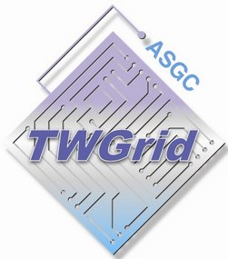


















LHCONE: A global infrastructure for the LHC Tier1 data center and Tier 2/3 analysis center connectivity
SimFraU
CANARIE
Canada
SCINET
(UTor)
NDGF-T1
UVic
UAlb
NDGF-T1b
NDGF-T1c
GLORIAD
(global)
TRIUMF-T1
NL-T1
NORDUnet
Nordic
McGill
SARA
Netherlands
KurchatovT1
ICEPP
U Tokyo
CERN-T1
Korea
SINET
Japan
MREN
(Chicago)
CERN
(CERNLight)
Geneva
KISTI
Korea
Chicago
(StarLight)
Amsterdam
(NetherLight)
TIFR
India
Geneva
KNU
CIC
OmniPoP
(Chicago)
Indiana
GigaPoP
KERONET2
Korea
AGLT2 (3)
UIUC
MWT2
DESY
RWTH
Wup.U
DE-KIT-T1
SLAC
ESnet
USA
GSI
DFN
Germany
CERN
FNAL-T1
New York
(MAN LAN)
Seattle
(PNWG)
BNL-T1
India
ASGC-T1+T2
CENIC
USA
GÉANT
Europe
ASGC2
Caltech
ASGC
Taiwan
Los
Angeles
AGLT2
MSU
IU
MIT
AGLT2
UM
AGLT2
WSU
UNL
UIUC
MWT2
CC-IN2P3-T1
NCU
NTU
TWAREN
Taiwan
UWisc
UCSD
Washington
(WIX)
IN2P3
(10 sites)
RENATER
France
CEA
(IRFU)
UFlorida
NE
PurU
UNeb
GLakes
SoW
Vandebilt
Internet2
USA
Harvard
PIC-T1
INFN
(9 sites)
CNAF-T1
RedIRIS
Spain
GARR
Italy
UNAM
CUDI
Mexico
LHCONE VRF domain
NTU
End sites – LHC Tier 2/3
unless indicated as Tier 1
LHCONE VRF aggregrator networks
UNL
Sites that are standalone VRFs
Chicago
Regional R&E communication nexus
Communication links, 10, 20, 30, and 100Gb/s
12 August 2014
See http://lhcone.net for details.

