Slide 1
LHCONE & TEIN
TABLE OF CONTENTS
TEIN4 Networks
Understanding of Data Flow from CERN
Benefits for deploying LHCONE in TEIN
Possible Implementation Scenario
Further considerations & Implications
Nantou, TW
13 August 2014
TEIN*CC
Patch Lee

Slide 2
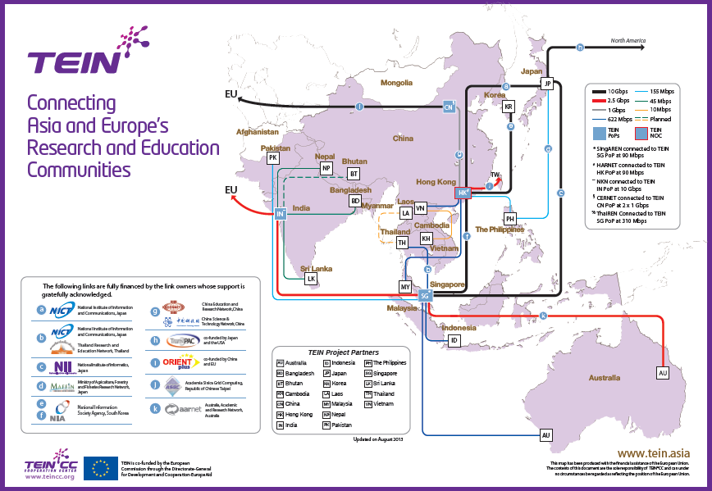
1. TEIN4 – Diagram of Networks
BJ
TW
HK
IN
SG

Slide 3
1. TEIN4 – Diagram of Networks (cont.)
# | COUNTRY | LINK | TEIN4 | # | COUNTRY | LINK | TEIN4
1 | Afghanistan | To GEANT | 155M | 12 | *Sri Lanka | IN – LK | 45M
2 | *Bangladesh | IN – BD | 45M | 13 | Thailand | SG - TH | 622M(310M)
3 | Bhutan | - | - | 14 | *Vietnam | HK - VN | 622M
4 | Cambodia | KH – VN | 10M | 15 | *Australia | SG - AU | 2.5G
5 | *India | IN – EU/IN - SG | 2.5G/2.5G | 16 | China | BJ - HK | 1G
6 | *Indonesia | SG – ID | 622M | 17 | Hong Kong | - | 120M
7 | *Laos | TH - LA | 10M | 18 | Japan | SG-JP/HK-JP | 10G/10G
8 | *Malaysia | HK – MY | 622M | 19 | Korea | SG-HK/HK-KR | 10G/10G
9 | *Nepal | IN – NP | 45M | 20 | Singapore | - | 90M
10 | *Pakistan | SG – PK | 155M | 21 | Myanmar | - | -
11 | *Philippines | HK - PH | 155M | 22 | Mongolia | - | -
* Denotes the link is owned by TEIN*CC

Slide 4
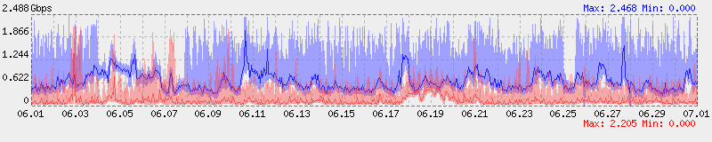
1. TEIN4 – Link Utilization Info (2.5G, MB-EU)
  {Source: TEIN NOC}

Slide 5
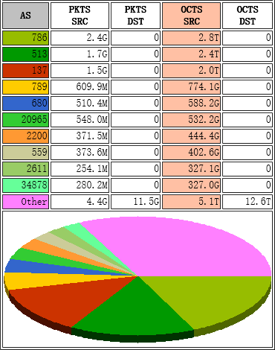
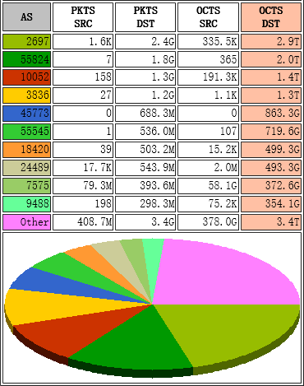
1. TEIN4 – AS TOP 10 (ASIA 2 EUROPE)
AS786
JANET
(UK)
AS2697
ERNET
(India)
AS513
CERN
(Switzerland)
AS55824
NKN
(India)
AS137
GARR
(Italia)
AS10052
KNU
(Korea)
AS789
IN2P3
(France)
AS3836
THAISARN
(Thailand)
AS680
DFN
(Germany)
AS45773
PERN
(Pakistan)
AS20965
GEANT
(Europe)
AS55545
SUT
(Thailand)
AS2200
RENATER
(France)
AS18420
NCU
(Taiwan)
AS559
SWITCH
(Switzerland)
AS24489
TEIN
(Asia)
AS2611
BELNET
(Belgium)
AS7575
AARNET
(Australia)
AS34878
KIT
(Germany)
AS9488
SNU
(Korea)
By source AS
By destination AS
  {Source: TEIN NOC}

Slide 6
2. Understanding of Data Flow from CERN
CERN
TIER1
Any
TIER1
Any
TIER2
Any
TIER3
TIER2
TIER3
<Change of Structure of Data flow from CERN>

Slide 7
3. Benefits for deploying LHCONE in TEIN
  TEIN can keep the regional traffic within Asia
  NRENs and the TEIN network to segregate
  LHC traffic flows from the general purpose
  IP traffic and give a better view of the
  connectivity requirement of LHC sites in Asia
  {Source: Dante}

Slide 8
4. Possible Implementation Scenario
  BASIC UNDERSTANDING & ACCORDING APPROACH I
  VRF technology is well used and recognized safe to implement in the running networks
  It can be applied without affecting other traffics
  GEANT has been with it already more than 2 years
  Internet2, SINET, etc. established collaborative links with GEANT already
  therefore, TEIN*CC considers to implement LHC VRF based on requests from each partner

Slide 9
4. Possible Implementation Scenario
  {Source: Dante}

Slide 10
5. Further considerations & Implications
  ISSUES TO BE CONSIDERED
  Further safety check for SDH link (MB-EU) before implementing VRF
  Installation of a system of perfSONAR to troubleshoot network related issues
  Implications from LHC vrf
  To maximize the great benefits of vrf technology throughout the TEIN networks
  TEIN*CC would like to consider vrf to be applied to other big applications, for instance, Tele-medicine vrf, etc.

Slide 11
Thank you.
Q&A
patch.lee@teincc.org

