Slide 1

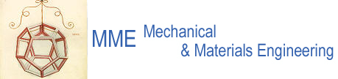
Accueil
  Groupe de Recherche sur le Tolérancement
Engineering Department
  F. Bertinelli EN/MME
  (4 Juin, 2014 - 15 minutes)
  Bienvenus au CERN
  CERN, EN et MME
  Un appel personnel …
EN

Slide 2
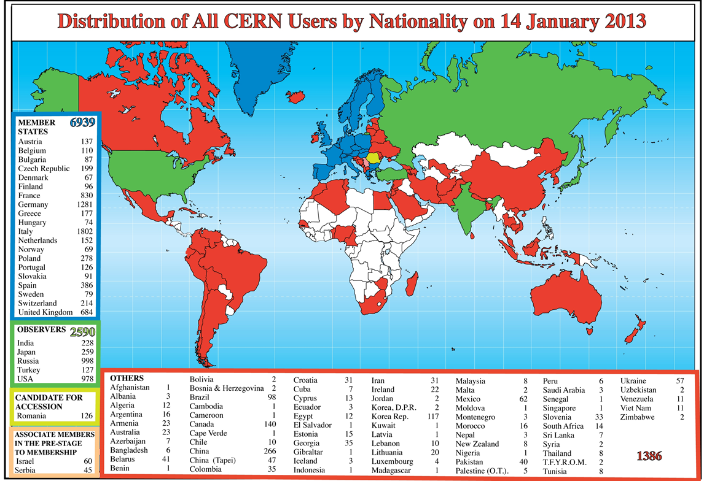
CERN is a Global Lab
CERN was founded in 1954 as a Peace Initiative by 12 European States
Today it counts 21 Member States : Austria, Belgium, Bulgaria, the Czech Republic, Denmark, Finland, France, Germany, Greece, Hungary, Israel, Italy, the Netherlands, Norway, Poland, Portugal, Slovakia, Spain, Sweden, Switzerland and the United Kingdom
2300 staff
  physicists, engineers, technicians, administrative personnel
1000 personnel on contract
11000 users
  who represent more than half of the living particle physicists originating from 500 universities and institutes and of more than 80 nationalities

Slide 3
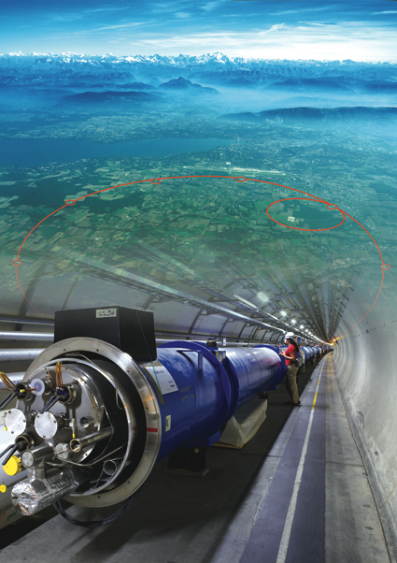
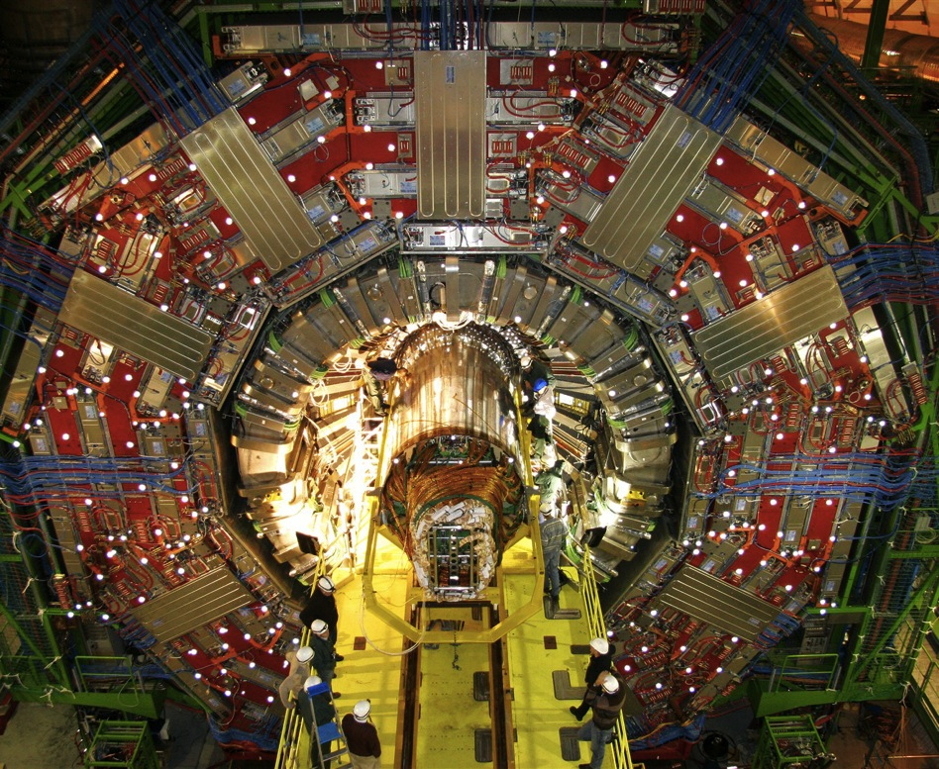
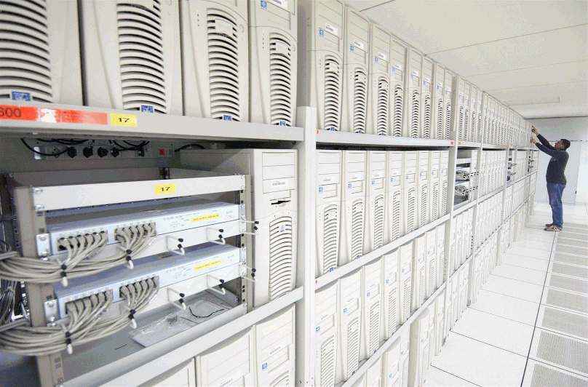
Nos outils …
1. Particle accelerator :
Boost particles to high energies and make them collide
2. Detectors :
Gigantic instruments that observe and record the results of the collisions
(particle trajectories, energy, charge…)
3. Computers :
Collect, store, and send around the world the big quantity of data received from the detectors for data analysis.

Slide 4
EN: Engineering Department
Department Head: R. Saban
Deputy: S. Baird
Operation
  Infrastructure
  Accelerators
  Experimental Areas
Projects
  Consolidation
  Upgrades
  New facilities
  Design & Manufacturing
Studies
Head of Department’s Office
(EN-HDO)
R. Saban
Cooling & Ventilation
(EN-CV)
M. Nonis
5
61
Electrical Engineering
(EN-EL)
F. Duval
General Management & Secretariats
(EN-GMS)
S. Prodon
67
11
Handlling Engineering
(EN-HE)
I. Rühl
Industrial Controls & Engineering
(EN-ICE)
Ph. Gayet
27
32
Machines & Experimental Facilities
(EN-MEF)
S. Baird
Mechanical & Materials Engineering
(EN-MME)
F. Bertinelli
78
76
Sources, Targets & Interactions
(EN-STI)
R. Losito
37
Notes:
370 staff

Slide 5
MME : domains of activities
Engineering & Design
Fabrication
Machining & Maintenance
Preparation & Subcontracting
Assembly & Forming
Materials & Metrology
Internal Design Office facilities, 40 designers (Staff and Industrial Support)
CATIA / SmarTeam, ANSYS
Mechanical measurements lab
4000 m² of internal workshop facilities, 50 technicians (Staff and Industrial Support): CNC machining, sheet metal work & welding, electron beam & laser, vacuum brazing
External subcontracting service
Free access Users workshop
Material selection, analysis & metallurgy: microscopy, mechanical testing
NDT: US, radiography, tomography
350 m² of internal metrology facilities: CMM

Slide 6
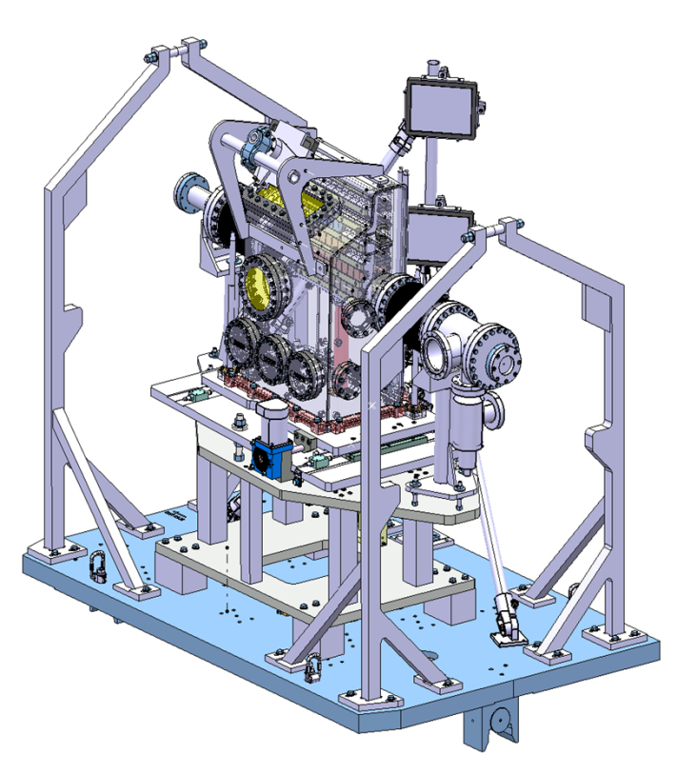
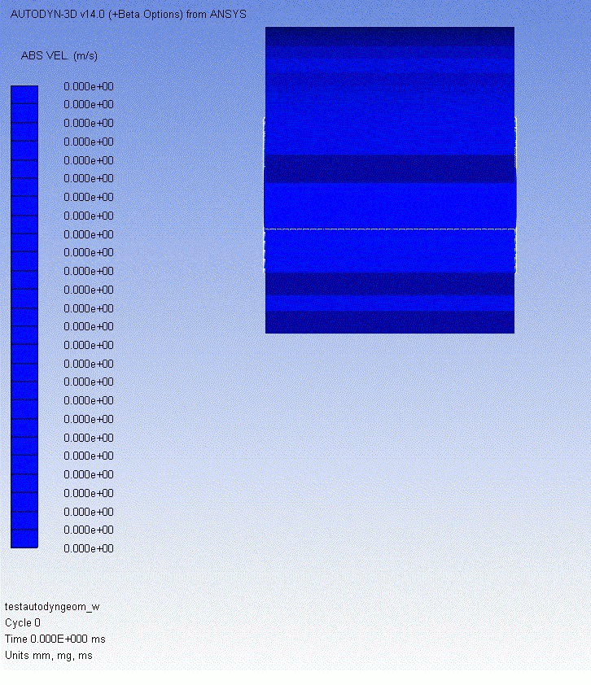
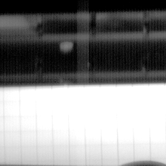
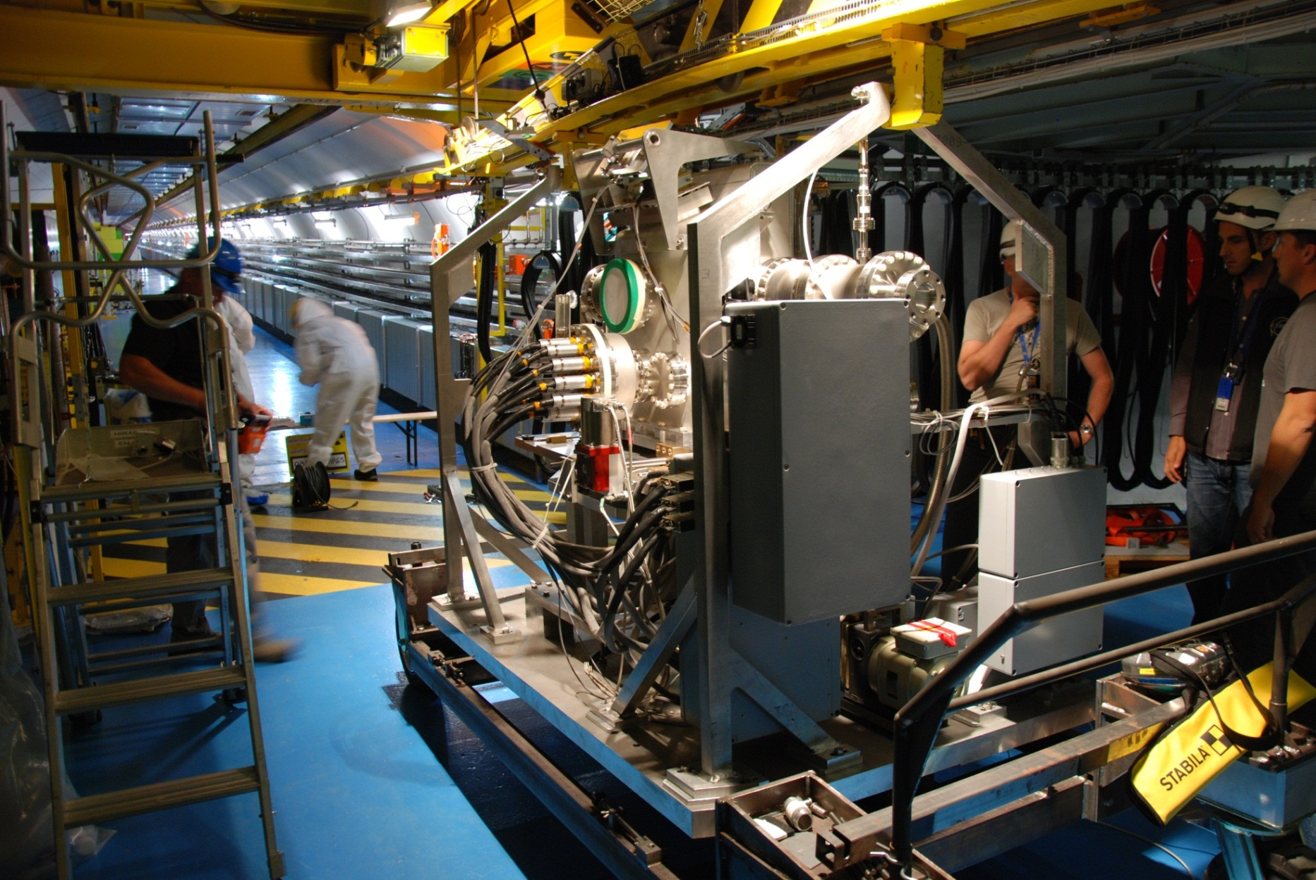
MME: Mechanical & Materials Engineering
The mandate : provide to the CERN community specific engineering solutions combining mechanical design, production facilities and material sciences. This group owns, maintains and develops the know-how on the mechanical constructions in the accelerators and the physics detectors.
Beam
  Inermet : comparison Autodyn (SPH) between simulation and experiment

Slide 7
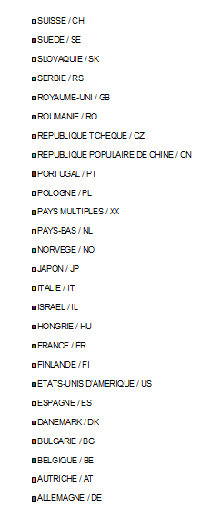
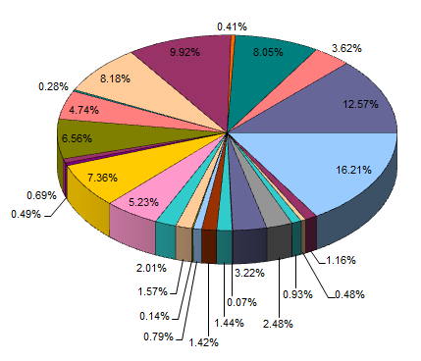
Fabrication sous-traitance

Slide 8
Mon constat sur le tolérancement
  Nos partenaires en fabrication, tous pays Européens confondus, sont typiquement des entreprises de moyenne dimension
  La tendance vers un tolérancement plus sophistiqué (p. ex. projection, mini/maxi) n’est pas ressenti comme un besoin ou une opportunité, mais plutôt une charge et un cout supplémentaires
  Comme nous, leur travaille ne justifie pas un Bureau de Méthodes dédié
  Ils ne sont pas des automobilistes …
  Attention a ne pas creuser une fossé entre Bureau d’Etude / métrologues et le monde de la fabrication
  Le but doit rester le gain en économie (dans le sens large …)

Slide 9
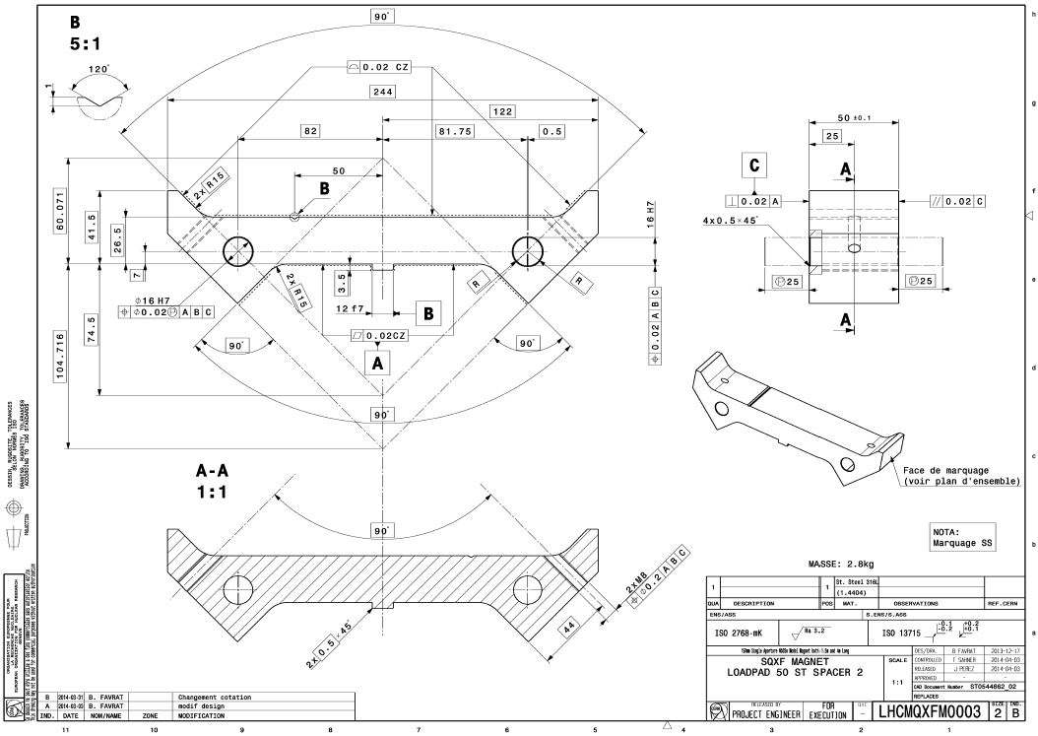
Exemple récent en Norvège

Slide 10
  Merci pour l’attention
  Passez deux bonnes journées au CERN
  fun et travail

