Slide 1
Optical Pumping Simulations of Copper and Magnesium Isotopes
Julie Hammond
Boston University
ISOLDE CERN
11.5.14

Slide 2
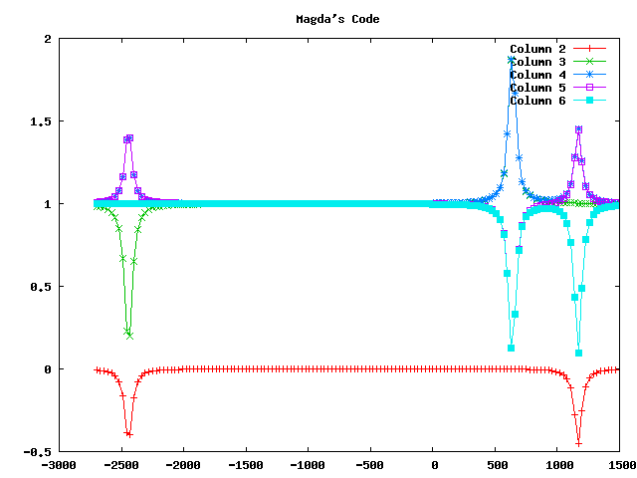
31Mg s1/2 to p1/2
(Asymmetry factor in red;
other lines correspond to populations.)

Slide 3
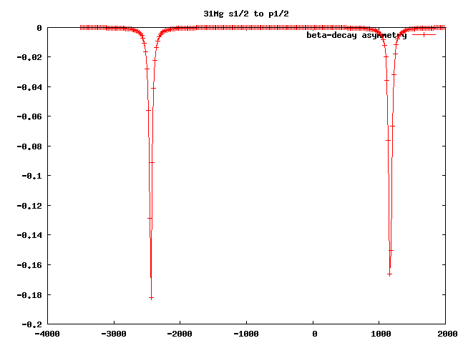
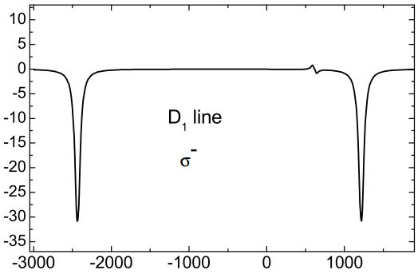
31Mg S_{1/2} to P_{1/2}
negatively circularly polarized light
Trial simulation
Published simulation, for comparison

Slide 4
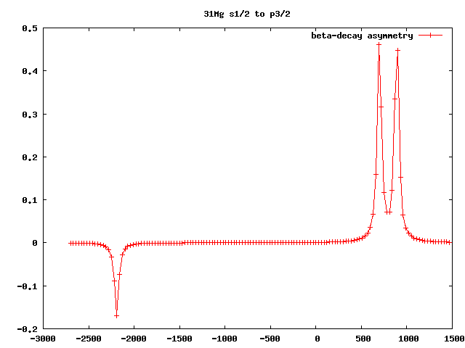
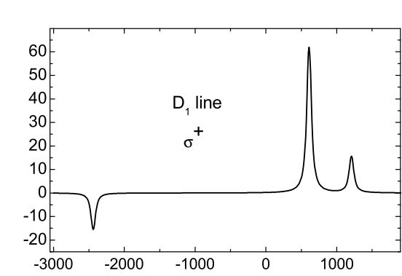
31Mg S_{1/2} to P_{3/2}
positively circularly polarized light
Trial simulation
Published simulation, for comparison

Slide 5
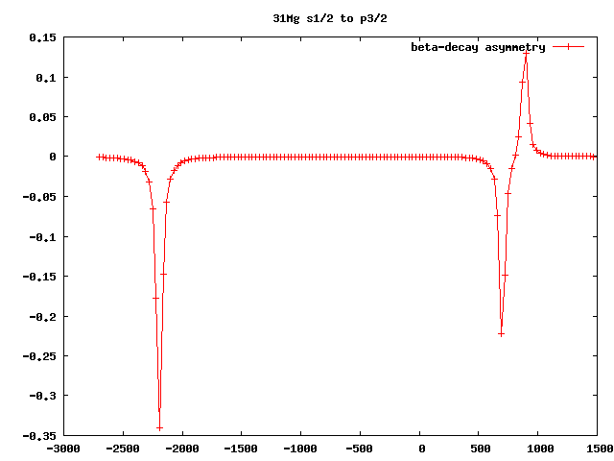
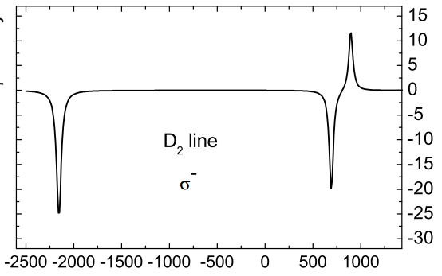
31Mg S_{1/2} to P_{3/2}
negatively circularly polarized light
Trial simulation
Published simulation, for comparison

Slide 6
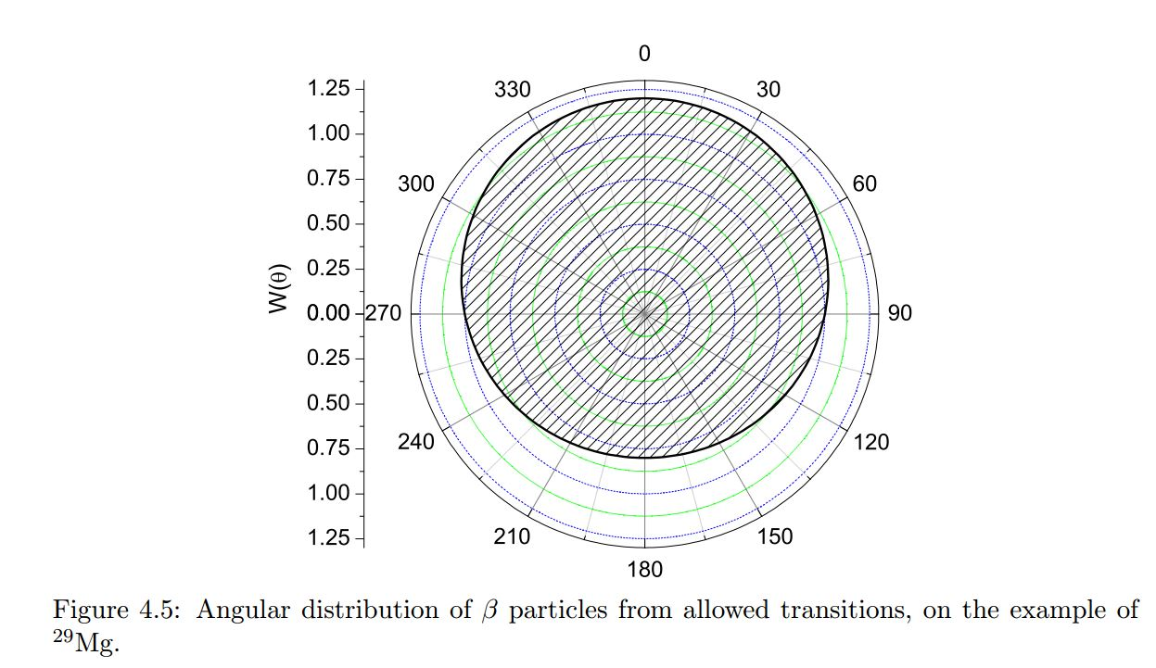
A Visual Representation of the Asymmetry Factor
W (θ) = 1 + a * (v/c) * P_{I} * cos(θ)

Slide 7
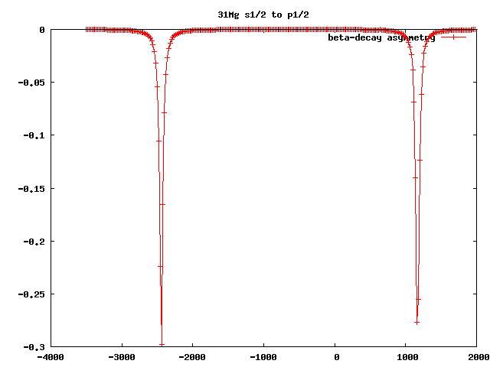
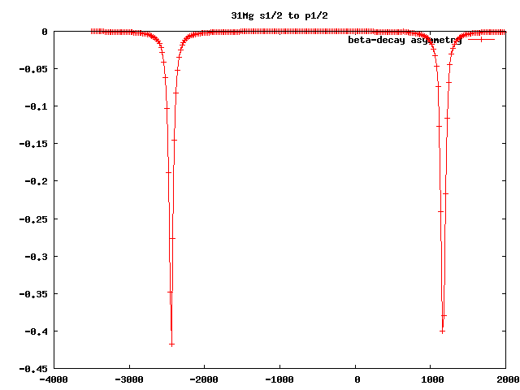
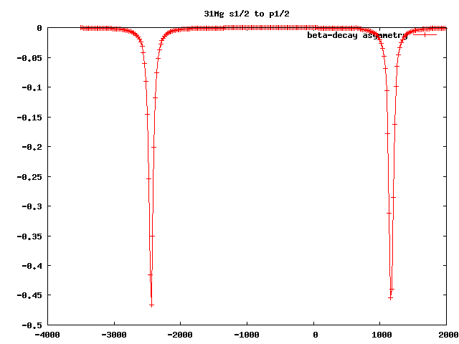
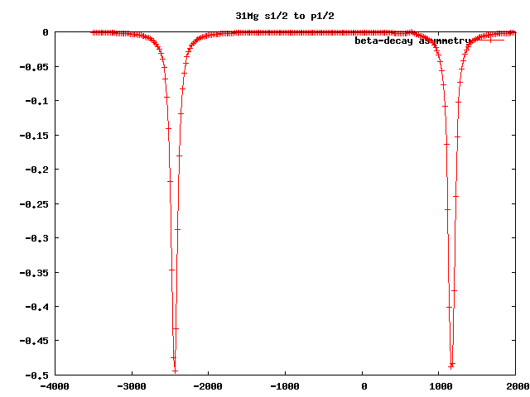
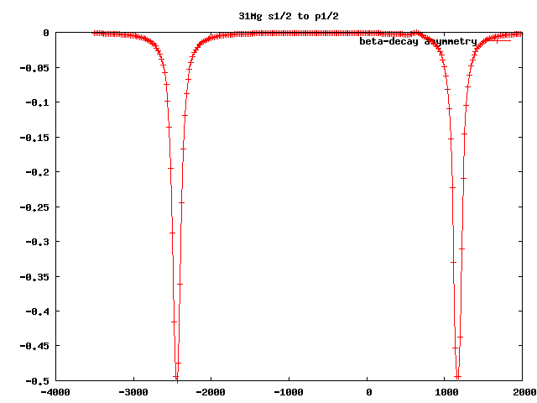
Asymmetry factor of 31Mg as a function of laser intensity
20 W/m²; a = -0.182
40 W/m²; a = -0.0.298
80 W/m²; a = -0.419
120 W/m²; a = -0.467
200 W/m²; a = -0.495
300 W/m²; a = -0.498

Slide 8
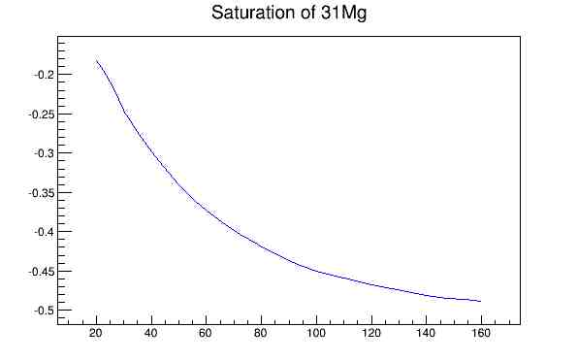
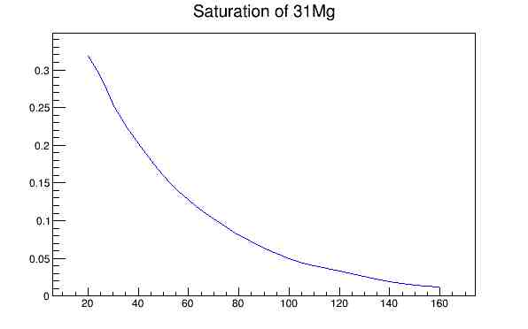
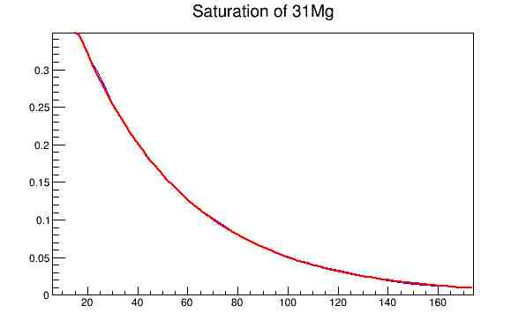
Asymmetry vs. laser density
Data
Results:
a = 0.5e^{-0.023x} – 0.5
Where a is the asymmetry factor and x is the laser intensity.
x-axes are given in MHz laser densities and y-axes correspond to asymmetry factors.
Data translated by -0.5

Slide 9
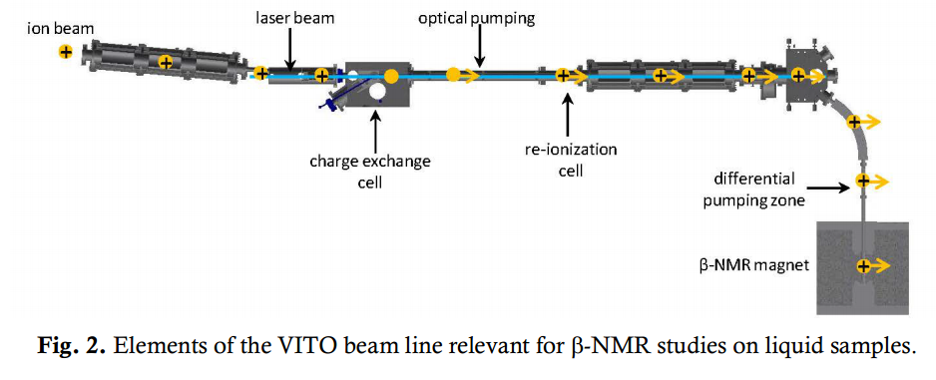
Another variable: Time of Interaction

Slide 10
Another variable: Time of Interaction
Constraints: 60keV beam, 2m optical pumping length
=> interaction time is given:
31Mg: 3.28 μs
58Cu: 4.49 μs
74Cu: 5.07 μs
75Cu: 5.11 μs

Slide 11
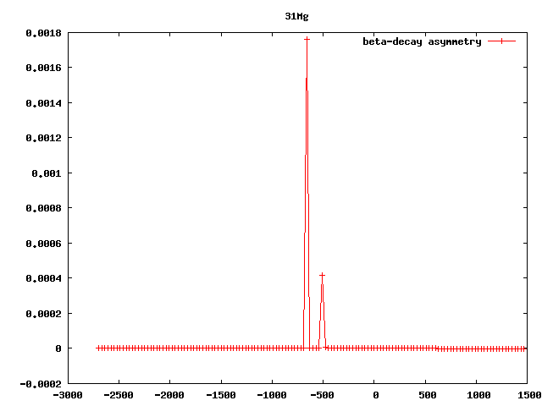
Asymmetry Factor for 58Cu

Slide 12
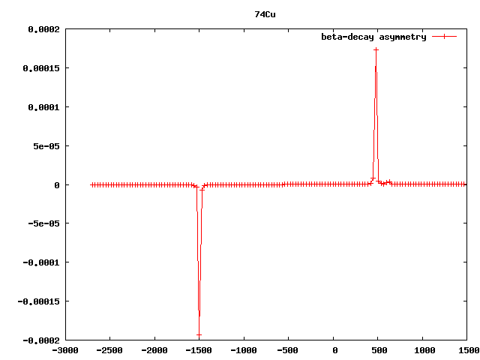
Asymmetry factor for 74Cu

Slide 13
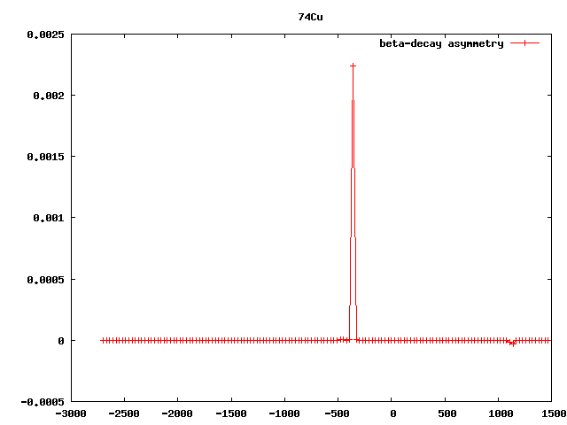
Asymmetry factor for 75Cu

Slide 14
Questions?

